Slide 1
Welcome to Wk07
MATH225 Applications of Discrete Mathematics and Statistics
http://media.dcnews.ro/image/201109/w670/statistics.jpg

Slide 2
THOUGHT PROBLEM
Date | A-Bomb | H-Bomb | Unknown | Country
7/16/1945 | 18 |  |  | USA
8/6/1945 | 12 |  |  | USA
8/9/1945 | 18 |  |  | USA
8/29/1949 | 22 |  |  | USSR
10/3/1952 | 25 |  |  | UK
11/1/1952 |  | 10,400 |  | USA
11/16/1952 | 500 |  |  | USA
8/12/1953 |  | 400 |  | USSR
3/1/1954 |  | 15,000 |  | USA
11/22/1955 |  | 1,600 |  | USSR
5/31/1957 | 720 |  |  | UK
11/8/1957 |  | 1,800 |  | UK
2/13/1960 | 70 |  |  | France
10/31/1961 |  | 50,000 |  | USSR
10/16/1964 | 22 |  |  | PR China
6/17/1967 |  | 3,300 |  | PR China
8/24/1968 |  | 2,600 |  | France
5/18/1974 | 12 |  |  | India
5/11/1998 | 60 |  |  | India
5/28/1998 | 40 |  |  | Pakistan
5/30/1998 | 20 |  |  | Pakistan
10/9/2006 | 2 |  |  | North Korea
5/25/2009 | 1 |  |  | North Korea
2/16/2013 | 9 |  |  | North Korea
1/6/2016 |  |  | 14 | North Korea
A-bomb
or
H-bomb?
http://static5.businessinsider.com/image/50f0c59e6bb3f7b23800000b-1173-879/nuclear-weapon-bomb-castle-romeo-1.jpg

Slide 3
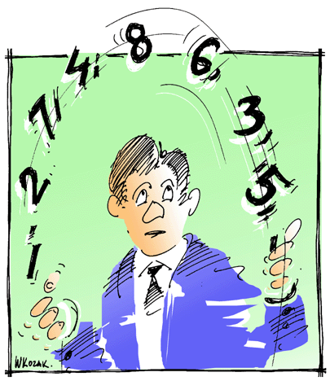
Statistics??
So, howcum you have to take STATISTICS
terror of college
students,
fodder for
late-night comics??
http://www.cogniview.com/blog/wp-content/uploads/2013/06/statistics.gif

Slide 4
Statistics??
Statistics is the basis
for all scientific claims
from Darwin's theory of evolution to commercials
about aspirin

Slide 5
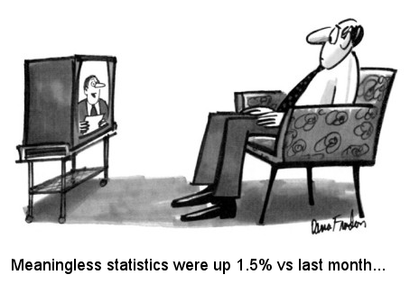
Statistics??
The government stands (nervously) on statistical projections

Slide 6
Statistics??
Everyone is affected by statistics, for good or ill
Statistics can be used
to support anything
(true or false)

Slide 7
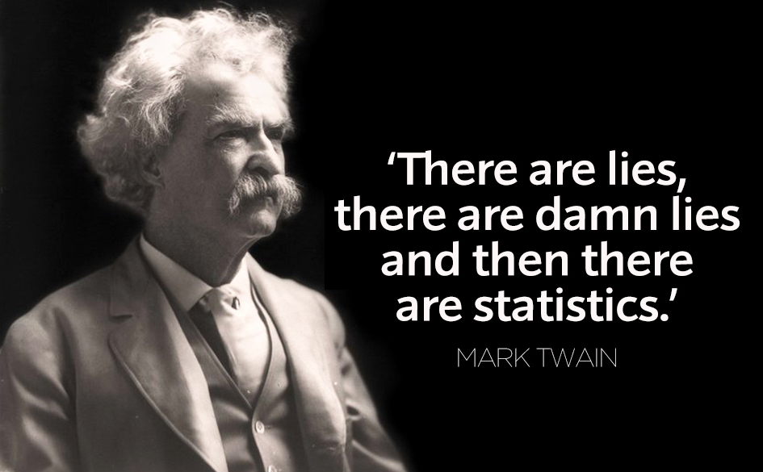
Statistics??
http://circuitfactory.ae/blog/wp-content/uploads/2012/08/5.-Mark-Twain-Quote.jpg

Slide 8
Statistics??
Everyone in the twenty-first century should become skeptical consumers of
statistical
information

Slide 9
Statistics??
numbers DO lie !
In this course
we will learn how to do statistics,
but we will also learn how pervasive statistical lying is and
how to recognize a potential lie
when we see one

Slide 10
Statistics!!
Statistics is the mathematics
of uncertainty
so, in our uncertain world
statistics is the
mathematics of
making decisions

Slide 11
STATISTICS??
IN-CLASS PROBLEMS
Origin of the word "statistics"
http://ryanaweaver.com/files/2013/02/puzzled-look.jpg

Slide 12
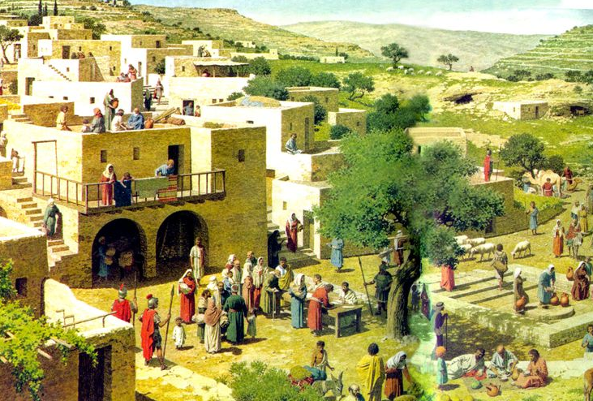
Statistics
The Bible…
https://s-media-cache-ak0.pinimg.com/736x/d2/7d/01/d27d01f75c7484e509ad12d3ef47c7bb.jpg

Slide 13
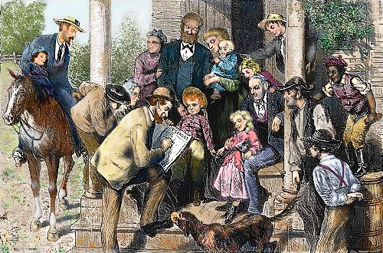
Statistics
The ASA
http://tngenweb.org/census/census1a.jpg

Slide 14
STATISTICS??
IN-CLASS PROBLEMS
Statistics originally was focused on:
a) predicting the outcome of
elections
b) taxation and the draft
c) death rates from certain
diseases
d) probability of winning at
gambling

Slide 15
Statistics
collecting, organizing,
analyzing,
and interpreting data
in order to make
decisions

Slide 16
Statistics
Descriptive statistics:
organization, summarization, and display of data
Inferential statistics:
using a sample to draw conclusions about a population

Slide 17
How It Works
Start with a question you want to answer:
What brand of headache medicine cures headaches fastest?
How many species of fish live in the Earth’s oceans?
Who will voters elect in the next election?

Slide 18
How It Works
Each of these questions require a count or a measurement to answer:
How fast each medication cures headaches
Count of all the fish species detected in Earth’s oceans
Count of voting preferences

Slide 19
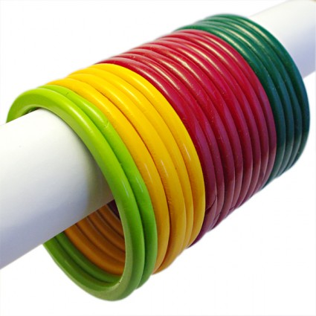
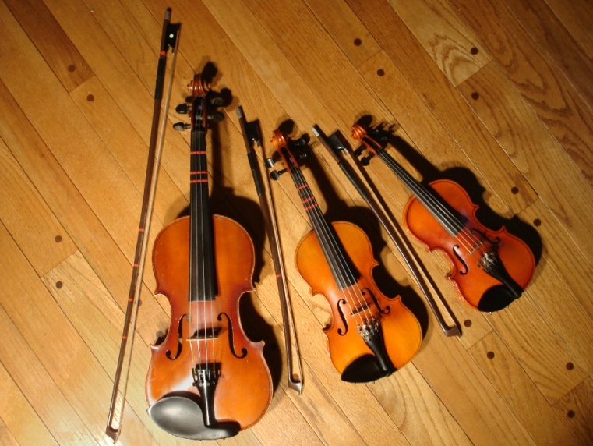
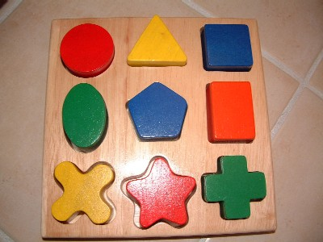
How It Works
Counts or measurements taken are called variables because their values are free to vary

Slide 20
How It Works
So, we have a question we want to answer about something BIG:
All the times it takes to cure all of the headaches
All the fish in the oceans
All the voters
These BIG things are too big for us to get our hands on !

Slide 21
How It Works
So, what do we do now????
wring our hands
weep
curse
give up
let somebody
else do it
http://whatsdavedoing.com/wp-content/uploads/2011/05/white-flag-e1381530152918.jpg

Slide 22
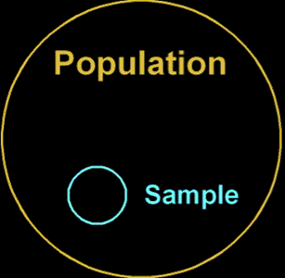
How It Works
or… maybe…
take a piece of the big group?

Slide 23
How It Works
If we are lucky, our small piece will be representative of the BIG thing, and the answer to our question will be right
http://www.christinarosalie.com/mytopography/wp-content/uploads/2011/05/MG_0223.jpg

Slide 24
How It Works
The BIG thing we want to answer a question about is called our
POPULATION
The small piece of it we actually take is called our
SAMPLE

Slide 25
How It Works
The count or measurement we need to answer our question about the population is called a
PARAMETER
The count or measurement we actually take to answer our question using a sample is called a STATISTIC

Slide 26
How It Works

Slide 27
So… unfortunately…
STATISTICS = the methods of collecting, organizing, analyzing, and interpreting data in order to make decisions
and
STATISTICS = counts or measurements we take on a sample to estimate counts or measurements on a population

Slide 28
How It Works
IN-CLASS PROBLEMS
What would a measurement on the whole population be called?
Hint – the US does one every 10 years…

Slide 29
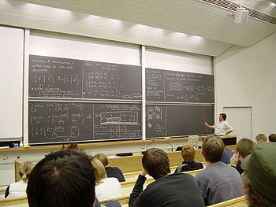
How It Works
IN-CLASS PROBLEMS
Question: How many students are majoring in IT?
Population:
Parameter:
Sample:
Statistic:

Slide 30
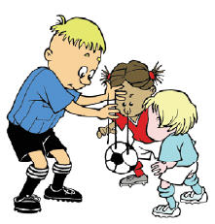
How It Works
IN-CLASS PROBLEMS
Question: Does gravity always pull a dropped ball downward?
Population:
Parameter:
Sample:
Statistic:

Slide 31
How It Works
IN-CLASS PROBLEMS
A September 2005 survey of 2,104 households in the United States found that 65% of them subscribed to cable television
What is the population for the survey?

Slide 32
How It Works
IN-CLASS PROBLEMS
A September 2005 survey of 2,104 households in the United States found that 65% of them subscribed to cable television
How many households are in the sample?

Slide 33
How It Works
IN-CLASS PROBLEMS
A September 2005 survey of 2,104 households in the United States found that 65% of them subscribed to cable television
Of the households surveyed, how many households subscribe to cable television?

Slide 34
How It Works
IN-CLASS PROBLEMS
A follow-up survey of a sample of 1,200 U.S. households found that 360 households have high-speed Internet connection
Estimate what percentage of all U.S. households have high-speed Internet:

Slide 35
How It Works
IN-CLASS PROBLEMS
The survey showed that households without Internet are twice as likely to subscribe to a daily newspaper than the households with Internet connection

Slide 36
How It Works
IN-CLASS PROBLEMS
The researchers concluded households with Internet connection often get their news
from Web sites instead of daily newspapers
Is this conclusion warranted by the results of the survey? Why or why not?

Slide 37
Questions?

Slide 38
Sampling
You want to have a sample that closely resembles your population – a representative sample

Slide 39
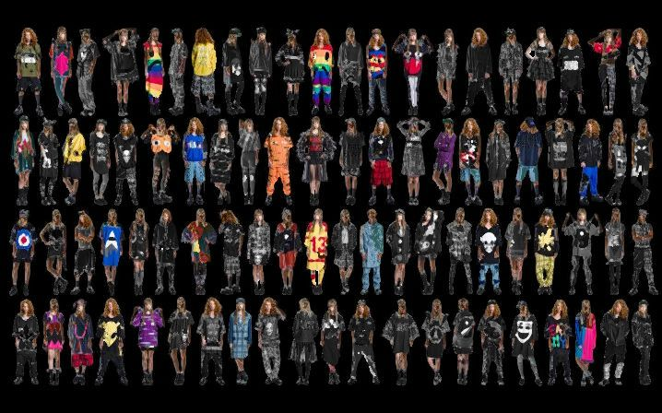
Sampling
IN-CLASS PROBLEMS
Is it a representative sample?
population
sample

Slide 40
Sampling
How do you make sure your sample statistic is close to your population parameter?

Slide 41
Sampling
Your sample will RARELY be exactly the same as your population

Slide 42
Sampling
Make sure that every element/subject in the population has an equal chance of being in the sample
a RANDOM sample

Slide 43
Sampling
How do you make sure your sample statistic is close to your population parameter?

Slide 44
Sampling
Take the BIGGEST sample you can
the LAW OF LARGE NUMBERS

Slide 45
Sampling
Which school has the more believable results?
Favorite Class | School A # of Students | School B # of Students
English | 11 | 3
Math | 7 | 4
Science | 12 | 3
Social Studies | 10 | 2
Computer Science | 13 | 2
Music/Art | 12 | 2
Physical Education | 15 | 1
Foreign Language | 6 | 1

Slide 46
Sampling
The number in your sample is called the “sample size”
It is usually called “n”

Slide 47
Sampling
How do you make sure your sample statistic is close to your population parameter?

Slide 48
Sampling
Sampling errors can lead to results which have a specific bias or are only relevant to a specific subgroup

Slide 49
Sampling
Suppose that you want to find out how successful ($) a film will be
Suppose your film only appeals to a certain audience

Slide 50
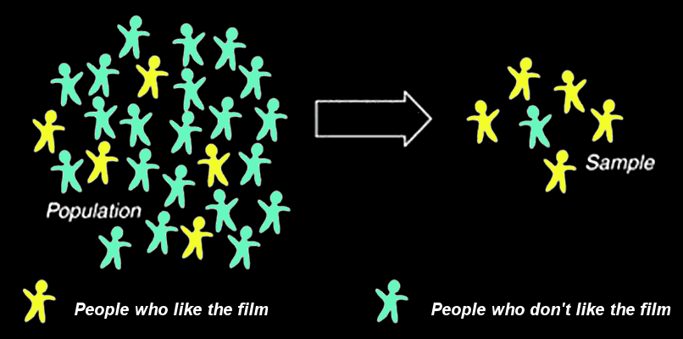
Sampling
IN-CLASS PROBLEMS
Bad luck sample:
What will you deduce from this sample?

Slide 51
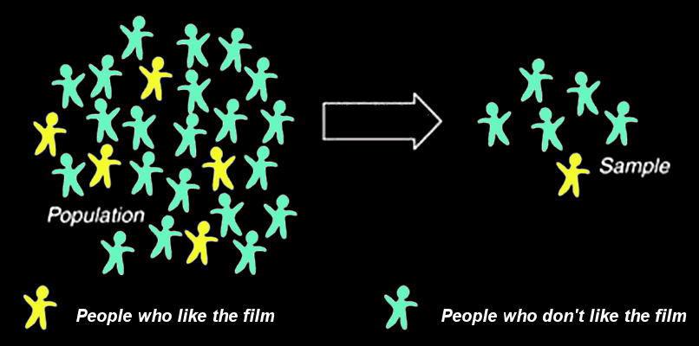
Sampling
IN-CLASS PROBLEMS
Unbiased sample:
What will you deduce from this sample?

Slide 52
Sampling
IN-CLASS PROBLEMS
How do you make sure your sample statistic is close to your population parameter?

Slide 53
Sampling
IN-CLASS PROBLEMS
A statistic measures in a sample what a parameter measures in a population
true
false

Slide 54
Sampling
IN-CLASS PROBLEMS
A good sample is representative and unbiased
true
false

Slide 55
Sampling
IN-CLASS PROBLEMS
A good sample will be a faster, cheaper, easier and possibly even more accurate way than a complete census to find out about a population
true
false

Slide 56
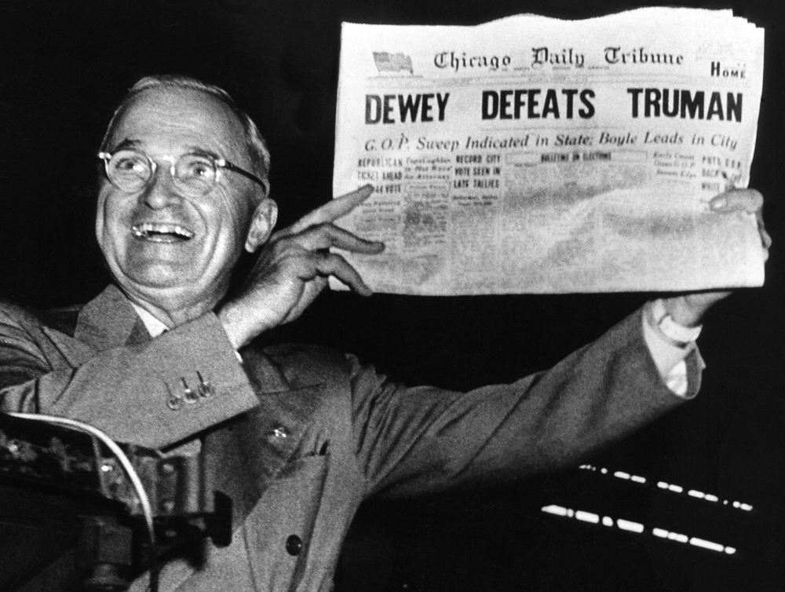
How To Lie With Statistics #1
Truman vs Dewey 1948
Why did they make the wrong forecast?
What would you do
differently to get
an accurate
forecast?
http://www.theipinionsjournal.com

Slide 57
How To Lie With Statistics #1
In the presidential election of 1948, a major newspaper poll predicted Dewey would win because:

Slide 58
Questions?

Slide 59
Types of Data
Two levels of measurement for
data:
counts
measurements

Slide 60
Types of Data
Two classifications of data:
qualitative – a category
quantitative – a number
Qualitative Quantitative

Slide 61
Types of Data
We count qualitative data (how many fall into each category)
We measure quantitative data

Slide 62
Types of Data
IN-CLASS PROBLEMS
Lengths of time three brands of aspirin take to cure headaches
Qualitative or
quantitative?

Slide 63
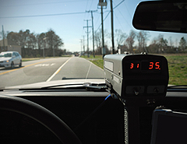
Types of Data
IN-CLASS PROBLEMS
Speed of your car taken by the cop
Qualitative or quantitative?

Slide 64
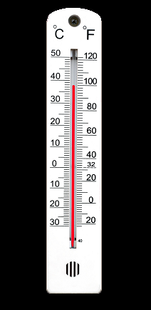
Types of Data
IN-CLASS PROBLEMS
Maximum daily temperatures for Denver 1880-2011
Qualitative or quantitative?

Slide 65
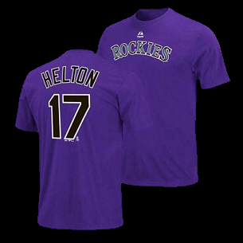
Types of Data
Some numbers are really names!
(qualitative, not quantitative)

Slide 66
Types of Data
IN-CLASS PROBLEMS
List of social security numbers
Qualitative or quantitative?

Slide 67
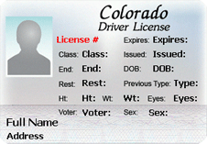
Types of Data
IN-CLASS PROBLEMS
Your CO driver’s license info
Qualitative or quantitative?

Slide 68
Types of Data
IN-CLASS PROBLEMS
The “Q” Game

Slide 69
Measurement
Traditionally, we study measurement because the level of scale of measurement determines what statistics we will calculate to answer our questions

Slide 70
Measurement
In practice, it is not always clear cut

Slide 71
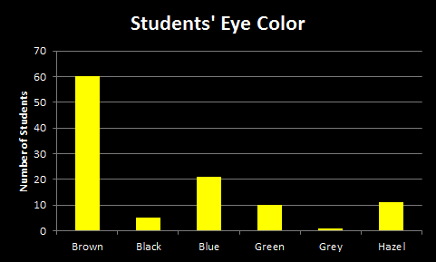
Measurement
IN-CLASS PROBLEMS
What single number would you use to illustrate the “typical” response to this survey question:

Slide 72
Measurement
The most commonly occurring response is called the “mode”

Slide 73
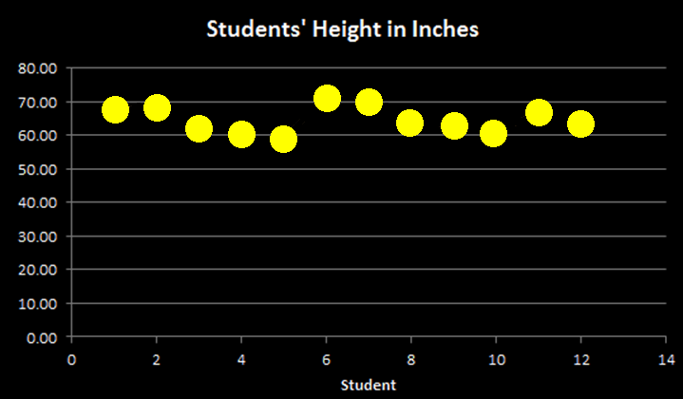
Measurement
IN-CLASS PROBLEMS
What single number would you use to illustrate the “typical” response to this experimental result:

Slide 74
Measurement
For this, the “average” height of the 12 students would be better

Slide 75
Questions?

Slide 76
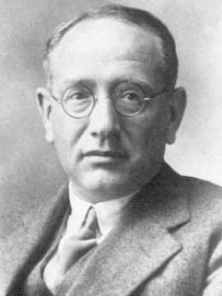
Experimental Design
Mr Pólya’s Method:
Understand the
problem
2) Plan!
3) Do it!
4) Look back
George Pólya

Slide 77
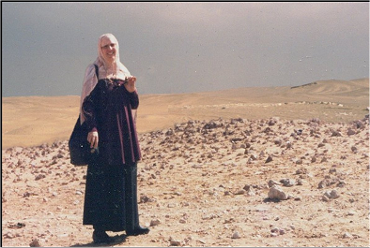
Who am I when I’m not here?

Slide 78
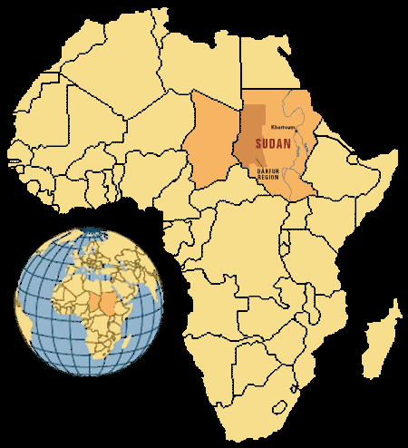
A Research Project
January 1998 – Refugees
first enter eastern Chad
coming from the
Darfur area of Sudan
April 1998 – .
Alkhalil Adoum .
(USAID FEWS) .
goes to this remote area after hearing rumors that refugees are overwhelming local villages

Slide 79
A Research Project
July 1998 Chad
Who are the mysterious refugees?
Will we be able to help them?
Can we get supplies in-region?

Slide 80
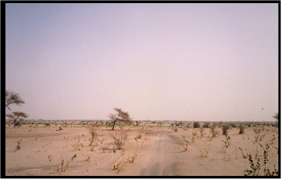
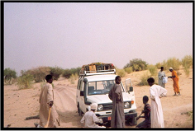
The African nation of Chad is covered by an extensive network of highways
Of course, the are not necessarily PAVED highways
the road

Slide 81
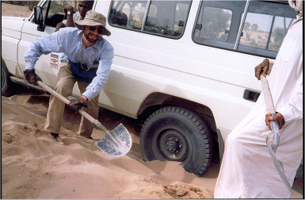
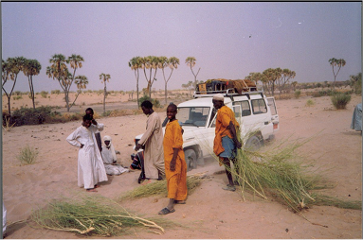
So, when
traveling in Chad,
you spend a
great deal of
time digging out
your vehicle…
Or having
someone
else help you dig
out your vehicle…

Slide 82
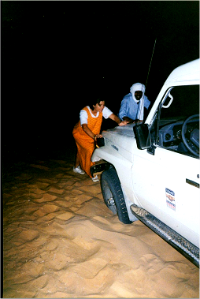
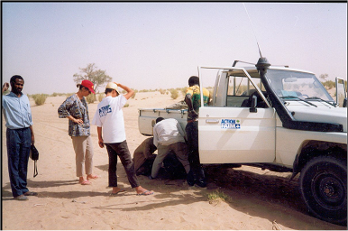
Or helping someone else dig out their vehicle…

Slide 83
But soon
you’re on your
way again!
Standing water –
a rarity in Chad

Slide 84
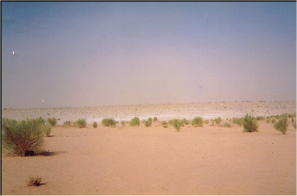
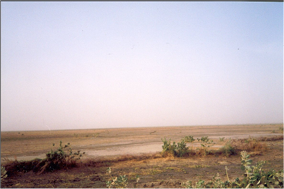
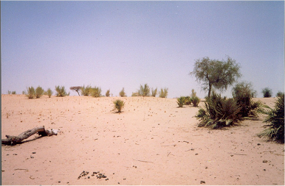
Chad has a lot of the scenic beauty of the great state of Nevada…

Slide 85
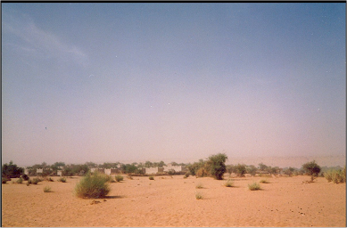
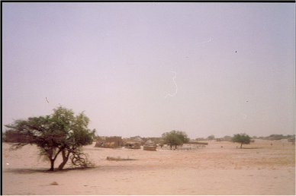
Suddenly, you begin to see
signs of civilization…

Slide 86
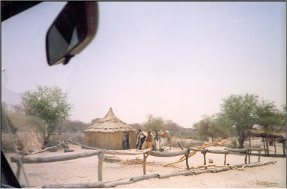
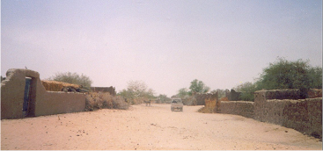
And, next thing you know,
you’re driving down main street!

Slide 87
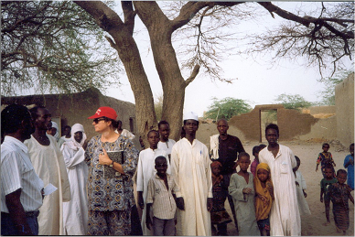
Where all the action is !!

Slide 88
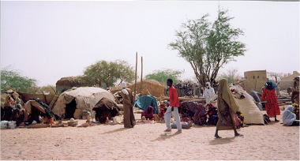
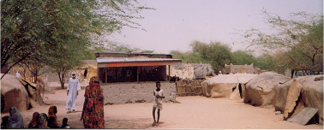
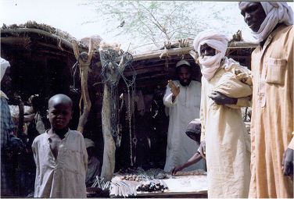
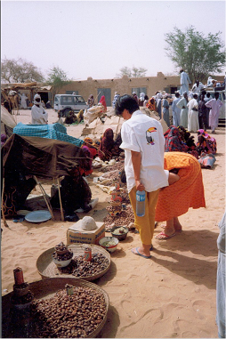
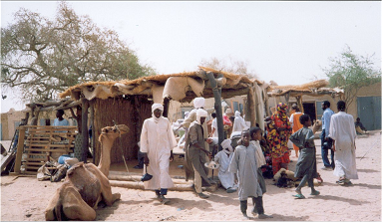
The
shopping!!!!

Slide 89
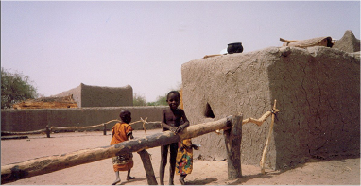
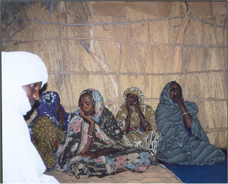
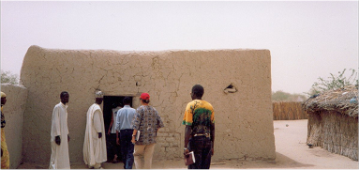
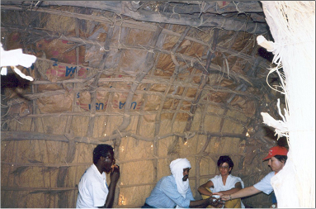
Come visit my house!
Nothing is wasted –
Food aid bags are
used to construct
this house

Slide 90
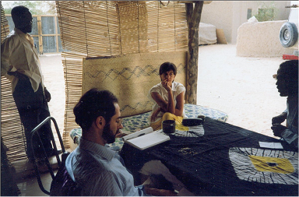
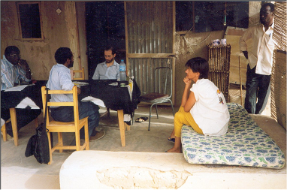
A Chief’s house

Slide 91
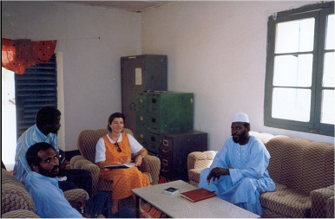
A typical office
No electricity…
When it’s dark…
It’s DARK !

Slide 92
Interviewing farmers – do
you have any extra food?

Slide 93
Visiting health clinics –
can you handle any additional patients?

Slide 94
A major food aid
facility – is there enough food in position?
Canada
the US
Food from…
Ghana

Slide 95
Some facilities
are large and
have fancy
equipment…

Slide 96
Local
facilities
are small

Slide 97
Ground zero –
where the refugees are

Slide 98
Before UNHCR arrives:
Our medical tent

Slide 99
After UNHCR arrives:
Distributing clothing
Food aid
Refugee housing

Slide 100
Medical and
supply tents
Measuring
babies to
see if they
are
undernourished

Slide 101
Understand the Problem: Investigate refugee rumors – who are the refugees, what is the extent of the problem, what aid is needed, can it be supplied in-region
Plan: On-site visit to assess the situation, surveys enroute to assess in-area sources of food and medical care
Do it!: As of July 1998, there are approximately 500 political refugees from Darfur, Sudan camped just over the border in Chad. The number is increasing rapidly. Refugees have no housing, clothing or household goods. There is no food available in the area and medical facilities are already strained beyond capacity.
Look Back: Food, clothing, shelter, cooking equipment, personal needs, safe water, sanitation, security and medical supplies and services are required immediately for at least 750 persons. Send report to UNHCR.

Slide 102
Questions?

Slide 103
Organizing Data
The population is huge
We can’t handle it
So we take a sample
We take counts or measurements
on the sample
These are messy and
hard to understand
NOW WHAT???

Slide 104
Hands-on Project
What is the proportion of clear beads
in the container?
What is the proportion of red beads?
What is the proportion of white
beads?
What is the
proportion of
green beads?
http://www.nvcc.edu/home/cbentley/world_photos.htm

Slide 105
Organizing Data
Step 1: Put your data into Excel
Step 2: Graph it!

Slide 106
Organizing Data
Open Excel
Enter the data:
This is called a “Data Table”

Slide 107
Organizing Data
Once in Excel we have a variety of organizing tools we can use for our data

Slide 108
Organizing Data
Always do a quick graph of your data table to identify problems
http://mathworld.wolfram.com/images/eps-gif/OutlierScatterplot_1000.gif

Slide 109
Graphs
The best way to understand any data set is to GRAPH IT!

Slide 110
Graphs
If you don’t graph your data, the Stat Demons will get ya!

Slide 111
Graphs
Graphs are easier for most people to understand than a table of numbers or text

Slide 112
Graphs
Graphs are pictures of something mathematical
- counts
- measurements
- a mathematical relationship

Slide 113
Graphs
Graphs=Charts=Plots=Diagrams

Slide 114
Excel Graphs
Graphs are easy-peasy in Excel!

Slide 115
Excel Graphs
Highlight the data in your data table
Be sure to include your labels!

Slide 116
Excel Graphs
Click the “Insert” tab
In the middle is “Charts”
Pick the chart you want!

Slide 117
Excel Graphs
TAH-DAH!
A (kinda ugly) graph!

Slide 118
Excel Graphs
But… you aren’t done yet!
(You were hoping… right?)

Slide 119
Excel Graphs
Graphs need to be a complete story in themselves
By looking at the graph, the viewer should understand the question and its answer

Slide 120
Excel Graphs
Graphs need:
Titles
Axis labels
Legends
If you don’t have these…
you get points taken off!

Slide 121
Excel Graphs
Voila!
Pretty AND informative!

Slide 122
Excel Graphs
To make your graph even more informative, right click on any of the bars and click “Add Data Labels”

Slide 123
Excel Graphs
Scroll through “Chart Styles” until you find something you like!

Slide 124
Excel Graphs
The perfect beautiful and informative graph!

Slide 125
Questions?

Slide 126
History of Graphs
In the 14th century
Nicole Oresme used a
bar chart to plot the
velocity of a constantly accelerating object
vs time
https://upload.wikimedia.org/wikipedia/commons/thumb/0/03/Oresmes_diagrams.gif/220px-Oresmes_diagrams.gif

Slide 127
History of Graphs
Each bar is of equal width, and this is one of the fundamental rules of bar graphs to this very day

Slide 128
History of Graphs
In the early 1600s René Descartes invented the x-y “scatter” plot
https://upload.wikimedia.org/wikipedia/commons/7/73/Frans_Hals_-_Portret_van_Ren%C3%A9_Descartes.jpg

Slide 129
History of Graphs
In 1765 Joseph Priestley created a timeline which was a horizontal bar graph
http://www.jpowered.com/graphs-and-charts/images/timeline-bar-chart-600x287.png

Slide 130
History of Graphs
In 1780, William Playfair used bar charts to show Scottish imports/exports
https://upload.wikimedia.org/wikipedia/commons/thumb/e/e0/1786_Playfair_-_Exports_and_Imports_of_Scotland_to_and_from_different_parts_for_one_Year_from_Christmas_1780_to_Christmas_1781.jpg/500px-1786_Playfair_-_Exports_and_Imports_of_Scotland_to_and_from_different_parts_for_one_Year_from_Christmas_1780_to_Christmas_1781.jpg

Slide 131
History of Graphs
This is the first example of numerical data being split into categories and plotted as bars
This is the reason Playfair is credited with the invention of the bar chart

Slide 132
History of Graphs
A fancy pie chart by William Playfair 1801
http://www.jpowered.com/graphs-and-charts/gallery/images/first-pie-chart-william-playfair.png

Slide 133
History of Graphs
A close-up of one of the pies:
http://www.jpowered.com/graphs-and-charts/gallery/images/first-pie-chart-william-playfair.png

Slide 134
History of Graphs
In the early 1800s, Adolphe Quetelet pioneered graphing things over time – the “time series graph”

Slide 135
Influential Graphs
John Snow’s
dot plot map
of the
London
cholera
epidemic -
1854
https://upload.wikimedia.org/wikipedia/commons/thumb/2/27/Snow-cholera-map-1.jpg/300px-Snow-cholera-map-1.jpg

Slide 136
Influential Graphs
Florence Nightingale’s “rose” - 1855
http://www.historyofinformation.com/images/3815a%20Large.jpg

Slide 137
Florence
Nightingale
and the ASA
https://upload.wikimedia.org/wikipedia/commons/1/13/Florence_Nightingale_three_quarter_length.jpg

Slide 138
Influential Graphs
Minard’s flow map - 1869
https://upload.wikimedia.org/wikipedia/commons/2/29/Minard.png

Slide 139
Influential Graphs
Mann, Bradley and Hughes Hockey Stick graph - 1994
http://www.odlt.org/dcd/images/mbh98_from_paper.jpg

Slide 140
Questions?

Slide 141
What About the Other Types of Graphs?

Slide 142
Types of Graphs
Bar and column charts should be used to highlight differences in the actual number
Pie charts are super for highlighting percentages

Slide 143
Types of Graphs
Here’s some salary data for the Chicago Bulls in 1998:
Player | Salary
Michael Jordan | $33,140,000
Ron Harper | $4,560,000
Toni Kukoc | $4,560,000
Dennis Rodman | $4,500,000
Luc Longley | $3,184,900
Scottie Pippen | $2,775,000
Bill Wennington | $1,800,000
http://www.basketball-reference.com/teams/CHI/1998.html

Slide 144
TYPES OF GRAPHS
IN-CLASS PROBLEMS
How can we show that Michael Jordan is paid a lot more than everyone else on the team?
Player | Salary
Michael Jordan | $33,140,000
Ron Harper | $4,560,000
Toni Kukoc | $4,560,000
Dennis Rodman | $4,500,000
Luc Longley | $3,184,900
Scottie Pippen | $2,775,000
Bill Wennington | $1,800,000

Slide 145
Types of Graphs
Graphs!!!
Player | Salary
Michael Jordan | $33,140,000
Ron Harper | $4,560,000
Toni Kukoc | $4,560,000
Dennis Rodman | $4,500,000
Luc Longley | $3,184,900
Scottie Pippen | $2,775,000
Bill Wennington | $1,800,000

Slide 146
TYPES OF GRAPHS
IN-CLASS PROBLEMS
What does the bar chart tell you?

Slide 147
TYPES OF GRAPHS
IN-CLASS PROBLEMS
What does the pie chart tell you?

Slide 148
TYPES OF GRAPHS
IN-CLASS PROBLEMS
For the container data:
Which type of graph would you use to emphasize that there are a lot more clear beads than any other color?

Slide 149
TYPES OF GRAPHS
IN-CLASS PROBLEMS
For the container data:
Which type of graph would you use to show that more than 50% of the contents are clear?

Slide 150
Types of Graphs

Slide 151
Types of Graphs
Pareto plot
An ordered
bar chart

Slide 152
Types of Graphs
Bars that are not based on counts
can be positive or negative

Slide 153
Types of Graphs
We used bar/column graphs to display measurement data (salaries, profit/loss, etc.)
There are other ways to show measurement data also

Slide 154
Types of Graphs
Scatter plot
aka: x-y plot
requires paired data
you don't split the data into classes or categories

Slide 155
Types of Graphs
Scatter plot

Slide 156
Types of Graphs
Time series plot
the x-axis variable is "time"

Slide 157
Types of Graphs
More exotic types of graphs

Slide 158
Types of Graphs
Open/Hi/Low/Close plot

Slide 159
Types of Graphs
Bubble chart

Slide 160
Types of Graphs
Map graph

Slide 161
Rule of Thumb:
TYPES OF GRAPHS
IN-CLASS PROBLEMS
Use column, bar and pie charts for categorical count data
Use line, scatter and area charts for quantitative measurement data

Slide 162
Questions?

Slide 163
Graphs
Graphs have a psychological component that CANNOT be ignored

Slide 164
How to Lie with Statistics #2
How to lie with graphs

Slide 165
Lying with graphs
Where’s the zero?

Slide 169
HOW TO LIE WITH GRAPHS
IN-CLASS PROBLEMS
What is the “lying” in the original Terri Schiavo poll graph?

Slide 170
Lying with graphs
Tricks our eyes play on us...

Slide 171
HOW TO LIE WITH GRAPHS
IN-CLASS PROBLEMS
Unintentional Optical Art?

Slide 172
Just because technology lets you make a 3D
graph doesn’t
necessarily
mean it’s a
good idea…

Slide 173
The “Too Pretty to Live” graph

Slide 174
HOW TO LIE WITH GRAPHS
IN-CLASS PROBLEMS
Sometimes pretty is just lying…

Slide 176
HOW TO LIE WITH GRAPHS
IN-CLASS PROBLEMS
How the real graph should look:

Slide 177
Graphs with an
Agenda
The way a graph is
drawn can have some
powerful psychological
impacts misleading
viewers
Data from National
Association of Realtors

Slide 178
HOW TO LIE WITH GRAPHS
IN-CLASS PROBLEMS
Graphs made of things that look like real objects are especially dangerous – our minds think “area” or “volume” and not “width” or “height” alone

Slide 179
The second image is supposed to show that 1940s steel capacity is 1.45 times that of the 1930s
Our minds
think "area" for
two-dimensional
figures
We see this
as 1.45 x 1.45
or 2.10 times bigger
From: How to Lie with Statistics by Darrell Huff

Slide 180
How it should look:
The area of the
second pic is now
1.45 times the
first

Slide 181
It’s even worse with things that look three dimensional
In 1860, there were 8 million cows in the U.S. vs. 25 million in 1936 (3.125 times more)
Our minds are thinking
“volume”:
3.125 x 3.125 x 3.125
= 30.518
times bigger!
From: How to Lie with Statistics by Darrell Huff

Slide 182
How it should look:

Slide 183
Obviously lying:

Slide 184
How it should look:

Slide 185
Self-Fulfilling Prophecies

Slide 186
Self-Fulfilling Prophecies
http://globalchangewatch.weebly.com/uploads/5/7/2/1/5721491/304554760.jpg?729

Slide 187
How to Lie with Videos
Video

Slide 188
How to Lie with Graphs
Why is this graph misleading?

Slide 189
How to Lie with Graphs
Why is this graph misleading?

Slide 190
Questions?

