Slide 1
Why Alaskan Fisheries?
Mary alder
Sci201 – Environmental science
30 Aug 2017

Slide 2
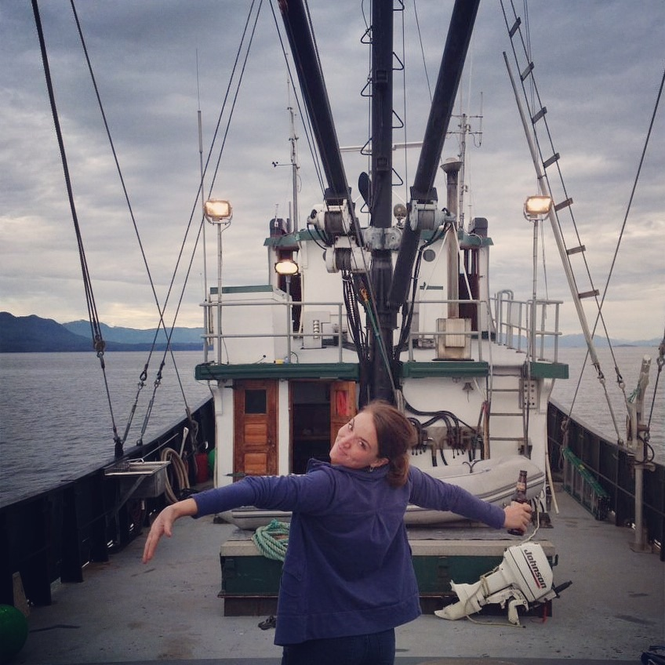
My Background with Alaska Fisheries
Certified Fisheries Boarding Officer from 2005-2012 for the U.S. Coast Guard/NOAA
Worked on a Salmon Tender in Ketchikan, Alaska in 2013
Advocate for wild caught and sustainable Alaskan Fisheries
https://pbs.twimg.com/profile_images/2584224153/irt7tggwqo8lm2ktomr0_400x400.jpeg
MKAlder, 2017

Slide 3
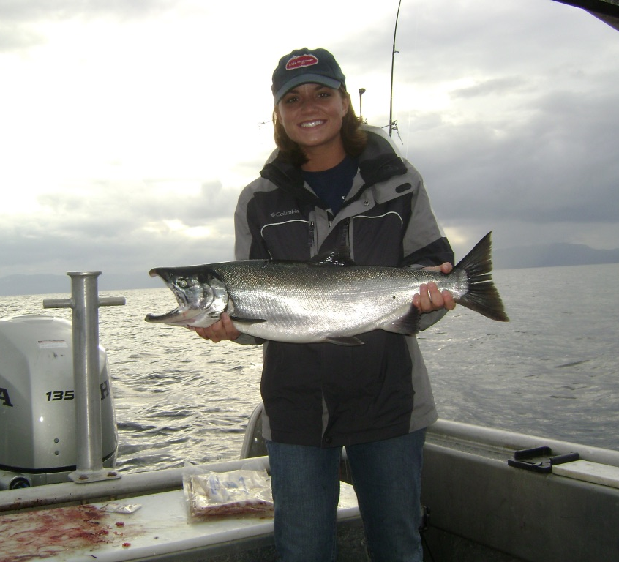
The difference Between Wild and Farm Raised Fisheries
Health Aspects
Ecological Impact
Alaska Economy
MKAlder, 2017

Slide 4
Health Impacts
Both farmed and wild fish contain Omega 3’s; however, wild fish provide much more usable Omega 3 (33% more). The reason for this discrepancy is that both Omega 3 and Omega 6 use the same enzymes for conversion into usable form. So when a food has high levels of Omega 6,as farmed salmon does, they use up the available conversion enzymes to produce pro-inflammatory agents, while preventing the usable form of Omega 3 to be produced.
Farmed Fish has much higher fat content than wild fish
Disease, parasites, and sea lice run rampant in farm raised fish
MKAlder, 2017

Slide 5
The difference is clear!
https://dailyhealthpost.com/wild-salmon-vs-farmed-salmon/

Slide 6
Ecological Impact
Effective, precise management assures Alaska’s fisheries are productive, sustainable, clean, and healthy-as mandated by the Alaska state government. Alaska has served as a model of fishery management around the globe since admittance into the Union in 1959. Alaska is the lone state in the nation with a constitutional mandate stating that all fish “be utilized, developed, and maintained on the sustained yield principle”, which is one main reason they have been able to accomplish such sustainability.
MKAlder, 2017

Slide 7
Hatcheries VS Farms
Alaska's hatchery program is designed to advance the science of fisheries enhancement in Alaska as well as to increase consumer confidence in Alaskan salmon by assuring the marketplace that these products come from sustainable and responsibly managed systems.
http://c8.alamy.com/comp/EKW88D/worker-at-a-fish-hatchery-near-paxon-pours-sockeye-salmon-roe-into-EKW88D.jpg
https://www.valdezfisheries.org/wp-content/uploads/the-solomon-gulch-hatchery.jpg

Slide 8
https://www.afdf.org/wp-content/uploads/1c-Economic-Analysis-to-Inform-AMI-Phase-I-Case-Studies.pdf

Slide 9
http://www.alaskafishradio.com/hot-fish-links/

Slide 10
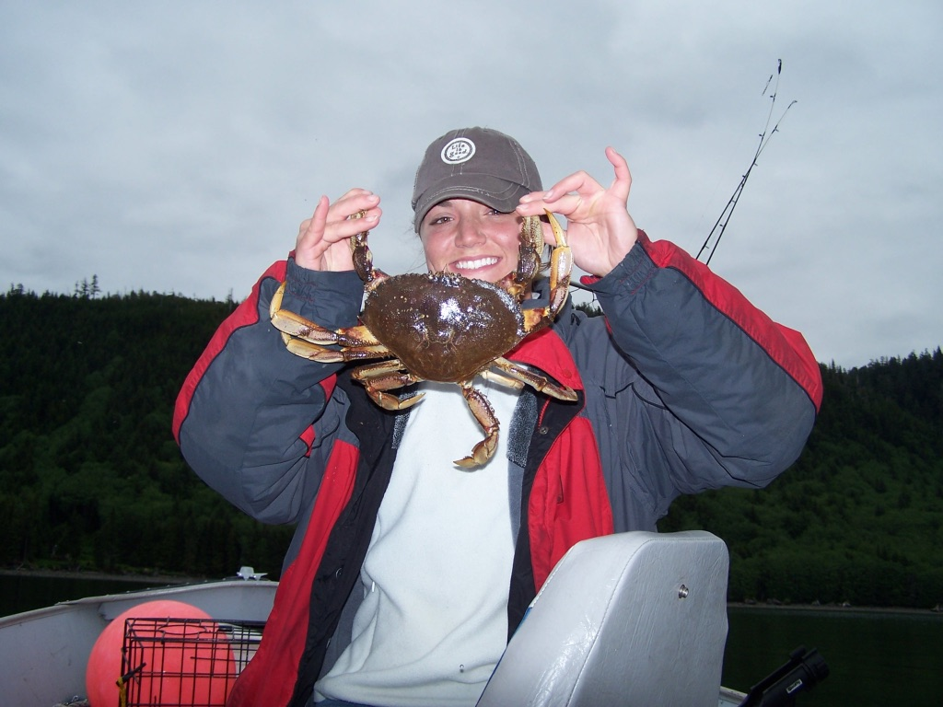
Alaskan Economy
The Alaska seafood industry creates an estimated 111,800 FTE jobs, $5.8 billion in annual labor income, $14.6 billion in economic output. The national economic impacts of Alaska's seafood industry includes $6.2 billion in direct output associated with fishing, processing, distribution, and retail.
MKAlder, 2017

Slide 11
Summary
Farmed-Raised fish present several hazards to the environment and our health. Eating wild caught fish is beneficial for the environment, your health, and the Alaskan economy. Though it may cost a few extra dollars more at the cash register the taste and quality of product is worth every penny!

Slide 12
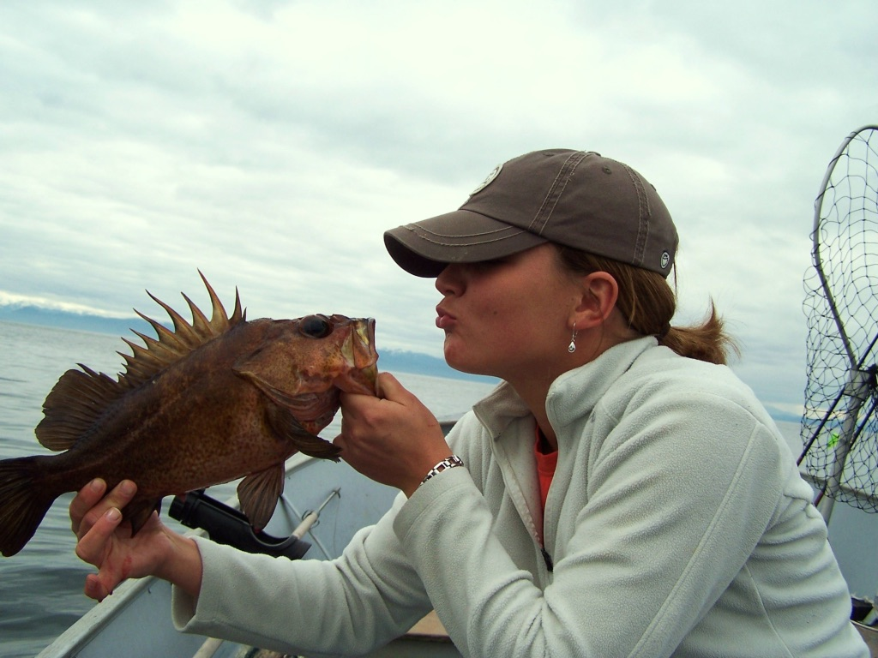
Questions?
MKAlder, 2017

Slide 13
Sources
AFDF. (2017) Retrieved from https://www.afdf.org/wp-content/uploads/1c-Economic-Analysis-to-Inform-AMI-Phase-I-Case-Studies.pdf
Alamy. (2017). Retrieved from http://c8.alamy.com/comp/EKW88D/worker-at-a-fish-hatchery-near-paxon-pours-sockeye-salmon-roe-into-EKW88D.jpg
Alaska Fish Radio. (2017). Retrieved from http://www.alaskafishradio.com/hot-fish-links/
Alaska Hatcheries . (2013, May 02). Retrieved August 29, 2017, from http://www.adfg.alaska.gov/index.cfm?adfg=fishinghatcheries.main
Alder, MK. (2017). Why Alaska Fisheries?. Unpublished manuscript, Colorado Technical University.
Daily Health Post. (2017) Retrieved from https://dailyhealthpost.com/wild-salmon-vs-farmed-salmon/
Echo-Hawk, A. (2013). Wild Caught. Retrieved August 29, 2017, from https://eatwildsalmon.com/2016/02/01/wild-vs-farm-raised-salmon/
French, V. (2017). SCI201 class lecture on Water Pollution. Personal Collection of V. French, Colorado Technical University, Aurora CO.
PBS. (2017) Retrieved from https://pbs.twimg.com/profile_images/2584224153/irt7tggwqo8lm2ktomr0_400x400.jpeg
Valdez Fisheries. (2017). Retrieved from https://www.valdezfisheries.org/wp-content/uploads/the-solomon-gulch-hatchery.jpg

