Slide 1
ANTHROPOCENE
(Human Age)
SCI201 Environmental Science
Luke Conwell
May 31, 2019

Slide 2
Have Humans Entered A “New” Epoch, Geologic Age?
Research Question

Slide 3
Why This Topic?
One Species Alone Is Driving These Changes
My Genealogy Directly Effects This Shift
99% Covered In Class
Post Apocalyptic?

Slide 4
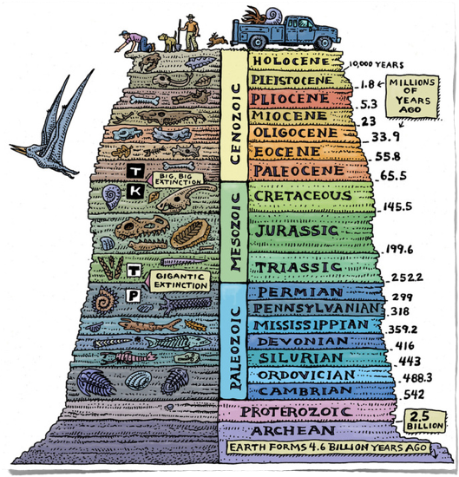
Recent Life
Middle Life
< .01%
Old Life
geologyin.com
clipart-library.com

Slide 5
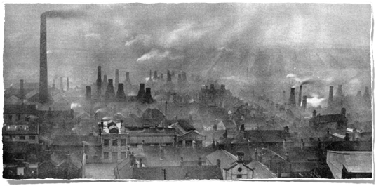
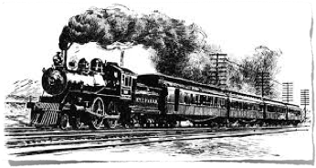
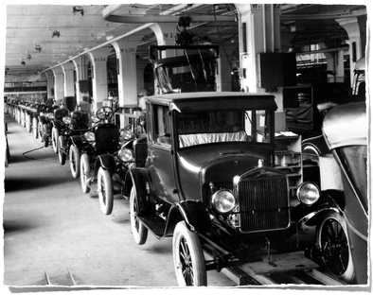
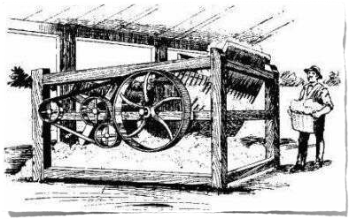
F
O
S
S
I
L
F
U
E
L
S
R
I
S
E
O
F
Info graph.venngage.com
cam.ac.uk
Industrial Revolution
asiasociety.org
product graph.io

Slide 6
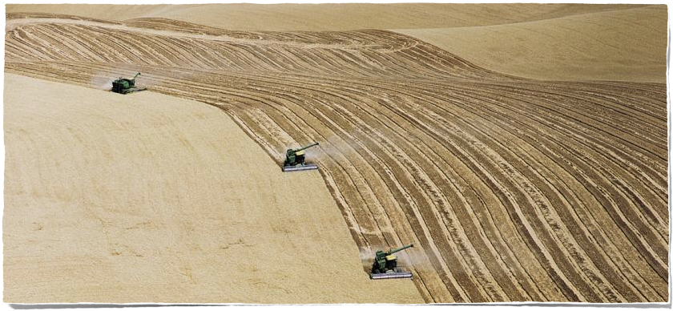
Industrialization of Agriculture
panna.org
Soil Conservation
Dust Bowl

Slide 7
Nuclear Explosions
mental floss.com
Late 1940s - Mid 1950s
Atmospheric Circulation?

Slide 8
Deforestation
google.com
1/2 As Many Trees Now Than
At The Dawn of Human Civilization

Slide 9
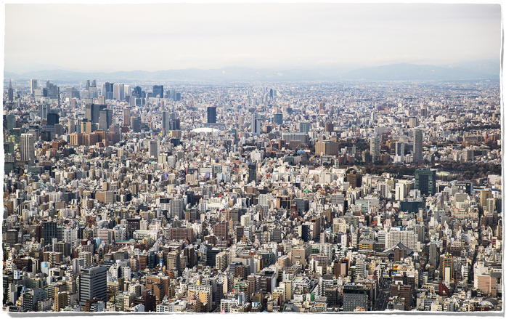
Urbanization
morphocode.com
More Than 1/2 Earth’s Population
7 Billion

Slide 10
International Geoshpere-Bioshpere Program
(IGBP)
12 Indicators of Human Activity
12 Indicators of The Earth’s System
Starting Point of 1750
ALL Indicator Graphs Looked Shockingly Similar
1950 Spike

Slide 11
-CONSUMPTION-
The Great Acceleration
Aluminum / Steele
Concrete
Plastics

Slide 12
Rapid Socioeconomic Growth - - 1950s
Greenhouse Gases Rising - - Temperatures Rising
Atmospheric Circulation Changing
Nitrogen Accumulating On Land and In Water
Oceans Are Acidifying
Species Are Dying
Carbon Dioxide We’ve Emitted Will Last
Tens of Thousands of Years

Slide 13
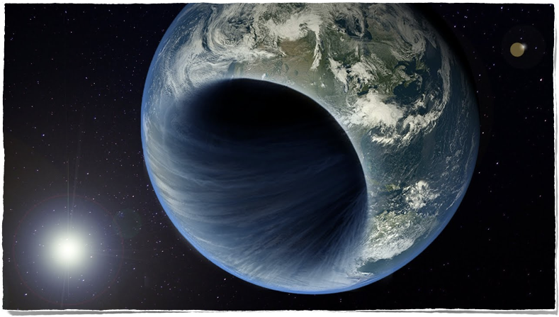
We’ve Altered The Way Our Planet Functions
YouTube.com
Proof?

Slide 14
Golden Spike
Marks Transition In The Rocks
Global Position
Base of Ediacaran Period
End Of Cryogenian Period (Snowball Earth)

Slide 15
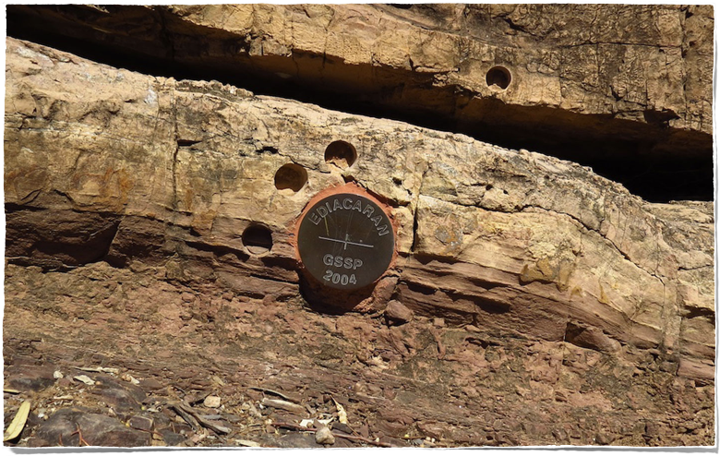
Chosen Place In The World
G
L
O
B
A
L
C
H
A
N
G
E
google.com
Ediacara, South Australia

Slide 16
‘Golden Spike’ To Mark Start Of Holocene
Ice Core In Copenhagen
Records Abrupt Shift In Climate
From Pleistocene to Holocene
Proof of ‘NEW’Epoch, Geologic Age?

Slide 17
Geo-Chemical Signals
Top-Sediments Full of Flash - -Burning of Fossil Fuels
Carbon Based Particles That Don’t Degrade
Lead From Automobile Exhaust
Increased Dramatically In 1950s

Slide 18
Biological Signal
Differently Shaped Fossils - - Breeding

Slide 19
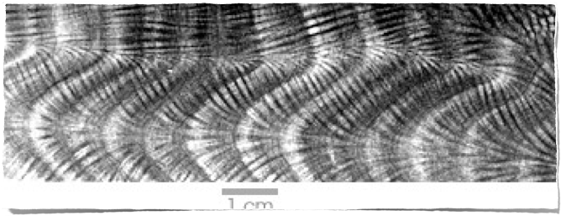
Coral Growth Bends
Globally Distributed Signal

Slide 20
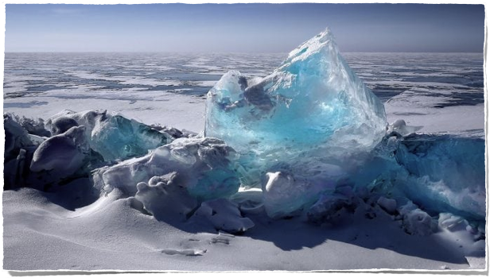
Antarctic Ice Sheet
Globally Distributed Signal

Slide 21
Mariana Trench
Globally Distributed Signal

Slide 22
Humans Have Entered A “New” Epoch, Geologic Age!
Summary

Slide 23
References
French, V. (2020). SCI201 class lecture on How the Earth Was Made. Personal Collection of V. French, Colorado Technical University, Aurora CO.
Levy, A., (May 15, 2019). “Bomb Carbon” Has Been Found in Deep-Ocean
Creatures. Retrieved from: https://www.scientificamerican.com/article/
bomb-carbon-has-been-found-in-deep-ocean-creatures/
Smithsonian Digital Studio. (2019). What Is the Anthropocene? Retrieved
from:https://www.smithsonianmag.com/videos/category/science/what-is-
the-anthropocene/
The Anthropocene | Has Earth Shifted Out of Its Holocene State? (2019).
Retrieved from:https://www.youtube.com/watch?v=ZZ845voIiOE

Slide 24
References
Clipart/Images Retrieved from: Animaker.com
Clipart/Images Retrieved from: https://morphocode.com/global-trends-urbanisation/
Clipart/Images Retrieved from:https://www.cam.ac.uk/research/news/industrial-revolution-damaging-psychological-imprint-persists-in-todays-populations
Clipart/Images Retrieved from:https://www.google.com/search?q=deforestation&source=lnms&tbm=isch&sa=X&ved=0ahUKEwjQ57-Lz8biAhWTvp4KHbfxDmUQ_AUIDigB&biw=1273&bih=1166#imgrc=NShun5K8Z2evbM:
Clipart/Images Retrieved from:https://www.google.com/search?biw=1273&bih=1166&tbm=isch&sa=1&ei=HmHxXKKrDu3O5gLQrKmIDw&q=the+geological+golden+spike&oq=the+geological+golden+spike&gs_l=img.3...10108.15659..18532...0.0..0.85.750.11......0....1..gws-wiz-img.......0i8i7i30.wDy6m6lkcf0#imgrc=hsdeto1DAMdU9M:

Slide 25
References
Clipart/Images Retrieved from: http://mentalfloss.com/article/20719/nuclear-bomb-vs-dirty-nuclear-bomb-whats-difference
Clipart/Images Retrieved from:https://productgraph.io/blogs/news/what-is-the-fourth-industrial-revolution
Clipart/Images Retrieved from:https://www.ucsusa.org/food_and_agriculture/our-failing-food-system/industrial-agriculture/hidden-costs-of-industrial.html
Clipart/Images Retrieved from:http://www.geologyin.com/2016/12/10-interesting-facts-about-geological.html
Clipart/Images Retrieved from:http://clipart-library.com/clipart/418330.htm

