Slide 1
Welcome to
SCI 201
Environmental
Science
Week 3
https://he.kendallhunt.com/product/environmental-science-lab-manual

Slide 2
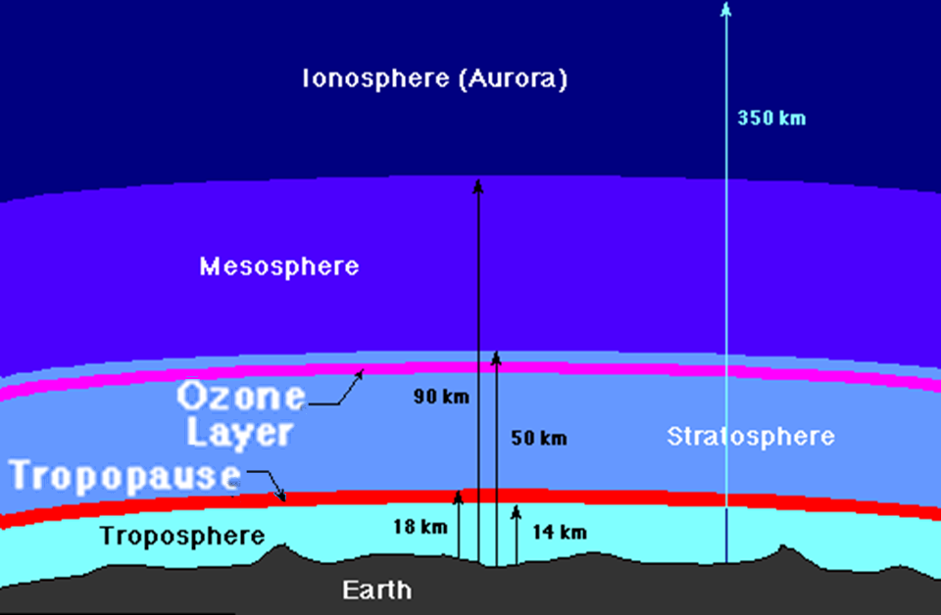
Problems from Greenhouse Gases
http://www.ngdir.ir/sitelinks/kids/html/water-mafahim_Alodegi%20hava_FF_8kontorol%20
alodegi%20hava.htm

Slide 3
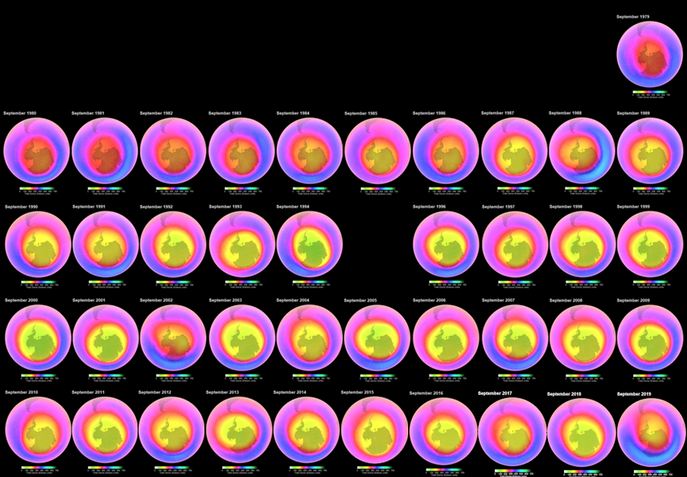
The "ozone hole"
http://ozonewatch.gsfc.nasa.gov/monthly/SH.html

Slide 4
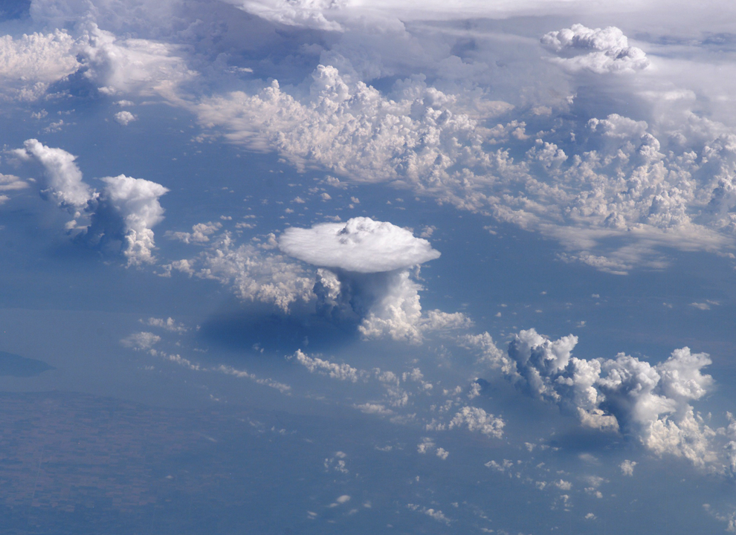
The Rising Tropopause
Increasing the height of the tropopause allows more space for big
storms
to brew
p/3516/widok-z-orbity-czesc-5

Slide 5
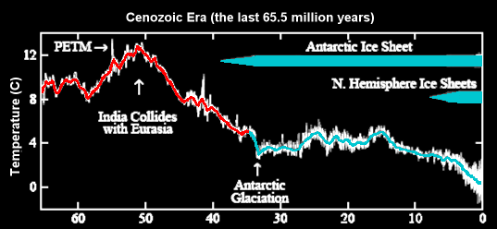
Long-Term Climate Change
PETM = Paleocene–Eocene Thermal Maximum
https://docsgreen.blogspot.com/2010/09/storms-of-my-grandchildren-james-hanson.html

Slide 6
Questions?
Discussion Board!
lol-rofl.com

Slide 7
Note:
What if I have a 58.5%
in the class????
http://newsfeed.time.com/2011/08/22/coming-to-an-in-flight-movie-near-you-weep-warnings/

Slide 8
Be sure to turn in all assignments to me by Friday
Have a great
BREAK!
www.playbuzz.com

Slide 9
Deep Time
http://nature.pagannewswirecollective.com/files/2011/10/deep-time1.jpg

Slide 10
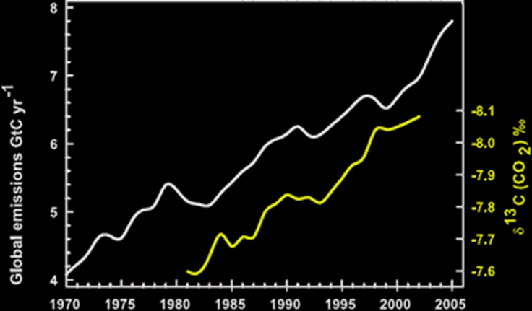
Deep Time
One of our graphs from last week:
https://static.skepticalscience.com/images/co2_vs_emissions.gif

Slide 11
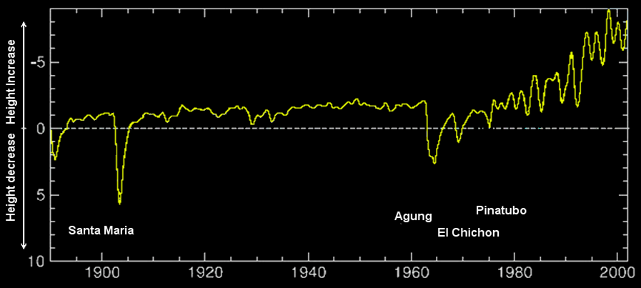
Deep Time
A graph with a longer time scale:

Slide 12
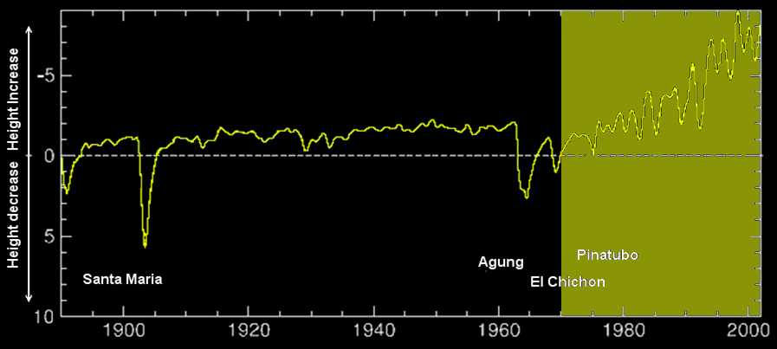
Deep Time
How much further back it goes:

Slide 13
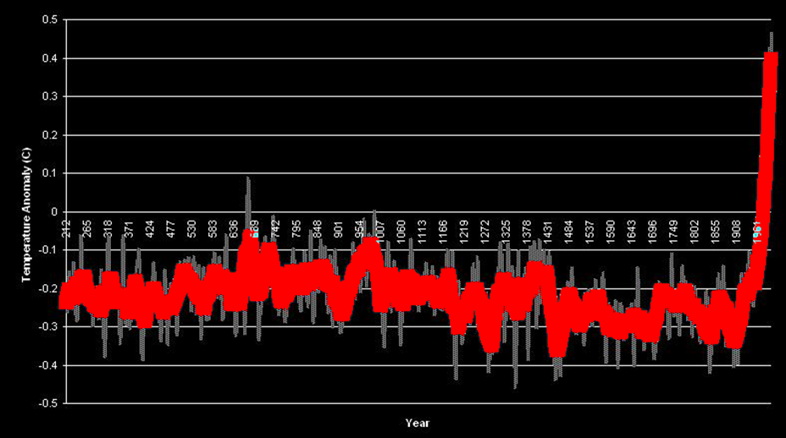
Deep Time
A graph with a longer time scale:

Slide 14
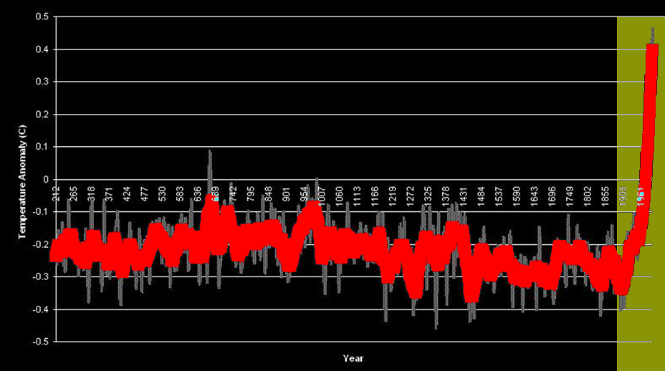
Deep Time
How much further back it goes:

Slide 15
Deep Time
A graph with a longer time scale:
PETM = Paleocene–Eocene Thermal Maximum

Slide 16
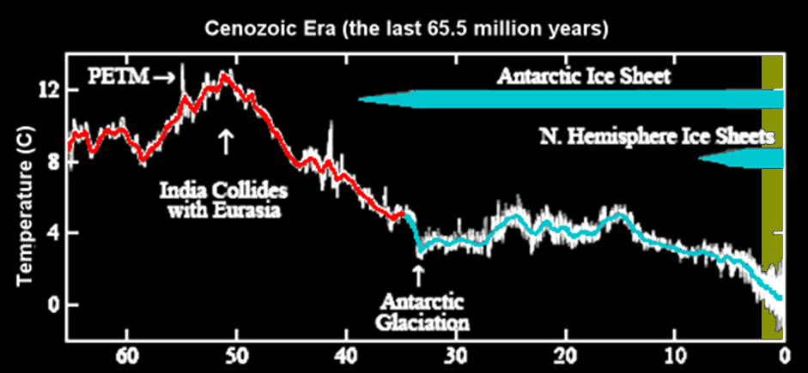
Deep Time
How much further back it goes:

Slide 17
Deep Time
As far back as it goes on Earth:

Slide 18
Deep Time
How much further back it goes:

Slide 19
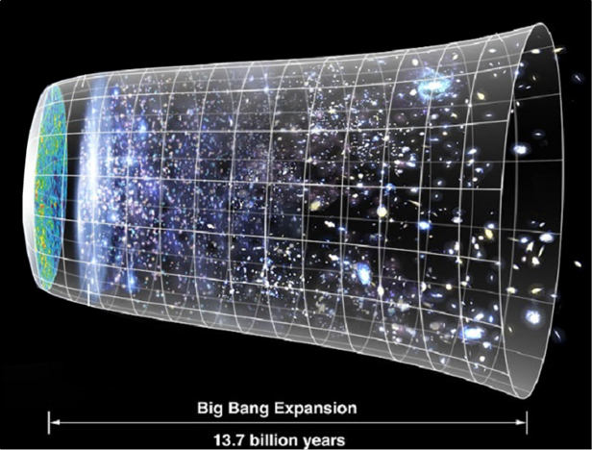
Deep Time
The Big Bang indicates the universe began about 13.8 billion years ago
https://en.wikipedia.org/wiki/Chronology_of_the_universe#/media/File:CMB_Timeline300_no_WMAP.jpg

Slide 20
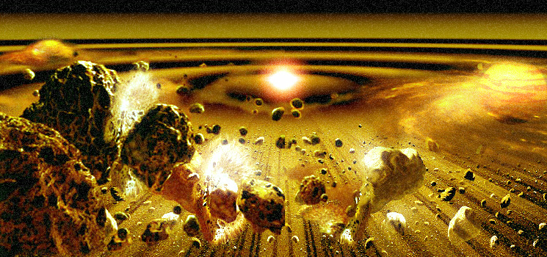
Deep Time
The Solar System began several star generations later
http://www.theseventhearth.com/images/large_diagrams/core_accretion.jpg

Slide 21
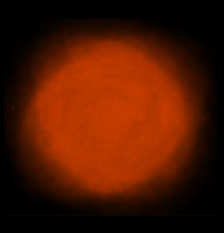
Deep Time
Initially, the Earth was shapeless and empty
French, 2015

Slide 22
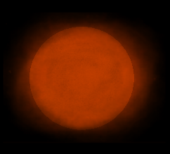
Hadean Period
The Earth “coagulated” about 4.6 billion years ago
French, 2015

Slide 23
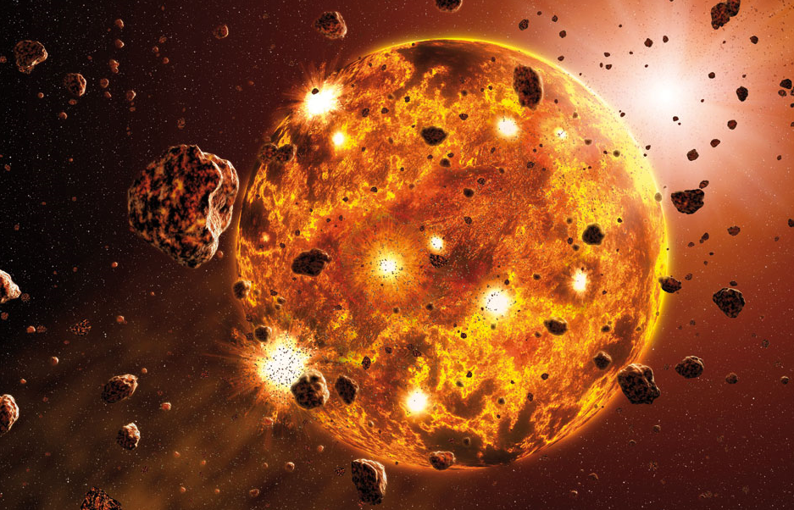
Hadean Period
Earth was initially molten due to extreme volcanism
https://planethunters.files.wordpress.com/2014/01/accretion-nature.jpg

Slide 24
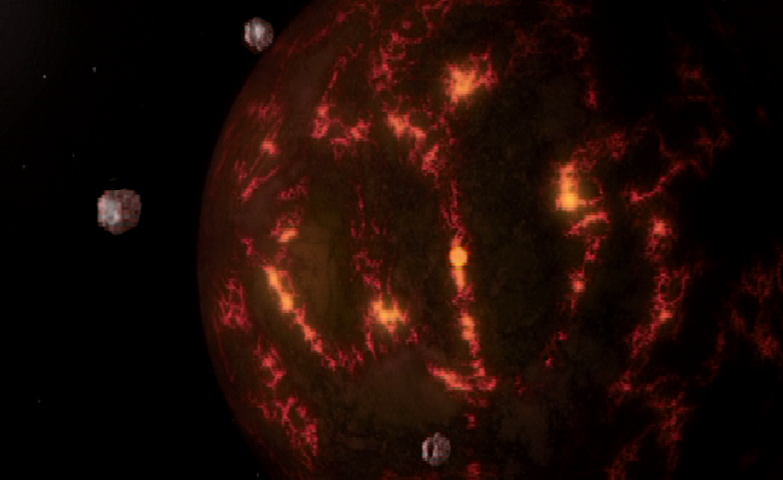
Hadean Period
Meteors bombarded the surface
How the Earth Was Made, Pioneer Productions, 2007

Slide 25
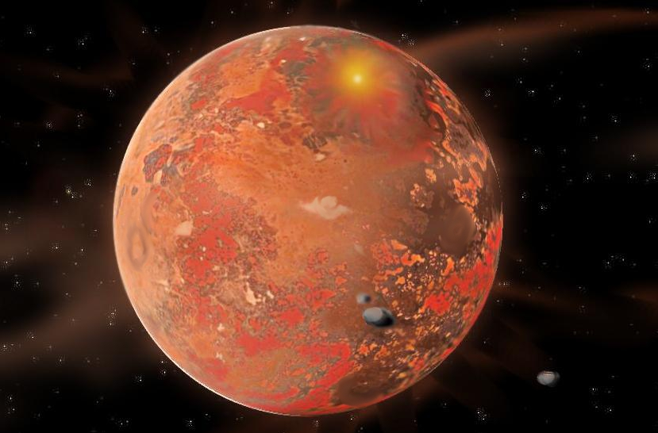
Hadean Period
Eventually, the outer layer of the planet cooled to form a solid crust made of a dark volcanic rock
called basalt
About 4.4 billion years ago
http://www.orionsarm.com/im_store/protoplanet2.jpg

Slide 26
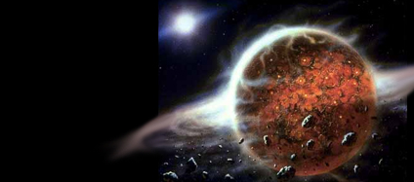
Hadean Period
Outgassing and volcanic activity produced the primordial atmosphere
https://i.ytimg.com/vi/2f5Fsy6WY1s/hqdefault.jpg

Slide 27
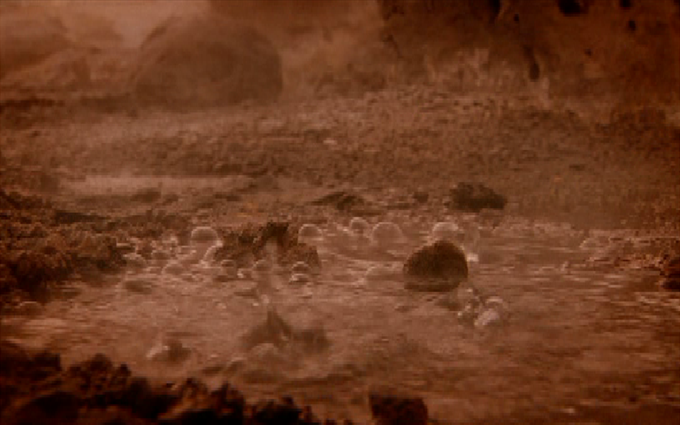
Hadean Period
Water began to form almost immediately – possibly from the meteors
How the Earth Was Made, Pioneer Productions, 2007

Slide 28
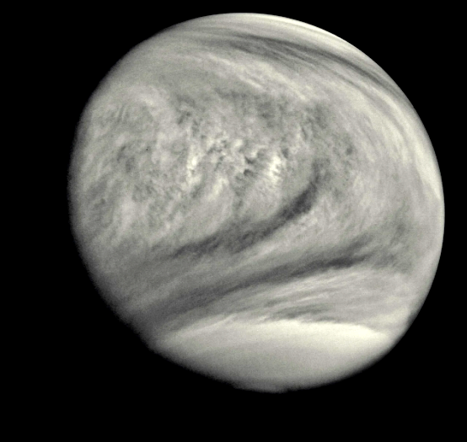
Hadean Period
Evaporation from
the hot
surface
formed
thick clouds
How the Earth Was Made, Pioneer Productions, 2007

Slide 29
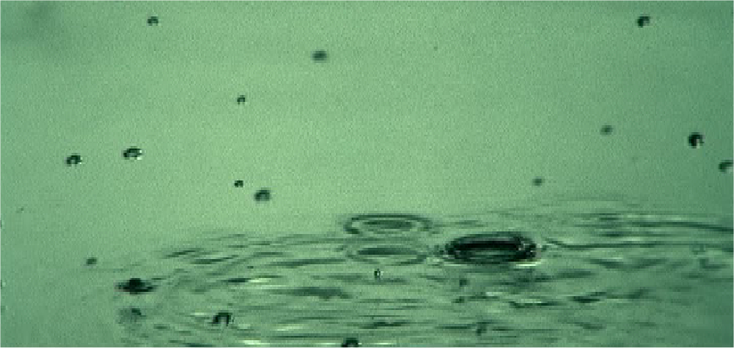
Hadean Period
When the clouds reached saturation, it began to rain …
How the Earth Was Made, Pioneer Productions, 2007

Slide 30
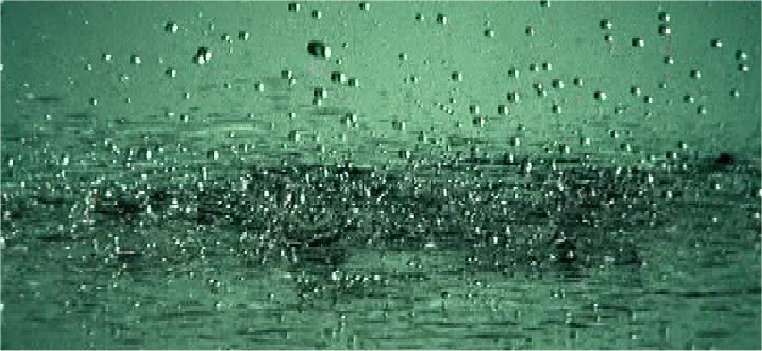
Hadean Period
… and kept raining for about 100 million years …
How the Earth Was Made, Pioneer Productions, 2007

Slide 31
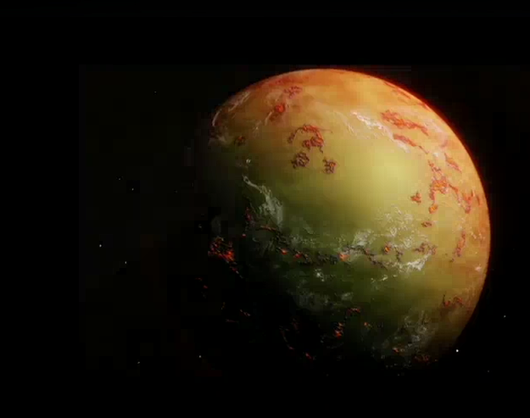
Hadean Period
… making Earth
a water-world
About 4.2 billion years ago
How the Earth Was Made, Pioneer Productions, 2007

Slide 32
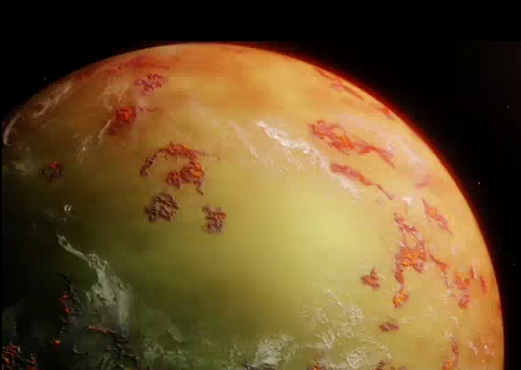
Hadean Period
Iron-rich ocean waters appeared green
How the Earth Was Made video 2009

Slide 33
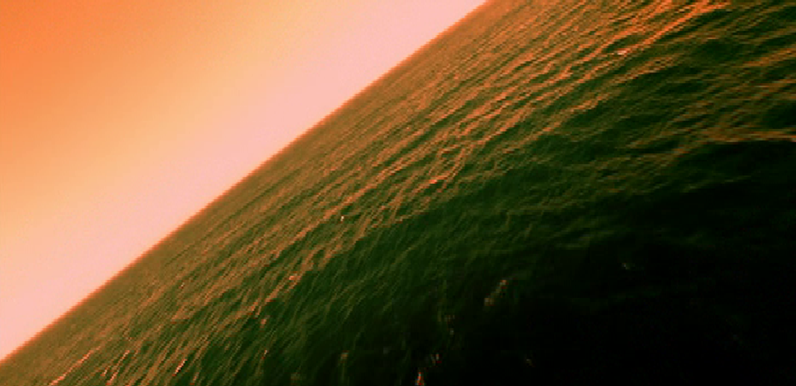
Hadean Period
The CO2-rich atmosphere was red
How the Earth Was Made, Pioneer Productions, 2007

Slide 34
Hadean Period
The dense atmosphere would squish you flat
How the Earth Was Made, Pioneer Productions, 2007

Slide 35
Hadean Period
The air temperature was above 200 degrees F
How the Earth Was Made, Pioneer Productions, 2007

Slide 36
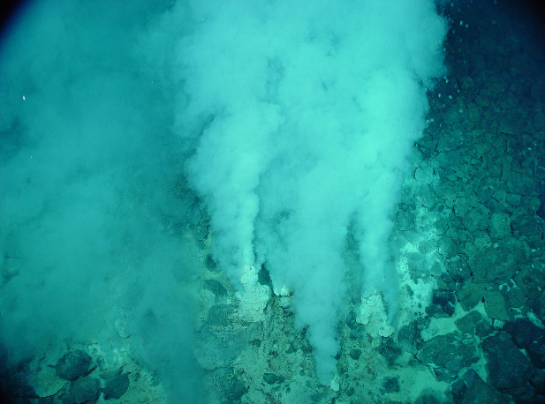
How the Earth Was Made
PROJECT QUESTIONS 1,2
The first life, one-celled bacteria, formed around warm volcanic vents in the deep waters
About 4 billion years ago
https://www.google.com/search?hl=en&site=imghp&tbm=isch&source=hp&biw=1169&bih=901&q=accretion+of+the+earth&oq=accretion+of+the+earth&gs_l=img.3..0i30.3827.8352.0.8665.22.14.0.8.8.0.187.2091.0j14.14.0....0...1ac.1.64.img..1.21.2003.V5s_Ph91ipk#hl=en&tbm=isch&q=underwater+volcanic+vent&imgrc=utw9oqqiS0NnnM%3A

Slide 37
Hadean Period
This is when Mars is believed to have lost its magnetosphere making surface life
impossible there
http://img12.deviantart.net/3ebb/i/2013/149/9/0/marvin_the_martian_emperor_by_g_chris-d6704j7.jpg

Slide 38
Archean Period
During the Archean Earth (4,000 to 2,500 million years ago) the Earth's crust cooled enough that rocks and continental plates began to form

Slide 39
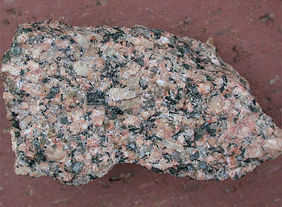
Archean Period
The first continents formed from strong, light granitic rocks
http://www.pitt.edu/~cejones/GeoImages/2IgneousRocks/IgneousCompositions/6Granite/GraniteSml.jpg

Slide 40
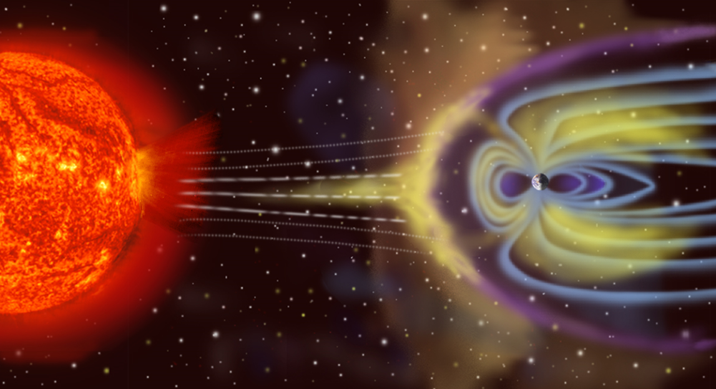
Archean Period
3.5 billion years ago, the Earth's magnetic field strengthened, damaging gamma and cosmic rays were blocked, and surface
life could
begin
https://upload.wikimedia.org/wikipedia/commons/f/f3/Magnetosphere_rendition.jpg

Slide 41
Archean Period
Chemical “fossils” date from this time – methylhopanes from cyano-bacteria
How the Earth Was Made, Pioneer Productions, 2007

Slide 42
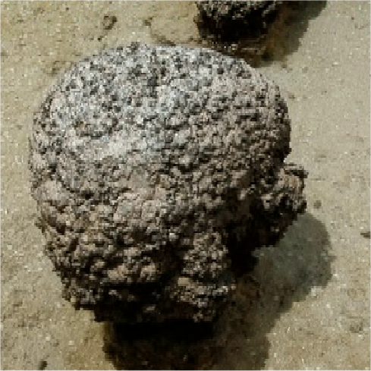
Archean Period
Poop from these bacteria formed deposits called “stromatolites” in the shallow waters around the continents
How the Earth Was Made, Pioneer Productions, 2007

Slide 43
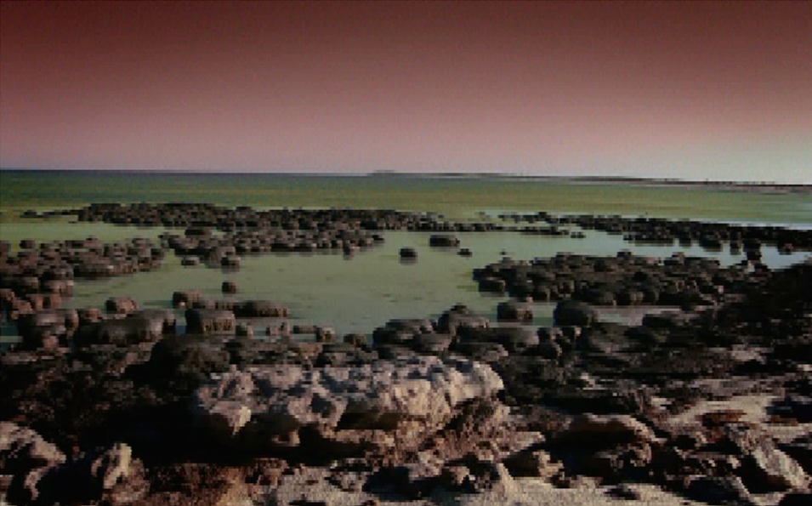
Archean Period
In the Big Bang Theory theme song, the “drooling autotrophs” are stromatolites
How the Earth Was Made, Pioneer Productions, 2007

Slide 44
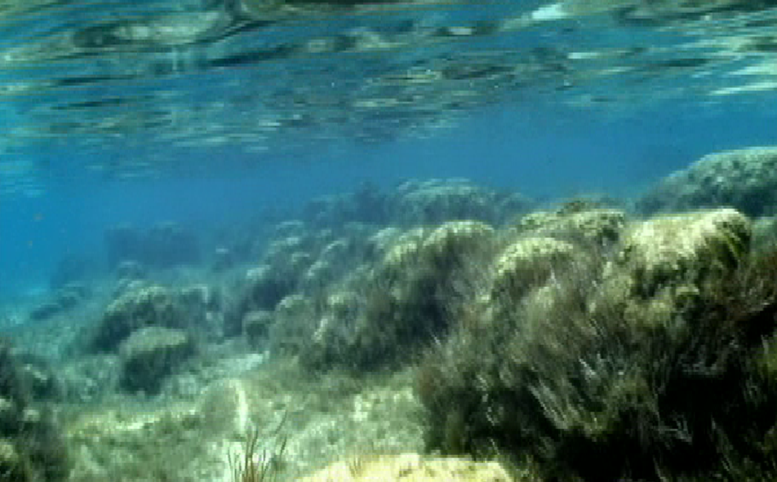
Archean Period
These now-rare bacterial algae created so much oxygen over a thousand-year period that they rusted the iron from the oceans making them blue
How the Earth Was Made, Pioneer Productions, 2007

Slide 45
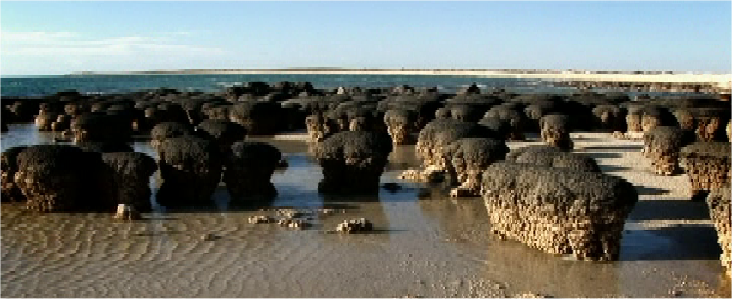
Archean Period
Then the oxygen created by the bacterial algae cleared the atmosphere
How the Earth Was Made, Pioneer Productions, 2007

Slide 46
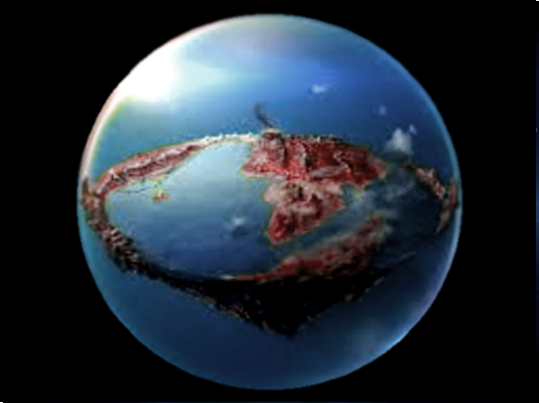
Archean Period
So we got our blue oceans and blue sky!
(called the
Great
Oxygenation
Event)
About 2.4 billion years ago
https://www.timetoast.com/timelines/geological-timeline-d08f854d-1a8d-4414-9017-a0a6e87d8029

Slide 47
How the Earth Was Made
PROJECT QUESTION 3
This probably caused the extinction of earlier life forms as new life forms took over
https://www.timetoast.com/timelines/geological-timeline-d08f854d-1a8d-4414-9017-a0a6e87d8029

Slide 48
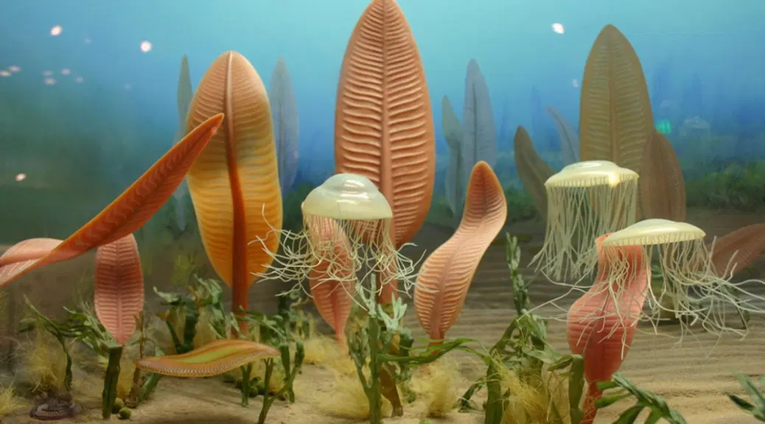
Proterozoic Period
“Ediacaran” life took over
https://allyouneedisbiology.wordpress.com/2019/04/14/ediacaran-fauna/

Slide 49
Proterozoic Period
Granitic continents drifted into two supercontinents (called Pannotia and Rodinia) which blocked oceanic circulation

Slide 50
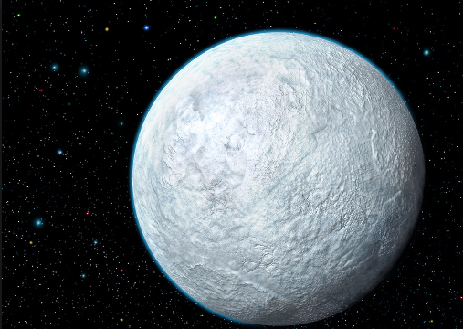
Proterozoic Period
This blockage climaxed with the “Snowball Earth”
http://2.bp.blogspot.com/-tfKzNgekBTQ/VFVRm63A6wI/AAAAAAAACJY/ GCOEreusz6U/s1600/ Snowball%2BEarth_20141102.jpg

Slide 51
How the Earth Was Made
PROJECT QUESTION 4
The mile-deep global snow layer blocked light and heat
This caused the extinction of almost all life on Earth

Slide 52
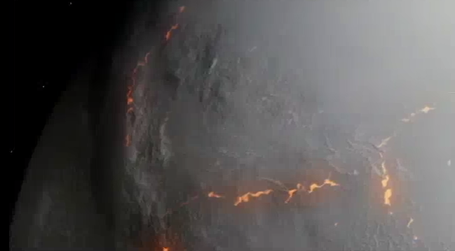
Proterozoic Period
Happily, the insulating snow blanket caused the Earth to rebel – volcanic activity split the supercontinents
How the Earth Was Made video 2009

Slide 53
Proterozoic Period
CO2 from the eruptions caused a greenhouse effect, warming the Earth and melting the snowball

Slide 54
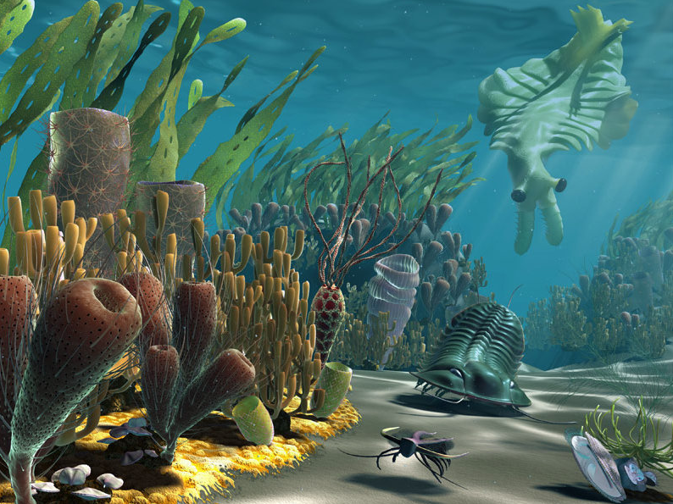
Cambrian Period
The melting of the snowball led to an explosion of new life forms
http://www.rttscience.com/fieldmuseumchicago_fullsize_story2.jpg

Slide 55
Ordovician Period
High levels of oxygen in the atmosphere allowed the formation of an ozone layer
which blocked UV radiation allowing life to move from the oceans to the land about 400 million years ago

Slide 56
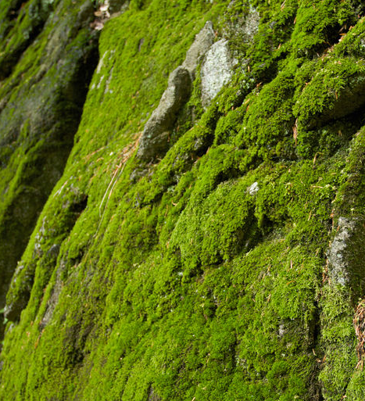
Ordovician Period
The first land
plants
(nonvascular)
occur in this
period
https://dr282zn36sxxg.cloudfront.net/datastreams/f-d%3Ab1c519278fec0849a145cf1a518def4fc 202353c002c19dbda258d59%2BIMAGE%2BIMAGE.1

Slide 57
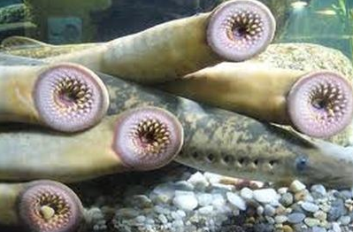
Ordovician Period
This period also saw the first vertebrates - fish with skeletons rather than exoskeletons
http://jawlessfishfacts.weebly.com/uploads/2/8/3/4/28346827/5478725.jpeg?405

Slide 58
Ordovician Period
The “first Great Extinction” occurred to end the Ordovician Period 443 million years ago – it killed 60-70% of all species

Slide 59
How the Earth Was Made
PROJECT QUESTION 5
There was a glaciation (ice age) that possibly caused the extinctions

Slide 60
How the Earth Was Made
PROJECT QUESTION 5
Some scientists have suggested that the extinctions could have been caused by a gamma-ray burst originating from a hypernova

Slide 61
How the Earth Was Made
PROJECT QUESTION 5
A ten-second burst would have stripped the Earth's atmosphere of half of its ozone exposing surface-dwelling organisms to high levels of extreme ultraviolet radiation

Slide 62
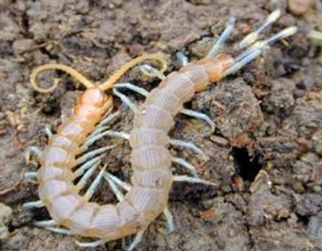
Silurian Period
At this time the first air-breathing animals (arthropods) appear
http://www.earlyearthcentral.com/images/arthropod.jpg

Slide 63
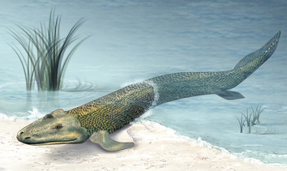
Devonian Period
The first seed plants and amphibians appear
http://i.livescience.com/images/i/000/062/902/iFF/tiktaalik.jpg?1393058866

Slide 64
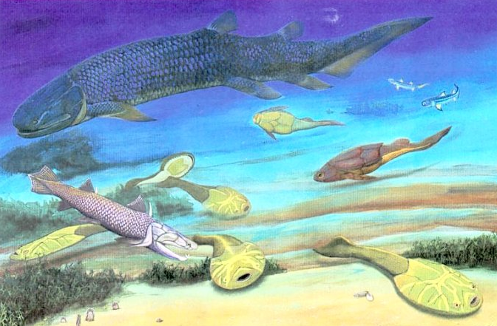
Devonian Period
This period is called the “Age of Fish”
https://universe-review.ca/I10-30-fish.jpg

Slide 65
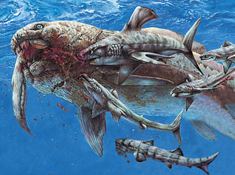
Devonian Period
Dunkleosteus, one of the largest armored fish to ever roam the
planet,
lived during
the late
Devonian
http://www.corzakinteractive.com/earth-life-history/assets/scenes/414a_devonian.jpg

Slide 66
Devonian Period
The Second Great Extinction ended the Devonian Period
It lasted about 20 million years
Extinction only affected marine life - especially the reefs
At least 75% of species dies

Slide 67
How the Earth Was Made
PROJECT QUESTION 6
We don’t know what caused it, but oceanic volcanism could have led to anoxia (lack of oxygen)

Slide 68
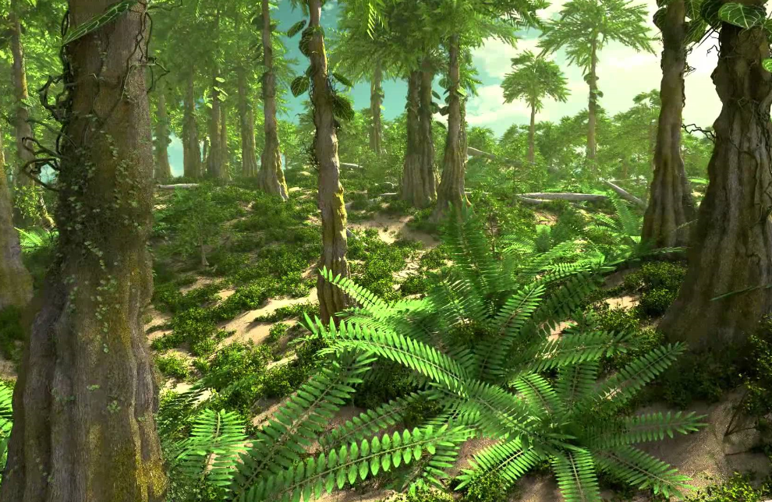
Carboniferous Period
This is the age of amphibians and tropical coal forests
http://i.ytimg.com/vi/KJdCytwAigU/maxresdefault.jpg

Slide 69
Carboniferous Period
These forests form the main source of our modern coal

Slide 70
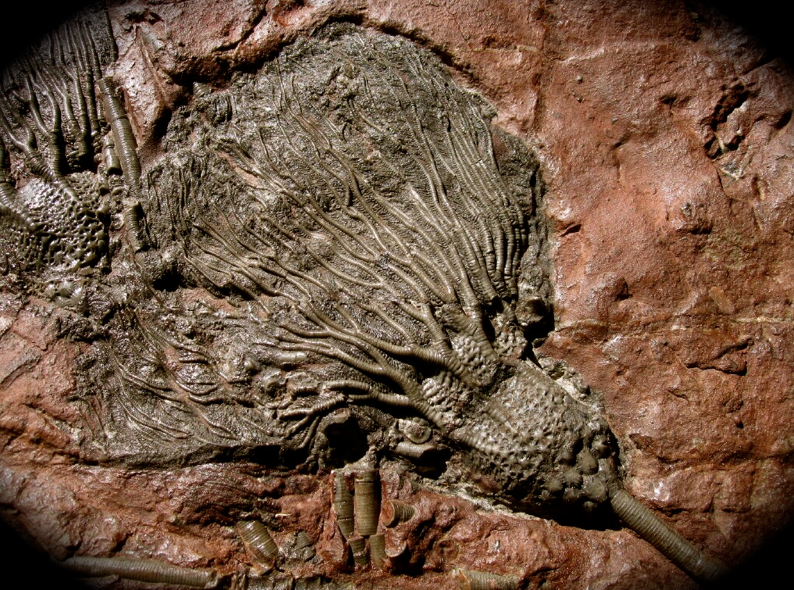
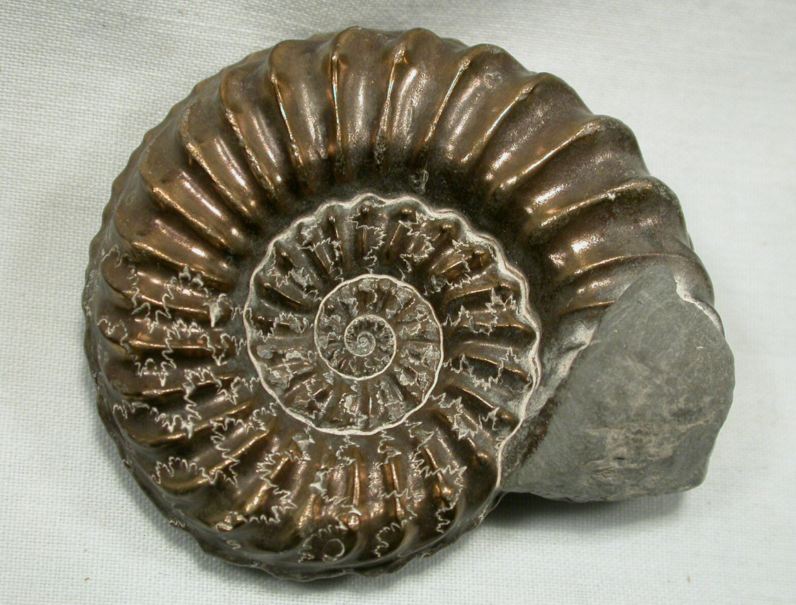
Carboniferous Period
A drop in sea level caused a large marine extinction, especially crinoids and ammonites
http://www.fossilmall.com/Pangaea/pfossils/pf40/pfo430b.JPG
http://www.fossilmuseum.net/Fossil_Galleries/Ammonites/Pleuroceras/Pleuroceras-orig.jpg

Slide 71
Permian Period
About 300 million years ago
all the Earth's major land masses, except portions of East Asia, were collected into a single supercontinent known as Pangaea which straddled the equator effected ocean currents

Slide 72
Permian Period
This supercontinent didn’t cause a snowball, but it did lead to volcanic activity!

Slide 73
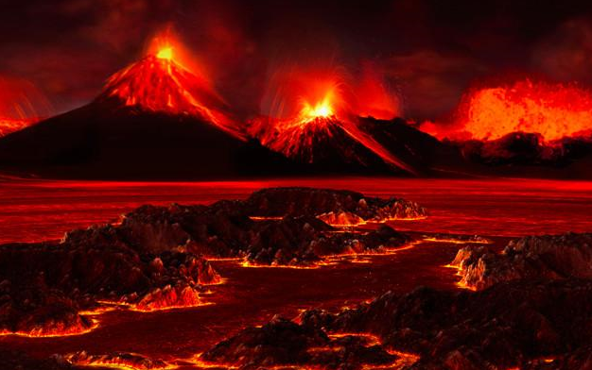
Permian Period
About 250 million years ago, a mantle plume eruption lasting about 1 million years
http://www.astrobio.net/wp-content/uploads/2014/08/unnamed.jpg

Slide 74
How the Earth Was Made
PROJECT QUESTION 7
This caused Earth's largest extinction
It killed 90-96% of all species

Slide 75
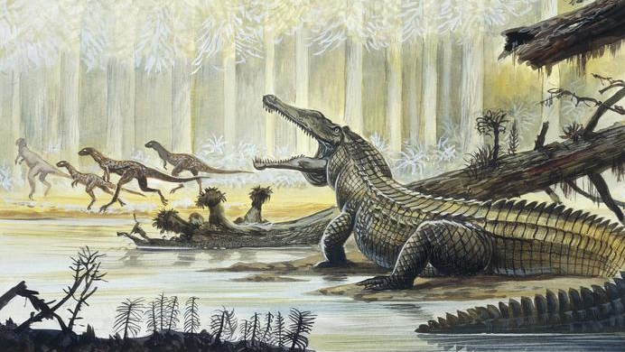
Triassic Period
Starting about 252 million years ago, steamy temperatures
encourage reptiles such as
alligators and turtles
http://cx.aos.ask.com/question/aq/700px-394px/did-triassic-period-begin-end_ d337631bc25c8716.jpg

Slide 76
Triassic Period
The Great End-Triassic Extinction killed 76% of all marine and terrestrial species
This allowed dinosaurs to become the dominant land animals on Earth

Slide 77
How the Earth Was Made
PROJECT QUESTION 8
The supercontinent Pangea split causing widespread volcanic activity
This released carbon dioxide causing a global greenhouse effect raising air temperatures and causing acidification of the oceans

Slide 78
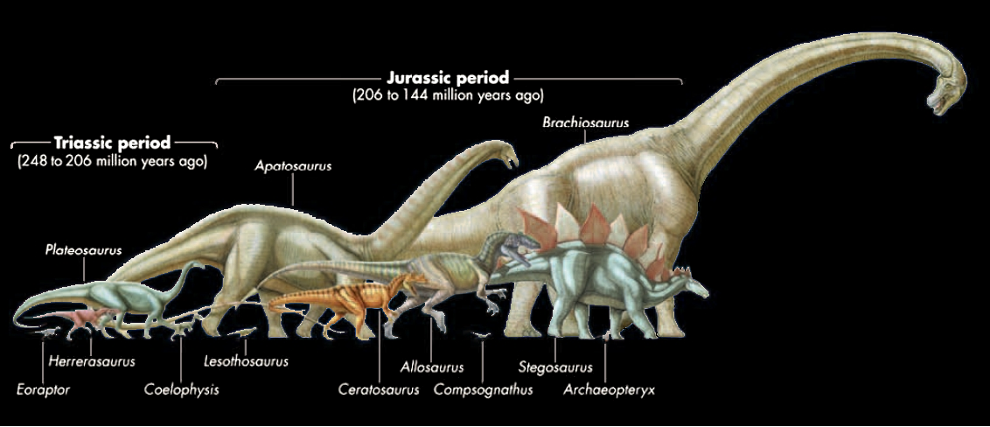
Jurassic Period
Dinosaurs dominate for 55 million years
https://earthandourecosystem.files.wordpress.com/2014/06/dinmjko.jpg

Slide 79
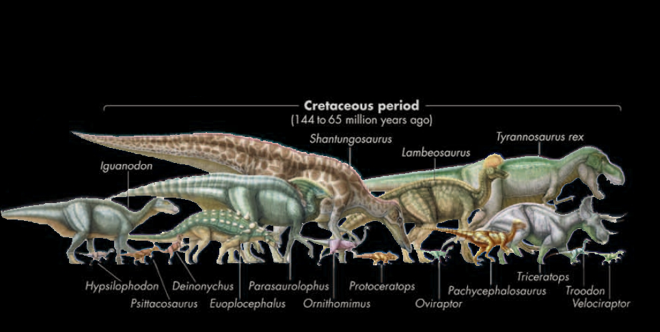
Cretaceous Period
Dinosaurs dominate for 55 million years
https://earthandourecosystem.files.wordpress.com/2014/06/dinmjko.jpg

Slide 80
Then, 66 million years ago in Chicxulub, Mexico…
http://loggiaonfire.com/wp-content/uploads/2016/09/Chicxulub-impact-2-300x218.png

Slide 81
Cretaceous Period
The resulting “nuclear winter” caused cooling and loss of food supplies that the dinosaurs could not survive
http://news.nationalgeographic.com/content/dam/news/photos/000/641/64137.jpg

Slide 82
How the Earth Was Made
PROJECT QUESTION 9
75% of species died during the Great End-Cretaceous mass extinction

Slide 83
Cretaceous Period
Luis and Walter
Alvarez
https://en.wikipedia.org/wiki/Alvarez_hypothesis#/media/File:LWA_with_Walt.JPG

Slide 84
Cenozoic Era
This started about 66 million years ago and extends to the present

Slide 85
Tertiary Period
Mammals began to be dominant

Slide 86
Tertiary Period
The earliest humanoid fossils date from about 4 million years ago
The earliest Homo erectus fossils date from about 1.9 million years ago

Slide 87
Pleistocene Epoch
Began about 2,580,000 years ago
This is the age of the large mammals including mammoths and mastodons and sabre-tooth cats

Slide 88
Pleistocene Epoch
During the ice ages, various extinction events occurred due to climate change

Slide 89
Pleistocene Epoch
640,000 years ago the Yellowstone Caldera supereruption caused climate change and extinctions globally

Slide 90
Questions?
www.career.gatech.edu

Slide 91
Humans
Hominin is a term that refers to modern humans and their immediate ancestors

Slide 92
Humans
The main defining trait of all hominins is bipedalism (walking on two legs)

Slide 93
Humans?
Ardipithecus lived from about 5.8 to 4.4 million years ago in East Africa
http://www.sci-news.com/othersciences/anthropology/science-ardipithecus-ramidus-human-lineage-01675.html

Slide 94
Humans?
Ardipithecus teeth are transitional between those of chimpanzees and the earliest australopithecus species

Slide 95
Humans?
The shape of its pelvis is similar to later bipedal hominins
The skeleton also retains traits of tree-climbing apes such as a divergent big toe that allows the foot to be used for grasping

Slide 96
Humans?
Australopithecines would have lived in Africa between about 4.2 and 2.5 million years ago
https://flexbooks.ck12.org/cbook/ck-12-college-human-biology-flexbook-2.0/section/7.4/primary/ lesson/early-hominin-evolution-chumbio

Slide 97
Humans?
Like modern humans, the legs of australopithecines were longer than their arms, and their feet had arches for better support of the body
In contrast, chimpanzee arms are longer and the feet lack arches

Slide 98
Humans?
The australopithecine pelvis is short and wide, like that of modern humans
The chimpanzee pelvis, in contrast, is tall and narrow, more suited for quadrupedalism

Slide 99
Humans?
Like the human big toe, the australopithecine big toe is not divergent
A divergent big toe, which allows the feet to be used for grasping branches, is not well suited for long-distance walking

Slide 100
Humans?
The fingers of australopithecines are short and straight like human fingers
Chimpanzees have longer, curved fingers useful for climbing trees

Slide 101
Humans?
“Lucy” is an
Australopithecus
Afarensis
(3.7-3
million
years ago)
https://www.haaretz.com/archaeology/MAGAZINE-lucy-walked-upright-but-baby-australopithecines-lurked-in-trees-1.6243522
https://en.wikipedia.org/wiki/Lucy_(Australopithecus)#/media/File:Reconstruction_of_the_fossil_skeleton_of_%22Lucy%22_the_Australopithecus_afarensis.jpg

Slide 102
Humans?
Australopithecus africanus would have lived in Africa between about 3 and 2 million years ago

Slide 103
Humans?
The Taung baby
(2.5 million years
ago)
https://www.the-scientist.com/foundations/the-first-australopithecus-1925-40797

Slide 104
Humans?
Homo habilis would have lived in Africa between about 2.1 and 1.5 million years ago
https://kanisearlyhuman.weebly.com/homo-habilis.html

Slide 105
Humans?
Homo erectus would have lived in Africa between about 1.9 million to 110,000 years ago

Slide 106
Humans?
Turkana Boy lived about 1.5-1.6 million years ago
https://en.wikipedia.org/wiki/Turkana_Boy#/media/File:Turkana_Boy.jpg

Slide 107
Humans!
Homo sapiens are dated to about 315,000 years ago (presently)

Slide 108
Humans
120,000 years ago (maybe 200,000 years ago) the first humans travelled northward into Asia but died out 90,000 years ago

Slide 109
Humans
Approximately 72,000 years ago humans travelled out of Africa through Saudi Arabia to India
All non-African people are descended from this subgroup

Slide 110
Humans
The Toba super-volcano in Indonesia triggered a nuclear winter thought to have nearly annihilated humans 70,000 years ago

Slide 111
Humans
50,000-60,000 years ago the first humans travelled to Australia

Slide 112
Humans
46,000 years ago humans entered Europe
European mitochondrial DNA dates to 50,000-13,000 years ago

Slide 113
Humans
40,000 years ago, humans came to East Asia

Slide 114
Humans
About 15,000 years ago humans came to the Americas

Slide 115
Neanderthals
Homo sapiens neanderthalensis date to the same time as Homo sapiens sapiens

Slide 116
Neanderthals
Neanderthal museum Krapina, Croatia

Slide 117
Are you a Neanderthal?
https://www.dreamstime.com/royalty-free-stock-image-african-american-businessman-image 5034526#res29250703

Slide 118
https://the-hollywood-gossip-res.cloudinary.com/iu/s--DOEweWc5--/t_full/
cs_srgb,f_auto,fl_strip_profile.lossy,q_auto:420/v1364526764/donald-trump-profile.jpg

Slide 119
Not Just Neanderthals!
https://thepaleolithicshelter.files.wordpress.com/2013/10/neandertal.jpg?w=500&h=525
https://pbs.twimg.com/media/CXZdJMEWEAAcz4t.jpg
https://cdn.arstechnica.net/wp-content/uploads/2016/02/A4HHo5R-640x537.jpg

Slide 120
Neanderthal Extinction?
https://upload.wikimedia.org/wikipedia/commons/e/e8/Campanian_Ignimbrite_Eruption_ash_cloud.jpg

Slide 121
The Younger Dryas
A rapid return to glacial conditions in the higher latitudes of the Northern Hemisphere between 12,900–11,500 years ago

Slide 122
The Younger Dryas
It has been believed that the transition occurred over a period of a decade or so, but the onset may have been faster

Slide 123
The Younger Dryas
Ice core measurements suggest the ending of the Younger Dryas took place around
11,550 – 10,000 BP

Slide 124
The Younger Dryas
This is also believed to have been caused by a meteor strike

Slide 125
The Younger Dryas
Impacts:
Replacement of forest in
Scandinavia with glacial tundra
Increased snow in mountain
ranges around the world
More dust in the atmosphere
from deserts in Asia

Slide 126
The Younger Dryas
Drought in the Middle East
motivating the development
of agriculture
http://i.kinja-img.com/gawker-media/image/upload/zlh1iknpwenlxpqon60o.jpg

Slide 127
The Younger Dryas
Decline of the Clovis Culture
and extinction of animal
species in North America
http://i.kinja-img.com/gawker-media/image/upload/zlh1iknpwenlxpqon60o.jpg

Slide 128
Holocene Extinction
As human populations grow and infringe on and change animal habitats, species are becoming extinct at an increasing rate
This is the one we can do something about!

Slide 129
You now have some great tools…
… go build something wonderful!
VFrench 2014

Slide 130
I’ll be missing you!
Have a
great
BREAK!
https://s-media-cache-ak0.pinimg.com/originals/64/02/40/ 6402400af94ef763ee11ddbe95d3b1b8.jpg

