Slide 1
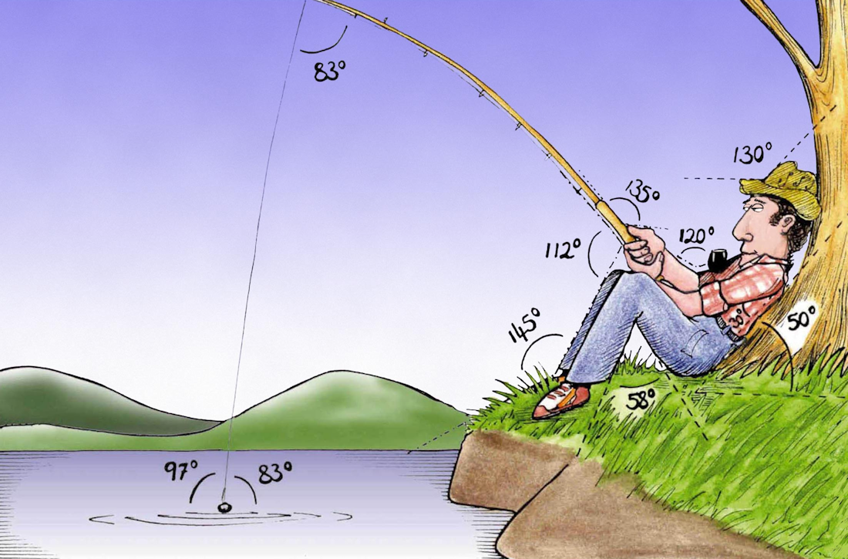
Welcome to
Week 8!
Analytic Trigonometry
http://www.lab-initio.com/images/fullsize/nz211.jpg

Slide 2
What’s Up?
Today we will be going over:
Review of complex numbers
and phasor arithmetic
Polar coordinates

Slide 3
What’s Up?
Obj 6) Perform computations with complex numbers in rectangular and polar form including the operations of powers and roots, both by "hand" and with technology.
Obj 7) Convert points and equations between rectangular and polar coordinates.

Slide 4
Review
http://995642590.r.lightningbase-cdn.com/wp-content/uploads/2010/12/looking-back-hrexaminer-v144-cover425px.jpg

Slide 5
Complex Numbers
Complex numbers include the "imaginary" unit:
i ≡ $\sqrt{\text{−}\text{1}}$

Slide 6
Complex Numbers
Complex numbers are written:
a + b i
real imaginary
part part

Slide 7
Complex Numbers
Complex numbers are usually designated "z“
z = a + b i

Slide 8
Complex Numbers
Arithmetic with complex numbers:
(a+bi) + (c+di) = (a+c) + (b+d)i
(a+bi) - (c+di) = (a-c) + (b-d)i

Slide 9
Complex Numbers
Multiplying:
(a+bi) × (c+di) =
(a×c) + (a×d+b×c)i + (b×d)i²
= ac + (ad+bc)i + bd(-1)
= (ac-bd) + (ad+bc) i

Slide 10
Complex Numbers
Don’t leave any exponents of i in a formula
http://scottsauls.com/wp-content/uploads/2015/06/Shame.jpg

Slide 11
Complex Numbers
$\sqrt{−\text{9}}$ × $\sqrt{−\text{36 }}$ = 3i × 6i
= 18i²
= -18
You need to take out the “i ” first
(If you don’t, you’ll get the wrong answer)

Slide 12
Phasor Arithmetic
Sine-shaped waves all with the same frequency but with different amplitudes and phases are represented by a real multiplier for frequency and time and a complex multiplier for amplitude (phasor)

Slide 13
Phasor Arithmetic
Combining these phasors is called phasor arithmetic

Slide 14
Questions?
lol-rofl.com

Slide 15
Polar Coordinates
We know about square graph paper
VFrench, 2015

Slide 16
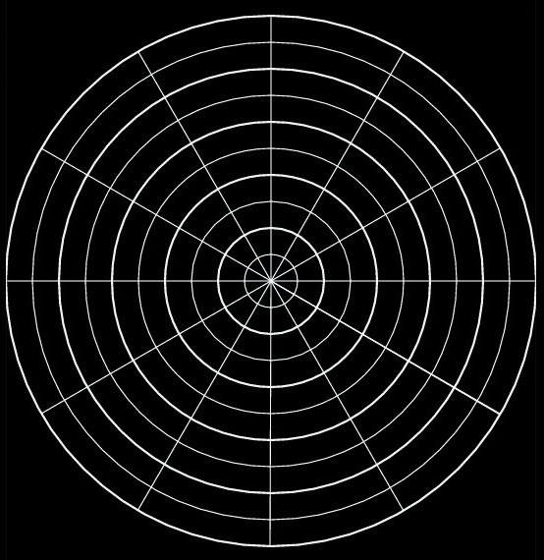
Polar Coordinates
Now we’re going to learn about circular graph paper!
VFrench, 2015

Slide 17
Polar Coordinates
In the 700s and 800s AD, Arabic astronomers developed methods for calculating the direction and distance to Mecca from any point on Earth

Slide 18
Polar Coordinates
They were using
spherical
trigonometry
to do this
Mecca
VFrench, 2015

Slide 19
Polar Coordinates
Just like with square graph paper, polar graph paper has a starting point
VFrench, 2015

Slide 20
Polar Coordinates
For square graph paper, this point is called the origin
For polar graph paper, it is called the pole
VFrench, 2015

Slide 21
Polar Coordinates
Just like square graph paper, the starting position is the right horizontal line
VFrench, 2015

Slide 22
Polar Coordinates
This is called the “polar axis”
VFrench, 2015

Slide 23
Polar Coordinates
The rotation for both square and polar graphs is counterclockwise
II I
III IV
VFrench, 2015

Slide 24
Polar Coordinates
Just like for (x,y) coordinates, there are a pair of polar coordinates (r,θ)
These are called the “polar coordinates”

Slide 25
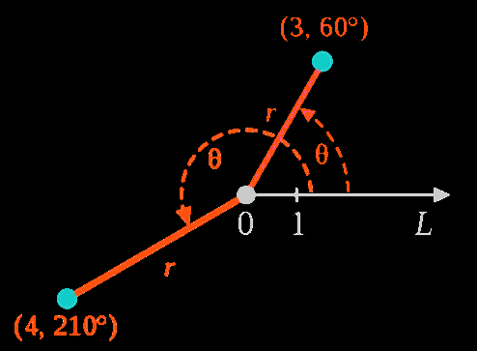
Polar Coordinates
r is the distance from the pole (the radius)
θ is the angle around the circle
VFrench, 2015

Slide 26
Polar Coordinates
Angles in polar notation can be expressed in either degrees or radians
105º
90º
75º
7π/12
π/2
5π/12
120º
60º
2π/3
π/3
135º
45º
3π/4
π/4
150º
30º
5π/6
π/6
165º
15º
11π/12
π/12
180º
1
2
3
0º, 360º
π
1
2
3
0, 2π
195º
345º
13π/12
23π/12
210º
330º
7π/6
11π/6
225º
315º
5π/4
7π/4
240º
300º
4π/3
5π/3
255º
270º
285º
17π/12
3π/2
19π/12
VFrench, 2015

Slide 27
Polar Coordinates
Degrees are traditionally used in navigation, surveying, and many applied disciplines
Radians are more common in mathematics and mathematical physics

Slide 28
Polar Coordinates
point P = (r,θ)
r is the distance (radius) from the pole to P (+,- or 0)
θ is the angle from the polar axis to the terminal side of the angle (degrees or radians)

Slide 29
Polar Coordinates
point P = (r,θ)
Hint: plot the angle θ first
Then the “r”

Slide 30
POLAR COORDINATES
IN-CLASS PROBLEM 1
Plot (2,135º)
(move the green dot)
105º
90º
75º
120º
60º
135º
45º
150º
30º
165º
15º
180º
0º, 360º
1
2
3
195º
345º
210º
330º
225º
315º
240º
300º
255º
270º
285º
VFrench, 2015

Slide 31
POLAR COORDINATES
IN-CLASS PROBLEM 1
Plot (2,135º)
Begin with the
angle θ=135º
105º
90º
75º
120º
60º
135º
45º
150º
30º
165º
15º
180º
0º, 360º
1
2
3
195º
345º
210º
330º
225º
315º
240º
300º
255º
270º
285º
VFrench, 2015

Slide 32
POLAR COORDINATES
IN-CLASS PROBLEM 1
Plot (2,135º)
Begin with the
angle θ=135º
105º
90º
75º
120º
60º
135º
45º
150º
30º
165º
15º
180º
0º, 360º
1
2
3
195º
345º
210º
330º
225º
315º
240º
300º
255º
270º
285º
VFrench, 2015

Slide 33
POLAR COORDINATES
IN-CLASS PROBLEM 1
Plot (2,135º)
Now find the point
on the line
corresponding
to the
radius “r”
105º
90º
75º
120º
60º
135º
45º
150º
30º
165º
15º
180º
0º, 360º
1
2
3
195º
345º
210º
330º
225º
315º
240º
300º
255º
270º
285º
VFrench, 2015

Slide 34
POLAR COORDINATES
IN-CLASS PROBLEM 1
Plot (2,135º)
Because the radius
is positive, the
point will be
along this
line - it
will be
r=2 radii
from the pole
105º
90º
75º
120º
60º
135º
45º
(2,135º)
150º
30º
165º
15º
180º
0º, 360º
1
2
3
195º
345º
210º
330º
225º
315º
240º
300º
255º
270º
285º
VFrench, 2015

Slide 35
Polar Coordinates
Positive angles are measured counterclockwise from the polar axis
Negative angles are measured clockwise from the polar axis

Slide 36
Polar Coordinates
If the angle is negative, just rotate it in a clockwise direction
VFrench, 2015

Slide 37
POLAR COORDINATES
IN-CLASS PROBLEM 2
Plot (1.5,-45º)
105º
90º
75º
120º
60º
135º
45º
150º
30º
165º
15º
180º
0º, 360º
1
2
3
195º
345º
210º
330º
225º
315º
240º
300º
255º
270º
285º
VFrench, 2015

Slide 38
POLAR COORDINATES
IN-CLASS PROBLEM 2
Plot (1.5,-45º)
Begin with the
angle θ=-45º
105º
90º
75º
120º
60º
135º
45º
150º
30º
165º
15º
180º
0º, 360º
1
2
3
195º
345º
210º
330º
225º
315º
240º
300º
255º
270º
285º
VFrench, 2015

Slide 39
POLAR COORDINATES
IN-CLASS PROBLEM 2
Plot (1.5,-45º)
Positive 45º
would be:
105º
90º
75º
120º
60º
135º
45º
150º
30º
165º
15º
180º
0º, 360º
1
2
3
195º
345º
210º
330º
225º
315º
240º
300º
255º
270º
285º
VFrench, 2015

Slide 40
POLAR COORDINATES
IN-CLASS PROBLEM 2
Plot (1.5,-45º)
-45º rotates
clockwise:
105º
90º
75º
120º
60º
135º
45º
150º
30º
165º
15º
180º
0º, 360º
1
2
3
195º
345º
210º
330º
225º
315º
300º
-45º
240º
255º
270º
285º
VFrench, 2015

Slide 41
POLAR COORDINATES
IN-CLASS PROBLEM 2
Plot (1.5,-45º)
You can calculate
it using
360 + θ:
360+(-45)
= 315º
105º
90º
75º
120º
60º
135º
45º
150º
30º
165º
15º
180º
0º, 360º
1
2
3
195º
345º
210º
330º
225º
315º
300º
-45º
240º
255º
270º
285º
VFrench, 2015

Slide 42
POLAR COORDINATES
IN-CLASS PROBLEM 2
Plot (1.5,-45º)
Now find the point
on the line
corresponding
to the
radius “r”
105º
90º
75º
120º
60º
135º
45º
150º
30º
165º
15º
180º
0º, 360º
1
2
3
195º
345º
210º
330º
225º
315º
300º
-45º
240º
255º
270º
285º
VFrench, 2015

Slide 43
POLAR COORDINATES
IN-CLASS PROBLEM 2
Plot (1.5,-45º)
Tah-dah!
105º
90º
75º
120º
60º
135º
45º
150º
30º
165º
15º
180º
0º, 360º
1
2
3
(1.5,-45º)
195º
345º
210º
330º
225º
315º
240º
300º
255º
270º
285º
VFrench, 2015

Slide 44
Polar Coordinates
P = (r,θ ) is located | r | units from the pole

Slide 45
Polar Coordinates
If the radius “r” is negative, it’s a little more complicated
VFrench, 2015

Slide 46
Polar Coordinates
Remember, when you “negativize” a number, it’s graph mirrors across 0
-3
0
3
VFrench, 2015

Slide 47
Polar Coordinates
In an ordered pair, the “negativized” number mirrors across it’s 0
(-3,1)
1
(3,1)
0
-3
0
3
VFrench, 2015

Slide 48
Polar Coordinates
In an ordered pair, the “negativized” number mirrors across it’s 0
1
(3,1)
0
-3
0
3
-1
(3,-1)
VFrench, 2015

Slide 49
Polar Coordinates
In an ordered pair, the “negativized” numbers mirror across both 0s
1
(3,1)
0
-3
0
3
(-3,-1)
-1
VFrench, 2015

Slide 50
Polar Coordinates
r > 0 – the point lies on the terminal side of θ
r < 0 - point lies along the ray opposite the terminal side of θ
r = 0 the point lies on the pole no matter what the value of θ is!

Slide 51
Polar Coordinates
As usual, it’s
easier to DO it than to explain
it!
http://ahungryrunner.files.wordpress.com/2013/07/confused-baby.png

Slide 52
POLAR COORDINATES
IN-CLASS PROBLEM 3
Plot (-3,270º)
Plot the angle
105º
90º
75º
120º
60º
135º
45º
150º
30º
165º
15º
180º
0º, 360º
1
2
3
195º
345º
210º
330º
225º
315º
240º
300º
255º
270º
285º
VFrench, 2015

Slide 53
POLAR COORDINATES
IN-CLASS PROBLEM 3
Plot (-3,270º)
Next mirror
the angle
105º
90º
75º
120º
60º
135º
45º
150º
30º
165º
15º
180º
0º, 360º
1
2
3
195º
345º
210º
330º
225º
315º
240º
300º
255º
270º
285º
VFrench, 2015

Slide 54
POLAR COORDINATES
IN-CLASS PROBLEM 3
Plot (-3,270º)
Now plot the
(positiv-ized)
point value
on the
mirrored
line
105º
90º
75º
120º
60º
135º
45º
150º
30º
165º
15º
180º
0º, 360º
1
2
3
195º
345º
210º
330º
225º
315º
240º
300º
255º
270º
285º
VFrench, 2015

Slide 55
POLAR COORDINATES
IN-CLASS PROBLEM 3
Plot (-3,270º)
(-3,270º)
105º
90º
75º
120º
60º
135º
45º
150º
30º
165º
15º
180º
0º, 360º
1
2
3
195º
345º
210º
330º
225º
315º
240º
300º
255º
270º
285º
VFrench, 2015

Slide 56
POLAR COORDINATES
IN-CLASS PROBLEM 4
Plot (-1,-30º)
105º
90º
75º
120º
60º
135º
45º
150º
30º
165º
15º
180º
0º, 360º
1
2
3
195º
345º
210º
330º
225º
315º
240º
300º
255º
270º
285º
VFrench, 2015

Slide 57
POLAR COORDINATES
IN-CLASS PROBLEM 4
Plot (-1,-30º)
Did you get
it right?
105º
90º
75º
120º
60º
135º
45º
150º
30º
165º
15º
180º
0º, 360º
1
2
3
195º
345º
210º
330º
225º
315º
240º
300º
255º
270º
285º
VFrench, 2015

Slide 58
Polar Coordinates
It works the same for radians

Slide 59
POLAR COORDINATES
IN-CLASS PROBLEM 5
Plot the point:
(2.5,7π/12)
7π/12
π/2
5π/12
2π/3
π/3
3π/4
π/4
5π/6
π/6
11π/12
π/12
π
0, 2π
1
2
3
13π/12
23π/12
7π/6
11π/6
5π/4
7π/4
4π/3
5π/3
17π/12
19π/12
3π/2
VFrench, 2015

Slide 60
POLAR COORDINATES
IN-CLASS PROBLEM 5
Plot the point:
(2.5,7π/12)
Did you
get it
right?
7π/12
π/2
5π/12
2π/3
π/3
3π/4
π/4
5π/6
π/6
11π/12
π/12
π
0, 2π
1
2
3
13π/12
23π/12
7π/6
11π/6
5π/4
7π/4
4π/3
5π/3
17π/12
19π/12
3π/2
VFrench, 2015

Slide 61
Questions?
http://i.imgur.com/aliTlT3.jpg

Slide 62
Polar to Rectangular
Originally, polar graph paper was designed to graph complex numbers

Slide 63
Polar to Rectangular
That way you would always know just by looking at the graph paper whether you were looking at a real number or a complex number

Slide 64
Polar to Rectangular
But people noticed you could plop rectangular graph paper right on top of the polar graph and get an easier-to-use graph

Slide 65
Polar to Rectangular
So they needed a way to convert from polar to rectangular in a mathematically accurate way (not just by plopping rectangular graph paper over polar graphs!)

Slide 66
Polar to Rectangular
Last week we showed 3 + 4i could be graphed:
i
4
3
2
1
0
x
-4
-3
-2
-1
0
1
2
3
4
-1
-2
-3
-4

Slide 67
Polar to Rectangular
In electrical engineering, this way of graphing complex numbers is called an Argand Diagram
https://www.electronics-tutorials.ws/accircuits/complex-numbers.html

Slide 68
Polar to Rectangular
But, it’s not the same as a true polar graph!
How would you graph 30º or 2π?

Slide 69
Polar to Rectangular
Polar to rectangular conversion
If you have a polar point:
P = (r,θ)
To convert to (x,y) coordinates:
x = r cos θ
y = r sin θ

Slide 70
POLAR TO RECTANGULAR
IN-CLASS PROBLEM 6
x = r cosθ
y = r sinθ
Find the rectangular coordinates:
P = (3,π/3)

Slide 71
POLAR TO RECTANGULAR
IN-CLASS PROBLEM 6
x = r cosθ
y = r sinθ
Find the rectangular coordinates:
P = (3,π/3)
x = rcosθ = 3cos(π/3) = 3(1/2) = 1.5
y = rsinθ = 3sin(π/3) = 3($\sqrt{\text{3}}$/2) ≈ 2.6
P = (3,π/3) in polar coordinates
is (x,y) = (1.5,2.6) in rectangular

Slide 72
Polar to Rectangular
Is P = (3,π/3) in polar coordinates (x,y) = (1.5,2.6) in rectangular?
7π/12
π/2
5π/12
2π/3
π/3
3π/4
π/4
3
5π/6
π/6
2
11π/12
π/12
1
π
0, 2π
0
1
2
3
-3
-2
-1
1
2
3
13π/12
23π/12
-1
7π/6
11π/6
-2
5π/4
7π/4
-3
4π/3
5π/3
17π/12
19π/12
VFrench, 2015
3π/2

Slide 73
POLAR TO RECTANGULAR
IN-CLASS PROBLEM 7
What quadrant is it in?
7π/12
π/2
5π/12
2π/3
π/3
3π/4
π/4
3
5π/6
π/6
2
11π/12
π/12
1
π
0, 2π
0
1
2
3
-3
-2
-1
1
2
3
13π/12
23π/12
-1
7π/6
11π/6
-2
5π/4
7π/4
-3
4π/3
5π/3
17π/12
19π/12
VFrench, 2015
3π/2

Slide 74
POLAR TO RECTANGULAR
IN-CLASS PROBLEM 8
x = r cosθ
y = r sinθ
Find the rectangular coordinates:
P = (-4,π/4)

Slide 75
POLAR TO RECTANGULAR
IN-CLASS PROBLEM 8
x = r cosθ
y = r sinθ
Find the rectangular coordinates:
P = (-4,π/4)
x = rcosθ = -4(cos(π/4) = -4$\sqrt{\text{2}}$/2
≈ -2.8
y = rsinθ = -4sin(π/4) = -4$\sqrt{\text{2}}$/2
≈ -2.8

Slide 76
POLAR TO RECTANGULAR
IN-CLASS PROBLEM 9
P = (-4,π/4) (x,y) ≈ (-2.8,-2.8)
What quadrant is it in?
7π/12
π/2
5π/12
2π/3
π/3
4
3π/4
π/4
3
5π/6
π/6
2
11π/12
π/12
1
π
0, 2π
0
1
2
3
4
-4
-3
-2
-1
1
2
3
4
13π/12
23π/12
-1
7π/6
11π/6
-2
5π/4
7π/4
-3
4π/3
5π/3
17π/12
19π/12
-4
VFrench, 2015
3π/2

Slide 77
Questions?
http://i.imgur.com/aliTlT3.jpg

Slide 78
Rectangular to Polar
Not as easy…
r = $\sqrt{{\text{x}}^{2}+ {\text{y}}^{2}}$
θ = arctan (y/x)

Slide 79
RECTANGULAR TO POLAR
IN-CLASS PROBLEM 10
r = $\sqrt{{\text{x}}^{2}+ {\text{y}}^{2}}$
θ = arctan (y/x)
Find the polar coordinates of:
(x,y) = (1,–$\sqrt{3}$)

Slide 80
RECTANGULAR TO POLAR
IN-CLASS PROBLEM 10
r = $\sqrt{{\text{x}}^{2}+ {\text{y}}^{2}}$
θ = arctan (y/x)
Find the polar coordinates of:
(x,y) = (1,–$\sqrt{3}$)
r = $\sqrt{{\text{1}}^{2}+ {\text{(}\text{–}\sqrt{3}\text{)}}^{2}}$ = $\sqrt{\text{1}+\text{3}}$ = $\sqrt{\text{4}}$ = 2
θ = tan⁻¹ (–$\sqrt{3}$/1) = 120°
or 2π/3 rad

Slide 81
Rectangular to Polar
But… is it? Is (x,y) = (1,–$\sqrt{3}$)
the same as P = (2,120°)?
105º
90º
75º
4
120º
60º
3
135º
45º
2
150º
30º
165º
15º
1
0
180º
0º, 360º
-4
-3
-2
-1
0
1
2
3
4
1
2
3
-1
195º
345º
-2
210º
330º
-3
225º
315º
240º
300º
-4
255º
270º
285º
VFrench, 2015

Slide 82
Rectangular to Polar
Oops! It’s in the wrong quadrant!
105º
90º
75º
4
120º
60º
3
135º
45º
2
150º
30º
165º
15º
1
0
180º
0º, 360º
-4
-3
-2
-1
0
1
2
3
4
1
2
3
-1
195º
345º
-2
210º
330º
-3
225º
315º
240º
300º
-4
255º
270º
285º
VFrench, 2015

Slide 83
Rectangular to Polar
It should be the other tan⁻¹=–$\sqrt{3}$ = 300° or 5π/3 rad
105º
90º
75º
4
120º
60º
3
135º
45º
2
150º
30º
165º
15º
1
0
180º
0º, 360º
-4
-3
-2
-1
0
1
2
3
4
1
2
3
-1
195º
345º
-2
210º
330º
-3
225º
315º
240º
300º
-4
255º
270º
285º
VFrench, 2015

Slide 84
RECTANGULAR TO POLAR
IN-CLASS PROBLEM 10
r = $\sqrt{{\text{x}}^{2}+ {\text{y}}^{2}}$
θ = arctan (y/x)
Find the polar coordinates of:
(x,y) = (1,–$\sqrt{3}$)
r = $\sqrt{{\text{1}}^{2}+ {\text{(}\text{–}\sqrt{3}\text{)}}^{2}}$ = $\sqrt{\text{1}+\text{3}}$ = $\sqrt{\text{4}}$ = 2
θ = tan⁻¹ (–$\sqrt{3}$/1) = 300°
or 5π/3 rad

Slide 85
Rectangular to Polar
You have to be VERY careful with these conversions to get the right quadrant!
(You see why we’ve been emphasizing quadrants?)

Slide 86
RECTANGULAR TO POLAR
IN-CLASS PROBLEM 11
r = $\sqrt{{\text{x}}^{2}+ {\text{y}}^{2}}$
θ = arctan (y/x)
Find the polar coordinates of: (x,y) = (0,–4)

Slide 87
RECTANGULAR TO POLAR
IN-CLASS PROBLEM 11
r = $\sqrt{{\text{x}}^{2}+ {\text{y}}^{2}}$
θ = arctan (y/x)
Find the polar coordinates of: (x,y) = (0,–4)
r = $\sqrt{{\text{0}}^{2}+ {\text{(–4)}}^{2}}$ = $\sqrt{\text{0}+\text{16}}$ = $\sqrt{\text{16}}$ = 4
θ = tan⁻¹ (–4/0) = 90°
or π/2 rad

Slide 88
RECTANGULAR TO POLAR
IN-CLASS PROBLEM 11
r = $\sqrt{{\text{x}}^{2}+ {\text{y}}^{2}}$
θ = arctan (y/x)
Find the polar coordinates of: (x,y) = (0,–4)
r = $\sqrt{{\text{0}}^{2}+ {\text{(–4)}}^{2}}$ = $\sqrt{\text{0}+\text{16}}$ = $\sqrt{\text{16}}$ = 4
θ = tan⁻¹ (–4/0) = 90°
Is this the right quadrant?
(ok… it’s interquadrantal!)

Slide 89
Rectangular to Polar
(x,y) = (0,–4)
105º
90º
75º
4
120º
60º
3
135º
45º
2
150º
30º
165º
15º
1
0
180º
0º, 360º
-4
-3
-2
-1
0
1
2
3
4
2
4
-1
195º
345º
-2
210º
330º
-3
225º
315º
240º
300º
-4
255º
270º
285º
VFrench, 2015

Slide 90
RECTANGULAR TO POLAR
IN-CLASS PROBLEM 11
r = $\sqrt{{\text{x}}^{2}+ {\text{y}}^{2}}$
θ = arctan (y/x)
Find the polar coordinates of: (x,y) = (0,–4)
r = $\sqrt{{\text{0}}^{2}+ {\text{(–4)}}^{2}}$ = $\sqrt{\text{0}+\text{16}}$ = $\sqrt{\text{16}}$ = 4
θ = tan⁻¹ (–4/0) = 270°
or 3π/2 rad

Slide 91
Questions?
http://i.imgur.com/aliTlT3.jpg

Slide 92
Polar Equations
Polar equations
have variables r and θ

Slide 93
Polar Equations
Converting rectangular equations to polar equations, replace:
x with r cosθ and
y with r sinθ

Slide 94
Polar Equations
Converting polar equations to rectangular equations:
NOT EASY!
you may have to square both sides,
take the tangent of both sides,
multiply both sides by r

Slide 95
Polar Equations
People actually use polar equations for real work…
But mostly you graph them because they change a ho-hum rectangular graph to a really interesting polar graph

Slide 96
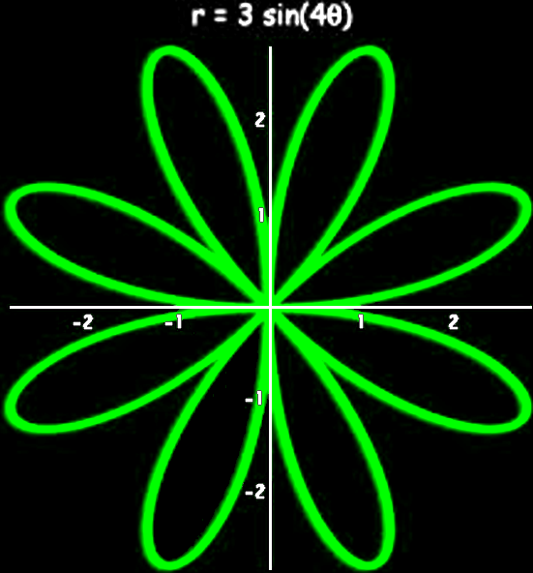
Polar Equations
14590966_346732725686454_3523543190558736384_n.jpg

Slide 97
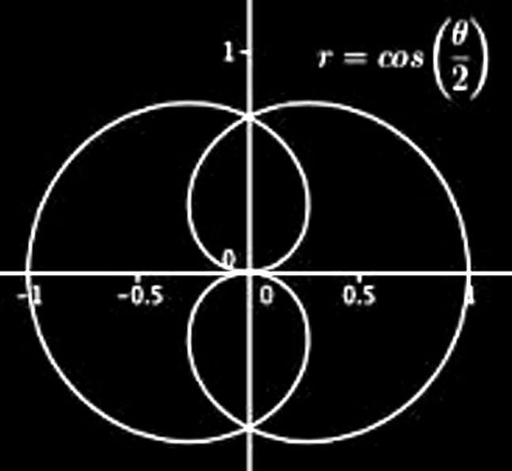
Polar Equations
14590966_346732725686454_3523543190558736384_q.jpg

Slide 98
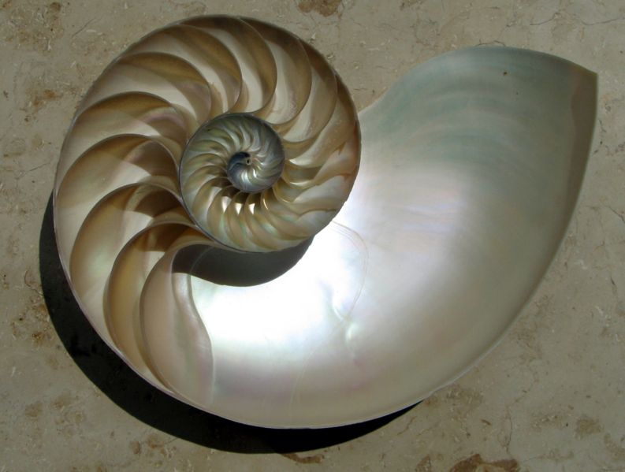
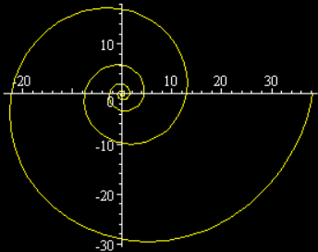
Polar Equations
Spiral of Archimedes
r = aθ
Archimedes Spiral.jpg

Slide 99
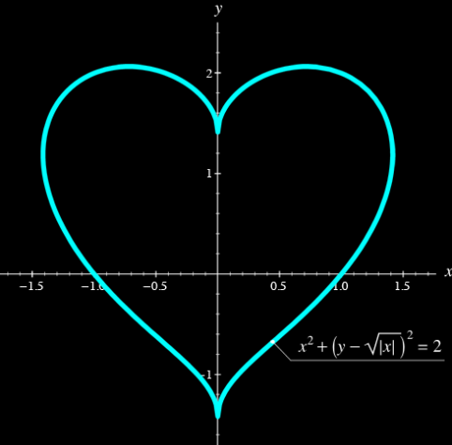
Polar Equations
polarheart.jpg

Slide 100
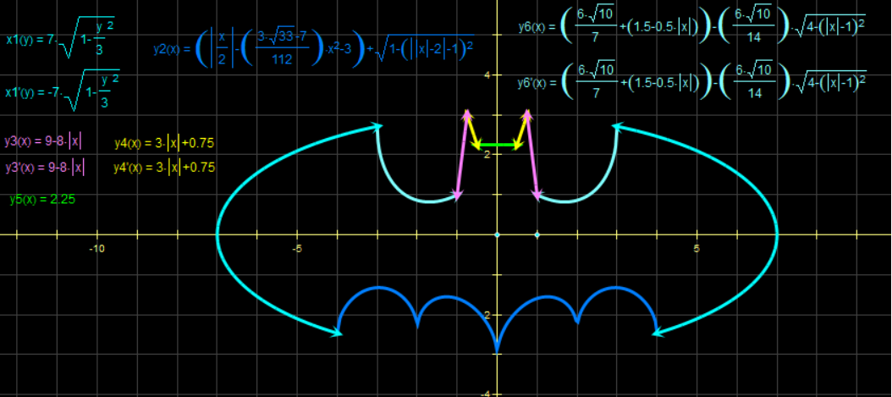
Polar Equations
batmanpolar.jpg

Slide 101
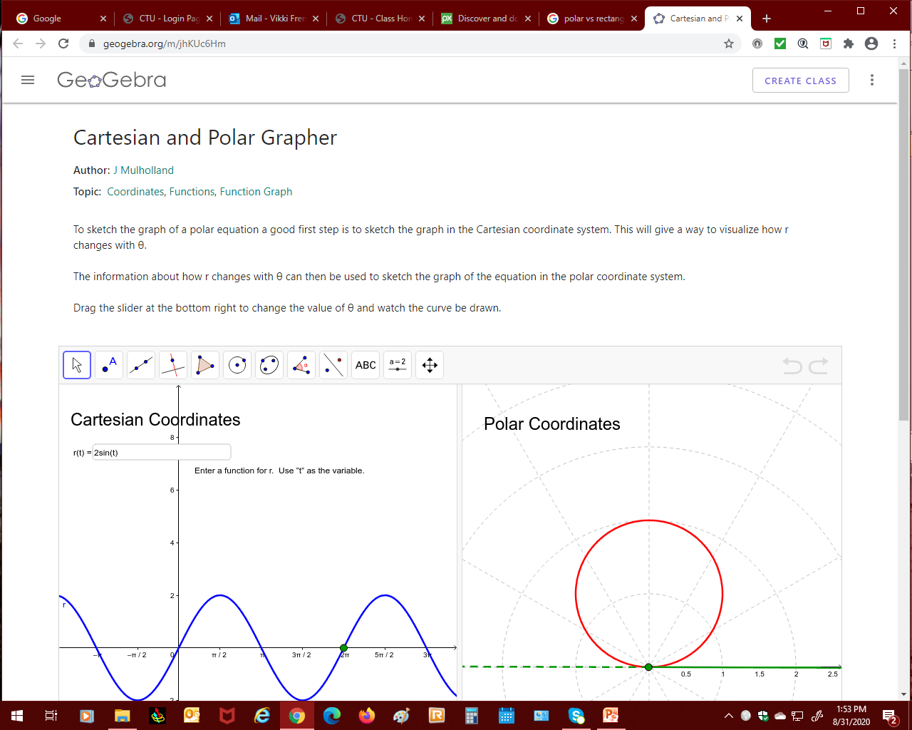
Polar Equations
https://www.geogebra.org

Slide 102
Questions?
http://i.imgur.com/aliTlT3.jpg

Slide 103
Polar Form
Polar form of a complex number:
z = a + bi becomes:
z = r (cos θ + i sin θ )
where a = r cos θ
b = r sin θ
r = $\sqrt{{\text{a}}^{2}+{\text{b}}^{2}}$
θ = arctan(b/a)

Slide 104
Polar Form
r is called the modulus
θ is called the argument

Slide 105
Polar Form
Always plot these first or you may end up in the wrong quadrant!
(This is because of the tan)

Slide 106
POLAR FORM
IN-CLASS PROBLEM 12
Plot z = -2 – 2i in the complex plane then write z in polar form

Slide 107
POLAR FORM
IN-CLASS PROBLEM 12
z = -2 – 2i
z = a + bi
a = ?
b = ?

Slide 108
POLAR FORM
IN-CLASS PROBLEM 12
z = -2 – 2i
z = a + bi
a = -2
b = -2
Plot?
4
3
2
1
-4
-3
-2
-1
0
1
2
3
4
-1
-2
-3
-4
VFrench, 2015

Slide 109
POLAR FORM
IN-CLASS PROBLEM 12
z = -2 – 2i
So it’s in quadrant 3
r = ?
i
4
3
2
1
-4
-3
-2
-1
0
1
2
3
4
-1
-2
-3
-4

Slide 110
POLAR FORM
IN-CLASS PROBLEM 12
z = -2 – 2i in quadrant 3
a = -2
b = -2
r = $\sqrt{\text{a}\text{2 }+\text{b}\text{2 }}$ = $\sqrt{\text{−2}\text{2 }\text{+}\text{−2}\text{2}}$
= $\sqrt{\text{8}}$= 2$\sqrt{\text{2}}$ ≈ 2.8
θ = ?

Slide 111
POLAR FORM
IN-CLASS PROBLEM 12
z = -2 – 2i in quadrant 3
a = -2
b = -2
r = 2$\sqrt{\text{2}}$ ≈ 2.8
θ = arctan(b/a) = -2/-2
So tan⁻¹(1) = θ

Slide 112
POLAR FORM
IN-CLASS PROBLEM 12
z = -2 – 2i in quadrant 3
a = -2
b = -2
r = 2$\sqrt{\text{2}}$ ≈ 2.8
If tan⁻¹(1) = θ (use your table!)
then θ = π/4 or 5π/4
Which?

Slide 113
POLAR FORM
IN-CLASS PROBLEM 12
z = -2 – 2i in quadrant 3
a = -2
b = -2
r = 2$\sqrt{\text{2}}$ ≈ 2.8
θ = 5π/4 (in quadrant 3)

Slide 114
POLAR FORM
IN-CLASS PROBLEM 12
z = -2 – 2i
r = 2$\sqrt{\text{2}}$ ≈ 2.8
θ = 5π/4
SO what is:
z = r (cosθ + i sinθ)

Slide 115
POLAR FORM
IN-CLASS PROBLEM 12
z = -2 – 2i
r = 2$\sqrt{\text{2}}$ ≈ 2.8
θ = 5π/4
SO:
z = 2$\sqrt{\text{2}}$ (cos 5π/4 + i sin 5π/4)

Slide 116
https://intuitturbotax.files.wordpress.com/2013/04/istock_000020645672xsmall.jpg

Slide 117
Rectangular Form
Rectangular form of a complex number
(You don’t have to plot these first!)

Slide 118
RECTANGULAR FORM
IN-CLASS PROBLEM 13
Write
z = 2(cos(60º) + i sin(60º))
in rectangular form

Slide 119
RECTANGULAR FORM
IN-CLASS PROBLEM 13
z = 2(cos(60º) + i sin(60º))
would mean:
r = 2 θ = 60 º

Slide 120
RECTANGULAR FORM
IN-CLASS PROBLEM 13
Write
z = 2(cos(60º) + i sin(60º))
r = 2 θ = 60 º
z = 2(1/2 + i $\sqrt{3}$/2)
z = 1 + $\sqrt{3}$ i

Slide 121
Questions?
http://i.imgur.com/aliTlT3.jpg

Slide 122
Absolute Values
Absolute Value of a complex number:
|a + bi| = $\sqrt{\text{a}\text{2}+\text{b}\text{2 }}$

Slide 123
ABSOLUTE VALUE OF A COMPLEX NUMBER
IN-CLASS PROBLEM 14
Find the absolute value of the complex number: z = 2 + 5i

Slide 124
ABSOLUTE VALUE OF A COMPLEX NUMBER
IN-CLASS PROBLEM 14
Find the absolute value of the complex number: z = 2 + 5i
What’s a?
What’s b?

Slide 125
ABSOLUTE VALUE OF A COMPLEX NUMBER
IN-CLASS PROBLEM 14
Find the absolute value of the complex number: z = 2 + 5i
What’s a? 2
What’s b? 5
|a + bi| = $\sqrt{\text{a}\text{2}+\text{b}\text{2 }}$

Slide 126
ABSOLUTE VALUE OF A COMPLEX NUMBER
IN-CLASS PROBLEM 14
Find the absolute value of the complex number: z = 2 + 5i
What’s a? 2
What’s b? 5
|a + bi| = $\sqrt{\text{2}\text{2}+\text{5}\text{2 }}$

Slide 127
ABSOLUTE VALUE OF A COMPLEX NUMBER
IN-CLASS PROBLEM 14
Find the absolute value of the complex number: z = 2 + 5i
What’s a? 2
What’s b? 5
|a + bi| = $\sqrt{\text{2}\text{2}+\text{5}\text{2 }}$ = $\sqrt{\text{2}\text{9}}$
≈ 5.4

Slide 128
Questions?
http://i.imgur.com/aliTlT3.jpg

Slide 129
DeMoivre’s Theorem
Powers of complex numbers in polar form

Slide 130
DeMoivre’s Theorem
the power of a complex number
z = r (cos θ + i sin θ )
For n>0
z^{n} = [r (cos θ + i sin θ )] ^{n}
= r^{n}(cos nθ + i sin nθ )

Slide 131
DE MOIVRE’S THEOREM
IN-CLASS PROBLEM 15
Find [2(cos 20° + i sin 20°)]⁶

Slide 132
DE MOIVRE’S THEOREM
IN-CLASS PROBLEM 15
Find [2(cos 20° + i sin 20°)]⁶
z^{n} = [r (cos θ + i sin θ )] ^{n}
So, what is n?
What is r?
What is θ?

Slide 133
DE MOIVRE’S THEOREM
IN-CLASS PROBLEM 15
Find [2(cos 20° + i sin 20°)]⁶
z^{n} = [r (cos θ + i sin θ )] ^{n}
n = 6
r = 2
θ = 20° yay! No radians!

Slide 134
DE MOIVRE’S THEOREM
IN-CLASS PROBLEM 15
n = 6
r = 2
θ = 20°
z^{n} = r^{n}(cos nθ + i sin nθ )
= 2⁶(cos 6(20°) + i sin 6(20°))

Slide 135
DE MOIVRE’S THEOREM
IN-CLASS PROBLEM 15
Z = 64 (cos 120° + i sin 120°)
= 64(-1/2 + i $\sqrt{\text{3}}$/2)
= -32 + 32 i $\sqrt{\text{3}}$
≈ -32 + 55.4 i
Z = -32 + j·55.4

Slide 136
DE MOIVRE’S THEOREM
IN-CLASS PROBLEM 16
Find (1 + i)⁸
z = a + bi
a = ?
b = ?

Slide 137
DE MOIVRE’S THEOREM
IN-CLASS PROBLEM 16
Find (1 + i)⁸
z = a + bi
a = 1
b = 1

Slide 138
DE MOIVRE’S THEOREM
IN-CLASS PROBLEM 16
Find (1 + i)⁸
a = 1
b = 1
Which quadrant?

Slide 139
DE MOIVRE’S THEOREM
IN-CLASS PROBLEM 16
(1 + i)⁸ Quadrant 1
a = 1
b = 1
r = $\sqrt{{\text{a}}^{2}+{\text{b}}^{2}}$ = ?

Slide 140
DE MOIVRE’S THEOREM
IN-CLASS PROBLEM 16
(1 + i)⁸ Quadrant 1
a = 1
b = 1
r = $\sqrt{{\text{a}}^{2}+{\text{b}}^{2}}$ = $\sqrt{{\text{1}}^{2}+{\text{1}}^{2}}$ = $\sqrt{\text{2}}$
θ = arctan (b/a) = ?

Slide 141
DE MOIVRE’S THEOREM
IN-CLASS PROBLEM 16
(1 + i)⁸ Quadrant 1
a = 1
b = 1
r = $\sqrt{{\text{a}}^{2}+{\text{b}}^{2}}$ = $\sqrt{{\text{1}}^{2}+{\text{1}}^{2}}$ = $\sqrt{\text{2}}$
tan θ = b/a = 1/1 = 1
and θ = π/4 or 45°
because θ is in Quadrant 1

Slide 142
DE MOIVRE’S THEOREM
IN-CLASS PROBLEM 16
(1 + i )⁸
r = $\sqrt{{\text{a}}^{2}+{\text{b}}^{2}}$ = $\sqrt{{\text{1}}^{2}+{\text{1}}^{2}}$ = $\sqrt{\text{2}}$
θ = π/4 or 45°
1 + i = r(cos θ + i sin θ)
= $\sqrt{\text{2}}$(cos π/4 + i sin π/4)

Slide 143
DE MOIVRE’S THEOREM
IN-CLASS PROBLEM 16
Use DeMoivre to raise it to the power 8:
(1 + i)⁸ = [$\sqrt{\text{2}}$(cos π/4 + i sin π/4)]⁸
= ($\sqrt{\text{2}}$)⁸(cos 8π/4 + i sin 8π/4)
= 16(cos 2π + i sin 2π)
= 16(1 + 0 i )
= 16 + 0 i or 16

Slide 144
Questions?
www.career.gatech.edu

Slide 145
You Survived!
Don’t forget
your Homework
due next week!
Have a great rest
of the week!
www.playbuzz.com

