Slide 1
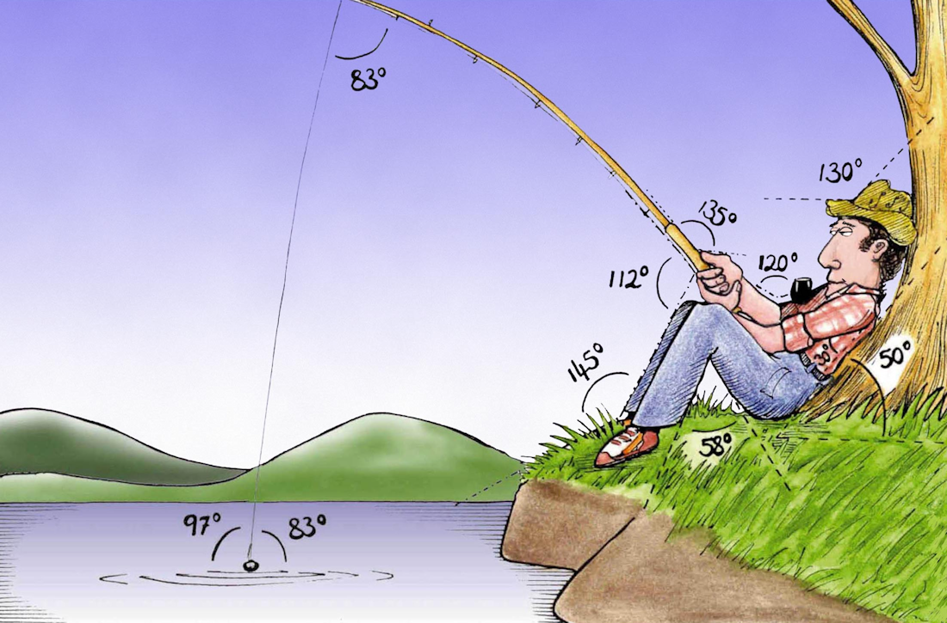
Welcome to
Week 10!
Analytic Trigonometry
http://www.lab-initio.com/images/fullsize/nz211.jpg

Slide 2
What’s Up?
Today we will be going over:
Review of vectors!
Angle between two vectors

Slide 3
What’s Up?
Obj 8) Perform vector operations and solve problems using vector magnitude, direction, components, dot product and angle between two vectors.

Slide 4
Review
http://995642590.r.lightningbase-cdn.com/wp-content/uploads/2010/12/looking-back-hrexaminer-v144-cover425px.jpg

Slide 5
Vectors
A vector is a directed line segment - from an initial point P to terminal point Q

Slide 6
Vectors
Vectors are shown by boldface letters: v w
or with arrows v w
→ →

Slide 7
Vectors
Vectors have both magnitude and direction
(ex: N 5mph)

Slide 8
Vectors
Scalars have only magnitude
(ex: 5mph)

Slide 9
Vectors
Magnitude (length) of a vector v (distance between initial point (x₁,y₁) and terminal point (x₂,y₂)
|| v || = $\sqrt{{(\text{x}\text{2}−\text{x}\text{1})}^{2}+{(\text{y}\text{2}−\text{y}\text{1})}^{2}}$

Slide 10
Vectors
Direction can be shown by slope:
m = $\frac{\text{y}\text{2}−\text{y}\text{1}}{\text{x}\text{2}−\text{x}\text{1}}$
if $\text{x}\text{2}−\text{x}\text{1}$≠0

Slide 11
Vectors
Interesting point…
because vectors are
designated by
only their
magnitude
and direction…
these are all the
same vector!
VFrench 2020

Slide 12
Vectors
We usually start vectors at (0,0)
called the
“standard
position”
VFrench 2020

Slide 13
Vectors
Because a vector’s location does not matter, we can make them all standard (initial point (0,0)) and write the vector using only the terminal point:
$$\left[\begin{matrix}\text{amount} \text{of} \text{horizontal} \text{displacement} \\ \text{amount} \text{of} \text{vertical} \text{displacement}\end{matrix}\right]$$

Slide 14
Vectors
Multiplying a vector by a constant is called “scalar multiplication”

Slide 15
Vectors
Just multiply the constant times the horizontal displacement for the new magnitude and the vertical displacement for its new magnitude:
c $\left[\begin{matrix}\text{h} \\ \text{v}\end{matrix}\right]$ = $\left[\begin{matrix}\text{c}\text{h} \\ \text{c}\text{v}\end{matrix}\right]$

Slide 16
Vectors
Scalar multiplication kv:
Multiplying a vector by a positive real number changes the magnitude but not the direction

Slide 17
Vectors
Scalar multiplication kv:
A negative scalar points the vector in the opposite direction

Slide 18
Vectors
To add two vectors:
$\left[\begin{matrix}\text{a} \\ \text{b}\end{matrix}\right]$ + $\left[\begin{matrix}\text{c} \\ \text{d}\end{matrix}\right]$
add the corresponding values:
= $\left[\begin{matrix}\text{a}\text{+}\text{c} \\ \text{b}\text{+}\text{d}\end{matrix}\right]$
The sum of two vectors is called the resultant

Slide 19
Vectors
Vector addition $\vec{\text{u}}$ + $\vec{\text{v}}$
the
resultant

Slide 20
Vectors
Vector subtraction $\vec{\text{u}}$ - $\vec{\text{v}}$
flip
the
resultant

Slide 21
Vectors
Plotting vectors
vector $\hat{\text{i}}$ is the unit vector whose direction is along the positive x-axis
vector $\hat{\text{j}}$ is the unit vector whose direction is along the positive y-axis

Slide 22
Vectors
So we can write the vector $\vec{\text{v}}$ from (0,0) to (a,b) as:
$\vec{\text{v}}$ = a $\hat{\text{i}}$ + b $\hat{\text{j}}$
a and b are the scalar
components of $\vec{\text{v}}$
a is the horizontal component
b is the vertical component

Slide 23
Vectors
$\vec{\text{v}}$ = a $\hat{\text{i}}$ + b $\hat{\text{j}}$
is called component form
or
“ai + bj form”

Slide 24
Vectors
Vector Operations
Scalar multiplication:
k$\vec{\text{v}}$ = (ka) $\hat{\text{i}}$ + (kb) $\hat{\text{j}}$

Slide 25
Vectors
Vector Operations
Vector addition:
$\vec{\text{v}}$ = a₁$\hat{\text{i}}$ + b₁$\hat{\text{j}}$
$\vec{\text{w}}$ = a₂$\hat{\text{i}}$ + b₂$\hat{\text{j}}$
$\vec{\text{v}}$ + $\vec{\text{w}}$ = (a₁+a₂)$\hat{\text{i}}$ + (b₁+b₂)$\hat{\text{j}}$

Slide 26
Vectors
The component form describes lines in 2-D

Slide 27
Vectors
You can easily do 3-D “lines” (planes):
$\vec{\text{v}}$ = a$\hat{\text{i}}$ + b$\hat{\text{j}}$+ c$\hat{\text{k}}$
You can write lines (planes… whatever) in n-D!

Slide 28
Vectors
The magnitude of $\vec{\text{v}}$
||$\vec{\text{v}}$|| = $\sqrt{{\text{a}}^{2}+{\text{b}}^{2}}$

Slide 29
Vectors
Position Vector
if $\vec{\text{v}}$ doesn't start at (0,0):
$\vec{\text{v}}$ = (x₂-x₁) $\hat{\text{i}}$ + (y₂-y₁) $\hat{\text{j}}$

Slide 30
Vectors
A “unit vector” has a magnitude of 1
Sometimes it is called a “direction vector”

Slide 31
Vectors
writing a vector in terms of its magnitude and direction:
magnitude ||$\vec{\text{v}}$|| direction angle θ
$\vec{\text{v}}$ = ||$\vec{\text{v}}$|| (cosθ $\hat{\text{i}}$ + sinθ $\hat{\text{j}}$)

Slide 32
Vectors
Dot Product - Multiplying two
vectors
For $\vec{\text{v}}$ = a₁$\hat{\text{i}}$ + b₁$\hat{\text{j}}$
and $\vec{\text{w}}$ = a₂$\hat{\text{i}}$ + b₂$\hat{\text{j}}$
$\vec{\text{v}}$● $\vec{\text{w}}$ = a₁a₂ + b₁b₂
Note: there are no $\hat{\text{i}}$’s or $\hat{\text{j}}$’s – only a number

Slide 33
Vectors
The dot product is sometimes called the “inner product”
You can think of the dot product as directional multiplication

Slide 34
Vectors
A dot product result can be:
zero: we don't have any growth
in the original direction
positive: we have growth in the
original direction
negative number: we have
reverse growth in the
original direction

Slide 35
Questions?
lol-rofl.com

Slide 36
Angle Between Two Vectors
Direct Current (DC) flows around an electrical circuit in one direction only:
A “Uni-directional” waveform
https://www.electronics-tutorials.ws/accircuits

Slide 37
Angle Between Two Vectors
DC has a fixed magnitude (amplitude) and a definite direction associated with it
For example, +12V represents 12 volts in the positive direction, or -5V represents 5 volts in the negative direction
https://www.electronics-tutorials.ws/accircuits

Slide 38
Angle Between Two Vectors
DC does not change value over time; it has a constant value flowing in a continuous steady state direction
https://www.electronics-tutorials.ws/accircuits

Slide 39
Angle Between Two Vectors
An alternating function or AC Waveform on the other hand varies in both magnitude and direction in more or less an even manner over time:
A “Bi-directional” waveform
https://www.electronics-tutorials.ws/accircuits

Slide 40
Angle Between Two Vectors
The shape of an AC waveform
is generally a mathematical sine function:
A(t) = A_{max}×sin(2πƒt)
t = period of the cycle in degrees or radians
ƒ = frequency per second in Hz
A = amplitude in volts or amps
https://www.electronics-tutorials.ws/accircuits

Slide 41
Angle Between Two Vectors
Not all sine waves will pass exactly through the zero axis point at the same time, but may be “shifted” to the right or the left compared to another sine wave
https://www.electronics-tutorials.ws/accircuits

Slide 42
Angle Between Two Vectors
Any sine wave that does not pass through zero at t = 0 has a phase shift
Sometimes called a phase difference
https://www.electronics-tutorials.ws/accircuits

Slide 43
Angle Between Two Vectors
A phase shift of a sine wave is the angle Φ (Greek letter Phi), in degrees or radians that the waveform has shifted from a certain reference point along the horizontal zero axis
https://www.electronics-tutorials.ws/accircuits

Slide 44
Angle Between Two Vectors
Sine waves of the same frequency can have a phase shift
https://www.electronics-tutorials.ws/accircuits

Slide 45
Angle Between Two Vectors
The equation for the instantaneous value of a sinusoidal voltage or current waveform becomes
A_{t} = A_{max} × sine(ωt ± Φ)
A_{max} = amplitude
ωt = angular frequency in rad/sec
Φ (phi) = phase shift in deg or rad
https://www.electronics-tutorials.ws/accircuits

Slide 46
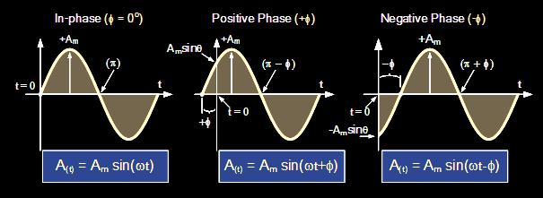
Angle Between Two Vectors
https://www.electronics-tutorials.ws/accircuits

Slide 47
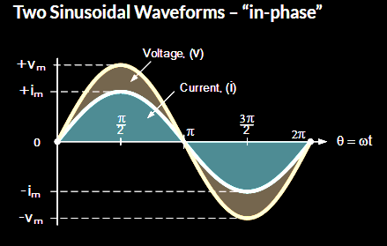
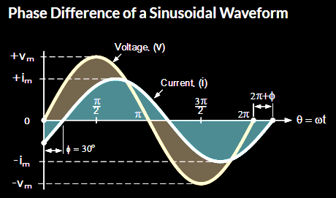
Angle Between Two Vectors
https://www.electronics-tutorials.ws/accircuits

Slide 48
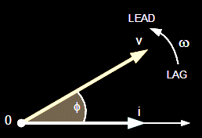
Angle Between Two Vectors
A phasor diagram is a graphical way of representing the magnitude and directional relationship between two or more alternating quantities
https://www.electronics-tutorials.ws/accircuits

Slide 49
Angle Between Two Vectors
Suppose you have two vectors:
4
3
2
$\vec{\text{u}}$ = 2$\hat{\text{i}}$ + 4$\hat{\text{j}}$
$\vec{\text{v}}$ = 1$\hat{\text{i}}$ + 3$\hat{\text{j}}$
1
0
-4
-3
-2
-1
1
2
3
4
-1
-2
-3
-4
VFrench, 2015

Slide 50
Angle Between Two Vectors
The angle θ between the two vectors can be found using:
θ = arccos$\left(\frac{\vec{\text{u}} \text{• }\vec{\text{v}}}{\text{||}\vec{\text{u}}\text{||}\text{×}\text{||}\vec{\text{v}}\text{|| }}\right)$

Slide 51
Angle Between Two Vectors
The angle θ between the two vectors can be found using:
θ = arccos$\left(\frac{\vec{\text{u}} \text{• }\vec{\text{v}}}{\text{||}\vec{\text{u}}\text{||}\text{×}\text{||}\vec{\text{v}}\text{|| }}\right)$
(this comes from the Law of Cosines)

Slide 52
Angle Between Two Vectors
The angle θ between the two vectors can be found using:
θ = arccos$\left(\frac{\vec{\text{u}} \text{• }\vec{\text{v}}}{\text{||}\vec{\text{u}}\text{||}\text{×}\text{||}\vec{\text{v}}\text{|| }}\right)$
(it also uses a lot of the skills you have learned in this class!)

Slide 53
ANGLE BETWEEN VECTORS
IN-CLASS PROBLEM
Find the angle between vectors
$\vec{\text{u}}$ = 2$\hat{\text{i}}$ + 4$\hat{\text{j}}$ and $\vec{\text{v}}$ = 1$\hat{\text{i}}$ + 3$\hat{\text{j}}$
θ = arccos$\left(\frac{\vec{\text{u}} \text{• }\vec{\text{v}}}{\text{||}\vec{\text{u}}\text{||}\text{×}\text{||}\vec{\text{v}}\text{|| }}\right)$

Slide 54
ANGLE BETWEEN VECTORS
IN-CLASS PROBLEM
Find the angle between vectors
$\vec{\text{u}}$ = 2$\hat{\text{i}}$ + 4$\hat{\text{j}}$ and $\vec{\text{v}}$ = 1$\hat{\text{i}}$ + 3$\hat{\text{j}}$
θ = arccos$\left(\frac{\vec{\text{u}} \text{• }\vec{\text{v}}}{\text{||}\vec{\text{u}}\text{||}\text{×}\text{||}\vec{\text{v}}\text{|| }}\right)$
= arccos$\left(\frac{\text{2}\text{×}\text{1}\text{+ }\text{4}\text{×3}}{\sqrt{{\text{2}}^{2}+ {\text{4}}^{2}} \text{×} \sqrt{{\text{1}}^{2}+{ \text{3}}^{2}}}\right)$

Slide 55
ANGLE BETWEEN VECTORS
IN-CLASS PROBLEM
Find the angle between vectors
$\vec{\text{u}}$ = 2$\hat{\text{i}}$ + 4$\hat{\text{j}}$ and $\vec{\text{v}}$ = 1$\hat{\text{i}}$ + 3$\hat{\text{j}}$
θ = arccos$\left(\frac{\text{2}\text{×}\text{1}\text{+ }\text{4}\text{×3}}{\sqrt{{\text{2}}^{2}+ {\text{4}}^{2}} \text{×} \sqrt{{\text{1}}^{2}+{ \text{3}}^{2}}}\right)$
= arccos$\left(\frac{\text{14}}{\sqrt{\text{2}\text{0}} \text{×} \sqrt{\text{10}}}\right)$

Slide 56
ANGLE BETWEEN VECTORS
IN-CLASS PROBLEM
Find the angle between vectors
$\vec{\text{u}}$ = 2$\hat{\text{i}}$ + 4$\hat{\text{j}}$ and $\vec{\text{v}}$ = 1$\hat{\text{i}}$ + 3$\hat{\text{j}}$
θ = arccos$\left(\frac{\text{14}}{\sqrt{\text{20}} \text{×} \sqrt{\text{10}}}\right)$
= arccos$\left(\frac{\text{14}}{\sqrt{\text{2}\text{00}}}\right)$ = arccos$\left(\frac{\text{14}}{\sqrt{\text{2}\text{×}\text{10}\text{0}}}\right)$
= arccos$\left(\frac{\text{14}}{\sqrt{\text{2}}\text{×}\sqrt{\text{100}}}\right)$

Slide 57
ANGLE BETWEEN VECTORS
IN-CLASS PROBLEM
Find the angle between vectors
$\vec{\text{u}}$ = 2$\hat{\text{i}}$ + 4$\hat{\text{j}}$ and $\vec{\text{v}}$ = 1$\hat{\text{i}}$ + 3$\hat{\text{j}}$
θ = arccos$\left(\frac{\text{14}}{\sqrt{\text{2}} \text{×} \sqrt{\text{100}}}\right)$
= arccos$\left(\frac{\text{14}}{\text{10}\sqrt{\text{2}}}\right)$ = arccos$\left(\frac{\text{14}\sqrt{\text{2}}}{\text{10}\text{×}\text{2}}\right)$
= arccos$\left(\frac{\text{7}\sqrt{\text{2}}}{\text{10}}\right)$

Slide 58
ANGLE BETWEEN VECTORS
IN-CLASS PROBLEM
Find the angle between vectors
$\vec{\text{u}}$ = 2$\hat{\text{i}}$ + 4$\hat{\text{j}}$ and $\vec{\text{v}}$ = 1$\hat{\text{i}}$ + 3$\hat{\text{j}}$
θ = arccos$\left(\frac{\text{7}\sqrt{\text{2}}}{\text{10}}\right)$ ≈ 8.13°

Slide 59
ANGLE BETWEEN VECTORS
IN-CLASS PROBLEMS
Find the angle between vector 2i+4j and vector 1i+3j

Slide 60
Questions?

Slide 61
REVIEW!
The rest of the slides are a review of the entire course

Slide 62
Angles
Positive angles - counterclockwise rotation from initial side
Negative angles - clockwise rotation from initial side
θ
θ
VFrench, 2015

Slide 63
Angles
An angle with a terminal side in a quadrant
"lies" in that
quadrant
II
I
III
IV
VFrench, 2015

Slide 64
Angles
A degree, symbolized by ° measures angles
23°
θ
VFrench, 2015

Slide 65
Angles
Types of angles:
Acute angles 0º< θ < 90º
Right angles θ = 90º
Obtuse angles 90º< θ < 180º
Straight angles θ = 180º
θ
θ
θ
θ
VFrench, 2015

Slide 66
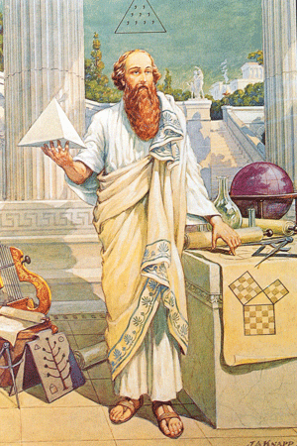
Triangles
Pythagorean Theorem
https://classicalwisdom.com/wp-content/uploads/2014/07/pythagoras-painting.jpg

Slide 67
Triangles
Based on a right triangle:
a² + b² = c²
B
Hypotenuse
c
a
Side opposite θ
θ
A
C
b
Side adjacent to θ
VFrench, 2015

Slide 68
Questions?

Slide 69
Trigonometry
This is called a “central angle”
.
VFrench, 2015

Slide 70
Trigonometry
The slope of the hypotenuse is: rise
run
hypotenuse
.
rise
θ
run
VFrench, 2015

Slide 71
Trigonometry
According to the Pythagorean Theorem, the length of the hypotenuse will be:
hyp² = rise² + run²
hypotenuse
.
rise
θ
run
VFrench, 2015

Slide 72
Trigonometry
In trigonometry, the terms “opposite” and “adjacent” are traditionally used for the “rise” and the “run”
hypotenuse
opposite
rise
.
θ
run
adjacent
VFrench, 2015

Slide 73
Trigonometry
sin(θ) = length of side opposite θ
length of hypotenuse
cos(θ) = length of side adjacent θ
length of hypotenuse
tan(θ) = length of side opposite θ
length of side adjacent θ

Slide 74
Trigonometry
cot(θ) = length of side adjacent θ
length of side opposite θ
sec(θ) = length of hypotenuse
length of side adjacent θ
csc(θ) = length of hypotenuse
length of side opposite θ

Slide 75
Questions?

Slide 76
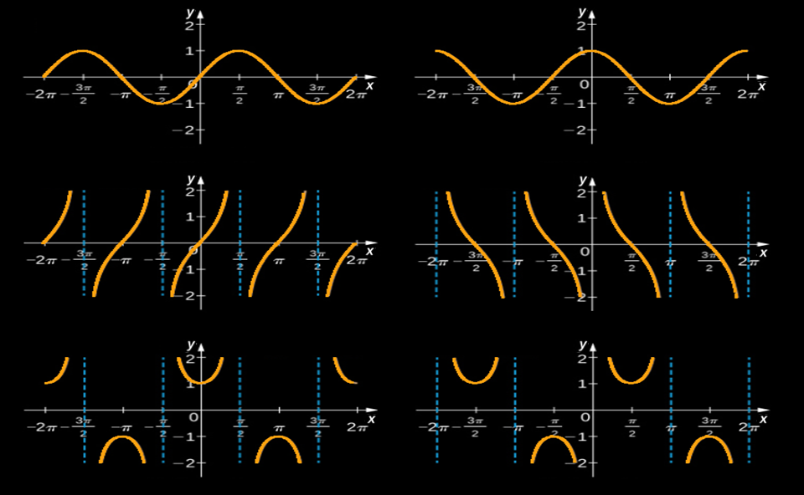
Graphs of Trig Functions
ƒ(x) = sin(x)
ƒ(x) = cos(x)
ƒ(x) = tan(x)
ƒ(x) = cot(x)
ƒ(x) = sec(x)
ƒ(x) = csc(x)
VFrench, 2015

Slide 77
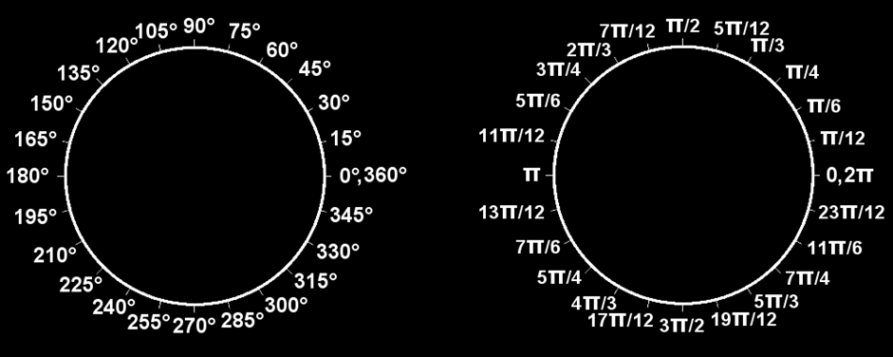
Degrees vs Radians
All the way around the circle once (360º) is 2π (a length)
VFrench, 2015

Slide 78
Arc Length
Sometimes we want to measure the length of the curve on the circle
s
r
.
θ
VFrench, 2015

Slide 79
Arc Length
The linear speed “ν ” is calculated in terms of the arc length:
ν = $\frac{\text{s}}{\text{t}}$
t = time in seconds
Note: ν (the Greek letter “nu”) is not the same as v

Slide 80
Arc Length
The angular speed “ω ” is calculated in terms of angle θ
ω = $\frac{\text{θ}}{\text{t}}$
θ = angle measured in radians
t = time in seconds
Note: ω (the Greek letter “omega”) is not the same as w

Slide 81
Questions?

Slide 82
Descriptors
Descriptors for the natural trig functions:
 | Max x | Min x | Max y | Min y | Period (rad) | Period (degrees)
sin | ∞ | -∞ | 1 | -1 | 2π | 360°
cos | ∞ | -∞ | 1 | -1 | 2π | 360°
tan | ∞ | -∞ | ∞ | -∞ | π | 360°
cot | ∞ | -∞ | ∞ | -∞ | π | 360°
sec | ∞ | -∞ | ∞ | -∞ | 2π | 360°
csc | ∞ | -∞ | ∞ | -∞ | 2π | 360°
VFrench, 2015

Slide 83
Exact Values
Deg | Rad | sin | cos | tan
0 | 0 | 0 | 1 | 0
30 | π/6 | 1/2 | $\sqrt{3}$/2 | $\sqrt{3}$/3
45 | π/4 | $\sqrt{2}$/2 | $\sqrt{2}$/2 | 1
60 | π/3 | $\sqrt{3}$/2 | 1/2 | $$\sqrt{3}$$
90 | π/2 | 1 | 0 | ∞
120 | 2π/3 | $\sqrt{3}$/2 | –1/2 | –$\sqrt{3}$
135 | 3π/4 | $\sqrt{2}$/2 | –$\sqrt{2}$/2 | –1
150 | 5π/6 | 1/2 | –$\sqrt{3}$/2 | –$\sqrt{3}$/3
180 | π | 0 | –1 | 0
210 | 7π/6 | –1/2 | –$\sqrt{3}$/2 | $\sqrt{3}$/3
225 | 5π/4 | –$\sqrt{2}$/2 | –$\sqrt{2}$/2 | 1
240 | 4π/3 | –$\sqrt{3}$/2 | –1/2 | $$\sqrt{3}$$
270 | 3π/2 | –1 | 0 | ∞
300 | 5π/3 | –$\sqrt{3}$/2 | 1/2 | –$\sqrt{3}$
315 | 7π/4 | –$\sqrt{2}$/2 | $\sqrt{2}$/2 | –1
330 | 11π/6 | –1/2 | $\sqrt{3}$/2 | –$\sqrt{3}$/3
360 | 2π | 0 | 1 | 0
Exact Values
of Trig
Functions
(leave them in
the square root
format)
VFrench, 2015

Slide 84
Transforming Functions
General form of trig functions:
y = A sin (Bx - C) + D
y = A cos (Bx - C) + D

Slide 85
Transforming Functions
y = A sin (Bx - C) + D
“A” stretches the graph up and down – “Amplitude”
“B” stretches the graph side to side – “Period”
“C” moves the graph side to side – “Phase shift”
“D” moves the graph up and down – “Vertical shift”

Slide 86
Questions?

Slide 87
Inverse Trig Functions
We want a way to “undo” trig functions
The inverse of a trig function “undoes” the trig operation

Slide 88
Inverse Trig Functions
The inverse of a sine is called an
“arcsine”
On your calculator, it is shown as:
sin ⁻¹

Slide 89
Inverse Trig Functions
An inverse trig function tells you the ANGLE that would give you that trig function value

Slide 90
Inverse Trig Functions
Because a tan is “rise/run” you can often find that given a graph or some values

Slide 91
Inverse Trig Functions
Because a tan is “rise/run” you can often find that given a graph or some values
The angle can be found using the arctan tan ⁻¹

Slide 92
RC Circuit Analysis
An RC circuit contains both a resistor and a capacitor
V_{S}
~
VFrench 2015

Slide 93
RC Circuit Analysis
The resistor reduces current flow
Called resistance
Symbolized “R”
Measured in
ohms Ω
R
~
47 Ω
V_{S}
VFrench 2015

Slide 94
RC Circuit Analysis
The capacitor also opposes current flow by causing the alternating voltage
to lag behind
the alternating
current
R
~
47 Ω
V_{S}
VFrench 2015

Slide 95
RC Circuit Analysis
This opposition is called capacitive reactance
Symbolized “X_{C}”
Measured in
ohms Ω
$${\text{X}}_{\text{C}}$$
R
~
47 Ω
100 Ω
V_{S}
VFrench 2015

Slide 96
RC Circuit Analysis
Reactance (X_{C}) has a 90° lag compared to resistance (R), so their angle of intersection
forms a right
angle
(Downward because
it lags)
R
${\text{X}}_{\text{C}}$
VFrench 2015

Slide 97
RC Circuit Analysis
Adding the impedance (Z) line at the angle θ makes a right triangle
This is called the
“impedance triangle”
R
θ
${\text{X}}_{\text{C}}$
Z
VFrench 2015

Slide 98
RC Circuit Analysis
Impedance Z comes from the
Pythagorean Theorem:
Z = $\sqrt{ \text{R}\text{2} \text{+} \text{X}\text{C}\text{2} }$
R
θ
${\text{X}}_{\text{C}}$
Z
VFrench 2015

Slide 99
RC Circuit Analysis
The value of the phase angle θ is:
θ = tan⁻¹$\left(\frac{{\text{X}}_{\text{C}}}{\text{R} }\right)$
R
θ
${\text{X}}_{\text{C}}$
Z
VFrench 2015

Slide 100
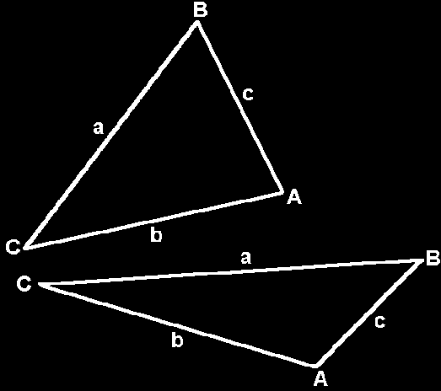
Oblique Triangles
Do not contain a right angle
VFrench 2015

Slide 101
Oblique Triangles
All the angles of a triangle
add up to 180°

Slide 102
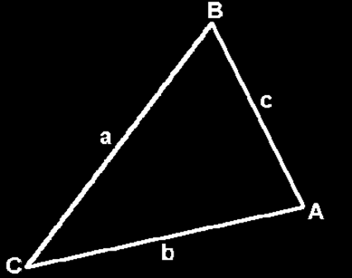
Area of a Triangle
Area = ½ cb sinA
= ½ ac sinB
= ½ ab sinC
Note: You need
two sides and the angle
between them (the “included” angle) OR you need two “little” letters and the other “big”
VFrench 2015

Slide 103
Heron’s Formula
When you have all 3 sides and no angles
First find:
s = ½ (a + b + c)
Then:
area = $\sqrt{\text{s}\text{(}\text{s}\text{−}\text{a}\text{)(}\text{s}\text{−}\text{b}\text{)(}\text{s}\text{−}\text{c}\text{)}}$

Slide 104
Questions?

Slide 105
Oblique Triangles
If you have measurements of some of the sides and some of the angles, it is usually
possible to figure
out all of the
measurements
of a triangle

Slide 106
Law of Sines
$\frac{\text{a}}{\text{sin}\text{(}\text{A}\text{)}}$ = $\frac{\text{b}}{\text{sin}\text{(}\text{B}\text{)}}$ = $\frac{\text{c}}{\text{sin}\text{(}\text{C}\text{)}}$
or
$\frac{\text{sin}\text{(}\text{A}\text{)}}{\text{a}}$ = $\frac{\text{sin}\text{(}\text{B}\text{)}}{\text{b}}$= $\frac{\text{sin}\text{(}\text{C}\text{)}}{\text{c}}$

Slide 107
Law of Sines
To calculate using the Law of Sines you need a “big” and a “little”:
A and a or
B and b or
C and c

Slide 108
Law of Cosines
a² = b² + c² - 2bc cosA or
b² = a² + c² - 2ac cosB or
c² = a² + b² - 2ab cosC

Slide 109
Law of Cosines
You use Law of Cosines when you don’t have a big and a little of the same letter

Slide 110
Law of Cosines
The Law of Cosines is used a lot to find angles:
A = arccos((a²-b²-c²)/(-2bc))
B = arccos((b²-a²-c²)/(-2ac))
C = arccos((c²-a²-b²)/(-2ab))

Slide 111
How Many Triangles
Rules for oblique triangles can be used to find out whether a certain set of measurements describes a real triangle or not

Slide 112
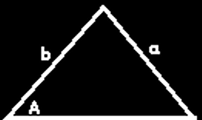
How Many Triangles
Sometimes the measurements describe a triangle that is unique:

Slide 113
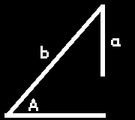
How Many Triangles
Sometimes the measurements
cannot possibly describe a real triangle:

Slide 114
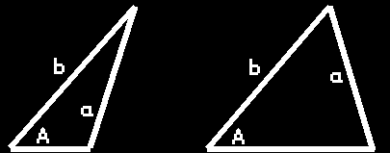
How Many Triangles
Sometimes the measurements
describe two possible triangles:
This is called the “ambiguous case”

Slide 115
How Many Triangles
h = b sinA
If a>h and a>b there is only one triangle
If a=h – it’s a right triangle!
If a<h there is no triangle
If a>h and a<b there are two triangles

Slide 116
Questions?

Slide 117
Complex Numbers
Complex numbers include the "imaginary" unit:
i ≡ $\sqrt{\text{−}\text{1}}$

Slide 118
Complex Numbers
Complex numbers are written:
a + b i
real imaginary
part part

Slide 119
Complex Numbers
Complex numbers are usually designated "z“
z = a + b i

Slide 120
Complex Numbers
Arithmetic with complex numbers:
(a+bi) + (c+di) = (a+c) + (b+d)i
(a+bi) - (c+di) = (a-c) + (b-d)i

Slide 121
Complex Numbers
Multiplying:
(a+bi) × (c+di) =
(a×c) + (a×d+b×c)i + (b×d)i²
= ac + (ad+bc)i + bd(-1)
= (ac-bd) + (ad+bc) i

Slide 122
Complex Numbers
Don’t leave any exponents of i in a formula
http://scottsauls.com/wp-content/uploads/2015/06/Shame.jpg

Slide 123
Complex Numbers
$\sqrt{−\text{9}}$ × $\sqrt{−\text{36 }}$ = 3i × 6i
= 18i²
= -18
You need to take out the “i ” first
(If you don’t, you’ll get the wrong answer)

Slide 124
Phasor Arithmetic
Sine-shaped waves all with the same frequency but with different amplitudes and phases are represented by a real multiplier for frequency and time and a complex multiplier for amplitude (phasor)

Slide 125
Phasor Arithmetic
Combining these phasors is called phasor arithmetic

Slide 126
Questions?

Slide 127
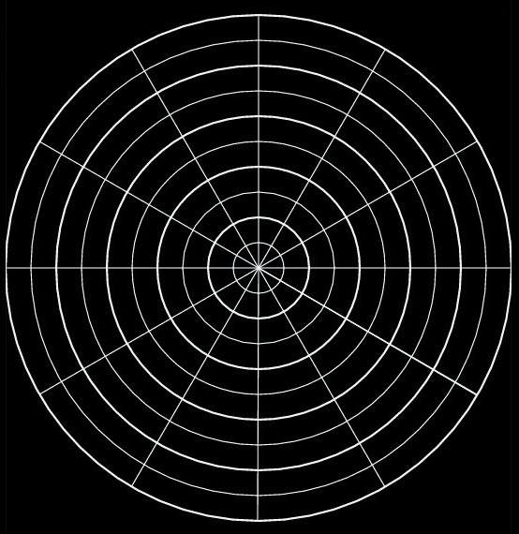
Polar Coordinates
Circular graph paper!
angle of rotation
polar axis
VFrench, 2015

Slide 128
Polar Coordinates
point P = (r,θ)
r is the distance (radius) from the pole to P (+,- or 0)
θ is the angle from the polar axis to the terminal side of the angle (degrees or radians)

Slide 129
Polar to Rectangular
Polar to rectangular conversion
If you have a polar point:
P = (r,θ)
To convert to (x,y) coordinates:
x = r cos θ
y = r sin θ

Slide 130
Rectangular to Polar
Not as easy…
r = $\sqrt{{\text{x}}^{2}+ {\text{y}}^{2}}$
θ = arctan (y/x)
AND…
You have to be VERY careful with these to get the right quadrant!

Slide 131
Polar Equations
Polar equations
have variables r and θ

Slide 132
Polar Equations
To convert rectangular equations to polar equations,
replace:
x with r cosθ and
y with r sinθ

Slide 133
Polar Form
Polar form of a complex number:
z = a + bi becomes:
z = r (cos θ + i sin θ )
where a = r cos θ
b = r sin θ
r = $\sqrt{{\text{a}}^{2}+{\text{b}}^{2}}$
tan θ = b/a

Slide 134
Polar Form
Always plot these first or you may end up in the wrong quadrant!
(This is because of the tan)

Slide 135
DeMoivre’s Theorem
the power of a complex number
z = r (cos θ + i sin θ )
For n>0
z^{n} = [r (cos θ + i sin θ )] ^{n}
= r^{n}(cos nθ + i sin nθ )

Slide 136
Questions?
www.career.gatech.edu

Slide 137
You Survived!
Have a great break!
www.playbuzz.com

