Slide 1

Welcome to
Unit 1- Part 01
MATH116-Foundations for Calculus
https://media.istockphoto.com/vectors/green-blackboard-mathematical-with-thin-line-shapes-and-inscriptions-vector-id1084380192?k=6&m=1084380192&s=612x612&w=0&h=TcEOVpnUmyuswT4Pay
AL6lNiHU8SS8g33yOSg-jR5BE=

Slide 2
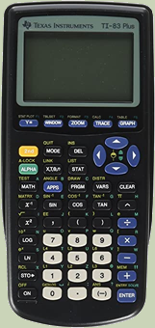
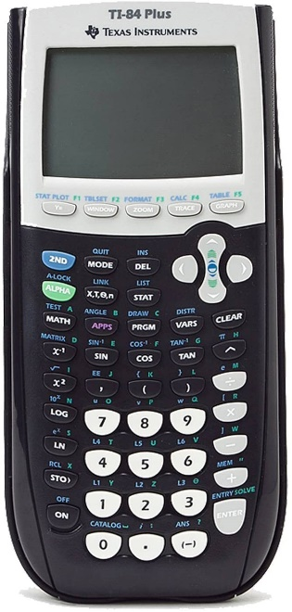
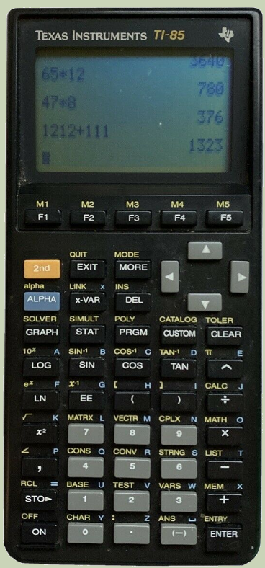
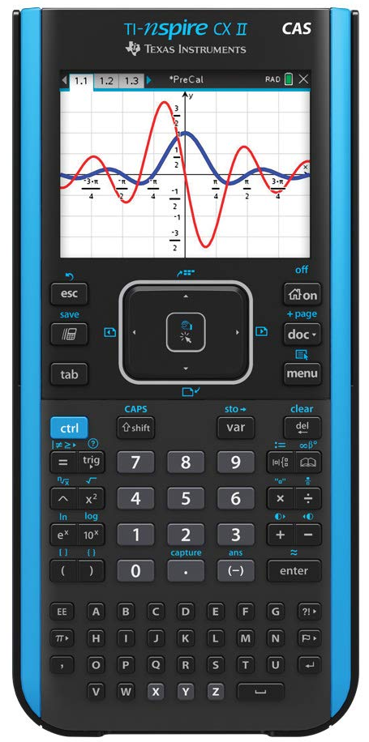
Fancy Calculator?
NO you won’t need a fancy calculator for this class… but you might for calculus… and for being an engineer…

Slide 3
Schedule
(Subject to change arbitrarily and without prior notice)
Week 01 Mathematical Models
Week 02 Review of Functions, Lines and Parabolas
Week 03 Complex Numbers and Zeros
Week 04 Polynomials and their graphs
Week 05 Rationals, Inequalities, Composites, Inverse
Week 06 Logarithms, Exponential, Growth and Decay
Week 07 Midterm break and Sequences
Week 08 Series and Conic Sections
Week 09 Conics and Systems
Week 10 Nonlinear and Parametrics
Week 11 Partial Fraction Decomposition
Week 12 Mathopoly!

Slide 4
What’s Up?
Today we will be going over:
Info for the class
Mathematical modeling

Slide 5
What’s Up?
Outcome 12) Solve a problem by identifying the given data, making a sketch as appropriate, modeling the problem, and calculating the final answer.

Slide 6
PreCalculus
PreCalculus often seems like a random, arbitrary hodge-podge of subjects…
Presumedly ones you will need for Calculus classes

Slide 7
PreCalculus
Well, you will need these skills for Calculus…
But there is another (more important) link between them

Slide 8
PreCalculus
These skills are necessary for creating and using
“mathematical models” –
formulas used to make commonly-used calculations

Slide 9
Mathematical Models
A mathematical model is a formula that gives results similar to those observed in a real-life situation

Slide 10
Mathematical Models
These formulas are everywhere in science, engineering, and business

Slide 11
Mathematical Models
In science and technology we often use mathematical formulas to calculate known relationships

Slide 12
Mathematical Models
In algebra we learned about using variables in mathematical formulas rather than just arithmetic (which requires numbers in every slot)

Slide 13
Mathematical Models
Mathematical models use letters to designate variables in the formulas

Slide 14
Mathematical Models
Mathematical models use letters to designate variables in the formulas
Often the letters used are the first letter in the real-world item in the formula

Slide 15
MATHEMATICAL MODELS
IN-CLASS PROBLEM 1
What does each letter mean in the mathematical model:
d = rt
e = mc²

Slide 16
MATHEMATICAL MODELS
IN-CLASS PROBLEM 1
What does each letter mean in the mathematical model:
d = rt
distance = rate × time
e = mc²

Slide 17
MATHEMATICAL MODELS
IN-CLASS PROBLEM 1
What does each letter mean in the mathematical model:
d = rt
distance = rate × time
e = mc²
energy = mass ×
speed of light²

Slide 18
Mathematical Models
Many of these relationships are simple and well-known:
Distance = Rate * Time
Area rectangle = L * W
Volume cube = L * W * H
Area circle = π r ²
Circumference circle = 2 π r
Ohm's Law: V = I R
e = mc²

Slide 19

POLYNOMIALS
IN-CLASS PROBLEM 2
US Grey Wolf Population
Insatiable killer.
That's the reputation the grey wolf acquired in the United States in the nineteenth and early twentieth centuries.
Although the label was
undeserved, an estimated 2
million wolves were shot,
trapped or poisoned.
By 1960, the population was
reduced to approximately 800
wolves.
Thanks to algebra student Dolton Holman for the stupendous wolf drawing!

Slide 20
POLYNOMIALS
IN-CLASS PROBLEM 2
US Grey Wolf Population
Algebra can be used to describe the increasing grey wolf population in the continental United States following mid 1960s
local protective
legislation and the
federal Endangered
Species Act of 1973.
Thanks to algebra student Dolton Holman for the stupendous wolf drawing!

Slide 21
POLYNOMIALS
IN-CLASS PROBLEM 2
US Grey Wolf Population
The algebraic expression:
0.72 x ² + 9.4 x + 783
approximates the grey wolf population in the continental United States x years after 1960.
Is the approximation formula a mathematical model?

Slide 22
POLYNOMIALS
IN-CLASS PROBLEM 2
US Grey Wolf Population
The algebraic expression:
0.72 x ² + 9.4 x + 783
approximates the grey wolf population in the continental United States x years after 1960.
Is the approximation formula a mathematical model? Yep!

Slide 23
POLYNOMIALS
IN-CLASS PROBLEM 2
US Grey Wolf Population
The algebraic expression:
0.72 x ² + 9.4 x + 783 = w
approximates the grey wolf population in the continental United States x years after 1960.
Use the model formula to calculate the expected number of grey wolves in the continental United States in 2010:

Slide 24
POLYNOMIALS
IN-CLASS PROBLEM 2
US Grey Wolf Population
0.72 x ² + 9.4 x + 783 = w
x years after 1960
To find the value in 2010, you first have to calculate “x ”:

Slide 25
POLYNOMIALS
IN-CLASS PROBLEM 2
US Grey Wolf Population
0.72 x ² + 9.4 x + 783 = w
x years after 1960
To find the value in 2010, you first have to calculate “x ”:
x = 2010 – 1960 = 50
Now calculate the estimated number of grey wolves in the US in 2010:

Slide 26
POLYNOMIALS
IN-CLASS PROBLEM 2
US Grey Wolf Population
0.72 x ² + 9.4 x + 783 = w
x = 2010 – 1960 = 50
Now calculate the estimated number of grey wolves in the US in 2010:
0.72(50²) + 9.4(50) + 783 = 3053 whats?

Slide 27
POLYNOMIALS
IN-CLASS PROBLEM 2
US Grey Wolf Population
0.72 x ² + 9.4 x + 783 = w
x = 2010 – 1960 = 50
Now calculate the estimated number of grey wolves in the US in 2010:
0.72(50²) + 9.4(50) + 783
= 3053 wolves

Slide 28
POLYNOMIALS
IN-CLASS PROBLEM 2
The estimated number of grey wolves in the US in 2010 = 3053
In 2010, the US Fish and Wildlife Service counted 5883 grey wolves in the continental United States.
Did the model do a good job predicting this number?

Slide 29
POLYNOMIALS
IN-CLASS PROBLEM 2
The estimated number of grey wolves in the US in 2010 = 3053
In 2010, the US Fish and Wildlife Service counted 5883 grey wolves in the continental United States.
Did the model do a good job predicting this number?
What might the error indicate about the grey wolf population in the US?

Slide 30

Questions?
http://i.imgur.com/aliTlT3.jpg

Slide 31
Mathematical Models
Mathematical models are “functions” – for every set of numbers you plug into the model, you will get only ONE possible (right) numerical answer

Slide 32
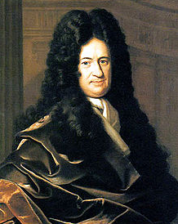
Mathematical Models
The term, "function" was coined by Gottfried Wilhelm Leibniz in 1673
https://en.wikipedia.org/wiki/Gottfried_Wilhelm_Leibniz#/media/File:Christoph_Bernhard_Francke_-_Bildnis_des_Philosophen_Leibniz_(ca._1695).jpg

Slide 33
Mathematical Models
Leibnitz observed that in many real-world processes there are inputs and outputs

Slide 34
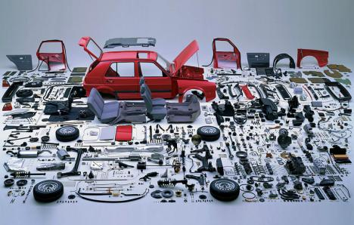
Mathematical Models
In a factory, the inputs are the components
https://3.bp.blogspot.com/-DEIw6og908M/VuLU19CgaII/AAAAAAAACgg/IcW5UTOy7MY4O9ZdcCeqPyV_NI63Ou-6Q/s1600/Screen%2BShot%2B2016-03-07%2Bat%2B11.23.54%2BAM.png

Slide 35
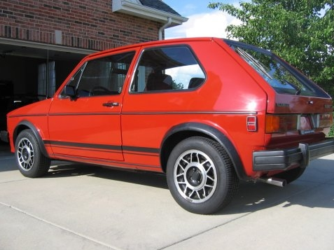
Mathematical Models
The output is the final product
https://i89.photobucket.com/albums/k230/echassin/GTI008.jpg

Slide 36
Mathematical Models
In formulas, some variables are “input” variables
The thing you are calculating with the formula is the “output”

Slide 37
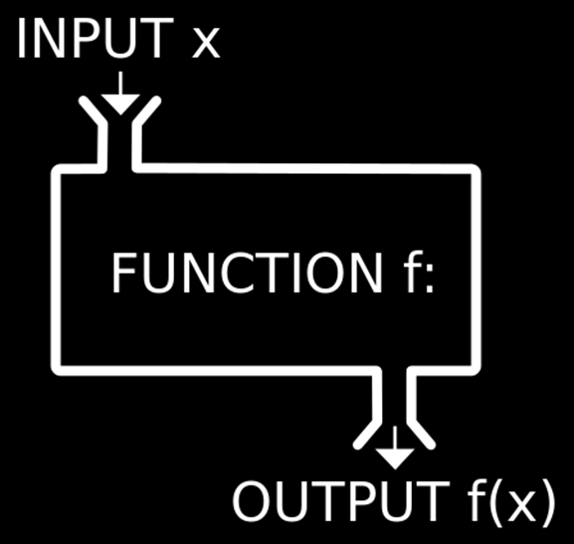
Mathematical Models
https://1.bp.blogspot.com/-YEqWLoN5V88/Wblu4NWyg4I/AAAAAAAAefY/G01iSXT2zn4L-W2-S-BETZHwvwHc_X1WQCLcBGAs/w530-h298-p/php-inbuilt-functions.jpg

Slide 38
MATHEMATICAL MODELS
IN-CLASS PROBLEM 2
In the formula:
Perimeter = 2πr
What is the input variable?
What is the output variable?

Slide 39
MATHEMATICAL MODELS
IN-CLASS PROBLEM 2
In the formula:
Perimeter = 2πr
What is the input variable?
r
What is the output variable?

Slide 40
MATHEMATICAL MODELS
IN-CLASS PROBLEM 2
In the formula:
Perimeter = 2πr
What is the input variable?
r
What is the output variable?
Perimeter

Slide 41
Mathematical Models
Perimeter = 2πr
The size of “r” the radius completely determines the perimeter of the circle

Slide 42
Mathematical Models
The input variable is ALWAYS put on the x-axis (horizontal axis)
No reason – it’s a TRADITION!

Slide 43
MATHEMATICAL MODELS
IN-CLASS PROBLEM 3
Identify which variable goes on the horizontal axis in
Perimeter = 2πr

Slide 44
MATHEMATICAL MODELS
IN-CLASS PROBLEM 3
Identify which variable goes on the horizontal axis in
Perimeter = 2πr
r

Slide 45
Questions?
http://i.imgur.com/aliTlT3.jpg

Slide 46
Mathematical Models
A complete graph is a stand-alone units that tells the whole story!

Slide 47
Mathematical Models
It will include:
an informative title
labels for the axes (unless
one is obviously “time”)
legends for colors or
symbols
UNITS!

Slide 48
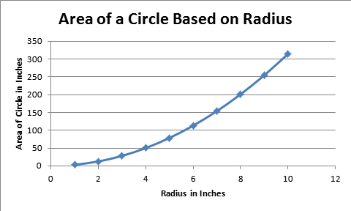
Mathematical Models
A graph that tells the whole story!
2
Vfrench 2008

Slide 49
Questions?
http://i.imgur.com/aliTlT3.jpg

Slide 50
Mathematical Models
What the output turns out to be depends on what the input is
The output is frequently called the “dependent” variable

Slide 51
Mathematical Models
The input is called the “independent” variable because it’s value comes from an outside (sometimes uncontrollable) source

Slide 52
Mathematical Models
When you have a certain input, you want to be able to forecast exactly what the output will be
https://3.bp.blogspot.com/-DEIw6og908M/VuLU19CgaII/AAAAAAAACgg/IcW5UTOy7MY4O9ZdcCeqPyV_NI63Ou-6Q/s1600/Screen%2BShot%2B2016-03-07%2Bat%2B11.23.54%2BAM.png
https://i89.photobucket.com/albums/k230/echassin/GTI008.jpg

Slide 53

Mathematical Models
You don’t want several possible forecasts
https://3.bp.blogspot.com/-DEIw6og908M/VuLU19CgaII/AAAAAAAACgg/IcW5UTOy7MY4O9ZdcCeqPyV_NI63Ou-6Q/s1600/Screen%2BShot%2B2016-03-07%2Bat%2B11.23.54%2BAM.png
https://i89.photobucket.com/albums/k230/echassin/GTI008.jpg

Slide 54
Mathematical Models
A special type of mathematical formula was designed for input-outputs: functions

Slide 55
Mathematical Models
For a formula to be a function, every x can have only one y

Slide 56
Questions?
http://i.imgur.com/aliTlT3.jpg

Slide 57
Mathematical Models
A mathematical model is a mathematical description (often by means of a function or an equation) of a real-world phenomenon

Slide 58
Mathematical Models
The purpose of the model is to understand the phenomenon and often to make predictions about future behavior (forecasts)

Slide 59
Mathematical Models
A mathematical model is never a completely accurate representation of a physical
situation

Slide 60
Mathematical Models
Unless it was developed as part of a scientific experiment to validate the particular relationship, there is no scientific evidence to show a particular model accurately explains a phenomenon

Slide 61
Mathematical Models
Still, it may be useful for forecasting

Slide 62
Mathematical Models
Functions are often used to model real-world phenomena

Slide 63
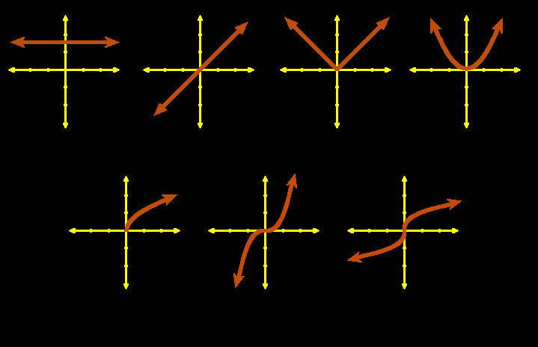
Mathematical Models
Graphs of common algebraic functions:
constant identity abs value quadratic
square root cubic cube root
VFrench, 2010

Slide 64
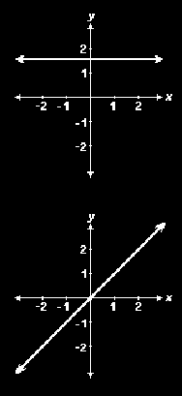
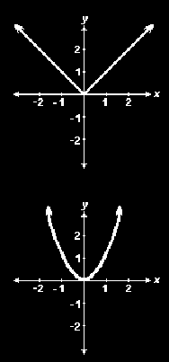
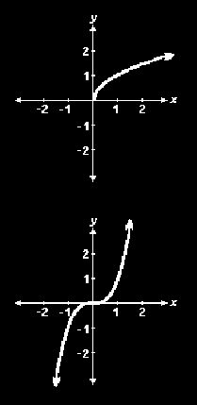
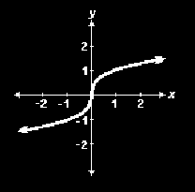
MATHEMATICAL MODELS
IN-CLASS PROBLEM 4
Which function?
Vfrench, 2010

Slide 65
Mathematical Models
We use these known functions to see if they will fit our observed data because we know their mathematical formulas
It’s a place to start!

Slide 66
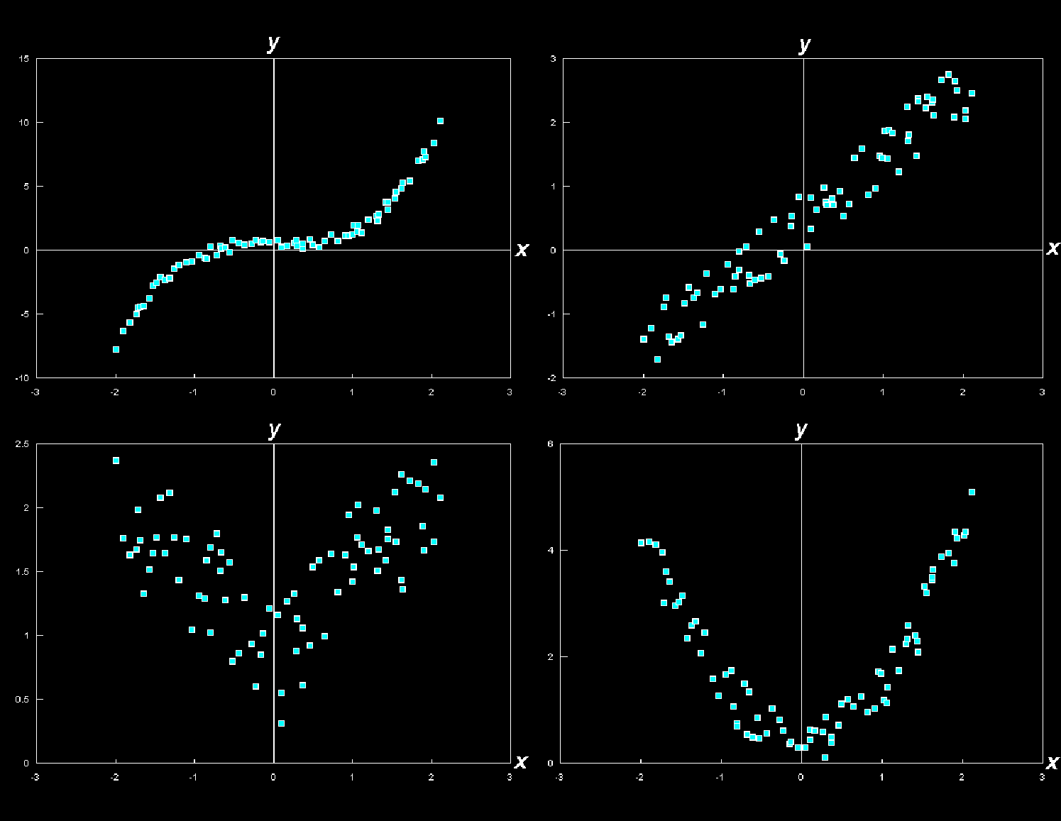
MATHEMATICAL MODELS
IN-CLASS PROBLEM 5
Which might fit?
Vfrench, 2010

Slide 67
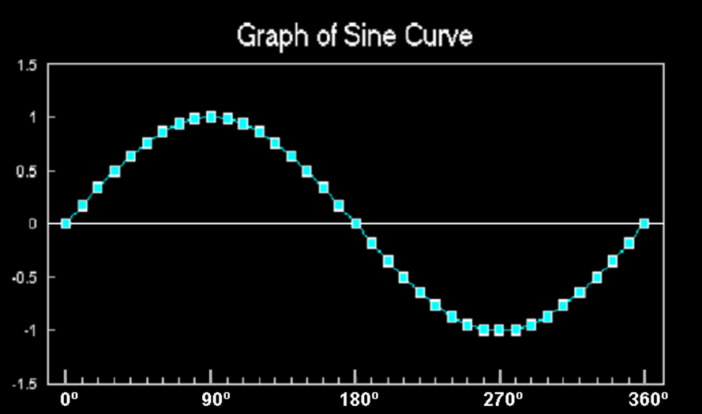
Mathematical Modeling
Trig functions (especially sine and cosine) are used to model cyclical phenomena
VFrench, 2015

Slide 68
Questions?
http://i.imgur.com/aliTlT3.jpg

Slide 69
Mathematical Modeling
Because data RARELY fits the known functions exactly, we have to transform the functions to fit the data

Slide 70
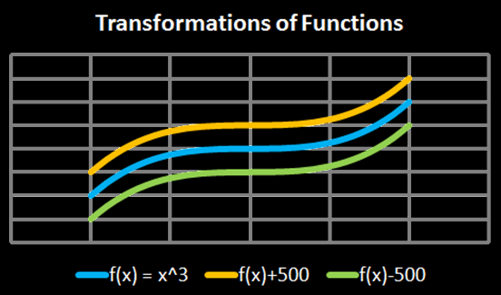
Transforming Functions
vertical shifts:
ƒ(x) + c plus shifts up
ƒ(x) - c minus shifts down
Vfrench, 2010

Slide 71
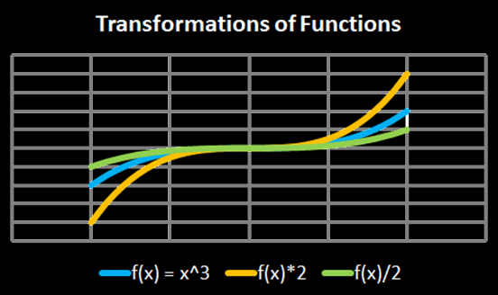
Transforming Functions
vertical stretch:
ƒ(x) × c stretches
ƒ(x) ÷ c squashes
Vfrench, 2010

Slide 72
Transforming Functions
Any operations done to the function outside of the parentheses affects the “y” values
These operations lead to an intuitive result

Slide 73
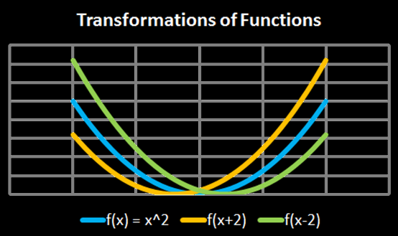
Transforming Functions
horizontal shifts:
ƒ(x + c) shifts left
ƒ(x - c) shifts right
Vfrench, 2010

Slide 74
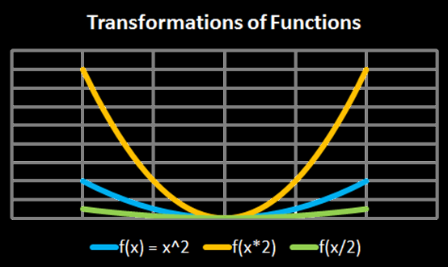
Transforming Functions
horizontal shifts:
ƒ(x × c) squashes
ƒ(x ÷ c) stretches
Vfrench, 2010

Slide 75
Transforming Functions
Another way to put it:
ƒ(x × c) increases the frequency
ƒ(x ÷ c) decreases the frequency
Vfrench, 2010

Slide 76
Transforming Functions
Any operations done to the function inside the parentheses affects the “x” values
These operations lead to a counterintuitive result

Slide 77
Transforming Functions
Excel demo

Slide 78
Questions?
http://i.imgur.com/aliTlT3.jpg

Slide 79

You Survived!
Today we studied:
Mathematical models

