Slide 1
Welcome to
Unit 2- Part 03
MATH116-Foundations for Calculus
https://media.istockphoto.com/vectors/green-blackboard-mathematical-with-thin-line-shapes-and-inscriptions-vector-id1084380192?k=6&m=1084380192&s=612x612&w=0&h=TcEOVpnUmyuswT4Pay
AL6lNiHU8SS8g33yOSg-jR5BE=

Slide 2
What’s Up?
Today we will be going over:
Review of functions
Lines
Quadratic equations

Slide 3
What’s Up?
Outcome 12) Solve problems by identifying the requirements, making a sketch as appropriate, modeling the problem, and calculating the final answer.

Slide 4
Review
http://995642590.r.lightningbase-cdn.com/wp-content/uploads/2010/12/looking-back-hrexaminer-v144-cover425px.jpg

Slide 5
Functions
For a formula to be a function, every x can have only one y

Slide 6
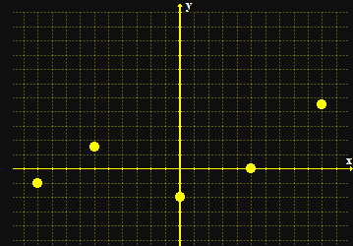
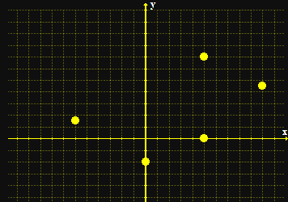
Functions
When you graph a function, none of the points fall on a vertical line
a function not a function
Vfrench 2008

Slide 7
Functions
To test whether a formula is a function, you graph it and do the “vertical line test”
If it passes the VLT, it is a function

Slide 8
Functions
The symbol for a function: ƒ(x) shows that the formula uses “x” as the input and the output depends on it

Slide 9
Functions
When you evaluate a function, you need to substitute the given value for x in the formula
ƒ(3) means “evaluate the function for x=3”

Slide 10
Functions
The “legal” values for a function are called:
Domain - the xs
Range - the ys

Slide 11
Functions
Increasing functions
Decreasing functions
Constant functions
relative maximums & minimums

Slide 12
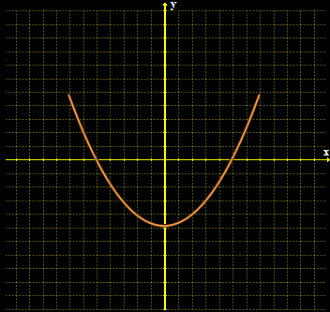
Functions
Even functions are symmetric with respect to the y-axis
ƒ(x) = ƒ(–x)
Vfrench 2008

Slide 13
Functions
Even functions written as equations have only even exponents of the variable
ƒ(x) = 3x⁴ - 15x² + 45

Slide 14
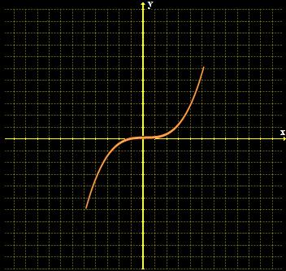
Functions
Odd functions are symmetric with respect to the origin
ƒ(-x) = –ƒ(x)
Vfrench 2008

Slide 15
Functions
Odd functions written as equations have only odd exponents of the variable
ƒ(x) = 3x⁵ - 15x³ + 45x

Slide 16
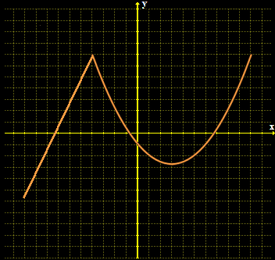
Functions
Types of functions:
piecewise functions - defined by two or more
equations
Vfrench 2008

Slide 17
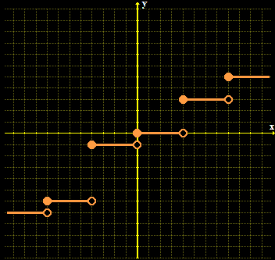
Functions
step functions: function values graphically form discontinuous steps
Vfrench 2008

Slide 18
Combining Functions
( ƒ + g)(x) = ƒ(x) + g (x)
( ƒ - g)(x) = ƒ(x) – g (x)
( ƒ∗g)(x) = ƒ(x) ∗ g (x)
( ƒ/ g)(x) = ƒ(x) / g (x)
when g (x) ≠ 0

Slide 19
Questions?
http://i.imgur.com/aliTlT3.jpg

Slide 20
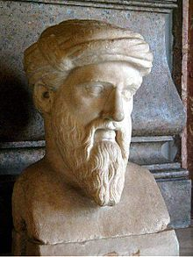
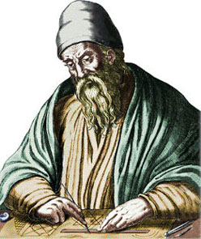
Lines
Lines were an important concept in geometry of the ancient Greeks
Pythagorus Euclid
https://en.wikipedia.org/wiki/File:Kapitolinischer_Pythagoras_adjusted.jpg
https://en.wikipedia.org/wiki/Euclid#/media/File:Euklid-von-Alexandria_1.jpg

Slide 21
Lines
The Greeks postulated lines that had no beginning or end

Slide 22
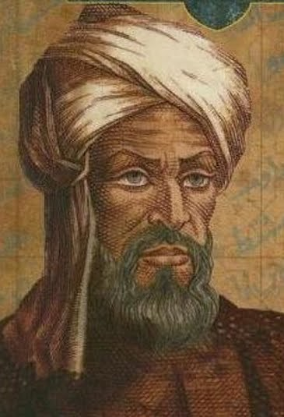
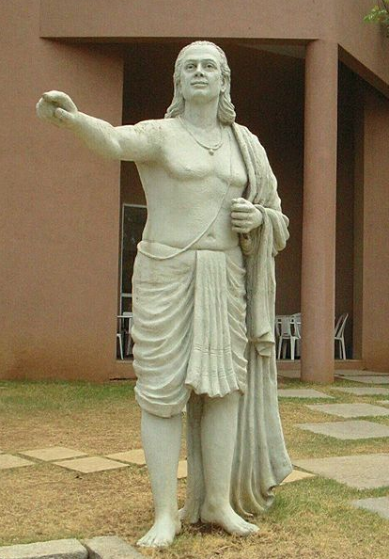
Lines
Lines were then incorporated into algebra as equations with constants and variables
Al-Khwarizmi Aryabhata
https://science4fun.info/wp-content/uploads/2019/05/Muhammad-ibn-Musa-al-Khwarizmi-portrait.jpg
https://upload.wikimedia.org/wikipedia/commons/thumb/a/af/2064_aryabhata-crp.jpg/300px-2064_aryabhata-crp.jpg

Slide 23
Lines
What defines a line?

Slide 24
Lines
To define a unique line, you need:
two points
or
a point and a slope

Slide 25
Lines
The standard form of the equation of a line involves a point and a slope:
y = mx + b
slope
y-intercept

Slide 26
Lines
“b” is the y-intercept
where the “x” value is 0
where the graph crosses
the y-axis

Slide 27
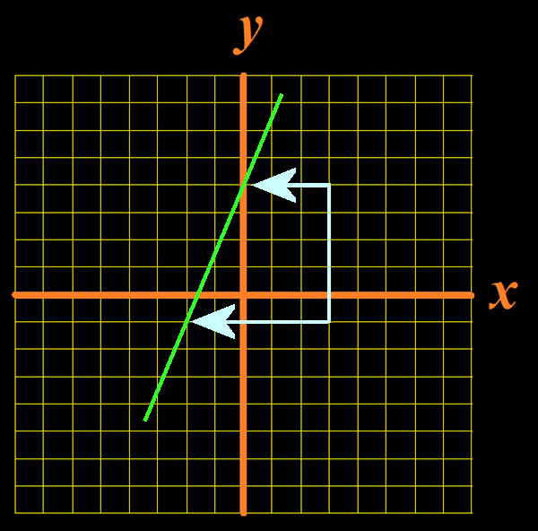
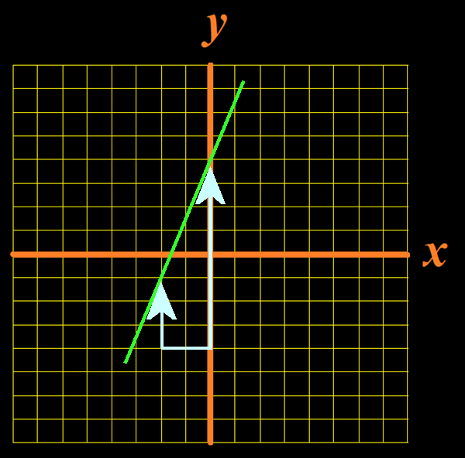
Lines
Slope of a line given a graph:
m =
rise run
rise
.
run
Vfrench, 2012

Slide 28
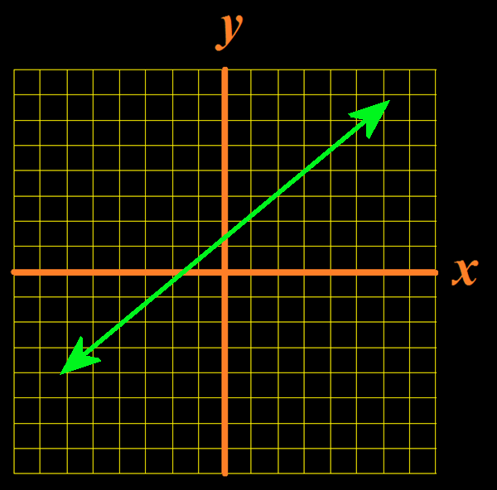
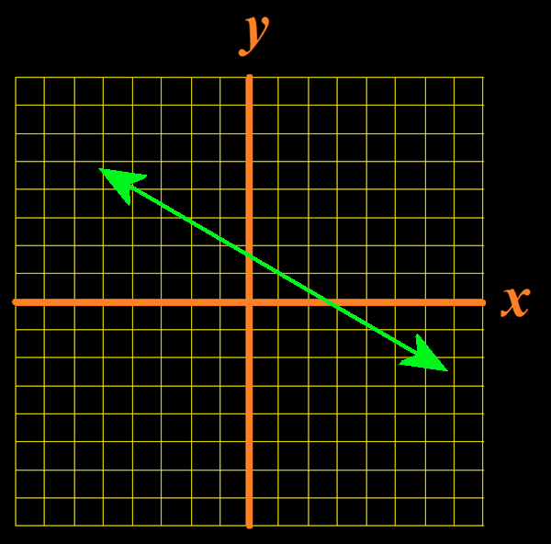
Lines
Positive slopes Negative slopes
move upward move downward
Vfrench, 2012

Slide 29
LINES
IN-CLASS PROBLEM 1
The ADA recommended slope for public access & walking elderly wheelchair ramps is "1:12" where 1 is the rise and 12 is the run
Calculate the slope of this ramp:

Slide 30
LINES
IN-CLASS PROBLEM 1
The ADA recommended slope for public access & walking elderly wheelchair ramps is "1:12" where 1 is the rise and 12 is the run
Calculate the slope of this ramp:
1/12

Slide 31
LINES
IN-CLASS PROBLEM 1
The maximum ramp slope recommended for residential use with an assistant is 2:12
Calculate the slope of this ramp:

Slide 32
LINES
IN-CLASS PROBLEM 1
The maximum ramp slope recommended for residential use with an assistant is 2:12
Calculate the slope of this ramp:
2/12 or 1/6

Slide 33
LINES
IN-CLASS PROBLEM 1
The maximum ramp slope recommended for loading unoccupied wheelchairs is 3:12
Calculate the slope of this ramp:

Slide 34
LINES
IN-CLASS PROBLEM 1
The maximum ramp slope recommended for loading unoccupied wheelchairs is 3:12
Calculate the slope of this ramp:
3/12 or 1/4

Slide 35
Questions?
http://i.imgur.com/aliTlT3.jpg

Slide 36
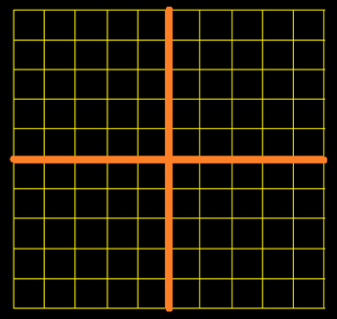
Lines
What is the equation of this line?
1
1
Vfrench, 2012

Slide 37
Lines
What is the equation of this line?
1
b = 2
1
Vfrench, 2012

Slide 38
Lines
What is the equation of this line?
.
another
clear
point
Vfrench, 2012

Slide 39
Lines
What is the equation of this line?
.
}
.
rise = 3
Vfrench, 2012

Slide 40
Lines
What is the equation of this line?
}
.
}
rise = 3
run = 4
Vfrench, 2012

Slide 41
Lines
What is the equation of this line?
y = mx + b
y = $\frac{\text{3}}{\text{4}}$x + 2
.
}
b = 2
.
}
rise = 3
Because it’s an “up”
slope, “m” is positive
run = 4
Vfrench, 2012

Slide 42
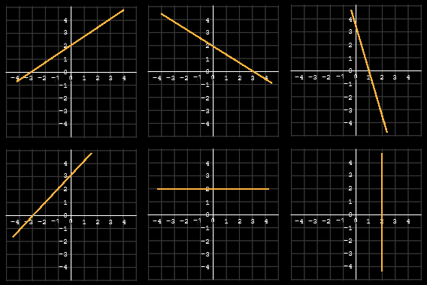
LINES
IN-CLASS PROBLEM 2
Write the equation of the graph:
a
c
b
e
f
d
Vfrench, 2021

Slide 43
LINES
IN-CLASS PROBLEM 2
Write the equation of the graph:
y = 2/3x + 2
y = -2/3x + 2
y = -3/1x + 3
e
f
d
Vfrench, 2021

Slide 44
LINES
IN-CLASS PROBLEM 2
Write the equation of the graph:
y = 2/3x + 2
y = -2/3x + 2
y = -3/1x + 3
e
f
d
Vfrench, 2021

Slide 45
LINES
IN-CLASS PROBLEM 2
Write the equation of the graph:
y = 2/3x + 2
y = -2/3x + 2
y = -3/1x + 3
y = 0x + 2
x = 2
y = 3/3x + 3
Vfrench, 2021

Slide 46
Questions?
http://i.imgur.com/aliTlT3.jpg

Slide 47
Lines
The most common form of the equation of a line uses the slope (m) and the y-intercept (b)
Slope-intercept form:
y = mx + b

Slide 48
LINES
IN-CLASS PROBLEM 3
What is the equation of a line with slope 4 and y-intercept 8?
What is the equation of a line with m=-2 and b=13
y = mx + b

Slide 49
LINES
IN-CLASS PROBLEM 3
What is the equation of a line with slope 4 and y-intercept 8?
y = 4x + 8
What is the equation of a line with m=-2 and b=13
y = mx + b

Slide 50
LINES
IN-CLASS PROBLEM 3
What is the equation of a line with slope 4 and y-intercept 8?
y = 4x + 8
What is the equation of a line with m=-2 and b=13
y = -2x + 13
y = mx + b

Slide 51
Lines
“b” is the y-intercept
where the “x” value is 0
where the graph crosses
the y-axis
b = y – mx

Slide 52
LINES
IN-CLASS PROBLEM 4
Calculate "b" given the point (1,0) and the slope m = –3/4:
Calculate "b" given the point
(–2,4) and the slope m = 5/2:
b = y – mx

Slide 53
LINES
IN-CLASS PROBLEM 4
Calculate "b" given the point (1,0) and the slope m = –3/4: ¾ or 0.75
Calculate "b" given the point
(–2,4) and the slope m = 5/2:
b = y – mx

Slide 54
LINES
IN-CLASS PROBLEM 4
Calculate "b" given the point (1,0) and the slope m = –3/4: ¾ or 0.75
Calculate "b" given the point
(–2,4) and the slope m = 5/2: 9
b = y – mx

Slide 55
Questions?
http://i.imgur.com/aliTlT3.jpg

Slide 56
Lines
Slope of a line given two points:
(x₁,y₁) (x₂,y₂)
m =
y₁ – y₂
.
x₁ – x₂

Slide 57
LINES
IN-CLASS PROBLEM 5
Calculate the slope of a line passing through the points:
(–3,4) and (–4,–2)
Calculate the slope of a line passing through the points:
(4,–2) and (–1,5)

Slide 58
LINES
IN-CLASS PROBLEM 5
Calculate the slope of a line passing through the points:
(–3,4) and (–4,–2)
m = (4--2)/(-3--4) = 6/1 or 6
Calculate the slope of a line passing through the points:
(4,–2) and (–1,5)

Slide 59
LINES
IN-CLASS PROBLEM 5
Calculate the slope of a line passing through the points:
(–3,4) and (–4,–2)
m = (4--2)/(-3--4) = 6/1 or 6
Calculate the slope of a line passing through the points:
(4,–2) and (–1,5)
m = (5--2)/(-1-4) = 7/-5 or -7/5
≈ -0.171

Slide 60
Questions?
http://i.imgur.com/aliTlT3.jpg

Slide 61
Lines
The most common form of the equation of a line uses the slope (m) and the y-intercept (b)
Slope-intercept form:
y = mx + b

Slide 62
Lines
Another way to write the equation of a line is based on having two points (x₁,y₁) and (x₂,y₂) – the Point-slope form

Slide 63
Lines
The “point” in the equation of a line can be either one of the two given points: (x₁,y₁) or (x₂,y₂)
The point-slope equation:
y – y₁ = m(x – x₁)
or
y – y₂ = m(x – x₂)

Slide 64
LINES
IN-CLASS PROBLEM 6
For the line with slope = 2 and passing through (3,5):
Write an equation for the line in the point–slope form:
Write an equation for the line in the slope intercept form:
y = mx + b
b = y – mx
y – y₁ = m(x – x₁)

Slide 65
LINES
IN-CLASS PROBLEM 6
For the line with slope = 2 and passing through (3,5):
Write an equation for the line in the point–slope form:
y = 2x + (5-2(3)) = 2x - 1
Write an equation for the line in the slope intercept form:
b = y – mx
y = mx + b
y – y₁ = m(x – x₁)

Slide 66
LINES
IN-CLASS PROBLEM 6
For the line with slope = 2 and passing through (3,5):
Write an equation for the line in the point–slope form:
y = 2x + (5-2(3)) = 2x - 1
Write an equation for the line in the slope intercept form:
y – 5 = 2(x – 3) or y - 5 = 2x - 6
b = y – mx
y = mx + b
y – y₁ = m(x – x₁)

Slide 67
Questions?
http://i.imgur.com/aliTlT3.jpg

Slide 68
Lines
There are other special lines that have their own names

Slide 69
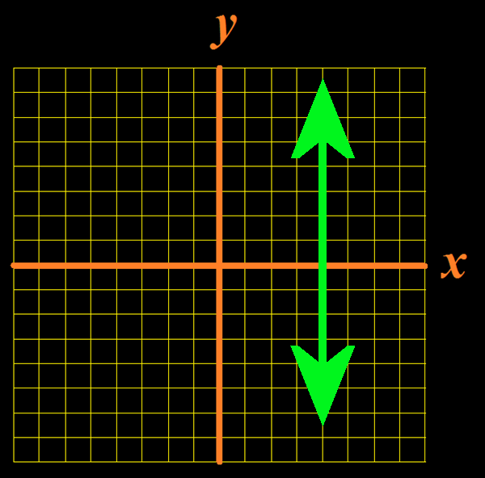
Lines
Equation of a vertical line:
x = a
where a is the x-intercept
(the slope is undefined)
Vfrench, 2012

Slide 70
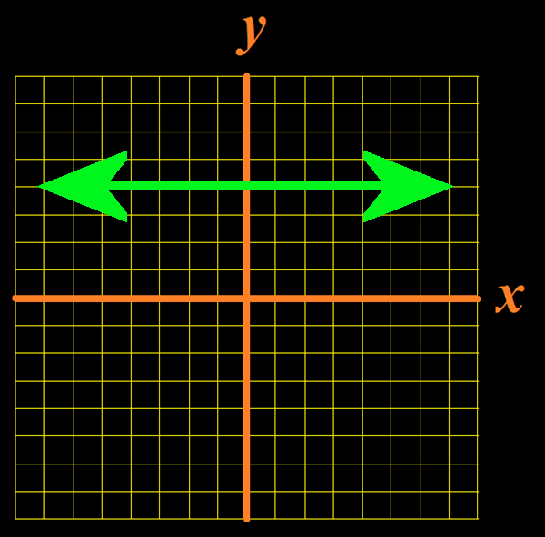
Lines
Equation of a horizontal line
y = b
where b is the y –intercept
(the slope is 0)
Vfrench, 2012

Slide 71
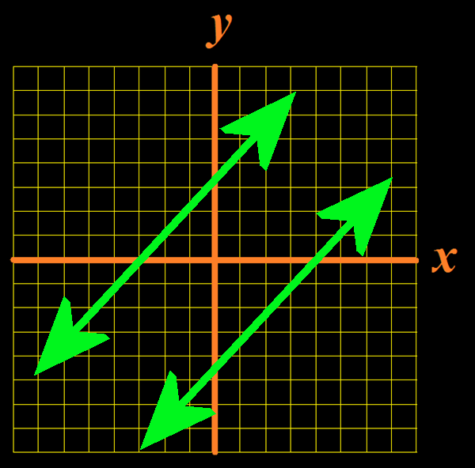
Lines
Parallel lines have the same slope m₁ = m₂
Vfrench, 2012

Slide 72
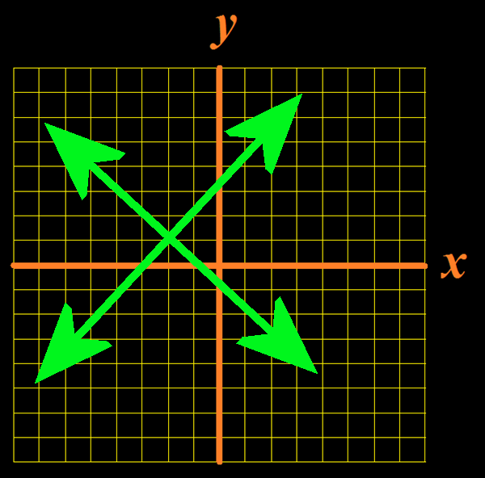
Lines
Perpendicular lines: the product of their slopes is -1
m₁ × m₂ = -1
Vfrench, 2012

Slide 73
Questions?
http://i.imgur.com/aliTlT3.jpg

Slide 74
Quadratics/Parabolas
Parabolas are one of the curves studied by the ancient Greeks
Menaechmus (no pic – sorry!) discovered parabolas while trying to solve the “Delian Problem”

Slide 75
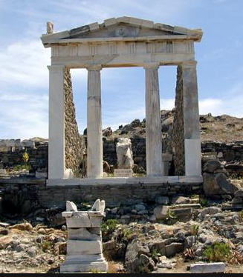
Quadratics/Parabolas
The citizens of Delos consulted the oracle at Delphi to stop a plague sent by Apollo
The oracle responded
that they must
double the size of
the altar to Apollo
20180222072831_808740587_14195_0.jpg

Slide 76
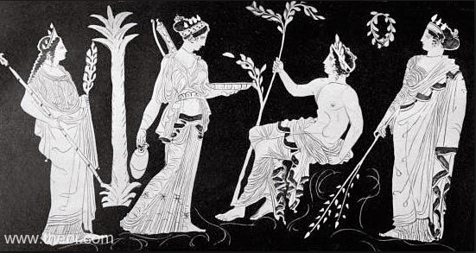
Quadratics/Parabolas
The Delians said “Huh?” and consulted Plato, who was able to interpret the oracle as the mathematical problem of doubling the volume of a cube
T14.7Leto.jpg

Slide 77
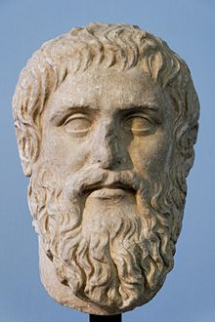
Quadratics/Parabolas
Plato saw the oracle was trying to get the people to study mathematics to distract them and stop them fighting among themselves
Plato Silanion Musei Capitolini MC1377.jpg

Slide 78
Quadratics/Parabolas
What does a parabola look like?

Slide 79
Quadratics/Parabolas
What does a parabola look like?
Is it symmetrical?

Slide 80
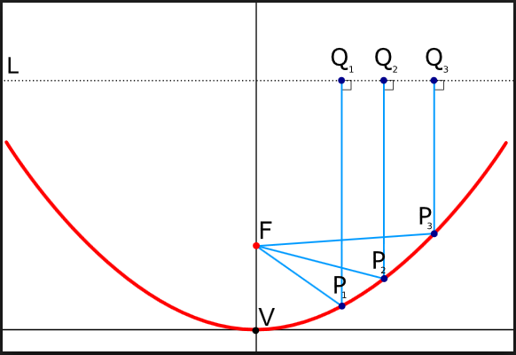
Quadratics/Parabolas
Parabolas are important in the modern world because they have a focus point:
Vfrench, 2015

Slide 81
Quadratics/Parabolas
This means the shape can be used for antennas
400px-ASTRA2Connect_Dish.jpg

Slide 82
Quadratics/Parabolas
The equation of a parabola is:
ax² + bx + c = y
This is also called a “quadratic equation”

Slide 83
Quadratics/Parabolas
In mathematics, a “quadratic” is a type of problem that deals with a variable multiplied by itself — an operation known as “squaring”

Slide 84
Quadratics/Parabolas
This language derives from the area of a square being its side length multiplied by itself
The word “quadratic” comes from quadratum, the Latin word for “square”

Slide 85
Quadratics/Parabolas
A quadratic equation must have a variable that is squared
(also called degree 2)

Slide 86
Quadratics/Parabolas
A quadratic equation has only one variable with degree 2

Slide 87
ZEROS OF FUNCTIONS
IN-CLASS PROBLEM 7
Which is a quadratic equation?
x + y = 2
5x² + 7x – 4 = 0
x² + y² = 9
2x³ + 8x² + 4x + 9 = 0
8x² + 4x + 9 = y²

Slide 88
ZEROS OF FUNCTIONS
IN-CLASS PROBLEM 7
Which is a quadratic equation?
x + y = 2 nope!
5x² + 7x – 4 = 0
x² + y² = 9
2x³ + 8x² + 4x + 9 = 0
8x² + 4x + 9 = y²

Slide 89
ZEROS OF FUNCTIONS
IN-CLASS PROBLEM 7
Which is a quadratic equation?
x + y = 2 nope!
5x² + 7x – 4 = 0 yep!
x² + y² = 9
2x³ + 8x² + 4x + 9 = 0
8x² + 4x + 9 = y²

Slide 90
ZEROS OF FUNCTIONS
IN-CLASS PROBLEM 7
Which is a quadratic equation?
x + y = 2 nope!
5x² + 7x – 4 = 0 yep!
x² + y² = 9 NOPE!
2x³ + 8x² + 4x + 9 = 0
8x² + 4x + 9 = y²

Slide 91
ZEROS OF FUNCTIONS
IN-CLASS PROBLEM 7
Which is a quadratic equation?
x + y = 2 nope!
5x² + 7x – 4 = 0 yep!
x² + y² = 9 NOPE!
2x³ + 8x² + 4x + 9 = 0 nope!
8x² + 4x + 9 = y²

Slide 92
ZEROS OF FUNCTIONS
IN-CLASS PROBLEM 7
Which is a quadratic equation?
x + y = 2 nope!
5x² + 7x – 4 = 0 yep!
x² + y² = 9 NOPE!
2x³ + 8x² + 4x + 9 = 0 nope!
8x² + 4x + 9 = y² nope!

Slide 93
Questions?
http://i.imgur.com/aliTlT3.jpg

Slide 94
Quadratics/Parabolas
The equation of a parabola is:
ax² + bx + c = y
“a” “b” and “c” determine the shape and location of the curve

Slide 95
QUADRATICS/PARABOLAS
IN-CLASS PROBLEM 8
What is “a” “b” and “c” for the equation:
56x² + 42x - 893 = y
a = b = c =
ax² + bx + c = y

Slide 96
QUADRATICS/PARABOLAS
IN-CLASS PROBLEM 8
What is “a” “b” and “c” for the equation:
56x² + 42x - 893 = y
a = 56 b = c =
ax² + bx + c = y

Slide 97
QUADRATICS/PARABOLAS
IN-CLASS PROBLEM 8
What is “a” “b” and “c” for the equation:
56x² + 42x - 893 = y
a = 56 b = 42 c =
ax² + bx + c = y

Slide 98
QUADRATICS/PARABOLAS
IN-CLASS PROBLEM 8
What is “a” “b” and “c” for the equation:
56x² + 42x - 893 = y
a = 56 b = 42 c = -893
ax² + bx + c = y

Slide 99
QUADRATICS/PARABOLAS
IN-CLASS PROBLEM 8
What is “a” “b” and “c” for:
y = -3x²
a = b = c =
y = x² + 4
a = b = c =
y = x² – 2x - 4
a = b = c =
y = -(x²) + 5x – 20
a = b = c =
ax² + bx + c = y

Slide 100
QUADRATICS/PARABOLAS
IN-CLASS PROBLEM 8
What is “a” “b” and “c” for:
y = -3x²
a = -3 b = 0 c = 0
y = x² + 4
a = b = c =
y = x² – 2x - 4
a = b = c =
y = -(x²) + 5x – 20
a = b = c =
ax² + bx + c = y

Slide 101
QUADRATICS/PARABOLAS
IN-CLASS PROBLEM 8
What is “a” “b” and “c” for:
y = -3x²
a = -3 b = 0 c = 0
y = x² + 4
a = 1 b = 0 c = 4
y = x² – 2x - 4
a = b = c =
y = -(x²) + 5x – 20
a = b = c =
ax² + bx + c = y

Slide 102
QUADRATICS/PARABOLAS
IN-CLASS PROBLEM 8
What is “a” “b” and “c” for:
y = -3x²
a = -3 b = 0 c = 0
y = x² + 4
a = 1 b = 0 c = 4
y = x² – 2x - 4
a = 1 b = -2 c = -4
y = -(x²) + 5x – 20
a = b = c =
ax² + bx + c = y

Slide 103
QUADRATICS/PARABOLAS
IN-CLASS PROBLEM 8
What is “a” “b” and “c” for:
y = -3x²
a = -3 b = 0 c = 0
y = x² + 4
a = 1 b = 0 c = 4
y = x² – 2x - 4
a = 1 b = -2 c = -4
y = -(x²) + 5x – 20
a = -1 b = 5 c = -20

Slide 104
Questions?
http://i.imgur.com/aliTlT3.jpg

Slide 105
Quadratics/Parabolas
What shape will the curve be?

Slide 106
Quadratics/Parabolas
ax² + bx + c = y
If “a” is positive, the curve will be cup-shaped
8
6
4
2
0
-2
–4
-6
-8
-4 –3 –2 –1 0 1 2 3 4
Vfrench, 2020

Slide 107
Quadratics/Parabolas
ax² + bx + c = y
If “a” is negative, the curve will be hill-shaped
8
6
4
2
0
-2
–4
-6
-8
-4 –3 –2 –1 0 1 2 3 4
Vfrench, 2020

Slide 108
QUADRATICS/PARABOLAS
IN-CLASS PROBLEM 9
Is each a “hill” or a “cup”?
y = -3x²
y = x² + 4
y = x² – 2x - 4
y = -(x²) + 5x – 20

Slide 109
QUADRATICS/PARABOLAS
IN-CLASS PROBLEM 9
Is each a “hill” or a “cup”?
y = -3x²
hill
y = x² + 4
y = x² – 2x - 4
y = -(x²) + 5x – 20

Slide 110
QUADRATICS/PARABOLAS
IN-CLASS PROBLEM 9
Is each a “hill” or a “cup”?
y = -3x²
hill
y = x² + 4
cup
y = x² – 2x - 4
y = -(x²) + 5x – 20

Slide 111
QUADRATICS/PARABOLAS
IN-CLASS PROBLEM 9
Is each a “hill” or a “cup”?
y = -3x²
hill
y = x² + 4
cup
y = x² – 2x - 4
cup
y = -(x²) + 5x – 20

Slide 112
QUADRATICS/PARABOLAS
IN-CLASS PROBLEM 9
Is each a “hill” or a “cup”?
y = -3x²
hill
y = x² + 4
cup
y = x² – 2x - 4
cup
y = -(x²) + 5x – 20
hill

Slide 113
Questions?
http://i.imgur.com/aliTlT3.jpg

Slide 114
Quadratics/Parabolas
A positive “c” shifts the curve up
A negative shifts it down
y = x² + 7
y = x² - 7
10
5
0
–5
-10
10
5
0
–5
-10
-8 –6 –4 –2 0 2 4 6 8
-8 –6 –4 –2 0 2 4 6 8
Vfrench, 2020

Slide 115
QUADRATICS/PARABOLAS
IN-CLASS PROBLEM 10
Is each shifted up or down?
y = -3x²
y = x² + 4
y = x² – 2x - 4
y = -(x²) + 5x – 20

Slide 116
QUADRATICS/PARABOLAS
IN-CLASS PROBLEM 10
Is each shifted up or down?
y = -3x²
no shift
y = x² + 4
y = x² – 2x - 4
y = -(x²) + 5x – 20

Slide 117
QUADRATICS/PARABOLAS
IN-CLASS PROBLEM 10
Is each shifted up or down?
y = -3x²
no shift
y = x² + 4
up
y = x² – 2x - 4
y = -(x²) + 5x – 20

Slide 118
QUADRATICS/PARABOLAS
IN-CLASS PROBLEM 10
Is each shifted up or down?
y = -3x²
no shift
y = x² + 4
up
y = x² – 2x - 4
down
y = -(x²) + 5x – 20

Slide 119
QUADRATICS/PARABOLAS
IN-CLASS PROBLEM 10
Is each shifted up or down?
y = -3x²
no shift
y = x² + 4
up
y = x² – 2x - 4
down
y = -(x²) + 5x – 20
down

Slide 120
Quadratics/Parabolas
Changing “b” will move the curve both vertically and horizontally
y = x² + 7x
y = x² - 7x
10
5
0
–5
-10
10
5
0
–5
-10
-8 –6 –4 –2 0 2 4 6 8
-8 –6 –4 –2 0 2 4 6 8
Vfrench, 2020

Slide 121
Questions?
http://i.imgur.com/aliTlT3.jpg

Slide 122
You Survived!
Today we covered:
Review of functions
Lines
Quadratic/parabolic equations
www.playbuzz.com

