Slide 1
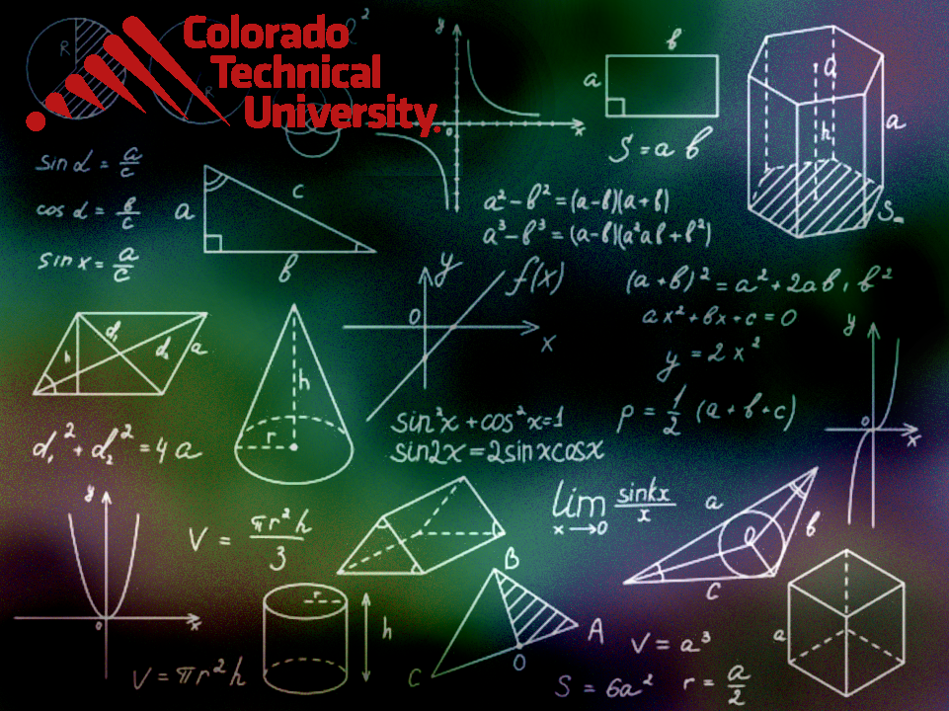
Welcome to
Unit 6- Part 12
MATH116-Foundations for Calculus
https://media.istockphoto.com/vectors/green-blackboard-mathematical-with-thin-line-shapes-and-inscriptions-vector-id1084380192?k=6&m=1084380192&s=612x612&w=0&h=TcEOVpnUmyuswT4Pay
AL6lNiHU8SS8g33yOSg-jR5BE=

Slide 2
What’s Up?
Review:
Compound functions, one-to-
one, inverse
New stuff:
Logarithms and exponentials

Slide 3
What’s Up?
Outcome 3) Graph rational, exponential, logarithmic functions, and their transformations
Outcome 7) Use properties of logarithms to solve exponential and logarithmic equations and applied problems involving exponential growth and decay.

Slide 4

Review
http://995642590.r.lightningbase-cdn.com/wp-content/uploads/2010/12/looking-back-hrexaminer-v144-cover425px.jpg

Slide 5
Composite Functions
Composite functions have an order - the output of g(x) is the input to ƒ(x)

Slide 6
Composite Functions
ƒ ○ g
means calculate g first, then input the result into ƒ

Slide 7
Composite Functions
ƒ ○ g ≠ g ○ ƒ

Slide 8
Composite Functions
To evaluate a composite, do the composite first, then plug in the value
The notation is a bit confusing:
(ƒ ○ g)(2)
means calculate “ƒ ○ g” then plug in “2” for “x”

Slide 9
Composite Functions
Most of the calculations engineers and scientists do are actually composite functions!

Slide 10
One-to-One Functions
A function is one-to-one if any two different inputs in the domain correspond to two different outputs in the range
A function is not one-to-one if
two different inputs correspond
to the same output

Slide 11
One-to-One Functions
How can you tell whether a function is one-to-one?
Horizontal-Line Test
If every horizontal line intersects the graph of a function in at most one
point, then ƒ is one-to-one

Slide 12
One-to-One Functions
Warning: in other disciplines, there is a special line called the 1:1 line (pronounced one-to-one)
The 1:1 line is the
line with a slope of 1
(where y=x) the
“identity line” or
“line of equality”
y
4
3
2
1
x
- 4
-3
-2
-1
1
2
3
4
- 1
- 2
- 3
- 4
VFrench, 2020

Slide 13
Inverse Functions
Undo a function

Slide 14
Inverse Functions
The domain of ƒ is equal to the range of ƒ⁻¹ and vice-versa

Slide 15
Inverse Functions
Calculating the Inverse
1) Replace "ƒ(x)" with "y"
2) Interchange "x" and "y"
3) Solve for "y"
4) Replace "y" in with ƒ⁻¹

Slide 16
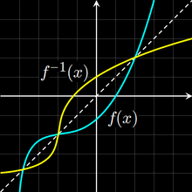
Inverse Functions
Because the domain of ƒ is equal to the range of ƒ⁻¹ and vice-versa, an inverse will
rotate a function
around the 1:1
y=x identity line
Vfrench, 2010

Slide 17
Inverse Functions
Remember, to be a function it must pass a vertical line test
For a function to have an inverse that is also a function, the original function must also pass a horizontal line test

Slide 18
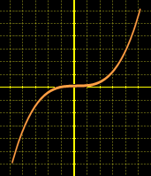
Inverse Functions
A cubic function:
ƒ(x) =ax³+ bx²+ cx + d
Does it pass the
horizontal line test?
Vfrench, 2010

Slide 19
Inverse Functions
A cubic function:
ƒ(x) =ax³+ bx²+ cx + d,
If all coefficients are non-zero, x∈ℝ, in general, the cubic function has no inverse because it is not a one-to-one function
Kimtee Goh, a mechanical engineer from UNIVERSITY OF MALAYA, MALAYSIA
https://www.quora.com/How-do-you-find-the-inverse-value-of-a-cubic-function

Slide 20
Inverse Functions
BUT cubic functions of the form:
(i) ƒ(x)=(ax+b)³+ c
(ii) ƒ(x)=a(x+b)³+ c
are invertible
Kimtee Goh, a mechanical engineer from UNIVERSITY OF MALAYA, MALAYSIA
https://www.quora.com/How-do-you-find-the-inverse-value-of-a-cubic-function

Slide 21
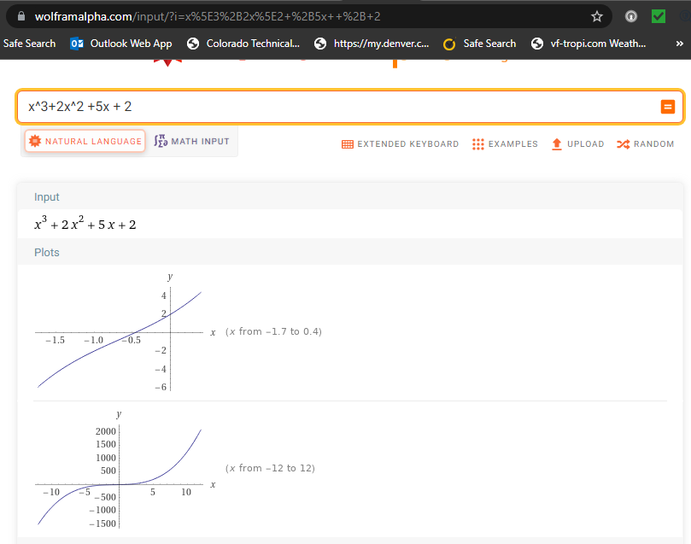
passes the horizontal line test
and the domain and range of its inverse is ℝ the domain and range of the original function

Slide 22
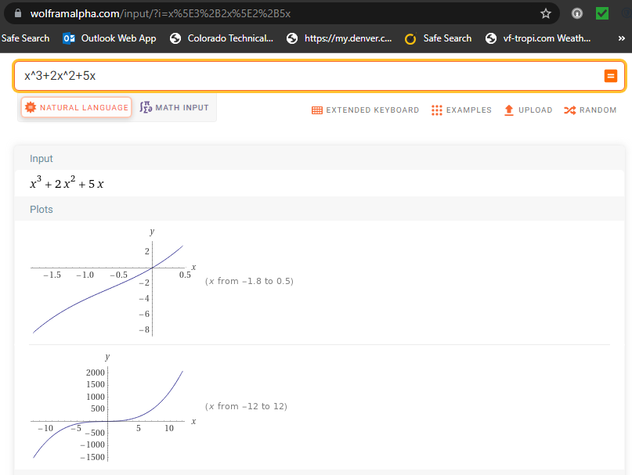
passes the horizontal line test
and the domain and range of its inverse is ℝ the domain and range of the original function

Slide 23
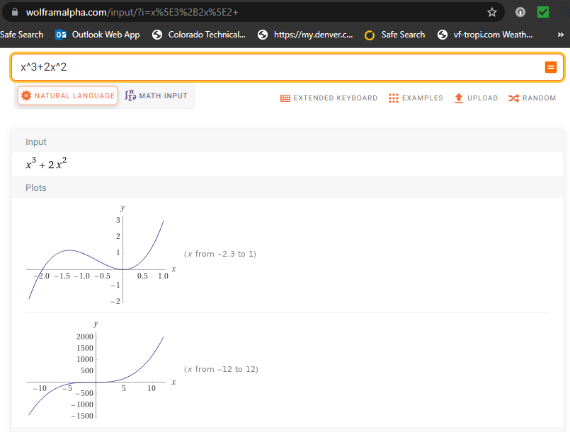
fails the horizontal line test

Slide 24
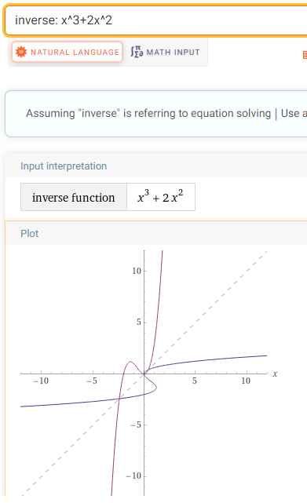

Slide 25
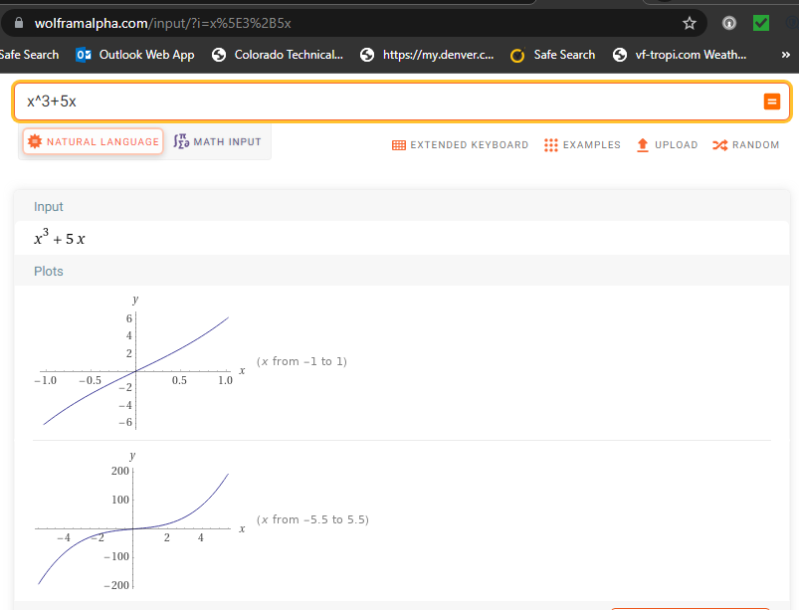
passes the horizontal line test
and the domain and range of its inverse is ℝ the domain and range of the original function

Slide 26
Inverse Functions
So, the trick seems to be:
if it’s got a “cx” term, it is invertible, otherwise probably not
Kimtee Goh, a mechanical engineer from UNIVERSITY OF MALAYA, MALAYSIA
https://www.quora.com/How-do-you-find-the-inverse-value-of-a-cubic-function

Slide 27
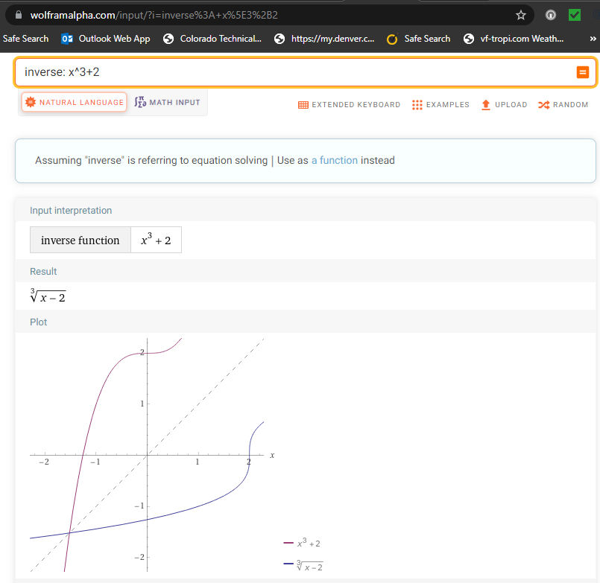
Still not sure…
Seems to be…

Slide 28
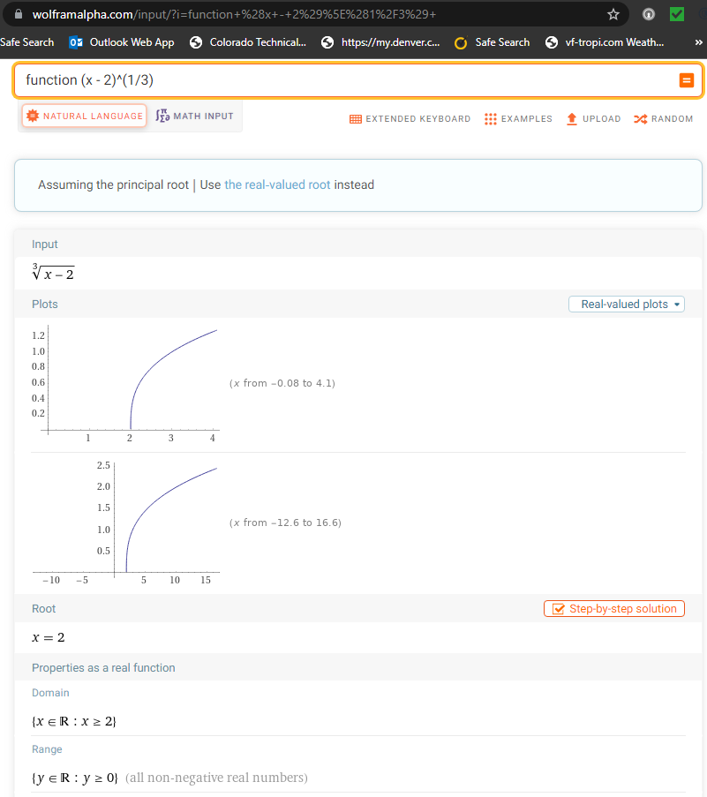
But, the domain and range of x^3+2 are both ℝ, so the domain and range of x^3+2 is NOT the range and domain of (x-2)^1/3
So IT’S NOT!

Slide 29

Questions?
http://i.imgur.com/aliTlT3.jpg

Slide 30
Logarithms
The logarithmic function is used in science and technology to model things as diverse as earthquakes and coaxial cables

Slide 31
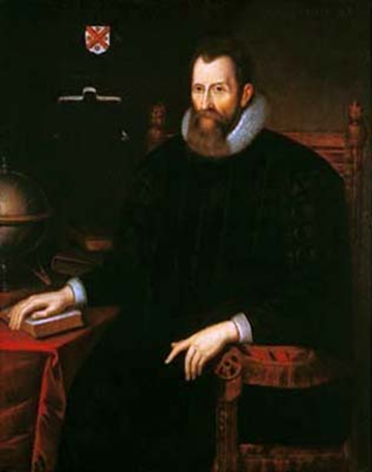
Logarithms
Logarithms were invented by Scottish Baron John Napier in 1614
https://upload.wikimedia.org/wikipedia/commons/thumb/e/e3/John_Napier.jpg/250px-John_Napier.jpg

Slide 32
Logarithms
He used them to simplify
“BIG” calculations
https://upload.wikimedia.org/wikipedia/commons/thumb/e/e3/John_Napier.jpg/250px-John_Napier.jpg

Slide 33
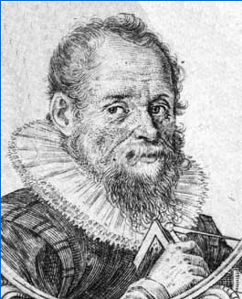
Logarithms
AND they were invented by Swiss clockmaker Joost Bürgi in 1620
https://www.maa.org/press/periodicals/convergence/logarithms-the-early-history-of-a-familiar-function-joost-b-rgi-introduces-logarithms

Slide 34
Logarithms
He wanted to create one table that could be used to solve ALL mathematical calculations
https://www.maa.org/press/periodicals/convergence/logarithms-the-early-history-of-a-familiar-function-joost-b-rgi-introduces-logarithms

Slide 35
Logarithms
Now we use them totally differently:
as an inverse for the exponent function

Slide 36
Logarithms
Whenever we do a calculation in math, we want a way to undo it

Slide 37
Logarithms
Whenever we do a calculation in math, we want a way to undo it
This is called the calculation’s “inverse”

Slide 38
Logarithms
What is the inverse of addition?

Slide 39
Logarithms
What is the inverse of division?

Slide 40
Logarithms
Now the tricky one…
What is the inverse of a square?

Slide 41
Logarithms
In exponentials:
b^{y} = x

Slide 42

Logarithms
To undo b^{y} = x
We need something like:
= b
y
$$\sqrt{\text{x}}$$

Slide 43

Logarithms
The logarithmic function
y = log_{b} x
“undoes” b^{y} = x in a more useful way than
= b
( ‘cause we always know what “b” is… it’s the base…)
y
$$\sqrt{\text{x}}$$

Slide 44
Logarithms
And just like
x + 2 = y
is the same as
x = y - 2

Slide 45
Logarithms
The logarithmic function
y = log_{b} x
is the same as
b^{y} = x
(if x>0, b>0 and b≠1)

Slide 46
Logarithms
log₂ 16
2 to what power gives 16?

Slide 47
Logarithms
log₂ 16 = 4
because 2⁴ = 16

Slide 48

LOGARITHMS
IN-CLASS PROBLEM 1
Evaluate:
log₁₀ 100
log₃₆ 6
log₅ 1/125
log₃ $\sqrt[7]{\text{3}}$
log_{b} x: b to what power gives x?

Slide 49

LOGARITHMS
IN-CLASS PROBLEM 1
Evaluate:
log₁₀ 100 = 2
log₃₆ 6
log₅ 1/125
log₃ $\sqrt[7]{\text{3}}$
log_{b} x: b to what power gives x?

Slide 50

LOGARITHMS
IN-CLASS PROBLEM 1
Evaluate:
log₁₀ 100 = 2
log₃₆ 6 = 0.5
log₅ 1/125
log₃ $\sqrt[7]{\text{3}}$
log_{b} x: b to what power gives x?

Slide 51

LOGARITHMS
IN-CLASS PROBLEM 1
Evaluate:
log₁₀ 100 = 2
log₃₆ 6 = 0.5
log₅ 1/125 = -3
log₃ $\sqrt[7]{\text{3}}$
log_{b} x: b to what power gives x?

Slide 52

LOGARITHMS
IN-CLASS PROBLEM 1
Evaluate:
log₁₀ 100 = 2
log₃₆ 6 = 0.5
log₅ 1/125 = -3
log₃ $\sqrt[7]{\text{3}}$ = 1/7
log_{b} x: b to what power gives x?

Slide 53
Questions?
http://i.imgur.com/aliTlT3.jpg

Slide 54
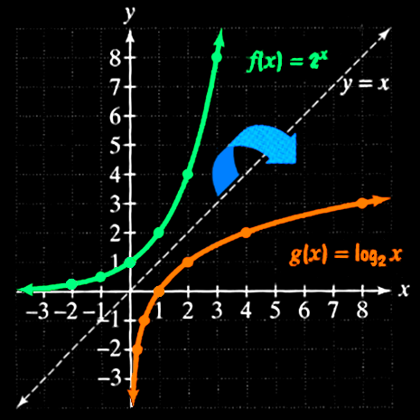
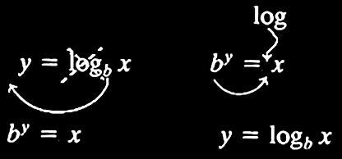
Logarithms
Logarithms are the inverse of exponential functions

Slide 55
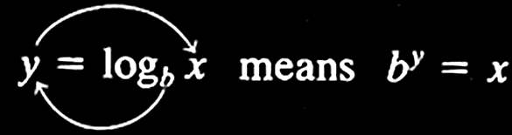
Logarithms
logarithmic function with base b
~or~
exponential function with base b

Slide 56
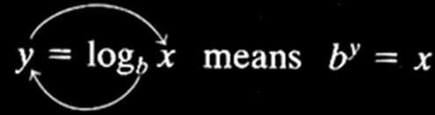
LOGARITHMS
IN-CLASS PROBLEM 2
Write in logarithmic form:
2³ = 8
8^{y} = 300
5⁻³ = 1/125
15² = x

Slide 57
LOGARITHMS
IN-CLASS PROBLEM 2
Write in logarithmic form:
2³ = 8 log₂ 8 = 3
8^{y} = 300
5⁻³ = 1/125
15² = x

Slide 58
LOGARITHMS
IN-CLASS PROBLEM 2
Write in logarithmic form:
2³ = 8 log₂ 8 = 3
8^{y} = 300 log₈ 300 = y
5⁻³ = 1/125
15² = x

Slide 59
LOGARITHMS
IN-CLASS PROBLEM 2
Write in logarithmic form:
2³ = 8 log₂ 8 = 3
8^{y} = 300 log₈ 300 = y
5⁻³ = 1/125 log₅ (1/125) = -3
15² = x

Slide 60
LOGARITHMS
IN-CLASS PROBLEM 2
Write in logarithmic form:
2³ = 8 log₂ 8 = 3
8^{y} = 300 log₈ 300 = y
5⁻³ = 1/125 log₅ (1/125) = -3
15² = x log₁₅ x = 2

Slide 61
LOGARITHMS
IN-CLASS PROBLEM 3
Write in exponential form:
4 = log₂ 16
6 = log₂ 64
3 = log_{x} 27
b = log_{c} a

Slide 62
LOGARITHMS
IN-CLASS PROBLEM 3
Write in exponential form:
4 = log₂ 16 2⁴ = 16
6 = log₂ 64
3 = log_{x} 27
b = log_{c} a

Slide 63
LOGARITHMS
IN-CLASS PROBLEM 3
Write in exponential form:
4 = log₂ 16 2⁴ = 16
6 = log₂ 64 2⁶ = 64
3 = log_{x} 27
b = log_{c} a

Slide 64
LOGARITHMS
IN-CLASS PROBLEM 3
Write in exponential form:
4 = log₂ 16 2⁴ = 16
6 = log₂ 64 2⁶ = 64
3 = log_{x} 27 x³ = 27
b = log_{c} a

Slide 65
LOGARITHMS
IN-CLASS PROBLEM 3
Write in exponential form:
4 = log₂ 16 2⁴ = 16
6 = log₂ 64 2⁶ = 64
3 = log_{x} 27 x³ = 27
b = log_{c} a c^{b} = a

Slide 66
LOGARITHMS
IN-CLASS PROBLEM 4
Solve for q:
log₅ (2q + 4) = 3
b = ?

Slide 67
LOGARITHMS
IN-CLASS PROBLEM 4
Solve for q:
log₅ (2q + 4) = 3
b = 5
y = ?

Slide 68
LOGARITHMS
IN-CLASS PROBLEM 4
Solve for q:
log₅ (2q + 4) = 3
b = 5
y = 3
x =

Slide 69
LOGARITHMS
IN-CLASS PROBLEM 4
Solve for q:
log₅ (2q + 4) = 3
b = 5
y = 3
x = 2q + 4
b^{y} = x ?

Slide 70
LOGARITHMS
IN-CLASS PROBLEM 4
Solve for q:
log₅ (2q + 4) = 3
b = 5
y = 3
x = 2q + 4
5³ = 2q + 4 solve for q

Slide 71
LOGARITHMS
IN-CLASS PROBLEM 4
Solve for q:
log₅ (2q + 4) = 3
b = 5
y = 3
x = 2q + 4
5³ = 2q + 4 solve for q
q = (5³ - 4)/2 = 60.5

Slide 72
Questions?
http://i.imgur.com/aliTlT3.jpg

Slide 73
Logarithms
The natural number “e” (for Euler’s number) is an important mathematical constant approximately equal to 2.71828

Slide 74
Logarithms
Like the constant π, e is irrational (it cannot be written as a ratio of integers), and it is transcendental (it is not a root of any non-zero polynomial with rational coefficients)

Slide 75
Logarithms
0,1,π,i and e are the five constants appearing in the formulation of Euler’s identity:
e^{iπ} + 1 = 0
These are the numbers that seem to run our universe!

Slide 76
Logarithms
Logs with base e are called
“natural logarithms”
Written "ln"

Slide 77
Logarithms
Logs with base 10 are called
“common logarithms”
Written "log"

Slide 78
Logarithms
The default logarithm
has base 10:
log₁₀ x = log x

Slide 79
Logarithms
BUT nowadays, the default logarithm sometimes has base e:
log_{e} x = ln x = “log x”
Be careful!
WolframAlpha uses “log” to mean “ln”

Slide 80
Logarithms
Properties of Logarithms:
log_{b} 1 = 0 log 1 = 0 ln 1 = 0
log_{b} b = 1 log 10 = 1 ln e = 1
log_{b} b^{x} = x log 10^{x} = x ln e^{x} = x
b^{logb x} = x 10^{logx} = x e^{ln x} = x

Slide 81
Logarithms
Mathematical facts about logs:
log(AB) = log(A) + log(B)
log(A/B) = log(A) – log(B)
log(A^{B}) = B×log(A)

Slide 82
Logarithms
BTW:
log₁₀(e) = 1/ln(10)

Slide 83
LOGARITHMS
IN-CLASS PROBLEM 5
Simplify:
log (p) + log (q)
log(AB) = log(A) + log(B)
log(A/B) = log(A) – log(B)
log(A^{B}) = B×log(A)

Slide 84
LOGARITHMS
IN-CLASS PROBLEM 5
Simplify:
log (p) + log (q) = log (pq)
log(AB) = log(A) + log(B)
log(A/B) = log(A) – log(B)
log(A^{B}) = B×log(A)

Slide 85
LOGARITHMS
IN-CLASS PROBLEM 5
Expand:
log (x/y)
log(AB) = log(A) + log(B)
log(A/B) = log(A) – log(B)
log(A^{B}) = B×log(A)

Slide 86
LOGARITHMS
IN-CLASS PROBLEM 5
Expand:
log (x/y) = log (x) – log (y)
log(AB) = log(A) + log(B)
log(A/B) = log(A) – log(B)
log(A^{B}) = B×log(A)

Slide 87
LOGARITHMS
IN-CLASS PROBLEM 5
Simplify:
3 log (m) – 2 log (n)
log(AB) = log(A) + log(B)
log(A/B) = log(A) – log(B)
log(A^{B}) = B×log(A)

Slide 88
LOGARITHMS
IN-CLASS PROBLEM 5
Simplify:
3 log (m) – 2 log (n) =
= log(m³) – log(n²)
= log(m³ / n²)
log(AB) = log(A) + log(B)
log(A/B) = log(A) – log(B)
log(A^{B}) = B×log(A)

Slide 89
Questions?
http://i.imgur.com/aliTlT3.jpg

Slide 90
Logarithms
How do you calculate:
log₅ 625
when your calculator only has base 10 and base e?

Slide 91
Logarithms
Changing the base of logarithms:
log_{b}M = log_{a}M / log_{a}b

Slide 92
LOGARITHMS
IN-CLASS PROBLEM 6
Calculate: log₅ 625
What’s b?
What’s M?
What’s a?
log_{b}M = log_{a}M / log_{a}b

Slide 93
LOGARITHMS
IN-CLASS PROBLEM 6
Calculate: log₅ 625
What’s b? 5
What’s M?
What’s a?
log_{b}M = log_{a}M / log_{a}b

Slide 94
LOGARITHMS
IN-CLASS PROBLEM 6
Calculate: log₅ 625
What’s b? 5
What’s M? 625
What’s a?
log_{b}M = log_{a}M / log_{a}b

Slide 95
LOGARITHMS
IN-CLASS PROBLEM 6
Calculate: log₅ 625
What’s b? 5
What’s M? 625
What’s a? either 10 or e
Do it!
log_{b}M = log_{a}M / log_{a}b

Slide 96
LOGARITHMS
IN-CLASS PROBLEM 6
log₅ 625 = log₁₀ 625 / log₁₀ 5
= 4
or
log₅ 625 = ln 625 / ln 5
= 4
log_{b}M = log_{a}M / log_{a}b

Slide 97
Questions?
http://i.imgur.com/aliTlT3.jpg

Slide 98
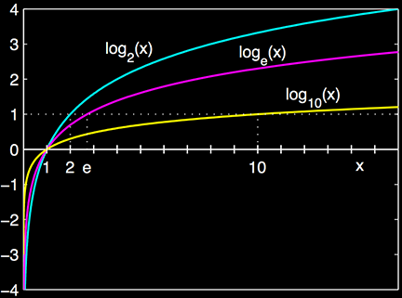
Logarithms
The graph of a logarithm looks like:
https://en.wikipedia.org/wiki/Logarithm

Slide 99
Logarithms
The slope of the logarithm curve is high for small values…
https://en.wikipedia.org/wiki/Logarithm

Slide 100
Logarithms
…and the slope is low for large values of the logarithm
https://en.wikipedia.org/wiki/Logarithm

Slide 101
Logarithms
The value of 1/x is also high for small values of x and low for large values of x
https://en.wikipedia.org/wiki/Logarithm

Slide 102
Logarithms
The value of 1/x is also high for small values of x and low for large values of x
…maybe a model?
https://en.wikipedia.org/wiki/Logarithm

Slide 103
Questions?
http://i.imgur.com/aliTlT3.jpg

Slide 104
Exponentials
Functions that contain exponents:
ƒ(x) = x^{c}
x is the base
c is the exponent

Slide 105
Exponentials
Exponential functions:
ƒ(x) = c^{x}
c is the base
x is the exponent

Slide 106
Exponentials
Limitations:
the base must be a constant
the base must be >0
the exponent must be a variable

Slide 107
EXPONENTIALS
IN-CLASS PROBLEM 7
Function containing an exponent or exponential function?
ƒ(w) = w⁹ ƒ(y) = 72^{y}
ƒ(x) = -83.2^{x} ƒ(x) = x⁵⁰
ƒ(z) = (8z+1)^{z} ƒ(x) = (x²+4)6^{x}

Slide 108
EXPONENTIALS
IN-CLASS PROBLEM 7
Function containing an exponent or exponential function?
ƒ(w) = w⁹ ƒ(y) = 72^{y}
fce
ƒ(x) = -83.2^{x} ƒ(x) = x⁵⁰
ƒ(z) = (8z+1)^{z} ƒ(x) = (x²+4)6^{x}

Slide 109
EXPONENTIALS
IN-CLASS PROBLEM 7
Function containing an exponent or exponential function?
ƒ(w) = w⁹ ƒ(y) = 72^{y}
fce exp fct
ƒ(x) = -83.2^{x} ƒ(x) = x⁵⁰
ƒ(z) = (8z+1)^{z} ƒ(x) = (x²+4)6^{x}

Slide 110
EXPONENTIALS
IN-CLASS PROBLEM 7
Function containing an exponent or exponential function?
ƒ(w) = w⁹ ƒ(y) = 72^{y}
fce exp fct
ƒ(x) = -83.2^{x} ƒ(x) = x⁵⁰
exp fct
ƒ(z) = (8z+1)^{z} ƒ(x) = (x²+4)6^{x}

Slide 111
EXPONENTIALS
IN-CLASS PROBLEM 7
Function containing an exponent or exponential function?
ƒ(w) = w⁹ ƒ(y) = 72^{y}
fce exp fct
ƒ(x) = -83.2^{x} ƒ(x) = x⁵⁰
exp fct fce
ƒ(z) = (8z+1)^{z} ƒ(x) = (x²+4)6^{x}

Slide 112
EXPONENTIALS
IN-CLASS PROBLEM 7
Function containing an exponent or exponential function?
ƒ(w) = w⁹ ƒ(y) = 72^{y}
fce exp fct
ƒ(x) = -83.2^{x} ƒ(x) = x⁵⁰
exp fct fce
ƒ(z) = (8z+1)^{z} ƒ(x) = (x²+4)6^{x}
exp fct

Slide 113
EXPONENTIALS
IN-CLASS PROBLEM 7
Function containing an exponent or exponential function?
ƒ(w) = w⁹ ƒ(y) = 72^{y}
fce exp fct
ƒ(x) = -83.2^{x} ƒ(x) = x⁵⁰
exp fct fce
ƒ(z) = (8z+1)^{z} ƒ(x) = (x²+4)6^{x}
exp fct exp fct

Slide 114
Questions?
http://i.imgur.com/aliTlT3.jpg

Slide 115
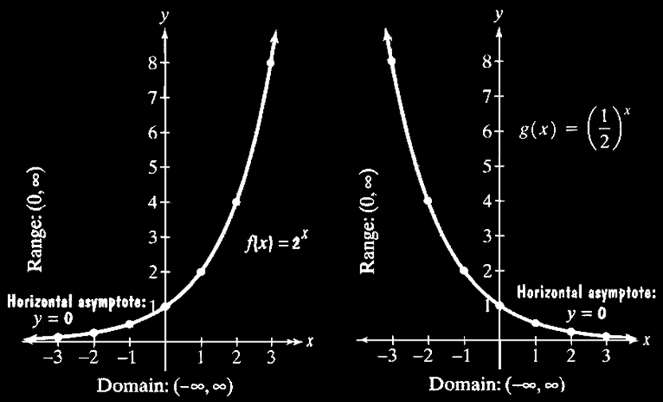
Exponentials
Graphs of Exponential Functions

Slide 116
Exponentials
If the base is > 1, then the graph goes up to the right
If 0<base<1, then the graph goes up to the left

Slide 117
Exponentials
All pass through the point (0,1) because a⁰=1

Slide 118
Exponentials
The domain (xs) is (-∞,∞) The range (ys) is (0,∞)

Slide 119
Exponentials
As I mentioned, logarithms
are the inverse of
exponential
functions

Slide 120
Logarithms vs Exponents
Graph of exponents vs logarithms
Is it getting
bigger faster
and faster
or slower and
slower?

Slide 121
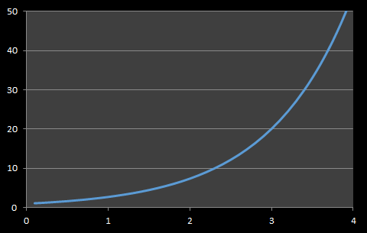
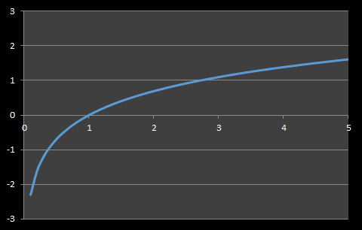
Logarithmic vs Exponential Models
Exponential Curve Logarithmic Curve
Is it getting bigger faster and faster
or slower and slower?

Slide 122
Logarithmic vs Exponential Models
Exponential Curve Logarithmic Curve
Starts slow
Then speeds up
Starts fast
Then slows down

Slide 123
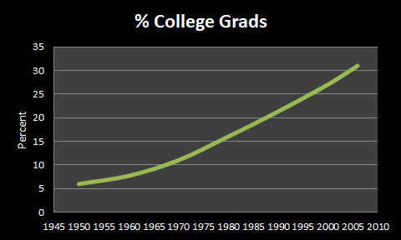
LOGARITHMS vs EXPONENTS
IN-CLASS PROBLEM 8
Percentage of college graduates – exponential or logarithmic?

Slide 124
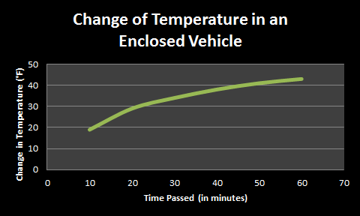
LOGARITHMS vs EXPONENTS
IN-CLASS PROBLEM 8
Change of temperature in an enclosed vehicle - exponential or logarithmic?

Slide 125
Questions?
http://i.imgur.com/aliTlT3.jpg

Slide 126
“e”
The “e”–based exponential usually has it’s own button on your calculator

Slide 127
“e”
The “e”–based exponential usually has it’s own button on your calculator (but it’s usually hiding)

Slide 128
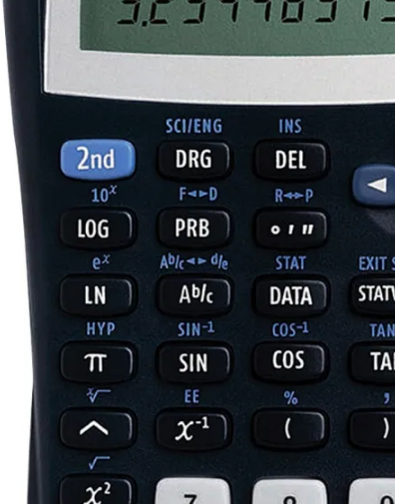
“e”
It’s usually
“shift-ln”
https://www.officedepot.com/a/products/176928/Texas-Instruments-TI-30X-IIS-Solar/?utm_source=google&utm_medium=cpc&mediacampaignid=71700000042240055_1599196543&&gclsrc=aw.ds&gclid=EAIaIQobChMImNqRtueY8wIVB2xvBB2NjgfZEAQYASABEgLZVvD_BwE&gclsrc=aw.ds

Slide 129
“e”
…and (unlike π,
which gets a
value-button),
the button is for
e^{x}
https://www.officedepot.com/a/products/176928/Texas-Instruments-TI-30X-IIS-Solar/?utm_source=google&utm_medium=cpc&mediacampaignid=71700000042240055_1599196543&&gclsrc=aw.ds&gclid=EAIaIQobChMImNqRtueY8wIVB2xvBB2NjgfZEAQYASABEgLZVvD_BwE&gclsrc=aw.ds

Slide 130
“e”
You have to enter
e¹ to get the
value of “e”
https://www.officedepot.com/a/products/176928/Texas-Instruments-TI-30X-IIS-Solar/?utm_source=google&utm_medium=cpc&mediacampaignid=71700000042240055_1599196543&&gclsrc=aw.ds&gclid=EAIaIQobChMImNqRtueY8wIVB2xvBB2NjgfZEAQYASABEgLZVvD_BwE&gclsrc=aw.ds

Slide 131
LOGARITHMS vs EXPONENTS
IN-CLASS PROBLEM 9
Calculate:
e²
2e³
e⁴/3
4e⁵/6

Slide 132
LOGARITHMS vs EXPONENTS
IN-CLASS PROBLEM 9
Calculate:
e² ≈ 7.389
2e³
e⁴/3
4e⁵/6

Slide 133
LOGARITHMS vs EXPONENTS
IN-CLASS PROBLEM 9
Calculate:
e² ≈ 7.389
2e³ ≈ 40.171
e⁴/3
4e⁵/6

Slide 134
LOGARITHMS vs EXPONENTS
IN-CLASS PROBLEM 9
Calculate:
e² ≈ 7.389
2e³ ≈ 40.171
e⁴/3 ≈ 18.199
4e⁵/6

Slide 135
LOGARITHMS vs EXPONENTS
IN-CLASS PROBLEM 9
Calculate:
e² ≈ 7.389
2e³ ≈ 40.171
e⁴/3 ≈ 18.199
4e⁵/6 ≈ 98.942

Slide 136
Questions?
http://i.imgur.com/aliTlT3.jpg

Slide 137

You Survived!
Today we studied:
Review of composite
functions, one-to-one and
inverse
Logarithms
and
exponentials

