Slide 1
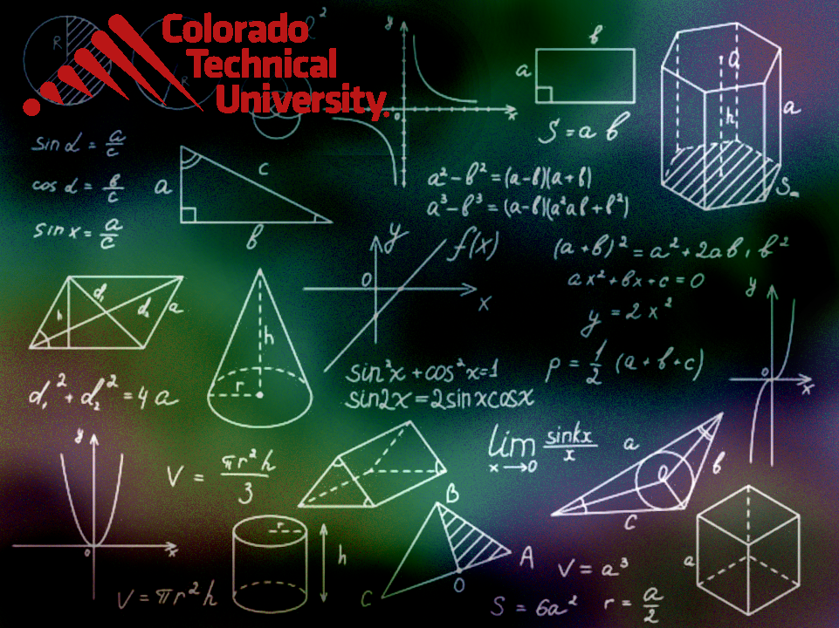
Welcome to
Unit 8- Part 16
MATH116-Foundations for Calculus
https://media.istockphoto.com/vectors/green-blackboard-mathematical-with-thin-line-shapes-and-inscriptions-vector-id1084380192?k=6&m=1084380192&s=612x612&w=0&h=TcEOVpnUmyuswT4Pay
AL6lNiHU8SS8g33yOSg-jR5BE=

Slide 2
What’s Up?
Review:
Series
New stuff:
Conics (most classes (and
your book) calls this
“Analytic Geometry”)

Slide 3
What’s Up?
Outcome 8) Graph and find the parameters of various types of conic sections, given the equation, including the center, foci, vertices and directrix, as applicable
Outcome 12) Solve problems by identifying the given data, making a sketch as appropriate, and calculating the final answer

Slide 4

Review
http://995642590.r.lightningbase-cdn.com/wp-content/uploads/2010/12/looking-back-hrexaminer-v144-cover425px.jpg

Slide 5
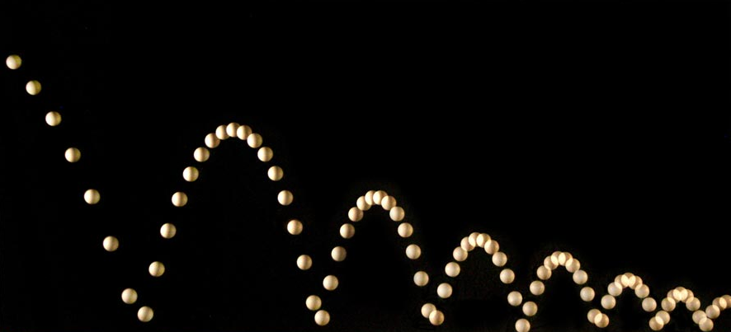
Sequences
If the terms of a sequence approach a specific number (or state), we say the sequence converges to the number (or state)
http://people.rit.edu/andpph/photofile-sci/bouncing-ball-7810.jpg

Slide 6
Sequences
Δƒ(x) ≥ 0 | Nondecreasing
Δƒ(x) ≤ 0 | Nonincreasing
Δƒ(x) > 0 | Strictly Increasing
Δƒ(x) < 0 | Strictly Decreasing
http://img.tfd.com/ggse/2c/gsed_0001_0016_0_img4169.png

Slide 7
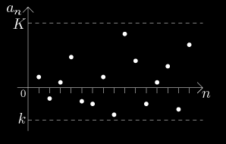
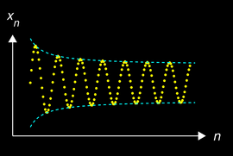
Sequences
Bounded – all terms are less than or equal to some finite number in magnitude
http://math.feld.cvut.cz/mt/txta/1/gifa1/pc3aa1ba.gif
http://upload.wikimedia.org/wikipedia/commons/thumb/f/f4/Cauchy_sequence_illustration2.png/250px-Cauchy_sequence_illustration2.png

Slide 8
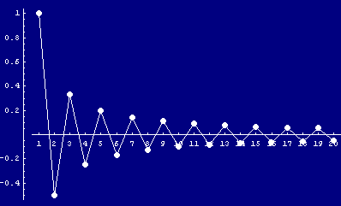
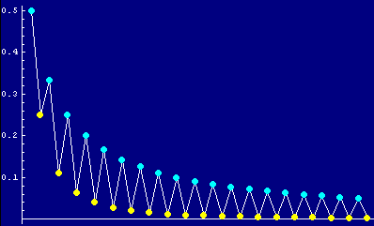
Sequences
Alternating Sequence:
Each term: (-1)^{n} a_{n}
http://www.cs.cas.cz/portal/AlgoMath/MathematicalAnalysis/InfiniteSeriesAndProducts/InfiniteSeries/SeriesWithArbitraryTerms/HTMLFiles/AlternatingSeries_38.gif
http://www.cs.cas.cz/portal/AlgoMath/MathematicalAnalysis/InfiniteSeriesAndProducts/InfiniteSeries/SeriesWithArbitraryTerms/HTMLFiles/AlternatingSeries_28.gif

Slide 9
Series
If you combine the numbers in a sequence into a single number, it’s called a “series”
This is usually done by adding up all of the terms or multiplying all of them together

Slide 10
Series
It’s math class… so there’s always a new symbol!
∑
means “add ‘em up!”

Slide 11
Series
If you want to multiply them all together rather than adding them:
Π
means “multiply ‘em up!”

Slide 12
Series
We usually use ∑ with a formula:
This means “add up the n’s where n goes from 1 to 10”
10
∑ n
n=1

Slide 13
Series
The sequence Sn defined by:
S₁ = a₁
S₂ = a₁ + a₂
S_{n} = a₁ + a₂ + a₃ + ... + a_{n}
n
= ∑ a_{k}
k=1
is called the sequence of partial sums of the series

Slide 14
Series
The sequence Sn defined by:
S₁ = a₁
S₂ = a₁ + a₂
S_{n} = a₁ + a₂ + a₃ + ... + a_{n}
n
= ∑ a_{k}
k=1
S_{n} is the nth partial sum

Slide 15
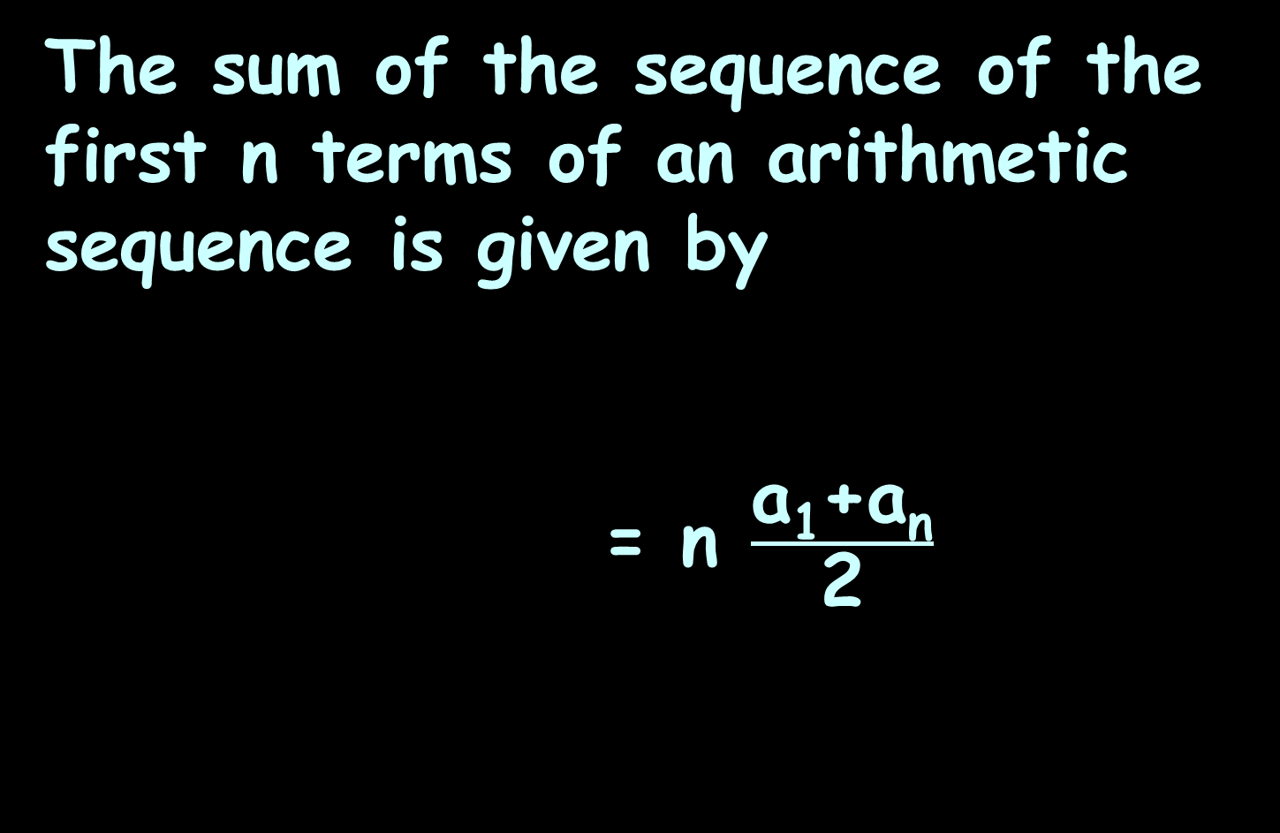
Arithmetic Series
The sum of the sequence of the first n terms of an arithmetic sequence is given by
= n $\frac{\text{a}\text{1}\text{+}\text{an}}{\text{2}}$
n
S_{n} = ∑ a₁ + (k-1) d
k=1
average

Slide 16
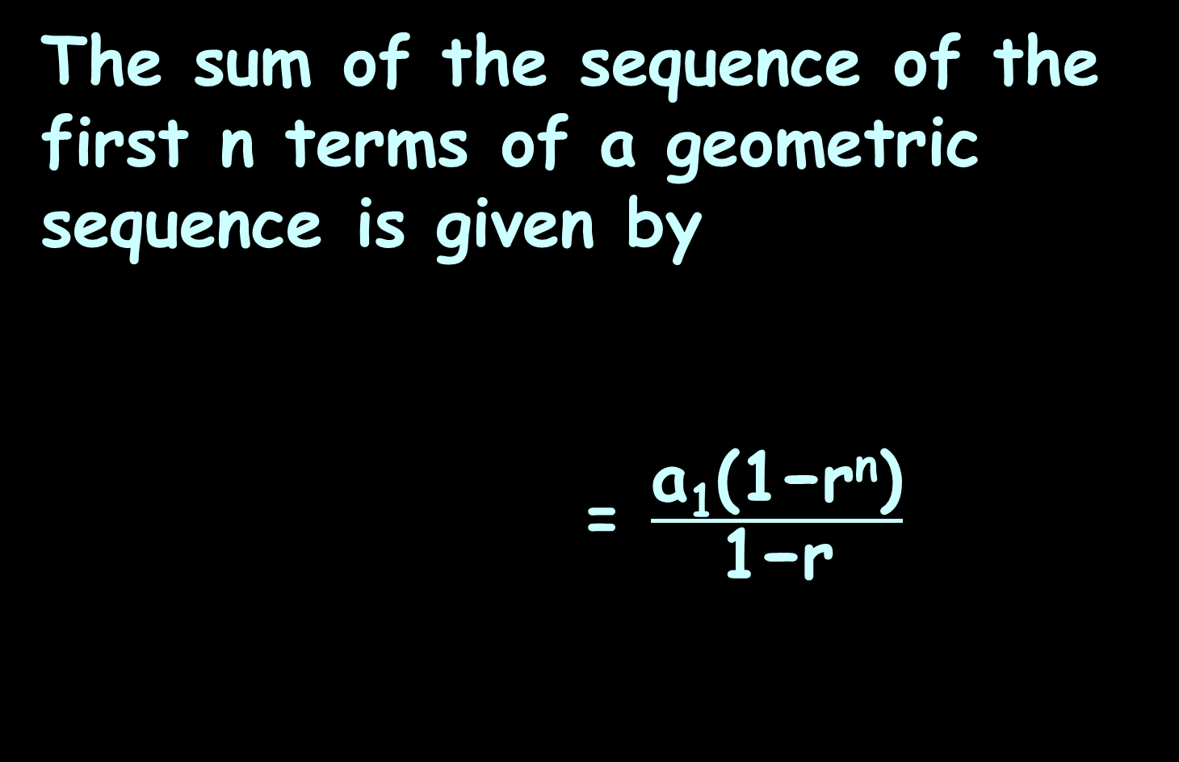
Geometric Series
The sum of the sequence of the first n terms of a geometric sequence is given by
= $\frac{\text{a}\text{1}\text{(1−}\text{rn}\text{)}}{\text{1−}\text{r}}$
n
S_{n} = ∑ a₁r^{k}
k=1

Slide 17
Series
Sequences and series can be a mixture of arithmetic and geometric
This is actually VERY common in the real world!

Slide 18
Counting
More new symbols!
Factorial notation
n! = n(n-1)(n-2)...3 × 2 × 1
These are used a LOT in what are called “counting” problems

Slide 19
Fundamental Counting Principle
the number of ways things can occur

Slide 20
Fundamental Counting Principle
The number of ways in which characteristics can be combined is found by multiplying the possibilities of each characteristic together

Slide 21

Questions?
http://i.imgur.com/aliTlT3.jpg

Slide 22
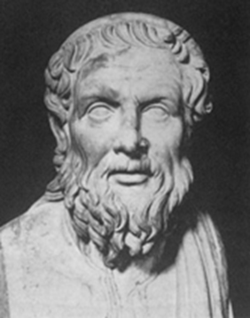
Conics
A “conic” (slice of a cone) was written about by Apollonius of Perga (262 BC –190 BC)
https://www.google.com/imgres?imgurl=https%3A%2F%2Fprabook.com%2Fweb%2Fshow-photo-icon.jpg%3Fid%3D1573696%26width%3D220%26cache%3Dfalse&imgrefurl=https%3A%2F%2Fprabook.com%2Fweb%2Fapollonius.of_perga%2F3735583&tbnid=xRhFbgxYZ-zqwM&vet=12ahUKEwjw5PqdpL7zAhVYAM0KHUCrCLsQMygEegUIARDXAQ..i&docid=d5WyOJV3FS5E9M&w=220&h=220&itg=1&q=apollonius%20of%20perga&hl=en&ved=2ahUKEwjw5PqdpL7zAhVYAM0KHUCrCLsQMygEegUIARDXAQ

Slide 23
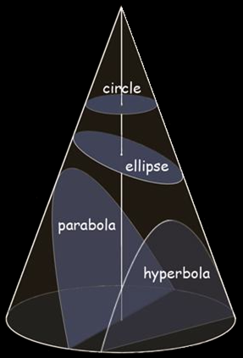
Conics
Any plane cutting a cone, regardless of its angle, will produce a “conic”
https://encrypted-tbn0.gstatic.com/images?q=tbn:ANd9GcSZxzK5mwZI2zwK4hs3_
n46LHjjrN4nNMJAuw&usqp=CAU

Slide 24
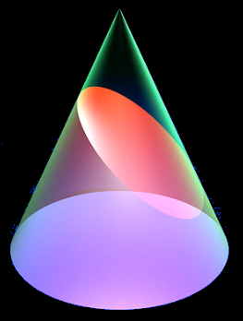
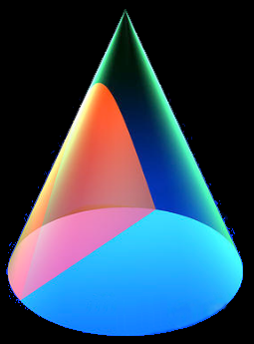
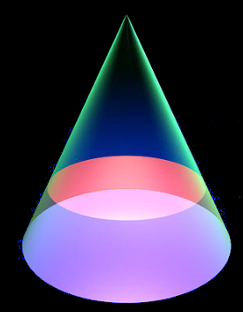
CONICS
IN-CLASS PROBLEM 1
Identify the conic sections:
a
c
d
b
https://images.fineartamerica.com/images-medium-large-5/conic-sections-poster-6-russell-kightley.jpg

Slide 25
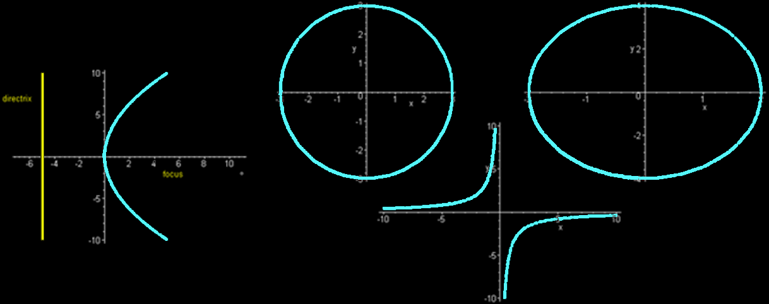
CONICS
IN-CLASS PROBLEM 1
Identify the conic sections:
f
h
e
g

Slide 26
Questions?
http://i.imgur.com/aliTlT3.jpg

Slide 27
Conics
Drawing conics

Slide 28
Conics
To draw a circle…

Slide 29
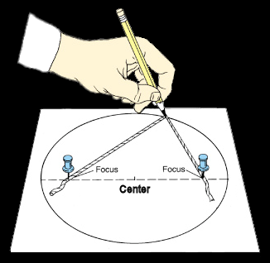
Conics
To draw an ellipse…
http://physics.uoregon.edu/~jimbrau/BrauImNew/Chap02/FG02_16.jpg

Slide 30
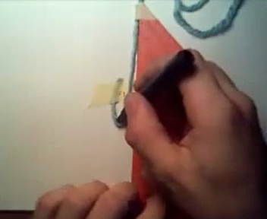
Conics
To draw a parabola…

Slide 31
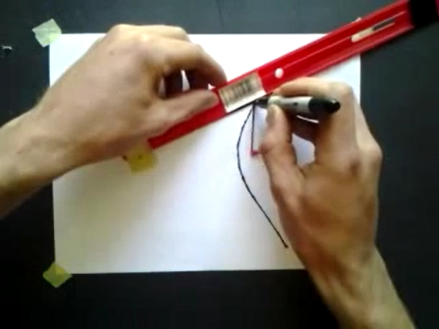
Conics
To draw a hyperbola…

Slide 32
Conics
The difference between drawing an ellipse (string and 2 foci) and a hyperbola (string and 2 foci)…

Slide 33
Questions?
http://i.imgur.com/aliTlT3.jpg

Slide 34
Conics
Things that look like parabolas/hyperbolas

Slide 35
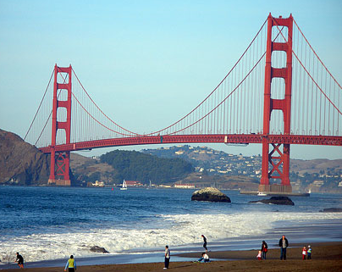
Conics
And probably are…
VFrench 1967

Slide 36
Conics
Things that look like parabolas/hyperbolas

Slide 37
Conics
Things that look like parabolas/hyperbolas
…But aren’t…

Slide 38
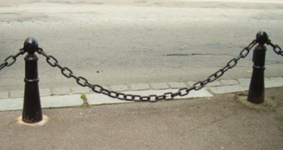
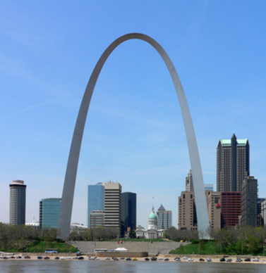
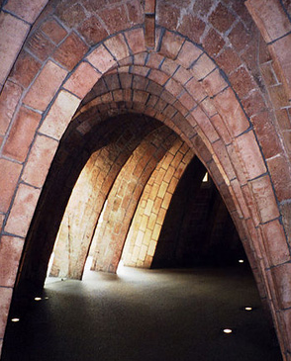
Conics
Catenary (not a conic)
https://en.wikipedia.org/wiki/Catenary#/

Slide 39
Project Part 2
Conics treasure hunt!

Slide 40
Questions?
http://i.imgur.com/aliTlT3.jpg

Slide 41
Conics
The most common use of conics is in calculating and describing orbits

Slide 42
Conics
While we thinks of orbits as circles, circular orbits are actually unstable

Slide 43
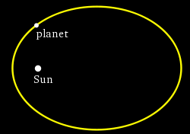
Conics
Most orbits (including that of
Earth around the Sun) are
not perfectly round
They follow an elliptical path
en.wikipedia.org

Slide 44
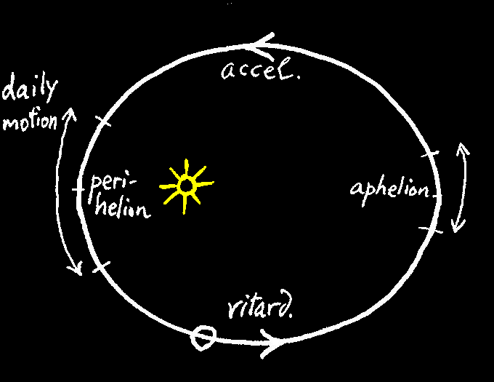
Conics
The elliptical path provides protection from orbital decay
Class notes - Culver

Slide 45
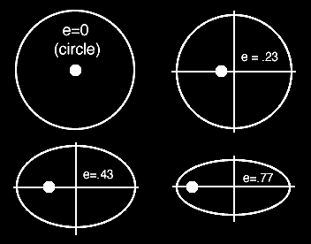
Conics
The difference between a circular orbit and an elliptical path is called “eccentricity”
hyperphysics.phy-astr.gsu.edu

Slide 46

Conics
Just like David’s slingshot the slight gravitational pull the planet gets moving toward the sun whips it
around and gives
it a boost when
traveling away
from the sun
etc.usf.edu

Slide 47
Questions?
http://i.imgur.com/aliTlT3.jpg

Slide 48
Conics
Ok… so circles and ellipses can be used to model orbits…

Slide 49
Conics
Ok… so circles and ellipses can be used to model orbits…
What about parabolas and hyperbolas?

Slide 50
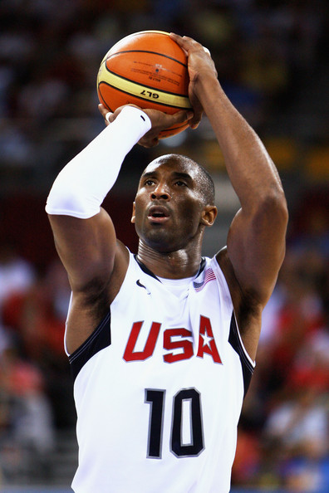
Conics
How does the ball get from here:
www.stepbystep.com

Slide 51

Conics
To here:
blog.castsoftware.com

Slide 52
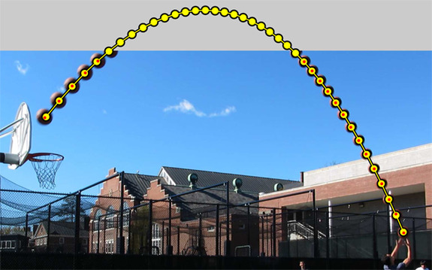
Conics
The ball sketches a parabola
pixgood.com

Slide 53
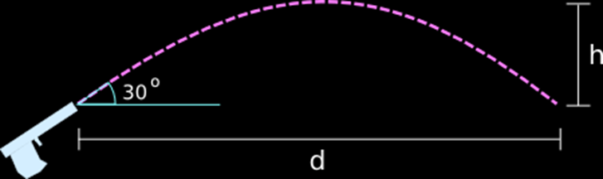
Conics
So does a fired bullet…
www.math.cornell.edu

Slide 54
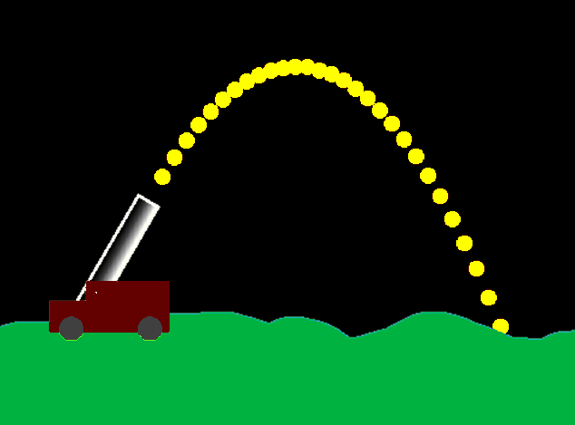
Conics
Or a cannonball…
scratch.mit.edu

Slide 55
Conics
What happens if you fire a cannon with more “oomph”?

Slide 56
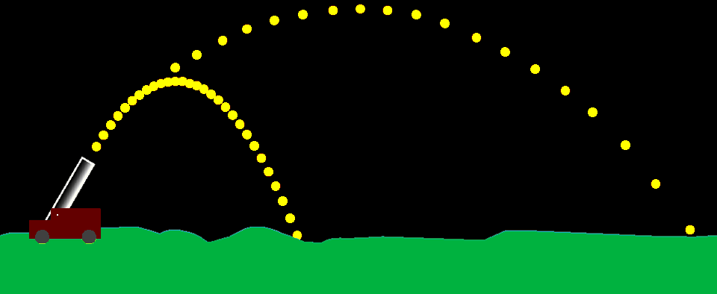
Conics
The additional speed propels it farther…
scratch.mit.edu

Slide 57
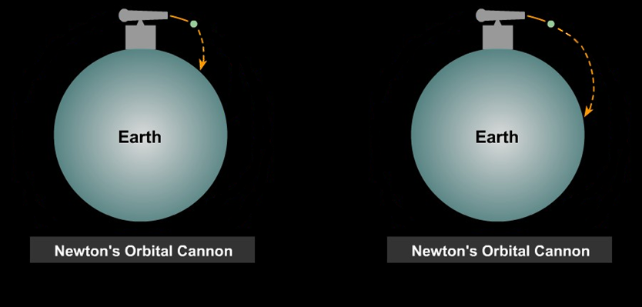
Conics
Newton hypothesized that it might be possible to fire a cannon farther and farther
csep10.phys.utk.edu

Slide 58
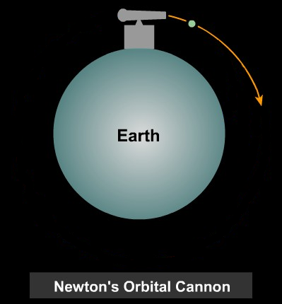
Conics
Eventually, the cannon would go beyond the curvature of the Earth
csep10.phys.utk.edu

Slide 59
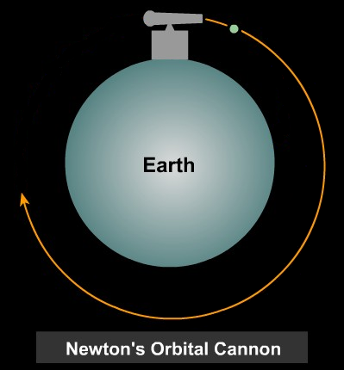
Conics
Gravity won’t let the cannonball fly away – it would keep the cannonball at that altitude, and the cannonball would
go completely
around
the Earth
csep10.phys.utk.edu

Slide 60
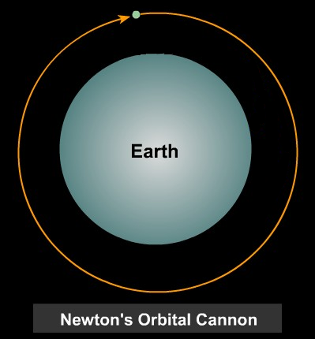
Conics
And (if the cannon wasn’t in the way) the cannonball would form an orbit
csep10.phys.utk.edu

Slide 61
Conics
So, a parabola is an interrupted orbit!

Slide 62
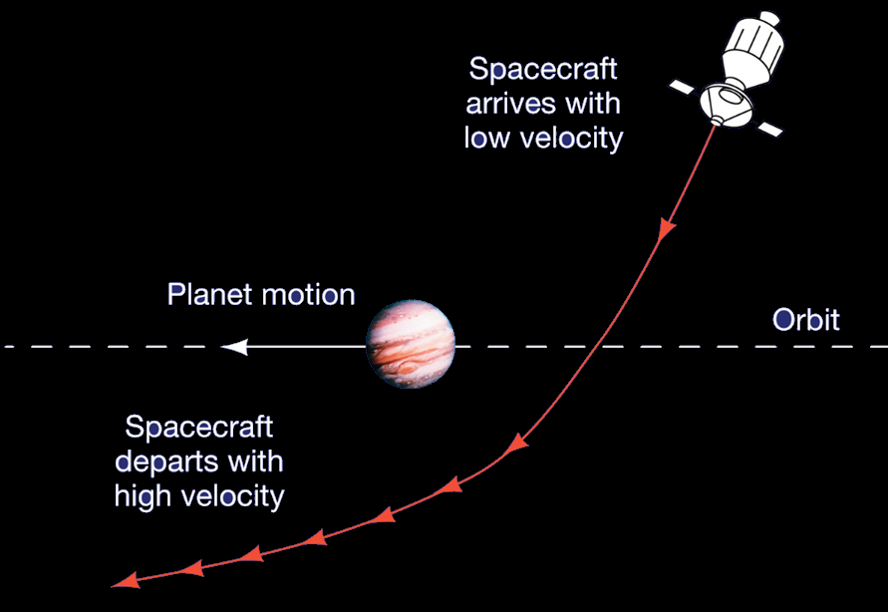
Conics
Gravitational
slingshot:
http://pages.uoregon.edu/jimbrau/BrauImNew/Chap06/7th/AT_7e_UnFigure_06_Pg144.jpg

Slide 63

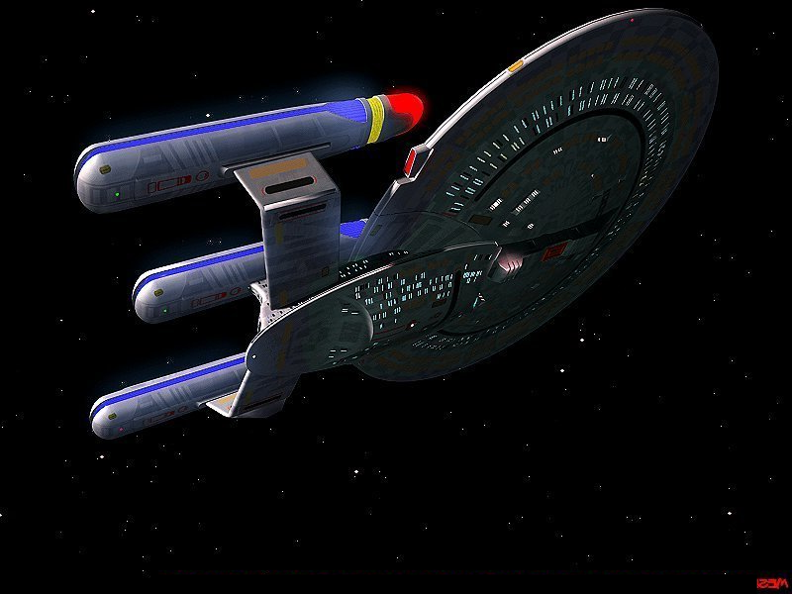
Conics
No, it wasn’t invented by Jean-Luc Picard
www.fanpop.com
startrekng.blogspot.com

Slide 64
Conics
Is it a parabola or a hyperbola?

Slide 65
Questions?
http://i.imgur.com/aliTlT3.jpg

Slide 66
Conics
Hyperspace

Slide 67
Not Exactly Conics…
The three body problem
http://www.artbylogic.com/parametricart/spirograph/spirograph.htm
r=29
R=365
d=50-1
x/y factor =.65
loops =1
http://mathiversity.com/online-spirograph

Slide 68
Questions?
http://i.imgur.com/aliTlT3.jpg

Slide 69
Conics
Circle: set of points in a plane whose distances from a fixed
point (the center) are constant (denoted "r")
( x - h )² + ( y - k )² = r²
Radius: r
Center: (h,k)

Slide 70
Conics
Ellipse: “squashed circle”
set of points in a plane whose distances from two fixed points
(the foci) have a constant sum

Slide 71
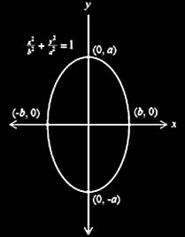
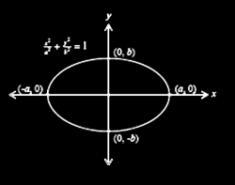
Conics
Two types of ellipses:
horizontal vertical
VFrench 2010

Slide 72
Conics
Horizontal ellipse:
(x - h)² + (y - k)² = 1
a² b²
Vertical ellipse:
(y - k) ² + (x - h)² = 1
a² b²
“a” is the long axis, “b” the short one, (h,k) is the center

Slide 73
Conics
Note: in standard form, x is written first:
(x - h)² + (y - k)² = 1
a² b²
(x - h) ² + (y - k)² = 1
b² a²

Slide 74
Conics
If “a” and “b” are equal:
(y - k) ² + (x - h)² = 1
a² a²

Slide 75
Conics
If “a” and “b” are equal:
(y - k) ² + (x - h)² = 1
a² a²
a² = (y-k)² + (x-h)²

Slide 76
Conics
If “a” and “b” are equal:
(y - k) ² + (x - h)² = 1
a² a²
a² = (y-k)² + (x-h)²
Which is the equation for a circle centered at (h,k) with radius “a”

Slide 77
Conics
A circle is a special case of the ellipse where the foci are the same point

Slide 78
Conics
The foci of an ellipse are two points whose sum of distances from any point on the ellipse is always the same
https://www.wolframalpha.com/input/?i=ellipse++foci%3A+%280%2C+-4%29%2C+%280%2C+4%29+and+vertices%3A++%280%2C+-6%29%2C+%280%2C+6%29

Slide 79
Conics
The foci lie on the ellipse's major radius (the long one “a”)
https://www.wolframalpha.com/input/?i=ellipse++foci%3A+%280%2C+-4%29%2C+%280%2C+4%29+and+vertices%3A++%280%2C+-6%29%2C+%280%2C+6%29

Slide 80
Conics
The vertices of an ellipse are the points where the ellipse crosses its major axis
https://www.wolframalpha.com/input/?i=ellipse++foci%3A+%280%2C+-4%29%2C+%280%2C+4%29+and+vertices%3A++%280%2C+-6%29%2C+%280%2C+6%29

Slide 81
Conics
If the graphs are centered at
(0,0):
A horizontal ellipse has foci at
(± c,0) and vertices at (± a,0)
A vertical ellipse has foci at
(0,± c) and vertices at (0,± a)
To find “c” use: c² = a² – b²

Slide 82
CONICS
IN-CLASS PROBLEM 2a
An ellipse has Foci: (0, -4),(0, 4)
Vertices: (0, -6), (0, 6)
Is it horizontal or vertical?

Slide 83
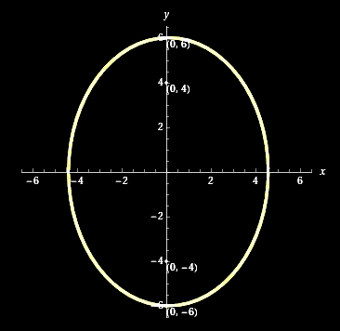
CONICS
IN-CLASS PROBLEM 2a
An ellipse has Foci: (0, -4),(0, 4)
Vertices: (0, -6), (0, 6)
Is it horizontal or vertical?
https://www.wolframalpha.com/input/?i=ellipse++foci%3A+%280%2C+-4%29%2C+%280%2C+4%29+and+vertices%3A++%280%2C+-6%29%2C+%280%2C+6%29

Slide 84
CONICS
IN-CLASS PROBLEM 2b
An ellipse has Foci: (-4, 0),(4, 0)
Vertices: (-6, 0), (6, 0)
Is it horizontal or vertical?

Slide 85
CONICS
IN-CLASS PROBLEM 2b
An ellipse has Foci: (-4, 0),(4, 0)
Vertices: (-6, 0), (6, 0)
Is it horizontal or vertical?
https://www.wolframalpha.com/input/?i=ellipse++foci%3A+%280%2C+-4%29%2C+%280%2C+4%29+and+vertices%3A++%280%2C+-6%29%2C+%280%2C+6%29

Slide 86
Conics
Ellipse with Foci: (0, -4),(0, 4)
Vertices: (0, -6), (0, 6)
vertical
Ellipse with Foci: (-4, 0),(4, 0)
Vertices: (-6, 0), (6,0)
horizontal
Can you see a pattern?

Slide 87
CONICS
IN-CLASS PROBLEM 2c
An ellipse has Foci: (-4, 0),(4, 0)
Vertices: (0, -6), (0, 6)
Is it horizontal or vertical?

Slide 88
CONICS
IN-CLASS PROBLEM 2c
An ellipse has Foci: (-4, 0),(4, 0)
Vertices: (0, -6), (0, 6)
Is it horizontal or vertical?
not a possible ellipse
https://www.wolframalpha.com/input/?i=ellipse++foci%3A+%280%2C+-4%29%2C+%280%2C+4%29+and+vertices%3A++%280%2C+-6%29%2C+%280%2C+6%29

Slide 89
Conics
To find the formula for an ellipse:
Identify the center: (h,k)

Slide 90
Conics
To find the formula for an ellipse:
Identify the center: (h,k)
If the center is (0,0) it’s easier
If it’s not… Wolfram is nice!

Slide 91
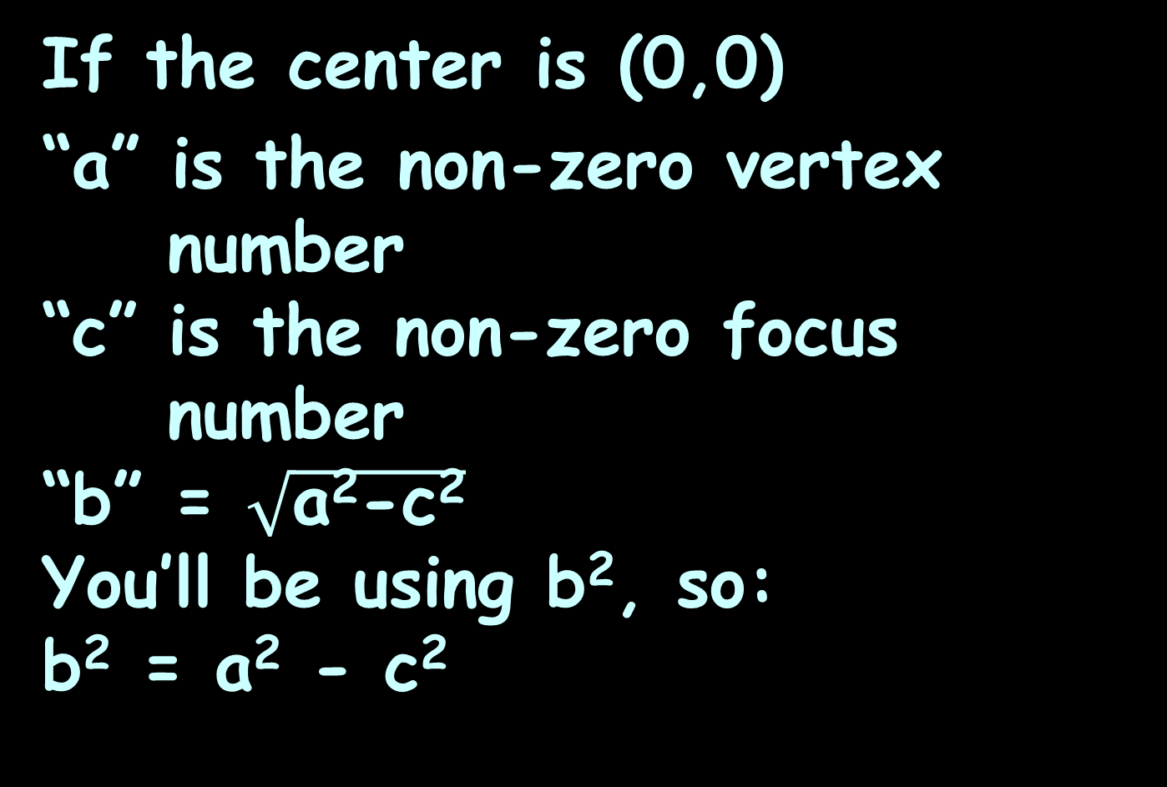
Conics
If the center is (0,0)
“a” is the non-zero vertex
number
“c” is the non-zero focus
number
“b” = $\sqrt{\text{a}\text{2}\text{−}\text{c}\text{2}}$
You’ll be using b², so:
b² = a² - c²

Slide 92
CONICS
IN-CLASS PROBLEM 2d
An ellipse has Foci: (0, -4),(0, 4)
Vertices: (0, -6), (0, 6)
Is it centered at (0,0)?

Slide 93
CONICS
IN-CLASS PROBLEM 2d
An ellipse has Foci: (0, -4),(0, 4)
Vertices: (0, -6), (0, 6)
Is it centered at (0,0)? yes!
Write the standard form of its equation:
What is “a”?
What is “c”?
“a” is the non-zero vertex number
“c” is the non-zero focus number

Slide 94
CONICS
IN-CLASS PROBLEM 2d
An ellipse has Foci: (0, -4),(0, 4)
Vertices: (0, -6), (0, 6)
Write the standard form of its equation:
What is “a”? 6
What is “c”?
“c” is the non-zero focus number

Slide 95
CONICS
IN-CLASS PROBLEM 2d
An ellipse has Foci: (0, -4),(0, 4)
Vertices: (0, -6), (0, 6)
What is “a”? 6
What is “c”? 4
Write the standard form of its equation:
Horizontal ellipse: (x)² + (y)² = 1
a² a²-c²
Vertical ellipse: (y)² + (x)² = 1
a² a²-c²

Slide 96
CONICS
IN-CLASS PROBLEM 2d
An ellipse has Foci: (0, -4),(0, 4)
Vertices: (0, -6), (0, 6)
Write the standard form of its equation:
(y-0)²/6² + (x-0)²/(6²-4²) = 1
Horizontal ellipse: (x)² + (y)² = 1
a² a²-c²
Vertical ellipse: (y)² + (x)² = 1
a² a²-c²

Slide 97
CONICS
IN-CLASS PROBLEM 2d
An ellipse has Foci: (0, -4),(0, 4)
Vertices: (0, -6), (0, 6)
Write the standard form of its equation:
(y-0)²/6² + (x-0)²/(6²-4²) = 1
y²/36 + x²/20 = 1 or
x²/20 + y²/36 = 1
Horizontal ellipse: (x)² + (y)² = 1
a² a²-c²
Vertical ellipse: (y)² + (x)² = 1
a² a²-c²

Slide 98
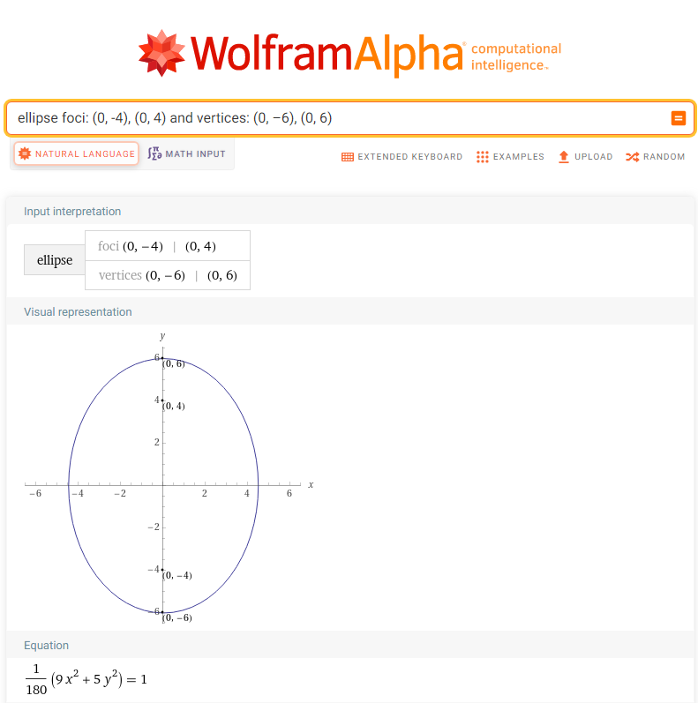

Slide 99
Conics
The “eccentricity” of an ellipse is how flat it is vs a circle

Slide 100
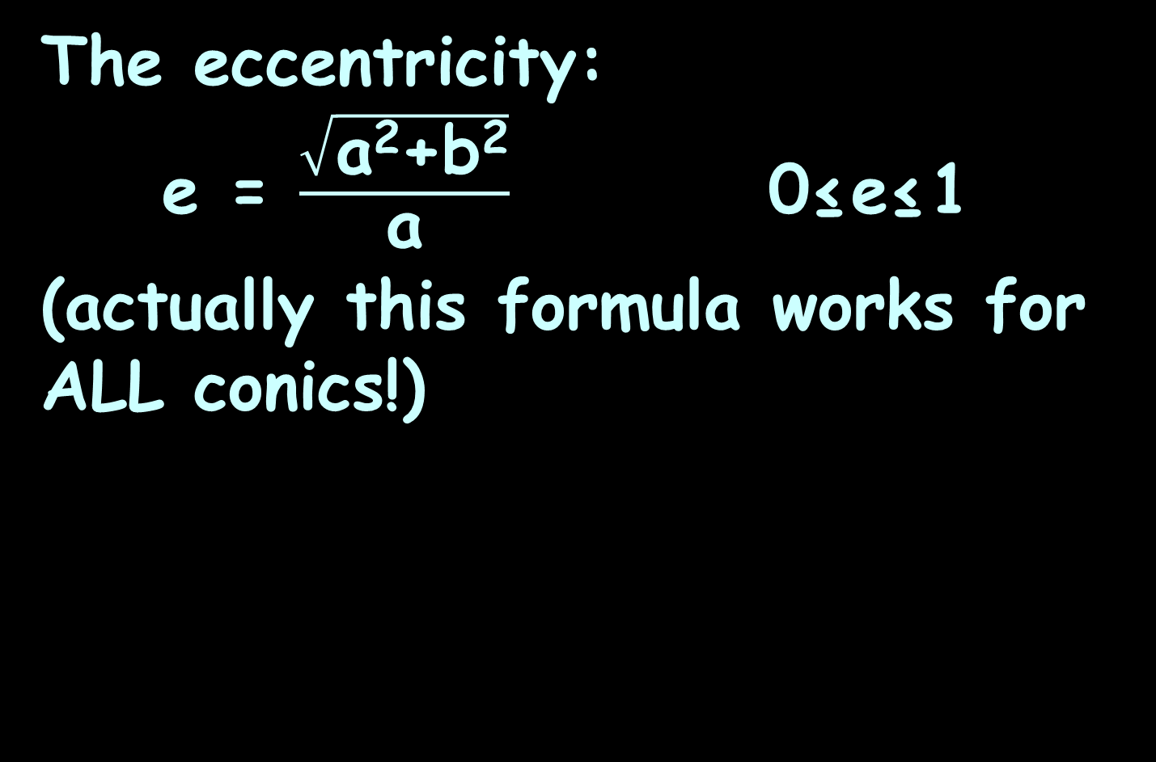
Conics
The eccentricity:
e = $\frac{\sqrt{\text{a}\text{2}\text{+}\text{b}\text{2}}}{\text{a}}$ 0≤e≤1
(actually this formula works for ALL conics!)

Slide 101
CONICS
IN-CLASS PROBLEM 2e
Calculate the eccentricity of the ellipse with Foci: (0, -4),(0, 4)
Vertices: (0, -6), (0, 6)

Slide 102

CONICS
IN-CLASS PROBLEM 2e
Calculate the eccentricity of the ellipse with Foci: (0, -4),(0, 4)
Vertices: (0, -6), (0, 6)
Calculate e = ?
c
a
e = $\frac{\text{c}}{\text{a}}$

Slide 103

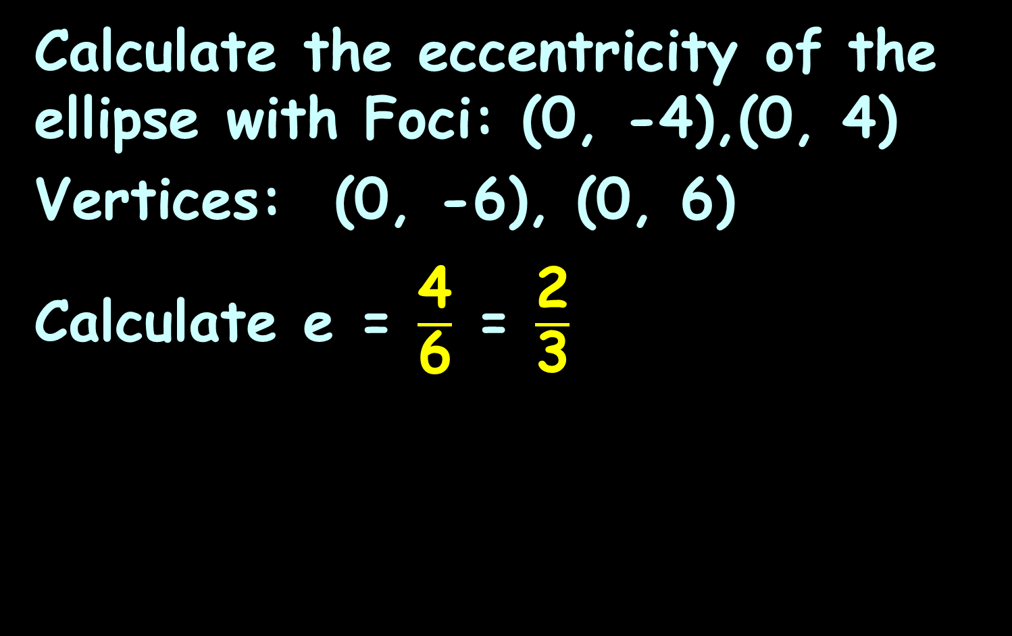
CONICS
IN-CLASS PROBLEM 2e
Calculate the eccentricity of the ellipse with Foci: (0, -4),(0, 4)
Vertices: (0, -6), (0, 6)
Calculate e = $\frac{\text{4}}{\text{6}}$ = $\frac{\text{2}}{\text{3}}$
c
a
e = $\frac{\sqrt{\text{a}\text{2}\text{+}\text{b}\text{2}}}{\text{a}}$

Slide 104
Conics
In an ellipse, foci have a special significance: any ray emitted from one focus will always reach the other focus after bouncing off the edge of the ellipse

Slide 105
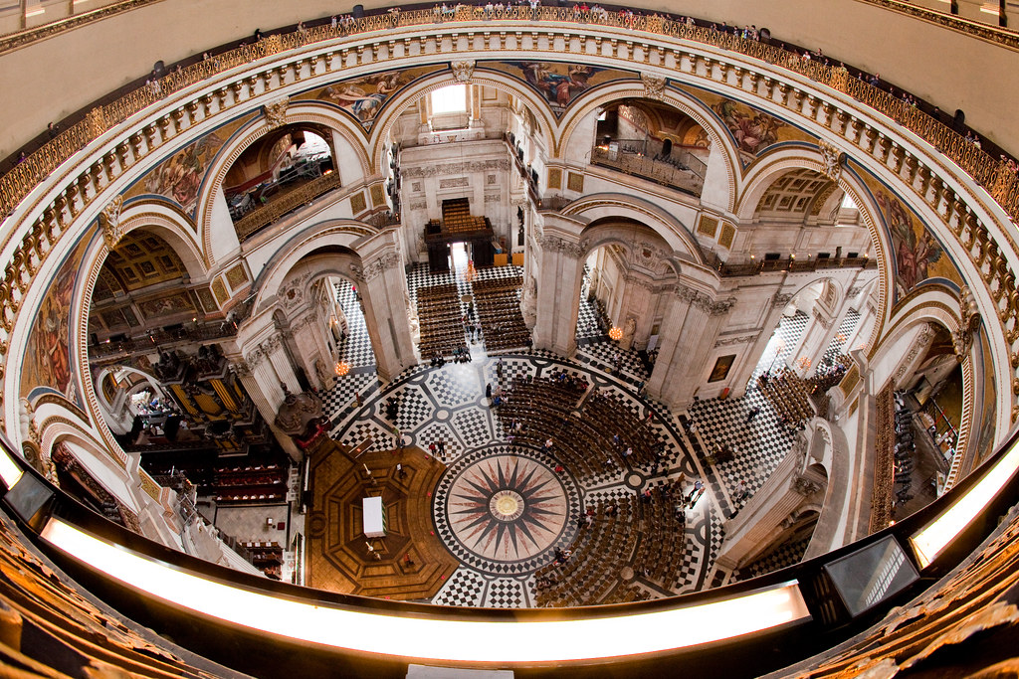
Conics
This is why whispering galleries are in the shape of an ellipsoid
St. Paul’s cathedral
whispering gallery
https://live.staticflickr.com/2640/3730158004_e0ac6ebb01_b.jpg

Slide 106
Questions?
http://i.imgur.com/aliTlT3.jpg

Slide 107
Conics
Parabola: set of points in a plane that are equidistant from a fixed point F (the focus)
and a fixed line (the directrix)
ax² + bx + c = y

Slide 108
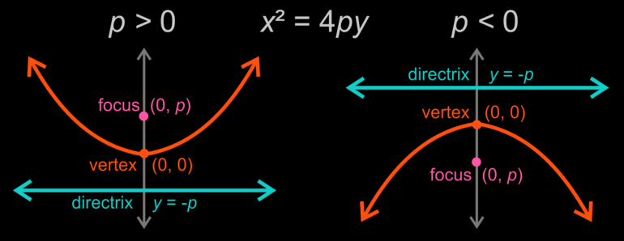
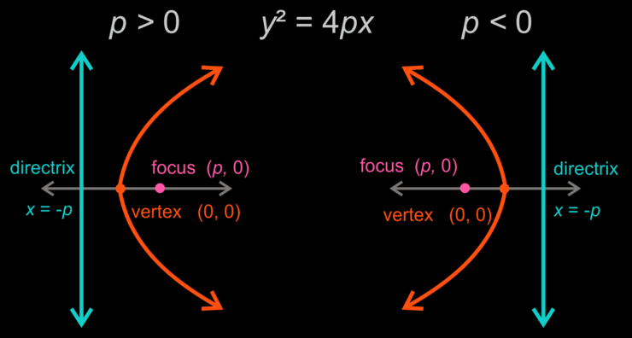
Conics
Two types of parabolas:
N/S
y = a(x - h)² + k
E/W
x = a(y - k)² + h
VFrench 2012

Slide 109
Conics
Parabolas have a property that makes them useful in the design of reflectors and transmitters

Slide 110
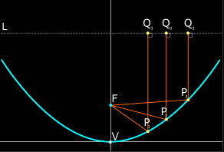
Conics
A particle approaching a parabola on a line parallel to the axis is reflected through the focus
VFrench 2012

Slide 111
Conics
This property is used to focus incoming light by a parabolic mirror on a telescope
VFrench 2012

Slide 112
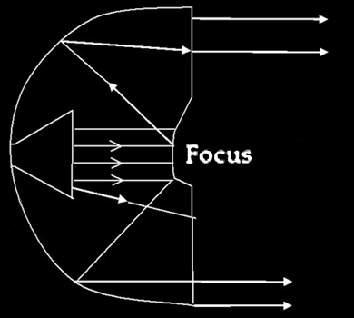
Conics
Also, signals emanating from the focus are reflected parallel to the axis, a property used in radio transmitters
and headlights
VFrench 2012

Slide 113
CONICS
IN-CLASS PROBLEM 3a
Where would you place the transmitter on a parabolic dish antenna to maximize the transmitted signal?
a) At the vertex
b) At the focus
c) At the directrix
d) At the outer edge of the dish

Slide 114
CONICS
IN-CLASS PROBLEM 3a
Where would you place the transmitter on a parabolic dish antenna to maximize the transmitted signal?
a) At the vertex
b) At the focus
c) At the directrix
d) At the outer edge of the dish

Slide 115




Conics
We already know parabolas can be functions
or not
VFrench 2012

Slide 116
Conics
We call the functions N/S
and the non-functions E/W
VFrench 2012

Slide 117
Conics
We have used the formula for a parabola:
ax² + bx + c = y
But now we’re writing it:
y = a(x – h)² + k (for N/S)
and
x = a(y – k)² + h (for E/W)

Slide 118
Conics
y = a(x – h)² + k (for N/S)
x = a(y – k)² + h (for E/W)
Just as before, “a” is the vertical stretch factor, and if a>0 for a N/S, it opens up (cup) and if a<0, it opens down (hill)

Slide 119
Conics
y = a(x – h)² + k (for N/S)
x = a(y – k)² + h (for E/W)
If a>0 for an E/W, it opens right (open parenthesis)
and if a<0, it opens left (closed parenthesis)

Slide 120
Conics
y = a(x – h)² + k (for N/S)
x = a(y – k)² + h (for E/W)
The vertex is (h,k)
For N/S, the axis of symmetry is y = k
For E/W, the axis of symmetry is x = h

Slide 121
Conics
Mathematically, a parabola is defined to be the set of points in a plane that are equidistant from a fixed point f (the focus) and a fixed line (the directrix)

Slide 122
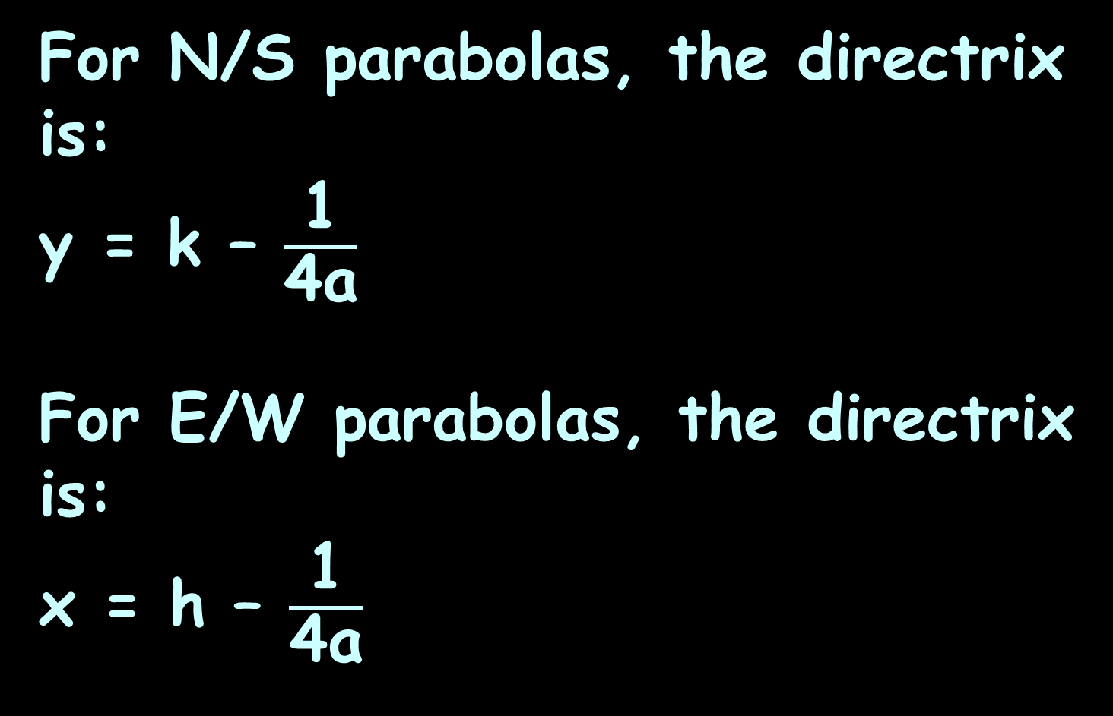
Conics
For N/S parabolas, the directrix
is:
y = k – $\frac{\text{1}}{\text{4}\text{a}}$
For E/W parabolas, the directrix
is:
x = h – $\frac{\text{1}}{\text{4}\text{a}}$

Slide 123
Conics
The focus is of primary importance for parabolas

Slide 124
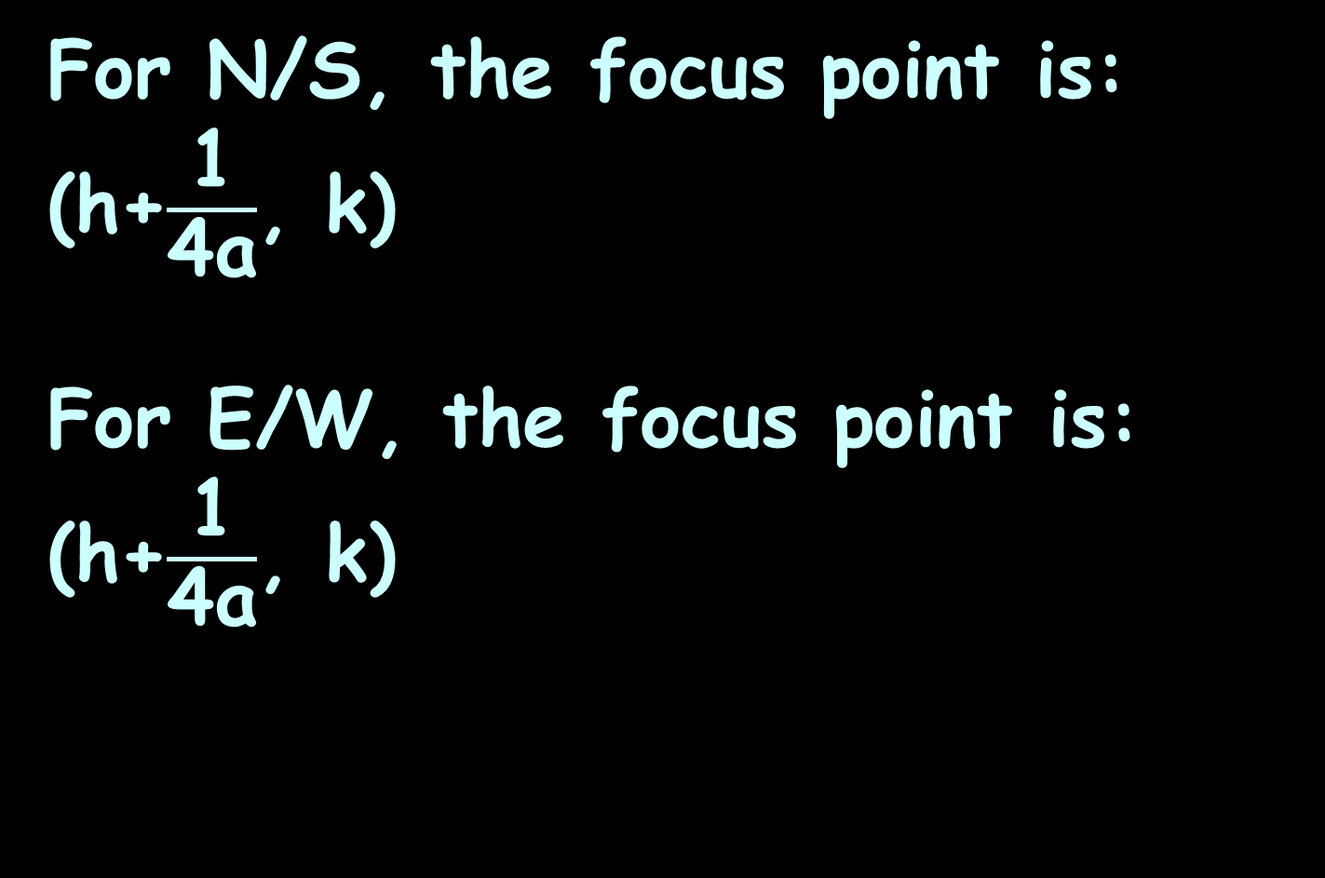
Conics
For N/S, the focus point is:
(h+$\frac{\text{1}}{\text{4}\text{a}}$, k)
For E/W, the focus point is:
(h+$\frac{\text{1}}{\text{4}\text{a}}$, k)

Slide 125
CONICS
IN-CLASS PROBLEM 3b
For a parabola: y = a(x – h)² + k
with center (h,k) = (2,5) and a=3
is the parabola N/S or E/W

Slide 126
CONICS
IN-CLASS PROBLEM 3b
For a parabola: y = a(x – h)² + k
with center (h,k) = (2,5) and a=3
is the parabola N/S or E/W
Identify the formula for the parabola:

Slide 127

CONICS
IN-CLASS PROBLEM 3b
For a N/S parabola:
y = a(x – h)² + k
with center (h,k) = (2,5) and a=3
Identify the formula for the parabola:
y = 3(x – 2)² + 5
Calculate the focus point
N/S, focus point: (h+$\frac{\text{1}}{\text{4}\text{a}}$, k)
E/W, focus point: (h+$\frac{\text{1}}{\text{4}\text{a}}$, k)

Slide 128
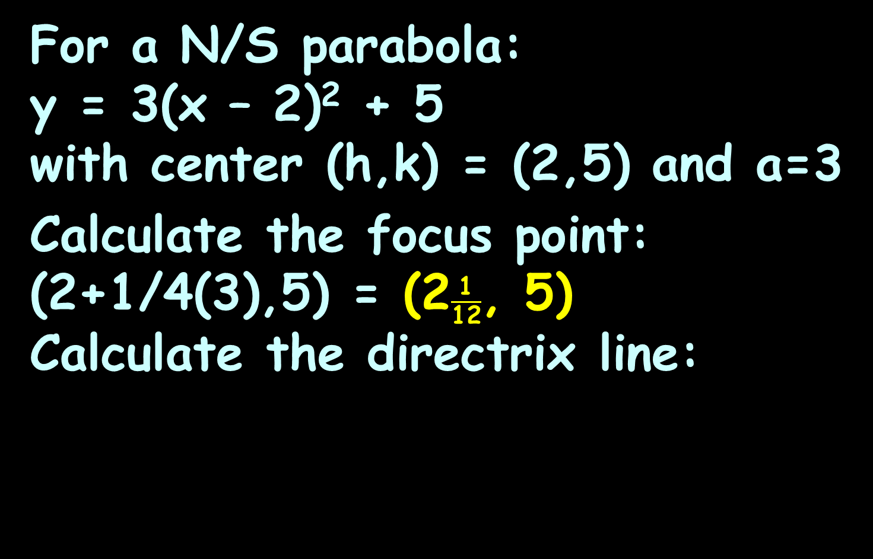

CONICS
IN-CLASS PROBLEM 3b
For a N/S parabola:
y = 3(x – 2)² + 5
with center (h,k) = (2,5) and a=3
Calculate the focus point:
(2+1/4(3),5) = (2$\frac{\text{1}}{\text{1}\text{2}}$, 5)
Calculate the directrix line:
N/S, directrix: y = k – $\frac{\text{1}}{\text{4}\text{a}}$
E/W, directrix: x = h – $\frac{\text{1}}{\text{4}\text{a}}$
N/S, focus point: (h+$\frac{\text{1}}{\text{4}\text{a}}$, k)
E/W, focus point: (h+$\frac{\text{1}}{\text{4}\text{a}}$, k)

Slide 129

CONICS
IN-CLASS PROBLEM 3b
For a N/S parabola:
y = 3(x – 2)² + 5
with center (h,k) = (2,5) and a=3
focus point: (2$\frac{\text{1}}{\text{1}\text{2}}$, 5)
Calculate the directrix line:
y = 5 – 1/4(3) = 5-1/12 = 4$\frac{\text{1}\text{1}}{\text{1}\text{2}}$
Notice this will ALWAYS be a constant
N/S, directrix: y = k – $\frac{\text{1}}{\text{4}\text{a}}$
E/W, directrix: x = h – $\frac{\text{1}}{\text{4}\text{a}}$
N/S, focus point: (h+$\frac{\text{1}}{\text{4}\text{a}}$, k)
E/W, focus point: (h+$\frac{\text{1}}{\text{4}\text{a}}$, k)

Slide 130
Conics
While lovely for math problems, these formulas are not so helpful for engineers

Slide 131

Conics
To find the focal distance of parabolic dish antennas, where D is the diameter of the dish, d is the depth of the dish and f is the focal distance:
f = D² / 16d
http://www.analyzemath.com/parabola/parabola_focus.html

Slide 132
CONICS
IN-CLASS PROBLEM 3c
Suppose you had a parabolic dish with distance across the top of the dish of 36 inches
The depth of the dish at the center is 3 inches
Find the focal distance
What is D?
What is d?
f = D² / 16d

Slide 133
CONICS
IN-CLASS PROBLEM 3c
Suppose you had a parabolic dish with distance across the top of the dish of 36 inches
The depth of the dish at the center is 3 inches
Find the focal distance
What is D? 36
What is d?
f = D² / 16d

Slide 134
CONICS
IN-CLASS PROBLEM 3c
Suppose you had a parabolic dish with distance across the top of the dish of 36 inches
The depth of the dish at the center is 3 inches
What is D? 36
What is d? 3
Find the focal distance:
f = D² / 16d

Slide 135
CONICS
IN-CLASS PROBLEM 3c
Suppose you had a parabolic dish with distance across the top of the dish of 36 inches
The depth of the dish at the center is 3 inches
What is D? 36
What is d? 3
Find the focal distance: 27 whats?
f = D² / 16d

Slide 136
CONICS
IN-CLASS PROBLEM 3c
Suppose you had a parabolic dish with distance across the top of the dish of 36 inches
The depth of the dish at the center is 3 inches
What is D? 36
What is d? 3
Find the focal distance: 27 inches
f = D² / 16d

Slide 137
Conics
In practice the shape of the dish is not a perfect parabola and therefore small adjustments are needed when positioning the feed
(the reality of engineering…)

Slide 138
Questions?
http://i.imgur.com/aliTlT3.jpg

Slide 139

Conics
Hyperbola: set of points in a plane whose distances from two fixed points
(the foci) have
a constant
difference
VFrench 2021

Slide 140

Conics
A hyperbola looks sort of like two mirrored parabolas
The two halves
are called
"branches"
VFrench 2021

Slide 141
Conics
A hyperbola is centered on a point (h,k) (called the “center”)
(h,k)
VFrench 2021

Slide 142
Conics
The point on each branch closest to the center is that branch’s "vertex"
(h,k)
VFrench 2021

Slide 143
Conics
The vertices are a fixed distance “a” from the center
{
a
{
a
VFrench 2021

Slide 144
Conics
The line going from one vertex, through the center, and ending at the other
vertex is called
the "transverse
axis"
{
a
{
a
VFrench 2021

Slide 145
Conics
The "foci" of a hyperbola are "inside" each branch, and each focus is located
a fixed distance
“c” from the
center
(so a < c)
{
c
{
a
{
{
a
c
VFrench 2021

Slide 146

Conics
There are two types of hyperbolas:
E/W:
N/S:
(x - h)² (y - k)²
a² b²
- = 1
(y - k)² (x - h)²
a² b²
- = 1
VFrench 2021

Slide 147
Conics
Ok… (h,k) is the center, and “a” is the distance from the center to the vertices, but what’s “b”?
E/W:
N/S:
(x - h)² (y - k)²
a² b²
- = 1
(y - k)² (x - h)²
a² b²
- = 1
VFrench 2021

Slide 148
Conics
The line segment of length 2b perpendicular to the transverse axis whose midpoint is the center is the conjugate axis of the hyperbola

Slide 149

Conics
The line segment of length 2b perpendicular to the transverse axis whose midpoint is the center is the conjugate axis of the hyperbola
http://ahungryrunner.files.wordpress.com/2013/07/confused-baby.png

Slide 150
Conics
b² = c² – a²
(Yes, the Pythagorean Theorem is used to prove this relationship)
(Yes, these are the same letters as are used in the Pythagorean Theorem)
(No, this is not the same thing as the Pythagorean Theorem)
(Yes, this is very confusing)

Slide 151
Conics
Remember “oblique” asymptotes?
A hyperbola has two:
VFrench 2021

Slide 152

Conics
The asymptotes of an E/W hyperbola are:
y = k + $\frac{\text{b}}{\text{a}}$(x - h)
y = k - $\frac{\text{b}}{\text{a}}$(x - h)
And for a N/S hyperbola:
y = k + $\frac{\text{a}}{\text{b}}$(x - h)
y = k - $\frac{\text{a}}{\text{b}}$(x - h)
VFrench 2021

Slide 153
Conics
The eccentricity of a hyperbola, like an ellipse, is e = c/a
VFrench 2021

Slide 154
Conics
The eccentricity of a hyperbola, like an ellipse, is e = c/a
For all hyperbolas, c>a, so e>1
VFrench 2021

Slide 155
Conics
If e is close to one, the branches of the hyperbola are very narrow, but if e is much greater than one, then the branches of the hyperbola are very flat
VFrench 2021

Slide 156
CONICS
IN-CLASS PROBLEM 4a
For a hyperbola:
(x-2)²/3² - (y-5)²/4² = 1
What is the center (h,k)?
E/W: N/S: c² = a² + b²
(x - h)² - (y - k)² = 1 (y - k)² - (x - h)² = 1 e = c/a
a² b² a² b²

Slide 157
CONICS
IN-CLASS PROBLEM 4a
For a hyperbola:
(x-2)²/3² - (y-5)²/4² = 1
What is the center (h,k)? (2,5)
What is a?
What is b?
E/W: N/S: c² = a² + b²
(x - h)² - (y - k)² = 1 (y - k)² - (x - h)² = 1 e = c/a
a² b² a² b²

Slide 158
CONICS
IN-CLASS PROBLEM 4a
For a hyperbola:
(x-2)²/3² - (y-5)²/4² = 1
What is the center (h,k)? (2,5)
What is a? 3
What is b?
E/W: N/S: c² = a² + b²
(x - h)² - (y - k)² = 1 (y - k)² - (x - h)² = 1 e = c/a
a² b² a² b²

Slide 159
CONICS
IN-CLASS PROBLEM 4a
For a hyperbola:
(x-2)²/3² - (y-5)²/4² = 1
What is the center (h,k)? (2,5)
What is a? 3
What is b? 4
What is c?
E/W: N/S: c² = a² + b²
(x - h)² - (y - k)² = 1 (y - k)² - (x - h)² = 1 e = c/a
a² b² a² b²

Slide 160
CONICS
IN-CLASS PROBLEM 4a
For a hyperbola:
(x-2)²/3² - (y-5)²/4² = 1
What is the center (h,k)? (2,5)
What is a? 3
What is b? 4
What is c? 5
Is it N/S or E/W?
E/W: N/S: c² = a² + b²
(x - h)² - (y - k)² = 1 (y - k)² - (x - h)² = 1 e = c/a
a² b² a² b²

Slide 161
CONICS
IN-CLASS PROBLEM 4a
For a hyperbola:
(x-2)²/3² - (y-5)²/4² = 1
What is the center (h,k)? (2,5)
What is a? 3
What is b? 4
What is c? 5
Is it N/S or E/W?
What is the eccentricity e?
E/W: N/S: c² = a² + b²
(x - h)² - (y - k)² = 1 (y - k)² - (x - h)² = 1 e = c/a
a² b² a² b²

Slide 162
CONICS
IN-CLASS PROBLEM 4a
For a hyperbola:
(x-2)²/3² - (y-5)²/4² = 1
What is the center (h,k)? (2,5)
What is a? 3
What is b? 4
What is c? 5
Is it N/S or E/W?
What is the eccentricity e? 5/3
E/W: N/S: c² = a² + b²
(x - h)² - (y - k)² = 1 (y - k)² - (x - h)² = 1 e = c/a
a² b² a² b²

Slide 163
Conics
For any point on an ellipse, the sum of the distances from that point to each of the foci is some fixed value
For any point on a hyperbola, the difference of the distances from that point to each of the foci is some fixed value

Slide 164
Conics
This fixed-difference property can used for determining locations:
If two beacons are placed in known and fixed positions, the difference in the times at which their signals are received can tell determine the location of the receiver

Slide 165
Conics
This principle is used by astronomers to locate colliding black holes using two gravitational wave detectors

Slide 166
Conics
The first collision of black holes was detected Feb 11, 2016 using Laser Interferometer Gravitational-Wave Observatory (LIGO) detectors, located in Livingston, Louisiana and Hanford, Washington

Slide 167

https://www.ligo.org/detections/images/ligoGW150914signals-lg.jpg

Slide 168
Questions?
http://i.imgur.com/aliTlT3.jpg

Slide 169
CONICS
IN-CLASS PROBLEM 5
Which conic section is the graph of the equation:
y² = 23x – 2
y²/2 – x²/4 = 1
x² + y² = 1
y²/2 + x²/4 = 1
Horizontal ellipse:
(x - h)² + (y - k)² = 1
a² b²
Vertical ellipse:
(y - k) ² + (x - h)² = 1
a² b²
Circle:
a² = (y-k)² + (x-h)²
E/W hyperbola:
(x - h)² - (y - k)² = 1
a² b²
N/S hyperbola
(y - k) ² - (x - h)² = 1
a² b²
N/S parabola:
y = a(x – h)² + k
E/W parabola:
x = a(y – k)² + h

Slide 170
CONICS
IN-CLASS PROBLEM 5
Which conic section is the graph of the equation:
y² = 23x – 2 parabola
y²/2 – x²/4 = 1
x² + y² = 1
y²/2 + x²/4 = 1
Horizontal ellipse:
(x - h)² + (y - k)² = 1
a² b²
Vertical ellipse:
(y - k) ² + (x - h)² = 1
a² b²
Circle:
a² = (y-k)² + (x-h)²
E/W hyperbola:
(x - h)² - (y - k)² = 1
a² b²
N/S hyperbola
(y - k) ² - (x - h)² = 1
a² b²
N/S parabola:
y = a(x – h)² + k
E/W parabola:
x = a(y – k)² + h

Slide 171
CONICS
IN-CLASS PROBLEM 5
Which conic section is the graph of the equation:
y² = 23x – 2 parabola
y²/2 – x²/4 = 1 hyperbola
x² + y² = 1
y²/2 + x²/4 = 1
Horizontal ellipse:
(x - h)² + (y - k)² = 1
a² b²
Vertical ellipse:
(y - k) ² + (x - h)² = 1
a² b²
Circle:
a² = (y-k)² + (x-h)²
E/W hyperbola:
(x - h)² - (y - k)² = 1
a² b²
N/S hyperbola
(y - k) ² - (x - h)² = 1
a² b²
N/S parabola:
y = a(x – h)² + k
E/W parabola:
x = a(y – k)² + h

Slide 172
CONICS
IN-CLASS PROBLEM 5
Which conic section is the graph of the equation:
y² = 23x – 2 parabola
y²/2 – x²/4 = 1 hyperbola
x² + y² = 1 circle
y²/2 + x²/4 = 1
Horizontal ellipse:
(x - h)² + (y - k)² = 1
a² b²
Vertical ellipse:
(y - k) ² + (x - h)² = 1
a² b²
Circle:
a² = (y-k)² + (x-h)²
E/W hyperbola:
(x - h)² - (y - k)² = 1
a² b²
N/S hyperbola
(y - k) ² - (x - h)² = 1
a² b²
N/S parabola:
y = a(x – h)² + k
E/W parabola:
x = a(y – k)² + h

Slide 173
CONICS
IN-CLASS PROBLEM 5
Which conic section is the graph of the equation:
y² = 23x – 2 parabola
y²/2 – x²/4 = 1 hyperbola
x² + y² = 1 circle
y²/2 + x²/4 = 1 ellipse
Horizontal ellipse:
(x - h)² + (y - k)² = 1
a² b²
Vertical ellipse:
(y - k) ² + (x - h)² = 1
a² b²
Circle:
a² = (y-k)² + (x-h)²
E/W hyperbola:
(x - h)² - (y - k)² = 1
a² b²
N/S hyperbola
(y - k) ² - (x - h)² = 1
a² b²
N/S parabola:
y = a(x – h)² + k
E/W parabola:
x = a(y – k)² + h

Slide 174
Questions?
http://i.imgur.com/aliTlT3.jpg

Slide 175

You Survived!
Today we studied:
Review of Series
Conic Sections
Note: most classes
(and your book)
calls this
“Analytic Geometry”

