Slide 1
Welcome to
Unit 9- Part 18
MATH116-Foundations for Calculus
https://media.istockphoto.com/vectors/green-blackboard-mathematical-with-thin-line-shapes-and-inscriptions-vector-id1084380192?k=6&m=1084380192&s=612x612&w=0&h=TcEOVpnUmyuswT4Pay
AL6lNiHU8SS8g33yOSg-jR5BE=

Slide 2
What’s Up?
Review: Systems of equations
New stuff:
Uses for systems of equations
Matrices

Slide 3
What’s Up?
Outcome 9) Solve systems of nonlinear equations, by substitution and elimination

Slide 4
Review
http://995642590.r.lightningbase-cdn.com/wp-content/uploads/2010/12/looking-back-hrexaminer-v144-cover425px.jpg

Slide 5
Systems of Equations
A system of equations is a collection of two or more equations with the same set of unknowns (variables)

Slide 6
Systems of Equations
In solving a system of equations, we try to find values for each of the unknowns that will satisfy every equation in the system

Slide 7
Systems of Equations
To solve a system, you must have at least as many equations as you have variables

Slide 8
Systems of Equations
A system is called consistent if there is a solution
A system is called inconsistent if there is no solution

Slide 9
Systems of Equations
A system of equations is considered determined if there are an equal number of equations and unknowns

Slide 10
Systems of Equations
A system of equations is considered overdetermined if there are more equations than unknowns
A system of equations is considered underdetermined if there are fewer equations than unknowns

Slide 11
Systems of Equations
Solve the system:
2x + 3y = 1
-x + y = -3
If you isolate “y” in the second equation and solve, you are using a method called substitution

Slide 12
Systems of Equations
2x + 3y = 1
-x + y = -3
If you multiply equation 2 by “2” on both sides of the “=” sign then add the two equations and back-substitute y, you are using a method called elimination

Slide 13
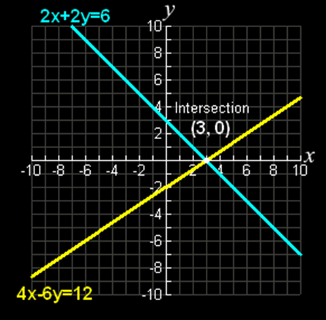
Systems of Equations
If you graph the equations in a system, the solution is where the lines
cross
Vfrench, 2010

Slide 14
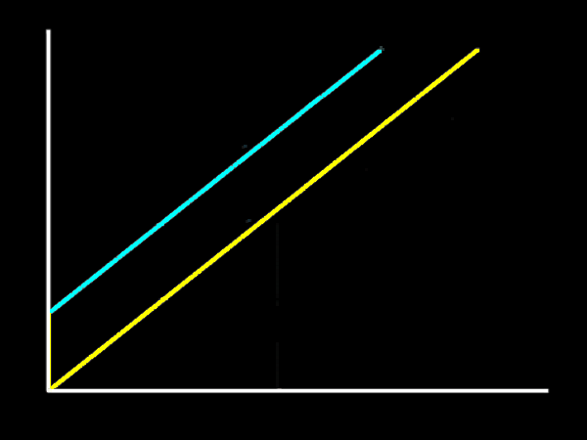
Systems of Equations
If they do not cross, there is no real solution (there may be a complex
solution)
Vfrench, 2010

Slide 15
Systems of Nonlinears
Nonlinear equations are the equations of curves
They will have squares and cubes and other higher-order exponents in the equations

Slide 16
Systems of Nonlinears
NATURALLY,
linear equations (ones that graph as straight lines) are simpler than non-linear (curved) equations
BUT you still use the same tricks to solve them!

Slide 17
Questions?
http://i.imgur.com/aliTlT3.jpg

Slide 18
Uses for Systems of Equations
Lots of business applications use systems of equations

Slide 19
Uses for Systems of Equations
The income function is the total amount generated by selling the product:
I(x) = (price per unit sold) × x
x is the quantity sold

Slide 20
Uses for Systems of Equations
The cost function is the total cost of producing the product:
C(x) = fixed cost +
(cost per unit produced) × x
x is the quantity produced

Slide 21
Uses for Systems of Equations
The profit function is the difference between the cost and the revenue functions:
P(x) = I(x) – C(x)
x is the quantity of the product

Slide 22
Uses for Systems of Equations
The x-solution for the two equations Cost and Income
is the true solution of the system of the two equations (the Cost and Income equations)

Slide 23
Uses for Systems of Equations
The solution to the system is called the “break-even point”

Slide 24
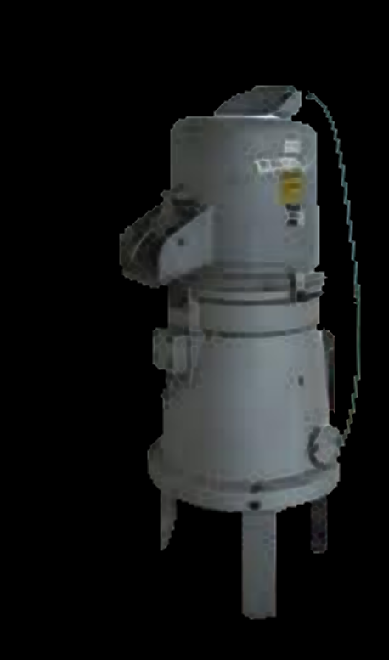
Uses for Systems of Equations
Example:
A widget-maker produces widgets
Each widget sells for $300
They sell 20,000 widgets each year
What is their annual income?

Slide 25
Uses for Systems of Equations
I(x) = (price per unit sold) × x
I = $300 (20,000)
= $6,000,000

Slide 26
Uses for Systems of Equations
They have a fixed cost (rent, utilities, salaries, etc.) of
$950,000 per year
Each widget costs $10 to make
They make 20,000 widgets each year
What is their annual cost?

Slide 27
Uses for Systems of Equations
C(x) = fixed cost +
(cost per unit produced) × x
C = $950,000 + $10(20,000)
= $1,150,000

Slide 28
Uses for Systems of Equations
What is their annual profit?

Slide 29
Uses for Systems of Equations
P(x) = I(x) – C(x)
P = $6,000,000 - $1,150,000
= $4,850,000

Slide 30
Uses for Systems of Equations
Let’s buy Widget stock!!!

Slide 31
Uses for Systems of Equations
Break-even point:
How many widgets you need to make for the cost to equal the income (profit of $0)

Slide 32
Uses for Systems of Equations
Break-even point:
C(x) = I(x)
fixed cost + (cost per unit) × x
=
(price per unit sold) × x

Slide 33
Uses for Systems of Equations
Break-even point:
950,000 + 10(x) = 300(x)
Algebra magic…
950,000 = 300x - 10x
950,000 = 290x
950,000/290 = x
So x = 3275.86 units

Slide 34
Uses for Systems of Equations
They will “break even” when they make and sell 3276 units
Since they make and sell a lot more, they are making a huge profit!

Slide 35
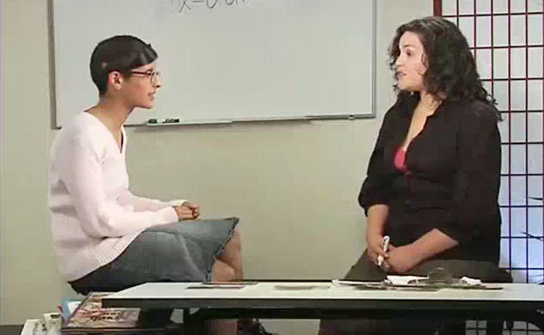
Uses for Systems of Equations
Break-even point video

Slide 36
Uses for Systems of Equations
Video
Revenue = 25x – 0.01x²
Cost = 1600 + 5x + 10x

Slide 37
Questions?
http://i.imgur.com/aliTlT3.jpg

Slide 38
SYSTEMS OF EQUATIONS
IN-CLASS PROBLEM 1a
A company manufactures wheelchairs
w is the number of wheelchairs produced
The revenue function is: R = $600w
The cost function is:
C = $500,000 + $400w
What is the profit function?

Slide 39
SYSTEMS OF EQUATIONS
IN-CLASS PROBLEM 1a
A company manufactures wheelchairs
w is the number of wheelchairs produced
The revenue function is: R = $600w
The cost function is:
C = $500,000 + $400w
What is the profit function?
P = $600w - $500,000 - $400w
= $200w - $500,000

Slide 40
SYSTEMS OF EQUATIONS
IN-CLASS PROBLEM 1b
What is the break-even point?
P = $200w - $500,000 = 0

Slide 41
SYSTEMS OF EQUATIONS
IN-CLASS PROBLEM 1b
What is the break-even point?
$600w = $500,000 + $400w
$200w = $500,000
w = $500,000/$200
w = 2500 wheelchairs

Slide 42
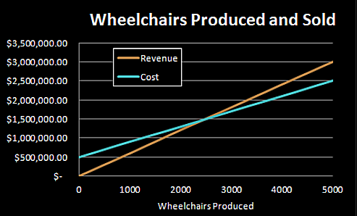
SYSTEMS OF EQUATIONS
IN-CLASS PROBLEM 1b
What is the break-even point?
VFrench 2010

Slide 43
Questions?
http://i.imgur.com/aliTlT3.jpg

Slide 44
SYSTEMS OF EQUATIONS
IN-CLASS PROBLEM 2a
A company that manufactures bicycles has a fixed cost of $100,000
It costs $100 to produce each bicycle
The selling price per bike is $300
Write the cost function C:

Slide 45
SYSTEMS OF EQUATIONS
IN-CLASS PROBLEM 2a
A company that manufactures bicycles has a fixed cost of $100,000
It costs $100 to produce each bicycle
The selling price per bike is $300
Write the cost function C:
C = $100,000 + $100b

Slide 46
SYSTEMS OF EQUATIONS
IN-CLASS PROBLEM 2b
A company that manufactures bicycles has a fixed cost of $100,000
It costs $100 to produce each bicycle
The selling price per bike is $300
Write the revenue function R:

Slide 47
SYSTEMS OF EQUATIONS
IN-CLASS PROBLEM 2b
A company that manufactures bicycles has a fixed cost of $100,000
It costs $100 to produce each bicycle
The selling price per bike is $300
Write the revenue function R:
R = $300b

Slide 48
SYSTEMS OF EQUATIONS
IN-CLASS PROBLEM 2c
A company that manufactures bicycles has a fixed cost of $100,000
It costs $100 to produce each bicycle
The selling price per bike is $300
Write the profit function P:

Slide 49
SYSTEMS OF EQUATIONS
IN-CLASS PROBLEM 2c
A company that manufactures bicycles has a fixed cost of $100,000
It costs $100 to produce each bicycle
The selling price per bike is $300
Write the profit function P:
P = $300b - $100,000 - $100b
= $200b - $100,000

Slide 50
SYSTEMS OF EQUATIONS
IN-CLASS PROBLEM 2d
A company that manufactures bicycles has a fixed cost of $100,000
It costs $100 to produce each bicycle
The selling price per bike is $300
Determine the break-even point:
P = $200b - $100,000 = 0

Slide 51
SYSTEMS OF EQUATIONS
IN-CLASS PROBLEM 2d
A company that manufactures bicycles has a fixed cost of $100,000
It costs $100 to produce each bicycle
The selling price per bike is $300
Determine the break-even point:
$300b = $100,000 +$100b
$200b = $100,000
b = 500 bicycles

Slide 52
Questions?
http://i.imgur.com/aliTlT3.jpg

Slide 53
SYSTEMS OF EQUATIONS
IN-CLASS PROBLEM 3
The perimeter of a rectangular field is 520 feet. The length of the field is 20 feet more than three times the width. Find the dimensions.

Slide 54
SYSTEMS OF EQUATIONS
IN-CLASS PROBLEM 3
The perimeter of a rectangular field is 520 feet:
The length of the field is 20 feet more than three times the width:
Find the dimensions:

Slide 55
SYSTEMS OF EQUATIONS
IN-CLASS PROBLEM 3
The perimeter of a rectangular field is 520 feet: 2L+2W = 520
The length of the field is 20 feet more than three times the width:
Find the dimensions:

Slide 56
SYSTEMS OF EQUATIONS
IN-CLASS PROBLEM 3
The perimeter of a rectangular field is 520 feet: 2L+2W = 520
The length of the field is 20 feet more than three times the width: L = 3W+20
Find the dimensions:

Slide 57
SYSTEMS OF EQUATIONS
IN-CLASS PROBLEM 3
2L+2W = 520
L = 3W+20
Find the dimensions:
2(3W+20)+2W = 520
6W+40+2W = 520
8W + 40 = 520
8W = 480
W = 480/8 = 60 feet
L = 3(60)+20 = 200 feet

Slide 58
Questions?
http://i.imgur.com/aliTlT3.jpg

Slide 59
SYSTEMS OF EQUATIONS
IN-CLASS PROBLEM 4
The length of a piece of sheet metal is twice the width. The difference in length and width is 20 inches. What are the dimensions?

Slide 60
SYSTEMS OF EQUATIONS
IN-CLASS PROBLEM 4
The length of a piece of sheet metal is twice the width:
The difference in length and width is 20 inches:
What are the dimensions?

Slide 61
SYSTEMS OF EQUATIONS
IN-CLASS PROBLEM 4
The length of a piece of sheet metal is twice the width: L = 2W
The difference in length and width is 20 inches:
What are the dimensions?

Slide 62
SYSTEMS OF EQUATIONS
IN-CLASS PROBLEM 4
The length of a piece of sheet metal is twice the width: L = 2W
The difference in length and width is 20 inches: L – W = 20
What are the dimensions?

Slide 63
SYSTEMS OF EQUATIONS
IN-CLASS PROBLEM 4
L = 2W
L – W = 20
What are the dimensions?
(2W) – W = 20
W = 20 inches
L = 2(20) = 40 inches

Slide 64
Questions?
http://i.imgur.com/aliTlT3.jpg

Slide 65
SYSTEMS OF EQUATIONS
IN-CLASS PROBLEM 5
The perimeter of a rectangular window is 14 feet and its length is 2 feet less than twice the width. What are the dimensions of the window?

Slide 66
SYSTEMS OF EQUATIONS
IN-CLASS PROBLEM 5
The perimeter of a rectangular window is 14 feet:
Its length is 2 feet less than twice the width:
What are the dimensions of the window?

Slide 67
SYSTEMS OF EQUATIONS
IN-CLASS PROBLEM 5
The perimeter of a rectangular window is 14 feet: 2L+2W = 14
Its length is 2 feet less than twice the width:
What are the dimensions of the window?

Slide 68
SYSTEMS OF EQUATIONS
IN-CLASS PROBLEM 5
The perimeter of a rectangular window is 14 feet: 2L+2W = 14
Its length is 2 feet less than twice the width: L = 2W-2
What are the dimensions of the window?

Slide 69
SYSTEMS OF EQUATIONS
IN-CLASS PROBLEM 5
2L+2W = 14
L = 2W-2
What are the dimensions of the window? 2(2W-2)+2W = 14
4W-4+2W = 14
6W-4 = 14
6W = 18
W = 18/6 = 3 feet
L = 2(3)-2 = 4 feet

Slide 70
Questions?
http://i.imgur.com/aliTlT3.jpg

Slide 71
SYSTEMS OF EQUATIONS
IN-CLASS PROBLEM 6
A logistics company uses two different models of computers in their office.
The first model costs $45 to upgrade and the second model costs $30 to upgrade.
If the company upgrades 200 computers and it costs $7,125 in total, how many units of each model are upgraded?

Slide 72
SYSTEMS OF EQUATIONS
IN-CLASS PROBLEM 6
The first model (call the number of these “a”) costs $45 to upgrade and the second model (call the number of these “b”) costs $30 to upgrade.
The company upgrades 200 computers:
It costs $7,125 in total:
How many units of each model are upgraded?

Slide 73
SYSTEMS OF EQUATIONS
IN-CLASS PROBLEM 6
The first model (a) costs $45 to upgrade and the second model (b) costs $30 to upgrade.
The company upgrades 200 computers:
It costs $7,125 in total:
How many units of each model are upgraded?

Slide 74
SYSTEMS OF EQUATIONS
IN-CLASS PROBLEM 6
The first model (a) costs $45 to upgrade and the second model (b) costs $30 to upgrade.
The company upgrades 200 computers: a + b = 200
It costs $7,125 in total:
How many units of each model are upgraded?

Slide 75
SYSTEMS OF EQUATIONS
IN-CLASS PROBLEM 6
The first model (a) costs $45 to upgrade and the second model (b) costs $30 to upgrade.
The company upgrades 200 computers: a + b = 200
It costs $7,125 in total:
$45a + $30b = $7125
How many units of each model are upgraded?

Slide 76
SYSTEMS OF EQUATIONS
IN-CLASS PROBLEM 6
a + b = 200
$45a + $30b = $7125
How many units of each model are upgraded?
a = 200 – b
$45(200-b) + $30b = $7125
$9000-$45b + $30b = $7125
-$15b = -$1875
b = 125 units
a = 200 -125 = 75 units

Slide 77
Questions?
http://i.imgur.com/aliTlT3.jpg

Slide 78
SYSTEMS OF EQUATIONS
IN-CLASS PROBLEM 7
A rectangular lot whose perimeter is 340 feet is fenced along three sides.
An expensive fencing along the lot’s length costs $20 per foot and an inexpensive fencing along the two side widths costs only $8 per foot.
The total cost of the fencing along the three sides comes to $3250.
What are the lot’s dimensions?

Slide 79
SYSTEMS OF EQUATIONS
IN-CLASS PROBLEM 7
A rectangular lot is fenced along three sides
with an expensive fencing along the lot’s length and an inexpensive fencing along the two side widths

Slide 80
SYSTEMS OF EQUATIONS
IN-CLASS PROBLEM 7
A rectangular lot whose perimeter is 340 feet:

Slide 81
SYSTEMS OF EQUATIONS
IN-CLASS PROBLEM 7
A rectangular lot whose perimeter is 340 feet: 2L + 2W = 340
It is fenced along three sides. An expensive fencing along the lot’s length costs $20 per foot and an inexpensive fencing along the two side widths costs only $8 per foot. The total cost of the fencing along the three sides comes to $3250:

Slide 82
SYSTEMS OF EQUATIONS
IN-CLASS PROBLEM 7
2L + 2W = 340
It is fenced along three sides. An expensive fencing along the lot’s length costs $20 per foot and an inexpensive fencing along the two side widths costs only $8 per foot. The total cost of the fencing along the three sides comes to $3250:
$20L + $8(2W) = $3250
What are the lot’s dimensions?

Slide 83
SYSTEMS OF EQUATIONS
IN-CLASS PROBLEM 7
2L + 2W = 340
$20L + $8(2W) = $3250
What are the lot’s dimensions?
2W = 340 - 2L

Slide 84
SYSTEMS OF EQUATIONS
IN-CLASS PROBLEM 7
2L + 2W = 340
$20L + $8(2W) = $3250
What are the lot’s dimensions?
2W = 340 - 2L
$20L + $8(340-2L) = $3250

Slide 85
SYSTEMS OF EQUATIONS
IN-CLASS PROBLEM 7
2L + 2W = 340
$20L + $8(2W) = $3250
What are the lot’s dimensions?
2W = 340 - 2L
$20L + $8(340-2L) = $3250
20L + 2720 – 16L = 3250

Slide 86
SYSTEMS OF EQUATIONS
IN-CLASS PROBLEM 7
2L + 2W = 340
$20L + $8(2W) = $3250
What are the lot’s dimensions?
2W = 340 - 2L
$20L + $8(340-2L) = $3250
20L + 2720 – 16L = 3250
4L = 530

Slide 87
SYSTEMS OF EQUATIONS
IN-CLASS PROBLEM 7
2L + 2W = 340
$20L + $8(2W) = $3250
What are the lot’s dimensions?
2W = 340 - 2L
$20L + $8(340-2L) = $3250
20L + 2720 – 16L = 3250
4L = 530
L = 530/4 = 132.5

Slide 88
SYSTEMS OF EQUATIONS
IN-CLASS PROBLEM 7
What are the lot’s dimensions?
2W = 340 - 2L
$20L + $8(340-2L) = $3250
20L + 2720 – 16L = 3250
4L = 530
L = 530/4 = 132.5
2W = 340 – 2(132.5) = 75
so W = 37.5
L = 132.5’ and W = 37.5’

Slide 89
Questions?
http://i.imgur.com/aliTlT3.jpg

Slide 90
Matrices
Matrix (plural matrices) - a rectangular table of elements (or entries), numbers or abstract quantities
Arranged in rows and columns

Slide 91
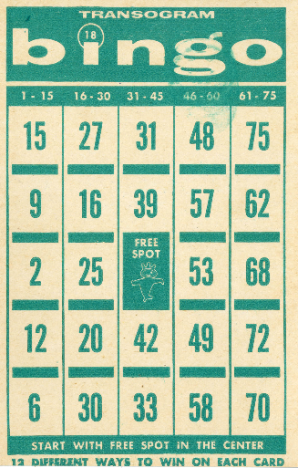
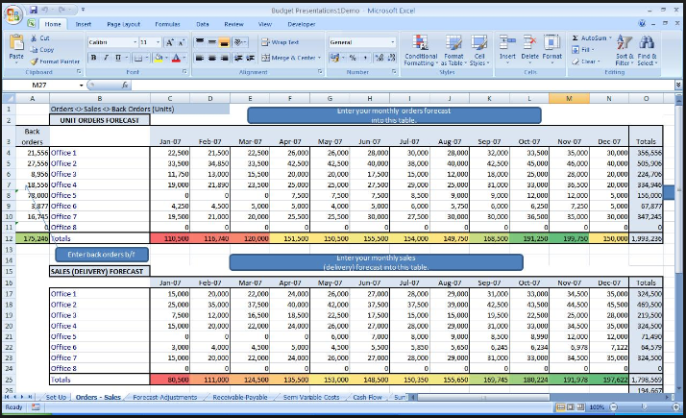
Matrices
Matrices in everyday life
https://collegejoliotcuriebron.files.wordpress.com/2018/10/calendrier2.png
http://creditspreadsheet.com/wp-content/uploads/2017/11/excel-business-spreadsheet-templates-excel-spreadsheet-for-business-income-and-expenses-and-compare-excel-spreadsheets-2010.jpg
https://upload.wikimedia.org/wikipedia/commons/thumb/a/ae/Bingo_card.jpg/440px-Bingo_card.jpg

Slide 92
Matrices
Horizontal lines in a matrix are called rows
Vertical lines are called columns

Slide 93
Matrices
A matrix with m rows and n columns is called an m-by-n matrix (written m × n)
m and n are called its dimensions

Slide 94
Matrices
The dimensions of a matrix are always given with the number of
rows first, then the number of columns:
r × c

Slide 95
Matrices
Matrices are usually given capital letter names like “A”

Slide 96
Matrices
To designate a specific element in a matrix, you use small letters with subscripts r and c:
a₃₇ means the element in matrix A in row 3 column 7

Slide 97
Matrices
In Math class, matrices are shown by listing the elements inside square braces: [ ]

Slide 98
Matrices
┌ ┐
│ a₁₁ a₁₂ a₁₃ │
A = │ a₂₁ a₂₂ a₂₃ │
│ a₃₁ a₃₂ a₃₃ │
└ ┘

Slide 99
Matrices
The Matrix Game

Slide 100
Questions?
http://i.imgur.com/aliTlT3.jpg

Slide 101
Matrices
A matrix can be used as a shorthand way of writing a system of equations

Slide 102
Matrices
Called an augmented matrix:
Each row is an equation
Each column is a variable or a constant
Each item is the coefficient
A vertical bar separates coefficients on the left side from constants on the right

Slide 103
Matrices
For example:
3x + 7y – 4z = 10
2x + 5y + z = 9
x + 6z = 15
(called “algebraic notation”

Slide 104
Matrices
3x + 7y – 4z = 10
2x + 5y + z = 9
x + 6z = 15 becomes:
x y z k
┌ ┐
eq 1 │ 3 7 -4 │ 10│
eq 2 │ 2 5 1 │ 9│
eq 3 │ 1 0 6 │ 15│
└ ┘
(called “matrix notation”

Slide 105
Matrices
It is traditional to use “k” to designate the constant rather than “c”
(Don’t ask me why!)
shutterstock_65175625.jpg

Slide 106
MATRICES
IN-CLASS PROBLEM 8a
What would be the matrix for the system of equations:
46x – 51y = 709
30x + 88y = -420

Slide 107
MATRICES
IN-CLASS PROBLEM 8a
46x – 51y = 709
30x + 88y = -420
x y k
┌ ┐
eq 1 │ 46 -51 │ 709│
eq 2 │ 30 88 │-420│
└ ┘

Slide 108
MATRICES
IN-CLASS PROBLEM 8b
What would be the matrix for the system of equations:
x = 7y + 8
y = x – 3
Careful!

Slide 109
MATRICES
IN-CLASS PROBLEM 8b
x = 7y + 8 x – 7y = 8
y = x – 3 -x + y = -3
x y k
┌ ┐
eq 1 │ 1 -7 │ 8 │
eq 2 │ -1 1 │-3 │
└ ┘

Slide 110
MATRICES
IN-CLASS PROBLEM 8c
You can also recover the original equations from a matrix
What would be the equations for the matrix:
x y k
┌ ┐
eq 1 │ 10 4 │ 92│
eq 2 │-43 0 │ 87│
└ ┘

Slide 111
MATRICES
IN-CLASS PROBLEM 8c
x y k
┌ ┐
eq 1 │ 10 4 │ 92│
eq 2 │-43 0 │ 87│
└ ┘
The equations would be:
10x + 4y = 92
-43x = 87

Slide 112
Questions?
http://i.imgur.com/aliTlT3.jpg

Slide 113
Matrices
The goal of a system of equations is to solve the system for values of the variables that work in all of the equations in the system

Slide 114
Matrices
Same thing with a matrix!

Slide 115
MATRICES
IN-CLASS PROBLEM 9
How would you solve:
x y z k
┌ ┐
eq 1 │ 1 0 0 │ 10│
eq 2 │ 0 1 0 │ 9│
eq 3 │ 0 0 1 │ 15│
└ ┘

Slide 116
MATRICES
IN-CLASS PROBLEM 9
How would you solve:
x y z k
┌ ┐
eq 1 │ 1 0 0 │ 10│
eq 2 │ 0 1 0 │ 9│
eq 3 │ 0 0 1 │ 15│
└ ┘
x = 10, y = 9, z = 15

Slide 117
Matrices
This pattern is easy to solve:
upper triangle
┌ ┐
eq 1 │ 1 0 0 │ 10│
eq 2 │ 0 1 0 │ 9│
eq 3 │ 0 0 1 │ 15│
└ ┘
lower triangle

Slide 118
Matrices
This form of the matrix (upper and lower triangles zero and 1s on the diagonal) is called “reduced row echelon” or “row canonical”

Slide 119
Matrices
A matrix in this form is “solved”

Slide 120
Questions?
http://i.imgur.com/aliTlT3.jpg

Slide 121
MATRICES
IN-CLASS PROBLEM 10
What if you had:
x y z k
┌ ┐
eq 1 │ 6 3 2 │ 19│
eq 2 │ 0 5 4 │ 15│
eq 3 │ 0 0 1 │ 5│
└ ┘

Slide 122
MATRICES
IN-CLASS PROBLEM 10
This is called a “lower triangular matrix”
x y z k
┌ ┐
eq 1 │ 6 3 2 │ 19│
eq 2 │ 0 5 4 │ 15│
eq 3 │ 0 0 1 │ 5│
└ ┘

Slide 123
Matrices
It’s also called “row echelon form”

Slide 124
MATRICES
IN-CLASS PROBLEM 10
Not quite as easy!
What value do you know?
x y z k
┌ ┐
eq 1 │ 6 3 2 │ 19│
eq 2 │ 0 5 4 │ 15│
eq 3 │ 0 0 1 │ 5│
└ ┘

Slide 125
MATRICES
IN-CLASS PROBLEM 10
x y z k
┌ ┐
eq 1 │ 6 3 2 │ 19│
eq 2 │ 0 5 4 │ 15│
eq 3 │ 0 0 1 │ 5│ z = 5 !
└ ┘

Slide 126
MATRICES
IN-CLASS PROBLEM 10
We’ll use the same techniques you used in solving systems of equations to solve for y and x
x y z k
┌ ┐
eq 1 │ 6 3 2 │ 19│
eq 2 │ 0 5 4 │ 15│
eq 3 │ 0 0 1 │ 5│
└ ┘

Slide 127
Matrices
Remember - each row in an augmented matrix represents an equation
So…anything that you can do to an equation can be done to the row of a matrix!

Slide 128
Matrices
Scalar multiplication:
3x + 7y = 15
2(3x + 7y) = 2(15)
You can multiply a row of an augmented matrix by a constant

Slide 129
Matrices
Scalar multiplication uses a special notation:
2R₁
This means multiply all of the elements in row 1 by the constant value 2

Slide 130
Matrices
Just like you can add two polynomial equations, you can also add two rows of an augmented matrix:
3x + 7y = 15
5x - 2y = 40
8x + 5y = 55

Slide 131
Matrices
You can multiply by a constant and add rows of a matrix at the same time

Slide 132
Matrices
3R1 + R2
means multiply the elements in row 1 by three, add it to the elements in row 2, and replace the elements in ROW 2 with the result

Slide 133
MATRICES
IN-CLASS PROBLEM 10
So… back to our problem:
x y z k
┌ ┐
eq 1 │ 6 3 2 │ 19│
eq 2 │ 0 5 4 │ 15│
eq 3 │ 0 0 1 │ 5│
└ ┘

Slide 134
MATRICES
IN-CLASS PROBLEM 10
If you multiply row 3 by -4 and add it to row 2, you can solve for y easily!
x y z k
┌ ┐
eq 1 │ 6 3 2 │ 19│
eq 2 │ 0 5 4 │ 15│
eq 3 │ 0 0 1 │ 5│
└ ┘

Slide 135
MATRICES
IN-CLASS PROBLEM 10
x y z k
┌ ┐
eq 1 │ 6 3 2 │ 19│
eq 2 │ 0 5 4 │ 15│
eq3∗-4 0 0 -4 -20
new eq2 0 5 0 -5
eq 3 │ 0 0 1 │ 5│
└ ┘

Slide 136
MATRICES
IN-CLASS PROBLEM 10
x y z k
┌ ┐
eq 1 │ 6 3 2 │ 19│
eq 2 │ 0 5 0 │ -5│
eq 3 │ 0 0 1 │ 5│
└ ┘
Now what?

Slide 137
MATRICES
IN-CLASS PROBLEM 10
x y z k
┌ ┐
eq 1 │ 6 3 2 │ 19│
eq 2 │ 0 5 0 │ -5│
eq 3 │ 0 0 1 │ 5│
└ ┘
Divide row 2 by 5!

Slide 138
MATRICES
IN-CLASS PROBLEM 10
x y z k
┌ ┐
eq 1 │ 6 3 2 │ 19│
eq 2 │ 0 1 0 │ -1│
eq 3 │ 0 0 1 │ 5│
└ ┘
Now what values do you know?

Slide 139
MATRICES
IN-CLASS PROBLEM 10
So now we know 2 values:
x y z k
┌ ┐
eq 1 │ 6 3 2 │ 19│
eq 2 │ 0 1 0 │ -1│ y = -1
eq 3 │ 0 0 1 │ 5│ z = 5
└ ┘

Slide 140
MATRICES
IN-CLASS PROBLEM 10
Use the same strategy to solve for x!
x y z k
┌ ┐
eq 1 │ 6 3 2 │ 19│
eq 2 │ 0 1 0 │ -1│
eq 3 │ 0 0 1 │ 5│
└ ┘

Slide 141
MATRICES
IN-CLASS PROBLEM 10
-3R2 + R1:
x y z k
┌ ┐
eq 1 │ 6 3 2 │ 19│
+0 -3 +0 3
6 0 2 22
eq 2 │ 0 1 0 │ -1│
eq 3 │ 0 0 1 │ 5│
└ ┘

Slide 142
MATRICES
IN-CLASS PROBLEM 10
Now what?
x y z k
┌ ┐
eq 1 │ 6 0 2 │ 22│
eq 2 │ 0 1 0 │ -1│
eq 3 │ 0 0 1 │ 5│
└ ┘

Slide 143
MATRICES
IN-CLASS PROBLEM 10
-2R3 + R1:
x y z k
┌ ┐
eq 1 │ 6 0 2 │ 22│
+0 +0 -2 -10
6 0 0 12
eq 2 │ 0 1 0 │ -1│
eq 3 │ 0 0 1 │ 5│
└ ┘

Slide 144
MATRICES
IN-CLASS PROBLEM 10
x y z k
┌ ┐
eq 1 │ 6 0 0 │ 12│
eq 2 │ 0 1 0 │ -1│
eq 3 │ 0 0 1 │ 5│
└ ┘
What now?

Slide 145
MATRICES
IN-CLASS PROBLEM 10
x y z k
┌ ┐
eq 1 │ 6 0 0 │ 12│
eq 2 │ 0 1 0 │ -1│
eq 3 │ 0 0 1 │ 5│
└ ┘
Divide row 1 by 6!

Slide 146
MATRICES
IN-CLASS PROBLEM 10
x y z k
┌ ┐
eq 1 │ 1 0 0 │ 2│
eq 2 │ 0 1 0 │ -1│
eq 3 │ 0 0 1 │ 5│
└ ┘
Now what values do we know?

Slide 147
MATRICES
IN-CLASS PROBLEM 10
Now what do we know?
x y z k
┌ ┐
eq 1 │ 1 0 0 │ 2│ x = 2
eq 2 │ 0 1 0 │ -1│ y = -1
eq 3 │ 0 0 1 │ 5│ z = 5
└ ┘

Slide 148
Matrices
So… if you have an upper and lower triangular (reduced row echelon) matrix, the solution is obvious:
┌ ┐
eq 1 │ 1 0 0 │ 10│
eq 2 │ 0 1 0 │ 9│
eq 3 │ 0 0 1 │ 15│
└ ┘
upper triangle
lower triangle

Slide 149
Matrices
And… if you have only one zero triangle (row echelon form), it’s more work:
┌ ┐
eq 1 │ 1 1 2 │ 19│
eq 2 │ 0 1 0 │ 3│
eq 3 │ 0 0 1 │ 5│
└ ┘
lower triangle

Slide 150
Inverse Matrices
BTW: In a lower triangular matrix the first nonzero entry of each row is called a pivot
The columns in which pivots appear are called pivot columns

Slide 151
Questions?
http://i.imgur.com/aliTlT3.jpg

Slide 152
Matrices
The upper and lower triangular form is called the “Gauss-Jordan” solution, the lower triangular form is called the “Gauss” solution

Slide 153
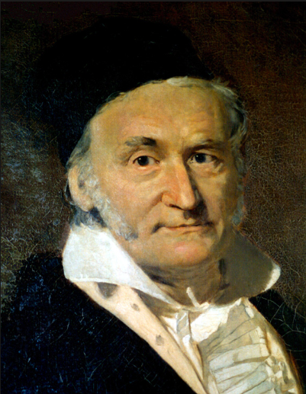
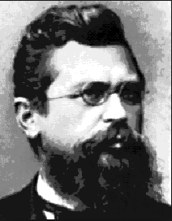
Matrices
This is called the Gauss-Jordan solution
Carl Friedrich Gauss Wilhelm Jordan
https://upload.wikimedia.org/wikipedia/commons/e/ec/Carl_Friedrich_Gauss_1840_by_Jensen.jpg
https://upload.wikimedia.org/wikipedia/commons/7/70/Wilhelm_Jordan.png

Slide 154
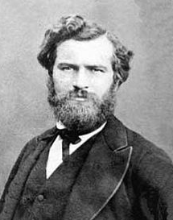
Matrices
Wilhelm Jordan Camille Jordan
https://upload.wikimedia.org/wikipedia/commons/7/70/Wilhelm_Jordan.png
https://encryptedtbn0.gstatic.com/images?q=tbn:ANd9GcTiQKlCbL4jWi3F7D_DTgJeTPqsSugJeEjNoPKLuJaQkeOQl3UvcwxWkOU6Nv1ubX5jgo&usqp=CAU

Slide 155
Matrices
Computers and calculators manipulate the matrix to achieve the Gauss-Jordan solution

Slide 156
Matrices
Computers and calculators do these processes using a strategy to reduce the matrix to the Gauss-Jordan “Easy-To-Solve” form

Slide 157
Matrices
Since each row in an augnented matrix represents an equation, anything that you can do to an equation can be done to the row of a matrix

Slide 158
Matrices
Scalar multiplication:
3x + 7y = 15
2(3x + 7y) = 2(15)
You can multiply a row of an augmented matrix by a constant

Slide 159
Matrices
Scalar multiplication uses a special notation
2R₁
means multiply all of the elements in row 1 by the scalar constant 2

Slide 160
Matrices
You can also add two rows of an augmented matrix
3R1 + R2
means multiply the elements in row 1 by three, add it to the elements in row 2, and replace the elements in ROW 2 with the result

Slide 161
Matrices
Computers and calculators do these processes using a strategy to reduce the matrix to the Gauss-Jordan “Easy-To-Solve” form

Slide 162
Matrices
For the Portal (and WolframAlpha) , we can’t write matrices like:
x y z k
┌ ┐
eq 1 │ 9 4 5 │ -3│
eq 2 │ 5 0 9 │ 4│
eq 3 │ 8 5 0 │ 3│
└ ┘

Slide 163
Matrices
┌ ┐
│ 9 4 5 │ -3│
│ 5 0 9 │ 4│
│ 8 5 0 │ 3│
└ ┘
Would be written:
{(9, 4, 5 | -3),(5, 0, 9 | 4),
(8, 5, 0 | 3)}

Slide 164
Matrices
Not nearly as cool!
http://images.sodahead.com/polls/001429875/yuck_answer_8_xlarge_answer_2_xlarge.jpeg

Slide 165
MATRICES
IN-CLASS PROBLEM 11
Solving: use wolframalpha.com
Solve using row reduction:
{(3, 1, 2 | 31), (1, 1, 2 | 19), (1, 3, 2 | 25)}

Slide 166
MATRICES
IN-CLASS PROBLEM 11
Solving: use symbolab
under Matrices and Vectors: gauss jordan:
select (3 × 4)
3 1 2 31
1 1 2 19
1 3 2 25

Slide 167
Questions?
http://i.imgur.com/aliTlT3.jpg

Slide 168
You Survived!
Today we studied:
Review of systems of
equations
Uses for systems of
equations
Matrices

