Slide 1

Welcome to
Unit 10 - Part 19
MATH116-Foundations for Calculus
https://media.istockphoto.com/vectors/green-blackboard-mathematical-with-thin-line-shapes-and-inscriptions-vector-id1084380192?k=6&m=1084380192&s=612x612&w=0&h=TcEOVpnUmyuswT4Pay
AL6lNiHU8SS8g33yOSg-jR5BE=

Slide 2
What’s Up?
Today we will be going over:
Review: systems of equations
New stuff: parametrics

Slide 3
What’s Up?
Outcome 10) Graph a curve given by parametric equations and convert between parametric and rectangular equations

Slide 4

Review
http://995642590.r.lightningbase-cdn.com/wp-content/uploads/2010/12/looking-back-hrexaminer-v144-cover425px.jpg

Slide 5
Systems of Equations
A system of equations is a collection of two or more equations with the same set of unknowns (variables)

Slide 6
Systems of Equations
In solving a system of equations, we try to find values for each of the unknowns that will satisfy every equation in the system

Slide 7
Systems of Equations
To solve a system, you must have at least as many equations as you have variables

Slide 8
Uses for Systems of Equations
The income function is the total amount generated by selling a product
The cost function is the total cost of producing the product
The solution to the system is called the “break-even point”

Slide 9
Matrices
Matrix (plural matrices) - a rectangular table of elements (or entries), numbers or abstract quantities

Slide 10
Matrices
Arranged in rows and columns
Horizontal lines in a matrix are called rows
Vertical lines are called columns

Slide 11
Matrices
A matrix with m rows and n columns is called an m-by-n matrix (written m × n)
m and n are called its dimensions

Slide 12
Matrices
The dimensions of a matrix are always given with the number of
rows first, then the number of columns:
r × c

Slide 13
Matrices
Matrices are usually given capital letter names like “A”

Slide 14
Matrices
To designate a specific element in a matrix, you use small letters with subscripts r and c:
a₃₇ means the element in matrix A in row 3 column 7

Slide 15
Matrices
In Math class, matrices are shown by listing the elements inside square braces: [ ]
┌ ┐
│ a₁₁ a₁₂ a₁₃ │
A = │ a₂₁ a₂₂ a₂₃ │
│ a₃₁ a₃₂ a₃₃ │
└ ┘

Slide 16
Matrices
A matrix can be used as a shorthand way of writing a system of equations

Slide 17
Matrices
Called an augmented matrix:
Each row is an equation
Each column is a variable or a constant
Each item is the coefficient
A vertical bar separates coefficients on the left side from constants on the right

Slide 18
Matrices
3x + 7y – 4z = 10
2x + 5y + z = 9
x + 6z = 15 becomes:
x y z k
┌ ┐
eq 1 │ 3 7 -4 │ 10│
eq 2 │ 2 5 1 │ 9│
eq 3 │ 1 0 6 │ 15│
└ ┘
(called “matrix notation”

Slide 19
Matrices
You can also recover the original equations from a matrix:
x y k
┌ ┐
eq 1 │ 10 4 │ 92 │
eq 2 │-43 0 │ 87 │
└ ┘
The algebraic notation would be:
10x + 4y = 92
-43x = 87

Slide 20
Matrices
The goal of a system of equations is to solve the system for values of the variables that work in all of the equations in the system
Same thing with a matrix!

Slide 21
Matrices
This pattern is easy to solve:
upper triangle
┌ ┐
eq 1 │ 1 0 0 │ 10│
eq 2 │ 0 1 0 │ 9│
eq 3 │ 0 0 1 │ 15│
└ ┘
lower triangle

Slide 22
Matrices
You can multiply a row of an augmented matrix by a constant
Scalar multiplication uses a special notation:
2R₁
This means multiply all of the elements in row 1 by the constant value 2

Slide 23
Matrices
You can multiply by a constant and add rows of a matrix at the same time
3R1 + R2
means multiply the elements in row 1 by three, add it to the elements in row 2, and replace the elements in ROW 2 with the result

Slide 24

Questions?
http://i.imgur.com/aliTlT3.jpg

Slide 25
Parametric Equations
We’ve looked almost exclusively at functions:
y=f(x) or x=h(y)

Slide 26
Parametric Equations
The problem is that not all curves or equations that we’d like to look at are functions

Slide 27
Parametric Equations
Take, for example, a circle
It is easy enough to write down the equation of a circle centered at the origin with radius r:
x² + y² = r²

Slide 28
Parametric Equations
However, we will never be able to write the equation of a circle down as function

Slide 29
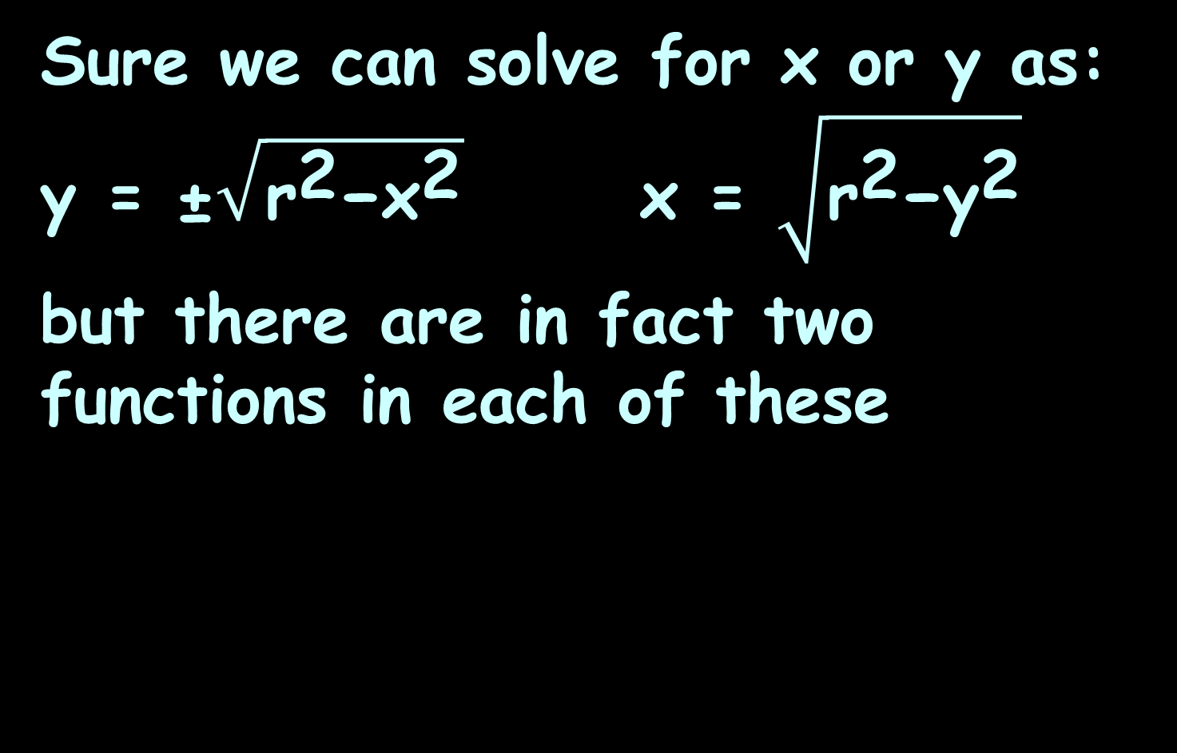
Parametric Equations
Sure we can solve for x or y as:
y = ±$\sqrt{{\text{r}}^{\text{2}}\text{−}{\text{x}}^{\text{2}}}$ x = $\sqrt{{\text{r}}^{\text{2}}\text{−}{\text{y}}^{\text{2}}}$
but there are in fact two functions in each of these

Slide 30
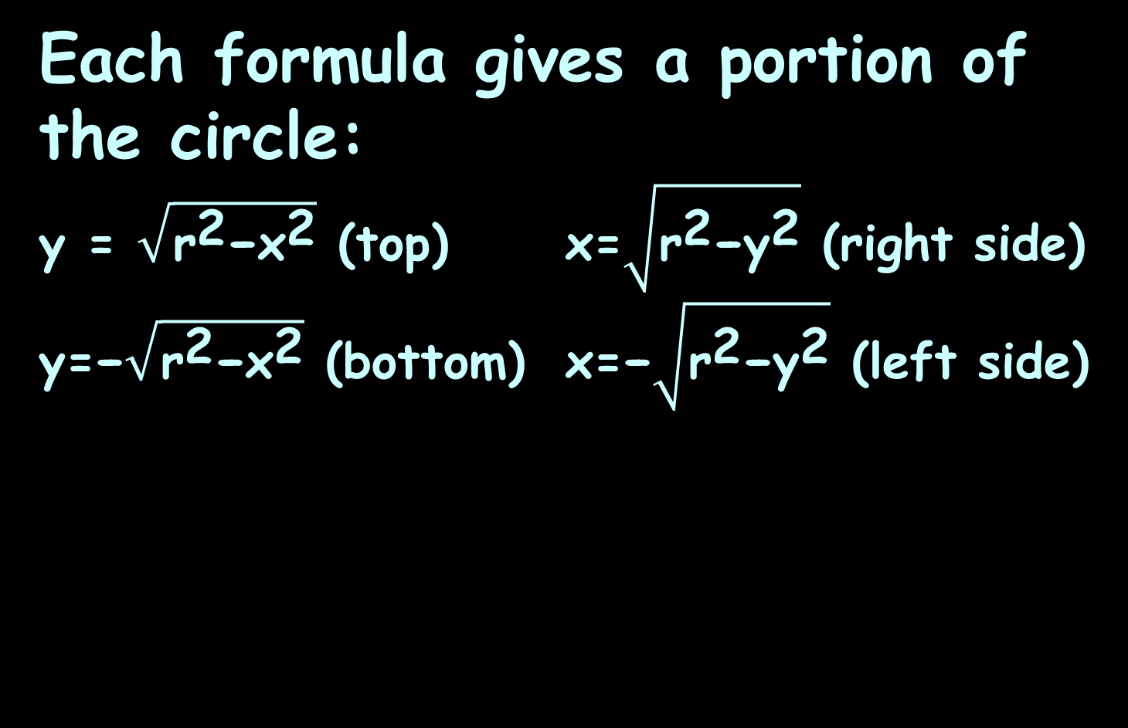
Parametric Equations
Each formula gives a portion of the circle:
y = $\sqrt{{\text{r}}^{\text{2}}\text{−}{\text{x}}^{\text{2}}}$ (top) x=$\sqrt{{\text{r}}^{\text{2}}\text{−}{\text{y}}^{\text{2}}}$ (right side)
y=−$\sqrt{{\text{r}}^{\text{2}}\text{−}{\text{x}}^{\text{2}}}$ (bottom) x=−$\sqrt{{\text{r}}^{\text{2}}\text{−}{\text{y}}^{\text{2}}}$ (left side)

Slide 31
Parametric Equations
Unfortunately, we usually are working on the whole circle, or simply can’t say that we’re going to be working only on one portion of it

Slide 32
Parametric Equations
Even if we can narrow things down to only one of these portions, the function is still often fairly unpleasant to work with

Slide 33
Parametric Equations
There are also a great many curves out there that we can’t even write down as a single equation in terms of only x and y

Slide 34
Parametric Equations
So, to deal with some of these problems we introduce parametric equations

Slide 35
Parametric Equations
Parametric equations of a curve express the coordinates of the points of the curve as functions of a variable called a “parameter”

Slide 36
Parametric Equations
Instead of defining y in terms of x (y=f(x)) or x in terms of y (x=h(y)) we define both x and y in terms of a third variable called a parameter

Slide 37
Parametric Equations
x=f(t) y=g(t)
This third variable is usually denoted by t (but doesn’t have to be)

Slide 38
Parametric Equations
Each value of t defines a point (x,y)=(f(t),g(t)) that we can plot

Slide 39
Parametric Equations
The collection of points that we get by letting t be all possible values is the graph of the parametric equations and is called the parametric curve

Slide 40
Parametric Equations
Think of dropping a ping-pong ball into a tub of sloshing water
https://tutorial.math.lamar.edu/classes/calcii/parametriceqn.aspx

Slide 41
Parametric Equations
The point (x,y)=(f(t),g(t)) will represent the location of the ping pong ball in the tank at time t
https://tutorial.math.lamar.edu/classes/calcii/parametriceqn.aspx

Slide 42
Parametric Equations
The parametric curve will be a trace of all the locations of the ping pong ball including direction of motion
https://tutorial.math.lamar.edu/classes/calcii/parametriceqn.aspx

Slide 43
Parametric Equations
Parametric functions often occur in dynamics
The parameter t represents time
(x(t), y(t)) represents the position of a particle as it varies with time
http://www3.ul.ie/~mlc/support/Loughborough%20website/chap12/12_3.pdf

Slide 44

Parametric Equations
The parametric approach to describing a curve:
x=h(t) y=g(t) t₀≤t≤t₁
parametric equations parametric range

Slide 45
Parametric Equations
As various values of t are chosen within the parameter range, the corresponding values of x, y are calculated from the parametric equations

Slide 46
Parametric Equations
When these points are plotted on an xy plane, they trace out a curve

Slide 47
Parametric Equations
The Cartesian equation of this curve is obtained by eliminating the parameter t from the parametric equations

Slide 48
PARAMETRIC EQUATIONS
IN-CLASS PROBLEM 1
What is the curve defined by these parametric equations:
x=2cos(t) y=2sin(t) 0≤t≤2π
parametric equations parametric range

Slide 49
PARAMETRIC EQUATIONS
IN-CLASS PROBLEM 1
Strategy: eliminate the “t” from both parametric equations
x=2cos(t) y=2sin(t)
We’ll divide both parametric equations by 2, square each and then add them together

Slide 50
PARAMETRIC EQUATIONS
IN-CLASS PROBLEM 1
x 2cos(t) y 2sin(t)
2 2 2 2
=
=

Slide 51
PARAMETRIC EQUATIONS
IN-CLASS PROBLEM 1
x 2cos(t) y 2sin(t)
2 2 2 2
x/2 = cos(t) y/2 = sin(t)
=
=

Slide 52
PARAMETRIC EQUATIONS
IN-CLASS PROBLEM 1
x 2cos(t) y 2sin(t)
2 2 2 2
x/2 = cos(t) y/2 = sin(t)
x²/4 = cos²(t) y²/4 = sin²(t)
=
=

Slide 53
PARAMETRIC EQUATIONS
IN-CLASS PROBLEM 1
x²/4 = cos²(t) y²/4 = sin²(t)
Now add the two:
x²/4 + y²/4 = cos²(t) + sin²(t)

Slide 54
PARAMETRIC EQUATIONS
IN-CLASS PROBLEM 1
x²/4 = cos²(t) y²/4 = sin²(t)
Now add the two:
x²/4 + y²/4 = cos²(t) + sin²(t)
But cos²(t) + sin²(t) = 1
(one of those identities…)

Slide 55
PARAMETRIC EQUATIONS
IN-CLASS PROBLEM 1
So
x²/4 + y²/4 = 1
Which means
x² + y² = 4

Slide 56
PARAMETRIC EQUATIONS
IN-CLASS PROBLEM 1
And…
x² + y² = 4
is the equation of a circle with center at (0,0) and radius 2

Slide 57
Parametric Equations
Important point:
If x = h(t) and y = g(t)
Then dy/dx = dy/dt ÷ dx/dt

Slide 58
Questions?
http://i.imgur.com/aliTlT3.jpg

Slide 59

Polar Coordinates
We know about square graph paper
VFrench, 2015

Slide 60
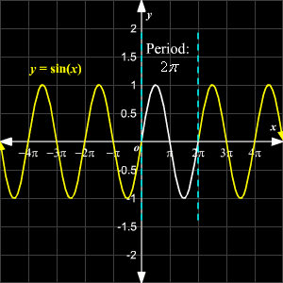
Polar Coordinates
All of the graphs we have done so far have been plotted on square graph paper
https://www.varsitytutors.com/assets/vt-hotmath-legacy/hotmath_help/topics/graphing-sine-function/sine-graph.gif

Slide 61
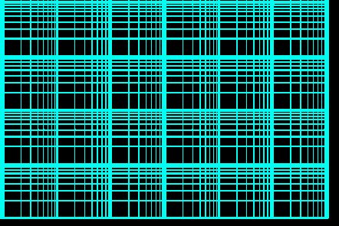
Polar Coordinates
You may have run into some exotic types of graph paper
This type (log/log) is used to graph relationships between variables that
change very
rapidly
https://cdn.eeweb.com/tools/assets/extras/log-log-graph-paper-small.png

Slide 62
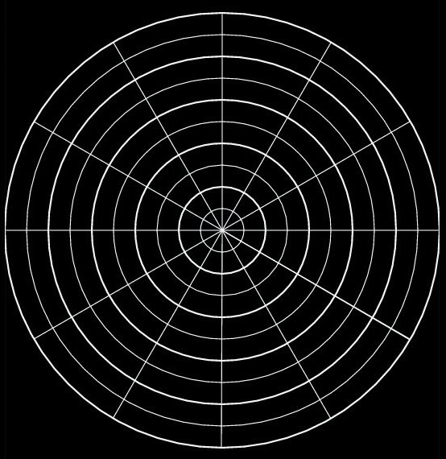
Polar Coordinates
Now we’re going to learn about circular graph paper!
VFrench, 2015

Slide 63
Polar Coordinates
In the 700s and 800s AD, Arabic astronomers developed methods for calculating the direction and distance to Mecca from any point on Earth

Slide 64
Polar Coordinates
They were using
spherical
trigonometry
to do this
Mecca
VFrench, 2015

Slide 65
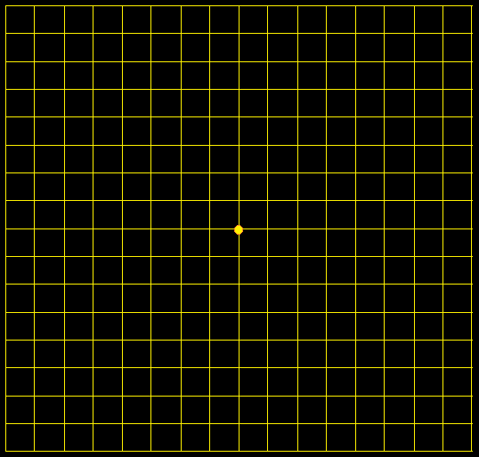
Polar Coordinates
Just like with square graph paper, polar graph paper has a starting point
VFrench, 2015

Slide 66
Polar Coordinates
For square graph paper, this point is called the origin
For polar graph paper, it is called the pole
VFrench, 2015

Slide 67
Polar Coordinates
Just like square graph paper, the starting position is the right horizontal line
VFrench, 2015

Slide 68
Polar Coordinates
This is called the “polar axis”
VFrench, 2015

Slide 69
Polar Coordinates
The rotation for both square and polar graphs is counterclockwise
II I
III IV
VFrench, 2015

Slide 70
Polar Coordinates
Just like for (x,y) coordinates, there are a pair of polar coordinates (r,θ)
These are called the “polar coordinates”

Slide 71
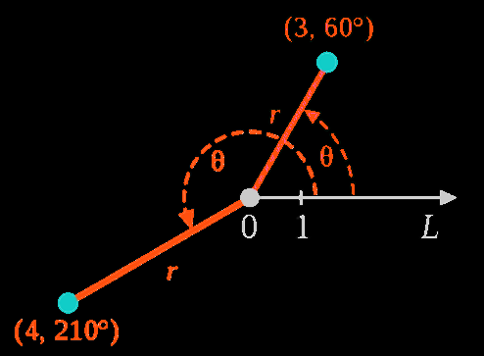
Polar Coordinates
r is the distance from the pole (the radius)
θ is the angle around the circle
VFrench, 2015

Slide 72
Polar Coordinates
r is the distance from the pole (the radius)
θ is the angle around the circle
.
.
r
θ
VFrench, 2015

Slide 73
Polar Coordinates
point P = (r,θ)
r is the distance (radius) from the pole to P (+,- or 0)
θ is the angle from the polar axis to the terminal side of the angle (degrees or radians)

Slide 74
Polar Coordinates
point P = (r,θ)
Hint: plot the angle θ first
Then the “r”

Slide 75
POLAR COORDINATES
IN-CLASS PROBLEM 2a
Plot (2,135º)
Begin with the
angle θ=135º
105º
90º
75º
120º
60º
135º
45º
150º
30º
165º
15º
180º
0º, 360º
2
4
6
195º
345º
210º
330º
225º
315º
240º
300º
255º
270º
285º
VFrench, 2015

Slide 76
POLAR COORDINATES
IN-CLASS PROBLEM 2a
Plot (2,135º)
Begin with the
angle θ=135º
105º
90º
75º
120º
60º
135º
45º
150º
30º
165º
15º
180º
0º, 360º
2
4
6
195º
345º
210º
330º
225º
315º
240º
300º
255º
270º
285º
VFrench, 2015

Slide 77
POLAR COORDINATES
IN-CLASS PROBLEM 2a
Plot (2,135º)
Now find the point
on the line
corresponding
to the
radius “r”
105º
90º
75º
120º
60º
135º
45º
150º
30º
165º
15º
180º
0º, 360º
2
4
6
195º
345º
210º
330º
225º
315º
240º
300º
255º
270º
285º
VFrench, 2015

Slide 78
POLAR COORDINATES
IN-CLASS PROBLEM 2a
Plot (2,135º)
Because the radius
is positive, the
point will be
along this
line - it
will be
r=2 radii
from the pole
105º
90º
75º
120º
60º
135º
45º
150º
30º
(2,135º)
165º
15º
180º
0º, 360º
2
4
6
195º
345º
210º
330º
225º
315º
240º
300º
255º
270º
285º
VFrench, 2015

Slide 79
Questions?
http://i.imgur.com/aliTlT3.jpg

Slide 80
Polar Coordinates
Positive angles are measured counterclockwise from the polar axis
Negative angles are measured clockwise from the polar axis
(you can subtract them from 360º)

Slide 81
Polar Coordinates
If the angle is negative, just rotate it in a clockwise direction
VFrench, 2015

Slide 82
POLAR COORDINATES
IN-CLASS PROBLEM 2b
Plot the polar coordinates:
P = (3.5,-45º)
105º
90º
75º
120º
60º
135º
45º
150º
30º
165º
15º
180º
0º, 360º
2
4
6
195º
345º
r is the distance from the pole
Positive angles are measured counterclockwise from the polar axis
Negative angles are measured clockwise from the polar axis
210º
330º
225º
315º
240º
300º
255º
270º
285º
VFrench, 2015

Slide 83
POLAR COORDINATES
IN-CLASS PROBLEM 2b
Plot the polar coordinates:
P = (3.5,-45º)
Begin with the
angle θ=-45º
105º
90º
75º
120º
60º
135º
45º
150º
30º
165º
15º
180º
0º, 360º
2
4
6
195º
345º
r is the distance from the pole
Positive angles are measured counterclockwise from the polar axis
Negative angles are measured clockwise from the polar axis
210º
330º
225º
315º
240º
300º
255º
270º
285º
VFrench, 2015

Slide 84
POLAR COORDINATES
IN-CLASS PROBLEM 2b
Plot the polar coordinates:
P = (3.5,-45º)
Positive 45º
would be:
105º
90º
75º
120º
60º
135º
45º
150º
30º
165º
15º
180º
0º, 360º
2
4
6
195º
345º
r is the distance from the pole
Positive angles are measured counterclockwise from the polar axis
Negative angles are measured clockwise from the polar axis
210º
330º
225º
315º
240º
300º
255º
270º
285º
VFrench, 2015

Slide 85
POLAR COORDINATES
IN-CLASS PROBLEM 2b
Plot the polar coordinates:
P = (3.5,-45º)
-45º rotates
clockwise:
105º
90º
75º
120º
60º
135º
45º
150º
30º
165º
15º
180º
0º, 360º
2
4
6
195º
345º
r is the distance from the pole
Positive angles are measured counterclockwise from the polar axis
Negative angles are measured clockwise from the polar axis
210º
330º
225º
315º
240º
300º
-45º
255º
270º
285º
VFrench, 2015

Slide 86
POLAR COORDINATES
IN-CLASS PROBLEM 2b
Plot the polar coordinates:
P = (3.5,-45º)
You can
calculate
it using
360 + θ:
360+(-45)
= 315º
105º
90º
75º
120º
60º
135º
45º
150º
30º
165º
15º
180º
0º, 360º
2
4
6
195º
345º
210º
330º
225º
315º
240º
300º
-45º
255º
270º
285º
VFrench, 2015

Slide 87
POLAR COORDINATES
IN-CLASS PROBLEM 2b
Plot the polar coordinates:
P = (3.5,-45º)
Now find the
point on the
line
corresponding
to the
radius “r”
105º
90º
75º
120º
60º
135º
45º
150º
30º
165º
15º
0º, 360º
2
4
6
195º
345º
210º
330º
225º
315º
240º
300º
-45º
255º
270º
285º
VFrench, 2015

Slide 88
POLAR COORDINATES
IN-CLASS PROBLEM 2b
Plot the polar coordinates:
P = (3.5,-45º)
Tah-dah!
105º
90º
75º
120º
60º
135º
45º
150º
30º
165º
15º
180º
0º, 360º
2
4
6
195º
345º
210º
330º
225º
315º
240º
300º
255º
270º
285º
VFrench, 2015

Slide 89
Questions?
http://i.imgur.com/aliTlT3.jpg

Slide 90
Polar Coordinates
P = (r,θ ) is located | r | units from the pole

Slide 91
Polar Coordinates
If the radius “r” is negative, it’s a little more complicated
VFrench, 2015

Slide 92
Polar Coordinates
Remember, when you “negativize” a number, it’s graph mirrors across 0
-3
0
3
VFrench, 2015

Slide 93
Polar Coordinates
In an ordered pair, the “negativized” number mirrors across it’s 0
(-3,1)
1
(3,1)
0
-3
0
3
VFrench, 2015

Slide 94
Polar Coordinates
In an ordered pair, the “negativized” number mirrors across it’s 0
1
(3,1)
0
-3
0
3
-1
(3,-1)
VFrench, 2015

Slide 95
Polar Coordinates
In an ordered pair, the “negativized” numbers mirror across both 0s
1
(3,1)
0
-3
0
3
(-3,-1)
-1
VFrench, 2015

Slide 96
Polar Coordinates
r > 0 – the point lies on the terminal side of θ
r < 0 - point lies along the ray opposite the terminal side of θ
r = 0 the point lies on the pole no matter what the value of θ is!

Slide 97

Polar Coordinates
As usual, it’s
easier to DO it than to explain
it!
http://ahungryrunner.files.wordpress.com/2013/07/confused-baby.png

Slide 98
POLAR COORDINATES
IN-CLASS PROBLEM 2c
Plot (-4,270º)
Plot the angle
105º
90º
75º
120º
60º
135º
45º
150º
30º
165º
15º
180º
0º, 360º
2
4
6
195º
345º
210º
330º
225º
315º
240º
300º
255º
270º
285º
VFrench, 2015

Slide 99
POLAR COORDINATES
IN-CLASS PROBLEM 2c
Plot (-4,270º)
Next mirror
the angle
105º
90º
75º
120º
60º
135º
45º
150º
30º
165º
15º
180º
0º, 360º
2
4
6
195º
345º
210º
330º
225º
315º
240º
300º
255º
270º
285º
VFrench, 2015

Slide 100
POLAR COORDINATES
IN-CLASS PROBLEM 2c
Plot (-4,270º)
Now plot the
(positiv-ized)
point value
on the
mirrored
line
105º
90º
75º
120º
60º
135º
45º
150º
30º
165º
15º
180º
0º, 360º
2
4
6
195º
345º
210º
330º
225º
315º
240º
300º
255º
270º
285º
VFrench, 2015

Slide 101
POLAR COORDINATES
IN-CLASS PROBLEM 2c
Plot (-4,270º)
(-4,270º)
105º
90º
75º
120º
60º
135º
45º
150º
30º
165º
15º
180º
0º, 360º
2
4
6
195º
345º
210º
330º
225º
315º
240º
300º
255º
270º
285º
VFrench, 2015

Slide 102
POLAR COORDINATES
IN-CLASS PROBLEM 2d
Plot (-5,-45º)
105º
90º
75º
120º
60º
135º
45º
150º
30º
165º
15º
180º
0º, 360º
1
2
3
195º
345º
210º
330º
225º
315º
240º
300º
255º
270º
285º
VFrench, 2015

Slide 103
POLAR COORDINATES
IN-CLASS PROBLEM 2d
Plot (-5,-45º)
Did you get
it right?
105º
90º
75º
120º
60º
135º
45º
150º
30º
165º
15º
180º
0º, 360º
1
2
3
195º
345º
210º
330º
225º
315º
240º
300º
255º
270º
285º
VFrench, 2015

Slide 104
Questions?
http://i.imgur.com/aliTlT3.jpg

Slide 105
Polar Coordinates
Angles in polar notation can be expressed in either degrees or radians
105º
90º
75º
7π/12
π/2
5π/12
120º
60º
2π/3
π/3
135º
45º
3π/4
π/4
150º
30º
5π/6
π/6
165º
15º
11π/12
π/12
180º
1
2
3
0º, 360º
π
1
2
3
0, 2π
195º
345º
13π/12
23π/12
210º
330º
7π/6
11π/6
225º
315º
5π/4
7π/4
240º
300º
4π/3
5π/3
255º
270º
285º
17π/12
3π/2
19π/12
VFrench, 2015

Slide 106
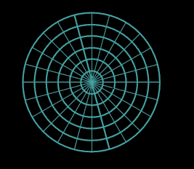
Polar Coordinates
So polar graph paper can use either degrees or (everybody’s favorite):
radians!
π/2
3π/4
π/4
π
1
2
3
4
5
6
0, 2π
5π/4
7π/4
3π/2
VFrench, 2021

Slide 107
Polar Coordinates
Degrees are traditionally used in navigation, surveying, and many applied disciplines
Radians are more common in mathematics and mathematical physics

Slide 108
POLAR COORDINATES
IN-CLASS PROBLEM 2e
Plot the polar coordinates:
P = (2.5,5π/4)
π/2
3π/4
π/4
π
1
2
3
4
5
6
0, 2π
5π/4
7π/4
3π/2
VFrench, 2021

Slide 109
POLAR COORDINATES
IN-CLASS PROBLEM 2e
Plot the polar coordinates:
P = (2.5,5π/4)
Did you get it right?
π/2
3π/4
π/4
π
1
2
3
4
5
6
0, 2π
5π/4
7π/4
3π/2
VFrench, 2021

Slide 110
POLAR COORDINATES
IN-CLASS PROBLEM 2f
Plot the polar coordinates:
P = (-4,-π/4)
π/2
3π/4
π/4
π
1
2
3
4
5
6
0, 2π
5π/4
7π/4
3π/2
VFrench, 2021

Slide 111
POLAR COORDINATES
IN-CLASS PROBLEM 2f
Plot the polar coordinates:
P = (-4,-π/4)
π/2
3π/4
π/4
π
1
2
3
4
5
6
0, 2π
(+4,-π/4)
5π/4
7π/4
3π/2
VFrench, 2021

Slide 112
POLAR COORDINATES
IN-CLASS PROBLEM 2f
Plot the polar coordinates:
P = (-4,-π/4)
Did you get it right?
π/2
3π/4
π/4
(-4,-π/4)
π
1
2
3
4
5
6
0, 2π
5π/4
7π/4
3π/2
VFrench, 2021

Slide 113
Questions?
http://i.imgur.com/aliTlT3.jpg

Slide 114
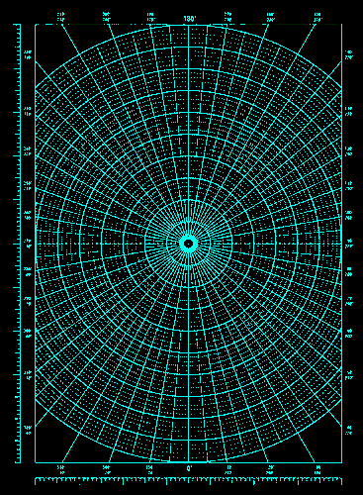
Polar Coordinates
In the West, polar graphs were originally created to plot complex numbers
That way,
no one could
confuse a
real number
graph with
a complex
one
3+4i
https://as1.ftcdn.net/v2/jpg/01/60/91/68/500_F_160916843_COfIenCS2NSkxfS8rqbLs20gmNEJzxv2.jpg

Slide 115
Polar Coordinates
Well, somebody figured out right away you could plop rectangular graph paper
right on top
and make it
an (x,y)
graph!
3+4i
https://as1.ftcdn.net/v2/jpg/01/60/91/68/500_F_160916843_COfIenCS2NSkxfS8rqbLs20gmNEJzxv2.jpg

Slide 116
Polar Coordinates
3 + 4i can be graphed:
i
4
3
2
1
0
ℝ
-4
-3
-2
-1
0
1
2
3
4
-1
-2
-3
-4

Slide 117
Polar Coordinates
In electrical engineering, this way of graphing complex numbers is called an Argand Diagram
https://www.electronics-tutorials.ws/accircuits/complex-numbers.html

Slide 118
Polar Coordinates
But, it’s not the same as a true polar graph!
How would you graph 30º or 2π?

Slide 119
Polar Coordinates
So then they needed a way to convert from polar to rectangular in a mathematically accurate way (not just by plopping rectangular graph paper over polar graphs!)

Slide 120
Polar Coordinates
Polar to rectangular conversion
If you have a polar point
P = (r,θ)
To convert to (x,y) coordinates:
x = r cos θ
y = r sin θ

Slide 121
POLAR COORDINATES
IN-CLASS PROBLEM 3a
Find the rectangular coordinates:
P = (-8,π/6)
x =
y =
x = r cos θ
y = r sin θ

Slide 122
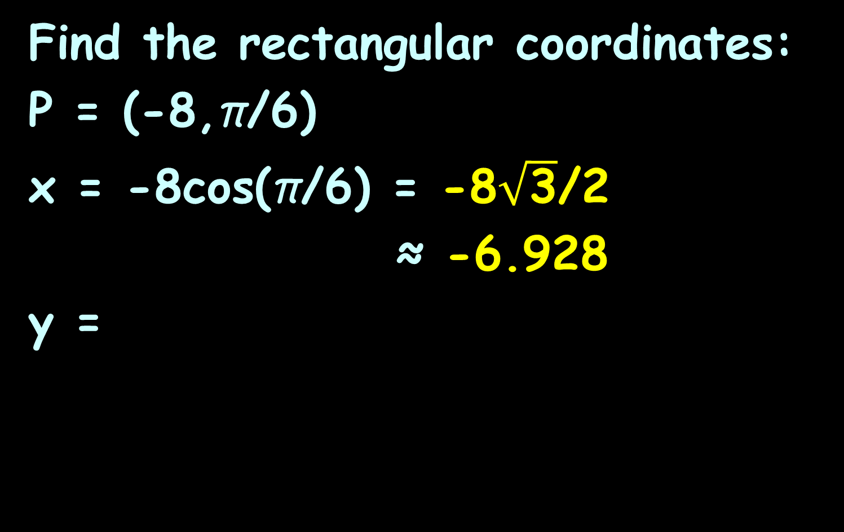
POLAR COORDINATES
IN-CLASS PROBLEM 3a
Find the rectangular coordinates:
P = (-8,π/6)
x = -8cos(π/6) = -8$\sqrt{\text{3}}$/2
≈ -6.928
y =
x = r cos θ
y = r sin θ

Slide 123
POLAR COORDINATES
IN-CLASS PROBLEM 3a
Find the rectangular coordinates:
P = (-8,π/6)
x ≈ -6.928
y = -8sin(π/6) = -4
What quadrant is it in?
II
I
III
IV
x = r cos θ
y = r sin θ

Slide 124
POLAR COORDINATES
IN-CLASS PROBLEM 3a
Find the rectangular coordinates:
P = (-8,π/6)
x ≈ -6.928
y = -4
What quadrant is it in? III
II
I
III
IV
x = r cos θ
y = r sin θ

Slide 125
Polar to Rectangular
Is P = (-8,π/6) in polar coordinates the same as
(x,y) = (-6.928,-4) in rectangular?

Slide 126
Polar to Rectangular
?
P = (-8,π/6) = (x,y) = (-6.928,-4)
(pretty close – just rounding error) and both are in QIII
7π/12
π/2
5π/12
2π/3
π/3
3π/4
π/4
6
5π/6
π/6
4
11π/12
π/12
2
π
0, 2π
0
2
4
6
-6
-4
-2
2
4
6
13π/12
23π/12
-2
7π/6
11π/6
-4
5π/4
7π/4
-6
4π/3
5π/3
17π/12
19π/12
VFrench, 2015
3π/2

Slide 127
POLAR COORDINATES
IN-CLASS PROBLEM 3b
Find the rectangular coordinates:
P = (3,π)
x =
y =
x = r cos θ
y = r sin θ

Slide 128
POLAR COORDINATES
IN-CLASS PROBLEM 3b
Find the rectangular coordinates:
P = (3,π)
x = 3cos(π) = -3
y =
x = r cos θ
y = r sin θ

Slide 129
POLAR COORDINATES
IN-CLASS PROBLEM 3b
Find the rectangular coordinates:
P = (3,π)
x = 3cos(π) = -3
y = 3sin(π) = 0
What quadrant is it in?
x = r cos θ
y = r sin θ

Slide 130
POLAR COORDINATES
IN-CLASS PROBLEM 3b
Find the rectangular coordinates:
P = (3,π)
x = 3cos(π) = -3
y = 3sin(π) = 0
What quadrant is it in?
“interquadrantal”
x = r cos θ
y = r sin θ

Slide 131
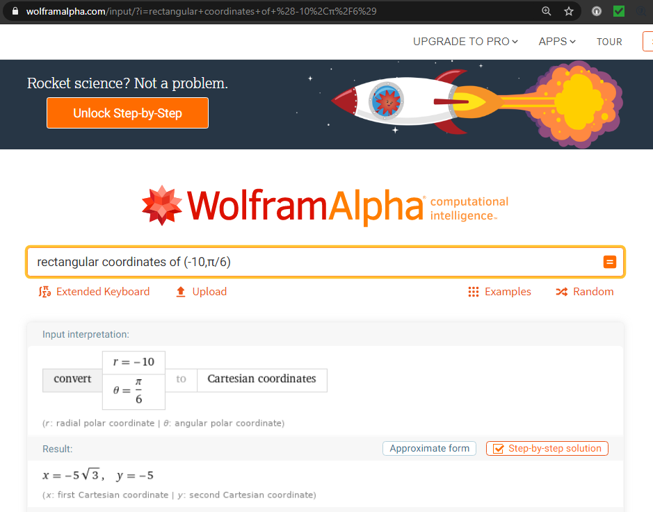

Slide 132
Polar Coordinates
For the graphs, you can use:
https://www.geogebra.org/m/jhKUc6Hm

Slide 133
Questions?
http://i.imgur.com/aliTlT3.jpg

Slide 134
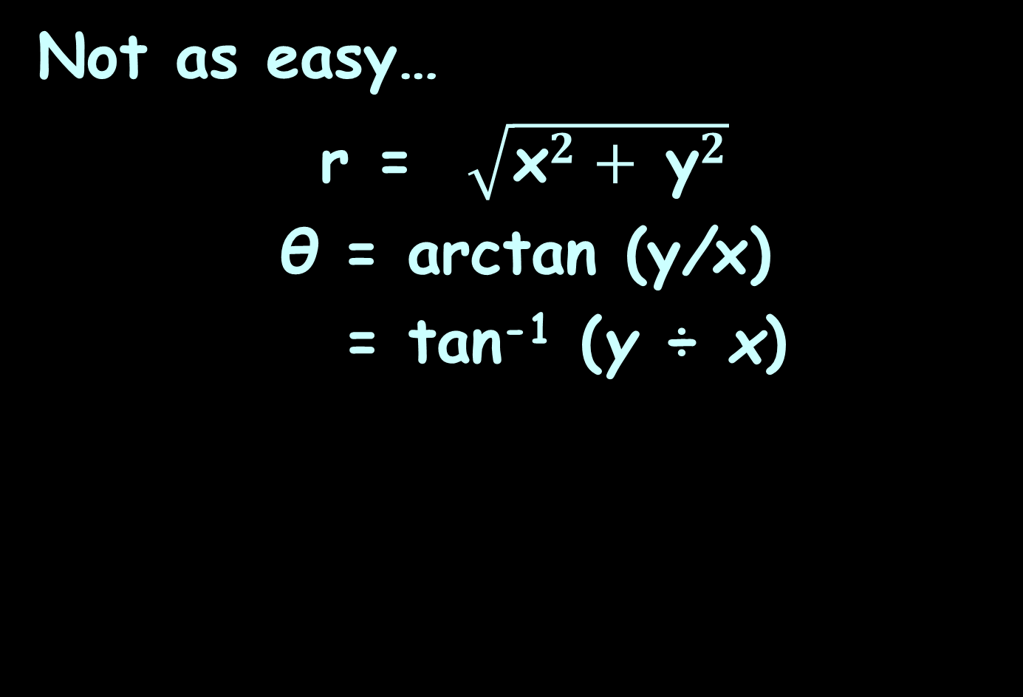
Rectangular to Polar
Not as easy…
r = $\sqrt{{\text{x}}^{2}+ {\text{y}}^{2}}$
θ = arctan (y/x)
= tan⁻¹ (y ÷ x)

Slide 135
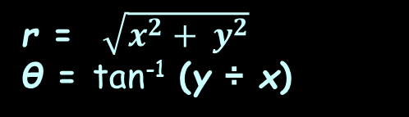
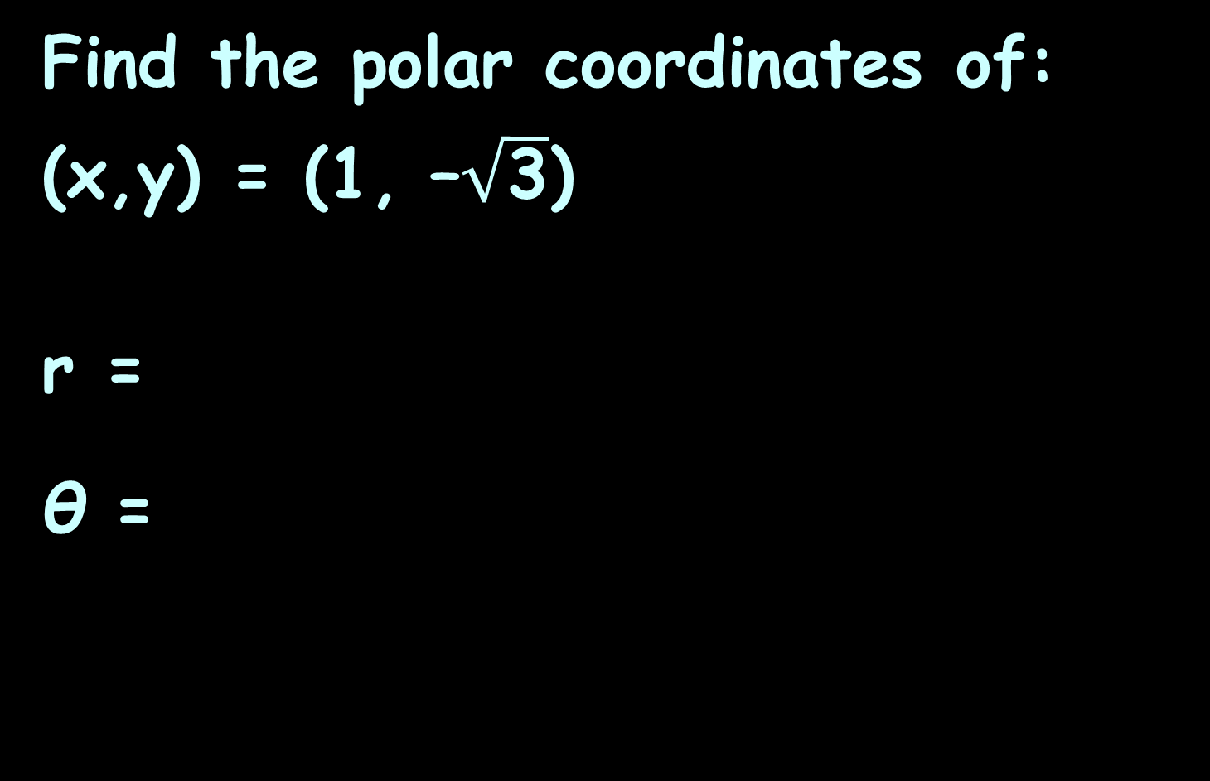
POLAR COORDINATES
IN-CLASS PROBLEM 4a
Find the polar coordinates of:
(x,y) = (1, –$\sqrt{\text{3}}$)
r =
θ =
r = $\sqrt{x^{2}+ y^{2}}$
θ = tan⁻¹ (y ÷ x)

Slide 136
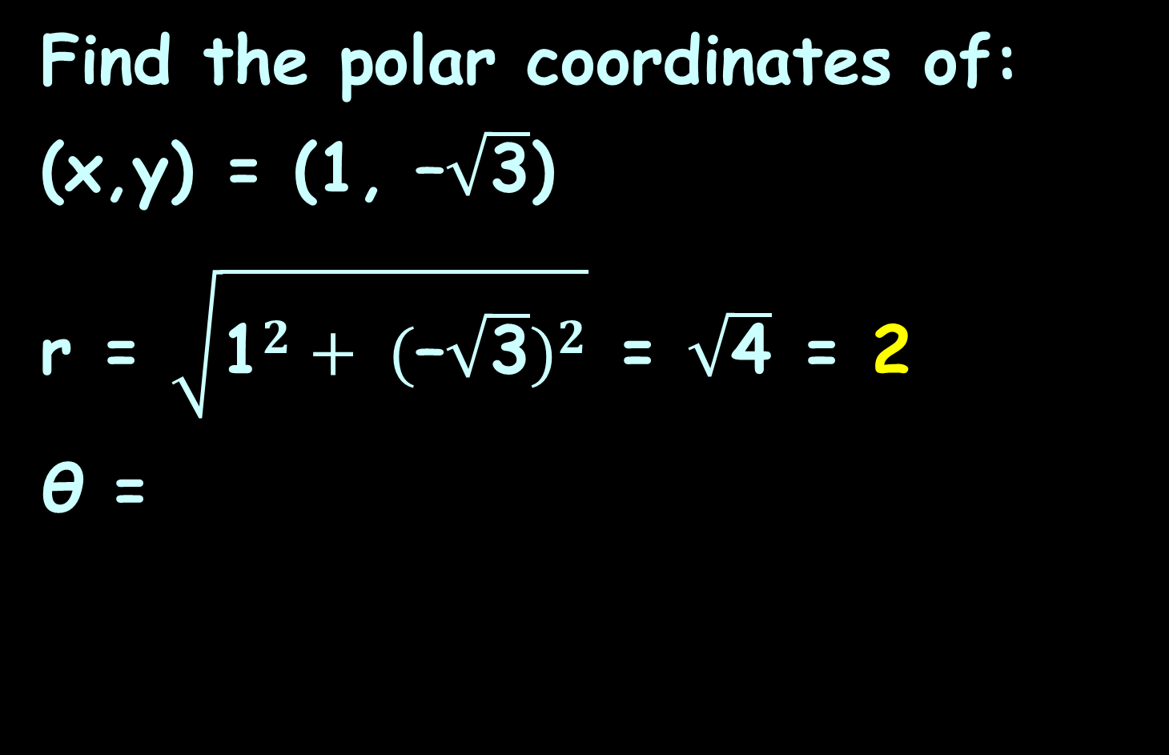
POLAR COORDINATES
IN-CLASS PROBLEM 4a
Find the polar coordinates of:
(x,y) = (1, –$\sqrt{\text{3}}$)
r = $\sqrt{{\text{1}}^{2}+ {(\text{–}\sqrt{\text{3}})}^{2}}$ = $\sqrt{\text{4}}$ = 2
θ =
r = $\sqrt{x^{2}+ y^{2}}$
θ = tan⁻¹ (y ÷ x)

Slide 137
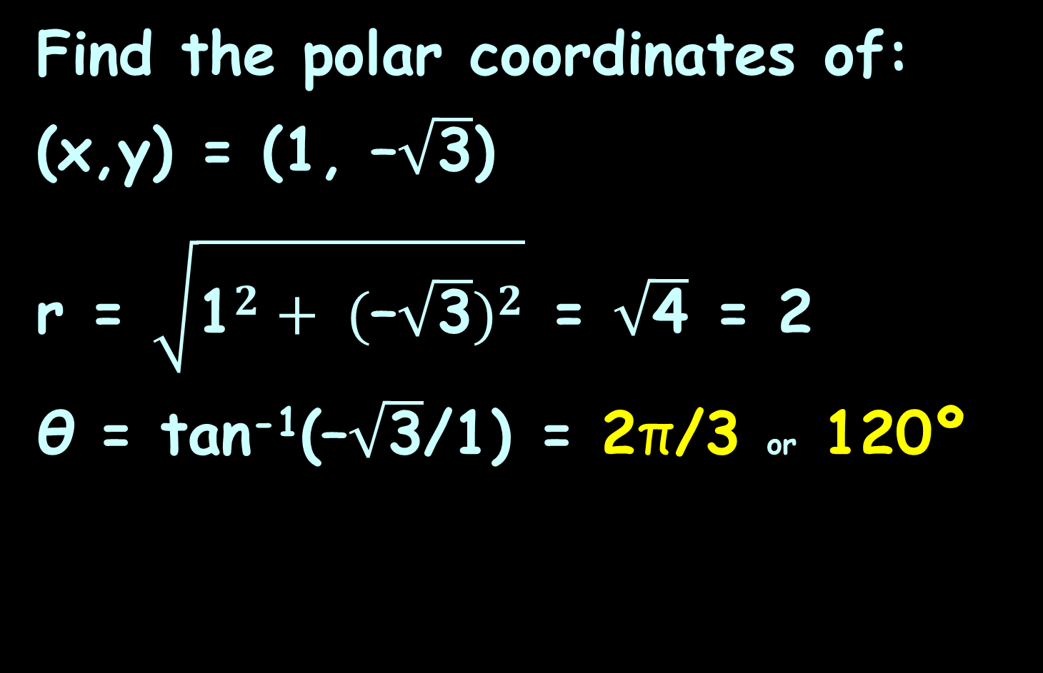
POLAR COORDINATES
IN-CLASS PROBLEM 4a
Find the polar coordinates of:
(x,y) = (1, –$\sqrt{\text{3}}$)
r = $\sqrt{{\text{1}}^{2}+ {(\text{–}\sqrt{\text{3}})}^{2}}$ = $\sqrt{\text{4}}$ = 2
θ = tan⁻¹($\text{–}\sqrt{\text{3}}$/1) = 2π/3 or 120º
r = $\sqrt{x^{2}+ y^{2}}$
θ = tan⁻¹ (y ÷ x)

Slide 138

Polar Coordinates
But… is it? Is (x,y) = (1,–$\sqrt{3}$)
the same as P = (2,120°)?
105º
90º
75º
4
120º
60º
3
135º
45º
2
150º
30º
165º
15º
1
0
180º
0º, 360º
-4
-3
-2
-1
0
1
2
3
4
1
2
3
-1
195º
345º
-2
210º
330º
-3
225º
315º
240º
300º
-4
255º
270º
285º
VFrench, 2015

Slide 139
Polar Coordinates
Oops! It’s in the wrong quadrant!
105º
90º
75º
4
120º
60º
3
135º
45º
2
150º
30º
165º
15º
1
0
180º
0º, 360º
-4
-3
-2
-1
0
1
2
3
4
1
2
3
-1
195º
345º
-2
210º
330º
-3
225º
315º
240º
300º
-4
255º
270º
285º
VFrench, 2015

Slide 140

Polar Coordinates
It should be the other tan⁻¹=–$\sqrt{3}$ = 300° or 5π/3 rad
105º
90º
75º
4
120º
60º
3
135º
45º
2
150º
30º
165º
15º
1
0
180º
0º, 360º
-4
-3
-2
-1
0
1
2
3
4
1
2
3
-1
195º
345º
-2
210º
330º
-3
225º
315º
240º
300º
-4
255º
270º
285º
VFrench, 2015

Slide 141
Polar Coordinates
You have to be VERY careful with these conversions to get the right quadrant!
(You see why we’ve been emphasizing quadrants?)

Slide 142
POLAR COORDINATES
IN-CLASS PROBLEM 4b
Find the polar coordinates of:
(x,y) = (0, – 4)
r =
θ =
r = $\sqrt{x^{2}+ y^{2}}$
θ = tan⁻¹ (y ÷ x)

Slide 143
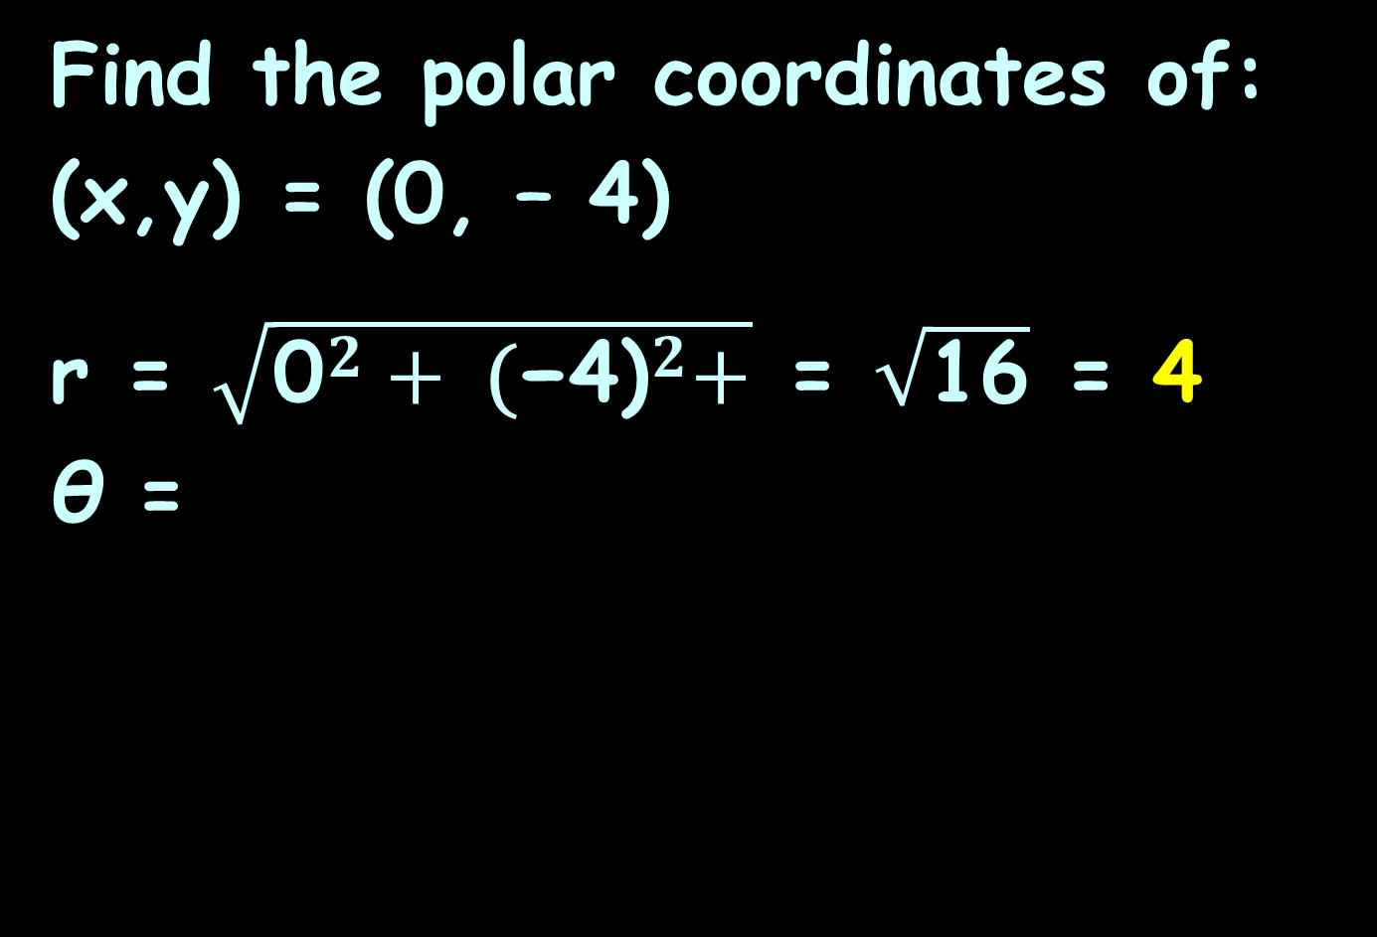
POLAR COORDINATES
IN-CLASS PROBLEM 4b
Find the polar coordinates of:
(x,y) = (0, – 4)
r = $\sqrt{{\text{0}}^{2}+ {\text{(}\text{−4)}}^{2}+}$ = $\sqrt{\text{16}}$ = 4
θ =
r = $\sqrt{x^{2}+ y^{2}}$
θ = tan⁻¹ (y ÷ x)

Slide 144
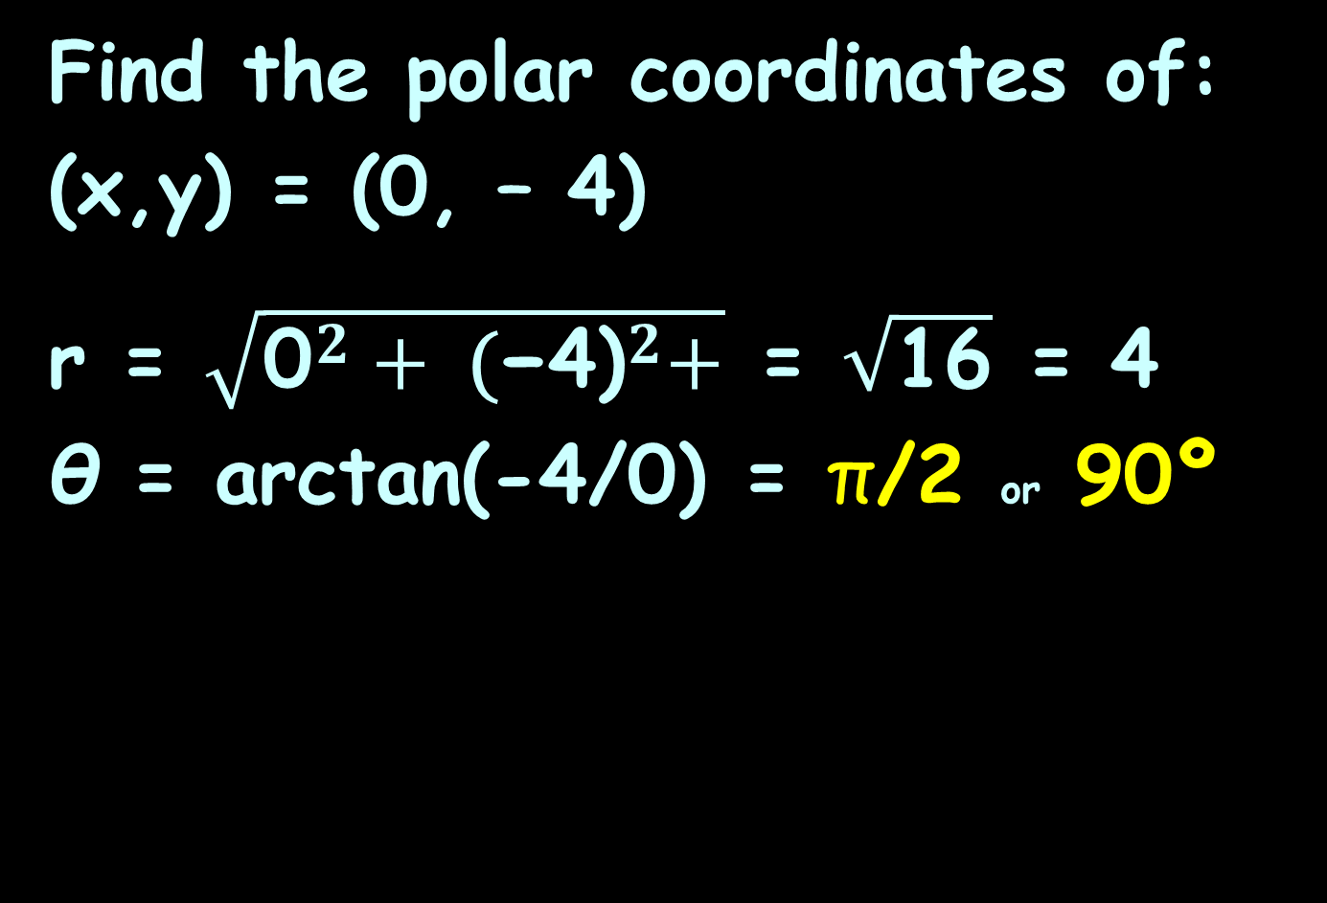
POLAR COORDINATES
IN-CLASS PROBLEM 4b
Find the polar coordinates of:
(x,y) = (0, – 4)
r = $\sqrt{{\text{0}}^{2}+ {\text{(}\text{−4)}}^{2}+}$ = $\sqrt{\text{16}}$ = 4
θ = arctan(-4/0) = π/2 or 90º
r = $\sqrt{x^{2}+ y^{2}}$
θ = tan⁻¹ (y ÷ x)

Slide 145
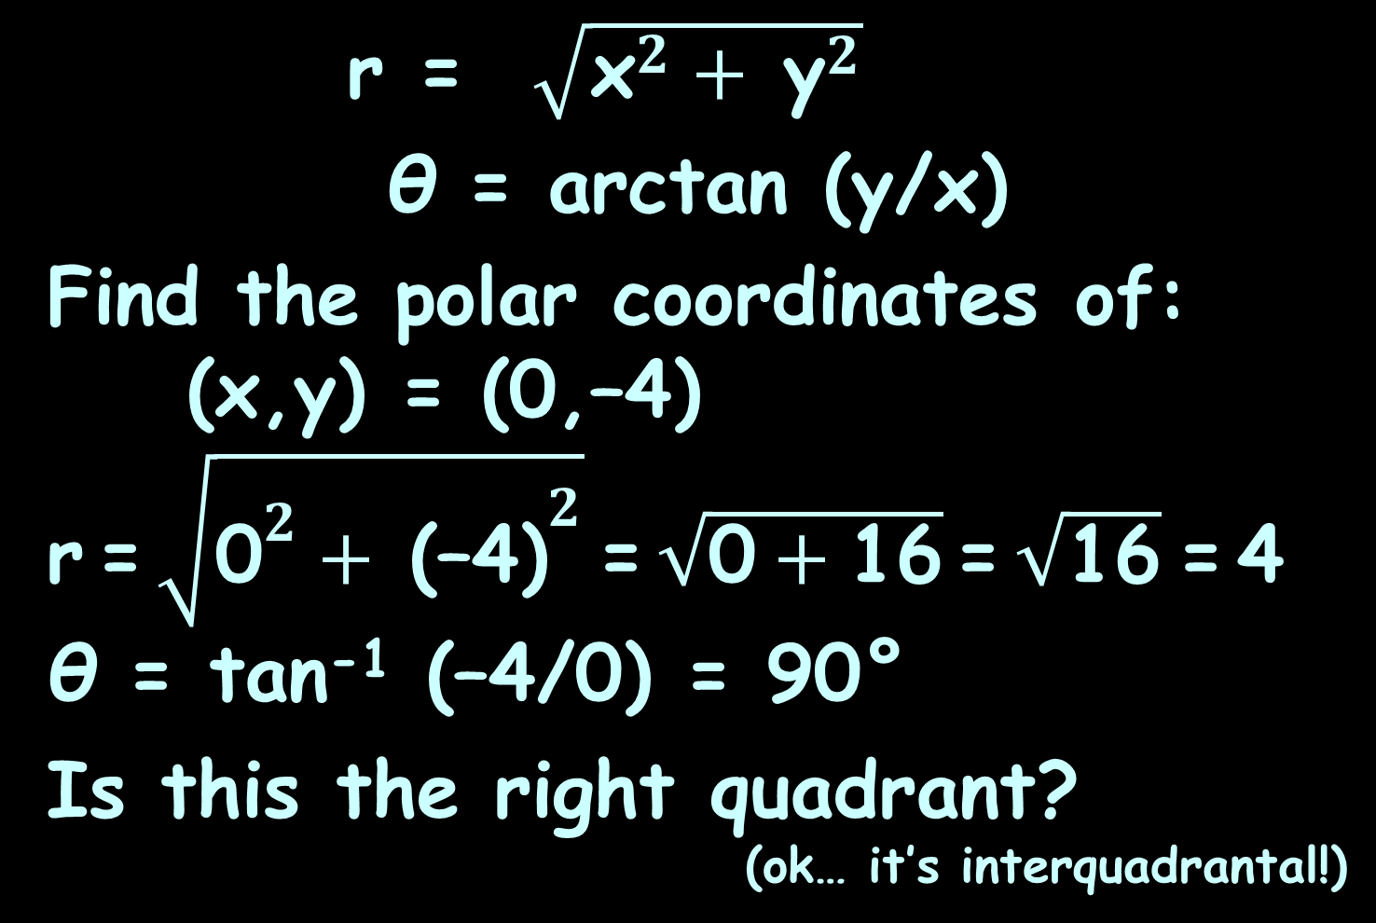
POLAR COORDINATES
IN-CLASS PROBLEM 4b
r = $\sqrt{{\text{x}}^{2}+ {\text{y}}^{2}}$
θ = arctan (y/x)
Find the polar coordinates of: (x,y) = (0,–4)
r = $\sqrt{{\text{0}}^{2}+ {\text{(–4)}}^{2}}$ = $\sqrt{\text{0}+\text{16}}$ = $\sqrt{\text{16}}$ = 4
θ = tan⁻¹ (–4/0) = 90°
Is this the right quadrant?
(ok… it’s interquadrantal!)

Slide 146
Polar Coordinates
(x,y) = (0,–4)
105º
90º
75º
4
120º
60º
3
135º
45º
2
150º
30º
165º
15º
1
0
180º
0º, 360º
-4
-3
-2
-1
0
1
2
3
4
2
4
-1
195º
345º
-2
210º
330º
-3
225º
315º
240º
300º
-4
255º
270º
285º
VFrench, 2015

Slide 147
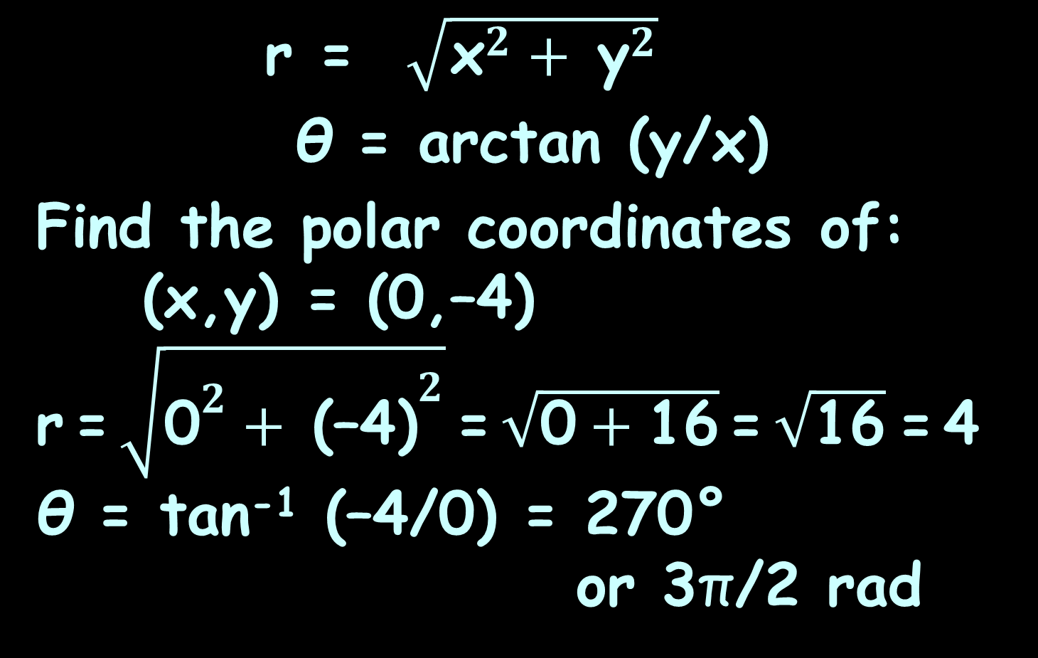
POLAR COORDINATES
IN-CLASS PROBLEM 4b
r = $\sqrt{{\text{x}}^{2}+ {\text{y}}^{2}}$
θ = arctan (y/x)
Find the polar coordinates of: (x,y) = (0,–4)
r = $\sqrt{{\text{0}}^{2}+ {\text{(–4)}}^{2}}$ = $\sqrt{\text{0}+\text{16}}$ = $\sqrt{\text{16}}$ = 4
θ = tan⁻¹ (–4/0) = 270°
or 3π/2 rad

Slide 148
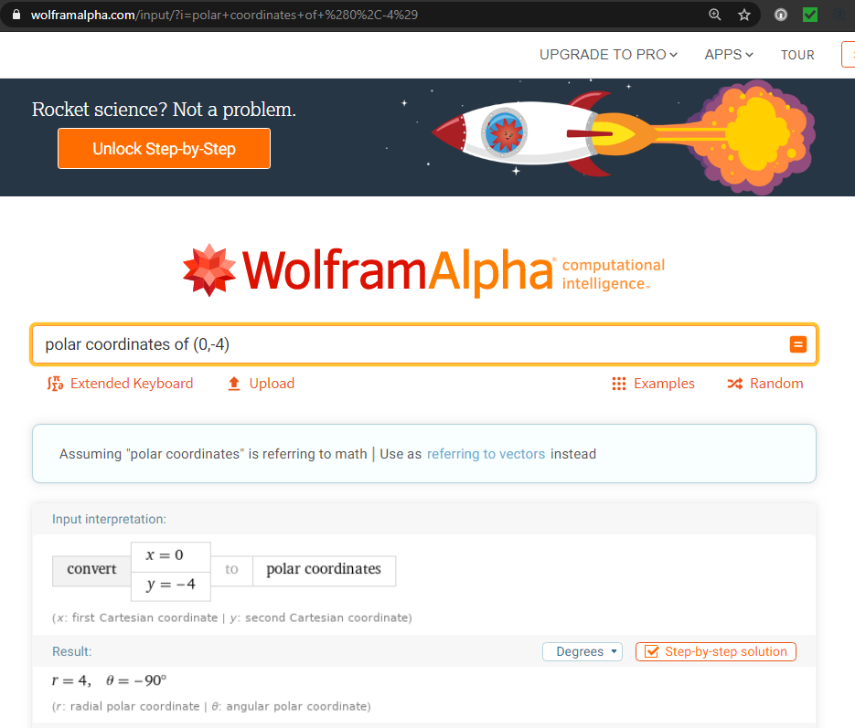

Slide 149
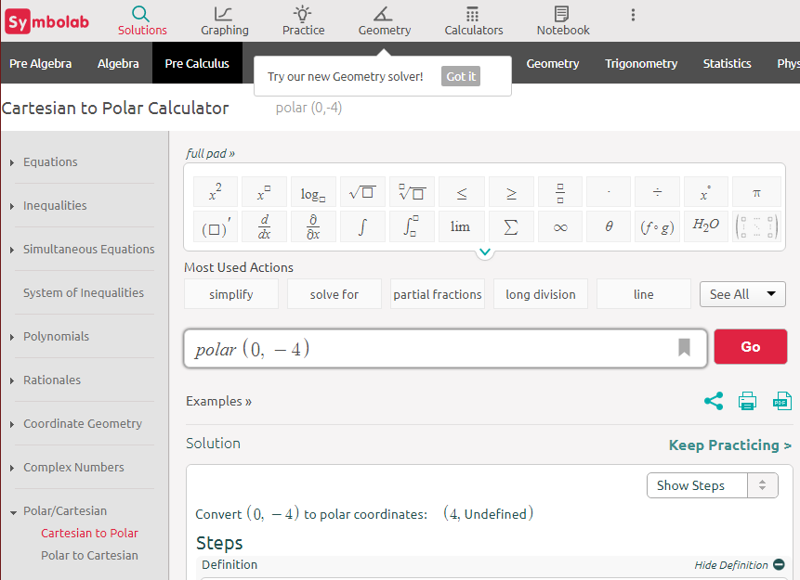

Slide 150
Polar Coordinates
The TI84 doesn’t work on this problem, but the TI89 does!

Slide 151
Questions?
http://i.imgur.com/aliTlT3.jpg

Slide 152
Polar Equations
Polar equations
have variables r and θ

Slide 153
Polar Equations
Converting rectangular equations to polar equations:
replace
x with r cosθ and
y with r sinθ

Slide 154
Polar Equations
This is, of course, an example of parametric equations

Slide 155
Polar Equations
x = cos t
y = sin t
Together, these equations are called a parametric representation of the curve

Slide 156
Polar Equations
Converting polar equations to rectangular equations is not easy –
you may have to square both sides,
take the tangent of both sides,
multiply both sides by r

Slide 157
Polar Equations
Try:
r ² = x² + y²
r cosθ = x
r sinθ = y
tanθ = y/x

Slide 158
Polar Equations
People actually use polar equations for real work…
But mostly you graph them because they change a ho-hum rectangular graph to a really interesting polar graph

Slide 159
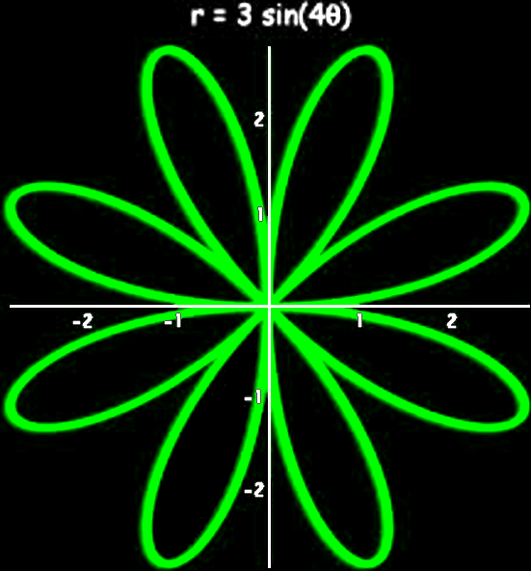
Polar Equations
14590966_346732725686454_3523543190558736384_n.jpg

Slide 160
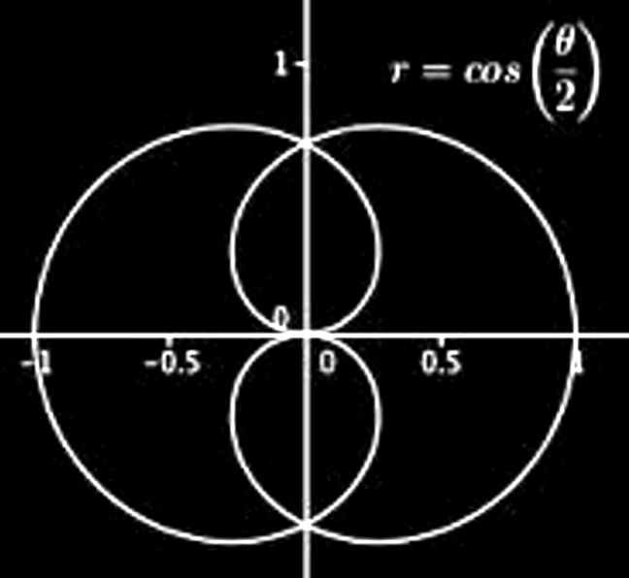
Polar Equations
14590966_346732725686454_3523543190558736384_q.jpg

Slide 161
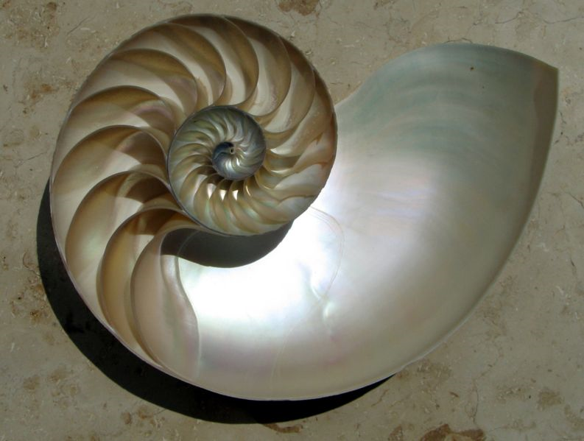
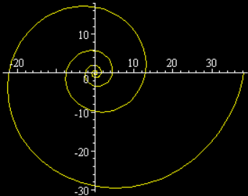
Polar Equations
Spiral of Archimedes
r = aθ
http://www.ceramicforms.com/wp-content/uploads/Nautilus_Cutaway_Logarithmic_Spiral.jpg

Slide 162
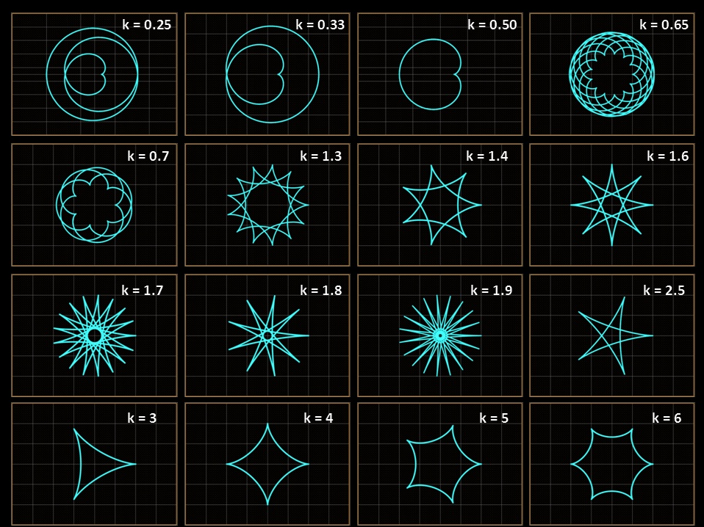
http://en.wikipedia.org/wiki/Parametric_equation#mediaviewer/File:Param_02.jpg

Slide 163
Polar Equations
https://telegrafi.com/wp-content/uploads/2016/01/dashuria-euml-sht-euml-matematik-euml-partneri-i-pest-euml-euml-sht-euml-ideali_hd.jpg

Slide 164
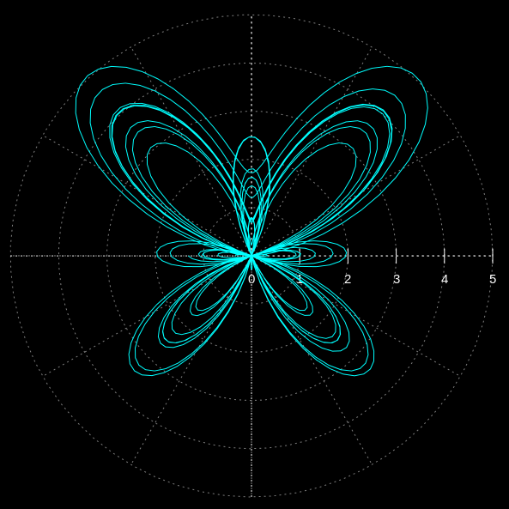
Polar Equations
http://en.wikipedia.org/wiki/Parametric_equation#mediaviewer/File:Butterfly_trans01.svg

Slide 165
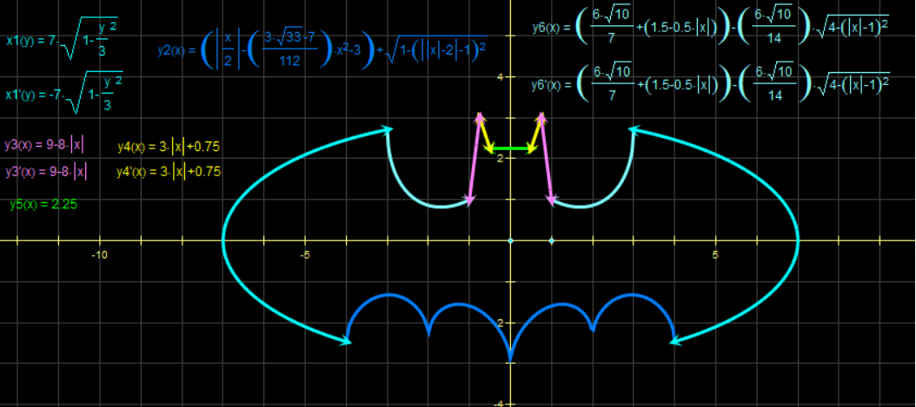
Polar Equations
http://4.bp.blogspot.com/-969pickI75I/Ud3W-cMdoRI/AAAAAAAACIo/H_umPfzRMeI/s1600/
1006005_681476468534370_67717180_n.png

Slide 166
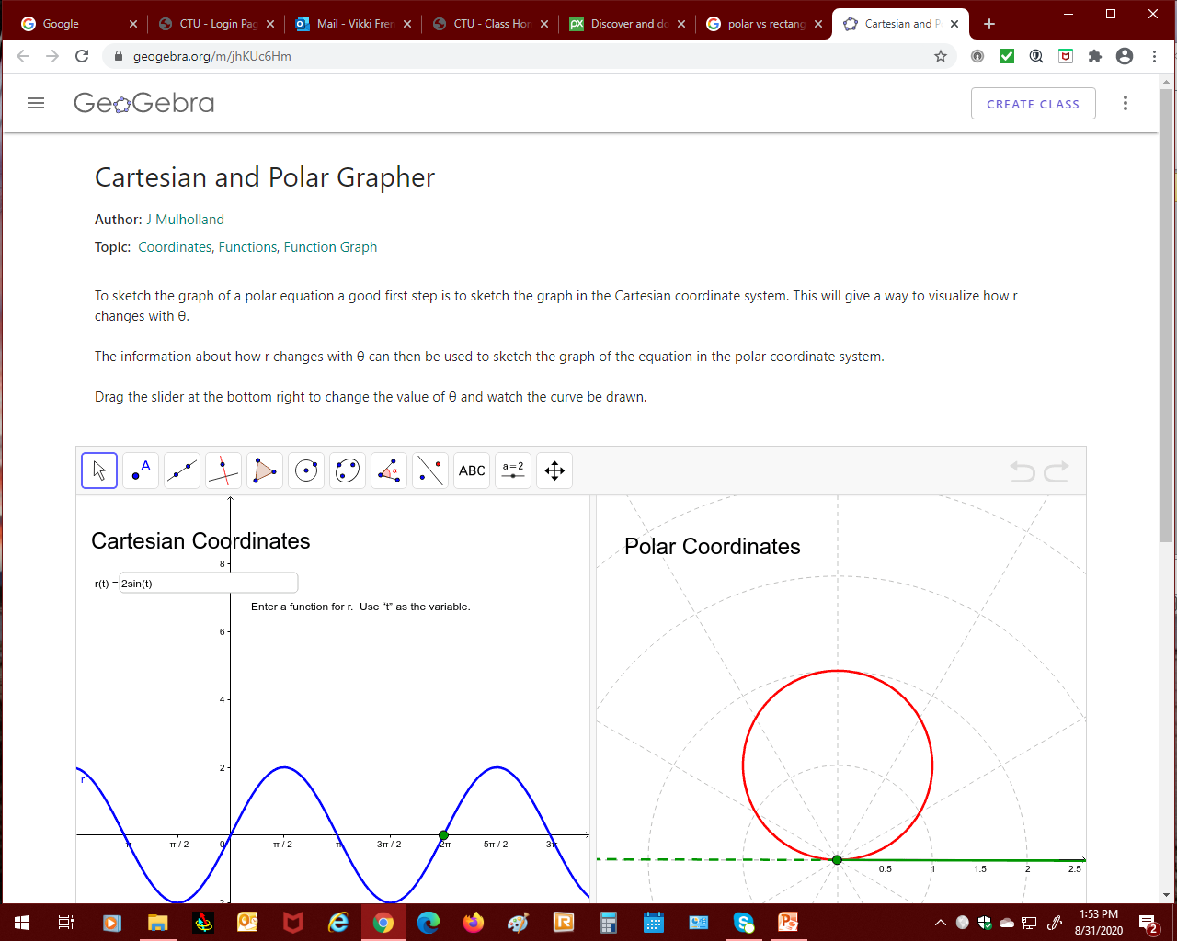
Graphing Polar Equations
https://www.geogebra.org

Slide 167
Questions?
http://i.imgur.com/aliTlT3.jpg

Slide 168

You Survived!
Today we studied:
Review of systems of
equations
Review of Matrices
Parametric Equations
www.playbuzz.com

