Slide 1
Welcome to
Unit 10 - Part 20
MATH116-Foundations for Calculus
https://media.istockphoto.com/vectors/green-blackboard-mathematical-with-thin-line-shapes-and-inscriptions-vector-id1084380192?k=6&m=1084380192&s=612x612&w=0&h=TcEOVpnUmyuswT4Pay
AL6lNiHU8SS8g33yOSg-jR5BE=

Slide 2
What’s Up?
Today we will be going over:
Review: parametric equations and polars
New stuff: partial fraction
decomposition

Slide 3
What’s Up?
Outcome 5) Decompose a rational function into partial fractions

Slide 4
Review
http://995642590.r.lightningbase-cdn.com/wp-content/uploads/2010/12/looking-back-hrexaminer-v144-cover425px.jpg

Slide 5
Parametric Equations
The problem is that not all curves or equations that we’d like to look at are functions
For example, we will never be able to write the equation of a circle down as function

Slide 6
Parametric Equations
There are also a great many curves out there that we can’t even write down as a single equation in terms of only x and y

Slide 7
Parametric Equations
So, to deal with some of these problems we introduce parametric equations

Slide 8
Parametric Equations
Parametric equations of a curve express the coordinates of the points of the curve as functions of a variable called a “parameter”

Slide 9
Parametric Equations
Instead of defining y in terms of x (y=f(x)) or x in terms of y (x=h(y)) we define both x and y in terms of a third variable called a parameter often designated “t”

Slide 10
Parametric Equations
The collection of points that we get by letting “t” be all possible values is the graph of the parametric equations and is called the parametric curve

Slide 11
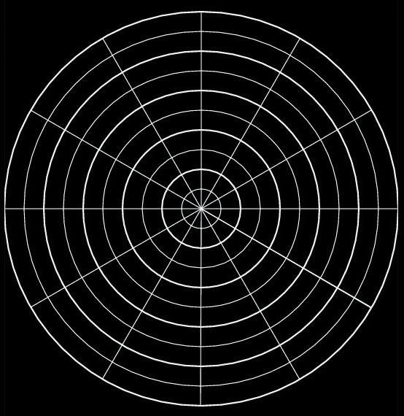
Polar Coordinates
r is the distance from the pole (the radius)
θ is the angle around the circle
.
.
r
θ
VFrench, 2015

Slide 12
Polar Coordinates
Positive angles are measured counterclockwise from the polar axis
Negative angles are measured clockwise from the polar axis
(you can subtract them from 360º)

Slide 13
Polar Coordinates
r > 0 – the point lies on the terminal side of θ
r < 0 - point lies along the ray opposite the terminal side of θ
r = 0 the point lies on the pole no matter what the value of θ is!

Slide 14
Polar Coordinates
Angles in polar notation can be expressed in either degrees or radians
105º
90º
75º
7π/12
π/2
5π/12
120º
60º
2π/3
π/3
135º
45º
3π/4
π/4
150º
30º
5π/6
π/6
165º
15º
11π/12
π/12
180º
1
2
3
0º, 360º
π
1
2
3
0, 2π
195º
345º
13π/12
23π/12
210º
330º
7π/6
11π/6
225º
315º
5π/4
7π/4
240º
300º
4π/3
5π/3
255º
270º
285º
17π/12
3π/2
19π/12
VFrench, 2015

Slide 15
Polar Coordinates
We need a way to convert from polar to rectangular in a mathematically accurate way (not just by plopping rectangular graph paper over polar graphs!)

Slide 16
Polar Coordinates
Polar to rectangular conversion
If you have a polar point
P = (r,θ)
To convert to (x,y) coordinates:
x = r cos θ
y = r sin θ

Slide 17
Polar Coordinates
Rectangular to polar coordinates
r = $\sqrt{x^{2}+ y^{2}}$
θ = arctan (y ÷ x)
= tan⁻¹ (y ÷ x)

Slide 18
Polar Coordinates
You have to be VERY careful with these conversions to get the right quadrant!
(That is why we emphasize quadrants)

Slide 19
Polar Equations
Polar equations
have variables r and θ

Slide 20
Polar Equations
Converting rectangular equations to polar equations:
replace
x with r cosθ and
y with r sinθ

Slide 21
Polar Equations
This is, of course, an example of parametric equations

Slide 22
Polar Equations
x = cos t
y = sin t
Together, these equations are called a parametric representation of the curve

Slide 23
Polar Equations
Converting polar equations to rectangular equations is not easy –
you may have to square both sides,
take the tangent of both sides,
multiply both sides by r

Slide 24
Polar Equations
Try:
r ² = x² + y²
r cosθ = x
r sinθ = y
tanθ = y/x

Slide 25
Questions?
http://i.imgur.com/aliTlT3.jpg

Slide 26
Partial Fractions
When we studied rational equations, we found they were equations containing fractions with polynomials in them

Slide 27
Partial Fractions
We solved them by getting all of the numerators over a common denominator, then we erased the denominators and just solved using the numerators

Slide 28
Partial Fractions
Remember, in math we always want to be able to “undo” all of our operations

Slide 29
Partial Fractions
Partial fractions is a way of "breaking apart" fractions with polynomials in them

Slide 30
Partial Fractions
This allows us to “undo” those rational equation solutions

Slide 31
Partial Fractions
It is how to find the "parts" that make up the single fraction (the "partial fractions")

Slide 32
Partial Fractions
Why would we want to do that?

Slide 33
Partial Fractions
Why would we want to do that?
Because the partial fractions are each simpler
This can help solve the more complicated fraction

Slide 34
Partial Fractions
We’ll be using it in integral calculus (MATH207)

Slide 35
Partial Fractions
Partial fractions can be pretty tough to solve—especially if fractions are not your strong point
https://www.campusreform.org/?ID=8934

Slide 36
Partial Fractions
Problems typically involve the splitting up of a single fraction into two or more fractions that each contain a single factor in the denominators

Slide 37
Partial Fractions
$\frac{\text{6}}{\text{x}\text{2}\text{+2}\text{x}\text{−8}} = \frac{\text{1}}{\text{x}\text{−2}}$ - $\frac{\text{1}}{\text{x}\text{+4}}$
means that you have expressed $\frac{\text{6}}{\text{x}\text{2}\text{+2}\text{x}\text{−8}}$ in partial fractions

Slide 38
Partial Fractions
$\frac{\text{6}}{\text{x}\text{2}\text{+2}\text{x}\text{−8}} = \frac{\text{1}}{\text{x}\text{−2}}$ - $\frac{\text{1}}{\text{x}\text{+4}}$
When we do this, it is called “partial fraction decomposition” or “pdf”

Slide 39
Partial Fractions
$\frac{\text{6}}{\text{x}\text{2}\text{+2}\text{x}\text{−8}} = \frac{\text{1}}{\text{x}\text{−2}}$ - $\frac{\text{1}}{\text{x}\text{+4}}$
Sometimes it is called “partial fraction expansion” or “pde”

Slide 40
Partial Fractions
$\frac{\text{6}}{\text{x}\text{2}\text{+2}\text{x}\text{−8}} = \frac{\text{1}}{\text{x}\text{−2}}$ - $\frac{\text{1}}{\text{x}\text{+4}}$
Note: you had to know (or figure out) that:
(x-2)(x+4) = x²+2x-8

Slide 41
Partial Fractions
$\frac{\text{6}}{\text{x}\text{2}\text{+2}\text{x}\text{−8}} = \frac{\text{1}}{\text{x}\text{−2}}$ - $\frac{\text{1}}{\text{x}\text{+4}}$
Note: you also had to balance the numerators (that is the tricky part)

Slide 42
PARTIAL FRACTION DECOMPOSITION
IN-CLASS PROBLEM 1
Express as a partial fraction:
$$\frac{\text{x}\text{−1 }}{\text{(3}\text{x}\text{−5) (}\text{x}\text{−3) }}$$

Slide 43
PARTIAL FRACTION DECOMPOSITION
IN-CLASS PROBLEM 1
Express as a partial fraction:
$$\frac{\text{x}\text{−1 }}{\text{(3}\text{x}\text{−5) (}\text{x}\text{−3) }}$$
First write the fraction as:
$\frac{\text{x}\text{−1 }}{\text{(3}\text{x}\text{−5) (}\text{x}\text{−3) }}$= $\frac{\text{A}}{\text{3}\text{x}\text{−5}}$ + $\frac{\text{B}}{\text{x}\text{−3}}$
A and B are the mystery numbers we need to discover

Slide 44
Partial Fractions
We’ll be solving this using algebra…
http://images.sodahead.com/polls/001429875/yuck_answer_8_xlarge_answer_2_xlarge.jpeg

Slide 45
PARTIAL FRACTION DECOMPOSITION
IN-CLASS PROBLEM 1
$\frac{\text{x}\text{−1 }}{\text{(3}\text{x}\text{−5) (}\text{x}\text{−3) }}$= $\frac{\text{A}}{\text{3}\text{x}\text{−5}}$ + $\frac{\text{B}}{\text{x}\text{−3}}$
First get rid of the denominators by multiplying:
$\frac{\text{(}\text{x}\text{−1}\text{)}\text{(3}\text{x}\text{−5)(}\text{x}\text{−3)}}{\text{(3}\text{x}\text{−5) (}\text{x}\text{−3) }}$ =
= $\frac{\text{A}\text{(3}\text{x}\text{−5)(}\text{x}\text{−3)}}{\text{3}\text{x}\text{−5}}$ + $\frac{\text{B}\text{(3}\text{x}\text{−5)(}\text{x}\text{−3)}}{\text{x}\text{−3}}$

Slide 46
PARTIAL FRACTION DECOMPOSITION
IN-CLASS PROBLEM 1
Cancel out stuff:
$\frac{\text{(}\text{x}\text{−1}\text{)}\text{(3}\text{x}\text{−5)(}\text{x}\text{−3)}}{\text{(3}\text{x}\text{−5) (}\text{x}\text{−3) }}$ =
= $\frac{\text{A}\text{(3}\text{x}\text{−5)(}\text{x}\text{−3)}}{\text{3}\text{x}\text{−5}}$ + $\frac{\text{B}\text{(3}\text{x}\text{−5)(}\text{x}\text{−3)}}{\text{x}\text{−3}}$
Now we have:
x - 1 = A(x-3) + B(3x-5)

Slide 47
PARTIAL FRACTION DECOMPOSITION
IN-CLASS PROBLEM 1
x - 1 = A(x-3) + B(3x-5)
Our strategy:
get one of the factors multiplying A or B to be 0…

Slide 48
PARTIAL FRACTION DECOMPOSITION
IN-CLASS PROBLEM 1
x - 1 = A(x-3) + B(3x-5)
Our strategy:
get one of the factors multiplying A or B to be 0…
Like if x=3
(as usual, start by looking for an “easy” 0, but you’ll end up doing both of them)

Slide 49
PARTIAL FRACTION DECOMPOSITION
IN-CLASS PROBLEM 1
x - 1 = A(x-3) + B(3x-5)
Plug in x=3:
3 – 1 = A(3-3) + B(3×3-5)
2 = 0 + B(4)
So B = 2/4 or ½ or 0.5
Repeat the process with “B” to calculate “A”

Slide 50
PARTIAL FRACTION DECOMPOSITION
IN-CLASS PROBLEM 1
x - 1 = A(x-3) + B(3x-5)
What would x have to be to make the “B” factor 0?

Slide 51
PARTIAL FRACTION DECOMPOSITION
IN-CLASS PROBLEM 1
x - 1 = A(x-3) + B(3x-5)
What would x have to be to make the “B” factor 0?
x = 5/3

Slide 52
PARTIAL FRACTION DECOMPOSITION
IN-CLASS PROBLEM 1
x - 1 = A(x-3) + B(3x-5)
Plug in x=5/3

Slide 53
PARTIAL FRACTION DECOMPOSITION
IN-CLASS PROBLEM 1
x - 1 = A(x-3) + B(3x-5)
Plug in x=5/3
5/3 – 1 = A(5/3-3) + B(3×5/3-5)
2/3 = A(-4/3)
So A = $\frac{\text{2/3}}{\text{−4/3}}$ = -½ = -0.5
Now we have the answer to our problem!

Slide 54
Partial Fractions
$\frac{\text{x}\text{−1 }}{\text{(3}\text{x}\text{−5) (}\text{x}\text{−3) }}$= $\frac{\text{−}\text{0.5}}{\text{3}\text{x}\text{−5}}$ + $\frac{\text{0.5}}{\text{x}\text{−3}}$
or
$\frac{\text{x}\text{−1 }}{\text{(3}\text{x}\text{−5) (}\text{x}\text{−3) }}$= $\frac{\text{−1}}{\text{2(3}\text{x}\text{−5)}}$ + $\frac{\text{1}}{\text{2(}\text{x}\text{−}\text{3)}}$
or
$\frac{\text{x}\text{−1 }}{\text{(3}\text{x}\text{−5) (}\text{x}\text{−3) }}$= $\frac{\text{−1}}{\text{6}\text{x}\text{−}\text{10}\text{)}}$ + $\frac{\text{1}}{\text{2}\text{x}\text{−}\text{6}}$

Slide 55
Questions?
http://i.imgur.com/aliTlT3.jpg

Slide 56
PARTIAL FRACTION DECOMPOSITION
IN-CLASS PROBLEM 2
Express as a partial fraction:
(5x-4)/(x²-x-2)

Slide 57
PARTIAL FRACTION DECOMPOSITION
IN-CLASS PROBLEM 2
Express as a partial fraction:
(5x-4)/(x²-x-2)
Step 1: factor the denominator

Slide 58
PARTIAL FRACTION DECOMPOSITION
IN-CLASS PROBLEM 2
Express as a partial fraction:
(5x-4)/(x²-x-2)
Step 1: factor the denominator
(x²-x-2)
Well, the constant “-2” is going to have to be: -2×1 or 2×-1

Slide 59
PARTIAL FRACTION DECOMPOSITION
IN-CLASS PROBLEM 2
Express as a partial fraction:
(5x-4)/(x²-x-2)
Step 1: factor the denominator
(x²-x-2)
Well, the constant “-2” is going to have to be: -2×1 or 2×-1
The “-x” means choose -2×1
Factoring x is easy: x×x

Slide 60
PARTIAL FRACTION DECOMPOSITION
IN-CLASS PROBLEM 2
Express as a partial fraction:
(5x-4)/(x²-x-2)
Step 1: factor the denominator
(x²-x-2) = (x-2)(x+1)
(5x-4)/(x²-x-2)=(5x-4)/(x-2)(x+1)

Slide 61
Partial Fractions
Note: because of the factoring, you might end up with complex numbers

Slide 62
Partial Fractions
Note: because of the factoring, you might end up with complex numbers
It is traditional in partial fraction decomposition to declare “I surrender” at this point

Slide 63
PARTIAL FRACTION DECOMPOSITION
IN-CLASS PROBLEM 2
Express as a partial fraction:
(5x-4)/(x²-x-2)
Step 1: factor the denominator
(x²-x-2) = (x-2)(x+1)
(5x-4)/(x²-x-2)=(5x-4)/(x-2)(x+1)
Step 2: Write one partial fraction for each of those factors (the “A” “B” thing)

Slide 64
PARTIAL FRACTION DECOMPOSITION
IN-CLASS PROBLEM 2
Express as a partial fraction:
(5x-4)/(x²-x-2) = A/(x-2) + B/(x+1)
Step 2: Write one partial fraction for each of those factors (the “A” “B” thing)
(5x-4)/(x²-x-2)=(5x-4)/(x-2)(x+1)
=A/(x-2) + B/(x+1)
Multiply all the numerators by all the denominators

Slide 65
PARTIAL FRACTION DECOMPOSITION
IN-CLASS PROBLEM 2
Express as a partial fraction:
(5x-4)/(x²-x-2) = A/(x-2) + B/(x+1)
$\frac{\text{(5}\text{x}\text{−4)(}\text{x}\text{−2)(}\text{x}\text{+1)}}{\text{(}\text{x}\text{−2)(}\text{x}\text{+1)}}$ =
= $\frac{\text{A}\text{(}\text{x}\text{−2)(}\text{x}\text{+1)}}{\text{(}\text{x}\text{−2)}}$ + $\frac{\text{B}\text{(}\text{x}\text{−2)(}\text{x}\text{+1)}}{\text{(}\text{x}\text{+1}\text{)}}$
Now, cancel stuff! (The fun part!)

Slide 66
PARTIAL FRACTION DECOMPOSITION
IN-CLASS PROBLEM 2
Express as a partial fraction:
(5x-4)/(x²-x-2) = A/(x-2) + B/(x+1)
$\frac{\text{(5}\text{x}\text{−4)(}\text{x}\text{−2)(}\text{x}\text{+1)}}{\text{(}\text{x}\text{−2)(}\text{x}\text{+1)}}$ =
= $\frac{\text{A}\text{(}\text{x}\text{−2)(}\text{x}\text{+1)}}{\text{(}\text{x}\text{−2)}}$ + $\frac{\text{B}\text{(}\text{x}\text{−2)(}\text{x}\text{+1)}}{\text{(}\text{x}\text{+1}\text{)}}$
So we have:
5x-4 = A(x+1) + B(x-2)
Now find the zeros! Zero for A?

Slide 67
PARTIAL FRACTION DECOMPOSITION
IN-CLASS PROBLEM 2
Express as a partial fraction:
(5x-4)/(x²-x-2) = A/(x-2) + B/(x+1)
5x-4 = A(x+1) + B(x-2)
The zeros for A will happen at
x = -1, so plug that in!

Slide 68
PARTIAL FRACTION DECOMPOSITION
IN-CLASS PROBLEM 2
Express as a partial fraction:
(5x-4)/(x²-x-2) = A/(x-2) + B/(x+1)
5x-4 = A(x+1) + B(x-2)
The zeros for A will happen at
x = -1:
5(-1)-4 = A(-1+1) + B(-1-2)
-9 = 0 -3B
So B = ?

Slide 69
PARTIAL FRACTION DECOMPOSITION
IN-CLASS PROBLEM 2
Express as a partial fraction:
(5x-4)/(x²-x-2) = A/(x-2) + 3/(x+1)
5x-4 = A(x+1) + B(x-2)
The zeros for A will happen at
x = -1:
5(-1)-4 = A(-1+1) + B(-1-2)
-9 = 0 -3B
So B = 3
Now, what is the zero for B?

Slide 70
PARTIAL FRACTION DECOMPOSITION
IN-CLASS PROBLEM 2
Express as a partial fraction:
(5x-4)/(x²-x-2) = A/(x-2) + 3/(x+1)
5x-4 = A(x+1) + B(x-2)
The zeros for B will happen at
x = 2, so plug that in!

Slide 71
PARTIAL FRACTION DECOMPOSITION
IN-CLASS PROBLEM 2
Express as a partial fraction:
(5x-4)/(x²-x-2) = A/(x-2) + 3/(x+1)
5x-4 = A(x+1) + B(x-2)
The zeros for B will happen at
x = 2:
5(2)-4 = A(2+1) + 3(2-2)

Slide 72
PARTIAL FRACTION DECOMPOSITION
IN-CLASS PROBLEM 2
Express as a partial fraction:
(5x-4)/(x²-x-2) = A/(x-2) + 3/(x+1)
5x-4 = A(x+1) + B(x-2)
The zeros for B will happen at
x = 2:
5(2)-4 = A(2+1) + 3(2-2)
6 = 3A + 0
So A = ?

Slide 73
PARTIAL FRACTION DECOMPOSITION
IN-CLASS PROBLEM 2
Express as a partial fraction:
(5x-4)/(x²-x-2) = 2/(x-2) + 3/(x+1)
5x-4 = A(x+1) + B(x-2)
The zeros for B will happen at
x = 2:
5(2)-4 = A(2+1) + B(2-2)
6 = 3A + 0
So A = 2

Slide 74
PARTIAL FRACTION DECOMPOSITION
IN-CLASS PROBLEM 2
Express as a partial fraction:
(5x-4)/(x²-x-2) = 2/(x-2) + 3/(x+1)

Slide 75
Questions?
http://i.imgur.com/aliTlT3.jpg

Slide 76
Partial Fractions
Partial fraction decomposition (PFD) is the “undo” (inverse) of combining rational functions over a common denominator

Slide 77
Partial Fractions
In general: if ƒ(x) = P(x)/Q(x)
where P and Q are polynomials
and the degree of P is less than the degree of Q (a “proper” fraction) then it is possible to express ƒ as a sum of simpler fractions

Slide 78
PARTIAL FRACTION DECOMPOSITION
IN-CLASS PROBLEM 3
Can you express this as a sum of simpler fractions?
(x-3)/((x+5)(x-1))
(x²-3)/((x+5)(x-1))
(x³-3)/((x+5)(x-1))
(x³-3)/((x²+5)(x²-1))
For ƒ(x)=P(x)/Q(x), if the degree of P is less than the degree of Q, then it is possible to express ƒ as a sum of simpler fractions

Slide 79
PARTIAL FRACTION DECOMPOSITION
IN-CLASS PROBLEM 3
Can you express this as a sum of simpler fractions?
(x-3)/((x+5)(x-1)) yes
(x²-3)/((x+5)(x-1))
(x³-3)/((x+5)(x-1))
(x³-3)/((x²+5)(x²-1))
For ƒ(x)=P(x)/Q(x), if the degree of P is less than the degree of Q, then it is possible to express ƒ as a sum of simpler fractions

Slide 80
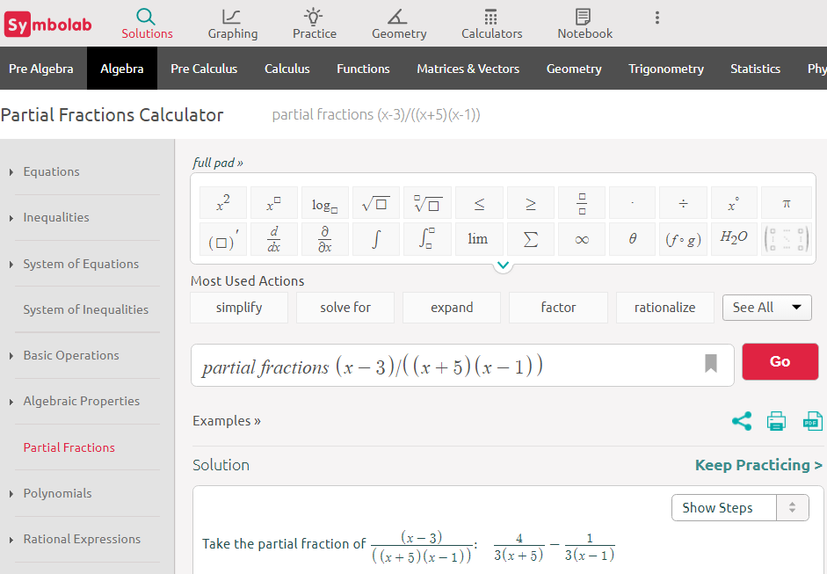

Slide 81
PARTIAL FRACTION DECOMPOSITION
IN-CLASS PROBLEM 3
Can you express this as a sum of simpler fractions?
(x-3)/((x+5)(x-1)) yes
(x²-3)/((x+5)(x-1)) no
(x³-3)/((x+5)(x-1))
(x³-3)/((x²+5)(x²-1))
For ƒ(x)=P(x)/Q(x), if the degree of P is less than the degree of Q, then it is possible to express ƒ as a sum of simpler fractions

Slide 82
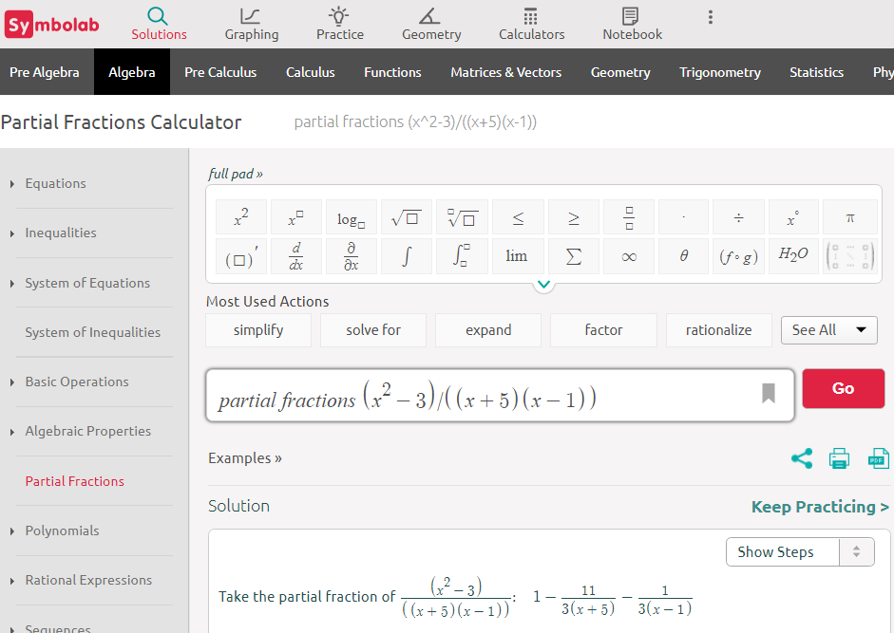

Slide 83
PARTIAL FRACTION DECOMPOSITION
IN-CLASS PROBLEM 3
Can you express this as a sum of simpler fractions?
(x-3)/((x+5)(x-1)) yes
(x²-3)/((x+5)(x-1)) no
(x³-3)/((x+5)(x-1)) no
(x³-3)/((x²+5)(x²-1))
For ƒ(x)=P(x)/Q(x), if the degree of P is less than the degree of Q, then it is possible to express ƒ as a sum of simpler fractions

Slide 84
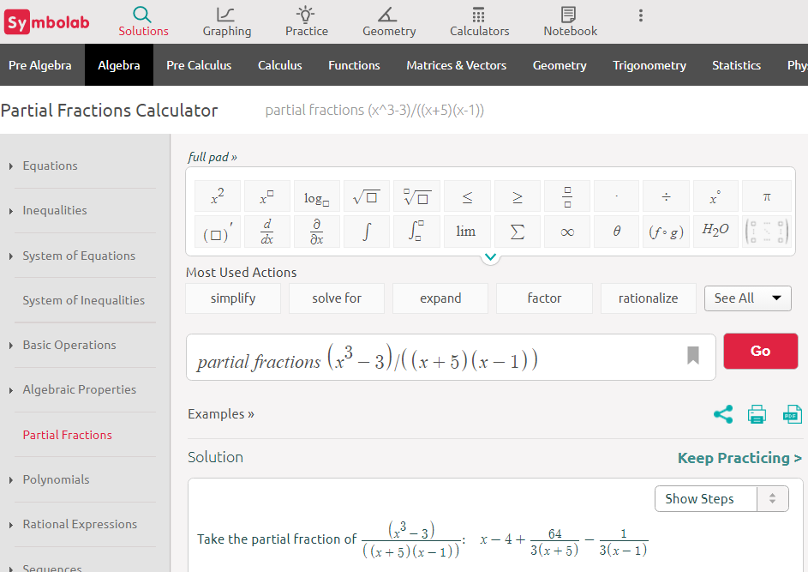

Slide 85
PARTIAL FRACTION DECOMPOSITION
IN-CLASS PROBLEM 3
Can you express this as a sum of simpler fractions?
(x-3)/((x+5)(x-1)) yes
(x²-3)/((x+5)(x-1)) no
(x³-3)/((x+5)(x-1)) no
(x³-3)/((x²+5)(x²-1)) yes
For ƒ(x)=P(x)/Q(x), if the degree of P is less than the degree of Q, then it is possible to express ƒ as a sum of simpler fractions

Slide 86
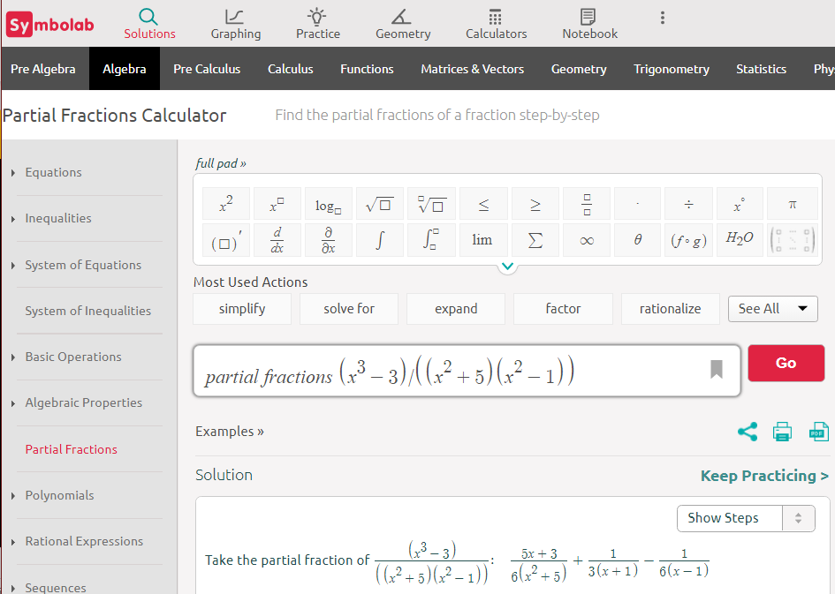

Slide 87
Partial Fractions
Note: if the denominator has a higher degree than the numerator, you must solve the problem using polynomial long division (which we did in week 05)

Slide 88
Questions?
http://i.imgur.com/aliTlT3.jpg

Slide 89
Partial Fractions
Sometimes you may get a factor with an exponent, like (x−2)³
For this problem you will need a partial fraction for each exponent
(x−2)³ has partial fractions:
A₁/x−2 + A₂/(x−2)² + A₃/(x−2)³

Slide 90
Partial Fractions
Even after using the roots (zeros) of the denominator, you can end up with unknown constants
So the next thing to do is:
Gather all powers of x together and then solve it as a system of linear equations

Slide 91
Partial Fractions
Summary:
1) Start with a Proper Rational
Expressions (if not, do
division first)
2) Factor the bottom into linear
factors or "irreducible"
quadratic factors

Slide 92
Partial Fractions
Summary:
3) Write out a partial fraction
for each factor (and every
exponent of each)
4) Multiply the whole equation
by the bottom

Slide 93
Partial Fractions
Summary:
5) Solve for the coefficients by
substituting zeros of the
bottom or making a system
of linear equations (of each
power) and solving
6) Victory!

Slide 94
Questions?
http://i.imgur.com/aliTlT3.jpg

Slide 95
Partial Fractions
Students love doing partial fractions…
http://2.bp.blogspot.com/-FO4FNaHVPdg/TlnSJr9Sv8I/AAAAAAAACxI/SM31CPHBgQA/
s1600/I%20hate%20myself%20wallpaper1.jpg

Slide 96
PARTIAL FRACTION DECOMPOSITION
IN-CLASS PROBLEM 4a
Express as a partial fraction:
(x-3)/(x²+5)

Slide 97
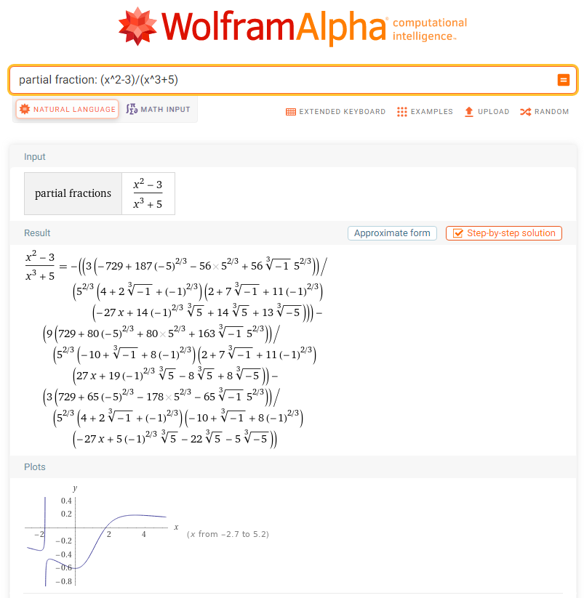

Slide 98
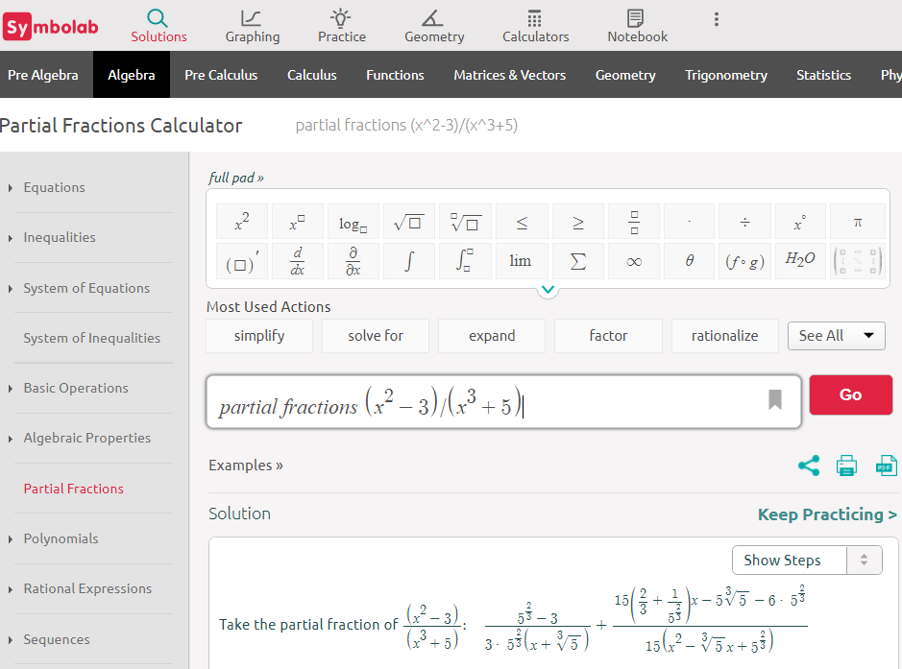

Slide 99
Partial Fractions
Note: this is NOT a problem you would want to do by hand…

Slide 100
Partial Fractions
There may be a way to do this in Microsoft Math Solver, but I haven’t found it yet…

Slide 101
PARTIAL FRACTION DECOMPOSITION
IN-CLASS PROBLEM 4b
Express as a partial fraction:
$$\frac{\text{1 }}{\text{(}\text{x}\text{+}\text{5) (}\text{x}\text{+4}\text{) }}$$

Slide 102
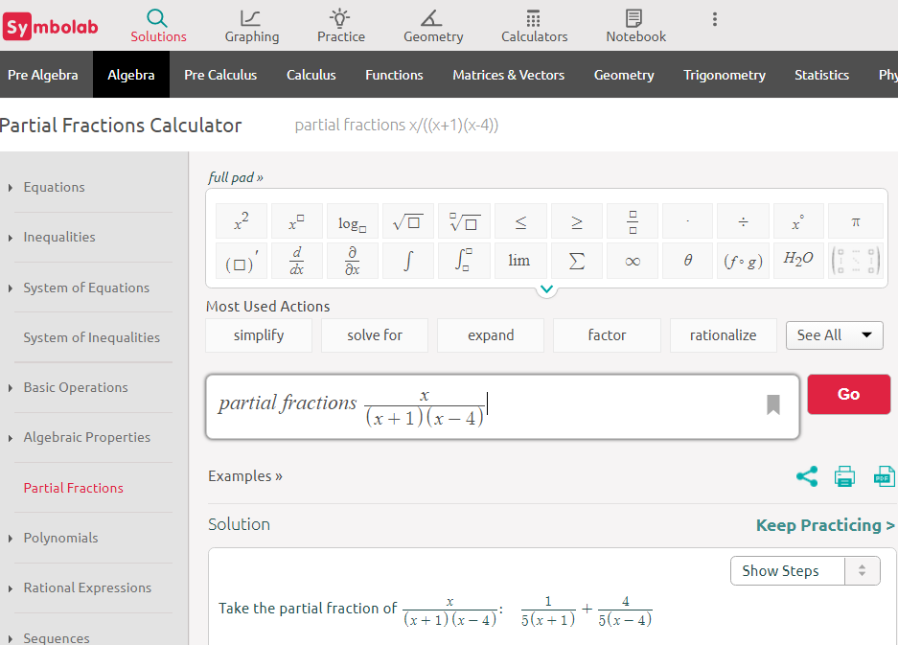

Slide 103
PARTIAL FRACTION DECOMPOSITION
IN-CLASS PROBLEM 4c
Express as a partial fraction:
$$\frac{\text{(2(}\text{1}\text{+}\text{x}\text{))} }{\text{x}\text{(}{\text{x}}^{\text{2}} \text{+ }\text{3}\text{x}\text{ + 2}\text{) }}$$

Slide 104
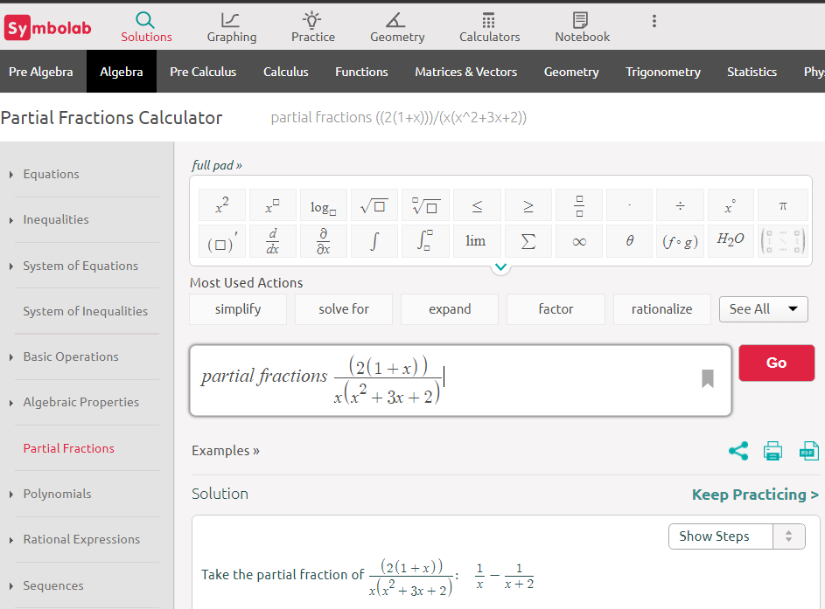

Slide 105
PARTIAL FRACTION DECOMPOSITION
IN-CLASS PROBLEM 4d
Express as a partial fraction:
$$\frac{{\text{x}}^{\text{2}} \text{+ 2} }{{\text{(}\text{x}\text{+2)}}^{\text{2}} \text{(}\text{x}\text{+3}\text{) }}$$

Slide 106
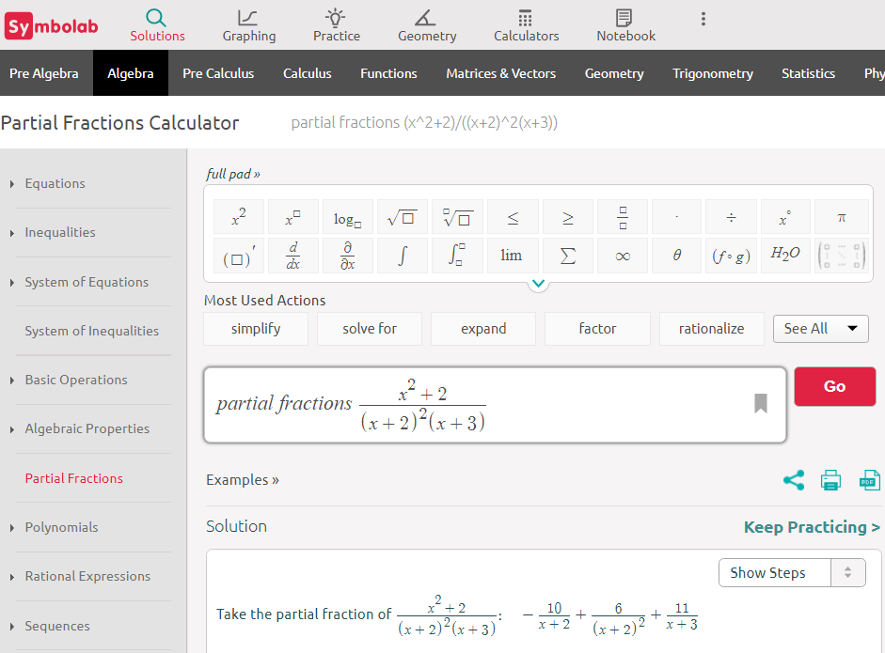

Slide 107
Questions?
http://i.imgur.com/aliTlT3.jpg

Slide 108
You Survived!
Today we studied:
Review parametric equations
and polars
Partial fraction
decomposition

