Slide 1
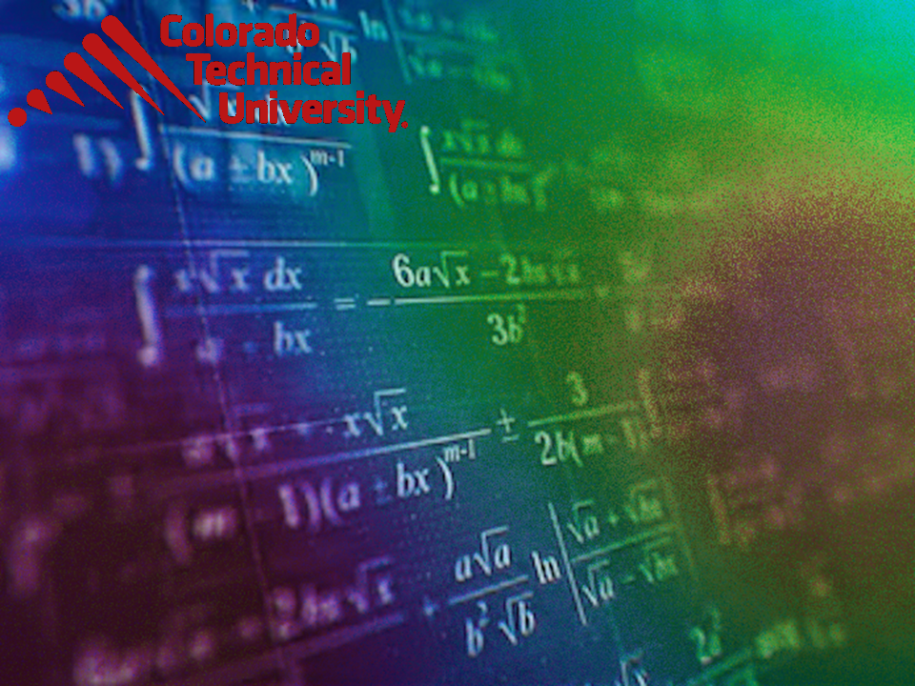
Welcome to
Unit 1 ! .
MATH 205 Differential Calculus
https://www.smu.edu.sg/programmes/core-curriculum/course-structure/calculus

Slide 2
What’s Up?
Outcome 2) Use algebra and limits to examine the properties and graphs of functions
Outcome 7) Solve problems by identifying the requirements, making a sketch as appropriate, and using calculus techniques to model the problem, calculating the final answer and verifying the solution

Slide 3
Course Description
  Demonstrate differentiation skills for linear, polynomial, rational, trigonometric, exponential, and logarithmic functions and proper application of the Product, Quotient and Chain Rules of differentiation.
  Use algebra, limits and derivatives to examine the properties and graphs of functions, including finding their extrema, inflection points, and intervals of monotonicity and concavity.
  Apply derivatives to solve optimization and related rates problems.
  Use l’Hôpital’s Rule and other methods to find nontrivial limits of functions.
  Use basic integration techniques, including the method of substitution and the Fundamental Theorem of Calculus.
  Use definite integrals to find areas under and between curves.
  Solve problems by identifying the requirements, making a sketch as appropriate, and using calculus techniques to model the problem, calculating the final answer and verifying the solution.

Slide 4
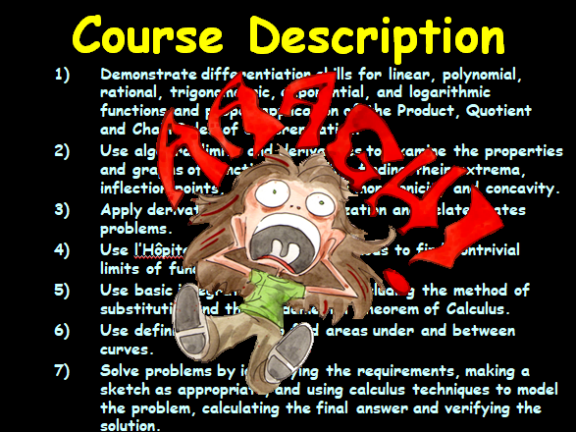

Slide 5
Course Outcomes
But, what I really want is for you to…

Slide 6
Course Outcomes
Learn how to think!

Slide 7
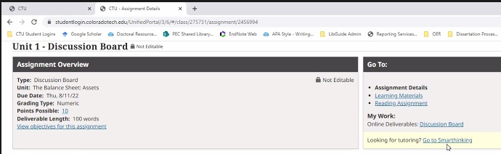
Tutoring!
You have unlimited tutoring available 24/7 365 at:

Slide 8
Instructional Approach
The primary Discussion Board posting is due Thursday 10:59pm MT
Everything else is due
Sunday night 10:59pm MT

Slide 9
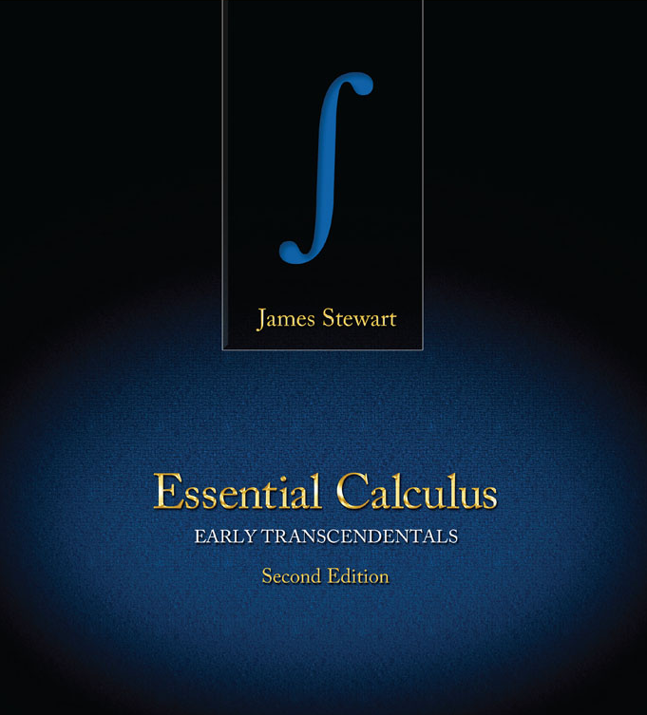
Textbook
Don’t let the title scare you!
https://coloradotech.vitalsource.com/#/books/9780357233375/cfi/6/20!/4/76@0:5.85

Slide 10

Questions?
http://i.imgur.com/aliTlT3.jpg

Slide 11
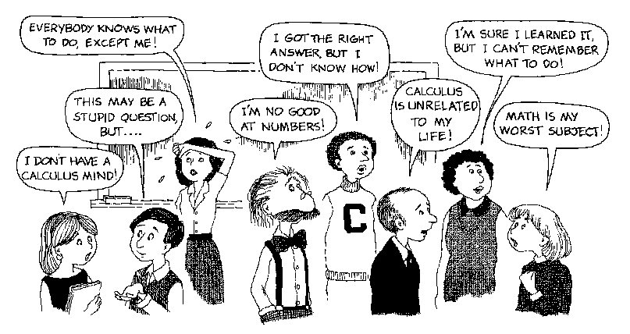
So… Howcum we have to take CALCULUS ???
https://www.smu.edu.sg

Slide 12
What Is Calculus?

Slide 13
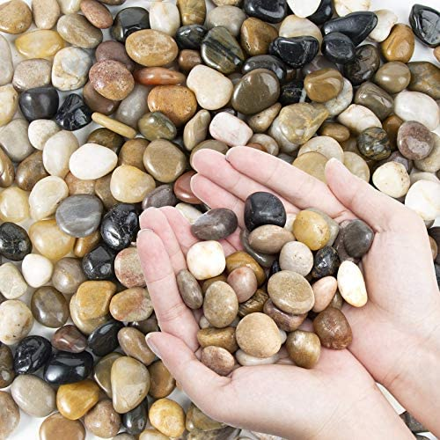
What Is Calculus?
Ancient Romans used smooth pebbles to count with called “calculus”
https://m.media-amazon.com/images/I/51CKuWNdSxL._AC_.jpg

Slide 14
What Is Calculus?
We get words like “calculate” from these pebbles!

Slide 15
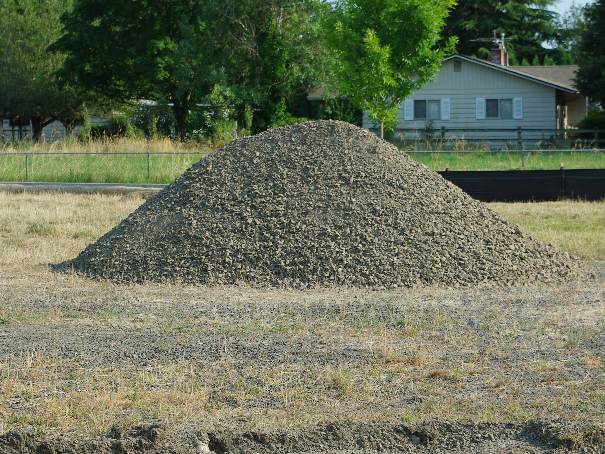
But, it’s not just rocks…
1280px-Lone_pile_of_gravel_-_Hillsboro,_Oregon.JPG

Slide 16

CALCULUS
is the mathematics of CHANGE
541711_329185230530409_2035452876_n.jpg

Slide 17
New Symbol
∆ means “change”
∆x means the change in x
∆y means the change in y

Slide 18
Another Way to Write It
“d” also means change
dx means the change in x
dy means the change in y

Slide 19
∆ Increments
An increment Δ is the final value minus the initial value:
Δx (the change in x) = x_{final} - x_{initial}
Δy (the change in y) = y_{final} - y_{initial}

Slide 20
INCREMENTS
IN-CLASS PROBLEM 1
The price of an item changes from $16.50 to $26.90. What is the increment in price Δp?

Slide 21
INCREMENTS
IN-CLASS PROBLEM 1
The price of an item changes from $16.50 to $26.90. What is the increment in price Δp?
What is the initial price?
Δx = x_{final} - x_{initial}

Slide 22
INCREMENTS
IN-CLASS PROBLEM 1
The price of an item changes from $16.50 to $26.90. What is the increment in price Δp?
What is the initial price?
x_{initial} = $16.50
What is the final price?
Δx = x_{final} - x_{initial}

Slide 23
INCREMENTS
IN-CLASS PROBLEM 1
The price of an item changes from $16.50 to $26.90. What is the increment in price Δp?
x_{initial} = $16.50
What is the final price?
x_{final} = $26.90
Δx = x_{final} - x_{initial}

Slide 24
INCREMENTS
IN-CLASS PROBLEM 1
The price of an item changes from $16.50 to $26.90. What is the increment in price Δp?
x_{initial} = $16.50
x_{final} = $26.90
What is the price increment?
Δx = x_{final} - x_{initial}

Slide 25
INCREMENTS
IN-CLASS PROBLEM 1
The price of an item changes from $16.50 to $26.90. What is the increment in price Δp?
x_{initial} = $16.50
x_{final} = $26.90
What is the price increment?
Δx = 26.9 – 16.5
= 10.4 is this the answer?

Slide 26
INCREMENTS
IN-CLASS PROBLEM 1
The price of an item changes from $16.50 to $26.90. What is the increment in price Δp?
Δx = 26.9 – 16.5
= $10.40
Don't forget the units!
(you lose points if you do…)

Slide 27
Questions?
www.career.gatech.edu

Slide 28
Rate of Change
The ratio of two increments will be a rate of change

Slide 29
Rate of Change
∆ location (distance you went)
d_{final} – d_{initial}
∆ time (time it took)
t_{final} – t_{initial}
∆location / ∆time is the rate of change of your distance vs change in time “mph”

Slide 30
Average Speed
mph an average value over the entire journey

Slide 31
RATE OF CHANGE
IN-CLASS PROBLEM 2
Your car is in the garage (distance = 0). You drive to the grocery store 2.3 miles away. It takes 5 minutes. What is your rate of change in miles per minute?
What is d_{initial}?

Slide 32
RATE OF CHANGE
IN-CLASS PROBLEM 2
Your car is in the garage (distance = 0). You drive to the grocery store 2.3 miles away. It takes 5 minutes. What is your rate of change in miles per minute?
What is d_{initial}? 0
What is d_{final}?

Slide 33
RATE OF CHANGE
IN-CLASS PROBLEM 2
Your car is in the garage (distance = 0). You drive to the grocery store 2.3 miles away. It takes 5 minutes. What is your rate of change in miles per minute?
What is d_{initial}? 0
What is d_{final}? 2.3

Slide 34
RATE OF CHANGE
IN-CLASS PROBLEM 2
Your car is in the garage (distance = 0). You drive to the grocery store 2.3 miles away. It takes 5 minutes. What is your rate of change in miles per minute?
d_{initial} = 0 d_{final} = 2.3
What is t_{initial}?

Slide 35
RATE OF CHANGE
IN-CLASS PROBLEM 2
Your car is in the garage (distance = 0). You drive to the grocery store 2.3 miles away. It takes 5 minutes. What is your rate of change in miles per minute?
d_{initial} = 0 d_{final} = 2.3
What is t_{initial}? 0

Slide 36
RATE OF CHANGE
IN-CLASS PROBLEM 2
Your car is in the garage (distance = 0). You drive to the grocery store 2.3 miles away. It takes 5 minutes. What is your rate of change in miles per minute?
d_{initial} = 0 d_{final} = 2.3
t_{initial} = 0 What is t_{final}?

Slide 37
RATE OF CHANGE
IN-CLASS PROBLEM 2
Your car is in the garage (distance = 0). You drive to the grocery store 2.3 miles away. It takes 5 minutes. What is your rate of change in miles per minute?
d_{initial} = 0 d_{final} = 2.3
t_{initial} = 0 What is t_{final}? 5
(d₁ – d₀)/(t₁ – t₀)

Slide 38
RATE OF CHANGE
IN-CLASS PROBLEM 2
Your car is in the garage (distance = 0). You drive to the grocery store 2.3 miles away. It takes 5 minutes.
d_{initial} = 0 d_{final} = 2.3
t_{initial} = 0 What is t_{final}? 5
What is your rate of change in miles per minute?

Slide 39
RATE OF CHANGE
IN-CLASS PROBLEM 2
Your car is in the garage (distance = 0). You drive to the grocery store 2.3 miles away. It takes 5 minutes.
d_{initial} = 0 d_{final} = 2.3
t_{initial} = 0 What is t_{final}? 5
What is your rate of change in miles per minute? (2.3-0)/(5-0)
2.3/5 = 0.46 is it?

Slide 40
RATE OF CHANGE
IN-CLASS PROBLEM 2
Your car is in the garage (distance = 0). You drive to the grocery store 2.3 miles away. It takes 5 minutes.
d_{initial} = 0 d_{final} = 2.3
t_{initial} = 0 What is t_{final}? 5
What is your rate of change in miles per minute? (2.3-0)/(5-0)
2.3/5 mpm = 0.46 mpm

Slide 41
RATE OF CHANGE
IN-CLASS PROBLEM 2
What is your rate of change in miles per hour?
If it was 0.46 mpm, how do you make it mph?

Slide 42
RATE OF CHANGE
IN-CLASS PROBLEM 2
What is your rate of change in miles per hour?
If it was 0.46 mpm, how do you make it mph?
Since there are 60 minutes in an hour, you multiply by 60:

Slide 43
RATE OF CHANGE
IN-CLASS PROBLEM 2
What is your rate of change in miles per hour?
If it was 0.46 mpm, how do you make it mph?
Since there are 60 minutes in an hour, you multiply by 60:
0.46 x 60 = 27.6 are we done?

Slide 44
RATE OF CHANGE
IN-CLASS PROBLEM 2
What is your rate of change in miles per hour?
If it was 0.46 mpm, how do you make it mph?
Since there are 60 minutes in an hour, you multiply by 60:
0.46 x 60 = 27.6 mph

Slide 45
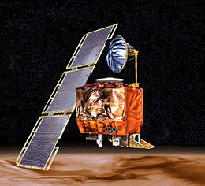
UNITS
Getting the correct units for your answer is as important as getting the right numbers
https://upload.wikimedia.org/wikipedia/commons/thumb/1/19/Mars_Climate_Orbiter_2.jpg/260px-Mars_Climate_Orbiter_2.jpg

Slide 46
Questions?
www.career.gatech.edu

Slide 47
Instantaneous Speed
At any instant in time, your speed would be a bit different from the average
This is called your “instantaneous speed”

Slide 48
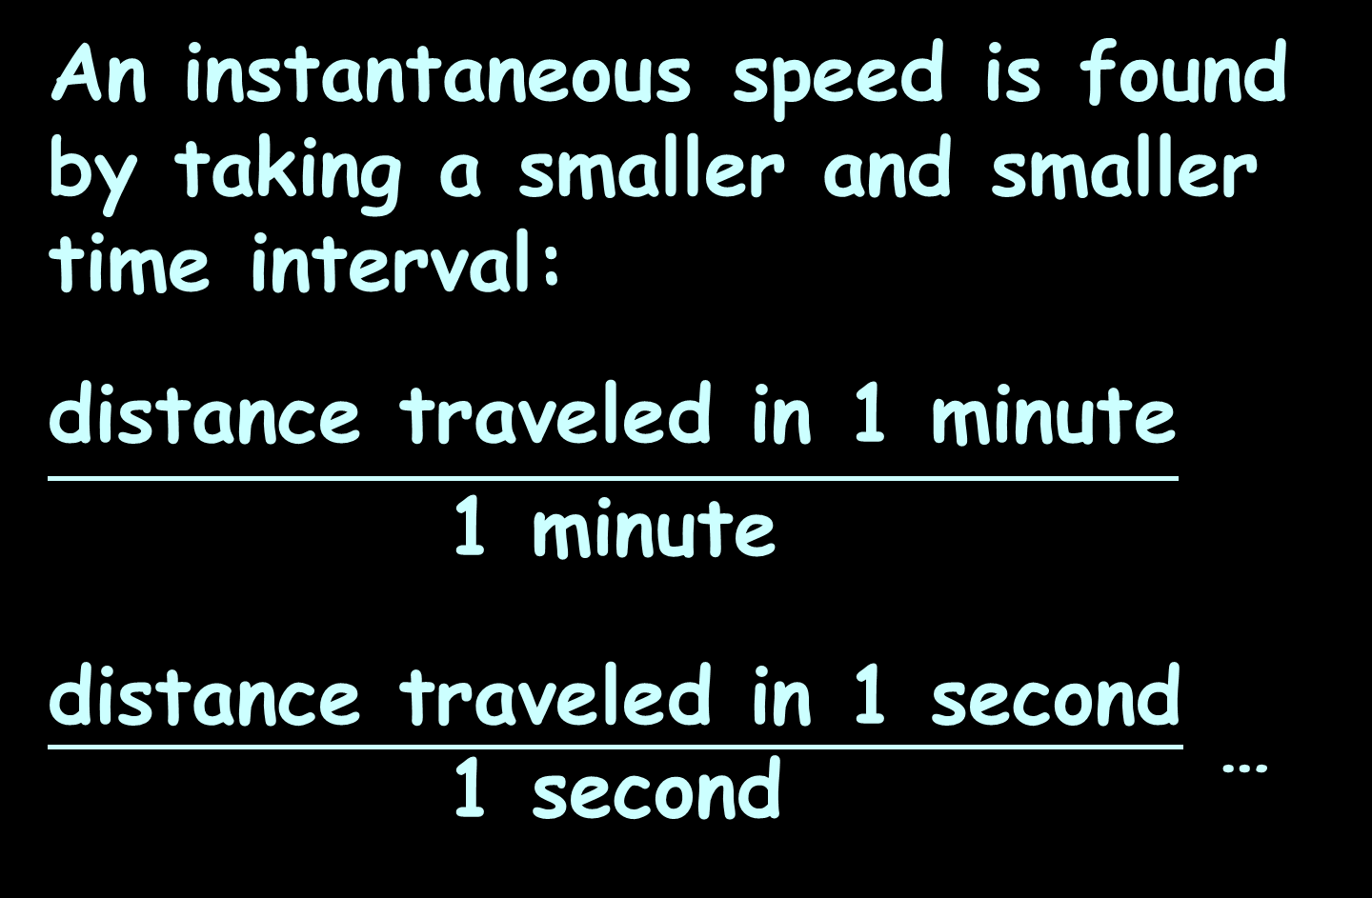
Instantaneous Speed
An instantaneous speed is found by taking a smaller and smaller time interval:
$$\frac{\text{distance} \text{traveled} \text{in}\text{ 1 }\text{minute}}{\text{1 }\text{minute}}$$
$\frac{\text{distance} \text{traveled} \text{in}\text{ 1 }\text{second}}{\text{1 }\text{second}}$ …

Slide 49
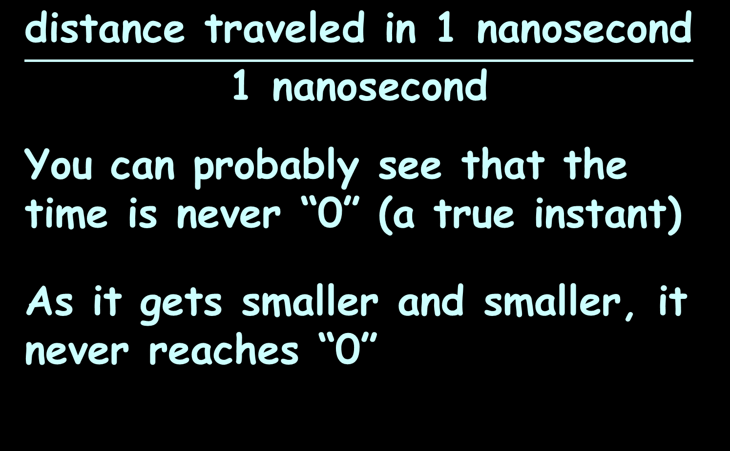
Instantaneous Speed
$$\frac{\text{distance} \text{traveled} \text{in}\text{ 1 }\text{nano}\text{second}}{\text{1 }\text{nano}\text{second}}$$
You can probably see that the time is never “0” (a true instant)
As it gets smaller and smaller, it never reaches “0”

Slide 50
Instantaneous Speed
This is the basis for the first subject we study in calculus:
limits
As we get closer and closer to the thing we want to know, are we zeroing in on a single value or not?

Slide 51
INSTANTANEOUS SPEED
IN-CLASS PROBLEM 3
Is there an instantaneous speed? What is it (approximately)?
99.6ft/10sec =
49.75ft/5sec
9.945ft/1sec

Slide 52
INSTANTANEOUS SPEED
IN-CLASS PROBLEM 3
Is there an instantaneous speed? What is it (approximately)?
99.6ft/10sec = 9.96 fps
49.75ft/5sec =
9.945ft/1sec

Slide 53
INSTANTANEOUS SPEED
IN-CLASS PROBLEM 3
Is there an instantaneous speed? What is it (approximately)?
99.6ft/10sec = 9.96 fps
49.75ft/5sec = 9.95 fps
9.945ft/1sec =

Slide 54
INSTANTANEOUS SPEED
IN-CLASS PROBLEM 3
Is there an instantaneous speed? What is it (approximately)?
99.6ft/10sec = 9.96 fps
49.75ft/5sec = 9.95 fps
9.945ft/1sec = 9.945 fps

Slide 55
INSTANTANEOUS SPEED
IN-CLASS PROBLEM 3
Is there an instantaneous speed? What is it (approximately)?
99.6ft/10sec = 9.96 fps
49.75ft/5sec = 9.95 fps
9.945ft/1sec = 9.945 fps
This is a bit in the eyes of the beholder – probably “yes” and probably 9.945 or 9.94 fps

Slide 56
Limits
This concept of getting closer and closer to a value or a location on a graph is called
finding a “limit”

Slide 57
LIMITS
IN-CLASS PROBLEM 4
What would you estimate the limit to be for this table of data?
Distance | Time Interval | Change in Time | Average Speed
48 ft | [1, 2] | 2 – 1 = 1 sec | 48 ft/sec
28 ft | [1, 1.5] | 1.5 – 1 = 0.5 sec | 56 ft/sec
6.24 ft | [1, 1.1] | 1.1 – 1 = 0.1 sec | 62.4 ft/sec
0.6384 ft | [1, 1.01] | 1.01 – 1 = 0.01 sec | 63.84 ft/sec
0.063984 ft | [1, 1.001] | 1.001 – 1 = 0.001 sec | 63.984 ft/sec
0.00639984 ft | [1, 1.0001] | 1.0001 – 1 = 0.0001 sec | 63.9984 ft/sec

Slide 58
LIMITS
IN-CLASS PROBLEM 4
What would you estimate the limit to be for this table of data?
It’s getting really close to 64 ft/sec
Distance | Time Interval | Change in Time | Average Speed
48 ft | [1, 2] | 2 – 1 = 1 sec | 48 ft/sec
28 ft | [1, 1.5] | 1.5 – 1 = 0.5 sec | 56 ft/sec
6.24 ft | [1, 1.1] | 1.1 – 1 = 0.1 sec | 62.4 ft/sec
0.6384 ft | [1, 1.01] | 1.01 – 1 = 0.01 sec | 63.84 ft/sec
0.063984 ft | [1, 1.001] | 1.001 – 1 = 0.001 sec | 63.984 ft/sec
0.00639984 ft | [1, 1.0001] | 1.0001 – 1 = 0.0001 sec | 63.9984 ft/sec

Slide 59
Limits
We write this as:
lim = 64
change in time →0
or
lim = 64
∆time →0
or
lim = 64
∆t→0
or
lim(∆t → 0) = 64

Slide 60
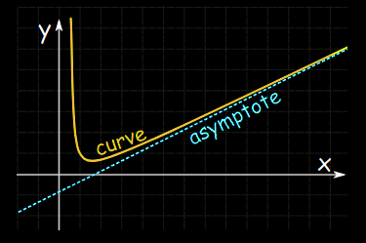
Limits
Asymptotes get closer and closer to a value, but never actually get there
https://www.mathsisfun.com/algebra/asymptote.html

Slide 61
Questions?
http://i.imgur.com/aliTlT3.jpg

Slide 62
The secret word for this unit is:
RADAR

Slide 63
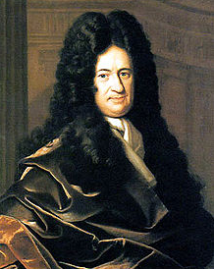
Functions
The term, "function" was coined by Gottfried Wilhelm Leibniz in 1673
https://en.wikipedia.org/wiki/Gottfried_Wilhelm_Leibniz#/media/File:Christoph_Bernhard_Francke_-_Bildnis_des_Philosophen_Leibniz_(ca._1695).jpg

Slide 64
Functions
Leibnitz observed that in many real-world processes there are inputs and outputs

Slide 65
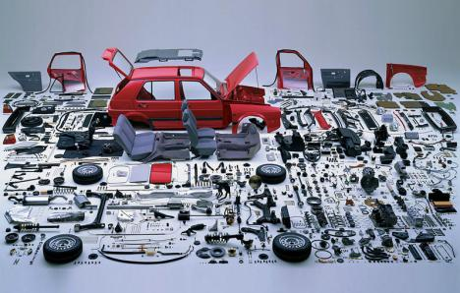
Functions
In a factory, the inputs are the components
https://3.bp.blogspot.com/-DEIw6og908M/VuLU19CgaII/AAAAAAAACgg/
IcW5UTOy7MY4O9ZdcCeqPyV_NI63Ou-6Q/s1600/Screen%2BShot%2B2016-03-07%2Bat%2B11.23.54%2BAM.png

Slide 66
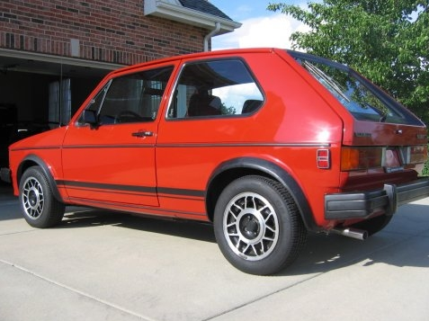
Functions
The output is the final product
https://i89.photobucket.com/albums/k230/echassin/GTI008.jpg

Slide 67
Functions
In formulas, some variables are “input” variables
The thing you are calculating with the formula is the “output”

Slide 68
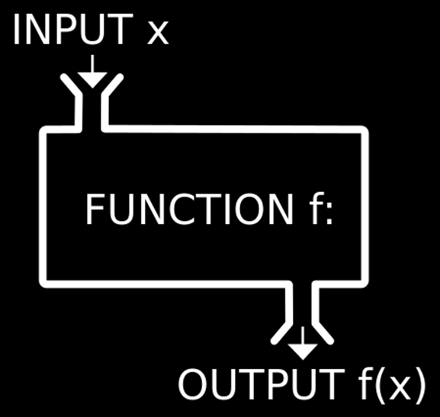
Functions
https://1.bp.blogspot.com/-YEqWLoN5V88/Wblu4NWyg4I/AAAAAAAAefY/G01iSXT2zn4L-W2-S-BETZHwvwHc_X1WQCLcBGAs/w530-h298-p/php-inbuilt-functions.jpg

Slide 69
Functions
A = πr²
The size of “r” the radius completely determines A the area of the circle so “r” is the input variable and “A” is the output variable

Slide 70
Functions
The input variable is ALWAYS put on the x-axis (horizontal axis)
No reason – it’s a TRADITION!

Slide 71
Functions
What the output turns out to be depends on what the input is
The output is frequently called the “dependent” variable

Slide 72
Functions
The input is called the “independent” variable because it’s value comes from an outside (sometimes uncontrollable) source

Slide 73
Functions
When you have a certain input, you want to be able to forecast exactly what the output will be
https://3.bp.blogspot.com/-DEIw6og908M/VuLU19CgaII/AAAAAAAACgg/IcW5UTOy7MY4O9ZdcCeqPyV_NI63Ou-6Q/s1600/Screen%2BShot%2B2016-03-07%2Bat%2B11.23.54%2BAM.png
https://i89.photobucket.com/albums/k230/echassin/GTI008.jpg

Slide 74

Functions
You don’t want several possible outputs
https://3.bp.blogspot.com/-DEIw6og908M/VuLU19CgaII/AAAAAAAACgg/IcW5UTOy7MY4O9ZdcCeqPyV_NI63Ou-6Q/s1600/Screen%2BShot%2B2016-03-07%2Bat%2B11.23.54%2BAM.png
https://i89.photobucket.com/albums/k230/echassin/GTI008.jpg

Slide 75
Functions
A special type of mathematical formula was designed for input-outputs: functions

Slide 76
Functions
For a formula to be a function, every x can have only one y

Slide 77
Functions
Example:
The set: {(1,3)(2,4)(7,25)}
is a function because:
every x-value (1,2,7) has only one y-value:
1→3
2→4
7→25

Slide 78
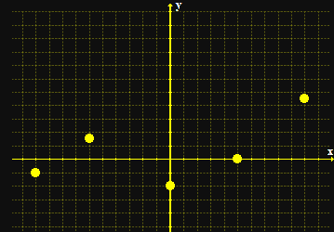
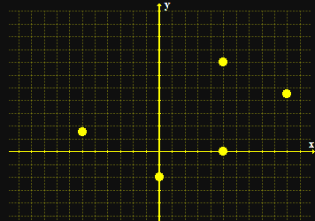
Functions
When you graph a function, only one of the points fall on a vertical line
a function not a function
Vfrench 2008

Slide 79
Functions
To test whether a formula is a function, you graph it and do the “vertical line test”
If it passes the VLT, it is a function

Slide 80
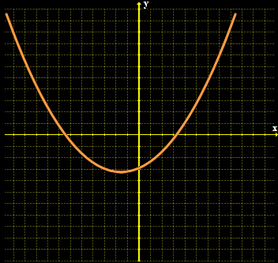
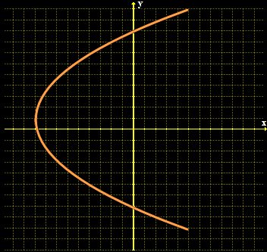
FUNCTIONS
PRACTICE PROBLEM 5
Is it a function?
Vfrench 2008

Slide 81
FUNCTIONS
PRACTICE PROBLEM 5
Is it a function?
yes
no
Vfrench 2008

Slide 82
FUNCTIONS
PRACTICE PROBLEM 5
Is it a function?
{(2,1), (4,5), (8,4), (1,0)}
{(0,8), (9,6), (6,6), (9,0)}
{(7,7), (7,8), (8,8), (9,8)}
VFrench 2015

Slide 83
Functions
Naturally, there is a special symbol for functions
Where you used to write
y = 8x + 13
A function is written:
ƒ(x) = 8x + 13
read as: “f of x”

Slide 84
Functions
ƒ(x) shows that the formula uses “x” as the input and the output depends on it
y = ƒ(x)

Slide 85
Functions
When you evaluate a function, you need to substitute the given value for x in the formula

Slide 86
Functions
ƒ(3) means “evaluate the function for x=3”

Slide 87
Evaluating Functions
The Order of Operations to get the right answer is:
P parentheses
E exponents
M multiplication
D division
A addition
S subtraction
>
Done at the same
time left to right
>
Done at the same
time left to right

Slide 88
FUNCTIONS
PRACTICE PROBLEM 6
ƒ(x) = 8x + 13
Calculate ƒ(2) =
Calculate ƒ(-1)
Calculate ƒ(1)

Slide 89
FUNCTIONS
PRACTICE PROBLEM 6
ƒ(x) = 8x + 13
Calculate ƒ(2) = 29
Calculate ƒ(-1) =
Calculate ƒ(1)

Slide 90
FUNCTIONS
PRACTICE PROBLEM 6
ƒ(x) = 8x + 13
Calculate ƒ(2) = 29
Calculate ƒ(-1) = 5
Calculate ƒ(1) =

Slide 91
FUNCTIONS
PRACTICE PROBLEM 6
ƒ(x) = 8x + 13
Calculate ƒ(2) = 29
Calculate ƒ(-1) = 5
Calculate ƒ(1) = 21

Slide 92
Polynomials
“poly” means “many”
“nomials” means “names” (variables)

Slide 93
Polynomials
Polynomials – algebraic formulas with only non-negative integer exponents

Slide 94
Polynomials
Contain many variables:
7x² + 4x - 2.5x³y + 41y³ = 723.6

Slide 95
Polynomials
Parts of a polynomial:
Terms are separated by
+ - or = signs

Slide 96
Polynomials
Each “term” is separated by a “+” “-” or “=”:
7x² + 4x - 2.5x³y + 41y³ = 723.6
term1
term2
term3
term4
term5

Slide 97
Polynomials
The number multiplying a variable term is called a coefficient

Slide 98
Polynomials
The number that is not multiplying any variable term is called a constant

Slide 99
Polynomials
The number multiplying each term is called the “coefficient”:
7x² + 4x - 2.5x³y + 41y³ = 723.6
coeff
term1
coeff
term2
coeff
term3
coeff
term4
constant

Slide 100
Polynomials
Degree of a polynomial
Sum the exponents in each
term
The largest sum is the
degree of the polynomial

Slide 101
Polynomials
The largest exponent determines the “degree” of the polynomial:
7x² + 4x - 2.5x³y + 41y³ = 723.6
expon
term1
=2
expon
term2
=1
add
expon
term3
=4
expon
term4
=3
constant
exponent is 0
(x⁰=1)

Slide 102
Polynomials
So the degree of this polynomial is “4”:
7x² + 4x - 2.5x³y + 41y³ = 723.6
expon
term1
=2
expon
term2
=1
add
expon
term3
=4
expon
term4
=3
constant
exponent is 0
(x⁰=1)

Slide 103
Functions
Increasing functions
Decreasing functions
Constant functions
relative maximums and minimums

Slide 104
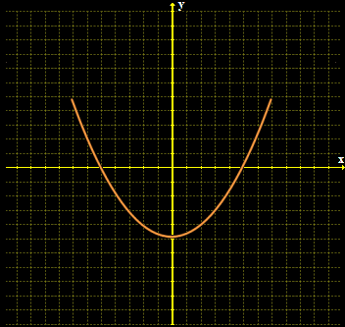
Functions
Even functions are symmetric with respect to the y-axis
ƒ(x) = ƒ(–x)
Vfrench 2008

Slide 105
Functions
Even functions written as equations have only even exponents of the variable
ƒ(x) = 3x⁴ - 15x² + 45

Slide 106
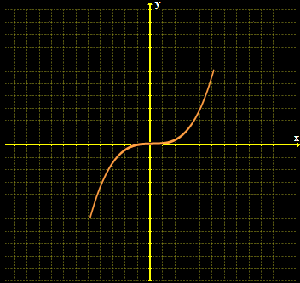
Functions
Odd functions are symmetric with respect to the origin
ƒ(-x) = –ƒ(x)
Vfrench 2008

Slide 107
Functions
Odd functions written as equations have only odd exponents of the variable
ƒ(x) = 3x⁵ - 15x³ + 45x

Slide 108
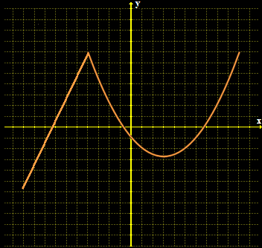
Functions
Types of functions:
piecewise functions - defined by two or more
equations
Vfrench 2008

Slide 109
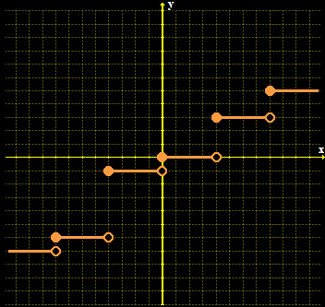
Functions
Step functions: function values graphically form discontinuous steps
Vfrench 2008

Slide 110
Questions?
http://i.imgur.com/aliTlT3.jpg

Slide 111

You Survived!
Today we studied:
Increments
Rate of Change
Limits
Functions
www.playbuzz.com

