Slide 1
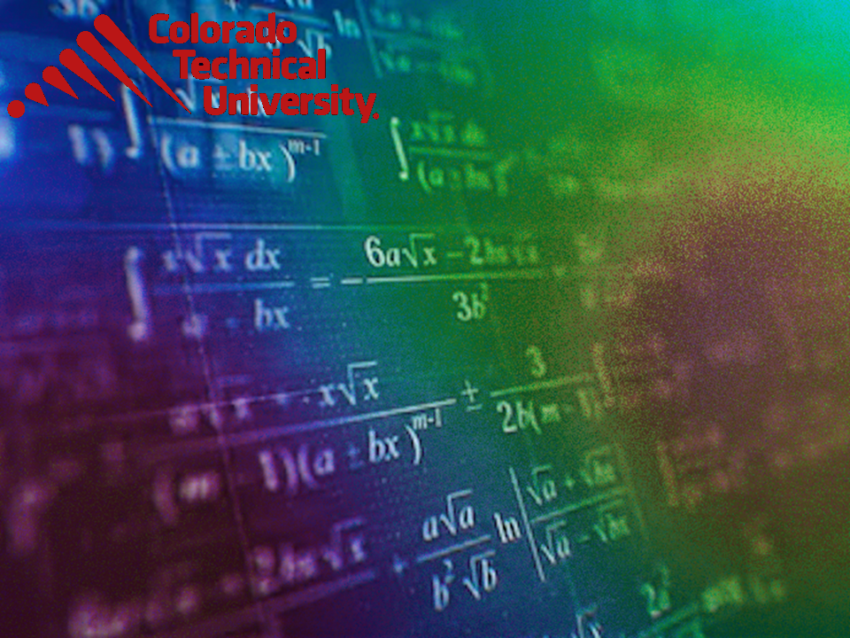
Welcome to
Unit 2 Part 4!
MATH 205 Differential Calculus
https://www.smu.edu.sg/programmes/core-curriculum/course-structure/calculus

Slide 2
What’s Up?
Review: functions, mathematical modeling, transforming functions
New stuff:
limits
continuity

Slide 3
What’s Up?
Outcome 2) Use algebra and limits to examine the properties and graphs of functions
Outcome 7) Solve problems by identifying the requirements, making a sketch as appropriate, and using calculus techniques to model the problem, calculating the final answer and verifying the solution

Slide 4

Review
http://995642590.r.lightningbase-cdn.com/wp-content/uploads/2010/12/looking-back-hrexaminer-v144-cover425px.jpg

Slide 5
Functions
In formulas, some variables are “input” variables
The thing you are calculating with the formula is the “output”

Slide 6
Functions
What the output turns out to be depends on what the input is
The output is frequently called the “dependent” variable

Slide 7
Functions
The input is called the “independent” variable because it’s value comes from an outside (sometimes uncontrollable) source

Slide 8
Functions
For a formula to be a function, every x can have only one y

Slide 9
Mathematical Modeling
A mathematical model is a mathematical description (often by means of a function or an equation) of a real-world phenomenon

Slide 10
Mathematical Modeling
The purpose of the model is to understand the phenomenon and often to make predictions about future behavior (forecasts)

Slide 11
Mathematical Modeling
A mathematical model is never a completely accurate representation of a physical
situation

Slide 12
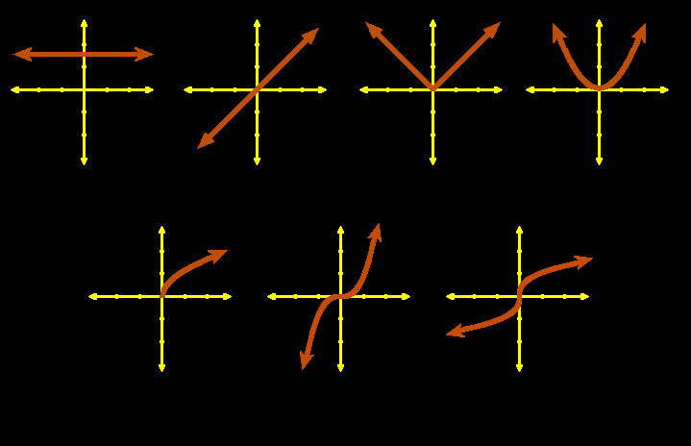
Mathematical Modeling
Graphs of common algebraic functions:
constant identity abs value quadratic
square root cubic cube root
VFrench, 2010

Slide 13
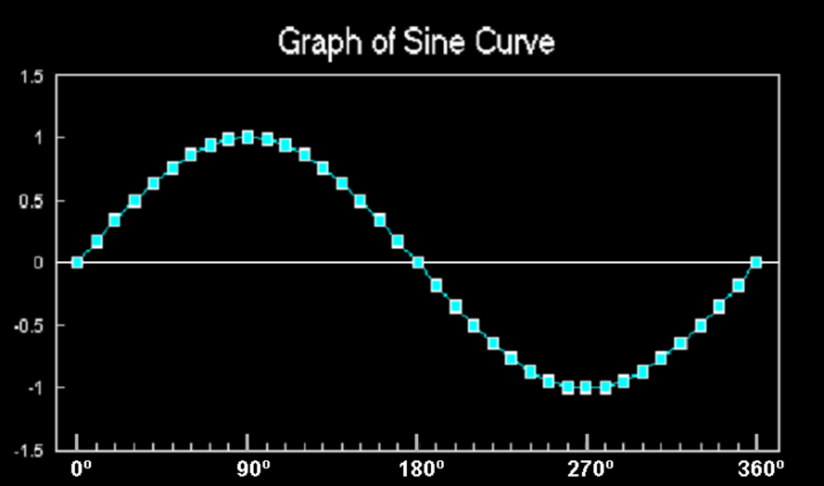
Mathematical Modeling
Trig functions (especially sine and cosine) are used to model cyclical phenomena
VFrench, 2015

Slide 14
Mathematical Modeling
Exponential functions use:
ƒ(x) = a^{x}
where the base
a is a positive
constant
https://www.quora.com/How-do-you-find-the-domain-and-range-of-an-exponential-function

Slide 15
Mathematical Modeling
Logarithmic functions use:
ƒ(x) = log_{a}x
where the base a is a positive constant
https://en.wikipedia.org/wiki/Logarithm

Slide 16
Mathematical Modeling
Because data RARELY fits the known functions exactly, we have to transform the functions to fit the data

Slide 17
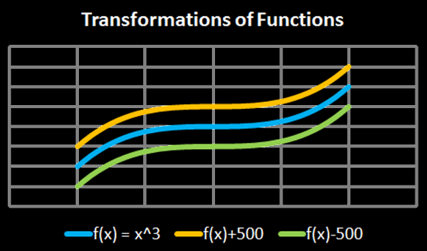
Transforming Functions
vertical shifts:
ƒ(x) + c plus shifts up
ƒ(x) - c minus shifts down
Vfrench, 2010

Slide 18
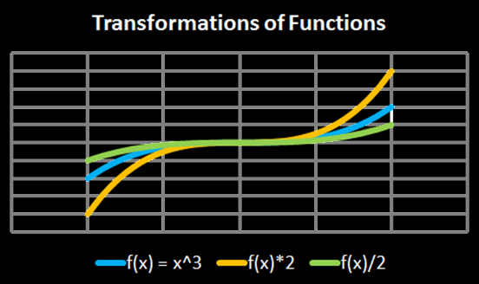
Transforming Functions
vertical stretch:
ƒ(x) × c stretches
ƒ(x) ÷ c squashes
Vfrench, 2010

Slide 19
Transforming Functions
Any operations done to the function outside of the parentheses affects the “y” values
These operations lead to an intuitive result

Slide 20
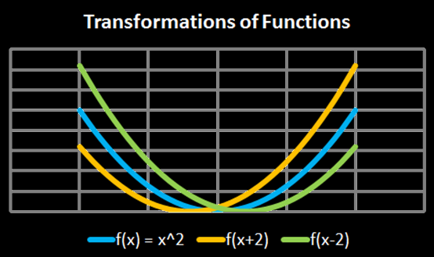
Transforming Functions
horizontal shifts:
ƒ(x + c) shifts left
ƒ(x - c) shifts right
It’s shifting the y-axis
Vfrench, 2010

Slide 21
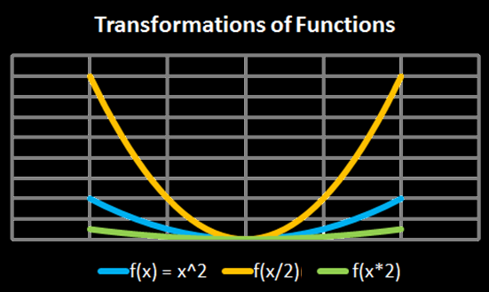
Transforming Functions
horizontal shifts:
ƒ(x × c) squashes
ƒ(x ÷ c) stretches
Think of these as “frequency”
Vfrench, 2010

Slide 22
Transforming Functions
Any operations done to the function inside the parentheses affects the “x” values
These operations lead to a counterintuitive result

Slide 23

Questions?
www.career.gatech.edu

Slide 24
Limits
On Wk01 we looked at the limits of sequences

Slide 25
Calculating Limits
On Wk01 we looked at the limits of sequences
You can do the same thing with algebraic functions

Slide 26
CALCULATING LIMITS
IN-CLASS PROBLEM 1
Find: lim (6x² – 3x + 5)
x → 0
Just plug in x = 0 and solve!

Slide 27
CALCULATING LIMITS
IN-CLASS PROBLEM 1
Find: lim (6x² – 3x + 5)
x → 0
= 5

Slide 28
Calculating Limits
Even if functions are not the same, their limits at some target point may be the same
A
https://www.mathsisfun.com/calculus/limits.html

Slide 29
Questions?
http://i.imgur.com/aliTlT3.jpg

Slide 30
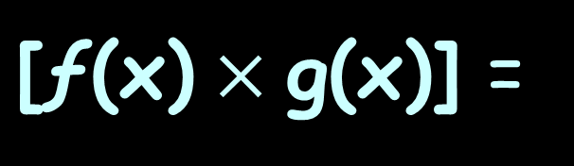


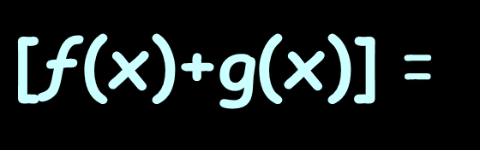

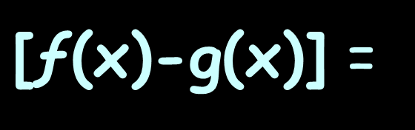



Calculating Limits
Rules for Limits:
lim
x→a
$\text{[ƒ(}\text{x}\text{)+}\text{g}\text{(}\text{x}\text{)]}$ =
lim
x→a
$\text{ƒ(}\text{x}\text{)}$ $\text{+}$
lim
x→a
$$\text{g}\text{(}\text{x}\text{)}$$
lim
x→a
$\text{[ƒ(}\text{x}\text{)}\text{−}\text{g}\text{(}\text{x}\text{)]}$ =
lim
x→a
$\text{ƒ(}\text{x}\text{)}$ $\text{−}$
lim
x→a
$$\text{g}\text{(}\text{x}\text{)}$$
lim
x→a
$\text{[ƒ(}\text{x}\text{)}×\text{g}\text{(}\text{x}\text{)]}$ =
lim
x→a
$\text{ƒ(}\text{x}\text{)}$ $×$
lim
x→a
$$\text{g}\text{(}\text{x}\text{)}$$

Slide 31
CALCULATING LIMITS
IN-CLASS PROBLEM 2
Find: lim (6x³ – 3x² + 5x)
x → 0
That would be the same as:
6x³ - 3x² + 5x
lim
x→0
lim
x→0
lim
x→0

Slide 32
CALCULATING LIMITS
IN-CLASS PROBLEM 2
Find: lim (6x³ – 3x² + 5x)
x → 0
That would be the same as:
6x³ - 3x² + 5x
= 0 - 0 + 0
= 0
lim
x→0
lim
x→0
lim
x→0

Slide 33
Questions?
http://i.imgur.com/aliTlT3.jpg

Slide 34
CALCULATING LIMITS
IN-CLASS PROBLEM 3
The position (in feet) of an object moving along a line is:
s(t) = -16t² +128t
Find the average speed over the time interval 1sec ≤ t ≤ 2sec

Slide 35
CALCULATING LIMITS
IN-CLASS PROBLEM 3
s(t) = -16t² + 128t 1≤t≤2
First evaluate the function at the final value: 2
Then evaluate the function at the initial value: 1

Slide 36
CALCULATING LIMITS
IN-CLASS PROBLEM 3
s(t) = -16t² +128t
s(2) = -16(2²) + 128(2)
= -64 + 256 = 192
s(1) = ?

Slide 37
CALCULATING LIMITS
IN-CLASS PROBLEM 3
s(t) = -16t² +128t
s(2) = -16(2²) + 128(2)
= -64 + 256 = 192
s(1) = -16(1²) +128(1)
= -16 +128 = 112

Slide 38
CALCULATING LIMITS
IN-CLASS PROBLEM 3
The average speed will be:
(s(final t) – s(initial t))
(final t – initial t)

Slide 39
CALCULATING LIMITS
IN-CLASS PROBLEM 3
The average speed will be:
(s(final t) – s(initial t))
(final t – initial t)
In this case:
(192 – 112) / (2 - 1) = ?

Slide 40
CALCULATING LIMITS
IN-CLASS PROBLEM 3
The average speed will be:
(s(final t) – s(initial t))
(final t – initial t)
In this case:
(192 – 112) / (2 - 1) = 80/1
= 80 is it?

Slide 41
CALCULATING LIMITS
IN-CLASS PROBLEM 3
The average speed will be:
(s(final t) – s(initial t))
(final t – initial t)
In this case:
(192 – 112) / (2 - 1) = 80/1
= 80 ft/sec

Slide 42
CALCULATING LIMITS
IN-CLASS PROBLEM 4
The position (ft) of an object moving along a line is:
s(t) = -16t² +128t
Find the average speed over the interval 1sec ≤ t ≤ 1.5sec
Avg speed =
(s(final t) – s(initial t))
(final t – initial t)

Slide 43
CALCULATING LIMITS
IN-CLASS PROBLEM 4
s(t) = -16t² +128t
s(1.5) = -16(1.5²) + 128(1.5)
= -36 + 192 = 156
s(1) = -16(1²) +128(1)
= -16 +128 = 112
So the average speed is: ?
Avg speed =
(s(final t) – s(initial t))
(final t – initial t)

Slide 44
CALCULATING LIMITS
IN-CLASS PROBLEM 4
s(t) = -16t² +128t
s(2) = -16(1.5²) + 128(1.5)
= -36 + 192 = 156
s(1) = -16(1²) +128(1)
= -16 +128 = 112
(156 – 112) / (1.5 - 1) = 44/0.5
= 88 ft/sec
Avg speed =
(s(final t) – s(initial t))
(final t – initial t)

Slide 45
CALCULATING LIMITS
IN-CLASS PROBLEM 5
The position (ft) of an object moving along a line is:
s(t) = -16t² +128t
Find the average speed over the interval 1sec ≤ t ≤ 1.1sec
Avg speed =
(s(final t) – s(initial t))
(final t – initial t)

Slide 46
CALCULATING LIMITS
IN-CLASS PROBLEM 5
s(t) = -16t² +128t
s(1.1) = -16(1.1²) + 128(1.1)
= -19.36 + 140.8 = 121.44
s(1) = -16(1²) +128(1)
= -16 +128 = 112
Average speed is:
Avg speed =
(s(final t) – s(initial t))
(final t – initial t)

Slide 47
CALCULATING LIMITS
IN-CLASS PROBLEM 5
s(t) = -16t² +128t
s(2) = -16(1.1²) + 128(1.1)
= -19.36 + 140.8 = 121.44
s(1) = -16(1²) +128(1)
= -16 +128 = 112
(121.44–112)/(1.1-1) = 9.44/0.1
= 94.4 ft/sec
Avg speed =
(s(final t) – s(initial t))
(final t – initial t)

Slide 48
Calculating Limits
As the change in time is
getting closer and closer to
0 time
The average velocity is getting
closer and closer to:
some value ft/sec

Slide 49
Calculating Limits
As the change in time is
getting closer and closer to
0 time
The average velocity is getting
closer and closer to:
some value ft/sec
This will be called the “limit”

Slide 50
Questions?
http://i.imgur.com/aliTlT3.jpg

Slide 51
Calculating Limits
Sometimes we can't work the value out directly…
but we can see what it should be as we get closer and closer!

Slide 52
Calculating Limits
What if you end up with division by zero? lim 1/x
x → 0
https://www.mathsisfun.com/calculus/limits.html

Slide 53

CALCULATING LIMITS
IN-CLASS PROBLEM 6
Suppose we wanted to know what
$$\frac{\text{x}\text{2}\text{ − 1}}{\text{x}\text{ − 1}}$$
is at x=1

Slide 54

Calculating Limits
At x=1:
$$\frac{\text{x}\text{2}\text{ − 1}}{\text{x}\text{ − 1}}$$
$$\frac{\text{1}\text{2}\text{ − 1}}{\text{1}\text{ − 1}}$$
$\frac{\text{0}}{\text{0}}$
oops…

Slide 55
Calculating Limits
We need another way of answering this
Instead of trying to work it out for x=1 algebraically, let's try approaching it closer and closer

Slide 56
Calculating Limits
…and let’s do it in Excel (so we don’t spend our entire lives doing this…)

Slide 57
Calculating Limits
As x gets closer and closer to 1
x | (x² − 1) (x − 1)
0.5 | 1.50000
0.9 | 1.90000
0.99 | 1.99000
0.999 | 1.99900
0.9999 | 1.99990
0.99999 | 1.99999
... | ..

Slide 58
Calculating Limits
What does our ratio get closer and closer to?
x | (x² − 1) (x − 1)
0.5 | 1.50000
0.9 | 1.90000
0.99 | 1.99000
0.999 | 1.99900
0.9999 | 1.99990
0.99999 | 1.99999
... | ..

Slide 59
Calculating Limits
We are now faced with an interesting situation:
When x=1 we don't know the answer (it is indeterminate)…
but we can see that it is going to be 2

Slide 60
Calculating Limits
We want to give the answer "2"
but we can’t (it’s algebraically
indeterminate),
so instead we say:
The limit of (x²−1)/(x−1) as x approaches 1 is 2

Slide 61
Calculating Limits
It is written symbolically as:
x²−1
x−1
lim
x→1
= 2

Slide 62
Calculating Limits
So it is a way of saying:
"ignoring what happens when we get there, as we get closer and closer to x=1, the answer gets closer and closer to 2"

Slide 63

Calculating Limits
Remember how I told you calculus was all about ignoring reality and going with what works?
http://ahungryrunner.files.wordpress.com/2013/07/confused-baby.png

Slide 64
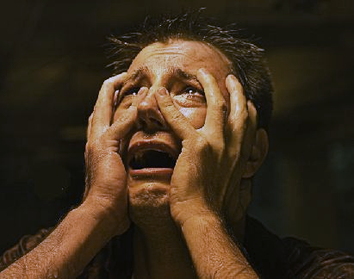
Calculating Limits
This is one of those moments
https://henrytrocino.files.wordpress.com/2013/08/weeping-and-gnashing-of-teeth-300x236.jpg

Slide 65

Calculating Limits
This is one of those moments
(There will be lots more…)
https://www.yourdictionary.com/images/main.shriek.jpg

Slide 66
Calculating Limits
Graphically, it
would look like:
https://www.mathsisfun.com/calculus/limits.html

Slide 67
Calculating Limits
Test both sides of the hole!
(we’ve already got the “coming up from the left” part)

Slide 68
Calculating Limits
Coming up from the left:
x | (x² − 1) (x − 1)
0.5 | 1.50000
0.9 | 1.90000
0.99 | 1.99000
0.999 | 1.99900
0.9999 | 1.99990
0.99999 | 1.99999
... | ..

Slide 69
Calculating Limits
Now we need the “going down from the right” part
(back to Excel)

Slide 70
Calculating Limits
Going down from the right:
x | (x² − 1) (x − 1)
1.5 | 2.50000
1.1 | 2.10000
1.01 | 2.01000
1.001 | 2.00100
1.0001 | 2.00010
1.00001 | 2.00001
... | ..

Slide 71
Calculating Limits
Since both sides give you the same answer, all is well!

Slide 72
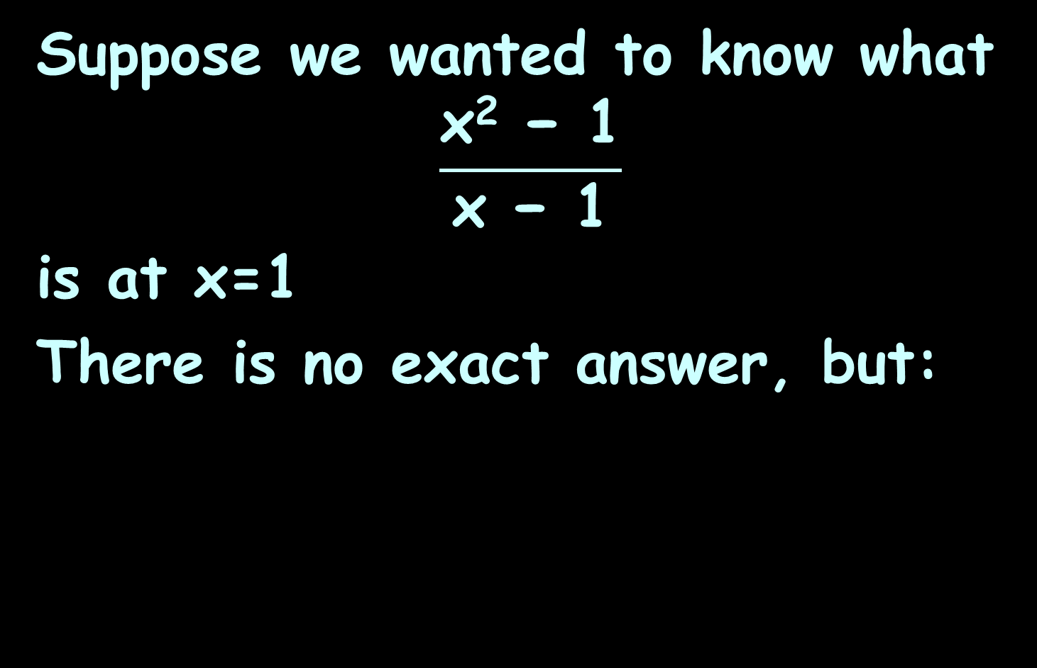
CALCULATING LIMITS
IN-CLASS PROBLEM 6
Suppose we wanted to know what
$$\frac{\text{x}\text{2}\text{ − 1}}{\text{x}\text{ − 1}}$$
is at x=1
There is no exact answer, but:
x²−1
x−1
lim
x→1
= 2

Slide 73
Questions?
http://i.imgur.com/aliTlT3.jpg

Slide 74
Calculating Limits
It is like running up a hill and then finding the path is magically "not there"...

Slide 75
Calculating Limits
It is like running up a hill and then finding the path is magically "not there"...
... but if we only check one side, who knows what happens?

Slide 76
Calculating Limits
It is like running up a hill and then finding the path is magically "not there"...
... but if we only check one side, who knows what happens?
So we need to test it from both directions to be sure where it "should be"!

Slide 77
Calculating Limits
Remember how I said it doesn’t always work?

Slide 78
CALCULATING LIMITS
IN-CLASS PROBLEM 7
What is the limit at x=5.5?
https://www.mathsisfun.com/calculus/limits.html

Slide 79
Calculating Limits
It’s not a hole… it’s a cliff!
https://www.mathsisfun.com/calculus/limits.html

Slide 80
Calculating Limits
We can't say what the value at 5.5 is, because there are two competing answers:
3.8 from the left, and
1.3 from the right
https://www.mathsisfun.com/calculus/limits.html

Slide 81
Calculating Limits
But we can define “one sided limits”:
the left-hand limit
is 3.8
the right-hand limit
is 1.3
the ordinary limit "does not exist"
https://www.mathsisfun.com/calculus/limits.html

Slide 82
Calculating Limits
This mess is written symbolically as:
and
lim
x→5.5⁻
= 3.8
lim
x→5.5⁺
= 1.3
lim
x→5.5
Does not exist
https://www.mathsisfun.com/calculus/limits.html

Slide 83
CALCULATING LIMITS
IN-CLASS PROBLEM 7
What is the limit at x=5.5?
While
lim
x→5.5
does not exist
lim
x→5.5⁻
= 3.8
lim
x→5.5⁺
= 1.3
https://www.mathsisfun.com/calculus/limits.html

Slide 84
CALCULATING LIMITS
IN-CLASS PROBLEM 8
What is the limit as x approaches 2?
https://www.mathsisfun.com/calculus/limits.html

Slide 85
CALCULATING LIMITS
IN-CLASS PROBLEM 8
What is the limit as x approaches 2? Does not exist
https://www.mathsisfun.com/calculus/limits.html

Slide 86
THE LIMIT DOES NOT EXIST

Slide 87
CALCULATING LIMITS
IN-CLASS PROBLEM 8
Are there right- and left-handed limits as x approaches 2? If so, what are they?
https://www.mathsisfun.com/calculus/limits.html

Slide 88
CALCULATING LIMITS
IN-CLASS PROBLEM 8
Are there right- and left-handed limits as x approaches 2? If so, what are they?
Lhl=2
Rhl=1
https://www.mathsisfun.com/calculus/limits.html

Slide 89
Questions?
http://i.imgur.com/aliTlT3.jpg

Slide 90
Continuity
The limit of a function as x approaches “a” can often be found simply by calculating the value of the function at a
Functions with this property are called “continuous at a”

Slide 91
Continuity
The mathematical definition of continuity corresponds closely with the meaning of the word continuity in everyday language

Slide 92
Continuity
A continuous process is one that takes place gradually, without interruption or abrupt change

Slide 93
Continuity
If a function is not continuous at a particular point, it is called “discontinuous” at that point
or that it has a “discontinuity” at that point

Slide 94
Continuity
continuous at “a”
discontinuous
at 1,3 and 5
https://coloradotech.vitalsource.com/#/books/9780357233375/cfi/6/20!/4/2372/4@0:76.0

Slide 95
Continuity
Three things are necessary for ƒ to be continuous at a:
1. ƒ(a) is defined (that is, a is in the domain of ƒ)
2. ƒ(x) exists
3. ƒ(x) = ƒ(a)
lim
x→a
lim
x→a

Slide 96
Continuity
A continuous function ƒ has the property that a small change in x produces only a small change in ƒ(x)

Slide 97
Continuity
In fact, the change in ƒ(x) can be kept as small as we please by keeping the change in x sufficiently small

Slide 98
Continuity
Physical phenomena are usually continuous
For instance, the speed of a vehicle varies continuously with time
So does a person's height

Slide 99
Continuity
Some things are NOT continuous (tax tables for example)

Slide 100
Continuity
Discontinuities do occur in electric currents

Slide 101
Continuity
The Heaviside function H (named after the electrical engineer Oliver Heaviside (1850–1925)) is defined by
H(t)=
{
0 if t<0
1 if t≥0
https://en.wikipedia.org/wiki/Oliver_Heaviside#/media/File:Oheaviside.jpg

Slide 102
Continuity
(BTW – Heaviside is the one who brought complex numbers into circuit analysis – so if you don’t like the “j” – blame him!)
https://en.wikipedia.org/wiki/Oliver_Heaviside#/media/File:Oheaviside.jpg

Slide 103
Continuity
{
0 if t<0
1 if t≥0
H(t)=
This function is used to describe an electric current that is switched on at time
t = 0
https://en.wikipedia.org/wiki/Oliver_Heaviside#/media/File:Oheaviside.jpg

Slide 104
Continuity
{
0 if t<0
1 if t≥0
H(t)=
As t approaches 0 from the left, H(t) approaches 0
As t approaches 0
from the right
H(t) approaches 1
https://en.wikipedia.org/wiki/Oliver_Heaviside#/media/File:Oheaviside.jpg

Slide 105
Continuity
{
0 if t<0
1 if t≥0
H(t)=
There is no single number that H(t) approaches as t approaches 0
So does not exist
lim
t→0
https://en.wikipedia.org/wiki/Oliver_Heaviside#/media/File:Oheaviside.jpg

Slide 106
Continuity
{
0 if t<0
1 if t≥0
H(t)=
There is no single number that H(t) approaches as t approaches 0
H(t) = 0
H(t) = 1
lim
t→0⁻
lim
t→0⁺
https://en.wikipedia.org/wiki/Oliver_Heaviside#/media/File:Oheaviside.jpg

Slide 107
CONTINUITY
IN-CLASS PROBLEM 9
Where is the function discontinuous?
ƒ(x) =
{
1 .
x²
if x≠0
1 if x=0

Slide 108
CONTINUITY
IN-CLASS PROBLEM 9
Where is the function discontinuous? at x=0
ƒ(x) =
{
1 .
x²
if x≠0
1 if x=0

Slide 109

CONTINUITY
IN-CLASS PROBLEM 10
Where is the function discontinuous?
ƒ(x) = $\frac{\text{x}\text{2}\text{−}\text{x}\text{−2}}{\text{x}\text{−2}}$

Slide 110

CONTINUITY
IN-CLASS PROBLEM 10
Where is the function discontinuous? at x=2
ƒ(x) = $\frac{\text{x}\text{2}\text{−}\text{x}\text{−2}}{\text{x}\text{−2}}$

Slide 111
CONTINUITY
IN-CLASS PROBLEM 11
Where is the function discontinuous?
ƒ(x) = all integers

Slide 112
CONTINUITY
IN-CLASS PROBLEM 11
Where is the function discontinuous? at every integer
ƒ(x) = all integers

Slide 113
Continuity
A function can be continuous from the right
A function can be continuous from the left

Slide 114
Continuity
A function is continuous on an interval if it is continuous at every number in the interval

Slide 115
Questions?
http://i.imgur.com/aliTlT3.jpg

Slide 116
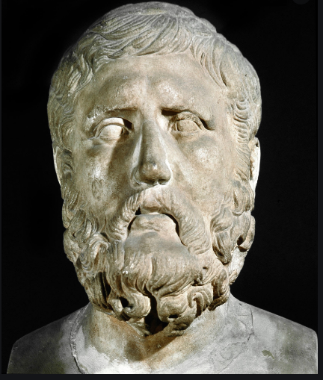
Limits & Zeno’s Paradox
The Greek philosopher Zeno
(b.≈ 490 B.C.) explored “ontological pluralism” – that the belief in the existence of many things rather than only one leads to
absurd conclusions
called “paradoxes”
http://t3.gstatic.com/licensed-image?q=tbn:ANd9GcRPIaLI8VyIPNFpFvmMdIU1nA1rLiln4O6er
TzcK9JFSIFB1HRpKNesW7gXHz2j

Slide 117
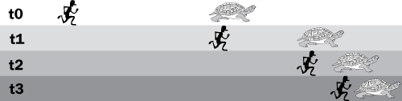
Limits & Zeno’s Paradox
His second paradox has Achilles chasing the tortoise
He is unable to ever overtake the tortoise
https://www.skeptic.com/eskeptic/2011/images/11-04-27/zeno-paradox-illo.png

Slide 118
Limits & Zeno’s Paradox
Achilles must traverse the following infinite series of distances before he catches the tortoise:
first 0.9m,
then an additional 0.09m,
then 0.009m, …
https://plato.stanford.edu/entries/paradox-zeno/#AchTor

Slide 119
Limits & Zeno’s Paradox
These are the series of distances ahead that the tortoise reaches at the start of each of Achilles’ catch-ups
first 0.9m,
then an additional 0.09m,
then 0.009m, …
https://plato.stanford.edu/entries/paradox-zeno/#AchTor

Slide 120
Limits & Zeno’s Paradox
What do you think is the problem with this paradox?

Slide 121
Limits & Zeno’s Paradox
Once again, the principles of calculus may be nonsense, but they work!
Zeno’s principles seem logical, but they don’t work!

Slide 122
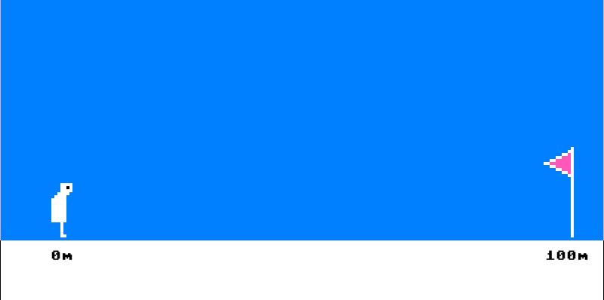
The Golf Paradox
I may get closer and closer to the hole, but the ball never goes in…
https://www.skeptic.com/eskeptic/2011/images/11-04-27/golf-paradox.png

Slide 123
Questions?
http://i.imgur.com/aliTlT3.jpg

Slide 124
Summary
Today we studied:
Review of functions, mathematical modeling, transforming functions
New stuff: limits, continuity

Slide 125

You Survived!
www.playbuzz.com

