Slide 1
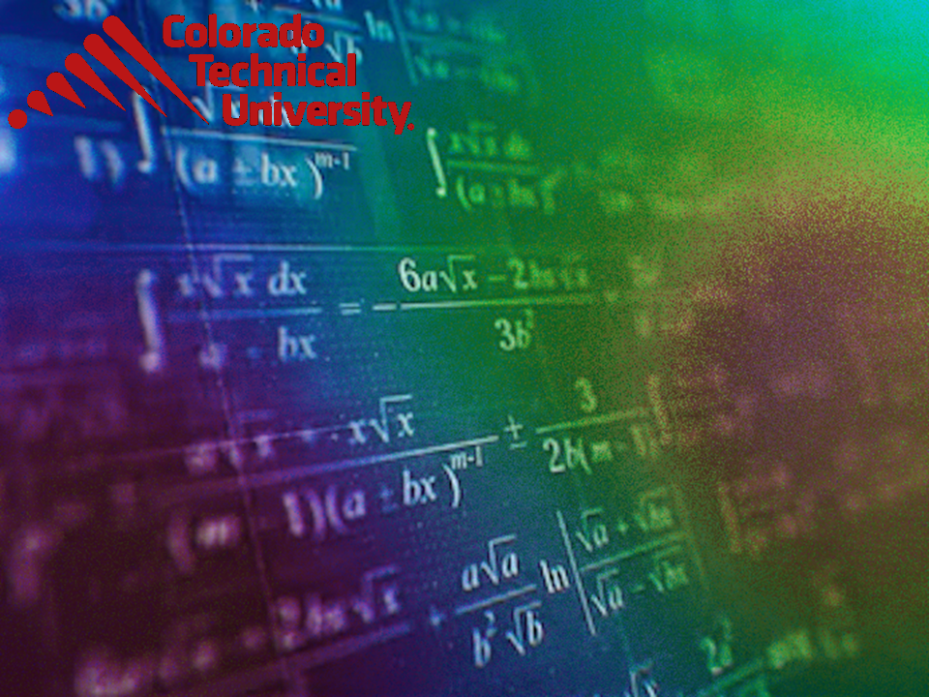
Welcome to
Unit 3 ! .
MATH 205 Differential Calculus
https://www.smu.edu.sg/programmes/core-curriculum/course-structure/calculus

Slide 2
What’s Up?
Outcome 1) Demonstrate differentiation skills for linear and polynomial functions
Outcome 2) Use algebra and limits to examine the properties and graphs of functions
Outcome 7) Solve problems by identifying the requirements, making a sketch as appropriate, and using calculus techniques to model the problem, calculating the final answer and verifying the solution

Slide 3
Limits
What about the limit as x approaches infinity?

Slide 4
Limits
https://www.mathsisfun.com/calculus/limits.html

Slide 5
Infinite Limits
Infinity is a very special idea
We know we can't reach it, but we can still try to work out the value of functions that have infinity in them

Slide 6

INFINITE LIMITS
IN-CLASS PROBLEM 1
Find the limit:
$$\frac{\text{1}}{\text{x}}$$
lim
x→∞

Slide 7
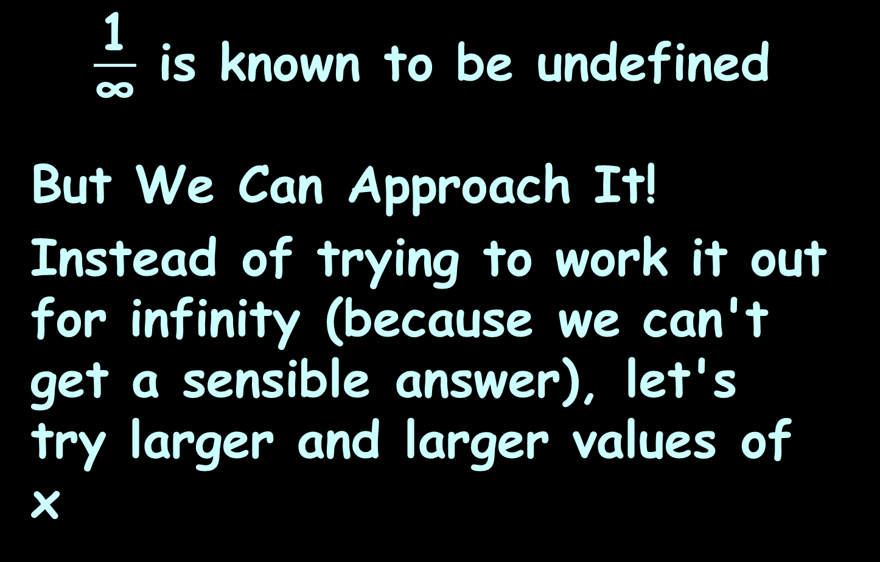
Infinite Limits
$\frac{\text{1}}{\text{∞}}$ is known to be undefined
But We Can Approach It!
Instead of trying to work it out for infinity (because we can't get a sensible answer), let's try larger and larger values of x

Slide 8
INFINITE LIMITS
IN-CLASS PROBLEM 1
Is there a pattern?
x | 1 x
1 | 1
2 | 0.5
4 | 0.25
10 | 0.1
100 | 0.01
1,000 | 0.001
10,000 | 0.0001

Slide 9
INFINITE LIMITS
IN-CLASS PROBLEM 1
As x gets larger,
1/x tends towards 0

Slide 10
INFINITE LIMITS
IN-CLASS PROBLEM 1
We can't say what happens when x gets to infinity
(it’s another “hole”)
but we can see that 1/x is going towards 0 as x gets larger and larger

Slide 11
INFINITE LIMITS
IN-CLASS PROBLEM 1
The limit of 1/x as x approaches infinity is 0
Written:
1
x
lim
x→∞
= 0

Slide 12
Infinite Limits
In other words:
As x approaches infinity, then 1/x approaches 0
When you see "limit", think "approaching"

Slide 13
Infinite Limits
lim formula = value
indep var → ∞

Slide 14
INFINITE LIMITS
IN-CLASS PROBLEMS 2
What is lim ? lim ?
x → -∞ x → ∞
https://www.mathsisfun.com/calculus/limits.html

Slide 15
INFINITE LIMITS
IN-CLASS PROBLEMS 2
What is lim ? lim ?
x → -∞ x → ∞
0
https://www.mathsisfun.com/calculus/limits.html

Slide 16
INFINITE LIMITS
IN-CLASS PROBLEMS 2
What is lim ? lim ?
x → -∞ x → ∞
0 0
https://www.mathsisfun.com/calculus/limits.html

Slide 17
INFINITE LIMITS
IN-CLASS PROBLEMS 3
What is lim ? lim ?
x → -∞ x → ∞
https://www.mathsisfun.com/calculus/limits.html

Slide 18
INFINITE LIMITS
IN-CLASS PROBLEMS 3
What is lim ? lim ?
x → -∞ x → ∞
-1.6
https://www.mathsisfun.com/calculus/limits.html

Slide 19
INFINITE LIMITS
IN-CLASS PROBLEMS 3
What is lim ? lim ? “ogive”
x → -∞ x → ∞
-1.6 1.6
https://www.mathsisfun.com/calculus/limits.html

Slide 20
INFINITE LIMITS
IN-CLASS PROBLEM 4
Newton’s Law of Gravity states: The gravitational force between two masses, m₁ and m₂, that are separated by a distance r is defined by
F = G × m₁ × m₂ / r ²
What is lim ?
r → ∞

Slide 21
INFINITE LIMITS
IN-CLASS PROBLEM 4
F = G × m₁ × m₂ / r ²
What is lim ? 0
r → ∞
This means, the farther apart two objects are, the less gravitational attraction there is between them

Slide 22

Questions?
http://i.imgur.com/aliTlT3.jpg

Slide 23
INFINITE LIMITS
IN-CLASS PROBLEM 5
What is the limit of
y = 2x
as x approaches infinity?

Slide 24
Infinite Limits
Is there a pattern?
x | 2x
1 | 2
2 | 4
4 | 8
10 | 20
100 | 200
1,000 | 2,000
10,000 | 20,000

Slide 25
Infinite Limits
Obviously as "x" gets larger, so does "2x"
x | 2x
1 | 2
2 | 4
4 | 8
10 | 20
100 | 200
1,000 | 2,000
10,000 | 20,000

Slide 26
INFINITE LIMITS
IN-CLASS PROBLEM 5
So as "x" approaches infinity, then "2x" also approaches infinity
Written:
The limit as x goes to infinity of 2x = infinity
lim
x→∞
2x = ∞

Slide 27
Infinite Limits
But don't be fooled by the "="
We cannot actually get to infinity, but in "limits" language the limit is infinity
(which is really saying the function is limitless)

Slide 28
INFINITE LIMITS
IN-CLASS PROBLEM 6
What would be?
lim
x→∞
2x²

Slide 29
INFINITE LIMITS
IN-CLASS PROBLEM 6
What would be?
+infinity
lim
x→∞
2x²

Slide 30
INFINITE LIMITS
IN-CLASS PROBLEM 7
What would be?
lim
x→∞
-5x

Slide 31
INFINITE LIMITS
IN-CLASS PROBLEM 7
What would be?
-infinity
The sign is critical!
lim
x→∞
-5x

Slide 32
INFINITE LIMITS
IN-CLASS PROBLEM 8
What would be?
lim
x→∞
2x²-5x

Slide 33
Infinite Limits
x² grows more rapidly than x,
so 2x² − 5x will head towards +infinity

Slide 34
INFINITE LIMITS
IN-CLASS PROBLEM 8
What would be?
lim
x→∞
2x²-5x

Slide 35
INFINITE LIMITS
IN-CLASS PROBLEM 8
What would be?
+infinity
lim
x→∞
2x²-5x

Slide 36
Infinite Limits
When we look at the degree of a term in a function we can tell the limit for that term:
When the degree is:
greater than 0, the limit is
infinity (or −infinity)

Slide 37
Infinite Limits
When we look at the degree of a term in a function we can tell the limit for that term:
When the degree is:
greater than 0, the limit is
infinity (or −infinity)
less than 0, the limit is 0

Slide 38
Infinite Limits
Use the limit for the largest degree of a polynomial term

Slide 39
Questions?
http://i.imgur.com/aliTlT3.jpg

Slide 40

Limits of Ratios
When we do infinite limits, we are using a type of mathematics called “Cantor Arithmetic”
Some infinities are
bigger than others!
http://themacadvocate.com/Home/wp-content/uploads/2009/07/skeptical.jpg

Slide 41
Limits of Ratios
A rational function is the ratio of two polynomials:
ƒ(x) = P(x)/Q(x)

Slide 42
Limits of Ratios
For example, suppose
P(x) = x³ + 2x − 1,
and Q(x) = 6x²:
ƒ(x) = (x³+2x-1)/6x²

Slide 43
Limits of Ratios
ƒ(x) = (x³+2x-1)/6x²
Following on from our idea of the degree of the polynomial, the first step to find the limit is to
Compare the degree of the top
to the degree of the bottom

Slide 44
Limits of Ratios
If the degree of the top is greater than the degree of the bottom …

Slide 45
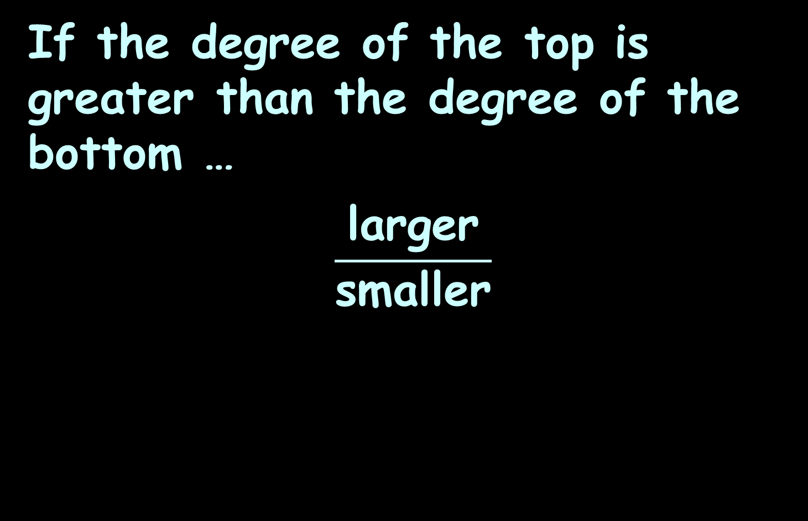
Limits of Ratios
If the degree of the top is greater than the degree of the bottom …
$$\frac{\text{larger}}{\text{small}\text{er}}$$

Slide 46

Limits of Ratios
If the degree of the top is greater than the degree of the bottom …
the limit is positive infinity…
…or maybe negative infinity
We need to look at the signs of the coefficients!
$$\frac{\text{larger}}{\text{small}\text{er}}$$

Slide 47
Limits of Ratios
We figure out the sign (positive or negative) by the ratio of the sign of the coefficient for the largest numerator term divided by the sign of the coefficient for the largest denominator term

Slide 48

LIMIT OF RATIOS
IN-CLASS PROBLEM 9
Find the limit:
$$\frac{\text{x}\text{3}\text{+}\text{2}\text{x}\text{−1}}{\text{6}\text{x}\text{2}}$$
lim
x→∞
=

Slide 49

LIMIT OF RATIOS
IN-CLASS PROBLEM 9
Find the limit:
$$\frac{\text{x}\text{3}\text{+2}\text{x}\text{−1}}{\text{6}\text{x}\text{2}}$$
lim
x→∞
= +∞
positive
positive

Slide 50

LIMIT OF RATIOS
IN-CLASS PROBLEM 10
Find the limit:
$$\frac{\text{−7}\text{x}\text{3}\text{−1}}{\text{4}\text{x}\text{2}\text{+5}}$$
lim
x→∞
=

Slide 51
LIMIT OF RATIOS
IN-CLASS PROBLEM 10
Find the limit:
$$\frac{\text{−7}\text{x}\text{3}\text{−1}}{\text{4}\text{x}\text{2}\text{+5}}$$
lim
x→∞
= -∞
negative
positive

Slide 52

LIMIT OF RATIOS
IN-CLASS PROBLEM 10
BUT: Find the limit:
$$\frac{\text{7}\text{x}\text{3}\text{−1}}{\text{−4}\text{x}\text{2}\text{+5}}$$
lim
x→∞

Slide 53
LIMIT OF RATIOS
IN-CLASS PROBLEM 10
BUT: Find the limit:
$$\frac{\text{7}\text{x}\text{3}\text{−1}}{\text{−4}\text{x}\text{2}\text{+5}}$$
lim
x→∞
= -∞
positivenegative

Slide 54

LIMIT OF RATIOS
IN-CLASS PROBLEM 10b
BUT: Find the limit:
$$\frac{\text{−7}\text{x}\text{3}\text{−1}}{\text{−4}\text{x}\text{2}\text{+5}}$$
lim
x→∞

Slide 55
LIMIT OF RATIOS
IN-CLASS PROBLEM 10b
BUT: Find the limit:
$$\frac{\text{−7}\text{x}\text{3}\text{−1}}{\text{−4}\text{x}\text{2}\text{+5}}$$
lim
x→∞
= +∞
negativenegative

Slide 56
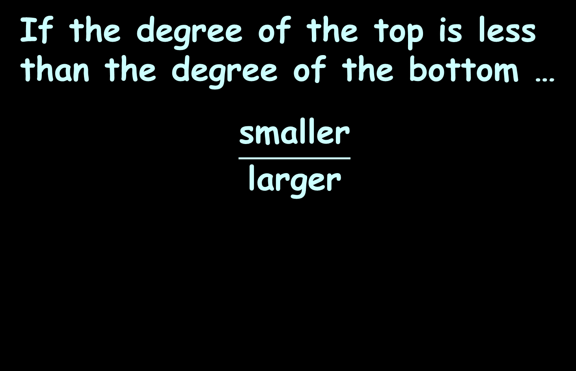
Limits of Ratios
If the degree of the top is less than the degree of the bottom …
$$\frac{\text{s}\text{maller}}{\text{l}\text{arg}\text{er}}$$

Slide 57
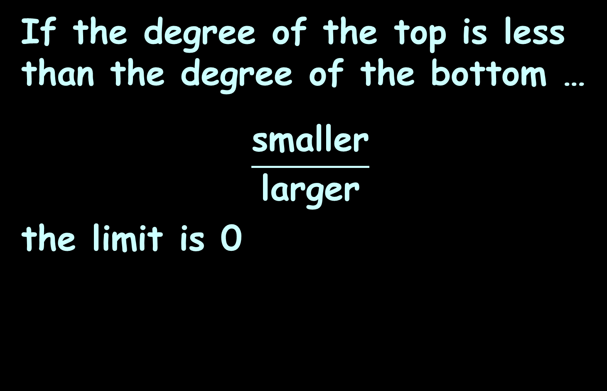
Limits of Ratios
If the degree of the top is less than the degree of the bottom …
$$\frac{\text{s}\text{maller}}{\text{l}\text{arg}\text{er}}$$
the limit is 0

Slide 58
Limits of Ratios
If the degree of the top is the same as the degree of the bottom …

Slide 59
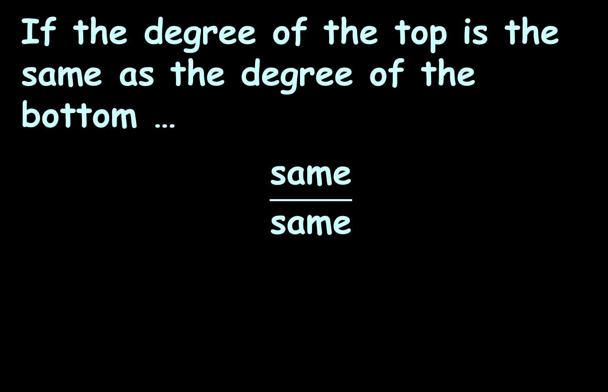
Limits of Ratios
If the degree of the top is the same as the degree of the bottom …
$$\frac{\text{same}}{\text{sam}\text{e}}$$

Slide 60
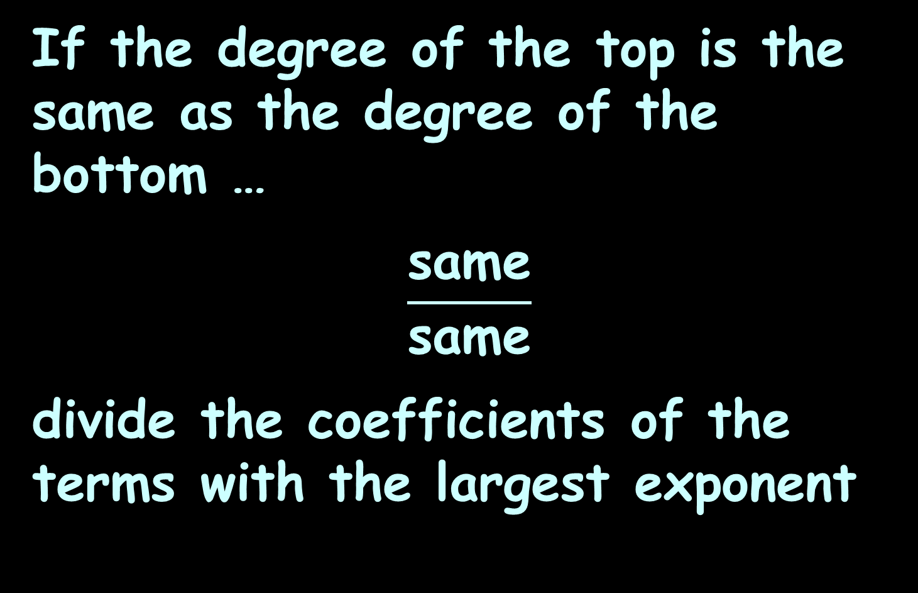
Limits of Ratios
If the degree of the top is the same as the degree of the bottom …
$$\frac{\text{same}}{\text{sam}\text{e}}$$
divide the coefficients of the terms with the largest exponent

Slide 61

LIMIT OF RATIOS
IN-CLASS PROBLEM 11
Find the limit:
$$\frac{\text{5}\text{x}\text{2}\text{+}\text{1}}{\text{3}\text{x}\text{2}\text{−}\text{1}}$$
lim
x→∞
=

Slide 62
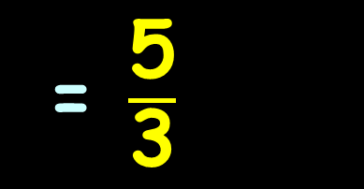
LIMIT OF RATIOS
IN-CLASS PROBLEM 11
Find the limit:
Check this in Excel!
$$\frac{\text{5}\text{x}\text{2}\text{+1}}{\text{3}\text{x}\text{2}\text{−1}}$$
= $\frac{\text{5}}{\text{3}}$
lim
x→∞
https://www.mathsisfun.com/calculus/limits-infinity.html

Slide 63

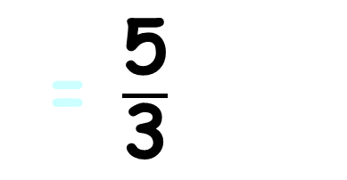
LIMIT OF RATIOS
IN-CLASS PROBLEM 11
Find the limit:
$$\frac{\text{−5}\text{x}\text{2}\text{+1}}{\text{3}\text{x}\text{2}\text{−1}}$$
= $\frac{\text{5}}{\text{3}}$
lim
x→∞
https://www.mathsisfun.com/calculus/limits-infinity.html

Slide 64
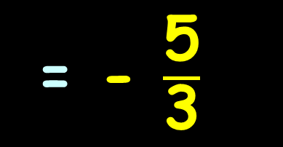
LIMIT OF RATIOS
IN-CLASS PROBLEM 11
Find the limit:
Check this in Excel!
$$\frac{\text{−5}\text{x}\text{2}\text{+1}}{\text{3}\text{x}\text{2}\text{−1}}$$
= - $\frac{\text{5}}{\text{3}}$
lim
x→∞
https://www.mathsisfun.com/calculus/limits-infinity.html

Slide 65

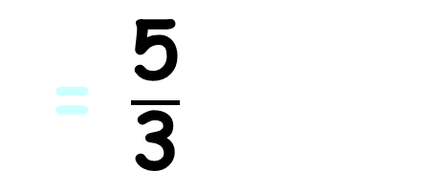
LIMIT OF RATIOS
IN-CLASS PROBLEM 11
Find the limit:
$$\frac{\text{−5}\text{x}\text{2}\text{+1}}{\text{−3}\text{x}\text{2}\text{−1}}$$
= $\frac{\text{5}}{\text{3}}$
lim
x→∞
https://www.mathsisfun.com/calculus/limits-infinity.html

Slide 66
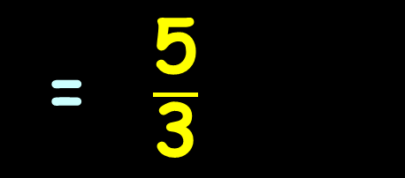
LIMIT OF RATIOS
IN-CLASS PROBLEM 11
Find the limit:
Check this in Excel!
$$\frac{\text{−5}\text{x}\text{2}\text{+1}}{\text{−3}\text{x}\text{2}\text{−1}}$$
= $\frac{\text{5}}{\text{3}}$
lim
x→∞
https://www.mathsisfun.com/calculus/limits-infinity.html

Slide 67



Limits of Infinite Ratios
At this point, these are sort of “rules”
Later, we’ll see where they came from (differential calculus)
$$\frac{\text{larger}}{\text{small}\text{er}}$$
$$\frac{\text{sam}\text{e}}{\text{sa}\text{m}\text{e}}$$
$$\frac{\text{smalle}\text{r}}{\text{larger}}$$

Slide 68
Questions?
http://i.imgur.com/aliTlT3.jpg

Slide 69

Limits of Ratios
A helpful web site is:
wolframalpha.com

Slide 70
Limits of Ratios
Type:
limit
and a bunch of options pop up
Select one close to what you want (then you have to type less)

Slide 71
Limits of Ratios
Type:
limit x->∞ (5x^2+1)/(3x^2−x)

Slide 72
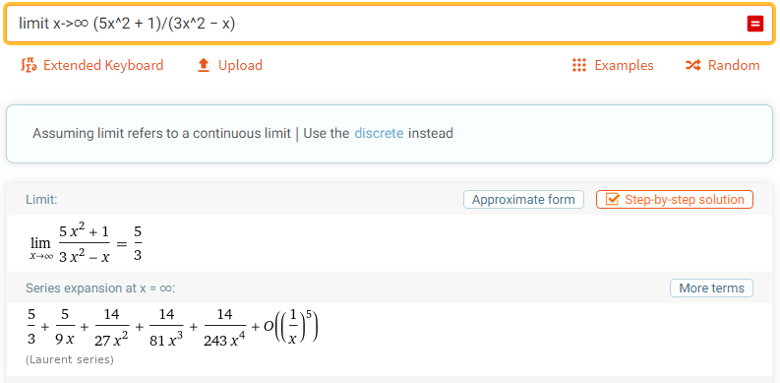
Limits of Ratios

Slide 73
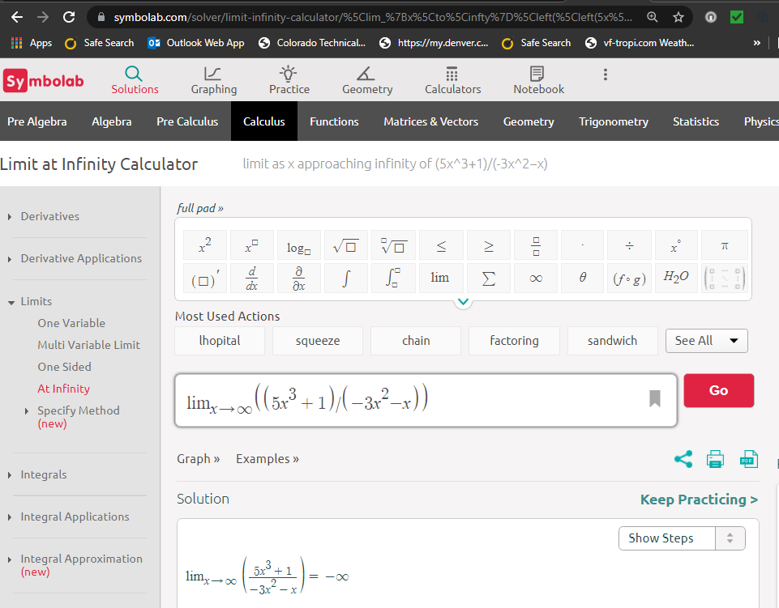

Slide 74
Questions?
http://i.imgur.com/aliTlT3.jpg

Slide 75
The secret word for this unit is:
SUSPECT

Slide 76
Graphical Rates of Change
What is the slope (rise/run) of the curve between x=6 and x=10?
15
10
5
0
0 1 2 3 4 5 6 7 8 9 10
https://ximera.osu.edu/mooculus/calculus1/derivativeAsAFunction/digInTheDerivativeAsAFunction

Slide 77
Graphical Rates of Change
If you have a well-drawn graph, this is easy!
15
10
5
0
0 1 2 3 4 5 6 7 8 9 10
https://ximera.osu.edu/mooculus/calculus1/derivativeAsAFunction/digInTheDerivativeAsAFunction

Slide 78
GRAPHICAL RATES OF CHANGE
IN-CLASS PROBLEM 12
What is Δy (the rise)?
What is Δx (the run)?
What is Δy/Δx (the slope)?
15
10
5
0
0 1 2 3 4 5 6 7 8 9 10
https://ximera.osu.edu/mooculus/calculus1/derivativeAsAFunction/digInTheDerivativeAsAFunction

Slide 79
GRAPHICAL RATES OF CHANGE
IN-CLASS PROBLEM 12
What is Δy (the rise)? 10
What is Δx (the run)?
What is Δy/Δx (the slope)?
15
10
5
0
0 1 2 3 4 5 6 7 8 9 10
https://ximera.osu.edu/mooculus/calculus1/derivativeAsAFunction/digInTheDerivativeAsAFunction

Slide 80
GRAPHICAL RATES OF CHANGE
IN-CLASS PROBLEM 12
What is Δy (the rise)? 10
What is Δx (the run)? 4
What is Δy/Δx (the slope)?
15
10
5
0
0 1 2 3 4 5 6 7 8 9 10
https://ximera.osu.edu/mooculus/calculus1/derivativeAsAFunction/digInTheDerivativeAsAFunction

Slide 81
GRAPHICAL RATES OF CHANGE
IN-CLASS PROBLEM 12
What is Δy (the rise)? 10
What is Δx (the run)? 4
What is Δy/Δx (the slope)? 10/4 = 5/2 = 2.5
15
10
5
0
0 1 2 3 4 5 6 7 8 9 10
https://ximera.osu.edu/mooculus/calculus1/derivativeAsAFunction/digInTheDerivativeAsAFunction

Slide 82
Graphical Rates of Change
Note: two very different functions can have the same average rate of change
http://www.mesacc.edu/~marfv02121/readings/average/index.html

Slide 83
Questions?
http://i.imgur.com/aliTlT3.jpg

Slide 84
Applications
The DC current at a point in a circuit is defined to be the total number of coulombs (electricity conveyed in one second by a current of one ampere) divided by the time

Slide 85
Applications
The mathematical model relating charge to voltage in a capacitor is:
Δq = CΔv
C is a constant capacitance value (in Farads)
v is voltage (in volts)
q is charge (in coulombs)

Slide 86
APPLICATIONS OF RATES OF CHANGE
IN-CLASS PROBLEM 13
A 500μF (microfarad) (.0005 F) capacitor has its voltage increased from 300 to 375 volts. What will be the change in charge?
What are we looking for?
Δq = CΔv

Slide 87
APPLICATIONS OF RATES OF CHANGE
IN-CLASS PROBLEM 13
A 500μF (microfarad) (.0005 F) capacitor has its voltage increased from 300 to 375 volts. What will be the change in charge?
What are we looking for? Δq
What do we know?
Δq = CΔv

Slide 88
APPLICATIONS OF RATES OF CHANGE
IN-CLASS PROBLEM 13
A 500μF (microfarad) (.0005 F) capacitor has its voltage increased from 300 to 375 volts. What will be the change in charge?
What are we looking for? Δq
What do we know? C, Δv
What values are those?
Δq = CΔv

Slide 89
APPLICATIONS OF RATES OF CHANGE
IN-CLASS PROBLEM 13
A 500μF (microfarad) (.0005 F) capacitor has its voltage increased from 300 to 375 volts. What will be the change in charge?
What are we looking for? Δq
What values? C = 0.0005,
Δv = 375-300 = 75
Δq = CΔv

Slide 90
APPLICATIONS OF RATES OF CHANGE
IN-CLASS PROBLEM 13
A 500μF (microfarad) capacitor has its voltage increased from 300 to 375 volts. What will be the change in charge?
Δq = CΔv
= (.0005)×(375-300)
Δq = CΔv

Slide 91
APPLICATIONS OF RATES OF CHANGE
IN-CLASS PROBLEM 13
A 500μF (microfarad) capacitor has its voltage increased from 300 to 375 volts. What will be the change in charge?
Δq = CΔv
= (.0005)×(375-300)
= .0375 whats?
Δq = CΔv

Slide 92
APPLICATIONS OF RATES OF CHANGE
IN-CLASS PROBLEM 13
A 500μF (microfarad) capacitor has its voltage increased from 300 to 375 volts. What will be the change in charge?
Δq = CΔv
= (.0005)×(375-300)
= 0.0375 coulombs
Δq = CΔv

Slide 93
Applications
The average current (amps) charging the plates of a capacitor is directly proportional to the average rate of change of its voltage with respect to time:
I_{avg} = C Δv/Δt
(t is in seconds)
Δq = CΔv

Slide 94
Applications
Let Δq be the total number of coulombs counted over our time
Let Δt be the time taken (in seconds)
Let I_{avg} be the average current (in amperes)

Slide 95
Applications
Let Δq be the total number of coulombs counted
Let Δt be the time taken
Let I_{avg} be the average current (in amperes)
I_{avg} = C Δv/Δt = Δq/Δt
Δq = CΔv

Slide 96
APPLICATIONS OF RATES OF CHANGE
IN-CLASS PROBLEM 14
How many coulombs of charge would have to pass through a resistor in 5 seconds for the average current to be 2.7 amperes?
I_{avg} = Δq/Δt

Slide 97
APPLICATIONS OF RATES OF CHANGE
IN-CLASS PROBLEM 14
How many coulombs of charge would have to pass through a resistor in 5 seconds for the average current to be 2.7 amperes?
I_{avg} = Δq/Δt or Δq = I_{avg}×Δt

Slide 98
APPLICATIONS OF RATES OF CHANGE
IN-CLASS PROBLEM 14
How many coulombs of charge would have to pass through a resistor in 5 seconds for the average current to be 2.7 amperes?
Δq = I_{avg}×Δt
Δq = 2.7 × 5 =

Slide 99
APPLICATIONS OF RATES OF CHANGE
IN-CLASS PROBLEM 14
How many coulombs of charge would have to pass through a resistor in 5 seconds for the average current to be 2.7 amperes?
Δq = I_{avg}×Δt
Δq = 2.7 × 5 = 13.5 whats?

Slide 100
APPLICATIONS OF RATES OF CHANGE
IN-CLASS PROBLEM 14
How many coulombs of charge would have to pass through a resistor in 5 seconds for the average current to be 2.7 amperes?
Δq = I_{avg}×Δt
Δq = 2.7 × 5 = 13.5 coulombs

Slide 101
Applications
But, why is “current” “I”?
Faraday video

Slide 102
Questions?
http://i.imgur.com/aliTlT3.jpg

Slide 103
Remember Trig?
A tangent (tan) is the sin/cos
A sin in a unit circle is the rise
A cos in a unit circle is the run
So a tangent is a slope: rise/run

Slide 104
Remember Trig?
AND a “tangent” is actually the line tangent to the unit circle at the point where
the right
triangle
intersects
the circle
tan
sin
.
θ
…and that’s why it’s called the “tangent”
cos
VFrench, 2015

Slide 105
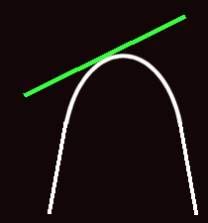
Remember Trig?
In fact, a “tangent” is the line tangent to any curve at a given point
VFrench, 2015

Slide 106
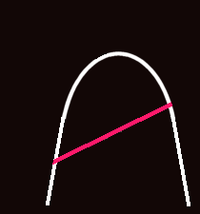
Remember Trig?
The line joining any two points on a curve is the “secant”
VFrench, 2015

Slide 107
Remember Trig?
The slope of the secant line is:
m_{sec} = ∆y / ∆x
VFrench, 2015

Slide 108
Limits in Trig
As you move the secant line in a parallel fashion toward the curve…
VFrench, 2020

Slide 109
Limits in Trig
As you move the secant line in a parallel fashion toward the curve…
VFrench, 2020

Slide 110
Limits in Trig
As you move the secant line in a parallel fashion toward the curve…
VFrench, 2020

Slide 111
Limits in Trig
It becomes the tangent when it hits the edge of the curve
VFrench, 2020

Slide 112
Another Way to Look at It
Pick any secant
Move the secant closer and
closer to one of its endpoints
When it touches an endpoint, it
becomes the tangent
secant
secant
secant
tangent
VFrench, 2020

Slide 113
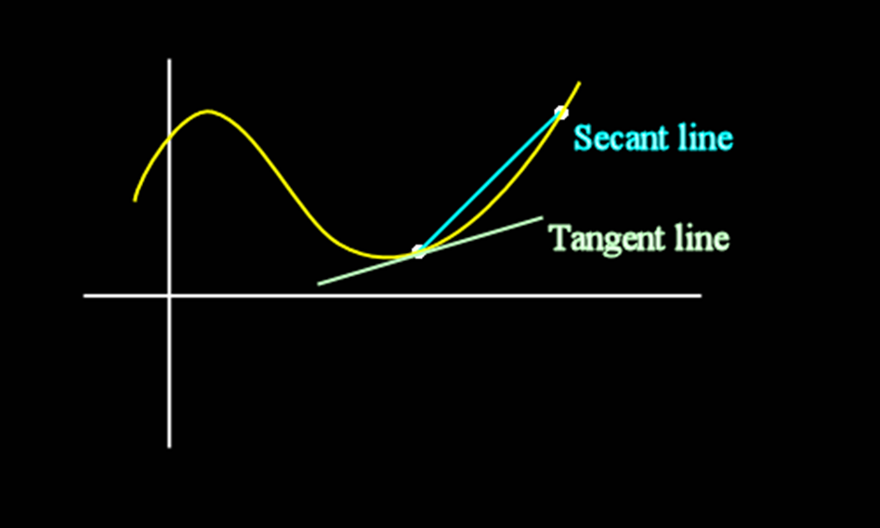
Secant vs Tangent
VFrench, 2015

Slide 114
Limits in Trig
This concept of getting closer and closer to a value or a location on a graph is called a
taking a “limit”

Slide 115
Questions?
http://i.imgur.com/aliTlT3.jpg

Slide 116
Derivatives
An average rate of change can be written:
Δy/Δx
Where:
Δx = x_{final} - x_{initial} = x₁ - x₀
Δy = y_{final} - y_{initial} = y₁ - y₀

Slide 117
Derivatives
An exact rate of change can be written:
lim Δy/Δx
Δx → 0

Slide 118
Derivatives
This is usually written:
dy/dx
and is called the derivative

Slide 119

Derivatives
The formal definition of a derivative is:
ƒ ′(x) = lim(h→0) $\frac{\text{ƒ}\text{(}\text{x}\text{+}\text{h}\text{)−}\text{ƒ}\text{(}\text{x}\text{)}}{\text{h}}$

Slide 120
Derivatives
The process of finding the
lim Δy/Δx
Δx → 0
or dy/dx
is called differentiation

Slide 121
Derivatives
When differentiating a function, it is usually written:
put the function here
d/dx
Example: for y = 3x² - 4x + 5
write: d/dx (3x² - 4x + 5)

Slide 122
Derivatives/Differentiation
Remember how I said calculus wasn’t REAL…

Slide 123
Derivatives/Differentiation
Remember how I said calculus wasn’t REAL…
That’s because the slope of a “line” with 0 length is nonsense

Slide 124
Derivatives/Differentiation
Remember how I said calculus wasn’t REAL…
That’s because the slope of a “line” with 0 length is nonsense
But we know what value the slope is approaching

Slide 125
Derivatives/Differentiation
Remember how I said calculus wasn’t REAL…
That’s because the slope of a “line” with 0 length is nonsense
But we know what value the slope is approaching
And it’s a way to do hard calculations more easily…

Slide 126
Questions?
http://i.imgur.com/aliTlT3.jpg

Slide 127

Derivatives/Differentiation
In order to do the calculations, you need to know some RULES
https://henrytrocino.files.wordpress.com/2013/08/weeping-and-gnashing-of-teeth-300x236.jpg

Slide 128
Derivatives/Differentiation
Rule #1: derivative of a constant:
d/dx c = 0

Slide 129
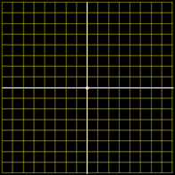
Derivatives/Differentiation
Remember it’s a slope at a given value of x
4
3
2
1
-4
-3
0
-2
-1
0
1
2
3
4
-1
-2
-3
-4
VFrench, 2015

Slide 130
Derivatives/Differentiation
What’s the slope (rise over run) at any x?
4
3
2
1
-4
-3
0
-2
-1
0
1
2
3
4
-1
-2
-3
-4
VFrench, 2015

Slide 131
Derivatives/Differentiation
What’s the slope (rise over run) at any x? 0
4
3
2
1
-4
-3
0
-2
-1
0
1
2
3
4
-1
-2
-3
-4
VFrench, 2015

Slide 132
DERIVATIVES
IN-CLASS PROBLEM 15
Find the derivative dy/dx of:
y = 5
y = -752.36
y = -763.87π
d/dx c = 0

Slide 133
DERIVATIVES
IN-CLASS PROBLEM 15
Find the derivative dy/dx of:
y = 5 d/dx 5 = 0
y = -752.36
y = -763.87π

Slide 134
DERIVATIVES
IN-CLASS PROBLEM 15
Find the derivative dy/dx of:
y = 5 d/dx 5 = 0
y = -752.36 d/dx -752.36 = 0
y = -763.87π

Slide 135
DERIVATIVES
IN-CLASS PROBLEM 15
Find the derivative dy/dx of:
y = 5 d/dx 5 = 0
y = -752.36 d/dx -752.36 = 0
y = -763.87π
dy/dx (-763.87π) = 0

Slide 136
Questions?
http://i.imgur.com/aliTlT3.jpg

Slide 137
Derivatives/Differentiation
What’s the slope at any x?
4
3
2
1
-4
-3
0
-2
-1
0
1
2
3
4
-1
-2
-3
-4
VFrench, 2015

Slide 138
Derivatives/Differentiation
What’s the slope at any x?
Well, it
changes
with every x
4
3
2
1
-4
-3
0
-2
-1
0
1
2
3
4
-1
-2
-3
-4
VFrench, 2015

Slide 139
Derivatives/Differentiation
What’s the slope at any x?
Well, it
changes
with every x
So the slope
will be a
function of x
4
3
2
1
-4
-3
0
-2
-1
0
1
2
3
4
-1
-2
-3
-4
VFrench, 2015

Slide 140
Derivatives/Differentiation
Rule #2: derivative of a power function:
d/dx cx^{n} = cn × x ^{n-1}

Slide 141
DERIVATIVES
IN-CLASS PROBLEM 16
Find the derivative dy/dx of:
y = x² = 1x² = 2*1 x²⁻¹ = 2x¹
= 2x
y = 7x⁵
y = -83.2x^{7.8}
d/dx cx^{n} = cn × x ^{n-1}

Slide 142
DERIVATIVES
IN-CLASS PROBLEM 16
Find the derivative dy/dx of:
y = x²
dy/dx x² = 2x
y = 7x⁵
dy/dx 7x⁵ = 35x⁴
y = -83.2x^{7.8}
d/dx cx^{n} = cn × x ^{n-1}

Slide 143
DERIVATIVES
IN-CLASS PROBLEM 16
Find the derivative dy/dx of:
y = x²
dy/dx x² = 2x
y = 7x⁵
dy/dx 7x⁵ = 35x⁴
y = -83.2x^{7.8}
dy/dx -83.2x^{7.8} = -648.96x^{6.8}
d/dx cx^{n} = cn × x ^{n-1}

Slide 144
Questions?
http://i.imgur.com/aliTlT3.jpg

Slide 145
Derivatives/Differentiation
Rule #3:
derivative of a sum u + v:
du/dx + dv/dx

Slide 146
Derivatives/Differentiation
Suppose we had:
derivative of a sum u + v:
7x² -3.2
du/dx + dv/dx

Slide 147
Derivatives/Differentiation
Suppose we had:
derivative of a sum u + v:
7x² -3.2
du/dx + dv/dx
14x¹ + 0
or 14x

Slide 148
DERIVATIVES
IN-CLASS PROBLEM 17
Find the derivative dy/dx of:
y = x³ + 10
y = 6x⁴ - 97
y = -12.2x^{2.1} + 75.2
d/dx cx^{n} = cn x ^{n-1}
du/dx + dv/dx

Slide 149
DERIVATIVES
IN-CLASS PROBLEM 17
Find the derivative dy/dx of:
y = x³ + 10
d/dx x³ + d/dx 10 = 3x²
y = 6x⁴ - 97
y = -12.2x^{2.1} + 75.2
d/dx cx^{n} = cn x ^{n-1}
du/dx + dv/dx

Slide 150
DERIVATIVES
IN-CLASS PROBLEM 17
Find the derivative dy/dx of:
y = x³ + 10 dy/dx = 3x²
y = 6x⁴ - 97
d/dx 6x⁴ - d/dx 97 = 24x³
y = -12.2x^{2.1} + 75.2
d/dx cx^{n} = cn x ^{n-1}
du/dx + dv/dx

Slide 151
DERIVATIVES
IN-CLASS PROBLEM 17
Find the derivative dy/dx of:
y = x³ + 10 dy/dx = 3x²
y = 6x⁴ - 97 dy/dx = 24x³
y = -12.2x^{2.1} + 75.2
d/dx -12.2x^{2.1} + d/dx 75.2 =
= -25.62x^{1.1}
d/dx cx^{n} = cn x ^{n-1}
du/dx + dv/dx

Slide 152
Questions?
http://i.imgur.com/aliTlT3.jpg

Slide 153
Derivatives
Different symbols are used for derivatives:
y’ or ƒ ′(x) (Newton’s symbol)
dy/dx (Leibnitz’s symbol)
∆y/∆x

Slide 154
Derivatives
Order matters!
dy/dx ≠ dx/dy

Slide 155
Derivatives
This is why I actually prefer Leibnitz’s dy/dx over Newton’s ƒ ′(x)
There are times we want to find dx/dy not dy/dx, and Newton’s symbols don’t handle that possibility

Slide 156
Derivatives
dy/dx is the rate of change of y vs x
dx/dy is the rate of change of x vs y
Both are useful!

Slide 157
DERIVATIVES
IN-CLASS PROBLEM 18
Suppose we had: y = 3x + 40
Find the derivative dy/dx:
Find the derivative dx/dy:

Slide 158
DERIVATIVES
IN-CLASS PROBLEM 18
Suppose we had: y = 3x + 40
Find the derivative dy/dx:
dy/dx = 3
Find the derivative dx/dy:

Slide 159
DERIVATIVES
IN-CLASS PROBLEM 18
Suppose we had: y = 3x + 40
Find the derivative dy/dx:
dy/dx = 3
Find the derivative dx/dy:
Rewrite it as x = _______

Slide 160
DERIVATIVES
IN-CLASS PROBLEM 18
Suppose we had: y = 3x + 40
Find the derivative dy/dx:
dy/dx = 3
Find the derivative dx/dy:
Rewrite it as x = _______
y -40 = 3x + 40 -40
(y – 40)/3 = 3x/3

Slide 161
DERIVATIVES
IN-CLASS PROBLEM 18
Suppose we had: y = 3x + 40
Find the derivative dy/dx:
dy/dx = 3
Find the derivative dx/dy:
x = (y – 40)/3 = 1/3 y¹ – 40/3
now you can find dx/dy!

Slide 162
DERIVATIVES
IN-CLASS PROBLEM 18
Suppose we had: y = 3x + 40
Find the derivative dy/dx:
dy/dx = 3
Find the derivative dx/dy:
x = 1/3 y¹ – 40/3 x

Slide 163
DERIVATIVES
IN-CLASS PROBLEM 18
Suppose we had: y = 3x + 40
Find the derivative dy/dx:
dy/dx = 3
Find the derivative dx/dy:
x = 1/3 y¹ – 40/3
dx/dy = 1/3

Slide 164
DERIVATIVES
IN-CLASS PROBLEM 18
Suppose we had: y = 3x + 40
Find the derivative dy/dx:
dy/dx = 3
Find the derivative dx/dy:
x = (y – 40)/3
x = y/3 – 40/3
dx/dy = 1/3
So dy/dx ≠ dx/dy

Slide 165
DERIVATIVES
IN-CLASS PROBLEM 18
Notice:
dy/dx is the inverse
of dx/dy
AND 3 is the inverse of 1/3
The “/” in dy/dx is a true division!

Slide 166
DERIVATIVES
IN-CLASS PROBLEM 18
Notice:
dy/dx is the inverse
of dx/dy
AND 3 is the inverse of 1/3
The “/” in dy/dx is a true division!
BUT dy is not d × y (it is an operator: ∆)

Slide 167
Questions?
http://i.imgur.com/aliTlT3.jpg

Slide 168
Derivatives
Not every function has a derivative at every point

Slide 169
DERIVATIVES
IN-CLASS PROBLEM 19
Find the derivative dy/dx for |x|
at x=0:
VFrench, 2021

Slide 170
DERIVATIVES
IN-CLASS PROBLEM 19
Find the derivative dy/dx for |x|
at x=0:
Well, there is no UNIQUE tangent line at that point…
VFrench, 2021

Slide 171
DERIVATIVES
IN-CLASS PROBLEM 19
Find the derivative dy/dx for |x|
at x=0:
Well, there is no UNIQUE tangent line at that point…
So there is no
derivative at x=0
VFrench, 2021

Slide 172
Derivatives
In addition, if the limit doesn’t exist (like at a cliff),
then the derivative doesn’t exist either

Slide 173
Derivatives
There’s no unique tangent line
so there’s no derivative
https://www.mathsisfun.com/calculus/limits.html

Slide 174
Derivatives
There’s no unique tangent line
so there’s no derivative
https://www.mathsisfun.com/calculus/limits.html

Slide 175
Derivatives
This doesn’t say anything about whether or not the derivative exists anywhere else
In fact, the derivative of the absolute value function exists at every point except the one we just looked at, x=0

Slide 176
Derivatives
…and there is a derivative for
every point except x=5.5
https://www.mathsisfun.com/calculus/limits.html

Slide 177
Derivatives
A function ƒ (x) is called differentiable at x = a if
ƒ ′(a) exists

Slide 178
Derivatives
ƒ (x) is called differentiable on an interval if the derivative exists for each point in that interval

Slide 179
Derivatives
Differentiable on the intervals:
0<x<5.5 and 5.5<x<10.1
(not 0≤x≤5.5 and 5.5≤x≤10.1)
https://www.mathsisfun.com/calculus/limits.html

Slide 180
Derivatives
In fact,
if ƒ (x) is differentiable
at x = a
then ƒ (x) is continuous
at x = a
https://tutorial.math.lamar.edu/Classes/CalcI/DefnOfDerivative.aspx

Slide 181
Derivatives
If ƒ (x) is not
continuous at x=a
then the derivative
does not exist
either!
https://www.mathsisfun.com/calculus/limits.html

Slide 182
Derivatives
If ƒ (x) is not
continuous at x=a
then the derivative
does not exist
either!
https://www.mathsisfun.com/calculus/limits.html

Slide 183
Derivatives
ƒ (x) is called globally differentiable if the derivative exists for every point on the number line

Slide 184
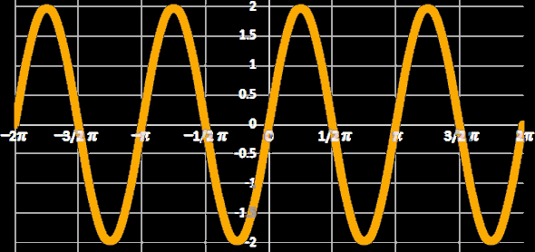
Derivatives
Does a tangent line exist for every point on a sine?
VFrench, 2015

Slide 185
Derivatives
Does a tangent line exist for every point on a sine? yes! So it is globally differentiable!
VFrench, 2015

Slide 186
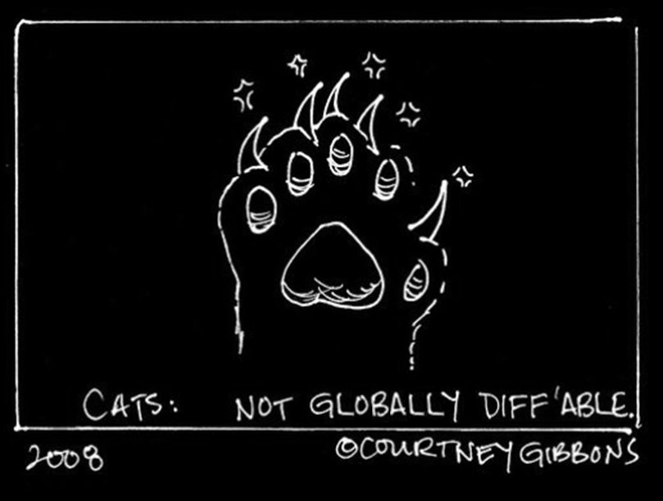
Derivatives

Slide 187
Questions?
http://i.imgur.com/aliTlT3.jpg

Slide 188

You Survived!
Today we studied:
Infinite limits
Rates of change
Differentiation!
www.playbuzz.com

