Slide 1
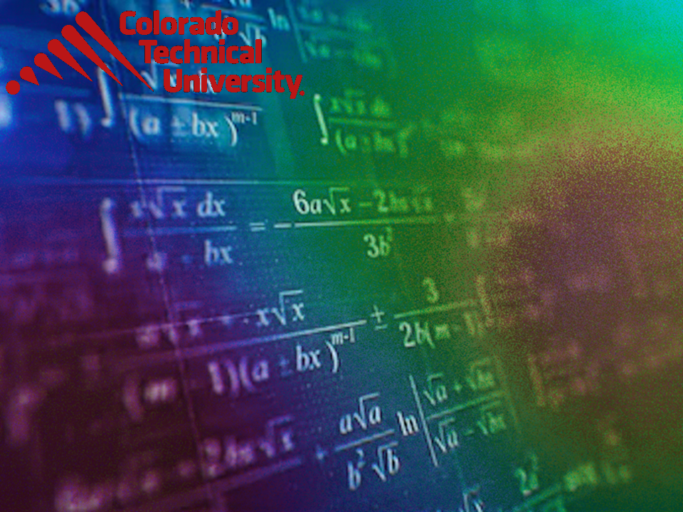
Welcome to
Unit 3 Part 5!
MATH 205 Differential Calculus
https://www.smu.edu.sg/programmes/core-curriculum/course-structure/calculus

Slide 2
What’s Up?
Review: Limits
New stuff:
Infinite Limits
Graphical Rates of Change
Applications for Rates of
Change

Slide 3
What’s Up?
Outcome 2) Use algebra and limits to examine the properties and graphs of functions
Outcome 7) Solve problems by identifying the requirements, making a sketch as appropriate, and using calculus techniques to model the problem, calculating the final answer and verifying the solution

Slide 4

Review
http://995642590.r.lightningbase-cdn.com/wp-content/uploads/2010/12/looking-back-hrexaminer-v144-cover425px.jpg

Slide 5
Calculating Limits
Evaluate: lim (6x² – 3x + 5)
x → 0
Just plug in x = 0 and solve!

Slide 6
Limits
Even if functions are not the same, their limits at some target point may be the same
https://www.mathsisfun.com/calculus/limits.html

Slide 7
Limits
Sometimes we can't work the value out directly…
but we can see what it should be as we get closer and closer!

Slide 8
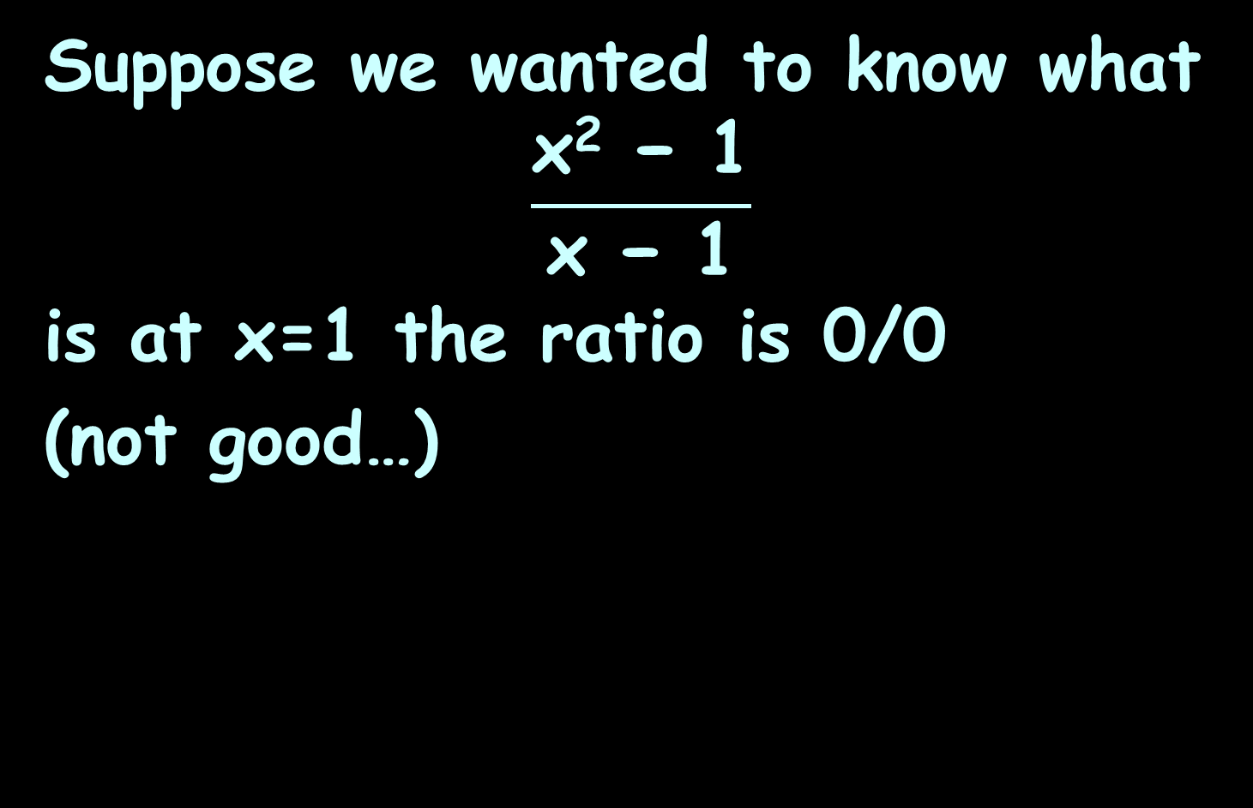
Limits
Suppose we wanted to know what
$$\frac{\text{x}\text{2}\text{ − 1}}{\text{x}\text{ − 1}}$$
is at x=1 the ratio is 0/0
(not good…)

Slide 9
Limits
But, as x gets closer and closer to 1
we can see a pattern
x | (x² − 1) (x − 1)
0.5 | 1.50000
0.9 | 1.90000
0.99 | 1.99000
0.999 | 1.99900
0.9999 | 1.99990
0.99999 | 1.99999

Slide 10
Limits
When x=1 we don't know the answer (it is indeterminate)…
But we can see that it is going to be 2…
so instead we say:
The limit of (x²−1)/(x−1) as x approaches 1 is 2

Slide 11
Limits
It is written symbolically as:
x²−1
x−1
lim
x→1
= 2

Slide 12
Limits
Graphically, it
would look like:
https://www.mathsisfun.com/calculus/limits.html

Slide 13
Limits
Test both sides of the hole!

Slide 14
Limits
Coming up from the left:
x | (x² − 1) (x − 1)
0.5 | 1.50000
0.9 | 1.90000
0.99 | 1.99000
0.999 | 1.99900
0.9999 | 1.99990
0.99999 | 1.99999
... | ..

Slide 15
Limits
Going down from the right:
x | (x² − 1) (x − 1)
1.5 | 2.50000
1.1 | 2.10000
1.01 | 2.01000
1.001 | 2.00100
1.0001 | 2.00010
1.00001 | 2.00001
... | ..

Slide 16
Limits
Since both sides give you the same answer, all is well!

Slide 17
Limits
What is the limit at x=5.5?
It’s not a hole… it’s a cliff!
https://www.mathsisfun.com/calculus/limits.html

Slide 18
Limits
We define “one sided limits”:
the left-hand limit
is 3.8
the right-hand limit
is 1.3
the ordinary limit "does not exist"
https://www.mathsisfun.com/calculus/limits.html

Slide 19
Limits
Written symbolically as:
and
lim
x→5.5⁻
= 3.8
lim
x→5.5⁺
= 1.3
lim
x→5.5
Does not exist
https://www.mathsisfun.com/calculus/limits.html

Slide 20
Continuity
continuous at “a”
discontinuous
at 1,3 and 5
https://coloradotech.vitalsource.com/#/books/9780357233375/cfi/6/20!/4/2372/4@0:76.0

Slide 21

Questions?
http://i.imgur.com/aliTlT3.jpg

Slide 22
New Stuff
What about the limit as x approaches infinity?

Slide 23
New Stuff
https://www.mathsisfun.com/calculus/limits.html

Slide 24
Infinite Limits
Infinity is a very special idea
We know we can't reach it, but we can still try to work out the value of functions that have infinity in them

Slide 25

INFINITE LIMITS
IN-CLASS PROBLEM 1
Find the limit:
$$\frac{\text{1}}{\text{x}}$$
lim
x→∞

Slide 26
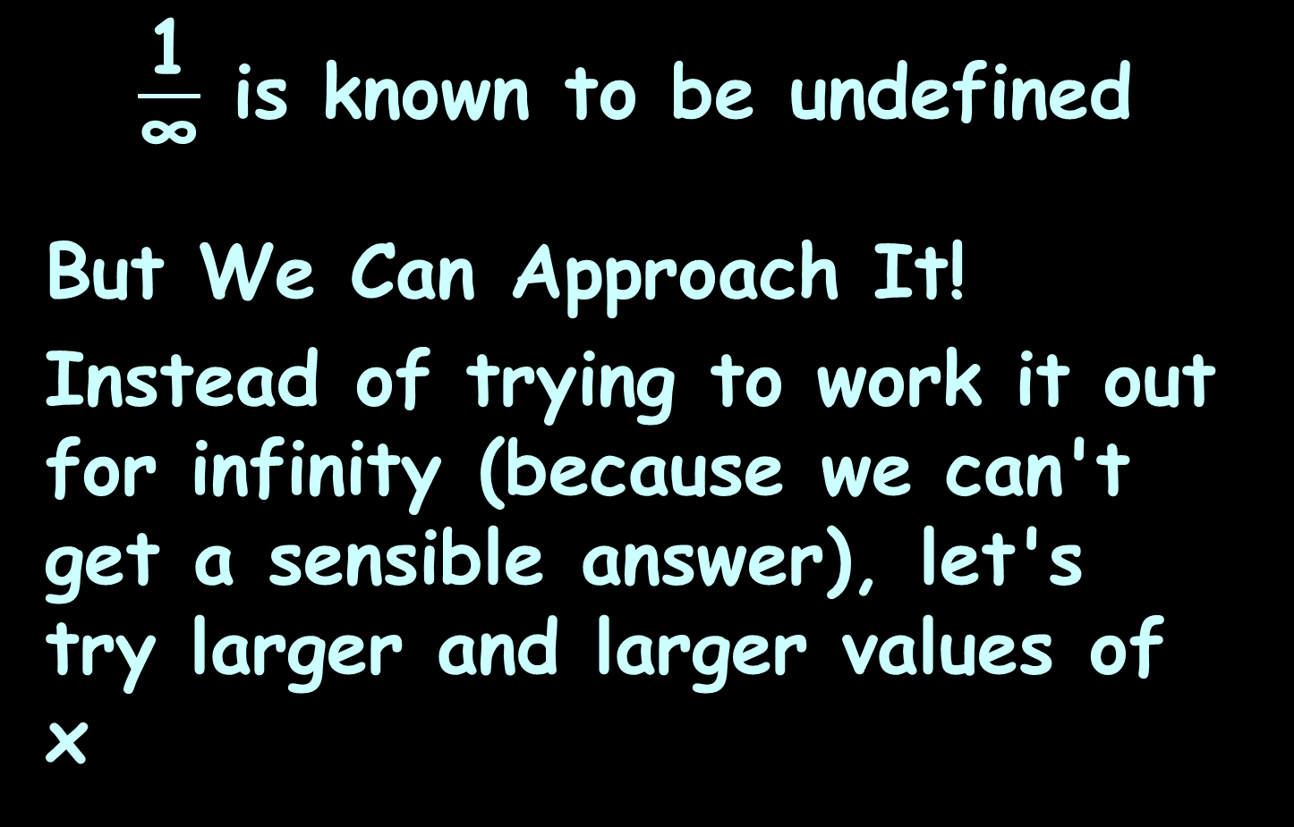
Infinite Limits
$\frac{\text{1}}{\text{∞}}$ is known to be undefined
But We Can Approach It!
Instead of trying to work it out for infinity (because we can't get a sensible answer), let's try larger and larger values of x

Slide 27
INFINITE LIMITS
IN-CLASS PROBLEM 1
Is there a pattern?
x | 1 x
1 | 1
2 | 0.5
4 | 0.25
10 | 0.1
100 | 0.01
1,000 | 0.001
10,000 | 0.0001

Slide 28
INFINITE LIMITS
IN-CLASS PROBLEM 1
As x gets larger,
1/x tends towards 0

Slide 29
INFINITE LIMITS
IN-CLASS PROBLEM 1
We can't say what happens when x gets to infinity
(it’s another “hole”)
but we can see that 1/x is going towards 0 as x gets larger and larger

Slide 30
INFINITE LIMITS
IN-CLASS PROBLEM 1
The limit of 1/x as x approaches infinity is 0
Written:
1
x
lim
x→∞
= 0

Slide 31
Infinite Limits
In other words:
As x approaches infinity, then 1/x approaches 0
When you see "limit", think "approaching"

Slide 32
Infinite Limits
lim formula = value
indep var → ∞

Slide 33
INFINITE LIMITS
IN-CLASS PROBLEMS 2,3
What is lim ? lim ?
x → -∞ x → ∞
https://www.mathsisfun.com/calculus/limits.html

Slide 34
INFINITE LIMITS
IN-CLASS PROBLEMS 2,3
What is lim ? lim ?
x → ∞ x → − ∞
0
https://www.mathsisfun.com/calculus/limits.html

Slide 35
INFINITE LIMITS
IN-CLASS PROBLEMS 2,3
What is lim ? lim ?
x → ∞ x → − ∞
0 0
https://www.mathsisfun.com/calculus/limits.html

Slide 36
INFINITE LIMITS REDO!
IN-CLASS PROBLEMS 4,5
What is lim ? lim ?
x → − ∞ x → ∞
https://www.mathsisfun.com/calculus/limits.html

Slide 37
INFINITE LIMITS
IN-CLASS PROBLEMS 4,5
What is lim ? lim ?
x → −∞ x → ∞
-1.6
https://www.mathsisfun.com/calculus/limits.html

Slide 38
INFINITE LIMITS
IN-CLASS PROBLEMS 4,5
What is lim ? lim ? “ogive”
x → −∞ x → ∞
-1.6 1.6
https://www.mathsisfun.com/calculus/limits.html

Slide 39
INFINITE LIMITS
IN-CLASS PROBLEM 6
Newton’s Law of Gravity states: The gravitational force between two masses, m₁ and m₂, that are separated by a distance r is defined by
F = G × m₁ × m₂ / r ²
What is lim ?
r → ∞

Slide 40
INFINITE LIMITS
IN-CLASS PROBLEM 6
F = G × m₁ × m₂ / r ²
What is lim ? 0
r → ∞
This means, the farther apart two objects are, the less gravitational attraction there is between them

Slide 41
Questions?
http://i.imgur.com/aliTlT3.jpg

Slide 42
INFINITE LIMITS
IN-CLASS PROBLEM 7
What is the limit of
y = 2x
as x approaches infinity?

Slide 43
Infinite Limits
Is there a pattern?
x | 2x
1 | 2
2 | 4
4 | 8
10 | 20
100 | 200
1,000 | 2,000
10,000 | 20,000

Slide 44
Infinite Limits
Obviously as "x" gets larger, so does "2x"
x | 2x
1 | 2
2 | 4
4 | 8
10 | 20
100 | 200
1,000 | 2,000
10,000 | 20,000

Slide 45
INFINITE LIMITS
IN-CLASS PROBLEM 7
So as "x" approaches infinity, then "2x" also approaches infinity
Written:
The limit as x goes to infinity of 2x = infinity
lim
x→∞
2x = ∞

Slide 46
Infinite Limits
But don't be fooled by the "="
We cannot actually get to infinity, but in "limits" language the limit is infinity
(which is really saying the function is limitless)

Slide 47
INFINITE LIMITS
IN-CLASS PROBLEM 8
What would be?
lim
x→∞
2x²

Slide 48
INFINITE LIMITS
IN-CLASS PROBLEM 8
What would be?
+infinity
lim
x→∞
2x²

Slide 49
INFINITE LIMITS
IN-CLASS PROBLEM 9
What would be?
lim
x→∞
-5x

Slide 50
INFINITE LIMITS
IN-CLASS PROBLEM 9
What would be?
-infinity
The sign is critical!
lim
x→∞
-5x

Slide 51
INFINITE LIMITS
IN-CLASS PROBLEM 10
What would be?
lim
x→∞
2x²-5x

Slide 52
Infinite Limits
x² grows more rapidly than x,
so 2x² − 5x will head towards +infinity

Slide 53
INFINITE LIMITS
IN-CLASS PROBLEM 10
What would be?
lim
x→∞
2x²-5x

Slide 54
INFINITE LIMITS
IN-CLASS PROBLEM 10
What would be?
+infinity
lim
x→∞
2x²-5x

Slide 55
Infinite Limits
When we look at the degree of a term in a function we can tell the limit for that term:
When the degree is:
greater than 0, the limit is
infinity (or −infinity)

Slide 56
Infinite Limits
When we look at the degree of a term in a function we can tell the limit for that term:
When the degree is:
greater than 0, the limit is
infinity (or −infinity)
less than 0, the limit is 0

Slide 57
Infinite Limits
Use the limit for the largest degree of a polynomial

Slide 58
Questions?
http://i.imgur.com/aliTlT3.jpg

Slide 59

Limits of Ratios
When we do infinite limits, we are using a type of mathematics called “Cantor Arithmetic”
Some infinities are
bigger than others!
http://themacadvocate.com/Home/wp-content/uploads/2009/07/skeptical.jpg

Slide 60
Limits of Ratios
A rational function is the ratio of two polynomials:
ƒ(x) = P(x)/Q(x)

Slide 61
Limits of Ratios
For example, suppose
P(x) = x³ + 2x − 1,
and Q(x) = 6x²:
ƒ(x) = (x³+2x-1)/6x²

Slide 62
Limits of Ratios
ƒ(x) = (x³+2x-1)/6x²
Following on from our idea of the degree of the polynomial, the first step to find the limit is to
Compare the degree of the top
to the degree of the bottom

Slide 63
Limits of Ratios
If the degree of the top is greater than the degree of the bottom …

Slide 64
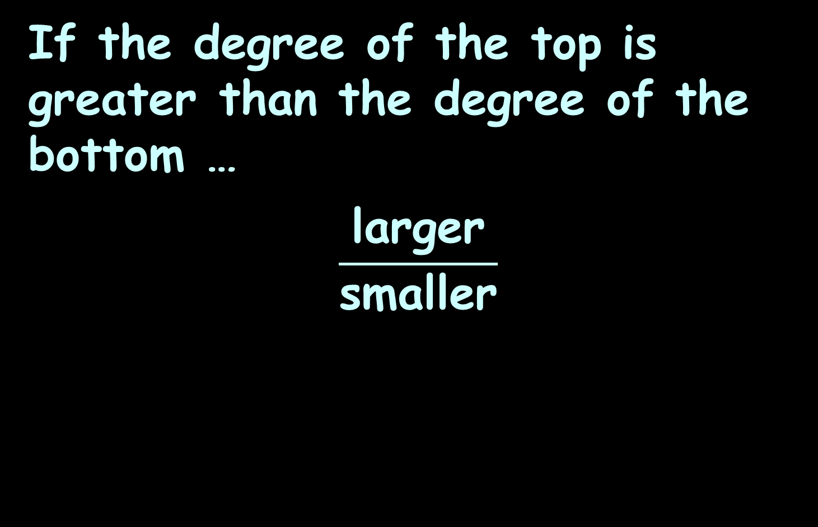
Limits of Ratios
If the degree of the top is greater than the degree of the bottom …
$$\frac{\text{larger}}{\text{small}\text{er}}$$

Slide 65

Limits of Ratios
If the degree of the top is greater than the degree of the bottom …
the limit is positive infinity…
…or maybe negative infinity
We need to look at the signs of the coefficients!
$$\frac{\text{larger}}{\text{small}\text{er}}$$

Slide 66
Limits of Ratios
We figure out the sign (positive or negative) by the ratio of the sign of the coefficient for the largest numerator term divided by the sign of the coefficient for the largest denominator term

Slide 67

LIMIT OF RATIOS
IN-CLASS PROBLEM 11
Find the limit:
$$\frac{\text{x}\text{3}\text{+}\text{2}\text{x}\text{−1}}{\text{6}\text{x}\text{2}}$$
lim
x→∞
=

Slide 68

LIMIT OF RATIOS
IN-CLASS PROBLEM 11
Find the limit:
$$\frac{\text{x}\text{3}\text{+2}\text{x}\text{−1}}{\text{6}\text{x}\text{2}}$$
lim
x→∞
= +∞
positive
positive

Slide 69

LIMIT OF RATIOS
IN-CLASS PROBLEM 12
Find the limit:
$$\frac{\text{−7}\text{x}\text{3}\text{−1}}{\text{4}\text{x}\text{2}\text{+5}}$$
lim
x→∞
=

Slide 70
LIMIT OF RATIOS
IN-CLASS PROBLEM 12
Find the limit:
$$\frac{\text{−7}\text{x}\text{3}\text{−1}}{\text{4}\text{x}\text{2}\text{+5}}$$
lim
x→∞
= -∞
negative
positive

Slide 71

LIMIT OF RATIOS
IN-CLASS PROBLEM 12
BUT: Find the limit:
$$\frac{\text{7}\text{x}\text{3}\text{−1}}{\text{−4}\text{x}\text{2}\text{+5}}$$
lim
x→∞

Slide 72
LIMIT OF RATIOS
IN-CLASS PROBLEM 12
BUT: Find the limit:
$$\frac{\text{7}\text{x}\text{3}\text{−1}}{\text{−4}\text{x}\text{2}\text{+5}}$$
lim
x→∞
= -∞
positivenegative

Slide 73

LIMIT OF RATIOS
IN-CLASS PROBLEM 12.5
BUT: Find the limit:
$$\frac{\text{−7}\text{x}\text{3}\text{−1}}{\text{−4}\text{x}\text{2}\text{+5}}$$
lim
x→∞

Slide 74
LIMIT OF RATIOS
IN-CLASS PROBLEM 12.5
BUT: Find the limit:
$$\frac{\text{−7}\text{x}\text{3}\text{−1}}{\text{−4}\text{x}\text{2}\text{+5}}$$
lim
x→∞
= +∞
negativenegative

Slide 75
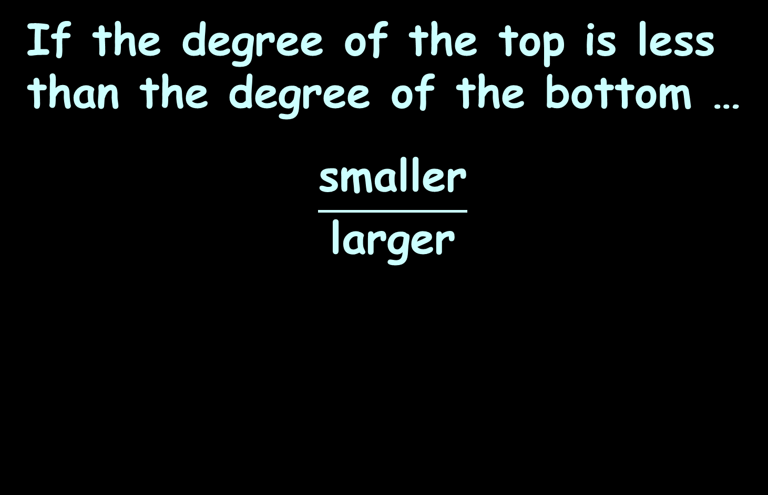
Limits of Ratios
If the degree of the top is less than the degree of the bottom …
$$\frac{\text{s}\text{maller}}{\text{l}\text{arg}\text{er}}$$

Slide 76
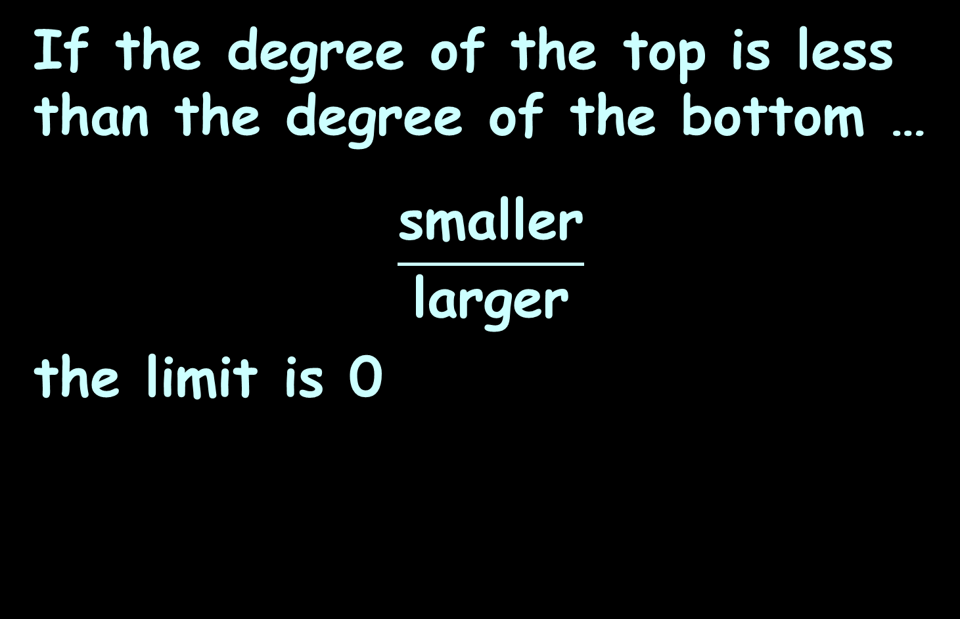
Limits of Ratios
If the degree of the top is less than the degree of the bottom …
$$\frac{\text{s}\text{maller}}{\text{l}\text{arg}\text{er}}$$
the limit is 0

Slide 77
Limits of Ratios
If the degree of the top is the same as the degree of the bottom …

Slide 78
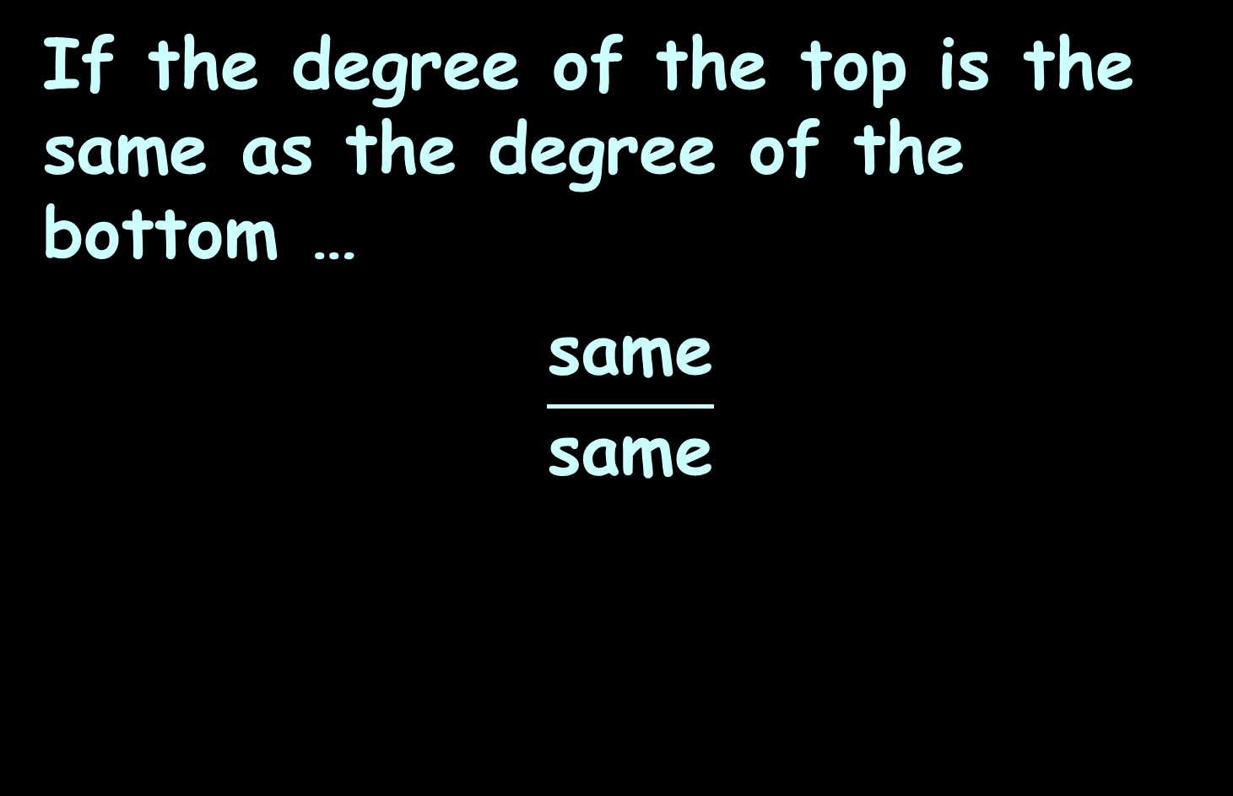
Limits of Ratios
If the degree of the top is the same as the degree of the bottom …
$$\frac{\text{same}}{\text{sam}\text{e}}$$

Slide 79
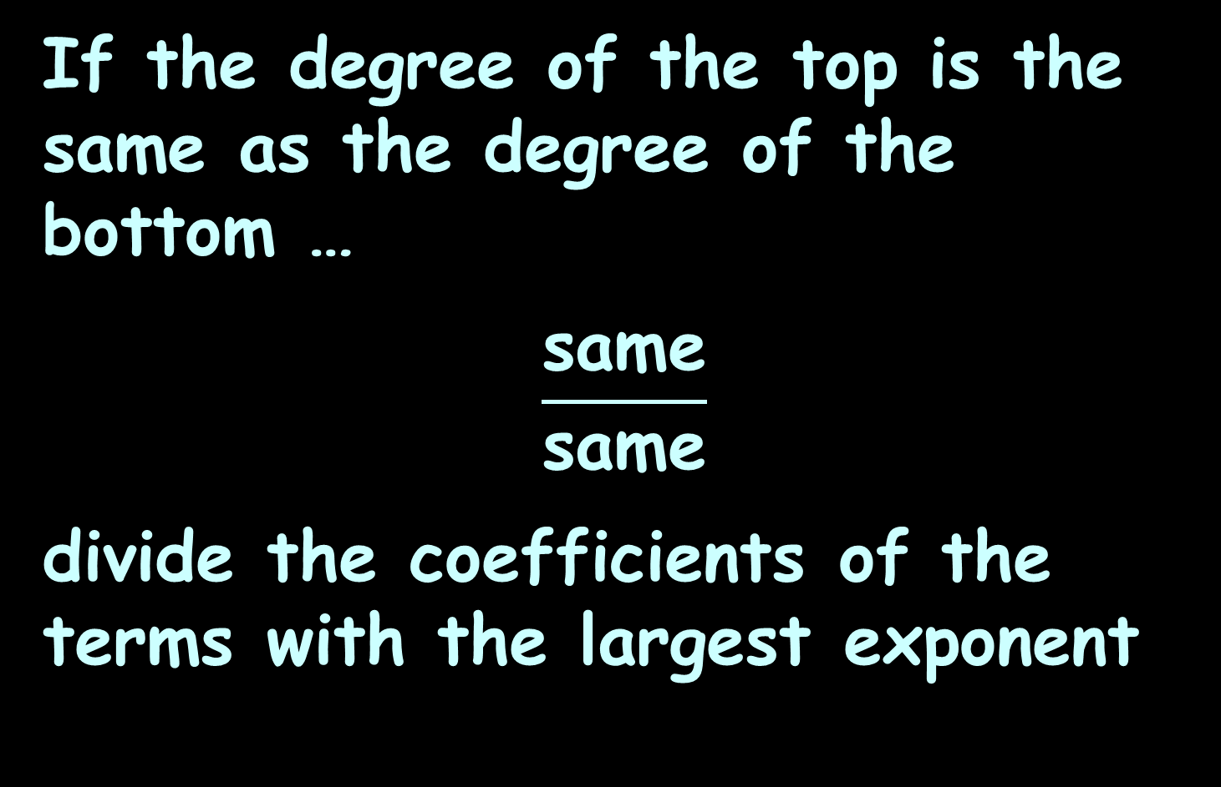
Limits of Ratios
If the degree of the top is the same as the degree of the bottom …
$$\frac{\text{same}}{\text{sam}\text{e}}$$
divide the coefficients of the terms with the largest exponent

Slide 80

LIMIT OF RATIOS
IN-CLASS PROBLEM 13
Find the limit:
$$\frac{\text{5}\text{x}\text{2}\text{+}\text{1}}{\text{3}\text{x}\text{2}\text{−}\text{1}}$$
lim
x→∞
=

Slide 81
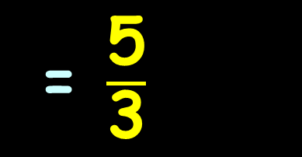
LIMIT OF RATIOS
IN-CLASS PROBLEM 13
Find the limit:
Check this in Excel!
$$\frac{\text{5}\text{x}\text{2}\text{+1}}{\text{3}\text{x}\text{2}\text{−1}}$$
= $\frac{\text{5}}{\text{3}}$
lim
x→∞
https://www.mathsisfun.com/calculus/limits-infinity.html

Slide 82

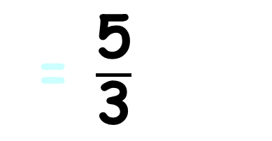
LIMIT OF RATIOS
IN-CLASS PROBLEM 13
Find the limit:
$$\frac{\text{−5}\text{x}\text{2}\text{+1}}{\text{3}\text{x}\text{2}\text{−1}}$$
= $\frac{\text{5}}{\text{3}}$
lim
x→∞
https://www.mathsisfun.com/calculus/limits-infinity.html

Slide 83
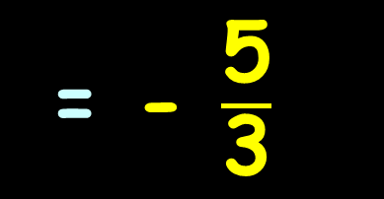
LIMIT OF RATIOS
IN-CLASS PROBLEM 13
Find the limit:
Check this in Excel!
$$\frac{\text{−5}\text{x}\text{2}\text{+1}}{\text{3}\text{x}\text{2}\text{−1}}$$
= - $\frac{\text{5}}{\text{3}}$
lim
x→∞
https://www.mathsisfun.com/calculus/limits-infinity.html

Slide 84

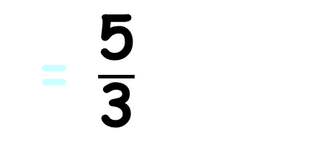
LIMIT OF RATIOS
IN-CLASS PROBLEM 13
Find the limit:
$$\frac{\text{−5}\text{x}\text{2}\text{+1}}{\text{−3}\text{x}\text{2}\text{−1}}$$
= $\frac{\text{5}}{\text{3}}$
lim
x→∞
https://www.mathsisfun.com/calculus/limits-infinity.html

Slide 85
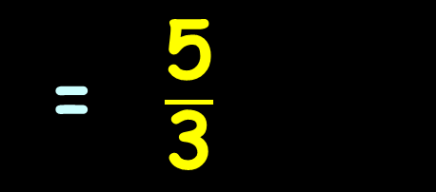
LIMIT OF RATIOS
IN-CLASS PROBLEM 13
Find the limit:
Check this in Excel!
$$\frac{\text{−5}\text{x}\text{2}\text{+1}}{\text{−3}\text{x}\text{2}\text{−1}}$$
= $\frac{\text{5}}{\text{3}}$
lim
x→∞
https://www.mathsisfun.com/calculus/limits-infinity.html

Slide 86
Questions?
http://i.imgur.com/aliTlT3.jpg

Slide 87

Limits of Ratios
A helpful web site is:
wolframalpha.com

Slide 88
Limits of Ratios
Type:
limit
and a bunch of options pop up
Select one close to what you want (then you have to type less)

Slide 89
Limits of Ratios
Type:
limit x->∞ (5x^2+1)/(3x^2−x)

Slide 90
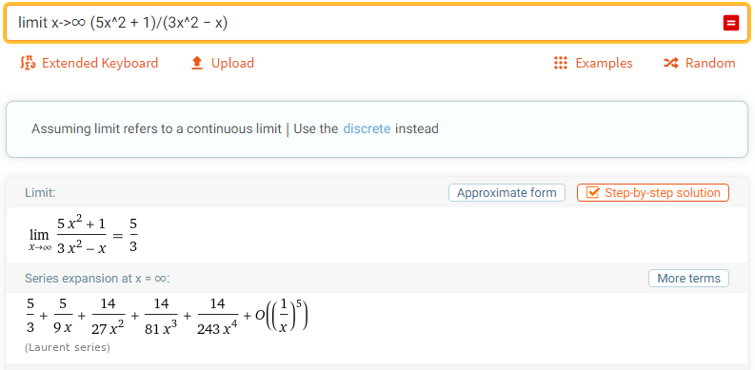
Limits of Ratios

Slide 91
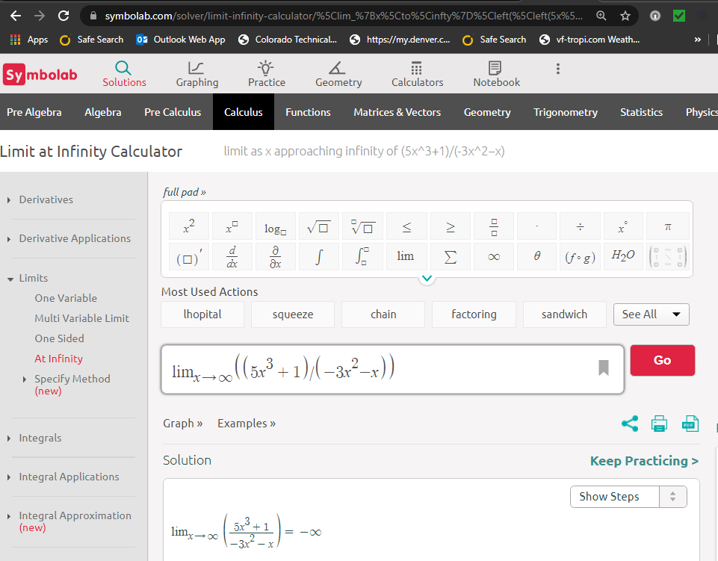

Slide 92
Questions?
http://i.imgur.com/aliTlT3.jpg

Slide 93
Graphical Increments
Suppose we have an equation:
y = 3x
L. Oliver, 2009

Slide 94
Graphical Increments
y = 3x
For a particular value of x (x₁) you can calculate a y value (y₁):
y₁ = 3x₁
L. Oliver, 2009

Slide 95
Graphical Increments
y₁ = 3x₁
For the value x₁ you can have a second x value an increment away in
distance:
x₁ + Δx
L. Oliver, 2009

Slide 96
Graphical Increments
y₁ = 3x₁
You can now calculate a y for that new x value:
3(x₁ + Δx)
L. Oliver, 2009

Slide 97
Graphical Increments
y₁ = 3x₁
Using 3(x₁ + Δx) the new y value will be some increment away from
y₁:
y₁ + Δy
L. Oliver, 2009

Slide 98
Graphical Increments
So, the new y will be:
y₁ + Δy = 3(x₁ + Δx)
Algebraically, this is the same as:
Δy = 3(x₁ + Δx) – y₁
which allows us to calculate the y increment

Slide 99
Graphical Increments
y₁ + Δy = 3(x₁ + Δx)
Algebraically, we can solve for the increment in y:
Δy = 3(x₁ + Δx) – y₁
Δy = 3x₁ + 3Δx – y₁

Slide 100
Graphical Increments
Δy = 3x₁ + 3Δx – y₁
But remember y₁= 3x₁:
Δy = 3x₁ + 3Δx – 3x₁
So:
Δy = 3Δx

Slide 101
Graphical Increments
Δy = 3Δx
Means no matter what x is, the increment in y will always be 3 times the increment in x

Slide 102
Questions?
http://i.imgur.com/aliTlT3.jpg

Slide 103
Graphical Rates of Change
What is the slope (rise/run) of the curve between x=6 and x=10?
15
10
5
0
0 1 2 3 4 5 6 7 8 9 10
https://ximera.osu.edu/mooculus/calculus1/derivativeAsAFunction/digInTheDerivativeAsAFunction

Slide 104
Graphical Rates of Change
If you have a well-drawn graph, this is easy!
15
10
5
0
0 1 2 3 4 5 6 7 8 9 10
https://ximera.osu.edu/mooculus/calculus1/derivativeAsAFunction/digInTheDerivativeAsAFunction

Slide 105
GRAPHICAL RATES OF CHANGE
IN-CLASS PROBLEM 14
What is Δy (the rise)?
What is Δx (the run)?
What is Δy/Δx (the slope)?
15
10
5
0
0 1 2 3 4 5 6 7 8 9 10
https://ximera.osu.edu/mooculus/calculus1/derivativeAsAFunction/digInTheDerivativeAsAFunction

Slide 106
GRAPHICAL RATES OF CHANGE
IN-CLASS PROBLEM 14
What is Δy (the rise)? 10
What is Δx (the run)?
What is Δy/Δx (the slope)?
15
10
5
0
0 1 2 3 4 5 6 7 8 9 10
https://ximera.osu.edu/mooculus/calculus1/derivativeAsAFunction/digInTheDerivativeAsAFunction

Slide 107
GRAPHICAL RATES OF CHANGE
IN-CLASS PROBLEM 14
What is Δy (the rise)? 10
What is Δx (the run)? 4
What is Δy/Δx (the slope)?
15
10
5
0
0 1 2 3 4 5 6 7 8 9 10
https://ximera.osu.edu/mooculus/calculus1/derivativeAsAFunction/digInTheDerivativeAsAFunction

Slide 108
GRAPHICAL RATES OF CHANGE
IN-CLASS PROBLEM 14
What is Δy (the rise)? 10
What is Δx (the run)? 4
What is Δy/Δx (the slope)? 10/4 = 5/2 = 2.5
15
10
5
0
0 1 2 3 4 5 6 7 8 9 10
https://ximera.osu.edu/mooculus/calculus1/derivativeAsAFunction/digInTheDerivativeAsAFunction

Slide 109
Graphical Rates of Change
If you are given values for x₁,x₂,y₁ and y₂ it’s even easier!

Slide 110
GRAPHICAL RATES OF CHANGE
IN-CLASS PROBLEM 15
If x₁=4.8, x₂=6.9,
y₁=23 and y₂=48,
find Δy/Δx:

Slide 111
GRAPHICAL RATES OF CHANGE
IN-CLASS PROBLEM 15
If x₁=4.8, x₂=6.9, y₁=23 and y₂=48, find Δy/Δx:
What is Δy?
What is Δx?
What is Δy/Δx?

Slide 112
GRAPHICAL RATES OF CHANGE
IN-CLASS PROBLEM 15
If x₁=4.8, x₂=6.9, y₁=23 and y₂=48, find Δy/Δx:
What is Δy? 48-23 = 25
What is Δx?
What is Δy/Δx?

Slide 113
GRAPHICAL RATES OF CHANGE
IN-CLASS PROBLEM 15
If x₁=4.8, x₂=6.9, y₁=23 and y₂=48, find Δy/Δx:
What is Δy? 25
What is Δx? 6.9-4.8 = 2.1
What is Δy/Δx?

Slide 114
GRAPHICAL RATES OF CHANGE
IN-CLASS PROBLEM 15
If x₁=4.8, x₂=6.9, y₁=23 and y₂=48, find Δy/Δx:
What is Δy? 25
What is Δx? 2.1
What is Δy/Δx? 25/2.1
≈ 11.905

Slide 115
Graphical Rates of Change
Note: two very different functions can have the same average rate of change
http://www.mesacc.edu/~marfv02121/readings/average/index.html

Slide 116
Questions?
http://i.imgur.com/aliTlT3.jpg

Slide 117
Applications
The DC current at a point in a circuit is defined to be the total number of coulombs (electricity conveyed in one second by a current of one ampere) divided by the time

Slide 118
Applications
The mathematical model relating charge to voltage in a capacitor is:
Δq = CΔv
C is a constant capacitance value (in Farads)
v is voltage (in volts)
q is charge (in coulombs)

Slide 119
APPLICATIONS OF RATES OF CHANGE
IN-CLASS PROBLEM 16
A 500μF (microfarad) (.0005 F) capacitor has its voltage increased from 300 to 375 volts. What will be the change in charge?
Δq = CΔv

Slide 120
APPLICATIONS OF RATES OF CHANGE
IN-CLASS PROBLEM 16
A 500μF (microfarad) capacitor has its voltage increased from 300 to 375 volts. What will be the change in charge?
Δq = CΔv
Δq = CΔv

Slide 121
APPLICATIONS OF RATES OF CHANGE
IN-CLASS PROBLEM 16
A 500μF (microfarad) capacitor has its voltage increased from 300 to 375 volts. What will be the change in charge?
Δq = CΔv
= (.0005)×(375-300)
Δq = CΔv

Slide 122
APPLICATIONS OF RATES OF CHANGE
IN-CLASS PROBLEM 16
A 500μF (microfarad) capacitor has its voltage increased from 300 to 375 volts. What will be the change in charge?
Δq = CΔv
= (.0005)×(375-300)
= .0375 whats?
Δq = CΔv

Slide 123
APPLICATIONS OF RATES OF CHANGE
IN-CLASS PROBLEM 16
A 500μF (microfarad) capacitor has its voltage increased from 300 to 375 volts. What will be the change in charge?
Δq = CΔv
= (.0005)×(375-300)
= 0.0375 coulombs
Δq = CΔv

Slide 124
Applications
The average current (amps) charging the plates of a capacitor is directly proportional to the average rate of change of its voltage with respect to time:
I_{avg} = C Δv/Δt
(t is in seconds)

Slide 125
APPLICATIONS OF RATES OF CHANGE
IN-CLASS PROBLEM 17
A technician connects a 10,000μF capacitor (0.01F) to a 0 to 50v DC power supply, initially set to 0v. When sweeping from 0v to 36v at a steady rate, a constant 30ma (0.03A) direct current could be maintained to the capacitor. How long did it take to sweep the voltage?
I_{avg} = C Δv/Δt

Slide 126
APPLICATIONS OF RATES OF CHANGE
IN-CLASS PROBLEM 4
17

Slide 127
APPLICATIONS OF RATES OF CHANGE
IN-CLASS PROBLEM 17
A technician connects a 10,000μF capacitor to a 0 to 50v DC power supply, initially set to 0v. When sweeping from 0v to 36v at a steady rate, a constant 30ma direct current could be maintained to the capacitor. How long did it take to sweep the voltage?
What do we want to solve for?
I_{avg} = C Δv/Δt

Slide 128
APPLICATIONS OF RATES OF CHANGE
IN-CLASS PROBLEM 17
A technician connects a 10,000μF capacitor to a 0 to 50v DC power supply, initially set to 0v. When sweeping from 0v to 36v at a steady rate, a constant 30ma direct current could be maintained to the capacitor. How long did it take to sweep the voltage?
What do we want to solve for?
How long
So which variable will it be?
I_{avg} = C Δv/Δt

Slide 129
APPLICATIONS OF RATES OF CHANGE
IN-CLASS PROBLEM 17
A technician connects a 10,000μF capacitor to a 0 to 50v DC power supply, initially set to 0v. When sweeping from 0v to 36v at a steady rate, a constant 30ma direct current could be maintained to the capacitor. How long did it take to sweep the voltage?
What do we want to solve for?
How long
So which variable will it be?
Δt
I_{avg} = C Δv/Δt

Slide 130
APPLICATIONS OF RATES OF CHANGE
IN-CLASS PROBLEM 17
A technician connects a 0.01F capacitor to a 0 to 50v DC power supply, initially set to 0v. When sweeping from 0v to 36v at a steady rate, a constant 30ma direct current could be maintained to the capacitor. How long did it take to sweep the voltage?
Solving for Δt:
I_{avg} = C Δv/Δt
Δt I_{avg} = C Δv
Δt = C Δv / I_{avg}

Slide 131
APPLICATIONS OF RATES OF CHANGE
IN-CLASS PROBLEM 17
A technician connects a 10,000μF (0.01 F) capacitor to a 0 to 50v DC power supply, initially set to 0v. When sweeping from 0v to 36v at a steady rate, a constant 30ma (0.03A) direct current could be maintained to the capacitor. How long did it take to sweep the voltage?
Δt = C Δv / I_{avg}
Plug in stuff!

Slide 132
APPLICATIONS OF RATES OF CHANGE
IN-CLASS PROBLEM 17
A technician connects a 10,000μF (0.01F) capacitor to a 0 to 50v DC power supply, initially set to 0v. When sweeping from 0v to 36v at a steady rate, a constant 30ma (0.03A) direct current could be maintained to the capacitor. How long did it take to sweep the voltage?
Δt = C Δv / I_{avg}
= (0.01)(36-0) = 12 whats?
(0.03)

Slide 133
APPLICATIONS OF RATES OF CHANGE
IN-CLASS PROBLEM 17
A technician connects a 10,000μF capacitor to a 0 to 50v DC power supply, initially set to 0v. When sweeping from 0v to 36v at a steady rate, a constant 30ma direct current could be maintained to the capacitor. How long did it take to sweep the voltage?
Δt = (10,000/1,000,000)(36-0)
(30/1000)
= 12 seconds

Slide 134
APPLICATIONS OF RATES OF CHANGE
IN-CLASS PROBLEM 4
17
https://intuitturbotax.files.wordpress.com/2013/04/istock_000020645672xsmall.jpg

Slide 135
Applications
But, why is “current” “I”?
Faraday video

Slide 136
Questions?
http://i.imgur.com/aliTlT3.jpg

Slide 137
Applications
Let Δq be the total number of coulombs counted
Let Δt be the time taken (in seconds)
Let I_{avg} be the average current (in amperes)

Slide 138
Applications
Let Δq be the total number of coulombs counted
Let Δt be the time taken
Let I_{avg} be the average current (in amperes)
I_{avg} = Δq/Δt

Slide 139
APPLICATIONS OF RATES OF CHANGE
IN-CLASS PROBLEM 18
How many coulombs of charge would have to pass through a resistor in 5 seconds for the average current to be 2.7 amperes?
I_{avg} = Δq/Δt

Slide 140
APPLICATIONS OF RATES OF CHANGE
IN-CLASS PROBLEM 18
How many coulombs of charge would have to pass through a resistor in 5 seconds for the average current to be 2.7 amperes?
I_{avg} = Δq/Δt or Δq = I_{avg}×Δt

Slide 141
APPLICATIONS OF RATES OF CHANGE
IN-CLASS PROBLEM 18
How many coulombs of charge would have to pass through a resistor in 5 seconds for the average current to be 2.7 amperes?
Δq = I_{avg}×Δt
Δq = 2.7 × 5 = 13.5 whats?

Slide 142
APPLICATIONS OF RATES OF CHANGE
IN-CLASS PROBLEM 18
How many coulombs of charge would have to pass through a resistor in 5 seconds for the average current to be 2.7 amperes?
Δq = I_{avg}×Δt
Δq = 2.7 × 5 = 13.5 coulombs

Slide 143
Questions?
http://i.imgur.com/aliTlT3.jpg

Slide 144
Summary
Today we covered:
Review of limits
Infinite limits
Graphical Rates of Change
Applications for Rates of
Change

Slide 145

You Survived!
www.playbuzz.com

