Slide 1

Welcome to
Unit 4! .
MATH 205 Differential Calculus
https://www.smu.edu.sg/programmes/core-curriculum/course-structure/calculus

Slide 2
What’s Up?
Outcome 1) Demonstrate differentiation skills for linear, polynomial, rational, trigonometric, exponential, and logarithmic functions and proper application of the Product and Quotient Rules of differentiation
Outcome 2) Use algebra, limits, and derivatives to examine the properties and graphs of functions

Slide 3
What about Generative AI?
It’s the big news of the year: Generative Pre-Trained Transformers (like ChatGPT)
Students are concerned they’ll be accused of plagiarism

Slide 4
What about Generative AI?
The solution:
https://www.perplexity.ai/
Gives you the sources they used
You can check them and use
them in your reports

Slide 5
New Calculus Quote
“If I can believe in Calculus, I can believe in witches and ghosts…”
Coyote Waits, PBS

Slide 6
Review of Limits
x² – 1
x – 1
What is the limit of as
x approaches 1?

Slide 7
Review of Limits
x² – 1
x – 1
What is the limit of as
x approaches 1?
It’s = 2 because
the RSL and LSL
are both = 2

Slide 8
Review of Limits
What if it’s not a hole…
it’s a cliff!

Slide 9
Review of Limits
What if it’s not a hole…
it’s a cliff!
LSL =
RSL =

Slide 10
Review of Limits
What if it’s not a hole…
it’s a cliff!
LSL = 3.8
RSL = 1.3
=
lim
x→5.5

Slide 11
Review of Limits
What if it’s not a hole…
it’s a cliff!
LSL = 3.8
RSL = 1.3
DNE
lim
x→5.5

Slide 12
Review of Limits
What if:
LSL =
RSL =

Slide 13
Review of Limits
What if:
LSL = 3.8
RSL = 1.3

Slide 14

Questions?
http://i.imgur.com/aliTlT3.jpg

Slide 15




Review of Limits
$$\frac{\text{x}\text{3}\text{+}\text{2}\text{x}\text{−1}}{\text{6}\text{x}\text{2}}$$
lim
x→∞
$$\frac{\text{s}\text{maller}}{\text{l}\text{arg}\text{er}}$$
$$\frac{\text{larger}}{\text{small}\text{er}}$$
$$\frac{\text{same}}{\text{sam}\text{e}}$$

Slide 16
Review of Limits
$$\frac{\text{x}\text{3}\text{+}\text{2}\text{x}\text{−1}}{\text{6}\text{x}\text{2}}$$
lim
x→∞
This is only for:
$$\frac{\text{s}\text{maller}}{\text{l}\text{arg}\text{er}}$$
$$\frac{\text{larger}}{\text{small}\text{er}}$$
$$\frac{\text{same}}{\text{sam}\text{e}}$$

Slide 17
Questions?
http://i.imgur.com/aliTlT3.jpg

Slide 18
Derivatives/Differentiation
Two Rules important enough to be included in the “Outcomes”

Slide 19
Derivatives/Differentiation
Rule #4: derivatives of function
multiplications u × v:
d(u × v)/dx = (u)×(dv/dx) + (v)×(du/dx)
The Product Rule

Slide 20
DERIVATIVES
IN-CLASS PROBLEM 1
Find the derivative dy/dx of:
y = (3x + 2)(7x – 5)
What is u?
What is v?
What is du/dx?
What is dv/dx?
d(u × v)/dx = (u)×(dv/dx) + (v)×(du/dx)

Slide 21
DERIVATIVES
IN-CLASS PROBLEM 1
Find dy/dx (3x + 2)(7x – 5):
u = 3x + 2 v =
du/dx = dv/dx =
d(u × v)/dx = (u)×(dv/dx) + (v)×(du/dx)

Slide 22
DERIVATIVES
IN-CLASS PROBLEM 1
Find dy/dx (3x + 2)(7x – 5):
u = 3x + 2 v = 7x - 5
du/dx = dv/dx =
d(u × v)/dx = (u)×(dv/dx) + (v)×(du/dx)

Slide 23
DERIVATIVES
IN-CLASS PROBLEM 1
Find dy/dx (3x + 2)(7x – 5):
u = 3x + 2 v = 7x - 5
du/dx = 3 dv/dx =

Slide 24
DERIVATIVES
IN-CLASS PROBLEM 1
Find dy/dx (3x + 2)(7x – 5):
u = 3x + 2 v = 7x - 5
du/dx = 3 dv/dx = 7
Plug these into:
d(u × v)/dx = u×dv/dx + v×du/dx

Slide 25
DERIVATIVES
IN-CLASS PROBLEM 1
Find dy/dx (3x + 2)(7x – 5):
u = 3x + 2 v = 7x - 5
du/dx = 3 dv/dx = 7
d(u × v)/dx = u×dv/dx + v×du/dx
= (3x+2)×7 + (7x-5)×3
u
dv/dx
v
du/dx

Slide 26
DERIVATIVES
IN-CLASS PROBLEM 1
Find dy/dx (3x + 2)(7x – 5):
u = 3x + 2 v = 7x - 5
du/dx = 3 dv/dx = 7
d(u × v)/dx = u×dv/dx + v×du/dx
= (3x+2)×7 + (7x-5)×3
= 21x+14 + 21x-15

Slide 27
DERIVATIVES
IN-CLASS PROBLEM 1
Find dy/dx (3x + 2)(7x – 5):
u = 3x + 2 v = 7x - 5
du/dx = 3 dv/dx = 7
d(u × v)/dx = u×dv/dx + v×du/dx
= (3x+2)×7 + (7x-5)×3
= 21x + 14 + 21x - 15
= 42x - 1

Slide 28
DERIVATIVES
IN-CLASS PROBLEM 1
OR:
Find dy/dx (3x + 2)(7x – 5):
y = 21x² – x - 10
dy/dx = 2(21)x²⁻¹ – 1 + 0
= 42x - 1

Slide 29
Questions?
http://i.imgur.com/aliTlT3.jpg

Slide 30
Derivatives/Differentiation
Rule #5: derivative of a ratio
u / v:
d(u / v)/dx = v×du/dx - u×dv/dx
v²
The Quotient Rule

Slide 31
Derivatives/Differentiation
Rule #5: derivative of a ratio
u / v: hi/lo
d(u / v)/dx = v×du/dx - u×dv/dx
v²
Lo-de-hi minus Hi-de-lo
over
lo square and away we go!

Slide 32
DERIVATIVES
IN-CLASS PROBLEM 2
Find the derivative dy/dx of:
y = (x² -1)/x
Find hi, lo, dhi, dlo

Slide 33
DERIVATIVES
IN-CLASS PROBLEM 2
y = (x² -1)/x
hi = lo =
dhi/dx = dlo/dx =

Slide 34
DERIVATIVES
IN-CLASS PROBLEM 2
y = (x² -1)/x
hi = (x² -1) lo =
dhi/dx = dlo/dx =

Slide 35
DERIVATIVES
IN-CLASS PROBLEM 2
y = (x² -1)/x
hi = (x² -1) lo = x
dhi/dx = dlo/dx =

Slide 36
DERIVATIVES
IN-CLASS PROBLEM 2
y = (x² -1)/x
hi = (x² -1) lo = x
dhi/dx = 2x dlo/dx =

Slide 37
DERIVATIVES
IN-CLASS PROBLEM 2
y = (x² -1)/x
u=hi=(x² -1) v=lo=x
du/dx=dhi/dx=2x dv/dx=dlo/dx=1
Lo-de-hi minus Hi-de-lo
over lo squared:
d(u / v)/dx = v×du/dx - u×dv/dx
v²

Slide 38
DERIVATIVES
IN-CLASS PROBLEM 2
y = (x² -1)/x
u=hi=(x² -1) v=lo=x
du/dx=dhi/dx=2x dv/dx=dlo/dx=1
Lo-de-hi minus Hi-de-lo
over lo square:
(x)(2x) – (x² -1)(1) 2x² – x² +1
(x)² x²
=
d(u / v)/dx = v×du/dx - u×dv/dx
v²

Slide 39
DERIVATIVES
IN-CLASS PROBLEM 2
y = (x² -1)/x
hi = (x² -1) lo = x
dhi/dx = 2x dlo/dx = 1
Lo-de-hi minus Hi-de-lo
over lo square:
(x)(2x) – (x² -1)(1) 2x² – x² + 1
(x)² x²
= (x²+1)/x² Away we go!
2x² – x² = x² – 1
=

Slide 40
Questions?
http://i.imgur.com/aliTlT3.jpg

Slide 41
Derivatives
Remember… when we calculate the derivative of a function, we are finding the exact rate of change of that function
This exact rate of change is also a function! And it is changing, too!

Slide 42
Derivatives
While mathematicians need to know and understand and be able to replicate the theory behind all mathematical concepts, engineers really need to be able to get THE RIGHT ANSWER for important real-world problems

Slide 43
Derivatives
As a statistician, I am AWFUL at getting the exact answer (close enuf is good enuf…)

Slide 44
Derivatives
As a statistician, I am AWFUL at getting the exact answer (close enuf is good enuf…)
You all need more accuracy!

Slide 45
Derivatives
To this end, the universe has kindly invented calculators and computers

Slide 46
Derivatives
The TI calculators are specifically designed by engineers for engineers

Slide 47
Derivatives
The TI 83, 84 and 85 can do many (but not all) of the problems we do in MATH205 and 207

Slide 48
Derivatives
The TI 89 titanium and
TI nspire can download apps to do virtually every problem
(the TI89 app is often free)

Slide 49
Derivatives
How to do a derivative problem with a TI 83, 84 or 85:
nDeriv(expression,variable,value,tolerance)

Slide 50
Derivatives
How to do a derivative problem with a TI 83, 84 or 85:
nDeriv(expression,variable,value,tolerance)
MATH 8 will bring up nDeriv

Slide 51
Derivatives
Suppose we want to find the derivative dy/dx for:
(4x²+7x +1)/(3x+5) at x=0
nDeriv((4x^2+7x+1)÷(3x+5),x,0)
ENTER
1.279999981

Slide 52
Derivatives
There is no built-in function on the TI-83 Plus to take a derivative in general

Slide 53
Derivatives
Theoretically you can access this functionality for the TI83 using an app on:
http://www.calcblog.com/three-applications-turn-ti83-ti84-into-ti89/
(I’ve never tried it… let me know what happens!)

Slide 54
Derivatives
There is no built-in function on the TI-84 Plus to take a derivative in general

Slide 55
Derivatives
Theoretically you can access this functionality for the TI84 using an app on:
https://www.ti84calcwiz.com/
mathprograms/symbolic-derivative-solver/
(I’ve never tried it… again, let me know what happens!)

Slide 56
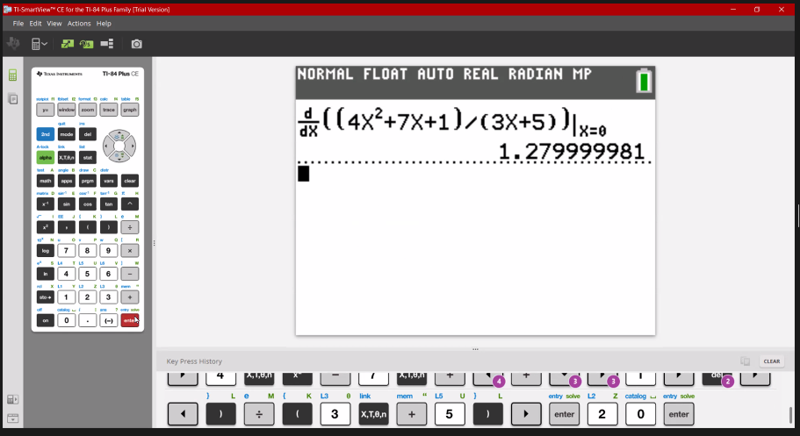
Derivatives
How to do a derivative problem with a TI 83, 84 or 85: MATH 8
Jose Mares, 2021

Slide 57
Derivatives
How to do a derivative problem with a TI 89:
HOME
2nd 8
Gives you the d
d( (4x^2+7x+1)÷(3x+5) , x )
ENTER

Slide 58
Derivatives
You get:
4·(3·x² + 10·x + 8)
(3·x + 5)²

Slide 59

Derivatives
How to do a derivative problem with a TI nspire:
menu
4: Calculus
1: Derivative
4x^2+7x+1
3x+5
https://www.google.com/search?q=how+to+find+the+general+derivative+of+a+function+on+ti+nspire+cx&ei=pMV8YPObDZaqtQaFt4eACw&oq=how+to+find+the+general+derivative+of+a+function+on+ti+nspire+cx&gs_lcp=Cgdnd3Mtd2l6EAM6BwgAEEcQsAM6BAgAEA06BQgAEM0COgQIIRAKUMHFA1iv0gNgltcDaAFwAngAgAGGAYgBjAaSAQM4LjGYAQCgAQGqAQdnd3Mtd2l6yAEIwAEB&sclient=gws-wiz&ved=0ahUKEwjz_ZP2_YjwAhUWVc0KHYXbAbAQ4dUDCA4&uact=5#kpvalbx=_4cV8YPC2MprWtQar4ZjADw19

Slide 60
Derivatives
What if you can’t afford a new calculator right now?

Slide 61
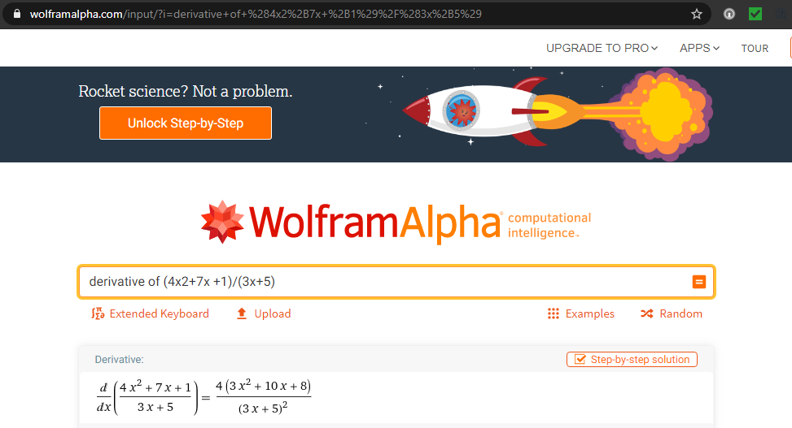
Derivatives
WolframAlpha:
https://www.wolframalpha.com/input/?i=derivative+of+%284x2%2B7x+%2B1%29%2F%283x%2B5%29

Slide 62
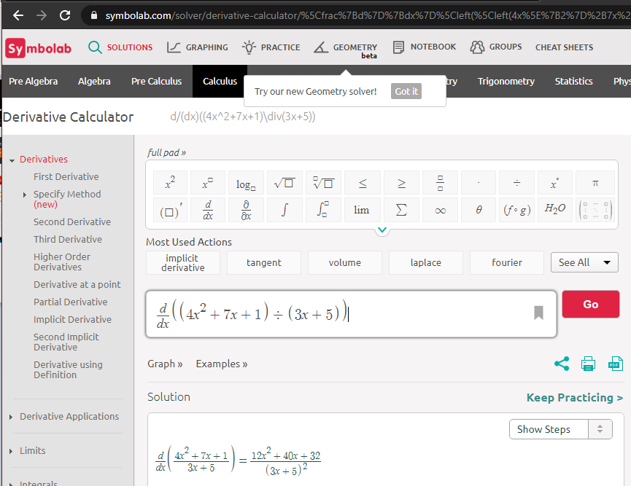
Derivatives
Symbolab:
https://www.symbolab.com/solver/derivative-calculator/%5Cfrac%7Bd%7D%7Bdx%7D%5Cleft
(%5Cleft(4x%5E%7B2%7D%2B7x%2B1%5Cright)%5Cdiv%5Cleft(3x%2B5%5Cright)%5Cright)

Slide 63
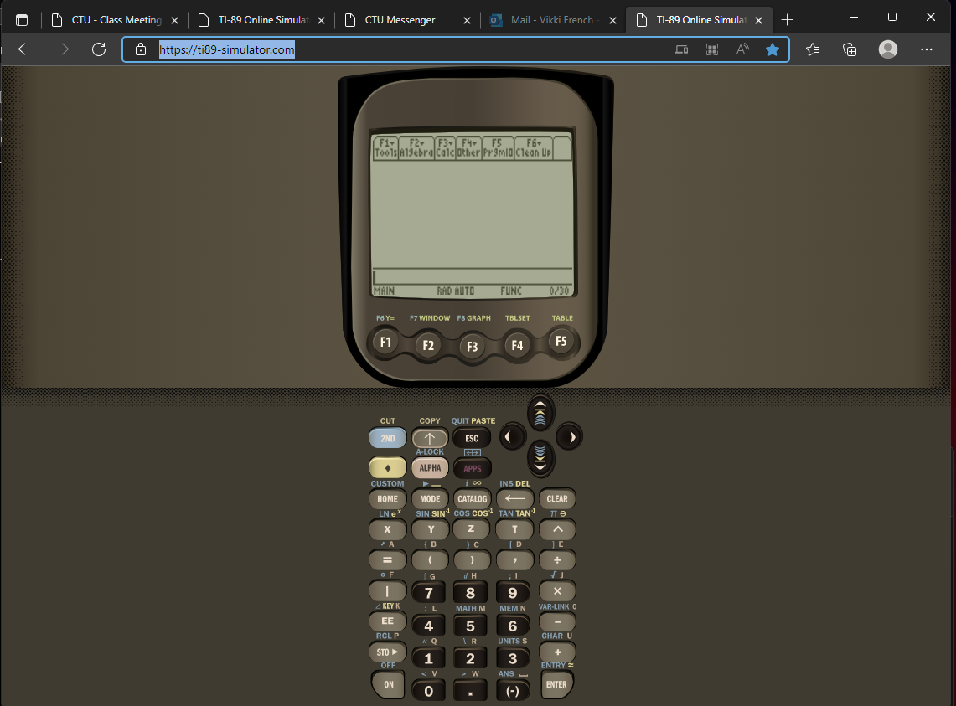
https://ti89-simulator.com/
The last time I tried to access this, it was no longer available...
but now it is again!

Slide 64
Questions?
http://i.imgur.com/aliTlT3.jpg

Slide 65
Fancy Derivatives
More rules for more complicated functions you might need to take a derivative of!

Slide 66
Transcendental Derivatives
Remember the title of our book implied we would be doing transcendentals early

Slide 67
Transcendental Derivatives
Remember the title of our book implied we would be doing transcendentals early…
That moment has come…

Slide 68
Transcendental Derivatives
A transcendental function is not a polynomial equation

Slide 69
Transcendental Derivatives
A transcendental function is not a polynomial equation
Trig functions, exponentials (c^{x}) and logarithms are transcendentals

Slide 70
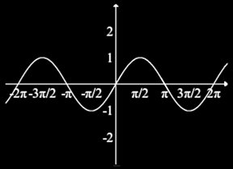
Transcendental Derivatives
sin(x):

Slide 71
Transcendental Derivatives
Remember, dy/dx is a tangent
sin(x) tangents:
slope = 0
slope = 1
slope = -1
slope = 0

Slide 72
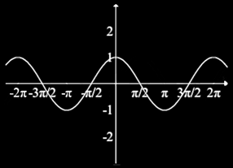
Transcendental Derivatives
When you graph the SLOPES:
…you get the cosine
slope = 0
slope = 1
slope = -1
slope = 0

Slide 73
Transcendental Derivatives
Rule: d(sin(x))/dx = cos(x)

Slide 74

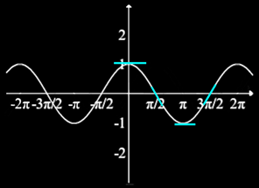
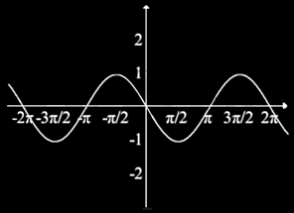
Transcendental Derivatives
Likewise d(cos(x))/dx = -sin(x)
graph of
cos tangents slopes

Slide 75
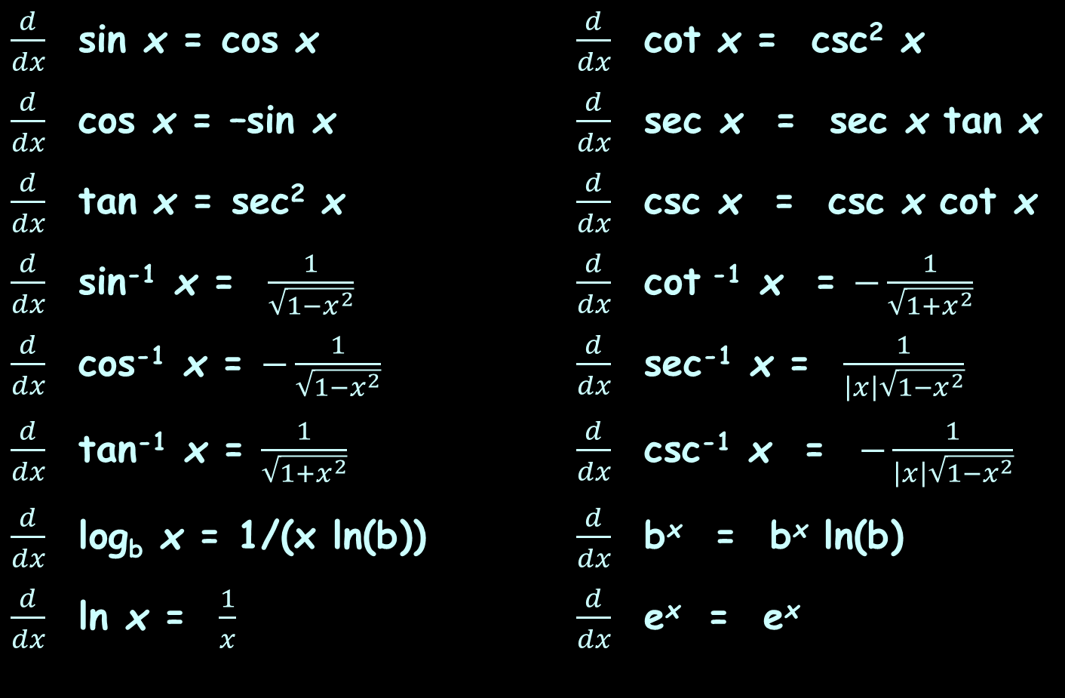
Transcendental Derivatives
$\frac{d}{dx}$ sin x = cos x $\frac{d}{dx}$ cot x = csc² x
$\frac{d}{dx}$ cos x = –sin x $\frac{d}{dx}$ sec x = sec x tan x
$\frac{d}{dx}$ tan x = sec² x $\frac{d}{dx}$ csc x = csc x cot x
$\frac{d}{dx}$ sin⁻¹ x = $\frac{1}{\sqrt{1−x^{2}}}$ $\frac{d}{dx}$ cot ⁻¹ x = $−\frac{1}{\sqrt{1+x^{2}}}$
$\frac{d}{dx}$ cos⁻¹ x = $−\frac{1}{\sqrt{1−x^{2}}}$ $\frac{d}{dx}$ sec⁻¹ x = $\frac{1}{\left|x\right|\sqrt{1−x^{2}}}$
$\frac{d}{dx}$ tan⁻¹ x = $\frac{1}{\sqrt{1+x^{2}}}$ $\frac{d}{dx}$ csc⁻¹ x = $−\frac{1}{\left|x\right|\sqrt{1−x^{2}}}$
$\frac{d}{dx}$ log_{b} x = 1/(x ln(b)) $\frac{d}{dx}$ b^{x} = b^{x} ln(b)
$\frac{d}{dx}$ ln x = $\frac{1}{x}$ $\frac{d}{dx}$ e^{x} = e^{x}

Slide 76

TRANSCENDENTAL DERIVATIVES
IN-CLASS PROBLEMS 3,4,5,6
Find the derivative d/dx:
y = sin x
y = - sin x
y = cos x
y = tan x
$\frac{d}{dx}$ sin x = cos x
$\frac{d}{dx}$ cot x = csc² x
$\frac{d}{dx}$ cos x = –sin x
$\frac{d}{dx}$ sec x = sec x tan x
$\frac{d}{dx}$ tan x = sec² x
$\frac{d}{dx}$ csc x = csc x cot x
$\frac{d}{dx}$ sin⁻¹ x = $\frac{1}{\sqrt{1−x^{2}}}$
$\frac{d}{dx}$ cot ⁻¹ x = $−\frac{1}{\sqrt{1+x^{2}}}$
$\frac{d}{dx}$ cos⁻¹ x = $−\frac{1}{\sqrt{1−x^{2}}}$
$\frac{d}{dx}$ sec⁻¹ x = $\frac{1}{\left|x\right|\sqrt{1−x^{2}}}$
$\frac{d}{dx}$ tan⁻¹ x = $\frac{1}{\sqrt{1+x^{2}}}$
$\frac{d}{dx}$ csc⁻¹ x = $−\frac{1}{\left|x\right|\sqrt{1−x^{2}}}$
$\frac{d}{dx}$ log_{b} x = 1/(x ln(b))
$\frac{d}{dx}$ b^{x} = b^{x} ln(b)
$\frac{d}{dx}$ ln x = $\frac{1}{x}$
$\frac{d}{dx}$ e^{x} = e^{x}

Slide 77
TRANSCENDENTAL DERIVATIVES
IN-CLASS PROBLEMS 3,4,5,6
Find the derivative:
d(sin x)/dx = cos x
d(-sin x)/dx =
d(cos x)/dx =
d(tan x)/dx =
$\frac{d}{dx}$ sin x = cos x
$\frac{d}{dx}$ cot x = csc² x
$\frac{d}{dx}$ cos x = –sin x
$\frac{d}{dx}$ sec x = sec x tan x
$\frac{d}{dx}$ tan x = sec² x
$\frac{d}{dx}$ csc x = csc x cot x
$\frac{d}{dx}$ sin⁻¹ x = $\frac{1}{\sqrt{1−x^{2}}}$
$\frac{d}{dx}$ cot ⁻¹ x = $−\frac{1}{\sqrt{1+x^{2}}}$
$\frac{d}{dx}$ cos⁻¹ x = $−\frac{1}{\sqrt{1−x^{2}}}$
$\frac{d}{dx}$ sec⁻¹ x = $\frac{1}{\left|x\right|\sqrt{1−x^{2}}}$
$\frac{d}{dx}$ tan⁻¹ x = $\frac{1}{\sqrt{1+x^{2}}}$
$\frac{d}{dx}$ csc⁻¹ x = $−\frac{1}{\left|x\right|\sqrt{1−x^{2}}}$
$\frac{d}{dx}$ log_{b} x = 1/(x ln(b))
$\frac{d}{dx}$ b^{x} = b^{x} ln(b)
$\frac{d}{dx}$ ln x = $\frac{1}{x}$
$\frac{d}{dx}$ e^{x} = e^{x}

Slide 78
TRANSCENDENTAL DERIVATIVES
IN-CLASS PROBLEMS 3,4,5,6
Find the derivative:
d(sin x)/dx = cos x
d(-sin x)/dx = -cos x
d(cos x)/dx =
d(tan x)/dx =
$\frac{d}{dx}$ sin x = cos x
$\frac{d}{dx}$ cot x = csc² x
$\frac{d}{dx}$ cos x = –sin x
$\frac{d}{dx}$ sec x = sec x tan x
$\frac{d}{dx}$ tan x = sec² x
$\frac{d}{dx}$ csc x = csc x cot x
$\frac{d}{dx}$ sin⁻¹ x = $\frac{1}{\sqrt{1−x^{2}}}$
$\frac{d}{dx}$ cot ⁻¹ x = $−\frac{1}{\sqrt{1+x^{2}}}$
$\frac{d}{dx}$ cos⁻¹ x = $−\frac{1}{\sqrt{1−x^{2}}}$
$\frac{d}{dx}$ sec⁻¹ x = $\frac{1}{\left|x\right|\sqrt{1−x^{2}}}$
$\frac{d}{dx}$ tan⁻¹ x = $\frac{1}{\sqrt{1+x^{2}}}$
$\frac{d}{dx}$ csc⁻¹ x = $−\frac{1}{\left|x\right|\sqrt{1−x^{2}}}$
$\frac{d}{dx}$ log_{b} x = 1/(x ln(b))
$\frac{d}{dx}$ b^{x} = b^{x} ln(b)
$\frac{d}{dx}$ ln x = $\frac{1}{x}$
$\frac{d}{dx}$ e^{x} = e^{x}

Slide 79
TRANSCENDENTAL DERIVATIVES
IN-CLASS PROBLEMS 3,4,5,6
Find the derivative:
d(sin x)/dx = cos x
d(-sin x)/dx = -cos x
d(cos x)/dx = -sin x
d(tan x)/dx =
$\frac{d}{dx}$ sin x = cos x
$\frac{d}{dx}$ cot x = csc² x
$\frac{d}{dx}$ cos x = –sin x
$\frac{d}{dx}$ sec x = sec x tan x
$\frac{d}{dx}$ tan x = sec² x
$\frac{d}{dx}$ csc x = csc x cot x
$\frac{d}{dx}$ sin⁻¹ x = $\frac{1}{\sqrt{1−x^{2}}}$
$\frac{d}{dx}$ cot ⁻¹ x = $−\frac{1}{\sqrt{1+x^{2}}}$
$\frac{d}{dx}$ cos⁻¹ x = $−\frac{1}{\sqrt{1−x^{2}}}$
$\frac{d}{dx}$ sec⁻¹ x = $\frac{1}{\left|x\right|\sqrt{1−x^{2}}}$
$\frac{d}{dx}$ tan⁻¹ x = $\frac{1}{\sqrt{1+x^{2}}}$
$\frac{d}{dx}$ csc⁻¹ x = $−\frac{1}{\left|x\right|\sqrt{1−x^{2}}}$
$\frac{d}{dx}$ log_{b} x = 1/(x ln(b))
$\frac{d}{dx}$ b^{x} = b^{x} ln(b)
$\frac{d}{dx}$ ln x = $\frac{1}{x}$
$\frac{d}{dx}$ e^{x} = e^{x}

Slide 80
TRANSCENDENTAL DERIVATIVES
IN-CLASS PROBLEMS 3,4,5,6
Find the derivative:
d(sin x)/dx = cos x
d(-sin x)/dx = -cos x
d(cos x)/dx = -sin x
d(tan x)/dx = sec² x
$\frac{d}{dx}$ sin x = cos x
$\frac{d}{dx}$ cot x = csc² x
$\frac{d}{dx}$ cos x = –sin x
$\frac{d}{dx}$ sec x = sec x tan x
$\frac{d}{dx}$ tan x = sec² x
$\frac{d}{dx}$ csc x = csc x cot x
$\frac{d}{dx}$ sin⁻¹ x = $\frac{1}{\sqrt{1−x^{2}}}$
$\frac{d}{dx}$ cot ⁻¹ x = $−\frac{1}{\sqrt{1+x^{2}}}$
$\frac{d}{dx}$ cos⁻¹ x = $−\frac{1}{\sqrt{1−x^{2}}}$
$\frac{d}{dx}$ sec⁻¹ x = $\frac{1}{\left|x\right|\sqrt{1−x^{2}}}$
$\frac{d}{dx}$ tan⁻¹ x = $\frac{1}{\sqrt{1+x^{2}}}$
$\frac{d}{dx}$ csc⁻¹ x = $−\frac{1}{\left|x\right|\sqrt{1−x^{2}}}$
$\frac{d}{dx}$ log_{b} x = 1/(x ln(b))
$\frac{d}{dx}$ b^{x} = b^{x} ln(b)
$\frac{d}{dx}$ ln x = $\frac{1}{x}$
$\frac{d}{dx}$ e^{x} = e^{x}

Slide 81
TRANSCENDENTAL DERIVATIVES
IN-CLASS PROBLEMS 7,8
Find the derivative:
d/dx 276^{x} =
d/dx log₁₀x =
$\frac{d}{dx}$ sin x = cos x
$\frac{d}{dx}$ cot x = csc² x
$\frac{d}{dx}$ cos x = –sin x
$\frac{d}{dx}$ sec x = sec x tan x
$\frac{d}{dx}$ tan x = sec² x
$\frac{d}{dx}$ csc x = csc x cot x
$\frac{d}{dx}$ sin⁻¹ x = $\frac{1}{\sqrt{1−x^{2}}}$
$\frac{d}{dx}$ cot ⁻¹ x = $−\frac{1}{\sqrt{1+x^{2}}}$
$\frac{d}{dx}$ cos⁻¹ x = $−\frac{1}{\sqrt{1−x^{2}}}$
$\frac{d}{dx}$ sec⁻¹ x = $\frac{1}{\left|x\right|\sqrt{1−x^{2}}}$
$\frac{d}{dx}$ tan⁻¹ x = $\frac{1}{\sqrt{1+x^{2}}}$
$\frac{d}{dx}$ csc⁻¹ x = $−\frac{1}{\left|x\right|\sqrt{1−x^{2}}}$
$\frac{d}{dx}$ log_{b} x = 1/(x ln(b))
$\frac{d}{dx}$ b^{x} = b^{x} ln(b)
$\frac{d}{dx}$ ln x = $\frac{1}{x}$
$\frac{d}{dx}$ e^{x} = e^{x}

Slide 82
TRANSCENDENTAL DERIVATIVES
IN-CLASS PROBLEMS 7,8
Find the derivative:
d/dx 276^{x} =
= 276^{x} ln(276)
≈ 276^{x} × 5.620
Don’t be tempted to
combine 276 and 5.62
$\frac{d}{dx}$ sin x = cos x
$\frac{d}{dx}$ cot x = csc² x
$\frac{d}{dx}$ cos x = –sin x
$\frac{d}{dx}$ sec x = sec x tan x
$\frac{d}{dx}$ tan x = sec² x
$\frac{d}{dx}$ csc x = csc x cot x
$\frac{d}{dx}$ sin⁻¹ x = $\frac{1}{\sqrt{1−x^{2}}}$
$\frac{d}{dx}$ cot ⁻¹ x = $−\frac{1}{\sqrt{1+x^{2}}}$
$\frac{d}{dx}$ cos⁻¹ x = $−\frac{1}{\sqrt{1−x^{2}}}$
$\frac{d}{dx}$ sec⁻¹ x = $\frac{1}{\left|x\right|\sqrt{1−x^{2}}}$
$\frac{d}{dx}$ tan⁻¹ x = $\frac{1}{\sqrt{1+x^{2}}}$
$\frac{d}{dx}$ csc⁻¹ x = $−\frac{1}{\left|x\right|\sqrt{1−x^{2}}}$
$\frac{d}{dx}$ log_{b} x = 1/(x ln(b))
$\frac{d}{dx}$ b^{x} = b^{x} ln(b)
$\frac{d}{dx}$ ln x = $\frac{1}{x}$
$\frac{d}{dx}$ e^{x} = e^{x}

Slide 83
TRANSCENDENTAL DERIVATIVES
IN-CLASS PROBLEMS 7,8
Find the derivative:
d/dx 276^{x} =
= 276^{x} ln(276)
≈ 276^{x} × 5.62
d/dx log₁₀x = ?
$\frac{d}{dx}$ sin x = cos x
$\frac{d}{dx}$ cot x = csc² x
$\frac{d}{dx}$ cos x = –sin x
$\frac{d}{dx}$ sec x = sec x tan x
$\frac{d}{dx}$ tan x = sec² x
$\frac{d}{dx}$ csc x = csc x cot x
$\frac{d}{dx}$ sin⁻¹ x = $\frac{1}{\sqrt{1−x^{2}}}$
$\frac{d}{dx}$ cot ⁻¹ x = $−\frac{1}{\sqrt{1+x^{2}}}$
$\frac{d}{dx}$ cos⁻¹ x = $−\frac{1}{\sqrt{1−x^{2}}}$
$\frac{d}{dx}$ sec⁻¹ x = $\frac{1}{\left|x\right|\sqrt{1−x^{2}}}$
$\frac{d}{dx}$ tan⁻¹ x = $\frac{1}{\sqrt{1+x^{2}}}$
$\frac{d}{dx}$ csc⁻¹ x = $−\frac{1}{\left|x\right|\sqrt{1−x^{2}}}$
$\frac{d}{dx}$ log_{b} x = 1/(x ln(b))
$\frac{d}{dx}$ b^{x} = b^{x} ln(b)
$\frac{d}{dx}$ ln x = $\frac{1}{x}$
$\frac{d}{dx}$ e^{x} = e^{x}

Slide 84
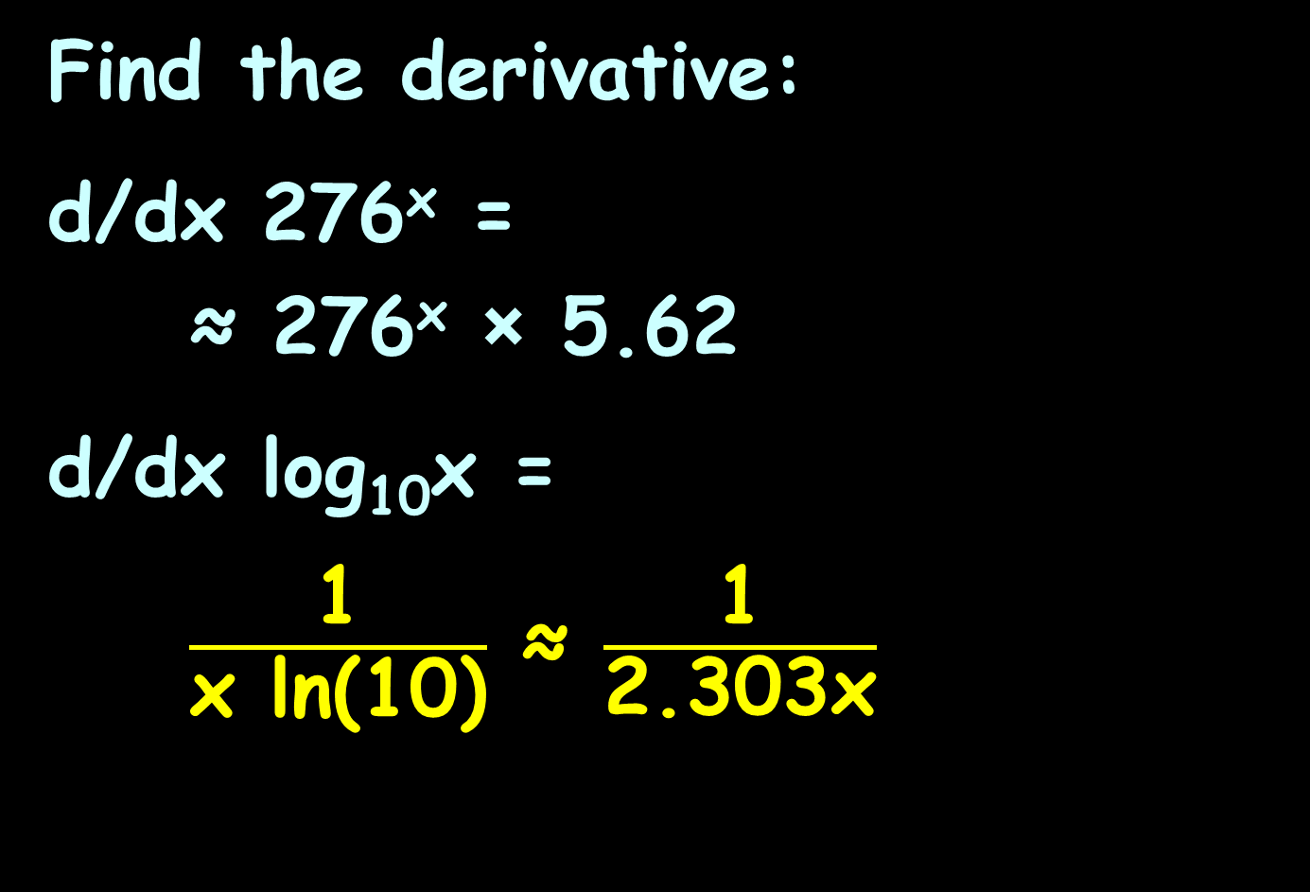
TRANSCENDENTAL DERIVATIVES
IN-CLASS PROBLEMS 7,8
Find the derivative:
d/dx 276^{x} =
≈ 276^{x} × 5.62
d/dx log₁₀x =
$\frac{\text{1}}{\text{x} \text{ln}\text{(10)}}$ ≈ $\frac{\text{1}}{\text{2.303}\text{x}}$
$\frac{d}{dx}$ sin x = cos x
$\frac{d}{dx}$ cot x = csc² x
$\frac{d}{dx}$ cos x = –sin x
$\frac{d}{dx}$ sec x = sec x tan x
$\frac{d}{dx}$ tan x = sec² x
$\frac{d}{dx}$ csc x = csc x cot x
$\frac{d}{dx}$ sin⁻¹ x = $\frac{1}{\sqrt{1−x^{2}}}$
$\frac{d}{dx}$ cot ⁻¹ x = $−\frac{1}{\sqrt{1+x^{2}}}$
$\frac{d}{dx}$ cos⁻¹ x = $−\frac{1}{\sqrt{1−x^{2}}}$
$\frac{d}{dx}$ sec⁻¹ x = $\frac{1}{\left|x\right|\sqrt{1−x^{2}}}$
$\frac{d}{dx}$ tan⁻¹ x = $\frac{1}{\sqrt{1+x^{2}}}$
$\frac{d}{dx}$ csc⁻¹ x = $−\frac{1}{\left|x\right|\sqrt{1−x^{2}}}$
$\frac{d}{dx}$ log_{b} x = 1/(x ln(b))
$\frac{d}{dx}$ b^{x} = b^{x} ln(b)
$\frac{d}{dx}$ ln x = $\frac{1}{x}$
$\frac{d}{dx}$ e^{x} = e^{x}

Slide 85

Derivatives
Note: if you use WolframAlpha, they use “log” to mean “ln” (really confusing!)
If you want log₁₀, you can select that

Slide 86
Questions?
http://i.imgur.com/aliTlT3.jpg

Slide 87
Derivatives
We’ve been doing all our derivatives vs “x”

Slide 88
Derivatives
We’ve been doing all our derivatives vs “x”
It doesn’t have to be that way!

Slide 89
Derivatives
The formula for the volume of a box is: v = l × w × h
Any one of the measures could change, which would cause the volume to change

Slide 90
Derivatives
To solve these problems, think of any variable that is not changing as a constant

Slide 91
DERIVATIVES
IN-CLASS PROBLEMS 9
The formula for the volume of a box is: v = l × w × h
Find dv/dw

Slide 92
DERIVATIVES
IN-CLASS PROBLEMS 9
The formula for the volume of a box is: v = l × w × h
Find dv/dw
That means v and w are free to change (variables)
BUT l and h are NOT free to change (constants)

Slide 93
DERIVATIVES
IN-CLASS PROBLEMS 9
The formula for the volume of a box is: v = l × w × h
Find dv/dw
Think of the formula as:
v = (c) × w
with c=lh (a constant)
w is the independent variable
v is the dependent variable

Slide 94
DERIVATIVES
IN-CLASS PROBLEMS 9
The formula for the volume of
a box is: v = l × w × h
Find dv/dw
Think of the formula as:
v = c w¹
dv/dw = c(1)w¹⁻¹ = c(1)(w⁰) =
= c(1)(1) = c (= lh)

Slide 95
DERIVATIVES
IN-CLASS PROBLEMS 9
The formula for the volume of a box is: v = l × w × h
Find dv/dw
Think of the formula as:
v = (lh) × w
Now it’s easy! What is dv/dw?
lh

Slide 96
DERIVATIVES
IN-CLASS PROBLEMS 9
The formula for the volume of a box is: v = l × w × h
Find dv/dh

Slide 97
DERIVATIVES
IN-CLASS PROBLEMS 9
The formula for the volume of a box is: v = l × w × h
Find dv/dh
v and h are now the variables
l and w are now the constants
v = (lw) h = c h

Slide 98
DERIVATIVES
IN-CLASS PROBLEMS 9
The formula for the volume of a box is: v = l × w × h
Find dv/dh
Think of the formula as:
v = c h
Now it’s easy! What is dv/dh?

Slide 99
DERIVATIVES
IN-CLASS PROBLEMS 9
The formula for the volume of a box is: v = l × w × h
Find dv/dh
Think of the formula as:
v = (c) h
Now it’s easy! What is dv/dh?
c = lw

Slide 100
DERIVATIVES
IN-CLASS PROBLEMS 9
The formula for the volume of a box is: v = l × w × h
Find dv/dl
Think of the formula as:
v = (wh) l = c l
Now it’s easy! What is dv/dl?
c = wh

Slide 101
Derivatives
Engineering applications are rarely in “x”s and “y”s

Slide 102

DERIVATIVES
IN-CLASS PROBLEMS 10
The charge of a resonant circuit is given by Q = $\frac{\text{1}}{\text{R}} \sqrt{\frac{\text{L}}{\text{C}}}$
Find dQ/dL
inductance

Slide 103
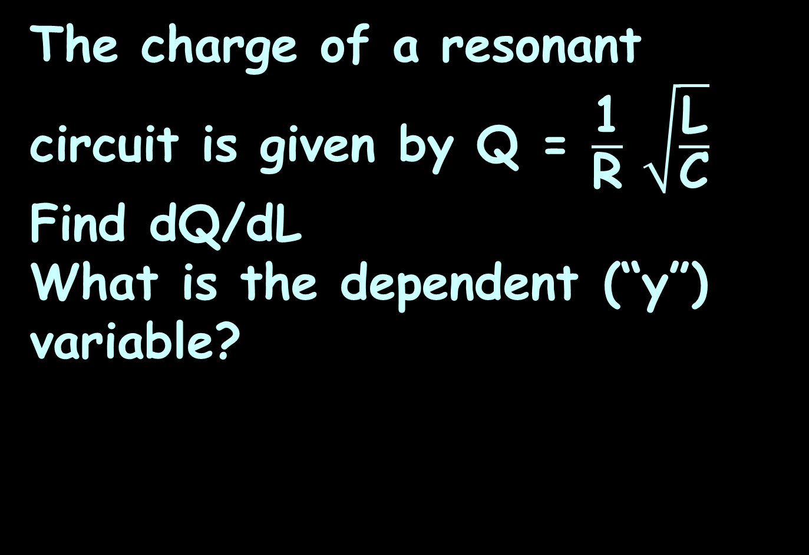
DERIVATIVES
IN-CLASS PROBLEMS 10
The charge of a resonant circuit is given by Q = $\frac{\text{1}}{\text{R}} \sqrt{\frac{\text{L}}{\text{C}}}$
Find dQ/dL
What is the dependent (“y”) variable?

Slide 104
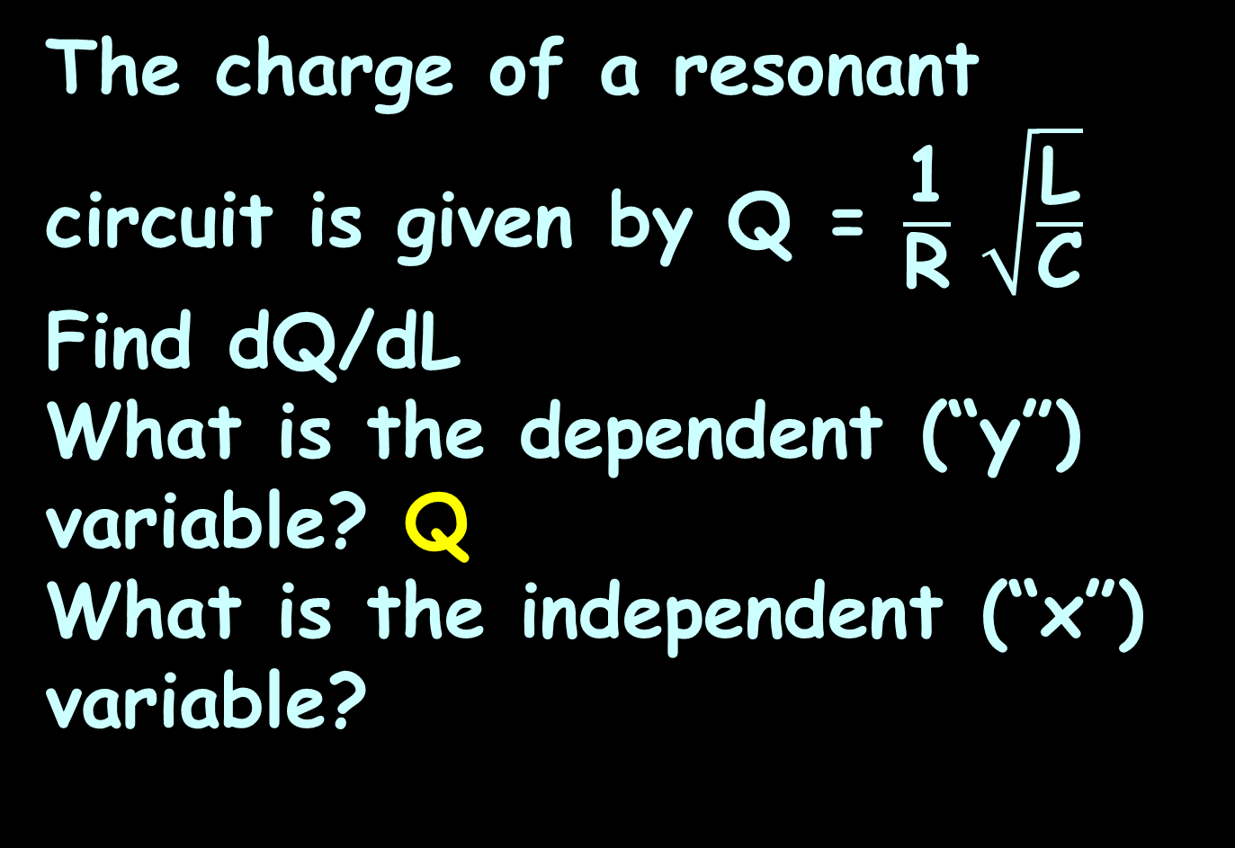
DERIVATIVES
IN-CLASS PROBLEMS 10
The charge of a resonant circuit is given by Q = $\frac{\text{1}}{\text{R}} \sqrt{\frac{\text{L}}{\text{C}}}$
Find dQ/dL
What is the dependent (“y”) variable? Q
What is the independent (“x”) variable?

Slide 105
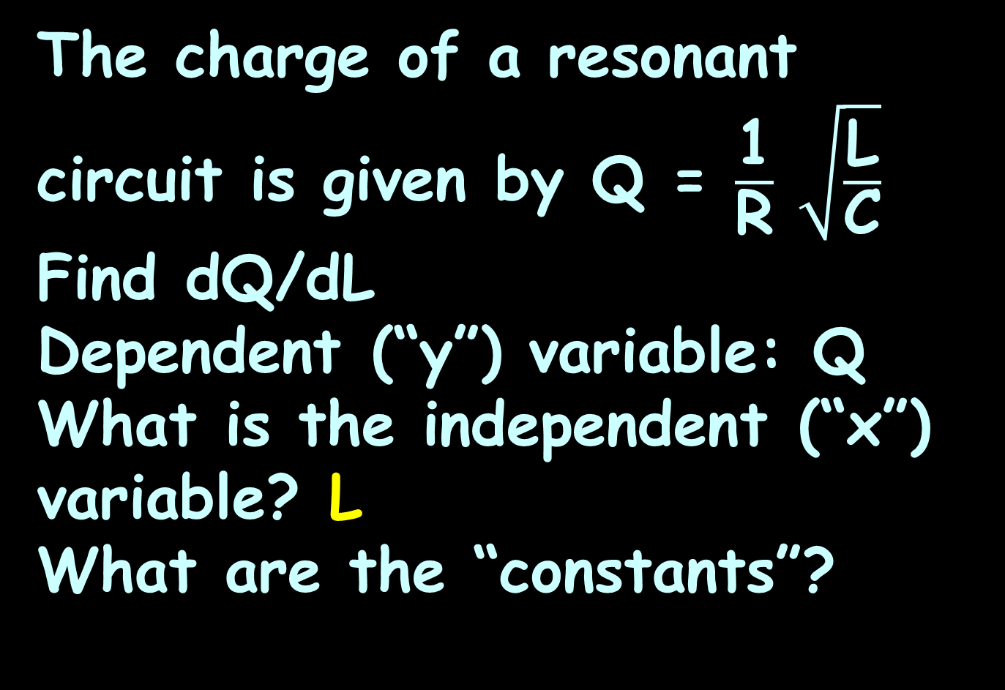
DERIVATIVES
IN-CLASS PROBLEMS 10
The charge of a resonant circuit is given by Q = $\frac{\text{1}}{\text{R}} \sqrt{\frac{\text{L}}{\text{C}}}$
Find dQ/dL
Dependent (“y”) variable: Q
What is the independent (“x”) variable? L
What are the “constants”?

Slide 106
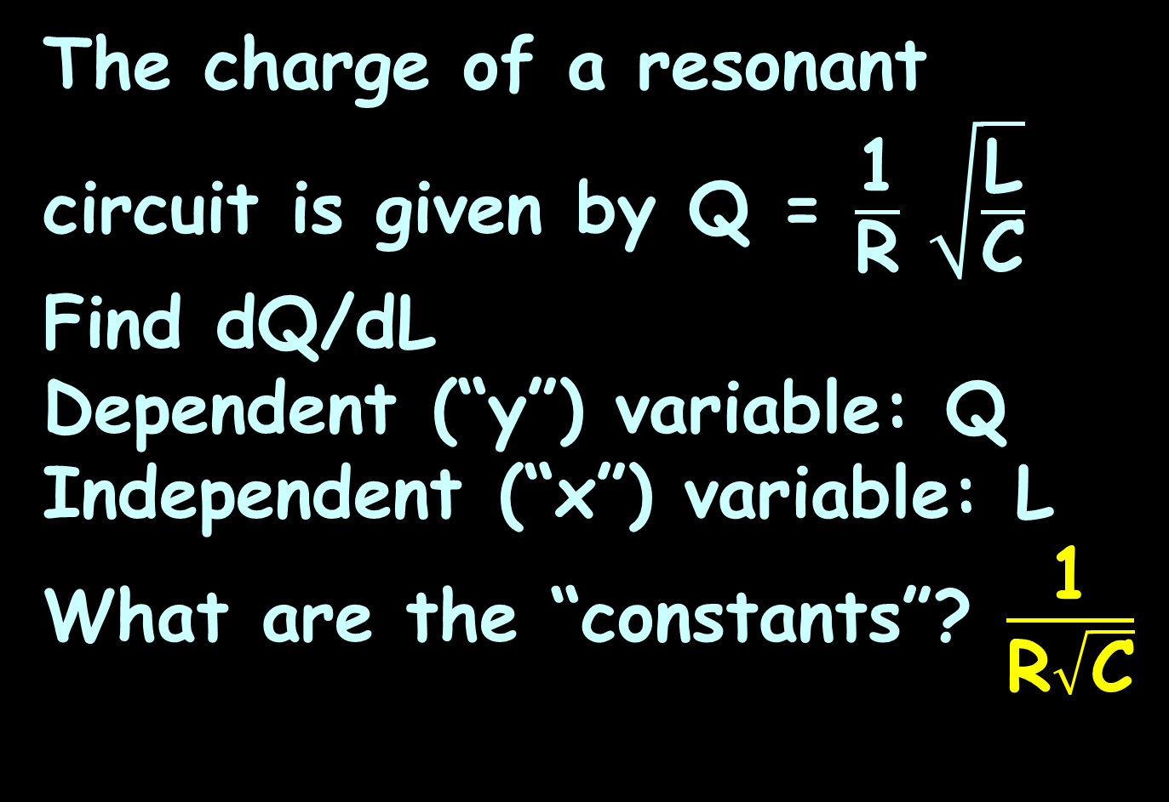
DERIVATIVES
IN-CLASS PROBLEMS 10
The charge of a resonant circuit is given by Q = $\frac{\text{1}}{\text{R}} \sqrt{\frac{\text{L}}{\text{C}}}$
Find dQ/dL
Dependent (“y”) variable: Q
Independent (“x”) variable: L
What are the “constants”? $\frac{\text{1}}{\text{R}\sqrt{\text{C}}}$

Slide 107
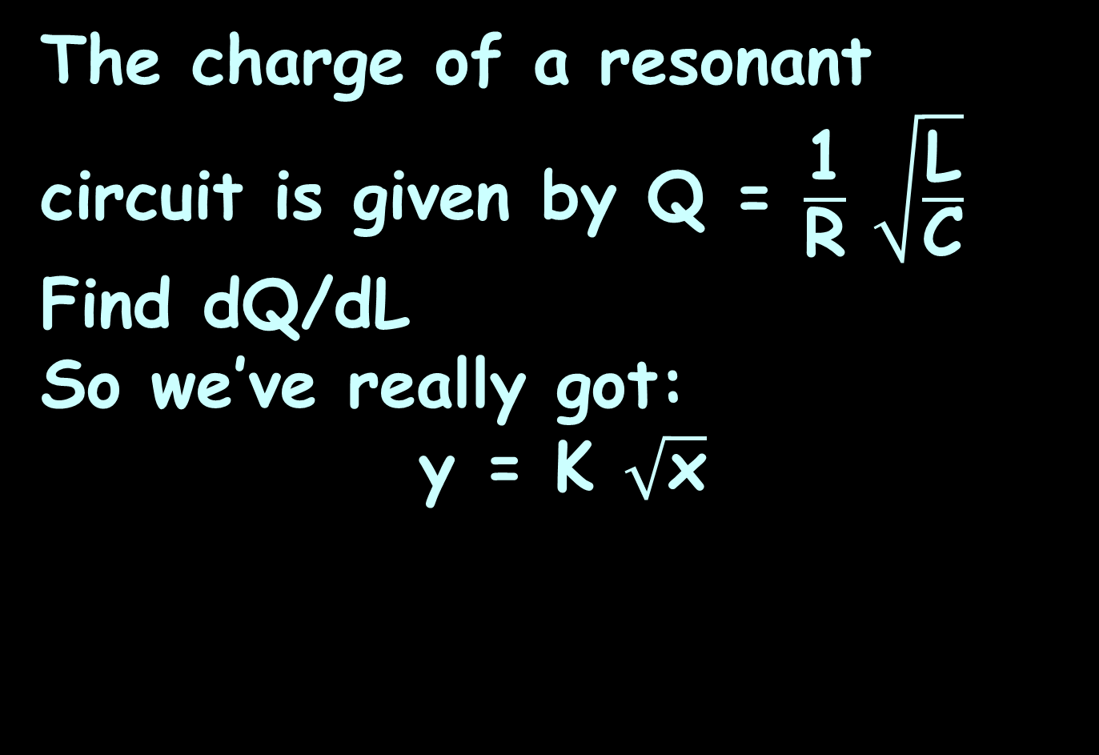


DERIVATIVES
IN-CLASS PROBLEMS 10
The charge of a resonant circuit is given by Q = $\frac{\text{1}}{\text{R}} \sqrt{\frac{\text{L}}{\text{C}}}$
Find dQ/dL
So we’ve really got:
y = K $\sqrt{\text{x}}$
Q
$$\sqrt{\text{L}}$$
$$\frac{\text{1}}{\text{R}\sqrt{\text{C}}}$$

Slide 108
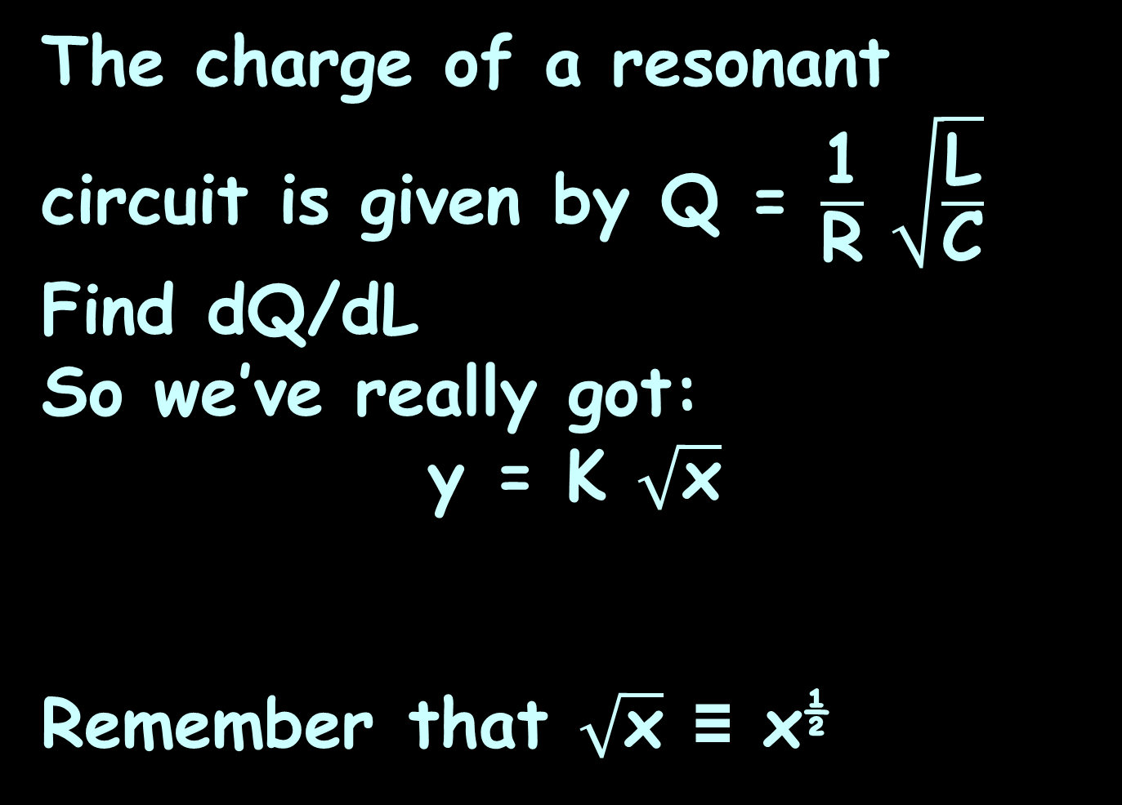
DERIVATIVES
IN-CLASS PROBLEMS 10
The charge of a resonant circuit is given by Q = $\frac{\text{1}}{\text{R}} \sqrt{\frac{\text{L}}{\text{C}}}$
Find dQ/dL
So we’ve really got:
y = K $\sqrt{\text{x}}$
Remember that $\sqrt{\text{x}}$ ≡ x^{½}
Q
$$\sqrt{\text{L}}$$
$$\frac{\text{1}}{\text{R}\sqrt{\text{C}}}$$

Slide 109
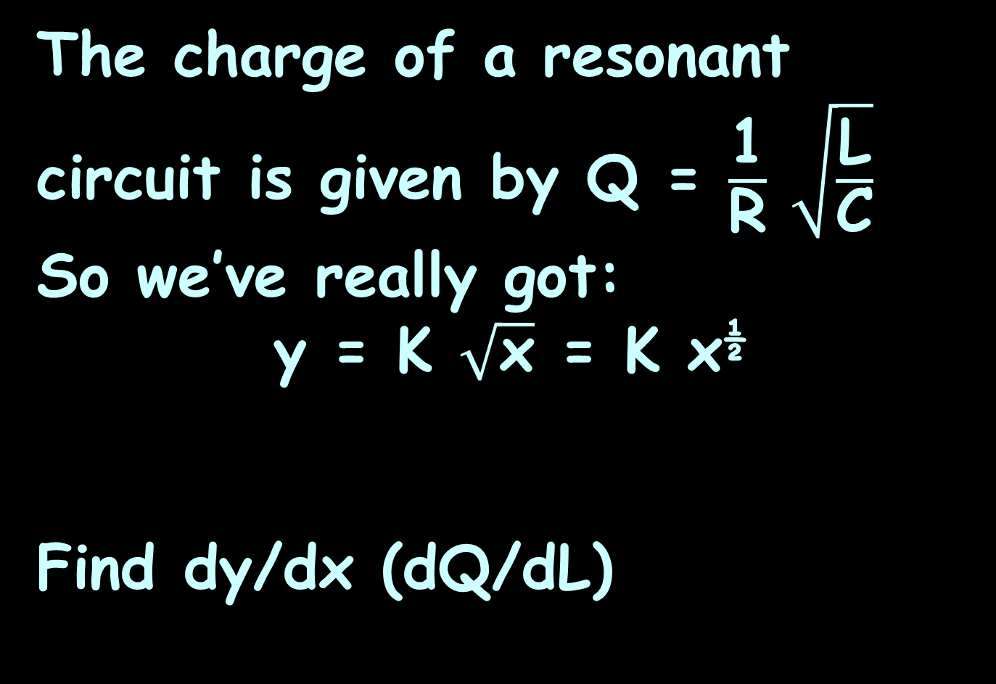


DERIVATIVES
IN-CLASS PROBLEMS 10
The charge of a resonant circuit is given by Q = $\frac{\text{1}}{\text{R}} \sqrt{\frac{\text{L}}{\text{C}}}$
So we’ve really got:
y = K $\sqrt{\text{x}}$ = K x^{½}
Find dy/dx (dQ/dL)
Q
$$\sqrt{\text{L}}$$
$$\frac{\text{1}}{\text{R}\sqrt{\text{C}}}$$

Slide 110
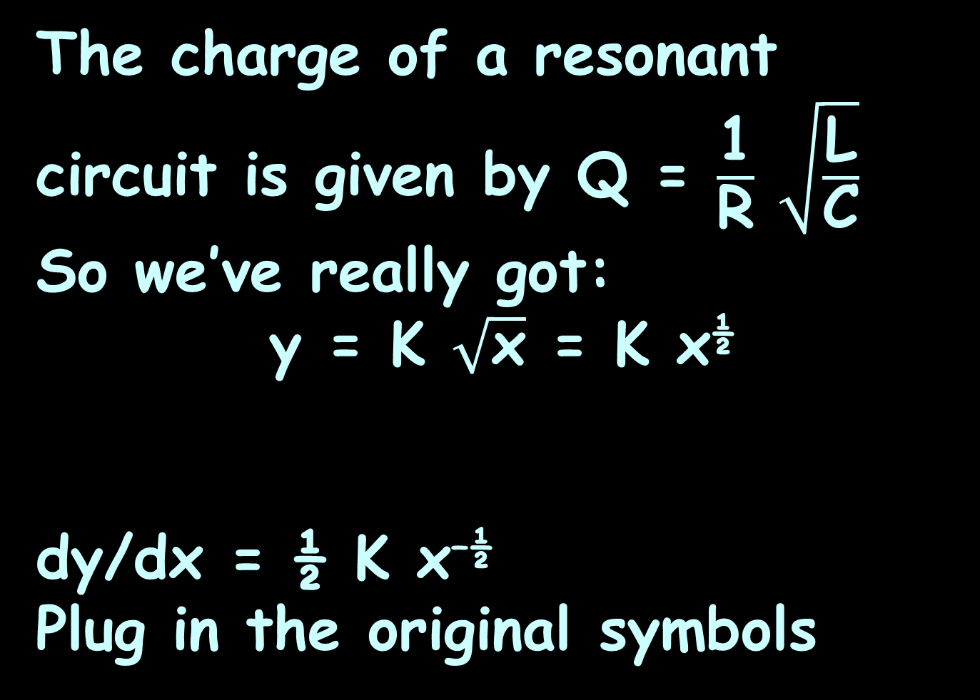
DERIVATIVES
IN-CLASS PROBLEMS 10
The charge of a resonant circuit is given by Q = $\frac{\text{1}}{\text{R}} \sqrt{\frac{\text{L}}{\text{C}}}$
So we’ve really got:
y = K $\sqrt{\text{x}}$ = K x^{½}
dy/dx = ½ K x^{–½}
Plug in the original symbols
Q
L
$$\frac{\text{1}}{\text{R}\sqrt{\text{C}}}$$

Slide 111

DERIVATIVES
IN-CLASS PROBLEMS 10
The charge of a resonant circuit is given by Q = $\frac{\text{1}}{\text{R}} \sqrt{\frac{\text{L}}{\text{C}}}$
So we’ve really got:
y = K $\sqrt{\text{x}}$ = k x^{½}
dy/dx = ½ K x^{–½}
Plug in the original symbols
Q
L
$$\frac{\text{1}}{\text{R}\sqrt{\text{C}}}$$

Slide 112
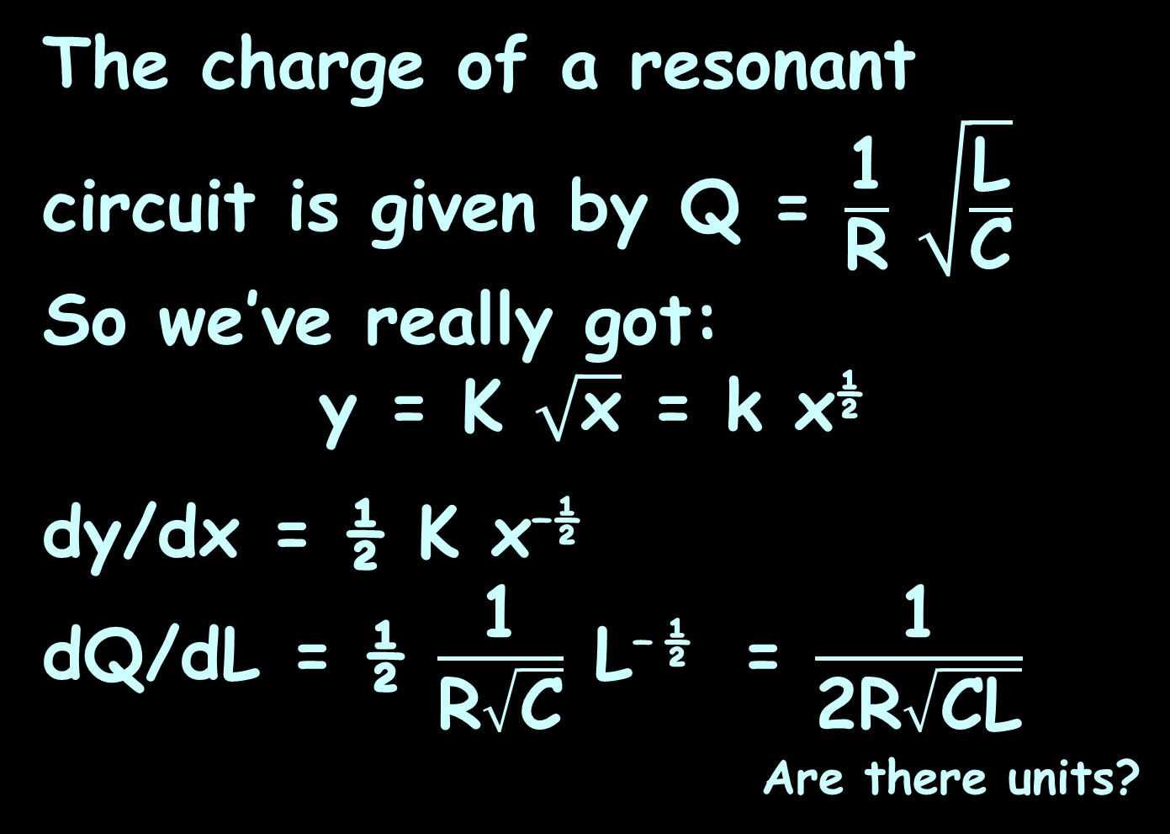
DERIVATIVES
IN-CLASS PROBLEMS 10
The charge of a resonant circuit is given by Q = $\frac{\text{1}}{\text{R}} \sqrt{\frac{\text{L}}{\text{C}}}$
So we’ve really got:
y = K $\sqrt{\text{x}}$ = k x^{½}
dy/dx = ½ K x^{–½}
dQ/dL = ½ $\frac{\text{1}}{\text{R}\sqrt{\text{C}}}$ L^{– ½} = $\frac{\text{1}}{\text{2}\text{R}\sqrt{\text{C}\text{L}}}$
_{Are there units?}
or

Slide 113
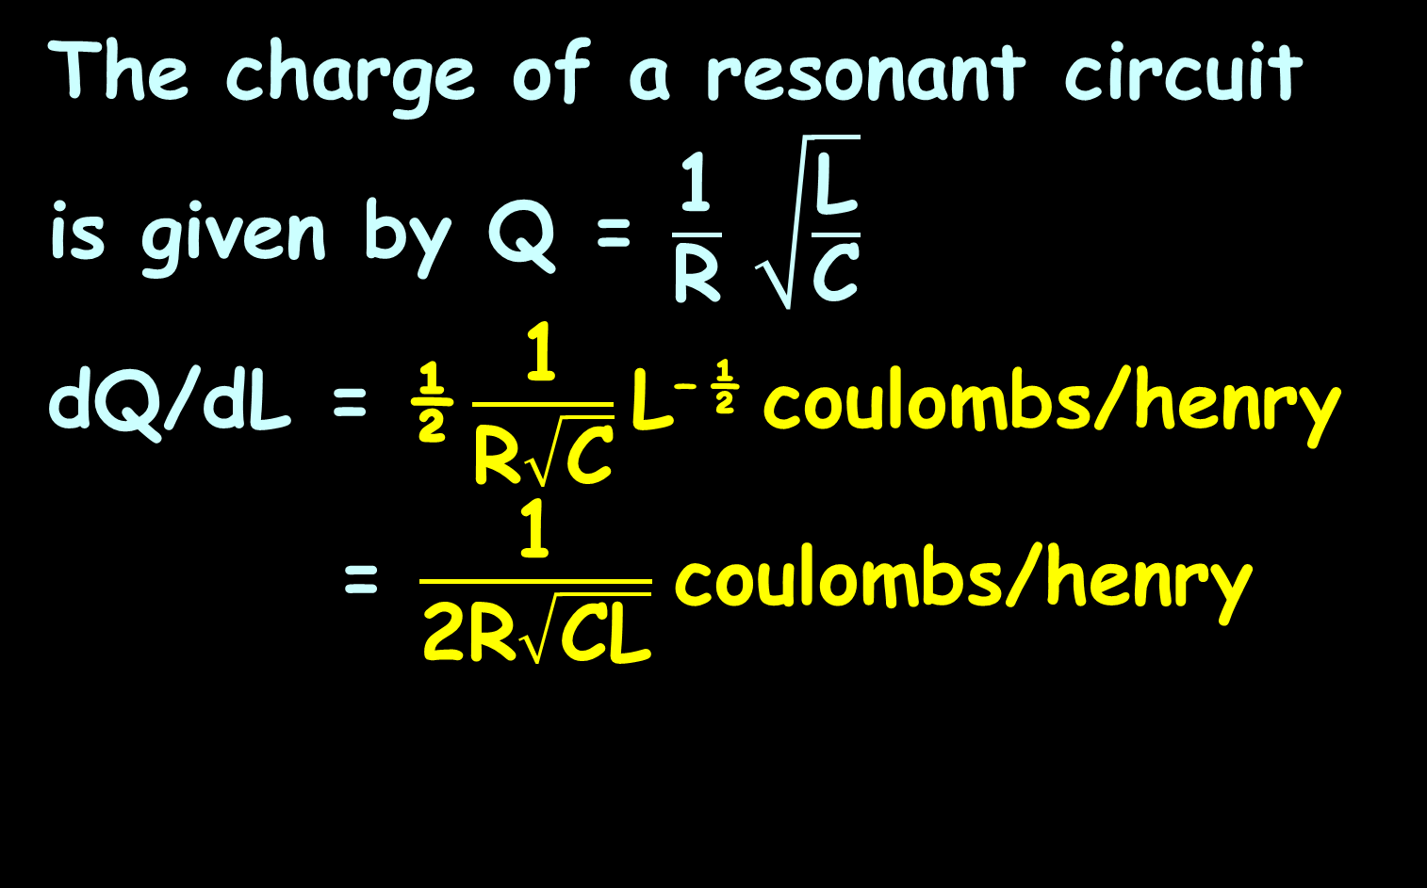
DERIVATIVES
IN-CLASS PROBLEMS 10
The charge of a resonant circuit is given by Q = $\frac{\text{1}}{\text{R}} \sqrt{\frac{\text{L}}{\text{C}}}$
dQ/dL = ½ $\frac{\text{1}}{\text{R}\sqrt{\text{C}}}$ L^{– ½} coulombs/henry
= $\frac{\text{1}}{\text{2}\text{R}\sqrt{\text{C}\text{L}}}$ coulombs/henry
or

Slide 114
Questions?
http://i.imgur.com/aliTlT3.jpg

Slide 115
The secret word for this unit is:
FLEX

Slide 116

Higher-Order Derivatives
Because the derivative of a function is also a function, you can take the derivative of a derivative!

Slide 117
Higher-Order Derivatives
dy/dx can also be written: y’
d(dy/dx)/dx is written: y’’
d²y/dx²
And so on…

Slide 118
HIGHER-ORDER DERIVATIVES
IN-CLASS PROBLEMS 11a
For the function: y = 2x⁵
Find y’

Slide 119
HIGHER-ORDER DERIVATIVES
IN-CLASS PROBLEMS 11b
For the function: y = 2x⁵
y’ = 10x⁴
Find y’’

Slide 120
HIGHER-ORDER DERIVATIVES
IN-CLASS PROBLEMS 11c
For the function: y = 2x⁵
y’ = 10x⁴
y’’ = 40x³
Find y’’’

Slide 121
HIGHER-ORDER DERIVATIVES
IN-CLASS PROBLEMS 11d
For the function: y = 2x⁵
y’ = 10x⁴
y’’ = 40x³
y’’’ = 120x²
Find y’’’’

Slide 122
HIGHER-ORDER DERIVATIVES
IN-CLASS PROBLEMS 11e
For the function: y = 2x⁵
y’ = 10x⁴
y’’ = 40x³
y’’’ = 120x²
y’’’’ = 240x
Find y’’’’’

Slide 123
HIGHER-ORDER DERIVATIVES
IN-CLASS PROBLEMS 11f
For the function: y = 2x⁵
y’ = 10x⁴
y’’ = 40x³
y’’’ = 120x²
y’’’’ = 240x
y’’’’’ = 240
Find y’’’’’’

Slide 124
HIGHER-ORDER DERIVATIVES
IN-CLASS PROBLEMS 11g
For the function: y = 2x⁵
y’ = 10x⁴
y’’ = 40x³
y’’’ = 120x²
y’’’’ = 240x
y’’’’’ = 240
y’’’’’’ = 0
What will y’’’’’’’ be?

Slide 125
HIGHER-ORDER DERIVATIVES
IN-CLASS PROBLEM 11g
For the function: y = 2x⁵
y’ = 10x⁴
y’’ = 40x³
y’’’ = 120x²
y’’’’ = 240x
y’’’’’ = 240
y’’’’’’ = 0
Any higher order derivative will be 0

Slide 126
Questions?
http://i.imgur.com/aliTlT3.jpg

Slide 127
Higher-Order Derivatives
This also works for more “complicated” derivatives

Slide 128
HIGHER-ORDER DERIVATIVES
IN-CLASS PROBLEMS 12a
For the function:
y = 3x² – 17x + 32
Find y’ =
y’’
y’’’
y’’’’

Slide 129
HIGHER-ORDER DERIVATIVES
IN-CLASS PROBLEMS 12b
For the function:
y = 3x² – 17x + 32
y’ = 6x – 17
y’’ =

Slide 130
HIGHER-ORDER DERIVATIVES
IN-CLASS PROBLEMS 12c
For the function:
y = 3x² – 17x + 32
y’ = 6x – 17
y’’ = 6
y’’’ =

Slide 131
HIGHER-ORDER DERIVATIVES
IN-CLASS PROBLEMS 12d
For the function:
y = 3x² – 17x + 32
y’ = 6x – 17
y’’ = 6
y’’’ = 0
y’’’’
Hmmmm……

Slide 132
HIGHER-ORDER DERIVATIVES
IN-CLASS PROBLEMS 12e
For the function:
y = 3x² – 17x + 32
y’ = 6x – 17
y’’ = 6
y’’’ = 0
y’’’’
All of the higher order derivatives will be 0

Slide 133
Higher-Order Derivatives
For multiple derivatives, you can only do the largest x power number of derivatives before you have only “zero” derivatives!

Slide 134
HIGHER-ORDER DERIVATIVES
IN-CLASS PROBLEM 12e
How many non-zero derivatives would you be able to calculate for:
y = x³⁶ – 4x²⁷ + 6x⁵⁹ -732x⁴²

Slide 135
HIGHER-ORDER DERIVATIVES
IN-CLASS PROBLEM 13
How many non-zero derivatives would you be able to calculate for:
y = x³⁶ – 4x²⁷ + 6x⁵⁹ -732x⁴²
59

Slide 136
Questions?
http://i.imgur.com/aliTlT3.jpg

Slide 137
Higher-Order Derivatives
It’s more complicated for our transcendentals…

Slide 138

HIGHER-ORDER DERIVATIVES
IN-CLASS PROBLEM 14a
What’s the first derivative of
y = sin(x)
$\frac{d}{dx}$ sin x = cos x
$\frac{d}{dx}$ cos x = –sin x
$\frac{d}{dx}$ log_{b} x = 1/(x ln(b))
$\frac{d}{dx}$ b^{x} = b^{x} ln(b)
$\frac{d}{dx}$ ln x = $\frac{1}{x}$
$\frac{d}{dx}$ e^{x} = e^{x}

Slide 139
HIGHER-ORDER DERIVATIVES
IN-CLASS PROBLEM 14b
What’s the first derivative of
y = sin(x)
y’ = cos(x)
What’s the second derivative?
$\frac{d}{dx}$ sin x = cos x
$\frac{d}{dx}$ cos x = –sin x
$\frac{d}{dx}$ log_{b} x = 1/(x ln(b))
$\frac{d}{dx}$ b^{x} = b^{x} ln(b)
$\frac{d}{dx}$ ln x = $\frac{1}{x}$
$\frac{d}{dx}$ e^{x} = e^{x}

Slide 140
HIGHER-ORDER DERIVATIVES
IN-CLASS PROBLEM 14c
y = sin(x)
y’ = cos(x)
What’s the second derivative?
y’’ = -sin(x)
What’s the third derivative?
$\frac{d}{dx}$ sin x = cos x
$\frac{d}{dx}$ cos x = –sin x
$\frac{d}{dx}$ log_{b} x = 1/(x ln(b))
$\frac{d}{dx}$ b^{x} = b^{x} ln(b)
$\frac{d}{dx}$ ln x = $\frac{1}{x}$
$\frac{d}{dx}$ e^{x} = e^{x}

Slide 141
HIGHER-ORDER DERIVATIVES
IN-CLASS PROBLEM 14d
y = sin(x)
y’ = cos(x)
y’’ = -sin(x)
What’s the third derivative?
y’’’ = -cos(x)
What’s the fourth derivative?
$\frac{d}{dx}$ sin x = cos x
$\frac{d}{dx}$ cos x = –sin x
$\frac{d}{dx}$ log_{b} x = 1/(x ln(b))
$\frac{d}{dx}$ b^{x} = b^{x} ln(b)
$\frac{d}{dx}$ ln x = $\frac{1}{x}$
$\frac{d}{dx}$ e^{x} = e^{x}

Slide 142
HIGHER-ORDER DERIVATIVES
IN-CLASS PROBLEM 14d
y = sin(x)
y’ = cos(x)
y’’ = -sin(x)
y’’’ = -cos(x)
What’s the fourth derivative?
y’’’’ = -(-sin(x)) = sin(x)
. . .
$\frac{d}{dx}$ sin x = cos x
$\frac{d}{dx}$ cos x = –sin x
$\frac{d}{dx}$ log_{b} x = 1/(x ln(b))
$\frac{d}{dx}$ b^{x} = b^{x} ln(b)
$\frac{d}{dx}$ ln x = $\frac{1}{x}$
$\frac{d}{dx}$ e^{x} = e^{x}

Slide 143
Higher-Order Derivatives
Polynomial functions can only go so far before ending up all 0s
Transcendentals can go forever

Slide 144
HIGHER-ORDER DERIVATIVES
IN-CLASS PROBLEM 15a
y = e^{x}
y’ =
y’’ =
y’’’ =
y’’’’ =
. . .
$\frac{d}{dx}$ sin x = cos x
$\frac{d}{dx}$ cos x = –sin x
$\frac{d}{dx}$ log_{b} x = 1/(x ln(b))
$\frac{d}{dx}$ b^{x} = b^{x} ln(b)
$\frac{d}{dx}$ ln x = $\frac{1}{x}$
$\frac{d}{dx}$ e^{x} = e^{x}

Slide 145
HIGHER-ORDER DERIVATIVES
IN-CLASS PROBLEM 15b
y = e^{x}
y’ = e^{x}
y’’ =
y’’’ =
y’’’’ =
. . .
$\frac{d}{dx}$ sin x = cos x
$\frac{d}{dx}$ cos x = –sin x
$\frac{d}{dx}$ log_{b} x = 1/(x ln(b))
$\frac{d}{dx}$ b^{x} = b^{x} ln(b)
$\frac{d}{dx}$ ln x = $\frac{1}{x}$
$\frac{d}{dx}$ e^{x} = e^{x}

Slide 146
HIGHER-ORDER DERIVATIVES
IN-CLASS PROBLEM 15c
y = e^{x}
y’ = e^{x}
y’’ = e^{x}
y’’’ =
y’’’’ =
. . .
$\frac{d}{dx}$ sin x = cos x
$\frac{d}{dx}$ cos x = –sin x
$\frac{d}{dx}$ log_{b} x = 1/(x ln(b))
$\frac{d}{dx}$ b^{x} = b^{x} ln(b)
$\frac{d}{dx}$ ln x = $\frac{1}{x}$
$\frac{d}{dx}$ e^{x} = e^{x}

Slide 147
HIGHER-ORDER DERIVATIVES
IN-CLASS PROBLEM 15d
y = e^{x}
y’ = e^{x}
y’’ = e^{x}
y’’’ = e^{x}
y’’’’ =
. . .
$\frac{d}{dx}$ sin x = cos x
$\frac{d}{dx}$ cos x = –sin x
$\frac{d}{dx}$ log_{b} x = 1/(x ln(b))
$\frac{d}{dx}$ b^{x} = b^{x} ln(b)
$\frac{d}{dx}$ ln x = $\frac{1}{x}$
$\frac{d}{dx}$ e^{x} = e^{x}

Slide 148
HIGHER-ORDER DERIVATIVES
IN-CLASS PROBLEM 15d
y = e^{x}
y’ = e^{x}
y’’ = e^{x}
y’’’ = e^{x}
y’’’’ = e^{x}
. . .
$\frac{d}{dx}$ sin x = cos x
$\frac{d}{dx}$ cos x = –sin x
$\frac{d}{dx}$ log_{b} x = 1/(x ln(b))
$\frac{d}{dx}$ b^{x} = b^{x} ln(b)
$\frac{d}{dx}$ ln x = $\frac{1}{x}$
$\frac{d}{dx}$ e^{x} = e^{x}

Slide 149
Questions?
http://i.imgur.com/aliTlT3.jpg

Slide 150
Derivatives as Rates of Change
Position function:
s = ƒ(t)
Where s is the distance from a starting point s=0
t is the amount of time that has elapsed since t=0

Slide 151
Derivatives as Rates of Change
Between t = “a” (start) and
t = “a” + ∆t (end) the displacement:
∆s = ƒ(a + ∆t) – ƒ(a)

Slide 152
Derivatives as Rates of Change
Remember the average velocity is:
∆s / ∆t
So now:
∆s = ƒ(a + ∆t) – ƒ(a)
∆t ∆t

Slide 153
Derivatives as Rates of Change
As ∆t approaches zero, the limit is the instantaneous velocity at “a”

Slide 154
Derivatives as Rates of Change
When you are interested only in the magnitude of the velocity, that is the speed:
speed = |velocity|

Slide 155
DERIVATIVES AS RATES OF CHANGE
IN-CLASS PROBLEM 16a
The speed of a vehicle with an instantaneous velocity of
-55mph is:
speed = |velocity|

Slide 156
DERIVATIVES AS RATES OF CHANGE
IN-CLASS PROBLEM 16a
The speed of a vehicle with an instantaneous velocity of
-55mph is: 55mph
(no negative direction)
speed = |velocity|

Slide 157
Derivatives as Rates of Change
So… remember all those physics formulas?

Slide 158
Derivatives as Rates of Change
So… remember all those physics formulas?
You really only needed to know one…

Slide 159
Derivatives as Rates of Change
So… remember all those physics formulas?
You really only needed to know one…
…And calculus

Slide 160
Derivatives as Rates of Change
The position function tells you where an object is at a certain point in time
position = ƒ(time)

Slide 161
Derivatives as Rates of Change
Instantaneous velocity is the first derivative of the position function
A rate of change of location

Slide 162
Derivatives as Rates of Change
Acceleration is its second derivative
A rate of change of velocity (change in location)

Slide 163
Derivatives as Rates of Change
The third derivative is called the “jerk”
This indicates those moments when the acceleration suddenly speeds up (like a lift ascending quickly) or slows down

Slide 164
Derivatives as Rates of Change
The fourth derivative is called the “jounce” or “snap”
when the speeding up (or slowing down) of the acceleration suddenly changes

Slide 165
Derivatives as Rates of Change
The fifth derivative is called the “crackle”
A change in the change of the change of the change in the rate of change

Slide 166
Derivatives as Rates of Change
The sixth derivative is called “pop”
A change in the change of the change of the change of the change in the rate of change

Slide 167
DERIVATIVES AS RATES OF CHANGE
IN-CLASS PROBLEM 16b
Suppose you have a position function:
s = 2t² + 5t – 42
with s in feet and t in seconds

Slide 168
DERIVATIVES AS RATES OF CHANGE
IN-CLASS PROBLEM 16b
s = 2t² + 5t – 42
This tells you how far the item has moved in feet after “t” seconds have passed

Slide 169
DERIVATIVES AS RATES OF CHANGE
IN-CLASS PROBLEM 16b
s = 2t² + 5t – 42
How far has the item moved after 10 seconds?

Slide 170
DERIVATIVES AS RATES OF CHANGE
IN-CLASS PROBLEM 16b
s = 2t² + 5t – 42
How far has the item moved after 10 seconds? 208 whats?

Slide 171
DERIVATIVES AS RATES OF CHANGE
IN-CLASS PROBLEM 16b
s = 2t² + 5t – 42
How far has the item moved after 10 seconds? 208 feet

Slide 172
DERIVATIVES AS RATES OF CHANGE
IN-CLASS PROBLEM 16c
What is the velocity function of:
s = 2t² + 5t – 42
(hint: it’s the first derivative)

Slide 173
DERIVATIVES AS RATES OF CHANGE
IN-CLASS PROBLEM 16d
What is the velocity function of:
s = 2t² + 5t – 42
speed: s’ = 4t + 5
What is the item’s velocity after 10 seconds?

Slide 174
DERIVATIVES AS RATES OF CHANGE
IN-CLASS PROBLEM 16d
What is the velocity function of:
s = 2t² + 5t – 42
speed: s’ = 4t + 5
What is the item’s velocity at 10 seconds? 45 whats?

Slide 175
DERIVATIVES AS RATES OF CHANGE
IN-CLASS PROBLEM 16d
What is the velocity function of:
s = 2t² + 5t – 42
speed: ds/dt = s’ = 4t + 5
What is the item’s velocity at 10 seconds? 45 ft/sec

Slide 176
DERIVATIVES AS RATES OF CHANGE
IN-CLASS PROBLEM 16e
What is the velocity function of:
s = 2t² + 5t – 42
velocity: s’ = 4t + 5
What is the acceleration function?
(hint: it’s the second derivative)

Slide 177
DERIVATIVES AS RATES OF CHANGE
IN-CLASS PROBLEM 16f
What is the speed function of:
s = 2t² + 5t – 42
velocity : s’ = 4t + 5 ft/sec
acceleration: s’’ = 4
What are the units?

Slide 178
DERIVATIVES AS RATES OF CHANGE
IN-CLASS PROBLEM 16f
What is the speed function of:
s = 2t² + 5t – 42
speed: s’ = 4t + 5 ft/sec
acceleration: d²s/dt² = s’’ = 4
What are the units? feet/sec²

Slide 179
DERIVATIVES AS RATES OF CHANGE
IN-CLASS PROBLEM 16f
Position function:
s = 2x² + 5x – 42
Velocity function:
s’ = 4x + 5 ft/sec
Acceleration function:
s’’ = 4 ft/sec^2
A constant acceleration!

Slide 180
Derivatives as Rates of Change
Acceleration video

Slide 181
Questions?
http://i.imgur.com/aliTlT3.jpg

Slide 182
DERIVATIVES AS RATES OF CHANGE
IN-CLASS PROBLEM 16g
Position function:
s = 2x² + 5x – 42
Velocity function:
s’ = 4x + 5
Acceleration function:
s’’ = 4
What is the third derivative?

Slide 183
DERIVATIVES AS RATES OF CHANGE
IN-CLASS PROBLEM 16g
Position function:
s = 2x² + 5x – 42
Velocity function:
s’ = 4x + 5
Acceleration function:
s’’ = 4
What is the third derivative?
0

Slide 184
DERIVATIVES AS RATES OF CHANGE
IN-CLASS PROBLEM 16h
Do you notice a pattern in the units of these higher derivatives?
s’ = 45 ft/sec
s’’ = 4 ft/sec²
What would be the units of the third derivative?

Slide 185
DERIVATIVES AS RATES OF CHANGE
IN-CLASS PROBLEM 16h
Do you notice a pattern in the units of these higher derivatives?
s’ = 45 ft/sec
s’’ = 4 ft/sec²
What would be the units of the third derivative? ft/sec³

Slide 186
DERIVATIVES AS RATES OF CHANGE
IN-CLASS PROBLEM 16i
Do you notice a pattern in the units of these higher derivatives?
s’ = 45 ft/sec
s’’ = 4 ft/sec²
What would be the units of the fourth derivative?

Slide 187
DERIVATIVES AS RATES OF CHANGE
IN-CLASS PROBLEM 16i
Do you notice a pattern in the units of these higher derivatives?
s’ = 45 ft/sec
s’’ = 4 ft/sec²
What would be the units of the fourth derivative? ft/sec⁴

Slide 188
DERIVATIVES AS RATES OF CHANGE
IN-CLASS PROBLEM 16j
Do you notice a pattern in the units of these higher derivatives?
s’ = 45 ft/sec
s’’ = 4 ft/sec²
What would be the units of the eighteenth derivative?

Slide 189
DERIVATIVES AS RATES OF CHANGE
IN-CLASS PROBLEM 16j
Do you notice a pattern in the units of these higher derivatives?
s’ = 45 ft/sec
s’’ = 4 ft/sec²
What would be the units of the eighteenth derivative? ft/sec¹⁸

Slide 190
Derivatives as Rates of Change
That is because you are actually taking a derivative with respect to t² t³ t⁴ t¹⁸…

Slide 191
Derivatives as Rates of Change
s = ƒ(t) position function
ƒ’(t) ds/dt velocity
ƒ’’(t) d²s/dt² acceleration
ƒ’’’(t) d³s/dt³ jerk
ƒ’’’’(t) d⁴s/dt⁴ snap
ƒ’’’’’(t) d⁵s/dt⁵ crackle
ƒ’’’’’’(t) d⁶s/dt⁶ pop

Slide 192
Questions?
http://i.imgur.com/aliTlT3.jpg

Slide 193
Derivatives in Engineering
If you have an energy function ω
ω’(t) = power
ω’’(t) = change in power

Slide 194
DERIVATIVES IN ENGINEERING
IN-CLASS PROBLEM 17a
The energy in a resistor is:
ω = 3t² + 2t joules
What is the power function?
ω’(t) = power

Slide 195
DERIVATIVES IN ENGINEERING
IN-CLASS PROBLEM 17b
The energy in a resistor is:
ω = 3t² + 2t¹ joules
What is the power function?
ω’(t) = power = 6t + 2
What’s the power at t=3 seconds?
ω’(t) = power

Slide 196
DERIVATIVES IN ENGINEERING
IN-CLASS PROBLEM 17b
The energy in a resistor is:
ω = 3t² + 2t joules
What is the power at t=3 seconds?
ω’(t) = power = 6t + 2
ω’(3) = 6(3) + 2 = 20 whats?
ω’(t) = power

Slide 197
DERIVATIVES IN ENGINEERING
IN-CLASS PROBLEM 17b
The energy in a resistor is:
ω = 3t² + 2t joules
What is the power at t=3 seconds?
dω/dt = ω’(t) = power = 6t + 2
ω’(3) = 6(3) + 2 = 20 watts
ω’(t) = power
1 watt = 1 joule per second

Slide 198
DERIVATIVES IN ENGINEERING
IN-CLASS PROBLEM 17c
The energy in a resistor is:
ω = 3t² + 2t joules
ω’(t) = power = 6t + 2 watts
How fast is the power changing?
ω’’(t) = change in power

Slide 199
DERIVATIVES IN ENGINEERING
IN-CLASS PROBLEM 17c
The energy in a resistor is:
ω = 3t² + 2t joules
ω’(t) = power = 6t + 2 watts
How fast is the power changing?
ω’’(t) = change in power = 6 whats?

Slide 200
DERIVATIVES IN ENGINEERING
IN-CLASS PROBLEM 17d
The energy in a resistor is:
ω = 3t² + 2t joules
ω’(t) = power = 6t + 2 watts
How fast is the power changing?
ω’’(t) = change in power
= 6 watts/sec
At t = 3 seconds?
1 watt = 1 joule per second

Slide 201
DERIVATIVES IN ENGINEERING
IN-CLASS PROBLEM 17d
The energy in a resistor is:
ω = 3t² + 2t joules
ω’(t) = power = 6t + 2 watts
How fast is the power changing?
ω’’(t) = change in power
= 6 watts/sec
At t = 3 seconds? 6 watts/sec
1 watt = 1 joule per second

Slide 202
Derivatives
Remember, these are all different ways of saying the same thing:
instantaneous velocity
exact rate of change
slope of a tangent line
lim Δy/Δx lim dy/dx
Δx → 0 dx → 0
derivative y’ dy/dx

Slide 203
Questions?
http://i.imgur.com/aliTlT3.jpg

Slide 204

You Survived!
Today we covered:
Product Rule
Quotient Rule
Differentiation of
transcendentals
Higher order
derivatives
www.playbuzz.com

