Slide 1
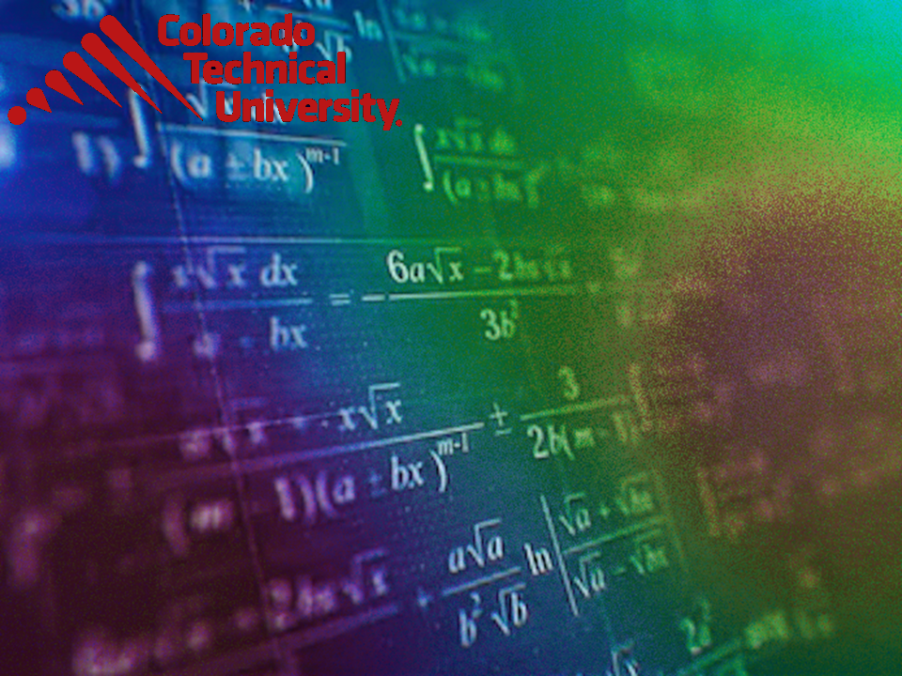
Welcome to
Unit 5 ! .
MATH 205 Differential Calculus
https://www.smu.edu.sg/programmes/core-curriculum/course-structure/calculus

Slide 2
What’s Up?
Outcome 1) Demonstrate differentiation skills for linear, polynomial, rational, trigonometric, exponential, and logarithmic functions and proper application of the Product, Quotient and Chain Rules of differentiation
Outcome 2) Use algebra, limits and derivatives to examine the properties and graphs of functions, including finding their extrema, inflection points, and intervals of monotonicity and concavity

Slide 3

The Best News!
July 18-24 is a CTU BREAK!

Slide 4
The Best News!
July 18-24 is a CTU BREAK!
We’ll have class July 17
then a BREAK!!!
then Office Hours July 30
and class Monday July 31

Slide 5
Chain Rule
A composite function is a function of a function

Slide 6
Chain Rule
y = (3x² + 7x + 5)³
is a composite function

Slide 7
Chain Rule
y = (3x² + 7x + 5)³
is a composite function
Think of it as:
y = u³
where
u = 3x² + 7x + 5

Slide 8
Chain Rule
y = (3x² + 7x + 5)³
is a function raised to a power
not a variable raised to a power
(so it has a different rule)

Slide 9
Chain Rule
Rule #6: derivative of the power of a function: y = u^{n} where u is a function of x
dy/dx = dy/du × du/dx

Slide 10
Chain Rule
Rule #6: derivative of the power of a function: y = u^{n} where u is a function of x
dy/dx = dy/du × du/dx
This one is so important it has its own name: The Chain Rule

Slide 11
Chain Rule
Rule #6: derivative of the power of a function: y = u^{n} where u is a function of x
dy/dx = dy/du × du/dx
Note: it works algebraically:
dy/du × du/dx = dy/dx

Slide 12
Chain Rule
We don’t typically use “dy” and “dx” as variables, but the algebra actually works like they are!

Slide 13
Chain Rule
In practice, I find:
dy/dx = du/dx × dy/du
is what I actually use more than:
dy/dx = dy/du × du/dx

Slide 14
CHAIN RULE
IN-CLASS PROBLEM 1
Find the derivative of:
y = (3x + 1)²

Slide 15
CHAIN RULE
IN-CLASS PROBLEM 1
Find the derivative of:
y = (3x + 1)²
It looks like: y = u ^{n}
So, we’ll use the chain rule

Slide 16
CHAIN RULE
IN-CLASS PROBLEM 1
Find the derivative of:
y = (3x + 1)²
using: y = u ^{n}
What is u?

Slide 17
CHAIN RULE
IN-CLASS PROBLEM 1
Find the derivative of:
y = (3x + 1)²
using: y = u ^{n}
What is u?
y = (3x + 1)²
^{u n}

Slide 18
CHAIN RULE
IN-CLASS PROBLEM 1
Find the derivative of:
y = (3x + 1)²
using: y = u ^{n}
What is u? 3x + 1
What is du/dx?

Slide 19
CHAIN RULE
IN-CLASS PROBLEM 1
Find the derivative of:
y = (3x + 1)²
using: y = u ^{n}
What is u? 3x + 1
What is du/dx? 3
What is dy/du? dy/dx for
y = u² y = x²
dy/dx = 2x

Slide 20
CHAIN RULE
IN-CLASS PROBLEM 1
Find the derivative of:
y = (3x + 1)²
using: y = u ^{n}
What is u? 3x + 1
What is du/dx? 3
What is dy/du? dy/dx for
y = u² y = x²
dy/du = 2u dy/dx = 2x

Slide 21
CHAIN RULE
IN-CLASS PROBLEM 1
Find the derivative of:
y = (3x + 1)² = u²
using: y = u ^{n}
What is du/dx? 3
What is dy/du? 2u
dy/dx = du/dx × dy/du
= 3 × 2u

Slide 22
CHAIN RULE
IN-CLASS PROBLEM 1
Find the derivative of:
y = (3x + 1)²
using: y = u ^{n}
What is du/dx? 3
What is dy/du? 2u
dy/dx = du/dx × dy/du
= 3 × 2u = 6u
= 6(3x + 1) = 18x + 6

Slide 23

Questions?
http://i.imgur.com/aliTlT3.jpg

Slide 24
Chain Rule
This works for more complicated problems, too!

Slide 25

CHAIN RULE
IN-CLASS PROBLEM 2
Find the derivative of:
y = $\sqrt{\text{13}\text{x}\text{2}\text{ – 5}\text{x}\text{ + 8}}$

Slide 26
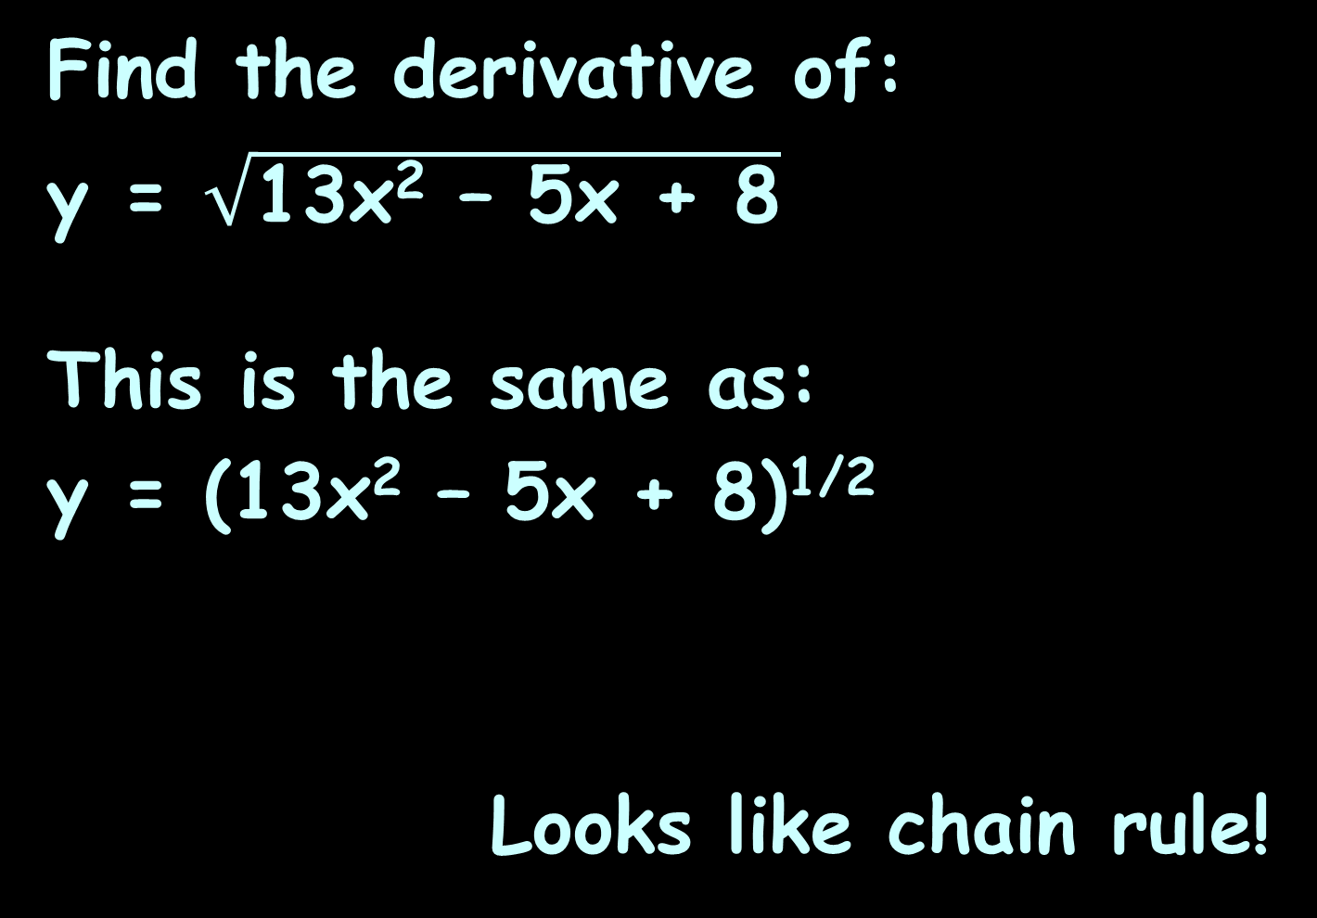
CHAIN RULE
IN-CLASS PROBLEM 2
Find the derivative of:
y = $\sqrt{\text{13}\text{x}\text{2}\text{ – 5}\text{x}\text{ + 8}}$
This is the same as:
y = (13x² – 5x + 8)^{1/2}
Looks like chain rule!

Slide 27
CHAIN RULE
IN-CLASS PROBLEM 2
y = (13x² – 5x + 8)^{1/2}
What is u?

Slide 28
CHAIN RULE
IN-CLASS PROBLEM 2
y = (13x² – 5x + 8)^{1/2}
What is u? u = 13x² – 5x + 8
What is du/dx?

Slide 29
CHAIN RULE
IN-CLASS PROBLEM 2
y = (13x² – 5x + 8)^{1/2} = u^{1/2}
What is u? u = 13x² – 5x + 8
What is du/dx? 26x - 5
What is dy/du? y = u^{1/2}

Slide 30
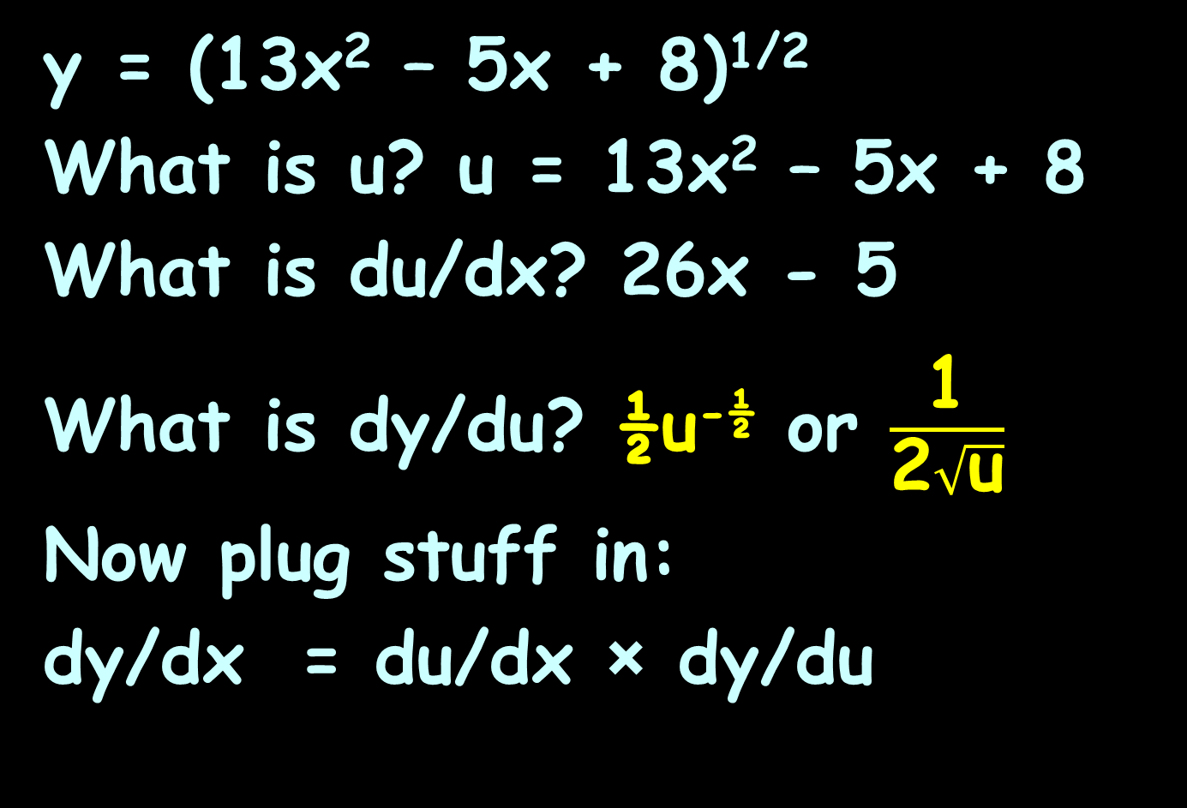
CHAIN RULE
IN-CLASS PROBLEM 2
y = (13x² – 5x + 8)^{1/2}
What is u? u = 13x² – 5x + 8
What is du/dx? 26x - 5
What is dy/du? ½u^{-½} or $\frac{\text{1}}{\text{2}\sqrt{\text{u}}}$
Now plug stuff in:
dy/dx = du/dx × dy/du

Slide 31

CHAIN RULE
IN-CLASS PROBLEM 2
u = 13x² – 5x + 8
dy/dx = du/dx × dy/du
= (26x – 5) × $\frac{\text{1}}{\text{2}\sqrt{\text{u}}}$

Slide 32
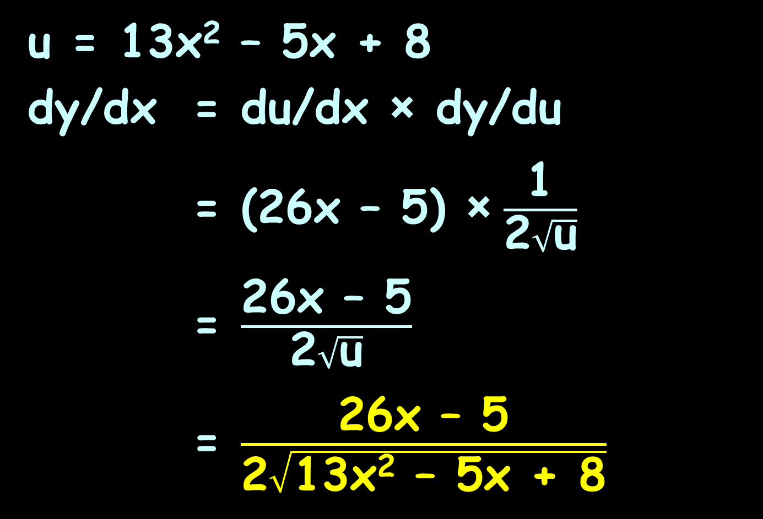
CHAIN RULE
IN-CLASS PROBLEM 2
u = 13x² – 5x + 8
dy/dx = du/dx × dy/du
= (26x – 5) × $\frac{\text{1}}{\text{2}\sqrt{\text{u}}}$
= $\frac{\text{26}\text{x}\text{ – 5}}{\text{2}\sqrt{\text{u}}}$
= $\frac{\text{26}\text{x}\text{ – 5}}{\text{2}\sqrt{\text{13}\text{x}\text{2}\text{ – 5}\text{x}\text{ + 8}}}$

Slide 33
Questions?
http://i.imgur.com/aliTlT3.jpg

Slide 34
Chain Rule
It’s not just for exponents of functions
Our transcendental functions can have functions lurking in them, too!

Slide 35
CHAIN RULE
IN-CLASS PROBLEM 16
Find the derivative of: y = sin(x⁵)
What’s “u”?

Slide 36
CHAIN RULE
IN-CLASS PROBLEM 16
Find the derivative of: y = sin(x⁵)
What’s “u”? x⁵
What’s du/dx?

Slide 37
CHAIN RULE
IN-CLASS PROBLEM 16
Find the derivative of: y = sin(x⁵)
What’s “u”? x⁵
What’s du/dx? 5x⁴
What’s dy/du? y = sin(u)

Slide 38
CHAIN RULE
IN-CLASS PROBLEM 16
Find the derivative of: y = sin(x⁵)
What’s “u”? x⁵
What’s du/dx? 5x⁴
What’s dy/du? cos(u)
Now… the chain!
dy/dx = du/dx × dy/du

Slide 39
CHAIN RULE
IN-CLASS PROBLEM 16
Find the derivative of: y = sin(x⁵)
What’s “u”? x⁵
What’s du/dx? 5x⁴
What’s dy/du? cos(u)
dy/dx = du/dx × dy/du
= 5x⁴ × cos(u)

Slide 40
CHAIN RULE
IN-CLASS PROBLEM 16
Find the derivative of: y = sin(x⁵)
What’s “u”? x⁵
What’s du/dx? 5x⁴
What’s dy/du? cos(u)
dy/dx = du/dx × dy/du
= 5x⁴ × cos(u)
= 5x⁴cos(x⁵)

Slide 41
Chain Rule
A more complicated problem – same solution!

Slide 42
Questions?
http://i.imgur.com/aliTlT3.jpg

Slide 43
CHAIN RULE
IN-CLASS PROBLEM 4
Find the derivative of:
y = sin(5x³ – 2x + 376.2)
What is u?

Slide 44
CHAIN RULE
IN-CLASS PROBLEM 4
Find the derivative of:
y = sin(5x³ – 2x + 376.2)
What is u? u = 5x³ – 2x + 376.2
What is du/dx ?

Slide 45
CHAIN RULE
IN-CLASS PROBLEM 4
Find the derivative of:
y = sin(5x³ – 2x + 376.2)
What is u? u = 5x³ – 2x + 376.2
What is du/dx ? 15x² – 2
What is dy/du? y = sin(u)

Slide 46
CHAIN RULE
IN-CLASS PROBLEM 4
Find the derivative of:
y = sin(5x³ – 2x + 376.2)
What is u? u = 5x³ – 2x + 376.2
What is du/dx ? 15x² – 2
What is dy/du? cos(u)
Now… dy/dx = du/dx × dy/du

Slide 47
CHAIN RULE
IN-CLASS PROBLEM 4
Find the derivative of:
y = sin(5x³ – 2x + 376.2)
What is u? u = 5x³ – 2x + 376.2
What is du/dx ? 15x² – 2
What is dy/du? cos(u)
dy/dx = du/dx × dy/du
= (15x² – 2) × cos(u)

Slide 48
CHAIN RULE
IN-CLASS PROBLEM 4
Find the derivative of:
y = sin(5x³ – 2x + 376.2)
What is u? u = 5x³ – 2x + 376.2
What is du/dx ? 15x² – 2
What is dy/du? cos(u)
dy/dx = du/dx × dy/du
= (15x²–2) × cos(u)
= (15x²–2) cos(5x³–2x+376.2)

Slide 49
CHAIN RULE
IN-CLASS PROBLEM 4
Find the derivative of:
y = sin(5x³ – 2x + 376.2)
dy/dx = du/dx × dy/du
= (15x²–2) cos(5x³–2x+376.2) or
= 15x²cos(5x³–2x+376.2) –
2cos(5x³–2x+376.2)

Slide 50
Questions?
http://i.imgur.com/aliTlT3.jpg

Slide 51
Chain Rule
They’re not ALL hard!
Some of them you will begin to be able to do in your head

Slide 52
CHAIN RULE
IN-CLASS PROBLEMS 5
Find the derivative of:
y = sin(x + 1)
y = sin(5x)
y = sin(x²)

Slide 53
CHAIN RULE
IN-CLASS PROBLEMS 5
Find the derivative of:
y = sin(x + 1)
y'= cos(x+1)
y = sin(5x)
y = sin(x²)

Slide 54
CHAIN RULE
IN-CLASS PROBLEMS 5
Find the derivative of:
y = sin(x + 1)
y'= cos(x+1)
y = sin(5x)
y'= 5 cos(5x)
y = sin(x²)

Slide 55
CHAIN RULE
IN-CLASS PROBLEMS 5
Find the derivative of:
y = sin(x + 1)
y'= cos(x+1)
y = sin(5x)
y'= 5 cos(5x)
y = sin(x²)
y'= 2x cos(x²)

Slide 56
Questions?
http://i.imgur.com/aliTlT3.jpg

Slide 57
Electronic Applications
All the stuff we’ve studied so far (with the possible exception of snap, crackle and pop) is important for electronics

Slide 58
ELECTRONICS APPLICATIONS
IN-CLASS PROBLEM 6
Find the rate of change versus time (in seconds) of a v=12 volt well-regulated dc supply
What are we asking for?

Slide 59
ELECTRONICS APPLICATIONS
IN-CLASS PROBLEM 6
Find the rate of change versus time (in seconds) of a v=12 volt well-regulated dc supply
What are we asking for?
dv/dt =

Slide 60
ELECTRONICS APPLICATIONS
IN-CLASS PROBLEM 6
Find the rate of change versus time (in seconds) of a v=12 volt well-regulated dc supply
dv/dt = 0 whats?

Slide 61
ELECTRONICS APPLICATIONS
IN-CLASS PROBLEM 6
Find the rate of change versus time (in seconds) of a v=12 volt well-regulated dc supply
dv/dt = 0 volts per second
So it’s steady-state
Rule 1

Slide 62
ELECTRONICS APPLICATIONS
IN-CLASS PROBLEM 7
The power available from a 36-volt dc supply is modelled by
p = 36i
What is the rate of change of power versus change in current?
What am I asking for?

Slide 63
ELECTRONICS APPLICATIONS
IN-CLASS PROBLEM 7
The power available from a 36-volt dc supply is modelled by
p = 36i
What is the rate of change of power versus change in current?
What am I asking for?
dp/di =

Slide 64
ELECTRONICS APPLICATIONS
IN-CLASS PROBLEM 7
The power available from a 36-volt dc supply is modelled by
p = 36i
What is the rate of change of power versus change in current?
dp/di = 36 whats?

Slide 65
ELECTRONICS APPLICATIONS
IN-CLASS PROBLEM 7
The power available from a 36-volt dc supply is modelled by
p = 36i
What is the rate of change of power versus change in current?
dp/di = 36 watts/amp
NOTE: Your units will still include the “i” units
Rule 2

Slide 66
ELECTRONICS APPLICATIONS
IN-CLASS PROBLEM 8
The energy stored in a 5000μF capacitor is modelled by:
ω = 2500×10⁻⁶ν²
Find a formula for the change in energy vs the change in voltage
What do I want?

Slide 67
ELECTRONICS APPLICATIONS
IN-CLASS PROBLEM 8
The energy stored in a 5000μF capacitor is modelled by:
ω = 2500×10⁻⁶ν²
Find a formula for the change in energy vs the change in voltage
What do I want?
dω/dν =

Slide 68
ELECTRONICS APPLICATIONS
IN-CLASS PROBLEM 8
The energy stored in a 5000μF capacitor is modelled by:
ω = 2500×10⁻⁶ν²
Find a formula for the change in energy vs the change in voltage
dω/dν = 5000×10⁻⁶ν …

Slide 69
ELECTRONICS APPLICATIONS
IN-CLASS PROBLEM 8
The energy stored in a 5000μF capacitor is modelled by:
ω = 2500×10⁻⁶ν²
Find a formula for the change in energy vs the change in voltage
dω/dν = 5000×10⁻⁶ν joules/volt
Rule 2

Slide 70
ELECTRONICS APPLICATIONS
IN-CLASS PROBLEM 9
The reactance of a .47μF capacitor is modeled by
X_{c} = 339000/f
where f is the frequency
What is the rate of change of capacitance versus change in frequency?
What do I want?
Capacitive Reactance

Slide 71
ELECTRONICS APPLICATIONS
IN-CLASS PROBLEM 9
The reactance of a .47μF capacitor is modeled by
X_{c} = 339000/f
where f is the frequency
What is the rate of change of capacitance versus change in frequency?
What do I want? dX_{c}/df
What is the formula?

Slide 72
ELECTRONICS APPLICATIONS
IN-CLASS PROBLEM 9
The reactance of a .47μF capacitor is modelled by
Xc = 339000/f ≡ 339000f⁻¹
where f is the frequency
What is the rate of change of capacitance versus change in frequency?
dXc/df = d(339000f⁻¹)/df

Slide 73
ELECTRONICS APPLICATIONS
IN-CLASS PROBLEM 9
The reactance of a .47μF capacitor is modelled by
Xc = 339000/f
where f is the frequency
What is the rate of change of capacitance versus change in frequency?
dXc/df = -339000f⁻² …

Slide 74
ELECTRONICS APPLICATIONS
IN-CLASS PROBLEM 9
The reactance of a .47μF capacitor is modelled by
Xc = 339000/f
where f is the frequency
What is the rate of change of capacitance versus change in frequency?
dXc/df = -339000f⁻² ohms/Hertz
Rule 2

Slide 75
Electronics Applications
dXc/df = -339000f⁻² ohms/Hertz
= -339000/f² ohms/Hertz
Now do you see where the denominator lo² came from in the Quotient Rule?

Slide 76

ELECTRONICS APPLICATIONS
IN-CLASS PROBLEM 10
Over a time interval, voltage varied as v = 35 $\sqrt[\text{5}]{{\text{t}}^{\text{3}}}$. Find how voltage varies over time (in sec).
What do I want?

Slide 77
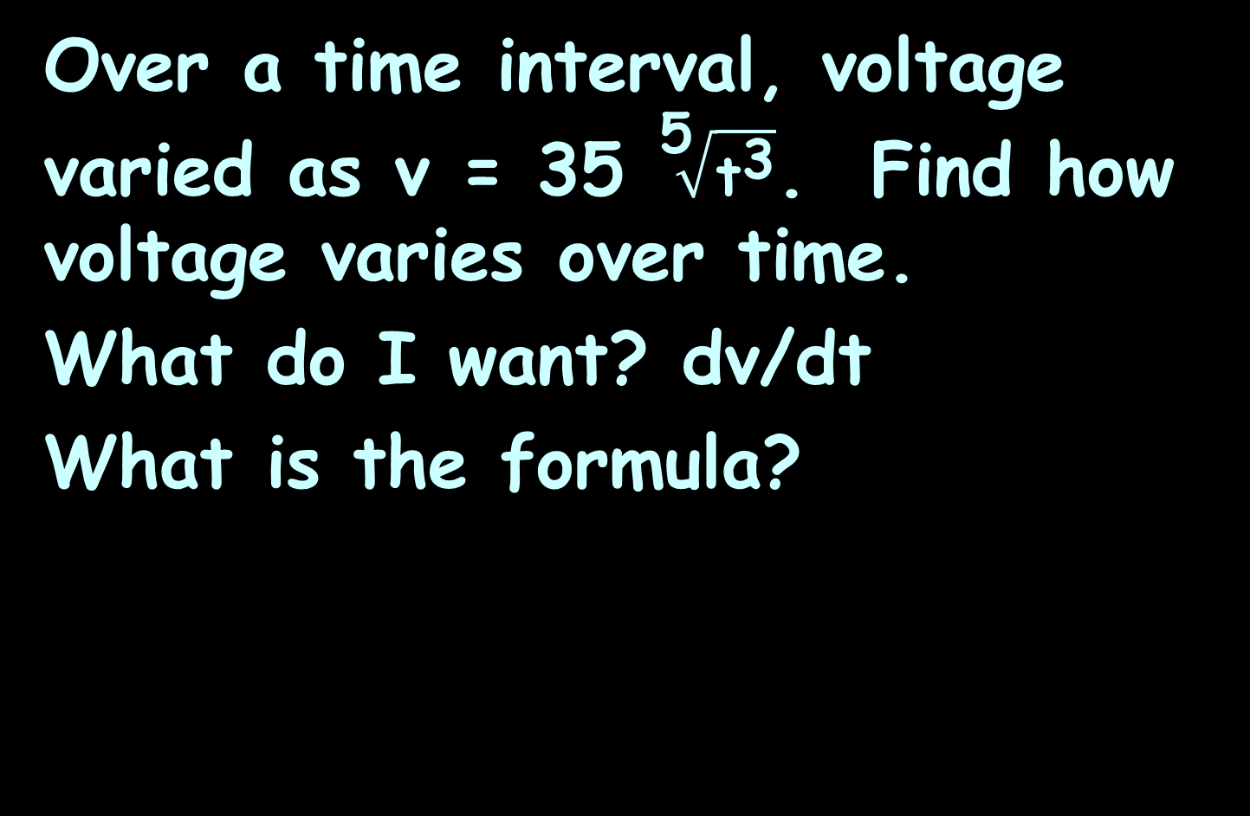
ELECTRONICS APPLICATIONS
IN-CLASS PROBLEM 10
Over a time interval, voltage varied as v = 35 $\sqrt[\text{5}]{{\text{t}}^{\text{3}}}$. Find how voltage varies over time.
What do I want? dv/dt
What is the formula?

Slide 78
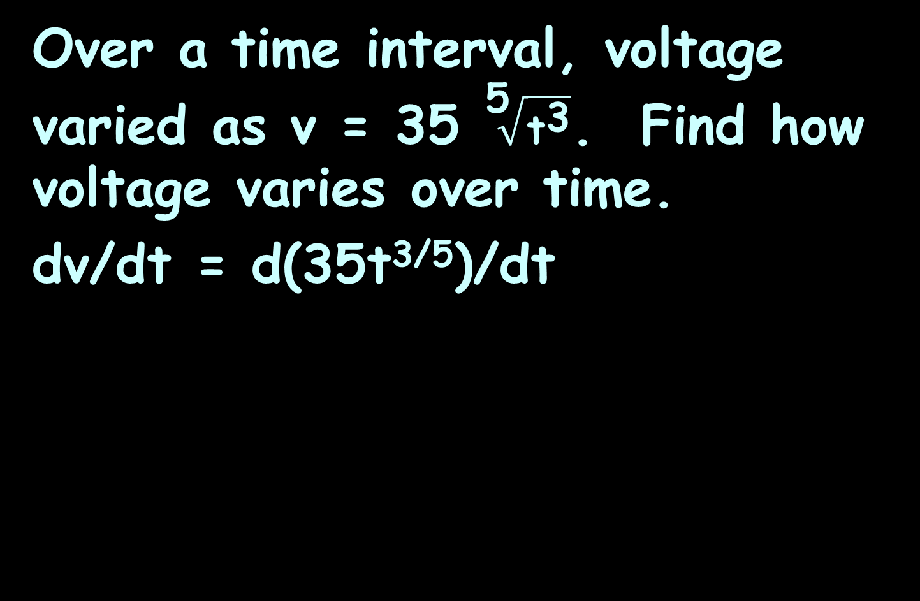
ELECTRONICS APPLICATIONS
IN-CLASS PROBLEM 10
Over a time interval, voltage varied as v = 35 $\sqrt[\text{5}]{{\text{t}}^{\text{3}}}$. Find how voltage varies over time.
dv/dt = d(35t^{3/5})/dt

Slide 79
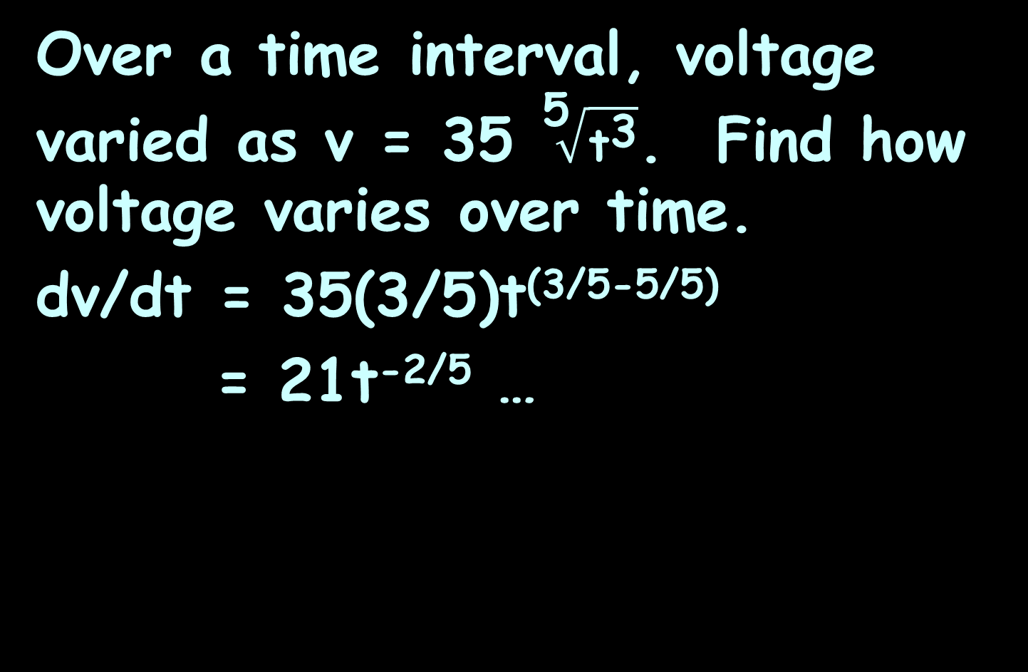
ELECTRONICS APPLICATIONS
IN-CLASS PROBLEM 10
Over a time interval, voltage varied as v = 35 $\sqrt[\text{5}]{{\text{t}}^{\text{3}}}$. Find how voltage varies over time.
dv/dt = 35(3/5)t^{(3/5-5/5)}
= 21t^{-2/5} …

Slide 80
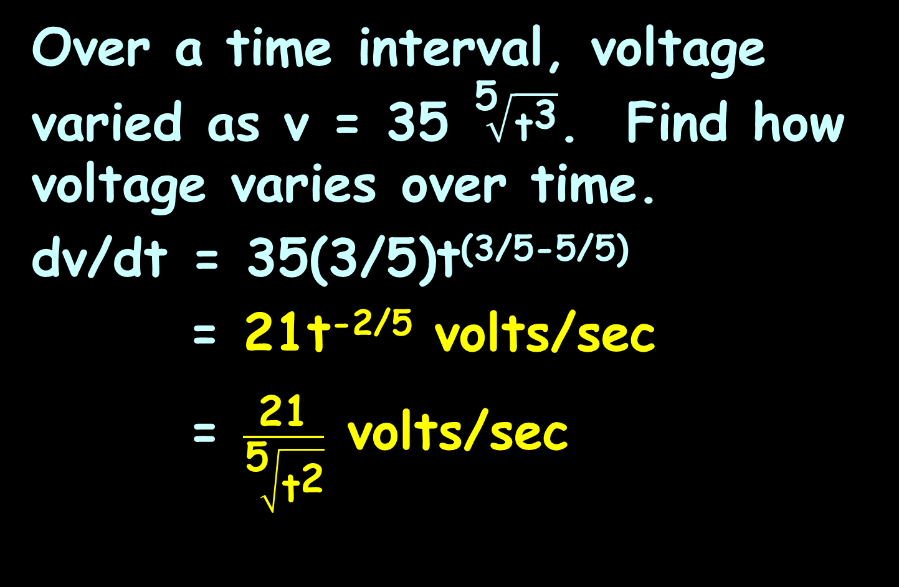
ELECTRONICS APPLICATIONS
IN-CLASS PROBLEM 10
Over a time interval, voltage varied as v = 35 $\sqrt[\text{5}]{{\text{t}}^{\text{3}}}$. Find how voltage varies over time.
dv/dt = 35(3/5)t^{(3/5-5/5)}
= 21t^{-2/5} volts/sec
= $\frac{\text{21}}{\sqrt[\text{5}]{{\text{t}}^{\text{2}}}}$ volts/sec
Rule 2

Slide 81
ELECTRONICS APPLICATIONS
IN-CLASS PROBLEM 11
The voltage produced by a thermocouple is modelled by:
V = 0.35 + 2.6T + 4T² millivolts
when T is measured in °C
Find the rate of change for voltage versus temperature when T=22°C
What’s the derivative?
A thermocouple produces a temperature-dependent voltage

Slide 82
ELECTRONICS APPLICATIONS
IN-CLASS PROBLEM 11
The voltage produced by a thermocouple is modelled by:
V = 0.35 + 2.6T + 4T² millivolts
when T is measured in °C
Find the instantaneous rate of change for voltage when T=22°C
What’s the derivative?
dV/dT =

Slide 83
ELECTRONICS APPLICATIONS
IN-CLASS PROBLEM 11
The voltage produced by a thermocouple is modelled by:
V = 0.35 + 2.6T + 4T² millivolts
when T is measured in °C
Find the instantaneous rate of change for voltage when T=22°C
dV/dT = 2.6 + 8T
Are we done?

Slide 84
ELECTRONICS APPLICATIONS
IN-CLASS PROBLEM 11
The voltage produced by a thermocouple is modelled by:
V = 0.35 + 2.6T + 4T² millivolts
when T is measured in °C
Find the instantaneous rate of change for voltage when T=22°C
dV/dT = 2.6 + 8T
dV/dT(@T=22) = 178.6 …

Slide 85
ELECTRONICS APPLICATIONS
IN-CLASS PROBLEM 11
The voltage produced by a thermocouple is modelled by:
V = 0.35 + 2.6T + 4T² millivolts
when T is measured in °C
Find the instantaneous rate of change for voltage when T=22°C
dV/dT = 2.6 + 8T
dV/dT(@T=22) = 178.6 mv/°C
Rule 3

Slide 86
Questions?
http://i.imgur.com/aliTlT3.jpg

Slide 87
The secret word for this unit is:
PURPLE

Slide 88
Implicit Differentiation
A special case of the chain rule

Slide 89
Implicit Differentiation
Many functions are written explicitly as a function of x:
y = sin(13x-2)
y = 3x² – 7x + 5
y = e^{x}

Slide 90
Implicit Differentiation
Some functions are written implicitly as a function of x:
x² + y = 25
xy = 41.9

Slide 91
Implicit Differentiation
By the way … these don’t have to be functions at all!
x² + y² = 25

Slide 92
Implicit Differentiation
Suppose you had the problem:
Find the derivative dy/dx for:
x² + y² = 25

Slide 93
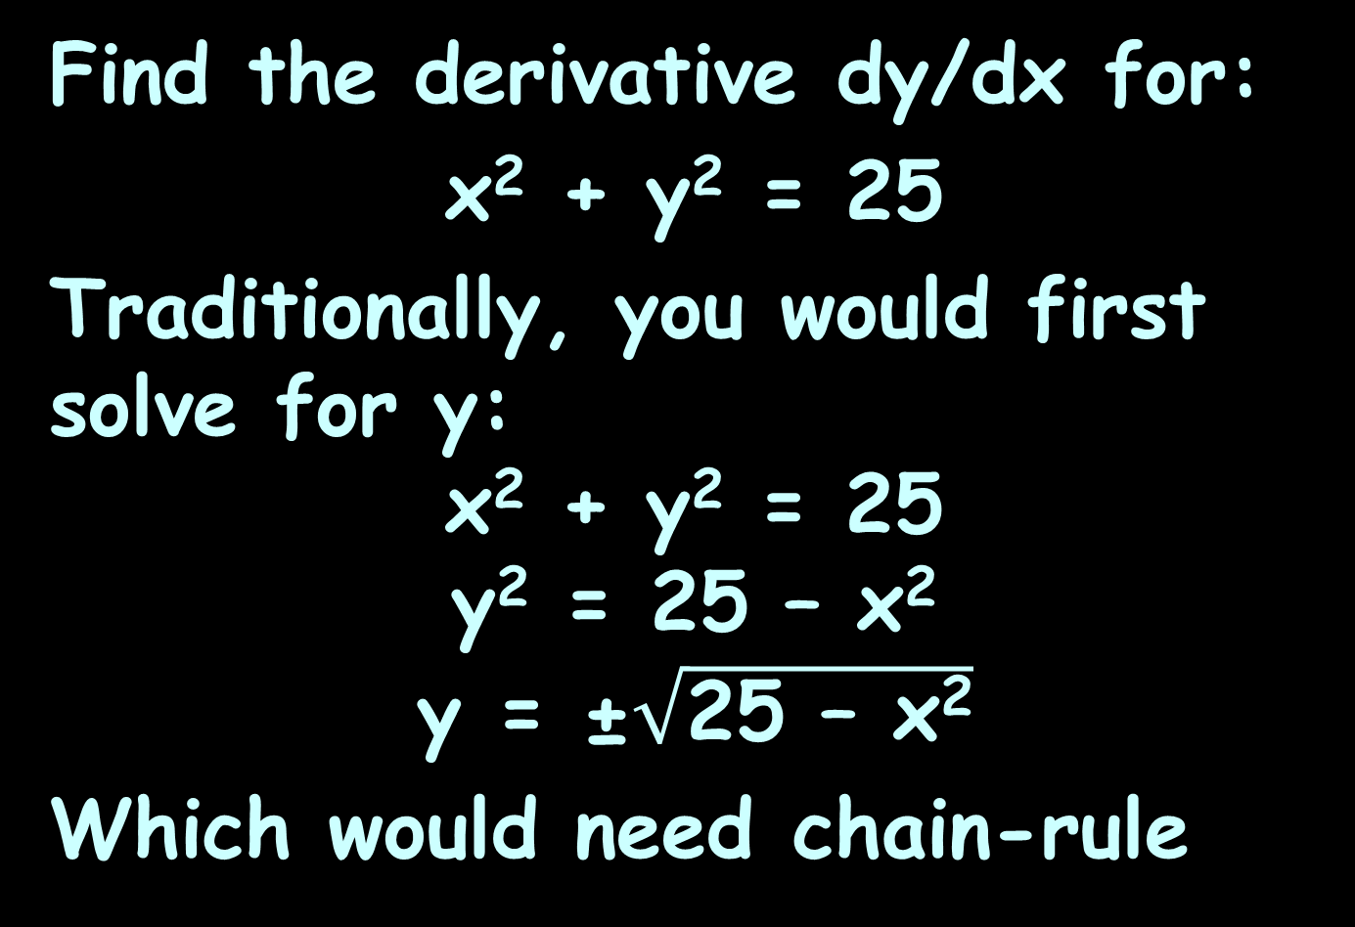
Implicit Differentiation
Find the derivative dy/dx for:
x² + y² = 25
Traditionally, you would first solve for y:
x² + y² = 25
y² = 25 – x²
y = ±$\sqrt{\text{25 – }\text{x}\text{2}}$
Which would need chain-rule

Slide 94
Good News!
You don’t have to solve for “y” to do the differentiation!

Slide 95
Good News!
You don’t have to solve for “y” to do the differentiation!
Just do the derivatives of everything “in place”

Slide 96
Implicit Differentiation
This is especially good news since some formulas are really, really hard to solve for “y”

Slide 97
IMPLICIT DIFFERENTIATION
IN-CLASS PROBLEM 12
Find dy/dx for: x² + y² = 25

Slide 98
IMPLICIT DIFFERENTIATION
IN-CLASS PROBLEM 12
Find dy/dx for: x² + y² = 25
First put in some “d”s:
d(x² + y²)/dx = d(25)/dx

Slide 99
IMPLICIT DIFFERENTIATION
IN-CLASS PROBLEM 12
Find dy/dx for: x² + y² = 25
First put in some “d”s:
d(x² + y²)/dx = d(25)/dx
This can be rewritten (using Rule 3):
d(x²)/dx + d(y²)/dx = d(25)/dx

Slide 100
IMPLICIT DIFFERENTIATION
IN-CLASS PROBLEM 12
Find dy/dx for: x² + y² = 25
First put in some “d”s:
d(x² + y²)/dx = d(25)/dx
Now just take the derivative of each term:
d(x²)/dx + d(y²)/dx = d(25)/dx

Slide 101
IMPLICIT DIFFERENTIATION
IN-CLASS PROBLEM 12
Find dy/dx for: x² + y² = 25
First put in some “d”s:
d(x² + y²)/dx = d(25)/dx
Now just take the derivative of each term:
d(x²)/dx + d(y²)/dx = d(25)/dx
This one is easy: 2x dx/dx

Slide 102
IMPLICIT DIFFERENTIATION
IN-CLASS PROBLEM 12
Find dy/dx for: x² + y² = 25
First put in some “d”s:
d(x² + y²)/dx = d(25)/dx
Now just take the derivative of each term:
d(x²)/dx + d(y²)/dx = d(25)/dx
2x dx/dx but dx/dx = 1 so:

Slide 103
IMPLICIT DIFFERENTIATION
IN-CLASS PROBLEM 12
Find dy/dx for: x² + y² = 25
First put in some “d”s:
d(x² + y²)/dx = d(25)/dx
Now just take the derivative of each term:
d(x²)/dx + d(y²)/dx = d(25)/dx
2x

Slide 104
IMPLICIT DIFFERENTIATION
IN-CLASS PROBLEM 12
Find dy/dx for: x² + y² = 25
First put in some “d”s:
d(x² + y²)/dx = d(25)/dx
Now just take the derivative of each term:
d(x²)/dx + d(y²)/dx = d(25)/dx
2x also easy:
0 dc/dx

Slide 105
IMPLICIT DIFFERENTIATION
IN-CLASS PROBLEM 12
Find dy/dx for: x² + y² = 25
First put in some “d”s:
d(x² + y²)/dx = d(25)/dx
Now just take the derivative of each term:
d(x²)/dx + d(y²)/dx = d(25)/dx
2x also easy:
0 dc/dx
0

Slide 106
IMPLICIT DIFFERENTIATION
IN-CLASS PROBLEM 12
Find dy/dx for: x² + y² = 25
First put in some “d”s:
d(x² + y²)/dx = d(25)/dx
Now just take the derivative of each term:
d(x²)/dx + d(y²)/dx = d(25)/dx
2x also easy:
0 x 0

Slide 107
IMPLICIT DIFFERENTIATION
IN-CLASS PROBLEM 12
Find dy/dx for: x² + y² = 25
First put in some “d”s:
d(x² + y²)/dx = d(25)/dx
Now just take the derivative of each term:
d(x²)/dx + d(y²)/dx = d(25)/dx
2x 0

Slide 108
IMPLICIT DIFFERENTIATION
IN-CLASS PROBLEM 12
Find dy/dx for: x² + y² = 25
First put in some “d”s:
d(x² + y²)/dx = d(25)/dx
Now just take the derivative of each term:
d(x²)/dx + d(y²)/dx = d(25)/dx
2x chain rule 0

Slide 109
IMPLICIT DIFFERENTIATION
IN-CLASS PROBLEM 12
Find dy/dx for: x² + y² = 25
First put in some “d”s:
d(x² + y²)/dx = d(25)/dx
Now just take the derivative of each term:
d(x²)/dx + d(y²)/dx = d(25)/dx
2x 2y dy/dx 0

Slide 110
IMPLICIT DIFFERENTIATION
IN-CLASS PROBLEM 12
Find dy/dx for: x² + y² = 25
First put in some “d”s:
d(x² + y²)/dx = d(25)/dx
Now just take the derivative of each term:
d(x²)/dx + d(y²)/dx = d(25)/dx
2x + 2y dy/dx = 0

Slide 111
IMPLICIT DIFFERENTIATION
IN-CLASS PROBLEM 12
2x + 2y dy/dx = 0
Now for some algebra…
Solve for dy/dx (the thing we’re looking for , remember?:
2x + 2y dy/dx = 0

Slide 112
IMPLICIT DIFFERENTIATION
IN-CLASS PROBLEM 12
Solve for dy/dx:
2x + 2y dy/dx = 0
2x + 2y dy/dx -2x = 0 -2x
2y dy/dx = -2x

Slide 113
IMPLICIT DIFFERENTIATION
IN-CLASS PROBLEM 12
Solve for dy/dx:
2x + 2y dy/dx = 0
2y dy/dx = -2x
2y dy/dx /2y = -2x /2y
dy/dx = -2x/2y

Slide 114
IMPLICIT DIFFERENTIATION
IN-CLASS PROBLEM 12
Solve for dy/dx:
2x + 2y dy/dx = 0
2y dy/dx = -2x
dy/dx = -2x/2y
dy/dx = -x/y
Since we wanted to find the derivative of y… which is dy/dx, we’re done!

Slide 115
Questions?
http://i.imgur.com/aliTlT3.jpg

Slide 116
IMPLICIT DIFFERENTIATION
IN-CLASS PROBLEMS 13
Solve for dy/dx:
61y = x
y¹⁵ = x
xy = 42

Slide 117
IMPLICIT DIFFERENTIATION
IN-CLASS PROBLEMS 13
Solve for dy/dx:
61y = x
61 dy/dx = 1 dx/dx = 1
y¹⁵ = x
xy = 42

Slide 118
IMPLICIT DIFFERENTIATION
IN-CLASS PROBLEMS 13
Solve for dy/dx:
61y = x
61 dy/dx = 1 dx/dx = 1
dy/dx = 1/61
y¹⁵ = x
xy = 42

Slide 119
IMPLICIT DIFFERENTIATION
IN-CLASS PROBLEMS 13
Solve for dy/dx:
61y = x dy/dx = 1/61
y¹⁵ = x
xy = 42

Slide 120
IMPLICIT DIFFERENTIATION
IN-CLASS PROBLEMS 13
Solve for dy/dx:
61y = x dy/dx = 1/61
y¹⁵ = x
(15y¹⁴) dy/dx = 1 dx/dx = 1
xy = 42

Slide 121
IMPLICIT DIFFERENTIATION
IN-CLASS PROBLEMS 13
Solve for dy/dx:
61y = x dy/dx = 1/61
y¹⁵ = x
15y¹⁴dy/dx = 1
dy/dx = 1/15y¹⁴
xy = 42

Slide 122
IMPLICIT DIFFERENTIATION
IN-CLASS PROBLEMS 13
Solve for dy/dx:
61y = x dy/dx = 1/61
y¹⁵ = 12x dy/dx = 12/15y¹⁴
xy = 42

Slide 123
IMPLICIT DIFFERENTIATION
IN-CLASS PROBLEMS 13
Solve for dy/dx:
61y = x
dy/dx = 1/61
y¹⁵ = 12x
dy/dx = 12/15y¹⁴ = 4/5y¹⁴
xy = 42
x × y = 42
x × dy/dx + y × dx/dx = 0
u
v
u
dv
v
du
Product Rule

Slide 124
IMPLICIT DIFFERENTIATION
IN-CLASS PROBLEMS 13
Solve for dy/dx:
61y = x dy/dx = 1/61
y¹⁵ = 12x dy/dx = 12/15y¹⁴ = 4/5y¹⁴
xy = 42
x × dy/dx + y(dx/dx) = 0
x × dy/dx = -y
dy/dx = -y/x
1

Slide 125
Questions?
http://i.imgur.com/aliTlT3.jpg

Slide 126
Implicit Differentiation
Do you get the same answers for implicit differentiation as you do for explicit differentiation?

Slide 127
Implicit Differentiation
Yes!
(sort of…)

Slide 128
Implicit Differentiation
xy = 42
can be solved explicitly as:
y = 42/x = 42x⁻¹

Slide 129
Implicit Differentiation
xy = 42
can be solved explicitly as:
y = 42/x = 42x⁻¹
The derivative dy/dx would be:

Slide 130
Implicit Differentiation
xy = 42
can be solved explicitly as:
y = 42/x = 42x⁻¹
The derivative dy/dx would be:
dy/dx = -42x⁻²

Slide 131
Implicit Differentiation
xy = 42
can be solved explicitly as:
y = 42/x = 42x⁻¹
dy/dx = -42x⁻²
But when we did implicit differentiation, we got:
dy/dx = -y/x

Slide 132

Implicit Differentiation
y = 42/x = 42x⁻¹
dy/dx = -42x⁻²
xy = 42
dy/dx = -y/x
Hmm… they don’t
LOOK the same?!
http://www.testically.org/wp-content/uploads/2010/11/hmm.jpg

Slide 133
Implicit Differentiation
y = 42/x = 42x⁻¹ dy/dx = -42x⁻²
xy = 42 dy/dx = -y/x
But, let’s test it to be sure:
If y = 42/x, plug that into:
dy/dx = -y/x = -(42/x)/x
= -42/x² = -42x⁻²
So -y/x DOES = -42x⁻² (even though it doesn’t look like it!)

Slide 134
Implicit Differentiation
So, you DO get the same answers for implicit differentiation as you do for explicit differentiation, but it will probably LOOK quite different!

Slide 135
Questions?
http://i.imgur.com/aliTlT3.jpg

Slide 136
Implicit Differentiation
For more complex formulas, just keep going!

Slide 137
IMPLICIT DIFFERENTIATION
IN-CLASS PROBLEM 14
Find dy/dx for 2x – 3y = y²

Slide 138
IMPLICIT DIFFERENTIATION
IN-CLASS PROBLEM 14
Find dy/dx for 2x – 3y = y²
Take the derivatives in place:
2x –3y = y²
?

Slide 139
IMPLICIT DIFFERENTIATION
IN-CLASS PROBLEM 14
Find dy/dx for 2x – 3y = y²
Take the derivatives in place:
2x –3y = y²
2dx/dx ?

Slide 140
IMPLICIT DIFFERENTIATION
IN-CLASS PROBLEM 14
Find dy/dx for 2x – 3y = y²
Take the derivatives in place:
2x –3y = y²
2 -3 dy/dx ?

Slide 141
IMPLICIT DIFFERENTIATION
IN-CLASS PROBLEM 14
Find dy/dx for 2x – 3y = y²
Take the derivatives in place:
2x –3y = y²
2 -3 dy/dx = 2y dy/dx

Slide 142
IMPLICIT DIFFERENTIATION
IN-CLASS PROBLEM 14
Algebra time… solve for dy/dx:
2 – 3 dy/dx = 2y dy/dx

Slide 143
IMPLICIT DIFFERENTIATION
IN-CLASS PROBLEM 14
Algebra time… solve for dy/dx:
2 – 3 dy/dx = 2y dy/dx
2 = 2y dy/dx + 3 dy/dx

Slide 144
IMPLICIT DIFFERENTIATION
IN-CLASS PROBLEM 14
Algebra time… solve for dy/dx:
2 – 3 dy/dx = 2y dy/dx
2 = 2y dy/dx + 3 dy/dx
2 = dy/dx(2y + 3)

Slide 145
IMPLICIT DIFFERENTIATION
IN-CLASS PROBLEM 14
Algebra time… solve for dy/dx:
2 – 3 dy/dx = 2y dy/dx
2 = 2y dy/dx + 3 dy/dx
2 = dy/dx(2y + 3)
2/(2y + 3) = dy/dx
Remember, we are trying to find dy/dx!

Slide 146
Questions?
http://i.imgur.com/aliTlT3.jpg

Slide 147
Implicit Differentiation
These can be very nasty polynomials!

Slide 148
IMPLICIT DIFFERENTIATION
IN-CLASS PROBLEM 15
Find dy/dx for: x²y² + 3y² = 36

Slide 149
IMPLICIT DIFFERENTIATION
IN-CLASS PROBLEM 15
Find dy/dx for:
x²y² + 3y² = 36
Product
Rule

Slide 150
IMPLICIT DIFFERENTIATION
IN-CLASS PROBLEM 15
Find dy/dx for:
x²y² + 3y² = 36
u=
v=
du=
dv=

Slide 151
IMPLICIT DIFFERENTIATION
IN-CLASS PROBLEM 15
Find dy/dx for:
x²y² + 3y² = 36
u=x²
v=
du=
dv=

Slide 152
IMPLICIT DIFFERENTIATION
IN-CLASS PROBLEM 15
Find dy/dx for:
x²y² + 3y² = 36
u=x²
v=y²
du=
dv=

Slide 153
IMPLICIT DIFFERENTIATION
IN-CLASS PROBLEM 15
Find dy/dx for:
x²y² + 3y² = 36
u=x²
v=y²
du=2x dx/dx
dv=

Slide 154
IMPLICIT DIFFERENTIATION
IN-CLASS PROBLEM 15
Find dy/dx for:
x²y² + 3y² = 36
u=x²
v=y²
du=2x
dv=2y dy/dx
Plug into: u dv + v du

Slide 155
IMPLICIT DIFFERENTIATION
IN-CLASS PROBLEM 15
Find dy/dx for:
x²y² + 3y² = 36
u=x²
v=y²
du=2x
dv=2y dy/dx
u dv + v du
x²(2y dy/dx) + y²(2x)

Slide 156
IMPLICIT DIFFERENTIATION
IN-CLASS PROBLEM 15
Find dy/dx for:
x²y² + 3y² = 36
x²(2y dy/dx)+y²(2x)
~sigh~ we’re not done…

Slide 157
IMPLICIT DIFFERENTIATION
IN-CLASS PROBLEM 15
Find dy/dx for:
x²y² + 3y² = 36
x²(2y dy/dx)+y²(2x) ?

Slide 158
IMPLICIT DIFFERENTIATION
IN-CLASS PROBLEM 15
Find dy/dx for:
x²y² + 3y² = 36
x²(2y dy/dx)+y²(2x) + 6y dydx ?

Slide 159
IMPLICIT DIFFERENTIATION
IN-CLASS PROBLEM 15
Find dy/dx for:
x²y² + 3y² = 36
x²(2y dy/dx)+y²(2x) + 6y dydx = 0
Are we done?

Slide 160
IMPLICIT DIFFERENTIATION
IN-CLASS PROBLEM 15
Find dy/dx for:
x²y² + 3y² = 36
x²(2y dy/dx)+y²(2x) + 6y dydx = 0
Are we done? Of course not…

Slide 161
IMPLICIT DIFFERENTIATION
IN-CLASS PROBLEM 15
Solve for dy/dx:
x²(2y dy/dx) + y²(2x) + 6y dydx = 0

Slide 162
IMPLICIT DIFFERENTIATION
IN-CLASS PROBLEM 15
Solve for dy/dx:
x²(2y dy/dx) + y²(2x) + 6y dydx = 0
dy/dx(2x²y) + 2xy² + dy/dx(6y) = 0

Slide 163
IMPLICIT DIFFERENTIATION
IN-CLASS PROBLEM 15
Solve for dy/dx:
x²(2y dy/dx) + y²(2x) + 6y dydx = 0
dy/dx(2x²y) + 2xy² + dy/dx(6y) = 0
dy/dx(2x²y+6y) + 2xy² = 0

Slide 164
IMPLICIT DIFFERENTIATION
IN-CLASS PROBLEM 15
Solve for dy/dx:
x²(2y dy/dx) + y²(2x) + 6y dydx = 0
dy/dx(2x²y) + 2xy² + dy/dx(6y) = 0
dy/dx(2x²y+6y) + 2xy² = 0
dy/dx(2x²y+6y) = -2xy²

Slide 165
IMPLICIT DIFFERENTIATION
IN-CLASS PROBLEM 15
Solve for dy/dx:
x²(2y dy/dx)+y²(2x) + 6y dydx = 0
dy/dx(2x²y) + 2xy² + dy/dx(6y) = 0
dy/dx(2x²y+6y) + 2xy² = 0
dy/dx(2x²y+6y) = -2xy²
dy/dx = -2xy²/(2x²y+6y)

Slide 166
IMPLICIT DIFFERENTIATION
IN-CLASS PROBLEM 15
Solve for dy/dx:
x²(2y dy/dx)+y²(2x) + 6y dydx = 0
dy/dx(2x²y) + 2xy² + dy/dx(6y) = 0
dy/dx(2x²y+6y) + 2xy² = 0
dy/dx(2x²y+6y) = -2xy²
dy/dx = -2xy²/(2x²y+6y)
dy/dx = -xy/(x²+3)

Slide 167
http://m.demotivation.us/whew-1281259.html

Slide 168
Implicit Differentiation
Note: this is on page 60 of the Larry Oliver book – and he’s got the wrong answer (oops!)

Slide 169
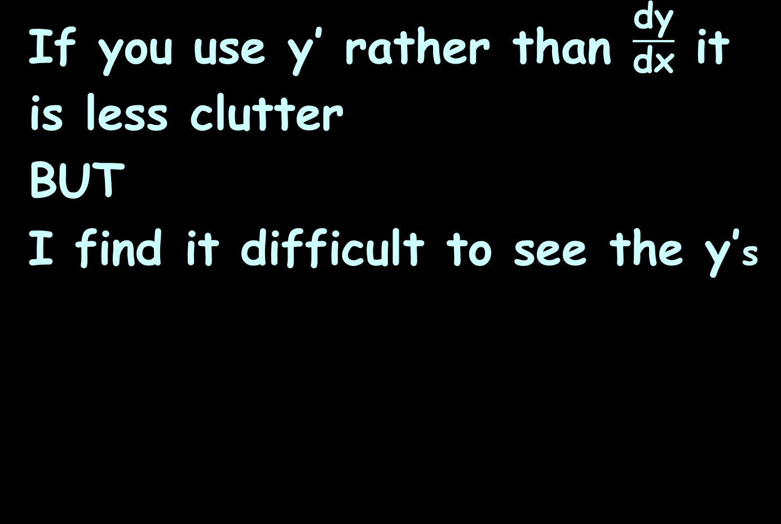
Implicit Differentiation
If you use y’ rather than $\frac{\text{dy}}{\text{dx}}$ it is less clutter
BUT
I find it difficult to see the y’s

Slide 170
Questions?
http://i.imgur.com/aliTlT3.jpg

Slide 171
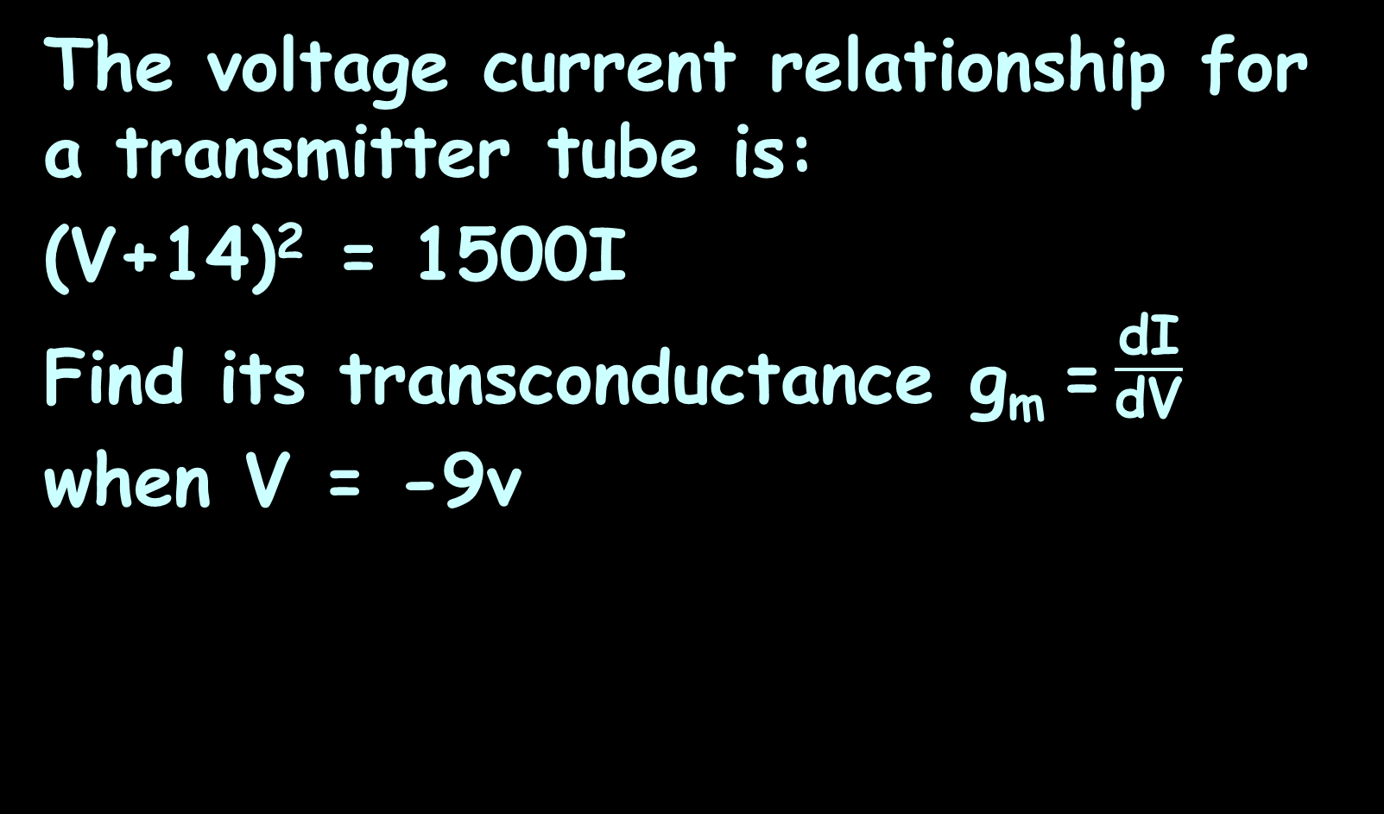
IMPLICIT DIFFERENTIATION
IN-CLASS PROBLEM 16
The voltage current relationship for a transmitter tube is:
(V+14)² = 1500I
Find its transconductance g_{m} = $\frac{\text{d}\text{I}}{\text{d}\text{V}}$ when V = -9v

Slide 172
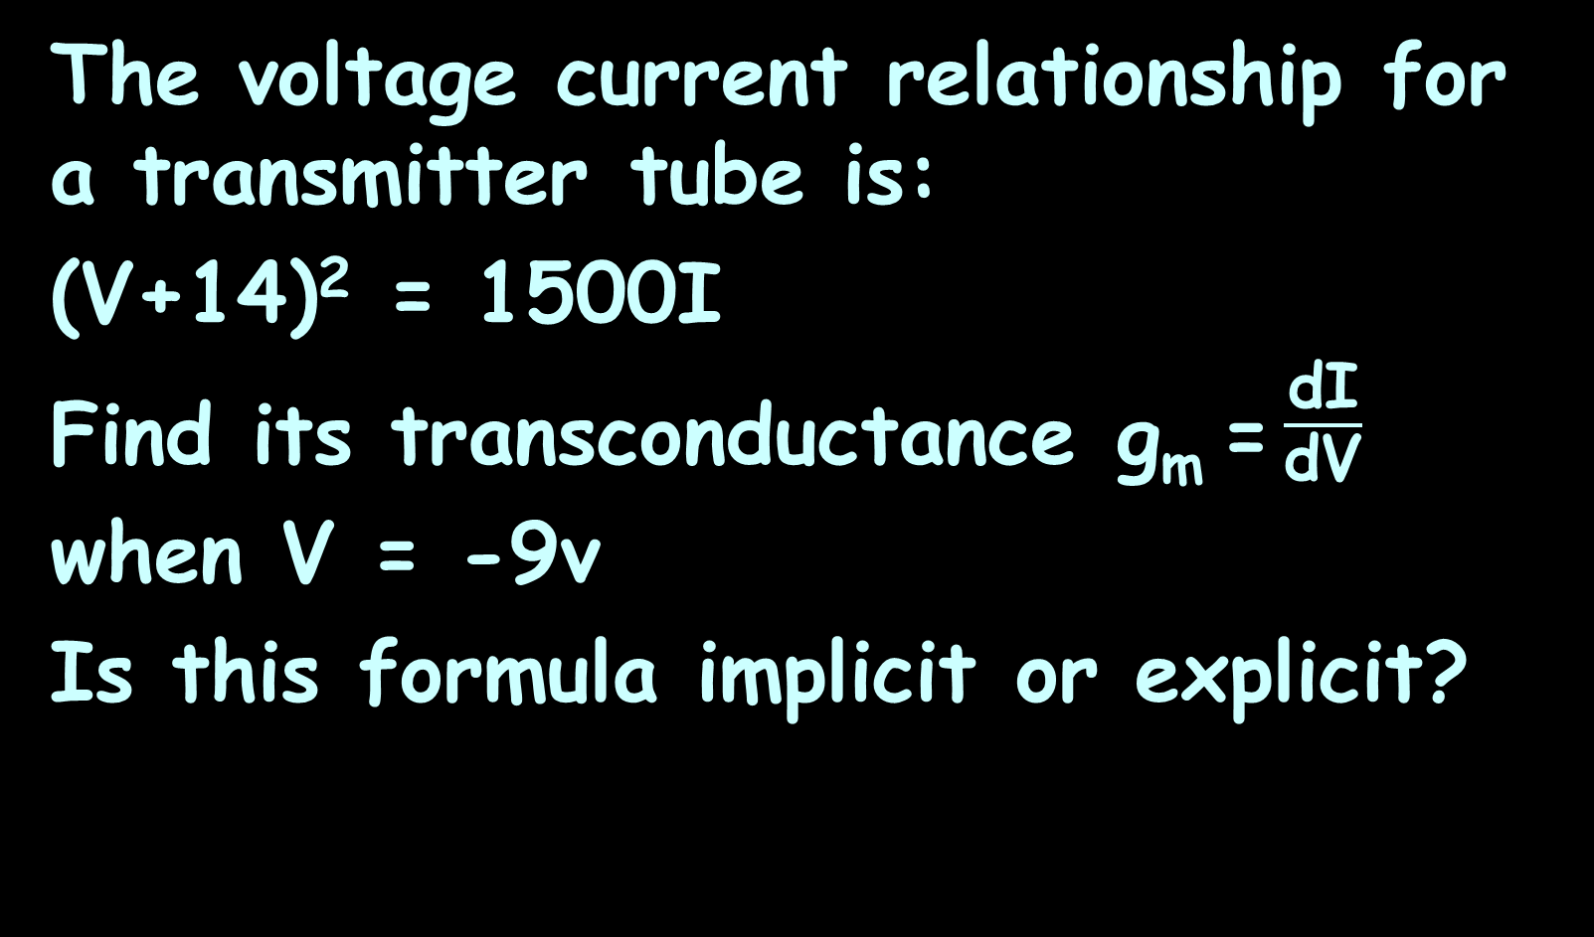
IMPLICIT DIFFERENTIATION
IN-CLASS PROBLEM 16
The voltage current relationship for a transmitter tube is:
(V+14)² = 1500I
Find its transconductance g_{m} = $\frac{\text{d}\text{I}}{\text{d}\text{V}}$ when V = -9v
Is this formula implicit or explicit?

Slide 173
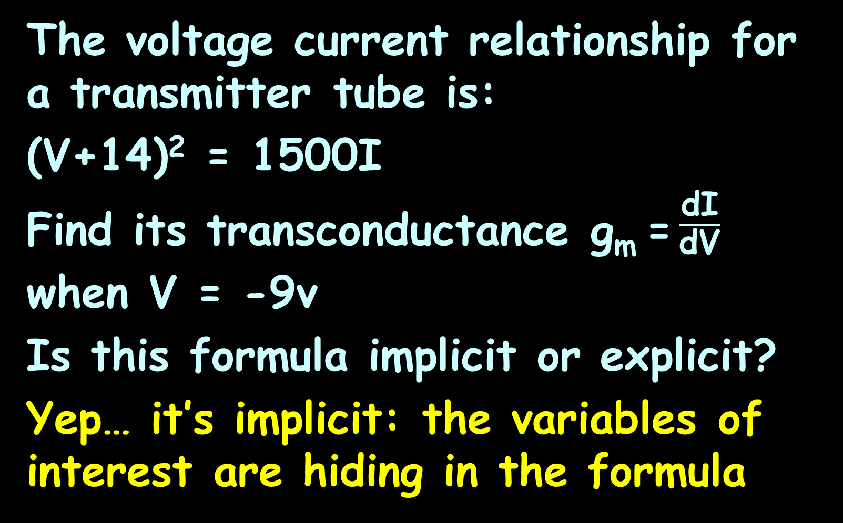
IMPLICIT DIFFERENTIATION
IN-CLASS PROBLEM 16
The voltage current relationship for a transmitter tube is:
(V+14)² = 1500I
Find its transconductance g_{m} = $\frac{\text{d}\text{I}}{\text{d}\text{V}}$ when V = -9v
Is this formula implicit or explicit?
Yep… it’s implicit: the variables of interest are hiding in the formula

Slide 174
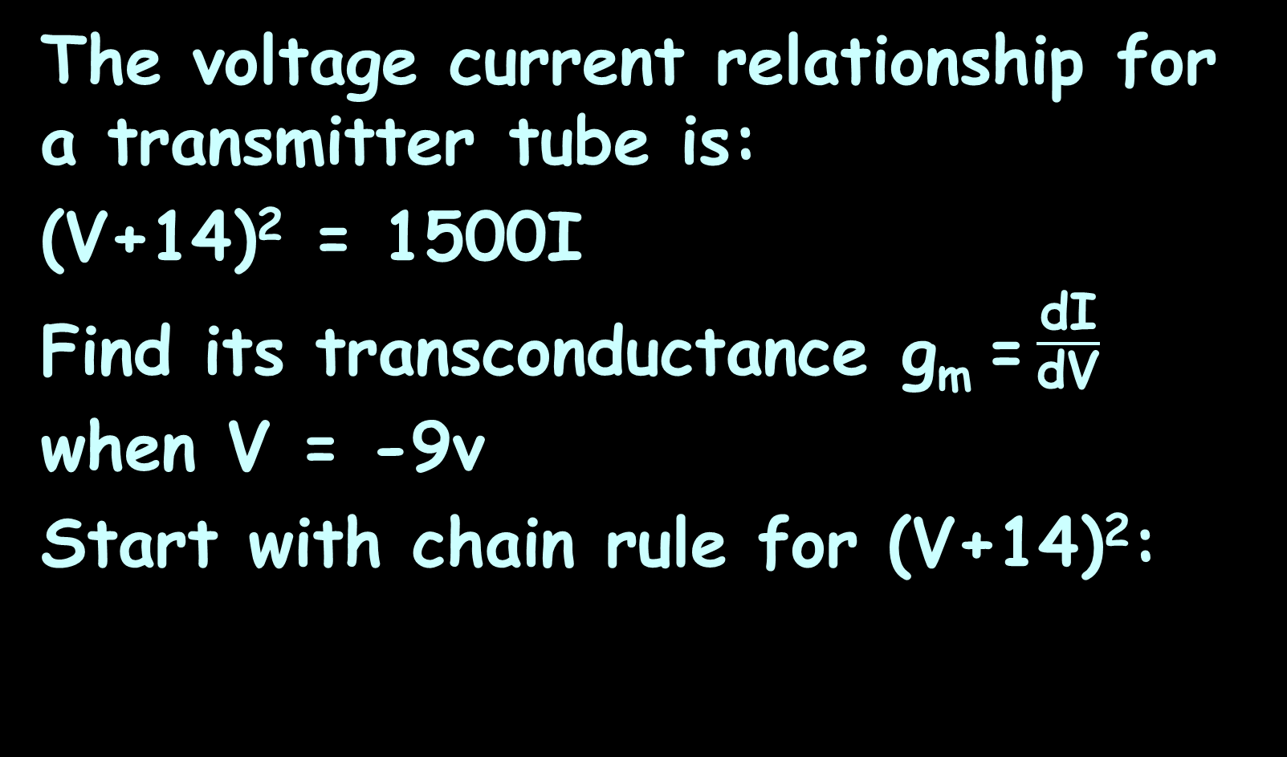
IMPLICIT DIFFERENTIATION
IN-CLASS PROBLEM 16
The voltage current relationship for a transmitter tube is:
(V+14)² = 1500I
Find its transconductance g_{m} = $\frac{\text{d}\text{I}}{\text{d}\text{V}}$ when V = -9v
Start with chain rule for (V+14)²:

Slide 175
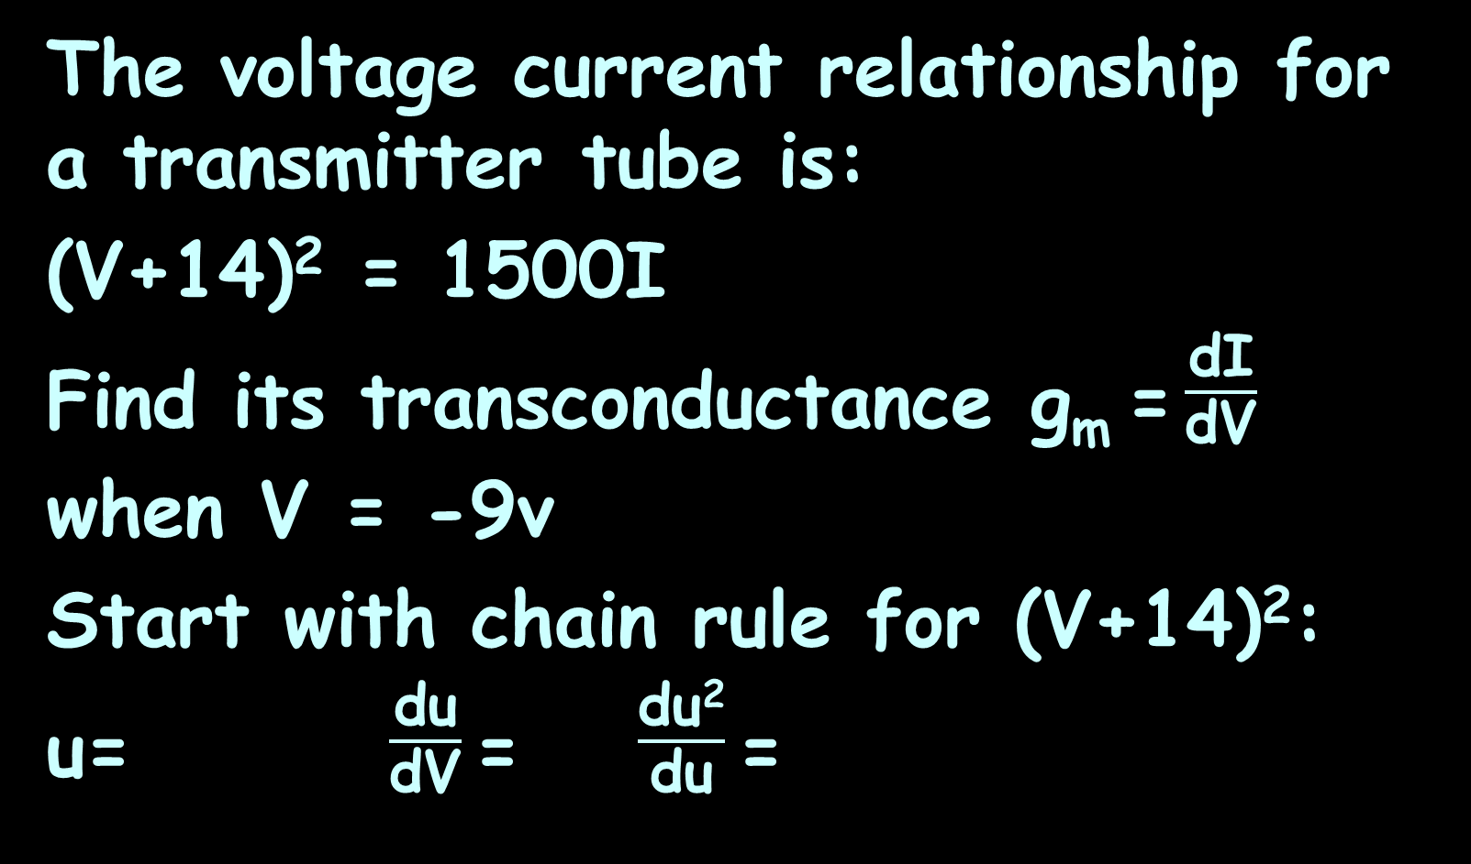
IMPLICIT DIFFERENTIATION
IN-CLASS PROBLEM 16
The voltage current relationship for a transmitter tube is:
(V+14)² = 1500I
Find its transconductance g_{m} = $\frac{\text{d}\text{I}}{\text{d}\text{V}}$ when V = -9v
Start with chain rule for (V+14)²:
u= $\frac{\text{d}\text{u}}{\text{d}\text{V}}$= $\frac{\text{du}\text{2}}{\text{d}\text{u}}$=

Slide 176
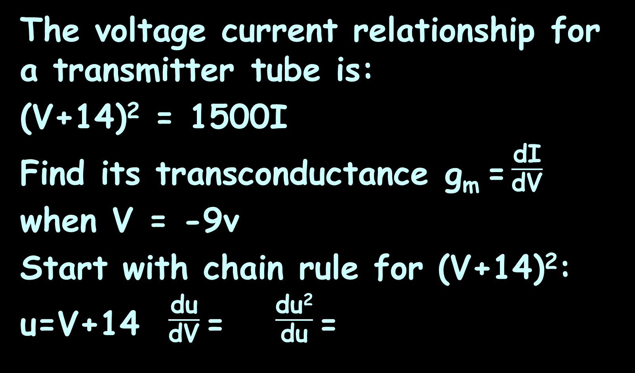
IMPLICIT DIFFERENTIATION
IN-CLASS PROBLEM 16
The voltage current relationship for a transmitter tube is:
(V+14)² = 1500I
Find its transconductance g_{m} = $\frac{\text{d}\text{I}}{\text{d}\text{V}}$ when V = -9v
Start with chain rule for (V+14)²:
u=V+14 $\frac{\text{d}\text{u}}{\text{d}\text{V}}$= $\frac{\text{du}\text{2}}{\text{d}\text{u}}$=

Slide 177
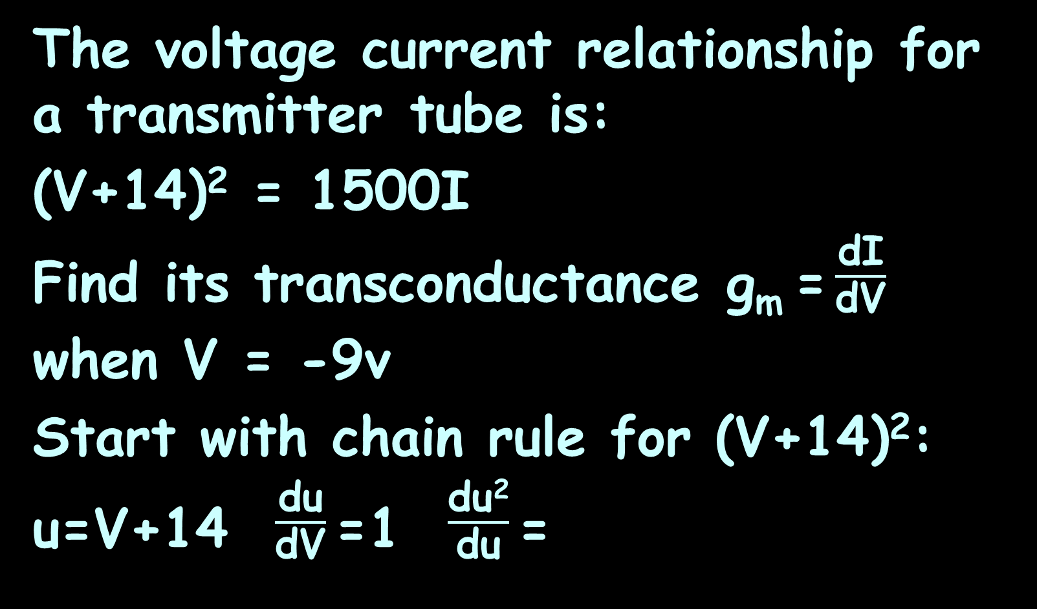
IMPLICIT DIFFERENTIATION
IN-CLASS PROBLEM 16
The voltage current relationship for a transmitter tube is:
(V+14)² = 1500I
Find its transconductance g_{m} = $\frac{\text{d}\text{I}}{\text{d}\text{V}}$ when V = -9v
Start with chain rule for (V+14)²:
u=V+14 $\frac{\text{d}\text{u}}{\text{d}\text{V}}$=1 $\frac{\text{du}\text{2}}{\text{d}\text{u}}$=

Slide 178
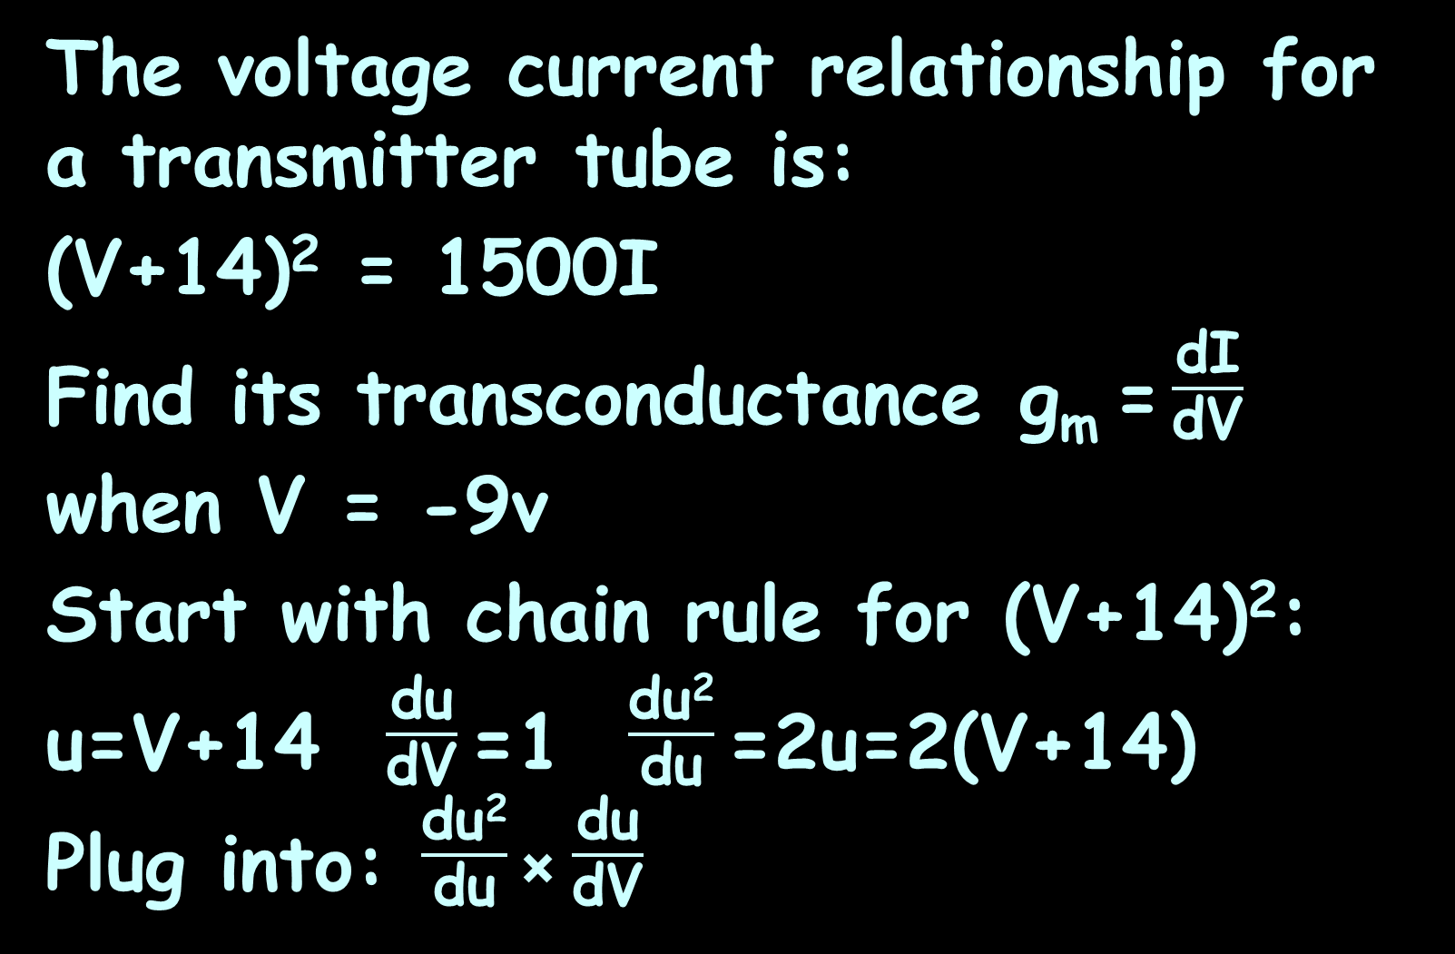
IMPLICIT DIFFERENTIATION
IN-CLASS PROBLEM 16
The voltage current relationship for a transmitter tube is:
(V+14)² = 1500I
Find its transconductance g_{m} = $\frac{\text{d}\text{I}}{\text{d}\text{V}}$ when V = -9v
Start with chain rule for (V+14)²:
u=V+14 $\frac{\text{d}\text{u}}{\text{d}\text{V}}$=1 $\frac{\text{du}\text{2}}{\text{d}\text{u}}$=2u=2(V+14)
Plug into: $\frac{\text{du}\text{2}}{\text{d}\text{u}}$× $\frac{\text{du}}{\text{d}\text{V}}$

Slide 179
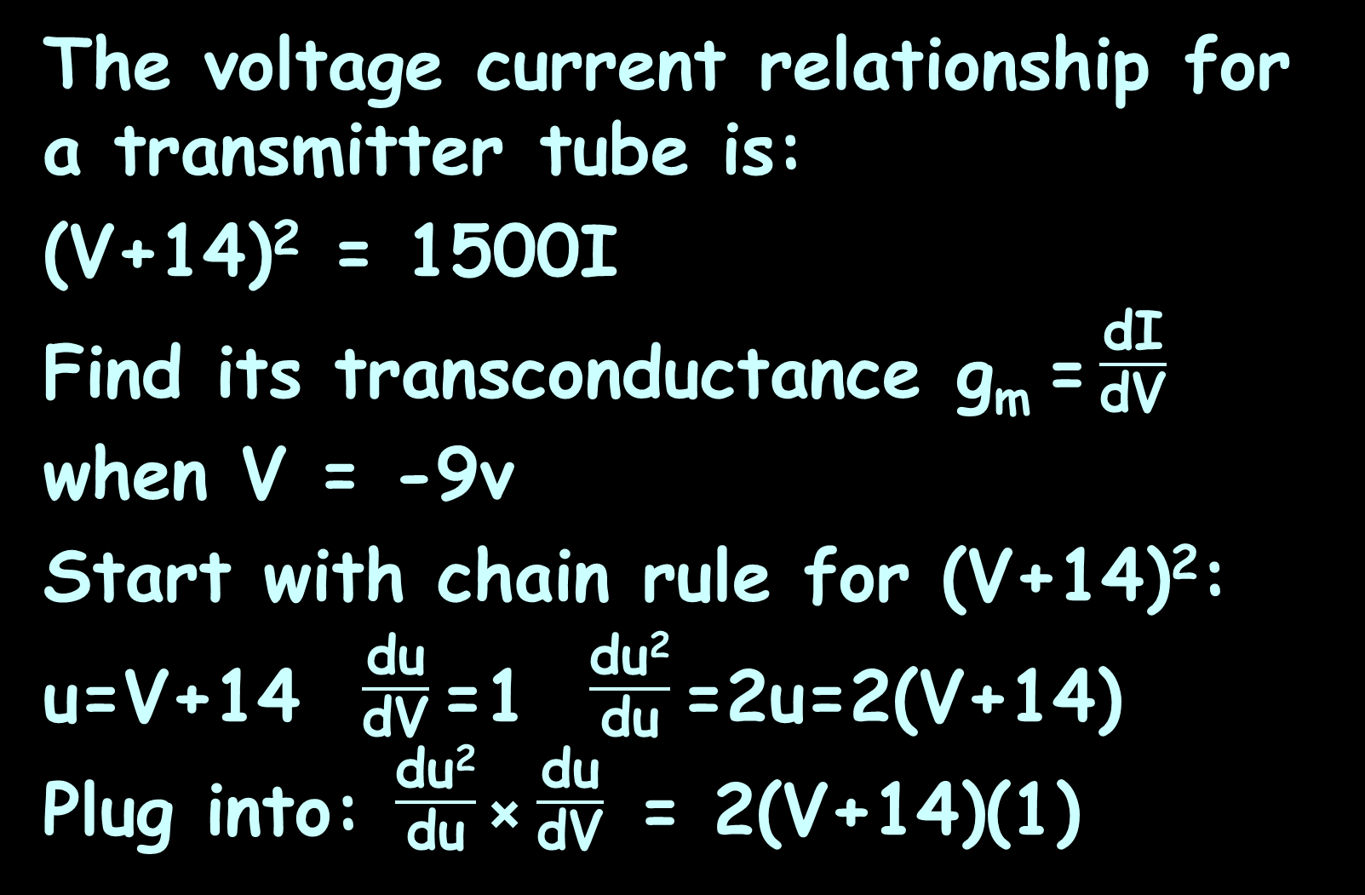
IMPLICIT DIFFERENTIATION
IN-CLASS PROBLEM 16
The voltage current relationship for a transmitter tube is:
(V+14)² = 1500I
Find its transconductance g_{m} = $\frac{\text{d}\text{I}}{\text{d}\text{V}}$ when V = -9v
Start with chain rule for (V+14)²:
u=V+14 $\frac{\text{d}\text{u}}{\text{d}\text{V}}$=1 $\frac{\text{du}\text{2}}{\text{d}\text{u}}$=2u=2(V+14)
Plug into: $\frac{\text{du}\text{2}}{\text{d}\text{u}}$× $\frac{\text{du}}{\text{d}\text{V}}$ = 2(V+14)(1)

Slide 180
IMPLICIT DIFFERENTIATION
IN-CLASS PROBLEM 16
The voltage current relationship for a transmitter tube is:
(V+14)² = 1500I
2(V+14)(1) ?

Slide 181
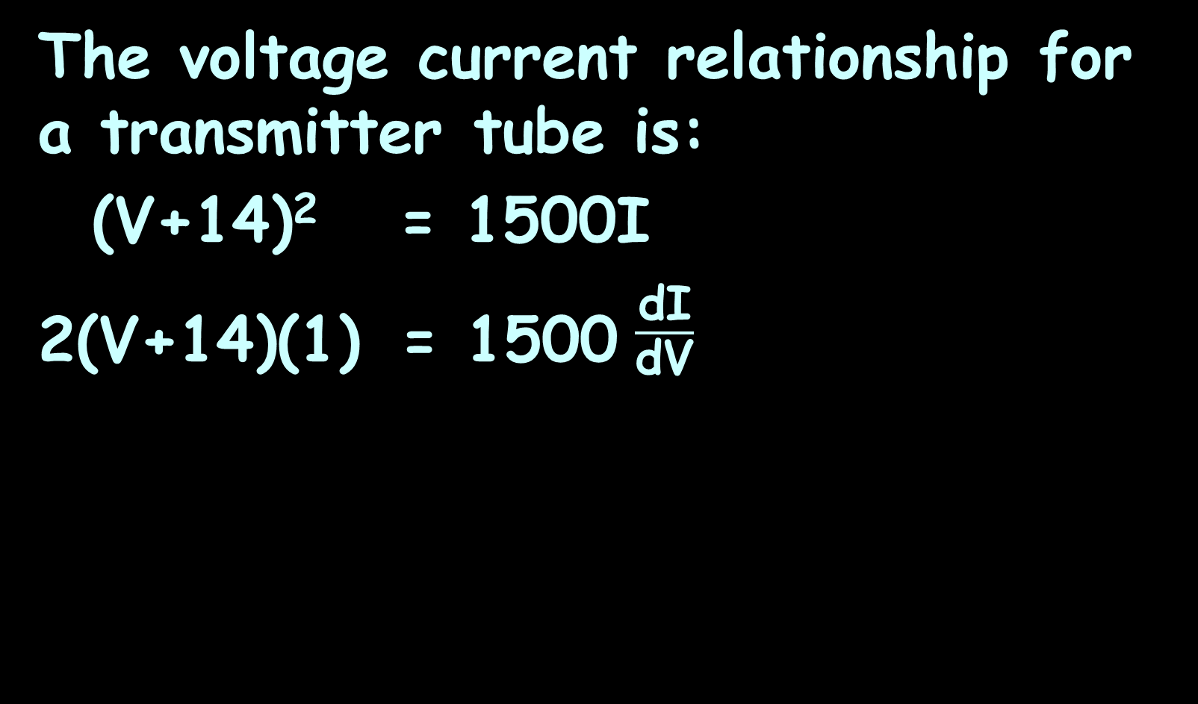
IMPLICIT DIFFERENTIATION
IN-CLASS PROBLEM 16
The voltage current relationship for a transmitter tube is:
(V+14)² = 1500I
2(V+14)(1) = 1500 $\frac{\text{d}\text{I}}{\text{d}\text{V}}$

Slide 182
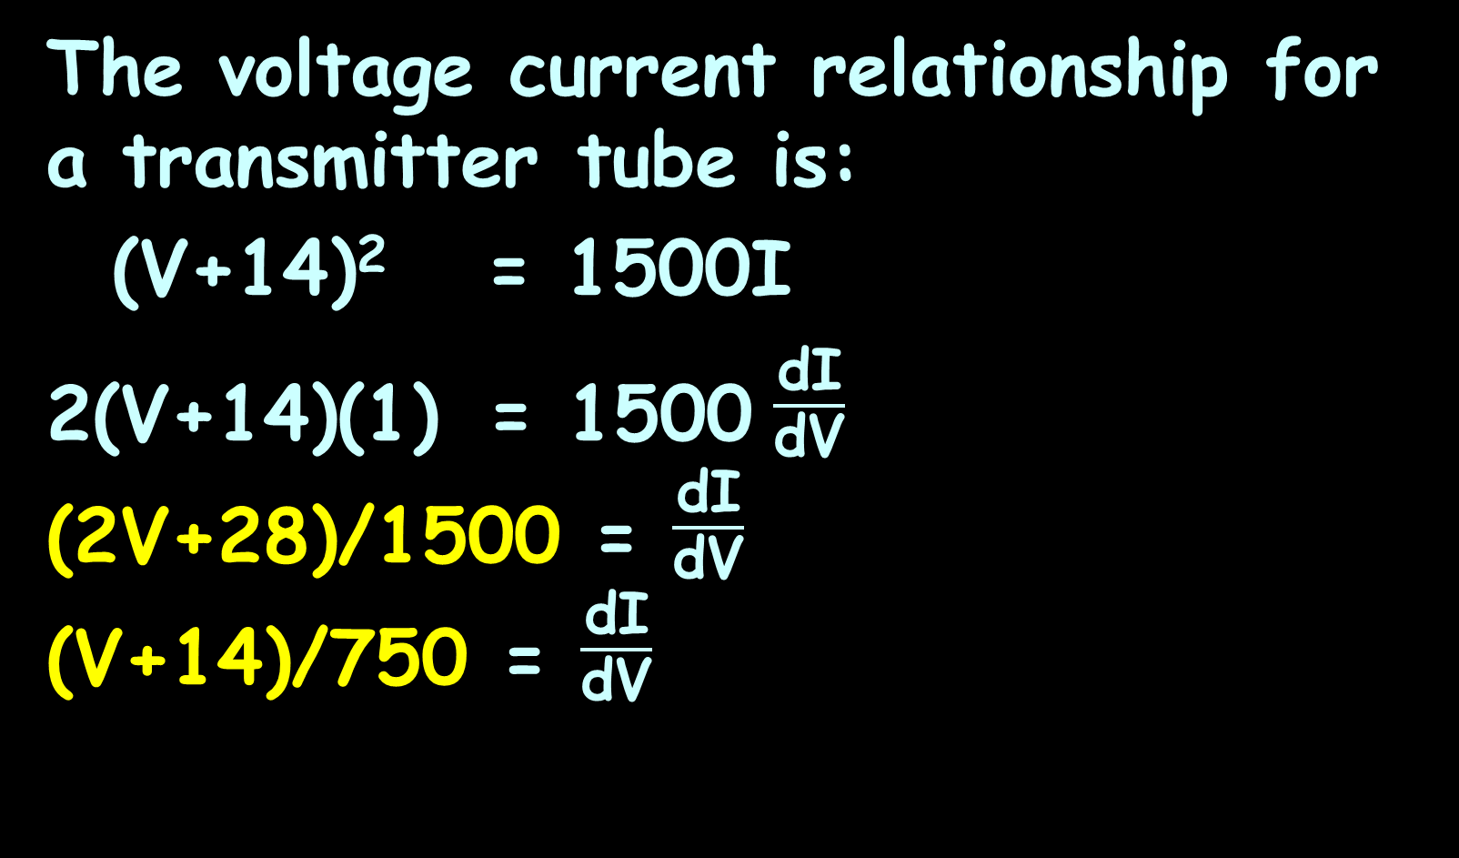
IMPLICIT DIFFERENTIATION
IN-CLASS PROBLEM 16
The voltage current relationship for a transmitter tube is:
(V+14)² = 1500I
2(V+14)(1) = 1500 $\frac{\text{d}\text{I}}{\text{d}\text{V}}$
(2V+28)/1500 = $\frac{\text{d}\text{I}}{\text{d}\text{V}}$
(V+14)/750 = $\frac{\text{d}\text{I}}{\text{d}\text{V}}$

Slide 183
Implicit Differentiation
That one wasn’t actually so hard!
But are we done?

Slide 184
Implicit Differentiation
That one wasn’t actually so hard!
But are we done? Nope…

Slide 185
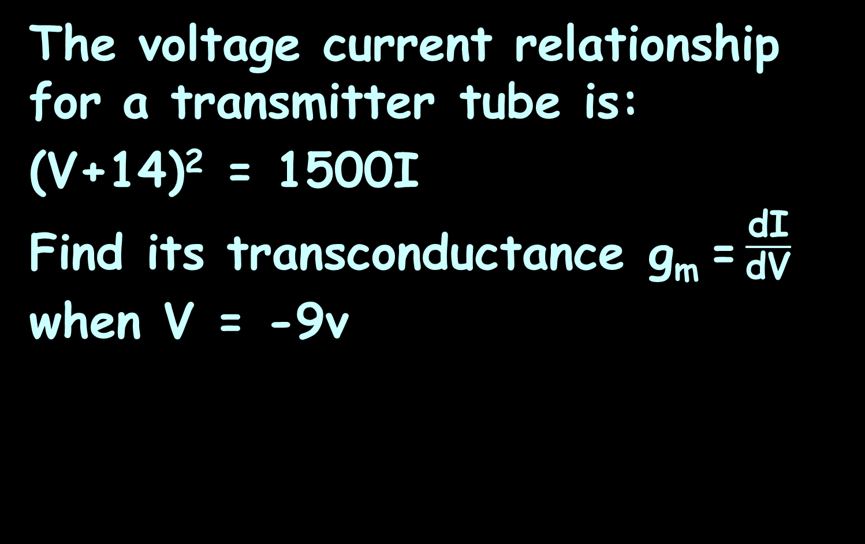
IMPLICIT DIFFERENTIATION
IN-CLASS PROBLEM 16
The voltage current relationship for a transmitter tube is:
(V+14)² = 1500I
Find its transconductance g_{m} = $\frac{\text{d}\text{I}}{\text{d}\text{V}}$ when V = -9v

Slide 186
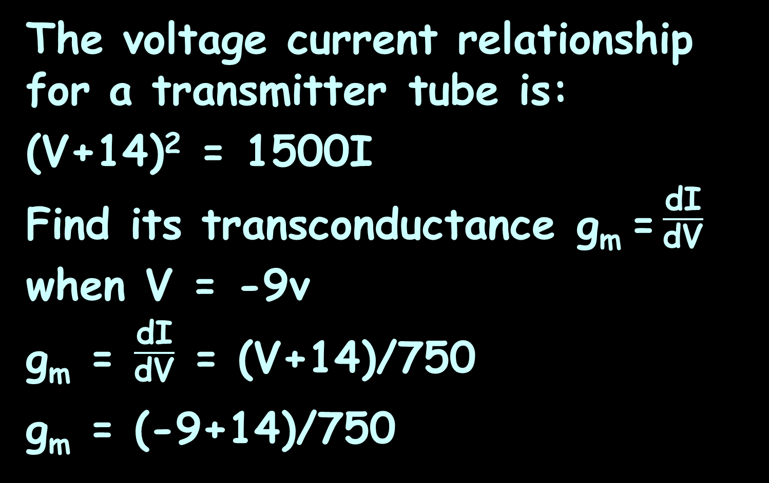
IMPLICIT DIFFERENTIATION
IN-CLASS PROBLEM 16
The voltage current relationship for a transmitter tube is:
(V+14)² = 1500I
Find its transconductance g_{m} = $\frac{\text{d}\text{I}}{\text{d}\text{V}}$ when V = -9v
g_{m} = $\frac{\text{d}\text{I}}{\text{d}\text{V}}$ = (V+14)/750
g_{m} = (-9+14)/750

Slide 187
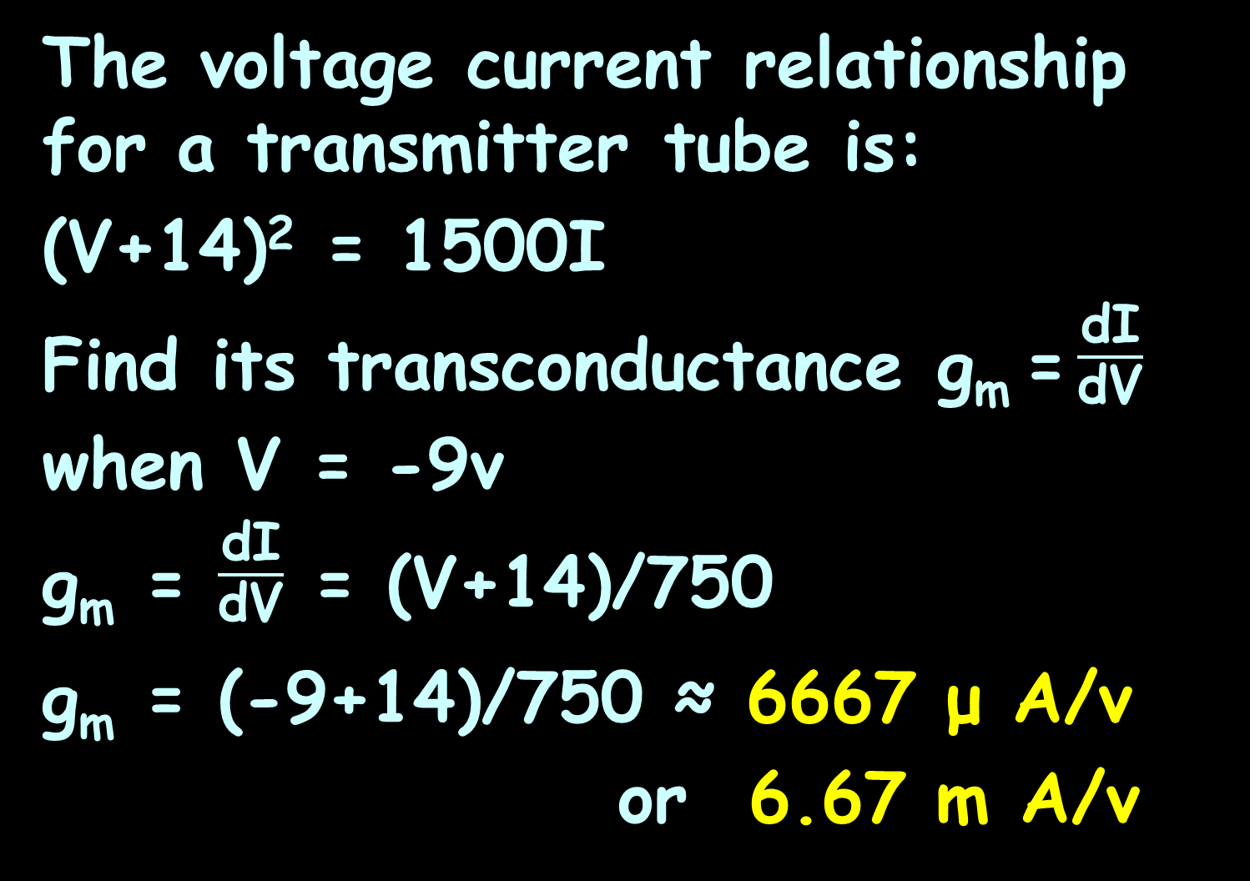
IMPLICIT DIFFERENTIATION
IN-CLASS PROBLEM 16
The voltage current relationship for a transmitter tube is:
(V+14)² = 1500I
Find its transconductance g_{m} = $\frac{\text{d}\text{I}}{\text{d}\text{V}}$ when V = -9v
g_{m} = $\frac{\text{d}\text{I}}{\text{d}\text{V}}$ = (V+14)/750
g_{m} = (-9+14)/750 ≈ 6667 μ A/v
or 6.67 m A/v
named after Ernst Werner von Siemens
siemens (S)

Slide 188
Questions?
http://i.imgur.com/aliTlT3.jpg

Slide 189

You Survived!
Today we covered:
Chain Rule
Implicit Differentiation

