Slide 1

Welcome to
Unit 6 ! .
MATH 205 Differential Calculus
https://www.smu.edu.sg/programmes/core-curriculum/course-structure/calculus

Slide 2
What’s Up?
Outcome 1) Demonstrate differentiation skills for linear, polynomial, rational, trigonometric, exponential, and logarithmic functions and proper application of the Product, Quotient and Chain Rules of differentiation
Outcome 2) Use algebra, limits and derivatives to examine the properties and graphs of functions, including finding their extrema, inflection points, and intervals of monotonicity and concavity
Outcome 3) Apply derivatives to solve optimization and related rates problems.

Slide 3
Extrema
Functions can have "hills and cups": places where they reach a minimum or maximum value

Slide 4
Extrema
At the highest point of the hill is a maximum value
At the lowest point in the cup there is a minimum

Slide 5
Extrema
The plural of maximum
is maxima
The plural of minimum is minima
Maxima and minima are
collectively called extrema

Slide 6
Extrema
The maximum or minimum over the entire function is called an "Absolute" or "Global" maximum or minimum

Slide 7
Extrema
A local maximum is the point where the height of the function is greater than (or equal to) the height anywhere else in that interval
Similar for a local minimum

Slide 8
Extrema
There is only one global maximum (and one global minimum) but there can be more than one local maximum or
minimum

Slide 9
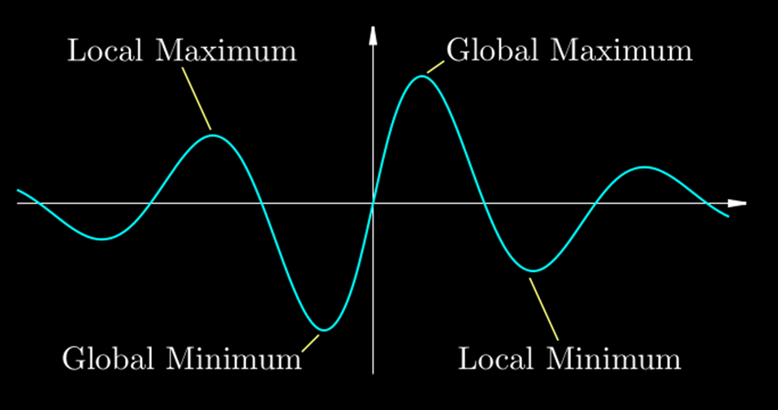
Extrema
VFrench 2013

Slide 10
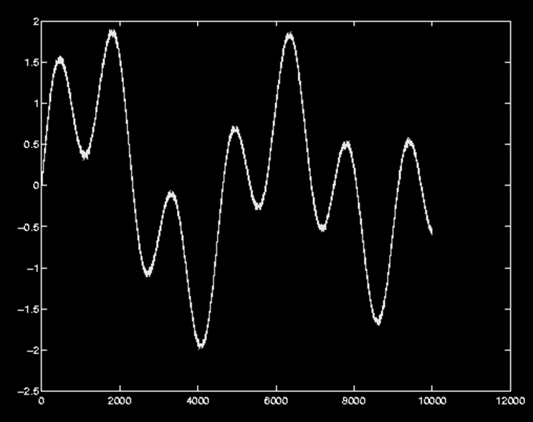
EXTREMA
IN-CLASS PROBLEM 1
Circle the local maxima and minima and mark the global maximum and minimum with Xs:
VFrench 2013

Slide 11
EXTREMA
IN-CLASS PROBLEM 1
Circle the local maxima and minima and mark the global maximum and minimum with Xs:
VFrench 2013

Slide 12
EXTREMA
IN-CLASS PROBLEM 1
Circle the local maxima and minima and mark the global maximum and minimum with Xs:
VFrench 2013

Slide 13

Questions?
http://i.imgur.com/aliTlT3.jpg

Slide 14
Extrema
The maximums and minimums of a graph occur where the slope of the tangent line (first derivative) is zero!

Slide 15
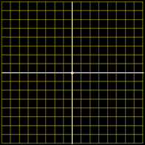
Extrema
4
3
2
1
0
-4
-3
-2
-1
0
1
2
3
4
-1
-2
-3
-4
VFrench 2020

Slide 16
Extrema
That is why the endpoints don’t count!
NOT
NOT

Slide 17
EXTREMA
IN-CLASS PROBLEM 2
Find the absolute maximum and minimum points for the function: ƒ(x) = x² – x
on the interval -2 ≤ x ≤ 2
The maximums and minimums occur where the first derivative is zero

Slide 18
EXTREMA
IN-CLASS PROBLEM 2
Find the absolute maximum and minimum points for the function: ƒ(x) = x² – x
on the interval -2 ≤ x ≤ 2
ƒ'= ?
The maximums and minimums occur where the first derivative is zero

Slide 19
EXTREMA
IN-CLASS PROBLEM 2
Find the absolute maximum and minimum points for the function: ƒ(x) = x² – x
on the interval -2 ≤ x ≤ 2
ƒ'= 2x - 1
Where between -2≤x≤2
is 2x-1=0?
The maximums and minimums occur where the first derivative is zero

Slide 20
EXTREMA
IN-CLASS PROBLEM 2
Find the absolute maximum and minimum points for the function: ƒ(x) = x² – x
on the interval -2 ≤ x ≤ 2
ƒ'= 2x - 1
Where between -2≤x≤2
is 2x-1=0?
Only at x=½
What is ƒ(x) at x=½?

Slide 21
EXTREMA
IN-CLASS PROBLEM 2
Find the absolute maximum and minimum points for the function: ƒ(x) = x² – x
on the interval -2 ≤ x ≤ 2
ƒ'= 2x - 1
Where between -2≤x≤2 is 2x=0?
Only at x=½
What is ƒ(x) at x=½?
ƒ(½) = (½)²-½ = ¼-½ = -¼

Slide 22
EXTREMA
IN-CLASS PROBLEM 2
Find the absolute maximum and minimum points for the function: ƒ(x) = x² – x
on the interval -2 ≤ x ≤ 2
ƒ'= 2x - 1
x=½ y= -¼ Is it a max or a min?

Slide 23

Extrema
OK, a graph works, but there HAS to be a more mathy way to do it!!
http://www.testically.org/wp-content/uploads/2010/11/hmm.jpg

Slide 24

Extrema
OK, a graph works, but there HAS to be a more mathy way to do it!! (there is!)
http://markvanderpool.naiwe.com/files/2013/01/bigstock-Bright-Idea-Kid.jpg

Slide 25
EXTREMA
IN-CLASS PROBLEM 2
One way to do it:
At x=½ ƒ(½) = ¼ - ½ = -¼
At x=1 ƒ(1) = 1 - 1 = 0
At x=0 ƒ(0) = 0 – 0 = 0
Both are bigger than -¼
So x=½ is a minimum
ƒ(x) = x² – x

Slide 26
EXTREMA
IN-CLASS PROBLEM 2
Another Way
ƒ ’ = 2x - 1
At x=½ ƒ ’(½) = 0
a horizontal tangent line
At x=1 ƒ ’(1) = 2-1 = 1
a positive slope tangent line
At x=0 ƒ ’(0) = 0-1 = -1
a negative slope tangent line

Slide 27
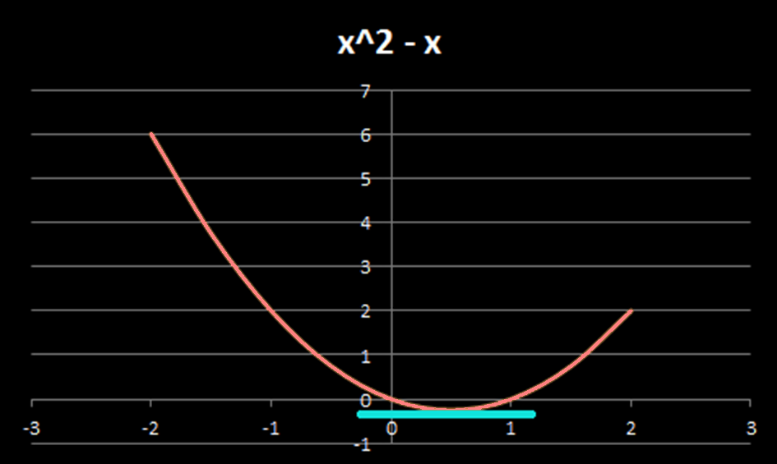
EXTREMA
IN-CLASS PROBLEM 2
VFrench 2013

Slide 28
EXTREMA
IN-CLASS PROBLEM 2
If x = ½ is the minimum, what is the maximum?
They will occur at other ƒ ’=0 points or on one or both of the extremes allowed for the interval

Slide 29
EXTREMA
IN-CLASS PROBLEM 2
Since there are no other ƒ ’=0 locations on the interval
-2 ≤ x ≤ 2
Plug in the two interval extremes in the original equation:
ƒ (2) = 2² – 2 = 4 – 2 = 2
ƒ (-2) = (-2)² – (-2) = 4 + 2 = 6
ƒ(x) = x² – x

Slide 30
EXTREMA
IN-CLASS PROBLEM 2
So, the absolute minimum is found at x=½ y=-¼ or (½,-¼)
And the absolute maximum is found at x=-2 y=6 or (-2,6)

Slide 31
EXTREMA
IN-CLASS PROBLEM 2
VFrench 2013

Slide 32
Extrema
This is called the Max-Min Test

Slide 33

Extrema
extrema of x^2-x
extrema of x^2-x for -2<x<2
(didn’t add anything)
extrema of x^2-x for -2≤x≤2
(worked for the max)

Slide 34
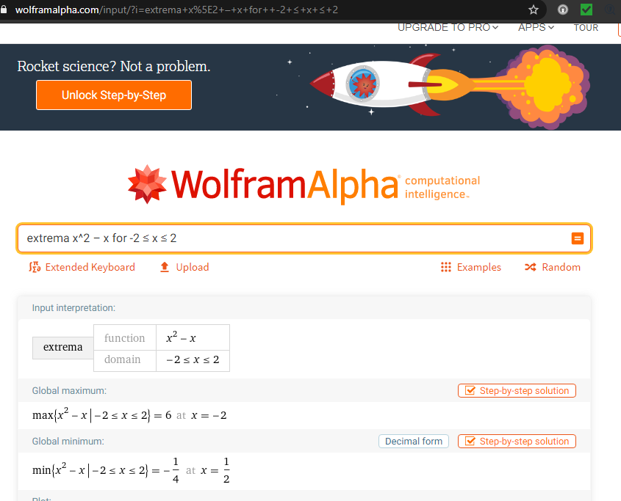

Slide 35
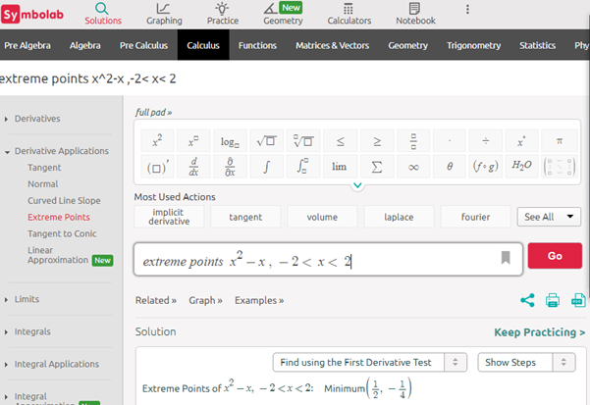

Slide 36
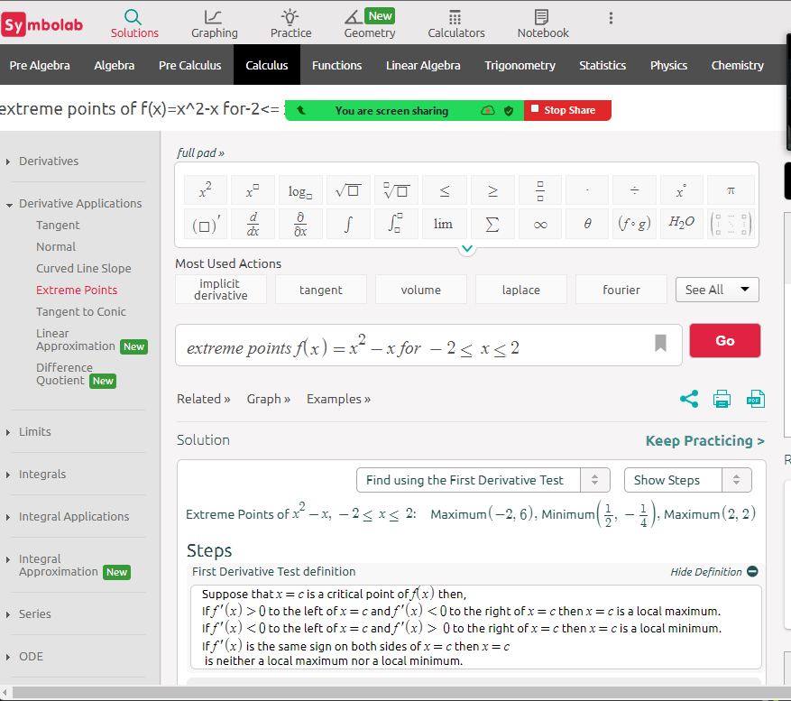

Slide 37
Note:
Wolfram and Symbolab will check the endpoints if you use
≤

Slide 38
Questions?
http://i.imgur.com/aliTlT3.jpg

Slide 39
EXTREMA
IN-CLASS PROBLEM 3
The power delivered to a load resistance of R ohms from a 10-volt generator with internal resistance of 8 ohms is modeled by: P = 100R/(64+16R+R²) watts
Find the value of R that allows maximum power
The maximums and minimums occur where the first derivative is zero

Slide 40
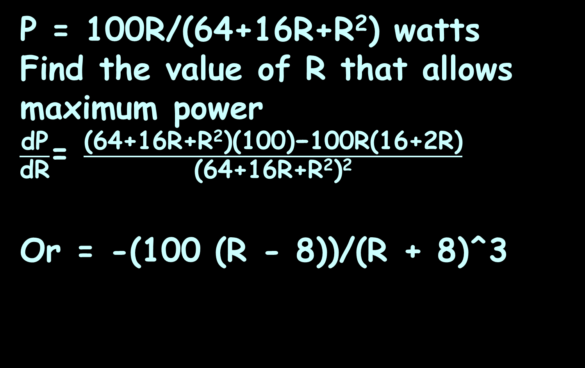
EXTREMA
IN-CLASS PROBLEM 3
P = 100R/(64+16R+R²) watts
Find the value of R that allows maximum power
$\frac{\text{dP}}{\text{d}\text{R}}$= $\frac{\text{(64+16}\text{R}\text{+}\text{R}\text{2}\text{)(100)−100}\text{R}\text{(16+2}\text{R}\text{)}}{\text{(}\text{64+16}\text{R}\text{+}\text{R}\text{2}\text{)}\text{2}}$
Or = -(100 (R - 8))/(R + 8)^3
Trust me…
Quotient Rule
The maximums and minimums occur where the first derivative is zero

Slide 41
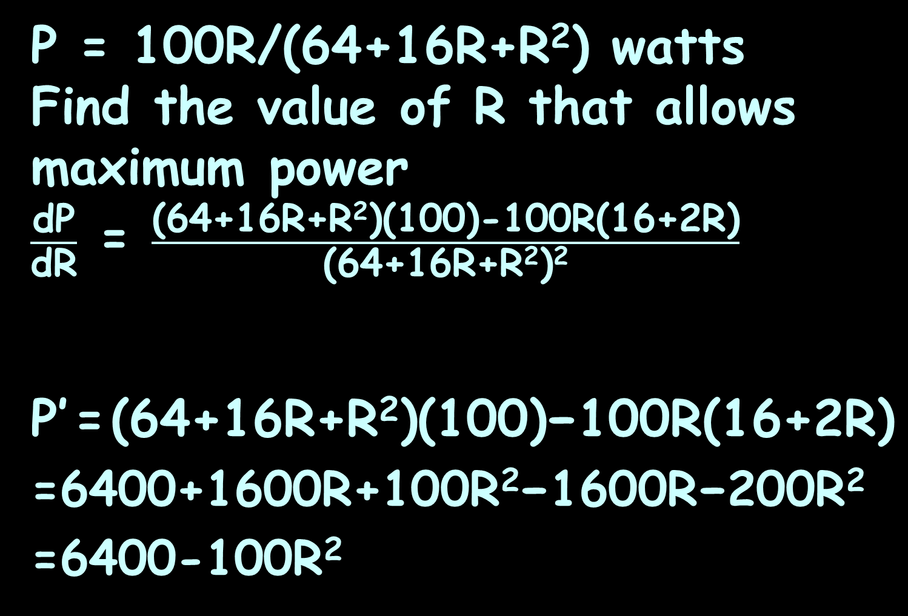
EXTREMA
IN-CLASS PROBLEM 3
P = 100R/(64+16R+R²) watts
Find the value of R that allows maximum power
$\frac{\text{dP}}{\text{d}\text{R}}$ = $\frac{\text{(64+16}\text{R}\text{+}\text{R}\text{2}\text{)(100)−100}\text{R}\text{(16+2}\text{R}\text{)}}{\text{(}\text{64+16}\text{R}\text{+}\text{R}\text{2}\text{)}\text{2}}$
P’ = $\text{(64+16}\text{R}\text{+}\text{R}\text{2}\text{)(100)−100}\text{R}\text{(16+2}\text{R}\text{)}$
=6400+1600R+100$\text{R}\text{2}\text{−}$1600R$\text{−}$200$\text{R}\text{2}$
=6400-100$\text{R}\text{2}$
Trust me…
When a ratio is set equal to zero, you can drop the denominator
The maximums and minimums occur where the first derivative is zero

Slide 42
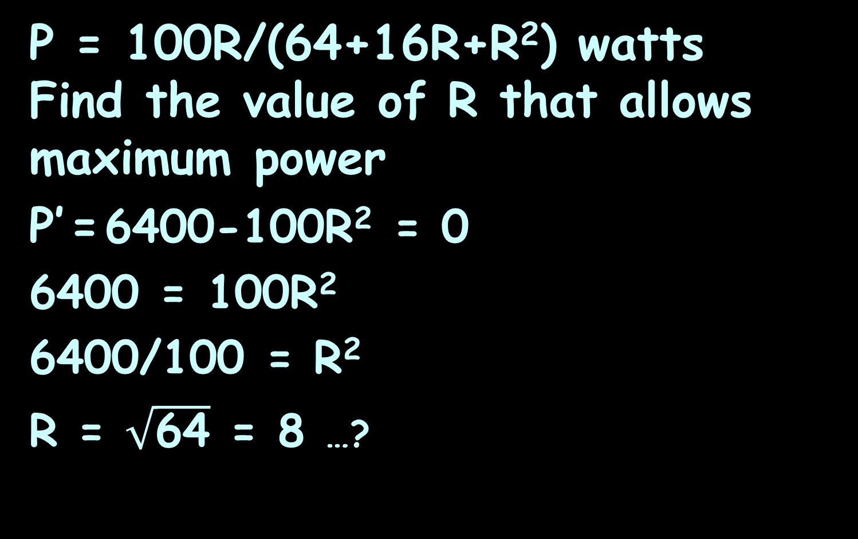
EXTREMA
IN-CLASS PROBLEM 3
P = 100R/(64+16R+R²) watts
Find the value of R that allows maximum power
P’ = 6400-100$\text{R}\text{2}$ = 0
6400 = 100$\text{R}\text{2}$
6400/100 = $\text{R}\text{2}$
R = $\sqrt{\text{64}}$ = 8 …?
800-100R = 0
R = 800/100
= 8 ...

Slide 43
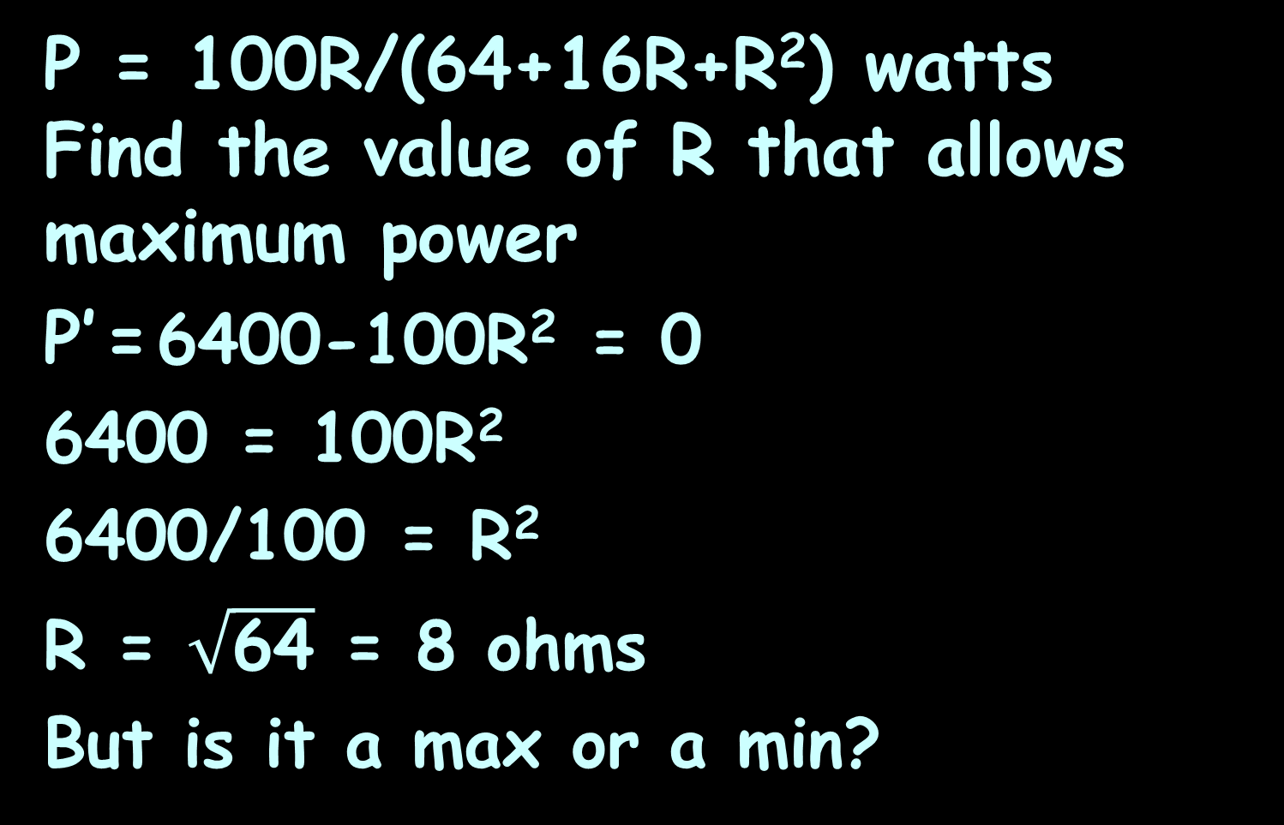
EXTREMA
IN-CLASS PROBLEM 3
P = 100R/(64+16R+R²) watts
Find the value of R that allows maximum power
P’ = 6400-100$\text{R}\text{2}$ = 0
6400 = 100$\text{R}\text{2}$
6400/100 = $\text{R}\text{2}$
R = $\sqrt{\text{64}}$ = 8 ohms
But is it a max or a min?

Slide 44
EXTREMA
IN-CLASS PROBLEM 3
P = 100R/(64+16R+R²) watts
Find the value of R that allows maximum power
P’=0 at R=8 ohms
But is it a max or a min?
Using P=100R/(64+16R+R²)
plug in R=7.9 and R=8.1 and compare the value to R=8

Slide 45
EXTREMA
IN-CLASS PROBLEM 3
P = 100R/(64+16R+R²) watts
Find the value of R that allows maximum power
P’=0 at R=8 ohms
But is it a max or a min?
P(R=7.9) ≈ 3.1249
P(R=8) ≈ 3.1250
P(R=8.1) ≈ 3.1249

Slide 46
EXTREMA
IN-CLASS PROBLEM 3
P = 100R/(64+16R+R²) watts
Find the value of R that allows maximum power
P’=0 at R=8 ohms
P(R=7.9) ≈ 3.1249
P(R=8) ≈ 3.1250
P(R=8.1) ≈ 3.1249
So P (3.1250 watts) is a max at R=8 ohms

Slide 47
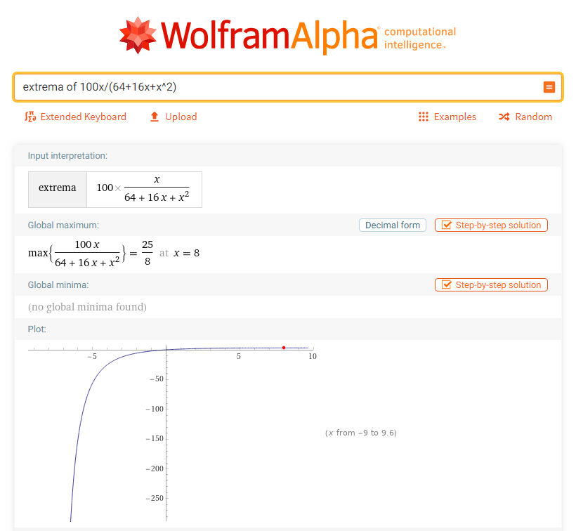

Slide 48
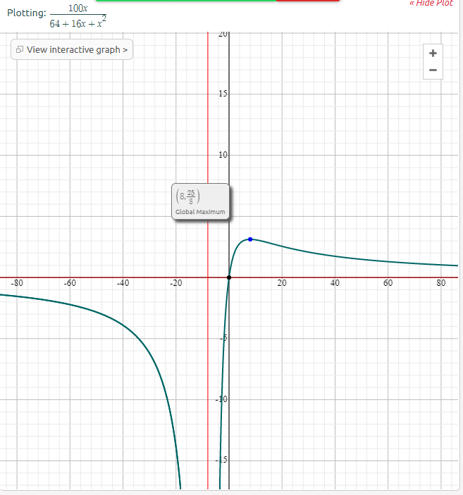

Slide 49
Questions?
http://i.imgur.com/aliTlT3.jpg

Slide 50
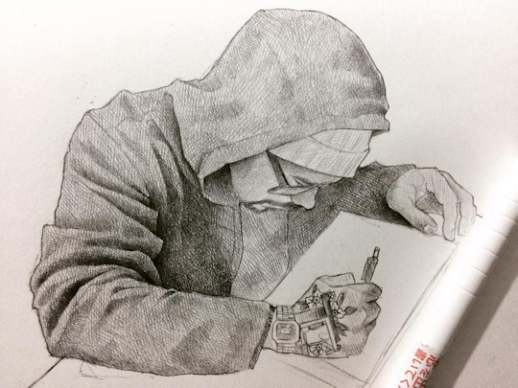
Shape of a Curve
Back in the day, it was hard to graph stuff
Art made by Mexican artist Efrain Malo

Slide 51

Shape of a Curve
Mathematicians were called on to come up with ways to know the shape of a graph without having to draw it
https://insights.dice.com/2019/08/16/mathematicians-hot-focus-nationwide-job-postings/

Slide 52
Shape of a Curve
Differential calculus can do that!
https://elcorreoweb.es/extra/karen-uhlenbeck-primera-mujer-que-gana-el-nobel-de-matematicas-AI5129929

Slide 53
Shape of a Curve
Maxima and minima occur where the first derivative is zero

Slide 54
Shape of a Curve
Points of inflection (where the graph changes direction) are also useful
https://www.mathsisfun.com/calculus/inflection-points.html

Slide 55
Shape of a Curve
Concave upward
is when the
slope increases
moving from
left to right
Also called “convex” or “convex downward”
https://www.mathsisfun.com/calculus/inflection-points.html

Slide 56
Shape of a Curve
Concave
downward
is when the
slope decreases
moving from
left to right
Also called “concave” or “convex upward”
https://www.mathsisfun.com/calculus/inflection-points.html

Slide 57
Shape of a Curve
An inflection point is where a curve changes from concave upward to concave downward (or vice versa)
Concave
upward
Concave
upward
Concave
downward
Concave
downward
Concave
upward
Concave
downward
https://www.mathsisfun.com/calculus/inflection-points.html

Slide 58
Shape of a Curve
So our task is to find where a curve goes from concave upward to concave downward (or vice versa)

Slide 59
Shape of a Curve
Derivatives help us!
The derivative of a function gives the slope
The second derivative tells us if the slope increases or decreases

Slide 60
Shape of a Curve
When the second derivative is positive, the function is concave upward (cup)
When the second derivative is negative, the function is concave downward (hill)

Slide 61
Shape of a Curve
And the inflection point is where it goes from concave upward to concave downward (or vice versa)

Slide 62
SHAPE OF A CURVE
IN-CLASS PROBLEM 4
Describe the shape of:
y = 5x³ + 3x² − 3x
y' = 15x² + 6x − 3
Hint: take the second derivative

Slide 63
SHAPE OF A CURVE
IN-CLASS PROBLEM 4
Describe the shape of:
y = 5x³ + 3x² − 3x
y' = 15x² + 6x − 3
y" =
Hint: take the second derivative

Slide 64
SHAPE OF A CURVE
IN-CLASS PROBLEM 4
Describe the shape of:
y = 5x³ + 3x² − 3x
y' = 15x² + 6x − 3
y" = 30x + 6
Where is y’’ zero? (that will be the inflection point)

Slide 65
SHAPE OF A CURVE
IN-CLASS PROBLEM 4
Describe the shape of:
y = 5x³ + 3x² − 3x
y' = 15x² + 6x − 3
y’’ = 30x + 6
Where is y’’ zero? -0.2
Where is y’’ negative?
Where is y’’ positive?

Slide 66
SHAPE OF A CURVE
IN-CLASS PROBLEM 4
Describe the shape of:
y = 5x³ + 3x² − 3x
y’’ = 30x + 6
30x + 4 is negative up to
x = -0.2 and
positive from there onwards

Slide 67
SHAPE OF A CURVE
IN-CLASS PROBLEM 4
Describe the shape of:
y = 5x³ + 3x² − 3x
y’’ = 30x + 6
So the graph is concave downward (hill-shaped) up to x = −0.2 (the inflection point) and concave upward (cup shaped) from x = −0.2 onward

Slide 68
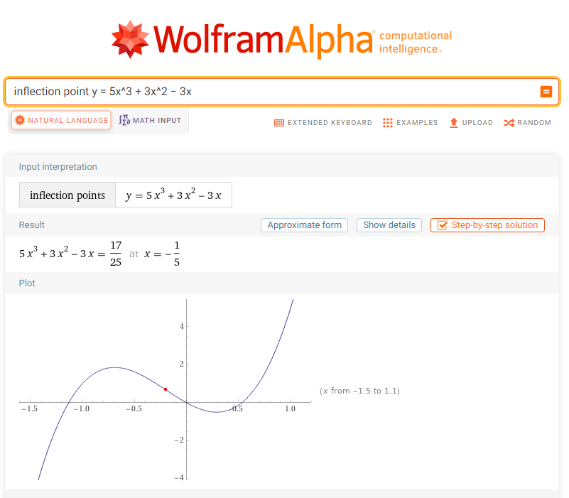

Slide 69
Questions?
http://i.imgur.com/aliTlT3.jpg

Slide 70
SHAPE OF A CURVE
IN-CLASS PROBLEM 5
A GE2P3 break back diode has its characteristic curve modeled by V=0.079I³-2.31I²+15.6I+22 volts
when I is measured in mA (milli amps). Find the V_{max} (called V_{BO} break over voltage) and V_{min} (called V_{BB} break back voltage)
Diode - an electrical component that allows the flow of current in only one direction
For diodes, the breakdown voltage is the minimum reverse voltage that makes the diode conduct appreciably in reverse

Slide 71
SHAPE OF A CURVE
IN-CLASS PROBLEM 5
V=0.079I³-2.31I²+15.6I+22 volts
Find V_{max} and V_{min}
What derivative do we want?

Slide 72

SHAPE OF A CURVE
IN-CLASS PROBLEM 5
V=0.079I³-2.31I²+15.6I+22 volts
Find V_{max} and V_{min}
What derivative do we want?
$\frac{\text{dV}}{\text{dI}}$ = ?

Slide 73
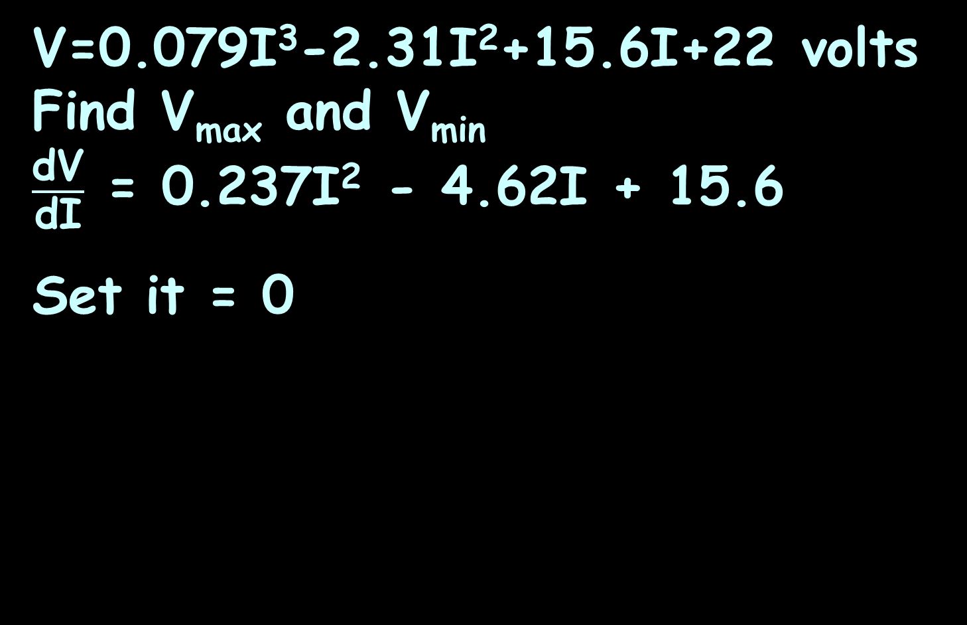
SHAPE OF A CURVE
IN-CLASS PROBLEM 5
V=0.079I³-2.31I²+15.6I+22 volts
Find V_{max} and V_{min}
$\frac{\text{dV}}{\text{dI}}$ = 0.237I² - 4.62I + 15.6
Set it = 0

Slide 74
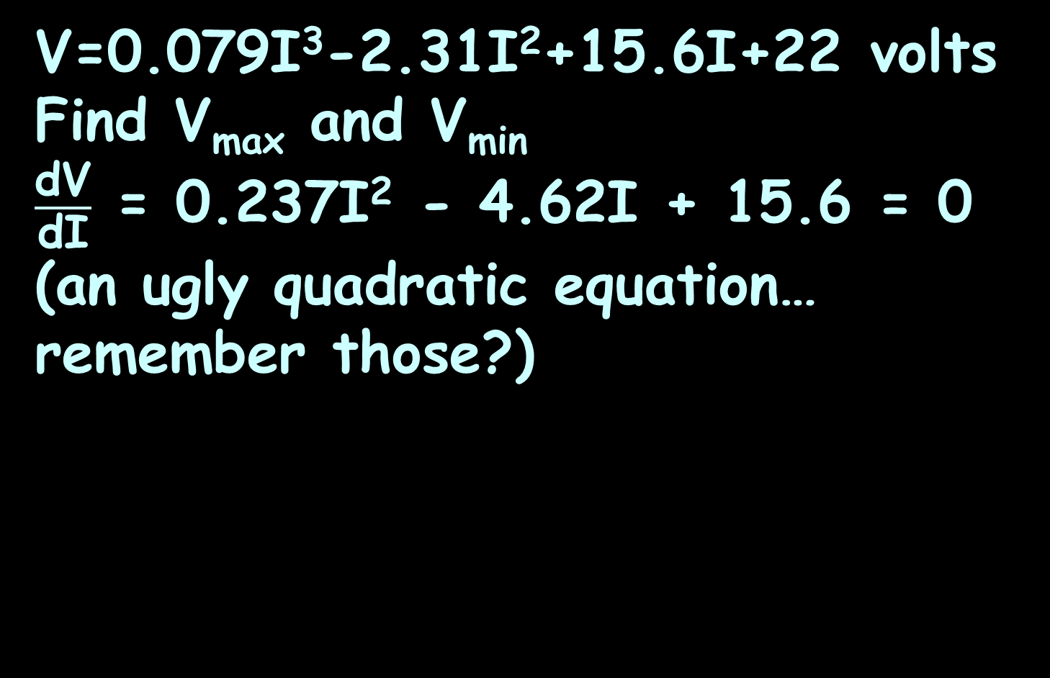
SHAPE OF A CURVE
IN-CLASS PROBLEM 5
V=0.079I³-2.31I²+15.6I+22 volts
Find V_{max} and V_{min}
$\frac{\text{dV}}{\text{dI}}$ = 0.237I² - 4.62I + 15.6 = 0
(an ugly quadratic equation… remember those?)

Slide 75
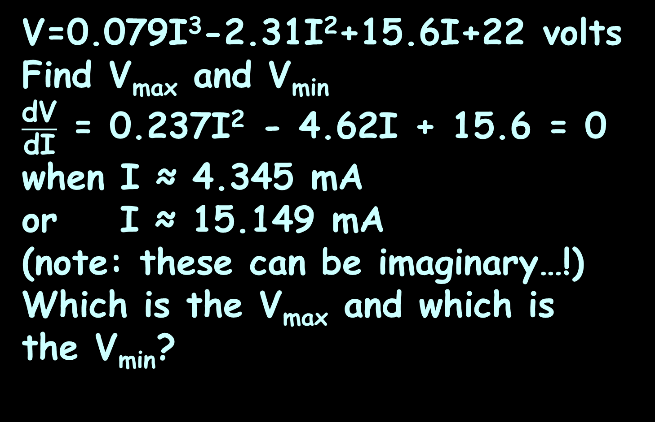
SHAPE OF A CURVE
IN-CLASS PROBLEM 5
V=0.079I³-2.31I²+15.6I+22 volts
Find V_{max} and V_{min}
$\frac{\text{dV}}{\text{dI}}$ = 0.237I² - 4.62I + 15.6 = 0
when I ≈ 4.345 mA
or I ≈ 15.149 mA
(note: these can be imaginary…!)
Which is the V_{max} and which is
the V_{min}?

Slide 76
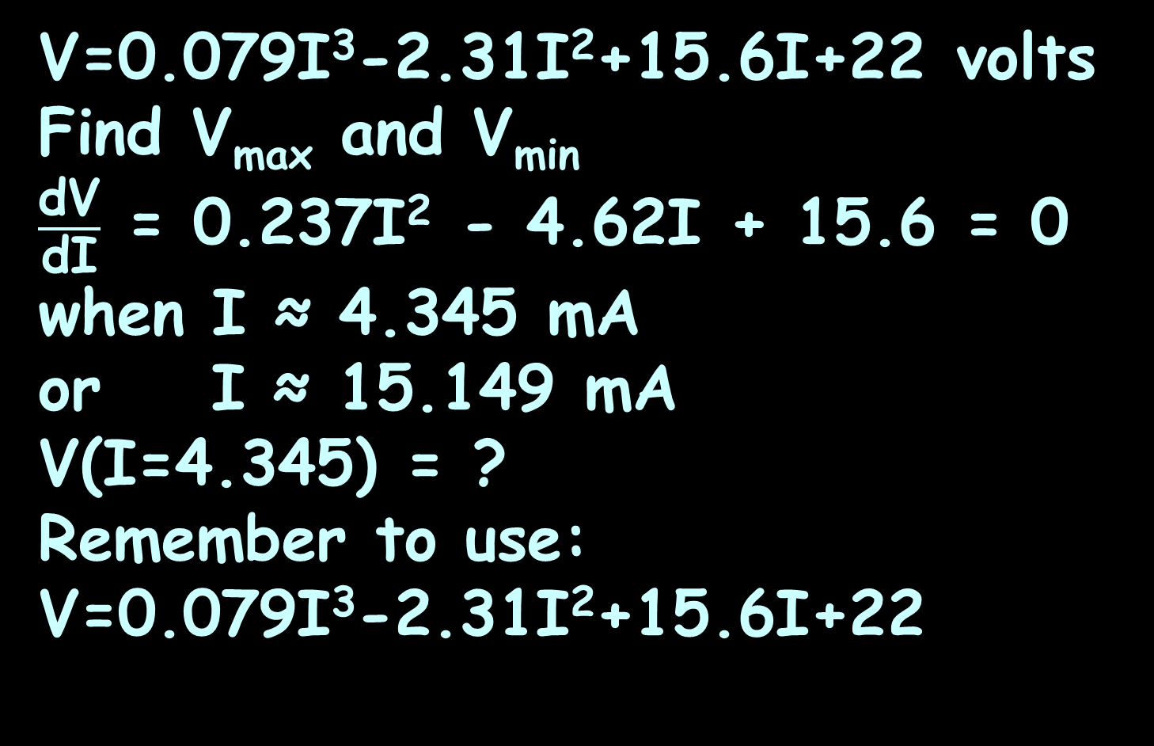
SHAPE OF A CURVE
IN-CLASS PROBLEM 5
V=0.079I³-2.31I²+15.6I+22 volts
Find V_{max} and V_{min}
$\frac{\text{dV}}{\text{dI}}$ = 0.237I² - 4.62I + 15.6 = 0
when I ≈ 4.345 mA
or I ≈ 15.149 mA
V(I=4.345) = ?
Remember to use:
V=0.079I³-2.31I²+15.6I+22

Slide 77
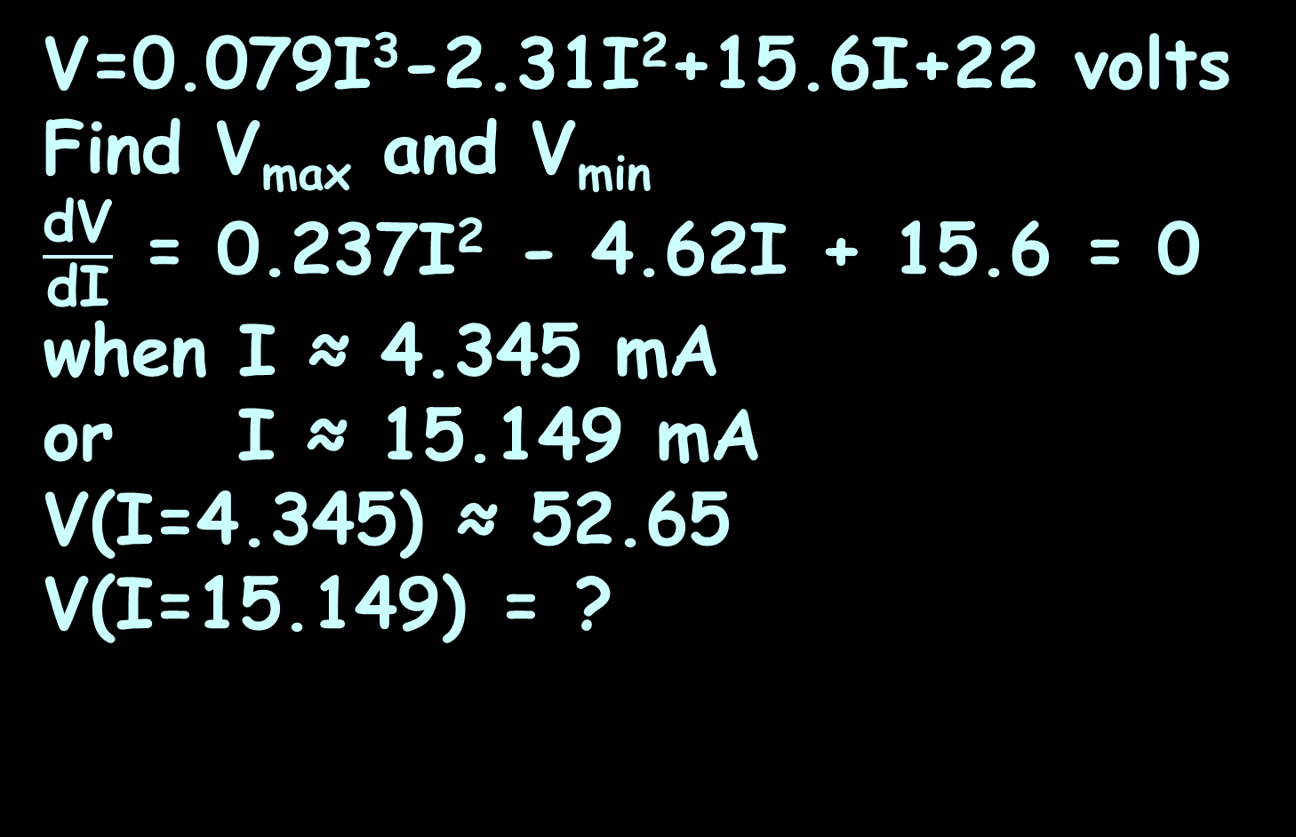
SHAPE OF A CURVE
IN-CLASS PROBLEM 5
V=0.079I³-2.31I²+15.6I+22 volts
Find V_{max} and V_{min}
$\frac{\text{dV}}{\text{dI}}$ = 0.237I² - 4.62I + 15.6 = 0
when I ≈ 4.345 mA
or I ≈ 15.149 mA
V(I=4.345) ≈ 52.65
V(I=15.149) = ?

Slide 78
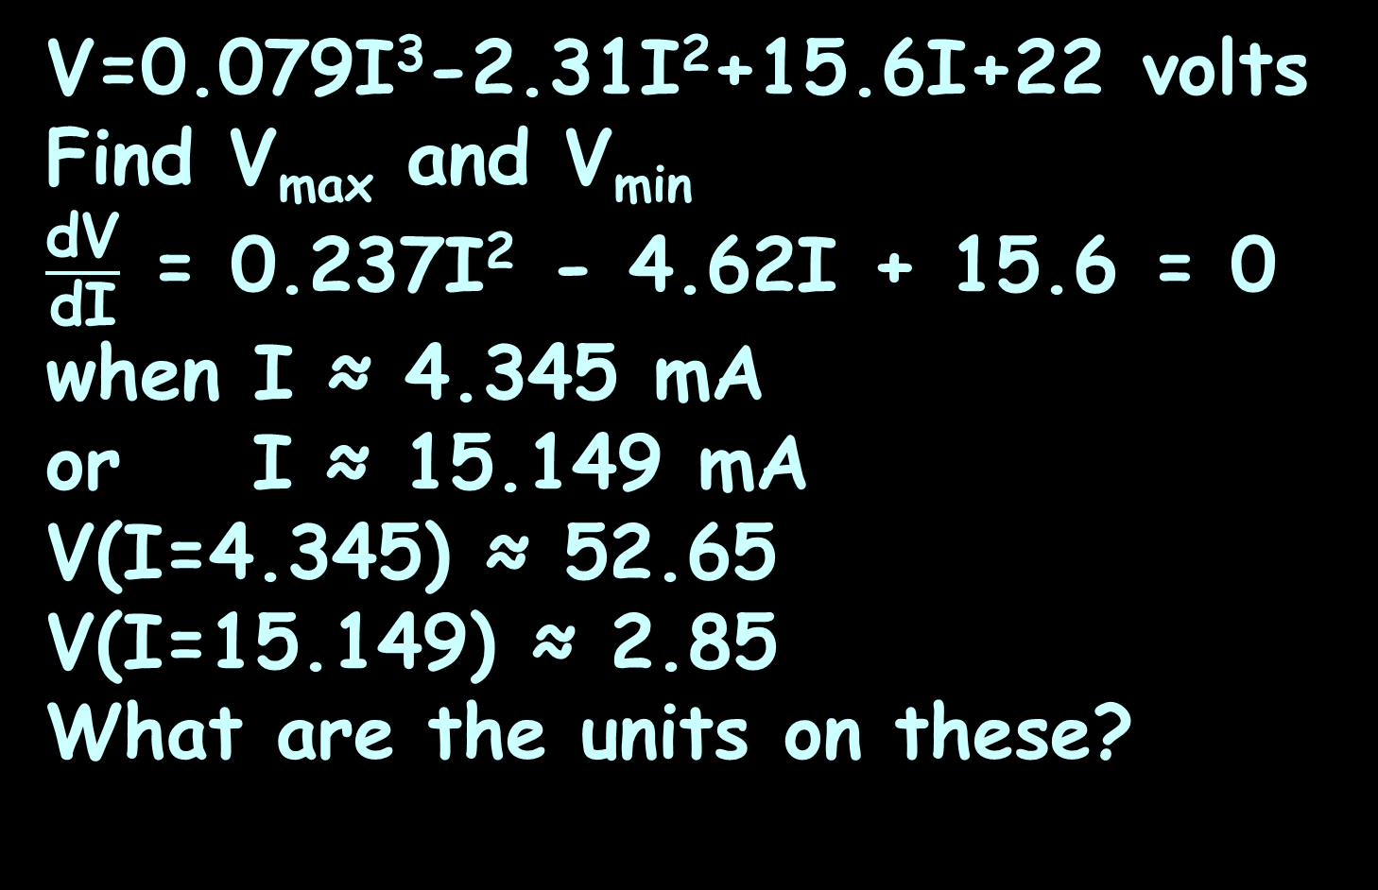
SHAPE OF A CURVE
IN-CLASS PROBLEM 5
V=0.079I³-2.31I²+15.6I+22 volts
Find V_{max} and V_{min}
$\frac{\text{dV}}{\text{dI}}$ = 0.237I² - 4.62I + 15.6 = 0
when I ≈ 4.345 mA
or I ≈ 15.149 mA
V(I=4.345) ≈ 52.65
V(I=15.149) ≈ 2.85
What are the units on these?

Slide 79
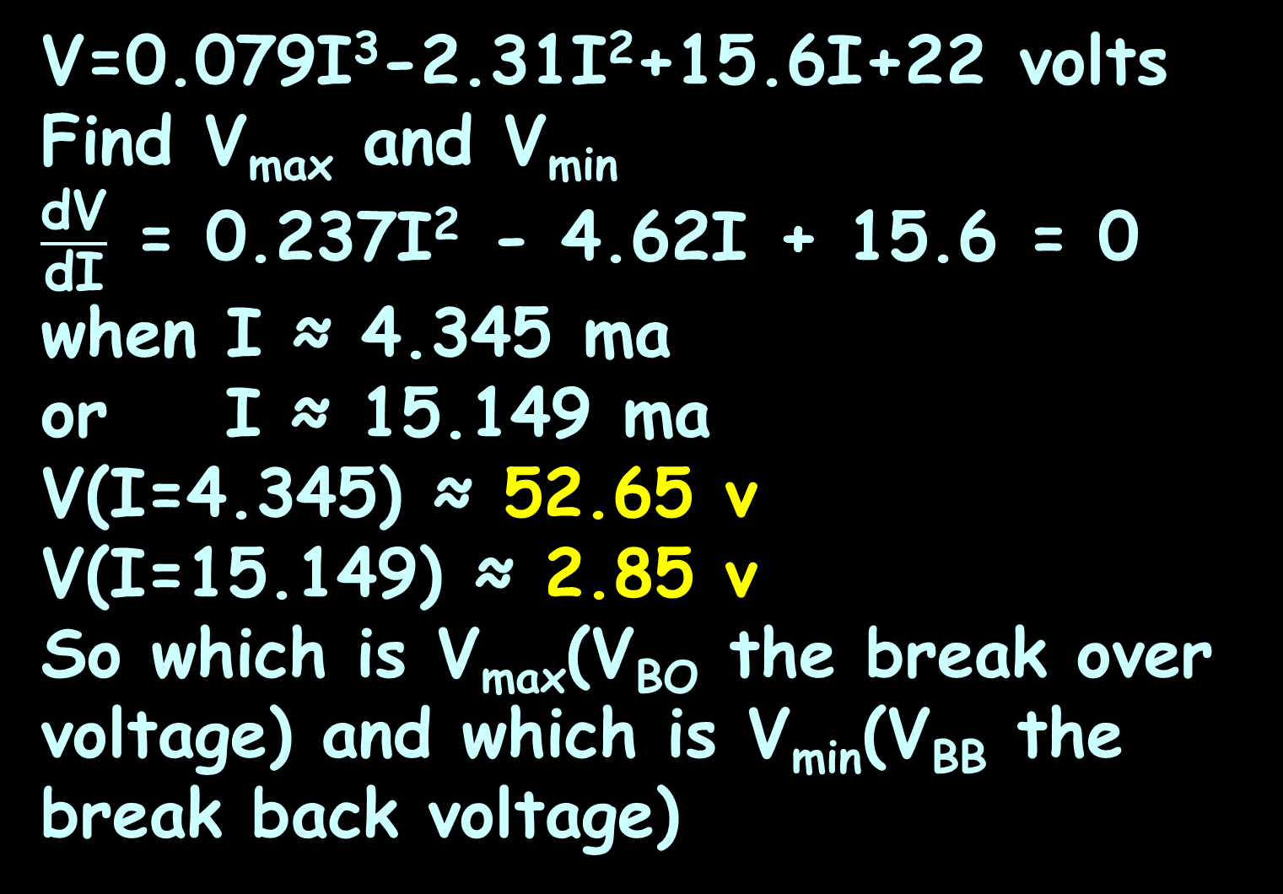
SHAPE OF A CURVE
IN-CLASS PROBLEM 5
V=0.079I³-2.31I²+15.6I+22 volts
Find V_{max} and V_{min}
$\frac{\text{dV}}{\text{dI}}$ = 0.237I² - 4.62I + 15.6 = 0
when I ≈ 4.345 ma
or I ≈ 15.149 ma
V(I=4.345) ≈ 52.65 v
V(I=15.149) ≈ 2.85 v
So which is V_{max}(V_{BO} the break over voltage) and which is V_{min}(V_{BB} the break back voltage)

Slide 80
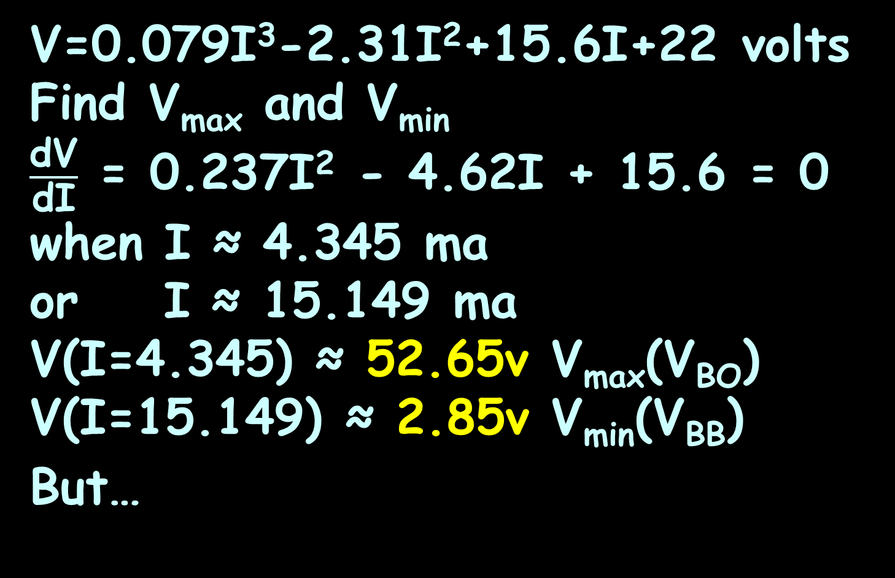
SHAPE OF A CURVE
IN-CLASS PROBLEM 5
V=0.079I³-2.31I²+15.6I+22 volts
Find V_{max} and V_{min}
$\frac{\text{dV}}{\text{dI}}$ = 0.237I² - 4.62I + 15.6 = 0
when I ≈ 4.345 ma
or I ≈ 15.149 ma
V(I=4.345) ≈ 52.65v V_{max}(V_{BO})
V(I=15.149) ≈ 2.85v V_{min}(V_{BB})
But…

Slide 81
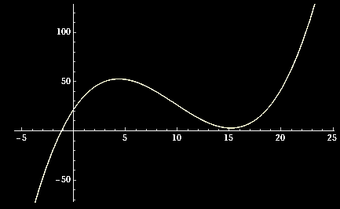
SHAPE OF A CURVE
IN-CLASS PROBLEM 6
V=0.079I³-2.31I²+15.6I+22 volts
Where is the inflection point?
P
52.65v
I
2.85v
VFrench, 2020

Slide 82
SHAPE OF A CURVE
IN-CLASS PROBLEM 6
V=0.079I³-2.31I²+15.6I+22 volts
Where is the inflection point?
What do we need to calculate?
P
52.65v
I
2.85v
VFrench, 2020

Slide 83
SHAPE OF A CURVE
IN-CLASS PROBLEM 6
V=0.079I³-2.31I²+15.6I+22 volts
Where is the inflection point?
V’ = 0.237I² - 4.62I + 15.6
V’’ = ?
V
52.65v
I
2.85v
VFrench, 2020

Slide 84
SHAPE OF A CURVE
IN-CLASS PROBLEM 6
V=0.079I³-2.31I²+15.6I+22 volts
Where is the inflection point?
V’ = 0.237I² - 4.62I + 15.6
V’’ = 0.474I – 4.62
Now what?
V
52.65v
I
2.85v
VFrench, 2020

Slide 85
SHAPE OF A CURVE
IN-CLASS PROBLEM 6
V=0.079I³-2.31I²+15.6I+22 volts
Where is the inflection point?
V’ = 0.237I² - 4.62I + 15.6
V’’ = 0.474I – 4.62 = 0
when I = ?
V
52.65v
I
2.85v
VFrench, 2020

Slide 86
SHAPE OF A CURVE
IN-CLASS PROBLEM 6
V=0.079I³-2.31I²+15.6I+22 volts
Where is the inflection point?
V’ = 0.237I² - 4.62I + 15.6
V’’ = 0.474I – 4.62 = 0
when I ≈ 9.7468 …?
V
52.65v
I
2.85v
VFrench, 2020

Slide 87
SHAPE OF A CURVE
IN-CLASS PROBLEM 6
V=0.079I³-2.31I²+15.6I+22 volts
Where is the inflection point?
V’ = 0.237I² - 4.62I + 15.6
V’’ = 0.474I – 4.62 = 0
when I ≈ 9.7468 mA
V
52.65v
I
2.85v
9.7468 mA
VFrench, 2020

Slide 88
SHAPE OF A CURVE
IN-CLASS PROBLEM 6
Describe the curve for:
V=0.079I³-2.31I²+15.6I+22 volts
V
52.65v
I
4.345 mA
2.85v
15.149 mA
9.75 mA
VFrench, 2020

Slide 89
SHAPE OF A CURVE
IN-CLASS PROBLEM 6
Describe the curve for:
V=0.079I³-2.31I²+15.6I+22 volts
The graph is concave downward (hill) (with a max of 52.65v at I=4.345mA) up to I=9.75mA and concave upward (cup) (with a min of 2.85v at I=15.149mA
beyond that point)
52.65v
4.345 mA
2.85v
15.149 mA
9.75 mA
VFrench, 2020

Slide 90
Questions?
http://i.imgur.com/aliTlT3.jpg

Slide 91
Monotonicity
A function is called “increasing” (or non-decreasing) if its values are only rising and never falling with increasing values of x
It is strictly increasing if values always become larger and cannot be constant

Slide 92
Monotonicity
A function is called “decreasing” (or non-increasing) if its values are only falling and never rising with increasing values of x
It is strictly decreasing if values always become smaller and cannot be constant

Slide 93
Monotonicity
If a function is either increasing, strictly increasing, decreasing, or strictly decreasing, the function is called monotonic

Slide 94
Monotonicity
If a function is either increasing, strictly increasing, decreasing, or strictly decreasing, the function is called monotonic
Some are globally monotonic, most are over intervals

Slide 95
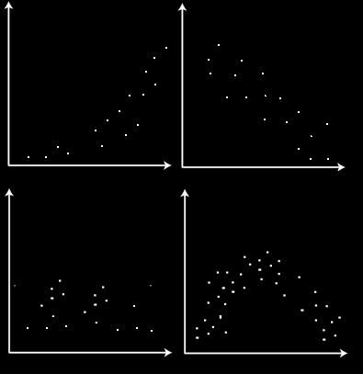
MONOTONICITY
IN-CLASS PROBLEM 7
Is the data trend monotonic?
https://www.tekportal.net/wp-content/uploads/2018/11/monotonically.png

Slide 96
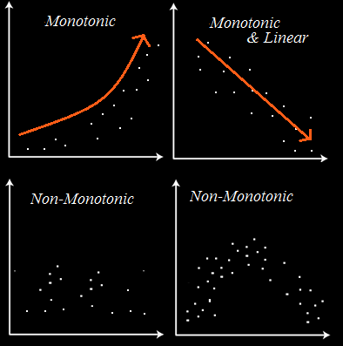
MONOTONICITY
IN-CLASS PROBLEM 7
Is the data trend monotonic?
https://www.tekportal.net/wp-content/uploads/2018/11/monotonically.png

Slide 97
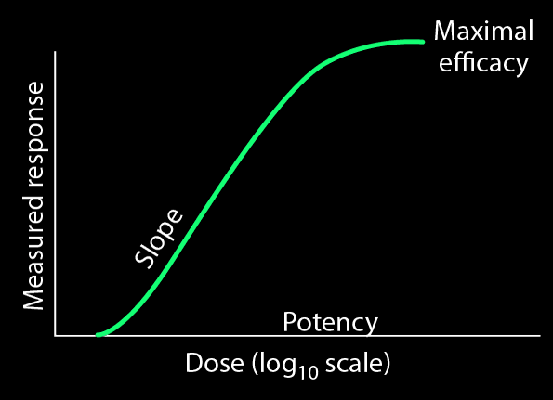
What Is This Used For?
Monotonicity is used a lot in drug dose response studies and in genetic response studies
https://www.merckmanuals.com/professional/clinical-pharmacology/pharmacodynamics/dose-response-relationships

Slide 98
Questions?
http://i.imgur.com/aliTlT3.jpg

Slide 99
The secret word for this unit is:
Monotonic

Slide 100
Related Rates
Remember when we did functions on week 2?

Slide 101
Related Rates
Changing one variable’s value changes the value of another variable that depended on it

Slide 102
Related Rates
Problems including variables whose rates of change are related and can be modeled by an equation are called related rates problems

Slide 103
Related Rates
        One or more rates are given, and other rates are to be calculated using the equation

Slide 104
Related Rates
This can be done for any combination of variables in the model
The others are considered to be constants

Slide 105
Related Rates
How to do it:
Draw a picture
What are you trying to find?
3) Find an equation relating the variables
4) Find dy/dx (usually chain rule)
5) Plug in known values
6) Solve for the rate of change

Slide 106
Related Rates
If there are values for the variables, plug them in at the end

Slide 107
RELATED RATES
IN-CLASS PROBLEM 8
The edge of a square is increasing at the rate of 3 cm/sec. At what rate is the square’s area changing when the edge of the square is 10 cm?

Slide 108
RELATED RATES
IN-CLASS PROBLEM 8
The edge of a square is increasing at the rate of 3 cm/sec. At what rate is the square’s area changing when the edge of the square is 10 cm?
Step 1: Draw a picture
dx/dt =
3 cm/sec
https://www.math.ucdavis.edu/~kouba/CalcOneDIRECTORY/relatedratesdirectory/solution01.html

Slide 109
RELATED RATES
IN-CLASS PROBLEM 8
The edge of a square is increasing at the rate of 3 cm/sec. At what rate is the square’s area changing when the edge of the square is 10 cm?
Step 2: What are you
trying to find?
dx/dt =
3 cm/sec
https://www.math.ucdavis.edu/~kouba/CalcOneDIRECTORY/relatedratesdirectory/solution01.html

Slide 110
RELATED RATES
IN-CLASS PROBLEM 8
The edge of a square is increasing at the rate of 3 cm/sec. At what rate is the square’s area changing when the edge of the square is 10 cm?
Step 2: What are you
trying to find? dA/dt
dx/dt =
3 cm/sec
https://www.math.ucdavis.edu/~kouba/CalcOneDIRECTORY/relatedratesdirectory/solution01.html

Slide 111
RELATED RATES
IN-CLASS PROBLEM 8
The edge of a square is increasing at the rate of 3 cm/sec. At what rate is the square’s area changing when the edge of the square is 10 cm?
Step 3: Find an equation
that relates the variables
dx/dt =
3 cm/sec
https://www.math.ucdavis.edu/~kouba/CalcOneDIRECTORY/relatedratesdirectory/solution01.html

Slide 112
RELATED RATES
IN-CLASS PROBLEM 8
The edge of a square is increasing at the rate of 3 cm/sec. At what rate is the square’s area changing when the edge of the square is 10 cm?
Step 3: Find an equation
that relates the variables
area A = x²
dx/dt =
3 cm/sec
https://www.math.ucdavis.edu/~kouba/CalcOneDIRECTORY/relatedratesdirectory/solution01.html

Slide 113
RELATED RATES
IN-CLASS PROBLEM 8
The edge of a square is increasing at the rate of 3 cm/sec. At what rate is the square’s area changing when the edge of the square is 10 cm?
Step 4: Take the derivative
with respect to time
(usually Chain Rule)
dx/dt =
3 cm/sec
https://www.math.ucdavis.edu/~kouba/CalcOneDIRECTORY/relatedratesdirectory/solution01.html

Slide 114
RELATED RATES
IN-CLASS PROBLEM 8
The edge of a square is increasing at the rate of 3 cm/sec. At what rate is the square’s area changing when the edge of the square is 10 cm?
Step 4: Take the derivative
with respect to time
dA/dt = dx²/dt
= 2x dx/dt
dx/dt =
3 cm/sec
https://www.math.ucdavis.edu/~kouba/CalcOneDIRECTORY/relatedratesdirectory/solution01.html

Slide 115
RELATED RATES
IN-CLASS PROBLEM 8
The edge of a square is increasing at the rate of 3 cm/sec. At what rate is the square’s area changing when the edge of the square is 10 cm?
Step 5: Plug in stuff you
know
dA/dt = 2x dx/dt
= 2(10)(3) = 60 whats?
dx/dt =
3 cm/sec
https://www.math.ucdavis.edu/~kouba/CalcOneDIRECTORY/relatedratesdirectory/solution01.html

Slide 116
RELATED RATES
IN-CLASS PROBLEM 8
The edge of a square is increasing at the rate of 3 cm/sec. At what rate is the square’s area changing when the edge of the square is 10 cm?
Step 5: Plug in stuff you
know
dA/dt = 60 cm²/sec
dx/dt =
3 cm/sec
https://www.math.ucdavis.edu/~kouba/CalcOneDIRECTORY/relatedratesdirectory/solution01.html

Slide 117
Questions?
http://i.imgur.com/aliTlT3.jpg

Slide 118
RELATED RATES
IN-CLASS PROBLEM 9
A ladder 13 feet long is leaning against a high wall. If the base of the ladder is pushed toward the wall at the rate of 2 ft/sec., at what rate is the top of the ladder moving up the wall when the base of the ladder is 5 feet from the wall ?

Slide 119
RELATED RATES
IN-CLASS PROBLEM 9
A ladder 13 feet long is leaning against a high wall. If the base of the ladder is pushed toward the wall at the rate of 2 ft/sec., at what rate is the top of the ladder moving up the wall when the base
of the ladder is 5 feet
from the wall ?
Step 1: Pic
dx/dt =
-2 ft/sec
https://www.math.ucdavis.edu/~kouba/CalcOneDIRECTORY/relatedratesdirectory/solution06.html

Slide 120
RELATED RATES
IN-CLASS PROBLEM 9
A ladder 13 feet long is leaning against a high wall. If the base of the ladder is pushed toward the wall at the rate of 2 ft/sec., at what rate is the top of the ladder moving up the wall when the base
of the ladder is 5 feet
from the wall ?
Step 2: What are you trying
to find?
dx/dt =
-2 ft/sec
https://www.math.ucdavis.edu/~kouba/CalcOneDIRECTORY/relatedratesdirectory/solution06.html

Slide 121
RELATED RATES
IN-CLASS PROBLEM 9
A ladder 13 feet long is leaning against a high wall. If the base of the ladder is pushed toward the wall at the rate of 2 ft/sec., at what rate is the top of the ladder moving up the wall when the base
of the ladder is 5 feet
from the wall ?
Step 2: What are you trying
to find? dy/dt
dx/dt =
-2 ft/sec
https://www.math.ucdavis.edu/~kouba/CalcOneDIRECTORY/relatedratesdirectory/solution06.html

Slide 122
RELATED RATES
IN-CLASS PROBLEM 9
A ladder 13 feet long is leaning against a high wall. If the base of the ladder is pushed toward the wall at the rate of 2 ft/sec., at what rate is the top of the ladder moving up the wall when the base
of the ladder is 5 feet
from the wall ?
Step 3: Eq?
dx/dt =
-2 ft/sec
https://www.math.ucdavis.edu/~kouba/CalcOneDIRECTORY/relatedratesdirectory/solution06.html

Slide 123
RELATED RATES
IN-CLASS PROBLEM 9
A ladder 13 feet long is leaning against a high wall. If the base of the ladder is pushed toward the wall at the rate of 2 ft/sec., at what rate is the top of the ladder moving up the wall when the base
of the ladder is 5 feet
from the wall ?
Step 3: x² + y² = 13² = 169
dx/dt =
-2 ft/sec
https://www.math.ucdavis.edu/~kouba/CalcOneDIRECTORY/relatedratesdirectory/solution06.html

Slide 124
RELATED RATES
IN-CLASS PROBLEM 9
A ladder 13 feet long is leaning against a high wall. If the base of the ladder is pushed toward the wall at the rate of 2 ft/sec., at what rate is the top of the ladder moving up the wall when the base
of the ladder is 5 feet
from the wall ?
Step 4: x² + y² = 169
d /dt
dx/dt =
-2 ft/sec
https://www.math.ucdavis.edu/~kouba/CalcOneDIRECTORY/relatedratesdirectory/solution06.html

Slide 125
RELATED RATES
IN-CLASS PROBLEM 9
A ladder 13 feet long is leaning against a high wall. If the base of the ladder is pushed toward the wall at the rate of 2 ft/sec., at what rate is the top of the ladder moving up the wall when the base
of the ladder is 5 feet
from the wall ?
Step 4: x² + y² = 169
2x dx/dt + 2y dy/dt = 0
x dx/dt + y dy/dt = 0
dx/dt =
-2 ft/sec
(what we want)
https://www.math.ucdavis.edu/~kouba/CalcOneDIRECTORY/relatedratesdirectory/solution06.html

Slide 126
RELATED RATES
IN-CLASS PROBLEM 9
A ladder 13 feet long is leaning against a high wall. If the base of the ladder is pushed toward the wall at the rate of 2 ft/sec., at what rate is the top of the ladder moving up the wall when the base
of the ladder is 5 feet
from the wall ?
x dx/dt + y dy/dt = 0
dy/dt = (-x dx/dt)/y
Step 5: Plug in stuff!
(what we want)
dx/dt =
-2 ft/sec
https://www.math.ucdavis.edu/~kouba/CalcOneDIRECTORY/relatedratesdirectory/solution06.html

Slide 127
RELATED RATES
IN-CLASS PROBLEM 9
A ladder 13 feet long is leaning against a high wall. If the base of the ladder is pushed toward the wall at the rate of 2 ft/sec., at what rate is the top of the ladder moving up the wall when the base
of the ladder is 5 feet
from the wall ?
Step 5: Plug in stuff!
dy/dt = (-x dx/dt)/y
dx/dt =
-2 ft/sec
(the thing we’re looking for)
https://www.math.ucdavis.edu/~kouba/CalcOneDIRECTORY/relatedratesdirectory/solution06.html

Slide 128
RELATED RATES
IN-CLASS PROBLEM 9
A ladder 13 feet long is leaning against a high wall. If the base of the ladder is pushed toward the wall at the rate of 2 ft/sec., at what rate is the top of the ladder moving up the wall when the base
of the ladder is 5 feet
from the wall ?
dy/dt = (-5 (-2))/y hmm…
dx/dt =
-2 ft/sec
https://www.math.ucdavis.edu/~kouba/CalcOneDIRECTORY/relatedratesdirectory/solution06.html

Slide 129
RELATED RATES
IN-CLASS PROBLEM 9
A ladder 13 feet long is leaning against a high wall. If the base of the ladder is pushed toward the wall at the rate of 2 ft/sec., at what rate is the top of the ladder moving up the wall when the base
of the ladder is 5 feet
from the wall ?
x² + y² = 169
5² + y² = 169
y = $\sqrt{\text{169−25}}$ = 12
dx/dt =
-2 ft/sec
https://www.math.ucdavis.edu/~kouba/CalcOneDIRECTORY/relatedratesdirectory/solution06.html

Slide 130
RELATED RATES
IN-CLASS PROBLEM 9
A ladder 13 feet long is leaning against a high wall. If the base of the ladder is pushed toward the wall at the rate of 2 ft/sec., at what rate is the top of the ladder moving up the wall when the base
of the ladder is 5 feet
from the wall ?
dy/dt = (-5 (-2))/12
= 10/12 = 5/6 whats?
dx/dt =
-2 ft/sec
https://www.math.ucdavis.edu/~kouba/CalcOneDIRECTORY/relatedratesdirectory/solution06.html

Slide 131
RELATED RATES
IN-CLASS PROBLEM 9
A ladder 13 feet long is leaning against a high wall. If the base of the ladder is pushed toward the wall at the rate of 2 ft/sec., at what rate is the top of the ladder moving up the wall when the base
of the ladder is 5 feet
from the wall ?
dy/dt = (-5 (-2))/12
= 10/12 = 5/6 ft/sec
dx/dt =
-2 ft/sec
https://www.math.ucdavis.edu/~kouba/CalcOneDIRECTORY/relatedratesdirectory/solution06.html

Slide 132
Questions?
http://i.imgur.com/aliTlT3.jpg

Slide 133
RELATED RATES
IN-CLASS PROBLEM 10
The radius of a circular oil slick on the surface of a pond is increasing at the rate of 10 meters/min. At what rate is the circle’s area changing when the radius of the oil slick is 20 m.?
Step 1:
dr/dt =
10m/min
https://www.math.ucdavis.edu/~kouba/CalcOneDIRECTORY/relatedratesdirectory/solution04.html

Slide 134
RELATED RATES
IN-CLASS PROBLEM 10
The radius of a circular oil slick on the surface of a pond is increasing at the rate of 10 meters/min. At what rate is the circle’s area changing when the radius of the oil slick is 20 m.?
Step 2:
dr/dt =
10m/min
https://www.math.ucdavis.edu/~kouba/CalcOneDIRECTORY/relatedratesdirectory/solution04.html

Slide 135
RELATED RATES
IN-CLASS PROBLEM 10
The radius of a circular oil slick on the surface of a pond is increasing at the rate of 10 meters/min. At what rate is the circle’s area changing when the radius of the oil slick is 20 m.?
Step 2: dA/dt
dr/dt =
10m/min
https://www.math.ucdavis.edu/~kouba/CalcOneDIRECTORY/relatedratesdirectory/solution04.html

Slide 136
RELATED RATES
IN-CLASS PROBLEM 10
The radius of a circular oil slick on the surface of a pond is increasing at the rate of 10 meters/min. At what rate is the circle’s area changing when the radius of the oil slick is 20 m.?
Step 3:
dr/dt =
10m/min
https://www.math.ucdavis.edu/~kouba/CalcOneDIRECTORY/relatedratesdirectory/solution04.html

Slide 137
RELATED RATES
IN-CLASS PROBLEM 10
The radius of a circular oil slick on the surface of a pond is increasing at the rate of 10 meters/min. At what rate is the circle’s area changing when the radius of the oil slick is 20 m?
Step 3: A = πr²
Step 4:
dr/dt =
10m/min
https://www.math.ucdavis.edu/~kouba/CalcOneDIRECTORY/relatedratesdirectory/solution04.html

Slide 138
RELATED RATES
IN-CLASS PROBLEM 10
The radius of a circular oil slick on the surface of a pond is increasing at the rate of 10 meters/min. At what rate is the circle’s area changing when the radius of the oil slick is 20 m?
A = πr²
Step 4: dA/dt = 2πr dr/dt
Step 5:
dr/dt =
10m/min
https://www.math.ucdavis.edu/~kouba/CalcOneDIRECTORY/relatedratesdirectory/solution04.html

Slide 139
RELATED RATES
IN-CLASS PROBLEM 10
The radius of a circular oil slick on the surface of a pond is increasing at the rate of 10 meters/min. At what rate is the circle’s area changing when the radius of the oil slick is 20 m?
dA/dt = 2πr dr/dt
Step 5: dA/dt = 2πr dr/dt
= 2π(20) (10)
≈ 1256.64 ?
dr/dt =
10m/min
https://www.math.ucdavis.edu/~kouba/CalcOneDIRECTORY/relatedratesdirectory/solution04.html

Slide 140
RELATED RATES
IN-CLASS PROBLEM 10
The radius of a circular oil slick on the surface of a pond is increasing at the rate of 10 meters/min. At what rate is the circle’s area changing when the radius of the oil slick is 20 m?
dA/dt = 2πr dr/dt
dA/dt ≈ 1256.64 m²/min
dr/dt =
10m/min
https://www.math.ucdavis.edu/~kouba/CalcOneDIRECTORY/relatedratesdirectory/solution04.html

Slide 141
Questions?
http://i.imgur.com/aliTlT3.jpg

Slide 142
RELATED RATES
IN-CLASS PROBLEM 11
The relationship between temperature and resistance for a device is modeled by:
R = 3 + 0.001T² (in ohms)
If the temperature T is increasing at the rate of 0.3°C/sec, how fast is the resistance changing when T=100°C?

Slide 143
RELATED RATES
IN-CLASS PROBLEM 11
The relationship between temperature and resistance for a device is modeled by:
R = 3 + 0.001T² (in ohms)
If the temperature T is increasing at the rate of 0.3°C/sec, how fast is the resistance changing when T=100°C?

Slide 144
RELATED RATES
IN-CLASS PROBLEM 11
R = 3 + 0.001T² (in ohms)
Temperature T is increasing at the rate of 0.3°C/sec
When T=100°C,
how fast (t) is the resistance changing?
What do we want to know?

Slide 145
RELATED RATES
IN-CLASS PROBLEM 11
R = 3 + 0.001T² (in ohms)
Temperature T is increasing at the rate of 0.3°C/sec
When T=100°C,
how fast (t) is the resistance changing?
What do we want to know?
dR/dt

Slide 146
RELATED RATES
IN-CLASS PROBLEM 11
R = 3 + 0.001T² (in ohms)
Temperature T is increasing at the rate of 0.3°C/sec
When T=100°C,
how fast (t) is the resistance changing?
What do we want to know? dR/dt
What do we know?

Slide 147
RELATED RATES
IN-CLASS PROBLEM 11
R = 3 + 0.001T² (in ohms)
Temperature T is increasing at the rate of 0.3°C/sec
When T=100°C,
how fast (t) is the resistance changing?
What do we want to know? dR/dt
What do we know? dT/dt

Slide 148
RELATED RATES
IN-CLASS PROBLEM 11
We want to know: dR/dt
when T=100°C
We know: dT/dt = 0.3°C/sec
From the equation:
R = 3 + 0.001T² (in ohms)
We can find dR/dT:
dR/dT = 0 + 2(0.001T) = 0.002T

Slide 149
RELATED RATES
IN-CLASS PROBLEM 11
Find dR/dt for R = 3 + 0.001T²
dR/dT = 0.002T
Are we done?

Slide 150
RELATED RATES
IN-CLASS PROBLEM 11
Find dR/dt for R = 3 + 0.001T²
dR/dT = 0.002T
Are we done? Not a chance…
If the temperature T is increasing at the rate of 0.3°C/sec, how fast is the resistance changing when T=100°C?
Hmmm…

Slide 151
RELATED RATES
IN-CLASS PROBLEM 11
Find dR/dt for R = 3 + 0.001T²
dR/dT = 0.002T
If the temperature T is increasing at the rate of 0.3°C/sec, how fast is the resistance changing when T=100°C?
Our equation related R and T but not dR/dt and dT/dt

Slide 152
RELATED RATES
IN-CLASS PROBLEM 11
Find dR/dt for R = 3 + 0.001T²
dR/dT = 0.002T
If the temperature T is increasing at the rate of 0.3°C/sec, how fast is the resistance changing when T=100°C?
Do we have either dR/dt or dT/dt?

Slide 153
RELATED RATES
IN-CLASS PROBLEM 11
Find dR/dt for R = 3 + 0.001T²
dR/dT = 0.002T
If the temperature T is increasing at the rate of 0.3°C/sec, how fast is the resistance changing when T=100°C?
Do we have either dR/dt or dT/dt?
dT/dt = 0.3°C/sec

Slide 154
RELATED RATES
IN-CLASS PROBLEM 11
Find dR/dt for R = 3 + 0.001T²
dR/dT = 0.002T
If the temperature T is increasing at the rate of 0.3°C/sec, how fast is the resistance changing when T=100°C?
We have dT/dt = 0.3°C/sec and
dR/dT = 0.002T
Can we use these to find dR/dt?

Slide 155
RELATED RATES
IN-CLASS PROBLEM 11
Find dR/dt for R = 3 + 0.001T²
Algebraically:
dR/dT × dT/dt = dR/dt (what we want)
dR/dT = 0.002T
dT/dt = 0.3
0.002T × 0.3 = dR/dt
Mathematicians use this trick all the time

Slide 156
RELATED RATES
IN-CLASS PROBLEM 11
Find dR/dt for R = 3 + 0.001T²
0.002T × 0.3 = dR/dt
Rewriting it:
dR/dt = 0.002T × 0.3
Now what?

Slide 157
RELATED RATES
IN-CLASS PROBLEM 11
Find dR/dt for R = 3 + 0.001T²
0.002T × 0.3 = dR/dt
Rewriting it:
dR/dt = 0.002T × 0.3
Now what? Plug in T=100°C
… and we get…?

Slide 158
RELATED RATES
IN-CLASS PROBLEM 11
Find dR/dt for R = 3 + 0.001T²
0.002T × 0.3 = dR/dt
Rewriting it:
dR/dt = 0.002T × 0.3
dR/dt @T=100:
= 0.002(100) × 0.3
= 0.06 …

Slide 159
RELATED RATES
IN-CLASS PROBLEM 11
Find dR/dt for R = 3 + 0.001T²
0.002T × 0.3 = dR/dt
Rewriting it:
dR/dt = 0.002T × 0.3
dR/dt @T=100:
= 0.002(100) × 0.3
= 0.06 ohms/sec

Slide 160
Related Rates
How to do it:
Find the equation relating the variables rates
Figure out which is “y” and which is “x”
Find dy/dx
Plug in any known rates and values
Solve for the desired rate of change

Slide 161
Questions?
http://i.imgur.com/aliTlT3.jpg

Slide 162

You Survived!
Today we covered:
“Extrema”
Inflection points
Monotonicity
Related rates
www.playbuzz.com

