Slide 1
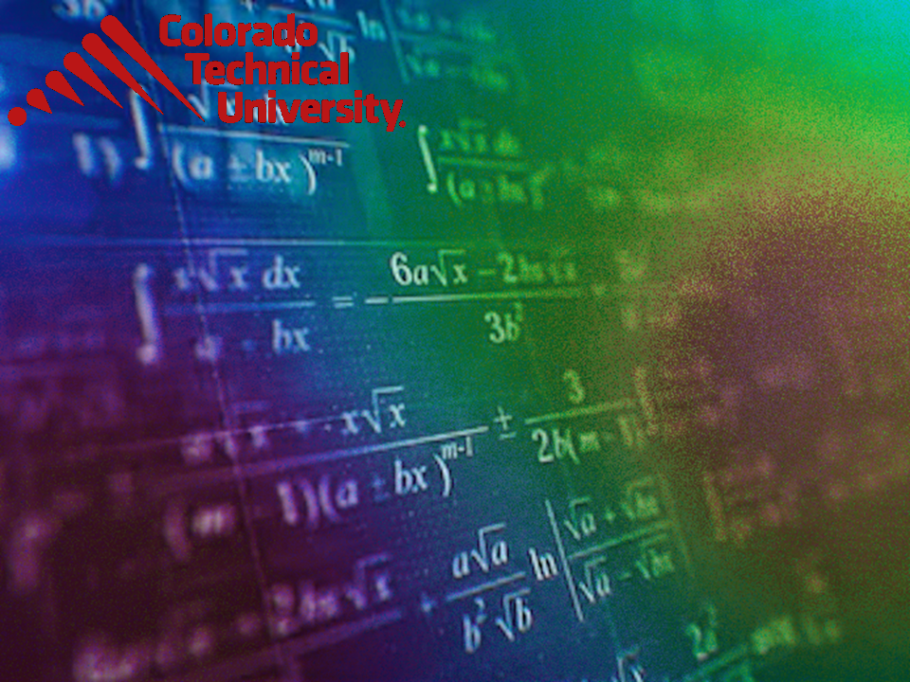
Welcome to
Unit 6 Part 11!
MATH 205 Differential Calculus
https://www.smu.edu.sg/programmes/core-curriculum/course-structure/calculus

Slide 2
What’s Up?
Review:
Implicit differentiation
New stuff:
“Extrema”

Slide 3
What’s Up?
Outcome 1) Demonstrate differentiation skills for linear, polynomial, rational, trigonometric, exponential, and logarithmic functions and proper application of the Product, Quotient and Chain Rules of differentiation
Outcome 2) Use algebra, limits and derivatives to examine the properties and graphs of functions, including finding their extrema, inflection points, and intervals of monotonicity and concavity

Slide 4

Review
http://995642590.r.lightningbase-cdn.com/wp-content/uploads/2010/12/looking-back-hrexaminer-v144-cover425px.jpg

Slide 5
Implicit Differentiation
A special case of the chain rule

Slide 6
Implicit Differentiation
Many functions are written explicitly as a function of x:
y = 3x² – sin(7x + 5)

Slide 7
Implicit Differentiation
Some functions are written implicitly as a function of x:
x² + y² = 25
Ok… that’s not a function… but…

Slide 8
Good News!
You don’t have to solve for “y” to do the differentiation!

Slide 9
Implicit Differentiation
This is especially good news since some functions are really, really hard to solve for “y”

Slide 10
Implicit Differentiation
Just do the derivatives of everything “in place” using all the rules we’ve learned so far

Slide 11

Questions?
http://i.imgur.com/aliTlT3.jpg

Slide 12
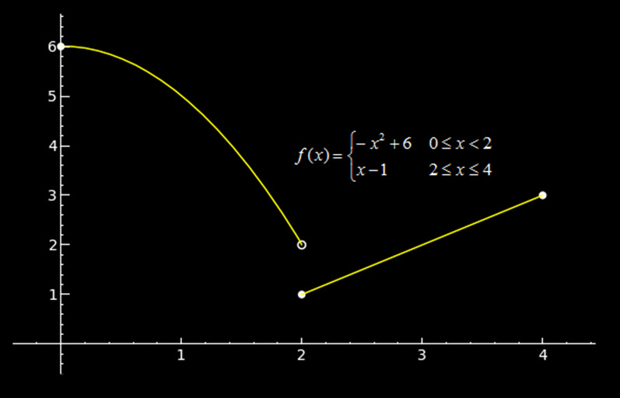
Continuity
Right and Left-Sided Limits
lim = 2
x → 2⁻
lim = 1
x → 2⁺
VFrench 2013

Slide 13
Continuity
But lim does not exist!
x → 2
lim = 2
x → 2⁻
lim = 1
x → 2⁺
VFrench 2013

Slide 14
Continuity
Because there is no unique tangent to the point on the graph at those discontinuous points
VFrench 2013

Slide 15
Continuity
Because there is no unique tangent at those discontinuous points there is no derivative at that point
VFrench 2013

Slide 16
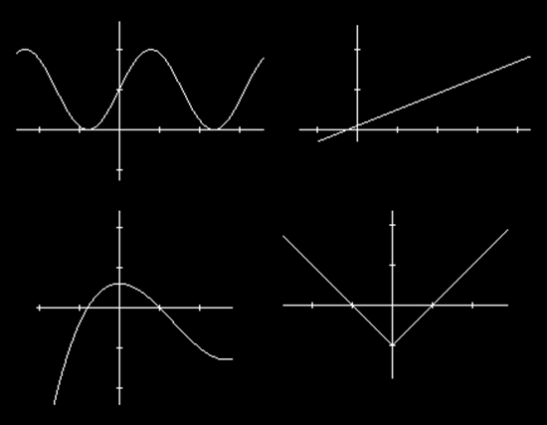
Continuity
Limits/derivatives occur only when graphs are continuous
VFrench 2013

Slide 17
CONTINUITY
IN-CLASS PROBLEM 1
Which graphs are continuous?
VFrench 2013

Slide 18
CONTINUITY
IN-CLASS PROBLEM 1
Which graphs are continuous?
VFrench 2013

Slide 19
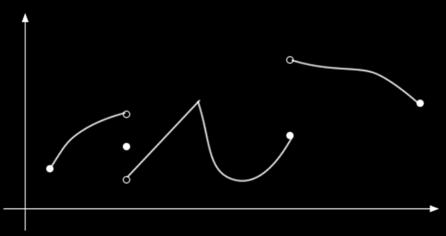
Continuity
If graphs are discontinuous, they are not differentiable at the discontinuous points
VFrench 2013

Slide 20
CONTINUITY
IN-CLASS PROBLEM 2
Where is the graph not differentiable?
VFrench 2013

Slide 21
CONTINUITY
IN-CLASS PROBLEM 2
VFrench 2013

Slide 22
CONTINUITY
IN-CLASS PROBLEM 2
What about pointy-points?
VFrench 2013

Slide 23
CONTINUITY
IN-CLASS PROBLEM 2
Not there either!
Remember a limit is a tangent line – there is no unique line tangent
to a
pointy-
point!
VFrench 2013

Slide 24
CONTINUITY
IN-CLASS PROBLEM 2
VFrench 2013

Slide 25
CONTINUITY
IN-CLASS PROBLEM 1
So “g” is continuous, but not universally differentiable
VFrench 2013

Slide 26
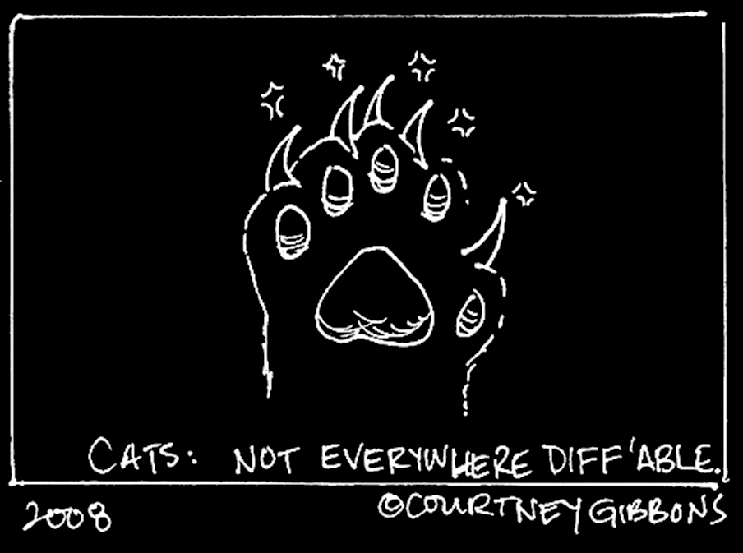

Slide 27
Questions?
http://i.imgur.com/aliTlT3.jpg

Slide 28
Extrema
Functions can have "hills and cups": places where they reach a minimum or maximum value

Slide 29
Extrema
At the highest point of the hill is a maximum value
At the lowest point in the cup there is a minimum

Slide 30
Extrema
The plural of maximum
is maxima
The plural of minimum is minima
Maxima and minima are
collectively called extrema

Slide 31
Extrema
The maximum or minimum over the entire function is called an "Absolute" or "Global" maximum or minimum

Slide 32
Extrema
A local maximum is the point where the height of the function is greater than (or equal to) the height anywhere else in that interval
Similar for a local minimum

Slide 33
Extrema
There is only one global maximum (and one global minimum) but there can be more than one local maximum or
minimum

Slide 34
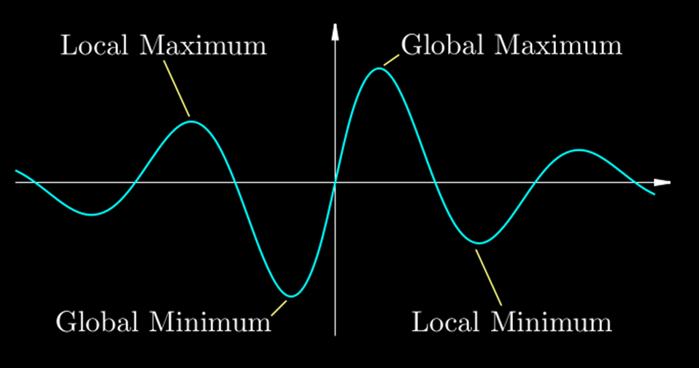
Extrema
VFrench 2013

Slide 35
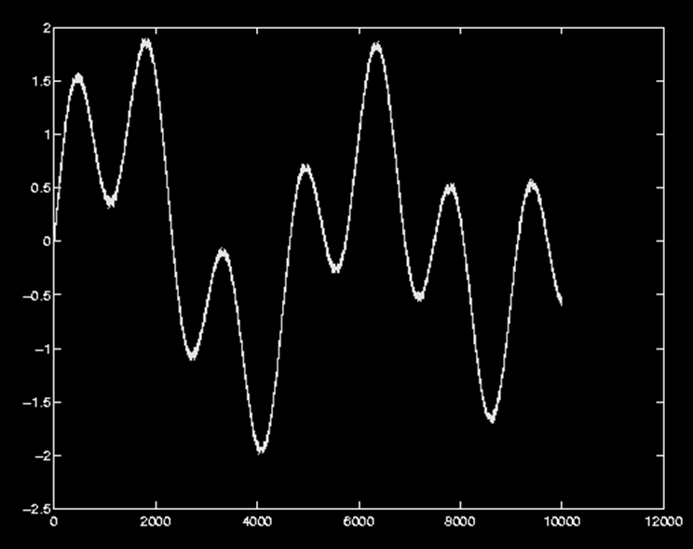
EXTREMA
IN-CLASS PROBLEM 3
Circle the local maxima and minima and mark the global maximum and minimum with Xs:
VFrench 2013

Slide 36
EXTREMA
IN-CLASS PROBLEM 3
Circle the local maxima and minima and mark the global maximum and minimum with Xs:
VFrench 2013

Slide 37
EXTREMA
IN-CLASS PROBLEM 3
Circle the local maxima and minima and mark the global maximum and minimum with Xs:
VFrench 2013

Slide 38
Questions?
http://i.imgur.com/aliTlT3.jpg

Slide 39
Extrema
The maximums and minimums of a graph occur where the slope of the tangent line (first derivative) is zero!

Slide 40
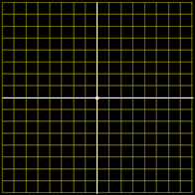
Extrema
4
3
2
1
0
-4
-3
-2
-1
0
1
2
3
4
-1
-2
-3
-4
VFrench 2020

Slide 41
Extrema
That is why the endpoints don’t count!
NOT
NOT

Slide 42
EXTREMA
IN-CLASS PROBLEM 4
Find the absolute maximum and minimum points for the function: ƒ(x) = x² – x
on the interval -2 ≤ x ≤ 2
The maximums and minimums occur where the first derivative is zero

Slide 43
EXTREMA
IN-CLASS PROBLEM 4
Find the absolute maximum and minimum points for the function: ƒ(x) = x² – x
on the interval -2 ≤ x ≤ 2
ƒ'= ?
The maximums and minimums occur where the first derivative is zero

Slide 44
EXTREMA
IN-CLASS PROBLEM 4
Find the absolute maximum and minimum points for the function: ƒ(x) = x² – x
on the interval -2 ≤ x ≤ 2
ƒ'= 2x - 1
Where between -2≤x≤2
is 2x-1=0?
The maximums and minimums occur where the first derivative is zero

Slide 45
EXTREMA
IN-CLASS PROBLEM 4
Find the absolute maximum and minimum points for the function: ƒ(x) = x² – x
on the interval -2 ≤ x ≤ 2
ƒ'= 2x - 1
Where between -2≤x≤2
is 2x-1=0?
Only at x=½
What is ƒ(x) at x=½?

Slide 46
EXTREMA
IN-CLASS PROBLEM 4
Find the absolute maximum and minimum points for the function: ƒ(x) = x² – x
on the interval -2 ≤ x ≤ 2
ƒ'= 2x - 1
Where between -2≤x≤2 is 2x=0?
Only at x=½
What is ƒ(x) at x=½?
ƒ(½) = (½)²-½ = ¼-½ = -¼

Slide 47
EXTREMA
IN-CLASS PROBLEM 4
Find the absolute maximum and minimum points for the function: ƒ(x) = x² – x
on the interval -2 ≤ x ≤ 2
ƒ'= 2x - 1
x=½ y= -¼ Is it a max or a min?

Slide 48

Extrema
OK, a graph works, but there HAS to be a more mathy way to do it!!
http://www.testically.org/wp-content/uploads/2010/11/hmm.jpg

Slide 49

Extrema
OK, a graph works, but there HAS to be a more mathy way to do it!! (there is!)
http://markvanderpool.naiwe.com/files/2013/01/bigstock-Bright-Idea-Kid.jpg

Slide 50
EXTREMA
IN-CLASS PROBLEM 4
One way to do it:
At x=½ ƒ(½) = ¼ - ½ = -¼
At x=1 ƒ(1) = 1 - 1 = 0
At x=0 ƒ(0) = 0 – 0 = 0
Both are bigger than -¼
So x=½ is a minimum
ƒ(x) = x² – x

Slide 51
EXTREMA
IN-CLASS PROBLEM 4
Another Way
ƒ ’ = 2x - 1
At x=½ ƒ ’(½) = 0
a horizontal tangent line
At x=1 ƒ ’(1) = 2-1 = 1
a positive slope tangent line
At x=0 ƒ ’(0) = 0-1 = -1
a negative slope tangent line

Slide 52
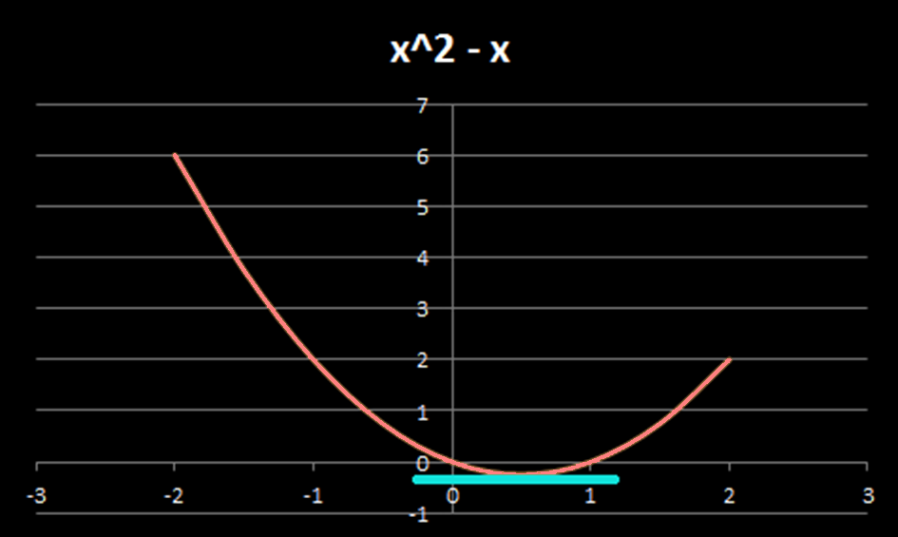
EXTREMA
IN-CLASS PROBLEM 4
VFrench 2013

Slide 53
EXTREMA
IN-CLASS PROBLEM 4
If x = ½ is the minimum, what is the maximum?
They will occur at other ƒ ’=0 points or on one or both of the extremes allowed for the interval

Slide 54
EXTREMA
IN-CLASS PROBLEM 4
Since there are no other ƒ ’=0 locations on the interval
-2 ≤ x ≤ 2
Plug in the two interval extremes in the original equation:
ƒ (2) = 2² – 2 = 4 – 2 = 2
ƒ (-2) = (-2)² – (-2) = 4 + 2 = 6
ƒ(x) = x² – x

Slide 55
EXTREMA
IN-CLASS PROBLEM 4
So, the absolute minimum is found at x=½ y=-¼ or (½,-¼)
And the absolute maximum is found at x=-2 y=6 or (-2,6)

Slide 56
EXTREMA
IN-CLASS PROBLEM 4
VFrench 2013

Slide 57
Extrema
This is called the Max-Min Test

Slide 58

Extrema
extrema of x^2-x
extrema of x^2-x for -2<x<2
(didn’t add anything)
extrema of x^2-x for -2≤x≤2
(worked for the min)

Slide 59
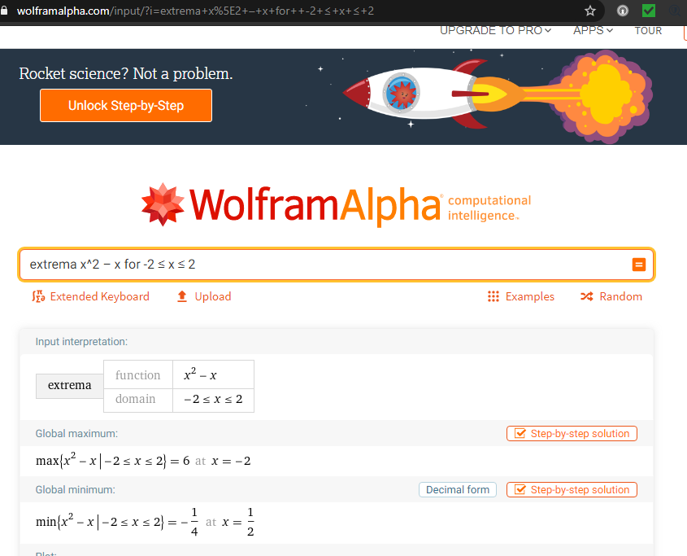

Slide 60
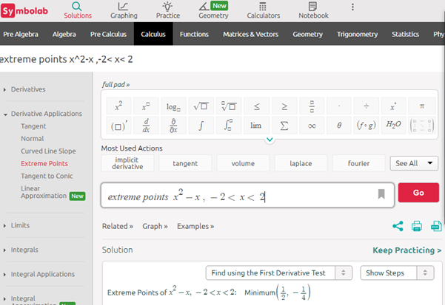

Slide 61
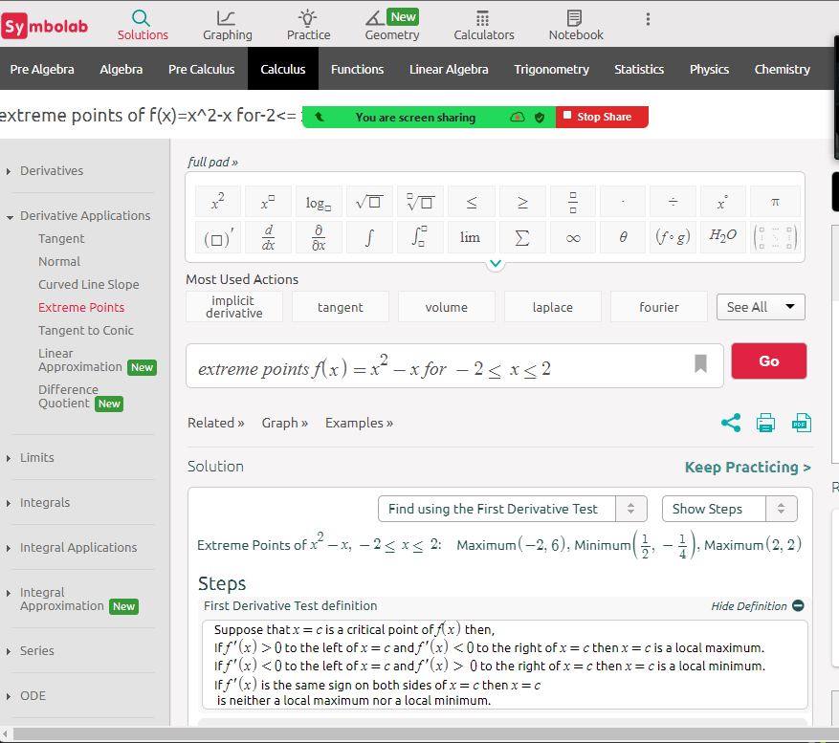

Slide 62
Note:
Wolfram and Symbolab will check the endpoints if you use
≤

Slide 63
Questions?
http://i.imgur.com/aliTlT3.jpg

Slide 64
EXTREMA
IN-CLASS PROBLEM 5
The power delivered to a load resistance of R ohms from a 10-volt generator with internal resistance of 8 ohms is modeled by: P = 100R/(64+16R+R²) watts
Find the value of R that allows maximum power
The maximums and minimums occur where the first derivative is zero

Slide 65
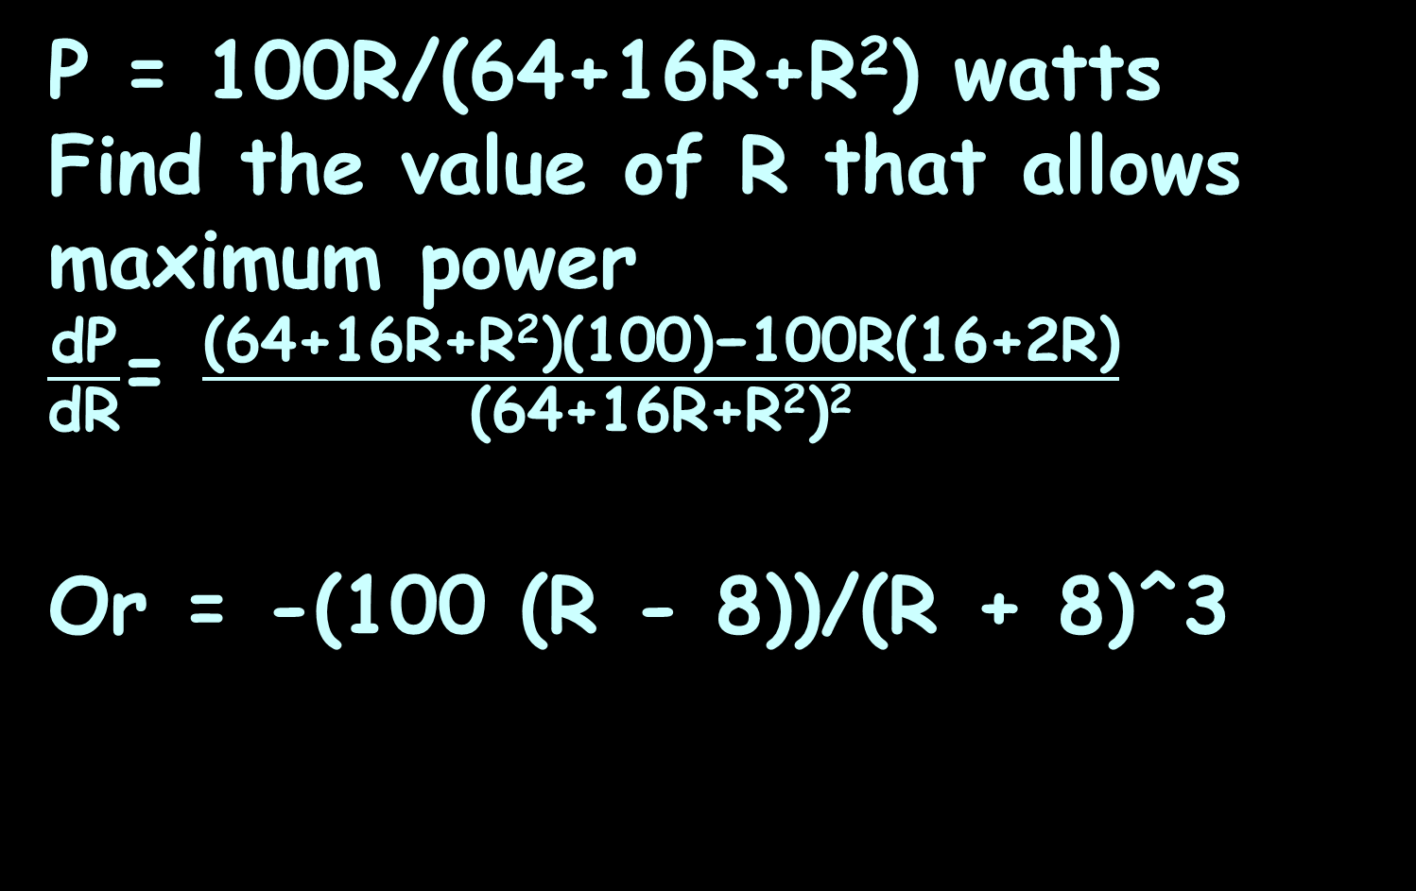
EXTREMA
IN-CLASS PROBLEM 5
P = 100R/(64+16R+R²) watts
Find the value of R that allows maximum power
$\frac{\text{dP}}{\text{d}\text{R}}$= $\frac{\text{(64+16}\text{R}\text{+}\text{R}\text{2}\text{)(100)−100}\text{R}\text{(16+2}\text{R}\text{)}}{\text{(}\text{64+16}\text{R}\text{+}\text{R}\text{2}\text{)}\text{2}}$
Or = -(100 (R - 8))/(R + 8)^3
Trust me…
Quotient Rule
The maximums and minimums occur where the first derivative is zero

Slide 66
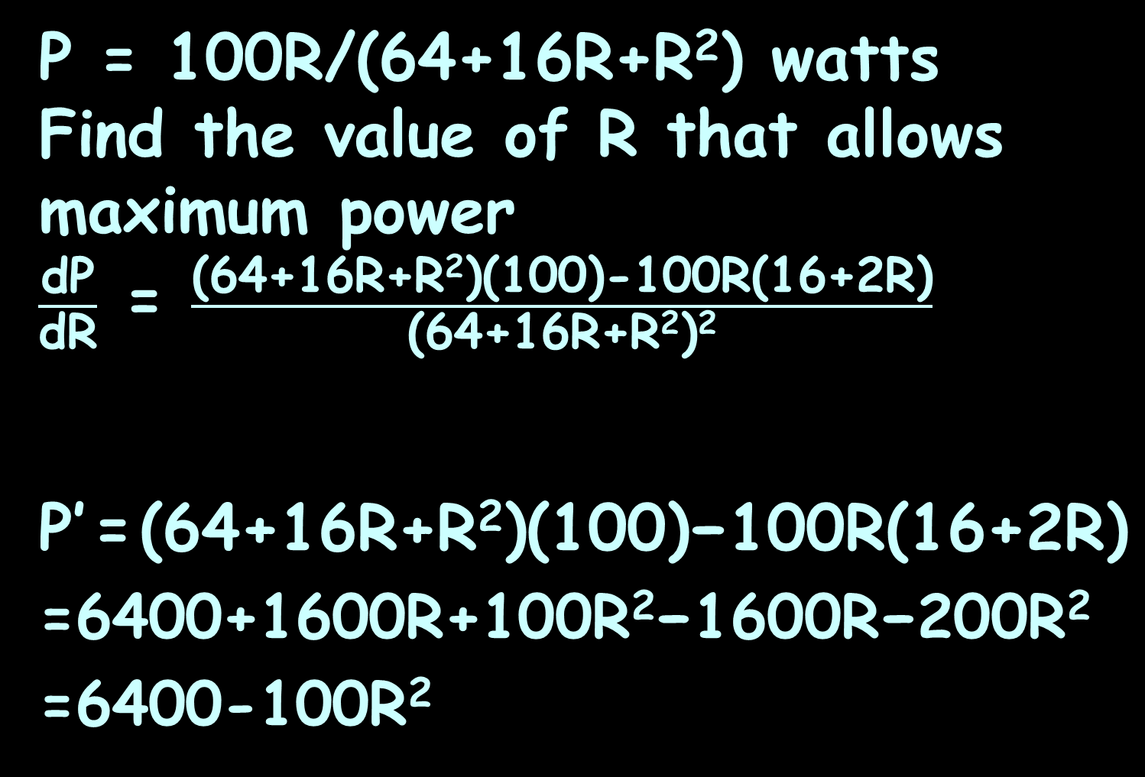
EXTREMA
IN-CLASS PROBLEM 5
P = 100R/(64+16R+R²) watts
Find the value of R that allows maximum power
$\frac{\text{dP}}{\text{d}\text{R}}$ = $\frac{\text{(64+16}\text{R}\text{+}\text{R}\text{2}\text{)(100)−100}\text{R}\text{(16+2}\text{R}\text{)}}{\text{(}\text{64+16}\text{R}\text{+}\text{R}\text{2}\text{)}\text{2}}$
P’ = $\text{(64+16}\text{R}\text{+}\text{R}\text{2}\text{)(100)−100}\text{R}\text{(16+2}\text{R}\text{)}$
=6400+1600R+100$\text{R}\text{2}\text{−}$1600R$\text{−}$200$\text{R}\text{2}$
=6400-100$\text{R}\text{2}$
Trust me…
When a ratio is set equal to zero, you can drop the denominator
The maximums and minimums occur where the first derivative is zero

Slide 67
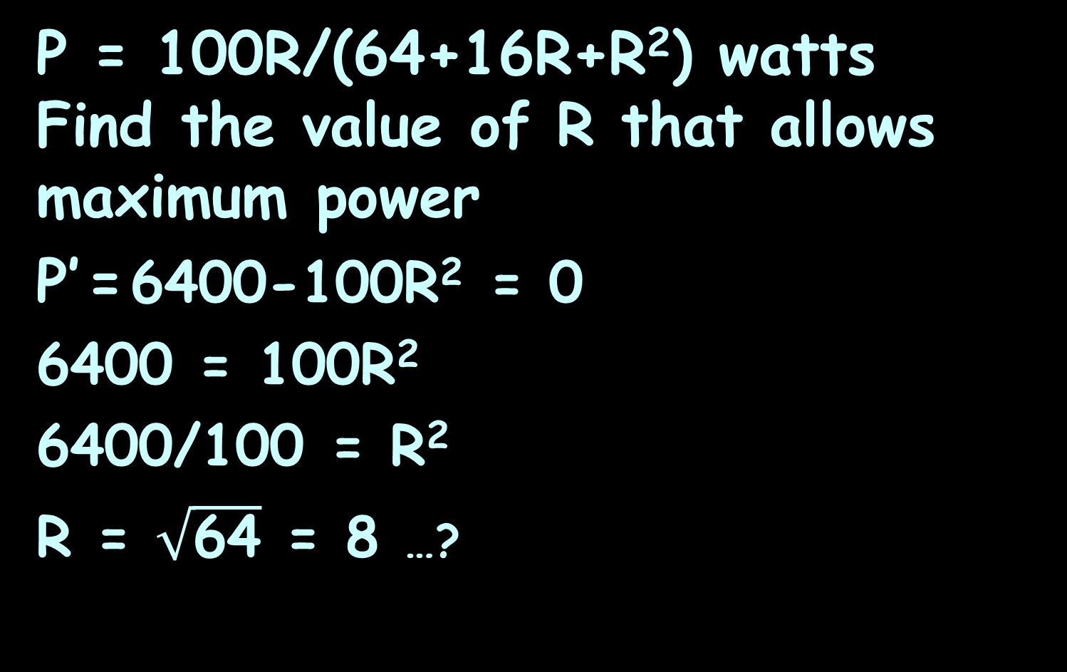
EXTREMA
IN-CLASS PROBLEM 5
P = 100R/(64+16R+R²) watts
Find the value of R that allows maximum power
P’ = 6400-100$\text{R}\text{2}$ = 0
6400 = 100$\text{R}\text{2}$
6400/100 = $\text{R}\text{2}$
R = $\sqrt{\text{64}}$ = 8 …?
800-100R = 0
R = 800/100
= 8 ...

Slide 68
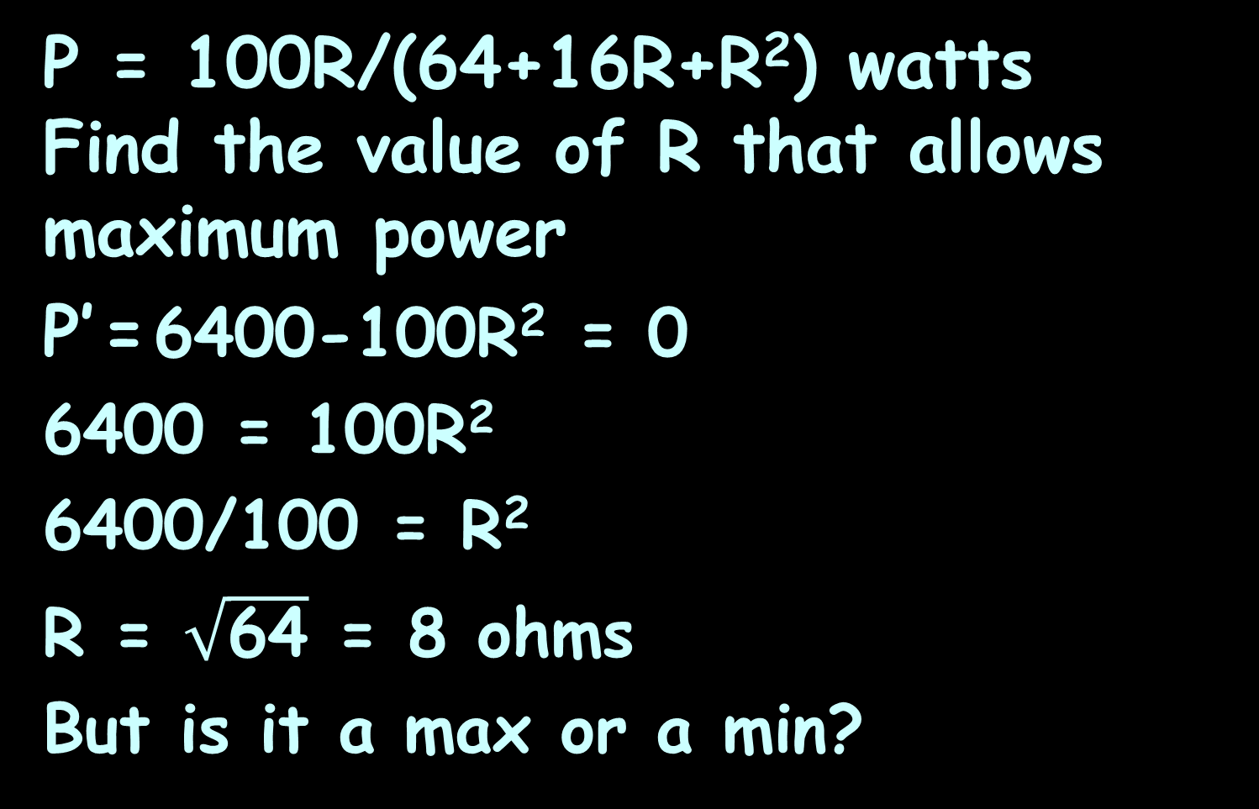
EXTREMA
IN-CLASS PROBLEM 5
P = 100R/(64+16R+R²) watts
Find the value of R that allows maximum power
P’ = 6400-100$\text{R}\text{2}$ = 0
6400 = 100$\text{R}\text{2}$
6400/100 = $\text{R}\text{2}$
R = $\sqrt{\text{64}}$ = 8 ohms
But is it a max or a min?

Slide 69
EXTREMA
IN-CLASS PROBLEM 5
P = 100R/(64+16R+R²) watts
Find the value of R that allows maximum power
P’=0 at R=8 ohms
But is it a max or a min?
Using P=100R/(64+16R+R²)
plug in R=7.9 and R=8.1 and compare the value to R=8

Slide 70
EXTREMA
IN-CLASS PROBLEM 5
P = 100R/(64+16R+R²) watts
Find the value of R that allows maximum power
P’=0 at R=8 ohms
But is it a max or a min?
P(R=7.9) ≈ 3.1249
P(R=8) ≈ 3.1250
P(R=8.1) ≈ 3.1249

Slide 71
EXTREMA
IN-CLASS PROBLEM 5
P = 100R/(64+16R+R²) watts
Find the value of R that allows maximum power
P’=0 at R=8 ohms
P(R=7.9) ≈ 3.1249
P(R=8) ≈ 3.1250
P(R=8.1) ≈ 3.1249
So P (3.1250 watts) is a max at R=8 ohms

Slide 72
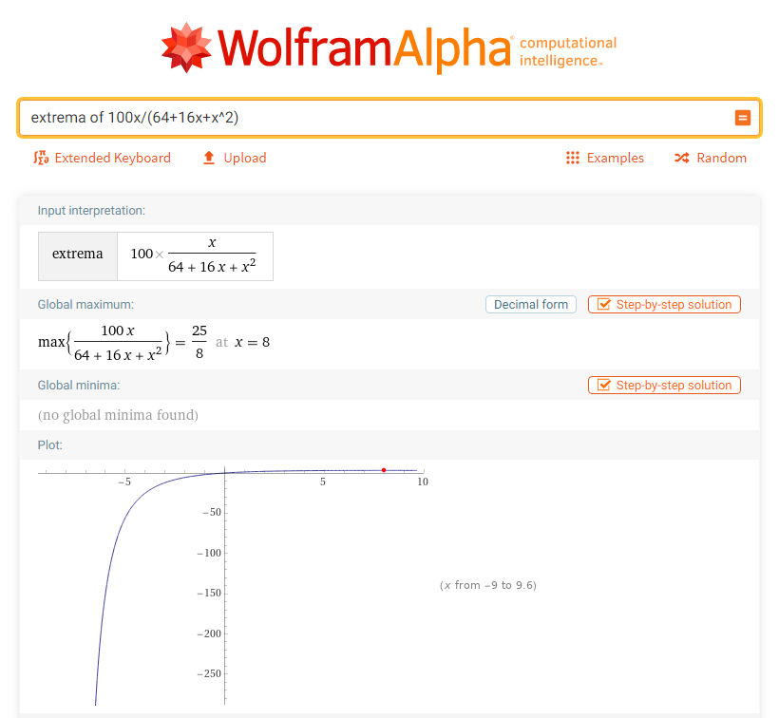

Slide 73
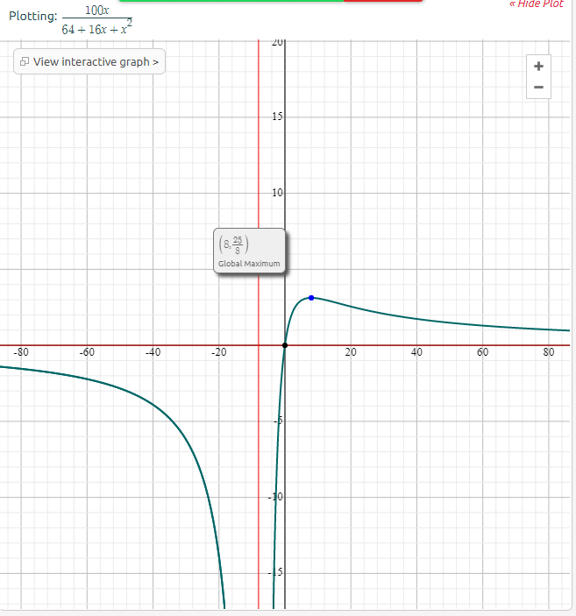

Slide 74
Questions?
http://i.imgur.com/aliTlT3.jpg

Slide 75
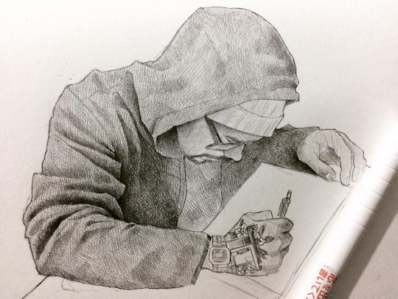
Shape of a Curve
Back in the day, it was hard to graph stuff
Art made by Mexican artist Efrain Malo

Slide 76
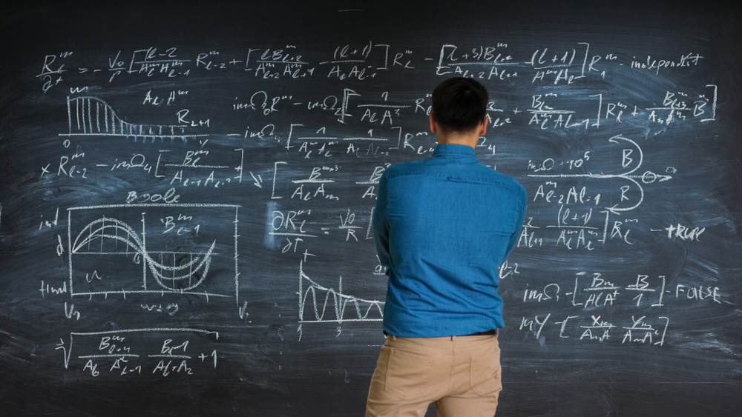
Shape of a Curve
Mathematicians were called on to come up with ways to know the shape of a graph without having to draw it
https://insights.dice.com/2019/08/16/mathematicians-hot-focus-nationwide-job-postings/

Slide 77
Shape of a Curve
Differential calculus can do that!
https://elcorreoweb.es/extra/karen-uhlenbeck-primera-mujer-que-gana-el-nobel-de-matematicas-AI5129929

Slide 78
Shape of a Curve
Maxima and minima occur where the first derivative is zero

Slide 79
Shape of a Curve
Points of inflection (where the graph changes direction) are also useful
https://www.mathsisfun.com/calculus/inflection-points.html

Slide 80
Shape of a Curve
Concave upward
is when the
slope increases
moving from
left to right
Also called “convex” or “convex downward”
https://www.mathsisfun.com/calculus/inflection-points.html

Slide 81
Shape of a Curve
Concave
downward
is when the
slope decreases
moving from
left to right
Also called “concave” or “convex upward”
https://www.mathsisfun.com/calculus/inflection-points.html

Slide 82
Shape of a Curve
An inflection point is where a curve changes from concave upward to concave downward (or vice versa)
Concave
upward
Concave
upward
Concave
downward
Concave
downward
Concave
upward
Concave
downward
https://www.mathsisfun.com/calculus/inflection-points.html

Slide 83
Shape of a Curve
So our task is to find where a curve goes from concave upward to concave downward (or vice versa)

Slide 84
Shape of a Curve
Derivatives help us!
The derivative of a function gives the slope
The second derivative tells us if the slope increases or decreases

Slide 85
Shape of a Curve
When the second derivative is positive, the function is concave upward (cup)
When the second derivative is negative, the function is concave downward (hill)

Slide 86
Shape of a Curve
And the inflection point is where it goes from concave upward to concave downward (or vice versa)

Slide 87
SHAPE OF A CURVE
IN-CLASS PROBLEM 6
Describe the shape of:
y = 5x³ + 3x² − 3x
y' = 15x² + 6x − 3
Hint: take the second derivative

Slide 88
SHAPE OF A CURVE
IN-CLASS PROBLEM 6
Describe the shape of:
y = 5x³ + 3x² − 3x
y' = 15x² + 6x − 3
y" =
Hint: take the second derivative

Slide 89
SHAPE OF A CURVE
IN-CLASS PROBLEM 6
Describe the shape of:
y = 5x³ + 3x² − 3x
y' = 15x² + 6x − 3
y" = 30x + 6
Where is y’’ zero? (that will be the inflection point)

Slide 90
SHAPE OF A CURVE
IN-CLASS PROBLEM 6
Describe the shape of:
y = 5x³ + 3x² − 3x
y' = 15x² + 6x − 3
y’’ = 30x + 6
Where is y’’ zero? -0.2
Where is y’’ negative?
Where is y’’ positive?

Slide 91
SHAPE OF A CURVE
IN-CLASS PROBLEM 6
Describe the shape of:
y = 5x³ + 3x² − 3x
y’’ = 30x + 6
30x + 4 is negative up to
x = -0.2 and
positive from there onwards

Slide 92
SHAPE OF A CURVE
IN-CLASS PROBLEM 6
Describe the shape of:
y = 5x³ + 3x² − 3x
y’’ = 30x + 6
So the graph is concave downward (hill-shaped) up to x = −0.2 (the inflection point) and concave upward (cup shaped) from x = −0.2 onward

Slide 93
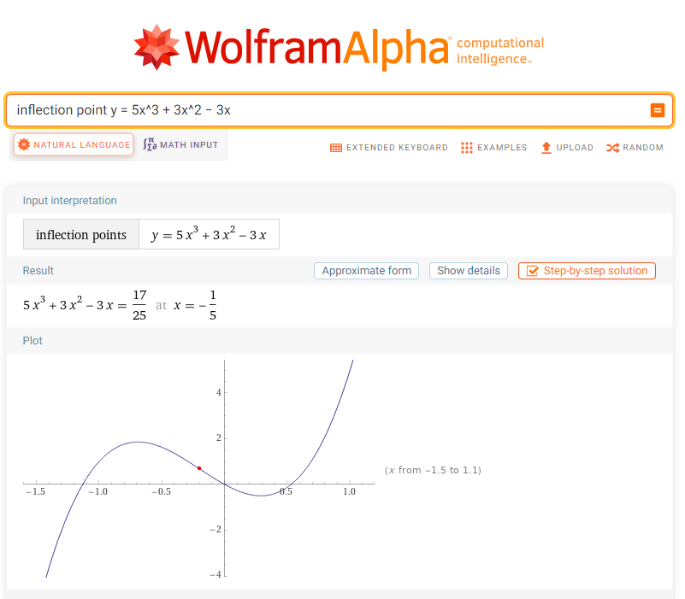

Slide 94
Questions?
http://i.imgur.com/aliTlT3.jpg

Slide 95
SHAPE OF A CURVE
IN-CLASS PROBLEM 7
A GE2P3 break back diode has its characteristic curve modeled by V=0.079I³-2.31I²+15.6I+22 volts
when I is measured in mA (milli amps). Find the V_{max} (called V_{BO} break over voltage) and V_{min} (called V_{BB} break back voltage)
Diode - an electrical component that allows the flow of current in only one direction
For diodes, the breakdown voltage is the minimum reverse voltage that makes the diode conduct appreciably in reverse

Slide 96
SHAPE OF A CURVE
IN-CLASS PROBLEM 7
V=0.079I³-2.31I²+15.6I+22 volts
Find V_{max} and V_{min}
What derivative do we want?

Slide 97

SHAPE OF A CURVE
IN-CLASS PROBLEM 7
V=0.079I³-2.31I²+15.6I+22 volts
Find V_{max} and V_{min}
What derivative do we want?
$\frac{\text{dV}}{\text{dI}}$ = ?

Slide 98
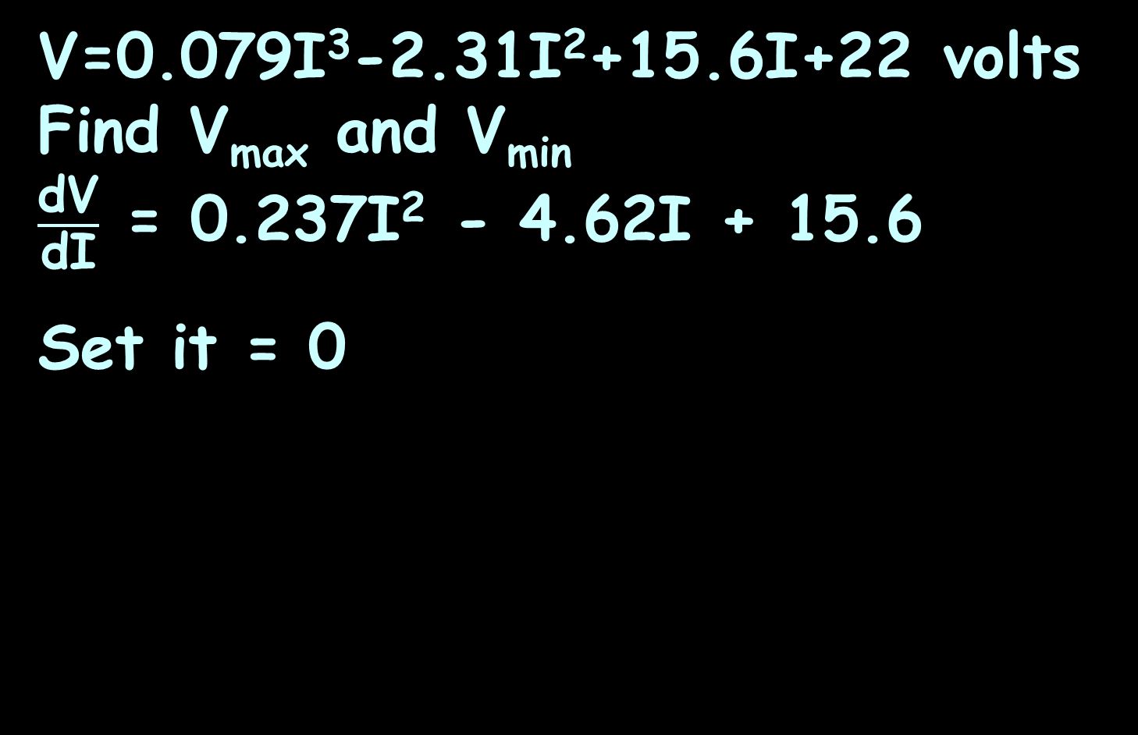
SHAPE OF A CURVE
IN-CLASS PROBLEM 7
V=0.079I³-2.31I²+15.6I+22 volts
Find V_{max} and V_{min}
$\frac{\text{dV}}{\text{dI}}$ = 0.237I² - 4.62I + 15.6
Set it = 0

Slide 99
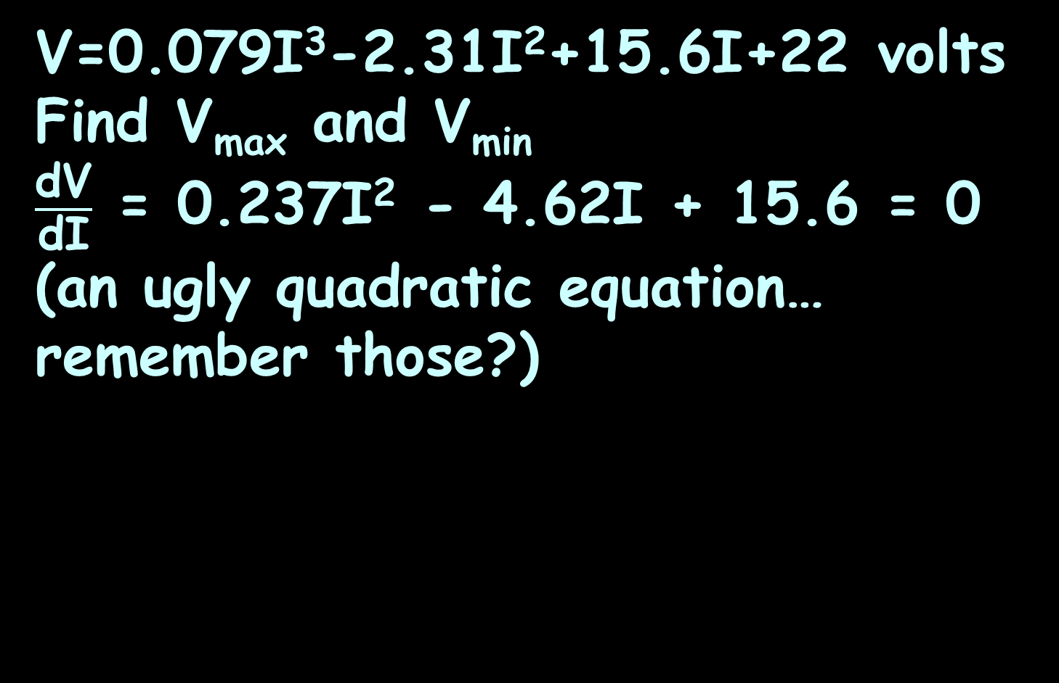
SHAPE OF A CURVE
IN-CLASS PROBLEM 7
V=0.079I³-2.31I²+15.6I+22 volts
Find V_{max} and V_{min}
$\frac{\text{dV}}{\text{dI}}$ = 0.237I² - 4.62I + 15.6 = 0
(an ugly quadratic equation… remember those?)

Slide 100
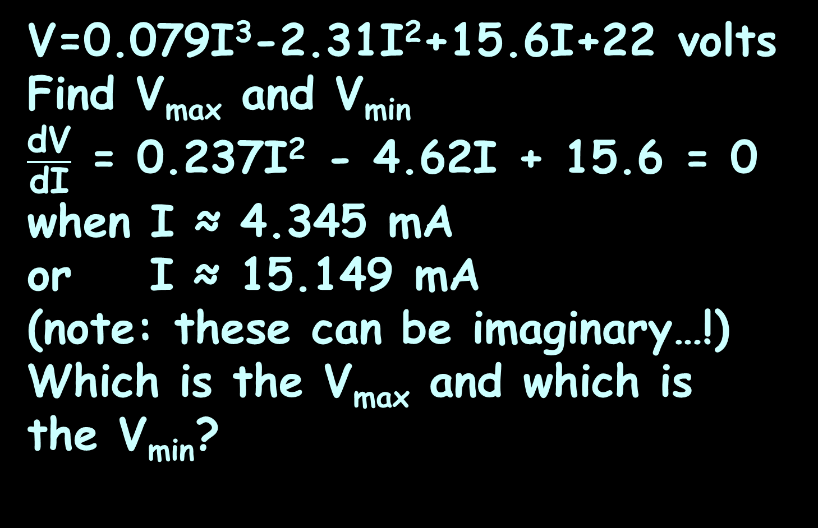
SHAPE OF A CURVE
IN-CLASS PROBLEM 7
V=0.079I³-2.31I²+15.6I+22 volts
Find V_{max} and V_{min}
$\frac{\text{dV}}{\text{dI}}$ = 0.237I² - 4.62I + 15.6 = 0
when I ≈ 4.345 mA
or I ≈ 15.149 mA
(note: these can be imaginary…!)
Which is the V_{max} and which is
the V_{min}?

Slide 101
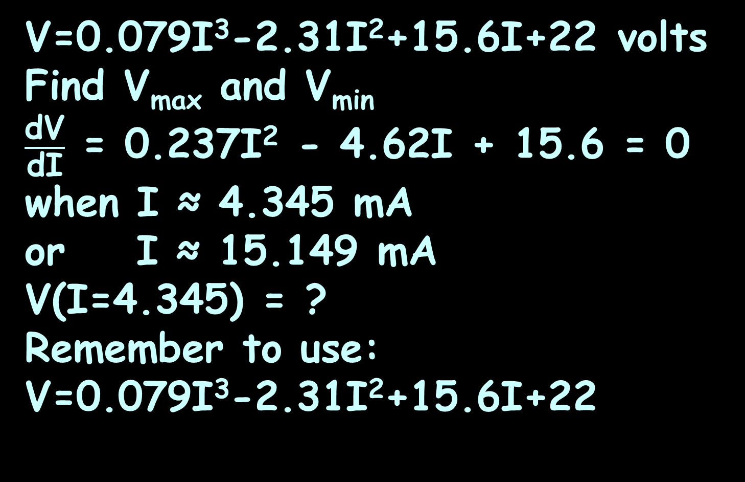
SHAPE OF A CURVE
IN-CLASS PROBLEM 7
V=0.079I³-2.31I²+15.6I+22 volts
Find V_{max} and V_{min}
$\frac{\text{dV}}{\text{dI}}$ = 0.237I² - 4.62I + 15.6 = 0
when I ≈ 4.345 mA
or I ≈ 15.149 mA
V(I=4.345) = ?
Remember to use:
V=0.079I³-2.31I²+15.6I+22

Slide 102
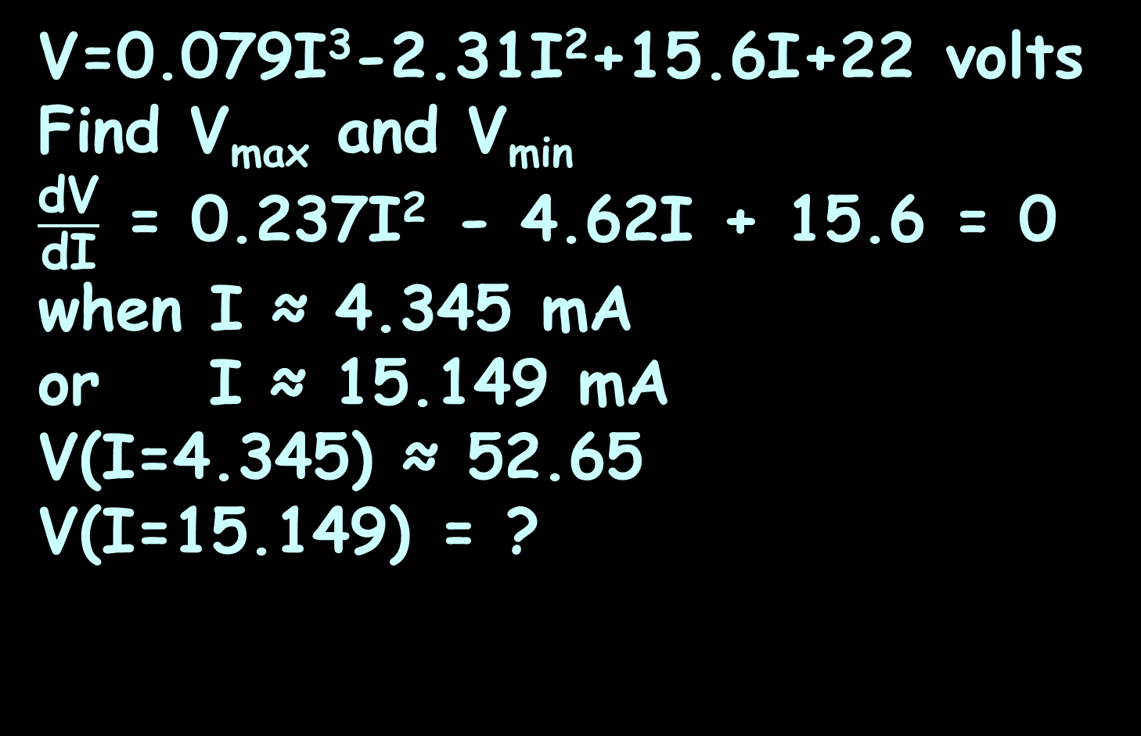
SHAPE OF A CURVE
IN-CLASS PROBLEM 7
V=0.079I³-2.31I²+15.6I+22 volts
Find V_{max} and V_{min}
$\frac{\text{dV}}{\text{dI}}$ = 0.237I² - 4.62I + 15.6 = 0
when I ≈ 4.345 mA
or I ≈ 15.149 mA
V(I=4.345) ≈ 52.65
V(I=15.149) = ?

Slide 103
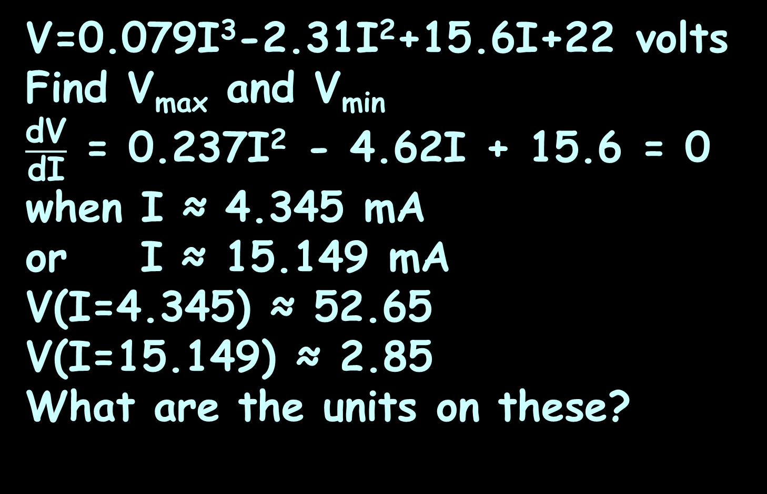
SHAPE OF A CURVE
IN-CLASS PROBLEM 7
V=0.079I³-2.31I²+15.6I+22 volts
Find V_{max} and V_{min}
$\frac{\text{dV}}{\text{dI}}$ = 0.237I² - 4.62I + 15.6 = 0
when I ≈ 4.345 mA
or I ≈ 15.149 mA
V(I=4.345) ≈ 52.65
V(I=15.149) ≈ 2.85
What are the units on these?

Slide 104
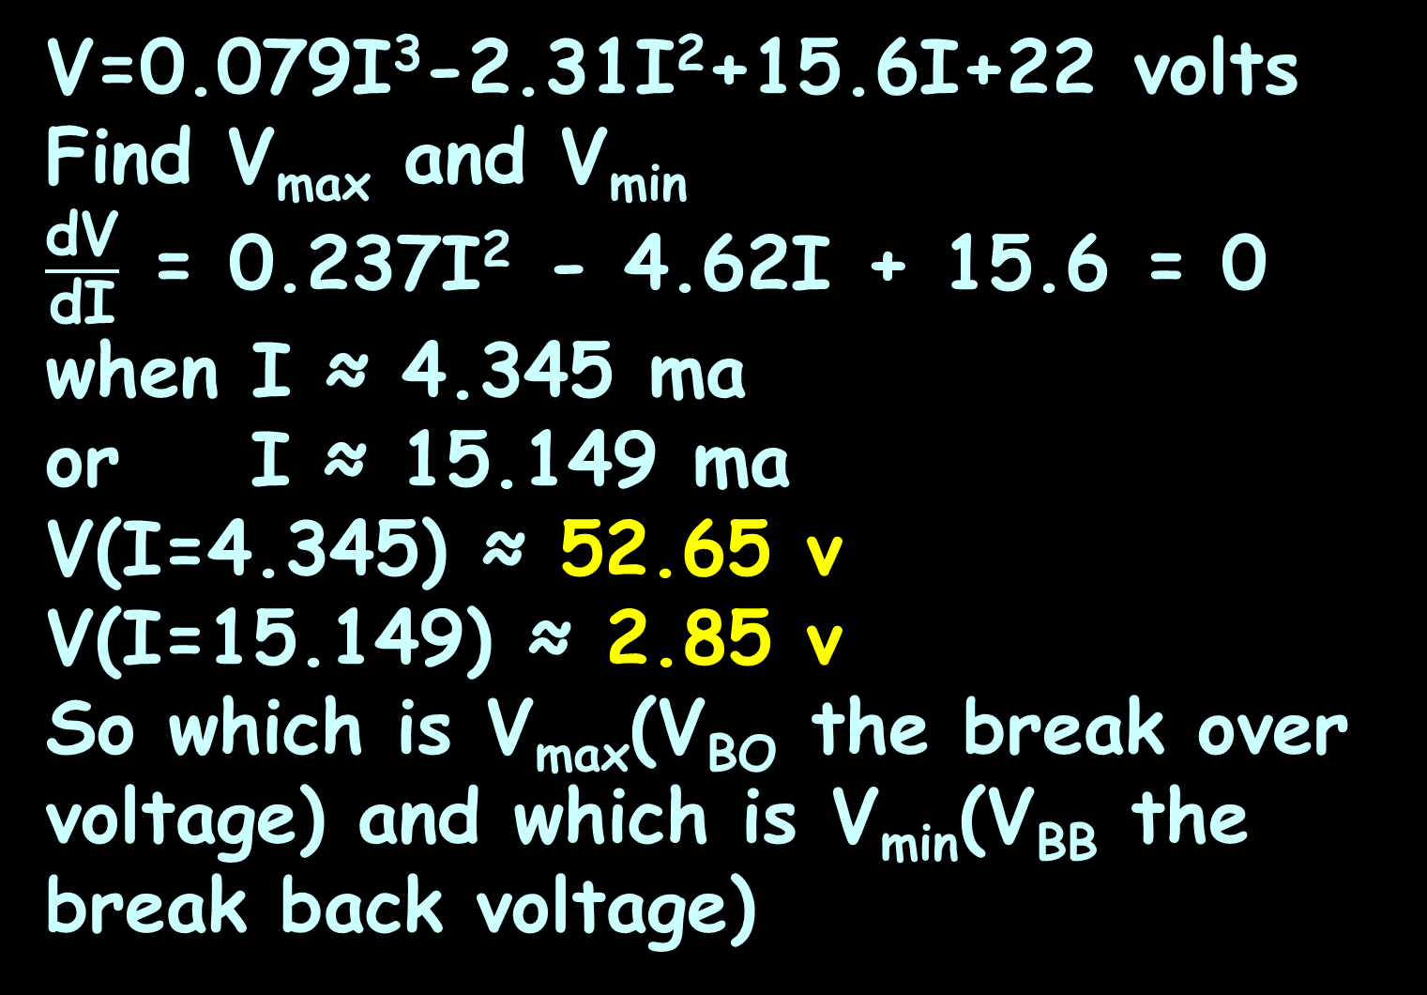
SHAPE OF A CURVE
IN-CLASS PROBLEM 7
V=0.079I³-2.31I²+15.6I+22 volts
Find V_{max} and V_{min}
$\frac{\text{dV}}{\text{dI}}$ = 0.237I² - 4.62I + 15.6 = 0
when I ≈ 4.345 ma
or I ≈ 15.149 ma
V(I=4.345) ≈ 52.65 v
V(I=15.149) ≈ 2.85 v
So which is V_{max}(V_{BO} the break over voltage) and which is V_{min}(V_{BB} the break back voltage)

Slide 105
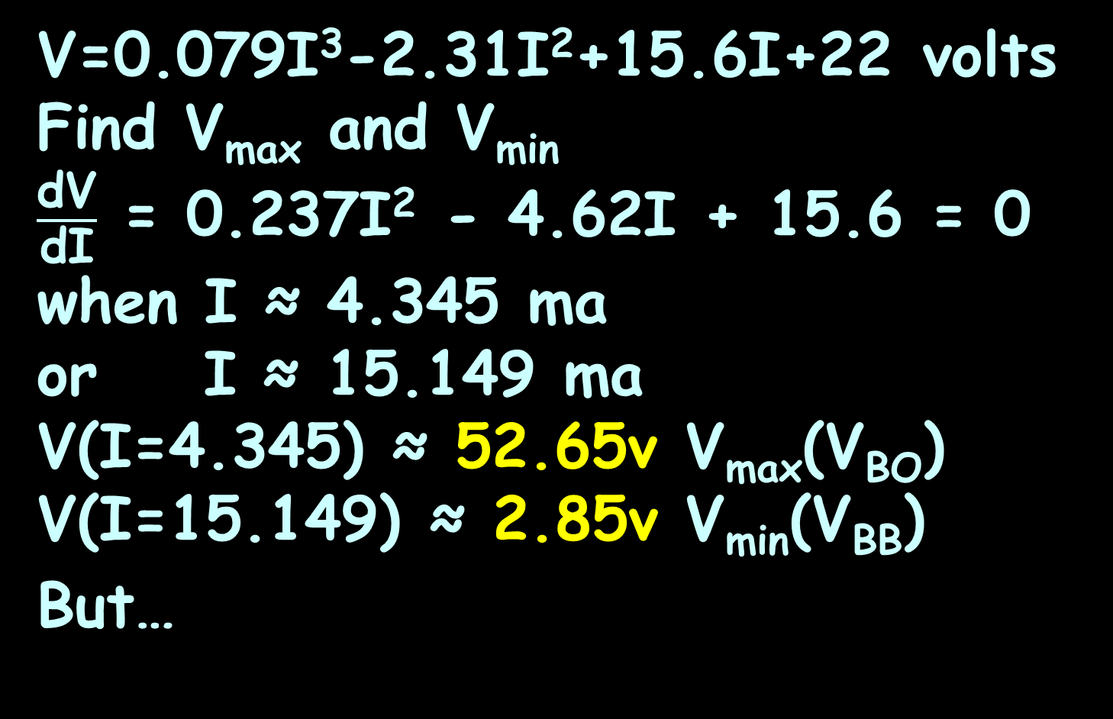
SHAPE OF A CURVE
IN-CLASS PROBLEM 7
V=0.079I³-2.31I²+15.6I+22 volts
Find V_{max} and V_{min}
$\frac{\text{dV}}{\text{dI}}$ = 0.237I² - 4.62I + 15.6 = 0
when I ≈ 4.345 ma
or I ≈ 15.149 ma
V(I=4.345) ≈ 52.65v V_{max}(V_{BO})
V(I=15.149) ≈ 2.85v V_{min}(V_{BB})
But…

Slide 106
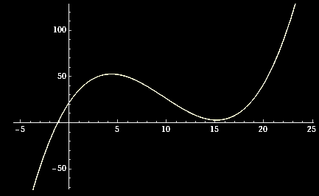
SHAPE OF A CURVE
IN-CLASS PROBLEM 8
V=0.079I³-2.31I²+15.6I+22 volts
Where is the inflection point?
P
52.65v
I
2.85v
VFrench, 2020

Slide 107
SHAPE OF A CURVE
IN-CLASS PROBLEM 8
V=0.079I³-2.31I²+15.6I+22 volts
Where is the inflection point?
What do we need to calculate?
P
52.65v
I
2.85v
VFrench, 2020

Slide 108
SHAPE OF A CURVE
IN-CLASS PROBLEM 8
V=0.079I³-2.31I²+15.6I+22 volts
Where is the inflection point?
V’ = 0.237I² - 4.62I + 15.6
V’’ = ?
V
52.65v
I
2.85v
VFrench, 2020

Slide 109
SHAPE OF A CURVE
IN-CLASS PROBLEM 8
V=0.079I³-2.31I²+15.6I+22 volts
Where is the inflection point?
V’ = 0.237I² - 4.62I + 15.6
V’’ = 0.474I – 4.62
Now what?
V
52.65v
I
2.85v
VFrench, 2020

Slide 110
SHAPE OF A CURVE
IN-CLASS PROBLEM 8
V=0.079I³-2.31I²+15.6I+22 volts
Where is the inflection point?
V’ = 0.237I² - 4.62I + 15.6
V’’ = 0.474I – 4.62 = 0
when I = ?
V
52.65v
I
2.85v
VFrench, 2020

Slide 111
SHAPE OF A CURVE
IN-CLASS PROBLEM 8
V=0.079I³-2.31I²+15.6I+22 volts
Where is the inflection point?
V’ = 0.237I² - 4.62I + 15.6
V’’ = 0.474I – 4.62 = 0
when I ≈ 9.7468 …?
V
52.65v
I
2.85v
VFrench, 2020

Slide 112
SHAPE OF A CURVE
IN-CLASS PROBLEM 8
V=0.079I³-2.31I²+15.6I+22 volts
Where is the inflection point?
V’ = 0.237I² - 4.62I + 15.6
V’’ = 0.474I – 4.62 = 0
when I ≈ 9.7468 mA
V
52.65v
I
2.85v
9.7468 mA
VFrench, 2020

Slide 113
SHAPE OF A CURVE
IN-CLASS PROBLEM 8
Describe the curve for:
V=0.079I³-2.31I²+15.6I+22 volts
V
52.65v
I
4.345 mA
2.85v
15.149 mA
9.75 mA
VFrench, 2020

Slide 114
SHAPE OF A CURVE
IN-CLASS PROBLEM 8
Describe the curve for:
V=0.079I³-2.31I²+15.6I+22 volts
The graph is concave downward (hill) (with a max of 52.65v at I=4.345mA) up to I=9.75mA and concave upward (cup) (with a min of 2.85v at I=15.149mA
beyond that point)
52.65v
4.345 mA
2.85v
15.149 mA
9.75 mA
VFrench, 2020

Slide 115
Questions?
http://i.imgur.com/aliTlT3.jpg

Slide 116
Monotonicity
A function is called “increasing” (or non-decreasing) if its values are only rising and never falling with increasing values of x
It is strictly increasing if values always become larger and cannot be constant

Slide 117
Monotonicity
A function is called “decreasing” (or non-increasing) if its values are only falling and never rising with increasing values of x
It is strictly decreasing if values always become smaller and cannot be constant

Slide 118
Monotonicity
If a function is either increasing, strictly increasing, decreasing, or strictly decreasing, the function is called monotonic

Slide 119
Monotonicity
If a function either increasing, strictly increasing, decreasing, or strictly decreasing, the function is called monotonic
Some are globally monotonic, most are over intervals

Slide 120
Monotonicity
To find the monotonicity of a function, we use the first derivative
The derivative is positive at a point if the function is rising and negative if it is falling

Slide 121
Monotonicity
The root of the derivative (where dy/dx=0) is a point at which the function is neither increasing nor decreasing
If the derivative has at least one root, the entire function cannot be strictly increasing or strictly decreasing

Slide 122
Monotonicity
If no root can be found, we can evaluate the derivative equation at any point to determine that the function is strictly increasing if it is positive, or strictly decreasing if it is negative

Slide 123
Monotonicity
If it has one or more roots, we can still determine its monotonicity in the intervals between the roots

Slide 124
Monotonicity
Alternatively, we can determine the monotonicity using the second derivative equation and evaluate it at the roots of the first derivative that we found already

Slide 125
Monotonicity
If the second derivative is positive, the monotonicity changed from falling to rising, and if it is negative it changes from rising to falling

Slide 126
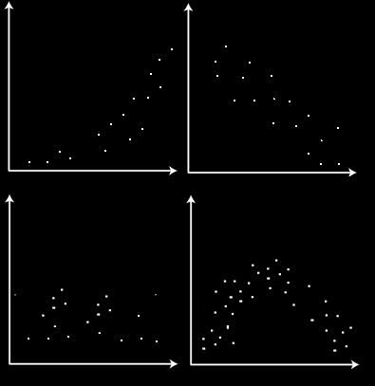
MONOTONICITY
IN-CLASS PROBLEM 9
Is the data trend monotonic?
https://www.tekportal.net/wp-content/uploads/2018/11/monotonically.png

Slide 127
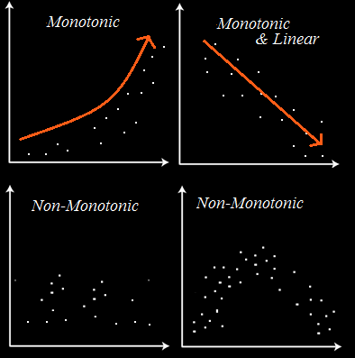
MONOTONICITY
IN-CLASS PROBLEM 9
Is the data trend monotonic?
https://www.tekportal.net/wp-content/uploads/2018/11/monotonically.png

Slide 128
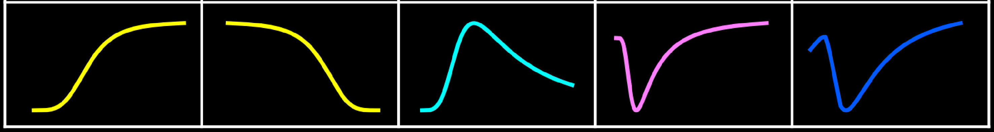
MONOTONICITY
IN-CLASS PROBLEM 10
Is the graph monotonic?
https://pdfs.semanticscholar.org/b1e4/67bfb6886b327f76a5bb2e91c3a634042bc9.pdf

Slide 129
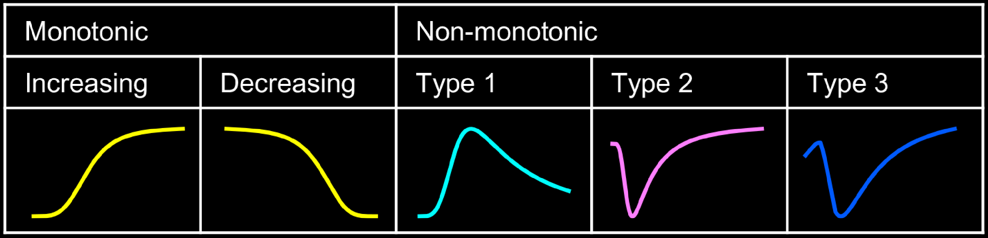
MONOTONICITY
IN-CLASS PROBLEM 10
Is the graph monotonic?
https://pdfs.semanticscholar.org/b1e4/67bfb6886b327f76a5bb2e91c3a634042bc9.pdf

Slide 130
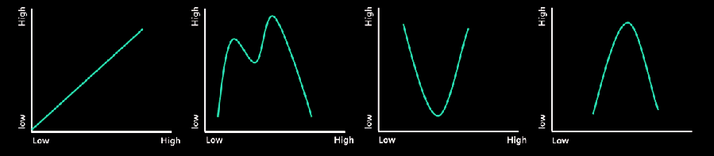
MONOTONICITY
IN-CLASS PROBLEM 11
Is the graph monotonic?
https://www.researchgate.net/figure/Examples-of-monotonic-and-non-monotonic-dose-response-curve_fig1_317419279

Slide 131
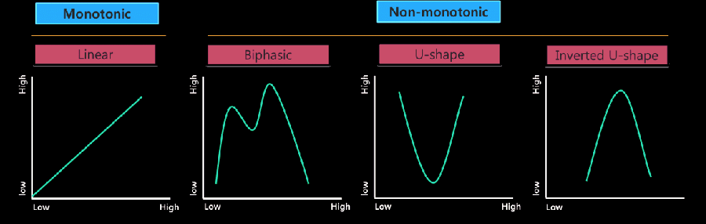
MONOTONICITY
IN-CLASS PROBLEM 11
Is the graph monotonic?
https://www.researchgate.net/figure/Examples-of-monotonic-and-non-monotonic-dose-response-curve_fig1_317419279

Slide 132
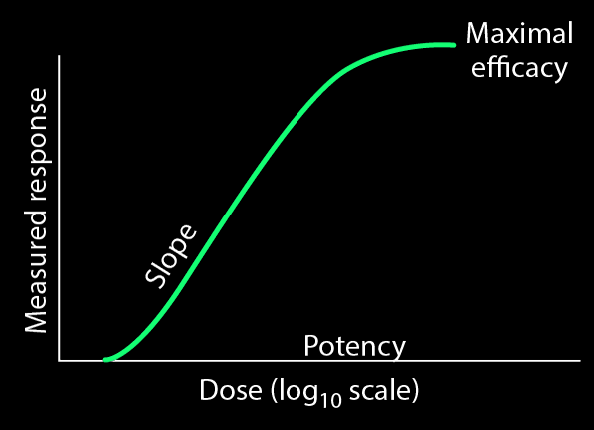
What Is This Used For?
Monotonicity is used a lot in drug dose response studies and in genetic response studies
https://www.merckmanuals.com/professional/clinical-pharmacology/pharmacodynamics/dose-response-relationships

Slide 133
Questions?
http://i.imgur.com/aliTlT3.jpg

Slide 134
Summary
Today we covered:
Review of implicit
differentiation
“Extrema”

Slide 135

You Survived!
www.playbuzz.com

