Slide 1
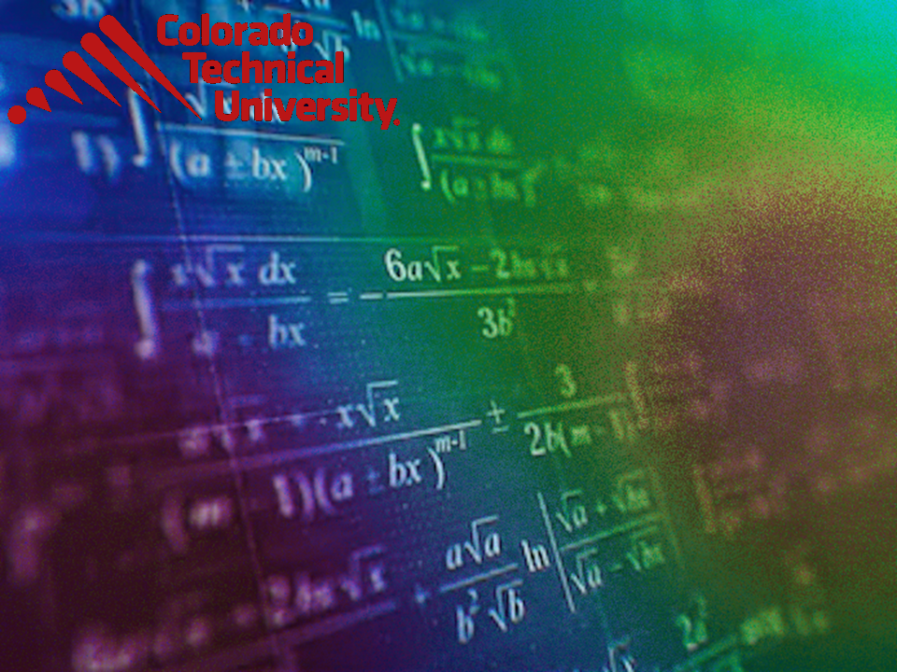
Welcome to
Unit 8 Part 15!
MATH 205 Differential Calculus
https://www.smu.edu.sg/programmes/core-curriculum/course-structure/calculus

Slide 2
What’s Up?
Review:
Optimization, L’Hôpital’s rule
New stuff:
Antiderivatives and
integration

Slide 3
What’s Up?
Outcome 5) Use basic integration techniques, including the method of substitution and the Fundamental Theorem of Calculus

Slide 4

Review
http://995642590.r.lightningbase-cdn.com/wp-content/uploads/2010/12/looking-back-hrexaminer-v144-cover425px.jpg

Slide 5
Optimization
In optimization problems we are looking for the largest value or the smallest value that a function can take subject to some kind of constraint

Slide 6
Optimization
The constraint can usually be described by some equation
The constraint must absolutely, positively be met no matter what the solution is

Slide 7
L’Hôpital’s Rule
Back to limits for a moment…

Slide 8
L’Hôpital’s Rule
Suppose lim f(x) = 0 or ∞ or - ∞
and lim g(x) = 0 or ∞ or - ∞
and you want to find lim f(x)/g(x)
Called “indeterminate forms”
We had all kinds of rules about finding lim f(x)/g(x)
x→c
x→c
x→c
x→c

Slide 9
L’Hôpital’s Rule
uses derivatives to find the limit of ratios

Slide 10
L’Hôpital’s Rule
If lim f(x) = 0 or ±∞
and lim g(x) = 0 or ±∞
and g’(x) ≠ 0 (‘cause we don’t want division by zero)
Then lim f(x)/g(x) = lim f’(x)/g’(x)
x→c
x→c
x→c
x→c

Slide 11
L’Hôpital’s Rule
The numerator and denominator are differentiated separately; the quotient rule does not apply (this is a common mistake)

Slide 12

Questions?
http://i.imgur.com/aliTlT3.jpg

Slide 13
Antidifferentiation
In mathematics we always want to be able to undo an operation

Slide 14
Antidifferentiation
Subtraction “undoes” addition
7 + 3 = 10
10 – 3 = 7
original
value
add
answer
answer
subtract
original
value

Slide 15
Antidifferentiation
What “undoes” subtraction?

Slide 16
Antidifferentiation
What “undoes” subtraction?
addition
What “undoes” multiplication?

Slide 17
Antidifferentiation
What “undoes” multiplication?
division
What “undoes” an exponent x²?

Slide 18

Antidifferentiation
What “undoes” an exponent x²?
a root $\sqrt{\text{x}}$
What “undoes” a sin(x)?

Slide 19
Antidifferentiation
What “undoes” a sin(x)?
an arcsin sin⁻¹(x)
What “undoes” a function ƒ(x)?

Slide 20
Antidifferentiation
What “undoes” a function ƒ(x)?
an inverse function ƒ⁻¹(x)

Slide 21
Antidifferentiation
We’ve just been taking derivatives dy/dx of various equations and expressions
So we need a way to undo this process, too!

Slide 22
Antidifferentiation
F(x) is an antiderivative of f(x) if F’(x) = f(x)

Slide 23
Antidifferentiation
F(x) is an antiderivative of f(x) if F’(x) = f(x)
We’re looking for an unknown function whose derivative is known (and the original function we want)

Slide 24
ANTIDIFFERENTIATION
IN-CLASS PROBLEM 1
Find a function with a derivative: 10x⁴

Slide 25
ANTIDIFFERENTIATION
IN-CLASS PROBLEM 1
Find a function with a derivative: dy/dx = 10x⁴

Slide 26
ANTIDIFFERENTIATION
IN-CLASS PROBLEM 1
Find a function with a derivative: dy/dx = 10x⁴
Well, how do we find the derivative of something in the form of kx^{n}?

Slide 27
ANTIDIFFERENTIATION
IN-CLASS PROBLEM 1
Find a function with a derivative: dy/dx = 10x⁴
Well, how do we find the derivative of something in the form of kx^{n}? nk x^{n-1}
So now we need to “undo” those steps

Slide 28
ANTIDIFFERENTIATION
IN-CLASS PROBLEM 1
Find a function with a derivative: dy/dx = 10x⁴
dy/dx kx^{n} = nk x^{n-1} = 10x⁴
So what would “n” be?
n-1

Slide 29
ANTIDIFFERENTIATION
IN-CLASS PROBLEM 1
Find a function with a derivative: dy/dx = 10x⁴
dy/dx kx^{n} = nk x^{n-1} = 10x⁴
So what would “n” be? 5
n-1

Slide 30
ANTIDIFFERENTIATION
IN-CLASS PROBLEM 1
Find a function with a derivative: dy/dx = 10x⁴
dy/dx kx^{n} = nk x^{n-1} = 10x⁴
Plug in 5

Slide 31
ANTIDIFFERENTIATION
IN-CLASS PROBLEM 1
Find a function with a derivative: dy/dx = 10x⁴
dy/dx kx⁵ = 5k x⁵⁻¹ = 10x⁴
So, what is “k”?

Slide 32
ANTIDIFFERENTIATION
IN-CLASS PROBLEM 1
Find a function with a derivative: dy/dx = 10x⁴
dy/dx kx⁵ = 5k x⁵⁻¹ = 10x⁴
So, what is “k”? 5k = 10
k = 2

Slide 33
ANTIDIFFERENTIATION
IN-CLASS PROBLEM 1
Find a function with a derivative: dy/dx = 10x⁴
dy/dx kx⁵ = 5k x⁵⁻¹ = 10x⁴
Plug in k = 2
So the original equation was…

Slide 34
ANTIDIFFERENTIATION
IN-CLASS PROBLEM 1
Find a function with a derivative: dy/dx = 10x⁴
dy/dx kx⁵ = 5k x⁵⁻¹ = 10x⁴
Plug in k = 2
So the original equation was 2x⁵

Slide 35
ANTIDIFFERENTIATION
IN-CLASS PROBLEM 1
Find a function with a derivative: dy/dx = 10x⁴
dy/dx 2x⁵ = 10x⁴

Slide 36
Questions?
http://i.imgur.com/aliTlT3.jpg

Slide 37
Antidifferentiation
dy/dx 2x⁵ = 10x⁴
But… is 2x⁵ the ONLY equation that has a derivative of 10x⁴?

Slide 38
Antidifferentiation
dy/dx 2x⁵ = 10x⁴
But… is 2x⁵ the ONLY equation that has a derivative of 10x⁴?
Remember, when we take the derivative of a constant, it is zero

Slide 39
Antidifferentiation
dy/dx 2x⁵ = 10x⁴
So dy/dx 2x⁵ + 1 = 10x⁴ also

Slide 40
Antidifferentiation
dy/dx 2x⁵ = 10x⁴
So dy/dx 2x⁵ + 1 = 10x⁴ also
So is dy/dx 2x⁵ + 276.38 = 10x⁴

Slide 41

Antidifferentiation
dy/dx 2x⁵ = 10x⁴
So dy/dx 2x⁵ + 1 = 10x⁴ also
So is dy/dx 2x⁵ + 276.38 = 10x⁴
How can we know
which one it
originally was?
https://henrytrocino.files.wordpress.com/2013/08/weeping-and-gnashing-of-teeth-300x236.jpg

Slide 42
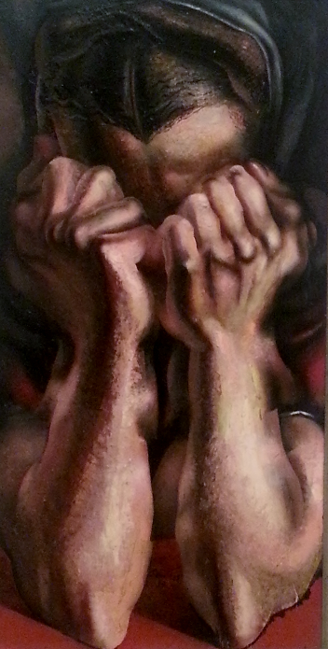
Antidifferentiation
dy/dx 2x⁵ = 10x⁴
So dy/dx 2x⁵ + 1 = 10x⁴ also
So is dy/dx 2x⁵ + 276.38 = 10x⁴
How can we know
which one it
originally was?
We can’t…
http://mommyneedscoffee.com/wp-content/uploads/2012/09/TheSob.jpg

Slide 43
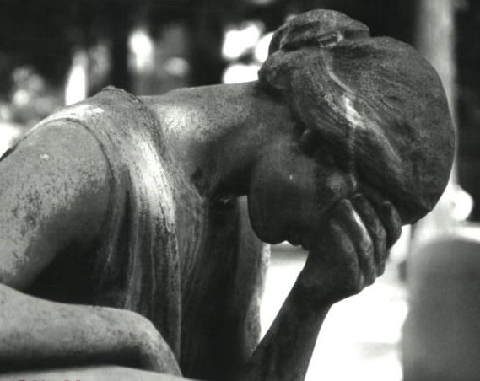
Antidifferentiation
There is no way to figure out what the original constant value was
http://notatthedinnertable.weebly.com/uploads/3/4/1/1/3411210/1794978.jpg

Slide 44
Antidifferentiation
Hence, these are called “indefinite integrals” because we can never be definite about what the original equation was

Slide 45

Antidifferentiation
Here’s what we do:
dy/dx 2x⁵ + c = 10x⁴
where “c” is the unknown constant we
can’t
reconstruct
http://dartoidsworld.net/wp-content/uploads/2015/02/so-what-pic.jpg

Slide 46
Antidifferentiation
Note: some people use “c”
Some use “C”
Some use “k”
Some use “K”
dy/dx 2x⁵ + c = 10x⁴
dy/dx 2x⁵ + C = 10x⁴
dy/dx 2x⁵ + k = 10x⁴
dy/dx 2x⁵ + K = 10x⁴

Slide 47
The way to succeed at antidifferentiation is to never forget to write “c”
VFrench 2020

Slide 48
ANTIDIFFERENTIATION
IN-CLASS PROBLEM 2
Find a function with a derivative: dy/dx = x² + 3x
Which derivative rule does this look like?

Slide 49
ANTIDIFFERENTIATION
IN-CLASS PROBLEM 2
Find a function with a derivative: dy/dx = x² + 3x
Which derivative rule does this look like? Addition Rule
So we want to undo the Addition Rule steps

Slide 50
ANTIDIFFERENTIATION
IN-CLASS PROBLEM 2
Find a function with a derivative: dy/dx = x² + 3x
What function would give a derivative of x² ?
{
first term

Slide 51
ANTIDIFFERENTIATION
IN-CLASS PROBLEM 2
Find a function with a derivative: dy/dx = x² + 3x
What function would give a derivative of x² ?
3 x ___ = 1
{
first term

Slide 52
ANTIDIFFERENTIATION
IN-CLASS PROBLEM 2
Find a function with a derivative: dy/dx = x² + 3x
What function would give a derivative of x² ? 1/3 x³ + c
(Did you get all the parts right?)
{
{
first term
second term

Slide 53
ANTIDIFFERENTIATION
IN-CLASS PROBLEM 2
Find a function with a derivative: dy/dx = x² + 3x
What function would give a derivative of x² ? 1/3 x³ + c
What function would give a derivative of 3x ?
{
{
first term
second term

Slide 54
ANTIDIFFERENTIATION
IN-CLASS PROBLEM 2
Find a function with a derivative: dy/dx = x² + 3x
What function would give a derivative of x² ? 1/3 x³ + c
What function would give a derivative of 3x ? 3/2 x² + c
{
{
first term
second term

Slide 55
ANTIDIFFERENTIATION
IN-CLASS PROBLEM 2
Find a function with a derivative: dy/dx = x² + 3x
What function would give a derivative of x² ? 1/3 x³ + c
What function would give a derivative of 3x ? 3/2 x² + c
Combine the two parts:
1/3 x³ + 3/2 x² + c
{
{
first term
second term

Slide 56
ANTIDIFFERENTIATION
IN-CLASS PROBLEM 2
Just to check… does
dy/dx 1/3 x³ + 3/2 x² + c = x² + 3x
?

Slide 57
ANTIDIFFERENTIATION
IN-CLASS PROBLEM 2
Just to check… does
dy/dx 1/3 x³ + 3/2 x² + c = x² + 3x
? It does…

Slide 58
Antidifferentiation
F(x) + c
can be viewed as a family of all curves whose derivatives for any given x are all equal to each other

Slide 59
Antidifferentiation
That means for any x value, the slopes of the curves are all equal

Slide 60
Questions?
http://i.imgur.com/aliTlT3.jpg

Slide 61
Antidifferentiation
So now we know how to do some simpler antidifferentiation (obviously something deriving from the Quotient Rule or the Chain Rule would be harder)

Slide 62
Antidifferentiation
But it’s a MATH class!
There’s always a symbol for everything!

Slide 63
Antidifferentiation
But it’s a MATH class!
There’s always a symbol for everything!
(And there is for antidifferentiation, too!)

Slide 64
Antidifferentiation
The symbol we use is: ∫
So ∫ 10x⁴ = 2x⁵ + c
But, we want to include which variable was being differentiated, so we write it as:
∫10x⁴ dx = 2x⁵ + c

Slide 65
Antidifferentiation
∫ (10x⁴) dx = 2x⁵ + c
is called “integral notation”
Could have been:
∫ (10y⁴) dy = 2y⁵ + c

Slide 66
Integration
The symbol for integration is:
∫
It is meant to represent a big, curvy “S”

Slide 67
Integration
That’s because dy/dx represents an infinitely-tiny difference (“d”, get it?)
While ∫ represents an infinitely-tiny sum (sum is the inverse of difference)

Slide 68
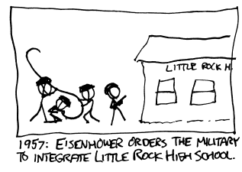

Slide 69
Integration
{
{
∫10x⁴ dx = 2x⁵ + c
integral sign
constant of integration
integrand
indefinite
integral
differential
variable of integration

Slide 70
Integration
{
{
∫10x⁴ dx = 2x⁵ + c
The integral is “indefinite” because we don’t know what “c” is
integral sign
constant of integration
integrand
indefinite
integral

Slide 71
Integration
When we solve the problem, we could say we are “antidifferentiating”
but usually we say we are “integrating”

Slide 72

INTEGRATION
IN-CLASS PROBLEM 3
How would you write:
dy/dx 1/3 x³ + 3/2 x² + c = x² + 3x
in integral notation?
Hint
$\int{\text{10}\text{x}\text{4}}$ dx = 2x⁵ + c

Slide 73
INTEGRATION
IN-CLASS PROBLEM 3
dy/dx 1/3 x³ + 3/2 x² + c = x² + 3x
Multiply both sides by “dx”
dy 1/3 x³ + 3/2 x² + c = (x²+3x) dx
Now put a ∫ in front of both sides
Hint
$\int{\text{10}\text{x}\text{4}}$ dx = 2x⁵ + c

Slide 74
INTEGRATION
IN-CLASS PROBLEM 3
dy/dx 1/3 x³ + 3/2 x² + c = x² + 3x
Multiply both sides by “dx”
∫dy 1/3 x³+3/2 x² c = ∫(x²+3x)dx
Hint
$\int{\text{10}\text{x}\text{4}}$ dx = 2x⁵ + c

Slide 75
INTEGRATION
IN-CLASS PROBLEM 3
dy/dx 1/3 x³ + 3/2 x² + c = x² + 3x
Multiply both sides by “dx”
∫dy 1/3 x³+3/2 x² c = ∫(x²+3x)dx
∫ is the “undo” of dy so they actually cancel each other out!
Hint
$\int{\text{10}\text{x}\text{4}}$ dx = 2x⁵ + c

Slide 76
INTEGRATION
IN-CLASS PROBLEM 3
How would you write:
dy/dx 1/3 x³ + 3/2 x² + c = x² + 3x
in integral notation?
∫(x² + 3x) dx = 1/3 x³ + 3/2 x² + c
Hint
$\int{\text{10}\text{x}\text{4}}$ dx = 2x⁵ + c

Slide 77
Questions?
http://i.imgur.com/aliTlT3.jpg

Slide 78

Integration
Ah, yes, and since it’s CALCULUS class, there are going to be a lot of rules…
https://www.campusreform.org/?ID=8934

Slide 79
Integration
But the rules are meant to make it easier to solve the integration problems

Slide 80
Integration
Back in differentiation, we had:
Rule #1: derivative of a constant:
d/dx c = 0
That’s (of course) what makes us have to stick a “+ c” at the end of all our integrals

Slide 81
Integration
Just like we had Rule 2 in differentiation:
Rule #2: derivative of a power function:
d/dx cx^{n} = cn × x ^{n-1}

Slide 82

Integration
We’ve already figured out the rule to “undo” a power function:
∫x^{n} dx = $\frac{\text{x}\text{n}\text{+1}}{\text{n}\text{+1 }}$ + c (n ≠ -1)
‘cause we don’t
want division
by zero

Slide 83
Integration
And we figured out how to undo derivatives of sums:
∫ (ƒ(x) + g(x)) dx =
∫(ƒ(x)) dx + ∫(g(x)) dx
Because the derivative of the sum of two functions equals the sum of their derivatives

Slide 84
Integration
Another helpful rule looks at how to handle a coefficient (which we were already doing):
∫ (k ƒ(x)) dx = k∫(ƒ(x)) dx
where k is a constant

Slide 85

INTEGRATION
IN-CLASS PROBLEMS 4
∫ dx = ?
∫ 5 dx = ?
∫ t³ dt = ?
∫ 10t⁴ dt = ?
Hint
$\int{\text{10}\text{x}\text{4}}$ dx = 2x⁵ + c
∫x² + 3x dx = 1/3 x³ + 3/2 x² + c

Slide 86
INTEGRATION
IN-CLASS PROBLEMS 4
∫ dx = ∫ 1 dx = ∫ 1x⁰ dx
∫ 5 dx = ?
∫ t³ dt = ?
∫ 10t⁴ dt = ?
Hint
$\int{\text{10}\text{x}\text{4}}$ dx = 2x⁵ + c
∫x² + 3x dx = 1/3 x³ + 3/2 x² + c

Slide 87
INTEGRATION
IN-CLASS PROBLEMS 4
∫ dx = x + c
∫ 5 dx = ?
∫ t³ dt = ?
∫ 10t⁴ dt = ?
Hint
$\int{\text{10}\text{x}\text{4}}$ dx = 2x⁵ + c
∫x² + 3x dx = 1/3 x³ + 3/2 x² + c

Slide 88
INTEGRATION
IN-CLASS PROBLEMS 4
∫ dx = x + c
∫ 5 dx = 5∫ dx
∫ t³ dt = ?
∫ 10t⁴ dt = ?
Hint
$\int{\text{10}\text{x}\text{4}}$ dx = 2x⁵ + c
∫x² + 3x dx = 1/3 x³ + 3/2 x² + c

Slide 89
INTEGRATION
IN-CLASS PROBLEMS 4
∫ dx = x + c
∫ 5 dx = 5x + c
∫ t³ dt = ?
∫ 10t⁴ dt = ?
Hint
$\int{\text{10}\text{x}\text{4}}$ dx = 2x⁵ + c
∫x² + 3x dx = 1/3 x³ + 3/2 x² + c

Slide 90
INTEGRATION
IN-CLASS PROBLEMS 4
∫ dx = x + c
∫ 5 dx = 5x + c
∫ t³ dt = ¼t⁴ + c
∫ 10t⁴ dt = ?
Hint
$\int{\text{10}\text{x}\text{4}}$ dx = 2x⁵ + c
∫x² + 3x dx = 1/3 x³ + 3/2 x² + c

Slide 91
INTEGRATION
IN-CLASS PROBLEMS 4
∫ dx = x + c
∫ 5 dx = 5x + c
∫ t³ dt = ¼t⁴ + c
∫ 10t⁴ dt = 2t⁵ + c
Hint
$\int{\text{10}\text{x}\text{4}}$ dx = 2x⁵ + c
∫x² + 3x dx = 1/3 x³ + 3/2 x² + c

Slide 92
Questions?
http://i.imgur.com/aliTlT3.jpg

Slide 93
Integration
While in math class we generally use the variable “x”, the real world rarely does!

Slide 94
Integration
We just did two problems “dt” which is very common in engineering

Slide 95
Integration
Just like derivatives, integrals can be dx or dt or versus any variable you like
Again, other variables not being “d-ed” will be treated as constants

Slide 96
INTEGRATION
IN-CLASS PROBLEM 5
Find y = ∫ (5w²p) dp

Slide 97
INTEGRATION
IN-CLASS PROBLEM 5
Find y = ∫ (5w²p) dp
What variable was this function differentiated with respect to?

Slide 98
INTEGRATION
IN-CLASS PROBLEM 5
Find y = ∫ (5w²p) dp
What variable was this function differentiated with respect to?
p
So what can be viewed as a constant?

Slide 99
INTEGRATION
IN-CLASS PROBLEM 5
Find y = ∫ (5w²p) dp
So what can be viewed as a constant? 5w²

Slide 100
INTEGRATION
IN-CLASS PROBLEM 5
Find y = ∫ (5w²p) dp
So what can be viewed as a constant? 5w²
Find y = ∫ (Kp) dp
So what is y?
5w²

Slide 101
INTEGRATION
IN-CLASS PROBLEM 5
Find y = ∫ (5w²p) dp
So what can be viewed as a constant? 5w²
Find y = ∫ (Kp) dp
So what is y? y = k/2 p²
is it?
5w²

Slide 102
INTEGRATION
IN-CLASS PROBLEM 5
Find y = ∫ (5w²p) dp
So what can be viewed as a constant? 5w²
Find y = ∫ (Kp) dp
So what is y? y = k/2 p² + c
= 5w²/2 p² + c
= 5w²p²/2 + c
= 5/2 w²p² + c
5w²

Slide 103
Integration
The integral with respect to one variable will not be the same as the integral with respect to another variable – so be careful with these!

Slide 104
INTEGRATION
IN-CLASS PROBLEM 5
Find y = ∫ (5w²p) dw

Slide 105
INTEGRATION
IN-CLASS PROBLEM 5
Find y = ∫ (5w²p) dw
What variable was this function differentiated with respect to?

Slide 106
INTEGRATION
IN-CLASS PROBLEM 5
Find y = ∫ (5w²p) dw
What variable was this function differentiated with respect to?
w
So what can be viewed as a constant?

Slide 107
INTEGRATION
IN-CLASS PROBLEM 5
Find y = ∫ (5w²p) dw
So what can be viewed as a constant? 5p

Slide 108
INTEGRATION
IN-CLASS PROBLEM 5
Find y = ∫ (5w²p) dw
So what can be viewed as a constant? 5p
Find y = ∫ (Kw²) dw
So what is y?
5p

Slide 109
INTEGRATION
IN-CLASS PROBLEM 5
Find y = ∫ (5w²p) dw
So what can be viewed as a constant? 5p
Find y = ∫ (Kw²) dw
So what is y? y = K/3 w³
is it?
5p

Slide 110
INTEGRATION
IN-CLASS PROBLEM 5
Find y = ∫ (5w²p) dw
So what can be viewed as a constant? 5p
Find y = ∫ (Kw²) dw
So what is y? y = K/3 w³ + c
= 5p/3 w³ + c
= 5pw³/3 + c
5p

Slide 111
INTEGRATION
IN-CLASS PROBLEM 5
So y = ∫(5w²p) dw
= 5p/3 w³ + c
= 5pw³/3 + c
But y = ∫(5w²p) dp
= 5w²/2 p² + c
= 5w²p²/2 + c
So watch the differential variable!

Slide 112
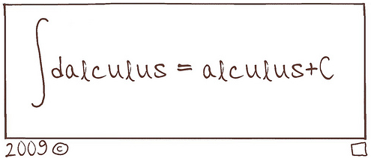
Antidifferentiation

Slide 113
Questions?
http://i.imgur.com/aliTlT3.jpg

Slide 114
Integration
If you are given a point the function goes though, you can actually find the missing “c” and have a definite value

Slide 115
INTEGRATION
IN-CLASS PROBLEM 6
The derivative of a function is known to be dy/dx = 24x³
and the function’s graph goes through the point x=1, y=11.
Find the function

Slide 116
INTEGRATION
IN-CLASS PROBLEM 6
The derivative of a function is known to be dy/dx = 24x³
and the function’s graph goes through the point x=1, y=11.
Find the function
What do we need to do first?

Slide 117
INTEGRATION
IN-CLASS PROBLEM 6
The derivative of a function is known to be dy/dx = 24x³
and the function’s graph goes through the point x=1, y=11.
Find the function
What do we need to do first?
∫ something dsomething =
What is the integral?

Slide 118
INTEGRATION
IN-CLASS PROBLEM 6
The derivative of a function is known to be dy/dx = 24x³
and the function’s graph goes through the point x=1, y=11.
Find the function
What is the integral?
∫ 24x³ dx =

Slide 119
INTEGRATION
IN-CLASS PROBLEM 6
The derivative of a function is known to be dy/dx = 24x³
and the function’s graph goes through the point x=1, y=11.
Find the function
What is the integral?
∫ 24x³ dx = 6x⁴ + c

Slide 120
INTEGRATION
IN-CLASS PROBLEM 6
The derivative of a function is known to be dy/dx = 24x³
and the function’s graph goes through the point x=1, y=11.
Find the function
What is the integral?
∫ 24x³ dx = 6x⁴ + c
Are we done?

Slide 121
INTEGRATION
IN-CLASS PROBLEM 6
The derivative of a function is known to be dy/dx = 24x³
and the function’s graph goes through the point x=1, y=11.
Find the function
y = 6x⁴ + c
Plug in x=1 and y=11

Slide 122
INTEGRATION
IN-CLASS PROBLEM 6
The derivative of a function is known to be dy/dx = 24x³
and the function’s graph goes through the point x=1, y=11.
Find the function
y = 6x⁴ + c
Plug in x=1 and y=11:
11 = 6(1⁴) + c so what is “c”?

Slide 123
INTEGRATION
IN-CLASS PROBLEM 6
The derivative of a function is known to be dy/dx = 24x³
and the function’s graph goes through the point x=1, y=11.
Find the function
y = 6x⁴ + c
Plug in x=1 and y=11:
11 = 6(1⁴) + c
c = 11 – 6 = 5

Slide 124
INTEGRATION
IN-CLASS PROBLEM 6
The derivative of a function is known to be dy/dx = 24x³
and the function’s graph goes through the point x=1, y=11.
Find the function
So what is the function?

Slide 125
INTEGRATION
IN-CLASS PROBLEM 6
The derivative of a function is known to be dy/dx = 24x³
and the function’s graph goes through the point x=1, y=11.
Find the function
So what is the function?
y = 6x⁴ + 5
A determinate (certain) function

Slide 126
Questions?
http://i.imgur.com/aliTlT3.jpg

Slide 127
Integration
If integration is the opposite of differentiation, why don't we just call differentiation “disintegration”?
Caleb Carter
CTU student
May, 2021

Slide 128
INTEGRATION
IN-CLASS PROBLEM 7
Find the equation modeling the velocity of an object moving along a straight line with constant acceleration 2 m/s² when the velocity at time t=3s is 10 m/s.

Slide 129
INTEGRATION
IN-CLASS PROBLEM 7
Find the equation modeling the velocity of an object moving along a straight line with constant acceleration 2 m/s² when the velocity at time t=3s is 10 m/s.
Don’t Panic!
What are we wanting to find?

Slide 130
INTEGRATION
IN-CLASS PROBLEM 7
Find the equation modeling the velocity of an object moving along a straight line with constant acceleration 2 m/s² when the velocity at time t=3s is 10 m/s.
What are we wanting to find?
velocity
What do we know?

Slide 131
INTEGRATION
IN-CLASS PROBLEM 7
Find the equation modeling the velocity of an object moving along a straight line with constant acceleration 2 m/s² when the velocity at time t=3s is 10 m/s.
We’re trying to find: velocity
What do we know? acceleration
What is the relation between velocity and acceleration?

Slide 132
INTEGRATION
IN-CLASS PROBLEM 7
Find the equation modeling the velocity of an object moving along a straight line with constant acceleration 2 m/s² when the velocity at time t=3s is 10 m/s.
acceleration = d/dt velocity
So, to find velocity using acceleration, what do we do?

Slide 133
INTEGRATION
IN-CLASS PROBLEM 7
Find the equation modeling the velocity of an object moving along a straight line with constant acceleration 2 m/s² when the velocity at time t=3s is 10 m/s.
acceleration = d/dt velocity
So, to find velocity using acceleration, what do we do?
integration

Slide 134
INTEGRATION
IN-CLASS PROBLEM 7
Find the equation modeling the velocity of an object moving along a straight line with constant acceleration 2 m/s² when the velocity at time t=3s is 10 m/s.
∫acceleration = ∫d/dt velocity
Now what?

Slide 135
INTEGRATION
IN-CLASS PROBLEM 7
Find the equation modeling the velocity of an object moving along a straight line with constant acceleration 2 m/s² when the velocity at time t=3s is 10 m/s.
∫acceleration = ∫d/dt velocity
Move the dt to the other side:
∫acceleration dt = ∫d velocity
= velocity
Now what?

Slide 136
INTEGRATION
IN-CLASS PROBLEM 7
Find the equation modeling the velocity of an object moving along a straight line with constant acceleration 2 m/s² when the velocity at time t=3s is 10 m/s.
∫ 2 dt = velocity
Do it!

Slide 137
INTEGRATION
IN-CLASS PROBLEM 7
Find the equation modeling the velocity of an object moving along a straight line with constant acceleration 2 m/s² when the velocity at time t=3s is 10 m/s.
∫ 2 dt = 2t + c = velocity
Are we done?

Slide 138
INTEGRATION
IN-CLASS PROBLEM 7
Find the equation modeling the velocity of an object moving along a straight line with constant acceleration 2 m/s² when the velocity at time t=3s is 10 m/s.
∫ 2 dt = 2t + c = velocity
2(3)+c = 10
What is c?

Slide 139
INTEGRATION
IN-CLASS PROBLEM 7
Find the equation modeling the velocity of an object moving along a straight line with constant acceleration 2 m/s² when the velocity at time t=3s is 10 m/s.
∫ 2 dt = 2t + c = velocity
2(3)+c = 10
What is c? 4
So what is the equation?
Remember we’re looking for an equation…

Slide 140
INTEGRATION
IN-CLASS PROBLEM 7
Find the equation modeling the velocity of an object moving along a straight line with constant acceleration 2 m/s² when the velocity at time t=3s is 10 m/s.
∫ 2 dt = 2t + c = velocity
c = 4
So what is the equation?
velocity = 2t + 4

Slide 141
Questions?
http://i.imgur.com/aliTlT3.jpg

Slide 142
Summary
Today we covered:
Review of related rates,
L’Hôpital’s rule
Antiderivatives and
integration

Slide 143

You Survived!
www.playbuzz.com

