Slide 1

Welcome to
Unit 9 Part 18!
MATH 205 Differential Calculus
https://www.smu.edu.sg/programmes/core-curriculum/course-structure/calculus

Slide 2
What’s Up?
Review:
Area under a curve and the Fundamental Theorem of Calculus
New stuff:
Area between two curves

Slide 3
What’s Up?
Outcome 5) Use basic integration techniques, including the method of substitution and the Fundamental Theorem of Calculus
Outcome 6) Use definite integrals to find areas under and between curves

Slide 4

Review
http://995642590.r.lightningbase-cdn.com/wp-content/uploads/2010/12/looking-back-hrexaminer-v144-cover425px.jpg

Slide 5
Area Under a Curve
Using integration as the inverse operation to undo differentiation is important, but there’s another use for integration

Slide 6
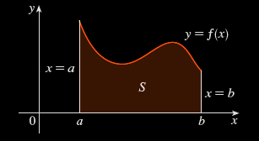
Area Under a Curve
We often use it to find the area under the curve in a specific interval a to b
https://coloradotech.vitalsource.com/#/books/9780357233375/cfi/6/28!/4/14@0:0

Slide 7
Area Under a Curve
It isn't easy to find the area of a region with curved sides

Slide 8
Area Under a Curve
For a curve, you can draw rectangles (which you CAN find the area for) to sort of fit the curve
http://archives.math.utk.edu/visual.calculus/4/midpoint.1/integral.html

Slide 9
Area Under a Curve
You can build
rectangles
above the
curve, below
the curve,
or going
through
midpoints
Kalkulus_Integral__cover.png

Slide 10
Area Under a Curve
You know the
true area under
the curve is a
number between
the sum of the
blue rectangles
and the sum of
the tan
rectangles
VFrench 2020

Slide 11
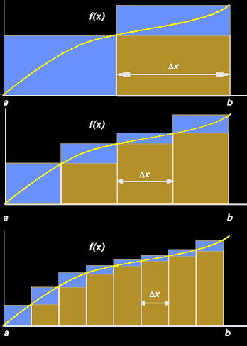
Area Under a Curve
As the rectangles
get narrower and
narrower (closer
and closer to
zero-width) the
area estimate
gets better
and better
VFrench 2020

Slide 12
Area Under a Curve
The true area is
going to be the
limit of the sum
of the blue and
tan rectangles (it
will converge)
VFrench 2020

Slide 13
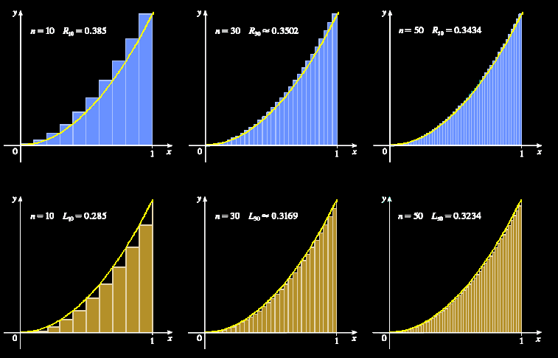
Area Under a Curve
https://coloradotech.vitalsource.com/#/books/9780357233375/cfi/6/28!/4/14@0:0

Slide 14
Area Under a Curve
This is what you are “adding up” that is the ∫um in integration – zillions of zero-width rectangles

Slide 15
Area Under a Curve
…and this is also why integral calculus in “nonsense”: you are adding up a whole bunch of zeros (areas of rectangles with zero width) to get something bigger than zero – the area under the curve

Slide 16
Area Under a Curve
…and this is also why integral calculus in “nonsense”: you are adding up a whole bunch of zeros (areas of rectangles with zero width) to get something bigger than zero – the area under the curve
Still, it works so well… let’s use it anyway!

Slide 17
Area Under a Curve
It’s also why this part of calculus is called “integration”: we are integrating all the slices together into a whole area

Slide 18
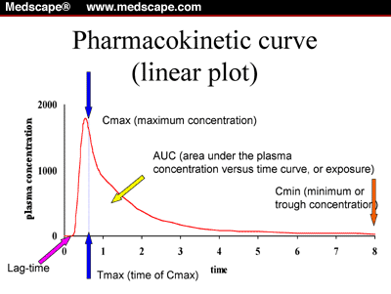
Area Under a Curve
Integration is used more than differentiation because a lot of people want to find areas under curves
(AUC means
“Area Under
Curve”)
cm.v17.fig1.gif

Slide 19
Area Under a Curve
Note: engineers use differentiation more than anybody else (physicists come close) and use differentiation more than integration

Slide 20
Area Under a Curve
This is the geometric interpretation of the integral (like tangent lines to the curve was the geometric interpretation of the derivative)

Slide 21
https://i2.wp.com/fractalkitty.com/wp-content/uploads/2019/07/untitled_artwork-10.jpg?fit=
2048%2C2048&ssl=1

Slide 22
Area Under a Curve
The height of each rectangle is the value of the function at some point “t” along the base of the rectangle
{
ƒ (t)
t
VFrench 2020

Slide 23
Area Under a Curve
The width of each rectangle is a constant Δt
Δt
{
t
VFrench 2020

Slide 24
Area Under a Curve
The area of each rectangle is area = height x width = ƒ(t)Δt
Δt
{
{
ƒ (t)
t
VFrench 2020

Slide 25
Area Under a Curve
This is why the units of the area under the curve are the units of the Y axis times units of the X axis

Slide 26
Area Under a Curve
The area under the curve between a and b (“n” rectangles) is approximately equal to the sum:
S_{n} = ƒ(t₁)Δt + ƒ(t₂)Δt +…+ ƒ(t_{n})Δt
Δt
{
{
ƒ (t)
a
t
b
VFrench 2020

Slide 27
Area Under a Curve
The smaller we choose the width Δx, the better the approximation for the area under the curve

Slide 28
Area Under a Curve
As Δx→0,
the number of terms n→∞
and the sum S_{n}→true area
under the curve:
S_{n} = A
lim
n→∞

Slide 29
Area Under a Curve
But, you wouldn’t want to actually do this to find the area under a curve

Slide 30
Area Under a Curve
But, you wouldn’t want to actually do this to find the area under a curve (it would take days to do even a simple problem)

Slide 31
Area Under a Curve
Instead, we use calculus:
A = ∫ƒ(b) dx - ∫ƒ(a) dx
upper
limit
lower
limit

Slide 32
Area Under a Curve
We write this symbolically as:
Where b is the upper limit and a the lower limit of the interval
∫ ƒ(x) dx
b
a

Slide 33
Area Under a Curve
The Fundamental Theorem of Calculus says if ƒ(x) is continuous on the interval a≤x≤b
then = F(b) – F(a)
where F’(x) = ƒ(x)
b
∫ ƒ(x) dx
a

Slide 34
Area Under a Curve
In other words, the technique for evaluating a definite integral is the same as finding the area under the curve

Slide 35
Area Under a Curve
You can have any function for your curve (even ones you personally can’t integrate)
The limits can also be anything you want

Slide 36
Area Under a Curve
Another calculus theorem for when the upper interval limit is a smaller number than the lower interval limit:
b
a
∫ ƒ(x) dx = -∫ ƒ(x) dx
a
b

Slide 37

Questions?
http://i.imgur.com/aliTlT3.jpg

Slide 38
Area Between Curves
The area under a curve is pretty easy if you know how to integrate the curve
https://www.math24.net/area-region-bounded-by-curves/

Slide 39
Area Between Curves
What if you wanted to know the area between two curves?
https://www.math24.net/area-region-bounded-by-curves/

Slide 40

Area Between Curves
That is easy, too!
(Believe it or not…)
rkitp/curriculum/v1n5/v1n5_wiki_how-t...
https://www.math24.net/area-region-bounded-by-curves/

Slide 41
Area Between Curves
Both curves have to be continuous over the interval
https://www.math24.net/area-region-bounded-by-curves/

Slide 42
Area Between Curves
It’s easier if one curve is always above or even with the other curve
https://www.math24.net/area-region-bounded-by-curves/

Slide 43
Area Between Curves
The area between the curves is:
- =
The area below the upper curve
The area below the lower curve
The area between the curves
https://www.math24.net/area-region-bounded-by-curves/

Slide 44
Area Between Curves
The area between the curves is:
- =
∫ ƒ(x) – g(x) dx
b
a
ƒ(x)
g(x)
The area below the upper curve
The area below the lower curve
The area between the curves
https://www.math24.net/area-region-bounded-by-curves/

Slide 45
Area Between Curves
Another way to look at it: what height is each rectangle in the Riemann sum?
https://www.math24.net/area-region-bounded-by-curves/

Slide 46
Area Between Curves
height = high value – low value
= ƒ(x) – g(x)
So the integral
will give
the area
∫ ƒ(x) – g(x) dx
b
a
https://www.math24.net/area-region-bounded-by-curves/

Slide 47
AREA BETWEEN CURVES
IN-CLASS PROBLEM 1
Find the area between the curves y = x² + 5 and y = x + 1 between x = 0 and x = 1
Which is the “top” curve?

Slide 48
AREA BETWEEN CURVES
IN-CLASS PROBLEM 1
Find the area between the curves y = x² + 5 and y = x + 1 between x = 0 and x = 1
Which is the “top” curve?
It doesn’t really
matter!
But x²+5 is higher
https://www.wolframalpha.com/input/?i=area+between+curves+y%3Dx%5E2%2B5+and+y%3Dx%2B1+interval+0%2C1

Slide 49
AREA BETWEEN CURVES
IN-CLASS PROBLEM 1
Find the area between the curves y = x² + 5 and y = x + 1 between x = 0 and x = 1
What is the integral?
What is a?
b
∫ ƒ(x) – g(x) dx
a

Slide 50
AREA BETWEEN CURVES
IN-CLASS PROBLEM 1
Find the area between the curves y = x² + 5 and y = x + 1 between x = 0 and x = 1
What is a? 0
What is b?
b
∫ ƒ(x) – g(x) dx
a

Slide 51
AREA BETWEEN CURVES
IN-CLASS PROBLEM 1
Find the area between the curves y = x² + 5 and y = x + 1 between x = 0 and x = 1
What is a? 0
What is b? 1
What is ƒ(x)?
b
∫ ƒ(x) – g(x) dx
a

Slide 52
AREA BETWEEN CURVES
IN-CLASS PROBLEM 1
Find the area between the curves y = x² + 5 and y = x + 1 between x = 0 and x = 1
What is a? 0
What is b? 1
What is ƒ(x)? x² + 5
What is g(x)?
b
∫ ƒ(x) – g(x) dx
a

Slide 53
AREA BETWEEN CURVES
IN-CLASS PROBLEM 1
Find the area between the curves y = x² + 5 and y = x + 1 between x = 0 and x = 1
What is a? 0
What is b? 1
What is ƒ(x)? x² + 5
What is g(x)? x + 1
What is the integral?
b
∫ ƒ(x) – g(x) dx
a

Slide 54
AREA BETWEEN CURVES
IN-CLASS PROBLEM 1
Find the area between the curves y = x² + 5 and y = x + 1 between x = 0 and x = 1
What is the integral?
Do it!
∫ (x² + 5) – (x+1) dx
1
0
b
∫ ƒ(x) – g(x) dx
a

Slide 55
AREA BETWEEN CURVES
IN-CLASS PROBLEM 1
Find the area between the curves y = x² + 5 and y = x + 1 between x = 0 and x = 1
=
= (x³/3+5x) – (x²/2+x)
∫ (x²+5) – (x+1) dx
1
0
|
|
1
1
0
0

Slide 56
AREA BETWEEN CURVES
IN-CLASS PROBLEM 1
Find the area between the curves y = x² + 5 and y = x + 1 between x = 0 and x = 1
=
= (x³/3+5x) – (x²/2+x)
= (((1³)/3+5(1))-((0³)/3+5(0)))
– ((1²/2+1)–(0²/2+0))
∫ (x²+5) – (x+1) dx
1
0
|
|
1
1
0
0

Slide 57
AREA BETWEEN CURVES
IN-CLASS PROBLEM 1
Find the area between the curves y = x² + 5 and y = x + 1 between x = 0 and x = 1
=
= (x³/3+5x) – (x²/2+x)
= (((1³)/3+5(1))-((0³)/3+5(0)))
– ((1²/2+1)–(0²/2+0))
= ((1/3+5)-(0+0))–((1/2+1)-(0+0))
∫ (x²+5) – (x+1) dx
1
0
|
|
1
1
0
0

Slide 58
AREA BETWEEN CURVES
IN-CLASS PROBLEM 1
Find the area between the curves y = x² + 5 and y = x + 1 between x = 0 and x = 1
=
= (x³/3+5x) – (x²/2+x)
= ((1/3+5)-(0+0))–((1/2+1)-(0+0))
= 16/3 – 3/2 = 32/6 – 9/6
= 23/6
∫ (x²+5) – (x+1) dx
1
0
|
|
1
1
0
0

Slide 59
AREA BETWEEN CURVES
IN-CLASS PROBLEM 1
Find the area between the curves y = x² + 5 and y = x + 1 between x = 0 and x = 1
= 23/6
∫ (x²+5) – (x+1) dx
1
0

Slide 60
Questions?
http://i.imgur.com/aliTlT3.jpg

Slide 61
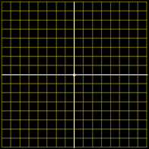
AREA BETWEEN CURVES
IN-CLASS PROBLEM 2a
Find the area between the curves on the interval 0,1
Each square
has an
area = ¼
4
3
2
1
-4
-3
0
-2
-1
0
1
2
3
4
-1
-2
-3
-4
VFrench 2020

Slide 62
AREA BETWEEN CURVES
IN-CLASS PROBLEM 2a
Find the area between the curves on the interval 0,1
Area = ½
How did you
do it?
4
3
2
1
-4
-3
0
-2
-1
0
1
2
3
4
-1
-2
-3
-4
VFrench 2020

Slide 63
AREA BETWEEN CURVES
IN-CLASS PROBLEM 2a
Find the area between the curves on the interval 0,1
Area = ½
How did you
do it?
Count the
squares
(1+½+½)* ¼
4
3
2
1
-4
-3
0
-2
-1
0
1
2
3
4
-1
Area
-2
-3
# of squares
-4
VFrench 2020

Slide 64
AREA BETWEEN CURVES
IN-CLASS PROBLEM 2b
Find the area between the curves on the interval -1,1
4
3
2
1
-4
-3
0
-2
-1
0
1
2
3
4
-1
-2
-3
-4
VFrench 2020

Slide 65
AREA BETWEEN CURVES
IN-CLASS PROBLEM 2b
Find the area between the curves on the interval -1,1
Area = 1
4
3
2
1
-4
-3
0
-2
-1
0
1
2
3
4
-1
-2
-3
-4
VFrench 2020

Slide 66
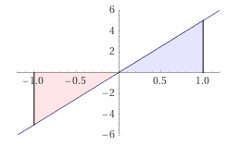

AREA BETWEEN CURVES
IN-CLASS PROBLEM 2b
Hold it! Last class we had:
Evaluate
= 0
Why is this
different???
1
∫ 5x dx
-1
https://www.wolframalpha.com/
input/?i=definite+integral
http://www.testically.org/wp-content/uploads/2010/11/hmm.jpg

Slide 67
AREA BETWEEN CURVES
IN-CLASS PROBLEM 2b
Last class was about the area UNDER a curve
There was an
required location
(between the
curve and the
x-axis)
and direction (below the curve)
https://www.wolframalpha.com/input/?i=definite+integral

Slide 68
AREA BETWEEN CURVES
IN-CLASS PROBLEM 2b
This part is going the wrong direction, so it’s
negative
https://www.wolframalpha.com/input/?i=definite+integral

Slide 69
AREA BETWEEN CURVES
IN-CLASS PROBLEM 2b
The area between curves, though, doesn’t specify which curve is on top
You just
calculate the
area between
the two curves
Area = 1
4
3
2
1
-4
-3
0
-2
-1
0
1
2
3
4
-1
-2
-3
-4
VFrench 2020

Slide 70
AREA BETWEEN CURVES
IN-CLASS PROBLEM 2c
Find the area between the curves on the interval 1,2
4
3
2
1
-4
-3
0
-2
-1
0
1
2
3
4
-1
-2
-3
-4
VFrench 2020

Slide 71
AREA BETWEEN CURVES
IN-CLASS PROBLEM 2c
Find the area between the curves on the interval 1,2
Area = 6(¼)
= 1.5
4
3
2
1
-4
-3
0
-2
-1
0
1
2
3
4
-1
-2
-3
-4
VFrench 2020

Slide 72
AREA BETWEEN CURVES
IN-CLASS PROBLEM 2d
Find the area between the curves on the interval 0,1
4
3
2
1
-4
-3
0
-2
-1
0
1
2
3
4
-1
-2
-3
-4
VFrench 2020

Slide 73
AREA BETWEEN CURVES
IN-CLASS PROBLEM 2d
Find the area between the curves on the interval 0,1
Area = 4(¼)
= 1
4
3
2
1
-4
-3
0
-2
-1
0
1
2
3
4
-1
-2
-3
-4
VFrench 2020

Slide 74
Questions?
http://i.imgur.com/aliTlT3.jpg

Slide 75
Area Between Curves
Sometimes the question is about areas between the intersections of two curves

Slide 76
Area Between Curves
Sometimes the question is about areas between the intersections of two curves (they’re not telling you the interval…)

Slide 77
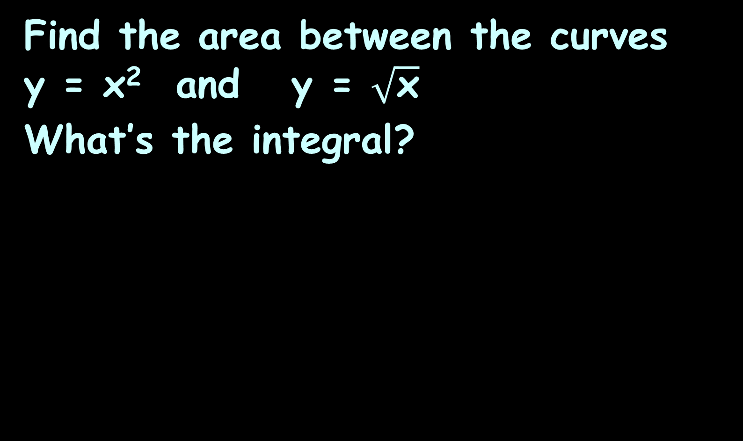
AREA BETWEEN CURVES
IN-CLASS PROBLEM 3
Find the area between the curves y = x² and y = $\sqrt{\text{x}}$
What’s the integral?
https://www.wolframalpha.com/input/?i=area+between+curves+y%3Dx%5E2+and+y%3Dsqrt%28x%29+

Slide 78
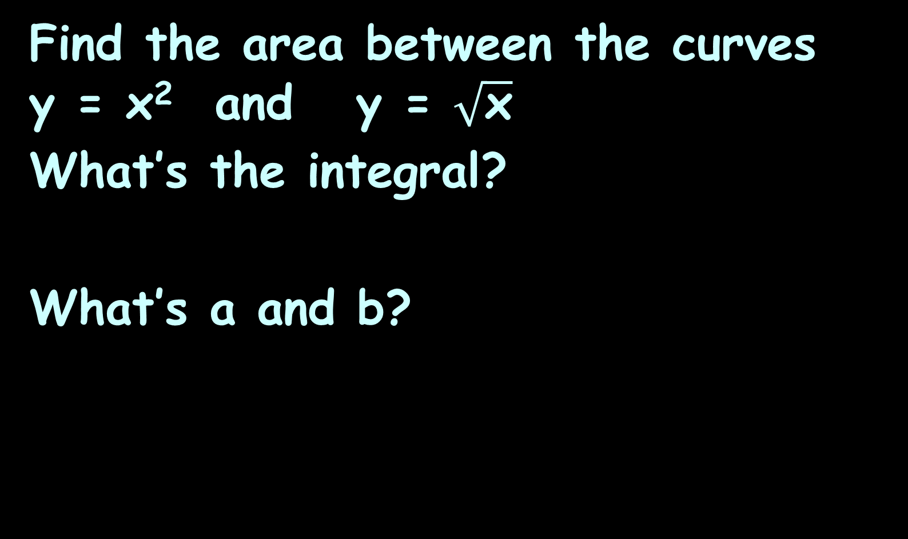

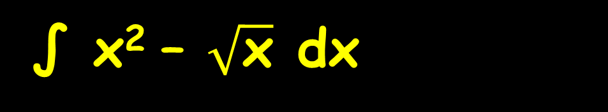
AREA BETWEEN CURVES
IN-CLASS PROBLEM 3
Find the area between the curves y = x² and y = $\sqrt{\text{x}}$
What’s the integral?
What’s a and b?
∫ x² – $\sqrt{\text{x}}$ dx
b
I’m guessing that
x² falls above $\sqrt{\text{x}}$…
I could be wrong…
a
b
∫ ƒ(x) – g(x) dx
a
https://www.wolframalpha.com/input/?i=area+between+curves+y%3Dx%5E2+and+y%3Dsqrt%28x%29+

Slide 79
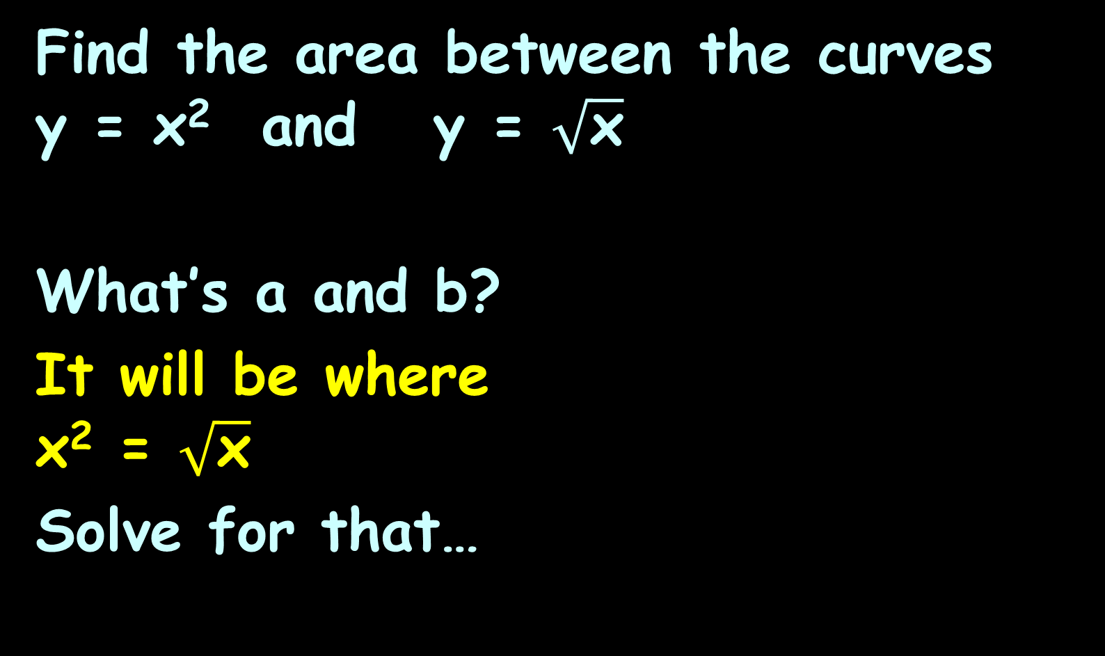

AREA BETWEEN CURVES
IN-CLASS PROBLEM 3
Find the area between the curves y = x² and y = $\sqrt{\text{x}}$
What’s a and b?
It will be where
x² = $\sqrt{\text{x}}$
Solve for that…
∫ x² – $\sqrt{\text{x}}$ dx
b
a
b
∫ ƒ(x) – g(x) dx
a
https://www.wolframalpha.com/input/?i=area+between+curves+y%3Dx%5E2+and+y%3Dsqrt%28x%29+

Slide 80
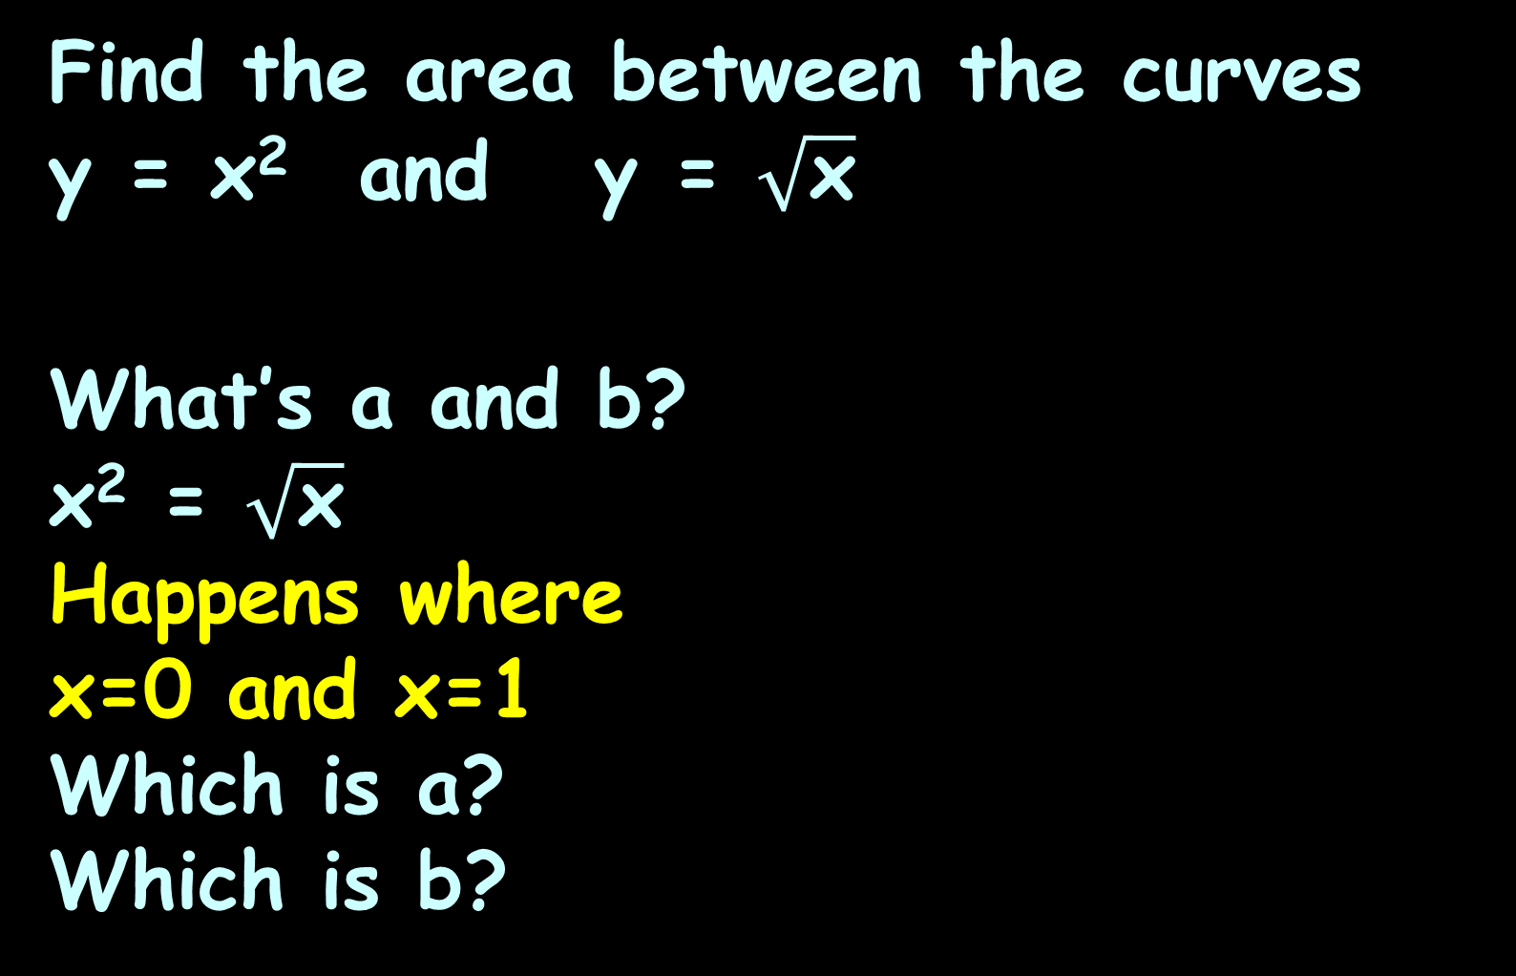
AREA BETWEEN CURVES
IN-CLASS PROBLEM 3
Find the area between the curves y = x² and y = $\sqrt{\text{x}}$
What’s a and b?
x² = $\sqrt{\text{x}}$
Happens where
x=0 and x=1
Which is a?
Which is b?
∫ x² – $\sqrt{\text{x}}$ dx
b
a
b
∫ ƒ(x) – g(x) dx
a
https://www.wolframalpha.com/input/?i=area+between+curves+y%3Dx%5E2+and+y%3Dsqrt%28x%29+

Slide 81
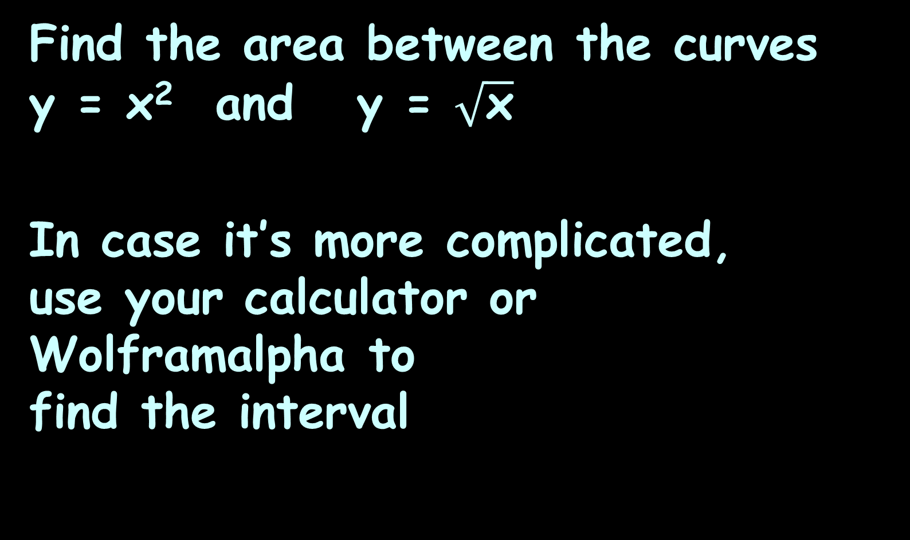
AREA BETWEEN CURVES
IN-CLASS PROBLEM 3
Find the area between the curves y = x² and y = $\sqrt{\text{x}}$
In case it’s more complicated,
use your calculator or Wolframalpha to
find the interval
∫ x² – $\sqrt{\text{x}}$ dx
1
0
b
∫ ƒ(x) – g(x) dx
a
https://www.wolframalpha.com/input/?i=area+between+curves+y%3Dx%5E2+and+y%3Dsqrt%28x%29+

Slide 82
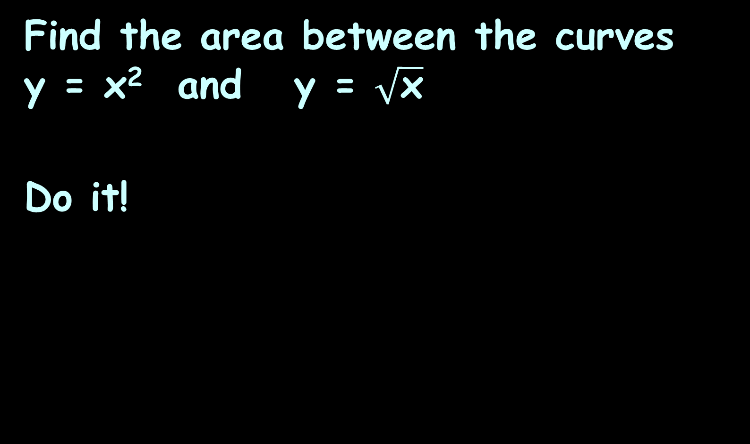
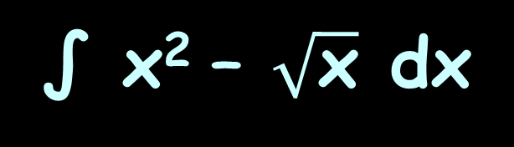
AREA BETWEEN CURVES
IN-CLASS PROBLEM 3
Find the area between the curves y = x² and y = $\sqrt{\text{x}}$
Do it!
∫ x² – $\sqrt{\text{x}}$ dx
1
0
https://www.wolframalpha.com/input/?i=area+between+curves+y%3Dx%5E2+and+y%3Dsqrt%28x%29+

Slide 83
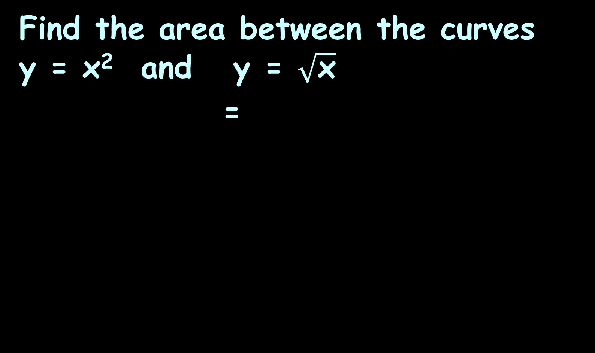
AREA BETWEEN CURVES
IN-CLASS PROBLEM 3
Find the area between the curves y = x² and y = $\sqrt{\text{x}}$
=
∫ x² – $\sqrt{\text{x}}$ dx
∫ x² – x^{½} dx
1
1
0
0
https://www.wolframalpha.com/input/?i=area+between+curves+y%3Dx%5E2+and+y%3Dsqrt%28x%29+

Slide 84
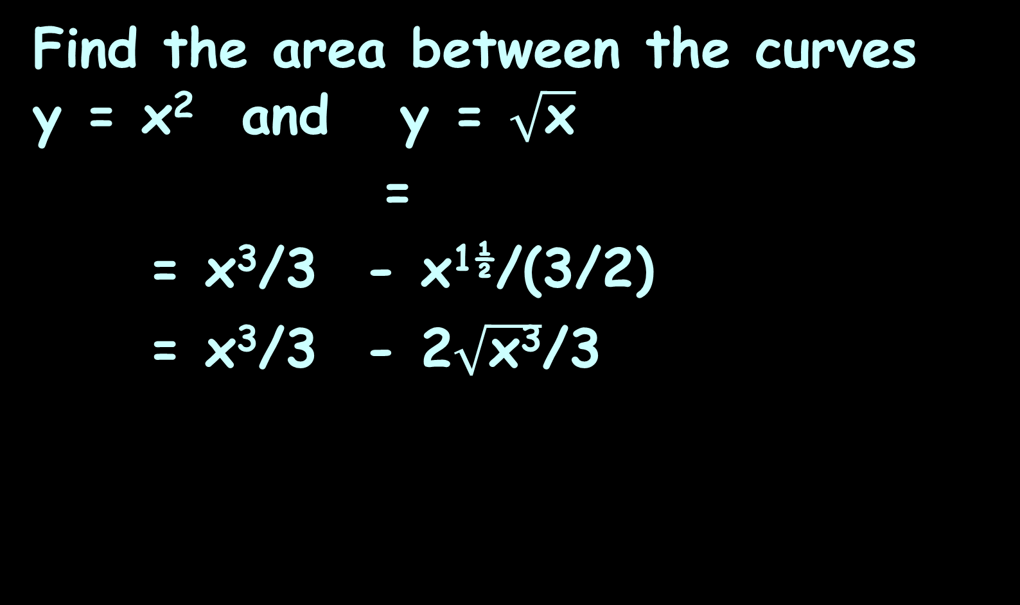
AREA BETWEEN CURVES
IN-CLASS PROBLEM 3
Find the area between the curves y = x² and y = $\sqrt{\text{x}}$
=
= x³/3 - x^{1½}/(3/2)
= x³/3 - 2$\sqrt{\text{x}\text{3}}$/3
∫ x² – $\sqrt{\text{x}}$ dx
∫ x² – x^{½} dx
1
1
0
0
|
1
|
1
0
0
|
1
|
1
0
0
https://www.wolframalpha.com/input/?i=area+between+curves+y%3Dx%5E2+and+y%3Dsqrt%28x%29+

Slide 85
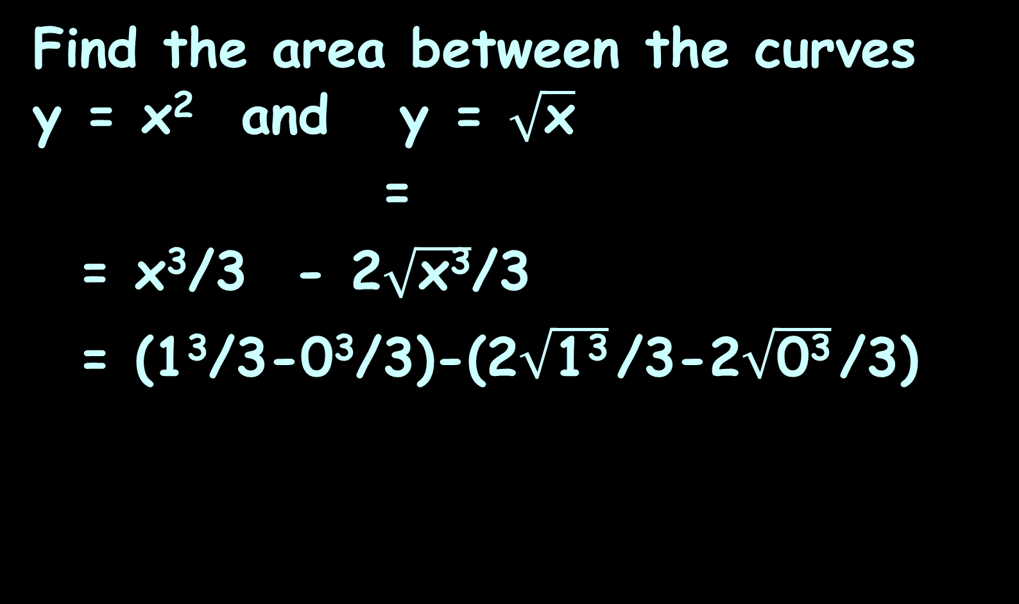
AREA BETWEEN CURVES
IN-CLASS PROBLEM 3
Find the area between the curves y = x² and y = $\sqrt{\text{x}}$
=
= x³/3 - 2$\sqrt{\text{x}\text{3}}$/3
= (1³/3-0³/3)-(2$\sqrt{\text{1}\text{3}}$/3-2$\sqrt{\text{0}\text{3}}$/3)
∫ x² – $\sqrt{\text{x}}$ dx
∫ x² – x^{½} dx
1
1
0
0
|
1
|
1
0
0
https://www.wolframalpha.com/input/?i=area+between+curves+y%3Dx%5E2+and+y%3Dsqrt%28x%29+

Slide 86
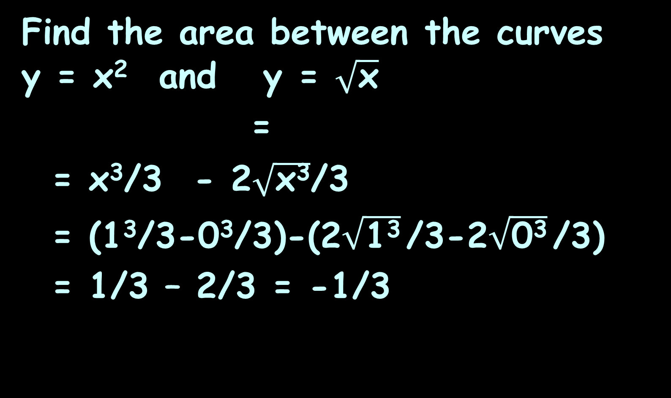
AREA BETWEEN CURVES
IN-CLASS PROBLEM 3
Find the area between the curves y = x² and y = $\sqrt{\text{x}}$
=
= x³/3 - 2$\sqrt{\text{x}\text{3}}$/3
= (1³/3-0³/3)-(2$\sqrt{\text{1}\text{3}}$/3-2$\sqrt{\text{0}\text{3}}$/3)
= 1/3 – 2/3 = -1/3
∫ x² – $\sqrt{\text{x}}$ dx
∫ x² – x^{½} dx
1
1
0
0
|
1
|
1
0
0
https://www.wolframalpha.com/input/?i=area+between+curves+y%3Dx%5E2+and+y%3Dsqrt%28x%29+

Slide 87
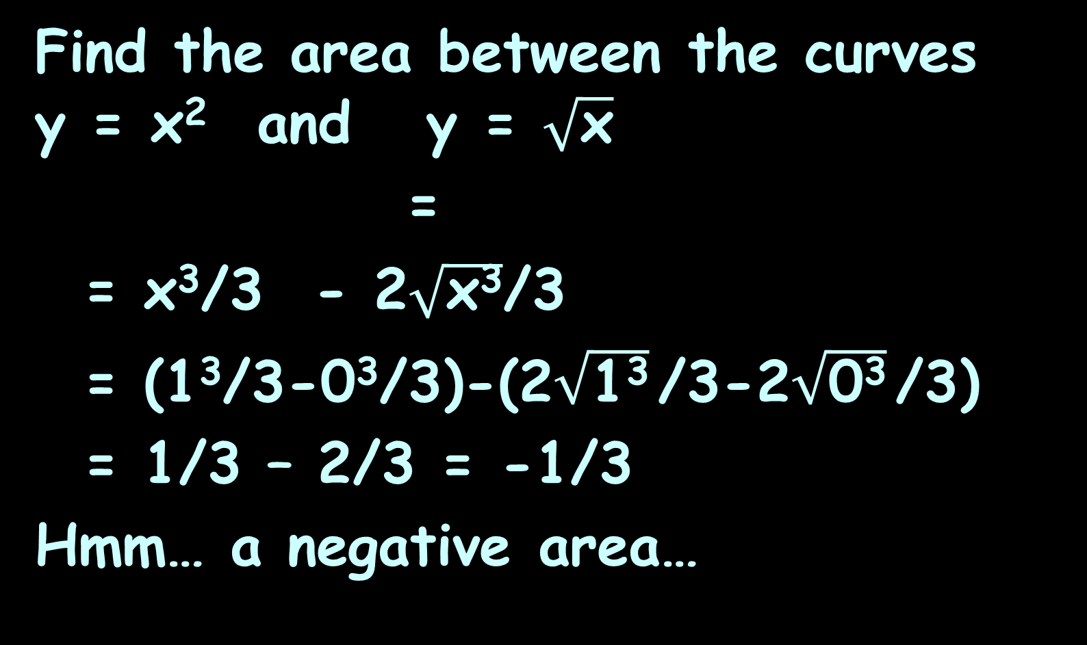
AREA BETWEEN CURVES
IN-CLASS PROBLEM 3
Find the area between the curves y = x² and y = $\sqrt{\text{x}}$
=
= x³/3 - 2$\sqrt{\text{x}\text{3}}$/3
= (1³/3-0³/3)-(2$\sqrt{\text{1}\text{3}}$/3-2$\sqrt{\text{0}\text{3}}$/3)
= 1/3 – 2/3 = -1/3
Hmm… a negative area…
∫ x² – $\sqrt{\text{x}}$ dx
∫ x² – x^{½} dx
1
1
0
0
|
1
|
1
0
0
https://www.wolframalpha.com/input/?i=area+between+curves+y%3Dx%5E2+and+y%3Dsqrt%28x%29+

Slide 88
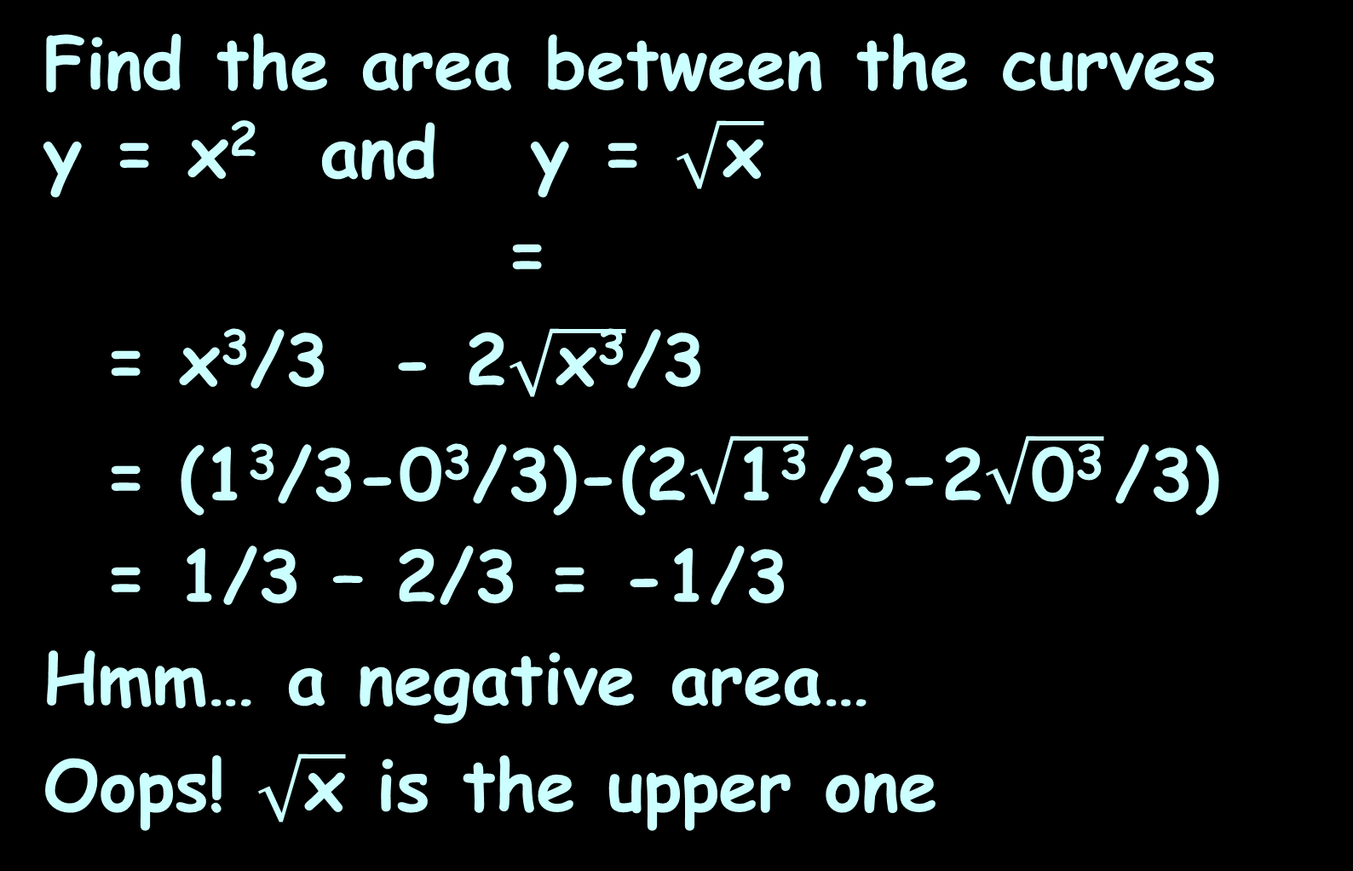
AREA BETWEEN CURVES
IN-CLASS PROBLEM 3
Find the area between the curves y = x² and y = $\sqrt{\text{x}}$
=
= x³/3 - 2$\sqrt{\text{x}\text{3}}$/3
= (1³/3-0³/3)-(2$\sqrt{\text{1}\text{3}}$/3-2$\sqrt{\text{0}\text{3}}$/3)
= 1/3 – 2/3 = -1/3
Hmm… a negative area…
Oops! $\sqrt{\text{x}}$ is the upper one
∫ x² – $\sqrt{\text{x}}$ dx
∫ x² – x^{½} dx
1
1
0
0
|
1
|
1
0
0
https://www.wolframalpha.com/input/?i=area+between+curves+y%3Dx%5E2+and+y%3Dsqrt%28x%29+

Slide 89
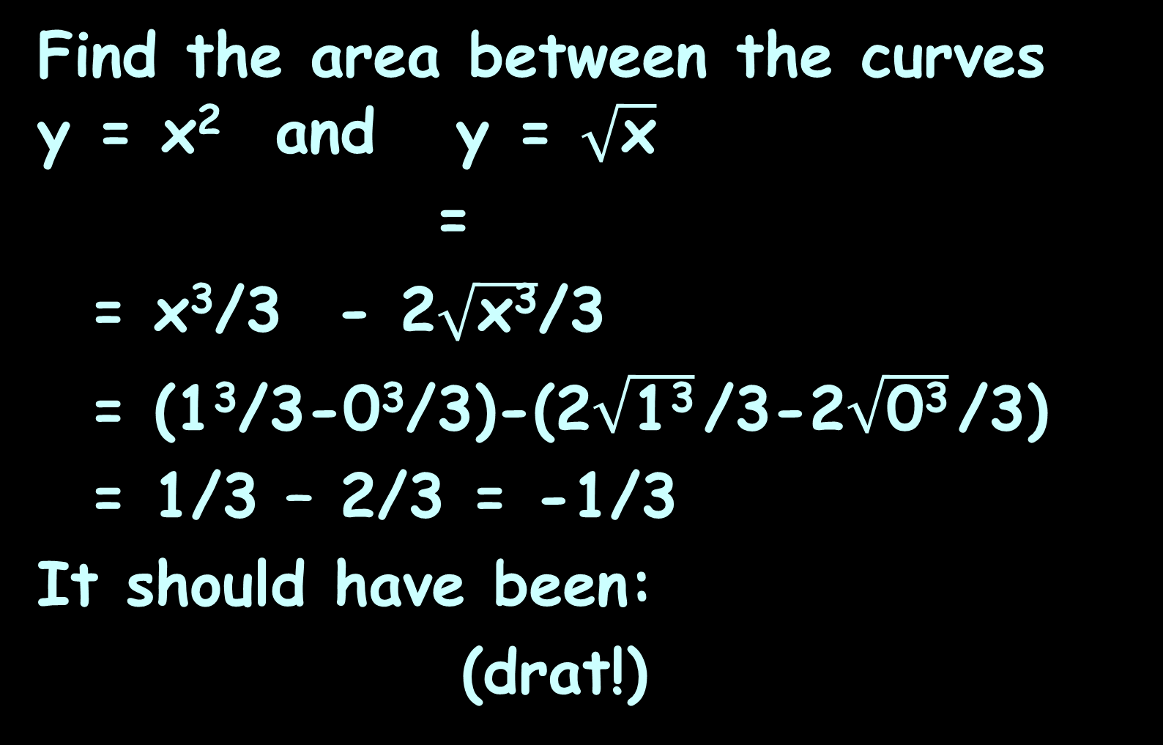
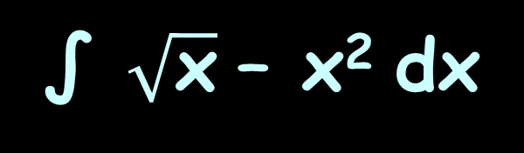
AREA BETWEEN CURVES
IN-CLASS PROBLEM 3
Find the area between the curves y = x² and y = $\sqrt{\text{x}}$
=
= x³/3 - 2$\sqrt{\text{x}\text{3}}$/3
= (1³/3-0³/3)-(2$\sqrt{\text{1}\text{3}}$/3-2$\sqrt{\text{0}\text{3}}$/3)
= 1/3 – 2/3 = -1/3
It should have been:
(drat!)
∫ x² – $\sqrt{\text{x}}$ dx
∫ x² – x^{½} dx
1
1
0
0
|
1
|
1
0
0
∫ $\sqrt{\text{x}}$ – x² dx
1
0
https://www.wolframalpha.com/input/?i=area+between+curves+y%3Dx%5E2+and+y%3Dsqrt%28x%29+

Slide 90
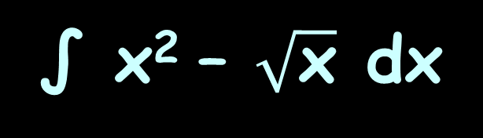

AREA BETWEEN CURVES
IN-CLASS PROBLEM 3
Good news!
= -
Using the Coefficient Rule:
=
All we have to do is multiply our (negative) answer by -1 to get the right (positive) answer
∫ $\sqrt{\text{x}}$ – x² dx
∫ x² – $\sqrt{\text{x}}$ dx
1
1
0
0
∫kƒ ’(x) dx
k∫ƒ ’(x) dx
https://www.wolframalpha.com/input/?i=area+between+curves+y%3Dx%5E2+and+y%3Dsqrt%28x%29+

Slide 91
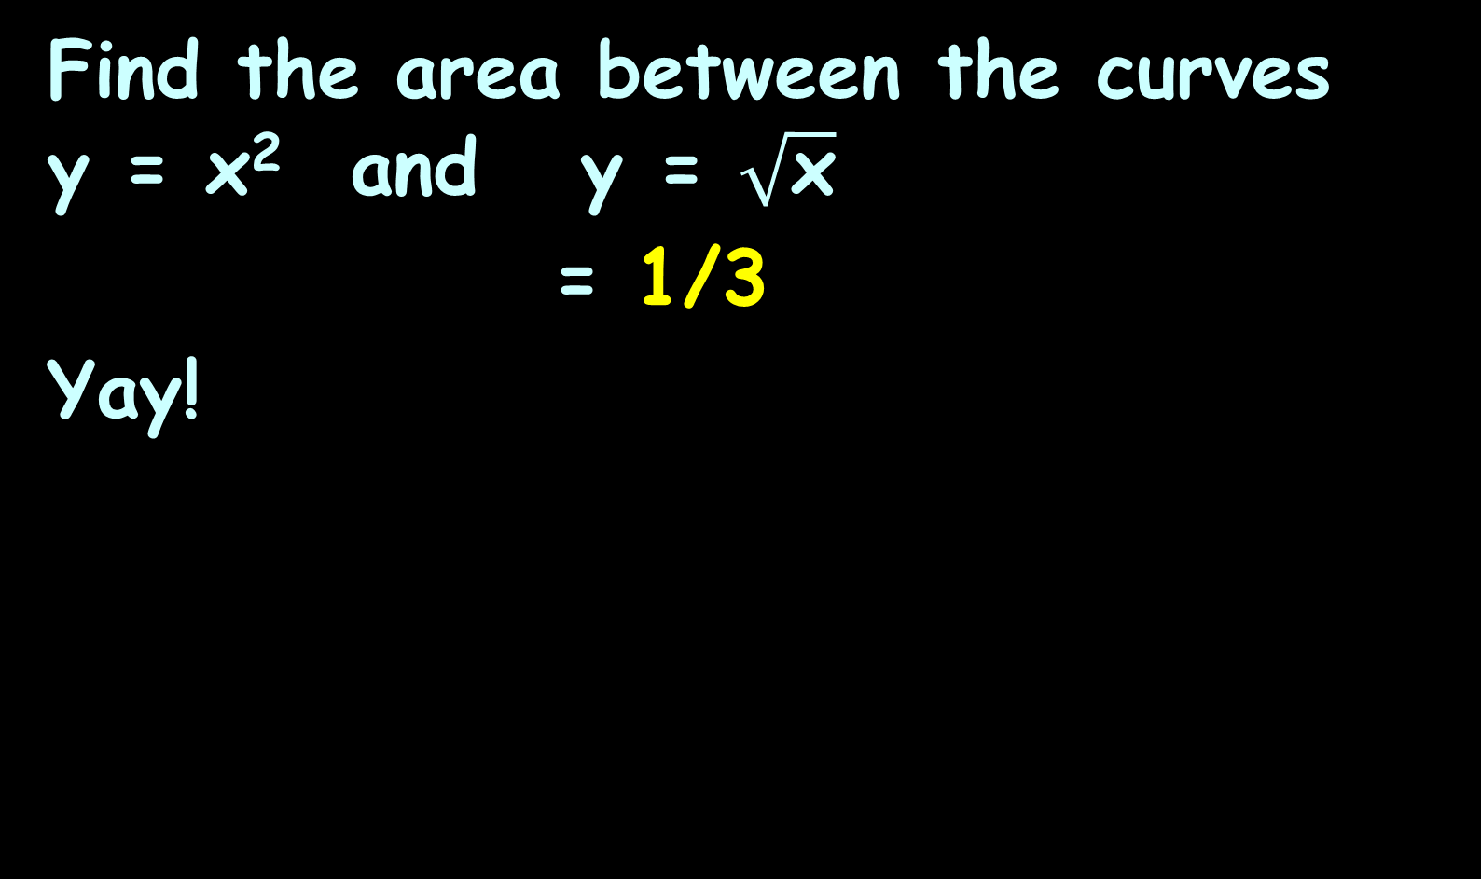
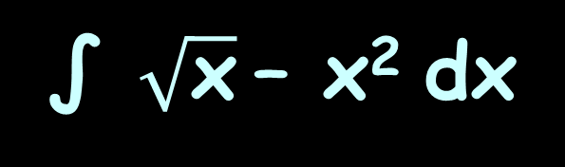
AREA BETWEEN CURVES
IN-CLASS PROBLEM 3
Find the area between the curves y = x² and y = $\sqrt{\text{x}}$
= 1/3
Yay!
∫ $\sqrt{\text{x}}$– x² dx
1
0
https://www.wolframalpha.com/input/?i=area+between+curves+y%3Dx%5E2+and+y%3Dsqrt%28x%29+

Slide 92
Area Between Curves
The Coefficient Rule
means you don’t really
have to know which curve is higher than
the other – if you get
a negative area (and
didn’t intend to) you
just make your answer
positive - No sweat!
http://www.vsexamprep.com/online-test.html

Slide 93
Area Between Curves
So if you have a question like:
Find the area between the curves y = 8 - x² and y = x + 2 between x = 0 and x = 1
And you don’t know which is the “top” curve - just pick one at random!
You can adjust your answer later

Slide 94
Questions?
http://i.imgur.com/aliTlT3.jpg

Slide 95
Area Between Curves
Sometimes the area between the curves crosses the axes
Does that make a difference?

Slide 96
AREA BETWEEN CURVES
IN-CLASS PROBLEM 4
Find the area between the curves y = 8 - x² and y = x + 2
What’s the range?
8 - x² = x + 2 and solve
b
∫ ƒ(x) – g(x) dx
a
https://www.wolframalpha.com/input/?i=area+between+curves

Slide 97
AREA BETWEEN CURVES
IN-CLASS PROBLEM 4
Find the area between the curves y = 8 - x² and y = x + 2
What’s the range?
8 - x² = x + 2 and solve
8 = x² + x + 2
x² + x + -6 = 0
a=1, b=1, c=-6
b
∫ ƒ(x) – g(x) dx
a
https://www.wolframalpha.com/input/?i=area+between+curves

Slide 98
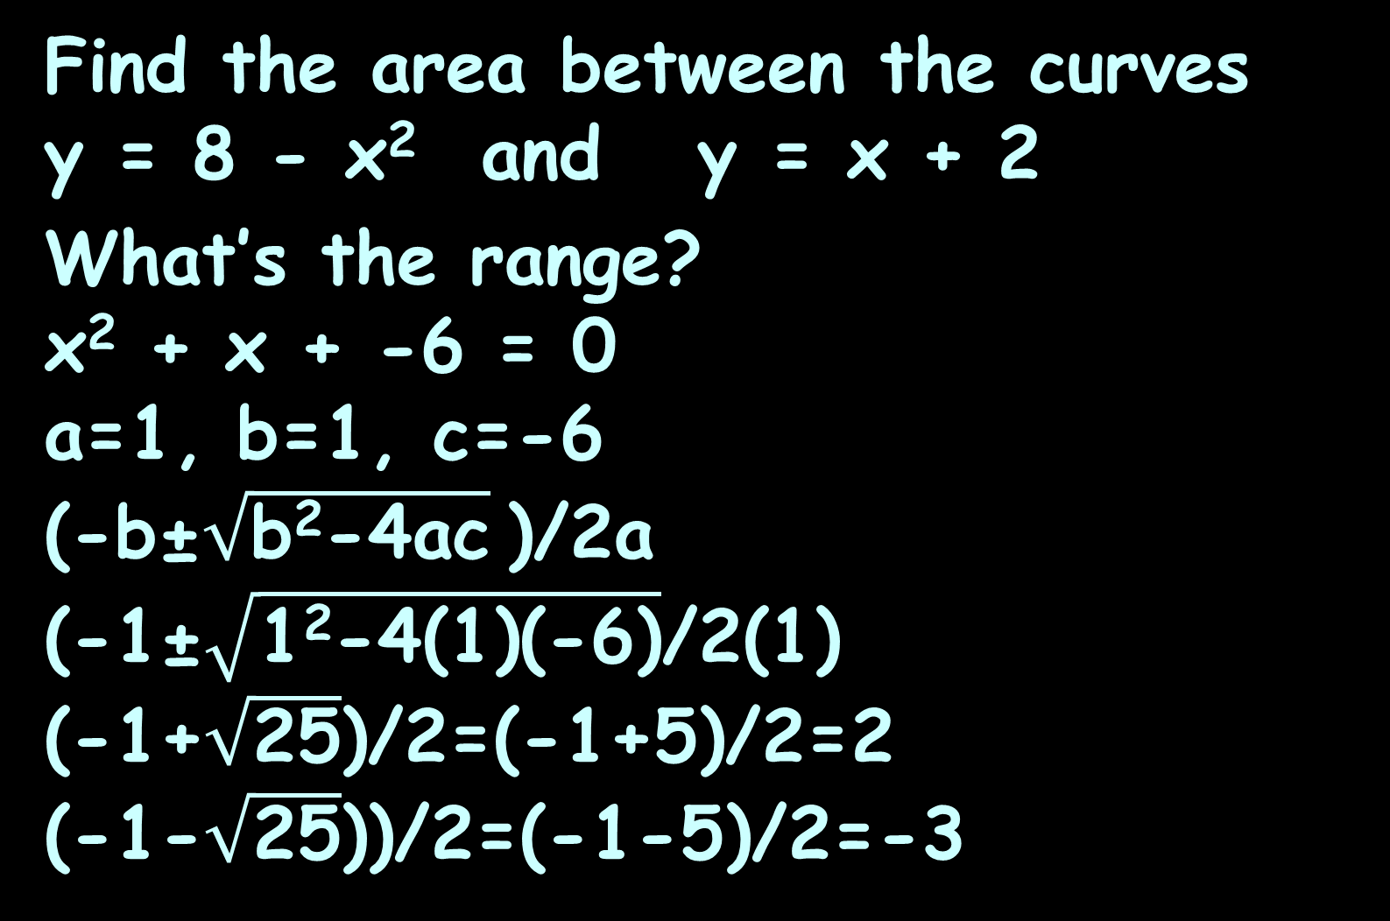
AREA BETWEEN CURVES
IN-CLASS PROBLEM 4
Find the area between the curves y = 8 - x² and y = x + 2
What’s the range?
x² + x + -6 = 0
a=1, b=1, c=-6
(-b±$\sqrt{\text{b}\text{2}\text{−4}\text{ac}}$)/2a
(-1±$\sqrt{\text{1}\text{2}\text{−4(1)(−6)}}$/2(1)
(-1+$\sqrt{\text{25}}$)/2=(-1+5)/2=2
(-1-$\sqrt{\text{25}}$))/2=(-1-5)/2=-3
b
∫ ƒ(x) – g(x) dx
a
https://www.wolframalpha.com/input/?i=area+between+curves

Slide 99
AREA BETWEEN CURVES
IN-CLASS PROBLEM 4
Find the area between the curves y = 8 - x² and y = x + 2
What’s the range? 2, -3
What’s a?
What’s b?
b
∫ ƒ(x) – g(x) dx
a
https://www.wolframalpha.com/input/?i=area+between+curves

Slide 100
AREA BETWEEN CURVES
IN-CLASS PROBLEM 4
Find the area between the curves y = 8 - x² and y = x + 2
What’s the range? 2, -3
What’s a? -3
What’s b? 2
What’s the integral?
b
∫ ƒ(x) – g(x) dx
a
https://www.wolframalpha.com/input/?i=area+between+curves

Slide 101
AREA BETWEEN CURVES
IN-CLASS PROBLEM 4
Find the area between the curves y = 8 - x² and y = x + 2
What’s the integral?
Do it!
∫ (8-x²) – (x+2) dx
2
-3
https://www.wolframalpha.com/input/?i=area+between+curves

Slide 102
AREA BETWEEN CURVES
IN-CLASS PROBLEM 4
Find the area between the curves y = 8 - x² and y = x + 2
(8x – x³/3) – (x²/2 +2x)
∫ (8-x²) – (x+2) dx
2
-3
|
2
-3
https://www.wolframalpha.com/input/?i=area+between+curves

Slide 103
AREA BETWEEN CURVES
IN-CLASS PROBLEM 4
Find the area between the curves y = 8 - x² and y = x + 2
(8x – x³/3) – (x²/2 +2x)
= ((8(2)-(2³)/3)-(8(-3)-((-3)³)/3))
– ((2²/2+2(2))-(((-3)²)/2+2(-3)))
= ((16-8/3)-(-24+27/3))
– ((2+4)-(9/2-6))
∫ (8-x²) – (x+2) dx
2
-3
|
2
-3

Slide 104
AREA BETWEEN CURVES
IN-CLASS PROBLEM 4
Find the area between the curves y = 8 - x² and y = x + 2
= ((16-8/3)-(-24+27/3))
– ((2+4)-(9/2-6))
= ((48/3-8/3)-(-72/3+27/3))
– (6-(9/2-12/2))
= ((48/3-8/3)-(-72/3+27/3))
– (12/2-(9/2-12/2))
∫ (8-x²) – (x+2) dx
2
-3

Slide 105
AREA BETWEEN CURVES
IN-CLASS PROBLEM 4
Find the area between the curves y = 8 - x² and y = x + 2
= ((48/3-8/3)-(-72/3+27/3))
– (12/2-(9/2-12/2))
= (85/3) – (15/2)
= 170/6 – 45/6 = 125/6
∫ [(8-x²) – (x+2)] dx
2
-3
https://www.wolframalpha.com/input/?i=area+between+curves

Slide 106
Area Between Curves
Sometimes the area between the curves crosses the axes
Does that make a difference?
Nope…

Slide 107
Questions?
http://i.imgur.com/aliTlT3.jpg

Slide 108
Area Between Curves
Sometimes the areas are complicated by overlapping curves

Slide 109
Area Between Curves
What would you have to do to calculate the area between these curves?
-
https://www.wolframalpha.com/input/?i=area+between+curves

Slide 110
Area Between Curves
What would you have to do to calculate the area between these curves?
Calculate piecewise
areas and add
them up!
-
https://www.wolframalpha.com/input/?i=area+between+curves

Slide 111
AREA BETWEEN CURVES
IN-CLASS PROBLEM 5
How many pieces would you need to find the area between the curves?
-
https://www.wolframalpha.com/input/?i=area+between+curves

Slide 112
AREA BETWEEN CURVES
IN-CLASS PROBLEM 5
How many pieces would you need to find the area between the curves? 2
-
https://www.wolframalpha.com/input/?i=area+between+curves

Slide 113
AREA BETWEEN CURVES
IN-CLASS PROBLEM 5
How many pieces would you need to find the area between the curves? 2
-
2x³ - x² - 5x
-x² + 3x
https://www.wolframalpha.com/input/?i=area+between+curves

Slide 114
AREA BETWEEN CURVES
IN-CLASS PROBLEM 5
The pieces you need will fall between locations where the graphs intersect
-
2x³ - x² - 5x
-x² + 3x
https://www.wolframalpha.com/input/?i=area+between+curves

Slide 115
AREA BETWEEN CURVES
IN-CLASS PROBLEM 5
Where do the curves intersect?
-
2x³ - x² - 5x
-x² + 3x
https://www.wolframalpha.com/input/?i=area+between+curves

Slide 116
AREA BETWEEN CURVES
IN-CLASS PROBLEM 5
Where do the curves intersect?
Where 2x³-x²-5x = -x²+3x
Find those points!
-
2x³ - x² - 5x
-x² + 3x
https://www.wolframalpha.com/input/?i=area+between+curves

Slide 117
AREA BETWEEN CURVES
IN-CLASS PROBLEM 5
Where do the curves intersect?
Where 2x³-x²-5x = -x²+3x
Well, one point is x=0, y=0
2x³-x²-5x = -x²+3x
2x³ = 3x+5x = 8x
Cancel an “x”
2x² = 8
x² = 4
So x = -2 and 2
-
2x³ - x² - 5x
-x² + 3x
Are we
done?
https://www.wolframalpha.com/input/?i=area+between+curves

Slide 118
AREA BETWEEN CURVES
IN-CLASS PROBLEM 5
Technically, yes, but you can also solve for the ys
So x = -2 and 2
y = -x²+3x
= -(-2²)+3(-2)
= -4-6 = -10
So a second point is:
(-2,-10)
-
2x³ - x² - 5x
-x² + 3x
https://www.wolframalpha.com/input/?i=area+between+curves

Slide 119
AREA BETWEEN CURVES
IN-CLASS PROBLEM 5
Technically, yes, but you can also solve for the ys
So x = -2 and 2
y = -x²+3x
= -(2²)+3(2)
= -4+6 = 2
So a third point is:
(2,2)
-
2x³ - x² - 5x
-x² + 3x
https://www.wolframalpha.com/input/?i=area+between+curves

Slide 120
AREA BETWEEN CURVES
IN-CLASS PROBLEM 5
So we need to do two integrals:
One to find the area between (-2,-10) and (0,0) and
a second between
(0,0) and (2,2)
-
2x³ - x² - 5x
-x² + 3x
https://www.wolframalpha.com/input/?i=area+between+curves

Slide 121
AREA BETWEEN CURVES
IN-CLASS PROBLEM 5
∫ ƒ(x) dx
Area1 =
Are a and b the xs or the ys?
b
a
-
2x³ - x² - 5x
-x² + 3x
https://www.wolframalpha.com/input/?i=area+between+curves

Slide 122
AREA BETWEEN CURVES
IN-CLASS PROBLEM 5
∫ ƒ(x) dx
Area1 =
Are a and b the xs or the ys?
The xs (‘cause it’s dx)
What is the
Area1 integral?
b
a
-
2x³ - x² - 5x
-x² + 3x
https://www.wolframalpha.com/input/?i=area+between+curves

Slide 123
AREA BETWEEN CURVES
IN-CLASS PROBLEM 5
What is the Area1 integral?
Ok, I generally don’t
advocate simplifying
first, but this one is
a nightmare
Since we know there
are no holes or cliffs
SIMPLIFY!
∫ (2x³-x²-5x)-(-x²+3x) dx
0
-2
-
2x³ - x² - 5x
-x² + 3x
https://www.wolframalpha.com/input/?i=area+between+curves

Slide 124
AREA BETWEEN CURVES
IN-CLASS PROBLEM 5
What is the Area1 integral?
=
=
Do it!
∫ (2x³-x²-5x)-(-x²+3x) dx
0
-2
∫ (2x³-x²-5x)-(-x²+3x) dx
0
-2
∫ 2x³-8x dx
0
-2
-
2x³ - x² - 5x
-x² + 3x
https://www.wolframalpha.com/input/?i=area+between+curves

Slide 125
AREA BETWEEN CURVES
IN-CLASS PROBLEM 5
What is the Area1 integral?
= (2x⁴/4-8x²/2)
∫ 2x³-8x dx
0
-2
|
0
-2
-
2x³ - x² - 5x
-x² + 3x
https://www.wolframalpha.com/input/?i=area+between+curves

Slide 126
AREA BETWEEN CURVES
IN-CLASS PROBLEM 5
What is the Area1 integral?
= (2x⁴/4-8x²/2)
= (2(0⁴)/4-8(0²)/2) -
(2((-2)⁴)/4-8((-2)²)/2)
= 0 – (8 – 16) = 8
∫ 2x³-8x dx
0
-2
|
0
-2
-
2x³ - x² - 5x
Are we done?
-x² + 3x
https://www.wolframalpha.com/input/?i=area+between+curves

Slide 127
AREA BETWEEN CURVES
IN-CLASS PROBLEM 5
What is the Area1 integral?
= (2x⁴/4-8x²/2)
= (2(0⁴)/4-8(0²)/2) -
(2(-2⁴)/4-8(-2²)/2)
= 0 – (8 – 16) = 8
∫ 2x³-8x dx
0
-2
|
0
-2
-
2x³ - x² - 5x
Are we done?
No, we’re half done… ~sigh~
-x² + 3x
https://www.wolframalpha.com/input/?i=area+between+curves

Slide 128
AREA BETWEEN CURVES
IN-CLASS PROBLEM 5
What is the Area2 integral?
Does the function change?
-
2x³ - x² - 5x
-x² + 3x
https://www.wolframalpha.com/input/?i=area+between+curves

Slide 129
AREA BETWEEN CURVES
IN-CLASS PROBLEM 5
What is the Area2 integral?
Does the function change? Yes - -x² + 3x is now on top
Do the a and b change?
-
2x³ - x² - 5x
-x² + 3x
https://www.wolframalpha.com/input/?i=area+between+curves

Slide 130
AREA BETWEEN CURVES
IN-CLASS PROBLEM 5
What is the Area2 integral?
Does the function change? yes
Do the a and b change? yes
What is the Area2
integral?
-
2x³ - x² - 5x
-x² + 3x
https://www.wolframalpha.com/input/?i=area+between+curves

Slide 131
AREA BETWEEN CURVES
IN-CLASS PROBLEM 5
What is the Area2 integral?
2
∫ (-x²+3x) – (2x³-x²-5x) dx
0
-
2x³ - x² - 5x
-x² + 3x
https://www.wolframalpha.com/input/?i=area+between+curves

Slide 132
AREA BETWEEN CURVES
IN-CLASS PROBLEM 5
What is the Area2 integral?
Do it!
2
∫ (-x²+3x) – (2x³-x²-5x) dx
∫ 8x - 2x³ dx
0
2
0
-
2x³ - x² - 5x
-x² + 3x
https://www.wolframalpha.com/input/?i=area+between+curves

Slide 133
AREA BETWEEN CURVES
IN-CLASS PROBLEM 5
What is the Area2 integral?
= (8x²/2-2x⁴/4)
What do you get?
∫ 8x - 2x³ dx
2
0
|
2
0
-
2x³ - x² - 5x
-x² + 3x
https://www.wolframalpha.com/input/?i=area+between+curves

Slide 134
AREA BETWEEN CURVES
IN-CLASS PROBLEM 5
What is the Area2 integral?
= (8x²/2-2x⁴/4)
= (8(2²)/2-2(2⁴)/4) -
(8(0²)/2-2(0⁴)/4)
= (16 - 8) – (0) = 8
∫ 8x - 2x³ dx
2
0
|
2
0
-
2x³ - x² - 5x
Are we done?
-x² + 3x
https://www.wolframalpha.com/input/?i=area+between+curves

Slide 135
AREA BETWEEN CURVES
IN-CLASS PROBLEM 5
Area = Area1 + Area2
= 8 + 8 = 16
-
8
8
2x³ - x² - 5x
-x² + 3x
https://www.wolframalpha.com/input/?i=area+between+curves

Slide 136
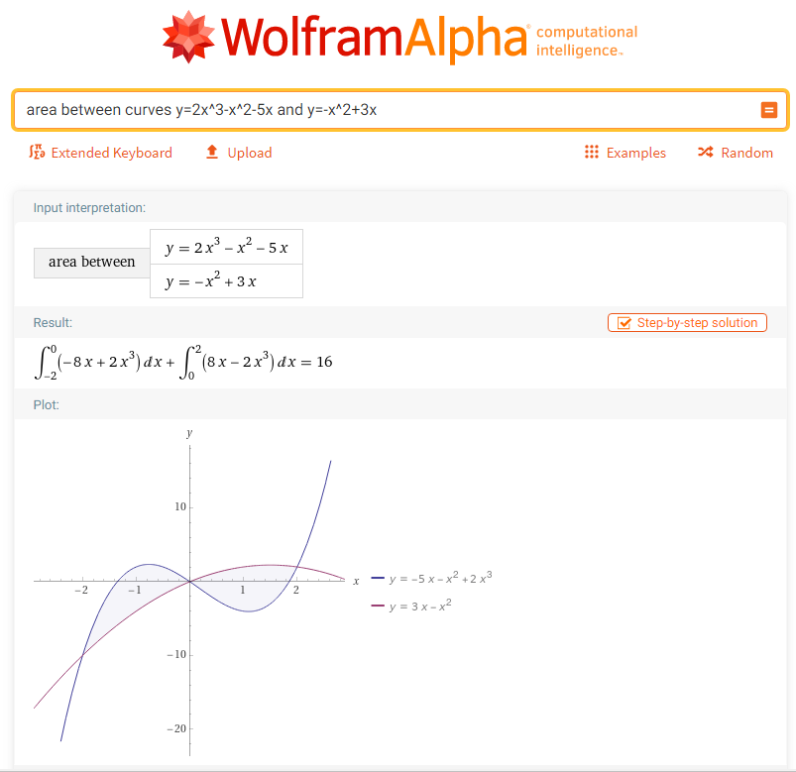

Slide 137
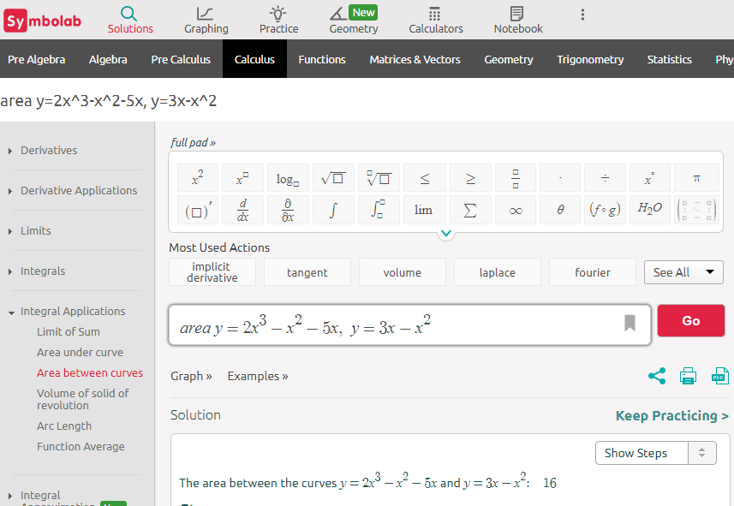

Slide 138
Questions?
http://i.imgur.com/aliTlT3.jpg

Slide 139
Area Between Curves
You can do this “sideways” too!
https://www.wolframalpha.com/input/?i=area+between+curves+x%3D-y%2B2++and+++x%3D4-y%5E2

Slide 140
Area Between Curves
When you do it sideways, write the formulas as x =
x=4-y²
x=4-y²
y=-x+2
x=-y+2
https://www.wolframalpha.com/input/?i=area+between+curves+x%3D-y%2B2++and+++x%3D4-y%5E2

Slide 141
AREA BETWEEN CURVES
IN-CLASS PROBLEM 6
Find the area between the line y = -x + 2 and the parabola
x = 4 – y²
Note: Wolframalpha
now will do
this!
(Symbolab does!)
x=4-y²
y=-x+2
https://www.wolframalpha.com/input/?i=area+between+curves+x%3D-y%2B2++and+++x%3D4-y%5E2
https://www.wolframalpha.com/input/?i=area+between+curves+x%3D-y%2B2++and+++x%3D4-y%5E2

Slide 142

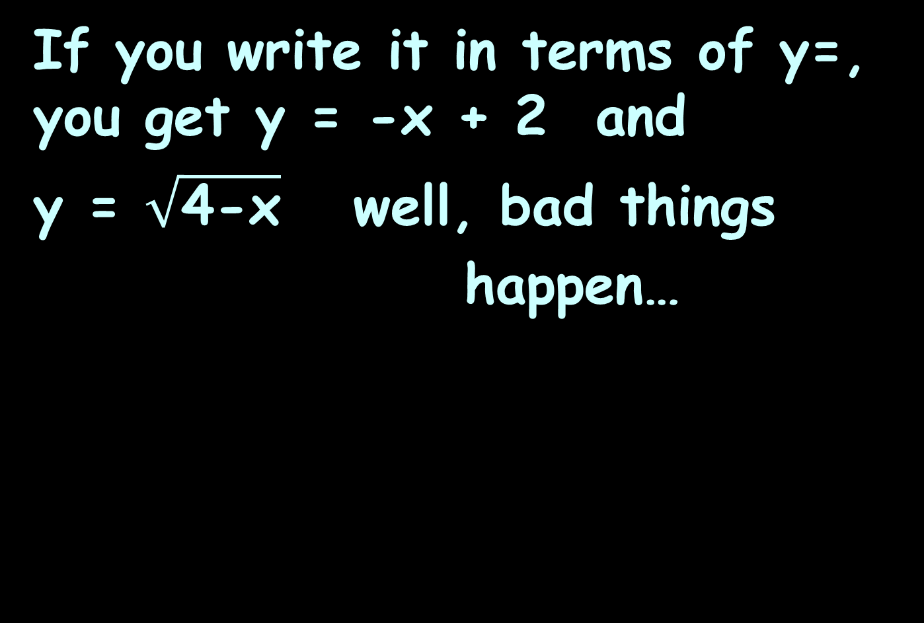
AREA BETWEEN CURVES
IN-CLASS PROBLEM 6
If you write it in terms of y=, you get y = -x + 2 and
y = $\sqrt{\text{4}\text{−}\text{x}}$ well, bad things
happen…
y = $\sqrt{\text{4}\text{−}\text{x}}$
y=-x+2
https://www.wolframalpha.com/input/?i=area+between+curves+x%3D-y%2B2++and+++x%3D4-y%5E2

Slide 143
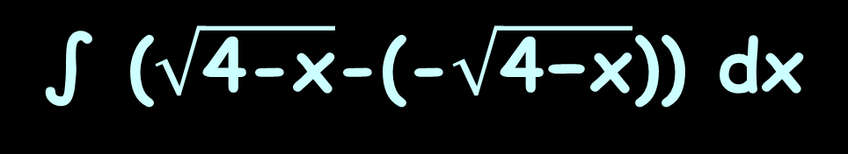

AREA BETWEEN CURVES
IN-CLASS PROBLEM 6
You would have to add two areas:
A1 =
= 19/6
A2 =
= 4/3 = 8/6
So A1+A2 = 27/6
= 4.5
∫ ($\sqrt{\text{4−}\text{x}}$-(-x+2)) dx
3
0
∫ ($\sqrt{\text{4−}\text{x}}$-(-$\sqrt{\text{4−}\text{x}}$)) dx
4
y=-x+2
3
x=4-y²
(0,2)
(4,0)
(3,-1)
https://www.wolframalpha.com/input/?i=area+between+curves+x%3D-y%2B2++and+++x%3D4-y%5E2

Slide 144
AREA BETWEEN CURVES
IN-CLASS PROBLEM 6
Easier way to handle it:
Change y = -x + 2 to x = -y + 2

Slide 145
AREA BETWEEN CURVES
IN-CLASS PROBLEM 6
Find the area between the line x = -y + 2 and the parabola
x = 4 – y² (Wolframalpha likes this version)
https://www.wolframalpha.com/input/?i=area+between+curves+x%3D-y%2B2++and+++x%3D4-y%5E2
https://www.wolframalpha.com/input/?i=area+between+curves+x%3D-y%2B2++and+++x%3D4-y%5E2

Slide 146
AREA BETWEEN CURVES
IN-CLASS PROBLEM 6
Find the area between the line x = -y + 2 and the parabola
x = 4 – y²
What’s our integral?
https://www.wolframalpha.com/input/?i=area+between+curves+x%3D-y%2B2++and+++x%3D4-y%5E2
https://www.wolframalpha.com/input/?i=area+between+curves+x%3D-y%2B2++and+++x%3D4-y%5E2

Slide 147
AREA BETWEEN CURVES
IN-CLASS PROBLEM 6
Find the area between the line x = -y + 2 and the parabola
x = 4 – y²
Did you get it right?
Lots of things were
adjusted
∫ (4-y²)-(-y+2) dy
2
-1
https://www.wolframalpha.com/input/?i=area+between+curves+x%3D-y%2B2++and+++x%3D4-y%5E2
https://www.wolframalpha.com/input/?i=area+between+curves+x%3D-y%2B2++and+++x%3D4-y%5E2

Slide 148
AREA BETWEEN CURVES
IN-CLASS PROBLEM 6
Find the area between the line x = -y + 2 and the parabola
x = 4 – y²
The interval is now
the ys not the xs
The variable is y not x
It’s dy not dx!
∫ (4-y²)-(-y+2) dy
2
-1
https://www.wolframalpha.com/input/?i=area+between+curves+x%3D-y%2B2++and+++x%3D4-y%5E2
https://www.wolframalpha.com/input/?i=area+between+curves+x%3D-y%2B2++and+++x%3D4-y%5E2

Slide 149
AREA BETWEEN CURVES
IN-CLASS PROBLEM 6
Find the area between the line x = -y + 2 and the parabola
x = 4 – y²
But everything else
now works the same
So… do it!
∫ (4-y²)-(-y+2)) dy
2
-1
https://www.wolframalpha.com/input/?i=area+between+curves+x%3D-y%2B2++and+++x%3D4-y%5E2
https://www.wolframalpha.com/input/?i=area+between+curves+x%3D-y%2B2++and+++x%3D4-y%5E2

Slide 150
AREA BETWEEN CURVES
IN-CLASS PROBLEM 6
Find the area between the line
x = -y + 2 and the parabola
x = 4 – y²
= (4y-y³/3) - (-y²/2+2y)
Simplify this to make it easier!
= -y³/3 + y²/2 + 4y - 2y
= -y³/3 + y²/2 + 2y
What do you get?
∫ ((4-y²)-(-y+2)) dy
2
-1
|
2
-1
|
2
|
-1
2
-1

Slide 151
AREA BETWEEN CURVES
IN-CLASS PROBLEM 6
Find the area between the line
x = -y + 2 and the parabola
x = 4 – y²
= -y³/3 + y²/2 + 2y
= (-(2³)/3+2²/2+2(2))
-(-(-1³)/3+(-1)²/2+2(-1))
= (-8/3+4/2+4)-(1/3+1/2-2)
= (-8/3+18/3)-(2/6+3/6-12/6)
∫ (4-y²)-(-y+2)) dy
2
-1
|
2
-1

Slide 152
AREA BETWEEN CURVES
IN-CLASS PROBLEM 6
Find the area between the line
x = -y + 2 and the parabola
x = 4 – y²
= (-8/3+18/3)-(2/6+3/6-12/6)
= 10/3 - -7/6 = 20/6 + 7/6
= 27/6 = 4.5
This is the value we got before using the 2 vertical areas
∫ (4-y²)-(-y+2)) dy
2
-1

Slide 153
AREA BETWEEN CURVES
IN-CLASS PROBLEM 6
You would have to add two areas:
A1 =
= 19/6
A2 =
= 4/3 = 8/6
So A1+A2 = 27/6
= 4.5
∫ ($\sqrt{\text{4−}\text{x}}$-(-x+2)) dx
3
0
∫ ($\sqrt{\text{4−}\text{x}}$-(-$\sqrt{\text{4−}\text{x}}$)) dx
4
y=-x+2
3
x=4-y²
(0,2)
(4,0)
(3,-1)
https://www.wolframalpha.com/input/?i=area+between+curves+x%3D-y%2B2++and+++x%3D4-y%5E2

Slide 154
Area Between Curves
… and this is why they invented calculators and Wolframalpha…

Slide 155
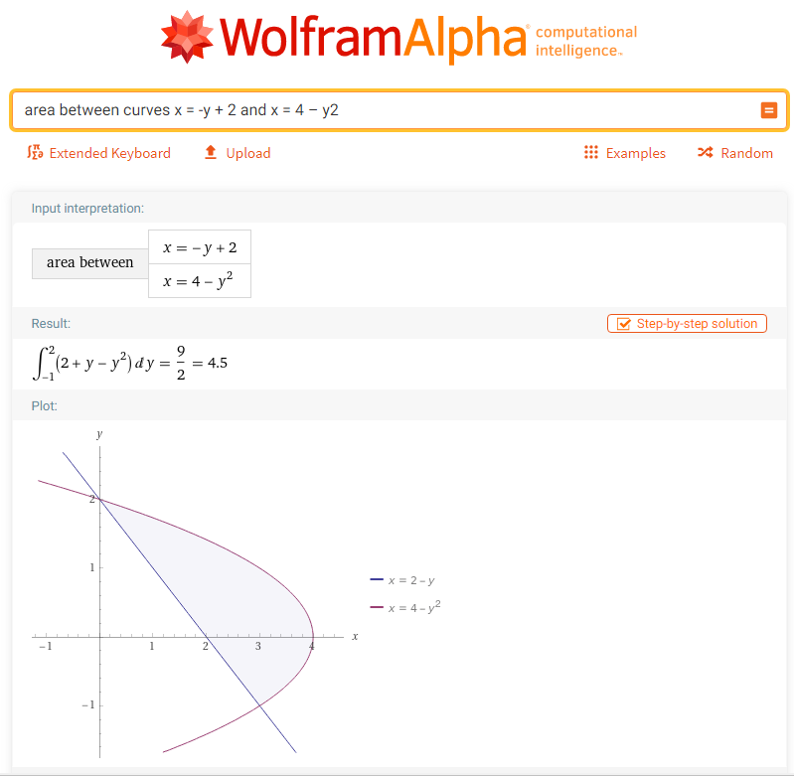

Slide 156
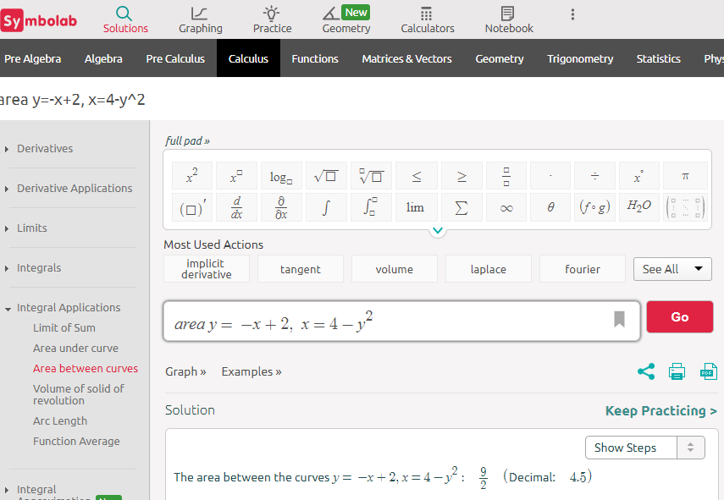

Slide 157
Questions?
http://i.imgur.com/aliTlT3.jpg

Slide 158
Summary
Today we covered:
Review of area under a curve and the Fundamental Theorem of Calculus
Area between two curves

Slide 159

You Survived!
www.playbuzz.com

