Slide 1
Welcome to
Unit 1
Part 1!
MATH 207 Integral Calculus
http://en.wikipedia.org/wiki/Differential_equation#mediaviewer/File:Elmer-pump-heatequation.png

Slide 2
What’s Up?
Today we will be going over:
Review of uses of integration
Trig Calculus

Slide 3
What’s Up?
Outcome 1) Demonstrate a high level of proficiency in differentiation and integration for linear, polynomial, rational, trigonometric, inverse trigonometric, exponential and logarithmic function, including using the method of substitution, integration by parts and partial fraction decomposition
Outcome 7) Solve problems by identifying the requirements, making a sketch as appropriate

Slide 4

Review
http://995642590.r.lightningbase-cdn.com/wp-content/uploads/2010/12/looking-back-hrexaminer-v144-cover425px.jpg

Slide 5
Average Value of a Function
The average value of a curve over an interval x=a to x=b is:
∫ ƒ(x) dx
b
a
y_{avg} =
b - a

Slide 6

Arc (Curve) Length
S = ∫_{a}^{b} $\sqrt{{\text{1+(}\text{dy}\text{/}\text{dx}\text{)}}^{\text{2}}}$ dx
Δy
{
- - -
Δx

Slide 7
Probability
Probability density functions satisfy these 2 conditions:
1) f(x)≥0 for all x (no negative probabilities)
2) The integral over the entire domain is 1 (the sum of probabilities for all possible values of x is 100%)

Slide 8
Probability
The probability of a value falling between an upper and lower limit will be the integral of the pdf between those limits

Slide 9
Hydrostatic Force
The hydrostatic force is
where w is the weight density of the fluid (for water: 9800 N/m³ or 62.4 lbs/ft³)
h(y) is the depth of the plate
L(y) is the width of the plate
d
F= w∫ h(y) L(y) dy
c

Slide 10
Center of Mass
x̅ = My/M
=
y̅ = Mx/M
=
b
∫ x(f(x)−g(x)) dx
a
b
∫ f(x)−g(x) dx
a
b
∫ ½(f(x)²−g(x)²) dx
a
b
∫ f(x)−g(x) dx
a

Slide 11

Questions?
http://i.imgur.com/aliTlT3.jpg

Slide 12
Trigonometry
In MATH205 we learned the formulas for taking derivatives and integrals of trig functions

Slide 13
Trigonometry
I promised we’d go into more detail in MATH207

Slide 14
Trigonometry
I promised we’d go into more detail in MATH207
…that starts now…

Slide 15
Trigonometry
I promised we’d go into more detail in MATH207
…that starts now…
…after a quick review of circuit analysis…

Slide 16
Trigonometry
Last term we found that mathematical formulas were often used to estimate the values of real-world phenomena

Slide 17
Trigonometry
Last term we found that mathematical formulas were often used to estimate the values of real-world phenomena
These are called “mathematical models”

Slide 18
Trigonometry
Mathematical models do not define how a phenomenon works, they only describe them

Slide 19
Trigonometry
One use of trig in engineering is in circuit analysis

Slide 20
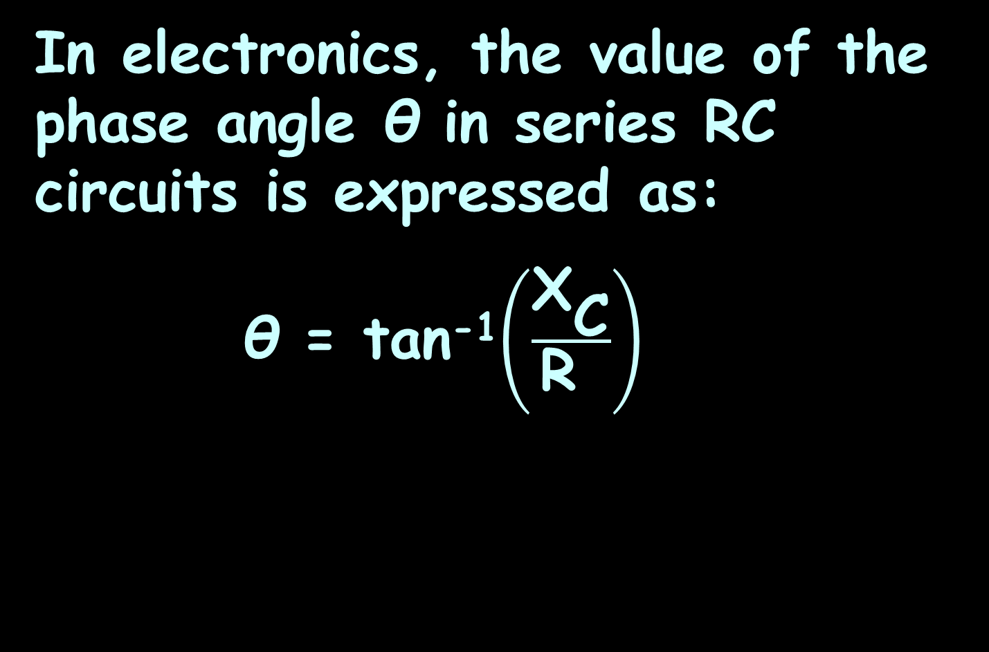
Trigonometry
In electronics, the value of the phase angle θ in series RC circuits is expressed as:
θ = tan⁻¹$\left(\frac{{\text{X}}_{\text{C}}}{\text{R} }\right)$
capacitive reactance
resistance

Slide 21
Trigonometry
An inverse trig function tan⁻¹ tells you the ANGLE that would give you that tangent value

Slide 22
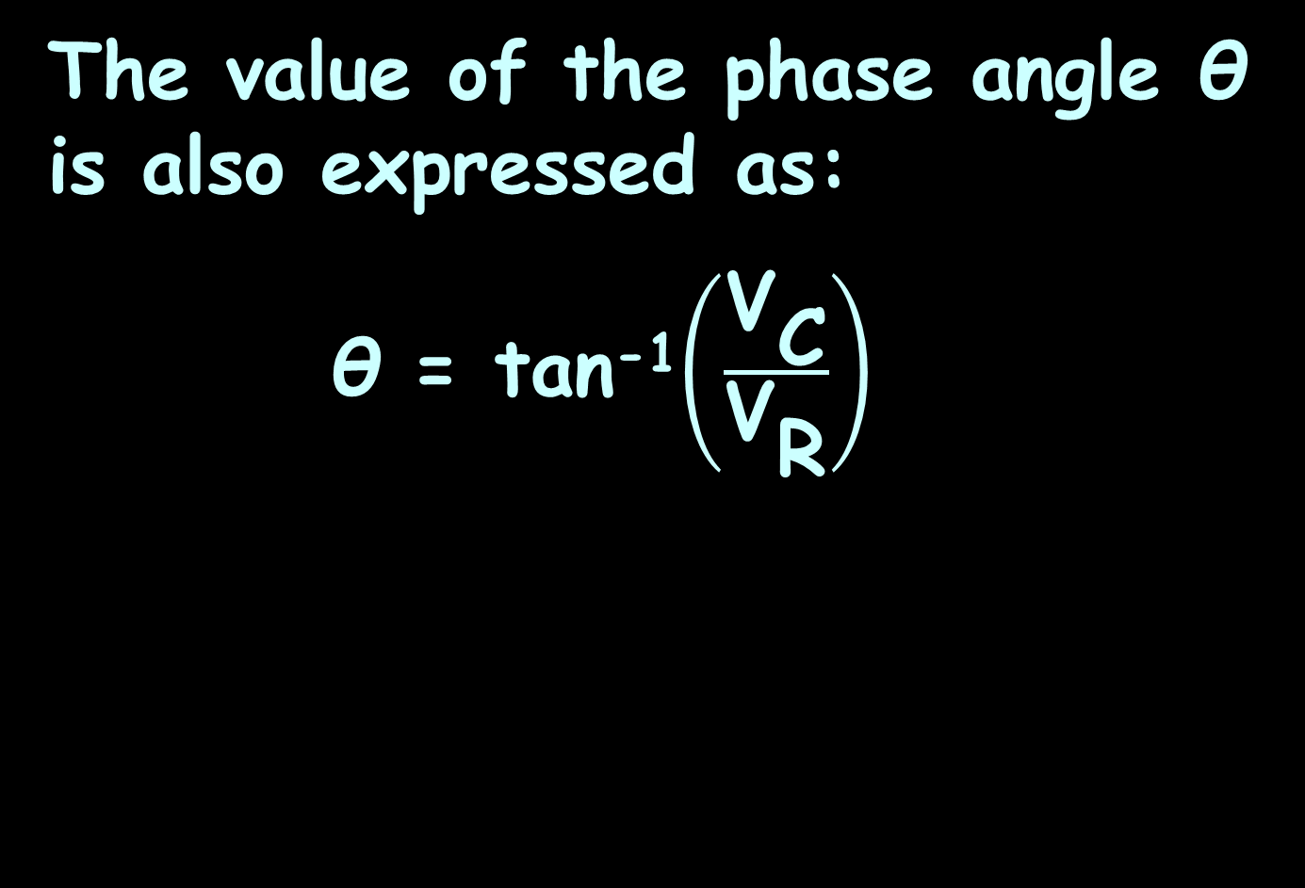
Trigonometry
The value of the phase angle θ is also expressed as:
θ = tan⁻¹$\left(\frac{{\text{V}}_{\text{C}}}{{\text{V}}_{\text{R}}}\right)$
source voltage
resistor voltage

Slide 23
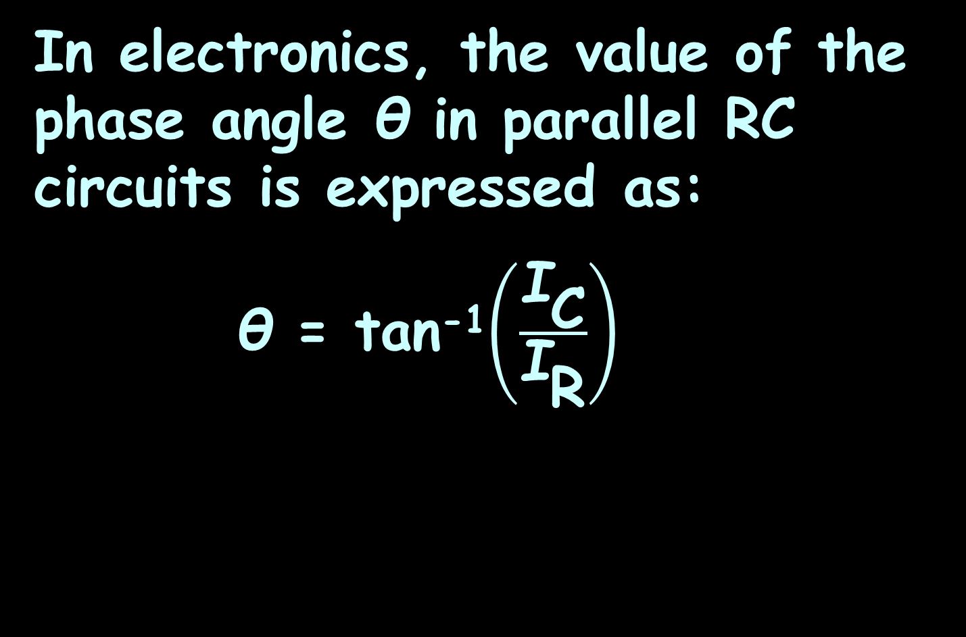
Trigonometry
In electronics, the value of the phase angle θ in parallel RC circuits is expressed as:
θ = tan⁻¹$\left(\frac{{\text{I}}_{\text{C}}}{{\text{I}}_{\text{R}}}\right)$
total current
resistor current

Slide 24

Trigonometry
Or:
θ = tan⁻¹$\left(\frac{\text{R}}{{\text{X}}_{\text{C}}}\right)$

Slide 25

TRIGONOMETRY
IN-CLASS PROBLEM 1,2
Calculate the impedance and phase angle of the RC circuit:
$${\text{X}}_{\text{C}}$$
R
~
47 Ω
100 Ω
V_{S}
VFrench, 2020

Slide 26
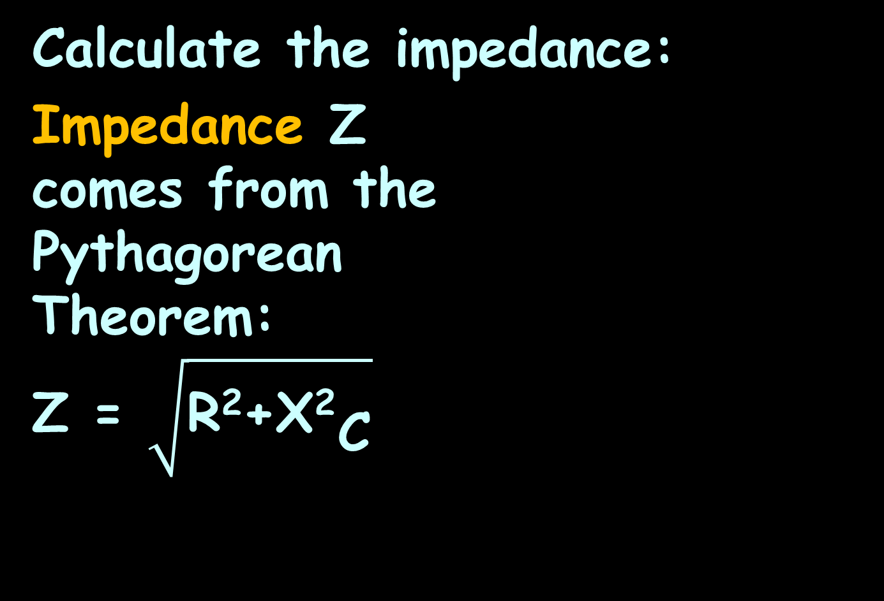
TRIGONOMETRY
IN-CLASS PROBLEM 1
Calculate the impedance:
Impedance Z
comes from the
Pythagorean
Theorem:
Z = $\sqrt{\text{R}\text{2}\text{+}{\text{X}\text{2}}_{\text{C}}}$
$${\text{X}}_{\text{C}}$$
R
~
47 Ω
100 Ω
V_{S}
VFrench, 2020

Slide 27
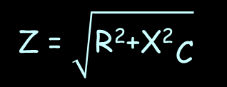
TRIGONOMETRY
IN-CLASS PROBLEM 1
Calculate the impedance Z of the RC circuit:
$${\text{X}}_{\text{C}}$$
R
~
47 Ω
100 Ω
V_{S}
Z = $\sqrt{\text{R}\text{2}\text{+}{\text{X}\text{2}}_{\text{C}}}$
VFrench, 2020

Slide 28

TRIGONOMETRY
IN-CLASS PROBLEM 1
Calculate the impedance:
Z = $\sqrt{\text{47}\text{2}\text{+}\text{100}\text{2}}$ ≈ 110.49 whats?
$${\text{X}}_{\text{C}}$$
R
~
47 Ω
100 Ω
V_{S}
Z = $\sqrt{\text{R}\text{2}\text{+}{\text{X}\text{2}}_{\text{C}}}$
VFrench, 2020

Slide 29

TRIGONOMETRY
IN-CLASS PROBLEM 1
Calculate the impedance:
Z = $\sqrt{\text{47}\text{2}\text{+}\text{100}\text{2}}$ ≈ 110.49 Ω
$${\text{X}}_{\text{C}}$$
R
~
47 Ω
100 Ω
V_{S}
Z = $\sqrt{\text{R}\text{2}\text{+}{\text{X}\text{2}}_{\text{C}}}$
VFrench, 2020

Slide 30
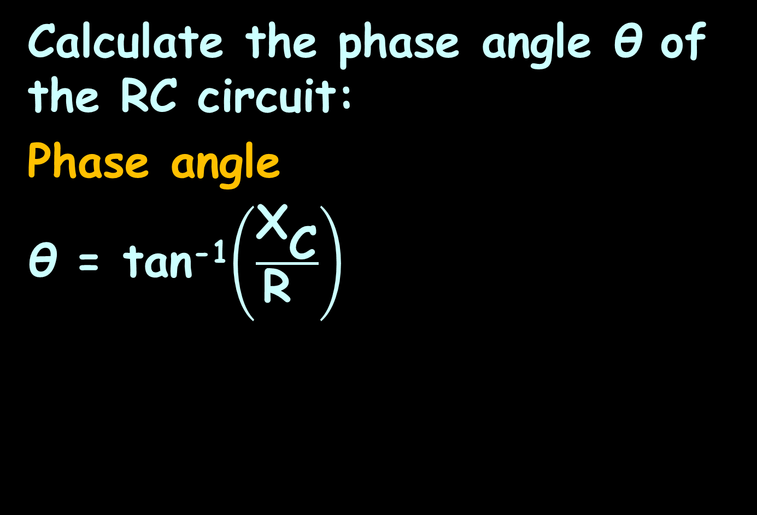
TRIGONOMETRY
IN-CLASS PROBLEM 2
Calculate the phase angle θ of the RC circuit:
Phase angle
θ = tan⁻¹$\left(\frac{{\text{X}}_{\text{C}}}{\text{R} }\right)$
$${\text{X}}_{\text{C}}$$
R
~
47 Ω
100 Ω
V_{S}
Leave your calculator in degrees!
VFrench, 2020

Slide 31
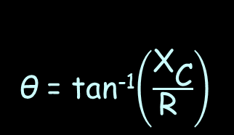
TRIGONOMETRY
IN-CLASS PROBLEM 2
Calculate the phase angle θ of the RC circuit:
$${\text{X}}_{\text{C}}$$
R
~
47 Ω
100 Ω
V_{S}
θ = tan⁻¹$\left(\frac{{\text{X}}_{\text{C}}}{\text{R} }\right)$
VFrench, 2020

Slide 32
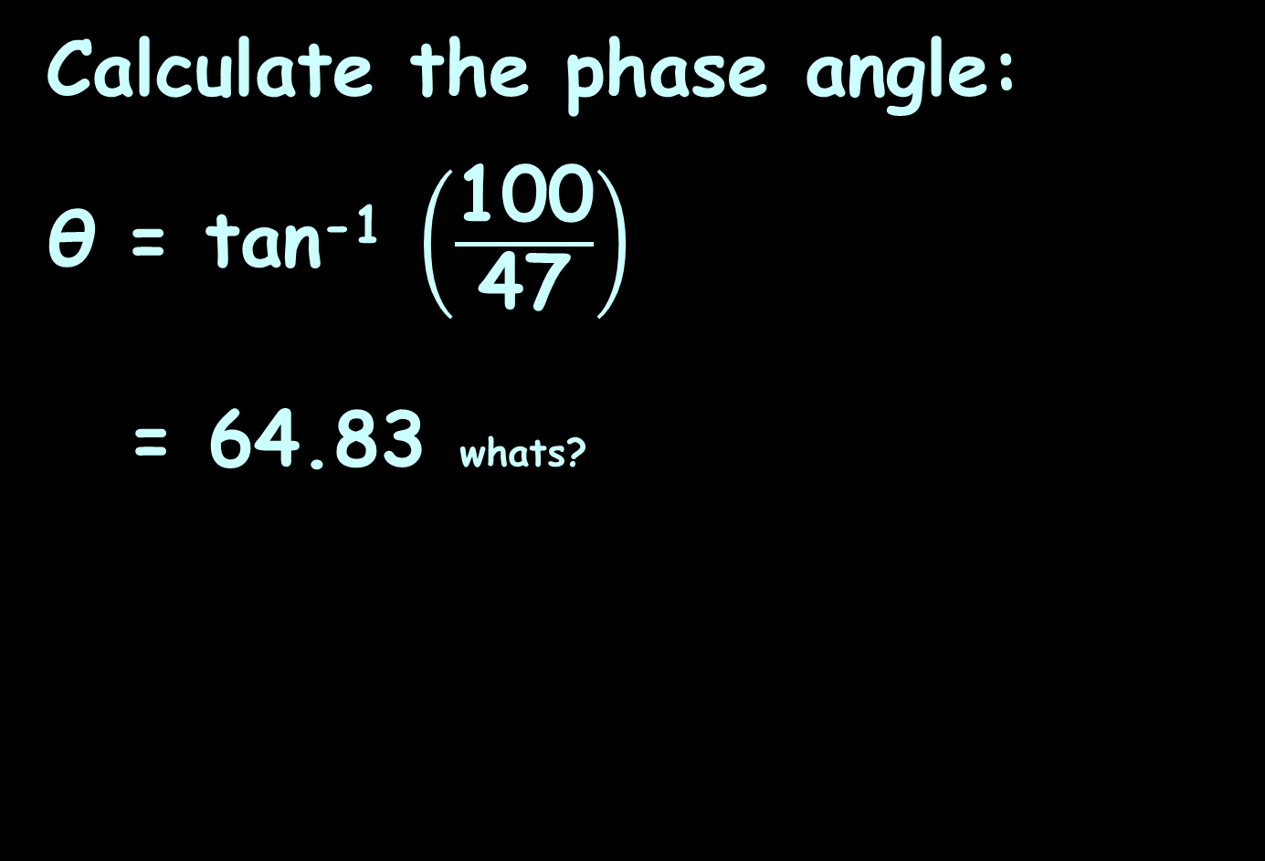
TRIGONOMETRY
IN-CLASS PROBLEM 2
Calculate the phase angle:
θ = tan⁻¹ $\left(\frac{\text{100}}{\text{47}}\right)$
= 64.83 whats?
$${\text{X}}_{\text{C}}$$
R
~
47 Ω
100 Ω
V_{S}
θ = tan⁻¹$\left(\frac{{\text{X}}_{\text{C}}}{\text{R} }\right)$
VFrench, 2020

Slide 33
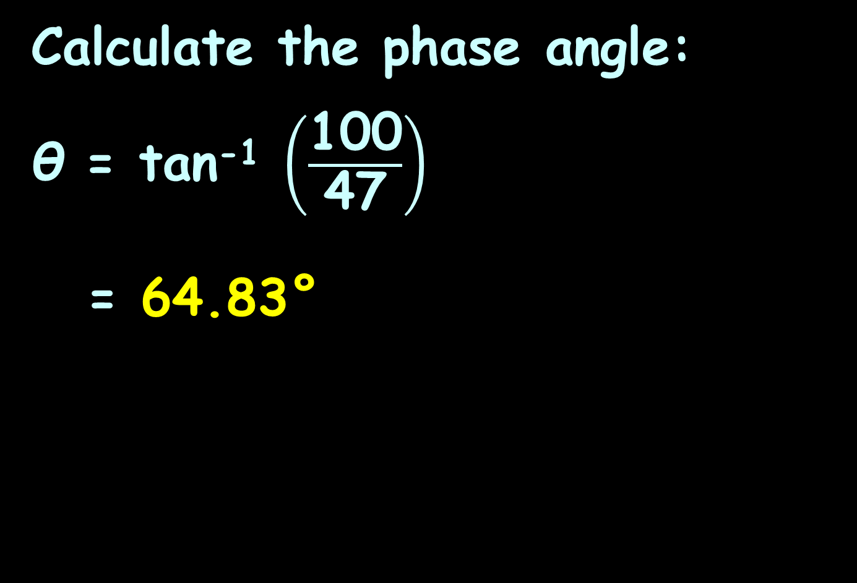
TRIGONOMETRY
IN-CLASS PROBLEM 2
Calculate the phase angle:
θ = tan⁻¹ $\left(\frac{\text{100}}{\text{47}}\right)$
= 64.83°
$${\text{X}}_{\text{C}}$$
R
~
47 Ω
100 Ω
V_{S}
θ = tan⁻¹$\left(\frac{{\text{X}}_{\text{C}}}{\text{R} }\right)$
VFrench, 2020

Slide 34
Trigonometry
Resistance (R) and reactance (X) are 90° apart, so their angle of intersection forms a right angle

Slide 35

Trigonometry
Resistance (R) and reactance (X) are 90° apart, so their angle of intersection forms a right angle
R
$${\text{X}}_{\text{C}}$$
VFrench, 2020

Slide 36
Trigonometry
Adding the impedance (Z) line at the angle θ makes a right triangle
R
θ
$${\text{X}}_{\text{C}}$$
Z
VFrench, 2020

Slide 37
Trigonometry
This is called the “impedance triangle”
R
θ
$${\text{X}}_{\text{C}}$$
Z
VFrench, 2020

Slide 38
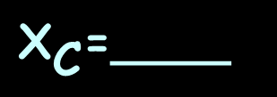
TRIGONOMETRY
IN-CLASS PROBLEM 3
Identify and fill in the values for the impedance triangle in our problem:
R=____
θ=____
${\text{X}}_{\text{C}}$=____
Z=____
VFrench, 2020

Slide 39
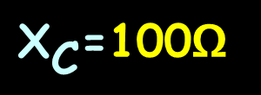
TRIGONOMETRY
IN-CLASS PROBLEM 3
Identify and fill in the values for the impedance triangle in our problem:
R=47Ω
θ=64.8°
${\text{X}}_{\text{C}}$=100Ω
Z=110Ω
VFrench, 2020

Slide 40
Questions?
http://i.imgur.com/aliTlT3.jpg

Slide 41
Trigonometry
The sine is the most common trig function used in electrical, electronic and computer engineering
v
t
VFrench, 2020

Slide 42
Trigonometry
The sine is used to model alternating currents and voltages
v
t
VFrench, 2020

Slide 43
Trigonometry
Depending on what you know about the waveform, the sine function for voltage can be represented in various ways

Slide 44
Trigonometry
v
v = V_{m}sin(ωt+θ)
v = V_{m}sin(ωt+θ)
Where:
v is the instantaneous value
V_{m} is the peak (max) value
ω is the frequency in rad/sec
t is the time in seconds
θ is the phase angle in radians
V_{m}
t
θ/ω
VFrench, 2020

Slide 45
Trigonometry
v = V_{m}sin(2πƒt+θ)
Where:
v is the instantaneous value
V_{m} is the peak (max) value
ƒ is the frequency in cycles/sec
t is the time in seconds
θ is the phase angle in radians

Slide 46
Trigonometry
v
v = V_{m}sin(2πt/T+θ)
v = V_{m}sin(2πt/T+θ)
Where:
v is the instantaneous value
V_{m} is the peak (max) value
T is the time period in seconds
t is the time in seconds
θ is the phase angle in radians
V_{m}
t
T
VFrench, 2020

Slide 47
Questions?
http://i.imgur.com/aliTlT3.jpg

Slide 48
Trig Calculus
Calculus is all about the rate of change

Slide 49
Trig Calculus
Calculus involving trig functions will be about the rate of change of the trig function

Slide 50
Trig Calculus
The rate of change of the sine function is what engineers are interested in
(Assume all angles are measured in radians)

Slide 51
Trig Calculus
The graph of the sine curve shows the rate of change is changing!
v
t
VFrench, 2020

Slide 52
TRIGONOMETRY
IN-CLASS PROBLEM 4
Where is the rate of change the fastest?
v
t
VFrench, 2020

Slide 53
TRIGONOMETRY
IN-CLASS PROBLEM 4
Identify where is the rate of change the fastest?
v
changing fast
changing fast
changing fast
changing fast
t
VFrench, 2020

Slide 54
TRIGONOMETRY
IN-CLASS PROBLEM 4
Identify where is the rate of change the slowest?
v
t
VFrench, 2020

Slide 55
TRIGONOMETRY
IN-CLASS PROBLEM 4
Identify where is the rate of change the slowest?
v
changing slowly
changing slowly
changing slowly
t
changing slowly
changing slowly
VFrench, 2020

Slide 56
Questions?
http://i.imgur.com/aliTlT3.jpg

Slide 57
Trig Calculus
Suppose we have y = sin(u)
where u = ƒ(x)
If x changes to a new value:
x+Δx, u will become a new value also: u+Δu
and we have:
y+Δy = sin(u+Δu)

Slide 58
Trig Calculus
y+Δy = sin(u+Δu)
sin(u+Δu) = sin(u)deriv(sin(Δu))
+ sin(Δu)deriv(sin(u))
sin(u+Δu) =
sin(u)cos(Δu) + cos(u)sin(Δu)
so
y+Δy = sin(u)cos(Δu)+cos(u)sin(Δu)
Chain rule:

Slide 59
Trig Calculus
y+Δy = sin(u)cos(Δu)+cos(u)sin(Δu)
We will be letting Δu→0 so:
y+Δy = sin(u)cos(Δu)+cos(u)sin(Δu)
= sin(u) +cos(u)sin(Δu)
cos(0)=1

Slide 60
Trig Calculus
So you might be tempted to go to:
y+Δy = sin(u)+cos(u)sin(Δu)
But resist temptation!
sin(0)=0
https://www.google.com/url?sa=i&url=https%3A%2F%2Fwww.redletterchristians.org%2Fwhy-is-temptation-so-tempting%2F&psig=AOvVaw2guD8aHkKbQk3ASD3RVUKq&ust=1608534111089000&source=images&cd=vfe&ved=0CAIQjRxqFwoTCKjrl9n-2-0CFQAAAAAdAAAAABAD

Slide 61
Trig Calculus
Instead, we’ll go with the fact that for very small angles (getting close to zero)
sin(θ) = θ
So, as Δu approaches zero, sin(Δu) approaches Δu

Slide 62
Trig Calculus
As Δu approaches zero, sin(Δu) approaches Δu:
y+Δy = sin(u)+cos(u)sin(Δu)
y+Δy = sin(u)+cos(u)Δu
sin(Δu)=Δu

Slide 63
Trig Calculus
y+Δy = sin(u)+cos(u)Δu
You may have forgotten, but our original equation was
y = sin(u)
So subtracting:
y+Δy = sin(u)+cos(u)Δu
-y -sin(u) .
Δy = cos(u) Δu

Slide 64
Trig Calculus
Δy = cos(u) Δu
Divide both sides by Δx:
Δy/Δx = cos(u) Δu/Δx
or dy/dx = cos(u) du/dx
So the derivative of y = sin(u)
y’ = cos(u) du/dx

Slide 65
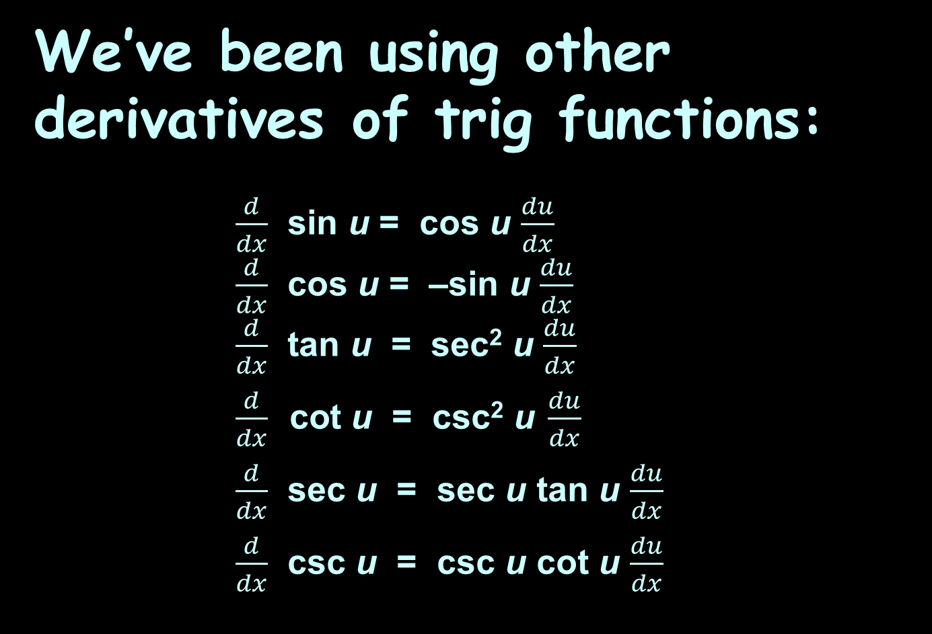
Trig Calculus
We’ve been using other derivatives of trig functions:
$\frac{d}{dx}$ sin u = cos u $\frac{du}{dx}$
$\frac{d}{dx}$ cos u = –sin u $\frac{du}{dx}$
$\frac{d}{dx}$ tan u = sec² u $\frac{du}{dx}$
$\frac{d}{dx} \text{cot} \text{u} \text{=} \text{csc}\text{2} \text{u} \frac{du}{dx}$
$\frac{d}{dx}$ sec u = sec u tan u $\frac{du}{dx}$
$\frac{d}{dx}$ csc u = csc u cot u $\frac{du}{dx}$

Slide 66
Trig Calculus
All of these are using the Chain Rule:
The “u” is the function being operated on by the trig function
Calculate its derivative
dy/dx = du/dx × dy/du

Slide 67

Trig Calculus
Calculate the derivative of:
y = sin(x⁵)
What’s “u”?
$\frac{d}{dx}$ sin u = cos u $\frac{du}{dx}$
$\frac{d}{dx}$ cos u = –sin u $\frac{du}{dx}$
$\frac{d}{dx}$ tan u = sec² u $\frac{du}{dx}$
$\frac{d}{dx} \text{cot} \text{u} \text{=} \text{csc}\text{2} \text{u} \frac{du}{dx}$
$\frac{d}{dx}$ sec u = sec u tan u $\frac{du}{dx}$
$\frac{d}{dx}$ csc u = csc u cot u $\frac{du}{dx}$

Slide 68
Trig Calculus
Calculate the derivative of:
y = sin(x⁵)
What’s “u”? x⁵
What’s du/dx?
$\frac{d}{dx}$ sin u = cos u $\frac{du}{dx}$
$\frac{d}{dx}$ cos u = –sin u $\frac{du}{dx}$
$\frac{d}{dx}$ tan u = sec² u $\frac{du}{dx}$
$\frac{d}{dx} \text{cot} \text{u} \text{=} \text{csc}\text{2} \text{u} \frac{du}{dx}$
$\frac{d}{dx}$ sec u = sec u tan u $\frac{du}{dx}$
$\frac{d}{dx}$ csc u = csc u cot u $\frac{du}{dx}$

Slide 69
Trig Calculus
Calculate the derivative of:
y = sin(x⁵)
What’s “u”? x⁵
What’s du/dx? 5x⁴
What’s dy/du?
$\frac{d}{dx}$ sin u = cos u $\frac{du}{dx}$
$\frac{d}{dx}$ cos u = –sin u $\frac{du}{dx}$
$\frac{d}{dx}$ tan u = sec² u $\frac{du}{dx}$
$\frac{d}{dx} \text{cot} \text{u} \text{=} \text{csc}\text{2} \text{u} \frac{du}{dx}$
$\frac{d}{dx}$ sec u = sec u tan u $\frac{du}{dx}$
$\frac{d}{dx}$ csc u = csc u cot u $\frac{du}{dx}$

Slide 70
Trig Calculus
Calculate the derivative of:
y = sin(x⁵)
What’s “u”? x⁵
What’s du/dx? 5x⁴
What’s dy/du? cos(u)
Now… the chain!
dy/dx = du/dx × dy/du
$\frac{d}{dx}$ sin u = cos u $\frac{du}{dx}$
$\frac{d}{dx}$ cos u = –sin u $\frac{du}{dx}$
$\frac{d}{dx}$ tan u = sec² u $\frac{du}{dx}$
$\frac{d}{dx} \text{cot} \text{u} \text{=} \text{csc}\text{2} \text{u} \frac{du}{dx}$
$\frac{d}{dx}$ sec u = sec u tan u $\frac{du}{dx}$
$\frac{d}{dx}$ csc u = csc u cot u $\frac{du}{dx}$

Slide 71
Trig Calculus
Calculate the derivative of: y = sin(x⁵)
What’s “u”? x⁵
What’s du/dx? 5x⁴
What’s dy/du? cos(u)
dy/dx = du/dx × dy/du
= 5x⁴ × cos(u)
$\frac{d}{dx}$ sin u = cos u $\frac{du}{dx}$
$\frac{d}{dx}$ cos u = –sin u $\frac{du}{dx}$
$\frac{d}{dx}$ tan u = sec² u $\frac{du}{dx}$
$\frac{d}{dx} \text{cot} \text{u} \text{=} \text{csc}\text{2} \text{u} \frac{du}{dx}$
$\frac{d}{dx}$ sec u = sec u tan u $\frac{du}{dx}$
$\frac{d}{dx}$ csc u = csc u cot u $\frac{du}{dx}$

Slide 72
Trig Calculus
Calculate the derivative of: y = sin(x⁵)
What’s “u”? x⁵
What’s du/dx? 5x⁴
What’s dy/du? cos(u)
dy/dx = du/dx × dy/du
= 5x⁴ × cos(u)
= 5x⁴cos(x⁵)
$\frac{d}{dx}$ sin u = cos u $\frac{du}{dx}$
$\frac{d}{dx}$ cos u = –sin u $\frac{du}{dx}$
$\frac{d}{dx}$ tan u = sec² u $\frac{du}{dx}$
$\frac{d}{dx} \text{cot} \text{u} \text{=} \text{csc}\text{2} \text{u} \frac{du}{dx}$
$\frac{d}{dx}$ sec u = sec u tan u $\frac{du}{dx}$
$\frac{d}{dx}$ csc u = csc u cot u $\frac{du}{dx}$

Slide 73
TRIG CALCULUS
IN-CLASS PROBLEMS 5-8
Calculate:
y’ for y=(sin(2x)) =
y’ for y=(cos(14x²)) =
y’ for y=(sin(3t²+5t)) =
y’ for y=(cos(7t²-6t+342)) =
$\frac{d}{dx}$ sin u = cos u $\frac{du}{dx}$
$\frac{d}{dx}$ cos u = –sin u $\frac{du}{dx}$
$\frac{d}{dx}$ tan u = sec² u $\frac{du}{dx}$
$\frac{d}{dx} \text{cot} \text{u} \text{=} \text{csc}\text{2} \text{u} \frac{du}{dx}$
$\frac{d}{dx}$ sec u = sec u tan u $\frac{du}{dx}$
$\frac{d}{dx}$ csc u = csc u cot u $\frac{du}{dx}$

Slide 74
TRIG CALCULUS
IN-CLASS PROBLEMS 5-8
Calculate:
y’(sin(2x)) = cos(2x)(2) = 2cos(2x)
y’(cos(14x²)) =
y’(sin(3t²+5t)) =
y’(cos(7t²-6t+342)) =
$\frac{d}{dx}$ sin u = cos u $\frac{du}{dx}$
$\frac{d}{dx}$ cos u = –sin u $\frac{du}{dx}$
$\frac{d}{dx}$ tan u = sec² u $\frac{du}{dx}$
$\frac{d}{dx} \text{cot} \text{u} \text{=} \text{csc}\text{2} \text{u} \frac{du}{dx}$
$\frac{d}{dx}$ sec u = sec u tan u $\frac{du}{dx}$
$\frac{d}{dx}$ csc u = csc u cot u $\frac{du}{dx}$

Slide 75
TRIG CALCULUS
IN-CLASS PROBLEMS 5-8
Calculate:
y’(sin(2x)) = 2cos(2x)
y’(cos(14x²)) = -28x sin(14x²) y’(sin(3t²+5t)) =
y’(cos(7t²-6t+342)) =
$\frac{d}{dx}$ sin u = cos u $\frac{du}{dx}$
$\frac{d}{dx}$ cos u = –sin u $\frac{du}{dx}$
$\frac{d}{dx}$ tan u = sec² u $\frac{du}{dx}$
$\frac{d}{dx} \text{cot} \text{u} \text{=} \text{csc}\text{2} \text{u} \frac{du}{dx}$
$\frac{d}{dx}$ sec u = sec u tan u $\frac{du}{dx}$
$\frac{d}{dx}$ csc u = csc u cot u $\frac{du}{dx}$

Slide 76
TRIG CALCULUS
IN-CLASS PROBLEMS 5-8
Calculate:
y’(sin(2x)) = 2cos(2x)
y’(cos(14x²)) = -28x sin(14x²)
y’(sin(3t²+5t)) = (6t+5)cos(3t²+5t)
y’(cos(7t²-6t+342)) =
$\frac{d}{dx}$ sin u = cos u $\frac{du}{dx}$
$\frac{d}{dx}$ cos u = –sin u $\frac{du}{dx}$
$\frac{d}{dx}$ tan u = sec² u $\frac{du}{dx}$
$\frac{d}{dx} \text{cot} \text{u} \text{=} \text{csc}\text{2} \text{u} \frac{du}{dx}$
$\frac{d}{dx}$ sec u = sec u tan u $\frac{du}{dx}$
$\frac{d}{dx}$ csc u = csc u cot u $\frac{du}{dx}$

Slide 77
TRIG CALCULUS
IN-CLASS PROBLEMS 5-8
Calculate:
y’(sin(2x)) = 2cos(2x)
y’(cos(14x²)) = -28x sin(14x²)
y’(sin(3t²+5t)) = (6t+5)cos(3t²+5t) y’(cos(7t²-6t+342)) =
-sin(7t²-6t+342) (14t-6) =
-(14t-6)sin(7t²-6t+342) =
(-14t+6)sin(7t²-6t+342) =
-2(7t-3)sin(7t²-6t+342)

Slide 78
Trig Calculus
“t” is the variable used most for differentiation in engineering

Slide 79
Questions?
http://i.imgur.com/aliTlT3.jpg

Slide 80
Trig Calculus
Of course, we want to see how it’s used in engineering!

Slide 81
TRIG CALCULUS
IN-CLASS PROBLEM 9
The voltage in a system is modeled by:
v = 170sin(377t) volts
(t in seconds)
How fast is this voltage changing when t=4.17 ms?

Slide 82
TRIG CALCULUS
IN-CLASS PROBLEM 9
The voltage in an electrical wall outlet is modeled by:
v = 170sin(377t) volts
How fast is this voltage changing when t=4.17 ms?
Identify what are we trying to calculate?

Slide 83
TRIG CALCULUS
IN-CLASS PROBLEM 9
The voltage in an electrical wall outlet is modeled by:
v = 170sin(377t) volts
How fast is this voltage changing when t=4.17 ms?
Identify what are we trying to calculate?
How fast is the voltage changing
What dsomething/dsomething would that be?

Slide 84
TRIG CALCULUS
IN-CLASS PROBLEM 9
The voltage in an electrical wall outlet is modeled by:
v = 170sin(377t) volts
How fast is this voltage changing when t=4.17 ms?
What dsomething/dsomething would that be? dv/dt
Do we have an equation relating these variables? (What is it?)

Slide 85
TRIG CALCULUS
IN-CLASS PROBLEM 9
The voltage in an electrical wall outlet is modeled by:
v = 170sin(377t) volts
We want: dv/dt when t=4.17 ms
Do we have an equation relating these variables? (What is it?)
v = 170sin(377t)
(Take the derivative)

Slide 86
TRIG CALCULUS
IN-CLASS PROBLEM 9
We want: dv/dt when t=4.17 ms
v = 170sin(377t)
dv/dt = (377)170cos(377t) dt/dt
= 64,090 cos(377t)
Now what?

Slide 87
TRIG CALCULUS
IN-CLASS PROBLEM 9
We want: dv/dt when t=4.17 ms
v = 170sin(377t)
dv/dt = 170cos(377t)(377) dt/dt
= 64,090 cos(377t)
Now what? Plug in t=4.17 ms
(0.00417 sec)
In radians

Slide 88
TRIG CALCULUS
IN-CLASS PROBLEM 9
We want: dv/dt when t=4.17 ms
v = 170sin(377t)
dv/dt = 170cos(377t)(377) dt/dt
= 64,090 cos(377t)
dv/dt = 64,090 cos(377(.00417))
(remember, these are in radians)

Slide 89
TRIG CALCULUS
IN-CLASS PROBLEM 9
We want: dv/dt when t=4.17 ms
v = 170sin(377t)
dv/dt = 170cos(377t)(377) dt/dt
= 64,090 cos(377t)
dv/dt = 64,090 cos(377(.00417))
(remember, these are in radians)
≈ 64,090(-.00129)
≈ -82.91 whats?

Slide 90
TRIG CALCULUS
IN-CLASS PROBLEM 9
We want: dv/dt when t=4.17 ms
v = 170sin(377t)
dv/dt = 170cos(377t)(377) dt/dt
= 64,090 cos(377t)
dv/dt = 64,090 cos(377(.00417))
(remember, these are in radians)
≈ 64,090(-.00129)
≈ -82.91 volts/sec

Slide 91
Trig Calculus
This relatively small negative number tells us the wave is starting to fall from its peak value
A sine wave near its quarter cycle point is changing
very slowly
quarter cycle
v
V_{m}
t

Slide 92
Questions?
http://i.imgur.com/aliTlT3.jpg

Slide 93
Trig Calculus
So, we can use differentiation to solve engineering problems using trig…

Slide 94
Trig Calculus
…How about integration?

Slide 95
Trig Calculus
The only difference is we use “+k” rather than “+c” (so we don’t get confused with capacitance)

Slide 96
Trig Calculus
Remember integration is the inverse operation for differentiation – it “undoes” the derivative back to the original equation

Slide 97
TRIG CALCULUS
IN-CLASS PROBLEM 10-13
Calculate:
∫ cos(x) dx =
∫ sin(x) dx =
∫ 2cos(t) dt =
∫ 7+cos(t) dt =
$\frac{d}{dx}$ sin u = cos u $\frac{du}{dx}$
$\frac{d}{dx}$ cos u = –sin u $\frac{du}{dx}$
$\frac{d}{dx}$ tan u = sec² u $\frac{du}{dx}$
$\frac{d}{dx} \text{cot} \text{u} \text{=} \text{csc}\text{2} \text{u} \frac{du}{dx}$
$\frac{d}{dx}$ sec u = sec u tan u $\frac{du}{dx}$
$\frac{d}{dx}$ csc u = csc u cot u $\frac{du}{dx}$

Slide 98
TRIG CALCULUS
IN-CLASS PROBLEM 10-13
Calculate:
∫ cos(x) dx = sin(x) + k
∫ sin(x) dx =
∫ 2cos(t) dt =
∫ 7+cos(t) dt =
$\frac{d}{dx}$ sin u = cos u $\frac{du}{dx}$
$\frac{d}{dx}$ cos u = –sin u $\frac{du}{dx}$
$\frac{d}{dx}$ tan u = sec² u $\frac{du}{dx}$
$\frac{d}{dx} \text{cot} \text{u} \text{=} \text{csc}\text{2} \text{u} \frac{du}{dx}$
$\frac{d}{dx}$ sec u = sec u tan u $\frac{du}{dx}$
$\frac{d}{dx}$ csc u = csc u cot u $\frac{du}{dx}$

Slide 99
TRIG CALCULUS
IN-CLASS PROBLEM 10-13
Calculate:
∫ cos(x) dx = sin(x) + k
∫ sin(x) dx = -cos(x) + k
∫ 2cos(t) dt =
∫ 7+cos(t) dt =
$\frac{d}{dx}$ sin u = cos u $\frac{du}{dx}$
$\frac{d}{dx}$ cos u = –sin u $\frac{du}{dx}$
$\frac{d}{dx}$ tan u = sec² u $\frac{du}{dx}$
$\frac{d}{dx} \text{cot} \text{u} \text{=} \text{csc}\text{2} \text{u} \frac{du}{dx}$
$\frac{d}{dx}$ sec u = sec u tan u $\frac{du}{dx}$
$\frac{d}{dx}$ csc u = csc u cot u $\frac{du}{dx}$

Slide 100
TRIG CALCULUS
IN-CLASS PROBLEM 10-13
Calculate:
∫ cos(x) dx = sin(x) + k
∫ sin(x) dx = -cos(x) + k
∫ 2cos(t) dt = 2sin(t) + k
∫ 7+cos(t) dt =
$\frac{d}{dx}$ sin u = cos u $\frac{du}{dx}$
$\frac{d}{dx}$ cos u = –sin u $\frac{du}{dx}$
$\frac{d}{dx}$ tan u = sec² u $\frac{du}{dx}$
$\frac{d}{dx} \text{cot} \text{u} \text{=} \text{csc}\text{2} \text{u} \frac{du}{dx}$
$\frac{d}{dx}$ sec u = sec u tan u $\frac{du}{dx}$
$\frac{d}{dx}$ csc u = csc u cot u $\frac{du}{dx}$

Slide 101
TRIG CALCULUS
IN-CLASS PROBLEM 10-13
Calculate:
∫ cos(x) dx = sin(x) + k
∫ sin(x) dx = -cos(x) + k
∫ 2cos(t) dt = 2sin(t) + k
∫ 7+cos(t) dt = 7t + sin(t) + k

Slide 102
Questions?
http://i.imgur.com/aliTlT3.jpg

Slide 103
Trig Calculus
But, all of those problems were just taking the trig function of “x” or “t”
We know it’s often not that easy!

Slide 104
Trig Calculus
But, all of those problems were just taking the trig function of “x” or “t”
We know it’s often not that easy!
We want to calculate:
∫ cos(5x²-3) dx

Slide 105
Trig Calculus
But, all of those problems were just taking the trig function of “x” or “t”
We want to calculate:
∫ cos(5x²-3) dx
We need a Chain Rule for integration…

Slide 106
Trig Calculus
This is called “integration by substitution” or “u-substitution” or the “Reverse Chain Rule”

Slide 107
Trig Calculus
The Reverse Chain Rule works for a lot of integrals, but you have to be alert to detect the derivatives
It only works if part of the integrand is the derivative of another part

Slide 108
Trig Calculus
Identify your “u” (for trig functions start with the function that’s being
“trig-ified”
2) Calculate du
3) Replace these in the original
problem (including limits!)
4) Integrate!
5) Replace the originals

Slide 109
TRIG CALCULUS
IN-CLASS PROBLEM 14
Calculate: ∫ 2x cos(x²) dx
What would “u” be?

Slide 110
TRIG CALCULUS
IN-CLASS PROBLEM 14
Calculate: ∫ 2x cos(x²) dx
What would “u” be? x²
Are there any “du”s lurking in this problem?

Slide 111
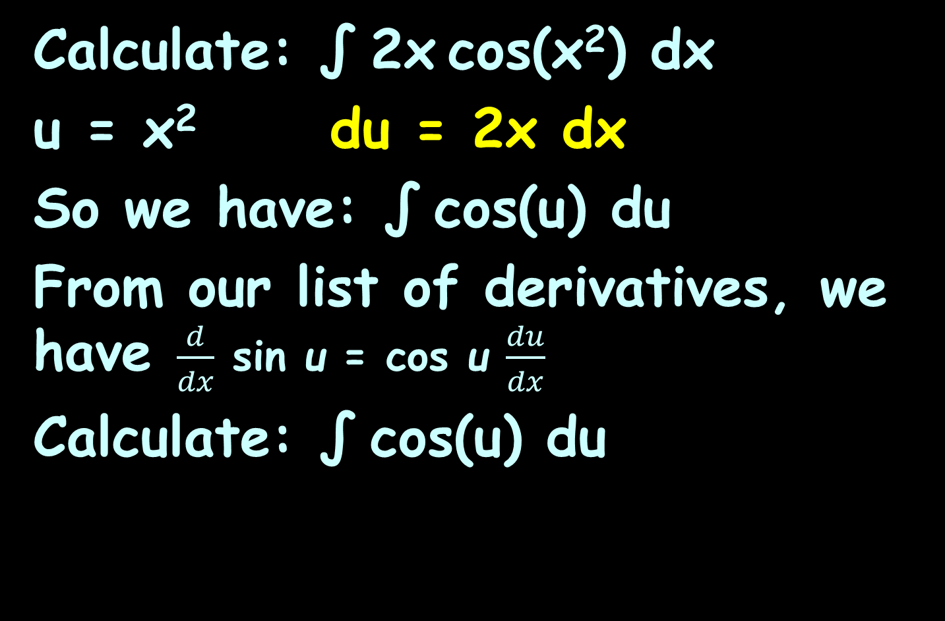
TRIG CALCULUS
IN-CLASS PROBLEM 14
Calculate: ∫ 2x cos(x²) dx
u = x² du = 2x dx
So we have: ∫ cos(u) du
From our list of derivatives, we have $\frac{d}{dx}$ sin u = cos u $\frac{du}{dx}$
Calculate: ∫ cos(u) du
$\frac{d}{dx}$ sin u = cos u $\frac{du}{dx}$
$\frac{d}{dx}$ cos u = –sin u $\frac{du}{dx}$
$\frac{d}{dx}$ tan u = sec² u $\frac{du}{dx}$
$\frac{d}{dx} \text{cot} \text{u} \text{=} \text{csc}\text{2} \text{u} \frac{du}{dx}$
$\frac{d}{dx}$ sec u = sec u tan u $\frac{du}{dx}$
$\frac{d}{dx}$ csc u = csc u cot u $\frac{du}{dx}$

Slide 112
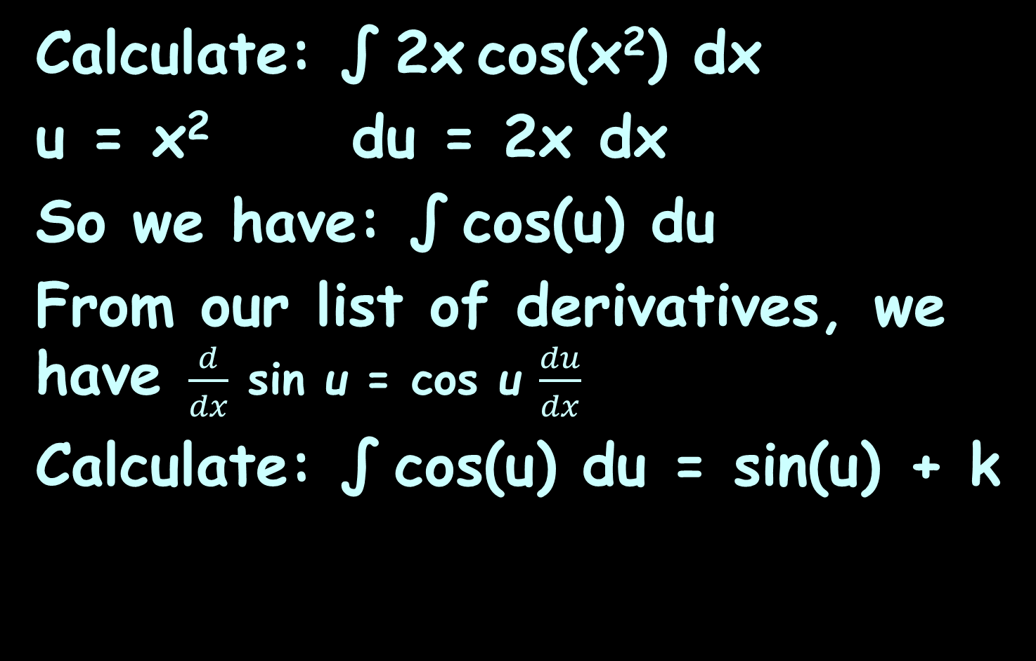
TRIG CALCULUS
IN-CLASS PROBLEM 14
Calculate: ∫ 2x cos(x²) dx
u = x² du = 2x dx
So we have: ∫ cos(u) du
From our list of derivatives, we have $\frac{d}{dx}$ sin u = cos u $\frac{du}{dx}$
Calculate: ∫ cos(u) du = sin(u) + k
Are we done?

Slide 113
TRIG CALCULUS
IN-CLASS PROBLEM 14
Calculate: ∫ 2x cos(x²) dx
u = x² du = 2x dx
So we have: ∫ cos(u) du
Calculate: ∫ cos(u) du = sin(u) + k
Calculate:
∫ 2x cos(x²) dx = sin(x²) + k

Slide 114
Questions?
http://i.imgur.com/aliTlT3.jpg

Slide 115
Trig Calculus
Sometimes we are just SO CLOSE to having the right derivative…

Slide 116
Trig Calculus
Sometimes we are just SO CLOSE to having the right derivative…
Sometimes we can fudge to make it so!

Slide 117
TRIG CALCULUS
IN-CLASS PROBLEM 15
Calculate: ∫ x cos(x²) dx
Shucks! It worked so well when it was ∫ 2x cos(x²) dx!

Slide 118
TRIG CALCULUS
IN-CLASS PROBLEM 15
Calculate: ∫ x cos(x²) dx
Shucks! It worked so well when it was ∫ 2x cos(x²) dx!
Let’s make it do that again!

Slide 119
TRIG CALCULUS
IN-CLASS PROBLEM 15
Calculate: ∫ x cos(x²) dx
Shucks! It worked so well when it was ∫ 2x cos(x²) dx!
Let’s make it do that again!
Calculate: ½∫ 2xcos(x²) dx
We’ve multiplied the problem by:
½×2 (which equals 1, so we haven’t changed anything…) and the problem is now so much easier!)

Slide 120
TRIG CALCULUS
IN-CLASS PROBLEM 15
Calculate: ½∫ 2xcos(x²) dx
Well, we already know
∫ 2xcos(x²) dx = sin(x²) + k
and there is a convenient coefficient rule for integration that says our answer will be:
½∫ 2xcos(x²) dx = ½(sin(x²) + k)

Slide 121
TRIG CALCULUS
IN-CLASS PROBLEM 15
Calculate: ½∫ 2xcos(x²) dx
½∫ 2xcos(x²) dx = ½(sin(x²) + k)
But, k is just an arbitrary constant, so we can just replace
½k with another “k”:
½∫ 2xcos(x²) dx = ½sin(x²) + k

Slide 122
Questions?
http://i.imgur.com/aliTlT3.jpg

Slide 123
Trig Calculus
Again, we want to be using this with engineering problems!

Slide 124
Trig Calculus
Please take careful note of how to do this problem… hint hint…

Slide 125
TRIG CALCULUS
IN-CLASS PROBLEM 16
A voltage v = 10sin(377t) is applied to a 4-henry inductor with negligible winding resistance. What is the formula for the current?

Slide 126
TRIG CALCULUS
IN-CLASS PROBLEM 16
A voltage v = 10sin(377t) is applied to a 4-henry inductor with negligible winding resistance. What is the formula for the current?
First we need an equation!

Slide 127
TRIG CALCULUS
IN-CLASS PROBLEM 16
v(t) = dw/dq v(t) is the voltage w is the energy q is the charge i(t) = dq/dt i(t) is the current t is the time (sec) i_{c} = C dv/dt i_{c} is instantaneous capacitor current C is capacitance | p(t) = dw/dt p(t) is the power v_{coil} = N dw/dt v_{coil} is the instantaneous coil voltage N is the number of primary turns V_{L} = L di/dt V_{L} is the instantaneous inductor voltage L is inductance in henrys

Slide 128
TRIG CALCULUS
IN-CLASS PROBLEM 16
A voltage v = 10sin(377t) is applied to a 4-henry inductor with negligible winding resistance. What is the formula for the current?
V_{L} = L di/dt
What do we want?

Slide 129
TRIG CALCULUS
IN-CLASS PROBLEM 16
A voltage v = 10sin(377t) is applied to a 4-henry inductor with negligible winding resistance. What is the formula for the current?
V_{L} = L di/dt
What do we want? current i

Slide 130
TRIG CALCULUS
IN-CLASS PROBLEM 16
A voltage v = 10sin(377t) is applied to a 4-henry inductor with negligible winding resistance. What is the formula for the current?
V_{L} = L di/dt
We want: current i
What do we know?

Slide 131
TRIG CALCULUS
IN-CLASS PROBLEM 16
A voltage v = 10sin(377t) is applied to a 4-henry inductor with negligible winding resistance. What is the formula for the current?
V_{L} = L di/dt
We want: current i
What do we know? L = 4

Slide 132
Trig Calculus
Remember the tricks:
Trick 0: come up with an equation
involving dy/dx
Trick 1: split the dy and dx into
two sides of the equation
Trick 2: integrate both sides
Trick 3: combine the “c”s
Trick 4: use any known values
(like at t=0) to calculate c

Slide 133
TRIG CALCULUS
IN-CLASS PROBLEM 16
What is the formula for the current?
V_{L} = 4 di/dt
split the dy and dx into two sides of the equation:

Slide 134
TRIG CALCULUS
IN-CLASS PROBLEM 16
What is the formula for the current?
V_{L} = 4 di/dt
split the dy and dx into two sides of the equation: V_{L} dt = 4 di
But what’s V?

Slide 135
TRIG CALCULUS
IN-CLASS PROBLEM 16
What is the formula for the current?
V_{L} dt = 4 di
v = 10sin(377t)
10(sin(377t)) dt = 4 di
Now integrate both sides

Slide 136
TRIG CALCULUS
IN-CLASS PROBLEM 16
What is the formula for the current?
∫ 10(sin(377t)) dt = ∫ 4 di
If this was:
∫ 377(sin(377t)) dt = ∫ 4 di it would be easy! (but… it’s not…)

Slide 137
TRIG CALCULUS
IN-CLASS PROBLEM 16
What is the formula for the current?
∫ 10(sin(377t)) dt = ∫ 4 di
We can make it:
10/377∫ 377(sin(377t)) × dt =∫ 4 di
u
du
Reverse Chain Rule

Slide 138

TRIG CALCULUS
IN-CLASS PROBLEM 16
What is the formula for the current?
10/377∫ 377(sin(377t)) × dt =
= ∫ 4 di
Do it!
I know it’s yucky!
This is why they’ve invented fancy calculators and WolframAlpha!
dreamstime.com

Slide 139
TRIG CALCULUS
IN-CLASS PROBLEM 16
What is the formula for the current?
10/377∫ (sin(377t))×377 dt =
= 4∫ di
10/(377) ∫ (sin(u)) du =
= 4 i + k
-10/377cos(377t) + k1 = 4i + k2
Now what?

Slide 140
TRIG CALCULUS
IN-CLASS PROBLEM 16
What is the formula for the current?
-10/377cos(377t) + k1 = 4i + k2
Now what? Combine the ks

Slide 141
TRIG CALCULUS
IN-CLASS PROBLEM 16
What is the formula for the current?
-10/377cos(377t) + k1 = 4i + k2
Combine the ks:
-10/(4×377)cos(377t) + k = i
-0.00663cos(377t) + k = i

Slide 142
TRIG CALCULUS
IN-CLASS PROBLEM 16
What is the formula for the current?
-10/377cos(377t) + k1 = 4i + k2
Combine the ks:
-0.00663cos(377t) + k = i
Well, that looks like a formula for current!
If we knew an initial condition, we could solve for “k”

Slide 143
TRIG CALCULUS
IN-CLASS PROBLEM 16
What is the formula for the current?
-0.00663cos(377t) + k = i
When t is zero, i = 0

Slide 144
TRIG CALCULUS
IN-CLASS PROBLEM 16
What is the formula for the current?
When t is zero, i = 0
-0.00663cos(377(0)) + k = 0
k ≈ .0066313
So the formula is:
-0.00663cos(377t)+0.00663 = i

Slide 145
Trig Calculus
Please take careful note of how to do this problem… hint hint…

Slide 146
Trig Calculus
As I’ve mentioned, integration is not as common in EE and CE as differentiation

Slide 147
Questions?
http://i.imgur.com/aliTlT3.jpg

Slide 148
Trig Calculus
Students often want to know why sines are used so much in electronics when it’s not really the shape of the movement of the electrons or the electromagnetic field
https://electronics.stackexchange.com/questions/469700/why-only-sine-waves

Slide 149
Trig Calculus
It’s because sinusoids (sines and cosines) have some important modeling properties
https://electronics.stackexchange.com/questions/469700/why-only-sine-waves

Slide 150
Trig Calculus
First, they are cyclical (what mathematicians call “periodic”)
They are also symmetrical
Both are characteristics of many things of interest in electronics
https://electronics.stackexchange.com/questions/469700/why-only-sine-waves

Slide 151
Trig Calculus
Sinusoids (sines and cosines) have other important mathematical properties for engineering problems because of how they behave under differentiation and integration
https://electronics.stackexchange.com/questions/469700/why-only-sine-waves

Slide 152
Trig Calculus
When a sinusoid is differentiated or integrated, the result is a sinusoid of the same frequency
The sinusoids are the only periodic functions from the reals to the reals for which this is true
Remember our 377t?
https://electronics.stackexchange.com/questions/469700/why-only-sine-waves

Slide 153
Trig Calculus
Adding two or more sine waves which have the same frequency (but possibly different phase) will either yield a null signal
or a single sine wave with the original frequency, whose amplitude and phase is the vector sum of the phase/
amplitude vectors being added
(think noise canceling earphones)
https://electronics.stackexchange.com/questions/469700/why-only-sine-waves

Slide 154
Trig Calculus
In other words…
Electrical Engineers use sines:
1) because they are cyclical
and symmetric
2) because calculus maintains
the frequency and the
amplitude and phase shift
formulas are known
https://electronics.stackexchange.com/questions/469700/why-only-sine-waves

Slide 155
Questions?
http://i.imgur.com/aliTlT3.jpg

Slide 156
Summary
Today we studied:
Review of uses of integration
Trig calculus

Slide 157

You Survived!
Don’t forget to fill in your Zoomwork and start your Homework (and your Discussion Board postings!)
See you Wednesday!
www.playbuzz.com

Slide 158
You Survived!
Don’t forget your Discussion
Board and Problems due Sunday!
Have a great rest
of the week!

