Slide 1
Welcome to
Unit 1
Part 2!
MATH 207 Integral Calculus
http://en.wikipedia.org/wiki/Differential_equation#mediaviewer/File:Elmer-pump-heatequation.png

Slide 2
What’s Up?
Review:
Trig Calculus
New stuff:
Logs and exponentials in calculus

Slide 3
What’s Up?
Outcome 1) Demonstrate a high level of proficiency in differentiation and integration for linear, polynomial, rational, trigonometric, inverse trigonometric, exponential and logarithmic function, including using the method of substitution, integration by parts and partial fraction decomposition
Outcome 7) Solve problems by identifying the requirements, making a sketch as appropriate

Slide 4

Review
http://995642590.r.lightningbase-cdn.com/wp-content/uploads/2010/12/looking-back-hrexaminer-v144-cover425px.jpg

Slide 5
Trigonometry
One use of trig in engineering is in circuit analysis

Slide 6
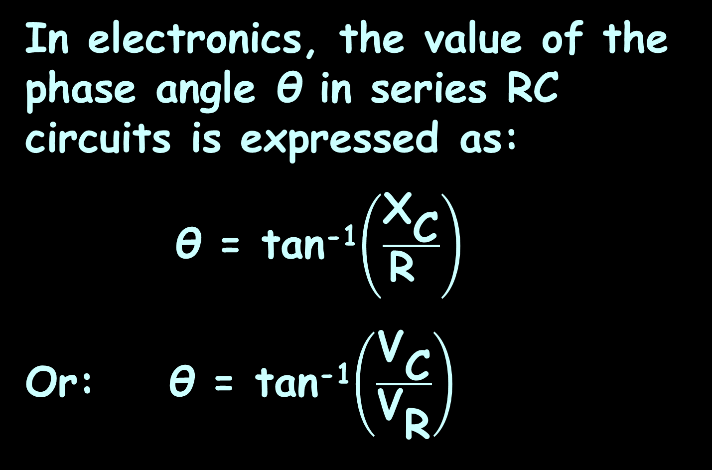
Trigonometry
In electronics, the value of the phase angle θ in series RC circuits is expressed as:
θ = tan⁻¹$\left(\frac{{\text{X}}_{\text{C}}}{\text{R} }\right)$
Or: θ = tan⁻¹$\left(\frac{{\text{V}}_{\text{C}}}{{\text{V}}_{\text{R}}}\right)$
capacitive reactance
resistance
source voltage
resistor voltage

Slide 7
Trigonometry
An inverse trig function tan⁻¹ tells you the ANGLE that would give you that tangent value

Slide 8
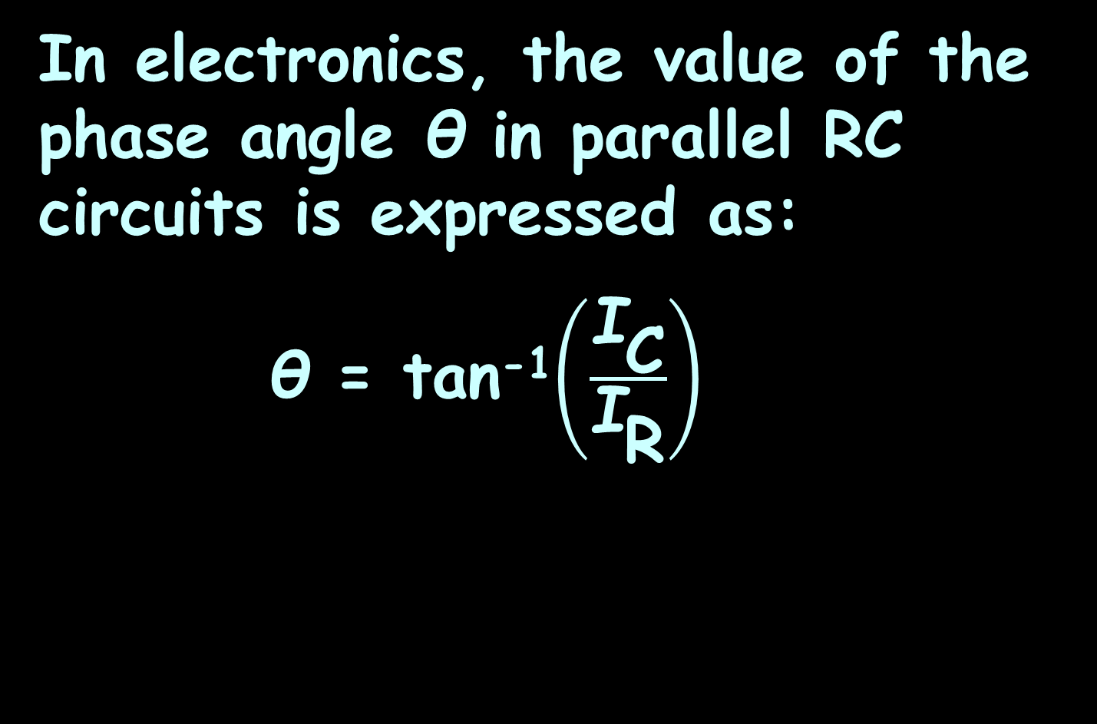
Trigonometry
In electronics, the value of the phase angle θ in parallel RC circuits is expressed as:
θ = tan⁻¹$\left(\frac{{\text{I}}_{\text{C}}}{{\text{I}}_{\text{R}}}\right)$
total current
resistor current

Slide 9
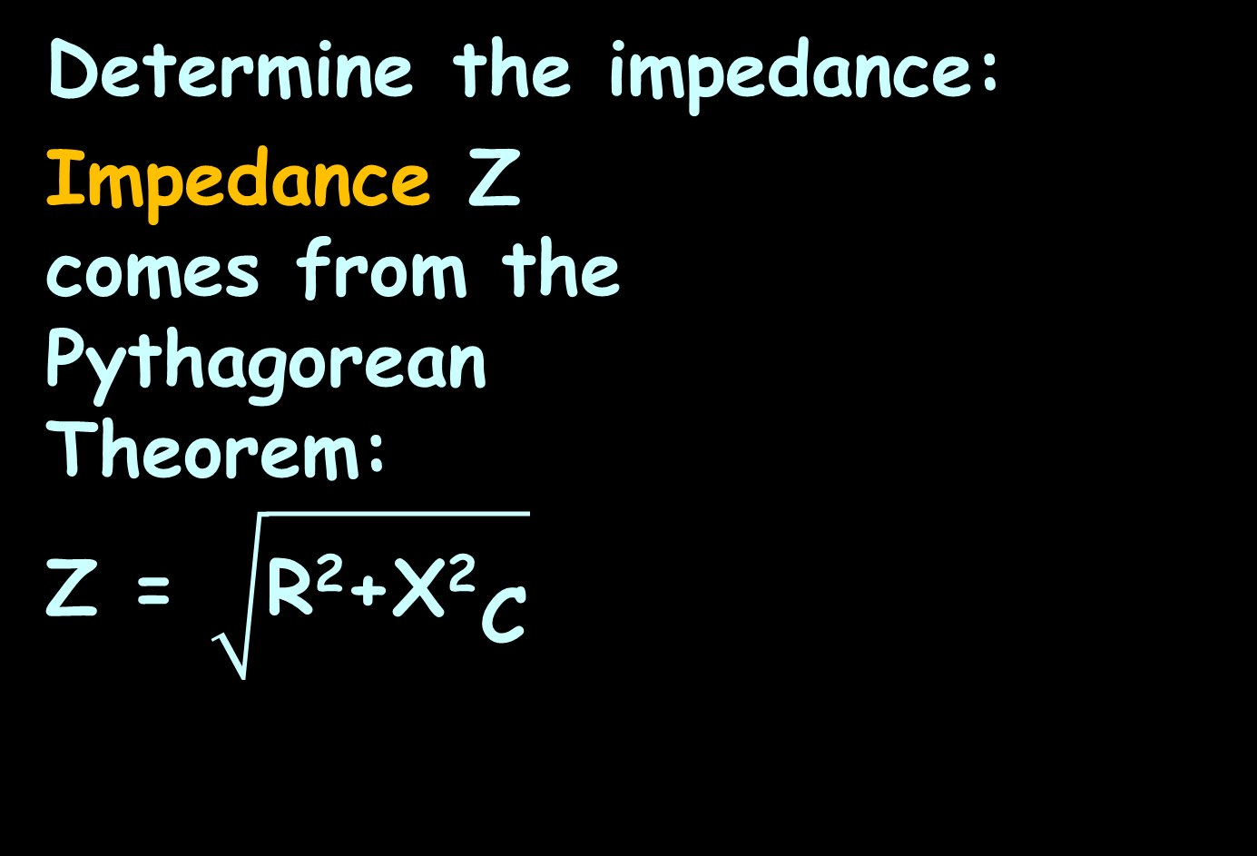

Trigonometry
Determine the impedance:
Impedance Z
comes from the
Pythagorean
Theorem:
Z = $\sqrt{\text{R}\text{2}\text{+}{\text{X}\text{2}}_{\text{C}}}$
$${\text{X}}_{\text{C}}$$
R
~
47 Ω
100 Ω
V_{S}
VFrench, 2020

Slide 10

Trigonometry
Resistance (R) and reactance (X) are 90° apart, so their angle of intersection forms a right angle
R
$${\text{X}}_{\text{C}}$$
VFrench, 2020

Slide 11
Trigonometry
Adding the impedance (Z) line at the angle θ makes a right triangle called the
“impedance triangle”
R
θ
$${\text{X}}_{\text{C}}$$
Z
VFrench, 2020

Slide 12
Trigonometry
The sine is used to model alternating currents and voltages
v
t
VFrench, 2020

Slide 13
Trig Calculus
Calculus is all about the rate of change
Calculus involving trig functions will be about the rate of change of the trig function
v
changing slowly
changing slowly
changing slowly
changing fast
changing fast
changing fast
changing fast
t
changing slowly
changing slowly
VFrench, 2020

Slide 14
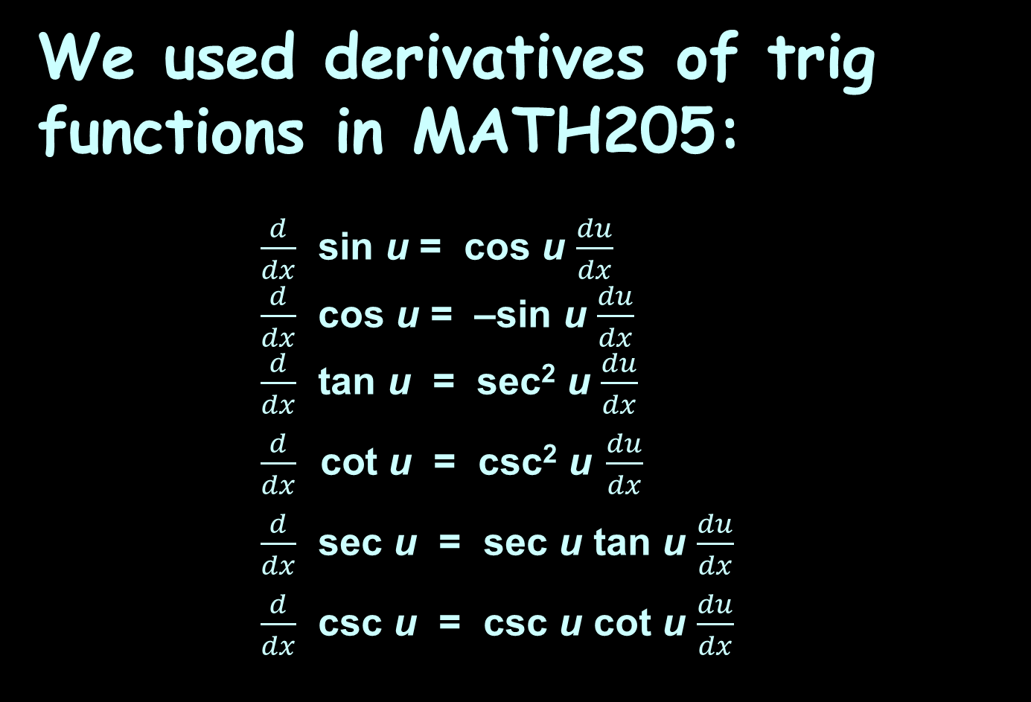
Trig Calculus
We used derivatives of trig functions in MATH205:
$\frac{d}{dx}$ sin u = cos u $\frac{du}{dx}$
$\frac{d}{dx}$ cos u = –sin u $\frac{du}{dx}$
$\frac{d}{dx}$ tan u = sec² u $\frac{du}{dx}$
$\frac{d}{dx} \text{cot} \text{u} \text{=} \text{csc}\text{2} \text{u} \frac{du}{dx}$
$\frac{d}{dx}$ sec u = sec u tan u $\frac{du}{dx}$
$\frac{d}{dx}$ csc u = csc u cot u $\frac{du}{dx}$

Slide 15
Trig Calculus
All of these are using the Chain Rule:
The “u” is the function being operated on by the trig function
Calculate its derivative
dy/dx = du/dx × dy/du

Slide 16

Trig Calculus
Calculate the derivative of:
y = sin(x⁵)
What’s “u”? x⁵
What’s du/dx? 5x⁴
What’s dy/du? cos(u)
dy/dx = du/dx × dy/du
= 5x⁴ × cos(u)
= 5x⁴cos(x⁵)
$\frac{d}{dx}$ sin u = cos u $\frac{du}{dx}$
$\frac{d}{dx}$ cos u = –sin u $\frac{du}{dx}$
$\frac{d}{dx}$ tan u = sec² u $\frac{du}{dx}$
$\frac{d}{dx} \text{cot} \text{u} \text{=} \text{csc}\text{2} \text{u} \frac{du}{dx}$
$\frac{d}{dx}$ sec u = sec u tan u $\frac{du}{dx}$
$\frac{d}{dx}$ csc u = csc u cot u $\frac{du}{dx}$

Slide 17
Trig Calculus
“t” is the variable used most for differentiation in engineering

Slide 18
Trig Calculus
Integration is the inverse operation for differentiation – it “undoes” the derivative back to the original equation

Slide 19
Trig Calculus
Because most engineering models involving sines and cosines are very complex, we need a Chain Rule for integration…

Slide 20
Trig Calculus
This is called “integration by substitution” or “u-substitution” or the “Reverse Chain Rule”
It only works if part of the integrand is the derivative of another part

Slide 21
Trig Calculus
Calculate your “u” (for trig functions start with the function that’s being
“trig-ified”
2) calculate du
3) Replace these in the original
problem (includes limits)
4) Integrate!
5) Replace the originals

Slide 22
Trig Calculus
Sometimes we are just SO CLOSE to having the right derivative…
Sometimes we can fudge to make it so!

Slide 23
Trig Calculus
∫ x cos(x²) dx
would work so much easier if it was:
∫ 2x cos(x²) dx!
Make it:
½∫ 2xcos(x²) dx

Slide 24

Questions?
http://i.imgur.com/aliTlT3.jpg

Slide 25
Logarithms
The logarithmic function is used in science and technology to model things as diverse as earthquakes and coaxial cables

Slide 26
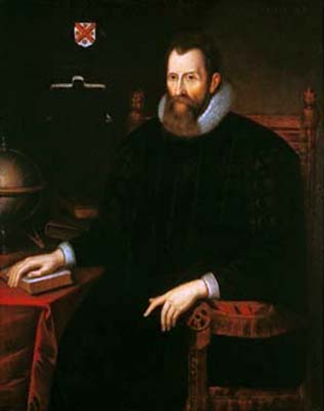
Logarithms
Logarithms were invented by Scottish Baron John Napier in 1614
https://upload.wikimedia.org/wikipedia/commons/thumb/e/e3/John_Napier.jpg/250px-John_Napier.jpg

Slide 27
Logarithms
He used them to simplify
“BIG” calculations
https://upload.wikimedia.org/wikipedia/commons/thumb/e/e3/John_Napier.jpg/250px-John_Napier.jpg

Slide 28
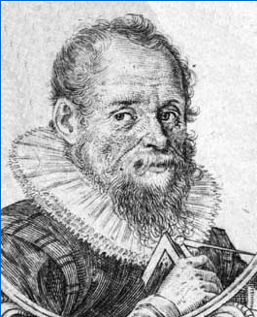
Logarithms
AND they were invented by Swiss clockmaker Joost Bürgi in 1620
https://www.maa.org/press/periodicals/convergence/logarithms-the-early-history-of-a-familiar-function-joost-b-rgi-introduces-logarithms

Slide 29
Logarithms
He wanted to create one table that could be used to solve ALL mathematical calculations
https://www.maa.org/press/periodicals/convergence/logarithms-the-early-history-of-a-familiar-function-joost-b-rgi-introduces-logarithms

Slide 30
Logarithms
Now we use them totally differently:
as an inverse for the exponent function

Slide 31
Logarithms
Whenever we do a calculation in math, we want a way to undo it

Slide 32
Logarithms
Whenever we do a calculation in math, we want a way to undo it
This is called the calculation’s “inverse”

Slide 33
Logarithms
What is the inverse of addition?

Slide 34
Logarithms
What is the inverse of division?

Slide 35
Logarithms
Now the tricky one…
What is the inverse of a square?

Slide 36
Logarithms
In exponentials:
b^{y} = x

Slide 37

Logarithms
To undo b^{y} = x
We need something like:
$\sqrt[\text{y}]{\text{x}}$ = b

Slide 38
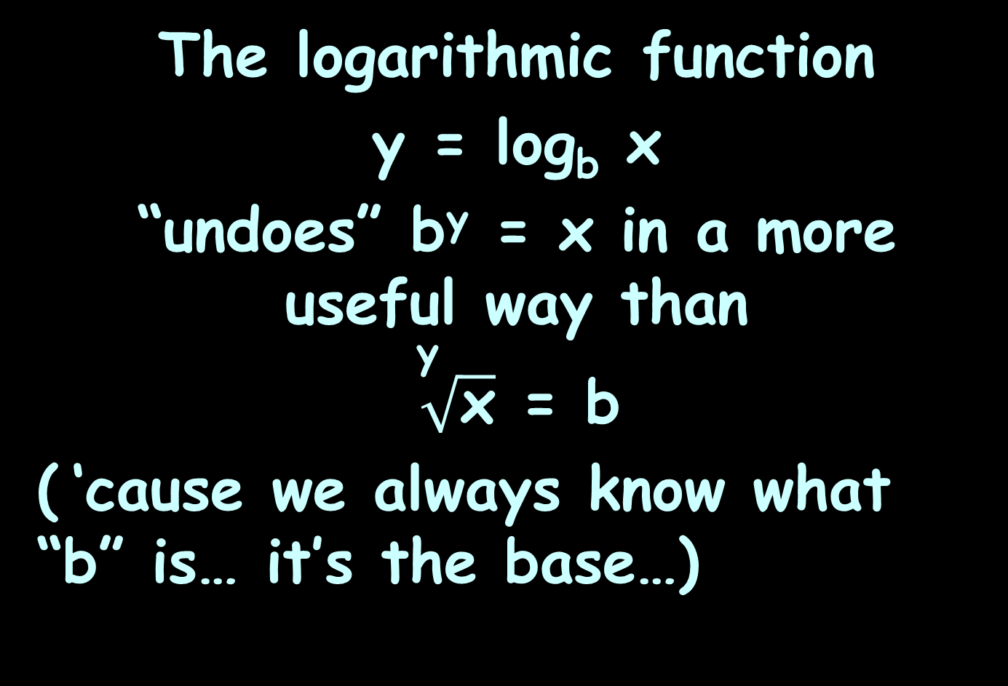
Logarithms
The logarithmic function
y = log_{b} x
“undoes” b^{y} = x in a more useful way than
$\sqrt[\text{y}]{\text{x}}$ = b
( ‘cause we always know what “b” is… it’s the base…)

Slide 39
Logarithms
And just like
x + 2 = y
is the same as
x = y - 2

Slide 40
Logarithms
The logarithmic function
y = log_{b} x
is the same as
b^{y} = x
(if x>0, b>0 and b≠1)

Slide 41
Logarithms
log₂ 16
2 to what power gives 16?

Slide 42
Logarithms
log₂ 16 = 4
because 2⁴ = 16

Slide 43

LOGARITHMS
IN-CLASS PROBLEMS 1-4
Evaluate:
log₁₀ 100
log₃₆ 6
log₅ 1/125
log₃ $\sqrt[7]{\text{3}}$
log_{b} x: b to what power gives x?

Slide 44

LOGARITHMS
IN-CLASS PROBLEMS 1-4
Evaluate:
log₁₀ 100 = 2
log₃₆ 6
log₅ 1/125
log₃ $\sqrt[7]{\text{3}}$
log_{b} x: b to what power gives x?

Slide 45

LOGARITHMS
IN-CLASS PROBLEMS 1-4
Evaluate:
log₁₀ 100 = 2
log₃₆ 6 = 0.5
log₅ 1/125
log₃ $\sqrt[7]{\text{3}}$
log_{b} x: b to what power gives x?

Slide 46

LOGARITHMS
IN-CLASS PROBLEMS 1-4
Evaluate:
log₁₀ 100 = 2
log₃₆ 6 = 0.5
log₅ 1/125 = -3
log₃ $\sqrt[7]{\text{3}}$
log_{b} x: b to what power gives x?

Slide 47

LOGARITHMS
IN-CLASS PROBLEMS 1-4
Evaluate:
log₁₀ 100 = 2
log₃₆ 6 = 0.5
log₅ 1/125 = -3
log₃ $\sqrt[7]{\text{3}}$ = 1/7
log_{b} x: b to what power gives x?

Slide 48
Questions?
http://i.imgur.com/aliTlT3.jpg

Slide 49
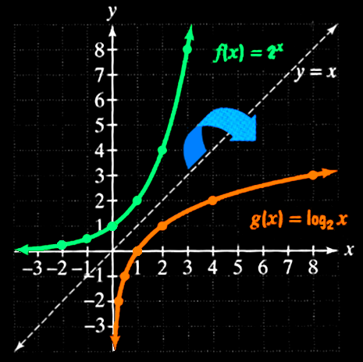
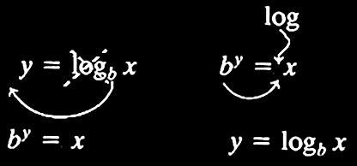
Logarithms
Logarithms are the inverse of exponential functions

Slide 50
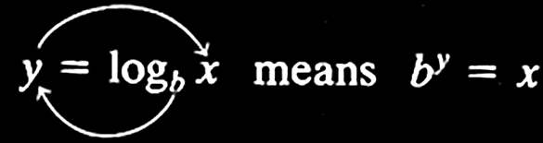
Logarithms
logarithmic function with base b
~or~
exponential function with base b
“Base of answer = exponent”
Stephanie Black, 2022

Slide 51
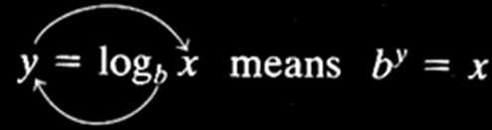
LOGARITHMS
IN-CLASS PROBLEMS 5-7
Write in logarithmic form:
2³ = 8
8^{y} = 300
15² = x
“Base of answer = exponent”

Slide 52
LOGARITHMS
IN-CLASS PROBLEMS 5-7
Write in logarithmic form:
2³ = 8 log₂ 8 = 3
8^{y} = 300
15² = x
“Base of answer = exponent”

Slide 53
LOGARITHMS
IN-CLASS PROBLEMS 5-7
Write in logarithmic form:
2³ = 8 log₂ 8 = 3
8^{y} = 300 log₈ 300 = y
15² = x
“Base of answer = exponent”

Slide 54
LOGARITHMS
IN-CLASS PROBLEMS 5-7
Write in logarithmic form:
2³ = 8 log₂ 8 = 3
8^{y} = 300 log₈ 300 = y
15² = x log₁₅ x = 2
“Base of answer = exponent”

Slide 55
LOGARITHMS
IN-CLASS PROBLEMS 8-10
Write in exponential form:
4 = log₂ 16
6 = log₂ 64
3 = log_{x} 27
“Base of answer = exponent”

Slide 56
LOGARITHMS
IN-CLASS PROBLEMS 8-10
Write in exponential form:
4 = log₂ 16 2⁴ = 16
6 = log₂ 64
3 = log_{x} 27
“Base of answer = exponent”

Slide 57
LOGARITHMS
IN-CLASS PROBLEMS 8-10
Write in exponential form:
4 = log₂ 16 2⁴ = 16
6 = log₂ 64 2⁶ = 64
3 = log_{x} 27
“Base of answer = exponent”

Slide 58
LOGARITHMS
IN-CLASS PROBLEMS 8-10
Write in exponential form:
4 = log₂ 16 2⁴ = 16
6 = log₂ 64 2⁶ = 64
3 = log_{x} 27 x³ = 27
“Base of answer = exponent”

Slide 59
LOGARITHMS
IN-CLASS PROBLEM 11
Solve for q:
log₅ (2q + 4) = 3
b = ?
“Base of answer = exponent”

Slide 60
LOGARITHMS
IN-CLASS PROBLEM 11
Solve for q:
log₅ (2q + 4) = 3
b = 5
y = ?
“Base of answer = exponent”

Slide 61
LOGARITHMS
IN-CLASS PROBLEM 11
Solve for q:
log₅ (2q + 4) = 3
b = 5
y = 3
x =
“Base of answer = exponent”

Slide 62
LOGARITHMS
IN-CLASS PROBLEM 11
Solve for q:
log₅ (2q + 4) = 3
b = 5
y = 3
x = 2q + 4
q = ?
“Base of answer = exponent”

Slide 63
LOGARITHMS
IN-CLASS PROBLEM 11
Solve for q:
log₅ (2q + 4) = 3
b = 5
y = 3
x = 2q + 4
5³ = 2q + 4
q = (5³ - 4)/2 = 60.5

Slide 64
Questions?
http://i.imgur.com/aliTlT3.jpg

Slide 65
Logarithms
The natural number “e” (for Euler’s number) is an important mathematical constant approximately equal to 2.71828

Slide 66
Logarithms
Like the constant π, e is irrational (it cannot be written as a ratio of integers), and it is transcendental (it is not a root of any non-zero polynomial with rational coefficients)

Slide 67
Logarithms
0,1,π,i and e are the five constants appearing in the formulation of Euler’s identity:
e^{iπ} + 1 = 0
These are the numbers that seem to run our universe!

Slide 68
Logarithms
Logs with base e are called
“natural logarithms”
Written "ln"

Slide 69
Logarithms
Logs with base 10 are called
“common logarithms”
Written "log"

Slide 70
Logarithms
The default logarithm
has base 10:
log₁₀ x = log x

Slide 71
Logarithms
BUT nowadays, the default logarithm sometimes has base e:
log_{e} x = ln x = “log x”
Be careful!
Wolframalpha uses “log” to mean “ln”

Slide 72
Logarithms
Properties of Logarithms:
log_{b} 1 = 0 log 1 = 0 ln 1 = 0
log_{b} b = 1 log 10 = 1 ln e = 1
log_{b} b^{x} = x log 10^{x} = x ln e^{x} = x
b^{logb x} = x 10^{logx} = x e^{ln x} = x

Slide 73
Logarithms
Mathematical facts about logs:
log(AB) = log(A) + log(B)
log(A/B) = log(A) – log(B)
log(A^{B}) = B×log(A)

Slide 74
LOGARITHMS
IN-CLASS PROBLEM 12
Simplify:
log (p) + log (q)
log(AB) = log(A) + log(B)
log(A/B) = log(A) – log(B)
log(A^{B}) = B×log(A)

Slide 75
LOGARITHMS
IN-CLASS PROBLEM 12
Simplify:
log (p) + log (q) = log (pq)
log(AB) = log(A) + log(B)
log(A/B) = log(A) – log(B)
log(A^{B}) = B×log(A)

Slide 76
LOGARITHMS
IN-CLASS PROBLEM 13
Expand:
log (x/y)
log(AB) = log(A) + log(B)
log(A/B) = log(A) – log(B)
log(A^{B}) = B×log(A)

Slide 77
LOGARITHMS
IN-CLASS PROBLEM 13
Expand:
log (x/y) = log (x) – log (y)
log(AB) = log(A) + log(B)
log(A/B) = log(A) – log(B)
log(A^{B}) = B×log(A)

Slide 78
LOGARITHMS
IN-CLASS PROBLEM 14
Simplify:
3 log (m) – 2 log (n)
log(AB) = log(A) + log(B)
log(A/B) = log(A) – log(B)
log(A^{B}) = B×log(A)

Slide 79
LOGARITHMS
IN-CLASS PROBLEM 14
Simplify:
3 log (m) – 2 log (n) =
= log(m³) – log(n²)
= log(m³ / n²)
log(AB) = log(A) + log(B)
log(A/B) = log(A) – log(B)
log(A^{B}) = B×log(A)

Slide 80
Questions?
http://i.imgur.com/aliTlT3.jpg

Slide 81
Logarithms
How do you calculate:
log₅ 625
when your calculator only has base 10 and base e?

Slide 82
Logarithms
Changing the base of logarithms:
log_{b}M = log_{a}M / log_{a}b

Slide 83
LOGARITHMS
IN-CLASS PROBLEM 15
Calculate: log₅ 625
What’s b?
What’s M?
What’s a?
log_{b}M = log_{a}M / log_{a}b

Slide 84
LOGARITHMS
IN-CLASS PROBLEM 15
Calculate: log₅ 625
What’s b? 5
What’s M?
What’s a?
log_{b}M = log_{a}M / log_{a}b

Slide 85
LOGARITHMS
IN-CLASS PROBLEM 15
Calculate: log₅ 625
What’s b? 5
What’s M? 625
What’s a?
log_{b}M = log_{a}M / log_{a}b

Slide 86
LOGARITHMS
IN-CLASS PROBLEM 15
Calculate: log₅ 625
What’s b? 5
What’s M? 625
What’s a? either 10 or e
Do it!
log_{b}M = log_{a}M / log_{a}b

Slide 87
LOGARITHMS
IN-CLASS PROBLEM 15
log₅ 625 = log₁₀ 625 / log₁₀ 5
= 4
or
log₅ 625 = ln 625 / ln 5
= 4
log_{b}M = log_{a}M / log_{a}b

Slide 88
Questions?
http://i.imgur.com/aliTlT3.jpg

Slide 89
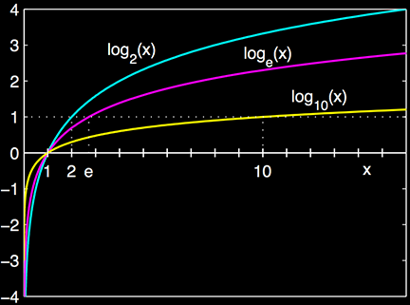
Calculus of Logarithms
The graph of a logarithm looks like:
https://en.wikipedia.org/wiki/Logarithm

Slide 90
Calculus of Logarithms
Remember, the derivative is a slope
https://en.wikipedia.org/wiki/Logarithm

Slide 91
Calculus of Logarithms
The slope of the logarithm curve is high for small values…
https://en.wikipedia.org/wiki/Logarithm

Slide 92
Calculus of Logarithms
…and the slope is low for large values of the logarithm
https://en.wikipedia.org/wiki/Logarithm

Slide 93
Calculus of Logarithms
The value of 1/x is also high for small values of x and low for large values of x
https://en.wikipedia.org/wiki/Logarithm

Slide 94
Calculus of Logarithms
The value of 1/x is also high for small values of x and low for large values of x
…maybe a model?
https://en.wikipedia.org/wiki/Logarithm

Slide 95
Calculus of Logarithms
In fact:
d(log_{a}(u))/dx = 1/u log_{a}(e) du

Slide 96
CALCULUS OF LOGARITHMS
IN-CLASS PROBLEM 16
If y=ln(3x) calculate dy/dx
d(log_{a}(u))/dx = 1/u log_{a}(e) du

Slide 97
CALCULUS OF LOGARITHMS
IN-CLASS PROBLEM 16
If y=ln(3x) calculate dy/dx
What’s u?
d(log_{a}(u))/dx = 1/u log_{a}(e) du

Slide 98
CALCULUS OF LOGARITHMS
IN-CLASS PROBLEM 16
If y=ln(3x) calculate dy/dx
What’s u? 3x
What’s du?
d(log_{a}(u))/dx = 1/u log_{a}(e) du

Slide 99
CALCULUS OF LOGARITHMS
IN-CLASS PROBLEM 16
If y=ln(3x) calculate dy/dx
What’s u? 3x
What’s du? 3
What’s a?
d(log_{a}(u))/dx = 1/u log_{a}(e) du

Slide 100
CALCULUS OF LOGARITHMS
IN-CLASS PROBLEM 16
If y=ln(3x) calculate dy/dx
What’s u? 3x
What’s du? 3
What’s a? e
What’s log_{a}(e)?
d(log_{a}(u))/dx = 1/u log_{a}(e) du

Slide 101
CALCULUS OF LOGARITHMS
IN-CLASS PROBLEM 16
If y=ln(3x) calculate dy/dx
What’s u? 3x
What’s du? 3
What’s log_{e}(e)? ln(e) = 1
What’s d(ln(3))/dx?
d(log_{a}(u))/dx = 1/u log_{a}(e) du

Slide 102
CALCULUS OF LOGARITHMS
IN-CLASS PROBLEM 16
If y=ln(3x) calculate dy/dx
What’s u? 3x
What’s du? 3
What’s log_{e}(e)? ln(e) = 1
What’s d(ln(3x))/dx?
(1/3x)(1)(3) = 1/x
d(log_{a}(u))/dx = 1/u log_{a}(e) du

Slide 103
CALCULUS OF LOGARITHMS
IN-CLASS PROBLEM 17
If y=log₁₀(3x²+6x-12) calculate dy/dx
What’s u?
d(log_{a}(u))/dx = 1/u log_{a}(e) du

Slide 104
CALCULUS OF LOGARITHMS
IN-CLASS PROBLEM 17
If y=log₁₀(3x²+6x-12) calculate dy/dx
What’s u? 3x²+6x-12
What’s du?
d(log_{a}(u))/dx = 1/u log_{a}(e) du

Slide 105
CALCULUS OF LOGARITHMS
IN-CLASS PROBLEM 17
If y=log₁₀(3x²+6x-12) calculate dy/dx
What’s u? 3x²+6x-12
What’s du? 6x + 6
What’s a?
d(log_{a}(u))/dx = 1/u log_{a}(e) du

Slide 106
CALCULUS OF LOGARITHMS
IN-CLASS PROBLEM 17
If y=log₁₀(3x²+6x-12) calculate dy/dx
What’s u? 3x²+6x-12
What’s du? 6x + 6
What’s a? 10
What’s log_{a}(e)?
d(log_{a}(u))/dx = 1/u log_{a}(e) du

Slide 107
CALCULUS OF LOGARITHMS
IN-CLASS PROBLEM 17
If y=log₁₀(3x²+6x-12) calculate dy/dx
What’s u? 3x²+6x-12
What’s du? 6x + 6
What’s log₁₀(e)? ≈ 0.43
What’s dy/dx?
this gets used a lot…
d(log_{a}(u))/dx = 1/u log_{a}(e) du

Slide 108
CALCULUS OF LOGARITHMS
IN-CLASS PROBLEM 17
If y=log₁₀(3x²+6x-12) calculate dy/dx
What’s u? 3x²+6x-12
What’s du? 6x + 6
What’s log₁₀(e)? ≈ 0.43
What’s dy/dx?
(1/(3x²+6x-12))(0.43)(6x+6)
= (0.43)(6x+6)/(3x²+6x-12)
= (0.43)(2x+2)/(x²+2x-4)
this gets used a lot…

Slide 109
Calculus of Logarithms
BTW:
log₁₀(e) = 1/ln(10)
Note: Wolframalpha says
“log(10)” for ln(10) – don’t get fooled!

Slide 110
Questions?
http://i.imgur.com/aliTlT3.jpg

Slide 111
Calculus of Logarithms
How about integration?

Slide 112
Calculus of Logarithms
How about integration?
… these can be a nightmare …

Slide 113
Calculus of Logarithms
∫ log_{a}(x) dx = xlog_{a}(x) – x/ln(a)+c
= (xln(x) – x)/ln(a)+c
∫ ln(ax) dx = xln(ax) – x +c
∫ ln(ax+b) dx =
= ((ax+b)ln(ax+b)-(ax+b))/a +c
∫ ln(x)² dx =
= x(ln(x))² – 2xlnx + 2x +c
…

Slide 114
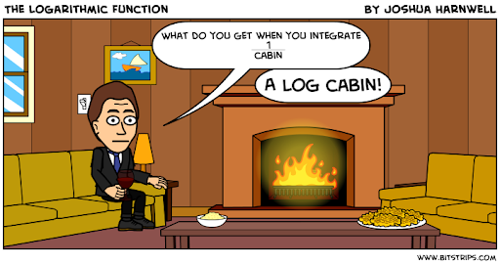
Calculus of Logarithms
But integration of logs is the source of one of the most enduring math comics
https://lh3.googleusercontent.com/proxy/DTnY2hPgi805rmrHsGnNsWMx0NDDZ571zp4gxEfx40IuVp_OydaHnFUc5BxsrGOhZ_8eQYYcLZiUPVocy43YVzS2Nw

Slide 115
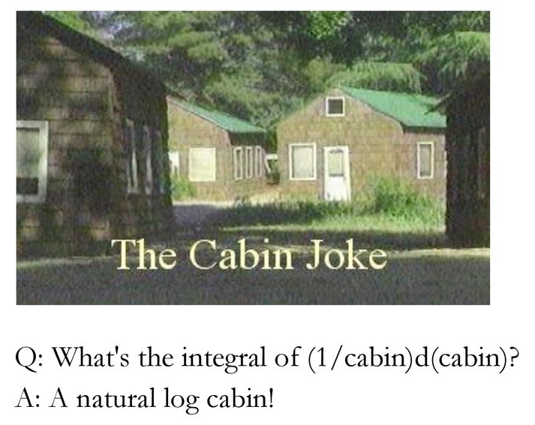
Calculus of Logarithms
https://slideplayer.com/slide/13604518/83/images/89/Q%3A+What+s+the+integral+of+%281%2Fcabin%29d%28cabin%29+A%3A+A+natural+log+cabin%21.jpg

Slide 116
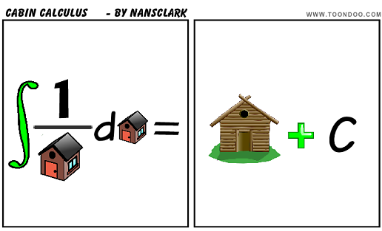
Calculus of Logarithms
https://i.pinimg.com/originals/1c/9a/e5/1c9ae5fb46d19073d19b9fe475897fc4.png

Slide 117
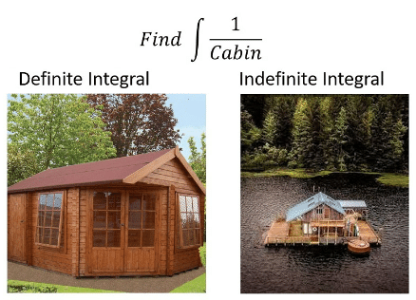
Calculus of Logarithms
What is the integral of 1/cabin?
log cabin
Nope. Houseboat: you forgot the “C”
https://pics.onsizzle.com/Calculate-cabin-definite-integral-indefinite-integral-sea-or-c--66242774.png

Slide 118
CALCULUS OF LOGARITHMS
IN-CLASS PROBLEM 18
What is the integral?
∫ 1/(x) dx =
∫ 1/(x+5) dx
∫ 1/(5x) dx

Slide 119
CALCULUS OF LOGARITHMS
IN-CLASS PROBLEM 18
What is the integral?
∫ 1/(x) dx = ln(x) +c
∫ 1/(x+5) dx =
∫ 1/(5x) dx

Slide 120
CALCULUS OF LOGARITHMS
IN-CLASS PROBLEM 18
What is the integral?
∫ 1/(x) dx = ln(x) +c
∫ 1/(x+5) dx = ln(x+5) +c
∫ 1/(5x) dx =

Slide 121
CALCULUS OF LOGARITHMS
IN-CLASS PROBLEM 18
What is the integral?
∫ 1/(x) dx = ln(x) +c
∫ 1/(x+5) dx = ln(x+5) +c
∫ 1/(5x) dx = 1/5 ln(5x) +c

Slide 122
Questions?
http://i.imgur.com/aliTlT3.jpg

Slide 123
Exponentials
Functions that contain exponents:
ƒ(x) = x^{c}
x is the base
c is the exponent

Slide 124
Exponentials
Exponential functions:
ƒ(x) = c^{x}
c is the base
x is the exponent

Slide 125
Exponentials
Limitations:
the base must be a constant
the base must be >0
the exponent must be a variable

Slide 126
EXPONENTIALS
IN-CLASS PROBLEM 19
Function containing an exponent or exponential function?
ƒ(w) = w⁹ ƒ(y) = 72^{y}
ƒ(x) = -83.2^{x} ƒ(x) = x⁵⁰
ƒ(z) = (8z+1)^{z} ƒ(x) = (x²+4)6^{x}

Slide 127
EXPONENTIALS
IN-CLASS PROBLEM 19
Function containing an exponent or exponential function?
ƒ(w) = w⁹ ƒ(y) = 72^{y}
fce
ƒ(x) = -83.2^{x} ƒ(x) = x⁵⁰
ƒ(z) = (8z+1)^{z} ƒ(x) = (x²+4)6^{x}

Slide 128
EXPONENTIALS
IN-CLASS PROBLEM 19
Function containing an exponent or exponential function?
ƒ(w) = w⁹ ƒ(y) = 72^{y}
fce exp fct
ƒ(x) = -83.2^{x} ƒ(x) = x⁵⁰
ƒ(z) = (8z+1)^{z} ƒ(x) = (x²+4)6^{x}

Slide 129
EXPONENTIALS
IN-CLASS PROBLEM 19
Function containing an exponent or exponential function?
ƒ(w) = w⁹ ƒ(y) = 72^{y}
fce exp fct
ƒ(x) = -83.2^{x} ƒ(x) = x⁵⁰
exp fct
ƒ(z) = (8z+1)^{z} ƒ(x) = (x²+4)6^{x}

Slide 130
EXPONENTIALS
IN-CLASS PROBLEM 19
Function containing an exponent or exponential function?
ƒ(w) = w⁹ ƒ(y) = 72^{y}
fce exp fct
ƒ(x) = -83.2^{x} ƒ(x) = x⁵⁰
exp fct fce
ƒ(z) = (8z+1)^{z} ƒ(x) = (x²+4)6^{x}

Slide 131
EXPONENTIALS
IN-CLASS PROBLEM 19
Function containing an exponent or exponential function?
ƒ(w) = w⁹ ƒ(y) = 72^{y}
fce exp fct
ƒ(x) = -83.2^{x} ƒ(x) = x⁵⁰
exp fct fce
ƒ(z) = (8z+1)^{z} ƒ(x) = (x²+4)6^{x}
exp fct

Slide 132
EXPONENTIALS
IN-CLASS PROBLEM 19
Function containing an exponent or exponential function?
ƒ(w) = w⁹ ƒ(y) = 72^{y}
fce exp fct
ƒ(x) = -83.2^{x} ƒ(x) = x⁵⁰
exp fct fce
ƒ(z) = (8z+1)^{z} ƒ(x) = (x²+4)6^{x}
exp fct exp fct

Slide 133
Questions?
http://i.imgur.com/aliTlT3.jpg

Slide 134
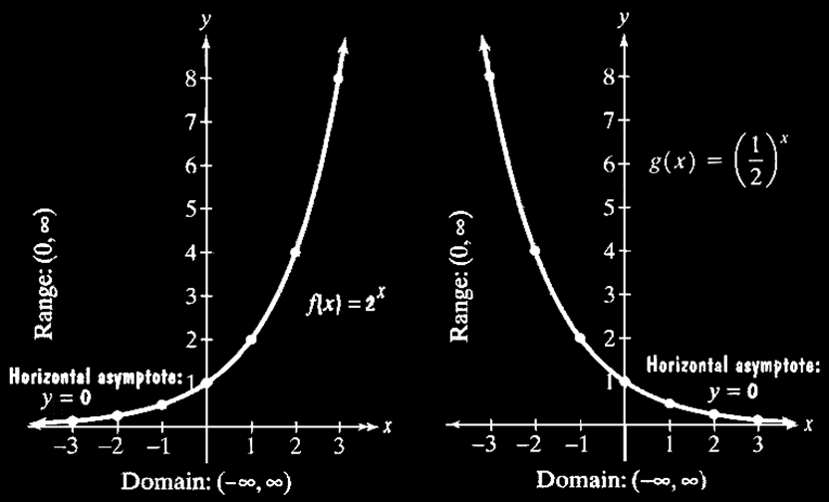
Exponentials
Graphs of Exponential Functions

Slide 135
Exponentials
If the base is > 1, then the graph goes up to the right
If 0<base<1, then the graph goes up to the left

Slide 136
Exponentials
All pass through the point (0,1) because a⁰=1

Slide 137
Exponentials
The domain (xs) is (-∞,∞) The range (ys) is (0,∞)

Slide 138
Exponentials
Logarithms are the inverse of exponential functions

Slide 139
Logarithms vs Exponents
Graph of exponents vs logarithms
Is it getting
bigger faster
and faster
or slower and
slower?

Slide 140
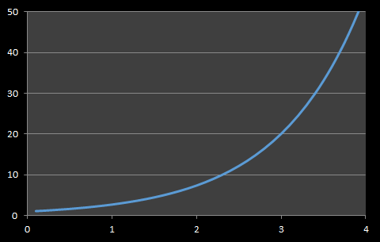
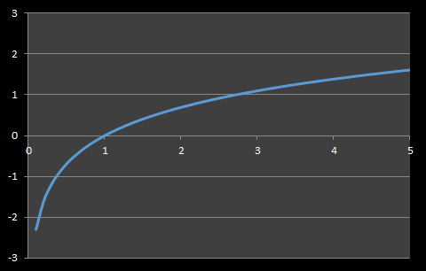
Logarithmic vs Exponential Models
Exponential Curve Logarithmic Curve
Is it getting bigger faster and faster
or slower and slower?

Slide 141
Logarithmic vs Exponential Models
Exponential Curve Logarithmic Curve
Starts slow
Then speeds up
Starts fast
Then slows down

Slide 142
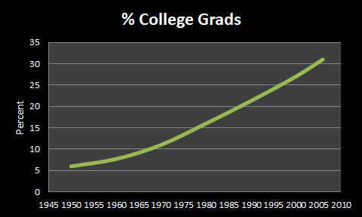
LOGARITHMS VS EXPONENTS
IN-CLASS PROBLEM 20a
Percentage of college graduates – exponential or logarithmic?

Slide 143
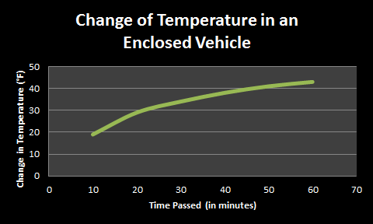
LOGARITHMS VS EXPONENTS
IN-CLASS PROBLEM 20b
Change of temperature in an enclosed vehicle - exponential or logarithmic?

Slide 144
Questions?
http://i.imgur.com/aliTlT3.jpg

Slide 145
Exponentials Calculus
Calculus involving e exponents is fairly simple!

Slide 146
Exponentials Calculus
d(e^{x})/dx = e^{x}
d(e^{u})/dx = e^{u} du/dx
∫ e^{x} dx = e^{x} +c
∫ e^{ax} dx = (1/a) e^{ax} +c

Slide 147
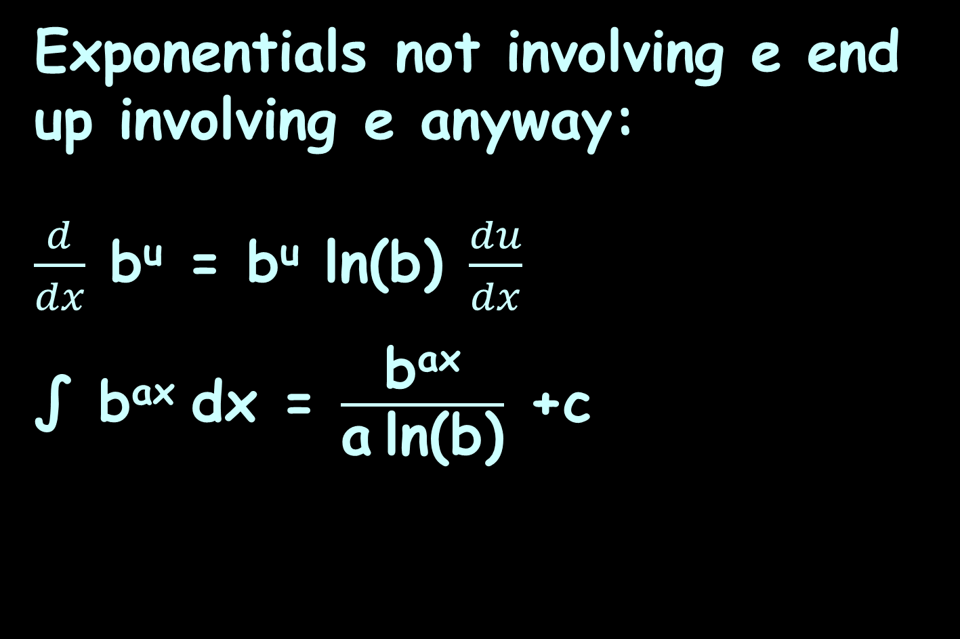
Exponentials Calculus
Exponentials not involving e end up involving e anyway:
$\frac{d}{dx}$ b^{u} = b^{u} ln(b) $\frac{du}{dx}$
∫ b^{ax} dx = $\frac{\text{b}\text{a}\text{x}}{\text{a} \text{ln}\text{(}\text{b}\text{)}}$ +c

Slide 148

CALCULUS OF EXPONENTIALS
IN-CLASS PROBLEM 21
Calculate d/dx for: 7^{2x}
What’s u?
$\frac{d}{dx}$ b^{u} = b^{u} ln(b) $\frac{du}{dx}$
∫ a^{bx} dx = $\frac{\text{a}\text{bx}}{\text{b} \text{ln}\text{(}\text{a}\text{)}}$ +c

Slide 149
CALCULUS OF EXPONENTIALS
IN-CLASS PROBLEM 21
Calculate d/dx for: 7^{2x}
What’s u? 2x
What’s du?
$\frac{d}{dx}$ b^{u} = b^{u} ln(b) $\frac{du}{dx}$
∫ a^{bx} dx = $\frac{\text{a}\text{bx}}{\text{b} \text{ln}\text{(}\text{a}\text{)}}$ +c

Slide 150
CALCULUS OF EXPONENTIALS
IN-CLASS PROBLEM 21
Calculate d/dx for: 7^{2x}
What’s u? 2x
What’s du? 2
What’s b?
$\frac{d}{dx}$ b^{u} = b^{u} ln(b) $\frac{du}{dx}$
∫ a^{bx} dx = $\frac{\text{a}\text{bx}}{\text{b} \text{ln}\text{(}\text{a}\text{)}}$ +c

Slide 151
CALCULUS OF EXPONENTIALS
IN-CLASS PROBLEM 21
Calculate d/dx for: 7^{2x}
What’s u? 2x
What’s du? 2
What’s b? 7
What’s ln(7)?
$\frac{d}{dx}$ b^{u} = b^{u} ln(b) $\frac{du}{dx}$
∫ a^{bx} dx = $\frac{\text{a}\text{bx}}{\text{b} \text{ln}\text{(}\text{a}\text{)}}$ +c

Slide 152
CALCULUS OF EXPONENTIALS
IN-CLASS PROBLEM 21
Calculate d/dx for: 7^{2x}
What’s u? 2x
What’s du? 2
What’s b? 7
What’s ln(7)? ≈ 1.95
What’s d(7^{2x})/dx?
$\frac{d}{dx}$ b^{u} = b^{u} ln(b) $\frac{du}{dx}$
∫ a^{bx} dx = $\frac{\text{a}\text{bx}}{\text{b} \text{ln}\text{(}\text{a}\text{)}}$ +c

Slide 153
CALCULUS OF EXPONENTIALS
IN-CLASS PROBLEM 21
Calculate d/dx for: 7^{2x}
What’s u? 2x
What’s du? 2
What’s b? 7
What’s ln(7)? ≈ 1.95
What’s d(7^{2x})/dx?
= 7^{2x} ln(7) (2) ≈ 7^{2x} (3.892)
Which can be simplified…
$\frac{d}{dx}$ b^{u} = b^{u} ln(b) $\frac{du}{dx}$
∫ a^{bx} dx = $\frac{\text{a}\text{bx}}{\text{b} \text{ln}\text{(}\text{a}\text{)}}$ +c

Slide 154
CALCULUS OF EXPONENTIALS
IN-CLASS PROBLEM 21
What’s d(7^{2x})/dx?
= 7^{2x} ln(7)(2)
= (7²)^{x} ln(7²)
= 49^{x} ln(49)
≈ 49^{x} (3.892)
x^{ab} = (xª)^{b}
log(A^{B}) = B×log(A)

Slide 155

CALCULUS OF EXPONENTIALS
IN-CLASS PROBLEM 22
Calculate ∫ 6^{2x} dx
$\frac{d}{dx}$ b^{u} = b^{u} ln(b) $\frac{du}{dx}$
∫ b^{ax} dx = $\frac{\text{b}\text{a}\text{x}}{\text{a} \text{ln}\text{(}\text{b}\text{)}}$ +c

Slide 156

CALCULUS OF EXPONENTIALS
IN-CLASS PROBLEM 22
Calculate ∫ 6^{2x} dx
= ($\text{6}\text{2}\text{x}$)$\left(\frac{\text{1}}{\text{2} \text{ln}\text{(6)}}\right)$ +c = $\frac{\text{6}\text{2}\text{x}}{\text{2} \text{ln}\text{(}\text{6}\text{)}}$ +c can it be simplified?
$\frac{d}{dx}$ b^{u} = b^{u} ln(b) $\frac{du}{dx}$
∫ a^{bx} dx = $\frac{\text{a}\text{bx}}{\text{b} \text{ln}\text{(}\text{a}\text{)}}$ +c

Slide 157
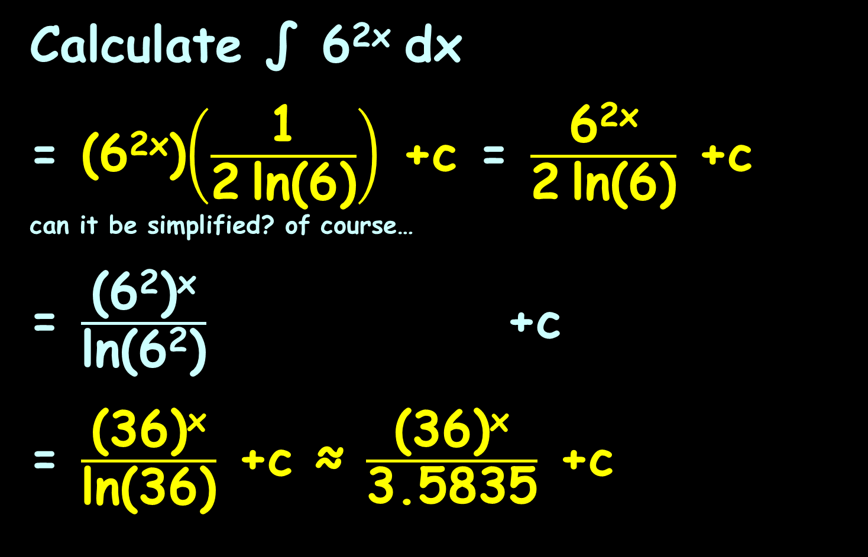
CALCULUS OF EXPONENTIALS
IN-CLASS PROBLEM 22
Calculate ∫ 6^{2x} dx
= ($\text{6}\text{2}\text{x}$)$\left(\frac{\text{1}}{\text{2} \text{ln}\text{(6)}}\right)$ +c = $\frac{\text{6}\text{2}\text{x}}{\text{2} \text{ln}\text{(6)}}$ +c can it be simplified? of course…
= $\frac{\text{(}\text{6}\text{2}\text{)}\text{x}}{\text{ln}\text{(}\text{6}\text{2}\text{)}}$ +c
= $\frac{\text{(}\text{36}\text{)}\text{x}}{\text{ln}\text{(}\text{36}\text{)}}$ +c ≈ $\frac{\text{(36)}\text{x}}{\text{3.5835}}$ +c
x^{ab} = (xª)^{b}
log(A^{B}) = B×log(A)
$\frac{d}{dx}$ b^{u} = b^{u} ln(b) $\frac{du}{dx}$
∫ a^{bx} dx = $\frac{\text{a}\text{bx}}{\text{b} \text{ln}\text{(}\text{a}\text{)}}$ +c

Slide 158
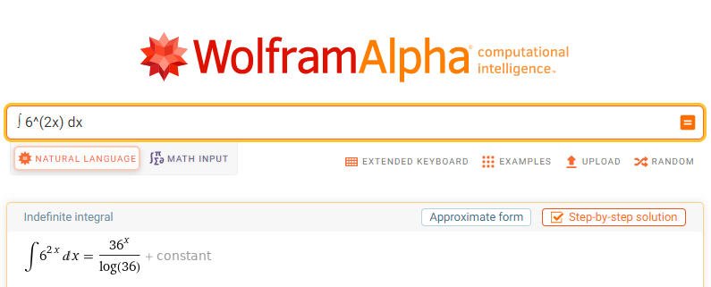
In Wolframalpha:
Just what we calculated!

Slide 159
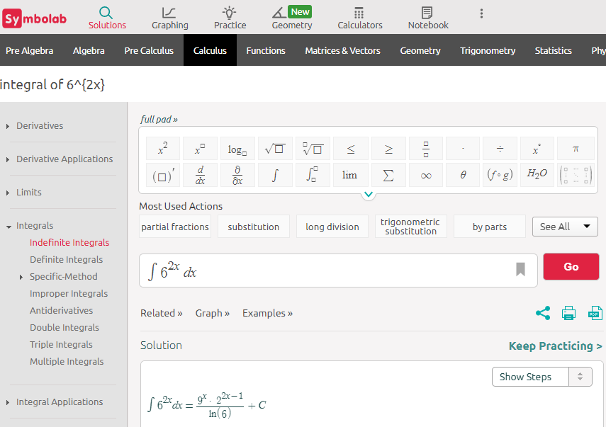
In Symbolab:

Slide 160
hmmm… looks different!

Slide 161
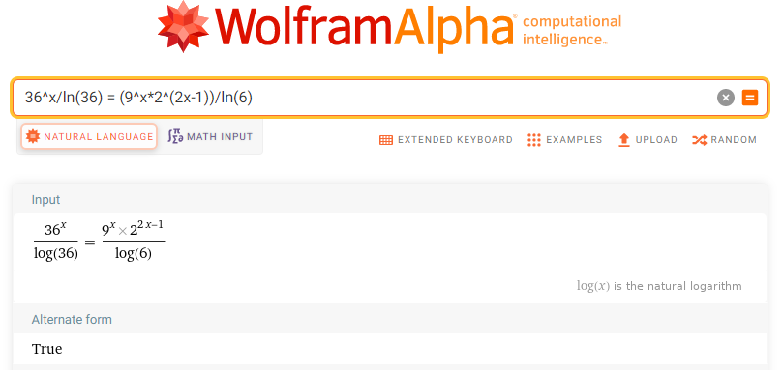
Another Useful Skill:
To test if
36^{x}/ln(36) = (9^{x}2^{(2x-1)})/ln(6)

Slide 162
Questions?
http://i.imgur.com/aliTlT3.jpg

Slide 163
Summary
Today we studied:
Review of Trig Calculus
Calculus of Logarithms and
Exponentials

Slide 164

You Survived!

