Slide 1
Welcome to
Unit 2
Part 3!
MATH 207 Integral Calculus
http://en.wikipedia.org/wiki/Differential_equation#mediaviewer/File:Elmer-pump-heatequation.png

Slide 2
What’s Up?
Review:
Logs and exponentials in calculus
New stuff:
Hyperbolic Functions

Slide 3
What’s Up?
Outcome 1) Demonstrate a high level of proficiency in differentiation and integration for linear, polynomial, rational, trigonometric, inverse trigonometric, exponential and logarithmic function, including using the method of substitution, integration by parts and partial fraction decomposition
Outcome 7) Solve problems by identifying the requirements, making a sketch as appropriate

Slide 4

Review
http://995642590.r.lightningbase-cdn.com/wp-content/uploads/2010/12/looking-back-hrexaminer-v144-cover425px.jpg

Slide 5
Logarithms
Are used nowadays as an inverse for the exponent function

Slide 6

Logarithms
To undo b^{y} = x
We need something like:
$\sqrt[\text{y}]{\text{x}}$ = b

Slide 7
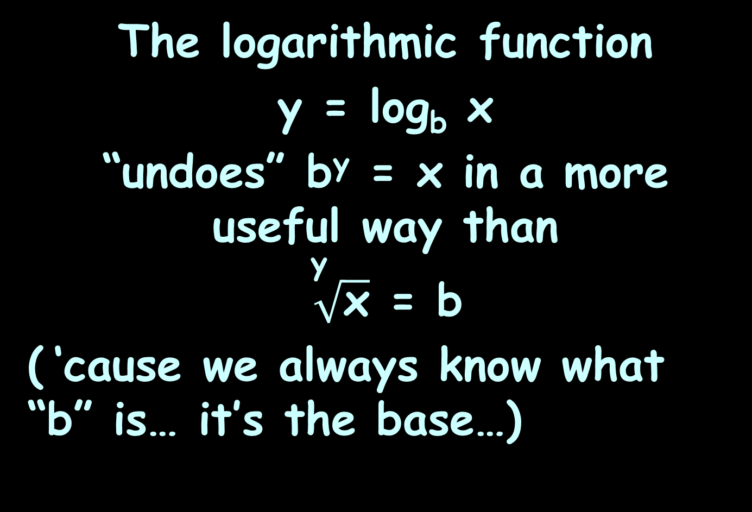
Logarithms
The logarithmic function
y = log_{b} x
“undoes” b^{y} = x in a more useful way than
$\sqrt[\text{y}]{\text{x}}$ = b
( ‘cause we always know what “b” is… it’s the base…)

Slide 8
Logarithms
The logarithmic function
y = log_{b} x
is the same as
b^{y} = x
(if x>0, b>0 and b≠1)

Slide 9
Logarithms
log₂ 16
2 to what power gives 16?

Slide 10
Logarithms
log₂ 16 = 4
because 2⁴ = 16

Slide 11
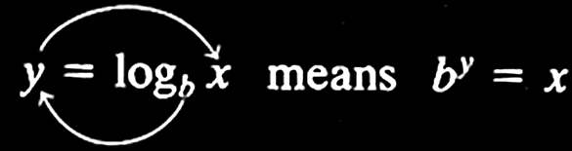
Logarithms
logarithmic function with base b
~or~
exponential function with base b

Slide 12
Logarithms
Logs with base e are called
“natural logarithms”
Written "ln"

Slide 13
Logarithms
Logs with base 10 are called
“common logarithms”
Written "log"

Slide 14
Logarithms
The default logarithm
has base 10:
log₁₀ x = log x

Slide 15
Logarithms
BUT nowadays, the default logarithm sometimes has base e:
log_{e} x = ln x = “log x”
Be careful!
WolframAlpha uses “log” to mean “ln”

Slide 16
Logarithms
Properties of Logarithms:
log_{b} 1 = 0 log 1 = 0 ln 1 = 0
log_{b} b = 1 log 10 = 1 ln e = 1
log_{b} b^{x} = x log 10^{x} = x ln e^{x} = x
b^{logb x} = x 10^{logx} = x e^{ln x} = x

Slide 17
Logarithms
Mathematical facts about logs:
log(AB) = log(A) + log(B)
log(A/B) = log(A) – log(B)
log(A^{B}) = B×log(A)

Slide 18
Logarithms
Changing the base of logarithms:
log_{b}M = log_{a}M / log_{a}b

Slide 19
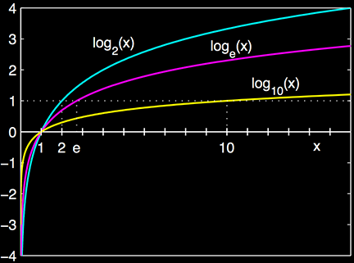
Calculus of Logarithms
The graph of a logarithm looks like:
https://en.wikipedia.org/wiki/Logarithm

Slide 20
Calculus of Logarithms
d(log_{a}(u))/dx = 1/u log_{a}(e) du

Slide 21
Calculus of Logarithms
BTW:
log₁₀(e) = 1/ln(10)
Note: Wolframalpha says
“log(10)” for ln(10) – don’t get fooled!

Slide 22
Calculus of Logarithms
∫ log_{a}(x) dx = xlog_{a}(x) – x/ln(a)+c
= (xln(x) – x)/ln(a)+c
∫ ln(ax) dx = xln(ax) – x +c
∫ ln(ax+b) dx =
= ((ax+b)ln(ax+b)-(ax+b))/a +c
∫ ln(x)² dx =
= x(ln(x))² – 2xlnx + 2x +c
…

Slide 23
Exponentials
Functions that contain exponents:
ƒ(x) = x^{c}
x is the base
c is the exponent

Slide 24
Exponentials
Exponential functions:
ƒ(x) = c^{x}
c is the base
x is the exponent

Slide 25
Exponentials
Limitations:
the base must be a constant
the base must be >0
the exponent must be a variable

Slide 26
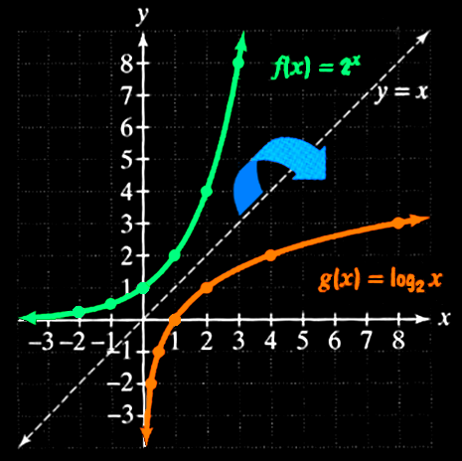
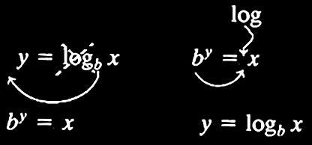
Exponentials
Logarithms are the inverse of exponential functions

Slide 27
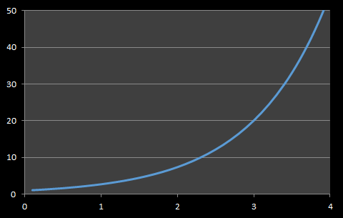
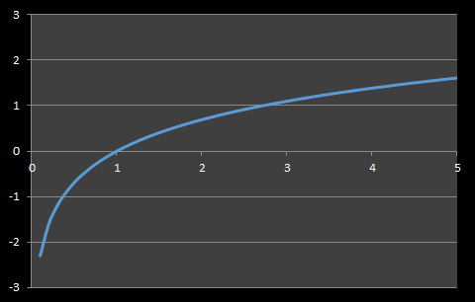
Logarithmic vs Exponential Models
Exponential Curve Logarithmic Curve
Starts slow
Then speeds up
Starts fast
Then slows down

Slide 28
Exponentials Calculus
d(e^{x})/dx = e^{x}
d(e^{u})/dx = e^{u} du/dx
∫ e^{x} dx = e^{x} +c
∫ e^{ax} dx = (1/a) e^{ax} +c

Slide 29
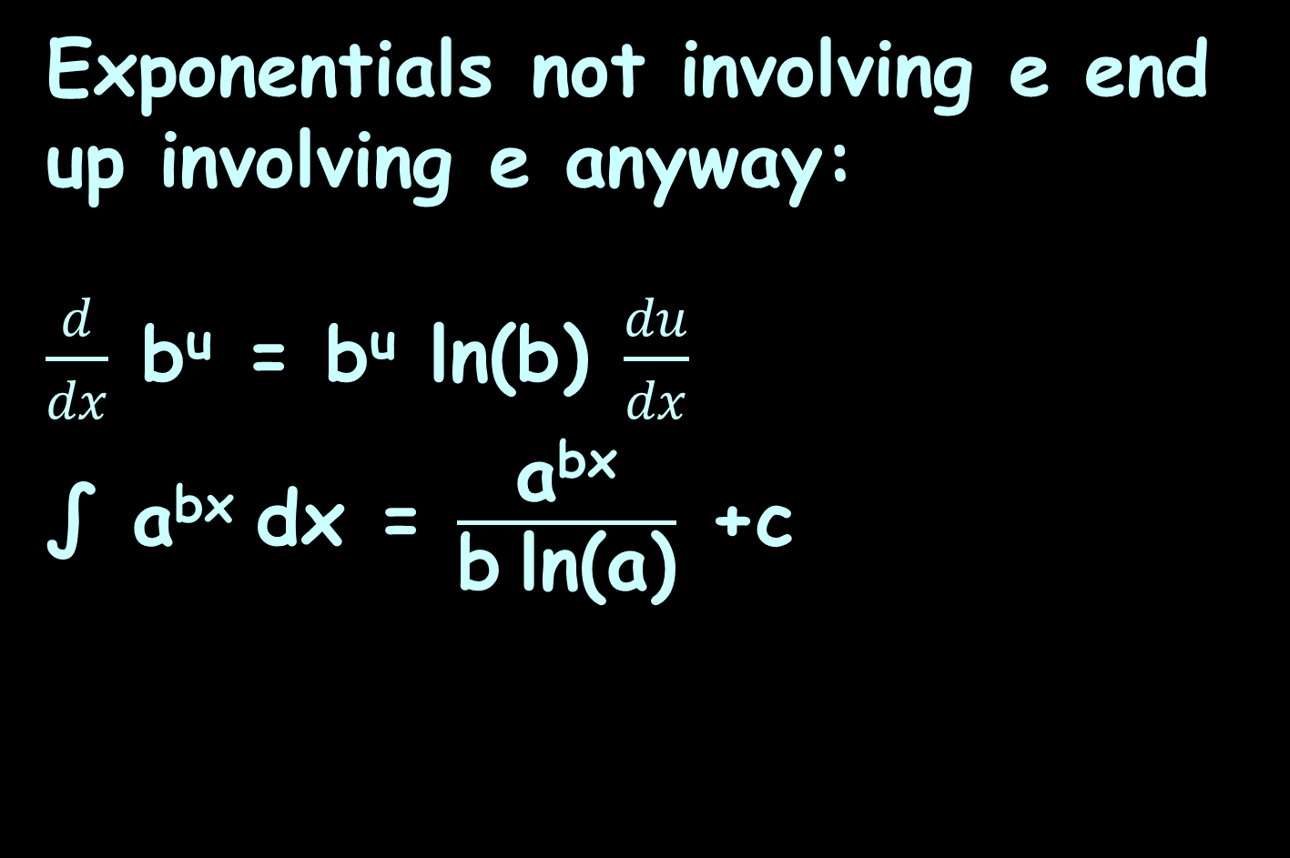
Exponentials Calculus
Exponentials not involving e end up involving e anyway:
$\frac{d}{dx}$ b^{u} = b^{u} ln(b) $\frac{du}{dx}$
∫ a^{bx} dx = $\frac{\text{a}\text{bx}}{\text{b} \text{ln}\text{(}\text{a}\text{)}}$ +c

Slide 30

Questions?
http://i.imgur.com/aliTlT3.jpg

Slide 31
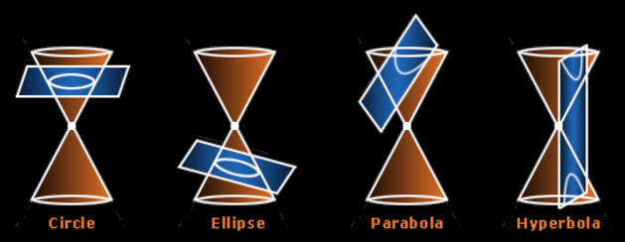
Hyperbolics
Conic Sections
Invented by Menaechmus
(380 BC- 320 BC)
https://s3.amazonaws.com/s3.timetoast.com/public/uploads/photo/8117141/image/9eedb26975599c604503db243b0a6e9a

Slide 32
Hyperbolics
Problems in advanced electronics can include
a hyperbolic function
https://en.wikipedia.org/wiki/Hyperbola#/media/File:Hyperbeln-gs-3.svg

Slide 33
Hyperbolics
Trig functions are
based on the
circle
Hyperbolics are
similar but
based on the
hyperbola
https://en.wikipedia.org/wiki/Hyperbola#/media/File:Hyperbolic_functions-2.svg

Slide 34
Hyperbolics
The hyperbolic functions are not periodic like trig functions
Both x and y just keep getting bigger and bigger as the hyperbolas arms expand outward

Slide 35
Hyperbolics
There are three basic hyperbolic functions:
sinh
cosh
tanh
https://en.wikipedia.org/wiki/Hyperbola#/media/File:Hyperbolic_functions-2.svg

Slide 36
Hyperbolics
-∞ < sinh(u) < +∞
1 ≤ cosh(u) < +∞
-1 ≤ tanh(u) ≤ +1
https://en.wikipedia.org/wiki/Hyperbola#/media/File:Hyperbolic_functions-2.svg

Slide 37
Hyperbolics
Can you calculate the hyperbolics on your calculator?
https://en.wikipedia.org/wiki/Hyperbola#/media/File:Hyperbolic_functions-2.svg

Slide 38
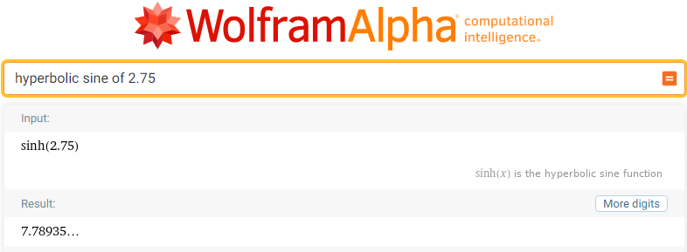
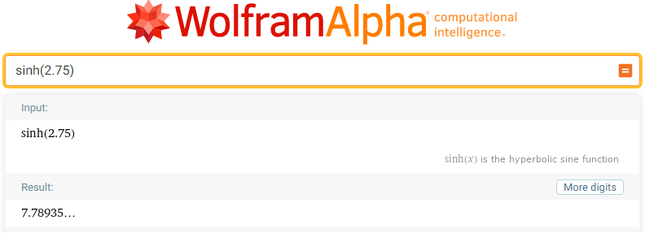
Hyperbolics
https://www.wolframalpha.com/input/?i=hyperbolic+sine+of+2.75

Slide 39
Hyperbolics
WolframAlpha, Symbolab and even Excel handle hyperbolic trig functions just fine…
For some reason, Mathway doesn’t include them

Slide 40
CALCULUS OF HYPERBOLICS
IN-CLASS PROBLEM 1
Each of the series arms of a symmetrical T attenuator which connects circuits of resistance R₀ should have a resistance
R = R₀tanh(N/2) where N is the desired attenuation in nepers. Calculate R if R₀=72 ohms and N = 2.2 nepers.

Slide 41
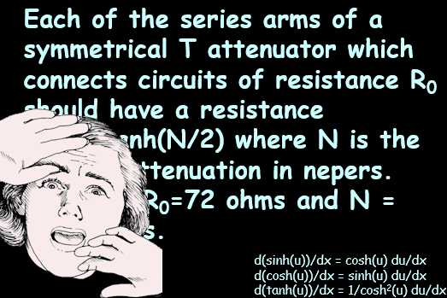
CALCULUS OF HYPERBOLICS
IN-CLASS PROBLEM 1
d(sinh(u))/dx = cosh(u) du/dx
d(cosh(u))/dx = sinh(u) du/dx
d(tanh(u))/dx = 1/cosh²(u) du/dx
scared-pic.jpg

Slide 42
CALCULUS OF HYPERBOLICS
IN-CLASS PROBLEM 1
Take it one step at a time!
Each of the series arms of a symmetrical T attenuator which connects circuits of resistance R₀ should have a resistance
R = R₀tanh(N/2) where N is the desired attenuation in nepers. Calculate R if R₀=72 ohms and N = 2.2 nepers.

Slide 43
CALCULUS OF HYPERBOLICS
IN-CLASS PROBLEM 1
Take it one step at a time!
Each of the series arms of a symmetrical T attenuator which connects circuits of resistance R₀ should have a resistance
R = R₀tanh(N/2) where N is the desired attenuation in nepers. Calculate R if R₀=72 ohms and N = 2.2 nepers.

Slide 44

CALCULUS OF HYPERBOLICS
IN-CLASS PROBLEM 1
R = R₀tanh(N/2)
R₀ = 72 ohms
N = 2.2 nepers
Calculate R
http://www.shutterstock.com/s/whew/search.html

Slide 45
CALCULUS OF HYPERBOLICS
IN-CLASS PROBLEM 1
R = R₀tanh(N/2)
R₀ = 72 ohms
N = 2.2 nepers
(A neper (Np) is like a decibel but using a base e logarithmic scale rather than a base 10)
Calculate R
Do it!

Slide 46
CALCULUS OF HYPERBOLICS
IN-CLASS PROBLEM 1
R = R₀tanh(N/2)
R₀ = 72 ohms
N = 2.2 nepers
Calculate R
R = 72tanh(2.2/2) = ?

Slide 47
CALCULUS OF HYPERBOLICS
IN-CLASS PROBLEM 1
R = R₀tanh(N/2)
R₀ = 72 ohms
N = 2.2 nepers
Calculate R
R = 72tanh(2.2/2) ≈ 57.64 whats?

Slide 48
CALCULUS OF HYPERBOLICS
IN-CLASS PROBLEM 1
R = R₀tanh(N/2)
R₀ = 72 ohms
N = 2.2 nepers
Calculate R
R = 72tanh(2.2/2) ≈ 57.64 ohms

Slide 49
Questions?
http://i.imgur.com/aliTlT3.jpg

Slide 50
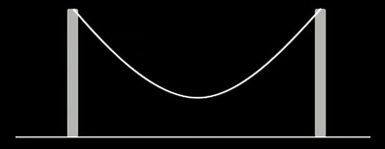
Hyperbolics
Freely-hanging ropes and chains form a “catenary” shape (it’s not actually a parabola)

Slide 51
HYPERBOLICS
IN-CLASS PROBLEM 2
The height of a flexible wire antenna suspended from points of equal height hangs can be modeled by: h = acosh(x/a).
“a” is the height of its lowest sag point. “x” is the horizontal distance from the
bottom of the sag.
https://a.fsdn.com/sd/articles/20/02/19/177207-1.jpg

Slide 52
HYPERBOLICS
IN-CLASS PROBLEM 2
h = acosh(x/a)
“a” height of its lowest sag point “x” horizontal distance from sag
Calculate the height of the end insulators if the sag height is 100 ft and the insulators are 75 feet from the antenna’s center.
What is “a”?
https://a.fsdn.com/sd/articles/20/02/19/177207-1.jpg

Slide 53
HYPERBOLICS
IN-CLASS PROBLEM 2
h = acosh(x/a)
“a” height of its lowest sag point “x” horizontal distance from sag
Calculate the height of the end insulators if the sag height is 100 ft and the insulators are 75 feet from the antenna’s center.
What is “a”? a = 100
What is “x”?
https://a.fsdn.com/sd/articles/20/02/19/177207-1.jpg

Slide 54
HYPERBOLICS
IN-CLASS PROBLEM 2
h = acosh(x/a)
“a” height of its lowest sag point “x” horizontal distance from sag
Calculate the height of the end insulators if the sag height is 100 ft and the insulators are 75 feet from the antenna’s center.
What is “a”? a = 100
What is “x”? x = 75
Do it!
https://a.fsdn.com/sd/articles/20/02/19/177207-1.jpg

Slide 55
HYPERBOLICS
IN-CLASS PROBLEM 2
h = acosh(x/a)
Calculate the height of the end insulators
a = 100
x = 75
h = 100cosh(75/100)
≈ 129.47 whats?
https://a.fsdn.com/sd/articles/20/02/19/177207-1.jpg

Slide 56
HYPERBOLICS
IN-CLASS PROBLEM 2
h = acosh(x/a)
Calculate the height of the end insulators
a = 100
x = 75
h = 100cosh(75/100)
≈ 129.47 ft
https://a.fsdn.com/sd/articles/20/02/19/177207-1.jpg

Slide 57
Questions?
http://i.imgur.com/aliTlT3.jpg

Slide 58
Hyperbolics
The hyperbolics can be defined in different ways:
in terms of exponentials
in terms of complex trig functions
in terms of differential equations

Slide 59
Hyperbolics
In terms of the exponential function:
sinh(x) = (e^{x} – e^{-x})/2
cosh(x) = (e^{x} + e^{-x})/2
tanh(x) = (e^{x} - e^{-x})/(e^{x} + e^{-x})

Slide 60
Hyperbolics
In terms of complex trig functions:
sinh(x) = - i sin(i x)
cosh(x) = cos(ix)
tanh(x) = -i (tan(i x)

Slide 61
Hyperbolics
The hyperbolic functions satisfy many identities, all of them similar in form to the trigonometric identities

Slide 62
Hyperbolics
sinh(-x) = -sinh(x) (an odd function)
cosh(-x) = cosh(x) (an even function)
tanh(-x) = -tanh(x) (an odd function)
https://en.wikipedia.org/wiki/Hyperbolic_functions#Derivatives

Slide 63
Hyperbolics
cosh(x) + sinh(x) = e^{x}
cosh(x) - sinh(x) = e^{-x}
cosh²(x) - sinh² (x) = 1
(which is similar to the Pythagorean theorem identity)
(but it’s not…)
https://en.wikipedia.org/wiki/Hyperbolic_functions#Derivatives

Slide 64
Hyperbolics
sinh(x+y) =
= sinh(x) cosh(y) + cosh(x) sinh(y)
cosh(x+y) =
= cosh(x) cosh(y) + sinh(x) sinh(y)
tanh(x+y) =
tanh(x)+tanh(y) .
1+tanh(x)tanh(y)
=
https://en.wikipedia.org/wiki/Hyperbolic_functions#Derivatives

Slide 65
Hyperbolics
…and it follows that:
sinh(2x) = 2sinh(x) cosh(x)
cosh(2x) = 2cosh²(x) - 1
tanh(2x) = 2tanh(x)/(1+tanh²(x))
https://en.wikipedia.org/wiki/Hyperbolic_functions#Derivatives

Slide 66
Hyperbolics
sinh²(x) = ½ (cosh(2x) - 1)
cosh²(x) = ½ (cosh(2x) + 1)
Note: in most texts it is not clear exactly what the calculation is for these
https://en.wikipedia.org/wiki/Hyperbolic_functions#Derivatives

Slide 67
Hyperbolics
Remember the “arc”s undo a trig function

Slide 68
Hyperbolics
The arcsine (sin⁻¹) of a sine value gives the original angle used to calculate the sine

Slide 69
Hyperbolics
Same for arccos (cos⁻¹) of a cosine value gives the original angle used to calculate the cosine

Slide 70
Hyperbolics
If hyperbolics are being defined as exponentials, their “arcs” will be logarithms

Slide 71
Hyperbolics
In math class, these are often called “arsinh” rather than “arcsinh” or “sinh⁻¹”
(in electronics, sinh⁻¹ seems to be used)
(in Excel, sinh⁻¹ is asinh)

Slide 72

Hyperbolics
sinh⁻¹(x) = ln(x+$\sqrt{\text{x}\text{2}\text{+1}}$)
cosh⁻¹(x) = ln(x+$\sqrt{\text{x}\text{2}\text{−}\text{1}}$)
tanh⁻¹(x) = ½ln$\left(\frac{\text{1+}\text{x}}{\text{1−}\text{x}}\right)$

Slide 73
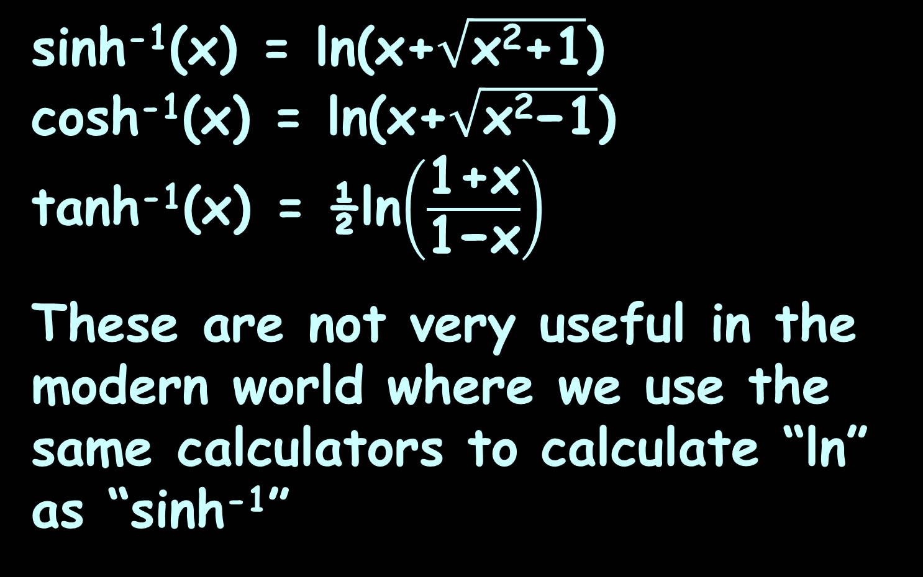
Hyperbolics
sinh⁻¹(x) = ln(x+$\sqrt{\text{x}\text{2}\text{+1}}$)
cosh⁻¹(x) = ln(x+$\sqrt{\text{x}\text{2}\text{−}\text{1}}$)
tanh⁻¹(x) = ½ln$\left(\frac{\text{1+}\text{x}}{\text{1−}\text{x}}\right)$
These are not very useful in the modern world where we use the same calculators to calculate “ln” as “sinh⁻¹”

Slide 74

HYPERBOLICS
IN-CLASS PROBLEM 3-6
Calculate:
y = sinh⁻¹(0.5)
y = cosh⁻¹(e)
y = tanh⁻¹(0)
y = tanh⁻¹(1)
sinh⁻¹(x) = ln(x+$\sqrt{\text{x}\text{2}\text{+1}}$)
cosh⁻¹(x) = ln(x+$\sqrt{\text{x}\text{2}\text{−}\text{1}}$)
tanh⁻¹(x) = ½ln$\left(\frac{\text{1+}\text{x}}{\text{1−}\text{x}}\right)$

Slide 75
HYPERBOLICS
IN-CLASS PROBLEM 3-6
Calculate:
y = sinh⁻¹(0.5) ≈ 0.48
y = cosh⁻¹(e)
y = tanh⁻¹(0)
y = tanh⁻¹(1)
sinh⁻¹(x) = ln(x+$\sqrt{\text{x}\text{2}\text{+1}}$)
cosh⁻¹(x) = ln(x+$\sqrt{\text{x}\text{2}\text{−}\text{1}}$)
tanh⁻¹(x) = ½ln$\left(\frac{\text{1+}\text{x}}{\text{1−}\text{x}}\right)$

Slide 76
HYPERBOLICS
IN-CLASS PROBLEM 3-6
Calculate:
y = sinh⁻¹(0.5) ≈ 0.48
y = cosh⁻¹(e) ≈ 1.66
y = tanh⁻¹(0)
y = tanh⁻¹(1)
sinh⁻¹(x) = ln(x+$\sqrt{\text{x}\text{2}\text{+1}}$)
cosh⁻¹(x) = ln(x+$\sqrt{\text{x}\text{2}\text{−}\text{1}}$)
tanh⁻¹(x) = ½ln$\left(\frac{\text{1+}\text{x}}{\text{1−}\text{x}}\right)$

Slide 77
HYPERBOLICS
IN-CLASS PROBLEM 3-6
Calculate:
y = sinh⁻¹(0.5) ≈ 0.48
y = cosh⁻¹(e) ≈ 1.66
y = tanh⁻¹(0) = 0
y = tanh⁻¹(1)
sinh⁻¹(x) = ln(x+$\sqrt{\text{x}\text{2}\text{+1}}$)
cosh⁻¹(x) = ln(x+$\sqrt{\text{x}\text{2}\text{−}\text{1}}$)
tanh⁻¹(x) = ½ln$\left(\frac{\text{1+}\text{x}}{\text{1−}\text{x}}\right)$

Slide 78
HYPERBOLICS
IN-CLASS PROBLEM 3-6
Calculate:
y = sinh⁻¹(0.5) ≈ 0.48
y = cosh⁻¹(e) ≈ 1.66
y = tanh⁻¹(0) = 0
y = tanh⁻¹(1) = ∞
sinh⁻¹(x) = ln(x+$\sqrt{\text{x}\text{2}\text{+1}}$)
cosh⁻¹(x) = ln(x+$\sqrt{\text{x}\text{2}\text{−}\text{1}}$)
tanh⁻¹(x) = ½ln$\left(\frac{\text{1+}\text{x}}{\text{1−}\text{x}}\right)$

Slide 79
Questions?
http://i.imgur.com/aliTlT3.jpg

Slide 80
Calculus of Hyperbolics
The exponential definitions allow easy derivation of derivatives:
d(sinh(u))/dx = d((e^{u} – e^{-u})/2)/dx
= (e^{u} + e^{-u})/2 du/dx
= cosh(u) du/dx

Slide 81
Calculus of Hyperbolics
Similarly:
d(cosh(u))/dx = d((e^{u} + e^{-u})/2)/dx
= (e^{u} - e^{-u})/2 du/dx
= sinh(u) du/dx
Notice: this one’s not a negative!

Slide 82
Calculus of Hyperbolics
Sadly, tanh is not quite as easy:
d(tanh(u))/dx =
= d((e^{u}-e^{-u})/(e^{u}+e^{-u})/dx
= 4/(e^{u} + e^{-u})² du/dx
= 1/cosh²(u) du/dx

Slide 83
CALCULUS OF HYPERBOLICS
IN-CLASS PROBLEMS 11-10
Calculate dy/dx for
y = sinh(5x)
y = cosh(x/7)
y = tanh(2)
y = tanh(2x)
d(sinh(u))/dx = cosh(u) du/dx
d(cosh(u))/dx = sinh(u) du/dx
d(tanh(u))/dx = 1/cosh²(u) du/dx

Slide 84
CALCULUS OF HYPERBOLICS
IN-CLASS PROBLEMS 11-10
Calculate dy/dx for
y = sinh(5x)
y’ = 5 cosh(5x)
y = cosh(x/7)
y = tanh(2)
y = tanh(2x)
d(sinh(u))/dx = cosh(u) du/dx
d(cosh(u))/dx = sinh(u) du/dx
d(tanh(u))/dx = 1/cosh²(u) du/dx

Slide 85
CALCULUS OF HYPERBOLICS
IN-CLASS PROBLEMS 11-10
Calculate dy/dx for
y = sinh(5x)
y’ = 5 cosh(5x)
y = cosh(x/7)
y’ = 1/7 sinh(x/7)
y = tanh(2)
y = tanh(2x)
d(sinh(u))/dx = cosh(u) du/dx
d(cosh(u))/dx = sinh(u) du/dx
d(tanh(u))/dx = 1/cosh²(u) du/dx

Slide 86
CALCULUS OF HYPERBOLICS
IN-CLASS PROBLEMS 11-10
Calculate dy/dx for
y = sinh(5x)
y’ = 5 cosh(5x)
y = cosh(x/7)
y’ = 1/7 sinh(x/7)
y = tanh(2)
y’ = 1/cosh²(2) (0) = 0
y = tanh(2x)
d(sinh(u))/dx = cosh(u) du/dx
d(cosh(u))/dx = sinh(u) du/dx
d(tanh(u))/dx = 1/cosh²(u) du/dx

Slide 87
CALCULUS OF HYPERBOLICS
IN-CLASS PROBLEMS 11-10
Calculate dy/dx for
y = sinh(5x)
y’ = 5 cosh(5x)
y = cosh(x/7)
y’ = 1/7 sinh(x/7)
y = tanh(2)
y’ = 1/cosh²(2) (0) = 0
y = tanh(2x)
y’ = 2/cosh²(2x)
= 2sech²(2x)
d(sinh(u))/dx = cosh(u) du/dx
d(cosh(u))/dx = sinh(u) du/dx
d(tanh(u))/dx = 1/cosh²(u) du/dx

Slide 88
CALCULUS OF HYPERBOLICS
IN-CLASS PROBLEM 11
Calculate dy/dx for y = 5tanh(x²)
Which formula?
d(sinh(u))/dx = cosh(u) du/dx
d(cosh(u))/dx = sinh(u) du/dx
d(tanh(u))/dx = 1/cosh²(u) du/dx

Slide 89
CALCULUS OF HYPERBOLICS
IN-CLASS PROBLEM 11
Calculate dy/dx for y = 5tanh(x²)
Which formula?
d(tanh(u))/dx = 1/cosh²(u) du/dx
What’s u?
d(sinh(u))/dx = cosh(u) du/dx
d(cosh(u))/dx = sinh(u) du/dx
d(tanh(u))/dx = 1/cosh²(u) du/dx

Slide 90
CALCULUS OF HYPERBOLICS
IN-CLASS PROBLEM 11
Calculate dy/dx for y = 5tanh(x²)
d(tanh(u))/dx = 1/cosh²(u) du/dx
What’s u? x²
What’s du/dx?
d(sinh(u))/dx = cosh(u) du/dx
d(cosh(u))/dx = sinh(u) du/dx
d(tanh(u))/dx = 1/cosh²(u) du/dx

Slide 91
CALCULUS OF HYPERBOLICS
IN-CLASS PROBLEM 11
Calculate dy/dx for y = 5tanh(x²)
d(tanh(u))/dx = 1/cosh²(u) du/dx
What’s u? x²
What’s du/dx? 2x
Do we have everything we need?
d(sinh(u))/dx = cosh(u) du/dx
d(cosh(u))/dx = sinh(u) du/dx
d(tanh(u))/dx = 1/cosh²(u) du/dx

Slide 92
CALCULUS OF HYPERBOLICS
IN-CLASS PROBLEM 11
Calculate dy/dx for y = 5tanh(x²)
d(tanh(u))/dx = 1/cosh²(u) du/dx
What’s u? x²
What’s du/dx? 2x
Do it!
d(sinh(u))/dx = cosh(u) du/dx
d(cosh(u))/dx = sinh(u) du/dx
d(tanh(u))/dx = 1/cosh²(u) du/dx

Slide 93
CALCULUS OF HYPERBOLICS
IN-CLASS PROBLEM 11
Calculate dy/dx for y = 5tanh(x²)
d(tanh(u))/dx = 1/cosh²(u) du/dx
What’s u? x²
What’s du/dx? 2x
dy/dx = 5(1/cosh²(u)) du/dx
= 5(1/cosh²(x²))(2x)
= 10x/cosh²(x²)
= 10x sech²(x²)
d(sinh(u))/dx = cosh(u) du/dx
d(cosh(u))/dx = sinh(u) du/dx
d(tanh(u))/dx = 1/cosh²(u) du/dx

Slide 94
Questions?
http://i.imgur.com/aliTlT3.jpg

Slide 95
Calculus of Hyperbolics
OK, we’ve done the derivatives… how about the integrals?

Slide 96
Calculus of Hyperbolics
∫ sinh(u) du = cosh(u) + k
∫ cosh(u) du = sinh(u) + k
∫ tanh(u) du = sinh(u)/cosh(u) + k

Slide 97
CALCULUS OF HYPERBOLICS
IN-CLASS PROBLEMS 12-15
Calculate:
∫ sinh(x) dx
∫₁⁵ sinh(x) dx
∫₁⁵ cosh(x) dx
∫₁⁵ tanh(x) dx
TI89: ∫(sinh(x),x)
∫ sinh(u) du = cosh(u) + k
∫ cosh(u) du = sinh(u) + k
∫ tanh(u) du = sinh(u)/cosh(u) + k

Slide 98
CALCULUS OF HYPERBOLICS
IN-CLASS PROBLEMS 12-15
Calculate:
∫ sinh(x) dx = cosh(x) + c
∫₁⁵ sinh(x) dx =
∫₁⁵ cosh(x) dx
∫₁⁵ tanh(x) dx
TI89: ∫(sinh(x),x,1,5)
∫ sinh(u) du = cosh(u) + k
∫ cosh(u) du = sinh(u) + k
∫ tanh(u) du = sinh(u)/cosh(u) + k

Slide 99
CALCULUS OF HYPERBOLICS
IN-CLASS PROBLEMS 12-15
Calculate:
∫ sinh(x) dx = cosh(x) + c
∫₁⁵ sinh(x) dx = cosh(5) – cosh(1)
≈ 72.67
∫₁⁵ cosh(x) dx
∫₁⁵ tanh(x) dx
TI89: ∫(cosh(x),x,1,5)
∫ sinh(u) du = cosh(u) + k
∫ cosh(u) du = sinh(u) + k
∫ tanh(u) du = sinh(u)/cosh(u) + k

Slide 100
CALCULUS OF HYPERBOLICS
IN-CLASS PROBLEMS 12-15
Calculate:
∫ sinh(x) dx = cosh(x) + c
∫₁⁵ sinh(x) dx = cosh(5) – cosh(1)
≈ 72.67
∫₁⁵ cosh(x) dx = sinh(5) – sinh(1)
≈ 73.03
∫₁⁵ tanh(x) dx
TI89: ∫(tanh(x),x,1,5)
∫ sinh(u) du = cosh(u) + k
∫ cosh(u) du = sinh(u) + k
∫ tanh(u) du = sinh(u)/cosh(u) + k

Slide 101
CALCULUS OF HYPERBOLICS
IN-CLASS PROBLEMS 12-15
Calculate:
∫ sinh(x) dx = cosh(x) + c
∫₁⁵ sinh(x) dx = cosh(5) – cosh(1)
≈ 72.67
∫₁⁵ cosh(x) dx = sinh(5) – sinh(1)
≈ 73.03
∫₁⁵ tanh(x) dx = sinh(x)/cosh(x)|₁⁵
≈ 3.87

Slide 102
CALCULUS OF HYPERBOLICS
IN-CLASS PROBLEM 16
Calculate: ∫ sinh(3x-6) dx
What’s u?
TI89: ∫(sinh(3*x-6),x)
∫ sinh(u) du = cosh(u) + k
∫ cosh(u) du = sinh(u) + k
∫ tanh(u) du = sinh(u)/cosh(u) + k

Slide 103
CALCULUS OF HYPERBOLICS
IN-CLASS PROBLEM 16
Calculate: ∫ sinh(3x-6) dx
What’s u? 3x-6
What’s du?
∫ sinh(u) du = cosh(u) + k
∫ cosh(u) du = sinh(u) + k
∫ tanh(u) du = sinh(u)/cosh(u) + k

Slide 104
CALCULUS OF HYPERBOLICS
IN-CLASS PROBLEM 16
Calculate: ∫ sinh(3x-6) dx
What’s u? 3x-6
What’s du? 3 dx
What do we do to make it work?
∫ sinh(u) du = cosh(u) + k
∫ cosh(u) du = sinh(u) + k
∫ tanh(u) du = sinh(u)/cosh(u) + k

Slide 105
CALCULUS OF HYPERBOLICS
IN-CLASS PROBLEM 16
Calculate: ∫ sinh(3x-6) dx
What’s u? 3x-6
What’s du? 3 dx
What do we do to make it work?
(1/3) ∫ sinh(u) du
Do it!
3x-6
3 dx
∫ sinh(u) du = cosh(u) + k
∫ cosh(u) du = sinh(u) + k
∫ tanh(u) du = sinh(u)/cosh(u) + k

Slide 106
CALCULUS OF HYPERBOLICS
IN-CLASS PROBLEM 16
Calculate: ∫ sinh(3x-6) dx
What’s u? 3x-6
What’s du? 3 dx
What do we do to make it work?
∫ 1/3 sinh(u) du = 1/3 cosh(u) + k
3x-6
3 dx
∫ sinh(u) du = cosh(u) + k
∫ cosh(u) du = sinh(u) + k
∫ tanh(u) du = sinh(u)/cosh(u) + k

Slide 107
CALCULUS OF HYPERBOLICS
IN-CLASS PROBLEM 16
Calculate: ∫ sinh(3x-6) dx
What’s u? 3x-6
What’s du? 3 dx
What do we do to make it work?
∫ 1/3 sinh(u) du = 1/3 cosh(u) + k
= 1/3 cosh(3x-6) + k
3x-6
3 dx
∫ sinh(u) du = cosh(u) + k
∫ cosh(u) du = sinh(u) + k
∫ tanh(u) du = sinh(u)/cosh(u) + k

Slide 108
Questions?
http://i.imgur.com/aliTlT3.jpg

Slide 109
CALCULUS OF HYPERBOLICS
IN-CLASS PROBLEM 17
Calculate:
∫ (5x⁴-4x)cosh(3x⁵-6x²) dx
What’s u?
∫ sinh(u) du = cosh(u) + k
∫ cosh(u) du = sinh(u) + k
∫ tanh(u) du = sinh(u)/cosh(u) + k

Slide 110
CALCULUS OF HYPERBOLICS
IN-CLASS PROBLEM 17
Calculate:
∫ (5x⁴-4x)cosh(3x⁵-6x²) dx
What’s u? 3x⁵-6x²
What’s du?
∫ sinh(u) du = cosh(u) + k
∫ cosh(u) du = sinh(u) + k
∫ tanh(u) du = sinh(u)/cosh(u) + k

Slide 111
CALCULUS OF HYPERBOLICS
IN-CLASS PROBLEM 17
Calculate:
∫ (5x⁴-4x)cosh(3x⁵-6x²) dx
What’s u? 3x⁵-6x²
What’s du? 15x⁴-12x dx
Are we there?
∫ sinh(u) du = cosh(u) + k
∫ cosh(u) du = sinh(u) + k
∫ tanh(u) du = sinh(u)/cosh(u) + k

Slide 112
CALCULUS OF HYPERBOLICS
IN-CLASS PROBLEM 17
Calculate:
∫ (5x⁴-4x)cosh(3x⁵-6x²) dx
What’s u? 3x⁵-6x²
What’s du? 15x⁴-12x dx
Are we there? no
Are we close?
∫ sinh(u) du = cosh(u) + k
∫ cosh(u) du = sinh(u) + k
∫ tanh(u) du = sinh(u)/cosh(u) + k

Slide 113
CALCULUS OF HYPERBOLICS
IN-CLASS PROBLEM 17
Calculate:
∫ (5x⁴-4x)cosh(3x⁵-6x²) dx
What’s u? 3x⁵-6x²
What’s du? 15x⁴-12x dx
Are we there? no
Are we close? yes
Are we off by a constant?
∫ sinh(u) du = cosh(u) + k
∫ cosh(u) du = sinh(u) + k
∫ tanh(u) du = sinh(u)/cosh(u) + k

Slide 114
CALCULUS OF HYPERBOLICS
IN-CLASS PROBLEM 17
Calculate:
∫ (5x⁴-4x)cosh(3x⁵-6x²) dx
What’s u? 3x⁵-6x²
What’s du? 15x⁴-12x dx
Are we there? no
Are we close? yes
Are we off by a constant?
yes, off by a factor of 3
What’s our formula?
∫ sinh(u) du = cosh(u) + k
∫ cosh(u) du = sinh(u) + k
∫ tanh(u) du = sinh(u)/cosh(u) + k

Slide 115

CALCULUS OF HYPERBOLICS
IN-CLASS PROBLEM 17
Calculate:
∫ (5x⁴-4x)cosh(3x⁵-6x²) dx
What’s u? 3x⁵-6x²
What’s du? 15x⁴-12x dx
∫ 1/3 cosh(3x⁵-6x²) 3(5x⁴-4x)dx
----- u -----
-------- du --------
∫ sinh(u) du = cosh(u) + k
∫ cosh(u) du = sinh(u) + k
∫ tanh(u) du = sinh(u)/cosh(u) + k
http://www.scienceteecher.com/images/D/just_du_it_calculus_shirt_white_large-01.jpg

Slide 116
CALCULUS OF HYPERBOLICS
IN-CLASS PROBLEM 17
Calculate:
∫ (5x⁴-4x)cosh(3x⁵-6x²) dx
What’s u? 3x⁵-6x²
What’s du? 15x⁴-12x dx
∫ 1/3 cosh(3x⁵-6x²) 3(5x⁴-4x)dx
= 1/3 sinh(u) + k
= 1/3 sinh(3x⁵-6x²) + k
----- u -----
-------- du --------
∫ sinh(u) du = cosh(u) + k
∫ cosh(u) du = sinh(u) + k
∫ tanh(u) du = sinh(u)/cosh(u) + k

Slide 117
Questions?
http://i.imgur.com/aliTlT3.jpg

Slide 118
Calculus of Hyperbolics
The derivatives of inverse hyperbolics are used in electronics (Sorry…!)

Slide 119
Calculus of Hyperbolics
In the design of resistive divider pads used to match two unequal impedances (Z₁ and Z₂), there are models like:
N = cosh⁻¹(Z₁/Z₂)^{½}

Slide 120
Calculus of Hyperbolics
For these problems, we want to investigate the rate of change of the inverse hyperbolic function

Slide 121

Calculus of Hyperbolics
d(sinh⁻¹(u)/dx = 1/$\sqrt{\text{u}\text{2}\text{+1}}$ du/dx
d(cosh⁻¹(u)/dx = 1/$\sqrt{\text{u}\text{2}\text{−}\text{1}}$ du/dx
d(tanh⁻¹(u)/dx = 1/(1-u²) du/dx

Slide 122
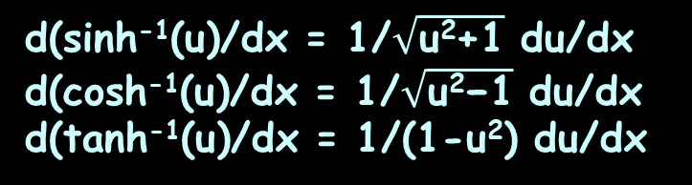
CALCULUS OF HYPERBOLICS
IN-CLASS PROBLEM 18-20
Calculate the derivative of:
sinh⁻¹(2x) =
cosh⁻¹(3x²) =
tanh⁻¹(x²) =
d(sinh⁻¹(u)/dx = 1/$\sqrt{\text{u}\text{2}\text{+1}}$ du/dx
d(cosh⁻¹(u)/dx = 1/$\sqrt{\text{u}\text{2}\text{−}\text{1}}$ du/dx
d(tanh⁻¹(u)/dx = 1/(1-u²) du/dx

Slide 123
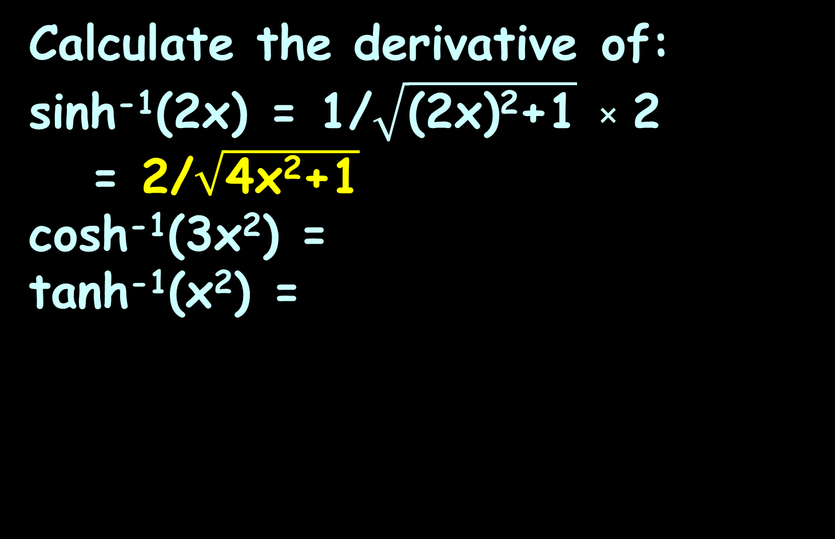
CALCULUS OF HYPERBOLICS
IN-CLASS PROBLEM 18-20
Calculate the derivative of:
sinh⁻¹(2x) = 1/$\sqrt{\text{(2}\text{x}\text{)}\text{2}\text{+1}}$ × 2
= 2/$\sqrt{\text{4}\text{x}\text{2}\text{+1}}$
cosh⁻¹(3x²) =
tanh⁻¹(x²) =
d(sinh⁻¹(u)/dx = 1/$\sqrt{\text{u}\text{2}\text{+1}}$ du/dx
d(cosh⁻¹(u)/dx = 1/$\sqrt{\text{u}\text{2}\text{−}\text{1}}$ du/dx
d(tanh⁻¹(u)/dx = 1/(1-u²) du/dx

Slide 124
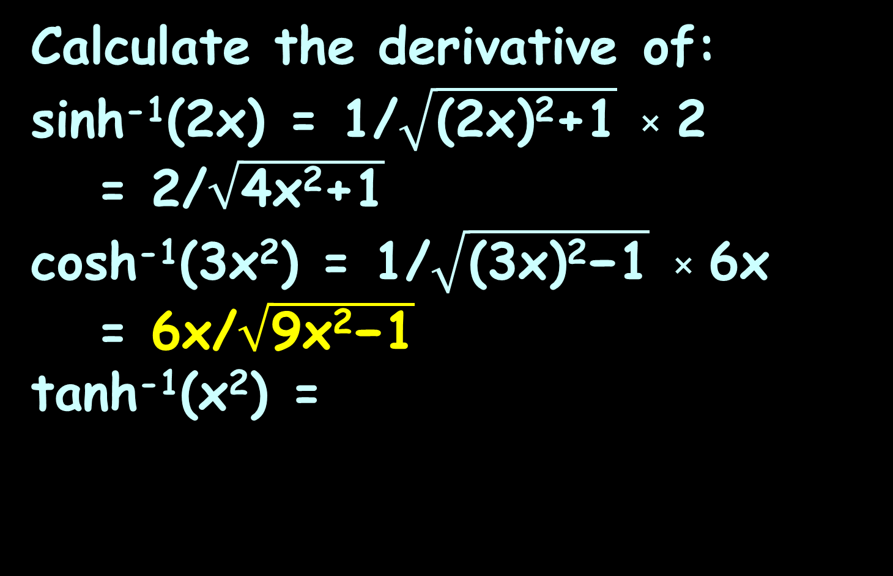
CALCULUS OF HYPERBOLICS
IN-CLASS PROBLEM 18-20
Calculate the derivative of:
sinh⁻¹(2x) = 1/$\sqrt{\text{(2}\text{x}\text{)}\text{2}\text{+1}}$ × 2
= 2/$\sqrt{\text{4}\text{x}\text{2}\text{+1}}$
cosh⁻¹(3x²) = 1/$\sqrt{\text{(3}\text{x}\text{)}\text{2}\text{−}\text{1}}$ × 6x
= 6x/$\sqrt{\text{9}\text{x}\text{2}\text{−}\text{1}}$
tanh⁻¹(x²) =
d(sinh⁻¹(u)/dx = 1/$\sqrt{\text{u}\text{2}\text{+1}}$ du/dx
d(cosh⁻¹(u)/dx = 1/$\sqrt{\text{u}\text{2}\text{−}\text{1}}$ du/dx
d(tanh⁻¹(u)/dx = 1/(1-u²) du/dx

Slide 125
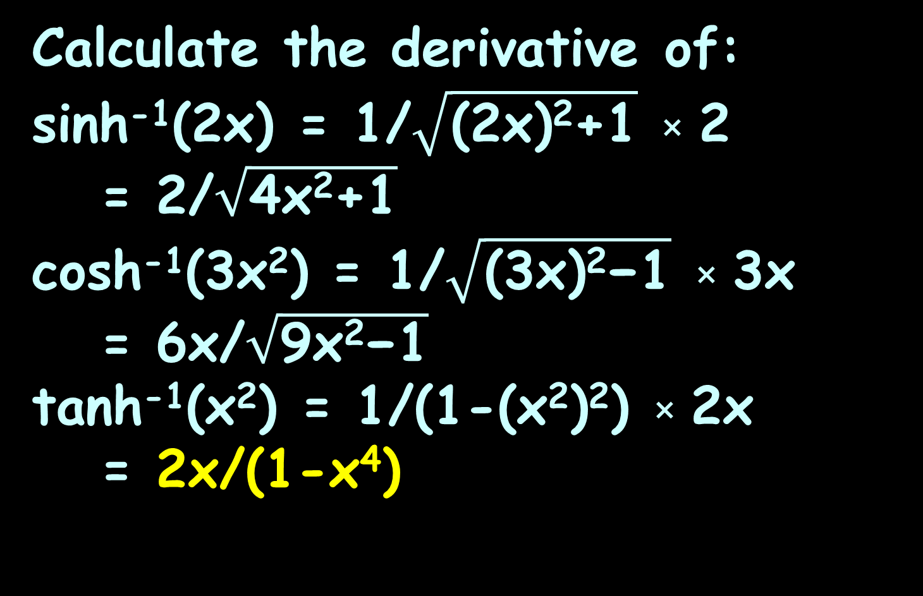
CALCULUS OF HYPERBOLICS
IN-CLASS PROBLEM 18-20
Calculate the derivative of:
sinh⁻¹(2x) = 1/$\sqrt{\text{(2}\text{x}\text{)}\text{2}\text{+1}}$ × 2
= 2/$\sqrt{\text{4}\text{x}\text{2}\text{+1}}$
cosh⁻¹(3x²) = 1/$\sqrt{\text{(3}\text{x}\text{)}\text{2}\text{−}\text{1}}$ × 3x
= 6x/$\sqrt{\text{9}\text{x}\text{2}\text{−}\text{1}}$
tanh⁻¹(x²) = 1/(1-(x²)²) × 2x
= 2x/(1-x⁴)
d(sinh⁻¹(u)/dx = 1/$\sqrt{\text{u}\text{2}\text{+1}}$ du/dx
d(cosh⁻¹(u)/dx = 1/$\sqrt{\text{u}\text{2}\text{−}\text{1}}$ du/dx
d(tanh⁻¹(u)/dx = 1/(1-u²) du/dx

Slide 126
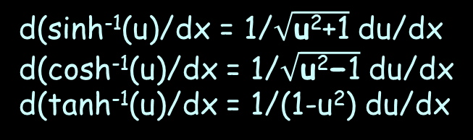
CALCULUS OF HYPERBOLICS
IN-CLASS PROBLEM 21
At a frequency f, the attenuation of a high-pass constant-k filter section is α = 2cosh⁻¹(f/(7×10⁶)) Calculate dα/df.
Which formula?
d(sinh⁻¹(u)/dx = 1/$\sqrt{\text{u}\text{2}\text{+1}}$ du/dx
d(cosh⁻¹(u)/dx = 1/$\sqrt{\text{u}\text{2}\text{−}\text{1}}$ du/dx
d(tanh⁻¹(u)/dx = 1/(1-u²) du/dx

Slide 127
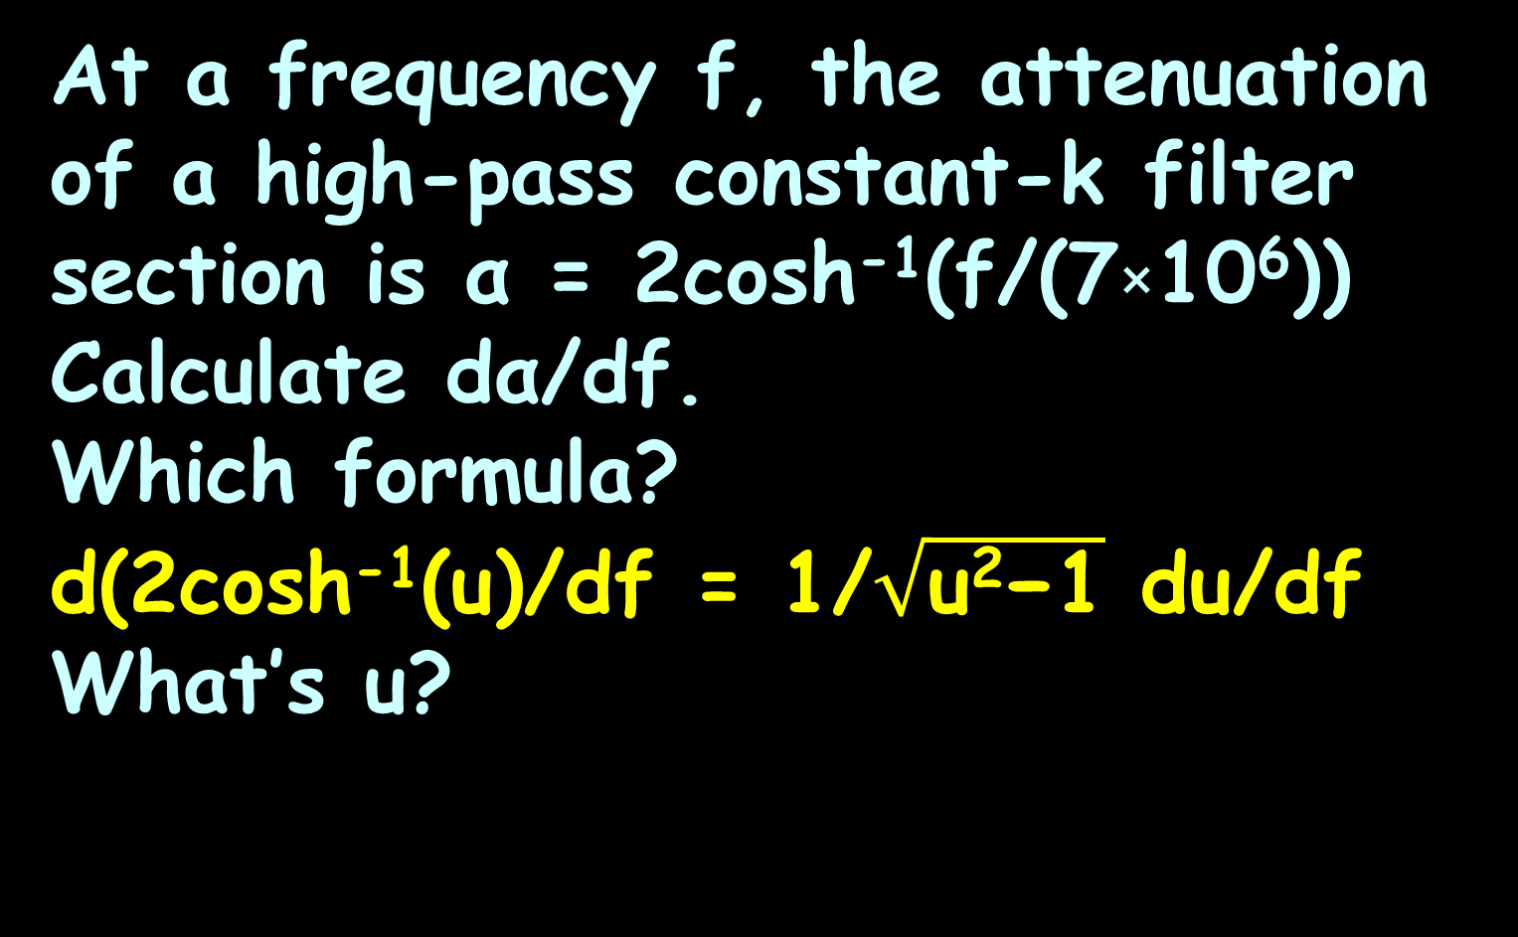
CALCULUS OF HYPERBOLICS
IN-CLASS PROBLEM 21
At a frequency f, the attenuation of a high-pass constant-k filter section is α = 2cosh⁻¹(f/(7×10⁶)) Calculate dα/df.
Which formula?
d(2cosh⁻¹(u)/df = 1/$\sqrt{\text{u}\text{2}\text{−}\text{1}}$ du/df
What’s u?
d(sinh⁻¹(u)/dx = 1/$\sqrt{\text{u}\text{2}\text{+1}}$ du/dx
d(cosh⁻¹(u)/dx = 1/$\sqrt{\text{u}\text{2}\text{−}\text{1}}$ du/dx
d(tanh⁻¹(u)/dx = 1/(1-u²) du/dx

Slide 128
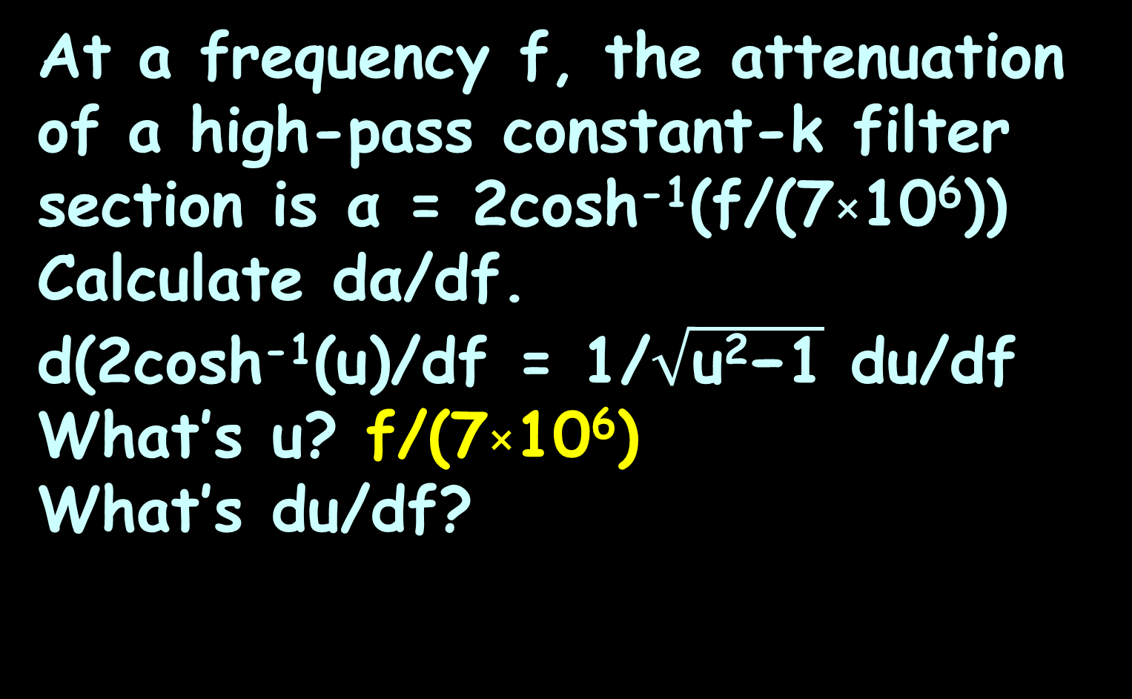
CALCULUS OF HYPERBOLICS
IN-CLASS PROBLEM 21
At a frequency f, the attenuation of a high-pass constant-k filter section is α = 2cosh⁻¹(f/(7×10⁶)) Calculate dα/df.
d(2cosh⁻¹(u)/df = 1/$\sqrt{\text{u}\text{2}\text{−}\text{1}}$ du/df
What’s u? f/(7×10⁶)
What’s du/df?

Slide 129
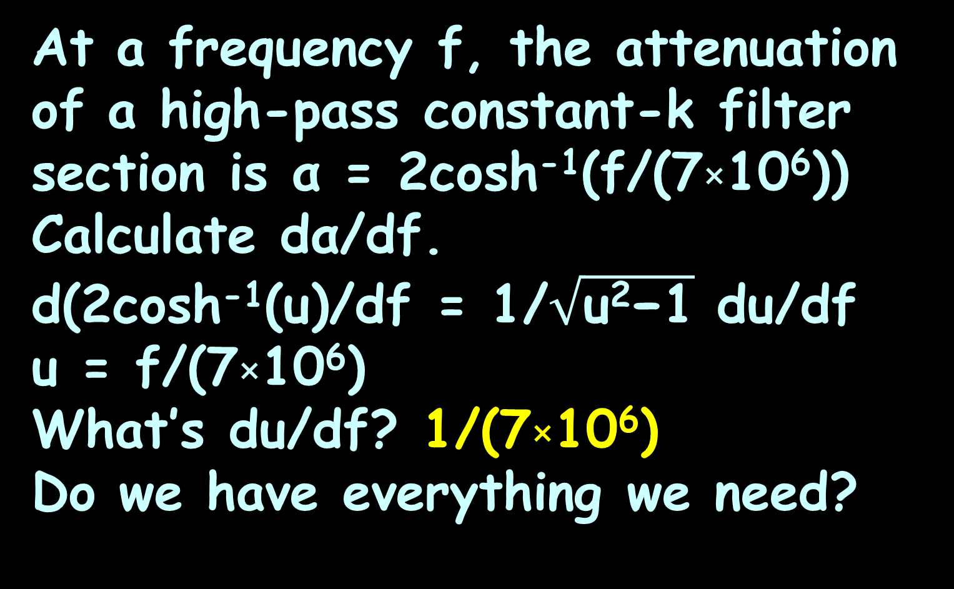
CALCULUS OF HYPERBOLICS
IN-CLASS PROBLEM 21
At a frequency f, the attenuation of a high-pass constant-k filter section is α = 2cosh⁻¹(f/(7×10⁶)) Calculate dα/df.
d(2cosh⁻¹(u)/df = 1/$\sqrt{\text{u}\text{2}\text{−}\text{1}}$ du/df
u = f/(7×10⁶)
What’s du/df? 1/(7×10⁶)
Do we have everything we need?

Slide 130
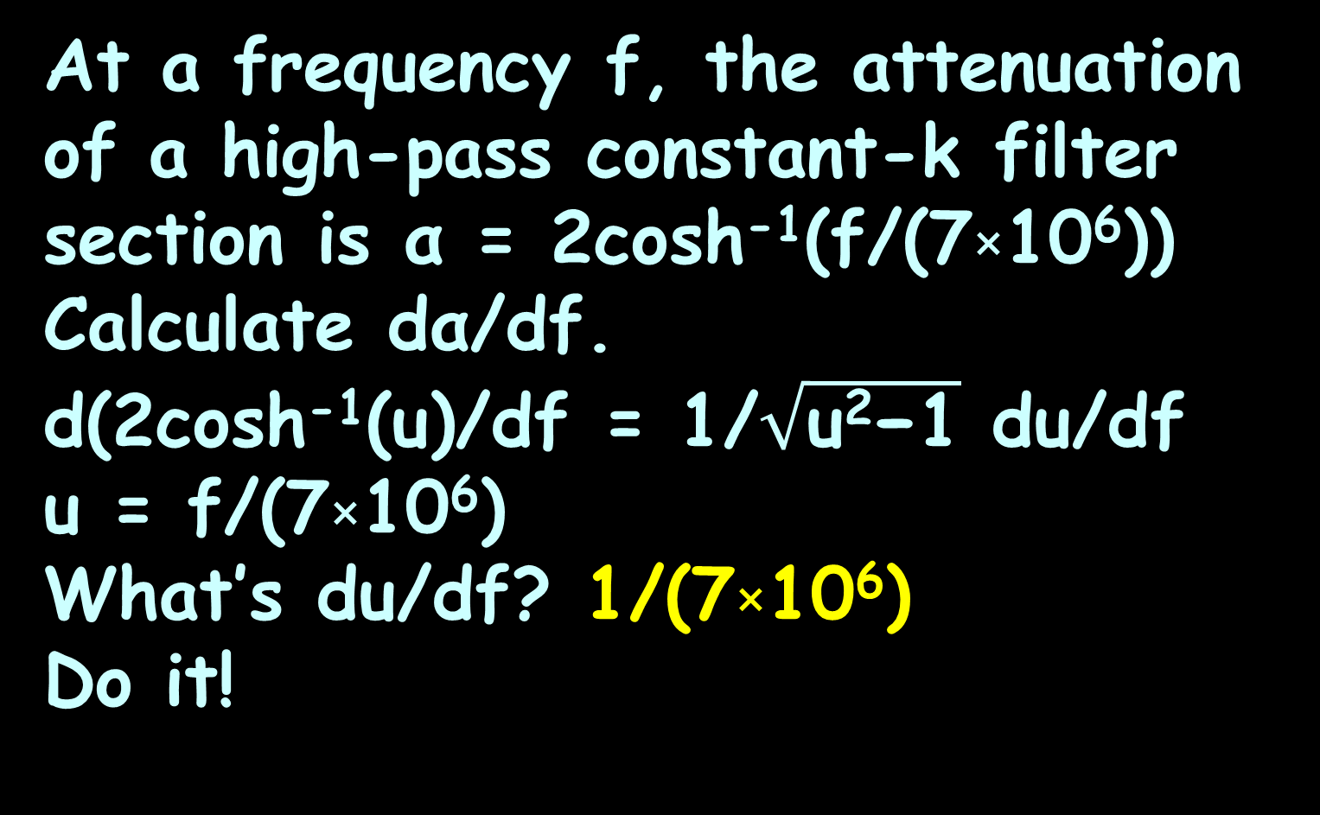
CALCULUS OF HYPERBOLICS
IN-CLASS PROBLEM 21
At a frequency f, the attenuation of a high-pass constant-k filter section is α = 2cosh⁻¹(f/(7×10⁶)) Calculate dα/df.
d(2cosh⁻¹(u)/df = 1/$\sqrt{\text{u}\text{2}\text{−}\text{1}}$ du/df
u = f/(7×10⁶)
What’s du/df? 1/(7×10⁶)
Do it!

Slide 131
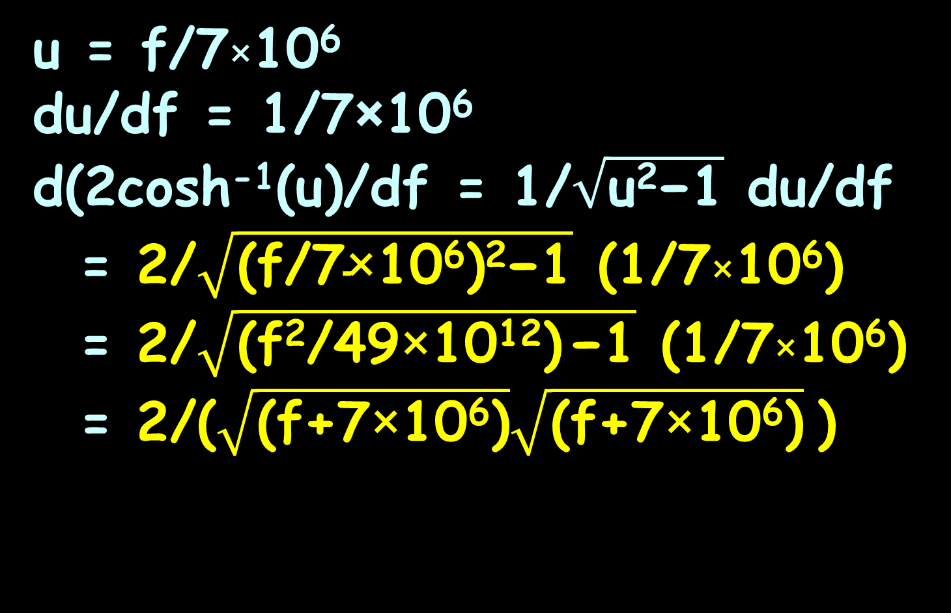
CALCULUS OF HYPERBOLICS
IN-CLASS PROBLEM 21
u = f/7×10⁶
du/df = 1/7×10⁶
d(2cosh⁻¹(u)/df = 1/$\sqrt{\text{u}\text{2}\text{−1}}$ du/df
= 2/$\sqrt{\text{(}\text{f}\text{/7}\text{×}\text{10}\text{6}\text{)}\text{2}\text{−1}}$ (1/7×10⁶)
= 2/$\sqrt{\text{(}\text{f}\text{2}\text{/}\text{49}\text{×}\text{10}\text{12}\text{)} \text{−1}}$ (1/7×10⁶)
= 2/($\sqrt{\text{(}\text{f}\text{+}\text{7}\text{×}\text{10}\text{6}\text{)}}\sqrt{\text{(}\text{f}\text{+7}\text{×}\text{10}\text{6}\text{)}}$ )

Slide 132
Questions?
http://i.imgur.com/aliTlT3.jpg

Slide 133
Calculus of Hyperbolics
Of course, we need the integrals, too!

Slide 134
Calculus of Hyperbolics
If the derivatives are scary, then the integrals must be absolutely terrifying

Slide 135
Calculus of Hyperbolics
If the derivatives are scary, then the integrals must be absolutely terrifying…
… they are …

Slide 136
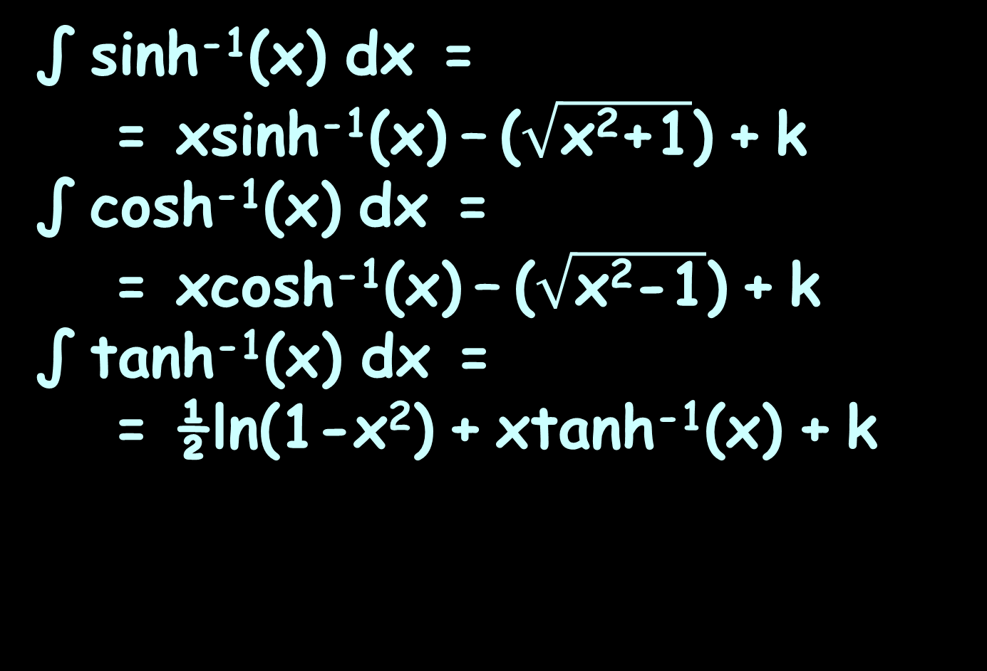
Calculus of Hyperbolics
∫ sinh⁻¹(x) dx =
= xsinh⁻¹(x) – ($\sqrt{\text{x}\text{2}\text{+}\text{1}}$) + k
∫ cosh⁻¹(x) dx =
= xcosh⁻¹(x) – ($\sqrt{\text{x}\text{2}\text{−1}}$) + k
∫ tanh⁻¹(x) dx =
= ½ln(1-x²) + xtanh⁻¹(x) + k

Slide 137
Calculus of Hyperbolics
To do the generalized versions (the “u” versions) we’ll need the skills we’ll learn on Wednesday

Slide 138
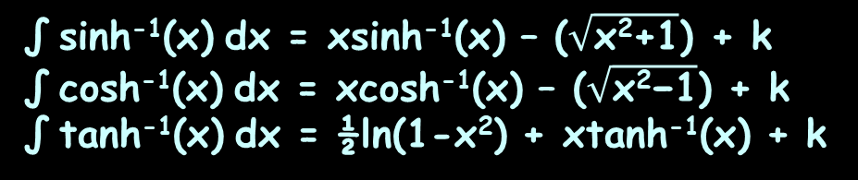
CALCULUS OF HYPERBOLICS
IN-CLASS PROBLEM 22-25
Calculate:
∫₁⁶ sinh⁻¹(x) dx
∫₁⁶ cosh⁻¹(x) dx
∫₀¹ tanh⁻¹(x) dx
∫₁⁶ tanh⁻¹(x) dx
∫ sinh⁻¹(x) dx = xsinh⁻¹(x) – ($\sqrt{\text{x}\text{2}\text{+}\text{1}}$) + k
∫ cosh⁻¹(x) dx = xcosh⁻¹(x) – ($\sqrt{\text{x}\text{2}\text{−1}}$) + k
∫ tanh⁻¹(x) dx = ½ln(1-x²) + xtanh⁻¹(x) + k

Slide 139
CALCULUS OF HYPERBOLICS
IN-CLASS PROBLEM 22-25
Calculate:
∫₁⁶ sinh⁻¹(x) dx ≈ 9.40
integrate sinh^-1(x) dx 1<x<6
∫₁⁶ cosh⁻¹(x) dx
∫₀¹ tanh⁻¹(x) dx
∫₁⁶ tanh⁻¹(x) dx
∫ sinh⁻¹(x) dx = xsinh⁻¹(x) – ($\sqrt{\text{x}\text{2}\text{+}\text{1}}$) + k
∫ cosh⁻¹(x) dx = xcosh⁻¹(x) – ($\sqrt{\text{x}\text{2}\text{−1}}$) + k
∫ tanh⁻¹(x) dx = ½ln(1-x²) + xtanh⁻¹(x) + k

Slide 140
CALCULUS OF HYPERBOLICS
IN-CLASS PROBLEM 22-25
Calculate:
∫₁⁶ sinh⁻¹(x) dx ≈ 9.40
∫₁⁶ cosh⁻¹(x) dx ≈ 8.95
∫₀¹ tanh⁻¹(x) dx
∫₁⁶ tanh⁻¹(x) dx
∫ sinh⁻¹(x) dx = xsinh⁻¹(x) – ($\sqrt{\text{x}\text{2}\text{+}\text{1}}$) + k
∫ cosh⁻¹(x) dx = xcosh⁻¹(x) – ($\sqrt{\text{x}\text{2}\text{−1}}$) + k
∫ tanh⁻¹(x) dx = ½ln(1-x²) + xtanh⁻¹(x) + k

Slide 141
CALCULUS OF HYPERBOLICS
IN-CLASS PROBLEM 22-25
Calculate:
∫₁⁶ sinh⁻¹(x) dx ≈ 9.40
∫₁⁶ cosh⁻¹(x) dx ≈ 8.95
∫₀¹ tanh⁻¹(x) dx = ln(2) ≈ 0.69
∫₁⁶ tanh⁻¹(x) dx
Try this!
∫ sinh⁻¹(x) dx = xsinh⁻¹(x) – ($\sqrt{\text{x}\text{2}\text{+}\text{1}}$) + k
∫ cosh⁻¹(x) dx = xcosh⁻¹(x) – ($\sqrt{\text{x}\text{2}\text{−1}}$) + k
∫ tanh⁻¹(x) dx = ½ln(1-x²) + xtanh⁻¹(x) + k

Slide 142
CALCULUS OF HYPERBOLICS
IN-CLASS PROBLEM 22-25
Calculate:
∫₁⁶ sinh⁻¹(x) dx ≈ 9.40
∫₁⁶ cosh⁻¹(x) dx ≈ 8.95
∫₀¹ tanh⁻¹(x) dx ≈ 0.69
∫₁⁶ tanh⁻¹(x) dx ≈ 2.09 – 7.85i
∫ sinh⁻¹(x) dx = xsinh⁻¹(x) – ($\sqrt{\text{x}\text{2}\text{+}\text{1}}$) + k
∫ cosh⁻¹(x) dx = xcosh⁻¹(x) – ($\sqrt{\text{x}\text{2}\text{−1}}$) + k
∫ tanh⁻¹(x) dx = ½ln(1-x²) + xtanh⁻¹(x) + k

Slide 143
Calculus of Hyperbolics
Howcum we got an “i ” ??
The exponential function can be defined for any complex
argument:
e^{ix} = cos(x) + i sin(x)
e^{-ix} = cos(x) - i sin(x)

Slide 144
Calculus of Hyperbolics
Since the exponential function can be defined for any complex argument, we can also extend the definitions of the hyperbolic functions to complex arguments

Slide 145
Calculus of Hyperbolics
The functions sinh(z) and cosh(z) are then holomorphic

Slide 146
Calculus of Hyperbolics
sinh(x+iy) =
sin(x)cos(y) + i cosh(x)sin(y)
cosh(x+iy) =
cos(x)cos(y) + i sinh(x)sin(y)
(tanh(x)+ i tan(y))
(1+i tanh(x)tan(y)
no hyperbolic
no hyperbolic
no hyperbolic
no hyperbolic
no hyperbolic
no hyperbolic
no hyperbolic
tanh(x+iy) =
no hyperbolic

Slide 147
Calculus of Hyperbolics
Thus, hyperbolic functions are periodic with respect to the imaginary component, with period 2πi (πi for hyperbolic tangent and cotangent)

Slide 148
Questions?
http://i.imgur.com/aliTlT3.jpg

Slide 149
Calculus of Hyperbolics
Most problems involve cases where the integral answer is the inverse hyperbolic

Slide 150
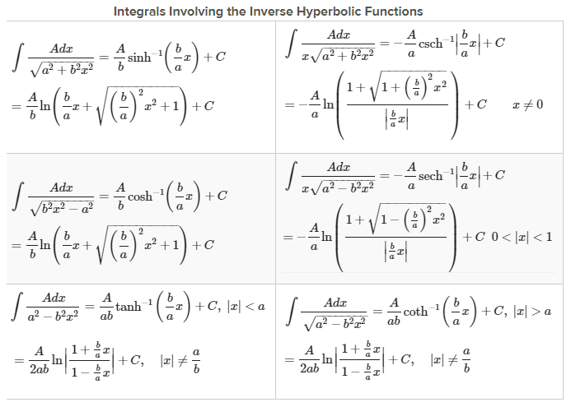
https://www.ck12.org/calculus/derivatives-and-integrals-of-inverse-hyperbolic-functions/lesson/
Derivatives-and-Integrals-Involving-Inverse-Hyperbolic-Functions-CALC/

Slide 151
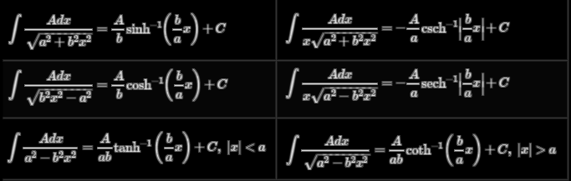

CALCULUS OF HYPERBOLICS
IN-CLASS PROBLEM 26
Calculate: ∫₁⁶ 7/$\sqrt{\text{9}\text{x}\text{2}\text{−4}}$ dx
Which formula?
1
4
2
5
3
6
https://www.ck12.org/calculus/derivatives-and-integrals-of-inverse-hyperbolic-functions/lesson/
Derivatives-and-Integrals-Involving-Inverse-Hyperbolic-Functions-CALC/

Slide 152
CALCULUS OF HYPERBOLICS
IN-CLASS PROBLEM 26
Calculate: ∫₁⁶ 7/$\sqrt{\text{9}\text{x}\text{2}\text{−4}}$ dx
Which formula?
1
4
2
5
3
6
https://www.ck12.org/calculus/derivatives-and-integrals-of-inverse-hyperbolic-functions/lesson/
Derivatives-and-Integrals-Involving-Inverse-Hyperbolic-Functions-CALC/

Slide 153

CALCULUS OF HYPERBOLICS
IN-CLASS PROBLEM 26
Calculate: ∫₁⁶ 7/$\sqrt{\text{9}\text{x}\text{2}\text{−4}}$ dx
∫ A/$\sqrt{\text{b}\text{2}\text{x}\text{2}\text{−}\text{a}\text{2}}$ dx =
= A/b cosh⁻¹(bx/a) + c
What’s A?

Slide 154
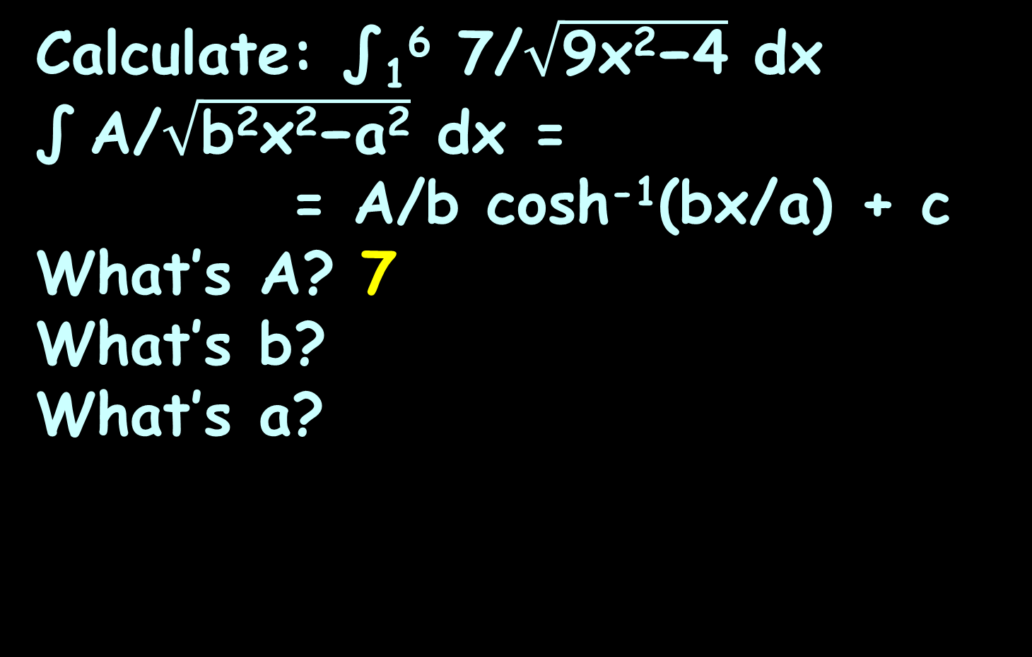
CALCULUS OF HYPERBOLICS
IN-CLASS PROBLEM 26
Calculate: ∫₁⁶ 7/$\sqrt{\text{9}\text{x}\text{2}\text{−4}}$ dx
∫ A/$\sqrt{\text{b}\text{2}\text{x}\text{2}\text{−}\text{a}\text{2}}$ dx =
= A/b cosh⁻¹(bx/a) + c
What’s A? 7
What’s b?
What’s a?

Slide 155
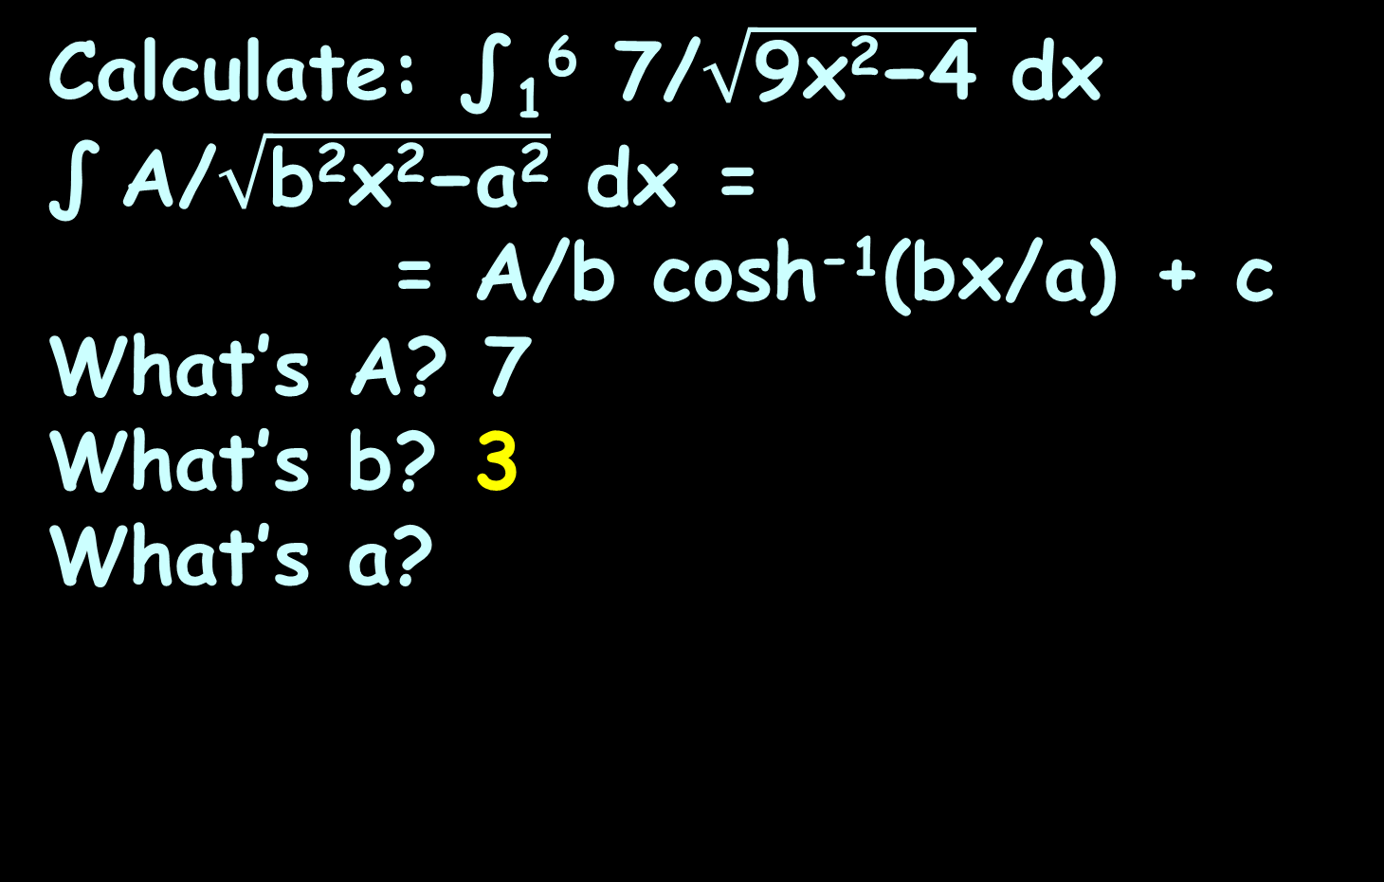
CALCULUS OF HYPERBOLICS
IN-CLASS PROBLEM 26
Calculate: ∫₁⁶ 7/$\sqrt{\text{9}\text{x}\text{2}\text{−4}}$ dx
∫ A/$\sqrt{\text{b}\text{2}\text{x}\text{2}\text{−}\text{a}\text{2}}$ dx =
= A/b cosh⁻¹(bx/a) + c
What’s A? 7
What’s b? 3
What’s a?

Slide 156
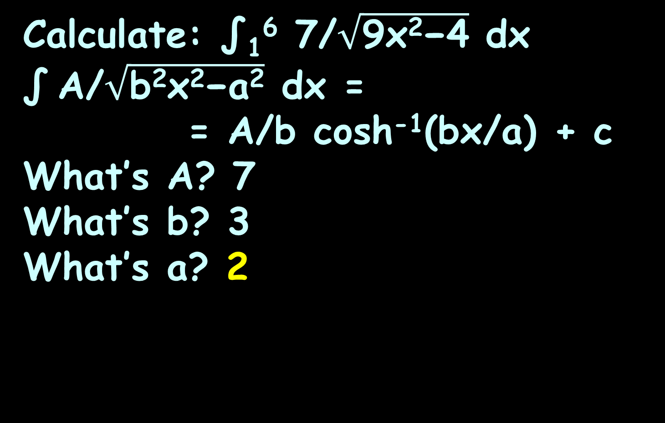
CALCULUS OF HYPERBOLICS
IN-CLASS PROBLEM 26
Calculate: ∫₁⁶ 7/$\sqrt{\text{9}\text{x}\text{2}\text{−4}}$ dx
∫ A/$\sqrt{\text{b}\text{2}\text{x}\text{2}\text{−}\text{a}\text{2}}$ dx =
= A/b cosh⁻¹(bx/a) + c
What’s A? 7
What’s b? 3
What’s a? 2
http://www.scienceteecher.com/images/D/just_du_it_calculus_shirt_white_large-01.jpg

Slide 157
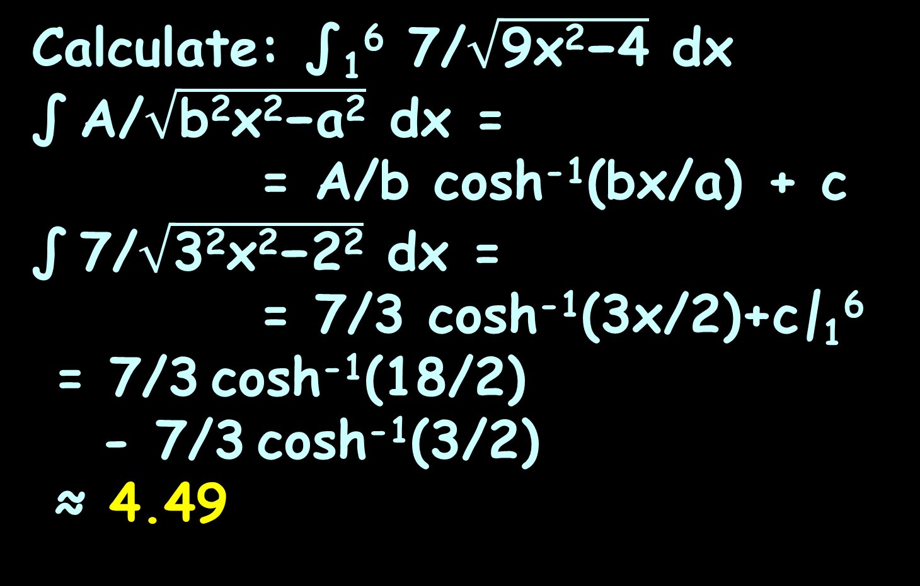
CALCULUS OF HYPERBOLICS
IN-CLASS PROBLEM 26
Calculate: ∫₁⁶ 7/$\sqrt{\text{9}\text{x}\text{2}\text{−4}}$ dx
∫ A/$\sqrt{\text{b}\text{2}\text{x}\text{2}\text{−}\text{a}\text{2}}$ dx =
= A/b cosh⁻¹(bx/a) + c
∫ 7/$\sqrt{\text{3}\text{2}\text{x}\text{2}\text{−}\text{2}\text{2}}$ dx =
= 7/3 cosh⁻¹(3x/2)+c|₁⁶
= 7/3 cosh⁻¹(18/2)
- 7/3 cosh⁻¹(3/2)
≈ 4.49

Slide 158
Calculus of Hyperbolics
NOTE: Wow! These are so hard!
Many websites show examples with the wrong answers!
Inaccuracies creep in because the ln is sensitive to rounding

Slide 159
Calculus of Hyperbolics
Thank goodness for our fancy calculators and Wolframalpha!
https://www.integral-calculator.com/
is also good!

Slide 160
Calculus of Hyperbolics
Start sneaky! Use the function that will give you the derivative you want!
y = sinh⁻¹(u)
Rewrite it as: u = sinh(y)
(it’s the inverse, remember!)

Slide 161
Calculus of Hyperbolics
y = sinh⁻¹(u)
u = sinh(y)
Now take the derivative:
du/dx = ?
d(sinh(u))/dx = cosh(u) du/dx
d(cosh(u))/dx = sinh(u) du/dx
d(tanh(u))/dx = 1/cosh²(u) du/dx

Slide 162
Calculus of Hyperbolics
y = sinh⁻¹(u)
u = sinh(y)
Now take the derivative:
du/dx = d(sinh(y))/dx
= cosh(y) dy/dx
But, remember, it’s dy/dx we want (sort of like implicit) so solve for that!
d(sinh(u))/dx = cosh(u) du/dx
d(cosh(u))/dx = sinh(u) du/dx
d(tanh(u))/dx = 1/cosh²(u) du/dx

Slide 163
Calculus of Hyperbolics
y = sinh⁻¹(u)
u = sinh(y)
du/dx = cosh(y) dy/dx
dy/dx = du/dx / cosh(y)

Slide 164
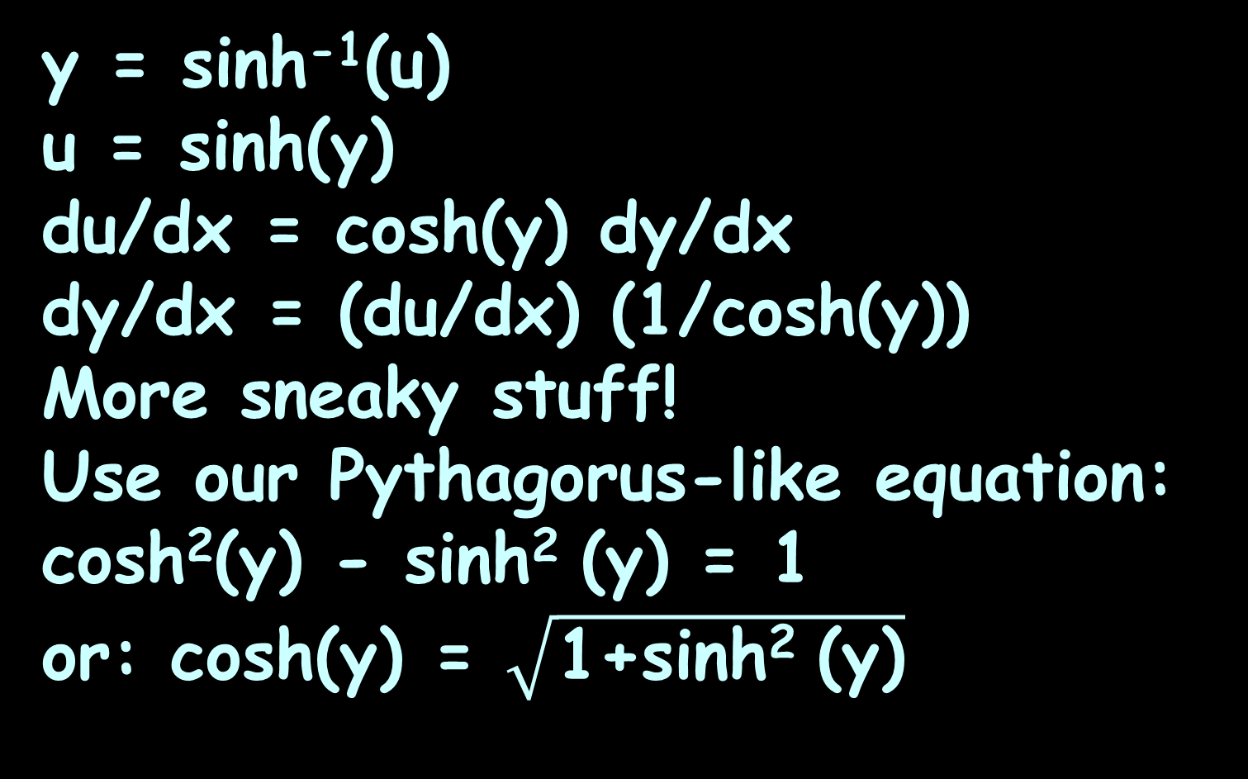
Calculus of Hyperbolics
y = sinh⁻¹(u)
u = sinh(y)
du/dx = cosh(y) dy/dx
dy/dx = (du/dx) (1/cosh(y))
More sneaky stuff!
Use our Pythagorus-like equation:
cosh²(y) - sinh² (y) = 1
or: cosh(y) = $\sqrt{\text{1}\text{+}\text{sinh}\text{2 }\text{(}\text{y}\text{)}}$

Slide 165

Calculus of Hyperbolics
y = sinh⁻¹(u)
u = sinh(y)
du/dx = cosh(y) dy/dx
dy/dx = (du/dx) (1/cosh(y))
= (du/dx) (1/$\sqrt{\text{1}\text{+}\text{sinh}\text{2 }\text{(}\text{y}\text{)}}$)
So it’s:
d(sinh⁻¹(u))/dx = (du/dx)(1/$\sqrt{\text{1}\text{+}\text{u}\text{2}}$)

Slide 166
Questions?
http://i.imgur.com/aliTlT3.jpg

Slide 167
Summary
Today we studied:
Review of Calculus of Logarithms and Exponentials
Hyperbolic Functions
Calculus of Hyperbolic
Functions

Slide 168

You Survived!

