Slide 1
Welcome to
Unit 7
Part 14!
MATH 207 Integral Calculus
http://en.wikipedia.org/wiki/Differential_equation#mediaviewer/File:Elmer-pump-heatequation.png

Slide 2
What’s Up?
Review:
Convergence and Divergence
New stuff:
Power series and Maclaurin series

Slide 3
What’s Up?
Outcome 3) Approximate functions using Taylor and MacLaurin polynomials
Outcome 7) Solve problems by identifying the requirements, making a sketch as appropriate

Slide 4

Review
http://995642590.r.lightningbase-cdn.com/wp-content/uploads/2010/12/looking-back-hrexaminer-v144-cover425px.jpg

Slide 5
Series
Given a sequence of numbers {a_{n}}, the sum of the terms of this sequence:
a₁ + a₂ + a₃ + ... + a_{n} + ...
is called an infinite series

Slide 6
Series
The sequence Sn defined by
S₁ = a₁
S₂ = a₁ + a₂
S_{n} = a₁ + a₂ + a₃ + ... + a_{n}
n
= ∑ a_{k}
k=1
is the sequence of partial sums of the series

Slide 7
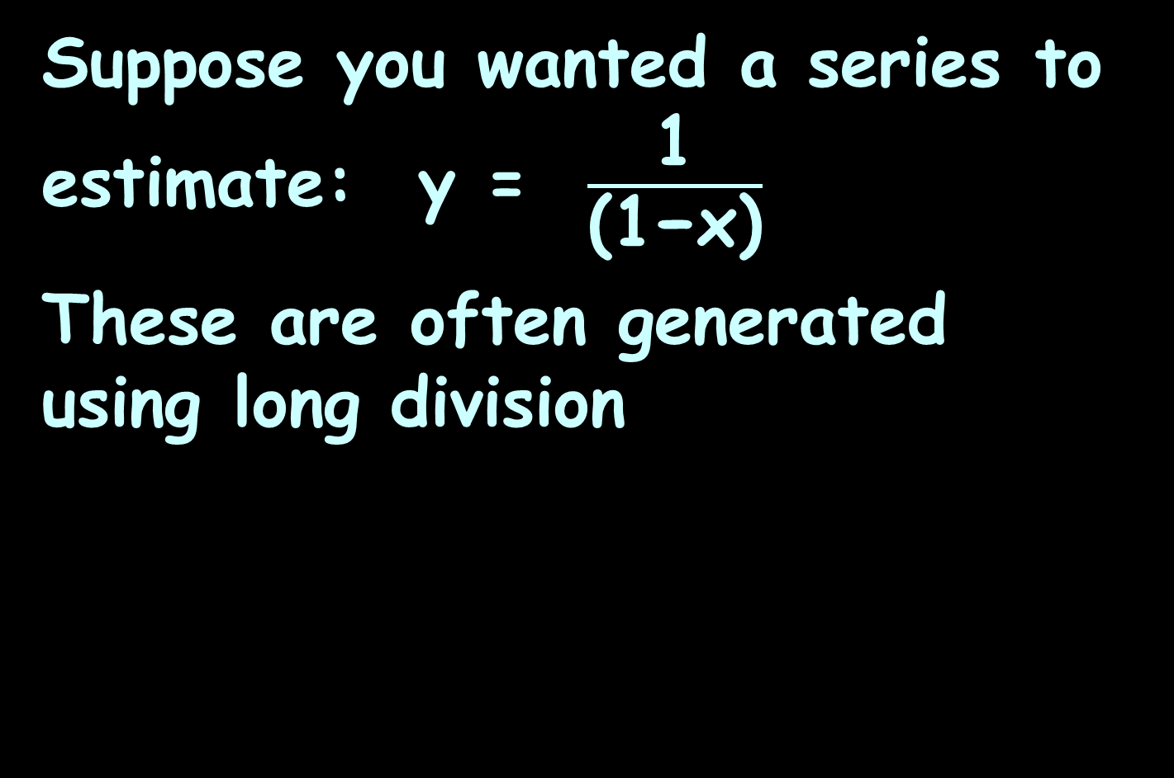
Series Convergence
Suppose you wanted a series to estimate: y = $\frac{\text{1}}{\text{(1−}\text{x}\text{)}}$
These are often generated using long division

Slide 8
Series Convergence
If the sequence of partial sums zero in on a limit L, then we can say that the series converges and its sum is L

Slide 9
Series Convergence
If the sequence of partial sums of the series does not converge, then the series diverges

Slide 10
Series Convergence
Range of convergence
Where is the series a good estimator of the original?

Slide 11
Series Convergence
The formulas in calculators and
computers are not lookup
tables
The formulas are calculated
using series approximations

Slide 12
Series Convergence
Companies look for:
accurate approximations
approximations that
converge quickly (after
only a few iterations)

Slide 13
Series Convergence
Obviously, only series that converge are of interest
… so, how can we tell if a series converges?
… because it is such an important topic, lots of methods have been developed to test for convergence

Slide 14
Series Convergence
Divergence & Convergence Tests
If ≠ 0, then the series
diverges
lim
n→∞

Slide 15
Series Convergence
Divergence & Convergence Tests
If a series converges, then the
= 0
But… if = 0, there is still
no guarantee the series
converges!
lim
n→∞
lim
n→∞

Slide 16
Series Convergence
Tests for Convergence/Divergence
Geometric series
Divergence test
Integral test
p-series
Ratio test
Root test
Comparison test
Limit comparison test
Alternating series test

Slide 17
Series Convergence
We are SO glad we live in the age of calculators and websites that handle these problems!!!!

Slide 18

Questions?
http://i.imgur.com/aliTlT3.jpg

Slide 19
Standard Series
A couple of classes ago we studied the arithmetic sequence
a_{n} = a_{n-1} + d

Slide 20
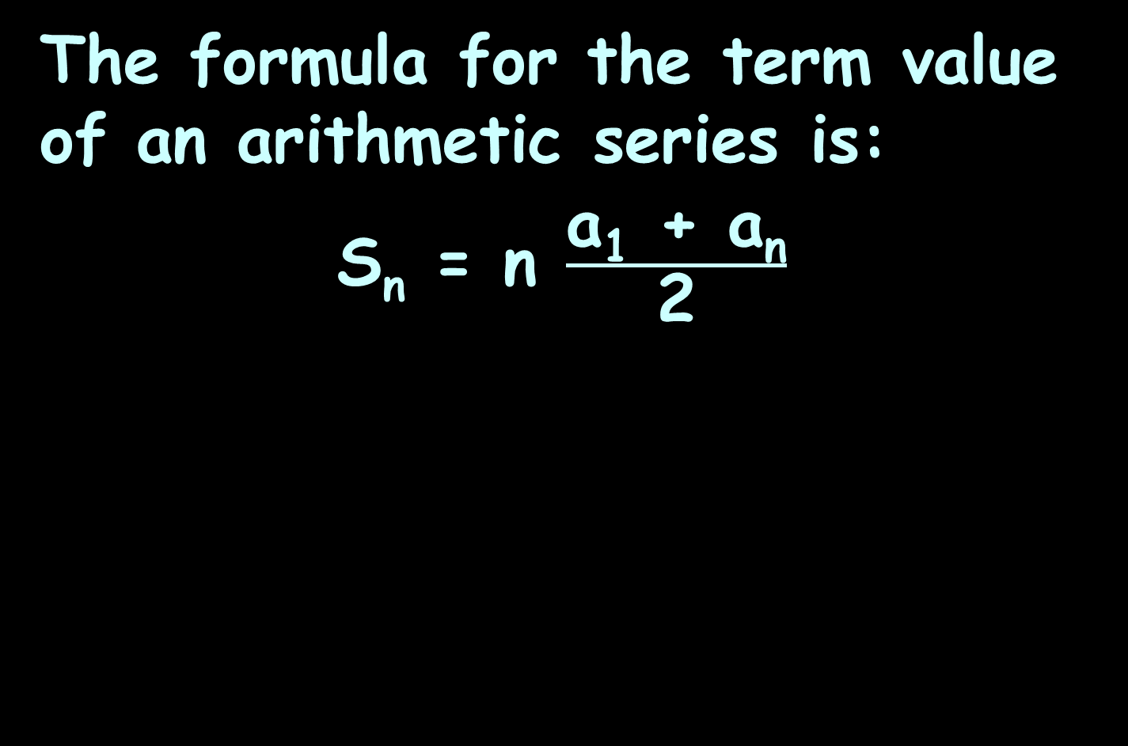
Standard Series
The formula for the term value of an arithmetic series is:
S_{n} = n $\frac{\text{a}\text{1}\text{ +} \text{a}\text{n}}{\text{2}}$

Slide 21
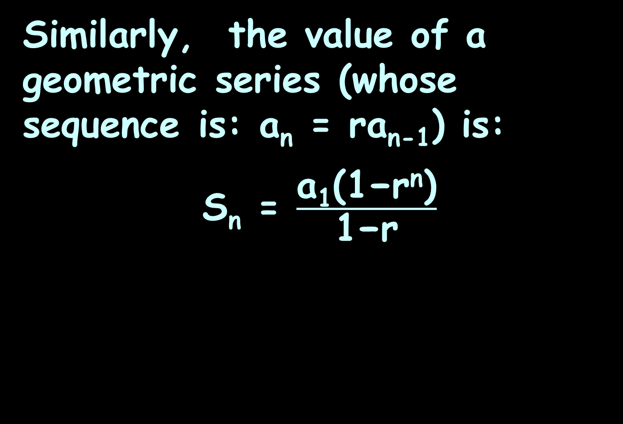
Standard Series
Similarly, the value of a geometric series (whose sequence is: a_{n} = ra_{n-1}) is:
S_{n} = $\frac{\text{a}\text{1}\text{(1−}\text{r}\text{n}\text{)}}{\text{1−}\text{r}}$

Slide 22
Standard Series
Another standard series is the power series (p-series)
ƒ = a₀ + a₁u + a₂u² + a₃u³ + … + a_{n}u^{n}
u will be some function of x

Slide 23
Power Series
The order of the power series is the smallest power of x with a nonzero coefficient

Slide 24
Power Series
These are frequently generated by long division

Slide 25
Power Series
Remember the geometric series we generated last class?

Slide 26
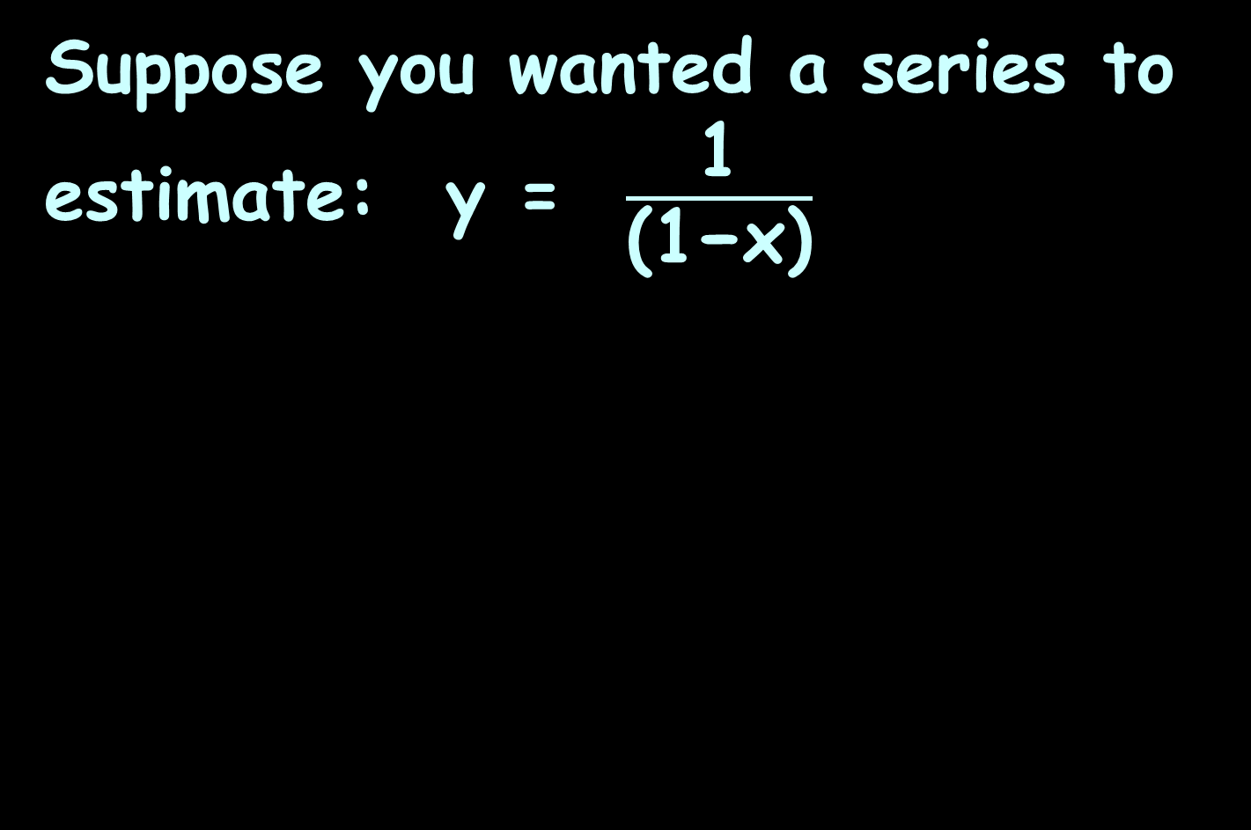
Power Series
Suppose you wanted a series to estimate: y = $\frac{\text{1}}{\text{(1−}\text{x}\text{)}}$

Slide 27
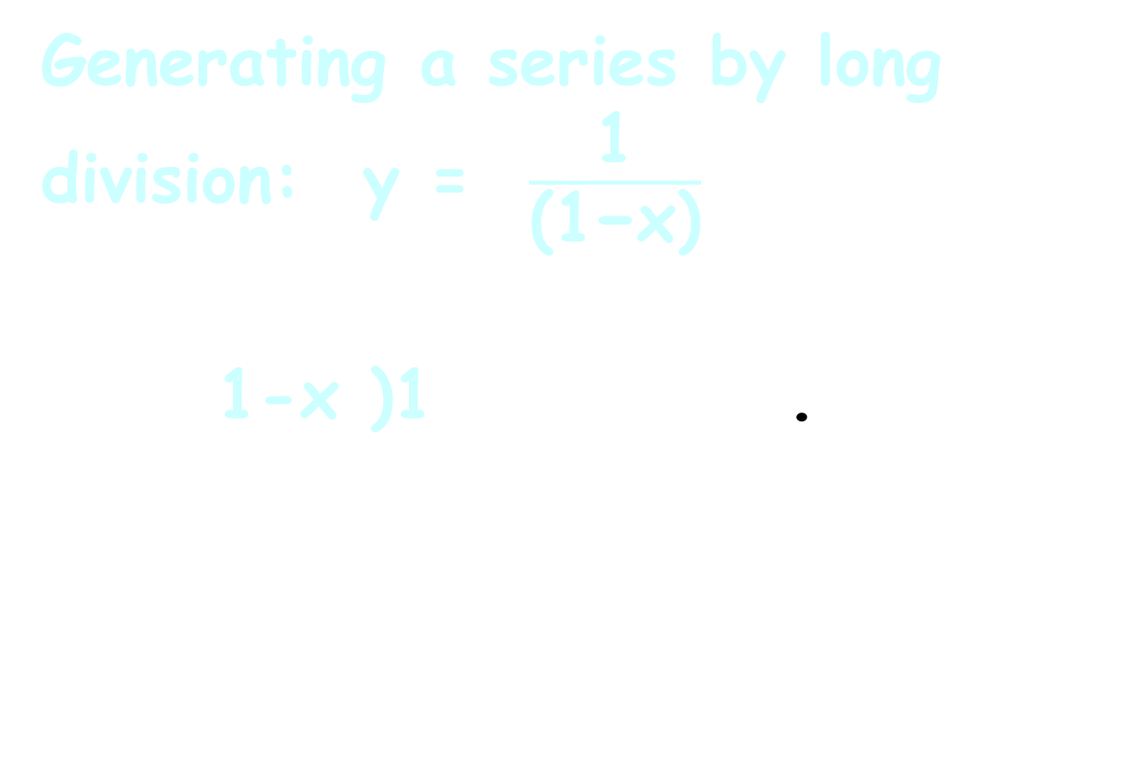
Power Series
Generating a series by long division: y = $\frac{\text{1}}{\text{(1−}\text{x}\text{)}}$
1-x )1 .
¯¯¯

Slide 28
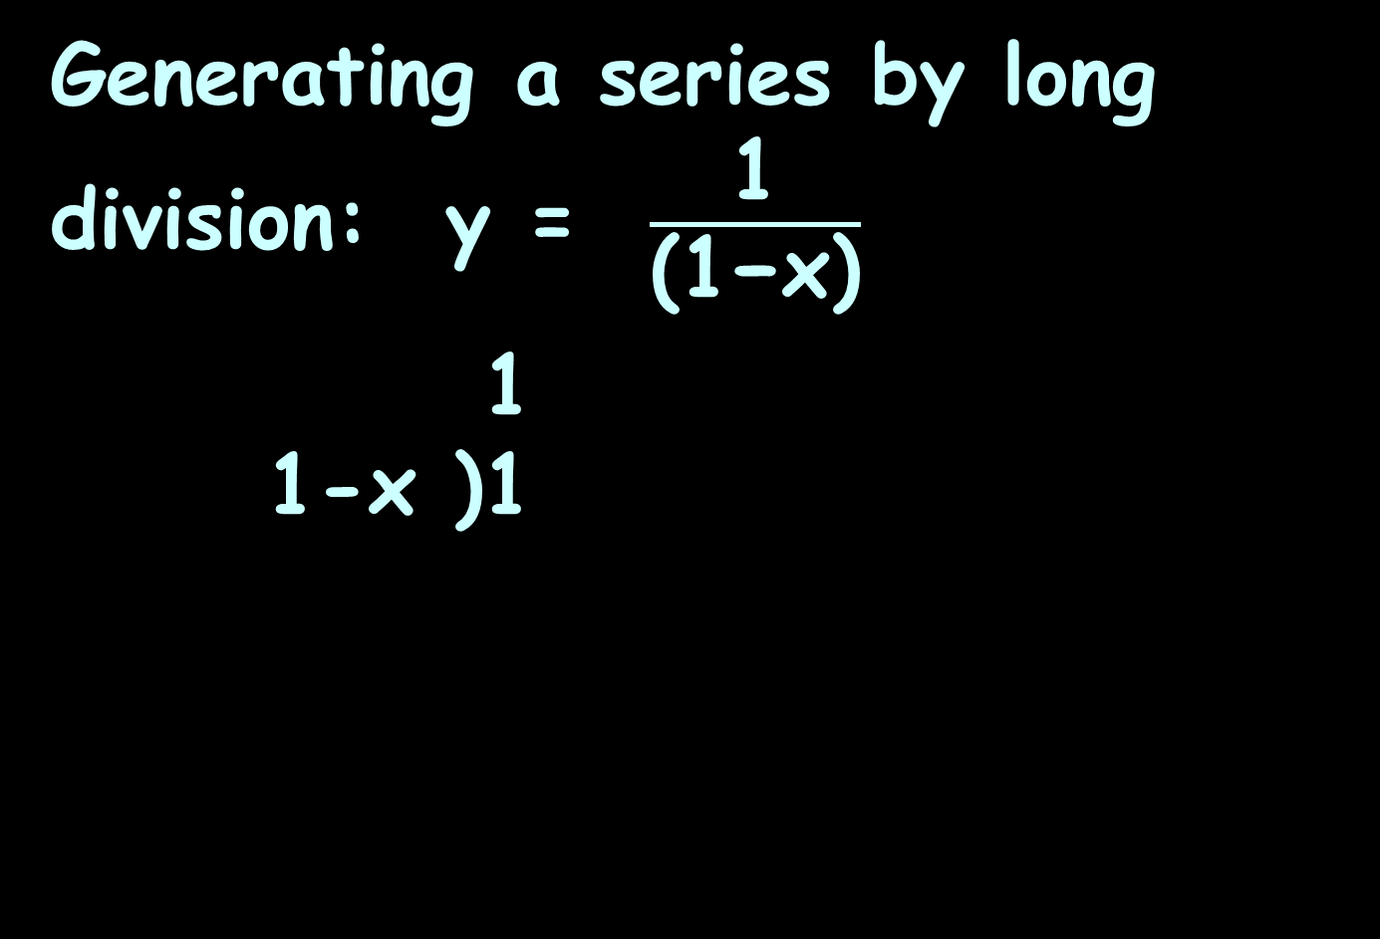
Power Series
Generating a series by long division: y = $\frac{\text{1}}{\text{(1−}\text{x}\text{)}}$
1
1-x )1
¯¯¯

Slide 29
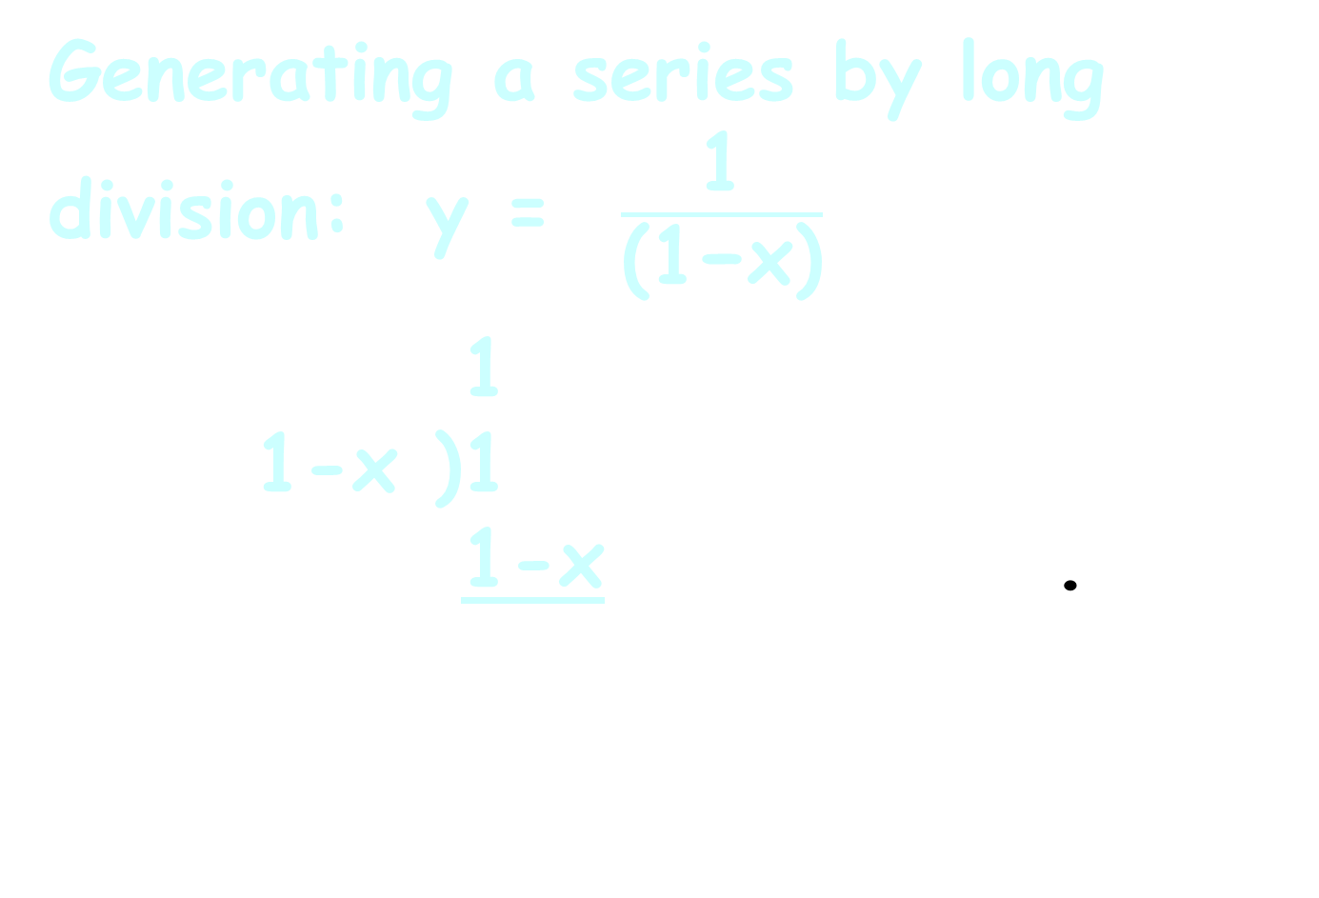
Power Series
Generating a series by long division: y = $\frac{\text{1}}{\text{(1−}\text{x}\text{)}}$
1
1-x )1
1-x .
¯¯¯

Slide 30
Power Series
Generating a series by long division: y = $\frac{\text{1}}{\text{(1−}\text{x}\text{)}}$
1
1-x )1
1-x .
¯¯¯
-( )

Slide 31
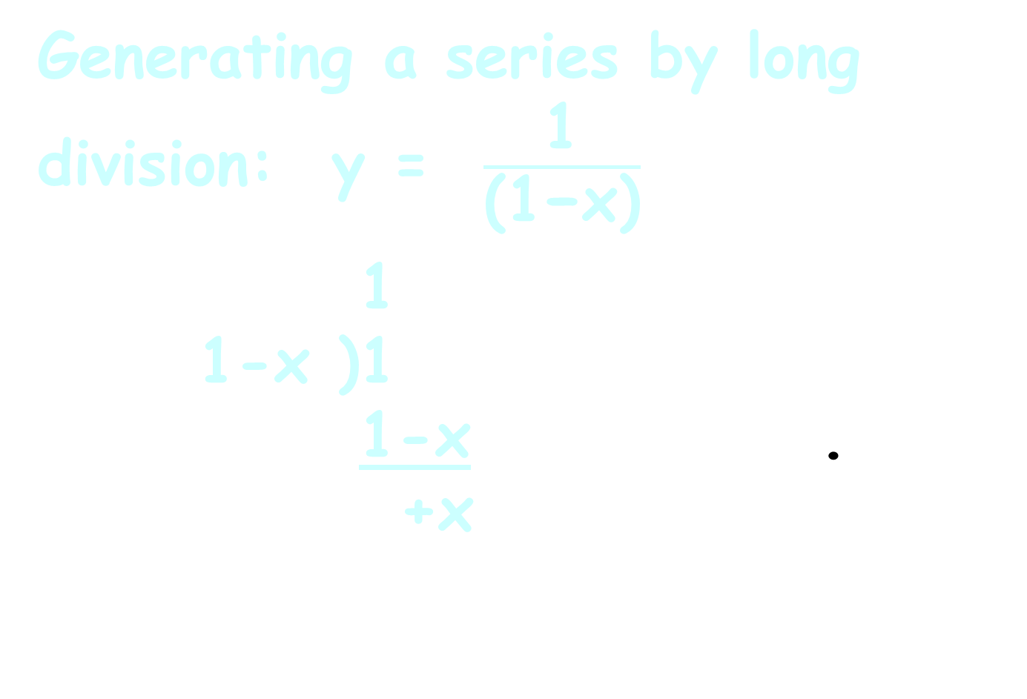
Power Series
Generating a series by long division: y = $\frac{\text{1}}{\text{(1−}\text{x}\text{)}}$
1
1-x )1
1-x .
+x
¯¯¯
-( )

Slide 32
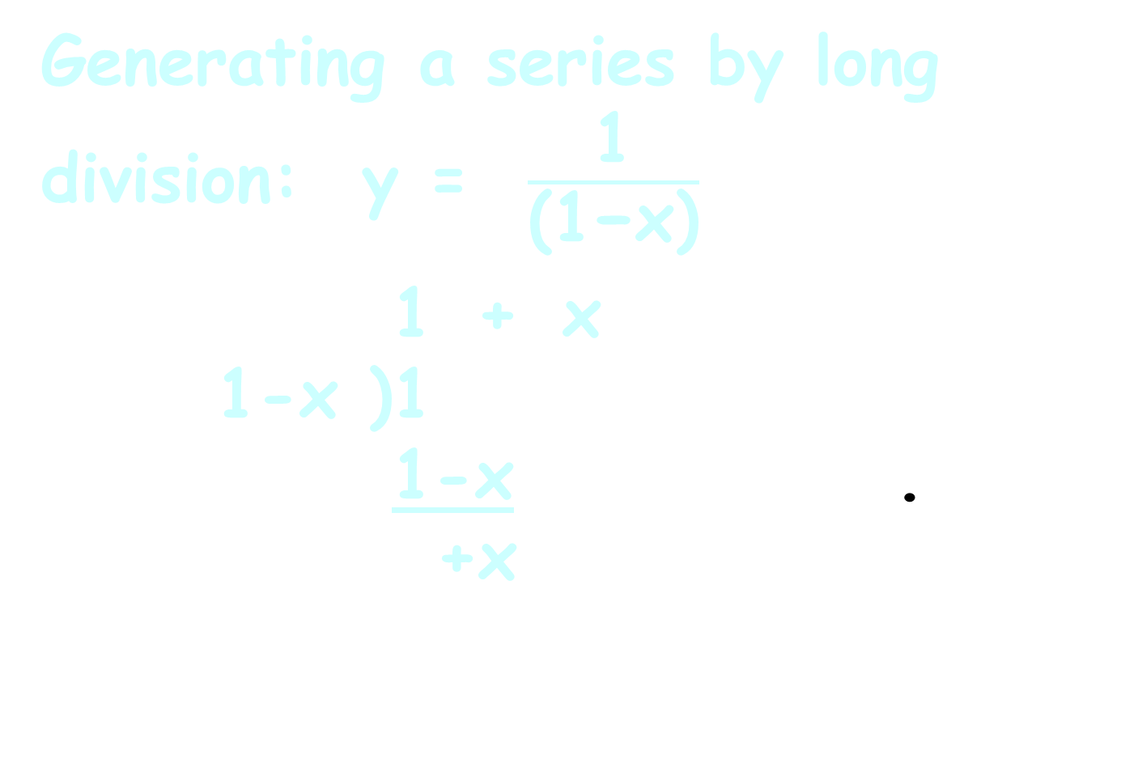
Power Series
Generating a series by long division: y = $\frac{\text{1}}{\text{(1−}\text{x}\text{)}}$
1 + x
1-x )1
1-x .
+x
¯¯¯¯¯¯
-( )

Slide 33
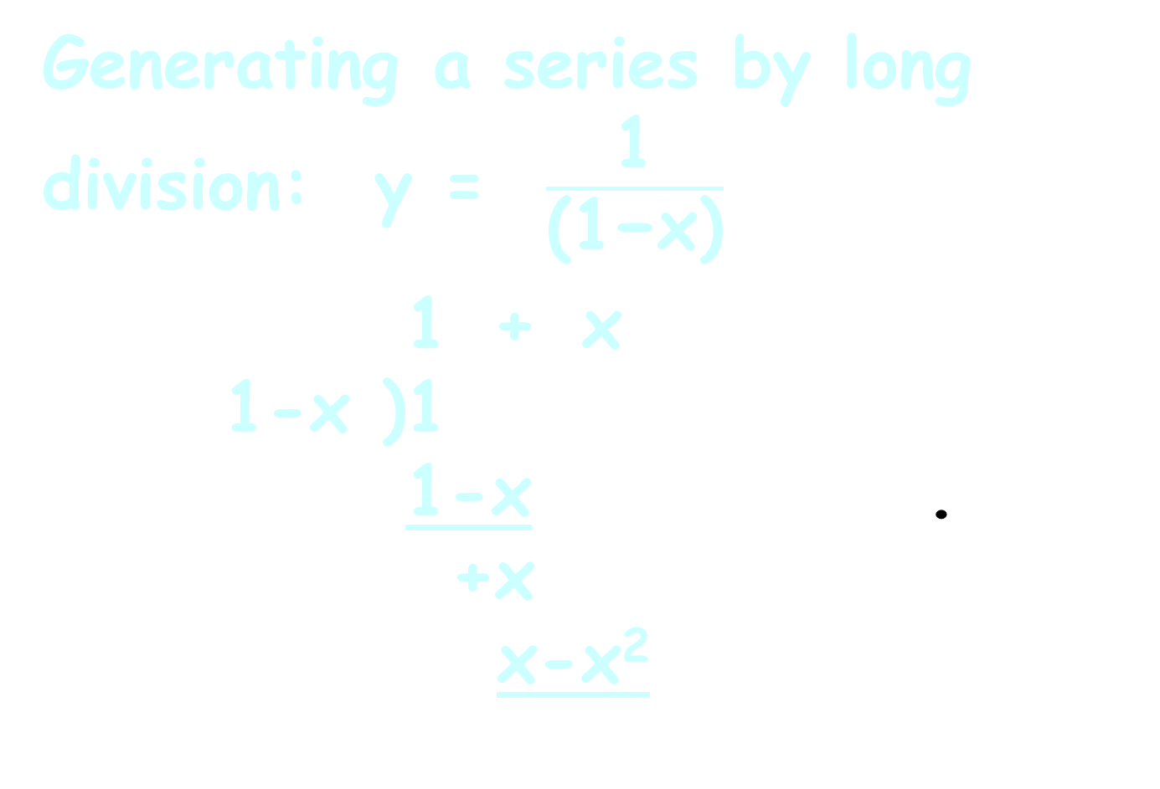
Power Series
Generating a series by long division: y = $\frac{\text{1}}{\text{(1−}\text{x}\text{)}}$
1 + x
1-x )1
1-x .
+x
x-x²
¯¯¯¯¯¯
-( )

Slide 34
Power Series
Generating a series by long division: y = $\frac{\text{1}}{\text{(1−}\text{x}\text{)}}$
1 + x
1-x )1
1-x .
+x
x-x²
¯¯¯¯¯¯
-( )
-( )

Slide 35
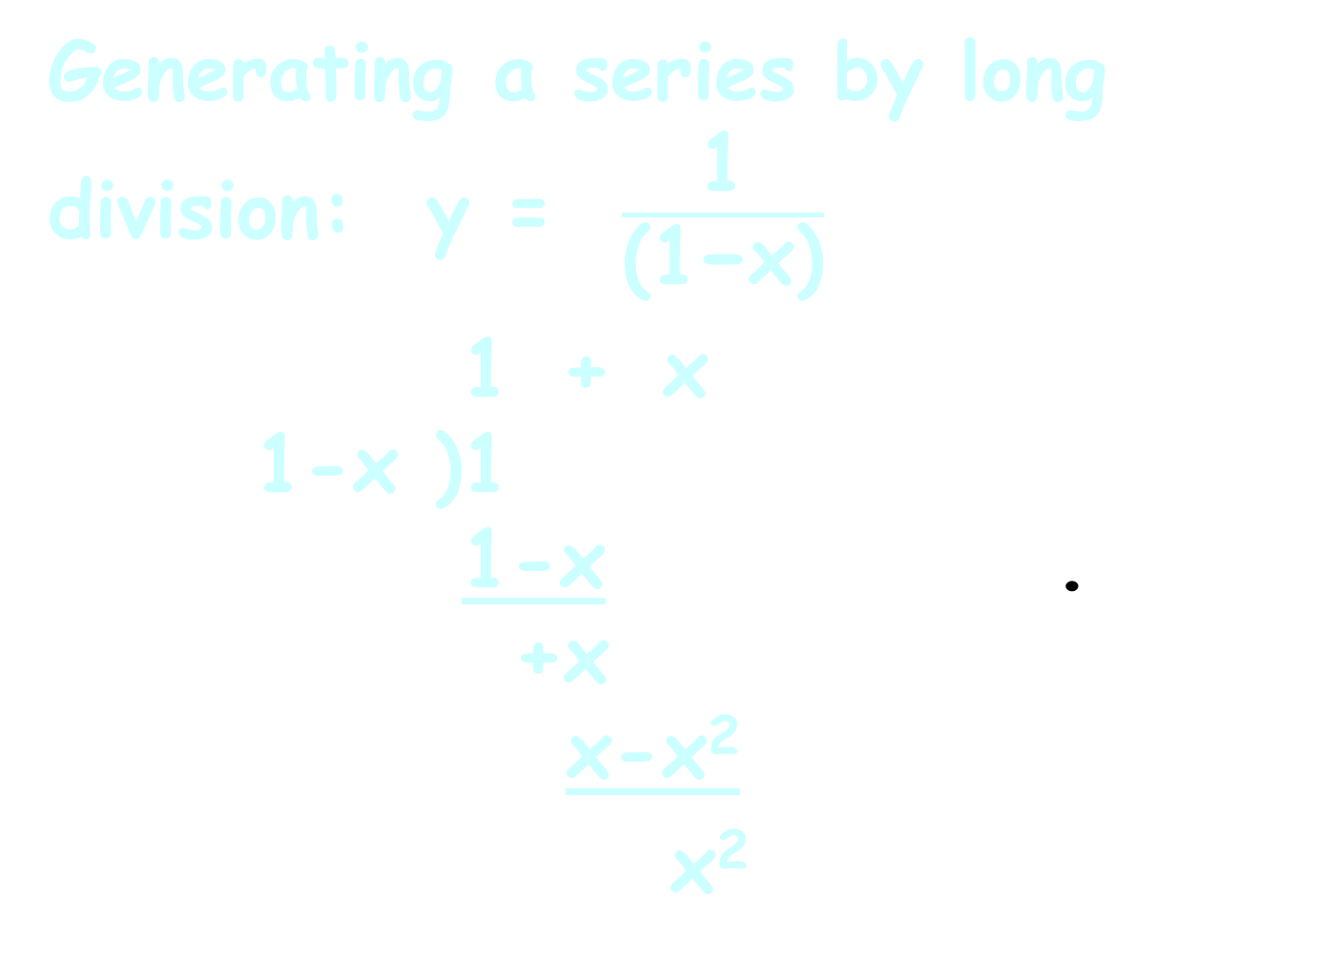
Power Series
Generating a series by long division: y = $\frac{\text{1}}{\text{(1−}\text{x}\text{)}}$
1 + x
1-x )1
1-x .
+x
x-x²
x²
¯¯¯¯¯¯
-( )
-( )

Slide 36
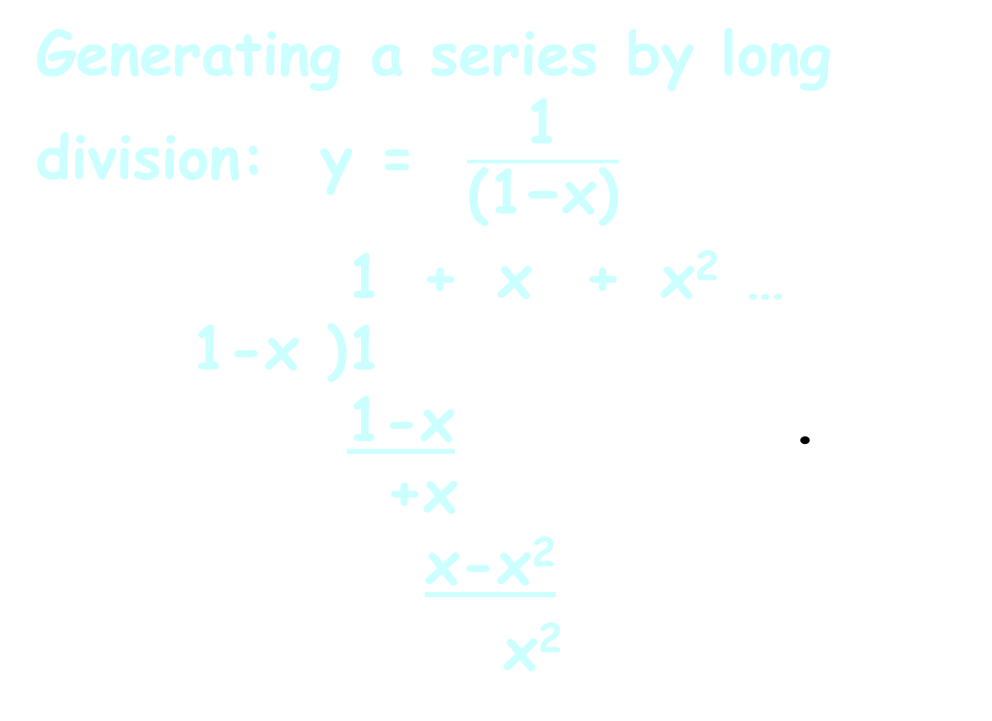
Power Series
Generating a series by long division: y = $\frac{\text{1}}{\text{(1−}\text{x}\text{)}}$
1 + x + x² …
1-x )1
1-x .
+x
x-x²
x²
¯¯¯¯¯¯¯¯¯¯¯

Slide 37
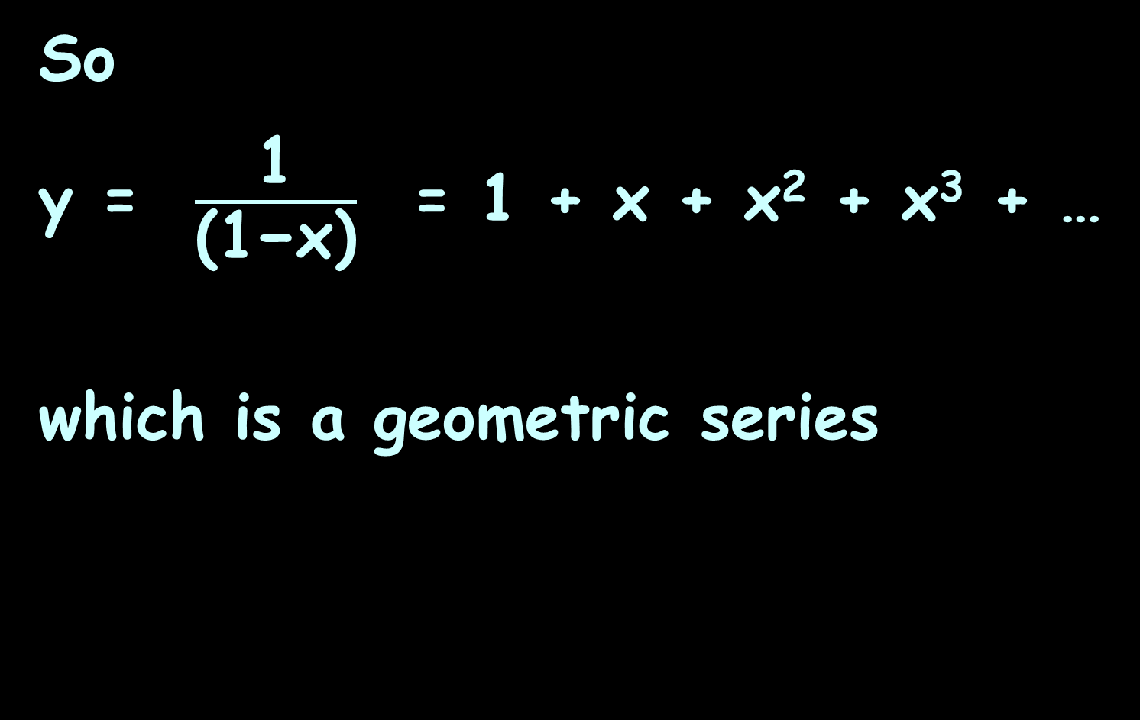
Power Series
So
y = $\frac{\text{1}}{\text{(1−}\text{x}\text{)}}$ = 1 + x + x² + x³ + …
which is a geometric series

Slide 38
Power Series
A geometric series is a special case of the power series
Geometric series:
y = 1 + x + x² + x³ + …
Power series:
y = a₀ + a₁u + a₂u² + a₃u³ + …

Slide 39
Power Series
For a power series:
y = a₀ +a₁u + a₂u² + a₃u³ + …
u can be any function of x
the a’s are the coefficients of
each term in the series

Slide 40
Power Series
Power series are used in electrical engineering under the name of the Z-transform
In mathematics and signal processing, the Z-transform converts a discrete-time signal, which is a sequence of real or complex numbers, into a complex frequency-domain (z-domain or z-plane) representation. It can be considered as a discrete-time equivalent of the Laplace transform (s-domain) (more about that later).

Slide 41
Power Series
Series for common electronic functions such as:
e ⁻¹
cos ωt
root (1+Q)
energy
charge

Slide 42
Power Series
The decimal notation for numbers is also a power series with integer coefficients and the argument x fixed at 10s

Slide 43
POWER SERIES
IN-CLASS PROBLEM 1
Develop the power series for the real number: ab,cde,fgh
a₈ a₇ a₆ a₅ a₄ a₃ a₂ a₁

Slide 44
POWER SERIES
IN-CLASS PROBLEM 1
ab,cde,fgh = h(10⁰) + g(10¹) +
f(10²) + e(10³) + d(10⁴) +
c(10⁵) + b(10⁶) + a(10⁷)
or:
S_{n} = Σa_{n}(10^{n-1})

Slide 45
Power Series
General power series:
ƒ(x) = a_{n}(x-c)^{n}
= a₀(x-c)⁰ + a₁(x-c)¹ +
a₂(x-c)² + a₃(x-c)³ + …
∞
∑
n=0

Slide 46
Power Series
Any polynomial can be expressed as a power series (usually with a whole lot of zero coefficients)

Slide 47
POWER SERIES
IN-CLASS PROBLEM 2
Develop the power series representation of
ƒ(x) = x² + 2x + 3
around a center c=0:

Slide 48
POWER SERIES
IN-CLASS PROBLEM 2
Develop the power series representation of
ƒ(x) = x² + 2x + 3
around a center c=0:
ƒ(x) = 3(x-0)⁰ + 2(x-0)¹ +
1(x-0)² + 0(x-0)³ +
0(x-0)⁴ + …

Slide 49
POWER SERIES
IN-CLASS PROBLEM 2
Develop the power series representation of
ƒ(x) = x² + 2x + 3
around a center c=0:
ƒ(x) = 3(x-0)⁰ + 2(x-0)¹ +
1(x-0)² + 0(x-0)³ +
0(x-0)⁴ + …
Notice that all multiplier values are 0 for terms x³ and higher

Slide 50
Power Series
A power series for a formula containing only exponents of the variable will have
(max exponent value) + 1
non-zero terms

Slide 51
Questions?
http://i.imgur.com/aliTlT3.jpg

Slide 52
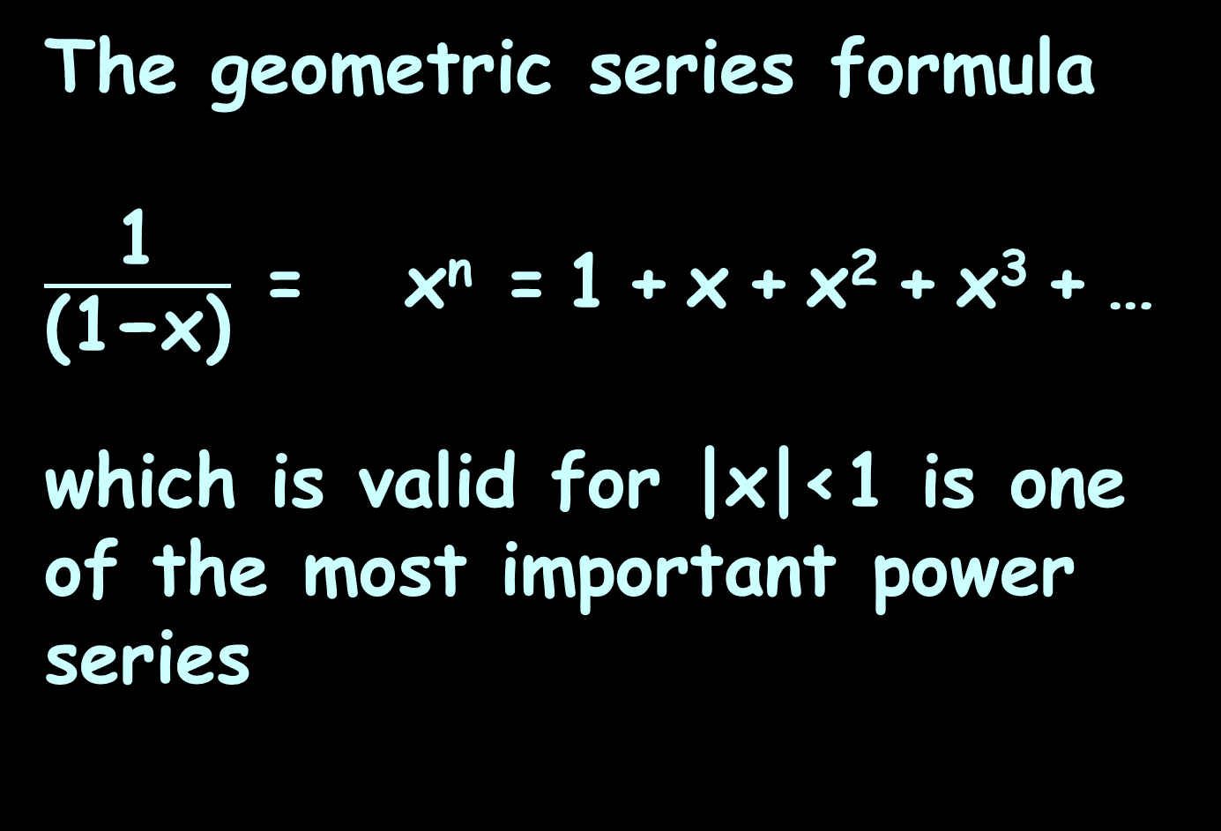
Power Series
The geometric series formula
$\frac{\text{1}}{\text{(1−}\text{x}\text{)}}$ = x^{n} = 1 + x + x² + x³ + …
which is valid for |x|<1 is one of the most important power series
∞
∑
n=0

Slide 53
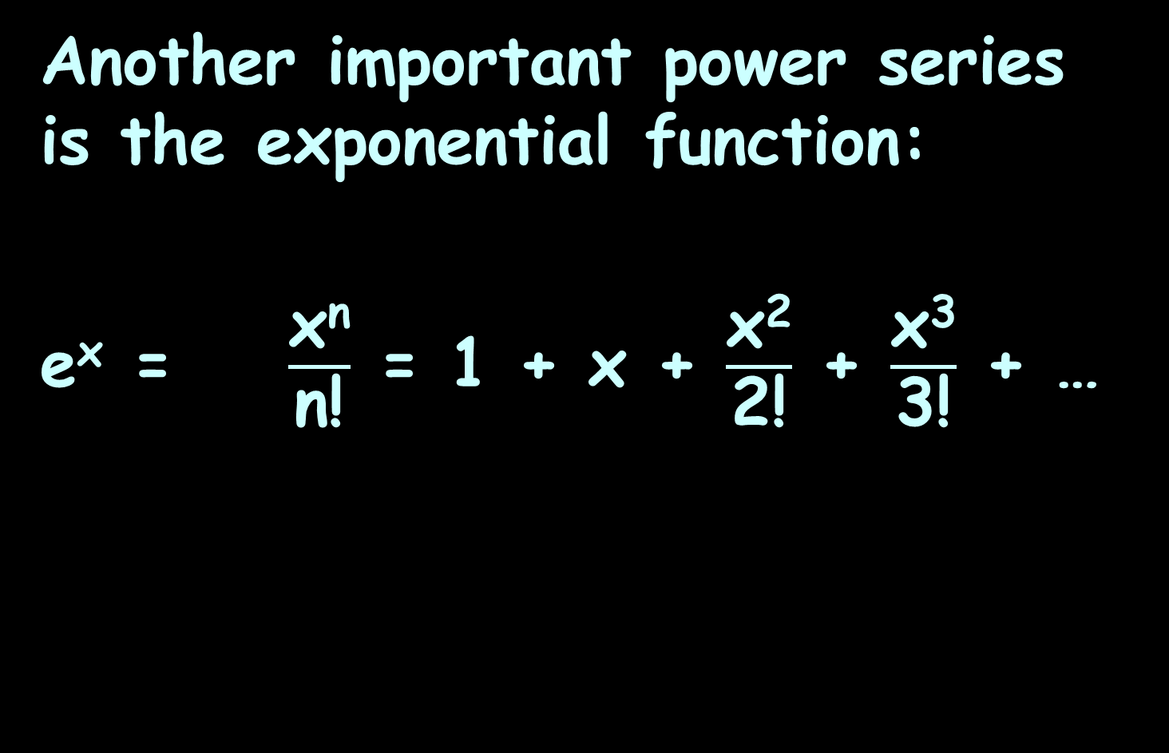
Power Series
Another important power series is the exponential function:
e^{x} = $\frac{\text{x}\text{n}}{\text{n}\text{!}}$ = 1 + x + $\frac{\text{x}\text{2}}{\text{2}\text{!}}$ + $\frac{\text{x}\text{3}}{\text{3}\text{!}}$ + …
∞
∑
n=0

Slide 54
Power Series
This formula is used by your calculator to calculate exponential functions

Slide 55
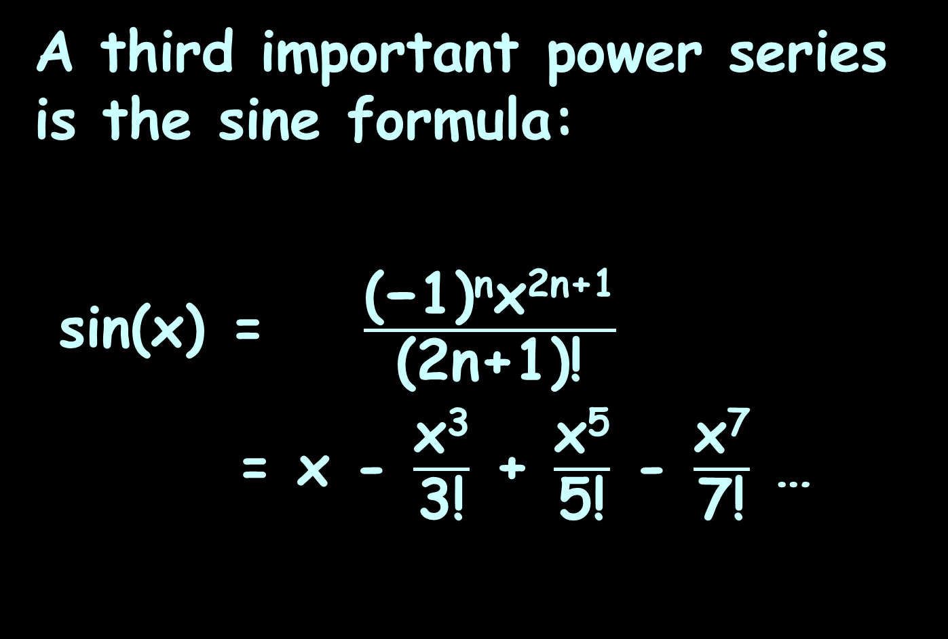
Power Series
A third important power series is the sine formula:
sin(x) = $\frac{\text{(−1)}\text{n}\text{x}\text{2}\text{n}\text{+1}}{\text{(2}\text{n}\text{+1}\text{)!}}$
= x - $\frac{\text{x}\text{3}}{\text{3}\text{!}}$ + $\frac{\text{x}\text{5}}{\text{5}\text{!}}$ - $\frac{\text{x}\text{7}}{\text{7}\text{!}}$ …
∞
∑
n=0

Slide 56
Power Series
Negative powers are not permitted in a power series

Slide 57
Power Series
1 + x⁻¹ + x⁻² …
is not a power series
(It IS another type of series called a “Laurent series”)

Slide 58
Power Series
Fractional powers are also not allowed

Slide 59
Power Series
x^{1/1} + x^{1/2} + x^{1/3} + …
is not a power series
(It is a Puiseux series…)

Slide 60
Power Series
The coefficients a_{n} are not allowed to depend on x

Slide 61
Power Series
sin(x)x + sin(2x)x² + sin(3x)x³ + …
is not a power series
(Here’s a chance to get a series named after YOU!!!)

Slide 62
Power Series
May converge for all values of x, for no values of x or converge for some and diverge for other values of x

Slide 63
POWER SERIES
IN-CLASS PROBLEMS 3-6
Identify if it is a power series:
2 + 2x + 2x² + 2x³ + …
1 + x⁻¹ + x² + x⁻³ + …
(2x)¹ + (2x)^{1/2} + (2x)^{1/3} + …
cos(x)x + cos(2x)x² + …

Slide 64
POWER SERIES
IN-CLASS PROBLEMS 3-6
Identify if it is a power series:
2 + 2x + 2x² + 2x³ + … yes
1 + x⁻¹ + x² + x⁻³ + …
(2x)¹ + (2x)^{1/2} + (2x)^{1/3} + …
cos(x)x + cos(2x)x² + …

Slide 65
POWER SERIES
IN-CLASS PROBLEMS 3-6
Identify if it is a power series:
2 + 2x + 2x² + 2x³ + … yes
1 + x⁻¹ + x² + x⁻³ + … no
(2x)¹ + (2x)^{1/2} + (2x)^{1/3} + …
cos(x)x + cos(2x)x² + …

Slide 66
POWER SERIES
IN-CLASS PROBLEMS 3-6
Identify if it is a power series:
2 + 2x + 2x² + 2x³ + … yes
1 + x⁻¹ + x² + x⁻³ + … no
(2x)¹ + (2x)^{1/2} + (2x)^{1/3} + … no
cos(x)x + cos(2x)x² + …

Slide 67
POWER SERIES
IN-CLASS PROBLEMS 3-6
Identify if it is a power series:
2 + 2x + 2x² + 2x³ + … yes
1 + x⁻¹ + x² + x⁻³ + … no
(2x)¹ + (2x)^{1/2} + (2x)^{1/3} + … no
cos(x)x + cos(2x)x² + … no

Slide 68
Questions?
http://i.imgur.com/aliTlT3.jpg

Slide 69
Power Series
All power series ƒ(x) in powers of (x-c) will converge at x = c

Slide 70
Power Series
If c is not the only convergent point, then there is always a number r with 0<r≤∞ such that the series converges whenever |x − c| < r and diverges whenever |x − c| > r

Slide 71
Power Series
The number r is called the radius of convergence of the power series

Slide 72
Power Series
Tests for convergence:
ratio, comparison

Slide 73
Questions?
http://i.imgur.com/aliTlT3.jpg

Slide 74
Function Approximation
Remember when we were trying
to find the area under a curve and length of curve

Slide 75
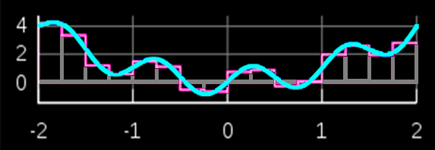

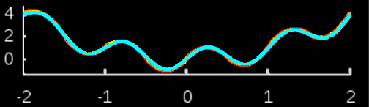
Function Approximation
Rectangular interpolation
We had some
different
ways to
approximate
the curve
Trapezoidal interpolation
Simpson’s Rule
VFrench 2020

Slide 76
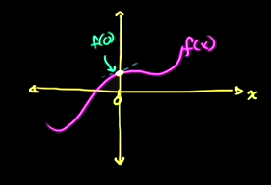
Function Approximation
Suppose we have a function that is messy
VFrench 2016

Slide 77
Function Approximation
We can develop some infinite series that will approximate our function (and be easier to calculate)
VFrench 2016

Slide 78
Function Approximation
A single point estimate of the function at x=0:
.
VFrench 2016

Slide 79
Function Approximation
This is a good estimate of the function only at the one point (x=0)
.
VFrench 2016

Slide 80
Function Approximation
Try a line
VFrench 2016

Slide 81
Function Approximation
Still good at x=0, but better in the vicinity (still not very good)
VFrench 2016

Slide 82
Function Approximation
Try a parabola:
VFrench 2016

Slide 83
Function Approximation
Better yet!
VFrench 2016

Slide 84
Function Approximation
If we kept on going, we would eventually capture a close approximation to the whole function
VFrench 2016

Slide 85
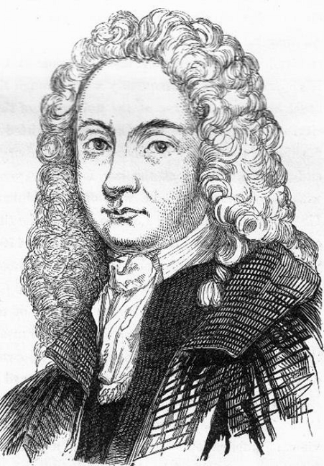
Function Approximation
A Maclaurin series approximates a function using a power series
The a_{n}’s are the
function's derivatives
plugging in x=0 (so
they are no longer a
function of x)
Colin Maclaurin
https://electricscotland.com/history/nation/images/Colin_Maclaurin.jpg

Slide 86
Maclaurin Series
A Maclaurin series approximates a function using:
ƒ(x) = ƒ(0) + ƒ '(0)x + ƒ ''(0)x²/2 +
ƒ '''(0) x³/3! + ƒ ''''(0) x⁴/4! …

Slide 87
MACLAURIN SERIES
IN-CLASS PROBLEM 7
Develop a Maclaurin series for
ƒ(x) = cos(x)
cos(x) = ƒ(0) + ƒ '(0)x + ƒ ''(0)x²/2 + ƒ '''(0) x³/3! + ƒ ''''(0) x⁴/4! …

Slide 88
MACLAURIN SERIES
IN-CLASS PROBLEM 7
Develop a Maclaurin series for
ƒ(x) = cos(x)
Start calculating the pieces!
What is ƒ(0) = cos(0)?
cos(x) = ƒ(0) + ƒ '(0)x + ƒ ''(0)x²/2 + ƒ '''(0) x³/3! + ƒ ''''(0) x⁴/4! …

Slide 89
MACLAURIN SERIES
IN-CLASS PROBLEM 7
Develop a Maclaurin series for
ƒ(x) = cos(x)
Start calculating the pieces!
What is ƒ(0) = cos(0)? 1
Plug that in!
cos(x) = ƒ(0) + ƒ '(0)x + ƒ ''(0)x²/2 + ƒ '''(0) x³/3! + ƒ ''''(0) x⁴/4! …

Slide 90
MACLAURIN SERIES
IN-CLASS PROBLEM 7
Develop a Maclaurin series for
ƒ(x) = cos(x)
cos(x) = 1 + ƒ '(0)x + ƒ ''(0)x²/2
+ ƒ '''(0) x³/3! + ƒ ''''(0) x⁴/4! …
What is ƒ ' of cos(x)?
cos(x) = ƒ(0) + ƒ '(0)x + ƒ ''(0)x²/2 + ƒ '''(0) x³/3! + ƒ ''''(0) x⁴/4! …

Slide 91
MACLAURIN SERIES
IN-CLASS PROBLEM 7
Develop a Maclaurin series for
ƒ(x) = cos(x)
cos(x) = 1 + ƒ '(0)x + ƒ ''(0)x²/2
+ ƒ '''(0) x³/3! + ƒ ''''(0) x⁴/4! …
What is ƒ ' of cos(x)? -sin(x)
What is –sin(0)?
cos(x) = ƒ(0) + ƒ '(0)x + ƒ ''(0)x²/2 + ƒ '''(0) x³/3! + ƒ ''''(0) x⁴/4! …

Slide 92
MACLAURIN SERIES
IN-CLASS PROBLEM 7
Develop a Maclaurin series for
ƒ(x) = cos(x)
cos(x) = 1 + ƒ '(0)x + ƒ ''(0)x²/2
+ ƒ '''(0) x³/3! + ƒ ''''(0) x⁴/4! …
What is ƒ ' of cos(x)? -sin(x)
What is –sin(0)? 0
Plug that in!
cos(x) = ƒ(0) + ƒ '(0)x + ƒ ''(0)x²/2 + ƒ '''(0) x³/3! + ƒ ''''(0) x⁴/4! …

Slide 93
MACLAURIN SERIES
IN-CLASS PROBLEM 7
Develop a Maclaurin series for
ƒ(x) = cos(x)
cos(x) = 1 + 0x + ƒ ''(0)x²/2
+ ƒ '''(0) x³/3! + ƒ ''''(0) x⁴/4! …
What is ƒ ' of cos(x)? -sin(x)
What is –sin(0)? 0
What is ƒ '' of cos(x)?
cos(x) = ƒ(0) + ƒ '(0)x + ƒ ''(0)x²/2 + ƒ '''(0) x³/3! + ƒ ''''(0) x⁴/4! …

Slide 94
MACLAURIN SERIES
IN-CLASS PROBLEM 7
Develop a Maclaurin series for
ƒ(x) = cos(x)
cos(x) = 1 + 0x + ƒ ''(0)x²/2
+ ƒ '''(0) x³/3! + ƒ ''''(0) x⁴/4! …
What is ƒ '' of cos(x)? –cos(x)
What is –cos(0)?
cos(x) = ƒ(0) + ƒ '(0)x + ƒ ''(0)x²/2 + ƒ '''(0) x³/3! + ƒ ''''(0) x⁴/4! …

Slide 95
MACLAURIN SERIES
IN-CLASS PROBLEM 7
Develop a Maclaurin series for
ƒ(x) = cos(x)
cos(x) = 1 + 0x + ƒ ''(0)x²/2
+ ƒ '''(0) x³/3! + ƒ ''''(0) x⁴/4! …
What is ƒ '' of cos(x)? –cos(x)
What is –cos(0)? -1
Plug that in!
cos(x) = ƒ(0) + ƒ '(0)x + ƒ ''(0)x²/2 + ƒ '''(0) x³/3! + ƒ ''''(0) x⁴/4! …

Slide 96
MACLAURIN SERIES
IN-CLASS PROBLEM 7
Develop a Maclaurin series for
ƒ(x) = cos(x)
cos(x) = 1 + 0x -1x²/2
+ ƒ '''(0) x³/3! + ƒ ''''(0) x⁴/4! …
What is ƒ '' of cos(x)? –cos(x)
What is –cos(0)? -1
Plug that in!
What is ƒ ''' of cos(x)?
cos(x) = ƒ(0) + ƒ '(0)x + ƒ ''(0)x²/2 + ƒ '''(0) x³/3! + ƒ ''''(0) x⁴/4! …

Slide 97
MACLAURIN SERIES
IN-CLASS PROBLEM 7
Develop a Maclaurin series for
ƒ(x) = cos(x)
cos(x) = 1 + 0x -1x²/2
+ ƒ '''(0) x³/3! + ƒ ''''(0) x⁴/4! …
What is ƒ ''' of cos(x)?
cos(x) = ƒ(0) + ƒ '(0)x + ƒ ''(0)x²/2 + ƒ '''(0) x³/3! + ƒ ''''(0) x⁴/4! …

Slide 98
MACLAURIN SERIES
IN-CLASS PROBLEM 7
Develop a Maclaurin series for
ƒ(x) = cos(x)
cos(x) = 1 + 0x -1x²/2
+ ƒ '''(0) x³/3! + ƒ ''''(0) x⁴/4! …
What is ƒ ''' of cos(x)? sin(x)
What is sin(0)?
cos(x) = ƒ(0) + ƒ '(0)x + ƒ ''(0)x²/2 + ƒ '''(0) x³/3! + ƒ ''''(0) x⁴/4! …

Slide 99
MACLAURIN SERIES
IN-CLASS PROBLEM 7
Develop a Maclaurin series for
ƒ(x) = cos(x)
cos(x) = 1 + 0x -1x²/2
+ ƒ '''(0) x³/3! + ƒ ''''(0) x⁴/4! …
What is ƒ ''' of cos(x)? sin(x)
What is sin(0)? 0
Plug that in!
cos(x) = ƒ(0) + ƒ '(0)x + ƒ ''(0)x²/2 + ƒ '''(0) x³/3! + ƒ ''''(0) x⁴/4! …

Slide 100
MACLAURIN SERIES
IN-CLASS PROBLEM 7
Develop a Maclaurin series for
ƒ(x) = cos(x)
cos(x) = 1 + 0x -1x²/2
+ 0x³/3! + ƒ ''''(0) x⁴/4! …
What is ƒ ''' of cos(x)? sin(x)
What is sin(0)? 0
Plug that in!
What is ƒ '''' of cos(x)?
cos(x) = ƒ(0) + ƒ '(0)x + ƒ ''(0)x²/2 + ƒ '''(0) x³/3! + ƒ ''''(0) x⁴/4! …

Slide 101
MACLAURIN SERIES
IN-CLASS PROBLEM 7
Develop a Maclaurin series for
ƒ(x) = cos(x)
cos(x) = 1 + 0x -1x²/2
+ 0x³/3! + ƒ ''''(0) x⁴/4! …
What is ƒ '''' of cos(x)? cos(x)
What is cos(0)?
cos(x) = ƒ(0) + ƒ '(0)x + ƒ ''(0)x²/2 + ƒ '''(0) x³/3! + ƒ ''''(0) x⁴/4! …

Slide 102
MACLAURIN SERIES
IN-CLASS PROBLEM 7
Develop a Maclaurin series for
ƒ(x) = cos(x)
cos(x) = 1 + 0x -1x²/2
+ 0x³/3! + ƒ ''''(0) x⁴/4! …
What is ƒ '''' of cos(x)? cos(x)
What is cos(0)? 1
Plug that in!
cos(x) = ƒ(0) + ƒ '(0)x + ƒ ''(0)x²/2 + ƒ '''(0) x³/3! + ƒ ''''(0) x⁴/4! …

Slide 103
MACLAURIN SERIES
IN-CLASS PROBLEM 7
Develop a Maclaurin series for
ƒ(x) = cos(x)
cos(x) = 1 + 0x -1x²/2
+ 0x³/3! + 1x⁴/4! …
What is ƒ '''' of cos(x)? cos(x)
What is cos(0)? 1
Plug that in!
cos(x) = ƒ(0) + ƒ '(0)x + ƒ ''(0)x²/2 + ƒ '''(0) x³/3! + ƒ ''''(0) x⁴/4! …

Slide 104
MACLAURIN SERIES
IN-CLASS PROBLEM 7
Develop a Maclaurin series for
ƒ(x) = cos(x)
cos(x) = 1 + 0x -1x²/2
+ 0x³/3! + 1x⁴/4! …
Tidying it up and continuing the pattern:
cos(x) = 1- x²/2 + x⁴/4! – x⁶/6! +
x⁸/8! …
cos(x) = ƒ(0) + ƒ '(0)x + ƒ ''(0)x²/2 + ƒ '''(0) x³/3! + ƒ ''''(0) x⁴/4! …

Slide 105
Maclaurin Series
This is the formula your calculator uses to calculate the cosine!
(not a big lookup table!)

Slide 106
Questions?
http://i.imgur.com/aliTlT3.jpg

Slide 107
Maclaurin Series
Start with a power series:
ƒ(x) = a₀ +a₁x + a₂x² + a₃x³ + …
You need to find the values for a₀ a₁ a₂ …
Let x = 0
ƒ(0) = a₀ +a₁0 + a₂0² + a₃0³ + …
= a₀

Slide 108
Maclaurin Series
Whatever value the function has at x = 0, that is the value for a₀

Slide 109
Maclaurin Series
To find a₁, take the first derivative:
ƒ(x) = a₀ + a₁x + a₂x² + a₃x³ + …
ƒ ' = a₁ + 2a₂x + 3a₃x² + …

Slide 110
Maclaurin Series
To find a₁, take the first derivative:
ƒ(x) = a₀ +a₁x + a₂x² + a₃x³ + …
ƒ ' = a₁ + 2a₂x + 3a₃x² + …
Again, let x=0:
ƒ '(0) = a₁ + 2a₂0 + 3a₃0² + …
= a₁

Slide 111
Maclaurin Series
Whatever value ƒ ' has at
x = 0, that is the value for a₁

Slide 112
Maclaurin Series
ƒ '' = 2a₂ + 6a₃x + 12a₄x² + …
ƒ ''(0) = 2a₂ + 6a₃0 + 12a₄0² + …
= 2a₂
a₂ = ƒ ''/2

Slide 113
Maclaurin Series
So:
a₀ = ƒ(0)
a₁ = ƒ '(0)
a₂ = ƒ ’’(0)/2
and so on…

Slide 114
Maclaurin Series
The pattern actually is:
a_{n} = ƒ ^{nth deriv}/n!

Slide 115
Questions?
http://i.imgur.com/aliTlT3.jpg

Slide 116
MACLAURIN SERIES
IN-CLASS PROBLEM 8
Develop a Maclaurin series for ƒ(x)=e^{x}

Slide 117
MACLAURIN SERIES
IN-CLASS PROBLEM 8
Develop a Maclaurin series for ƒ(x)=e^{x}
Determine ƒ '(0):

Slide 118
MACLAURIN SERIES
IN-CLASS PROBLEM 8
Develop a Maclaurin series for ƒ(x)=e^{x}
ƒ '(0) = e⁰ = 1
Determine ƒ ''(0):

Slide 119
MACLAURIN SERIES
IN-CLASS PROBLEM 8
Develop a Maclaurin series for ƒ(x)=e^{x}
ƒ '(0) = e⁰ = 1
ƒ ''(0) = e⁰ = 1
Determine ƒ '''(0): = e⁰ = 1

Slide 120
MACLAURIN SERIES
IN-CLASS PROBLEM 8
Develop a Maclaurin series for ƒ(x)=e^{x}
ƒ '(0) = e⁰ = 1
ƒ ''(0) = e⁰ = 1
ƒ '''(0) = e⁰ = 1
Determine ƒ ''''(0): = e⁰ = 1

Slide 121
MACLAURIN SERIES
IN-CLASS PROBLEM 8
Develop a Maclaurin series for ƒ(x)=e^{x}
ƒ '(0) = e⁰ = 1
ƒ ''(0) = e⁰ = 1
ƒ '''(0) = e⁰ = 1
ƒ ''''(0) = e⁰ = 1
Don’t you wish they were all this easy?

Slide 122
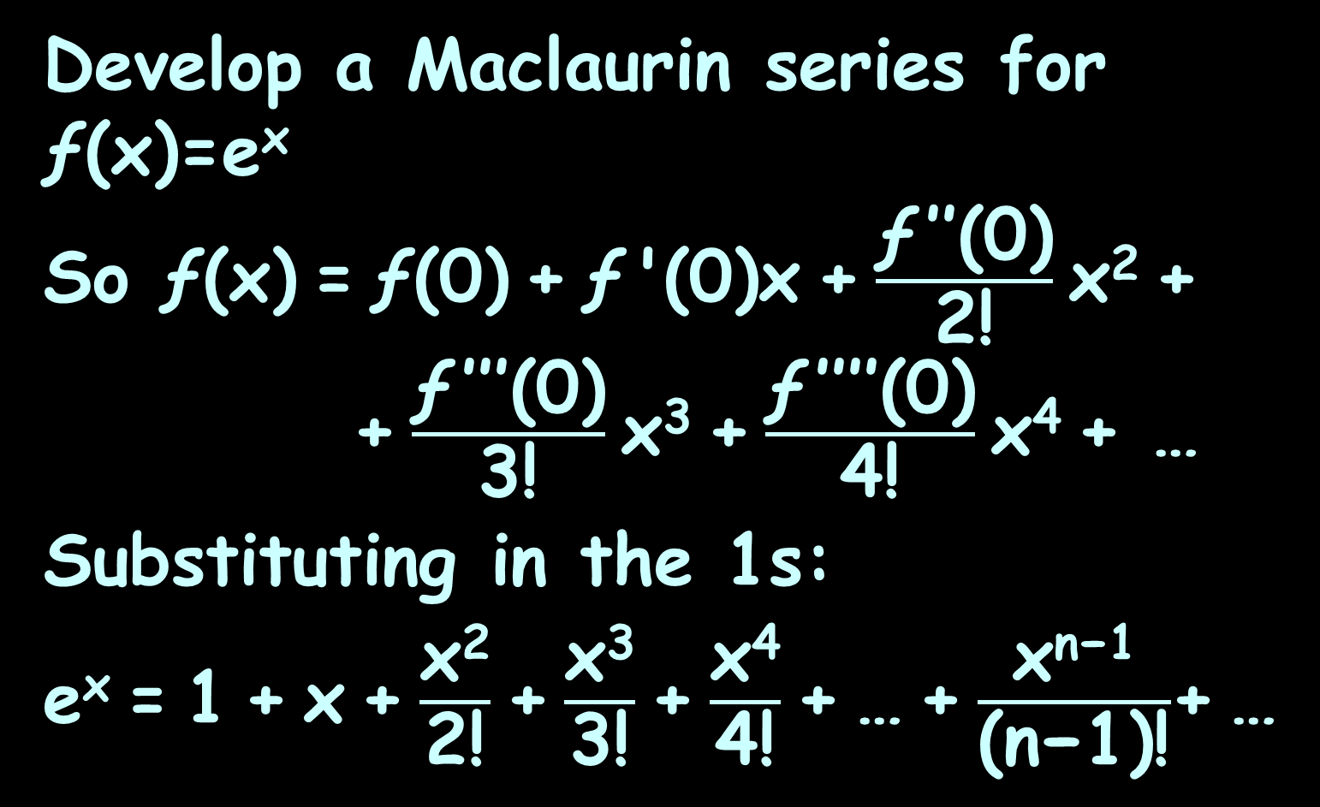
MACLAURIN SERIES
IN-CLASS PROBLEM 8
Develop a Maclaurin series for ƒ(x)=e^{x}
So ƒ(x) = ƒ(0) + ƒ '(0)x + $\frac{\text{ƒ} \text{′′(0)}}{\text{2!}}$ x² +
+ $\frac{\text{ƒ} \text{′′′(0)}}{\text{3}\text{!}}$ x³ + $\frac{\text{ƒ} \text{′′′′(0)}}{\text{4}\text{!}}$ x⁴ + …
Substituting in the 1s:
e^{x} = 1 + x + $\frac{\text{x}\text{2}}{\text{2!}}$ + $\frac{\text{x}\text{3}}{\text{3}\text{!}}$ + $\frac{\text{x}\text{4}}{\text{4}\text{!}}$ + … + $\frac{\text{x}\text{n}\text{−1}}{\text{(}\text{n}\text{−1)}\text{!}}$+ …

Slide 123
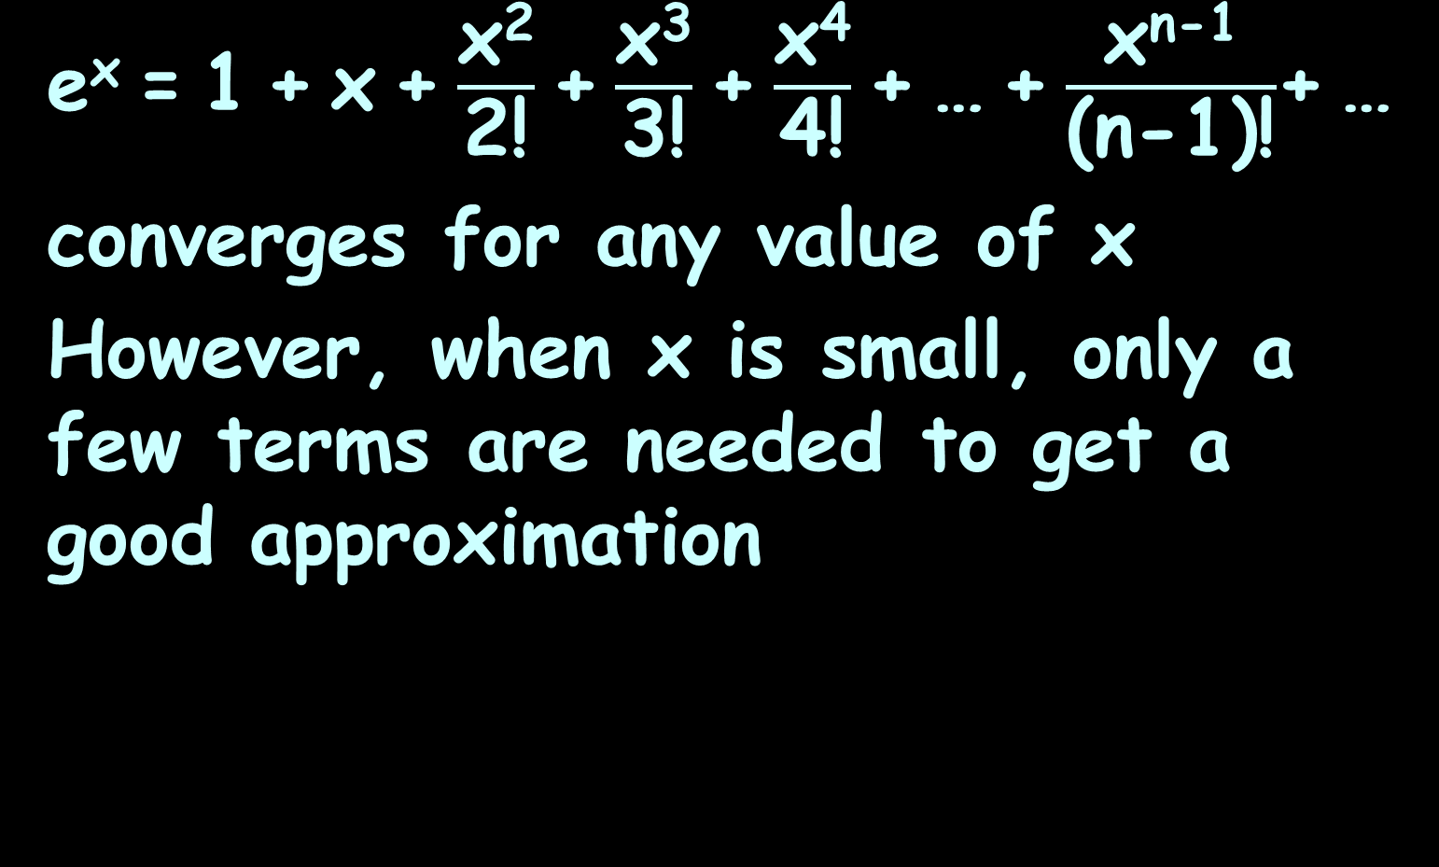
Maclaurin Series
e^{x} = 1 + x + $\frac{\text{x}\text{2}}{\text{2!}}$ + $\frac{\text{x}\text{3}}{\text{3}\text{!}}$ + $\frac{\text{x}\text{4}}{\text{4}\text{!}}$ + … + $\frac{\text{x}\text{n}\text{−1}}{\text{(}\text{n}\text{−1)!}}$+ …
converges for any value of x
However, when x is small, only a few terms are needed to get a good approximation

Slide 124
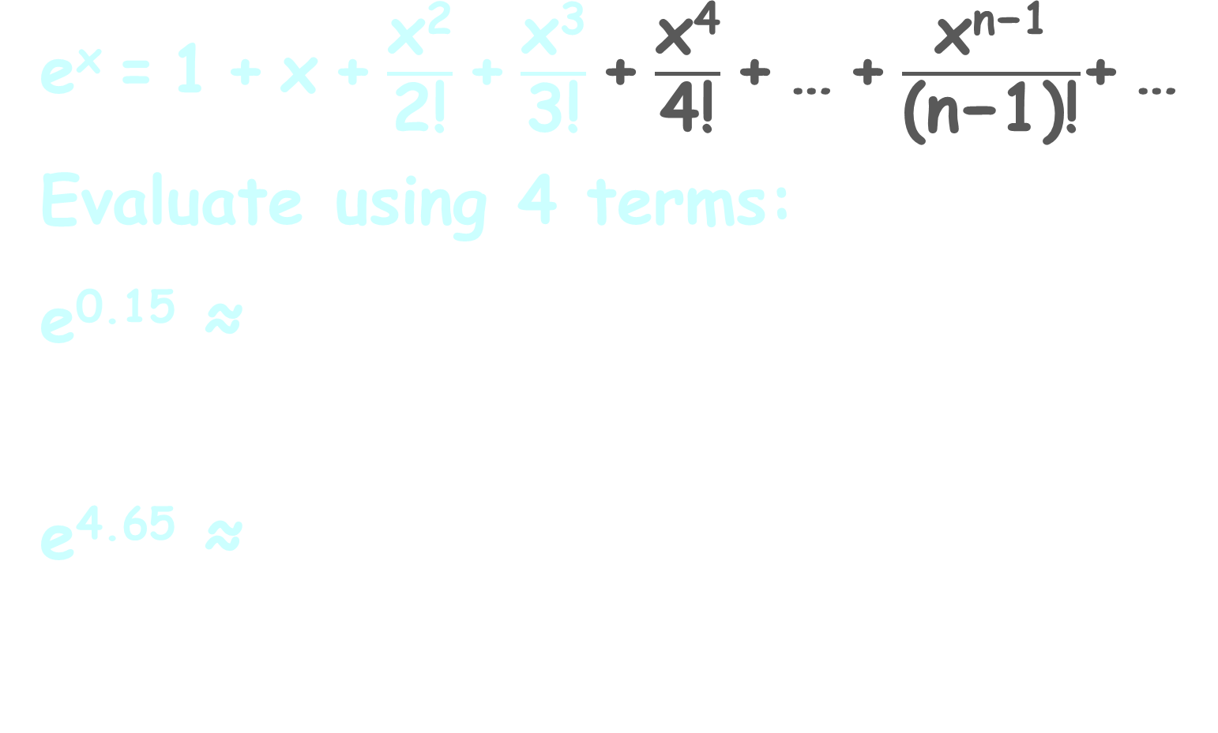
MACLAURIN SERIES
IN-CLASS PROBLEMS 9, 10
e^{x} = 1 + x + $\frac{\text{x}\text{2}}{\text{2!}}$ + $\frac{\text{x}\text{3}}{\text{3}\text{!}}$ + $\frac{\text{x}\text{4}}{\text{4}\text{!}}$ + … + $\frac{\text{x}\text{n}\text{−1}}{\text{(}\text{n}\text{−1)}\text{!}}$+ …
Evaluate using 4 terms:
e^{0.15} ≈
e^{4.65} ≈

Slide 125
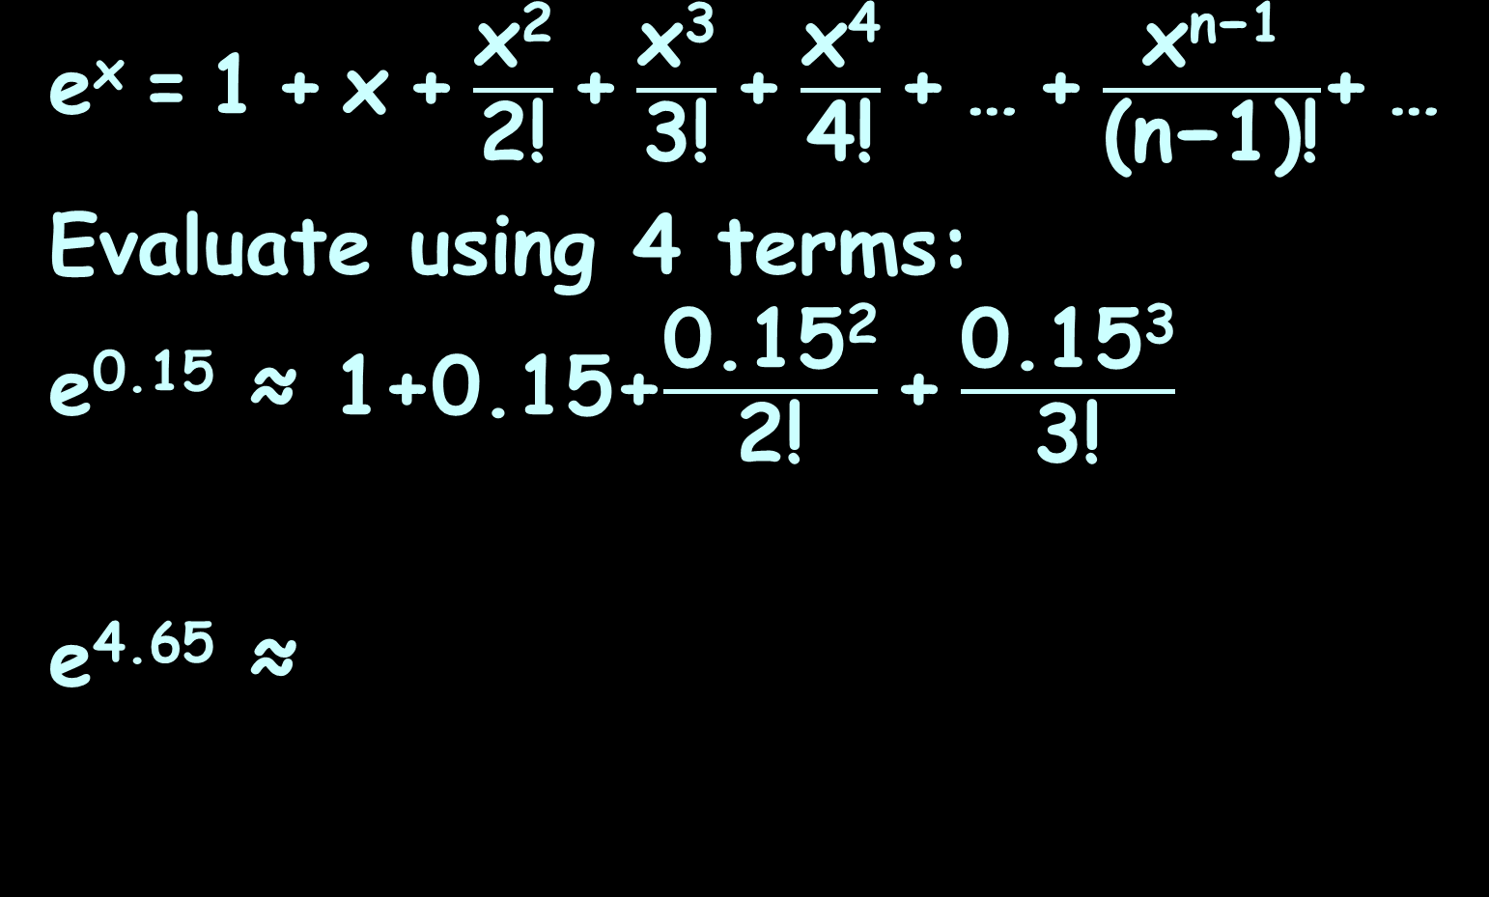
MACLAURIN SERIES
IN-CLASS PROBLEMS 9, 10
e^{x} = 1 + x + $\frac{\text{x}\text{2}}{\text{2!}}$ + $\frac{\text{x}\text{3}}{\text{3}\text{!}}$ + $\frac{\text{x}\text{4}}{\text{4}\text{!}}$ + … + $\frac{\text{x}\text{n}\text{−1}}{\text{(}\text{n}\text{−1)}\text{!}}$+ …
Evaluate using 4 terms:
e^{0.15} ≈ 1+0.15+$\frac{\text{0.15}\text{2}}{\text{2!}}$ + $\frac{\text{0.15}\text{3}}{\text{3}\text{!}}$
e^{4.65} ≈

Slide 126
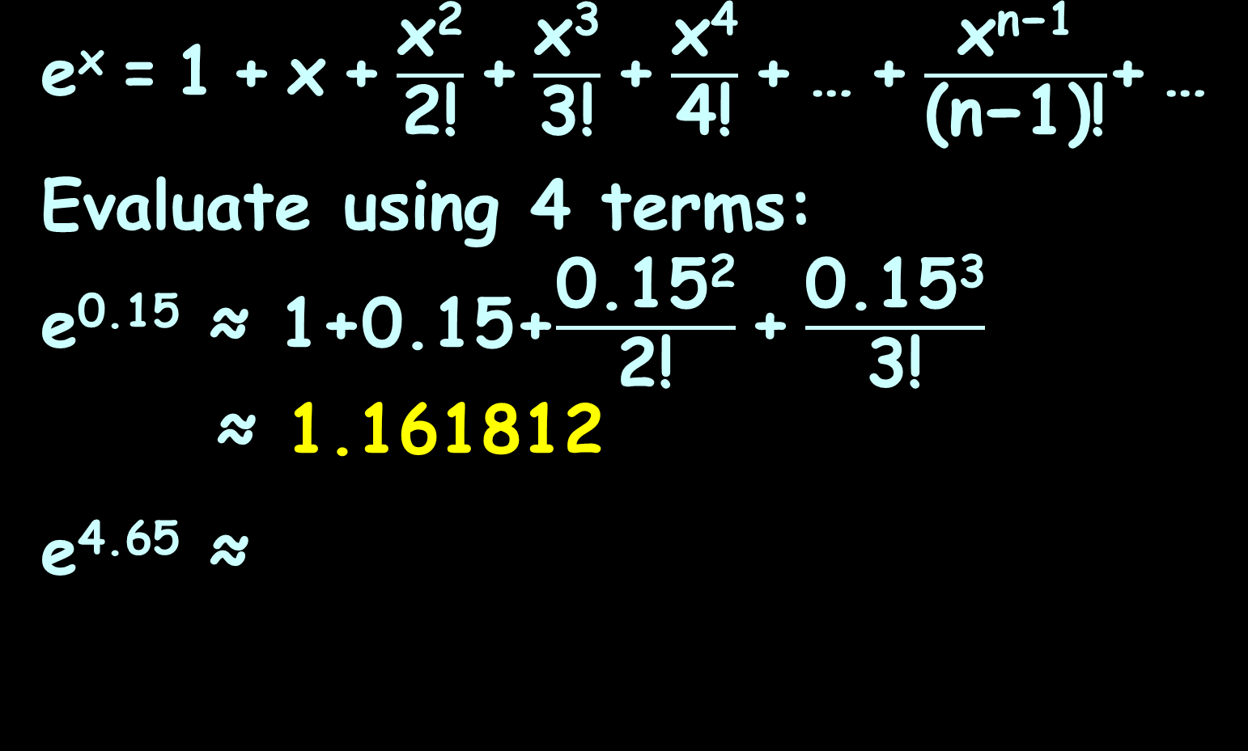
MACLAURIN SERIES
IN-CLASS PROBLEMS 9, 10
e^{x} = 1 + x + $\frac{\text{x}\text{2}}{\text{2!}}$ + $\frac{\text{x}\text{3}}{\text{3}\text{!}}$ + $\frac{\text{x}\text{4}}{\text{4}\text{!}}$ + … + $\frac{\text{x}\text{n}\text{−1}}{\text{(}\text{n}\text{−1)}\text{!}}$+ …
Evaluate using 4 terms:
e^{0.15} ≈ 1+0.15+$\frac{\text{0.15}\text{2}}{\text{2!}}$ + $\frac{\text{0.15}\text{3}}{\text{3}\text{!}}$
≈ 1.161812
e^{4.65} ≈
What does your calculator say?

Slide 127
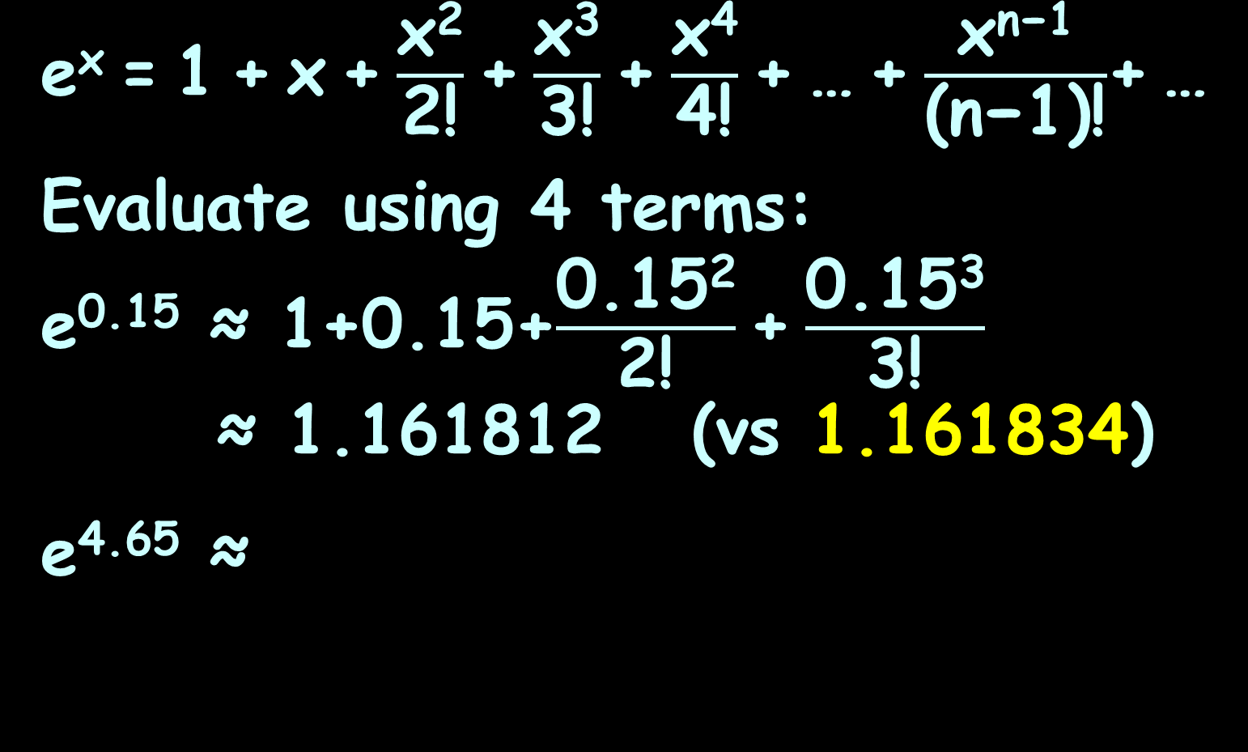
MACLAURIN SERIES
IN-CLASS PROBLEMS 9, 10
e^{x} = 1 + x + $\frac{\text{x}\text{2}}{\text{2!}}$ + $\frac{\text{x}\text{3}}{\text{3}\text{!}}$ + $\frac{\text{x}\text{4}}{\text{4}\text{!}}$ + … + $\frac{\text{x}\text{n}\text{−1}}{\text{(}\text{n}\text{−1)}\text{!}}$+ …
Evaluate using 4 terms:
e^{0.15} ≈ 1+0.15+$\frac{\text{0.15}\text{2}}{\text{2!}}$ + $\frac{\text{0.15}\text{3}}{\text{3}\text{!}}$
≈ 1.161812 (vs 1.161834)
e^{4.65} ≈
Is the approximation good ‘nuff?

Slide 128
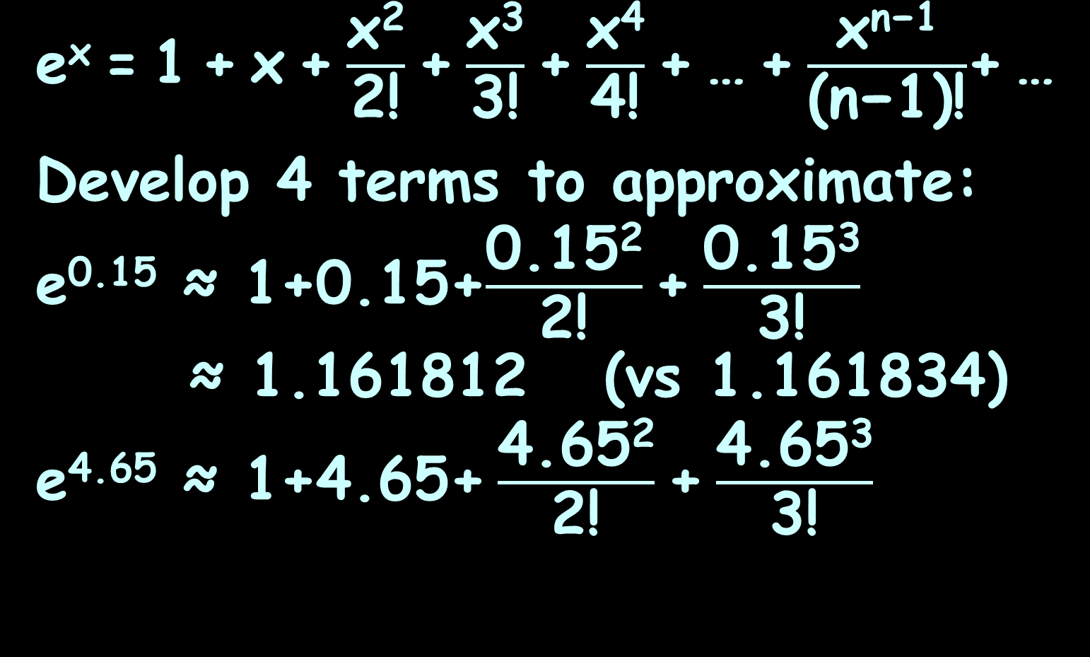
MACLAURIN SERIES
IN-CLASS PROBLEMS 9, 10
e^{x} = 1 + x + $\frac{\text{x}\text{2}}{\text{2!}}$ + $\frac{\text{x}\text{3}}{\text{3}\text{!}}$ + $\frac{\text{x}\text{4}}{\text{4}\text{!}}$ + … + $\frac{\text{x}\text{n}\text{−1}}{\text{(}\text{n}\text{−1)}\text{!}}$+ …
Develop 4 terms to approximate:
e^{0.15} ≈ 1+0.15+$\frac{\text{0.15}\text{2}}{\text{2!}}$ + $\frac{\text{0.15}\text{3}}{\text{3}\text{!}}$
≈ 1.161812 (vs 1.161834)
e^{4.65} ≈ 1+4.65+ $\frac{\text{4.65}\text{2}}{\text{2!}}$ + $\frac{\text{4.65}\text{3}}{\text{3}\text{!}}$

Slide 129
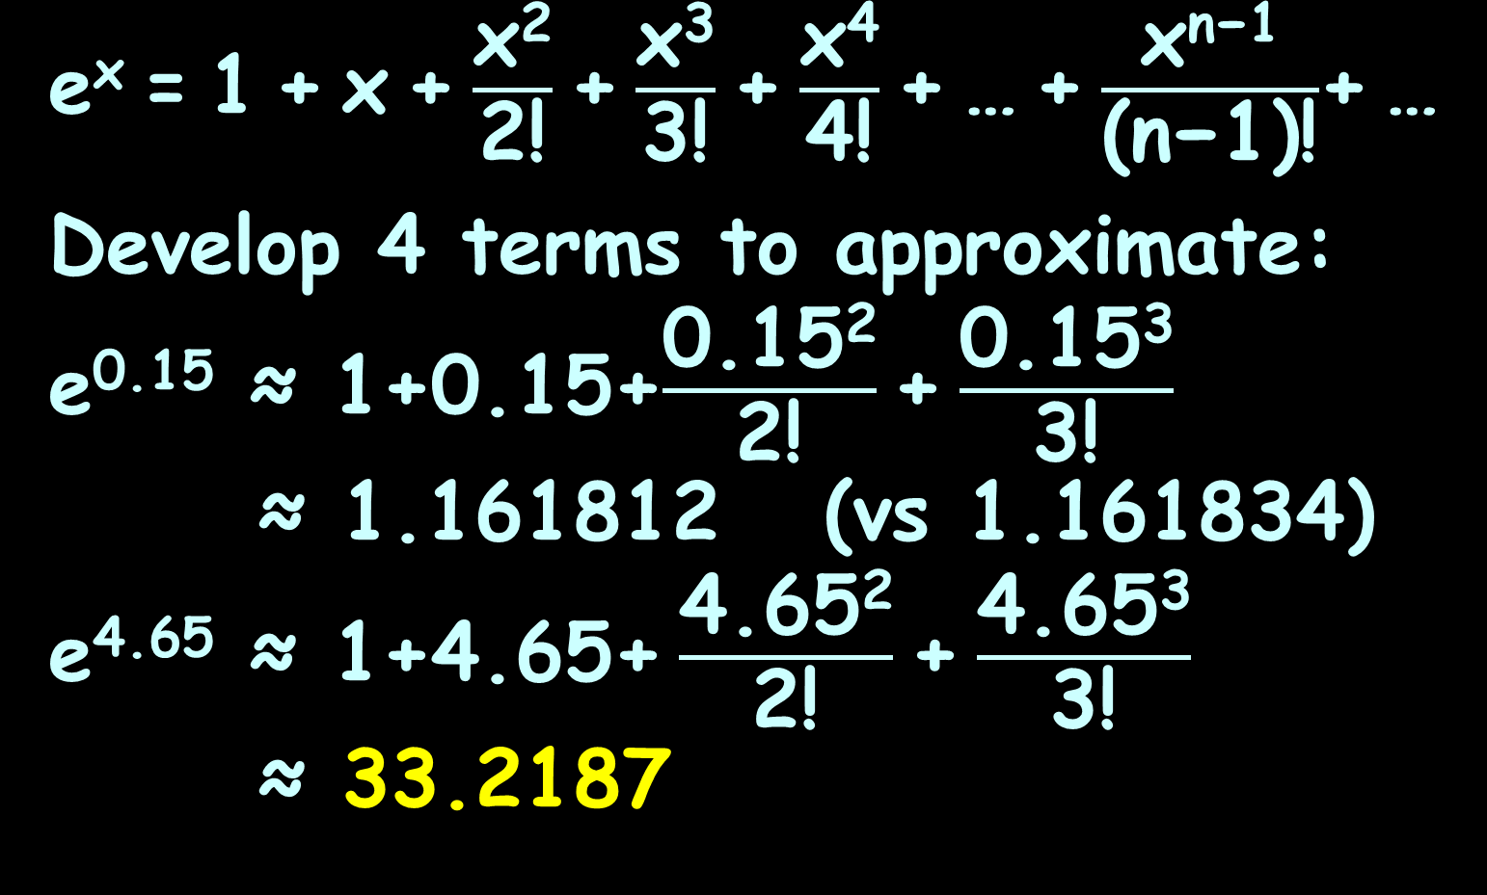
MACLAURIN SERIES
IN-CLASS PROBLEMS 9, 10
e^{x} = 1 + x + $\frac{\text{x}\text{2}}{\text{2!}}$ + $\frac{\text{x}\text{3}}{\text{3}\text{!}}$ + $\frac{\text{x}\text{4}}{\text{4}\text{!}}$ + … + $\frac{\text{x}\text{n}\text{−1}}{\text{(}\text{n}\text{−1)}\text{!}}$+ …
Develop 4 terms to approximate:
e^{0.15} ≈ 1+0.15+$\frac{\text{0.15}\text{2}}{\text{2!}}$ + $\frac{\text{0.15}\text{3}}{\text{3}\text{!}}$
≈ 1.161812 (vs 1.161834)
e^{4.65} ≈ 1+4.65+ $\frac{\text{4.65}\text{2}}{\text{2!}}$ + $\frac{\text{4.65}\text{3}}{\text{3}\text{!}}$
≈ 33.2187
What does your calculator say?

Slide 130
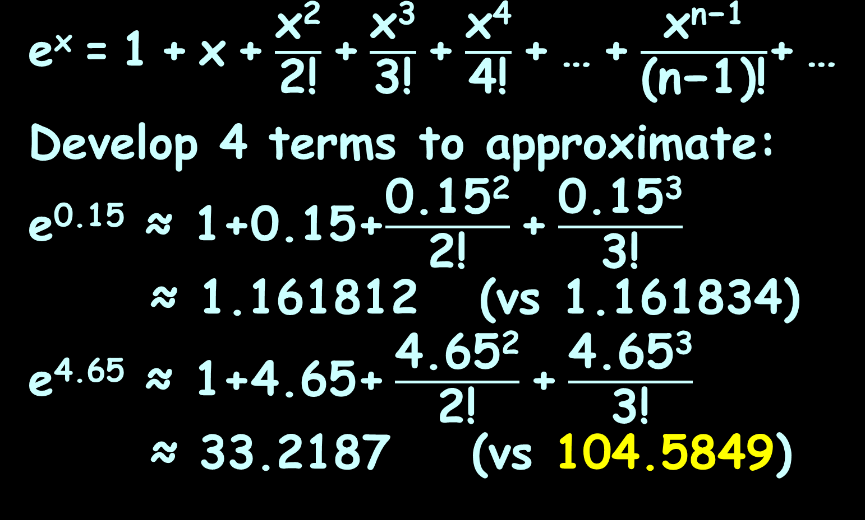
MACLAURIN SERIES
IN-CLASS PROBLEMS 9, 10
e^{x} = 1 + x + $\frac{\text{x}\text{2}}{\text{2!}}$ + $\frac{\text{x}\text{3}}{\text{3}\text{!}}$ + $\frac{\text{x}\text{4}}{\text{4}\text{!}}$ + … + $\frac{\text{x}\text{n}\text{−1}}{\text{(}\text{n}\text{−1)}\text{!}}$+ …
Develop 4 terms to approximate:
e^{0.15} ≈ 1+0.15+$\frac{\text{0.15}\text{2}}{\text{2!}}$ + $\frac{\text{0.15}\text{3}}{\text{3}\text{!}}$
≈ 1.161812 (vs 1.161834)
e^{4.65} ≈ 1+4.65+ $\frac{\text{4.65}\text{2}}{\text{2!}}$ + $\frac{\text{4.65}\text{3}}{\text{3}\text{!}}$
≈ 33.2187 (vs 104.5849)
Is the approximation good ‘nuff?

Slide 131
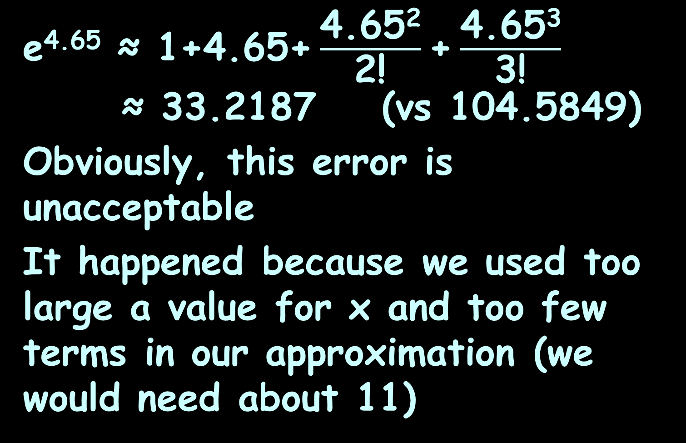
Maclaurin Series
e^{4.65} ≈ 1+4.65+ $\frac{\text{4.65}\text{2}}{\text{2!}}$ + $\frac{\text{4.65}\text{3}}{\text{3}\text{!}}$
≈ 33.2187 (vs 104.5849)
Obviously, this error is unacceptable
It happened because we used too large a value for x and too few terms in our approximation (we would need about 11)

Slide 132
Maclaurin Series
The Maclaurin series works best when x<1

Slide 133
Maclaurin Series
The Maclaurin series works best when x<1
This is because the x³, x⁴, … terms tend to become zero

Slide 134
Questions?
http://i.imgur.com/aliTlT3.jpg

Slide 135
Maclaurin Series
Graphically, the Maclaurin series makes a lot of sense

Slide 136
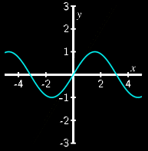
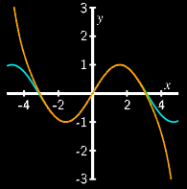
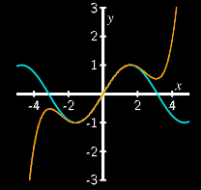
Maclaurin Series
y = x
y = x - x³/3!
original graph
y = x - x³/3! + x⁵/5!
y = x - x³/3! + x⁵/5! – x⁷/7!
https://math.libretexts.org/Bookshelves/Calculus/Book%3A_Active_Calculus_(Boelkins_et_al)/8%3A_Sequences_and_Series/8.5%3A_Taylor_Polynomials_and_Taylor_Series

Slide 137
Maclaurin Series
Notice that the Maclaurin series values are close to the original graph even for y=x when x<1
original graph
y = x
https://math.libretexts.org/Bookshelves/Calculus/Book%3A_Active_Calculus_(Boelkins_et_al)/8%3A_Sequences_and_Series/8.5%3A_Taylor_Polynomials_and_Taylor_Series

Slide 138
Maclaurin Series
For larger values of x, you must include more terms for the series values to become close to the original graph
original graph
y = x - x³/3! + x⁵/5!
y = x - x³/3! + x⁵/5! – x⁷/7!
https://math.libretexts.org/Bookshelves/Calculus/Book%3A_Active_Calculus_(Boelkins_et_al)/8%3A_Sequences_and_Series/8.5%3A_Taylor_Polynomials_and_Taylor_Series

Slide 139
Questions?
http://i.imgur.com/aliTlT3.jpg

Slide 140
Summary
Today we studied:
Review of Convergence
Power Series
Maclaurin Series

Slide 141

You Survived!

