Slide 1
Welcome to
Unit 9
Part 18!
MATH 207 Integral Calculus

Slide 2
What’s Up?
Review:
Parametric Equations
Polar Coordinates
New stuff:
Polar Calculus

Slide 3
What’s Up?
Outcome 7) Solve problems by identifying the requirements, making a sketch as appropriate

Slide 4

Review
http://995642590.r.lightningbase-cdn.com/wp-content/uploads/2010/12/looking-back-hrexaminer-v144-cover425px.jpg

Slide 5
Parametric Differentiation
Not all curves or equations that we’d like to look at are functions

Slide 6
Parametric Differentiation
So, to deal with these, we use parametric equations which express the coordinates of the points of the curve as functions of an additional variable called a “parameter” (usually “t”)

Slide 7
Parametric Differentiation
The collection of points that we get by letting t be all possible values is the graph of the parametric equations and is called the parametric curve

Slide 8
Parametric Differentiation
We will calculate the derivative dy/dx from the parametric derivatives dx/dt and dy/dt

Slide 9
Parametric Differentiation
Important point:
If x = h(t) and y = g(t)
Then dy/dx = dy/dt ÷ dx/dt

Slide 10
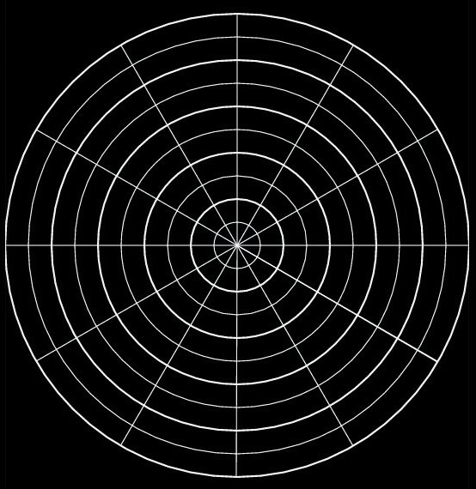
Polar Coordinates
Another way of plotting graphs (especially for periodic functions) is by using circular “polar” graph paper
VFrench, 2015

Slide 11
Polar Coordinates
Just like for (x,y) coordinates, there are a pair of polar coordinates (r,θ)
These are called the “polar coordinates”

Slide 12
Polar Coordinates
r is the distance from the pole (the radius)
θ is the angle around the circle
.
.
r
θ
VFrench, 2015

Slide 13
Polar Coordinates
Positive angles are measured counterclockwise from the polar axis
Negative angles are measured clockwise from the polar axis

Slide 14
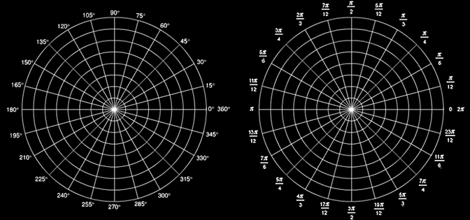
Polar Coordinates
Angles in polar notation can be expressed in either degrees or radians
VFrench, 2015

Slide 15
Polar Coordinates
r > 0 – the point lies on the terminal side of θ
r < 0 - point lies along the ray opposite the terminal side of θ
r = 0 the point lies on the pole no matter what the value of θ is!

Slide 16
Polar Coordinates
Polar to rectangular conversion
If you have a polar point
P = (r,θ)
To convert to (x,y) coordinates:
x = r cos θ
y = r sin θ

Slide 17

Polar Coordinates
Rectangular to polar coordinates
r = $\sqrt{x^{2}+ y^{2}}$
θ = arctan (y ÷ x)

Slide 18
Polar Equations
Converting rectangular equations to polar equations:
replace
x with r cosθ and
y with r sinθ
an example of parametric equations

Slide 19
Polar Equations
Converting polar equations to rectangular equations:
try
r ² = x² + y²
r cosθ = x
r sinθ = y
tanθ = y/x

Slide 20
Polar Equations
This is not easy –
you may have to square both sides,
take the tangent of both sides,
multiply both sides by r

Slide 21

Questions?
http://i.imgur.com/aliTlT3.jpg

Slide 22
Polar Derivatives
This is a calculus class…
http://tutorial.math.lamar.edu/Classes/CalcII/PolarTangents.aspx

Slide 23
Polar Derivatives
This is a calculus class…
so we’ll have to do derivatives and integrals of polars
http://tutorial.math.lamar.edu/Classes/CalcII/PolarTangents.aspx

Slide 24
Polar Derivatives
Find the slope of a polar curve
http://tutorial.math.lamar.edu/Classes/CalcII/PolarTangents.aspx

Slide 25

Polar Derivatives
Find the slope of a polar curve
Remember, a slope will be:
$\frac{\text{dy}}{\text{dx}}$

Slide 26
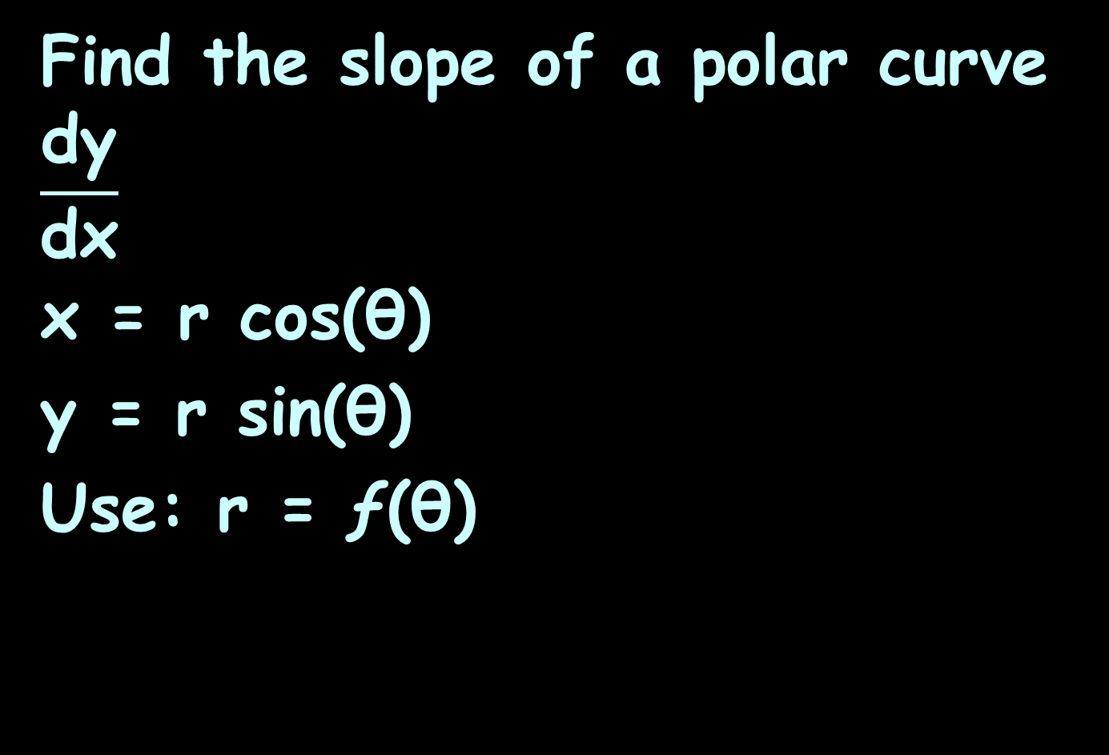
Polar Derivatives
Find the slope of a polar curve
$$\frac{\text{dy}}{\text{dx}}$$
x = r cos(θ)
y = r sin(θ)
Use: r = ƒ(θ)

Slide 27
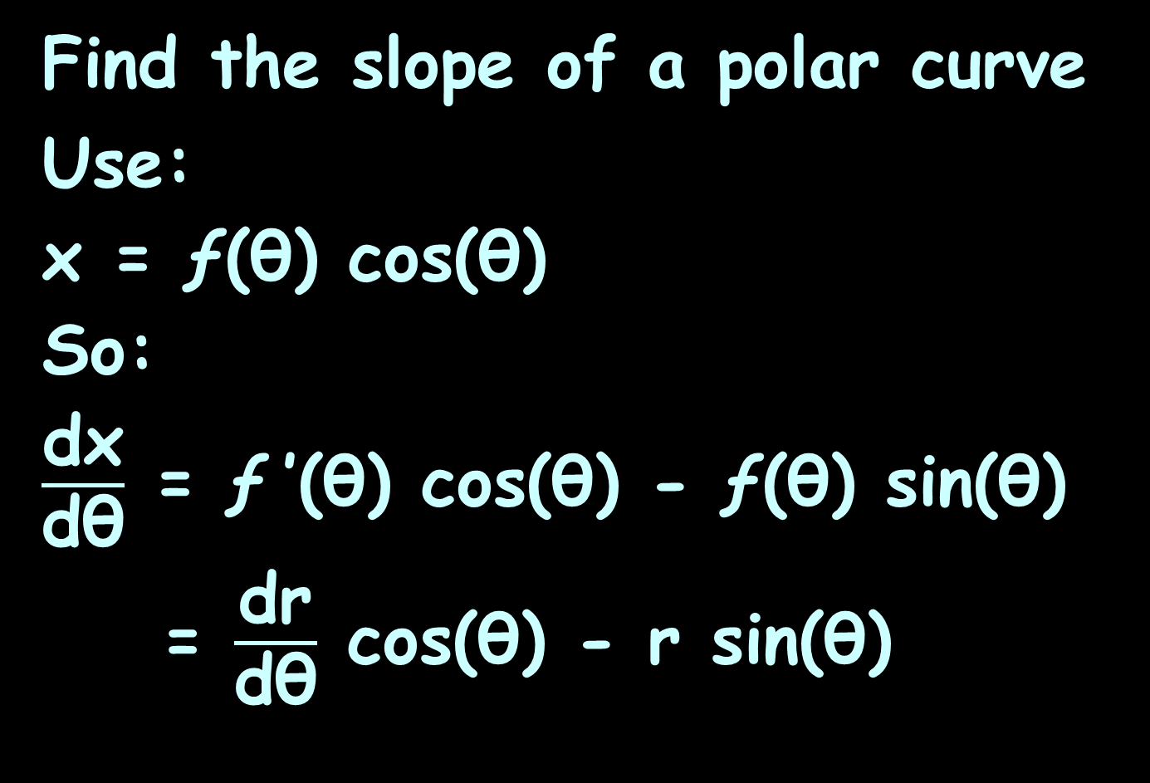
Polar Derivatives
Find the slope of a polar curve
Use:
x = ƒ(θ) cos(θ)
So:
$\frac{\text{dx}}{\text{dθ}}$ = ƒ ’(θ) cos(θ) - ƒ(θ) sin(θ)
= $\frac{\text{dr}}{\text{dθ}}$ cos(θ) - r sin(θ)

Slide 28
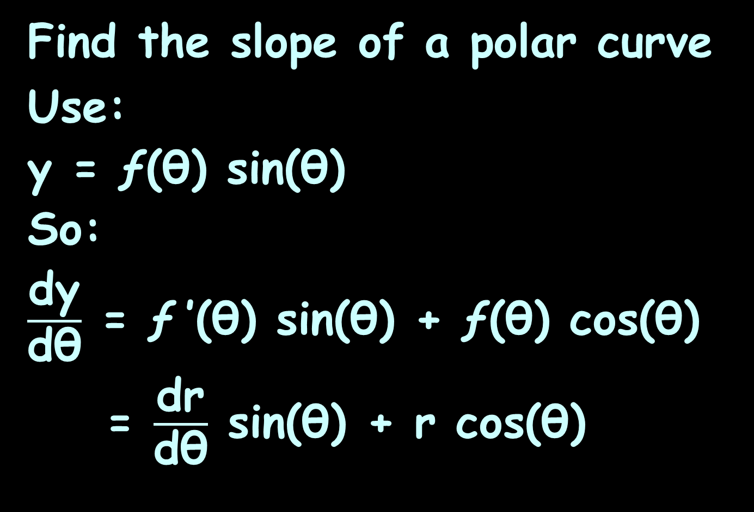
Polar Derivatives
Find the slope of a polar curve
Use:
y = ƒ(θ) sin(θ)
So:
$\frac{\text{d}\text{y}}{\text{dθ}}$ = ƒ ’(θ) sin(θ) + ƒ(θ) cos(θ)
= $\frac{\text{d}\text{r}}{\text{dθ}}$ sin(θ) + r cos(θ)

Slide 29
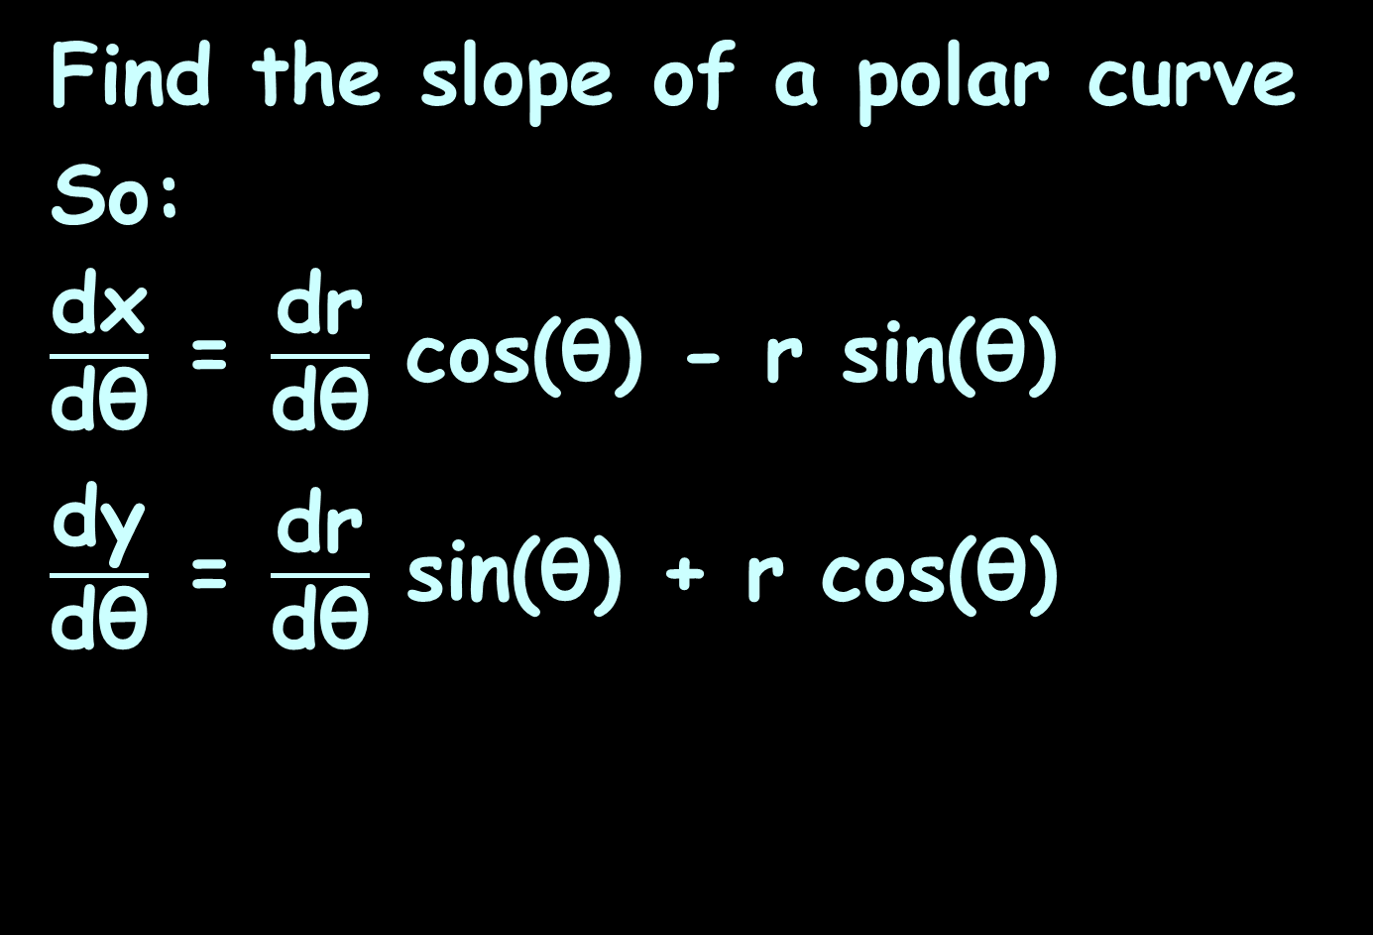
Polar Derivatives
Find the slope of a polar curve
So:
$\frac{\text{dx}}{\text{dθ}}$ = $\frac{\text{dr}}{\text{dθ}}$ cos(θ) - r sin(θ)
$\frac{\text{dy}}{\text{dθ}}$ = $\frac{\text{dr}}{\text{dθ}}$ sin(θ) + r cos(θ)

Slide 30
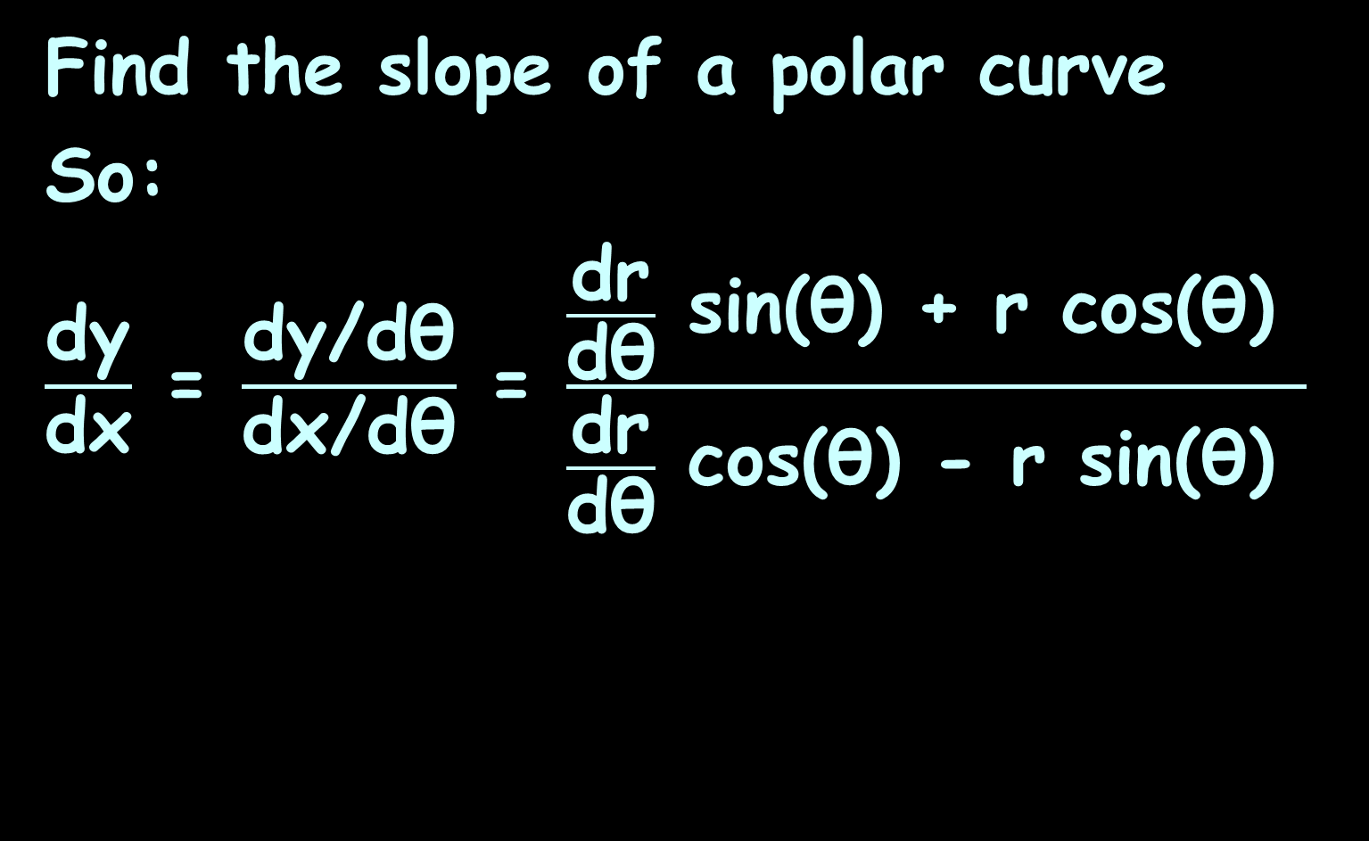
Polar Derivatives
Find the slope of a polar curve
So:
$\frac{\text{d}\text{y}}{\text{d}\text{x}}$ = $\frac{\text{dy}\text{/}\text{dθ}}{\text{d}\text{x}\text{/}\text{d}\text{θ}}$ = $\frac{\frac{\text{dr}}{\text{dθ}} \text{sin}\text{(}\text{θ}\text{) }\text{+} \text{r} \text{cos}\text{(}\text{θ}\text{) }}{\frac{\text{dr}}{\text{dθ}} \text{cos}\text{(}\text{θ}\text{) }\text{−} \text{r} \text{sin}\text{(}\text{θ}\text{) }}$
https://tutorial.math.lamar.edu/Classes/CalcII/PolarTangents.aspx

Slide 31
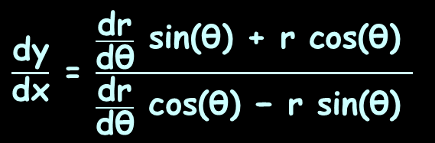

POLAR DERIVATIVES
IN-CLASS PROBLEM 1
$$\text{Find} \text{the} \text{slope} \text{of} \text{the} \text{tangent} \text{line} \text{to} \text{r}\text{ = }\text{sin}\text{(}\text{θ}\text{) }\text{at} \text{θ}\text{ = }\text{π}\text{/}\text{3}$$
$\frac{\text{dy}}{\text{dx}}$ = $\frac{\frac{\text{dr}}{\text{dθ}} \text{sin}\text{(}\text{θ}\text{) + }\text{r} \text{cos}\text{(}\text{θ}\text{) }}{\frac{\text{dr}}{\text{dθ}} \text{cos}\text{(}\text{θ}\text{) − }\text{r} \text{sin}\text{(}\text{θ}\text{) }}$

Slide 32

POLAR DERIVATIVES
IN-CLASS PROBLEM 1
$$\text{Find} \text{the} \text{slope} \text{of} \text{the} \text{tangent} \text{line} \text{to} \text{r}\text{ = }\text{sin}\text{(}\text{θ}\text{) }\text{at} \text{θ}\text{ = }\text{π}\text{/3}$$
$\frac{\text{dr}}{\text{dθ}}$ = ?
$\frac{\text{dy}}{\text{dx}}$ = $\frac{\frac{\text{dr}}{\text{dθ}} \text{sin}\text{(}\text{θ}\text{) + }\text{r} \text{cos}\text{(}\text{θ}\text{) }}{\frac{\text{dr}}{\text{dθ}} \text{cos}\text{(}\text{θ}\text{) − }\text{r} \text{sin}\text{(}\text{θ}\text{) }}$

Slide 33
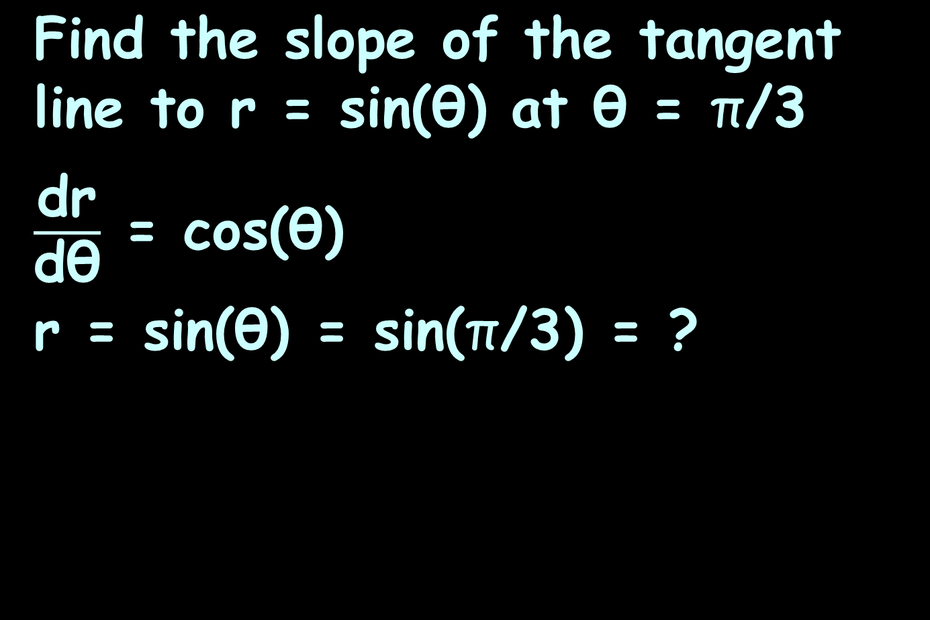
POLAR DERIVATIVES
IN-CLASS PROBLEM 1
$$\text{Find} \text{the} \text{slope} \text{of} \text{the} \text{tangent} \text{line} \text{to} \text{r}\text{ = }\text{sin}\text{(}\text{θ}\text{) }\text{at} \text{θ}\text{ = }\text{π}\text{/3}$$
$\frac{\text{dr}}{\text{dθ}}$ = cos($\text{θ}$)
r = sin($\text{θ}$) = sin($\text{π}\text{/3}$) = ?
$\frac{\text{dy}}{\text{dx}}$ = $\frac{\frac{\text{dr}}{\text{dθ}} \text{sin}\text{(}\text{θ}\text{) + }\text{r} \text{cos}\text{(}\text{θ}\text{) }}{\frac{\text{dr}}{\text{dθ}} \text{cos}\text{(}\text{θ}\text{) − }\text{r} \text{sin}\text{(}\text{θ}\text{) }}$

Slide 34
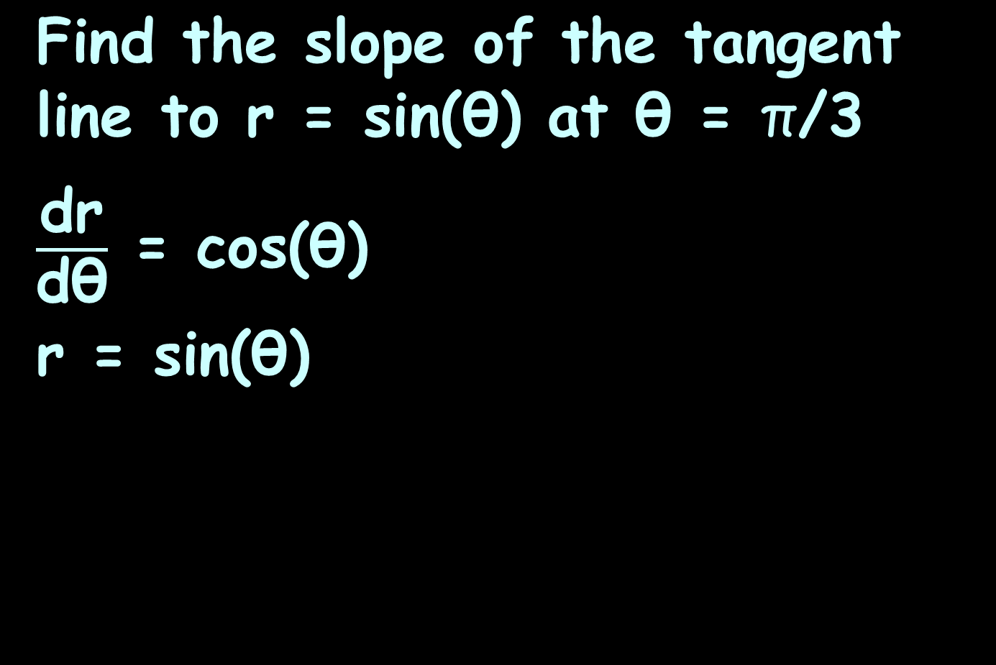
POLAR DERIVATIVES
IN-CLASS PROBLEM 1
$$\text{Find} \text{the} \text{slope} \text{of} \text{the} \text{tangent} \text{line} \text{to} \text{r}\text{ = }\text{sin}\text{(}\text{θ}\text{) }\text{at} \text{θ}\text{ = }\text{π}\text{/3}$$
$\frac{\text{dr}}{\text{dθ}}$ = cos($\text{θ}$)
r = sin($\text{θ}$)
$\frac{\text{dy}}{\text{dx}}$ = $\frac{\frac{\text{dr}}{\text{dθ}} \text{sin}\text{(}\text{θ}\text{) + }\text{r} \text{cos}\text{(}\text{θ}\text{) }}{\frac{\text{dr}}{\text{dθ}} \text{cos}\text{(}\text{θ}\text{) − }\text{r} \text{sin}\text{(}\text{θ}\text{) }}$

Slide 35
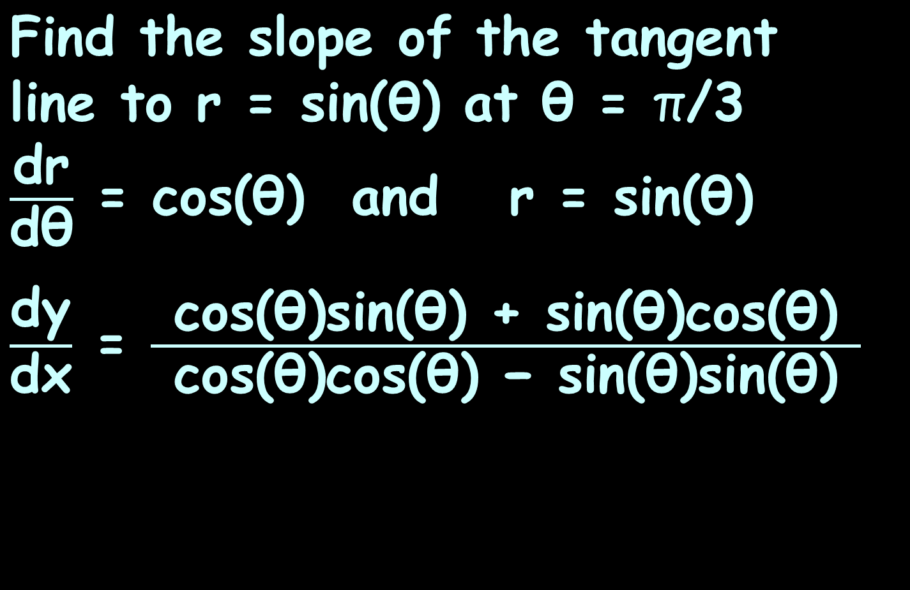
POLAR DERIVATIVES
IN-CLASS PROBLEM 1
$$\text{Find} \text{the} \text{slope} \text{of} \text{the} \text{tangent} \text{line} \text{to} \text{r}\text{ = }\text{sin}\text{(}\text{θ}\text{) }\text{at} \text{θ}\text{ = }\text{π}\text{/3}$$
$\frac{\text{dr}}{\text{dθ}}$ = cos($\text{θ}$) and $\text{r}\text{ = }\text{sin}\text{(}\text{θ}$)
$\frac{\text{dy}}{\text{dx}}$ = $\frac{ \text{cos}\text{(}\text{θ}\text{)}\text{sin}\text{(}\text{θ}\text{) }\text{+} \text{sin}\text{(}\text{θ}\text{)}\text{cos}\text{(}\text{θ}\text{) }}{ \text{cos}\text{(}\text{θ}\text{)}\text{cos}\text{(}\text{θ}\text{) }\text{−} \text{sin}\text{(}\text{θ}\text{)}\text{sin}\text{(}\text{θ}\text{) }}$
$\frac{\text{dy}}{\text{dx}}$ = $\frac{\frac{\text{dr}}{\text{dθ}} \text{sin}\text{(}\text{θ}\text{) + }\text{r} \text{cos}\text{(}\text{θ}\text{) }}{\frac{\text{dr}}{\text{dθ}} \text{cos}\text{(}\text{θ}\text{) − }\text{r} \text{sin}\text{(}\text{θ}\text{) }}$

Slide 36
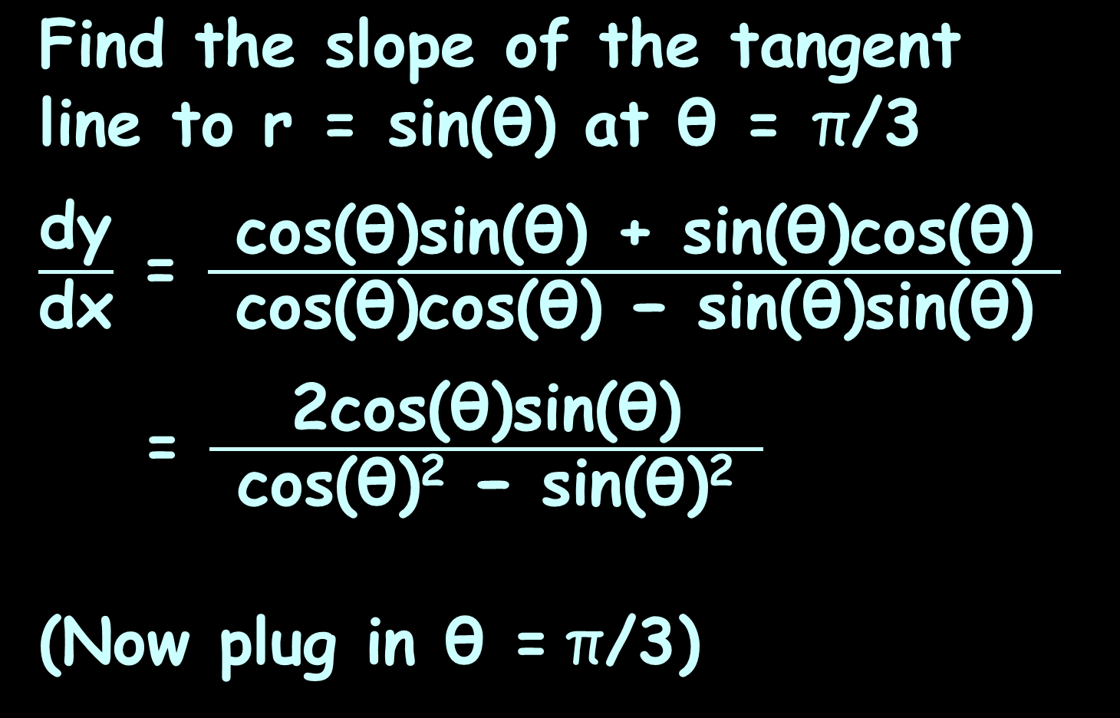
POLAR DERIVATIVES
IN-CLASS PROBLEM 1
$$\text{Find} \text{the} \text{slope} \text{of} \text{the} \text{tangent} \text{line} \text{to} \text{r}\text{ = }\text{sin}\text{(}\text{θ}\text{) }\text{at} \text{θ}\text{ = }\text{π}\text{/3}$$
$\frac{\text{dy}}{\text{dx}}$ = $\frac{ \text{cos}\text{(}\text{θ}\text{)}\text{sin}\text{(}\text{θ}\text{) + }\text{sin}\text{(}\text{θ}\text{)}\text{cos}\text{(}\text{θ}\text{) }}{ \text{cos}\text{(}\text{θ}\text{)}\text{cos}\text{(}\text{θ}\text{) }\text{−} \text{sin}\text{(}\text{θ}\text{)}\text{sin}\text{(}\text{θ}\text{) }}$
= $\frac{ \text{2}\text{cos}\text{(}\text{θ}\text{)}\text{sin}\text{(}\text{θ}\text{) }}{ \text{cos}\text{(}\text{θ}\text{)2 }\text{−} \text{s}\text{in}\text{(}\text{θ}\text{)2 }}$
(Now plug in $\text{θ}\text{ =} \text{π}\text{/}\text{3}$)

Slide 37

POLAR DERIVATIVES
IN-CLASS PROBLEM 1
$$\text{Find} \text{the} \text{slope} \text{of} \text{the} \text{tangent} \text{line} \text{to} \text{r}\text{ = }\text{sin}\text{(}\text{θ}\text{) }\text{at} \text{θ}\text{ = }\text{π}\text{/3}$$
$\frac{\text{dy}}{\text{dx}}$ = $\frac{ \text{2}\text{cos}\text{(}\text{π}\text{/3)}\text{sin}\text{(}\text{π}\text{/3) }}{ \text{cos}\text{(}\text{π}\text{/3)}\text{2} \text{−} \text{s}\text{in}\text{(}\text{π}\text{/3)}\text{2} }$

Slide 38
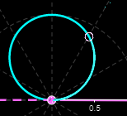
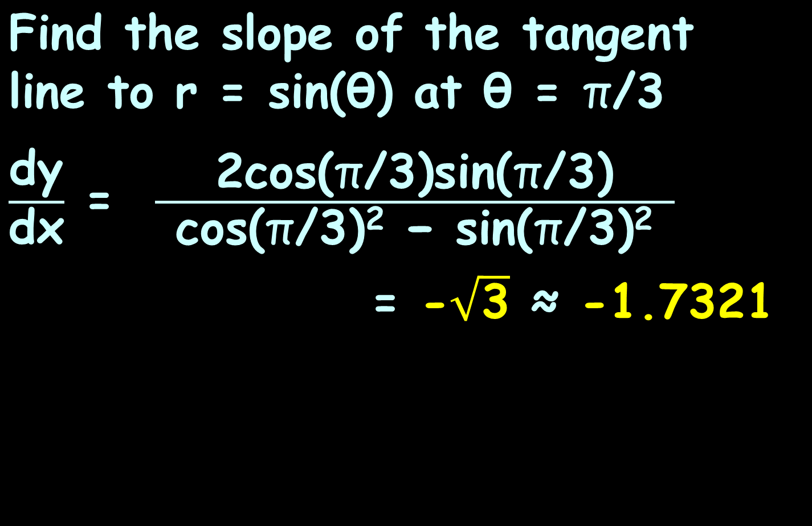

POLAR DERIVATIVES
IN-CLASS PROBLEM 1
$$\text{Find} \text{the} \text{slope} \text{of} \text{the} \text{tangent} \text{line} \text{to} \text{r}\text{ = }\text{sin}\text{(}\text{θ}\text{) }\text{at} \text{θ}\text{ = }\text{π}\text{/3}$$
$\frac{\text{dy}}{\text{dx}}$ = $\frac{ \text{2}\text{cos}\text{(}\text{π}\text{/3)}\text{sin}\text{(}\text{π}\text{/3) }}{ \text{cos}\text{(}\text{π}\text{/3)}\text{2} \text{−} \text{s}\text{in}\text{(}\text{π}\text{/3)}\text{2} }$
= -$\sqrt{\text{3}}$ ≈ -1.7321
$$\text{π}\text{/3}$$
VFrench, 2021

Slide 39
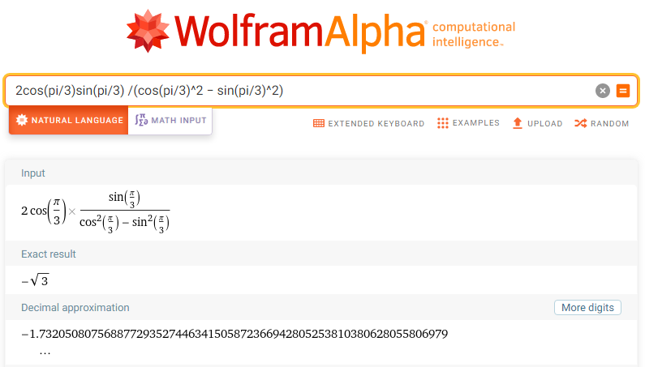
POLAR DERIVATIVES
IN-CLASS PROBLEM 1

Slide 40
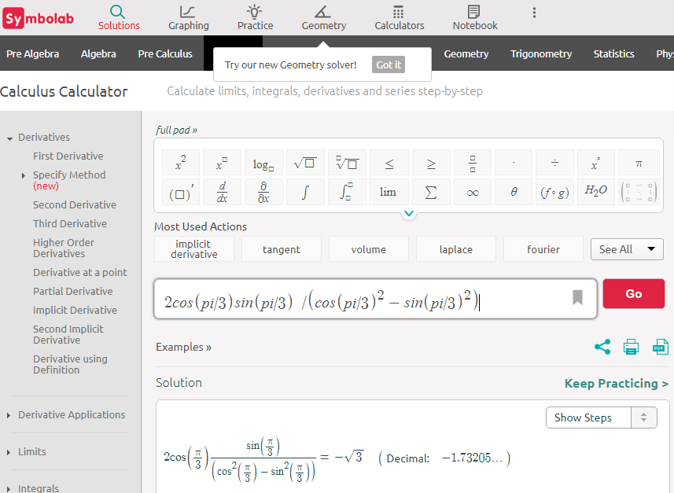

Slide 41
Questions?
http://i.imgur.com/aliTlT3.jpg

Slide 42
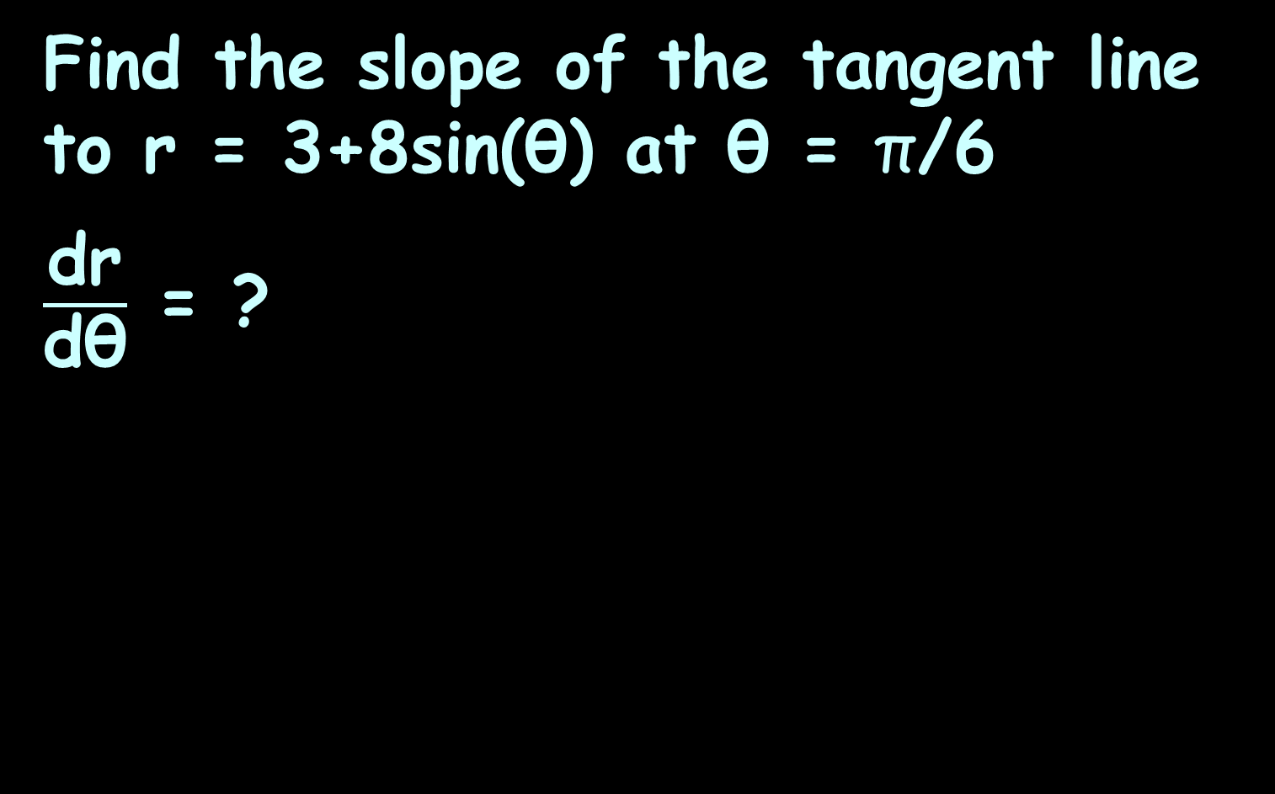
POLAR DERIVATIVES
IN-CLASS PROBLEM 2
Find the slope of the tangent line to r = 3+8sin(θ) at θ = π$\text{/}$6
$\frac{\text{dr}}{\text{dθ}}$ = ?
$\frac{\text{dy}}{\text{dx}}$ = $\frac{\frac{\text{dr}}{\text{dθ}} \text{sin}\text{(}\text{θ}\text{) + }\text{r} \text{cos}\text{(}\text{θ}\text{) }}{\frac{\text{dr}}{\text{dθ}} \text{cos}\text{(}\text{θ}\text{) − }\text{r} \text{sin}\text{(}\text{θ}\text{) }}$
https://tutorial.math.lamar.edu/Classes/CalcII/PolarTangents.aspx

Slide 43
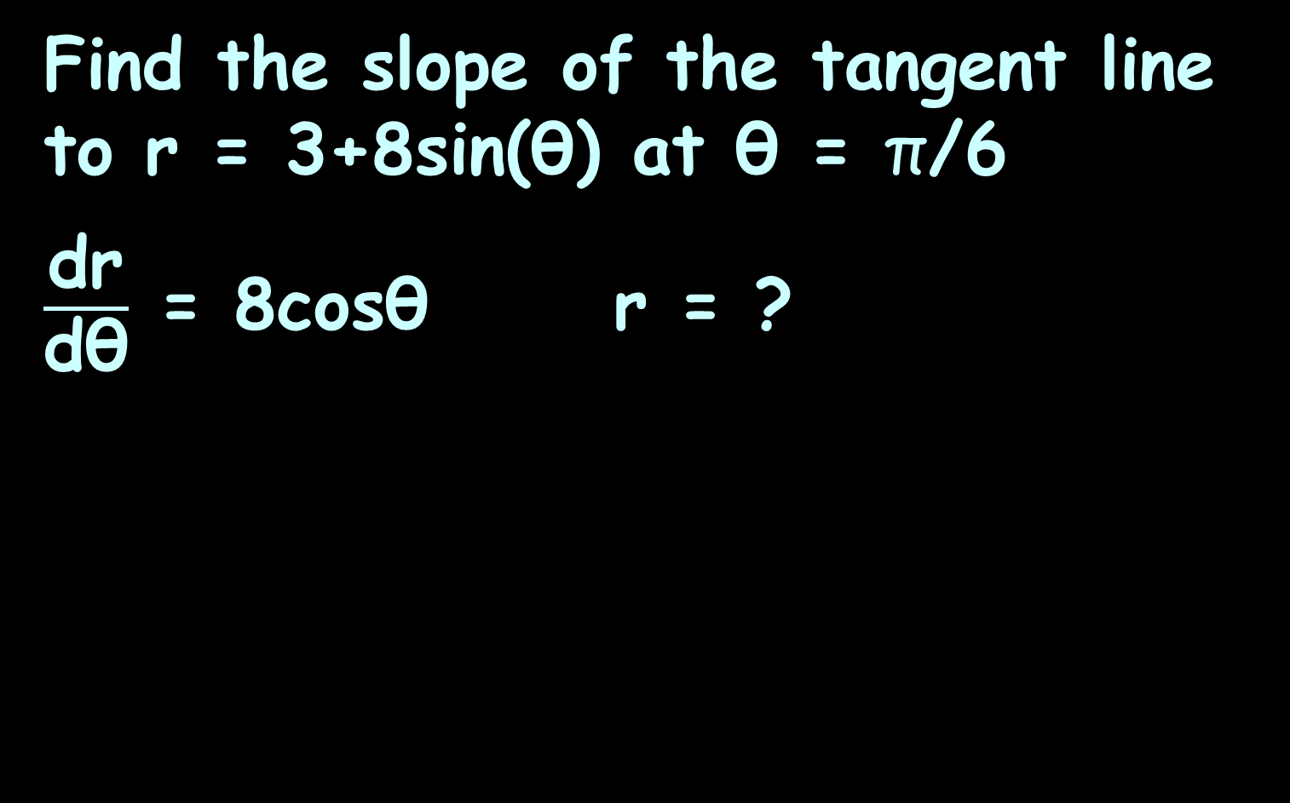
POLAR DERIVATIVES
IN-CLASS PROBLEM 2
Find the slope of the tangent line to r = 3+8sin(θ) at θ = π$\text{/}$6
$\frac{\text{dr}}{\text{dθ}}$ = 8cos$\text{θ}$ r = ?
$\frac{\text{dy}}{\text{dx}}$ = $\frac{\frac{\text{dr}}{\text{dθ}} \text{sin}\text{(}\text{θ}\text{) + }\text{r} \text{cos}\text{(}\text{θ}\text{) }}{\frac{\text{dr}}{\text{dθ}} \text{cos}\text{(}\text{θ}\text{) − }\text{r} \text{sin}\text{(}\text{θ}\text{) }}$
https://tutorial.math.lamar.edu/Classes/CalcII/PolarTangents.aspx

Slide 44
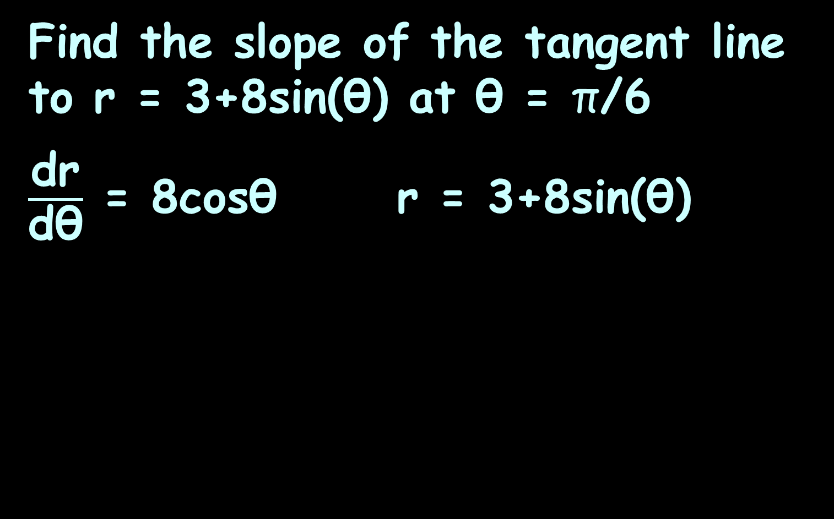
POLAR DERIVATIVES
IN-CLASS PROBLEM 2
Find the slope of the tangent line to r = 3+8sin(θ) at θ = π$\text{/}$6
$\frac{\text{dr}}{\text{dθ}}$ = 8cos$\text{θ}$ r = 3+8sin(θ)
$\frac{\text{dy}}{\text{dx}}$ = $\frac{\frac{\text{dr}}{\text{dθ}} \text{sin}\text{(}\text{θ}\text{) + }\text{r} \text{cos}\text{(}\text{θ}\text{) }}{\frac{\text{dr}}{\text{dθ}} \text{cos}\text{(}\text{θ}\text{) − }\text{r} \text{sin}\text{(}\text{θ}\text{) }}$
https://tutorial.math.lamar.edu/Classes/CalcII/PolarTangents.aspx

Slide 45
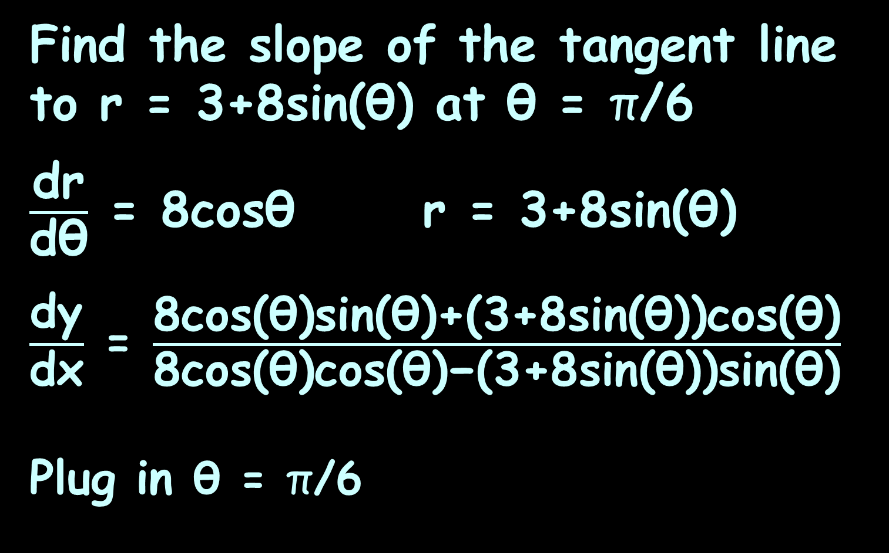
POLAR DERIVATIVES
IN-CLASS PROBLEM 2
Find the slope of the tangent line to r = 3+8sin(θ) at θ = π$\text{/}$6
$\frac{\text{dr}}{\text{dθ}}$ = 8cos$\text{θ}$ r = 3+8sin(θ)
$\frac{\text{dy}}{\text{dx}}$ = $\frac{\text{8}\text{cos}\text{(}\text{θ}\text{)}\text{sin}\text{(}\text{θ}\text{)}\text{+(3+8}\text{sin}\text{(}\text{θ}\text{))}\text{cos}\text{(}\text{θ}\text{)}}{\text{8}\text{cos}\text{(}\text{θ}\text{)}\text{cos}\text{(}\text{θ}\text{)}\text{−(3+8}\text{sin}\text{(}\text{θ}\text{))}\text{sin}\text{(}\text{θ}\text{)}}$
Plug in θ = π$\text{/}$6
$\frac{\text{dy}}{\text{dx}}$ = $\frac{\frac{\text{dr}}{\text{dθ}} \text{sin}\text{(}\text{θ}\text{) + }\text{r} \text{cos}\text{(}\text{θ}\text{) }}{\frac{\text{dr}}{\text{dθ}} \text{cos}\text{(}\text{θ}\text{) − }\text{r} \text{sin}\text{(}\text{θ}\text{) }}$
https://tutorial.math.lamar.edu/Classes/CalcII/PolarTangents.aspx

Slide 46
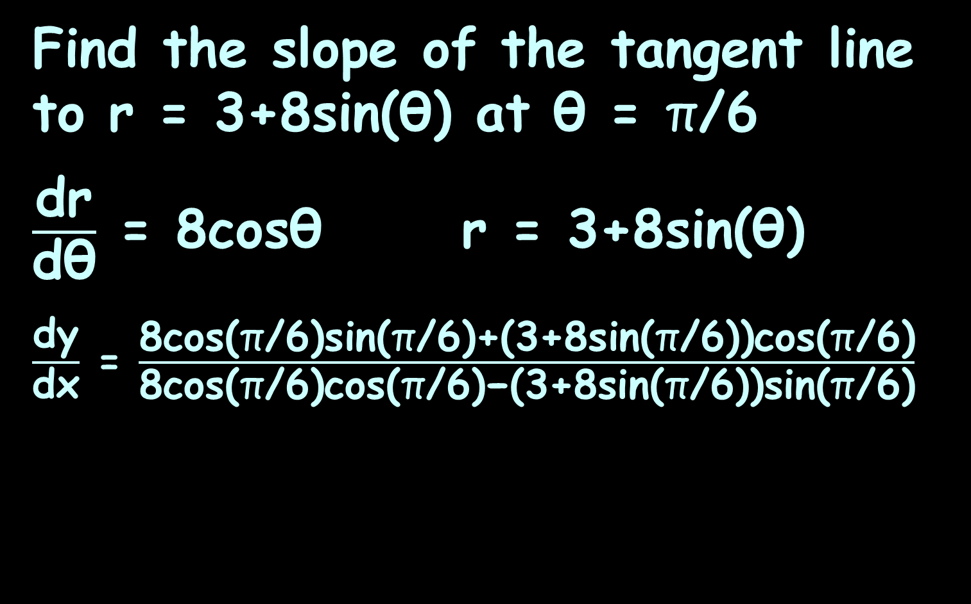
POLAR DERIVATIVES
IN-CLASS PROBLEM 2
Find the slope of the tangent line to r = 3+8sin(θ) at θ = π$\text{/}$6
$\frac{\text{dr}}{\text{dθ}}$ = 8cos$\text{θ}$ r = 3+8sin(θ)
$\frac{\text{dy}}{\text{dx}}$ = $\frac{\text{8}\text{cos}\text{(}\text{π}\text{/6}\text{)}\text{sin}\text{(}\text{π}\text{/6)}\text{+(3+8}\text{sin}\text{(}\text{π}\text{/6}\text{))}\text{cos}\text{(}\text{π}\text{/6)}}{\text{8}\text{cos}\text{(}\text{π}\text{/6}\text{)}\text{cos}\text{(}\text{π}\text{/6)}\text{−(3+8}\text{sin}\text{(}\text{π}\text{/6}\text{))}\text{sin}\text{(}\text{π}\text{/6)}}$
$\frac{\text{dy}}{\text{dx}}$ = $\frac{\frac{\text{dr}}{\text{dθ}} \text{sin}\text{(}\text{θ}\text{) + }\text{r} \text{cos}\text{(}\text{θ}\text{) }}{\frac{\text{dr}}{\text{dθ}} \text{cos}\text{(}\text{θ}\text{) − }\text{r} \text{sin}\text{(}\text{θ}\text{) }}$
https://tutorial.math.lamar.edu/Classes/CalcII/PolarTangents.aspx

Slide 47
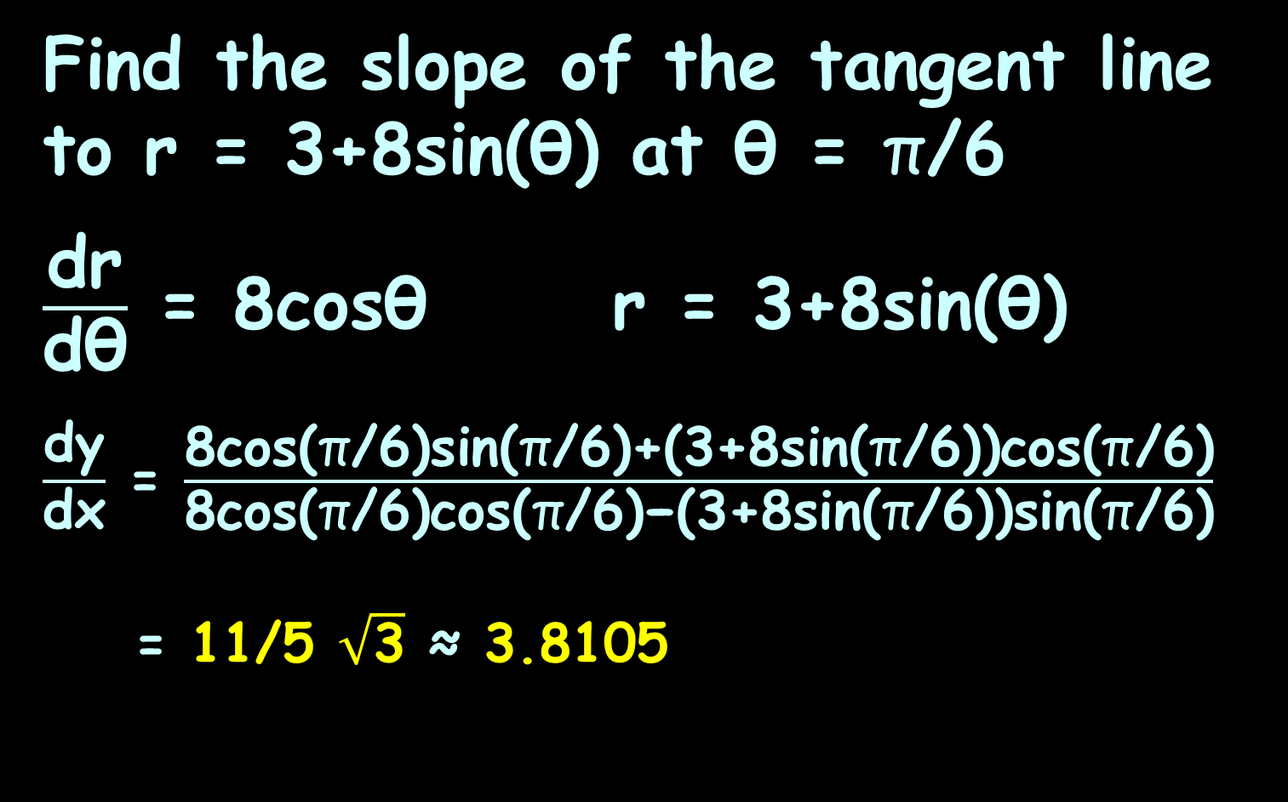
POLAR DERIVATIVES
IN-CLASS PROBLEM 2
Find the slope of the tangent line to r = 3+8sin(θ) at θ = π$\text{/}$6
$\frac{\text{dr}}{\text{dθ}}$ = 8cos$\text{θ}$ r = 3+8sin(θ)
$\frac{\text{dy}}{\text{dx}}$ = $\frac{\text{8}\text{cos}\text{(}\text{π}\text{/6}\text{)}\text{sin}\text{(}\text{π}\text{/6)}\text{+(3+8}\text{sin}\text{(}\text{π}\text{/6}\text{))}\text{cos}\text{(}\text{π}\text{/6)}}{\text{8}\text{cos}\text{(}\text{π}\text{/6}\text{)}\text{cos}\text{(}\text{π}\text{/6)}\text{−(3+8}\text{sin}\text{(}\text{π}\text{/6}\text{))}\text{sin}\text{(}\text{π}\text{/6)}}$
= 11/5 $\sqrt{\text{3}}$ ≈ 3.8105
https://tutorial.math.lamar.edu/Classes/CalcII/PolarTangents.aspx

Slide 48
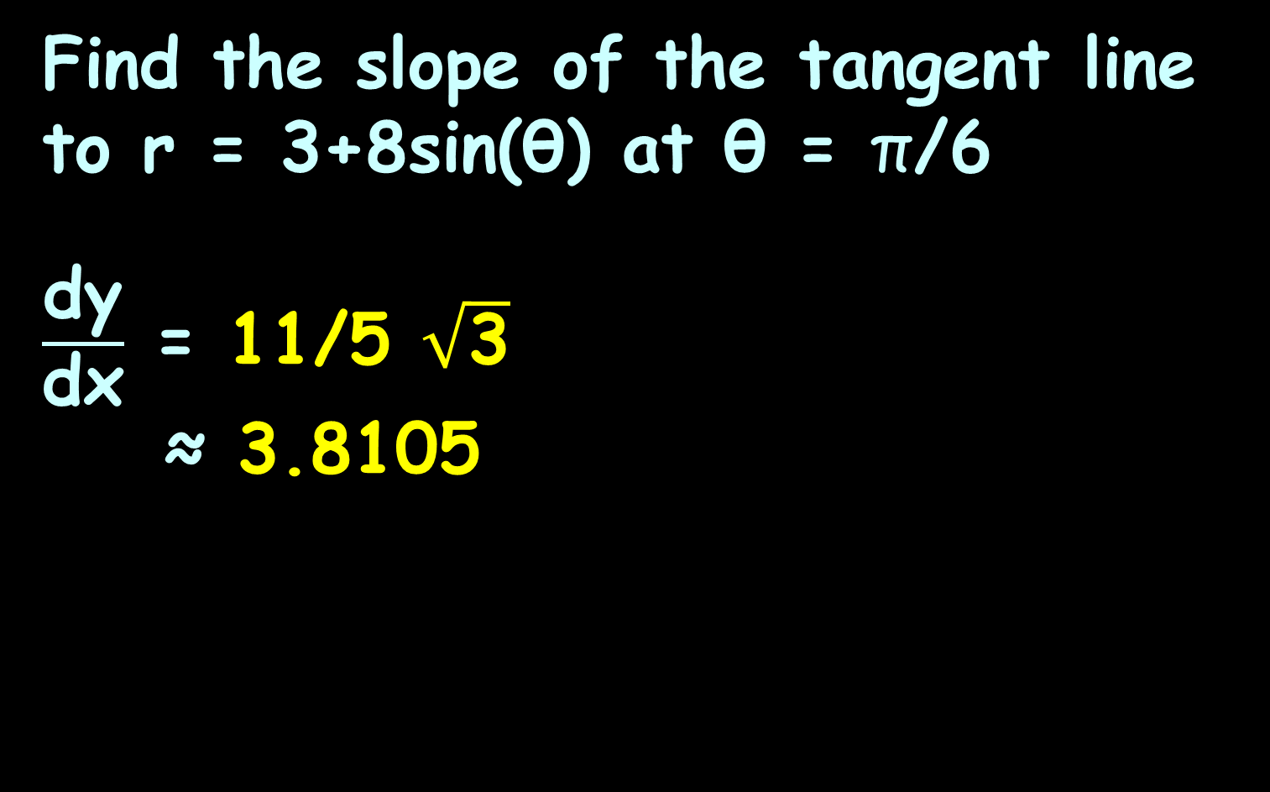

POLAR DERIVATIVES
IN-CLASS PROBLEM 2
Find the slope of the tangent line to r = 3+8sin(θ) at θ = π$\text{/}$6
$\frac{\text{d}\text{y}}{\text{d}\text{x}}$ = 11/5 $\sqrt{\text{3}}$
≈ 3.8105
π$\text{/}$6
https://tutorial.math.lamar.edu/Classes/CalcII/PolarTangents.aspx

Slide 49
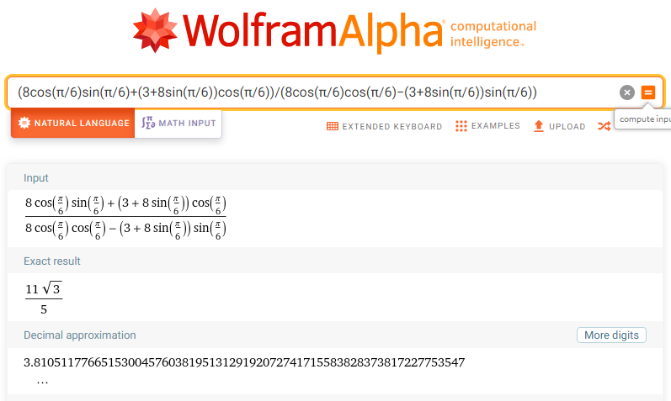

Slide 50
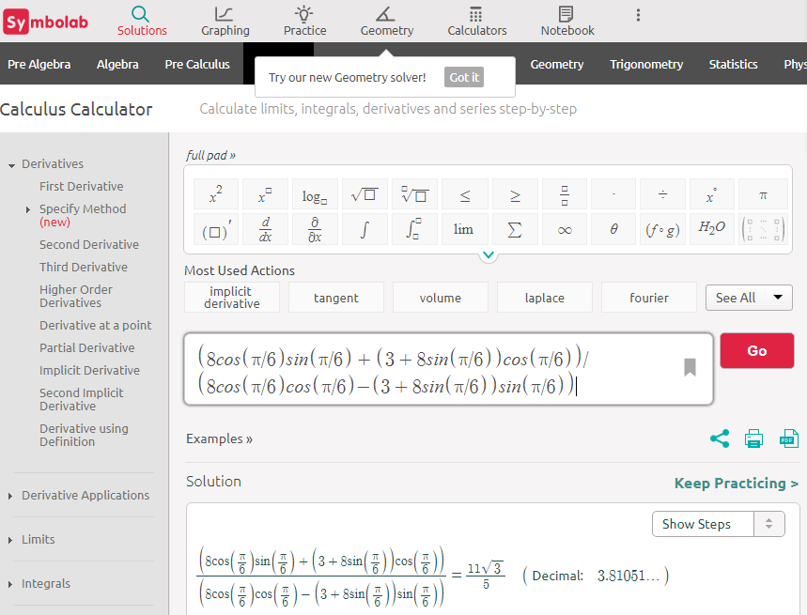

Slide 51
Questions?
http://i.imgur.com/aliTlT3.jpg

Slide 52
Polar Integration
How about integration?
Can we find areas enclosed by polar curves?
Note I said “enclosed by” instead of “under”
https://tutorial.math.lamar.edu/classes/calcii/PolarArea.aspx

Slide 53
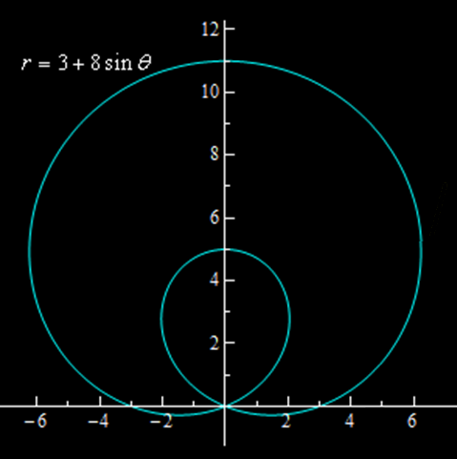
Polar Integration
These problems work a little differently in polar coordinates
Starts
here
VFrench, 2021

Slide 54
Polar Integration
https://www.geogebra.org/m/jhKUc6Hm
Will let you see where the graph starts and which way it goes

Slide 55
Polar Integration
The formula for finding this area is:
A=∫_{α}^{β} 1/2 r² dθ
Notice that we use r in the integral instead of ƒ(θ)
https://tutorial.math.lamar.edu/classes/calcii/PolarArea.aspx

Slide 56
POLAR INTEGRATION
IN-CLASS PROBLEM 3
Determine the area of the inner loop of r = 2 + 4cosθ
https://tutorial.math.lamar.edu/classes/calcii/PolarArea.aspx

Slide 57
POLAR INTEGRATION
IN-CLASS PROBLEM 3
Determine the area of the inner loop of r = 2 + 4cosθ
Since the formula is given as a function of θ, the
area will be:
A=∫_{α}^{β} 1/2 r² dθ
https://tutorial.math.lamar.edu/classes/calcii/PolarArea.aspx

Slide 58
POLAR INTEGRATION
IN-CLASS PROBLEM 3
Determine the area of the inner loop of r = 2 + 4cosθ
But we need the limits!
A=∫_{α}^{β} 1/2 r² dθ
https://tutorial.math.lamar.edu/classes/calcii/PolarArea.aspx

Slide 59
POLAR INTEGRATION
IN-CLASS PROBLEM 3
Determine the area of the inner loop of r = 2 + 4cosθ
The limits will most easily be found where the
curve goes through
the origin (r=0)
Starts
here
https://tutorial.math.lamar.edu/classes/calcii/PolarArea.aspx

Slide 60
POLAR INTEGRATION
IN-CLASS PROBLEM 3
Determine the area of the inner loop of r = 2 + 4cosθ
0 = 2 + 4cosθ
or
cosθ = -2/4 = -1/2
https://tutorial.math.lamar.edu/classes/calcii/PolarArea.aspx

Slide 61
POLAR INTEGRATION
IN-CLASS PROBLEM 3
Determine the area of the inner loop of r = 2 + 4cosθ
cosθ = -2/4 = -1/2
This happens when
θ = 2π/3 and
θ = 4π/3
2π/3
4π/3
Starts
here
https://tutorial.math.lamar.edu/classes/calcii/PolarArea.aspx

Slide 62
POLAR INTEGRATION
IN-CLASS PROBLEM 3
Determine the area of the inner loop of r = 2 + 4cosθ
So the area will be:
A=∫_{2π/3}^{4π/3} 1/2 r² dθ
=∫_{2π/3}^{4π/3} 1/2 (2+4cosθ)² dθ
=
https://tutorial.math.lamar.edu/classes/calcii/PolarArea.aspx

Slide 63
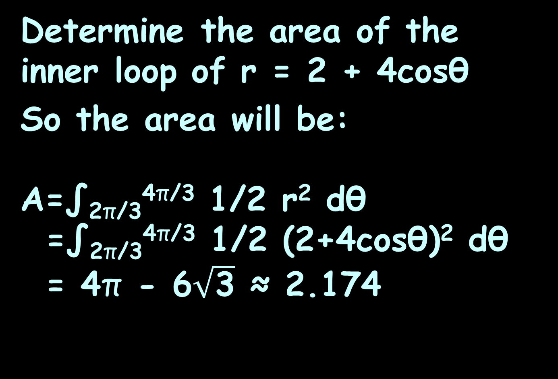
POLAR INTEGRATION
IN-CLASS PROBLEM 3
Determine the area of the inner loop of r = 2 + 4cosθ
So the area will be:
A=∫_{2π/3}^{4π/3} 1/2 r² dθ
=∫_{2π/3}^{4π/3} 1/2 (2+4cosθ)² dθ
= 4π - 6$\sqrt{\text{3}}$ ≈ 2.174
https://tutorial.math.lamar.edu/classes/calcii/PolarArea.aspx

Slide 64
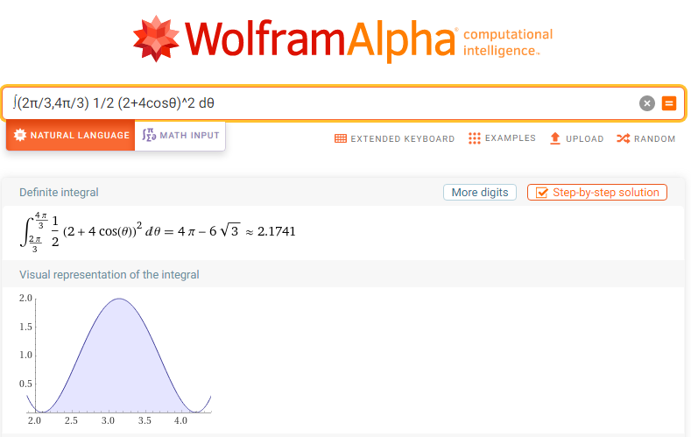

Slide 65
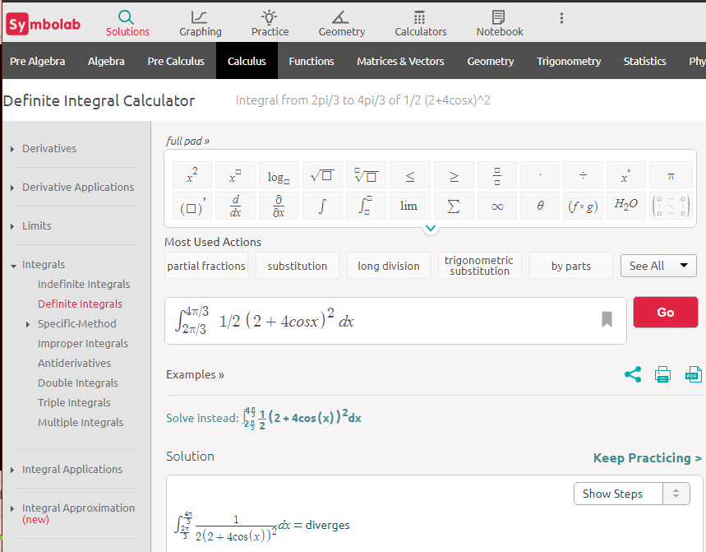

Slide 66
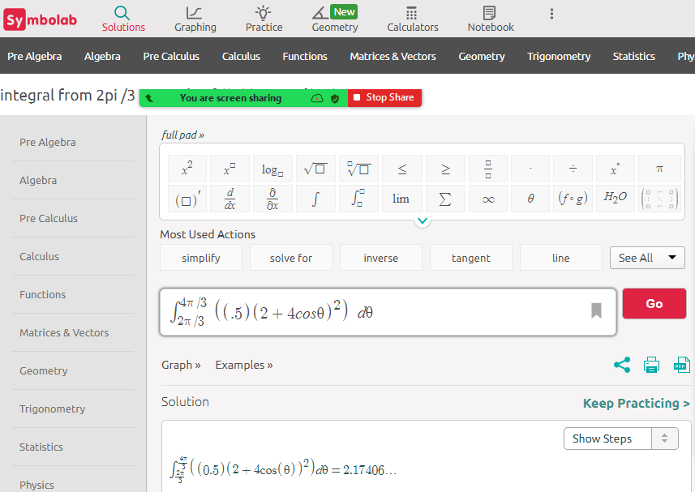

Slide 67
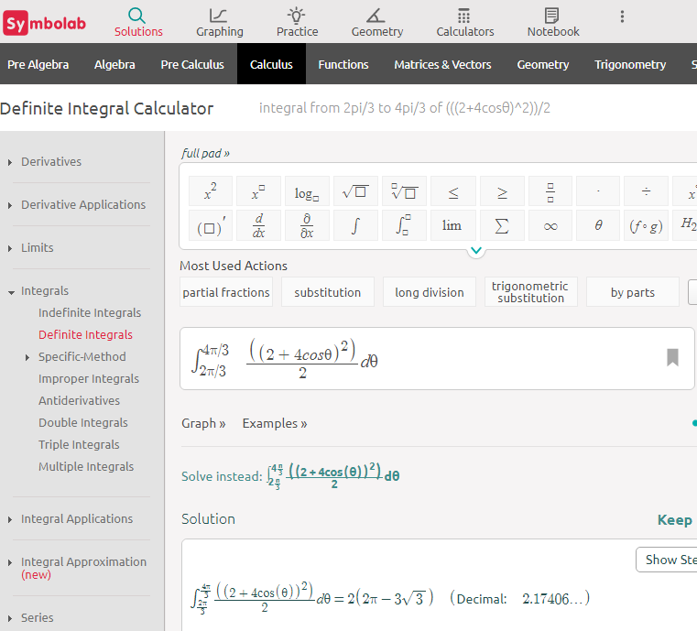

Slide 68
Questions?
http://i.imgur.com/aliTlT3.jpg

Slide 69
Polar Integration
What if we want to find the area between two polar curves?

Slide 70
Polar Integration
The formula for finding this area is:
A=∫_{α}^{β} 1/2 (r_{outer}² - r_{inner}²) dθ
https://tutorial.math.lamar.edu/classes/calcii/PolarArea.aspx

Slide 71
Polar Integration
Unlike before, it’s hugely critical to get the “inner” and “outer” right!
The limits will be where you need this

Slide 72
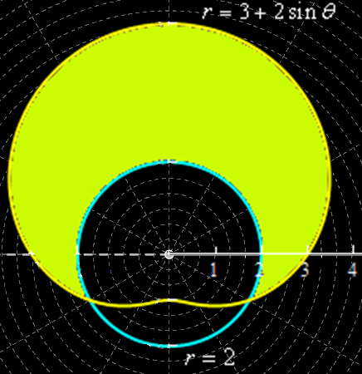
POLAR INTEGRATION
IN-CLASS PROBLEM 4
Determine the area that lies inside r = 3 + 2sinθ and outside r = 2
https://tutorial.math.lamar.edu/classes/calcii/PolarArea.aspx

Slide 73
POLAR INTEGRATION
IN-CLASS PROBLEM 4
Determine the area that lies inside r = 3 + 2sinθ and outside r = 2
A=∫_{α}^{β} 1/2 (r_{outer}² - r_{inner}²) dθ
A=∫_{α}^{β}1/2((3+2sinθ)²-(2)²) dθ
https://tutorial.math.lamar.edu/classes/calcii/PolarArea.aspx

Slide 74
POLAR INTEGRATION
IN-CLASS PROBLEM 4
Determine the area that lies inside r = 3 + 2sinθ and outside r = 2
A=∫_{α}^{β}1/2((3+2sinθ)²-(2)²) dθ
We need the points where the two graphs cross for the
limits
https://tutorial.math.lamar.edu/classes/calcii/PolarArea.aspx

Slide 75
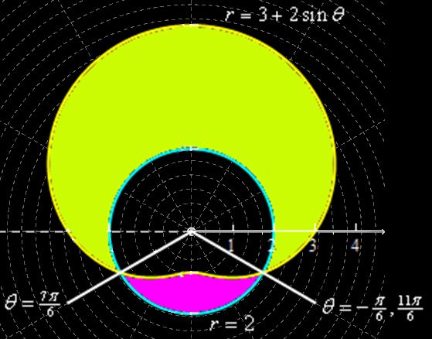
POLAR INTEGRATION
IN-CLASS PROBLEM 4
Solve: 3+2sinθ = 2
7π/6 and 11π/6 ?
https://tutorial.math.lamar.edu/classes/calcii/PolarArea.aspx

Slide 76
POLAR INTEGRATION
IN-CLASS PROBLEM 4
Solve: 3+2sinθ = 2
7π/6 and 11π/6 ? That will give us the pink area
https://tutorial.math.lamar.edu/classes/calcii/PolarArea.aspx

Slide 77
POLAR INTEGRATION
IN-CLASS PROBLEM 4
Solve: 3+2sinθ = 2
We’ll have to use -π/6 and 7π/6 to get the green area
https://tutorial.math.lamar.edu/classes/calcii/PolarArea.aspx

Slide 78
POLAR INTEGRATION
IN-CLASS PROBLEM 4
Determine the area that lies inside r = 3 + 2sinθ and outside r = 2
A=∫_{-π/6}^{7π/6}1/2((3+2sinθ)²-(2)²) dθ
Do it!
https://tutorial.math.lamar.edu/classes/calcii/PolarArea.aspx

Slide 79
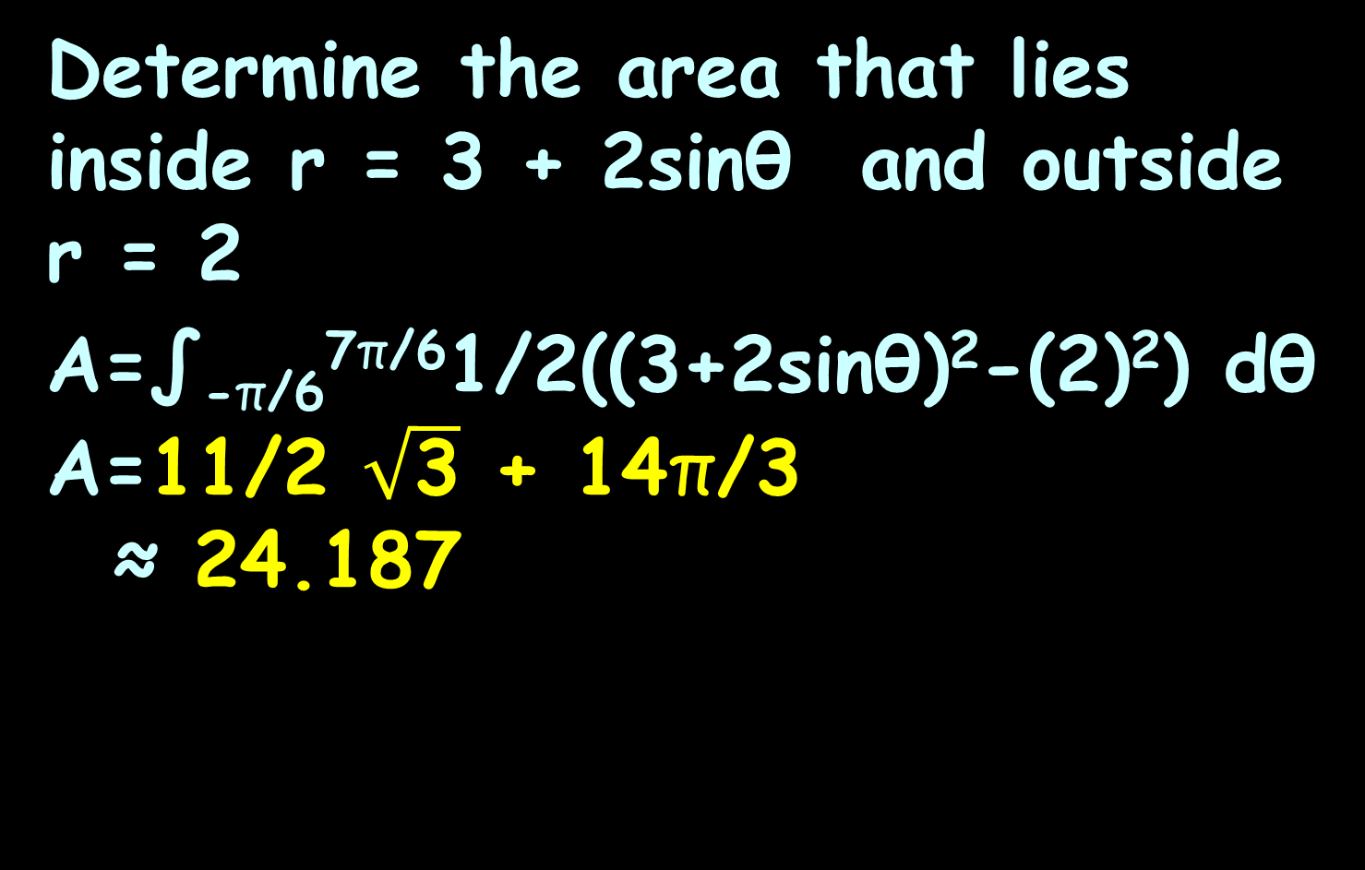
POLAR INTEGRATION
IN-CLASS PROBLEM 4
Determine the area that lies inside r = 3 + 2sinθ and outside r = 2
A=∫_{-π/6}^{7π/6}1/2((3+2sinθ)²-(2)²) dθ
A=11/2 $\sqrt{\text{3}}$ + 14π/3
≈ 24.187
https://tutorial.math.lamar.edu/classes/calcii/PolarArea.aspx

Slide 80
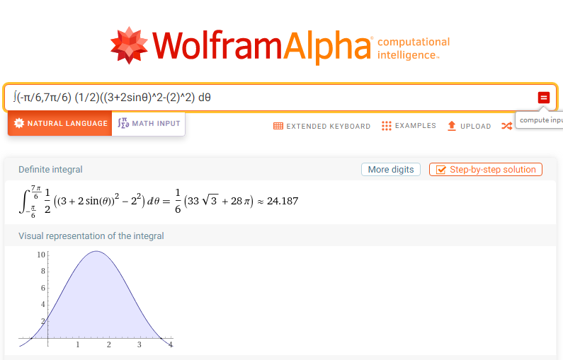

Slide 81
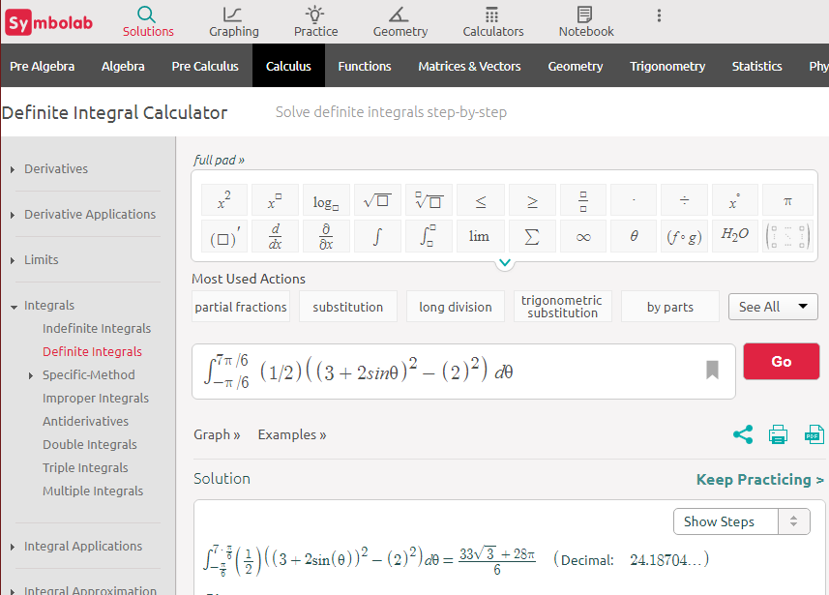

Slide 82
Questions?
http://i.imgur.com/aliTlT3.jpg

Slide 83
Summary
Today we studied:
Review Parametric Equations
and Polar Coordinates
Polar Differentiation
Polar Integration

Slide 84

You Survived!

