Slide 1
Welcome to
Unit 10
Part 19!
MATH 207 Integral Calculus

Slide 2
What’s Up?
Review:
Parametrics
Polars
New stuff:
Vectors

Slide 3
What’s Up?
Outcome 7) Solve problems by identifying the requirements, making a sketch as appropriate

Slide 4

Review
http://995642590.r.lightningbase-cdn.com/wp-content/uploads/2010/12/looking-back-hrexaminer-v144-cover425px.jpg

Slide 5
Parametric Equations
Not all curves or equations that we’d like to look at are functions

Slide 6
Parametric Equations
So, to deal with these, we use parametric equations which express the coordinates of the points of the curve as functions of an additional variable called a “parameter” (usually “t”)

Slide 7
Parametric Equations
The collection of points that we get by letting t be all possible values is the graph of the parametric equations and is called the parametric curve

Slide 8
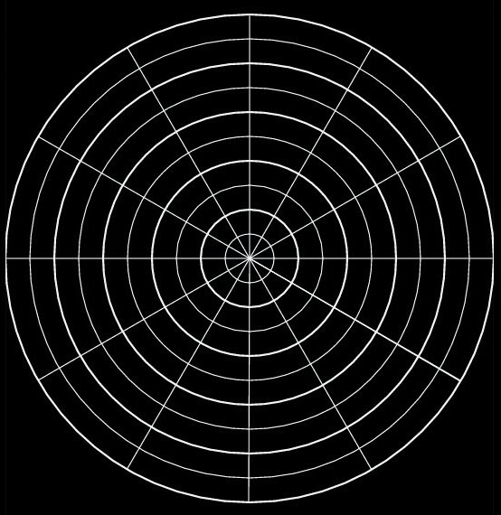
Polar Coordinates
Another way of plotting graphs (especially for periodic functions) is by using circular “polar” graph paper
VFrench, 2015

Slide 9
Polar Coordinates
Just like for (x,y) coordinates, there are a pair of polar coordinates (r,θ)
These are called the “polar coordinates”

Slide 10
Polar Coordinates
r is the distance from the pole (the radius)
θ is the angle around the circle
.
.
r
θ
VFrench, 2015

Slide 11
Polar Coordinates
Positive angles are measured counterclockwise from the polar axis
Negative angles are measured clockwise from the polar axis

Slide 12
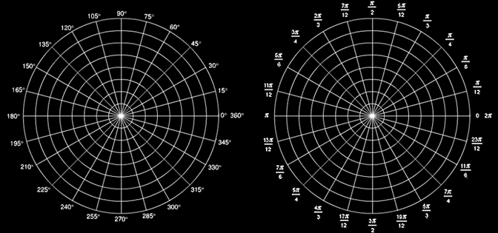
Polar Coordinates
Angles in polar notation can be expressed in either degrees or radians
VFrench, 2015

Slide 13
Polar Coordinates
r > 0 – the point lies on the terminal side of θ
r < 0 - point lies along the ray opposite the terminal side of θ
r = 0 the point lies on the pole no matter what the value of θ is!

Slide 14
Polar Coordinates
Polar to rectangular conversion
If you have a polar point
P = (r,θ)
To convert to (x,y) coordinates:
x = r cos θ
y = r sin θ

Slide 15

Polar Coordinates
Rectangular to polar coordinates
r = $\sqrt{x^{2}+ y^{2}}$
θ = arctan (y ÷ x)

Slide 16
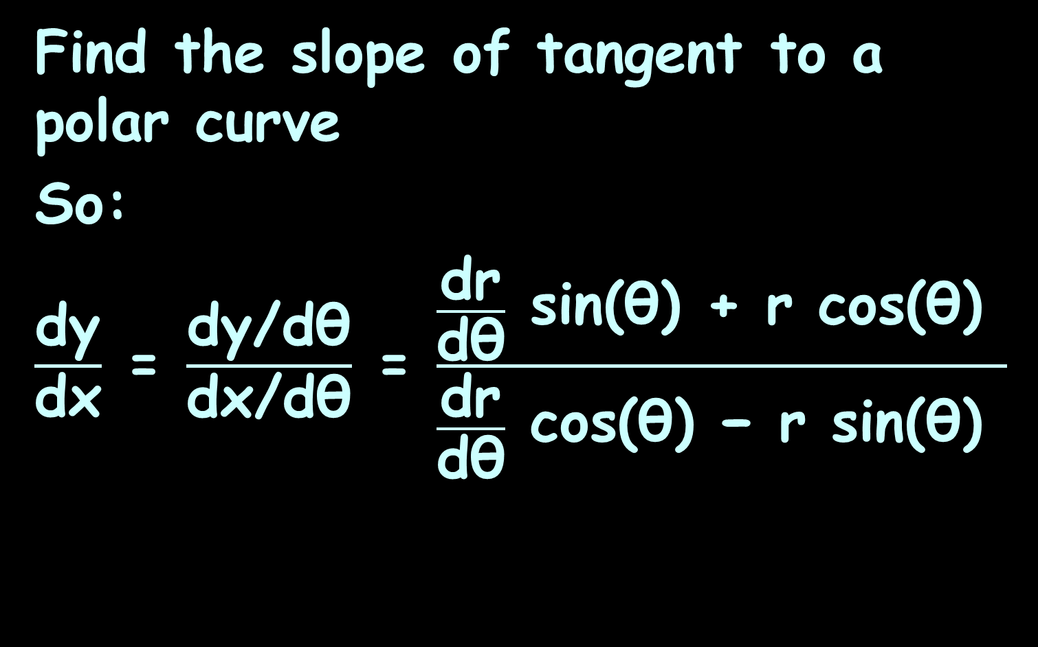
Polar Derivatives
Find the slope of tangent to a polar curve
So:
$\frac{\text{d}\text{y}}{\text{d}\text{x}}$ = $\frac{\text{dy}\text{/}\text{dθ}}{\text{d}\text{x}\text{/}\text{d}\text{θ}}$ = $\frac{\frac{\text{dr}}{\text{dθ}} \text{sin}\text{(}\text{θ}\text{) }\text{+} \text{r} \text{cos}\text{(}\text{θ}\text{) }}{\frac{\text{dr}}{\text{dθ}} \text{cos}\text{(}\text{θ}\text{) }\text{−} \text{r} \text{sin}\text{(}\text{θ}\text{) }}$

Slide 17
Polar Integration
Can we find areas enclosed by polar curves?
Note I said “enclosed by” instead of “under”
https://tutorial.math.lamar.edu/classes/calcii/PolarArea.aspx

Slide 18
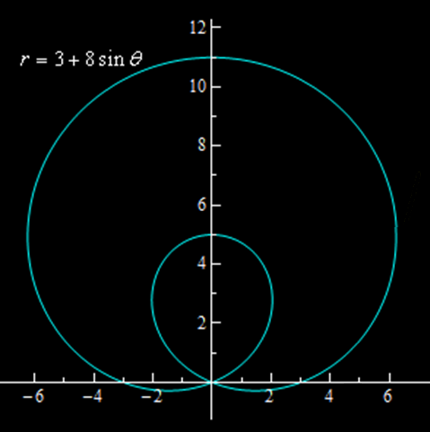
Polar Integration
These problems work a little differently in polar coordinates
Starts
here
https://tutorial.math.lamar.edu/classes/calcii/PolarArea.aspx

Slide 19
Polar Integration
The formula for finding this area is:
A=∫_{α}^{β} 1/2 r² dθ
Notice that we use r in the integral instead of f(θ)
https://tutorial.math.lamar.edu/classes/calcii/PolarArea.aspx

Slide 20
Polar Integration
What if we want to find the area between two polar curves?

Slide 21
Polar Integration
The formula for finding this area is:
A=∫_{α}^{β} 1/2 (r_{outer}² - r_{inner}²) dθ
https://tutorial.math.lamar.edu/classes/calcii/PolarArea.aspx

Slide 22
Polar Integration
Unlike before, it’s hugely critical to get the “inner” and “outer” right!
The limits will be where you need this

Slide 23

Questions?
http://i.imgur.com/aliTlT3.jpg

Slide 24
Vectors
A vector is a directed line segment - from an initial point P to terminal point Q

Slide 25
Vectors
Vectors have both magnitude and direction
(ex: N 5mph)
direction
magnitude

Slide 26
Vectors
Scalars have only magnitude
(ex: 5mph)

Slide 27

Vectors
Vectors are shown by boldface letters: v w
or with arrows $\vec{\text{v}}$ $\vec{\text{w}}$

Slide 28
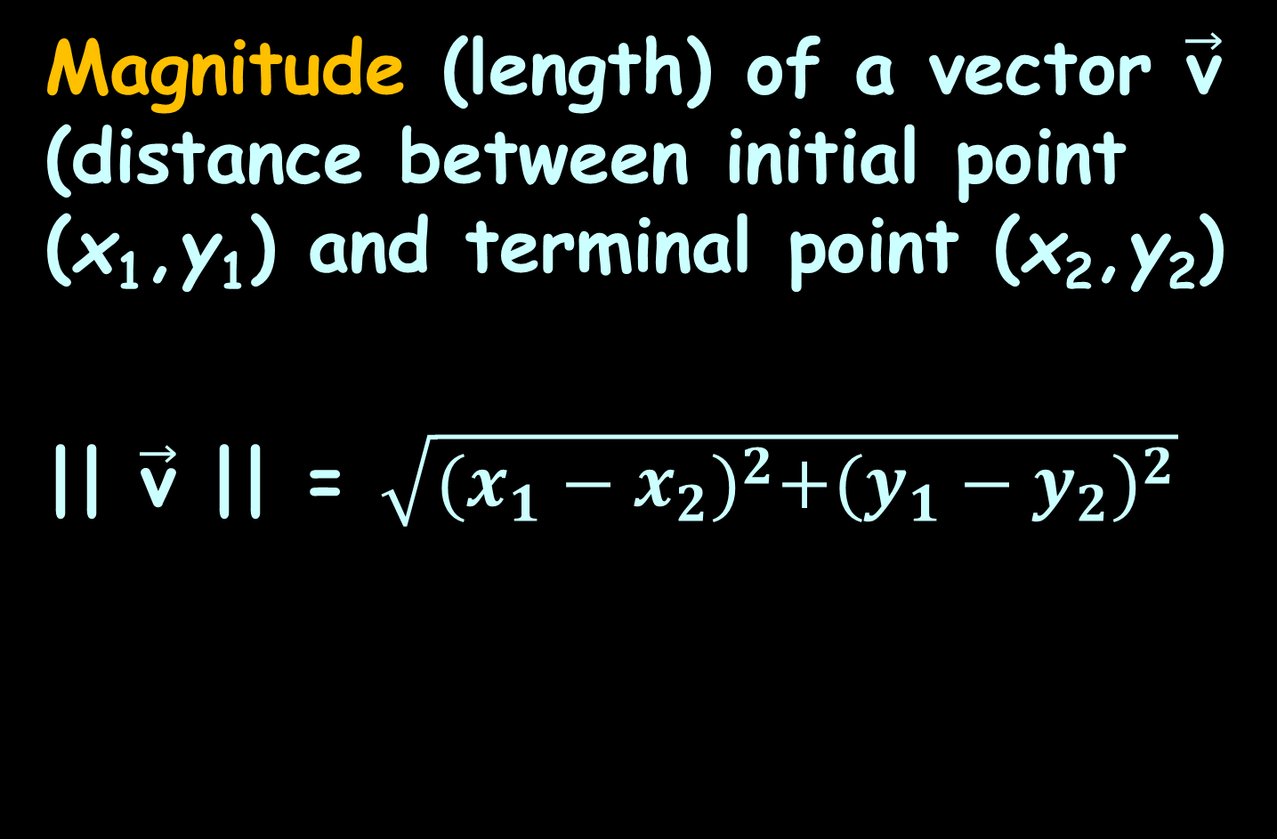
Vectors
Magnitude (length) of a vector $\vec{\text{v}}$ (distance between initial point (x₁,y₁) and terminal point (x₂,y₂)
|| $\vec{\text{v}}$ || = $\sqrt{{(x_{1}−x_{2})}^{2}+{(y_{1}−y_{2})}^{2}}$

Slide 29

Vectors
Direction can be shown by slope:
m = $\frac{y_{1}−y_{2}}{x_{1}−x_{2}}$
if $x_{1}−x_{2}$≠0

Slide 30
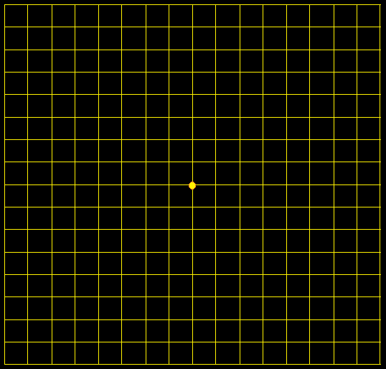
Vectors
Interesting point… because vectors are designated by only their magnitude and direction…
These are all the
same vector!
Location doesn’t
matter!
VFrench, 2017

Slide 31
Vectors
So we usually start them at (0,0)
(called the
“standard
position”
VFrench, 2017

Slide 32
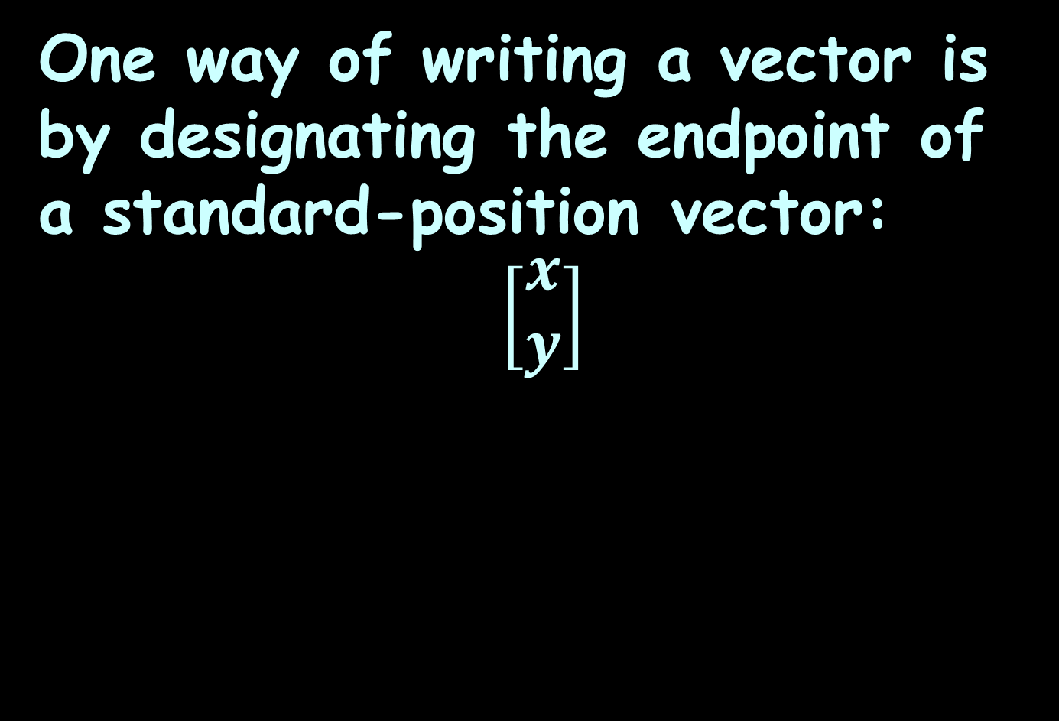
Vectors
One way of writing a vector is by designating the endpoint of a standard-position vector:
$$\left[\begin{matrix}x \\ y\end{matrix}\right]$$
VFrench, 2017

Slide 33

Vectors
Vector $\left[\begin{matrix}6 \\ 5\end{matrix}\right]$ would graph as:
VFrench, 2017

Slide 34
Vectors
Vector $\left[\begin{matrix}6 \\ 5\end{matrix}\right]$ would graph as:
8
7
6
5
4
3
2
1
0
0 1 2 3 4 5 6 7 8
VFrench, 2017

Slide 35

Vectors
What if we multiplied the vector by a scalar: 2 $\left[\begin{matrix}6 \\ 5\end{matrix}\right]$ ?
8
7
6
5
4
3
2
1
0
0 1 2 3 4 5 6 7 8
VFrench, 2017

Slide 36
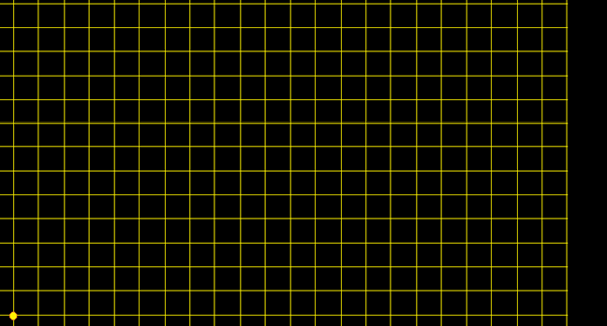

Vectors
What if we multiplied the vector by a scalar: 2 $\left[\begin{matrix}6 \\ 5\end{matrix}\right]$ = $\left[\begin{matrix}12 \\ 10\end{matrix}\right]$
1211
10
9
8
7
6
5
4
3
2
1
0
0 1 2 3 4 5 6 7 8 9 1 1 1 1 1 1
0 1 2 3 4 5
VFrench, 2017

Slide 37
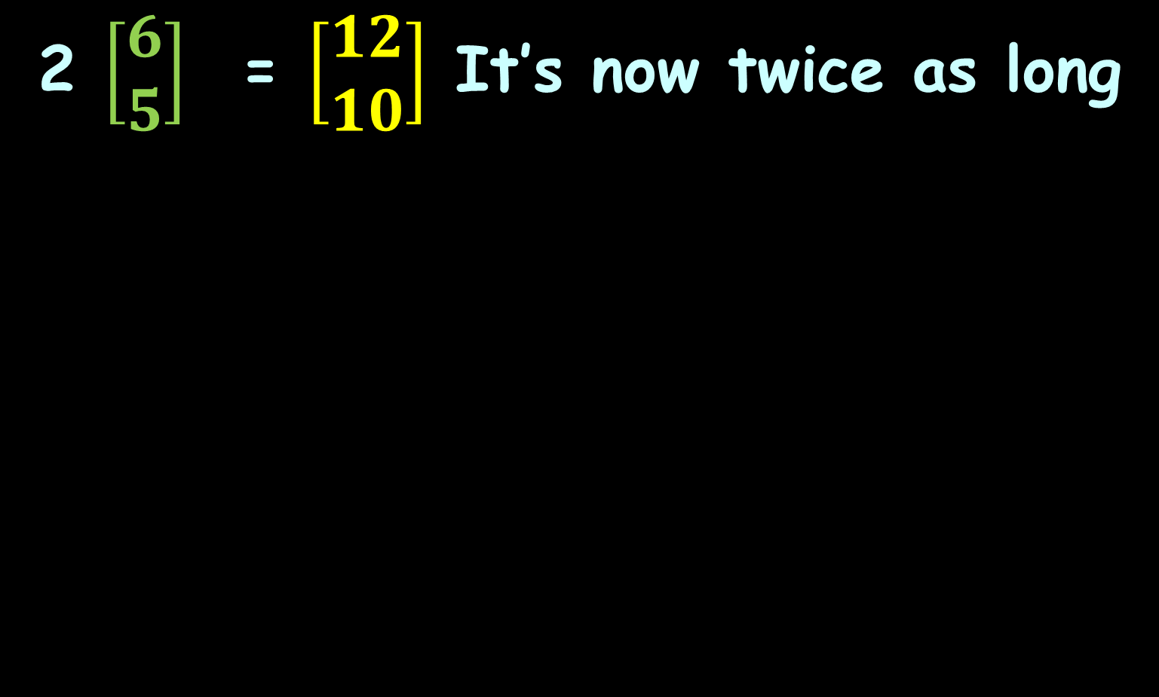
Vectors
2 $\left[\begin{matrix}6 \\ 5\end{matrix}\right]$ = $\left[\begin{matrix}12 \\ 10\end{matrix}\right]$ It’s now twice as long
1211
10
9
8
7
6
5
4
3
2
1
0
0 1 2 3 4 5 6 7 8 9 1 1 1 1 1 1
0 1 2 3 4 5
VFrench, 2017

Slide 38

Vectors
2 $\left[\begin{matrix}6 \\ 5\end{matrix}\right]$ = $\left[\begin{matrix}12 \\ 10\end{matrix}\right]$ It’s been “scaled”
1211
10
9
8
7
6
5
4
3
2
1
0
0 1 2 3 4 5 6 7 8 9 1 1 1 1 1 1
0 1 2 3 4 5
VFrench, 2017

Slide 39

Vectors
2 $\left[\begin{matrix}6 \\ 5\end{matrix}\right]$ = $\left[\begin{matrix}12 \\ 10\end{matrix}\right]$ Hence the name…
1211
10
9
8
7
6
5
4
3
2
1
0
0 1 2 3 4 5 6 7 8 9 1 1 1 1 1 1
0 1 2 3 4 5
VFrench, 2017

Slide 40
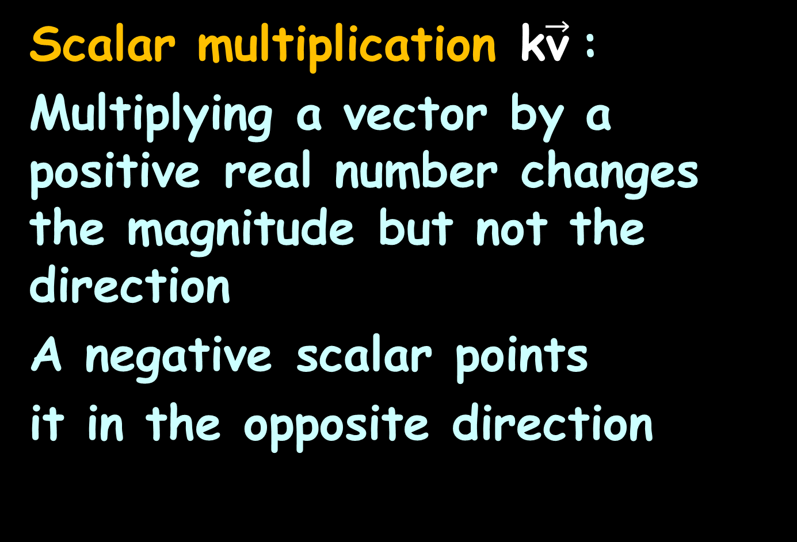
Vectors
Scalar multiplication k$\vec{\text{v}}$:
Multiplying a vector by a positive real number changes the magnitude but not the direction
A negative scalar points
it in the opposite direction

Slide 41
Questions?
http://i.imgur.com/aliTlT3.jpg

Slide 42

Vectors
What if we add two vectors?
$\left[\begin{matrix}6 \\ 5\end{matrix}\right]$ + $\left[\begin{matrix}3 \\ 7\end{matrix}\right]$
1211
10
9
8
7
6
5
4
3
2
1
0
0 1 2 3 4 5 6 7 8 9 1 1 1 1 1 1
0 1 2 3 4 5
VFrench, 2017

Slide 43

Vectors
What if we add two vectors?
$\left[\begin{matrix}6 \\ 5\end{matrix}\right]$ + $\left[\begin{matrix}3 \\ 7\end{matrix}\right]$ = $\left[\begin{matrix}9 \\ 12\end{matrix}\right]$
1211
10
9
8
7
6
5
4
3
2
1
0
0 1 2 3 4 5 6 7 8 9 1 1 1 1 1 1
0 1 2 3 4 5
VFrench, 2017

Slide 44

Vectors
Remember, it doesn’t matter where it starts…$\left[\begin{matrix}6 \\ 5\end{matrix}\right]$ + $\left[\begin{matrix}3 \\ 7\end{matrix}\right]$ = $\left[\begin{matrix}9 \\ 12\end{matrix}\right]$
1211
10
9
8
7
6
5
4
3
2
1
0
0 1 2 3 4 5 6 7 8 9 1 1 1 1 1 1
0 1 2 3 4 5
VFrench, 2017

Slide 45
Vectors
Remember, it doesn’t matter where it starts…$\left[\begin{matrix}6 \\ 5\end{matrix}\right]$ + $\left[\begin{matrix}3 \\ 7\end{matrix}\right]$ = $\left[\begin{matrix}9 \\ 12\end{matrix}\right]$
1211
10
9
8
7
6
5
4
3
2
1
0
0 1 2 3 4 5 6 7 8 9 1 1 1 1 1 1
0 1 2 3 4 5
VFrench, 2017

Slide 46

Vectors
The sum of two vectors is called the resultant…$\left[\begin{matrix}6 \\ 5\end{matrix}\right]$ + $\left[\begin{matrix}3 \\ 7\end{matrix}\right]$ = $\left[\begin{matrix}9 \\ 12\end{matrix}\right]$
1211
10
9
8
7
6
5
4
3
2
1
0
0 1 2 3 4 5 6 7 8 9 1 1 1 1 1 1
0 1 2 3 4 5
VFrench, 2017

Slide 47

Vectors
Put the original vectors “nose-to-tail”…$\left[\begin{matrix}6 \\ 5\end{matrix}\right]$ + $\left[\begin{matrix}3 \\ 7\end{matrix}\right]$ = $\left[\begin{matrix}9 \\ 12\end{matrix}\right]$
1211
10
9
8
7
6
5
4
3
2
1
0
0 1 2 3 4 5 6 7 8 9 1 1 1 1 1 1
0 1 2 3 4 5
VFrench, 2017

Slide 48

Vectors
But remember, location is irrelevant… $\left[\begin{matrix}6 \\ 5\end{matrix}\right]$ + $\left[\begin{matrix}3 \\ 7\end{matrix}\right]$ = $\left[\begin{matrix}9 \\ 12\end{matrix}\right]$
1211
10
9
8
7
6
5
4
3
2
1
0
0 1 2 3 4 5 6 7 8 9 1 1 1 1 1 1
0 1 2 3 4 5
VFrench, 2017

Slide 49
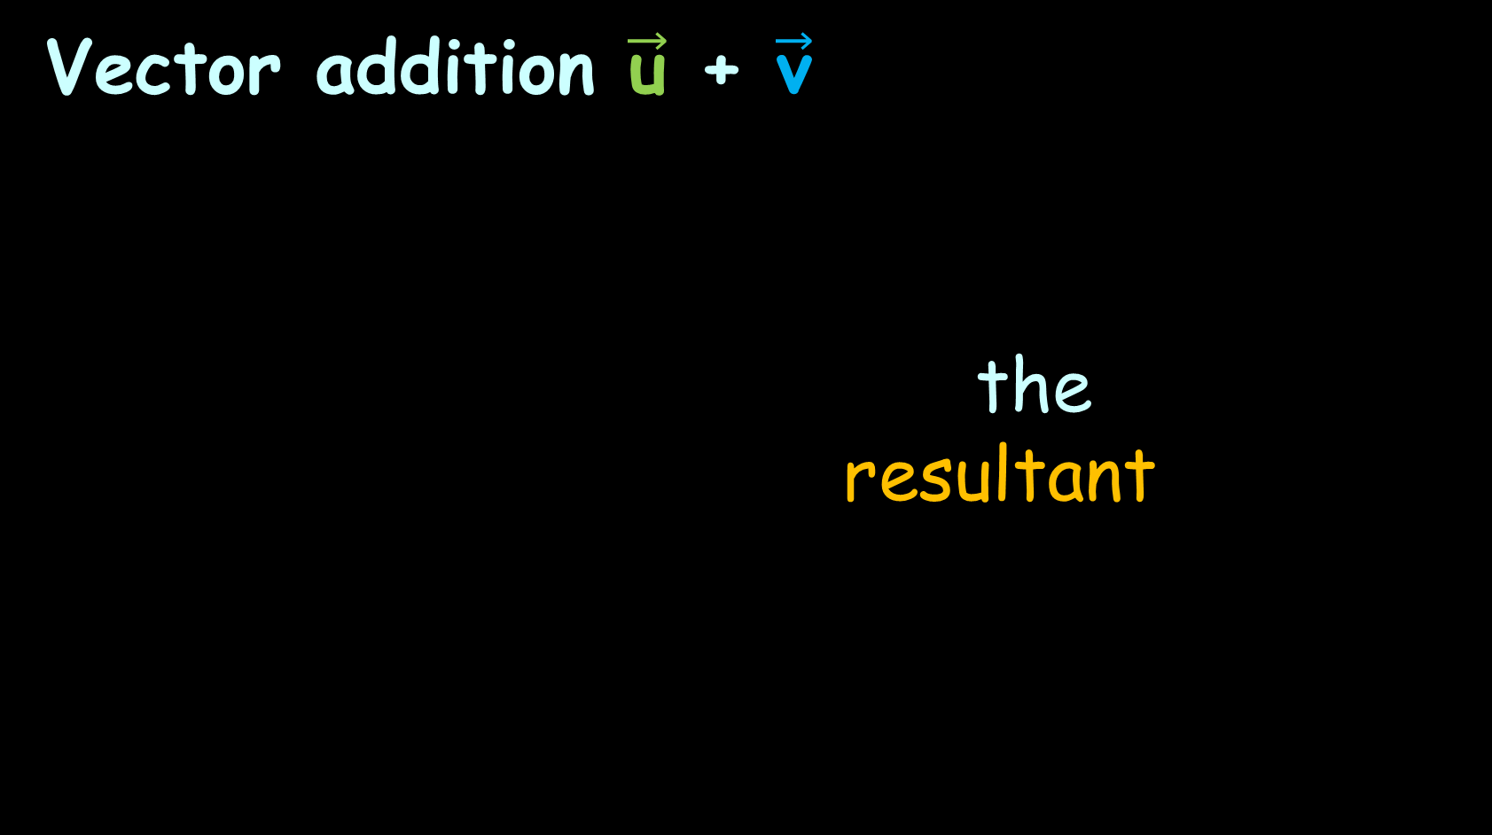
Vectors
Vector addition $\vec{\text{u}}$ + $\vec{\text{v}}$
the
resultant
VFrench, 2017

Slide 50

Vectors
Vector subtraction $\vec{\text{u}}$ - $\vec{\text{v}}$
flip
the
resultant
VFrench, 2017

Slide 51
Vectors
http://phet.colorado.edu/index.php
Under "How to Run Simulations" click "One at a Time"
Near the bottom of the list, click on “Explore 2D"

Slide 52
Questions?
http://i.imgur.com/aliTlT3.jpg

Slide 53
Vectors
Back in Trig we talked about the “unit circle”

Slide 54
Vectors
Back in Trig we talked about the “unit circle”
It was a circle with radius = 1

Slide 55
Vectors
Now we also have “unit vectors”

Slide 56
Vectors
Now we also have “unit vectors”
They have magnitude (length) = 1

Slide 57
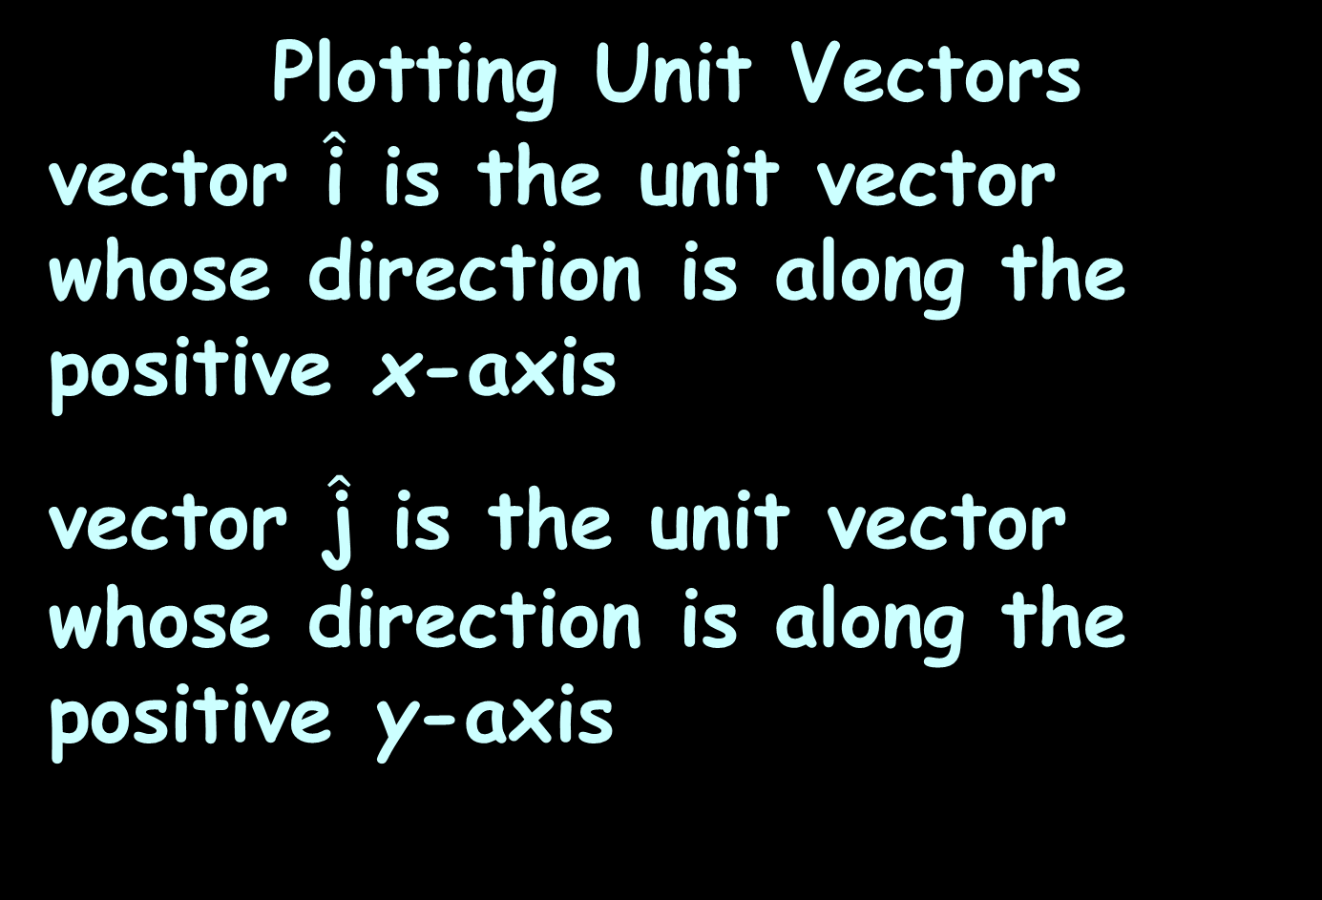
Vectors
Plotting Unit Vectors
vector $\hat{\text{i}}$ is the unit vector whose direction is along the positive x-axis
vector $\hat{\text{j}}$ is the unit vector whose direction is along the positive y-axis

Slide 58

Vectors
So we can write the vector $\vec{\text{v}}$ from (0,0) to (a,b) as:
$\vec{\text{v}}$ = a $\hat{\text{i}}$ + b $\hat{\text{j}}$

Slide 59
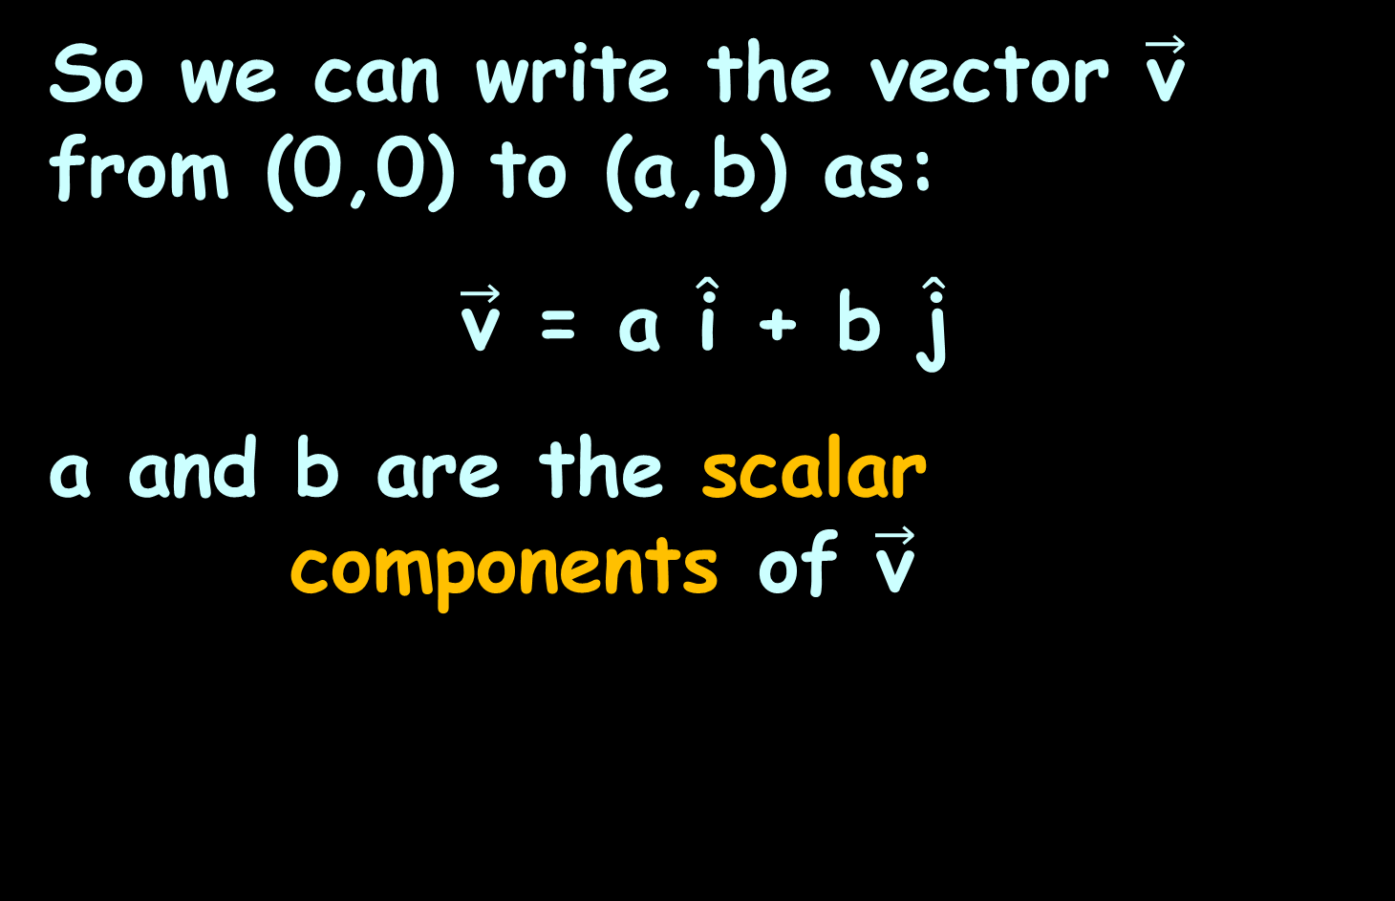
Vectors
So we can write the vector $\vec{\text{v}}$ from (0,0) to (a,b) as:
$\vec{\text{v}}$ = a $\hat{\text{i}}$ + b $\hat{\text{j}}$
a and b are the scalar
components of $\vec{\text{v}}$

Slide 60
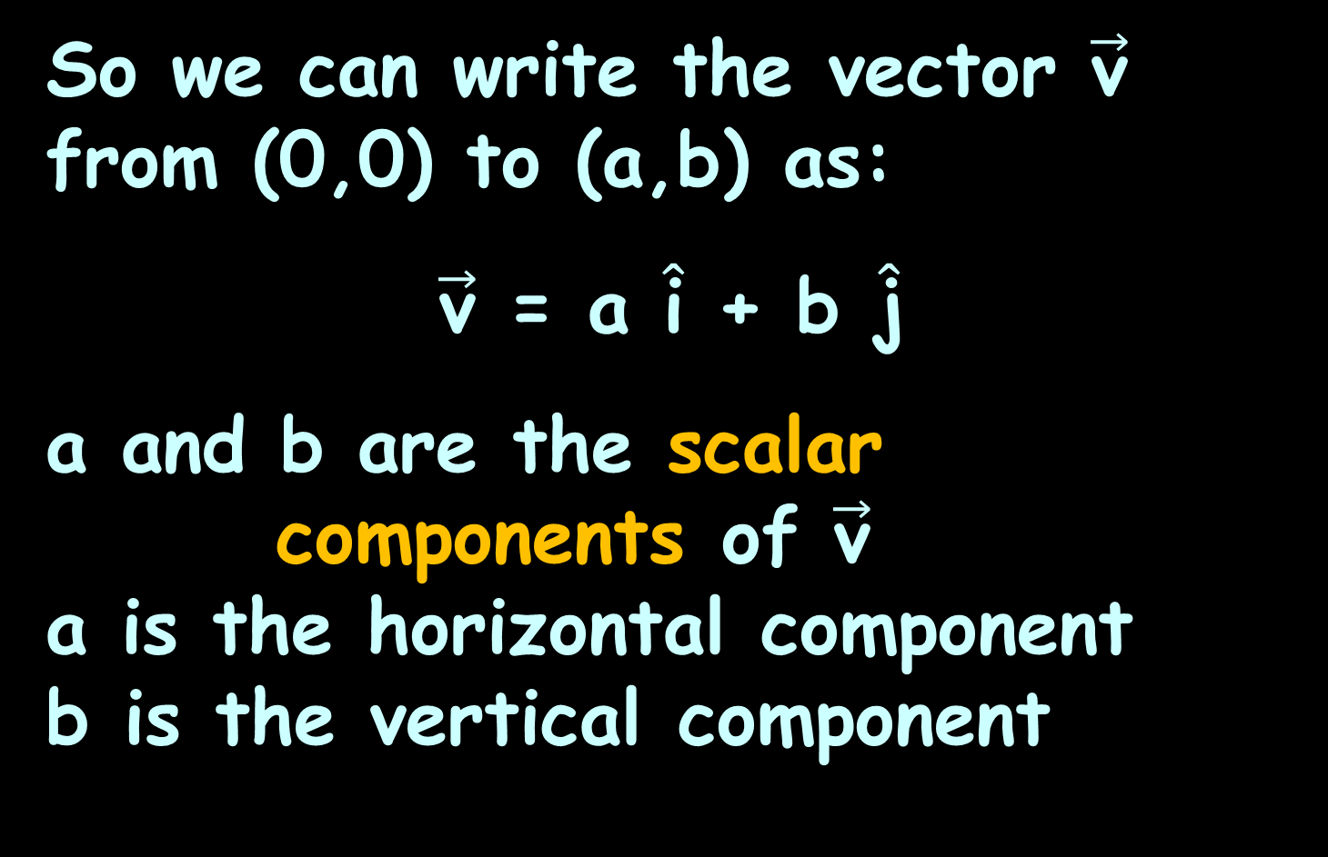
Vectors
So we can write the vector $\vec{\text{v}}$ from (0,0) to (a,b) as:
$\vec{\text{v}}$ = a $\hat{\text{i}}$ + b $\hat{\text{j}}$
a and b are the scalar
components of $\vec{\text{v}}$
a is the horizontal component
b is the vertical component

Slide 61

Vectors
$\vec{\text{v}}$ = a $\hat{\text{i}}$ + b $\hat{\text{j}}$
is called component form
or
“ai + bj form”

Slide 62
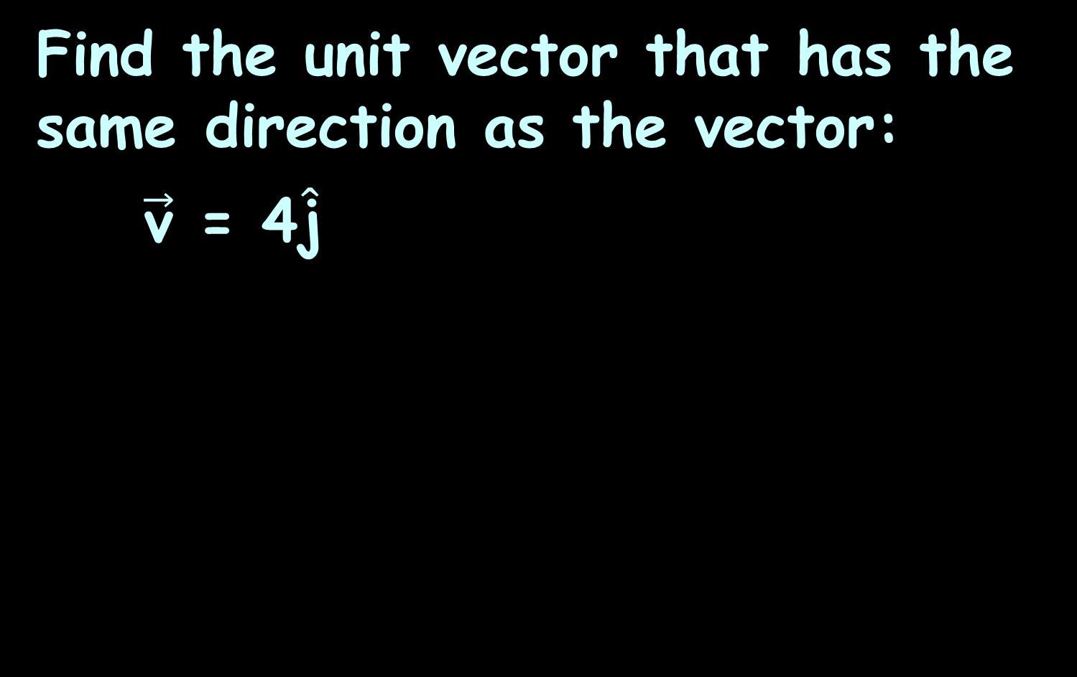
VECTORS
IN-CLASS PROBLEM 1
Find the unit vector that has the same direction as the vector:
$\vec{\text{v}}$ = 4$\hat{\text{j}}$
8
7
6
5
4
3
2
1
0
-1
-2
-3
-4
-5
-5
-7
-8
-8 -7 -6 -5 -4 -3 -2 -1 1 2 3 4 5 6 7 8
VFrench, 2017

Slide 63
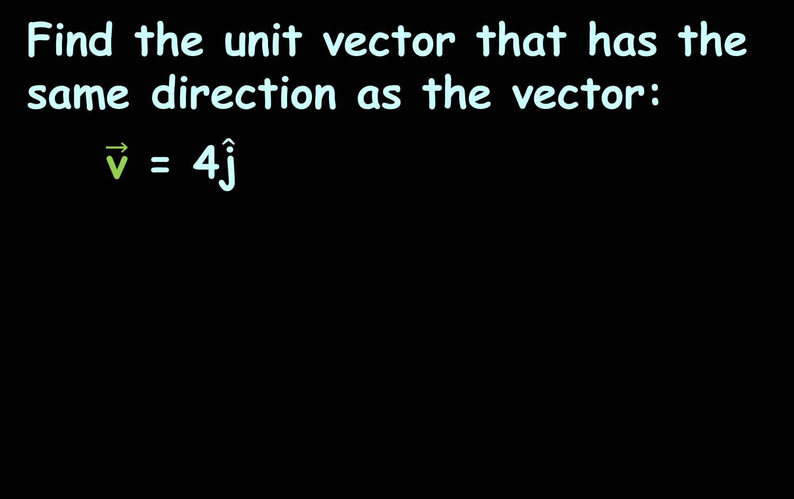
VECTORS
IN-CLASS PROBLEM 1
Find the unit vector that has the same direction as the vector:
$\vec{\text{v}}$ = 4$\hat{\text{j}}$
8
7
6
5
4
3
2
1
0
-1
-2
-3
-4
-5
-5
-7
-8
-8 -7 -6 -5 -4 -3 -2 -1 1 2 3 4 5 6 7 8
VFrench, 2017

Slide 64
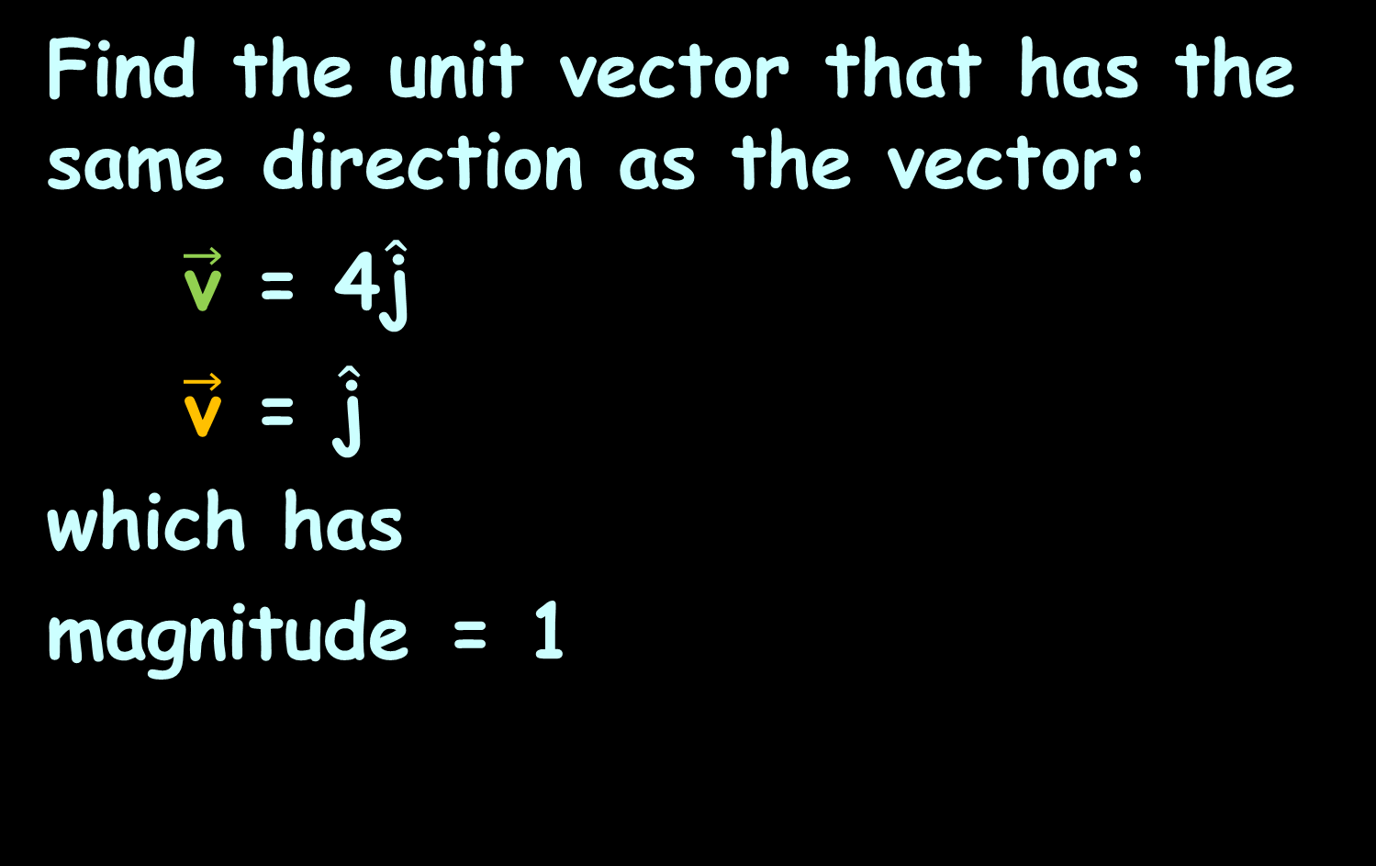
VECTORS
IN-CLASS PROBLEM 1
Find the unit vector that has the same direction as the vector:
$\vec{\text{v}}$ = 4$\hat{\text{j}}$
$\vec{\text{v}}$ = $\hat{\text{j}}$
which has
magnitude = 1
8
7
6
5
4
3
2
1
0
-1
-2
-3
-4
-5
-5
-7
-8
-8 -7 -6 -5 -4 -3 -2 -1 1 2 3 4 5 6 7 8
VFrench, 2017

Slide 65

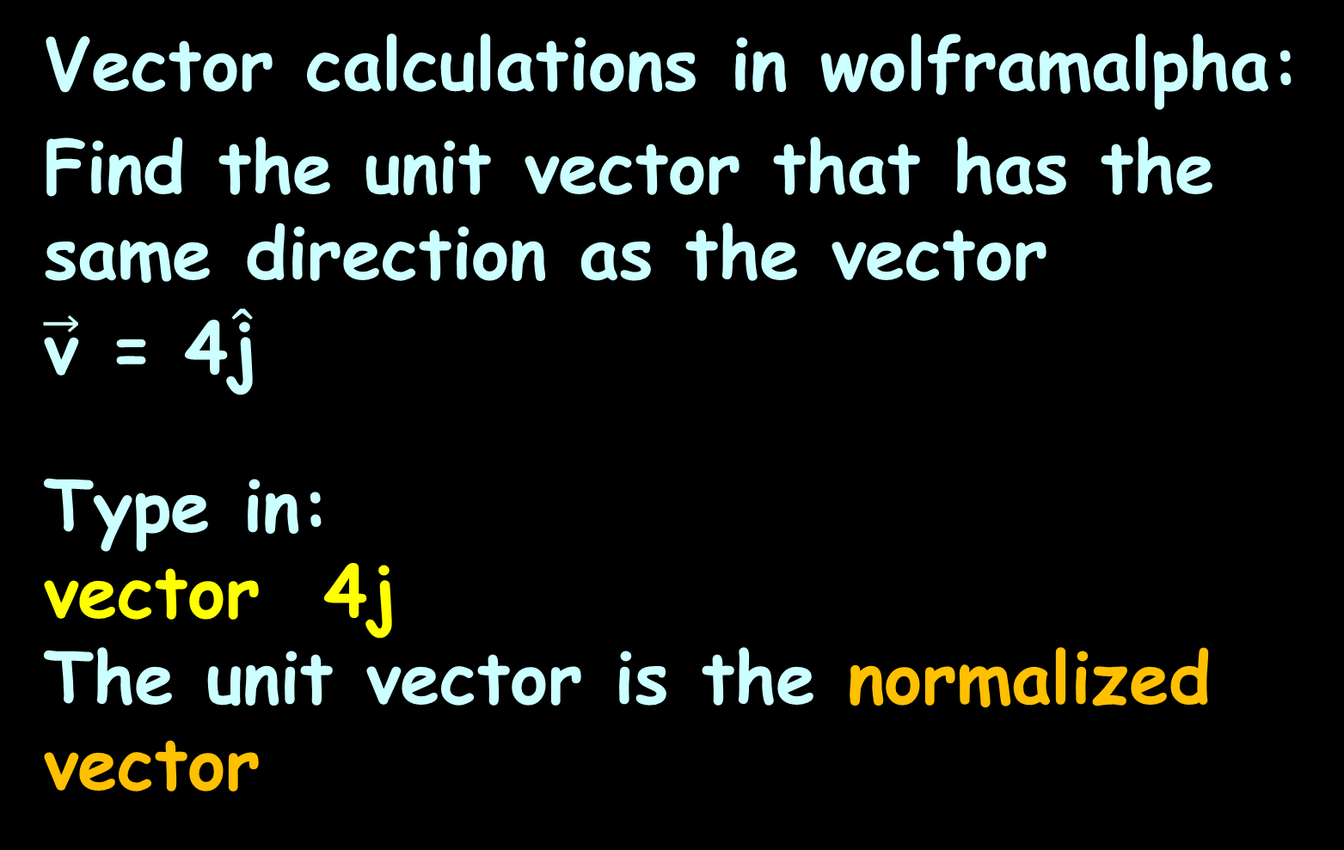
Vector calculations in wolframalpha:
Find the unit vector that has the same direction as the vector
$\vec{\text{v}}$ = 4$\hat{\text{j}}$
Type in:
vector 4j
The unit vector is the normalized vector

Slide 66
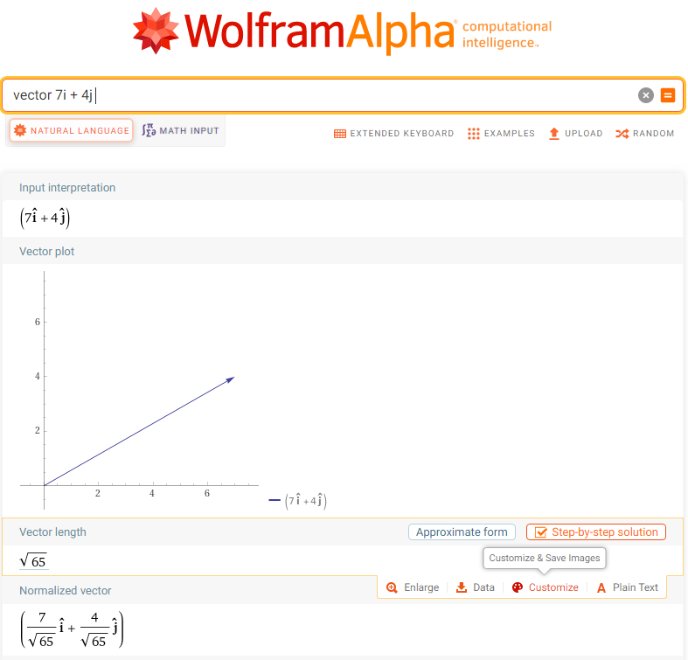

Slide 67
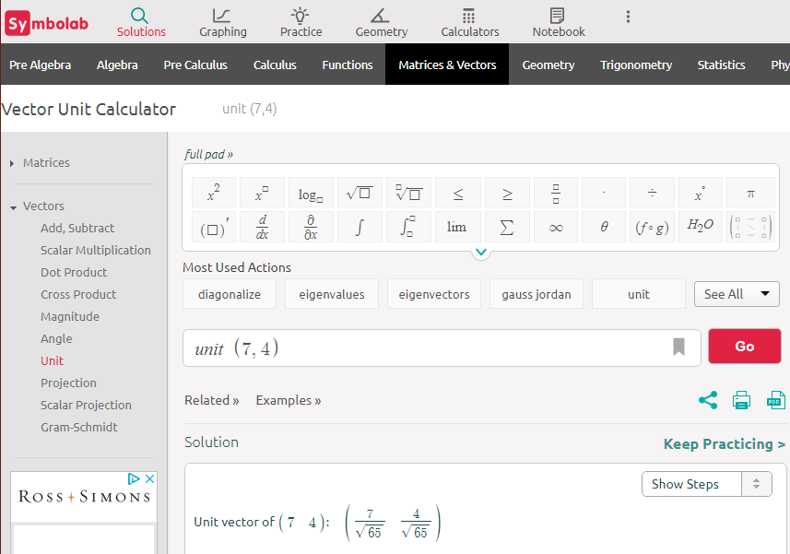

Slide 68
Questions?
http://i.imgur.com/aliTlT3.jpg

Slide 69

Vectors
Vector Operations
Scalar multiplication:
k$\vec{\text{v}}$ = (ka) $\hat{\text{i}}$ + (kb) $\hat{\text{j}}$

Slide 70


VECTORS
IN-CLASS PROBLEM 2a
Perform the indicated vector operation:
5$\vec{\text{v}}$ for $\vec{\text{v}}$ = -3$\hat{\text{i}}$ + 2$\hat{\text{j}}$
k$\vec{\text{v}}$ = (ka) $\hat{\text{i}}$ + (kb) $\hat{\text{j}}$

Slide 71
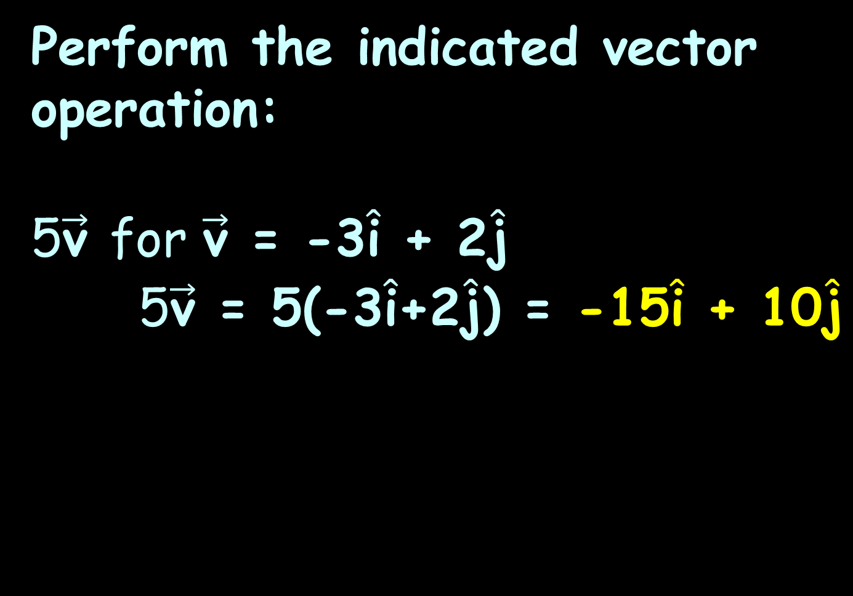
VECTORS
IN-CLASS PROBLEM 2a
Perform the indicated vector operation:
5$\vec{\text{v}}$ for $\vec{\text{v}}$ = -3$\hat{\text{i}}$ + 2$\hat{\text{j}}$
5$\vec{\text{v}}$ = 5(-3$\hat{\text{i}}$+2$\hat{\text{j}}$) = -15$\hat{\text{i}}$ + 10$\hat{\text{j}}$

Slide 72

VECTORS
IN-CLASS PROBLEM 2b
Perform the indicated vector operation:
7 $\vec{\text{v}}$ for $\vec{\text{v}}$ = -2$\hat{\text{i}}$ - 2$\hat{\text{j}}$

Slide 73
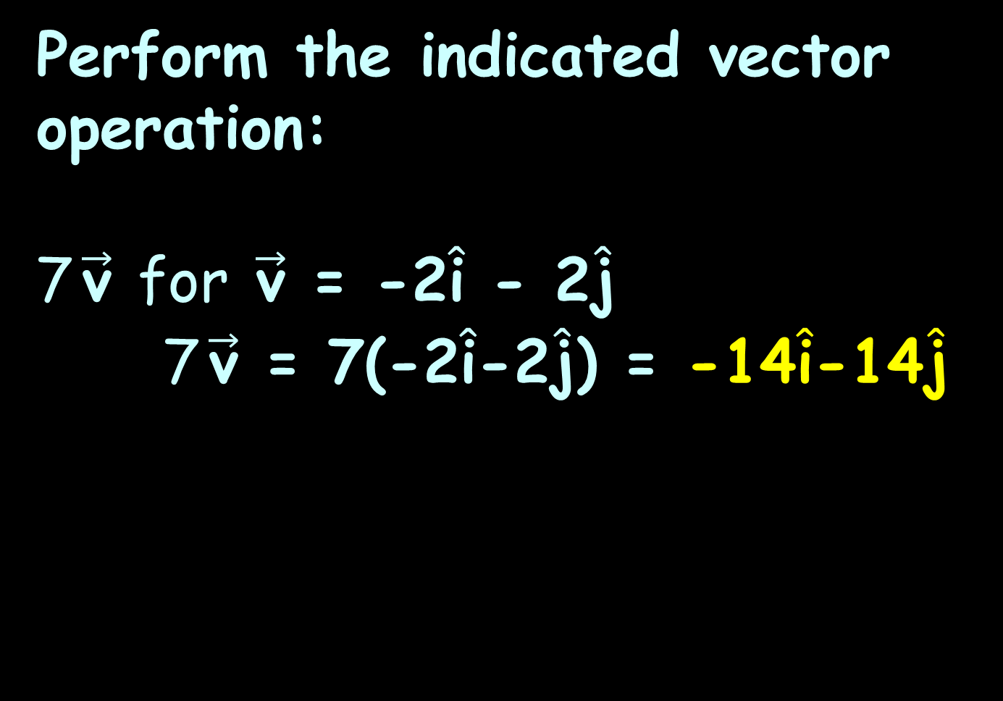
VECTORS
IN-CLASS PROBLEM 2b
Perform the indicated vector operation:
7 $\vec{\text{v}}$ for $\vec{\text{v}}$ = -2$\hat{\text{i}}$ - 2$\hat{\text{j}}$
7 $\vec{\text{v}}$ = 7(-2$\hat{\text{i}}$-2$\hat{\text{j}}$) = -14$\hat{\text{i}}$-14$\hat{\text{j}}$

Slide 74
Questions?
http://i.imgur.com/aliTlT3.jpg

Slide 75
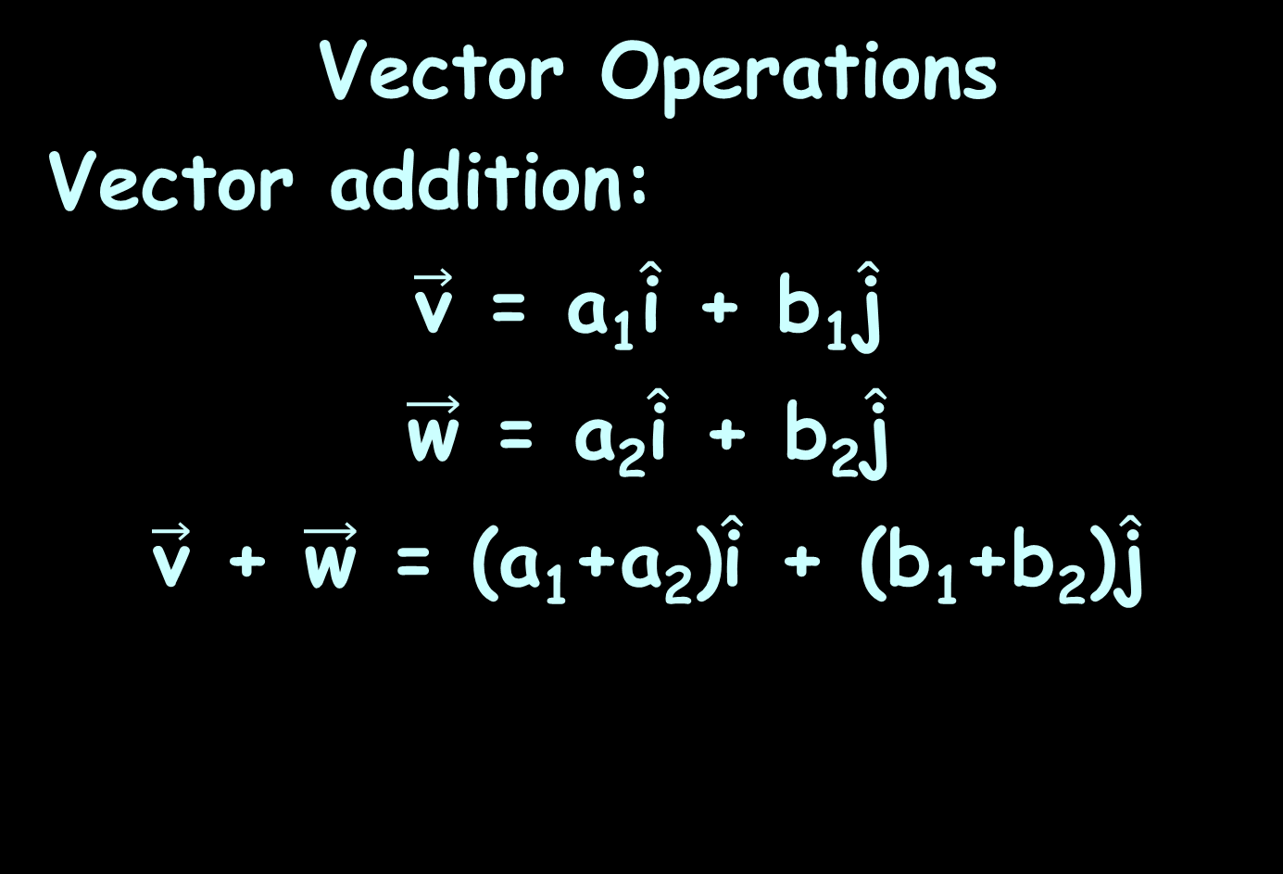
Vectors
Vector Operations
Vector addition:
$\vec{\text{v}}$ = a₁$\hat{\text{i}}$ + b₁$\hat{\text{j}}$
$\vec{\text{w}}$ = a₂$\hat{\text{i}}$ + b₂$\hat{\text{j}}$
$\vec{\text{v}}$ + $\vec{\text{w}}$ = (a₁+a₂)$\hat{\text{i}}$ + (b₁+b₂)$\hat{\text{j}}$

Slide 76


VECTORS
IN-CLASS PROBLEM 3a
$\vec{\text{v}}$ + $\vec{\text{w}}$ = ? for: $\vec{\text{v}}$ = 2$\hat{\text{i}}$ - 6$\hat{\text{j}}$ and
$\vec{\text{w}}$ = 3$\hat{\text{i}}$ + 4$\hat{\text{j}}$
$\vec{\text{v}}$ = a₁$\hat{\text{i}}$ + b₁$\hat{\text{j}}$
$\vec{\text{w}}$ = a₂$\hat{\text{i}}$ + b₂$\hat{\text{j}}$
$\vec{\text{v}}$ + $\vec{\text{w}}$ = (a₁+a₂)$\hat{\text{i}}$ + (b₁+b₂)$\hat{\text{j}}$

Slide 77
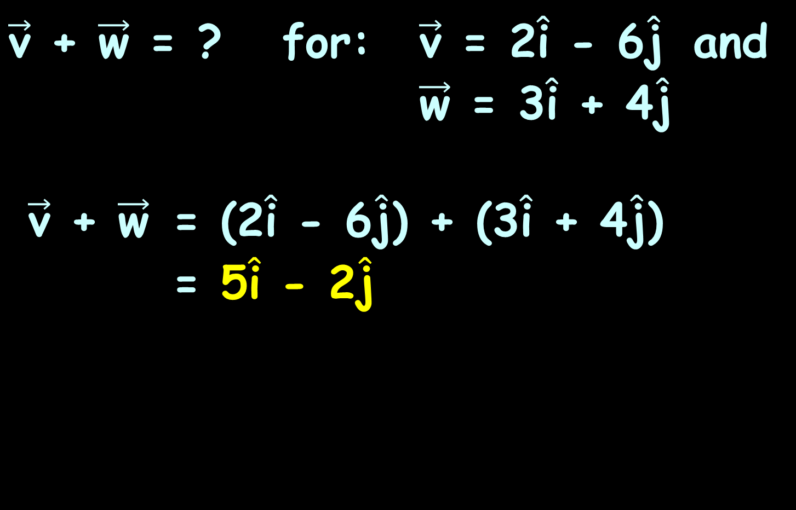
VECTORS
IN-CLASS PROBLEM 3a
$\vec{\text{v}}$ + $\vec{\text{w}}$ = ? for: $\vec{\text{v}}$ = 2$\hat{\text{i}}$ - 6$\hat{\text{j}}$ and
$\vec{\text{w}}$ = 3$\hat{\text{i}}$ + 4$\hat{\text{j}}$
$\vec{\text{v}}$ + $\vec{\text{w}}$ = (2$\hat{\text{i}}$ - 6$\hat{\text{j}}$) + (3$\hat{\text{i}}$ + 4$\hat{\text{j}}$)
= 5$\hat{\text{i}}$ - 2$\hat{\text{j}}$
$\vec{\text{v}}$ = a₁$\hat{\text{i}}$ + b₁$\hat{\text{j}}$
$\vec{\text{w}}$ = a₂$\hat{\text{i}}$ + b₂$\hat{\text{j}}$
$\vec{\text{v}}$ + $\vec{\text{w}}$ = (a₁+a₂)$\hat{\text{i}}$ + (b₁+b₂)$\hat{\text{j}}$

Slide 78

VECTORS
IN-CLASS PROBLEM 3b
$\vec{\text{v}}$ + $\vec{\text{w}}$ = ? for: $\vec{\text{v}}$ = 2$\hat{\text{i}}$ + 4$\hat{\text{j}}$ and
$\vec{\text{w}}$ = 3$\hat{\text{i}}$ - 4$\hat{\text{j}}$
$\vec{\text{v}}$ = a₁$\hat{\text{i}}$ + b₁$\hat{\text{j}}$
$\vec{\text{w}}$ = a₂$\hat{\text{i}}$ + b₂$\hat{\text{j}}$
$\vec{\text{v}}$ + $\vec{\text{w}}$ = (a₁+a₂)$\hat{\text{i}}$ + (b₁+b₂)$\hat{\text{j}}$

Slide 79
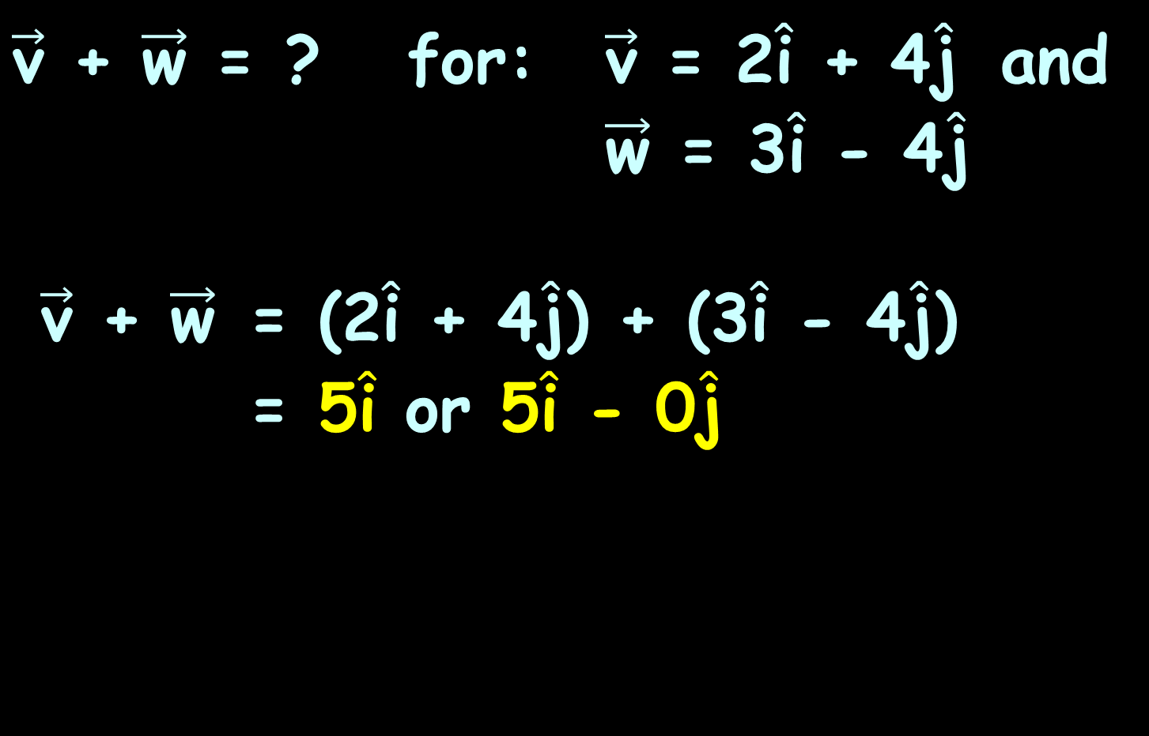
VECTORS
IN-CLASS PROBLEM 3b
$\vec{\text{v}}$ + $\vec{\text{w}}$ = ? for: $\vec{\text{v}}$ = 2$\hat{\text{i}}$ + 4$\hat{\text{j}}$ and
$\vec{\text{w}}$ = 3$\hat{\text{i}}$ - 4$\hat{\text{j}}$
$\vec{\text{v}}$ + $\vec{\text{w}}$ = (2$\hat{\text{i}}$ + 4$\hat{\text{j}}$) + (3$\hat{\text{i}}$ - 4$\hat{\text{j}}$)
= 5$\hat{\text{i}}$ or 5$\hat{\text{i}}$ - 0$\hat{\text{j}}$
$\vec{\text{v}}$ = a₁$\hat{\text{i}}$ + b₁$\hat{\text{j}}$
$\vec{\text{w}}$ = a₂$\hat{\text{i}}$ + b₂$\hat{\text{j}}$
$\vec{\text{v}}$ + $\vec{\text{w}}$ = (a₁+a₂)$\hat{\text{i}}$ + (b₁+b₂)$\hat{\text{j}}$

Slide 80

VECTORS
IN-CLASS PROBLEM 3c
$\vec{\text{v}}$ - $\vec{\text{w}}$ = ? for: $\vec{\text{v}}$ = 2$\hat{\text{i}}$ + 4$\hat{\text{j}}$ and
$\vec{\text{w}}$ = 3$\hat{\text{i}}$ - 4$\hat{\text{j}}$

Slide 81
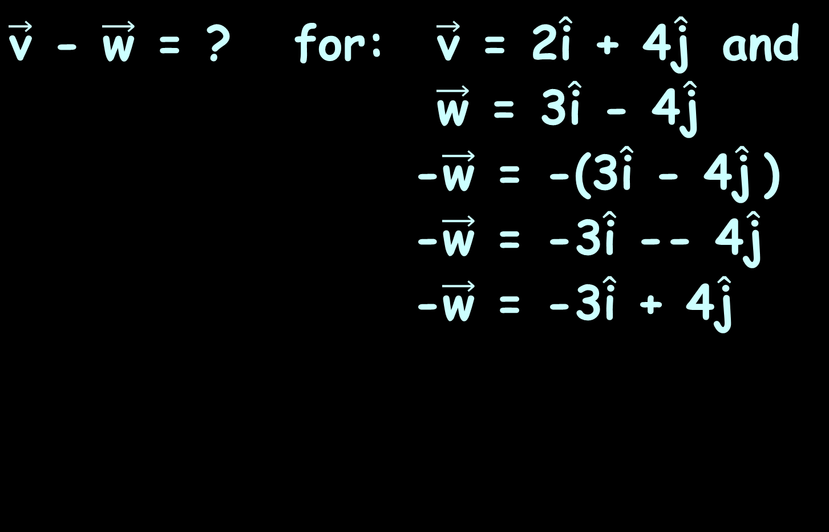
VECTORS
IN-CLASS PROBLEM 3c
$\vec{\text{v}}$ - $\vec{\text{w}}$ = ? for: $\vec{\text{v}}$ = 2$\hat{\text{i}}$ + 4$\hat{\text{j}}$ and
$\vec{\text{w}}$ = 3$\hat{\text{i}}$ - 4$\hat{\text{j}}$
-$\vec{\text{w}}$ = -(3$\hat{\text{i}}$ - 4$\hat{\text{j}}$)
-$\vec{\text{w}}$ = -3$\hat{\text{i}}$ -- 4$\hat{\text{j}}$
-$\vec{\text{w}}$ = -3$\hat{\text{i}}$ + 4$\hat{\text{j}}$

Slide 82
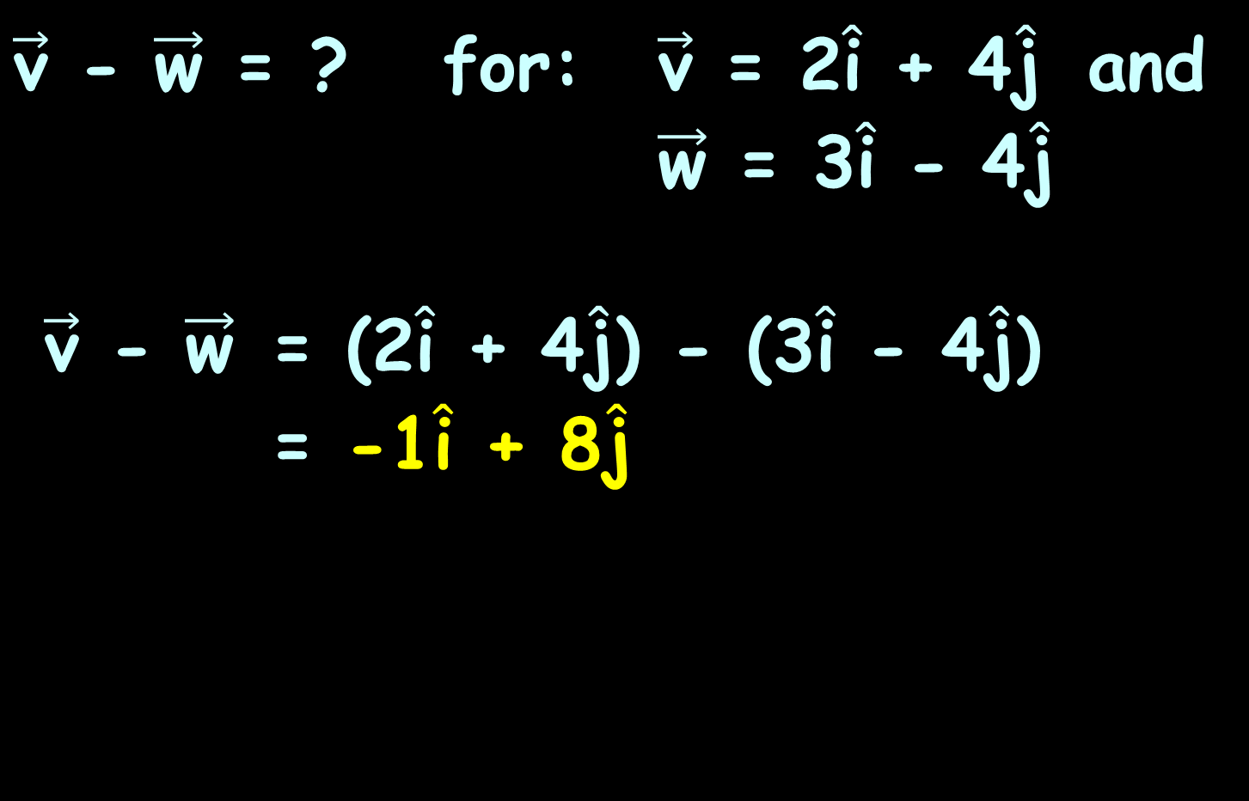
VECTORS
IN-CLASS PROBLEM 3c
$\vec{\text{v}}$ - $\vec{\text{w}}$ = ? for: $\vec{\text{v}}$ = 2$\hat{\text{i}}$ + 4$\hat{\text{j}}$ and
$\vec{\text{w}}$ = 3$\hat{\text{i}}$ - 4$\hat{\text{j}}$
$\vec{\text{v}}$ - $\vec{\text{w}}$ = (2$\hat{\text{i}}$ + 4$\hat{\text{j}}$) - (3$\hat{\text{i}}$ - 4$\hat{\text{j}}$)
= -1$\hat{\text{i}}$ + 8$\hat{\text{j}}$

Slide 83
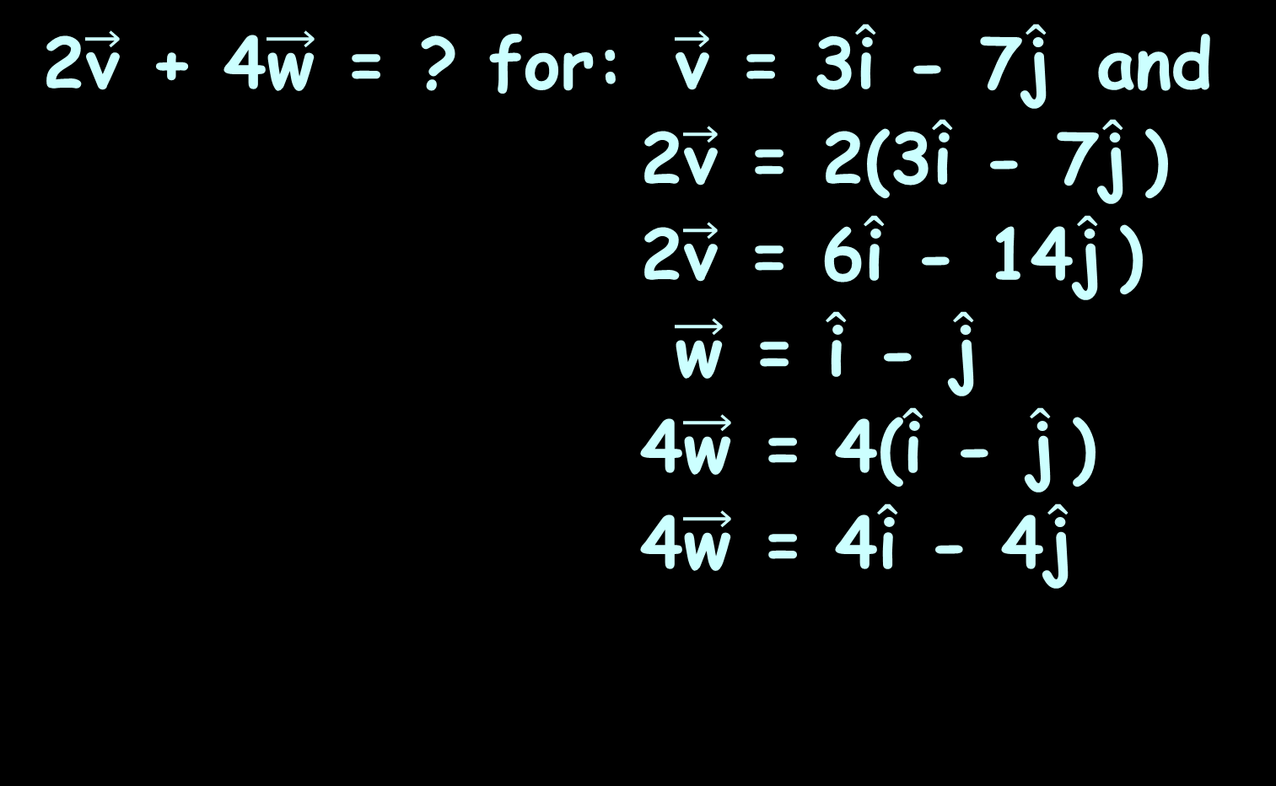
VECTORS
IN-CLASS PROBLEM 3d
2$\vec{\text{v}}$ + 4$\vec{\text{w}}$ = ? for: $\vec{\text{v}}$ = 3$\hat{\text{i}}$ - 7$\hat{\text{j}}$ and
2$\vec{\text{v}}$ = 2(3$\hat{\text{i}}$ - 7$\hat{\text{j}}$)
2$\vec{\text{v}}$ = 6$\hat{\text{i}}$ - 14$\hat{\text{j}}$)
$\vec{\text{w}}$ = $\hat{\text{i}}$ - $\hat{\text{j}}$
4$\vec{\text{w}}$ = 4($\hat{\text{i}}$ - $\hat{\text{j}}$)
4$\vec{\text{w}}$ = 4$\hat{\text{i}}$ - 4$\hat{\text{j}}$

Slide 84
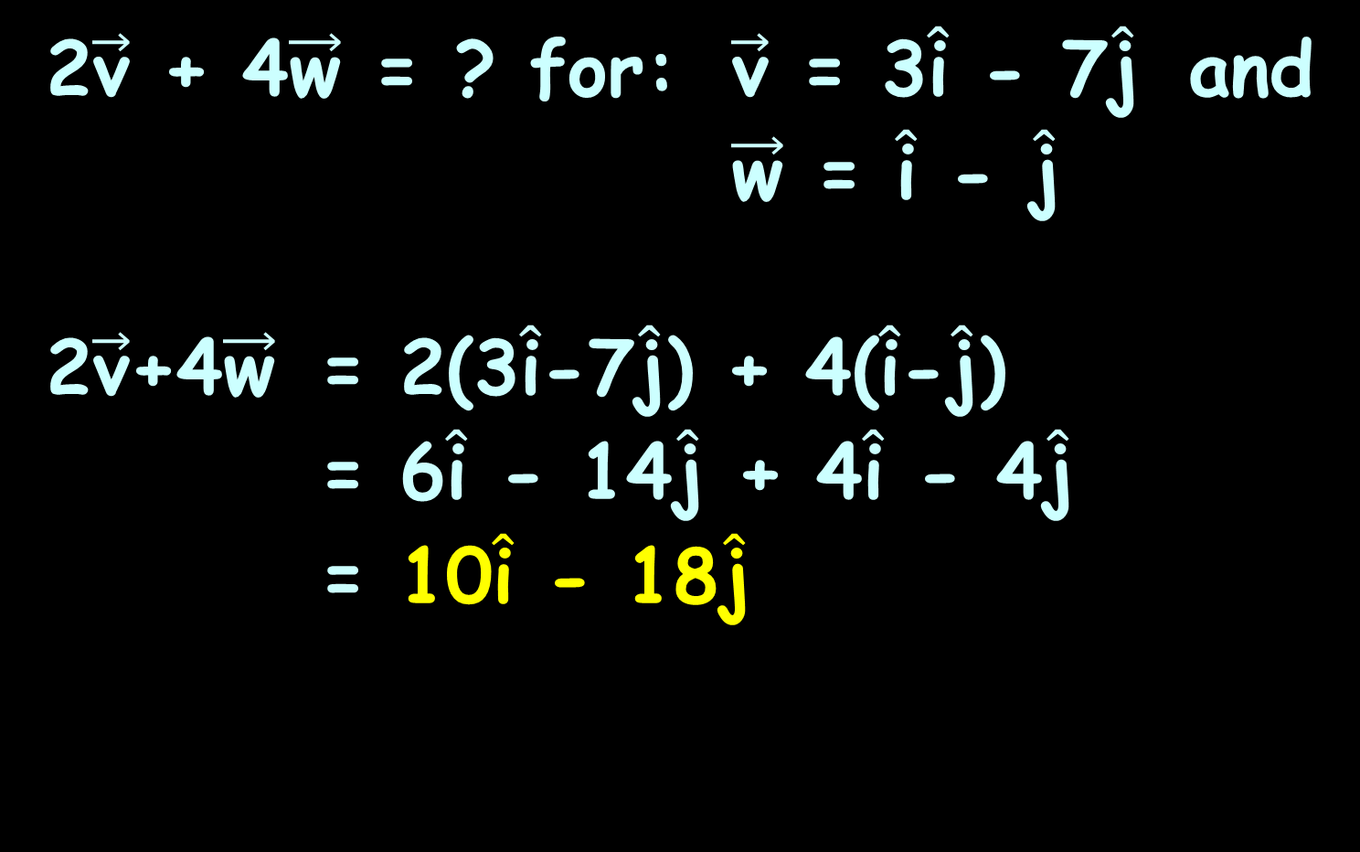
VECTORS
IN-CLASS PROBLEM 3d
2$\vec{\text{v}}$ + 4$\vec{\text{w}}$ = ? for: $\vec{\text{v}}$ = 3$\hat{\text{i}}$ - 7$\hat{\text{j}}$ and
$\vec{\text{w}}$ = $\hat{\text{i}}$ - $\hat{\text{j}}$
2$\vec{\text{v}}$+4$\vec{\text{w}}$ = 2(3$\hat{\text{i}}$-7$\hat{\text{j}}$) + 4($\hat{\text{i}}$-$\hat{\text{j}}$)
= 6$\hat{\text{i}}$ - 14$\hat{\text{j}}$ + 4$\hat{\text{i}}$ - 4$\hat{\text{j}}$
= 10$\hat{\text{i}}$ - 18$\hat{\text{j}}$

Slide 85

Vector calculations in wolframalpha:
To find $\vec{\text{v}}$ + $\vec{\text{w}}$ for
$\vec{\text{v}}$ = 2$\hat{\text{i}}$-5$\hat{\text{j}}$+4$\hat{\text{k}}$ and $\vec{\text{w}}$ = 7$\hat{\text{i}}$+4$\hat{\text{j}}$+15$\hat{\text{k}}$
Type in:
vector {2,-5,4} + vector {7,4,15}
gives: (9, -1, 19)
so the answer is: 9$\hat{\text{i}}$ – $\hat{\text{j}}$ + 19$\hat{\text{k}}$

Slide 86
Symbolab can do it, too!

Slide 87
Questions?
http://i.imgur.com/aliTlT3.jpg

Slide 88
Vectors
The component form describes lines in 2-D

Slide 89

Vectors
You can easily do 3-D “lines” (planes):
$\vec{\text{v}}$ = a$\hat{\text{i}}$ + b$\hat{\text{j}}$+ c$\hat{\text{k}}$

Slide 90
Vectors
You can write lines (planes… whatever) in n-D!

Slide 91


Slide 92


Slide 93
Questions?
http://i.imgur.com/aliTlT3.jpg

Slide 94

VECTORS
IN-CLASS PROBLEM 4a
In what quadrant is the terminal point of the vector located?
$\vec{\text{v}}$ = 5$\hat{\text{i}}$ - 3$\hat{\text{j}}$
II
I
III
IV
VFrench, 2017

Slide 95
VECTORS
IN-CLASS PROBLEM 4a
In what quadrant is the terminal point of the vector located?
$\vec{\text{v}}$ = 5$\hat{\text{i}}$ - 3$\hat{\text{j}}$
8
7
6
5
4
3
2
1
0
-1
-2
-3
-4
-5
-5
-7
-8
II
I
-8 -7 -6 -5 -4 -3 -2 -1 1 2 3 4 5 6 7 8
III
IV
VFrench, 2017

Slide 96

VECTORS
IN-CLASS PROBLEM 4b
If the vector $\vec{\text{v}}$ is multiplied by a scalar, in which quadrant will the terminal point of the product vector be?
$\vec{\text{v}}$ = 2$\hat{\text{i}}$ + 2$\hat{\text{j}}$
–2$\vec{\text{v}}$
8
7
6
5
4
3
2
1
0
-1
-2
-3
-4
-5
-5
-7
-8
II
I
-8 -7 -6 -5 -4 -3 -2 -1 1 2 3 4 5 6 7 8
III
IV

Slide 97

VECTORS
IN-CLASS PROBLEM 4b
If the vector $\vec{\text{v}}$ is multiplied by a scalar, in which quadrant will the terminal point of the product vector be?
$\vec{\text{v}}$ = 2$\hat{\text{i}}$ + 2$\hat{\text{j}}$
–2$\vec{\text{v}}$
8
7
6
5
4
3
2
1
0
-1
-2
-3
-4
-5
-5
-7
-8
II
I
-8 -7 -6 -5 -4 -3 -2 -1 1 2 3 4 5 6 7 8
III
IV

Slide 98

VECTORS
IN-CLASS PROBLEM 4b
If the vector $\vec{\text{v}}$ is multiplied by a scalar, in which quadrant will the terminal point of the product vector
be?
$\vec{\text{v}}$ = 2$\hat{\text{i}}$ + 2$\hat{\text{j}}$
–2$\vec{\text{v}}$
8
7
6
5
4
3
2
1
0
-1
-2
-3
-4
-5
-5
-7
-8
II
I
-8 -7 -6 -5 -4 -3 -2 -1 1 2 3 4 5 6 7 8
III
IV
VFrench, 2017

Slide 99

Vector calculations in wolframalpha:
In what quadrant is the terminal point of the vector $\vec{\text{v}}$ = 5$\hat{\text{i}}$ - 3$\hat{\text{j}}$?
Type in:
vector 5i - 3j
This will give you a plot, so you
can tell which quadrant it’s in

Slide 100
Questions?
http://i.imgur.com/aliTlT3.jpg

Slide 101

Vectors
The magnitude of $\vec{\text{v}}$
||$\vec{\text{v}}$|| = $\sqrt{{\text{a}}^{2}+{\text{b}}^{2}}$

Slide 102

Vectors
Demo: Find the magnitude of the vector:
$\vec{\text{v}}$ = -5$\hat{\text{i}}$ - 6$\hat{\text{j}}$

Slide 103

Vectors
Demo: Find the magnitude of the vector:
$\vec{\text{v}}$ = -5$\hat{\text{i}}$ - 6$\hat{\text{j}}$
$\vec{\text{v}}$ = a$\hat{\text{i}}$ + b$\hat{\text{j}}$
What is a?
What is b?

Slide 104

Vectors
Demo: Find the magnitude of the vector:
$\vec{\text{v}}$ = -5$\hat{\text{i}}$ - 6$\hat{\text{j}}$
a = -5
b = -6
||$\vec{\text{v}}$|| = $\sqrt{{\text{a}}^{2}+{\text{b}}^{2}}$

Slide 105


Vectors
Demo: Find the magnitude of the vector:
$\vec{\text{v}}$ = -5$\hat{\text{i}}$ - 6$\hat{\text{j}}$
a = -5
b = -6
2$\sqrt{\text{5}}$ b) $\sqrt{\text{61}}$
c) 30 d) 11
||$\vec{\text{v}}$|| = $\sqrt{{\text{a}}^{2}+{\text{b}}^{2}}$

Slide 106

Vectors
Demo: Find the magnitude of the vector:
$\vec{\text{v}}$ = -5$\hat{\text{i}}$ - 6$\hat{\text{j}}$
a = -5
b = -6
2$\sqrt{\text{5}}$ b) $\sqrt{\text{61}}$
c) 30 d) 11
||$\vec{\text{v}}$|| = $\sqrt{{\text{a}}^{2}+{\text{b}}^{2}}$

Slide 107


VECTORS
IN-CLASS PROBLEM 5a
Find the magnitude of the vector:
$\vec{\text{v}}$ = 3$\hat{\text{i}}$ + 4$\hat{\text{j}}$
||$\vec{\text{v}}$|| = $\sqrt{{\text{a}}^{2}+{\text{b}}^{2}}$

Slide 108


VECTORS
IN-CLASS PROBLEM 5a
Find the magnitude of the vector:
$\vec{\text{v}}$ = 3$\hat{\text{i}}$ + 4$\hat{\text{j}}$
||$\vec{\text{v}}$|| = $\sqrt{\text{(}\text{3}\text{)}\text{2}\text{+(}\text{4}\text{)}\text{2}}$
= $\sqrt{\text{9}\text{+1}\text{6}}$
= $\sqrt{\text{2}\text{5}}$
= 5
||$\vec{\text{v}}$|| = $\sqrt{{\text{a}}^{2}+{\text{b}}^{2}}$

Slide 109

VECTORS
IN-CLASS PROBLEM 5b
Find the magnitude of the vector:
$\vec{\text{v}}$ = -2$\hat{\text{i}}$ - 4$\hat{\text{j}}$
||$\vec{\text{v}}$|| = $\sqrt{{\text{a}}^{2}+{\text{b}}^{2}}$

Slide 110

VECTORS
IN-CLASS PROBLEM 5b
Find the magnitude of the vector:
$\vec{\text{v}}$ = -2$\hat{\text{i}}$ - 4$\hat{\text{j}}$
||$\vec{\text{v}}$|| = $\sqrt{\text{(−2)}\text{2}\text{+(−4)}\text{2}}$
= $\sqrt{\text{4+16}}$
= $\sqrt{\text{20}}$
= 2$\sqrt{\text{5}}$

Slide 111

VECTORS
IN-CLASS PROBLEM 5c
Find the magnitude of the vector:
$\vec{\text{v}}$ = 4$\hat{\text{i}}$ - 2$\hat{\text{j}}$
||$\vec{\text{v}}$|| = $\sqrt{{\text{a}}^{2}+{\text{b}}^{2}}$

Slide 112

VECTORS
IN-CLASS PROBLEM 5c
Find the magnitude of the vector:
$\vec{\text{v}}$ = 4$\hat{\text{i}}$ - 2$\hat{\text{j}}$
||$\vec{\text{v}}$|| = $\sqrt{\text{(4)}\text{2}\text{+(−2)}\text{2}}$
= $\sqrt{\text{16+4}}$
= $\sqrt{\text{20}}$
= 2$\sqrt{\text{5}}$
||$\vec{\text{v}}$|| = $\sqrt{{\text{a}}^{2}+{\text{b}}^{2}}$

Slide 113

VECTORS
IN-CLASS PROBLEM 5d
Find the magnitude of the vector:
$\vec{\text{v}}$ = -7$\hat{\text{i}}$ - 5$\hat{\text{j}}$
||$\vec{\text{v}}$|| = $\sqrt{{\text{a}}^{2}+{\text{b}}^{2}}$

Slide 114

VECTORS
IN-CLASS PROBLEM 5d
Find the magnitude of the vector:
$\vec{\text{v}}$ = -7$\hat{\text{i}}$ - 5$\hat{\text{j}}$
||$\vec{\text{v}}$|| = $\sqrt{\text{(}\text{−7}\text{)}\text{2}\text{+(−}\text{5}\text{)}\text{2}}$
= $\sqrt{\text{49}\text{+}\text{25}}$
= $\sqrt{\text{74}}$
||$\vec{\text{v}}$|| = $\sqrt{{\text{a}}^{2}+{\text{b}}^{2}}$

Slide 115

VECTORS
IN-CLASS PROBLEM 5e
Find the magnitude of the vector:
$\vec{\text{v}}$ = 5$\hat{\text{i}}$ - 2$\hat{\text{j}}$
||$\vec{\text{v}}$|| = $\sqrt{{\text{a}}^{2}+{\text{b}}^{2}}$

Slide 116

VECTORS
IN-CLASS PROBLEM 5e
Find the magnitude of the vector:
$\vec{\text{v}}$ = 5$\hat{\text{i}}$ - 2$\hat{\text{j}}$
||$\vec{\text{v}}$|| = $\sqrt{\text{(}\text{5}\text{)}\text{2}\text{+(−}\text{2}\text{)}\text{2}}$
= $\sqrt{\text{25}\text{+}\text{4}}$
= $\sqrt{\text{29}}$
||$\vec{\text{v}}$|| = $\sqrt{{\text{a}}^{2}+{\text{b}}^{2}}$

Slide 117

You can do some vector things in wolframalpha:
Suppose you wanted to find the magnitude of $\vec{\text{v}}$ = 2$\hat{\text{i}}$ - 5$\hat{\text{j}}$ + 4$\hat{\text{k}}$
Type in:
vector {2,-5, 4}
“vector length” is the magnitude

Slide 118


Slide 119


Slide 120
Questions?
http://i.imgur.com/aliTlT3.jpg

Slide 121

Vectors
Position Vector
if $\vec{\text{v}}$ doesn't start at (0,0):
$\vec{\text{v}}$ = (x₂-x₁) $\hat{\text{i}}$ + (y₂-y₁) $\hat{\text{j}}$

Slide 122

VECTORS
IN-CLASS PROBLEM 6a
A vector has:
Initial point: (–1, 1)
Terminal point: (2, –2)
What is the position vector?
$\vec{\text{v}}$ = (x₂-x₁) $\hat{\text{i}}$ + (y₂-y₁) $\hat{\text{j}}$

Slide 123

VECTORS
IN-CLASS PROBLEM 6a
A vector has:
Initial point: (–1, 1)
Terminal point: (2, –2)
What is the position vector?
$\vec{\text{v}}$ = (2-(-1)) $\hat{\text{i}}$ + (-2-1) $\hat{\text{j}}$
$\vec{\text{v}}$ = (x₂-x₁) $\hat{\text{i}}$ + (y₂-y₁) $\hat{\text{j}}$

Slide 124

VECTORS
IN-CLASS PROBLEM 6a
A vector has:
Initial point: (–1, 1)
Terminal point: (2, –2)
What is the position vector?
$\vec{\text{v}}$ = (2-(-1)) $\hat{\text{i}}$ + (-2-1) $\hat{\text{j}}$
$\vec{\text{v}}$ = 3$\hat{\text{i}}$ - 3$\hat{\text{j}}$

Slide 125
Questions?
http://i.imgur.com/aliTlT3.jpg

Slide 126

Vectors
writing a vector in terms of its magnitude and direction:
magnitude ||$\vec{\text{v}}$|| direction angle θ
$\vec{\text{v}}$ = ||$\vec{\text{v}}$|| (cosθ $\hat{\text{i}}$ + sinθ $\hat{\text{j}}$)

Slide 127
VECTORS
IN-CLASS PROBLEM 6b
A football quarterback throws the football with a speed of 48 feet per second at an angle of 45 degrees upward from the ground. What is the direction?

Slide 128

VECTORS
IN-CLASS PROBLEM 6b
A football quarterback throws the football with a speed of 48 feet per second at an angle of 45 degrees upward from the ground. What is the direction?
direction angle θ = 45º
$\vec{\text{v}}$ = ||$\vec{\text{v}}$|| (cosθ $\hat{\text{i}}$ + sinθ $\hat{\text{j}}$)

Slide 129
VECTORS
IN-CLASS PROBLEM 6b
A football quarterback throws the football with a speed of 48 feet per second at an angle of 45 degrees upward from the ground. What is the magnitude of the throw?
$\vec{\text{v}}$ = ||$\vec{\text{v}}$|| (cosθ $\hat{\text{i}}$ + sinθ $\hat{\text{j}}$)

Slide 130

VECTORS
IN-CLASS PROBLEM 6b
A football quarterback throws the football with a speed of 48 feet per second at an angle of 45 degrees upward from the ground. What is the magnitude of the throw?
magnitude ||$\vec{\text{v}}$|| = 48
$\vec{\text{v}}$ = ||$\vec{\text{v}}$|| (cosθ $\hat{\text{i}}$ + sinθ $\hat{\text{j}}$)

Slide 131


VECTORS
IN-CLASS PROBLEM 6b
magnitude ||$\vec{\text{v}}$|| = 48 direction angle θ = 45º
What is the vector describing the motion of the football?
$\vec{\text{v}}$ = ||$\vec{\text{v}}$|| (cosθ $\hat{\text{i}}$ + sinθ $\hat{\text{j}}$)

Slide 132

VECTORS
IN-CLASS PROBLEM 6b
magnitude ||$\vec{\text{v}}$|| = 48 direction angle θ = 45º
What is the vector describing the motion of the football?
$\vec{\text{v}}$ = 48 (cos45 $\hat{\text{i}}$ + sin45 $\hat{\text{j}}$)
$\vec{\text{v}}$ = ||$\vec{\text{v}}$|| (cosθ $\hat{\text{i}}$ + sinθ $\hat{\text{j}}$)

Slide 133

VECTORS
IN-CLASS PROBLEM 6b
magnitude ||$\vec{\text{v}}$|| = 48 direction angle θ = 45º
What is the vector describing the motion of the football?
$\vec{\text{v}}$ = 48 (cos45 $\hat{\text{i}}$ + sin45 $\hat{\text{j}}$)
= 48(sqrt(2)/2$\hat{\text{i}}$ + sqrt(2)/2$\hat{\text{j}}$)
≈ 33.94($\hat{\text{i}}$ + $\hat{\text{j}}$)
$\vec{\text{v}}$ = ||$\vec{\text{v}}$|| (cosθ $\hat{\text{i}}$ + sinθ $\hat{\text{j}}$)

Slide 134
Questions?
http://i.imgur.com/aliTlT3.jpg

Slide 135

Vectors
Dot Product - Multiplying two
vectors
For $\vec{\text{v}}$ = a₁$\hat{\text{i}}$ + b₁$\hat{\text{j}}$
and $\vec{\text{w}}$ = a₂$\hat{\text{i}}$ + b₂$\hat{\text{j}}$
$\vec{\text{v}}$● $\vec{\text{w}}$ = a₁a₂ + b₁b₂

Slide 136

Vectors
Dot Product - Multiplying two
vectors
For $\vec{\text{v}}$ = a₁$\hat{\text{i}}$ + b₁$\hat{\text{j}}$
and $\vec{\text{w}}$ = a₂$\hat{\text{i}}$ + b₂$\hat{\text{j}}$
$\vec{\text{v}}$● $\vec{\text{w}}$ = a₁a₂ + b₁b₂
Note: there are no $\hat{\text{i}}$’s or $\hat{\text{j}}$’s – only a number

Slide 137
Vectors
The dot product is sometimes called the “inner product”

Slide 138

Vectors
It comes from matrix multiplication:
$\left[\begin{matrix}\text{a}\text{1} & \text{b}\text{1}\end{matrix}\right]$ × $\left[\begin{matrix}\text{a}\text{2} \\ \text{b}\text{2}\end{matrix}\right]$

Slide 139
Vectors
You can think of the dot product as directional multiplication

Slide 140
Vectors
If a vector is "growth in a direction", adding vectors: accumulates the growth contained in several vectors

Slide 141
Vectors
If a vector is "growth in a direction", multiplying by a constant makes an existing vector stronger

Slide 142
Vectors
If a vector is "growth in a direction", the dot product applies the directional growth of one vector to another

Slide 143
Vectors
If a vector is "growth in a direction", the dot product applies the directional growth of one vector to another
The result is how much stronger we've made the original (positive, negative, or zero)

Slide 144
Vectors
Suppose there are two vectors:
3i+0j and 4i+0j
3 is "directional growth" in a single dimension
4 is "directional growth" in the same direction
3 x 4 = 12 means we get 12x growth in a that direction

Slide 145
Vectors
Suppose there are two vectors:
3i+0j and 0i+2j
i is “one orange"
j is “one banana"
3i+0j means triple the oranges,
destroy the bananas
0i+2j means destroy the
oranges, double the bananas

Slide 146
Vectors
Suppose there are two vectors:
3i+0j and 0i+2j
i is “oranges"
j is “bananas"
The dot product means “destroy all your fruit, buddy!”

Slide 147
Vectors
A dot product result can be:
zero: we don't have any growth
in the original direction
positive: we have growth in the
original direction
negative number: we have
reverse growth in the
original direction

Slide 148


VECTORS
IN-CLASS PROBLEM 7a
Find the dot product of vector $\vec{\text{v}}$ and vector $\vec{\text{w}}$ if:
$\vec{\text{v}}$ = 2$\hat{\text{i}}$ - 3$\hat{\text{j}}$ and $\vec{\text{w}}$ = $\hat{\text{i}}$ - $\hat{\text{j}}$
2×1 + -3×-1
$\vec{\text{v}}$● $\vec{\text{w}}$ = a₁a₂ + b₁b₂

Slide 149


VECTORS
IN-CLASS PROBLEM 7a
Find the dot product of vector $\vec{\text{v}}$ and vector $\vec{\text{w}}$ if:
$\vec{\text{v}}$ = 2$\hat{\text{i}}$ - 3$\hat{\text{j}}$ and $\vec{\text{w}}$ = $\hat{\text{i}}$ - $\hat{\text{j}}$
2×1 + -3×-1
2+3
5
$\vec{\text{v}}$● $\vec{\text{w}}$ = a₁a₂ + b₁b₂

Slide 150

VECTORS
IN-CLASS PROBLEM 7b
Find the dot product $\vec{\text{v}}$●$\vec{\text{w}}$:
$\vec{\text{v}}$ = 3$\hat{\text{i}}$ + 3$\hat{\text{j}}$ and $\vec{\text{w}}$ = $\hat{\text{i}}$ + 4$\hat{\text{j}}$
$\vec{\text{v}}$● $\vec{\text{w}}$ = a₁a₂ + b₁b₂

Slide 151

VECTORS
IN-CLASS PROBLEM 7b
For the following, find the dot product $\vec{\text{v}}$●$\vec{\text{w}}$:
$\vec{\text{v}}$ = 3$\hat{\text{i}}$ + 3$\hat{\text{j}}$ and $\vec{\text{w}}$ = $\hat{\text{i}}$ + 4$\hat{\text{j}}$
15
$\vec{\text{v}}$● $\vec{\text{w}}$ = a₁a₂ + b₁b₂

Slide 152

VECTORS
IN-CLASS PROBLEM 7c
For the following, find the dot product $\vec{\text{v}}$●$\vec{\text{w}}$:
$\vec{\text{v}}$ = 7$\hat{\text{i}}$ - 2$\hat{\text{j}}$ and $\vec{\text{w}}$ = -3$\hat{\text{i}}$ - $\hat{\text{j}}$
$\vec{\text{v}}$● $\vec{\text{w}}$ = a₁a₂ + b₁b₂

Slide 153

VECTORS
IN-CLASS PROBLEM 7c
For the following, find the dot product $\vec{\text{v}}$●$\vec{\text{w}}$:
$\vec{\text{v}}$ = 7$\hat{\text{i}}$ - 2$\hat{\text{j}}$ and $\vec{\text{w}}$ = -3$\hat{\text{i}}$ - $\hat{\text{j}}$
-19
$\vec{\text{v}}$● $\vec{\text{w}}$ = a₁a₂ + b₁b₂

Slide 154

VECTORS
IN-CLASS PROBLEM 7d
For the following, find the dot product $\vec{\text{v}}$●$\vec{\text{w}}$:
$\vec{\text{v}}$ = -8$\hat{\text{i}}$ - 3$\hat{\text{j}}$ and $\vec{\text{w}}$ = -10$\hat{\text{i}}$ - 5$\hat{\text{j}}$
$\vec{\text{v}}$● $\vec{\text{w}}$ = a₁a₂ + b₁b₂

Slide 155

VECTORS
IN-CLASS PROBLEM 7d
For the following, find the dot product $\vec{\text{v}}$●$\vec{\text{w}}$:
$\vec{\text{v}}$ = -8$\hat{\text{i}}$ - 3$\hat{\text{j}}$ and $\vec{\text{w}}$ = -10$\hat{\text{i}}$ - 5$\hat{\text{j}}$
95
$\vec{\text{v}}$● $\vec{\text{w}}$ = a₁a₂ + b₁b₂

Slide 156

Vector calculations in wolframalpha:
Find the dot product of vector
3$\hat{\text{i}}$ + 5$\hat{\text{j}}$ and vector 7$\hat{\text{i}}$ - 4$\hat{\text{j}}$
Type in:
Find the dot product of vector
3i + 5j and vector 7i - 4j

Slide 157

Symbolab ONLY wants the components

Slide 158
Questions?
http://i.imgur.com/aliTlT3.jpg

Slide 159
Vectors
The cross product or vector product between two vectors notation: a × b
(read "a cross b")
is a vector that is perpendicular
to both a and b

Slide 160
Vectors
The cross product is defined only in three-dimensional space
(the vectors will consist of three mutually perpendicular vectors defining the three coordinate axes: the x-, y-, and z-axis)

Slide 161
Vectors
Find the direction of the cross product by the right-hand rule:
×
a × b in perpendicular
plane
a and b
in same
plane
https://en.wikipedia.org/wiki/Cross_product
Notes:
ction o

Slide 162
Vectors
The magnitude is equal to the area of the parallelogram that the vectors span

Slide 163

Vectors
start with two vectors: $\vec{\text{a}}$=⟨a₁,a₂,a₃⟩ and $\vec{\text{b}}$=⟨b₁,b₂,b₃⟩ the cross product is:
$\vec{\text{a}}$× $\vec{\text{b}}$ =⟨a₂b₃−a₃b₂,a₃b₁−a₁b₃,a₁b₂−a₂b₁⟩

Slide 164

Vectors
start with two vectors: $\vec{\text{a}}$=⟨a₁,a₂,a₃⟩ and $\vec{\text{b}}$=⟨b₁,b₂,b₃⟩ the cross product is:
$\vec{\text{a}}$× $\vec{\text{b}}$ =⟨a₂b₃−a₃b₂,a₃b₁−a₁b₃,a₁b₂−a₂b₁⟩
https://henrytrocino.files.wordpress.com/2013/08/weeping-and-gnashing-of-teeth-300x236.jpg

Slide 165


VECTOR CALCULUS
IN-CLASS PROBLEM 8
If $\vec{\text{w}}$=⟨3,−1,5⟩ and $\vec{\text{v}}$=⟨0,4,−2⟩
compute $\vec{\text{v}}$× $\vec{\text{w}}$
=⟨w₂v₃−w₃v₂,w₃v₁−w₁v₃,w₁v₂−w₂v₁⟩
$\vec{\text{w}}$× $\vec{\text{v}}$ =⟨w₂v₃−w₃v₂,w₃v₁−w₁v₃,w₁v₂−w₂v₁⟩

Slide 166

VECTOR CALCULUS
IN-CLASS PROBLEM 8
If $\vec{\text{w}}$=⟨3,−1,5⟩ and $\vec{\text{v}}$=⟨0,4,−2⟩
compute $\vec{\text{v}}$× $\vec{\text{w}}$
=⟨w₂v₃−w₃v₂,w₃v₁−w₁v₃,w₁v₂−w₂v₁⟩
⟨(-1)(-2)-(5)(4),(5)(0)-(3)(-2),(3)(4)-(-1)(0)⟩
$\vec{\text{w}}$× $\vec{\text{v}}$ =⟨w₂v₃−w₃v₂,w₃v₁−w₁v₃,w₁v₂−w₂v₁⟩

Slide 167

VECTOR CALCULUS
IN-CLASS PROBLEM 8
If $\vec{\text{w}}$=⟨3,−1,5⟩ and $\vec{\text{v}}$=⟨0,4,−2⟩
compute $\vec{\text{v}}$× $\vec{\text{w}}$
=⟨w₂v₃−w₃v₂,w₃v₁−w₁v₃,w₁v₂−w₂v₁⟩
⟨(-1)(-2)-(5)(4),(5)(0)-(3)(-2),(3)(4)-(-1)(0)⟩
⟨ -18, 6, 12 ⟩
$\vec{\text{w}}$× $\vec{\text{v}}$ =⟨w₂v₃−w₃v₂,w₃v₁−w₁v₃,w₁v₂−w₂v₁⟩

Slide 168


VECTOR CALCULUS
IN-CLASS PROBLEM 8
If $\vec{\text{w}}$=⟨3,−1,5⟩ and $\vec{\text{v}}$=⟨0,4,−2⟩
compute $\vec{\text{v}}$× $\vec{\text{w}}$
=⟨w₂v₃−w₃v₂, =(-1)(-2)-(5)(4) = -18
w₃v₁−w₁v₃, =(5)(0) – (3)(-2) = 6
w₁v₂−w₂v₁⟩ =(3)(4) – (-1)(0) = 12
So:
$\vec{\text{v}}$× $\vec{\text{w}}$ = ⟨-18,6,12⟩

Slide 169


Slide 170


Slide 171
Vectors
The cross product is also defined to be:
a × b = ∥a∥ ∥b∥ sin(θ)n
where θ is the angle between a and b in the plane containing them, ‖a‖ and ‖b‖ are the magnitudes

Slide 172
Vectors
The cross product is also defined to be:
a × b = ∥a∥ ∥b∥ sin(θ)n
where n is a unit vector perpendicular to the plane containing a and b in the direction given by the right-hand rule

Slide 173


Vectors
Both the cross product and dot product were invented simultaneously by in 1881 Josiah Willard Gibbs (American) and Oliver Heaviside (British)
https://www.goodreads.com/author/show/3986960.Josiah_Willard_Gibbs
https://en.wikipedia.org/wiki/Oliver_Heaviside#/media/File:Oheaviside.jpg

Slide 174
Vectors
If two vectors have the same direction or have the exact opposite direction from one another or if either one has zero length, then their cross product is zero

Slide 175
Vectors
The magnitude of the product of two perpendicular vectors is the product of their lengths

Slide 176
Vectors
Order IS important!
a × b = − b × a

Slide 177
Vectors
It is distributive over addition:
a × (b + c) = a × b + a × c

Slide 178
Vectors
There is a major difference between dot products and cross products: The result of a dot product is a number and the result of a cross product is a vector!

Slide 179
Questions?
http://i.imgur.com/aliTlT3.jpg

Slide 180
Summary
Today we studied:
Review of Parametrics and
Polar Calculus
Vectors

Slide 181

You Survived!
www.playbuzz.com

