Slide 1
Welcome to
Unit 1 Part 1
MATH366 Probability and Statistics
https://online.stanford.edu/sites/default/files/styles/figure_default/public/2018-04/theory-of-probability_stats116.jpg?itok=ms4fRMO-

Slide 2
What’s Up?
Today we will be going over:
  Info for the class
  Population, sample
  Types of data:
  Qualitative/quantitative
  Observation/experiment
  Deterministic/nondeterministic
  Periodic/nonperiodic
  Continuous/discrete
  Stationary/nonstationary

Slide 3
What’s Up?
Outcome 1) Calculate statistical measures of central tendency and dispersion used in describing and summarizing collected samples. Both by hand calculation methods supported by calculators and programmed software procedures will be used to make these computations

Slide 4
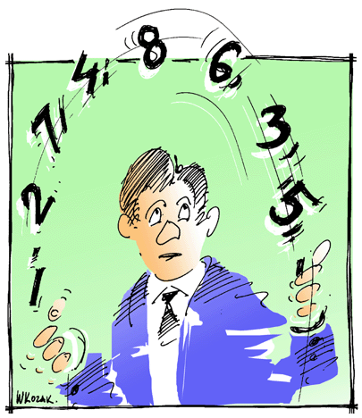
Statistics??
So, howcum you have to take STATISTICS
terror of college
students,
fodder for
late-night comics??
http://www.cogniview.com/blog/wp-content/uploads/2013/06/statistics.gif

Slide 5
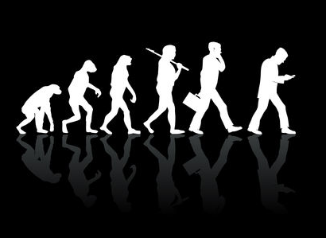

Statistics??
Statistics is the basis
for all scientific claims
from Darwin's theory of evolution to commercials
about aspirin
https://clk.tradedoubler.com/click?p=264355&a=3090189&g=24601032&url=https%3A%2F%2Fstock.adobe.com%2Fimages%2FEvolution%2F29640484%3Fas_campaign%3DTinEye%26as_content%3Dtineye_match&epi1=29640484
http://stevetilford.com/wp-content/uploads/2012/04/aspirin.jpg

Slide 6
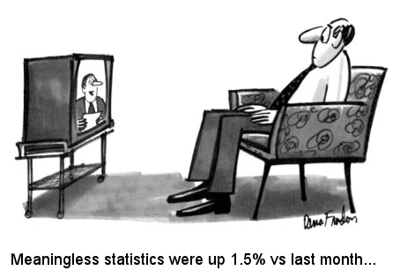
Statistics??
The government stands (nervously) on statistical projections
http://www.nirg.net/files/upenn2014/images/cartoon.jpg

Slide 7

Statistics??
Everyone is affected by statistics, for good or ill
Statistics can be used
to support anything
(true or false)
http://www.peteykins.com/sparklepics5/Briefcase11.jpg

Slide 8
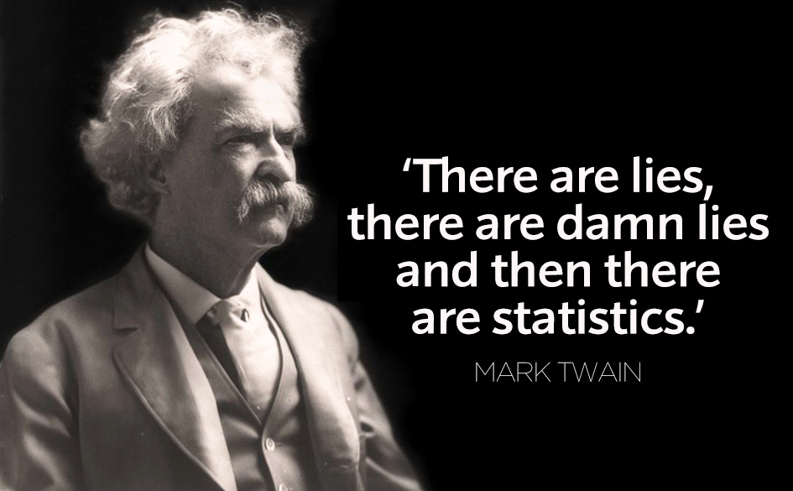
Statistics??
http://circuitfactory.ae/blog/wp-content/uploads/2012/08/5.-Mark-Twain-Quote.jpg

Slide 9
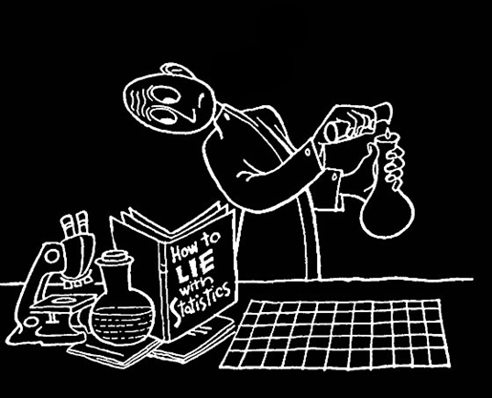
Statistics??
Everyone in the twenty-first century should become skeptical consumers of
statistical
information
How to Lie with Statistics, Darrell Huff, 1954

Slide 10
Statistics??
numbers DO lie !
In this course
we will learn how to do statistics and probability,
but we will also learn how pervasive statistical lying is and
how to recognize a potential lie
when we see one

Slide 11

Statistics!!
Statistics is the mathematics
of uncertainty
so, in our uncertain world
statistics is the
mathematics of
making decisions
http://babycalm.files.wordpress.com/2011/09/lost1.jpg

Slide 12
Statistics
Inference – making an educated guess about the whole based on a part

Slide 13
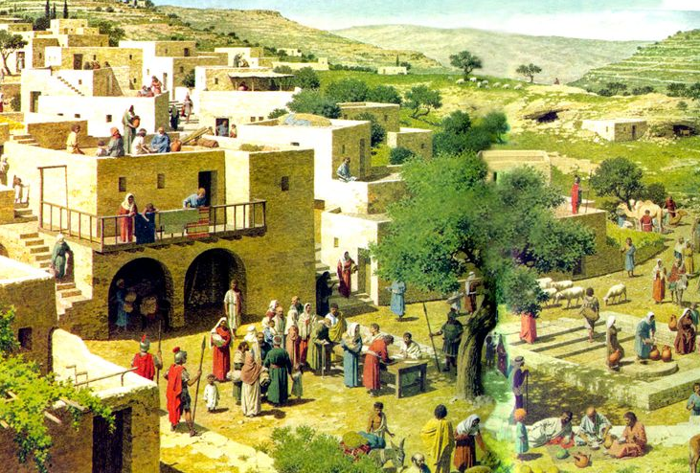
Statistics
The Bible…
https://s-media-cache-ak0.pinimg.com/736x/d2/7d/01/d27d01f75c7484e509ad12d3ef47c7bb.jpg

Slide 14
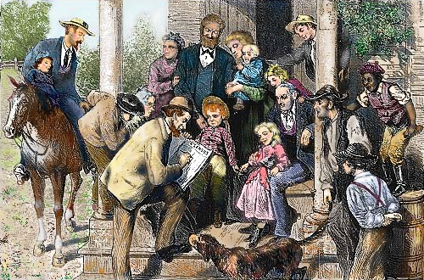
Statistics
The ASA
http://tngenweb.org/census/census1a.jpg

Slide 15


Statistics
collecting, organizing,
analyzing,
and interpreting data
in order to make
decisions
http://www.techbehindthescenes.com/uploads/1/0/1/4/101430402/published/561686.jpg?1489505076
https://static.vecteezy.com/system/resources/previews/002/996/590/non_2x/girl-with-question-mark-in-think-bubble-sits-on-the-table-young-vector.jpg

Slide 16
Statistics
Descriptive statistics:
organization, summarization, and display of data
Inferential statistics:
using a sample to draw conclusions about a population with a probability of being correct

Slide 17

How It Works
Start with a question you want to answer:
        What brand of headache medicine cures headaches fastest?
        How many species of fish live in the Earth’s oceans?
        Who will voters elect in the next election?
http://womenhc.com/media/blogs/ilam/4696_634207417938841250_l.jpg

Slide 18
How It Works
Each of these questions require a count or a measurement to answer:
  How fast each medication cures headaches
  Count of all the fish species detected in Earth’s oceans
  Count of voting preferences

Slide 19
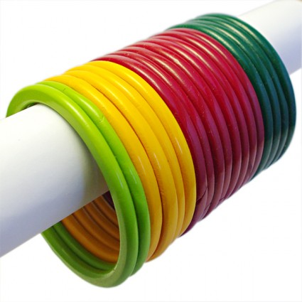

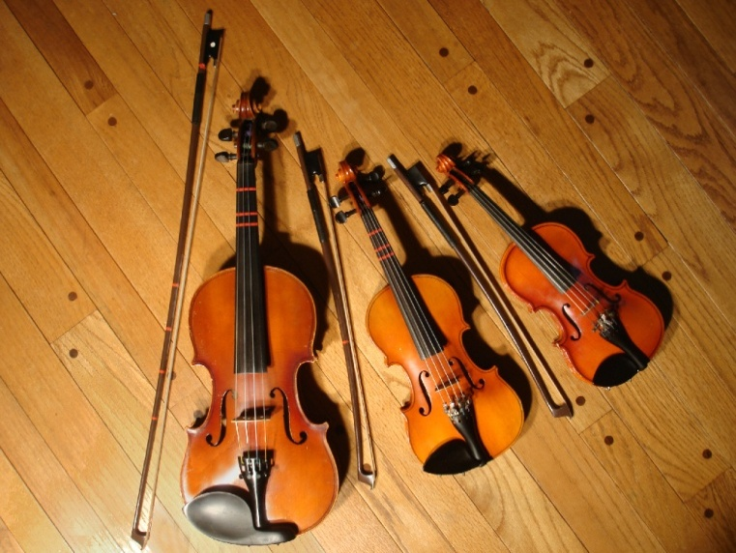
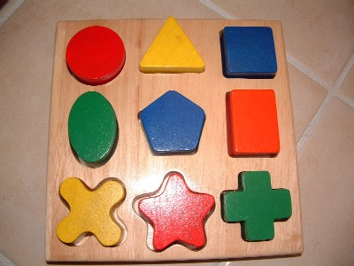
How It Works
Counts or measurements taken are called variables because their values are free to vary
http://www.pankaj-boutique.com/605-thickbox_01resp/bangles-lakh-indian.jpg
http://www.dvice.com/sites/dvice/files/styles/blog_post_media/public/humanvoiceviolin.jpg?itok=lRxIZgtA
https://www.nairaland.com/attachments/1994311_differentraces3_jpegb817a1394dd775da9a7d190082e863f8
http://www.monthome.com/photo/mont32.JPG

Slide 20
How It Works
So, we have a question we want to answer about something BIG:
      All the times it takes to cure all of the headaches
      All the fish in the oceans
      All the voters
These BIG things are too big for us to get our hands on !

Slide 21
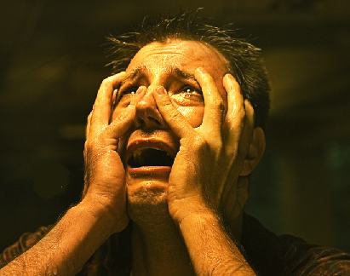
How It Works
So, what do we do now????
    wring our hands
    weep
    curse
    give up
    let somebody
    else do it
http://whatsdavedoing.com/wp-content/uploads/2011/05/white-flag-e1381530152918.jpg

Slide 22
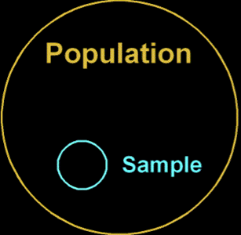
How It Works
or… maybe…
take a piece of the big group?
VFrench, 2020

Slide 23

How It Works
If we are lucky, our small piece will be representative of the BIG thing, and the answer to our question will be right
http://www.christinarosalie.com/mytopography/wp-content/uploads/2011/05/MG_0223.jpg

Slide 24
How It Works
The BIG thing we want to answer a question about is called our
POPULATION
The small piece of it we actually take is called our
SAMPLE

Slide 25
How It Works
The count or measurement we need to answer our question about the population is called a
PARAMETER
The count or measurement we actually take to answer our question using a sample is called a STATISTIC

Slide 26
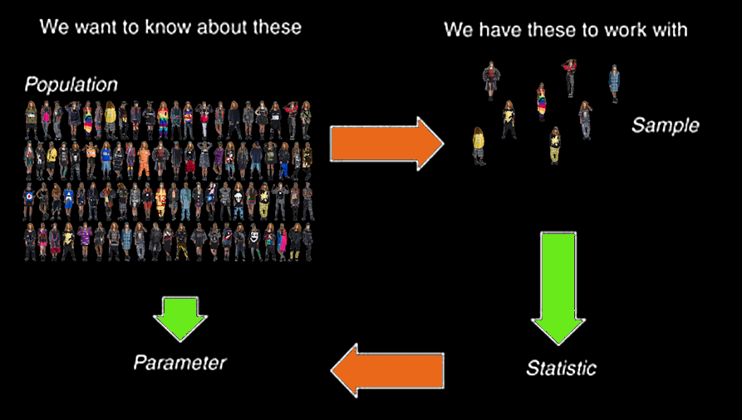
How It Works
VFrench, 2016

Slide 27
So… unfortunately…
STATISTICS = the methods of collecting, organizing, analyzing, and interpreting data in order to make decisions
and
STATISTICS = counts or measurements we take on a sample to estimate counts or measurements on a population

Slide 28
HOW IT WORKS
IN-CLASS PROBLEM 1
What would a measurement on the whole population be called?
Hint – the US does one every 10 years…

Slide 29
Sampling
A census is a “sampling” of “all” the members of a population

Slide 30

Questions?
http://i.imgur.com/aliTlT3.jpg

Slide 31
Sampling
You want to have a sample that closely resembles your population – a representative sample

Slide 32
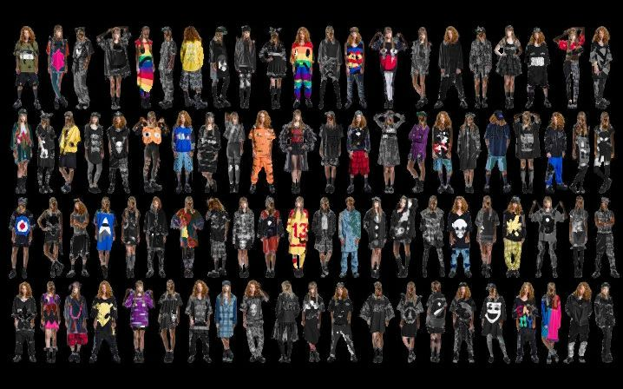
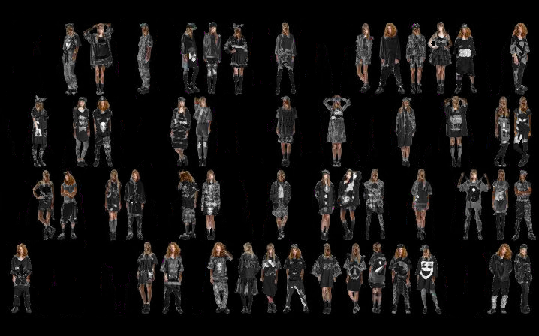
SAMPLING
IN-CLASS PROBLEM 2
Is it a representative sample?
population
sample
VFrench, 2016

Slide 33

Sampling
How do you make sure your sample statistic is close to your population parameter?
https://www.mcgill.ca/oss/article/critical-thinking/tips-better-thinking-shooting-first-drawing-bullseye-later-0

Slide 34
Sampling
A description of all the members of a population is called a
frame

Slide 35
Sampling
You want your sample to tell you as much accurate information as you can get about the population

Slide 36
Sampling
Your sample will RARELY be exactly the same as your population

Slide 37
Sampling
Make sure that every element/subject in the population has an equal chance of being in the sample
a RANDOM sample

Slide 38
Bias
If your sample is not representative of the population, the sample is
BIASED

Slide 39
Sampling
How do you make sure your sample statistic is close to your population parameter?

Slide 40
Sampling
Take the BIGGEST sample you can
the LAW OF LARGE NUMBERS

Slide 41
SAMPLING
IN-CLASS PROBLEM 3
Which school has the more believable results?
Favorite Class | School A # of Students | School B # of Students
English | 11 | 3
Math | 7 | 4
Science | 12 | 3
Social Studies | 10 | 2
Computer Science | 13 | 2
Music/Art | 12 | 2
Physical Education | 15 | 1
Foreign Language | 6 | 1

Slide 42
Sampling
The number in your sample is called the “sample size”
It is usually called “n”

Slide 43
Sampling
How do you make sure your sample statistic is close to your population parameter?

Slide 44
Sampling
Sampling errors can lead to results which have a specific bias or are only relevant to a specific subgroup

Slide 45
Sampling
Suppose that you want to find out how successful ($) a film will be
Suppose your film only appeals to a certain audience

Slide 46
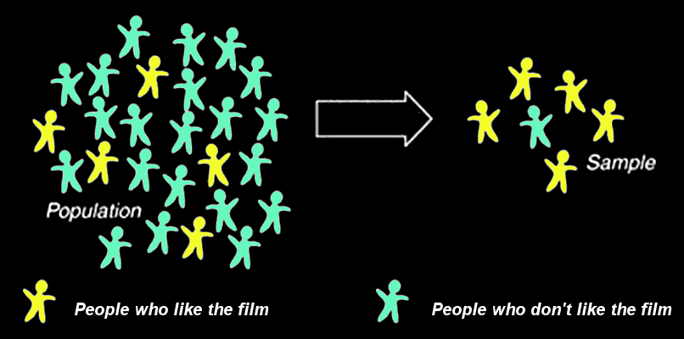
SAMPLING
IN-CLASS PROBLEM 4a
Bad luck sample:
What will you deduce from this sample?
https://www.cliffsnotes.com/study-guides/statistics/sampling/populations-samples-parameters-and-statistics

Slide 47
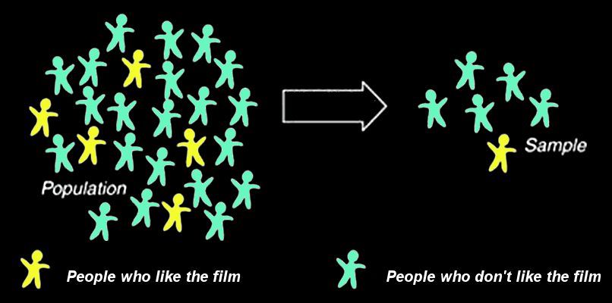
SAMPLING
IN-CLASS PROBLEM 4b
Unbiased sample:
What will you deduce from this sample?
https://www.cliffsnotes.com/study-guides/statistics/sampling/populations-samples-parameters-and-statistics

Slide 48
SAMPLING
IN-CLASS PROBLEM 4c
How do you make sure your sample statistic is close to your population parameter?

Slide 49
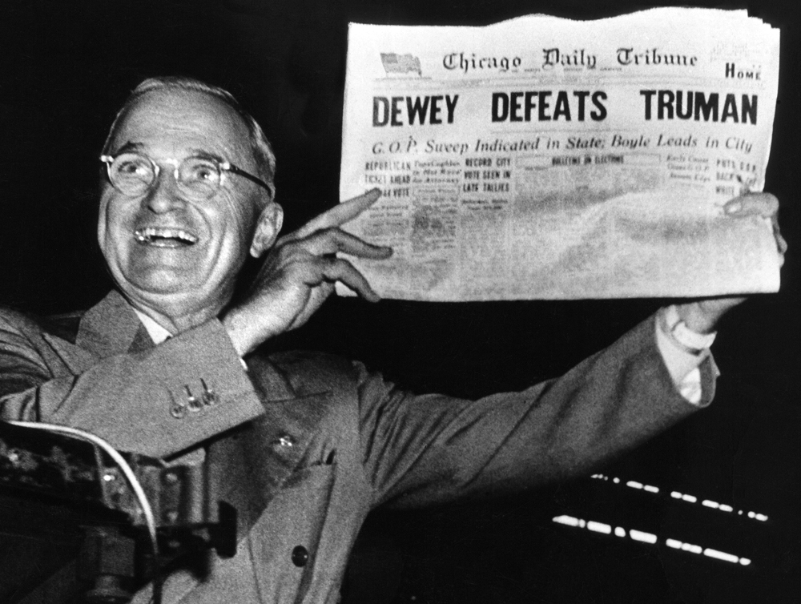
How To Lie With Statistics
Truman vs Dewey 1948
Why did they make the wrong forecast?
What would
you do differently
to get an
accurate
forecast?
http://www.theipinionsjournal.com

Slide 50
Questions?
http://i.imgur.com/aliTlT3.jpg

Slide 51

The Scientific Method
In science, evidence is called “data”
(no… not that kind of “Data”)
http://images2.fanpop.com/image/photos/9400000/Lt-Commander-Data-star-trek-the-next-generation-9406565-1694-2560.jpg

Slide 52

The Scientific Method
Data!
adquadrant.com

Slide 53
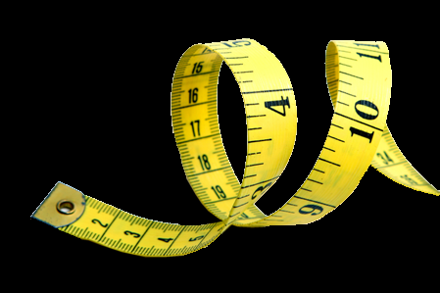
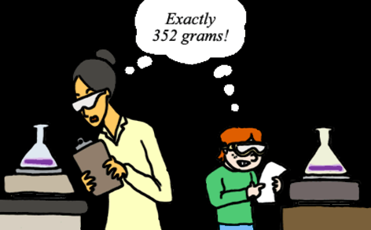
The Scientific Method
Science
deals only with things that are
Measurable
Replicable
undsci.berkeley.edu nationaldaycalendar.com

Slide 54
Types of Statistics
Two categories of statistics include:
descriptive
inferential

Slide 55
Types of Statistics
Descriptive statistics describe a dataset but do not make a probability statement about it
Inferential statistics use a probability model to make statements about the likelihood of a conclusion drawn from the data

Slide 56

Types of Data
Two levels of measurement for
data:
counts
measurements
https://alamy-ltd.ewrvdi.net
/c/77643/748811/10905?u=https%3A%2F%2Fwww.alamy.com%2Fchild-portrait-of-a-3-year-old-playing-counting-fingers-studio-shot-image6244887.html
http://www.ctmsas.com/images/medida.jpg

Slide 57





Types of Data
Two classifications of data:
qualitative – a category
quantitative – a number
  Qualitative Quantitative

Slide 58
Types of Data
We count qualitative data (how many fall into each category)
We measure quantitative data

Slide 59

TYPES OF DATA
IN-CLASS PROBLEM 5a
Lengths of time three brands of aspirin take to cure headaches
Qualitative or
quantitative?
https://www.google.com/imgres?imgurl=https%3A%2F%2Fcdn-prod.medicalnewstoday.com%2Fcontent%2Fimages%2Farticles%2F301%2F301766%2Fbottle-of-aspirin.jpg&imgrefurl=https%3A%2F%2Fwww.medicalnewstoday.com%2Farticles%2F301766&tbnid=V4e_qLzCcC0lwM&vet=12ahUKEwjlu8n20Pv1AhWyCJ0JHazMD3EQMygCegUIARDYAg..i&docid=uBNClZzzTpgp7M&w=700&h=466&q=aspirin&hl=en&ved=2ahUKEwjlu8n20Pv1AhWyCJ0JHazMD3EQMygCegUIARDYAg

Slide 60
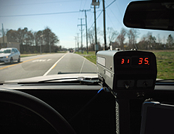
TYPES OF DATA
IN-CLASS PROBLEM 5b
Speed of your car measured by the cop
Qualitative or quantitative?
http://www.thetruthaboutcars.com/wp-content/uploads/2009/09/speed-trap-0607-lg.jpg

Slide 61
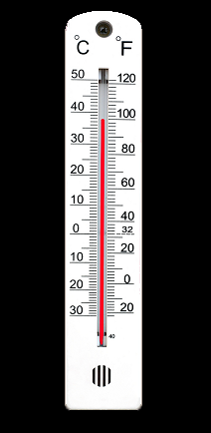
TYPES OF DATA
IN-CLASS PROBLEM 5c
Maximum daily temperatures for CoS 1880-2011
Qualitative or quantitative?
https://clk.tradedoubler.com/click?p=264355&a=3090189&g=24601032&url=https%3A%2F%2Fstock.adobe.com%2Fimages%2Fthermometer-100f%2F2432480%3Fas_campaign%3DTinEye%26as_content%3Dtineye_match&epi1=2432480

Slide 62
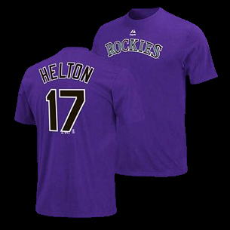
Types of Data
Some numbers are really names!
(qualitative, not quantitative)
http://fanshop.scheels.com/MLB_Colorado_Rockies_Mens_T-Shirts

Slide 63

TYPES OF DATA
IN-CLASS PROBLEM 5d
List of social security numbers
Qualitative or quantitative?
http://retirementgal.com/wp-content/uploads/2016/10/Social-Security-COLA-announcement-2016.png

Slide 64
TYPES OF DATA
IN-CLASS PROBLEM 5e
The “Q” Game

Slide 65
Questions?
http://i.imgur.com/aliTlT3.jpg

Slide 66
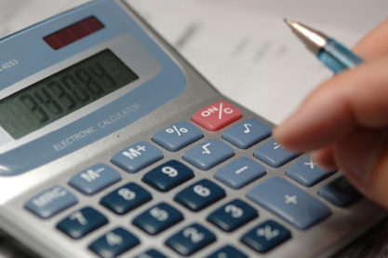
Types of Data
Traditionally, we study the different types of data because the level of scale of measurement determines what statistics we will calculate to answer our questions
https://clk.tradedoubler.com/click?p=264355&a=3090189&g=24601032&url=https%3A%2F%2Fstock.adobe.com%2Fimages%2Ffinancial-planning%2F88245%3Fas_campaign%3DTinEye%26as_content%3Dtineye_match&epi1=88245

Slide 67

Types of Data
In practice, it is not always clear cut
http://www.testically.org/wp-content/uploads/2010/11/hmm.jpg

Slide 68
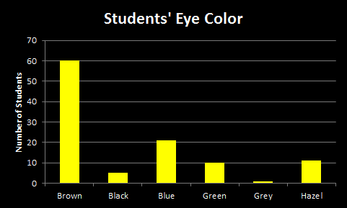
TYPES OF DATA
IN-CLASS PROBLEM 6a
What single number would you use to illustrate the “typical” response to this survey question:
VFrench, 2020

Slide 69
Types of Data
The most commonly occurring response is called the “mode”

Slide 70
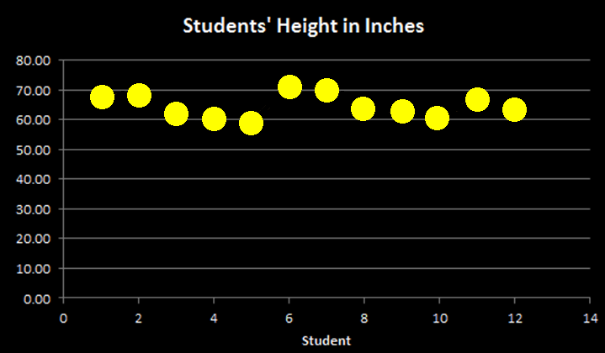
TYPES OF DATA
IN-CLASS PROBLEM 6b
What single number would you use to illustrate the “typical” response to this experimental result:
VFrench, 2020

Slide 71
Types of Data
For this, the “average” height of the 12 students would be better

Slide 72
Questions?
http://i.imgur.com/aliTlT3.jpg

Slide 73
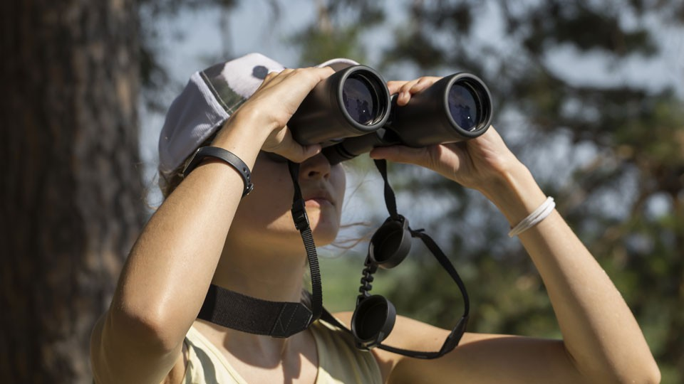
Types of Data
Observational/Experimental
Some data are gathered by observing what is going on
https://www.bhphotovideo.com/explora/amp/outdoors/tips-and-solutions/guide-birding-binoculars

Slide 74

Types of Data
Observational/Experimental
Other data are gathered in a controlled experiment
https://www.verywellmind.com/what-is-the-experimental-group-2795166

Slide 75
TYPES OF DATA
IN-CLASS PROBLEM 7a
Which would give the most reliable information? Why?

Slide 76
Types of Data
Deterministic/Nondeterministic
Some data can be described using a mathematical formula
https://d2r55xnwy6nx47.cloudfront.net/uploads/2020/06/Gravity_2880x1620_Lede.jpg

Slide 77

Types of Data
Deterministic/Nondeterministic
Others are so complicated we do not yet have a formula that works
https://chronicle.brightspotcdn.com/a3/27/d09b3017d21e39d901f54b81978c/55c6a744f320f9c830bdf9cbd9d10055.jpg

Slide 78
TYPES OF DATA
IN-CLASS PROBLEM 7b
Which do you think has the most potential for scientists and engineers? Why?

Slide 79
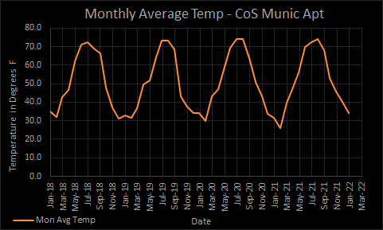
Types of Data
Periodic/Nonperiodic
Some data cycle around
VFrench, 2022

Slide 80
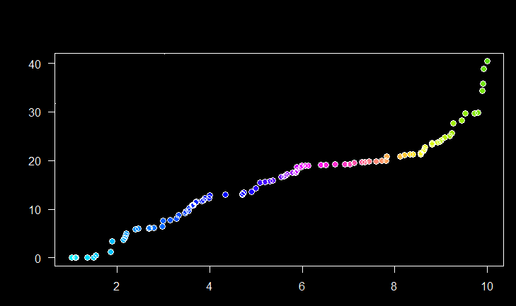
Types of Data
Periodic/Nonperiodic
Others do not
A
B
C
D
F
Grade in Class
Time Spent Studying (hrs per week)
VFrench, 2022

Slide 81
TYPES OF DATA
IN-CLASS PROBLEM 7c
Which do you think is more common in engineering?
A
B
C
D
F
Grade in Class
Time Spent Studying (hrs per week)

Slide 82
Types of Data
Continuous/Discrete
Some data can be ANY decimal value
https://www.g2.com/articles/discrete-vs-continuous-data

Slide 83
Types of Data
Continuous/Discrete
Some data can only be whole numbers
https://www.g2.com/articles/discrete-vs-continuous-data

Slide 84
TYPES OF DATA
IN-CLASS PROBLEM 7d
What are some data that can only be whole numbers?
https://www.g2.com/articles/discrete-vs-continuous-data

Slide 85
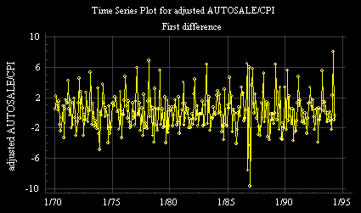
Types of Data
Stationary/Nonstationary
Some data have a constant “average” value
https://people.duke.edu/~rnau/dautocpi.gif

Slide 86
Types of Data
Stationary/Nonstationary
Some data have trend or displacement
https://miro.medium.com/max/822/1*-iOconMEaLW5ttxhHCdKBw.png

Slide 87
TYPES OF DATA
IN-CLASS PROBLEM 7e
Which do you think would be the most interesting to investigate? Why?

Slide 88
Questions?
http://i.imgur.com/aliTlT3.jpg

Slide 89
Summary
Today we studied:
Population, sample
Types of data:
Qualitative/quantitative
Observation/experiment
Deterministic/nondeterministic
Periodic/nonperiodic
Continuous/discrete
Stationary/nonstationary

Slide 90

You Survived!
www.playbuzz.com

