Slide 1
Welcome to
Unit 4 Part 07
MATH366 Probability and Statistics
https://online.stanford.edu/sites/default/files/styles/figure_default/public/2018-04/theory-of-probability_stats116.jpg?itok=ms4fRMO-

Slide 2
What’s Up?
Today we will be going over:
Review of relationships between variables, regression and time series
New: Nonlinear Time Series
Multiple Regression

Slide 3
What’s Up?
Outcome 1) Calculate statistical measures of central tendency and dispersion used in describing and summarizing collected samples. Both by hand calculation methods supported by calculators and programmed software procedures will be used to make these computations

Slide 4

Review
http://995642590.r.lightningbase-cdn.com/wp-content/uploads/2010/12/looking-back-hrexaminer-v144-cover425px.jpg

Slide 5
Two Variables
Subject | Height | Weight
1 5’8’’ 170
2 5’3’’ 120
3 6’ 200
4 5’7’’ 250
5 6’2’’ 195

Slide 6
Two Variables
With two variables measured on each subject, the measurements are “paired” – linked to each other
Using the pairing, you can determine if there is a
relationship
between the two variables

Slide 7
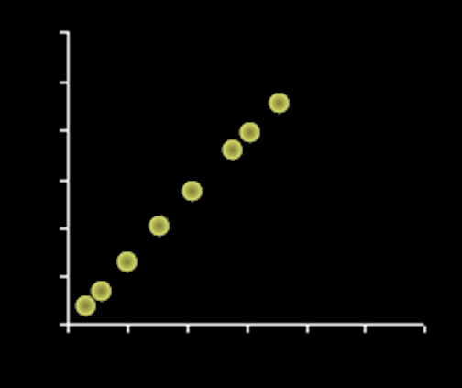
Correlation
There are all sorts of relationships, but we define a “correlation” to be a linear relationship
VFrench, 2016

Slide 8
Correlation
Correlation coefficient “r”:
Measures the strength of the linear relationship between two variables (x,y)

Slide 9
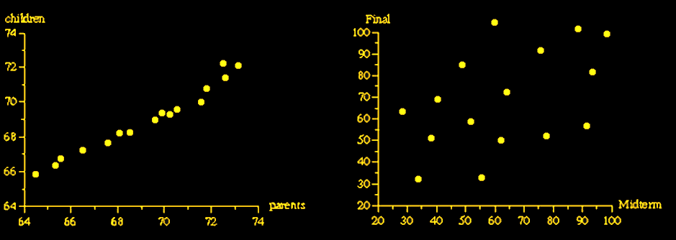
Correlation
Strong Weak
relationship relationship
VFrench, 2016

Slide 10
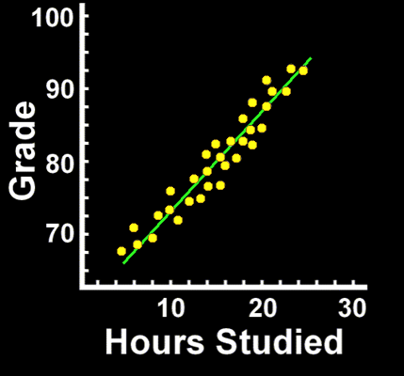
Correlation
Positive Correlation:
as one variable increases, the other also increases
VFrench, 2016

Slide 11
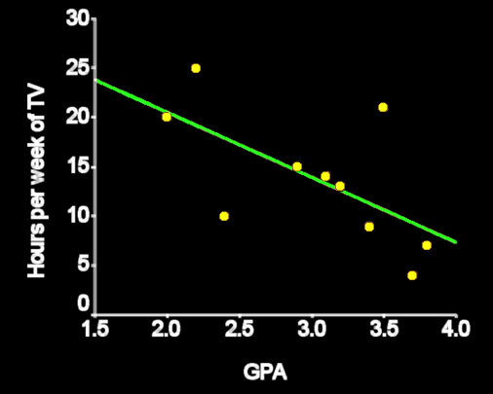
Correlation
Negative correlation:
as one variable increases, the other decreases
VFrench, 2016

Slide 12
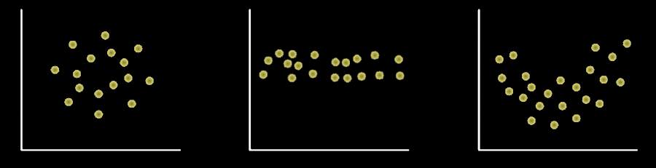
Correlation
Zero correlation:
no positive or negative LINEAR relationship

Slide 13
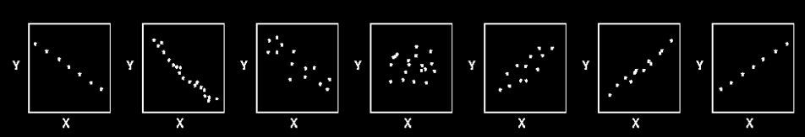
Correlation
Correlation coefficients range from -1.0 to +1.0
r=-1.0 r=-0.9 r=-0.5 r=0.0 r=0.5 r=0.9 r=1.0
VFrench, 2016

Slide 14
Correlation
If you square the correlation coefficient, R² (or RSQ) tells you in % how well the trend line fits the data

Slide 16
Inputs and Outputs
In formulas, some variables are “input” variables
The input variable is ALWAYS put on the x-axis (horizontal axis)
They are also called “independent” variables

Slide 17
Inputs and Outputs
The variable you are calculating with the formula is the “output”
The output variables (which depend on the values of the independent input variables) are called “dependent” variables

Slide 18
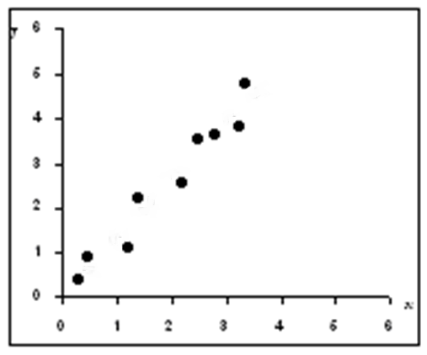
Line of Best Fit
Real-world data rarely lands exactly on a straight line
VFrench, 2016

Slide 19
Line of Best Fit
But we fit the “best” line to the data called a “trend line”
VFrench, 2016

Slide 20
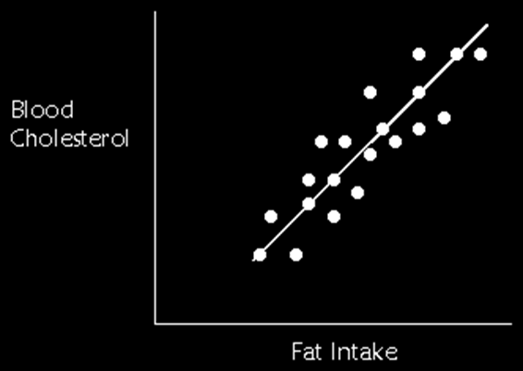
Regression
The line of best fit is also called the “regression” line

Slide 21
Regression
R² tells how closely the regression line “fits” the data –
“goodness of fit”

Slide 22

Regression
Excel does the scary
calculations!
hooray.jpg

Slide 23
Time Series
Data that change over time are called “time series” data

Slide 24

Questions?
http://i.imgur.com/aliTlT3.jpg

Slide 25
Regression
Because it is a line, the trend line has an equation:
y = b + mx
m = slope
b = y-intercept
VFrench, 2016

Slide 26
Regression
Note: some people use the symbol “ŷ” for estimates and forecasts of “y” from a regression equation

Slide 27
Questions?
http://i.imgur.com/aliTlT3.jpg

Slide 28
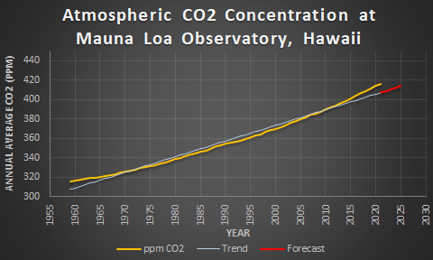
Nonlinear Time Series
How good was the CO2 linear trend forecast?
VFrench, 2022

Slide 29
Nonlinear Time Series
Not good!
VFrench, 2022

Slide 30
Nonlinear Time Series
The data are actually slightly curved
VFrench, 2022

Slide 31
Nonlinear Time Series
But the forecast was based on a straight line

Slide 32
Nonlinear Time Series
Can we make a curved trend line?
Sure can!
It takes some work…
And you have to know which
curve you need

Slide 33
Nonlinear Time Series
One way to generate a non-linear regression is to square the input (x) variable – this provides a parabolic curve fit
VFrench, 2022

Slide 34
Nonlinear Time Series
If you multiply the x² variable by -1, it will make a hill-shaped fit line
VFrench, 2022

Slide 35
Nonlinear Time Series
A square root of x will provide a dampening increase
VFrench, 2022

Slide 36
Nonlinear Time Series
A logarithmic curve will do this, too
VFrench, 2022

Slide 37
Nonlinear Time Series
e exponents provide an increasing curve
VFrench, 2022

Slide 38
Nonlinear Time Series
Sine curves provide an undulating curve
VFrench, 2022

Slide 39
Nonlinear Time Series
Any curving trend line is referred to as “curvilinear”

Slide 40
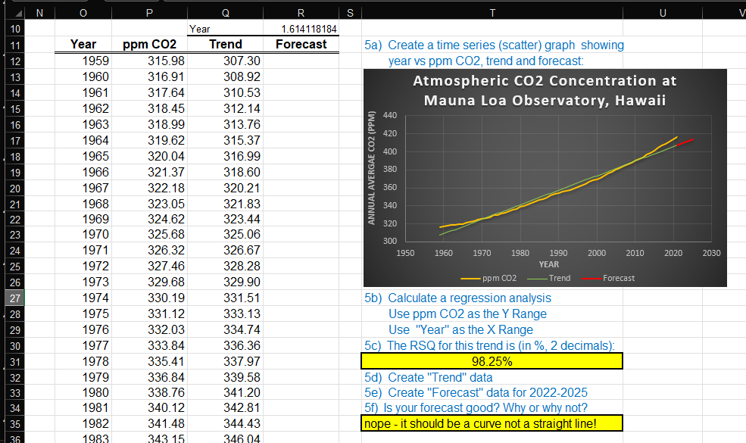
REGRESSION
IN-CLASS PROBLEM 1a
Open the spreadsheet
Go to the Zoomwork1 sheet

Slide 41
REGRESSION
IN-CLASS PROBLEM 1a
We’re going to copy your graph to the next sheet (so you won’t have to redo all your beautiful work!

Slide 42
REGRESSION
IN-CLASS PROBLEM 1a
We’re going to copy your graph to the next sheet (so you won’t have to redo all your beautiful work!

Slide 43
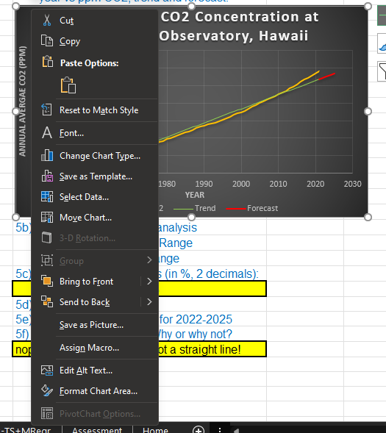
REGRESSION
IN-CLASS PROBLEM 1a
Right click the outside edge of the graph
Click “Copy”

Slide 44
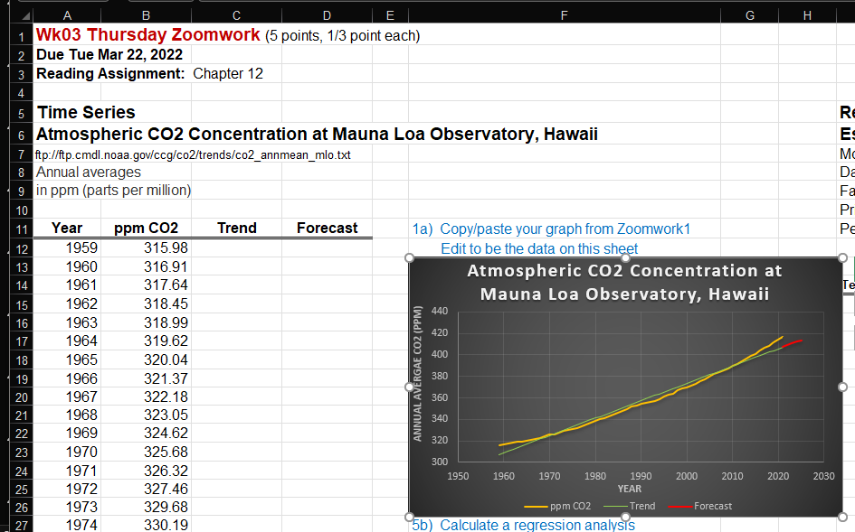
REGRESSION
IN-CLASS PROBLEM 1a
Move to the Zoomwork2 sheet
Put your curser in the F13 cell
and paste!

Slide 45
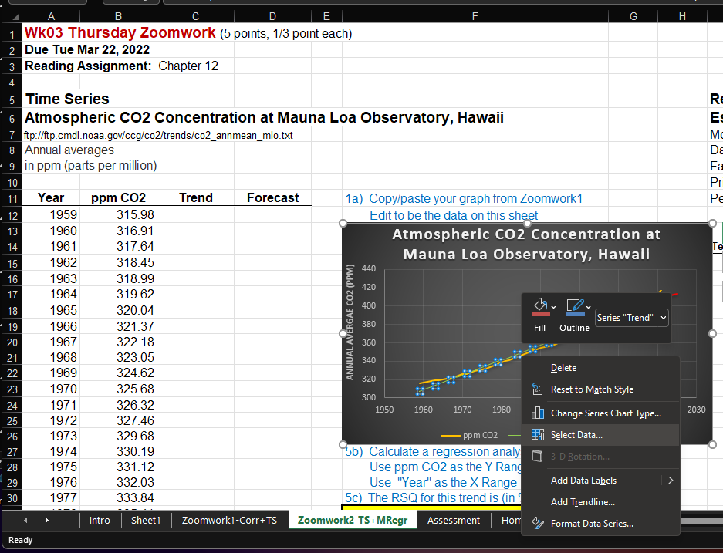
REGRESSION
IN-CLASS PROBLEM 1a
The graph is still referencing stuff on Zoomwork1
Right click any graph data line
Click
“Select Data”

Slide 46
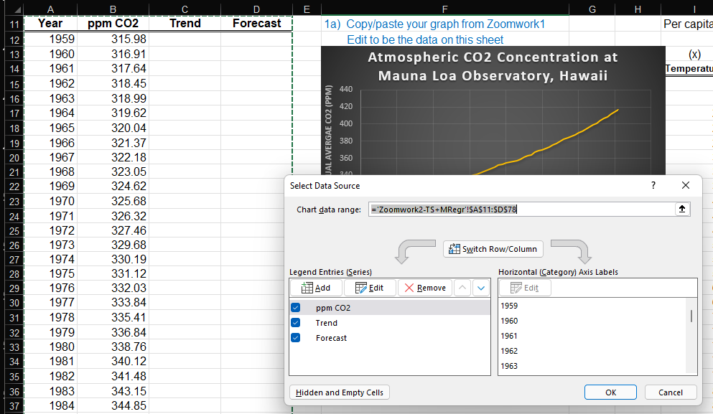
REGRESSION
IN-CLASS PROBLEM 1a
Adjust the series so it is the proper columns on the new sheet:

Slide 47
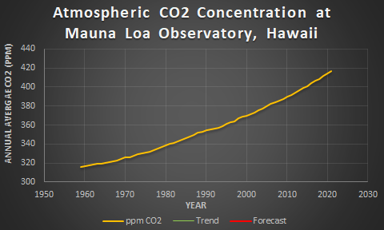
REGRESSION
IN-CLASS PROBLEM 1a
Poof! Your beautiful graph referencing the new data!
VFrench, 2022

Slide 48
Nonlinear Time Series
We need to come up with a curvey formula!

Slide 49
Nonlinear Time Series
The quadratic formula makes a parabolic curve
y = ax² + bx + c
and it’s easy!

Slide 50
Nonlinear Time Series
It has an “x²” in it:
y = ax² + bx + c

Slide 51
Nonlinear Time Series
What is “x” in our time series?

Slide 52
Nonlinear Time Series
What is “x” in our time series?
time

Slide 53
Nonlinear Time Series
If we use a squared “time”
term, we’ll get a curve!

Slide 54
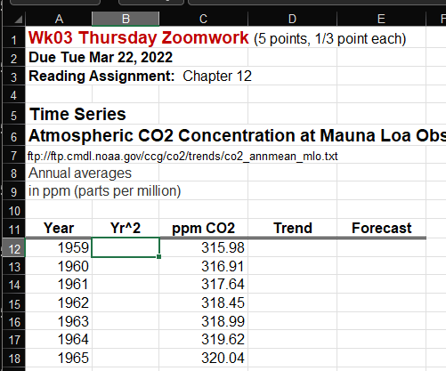
REGRESSION
IN-CLASS PROBLEM 1b
Add a new column next to “Year”
Label it Yr²

Slide 55
REGRESSION
IN-CLASS PROBLEM 1b
What will be the formula?

Slide 56
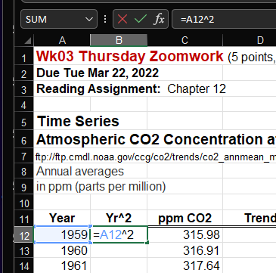
REGRESSION
IN-CLASS PROBLEM 1b
Fill in the formula to square the Year:
=a12^2

Slide 57
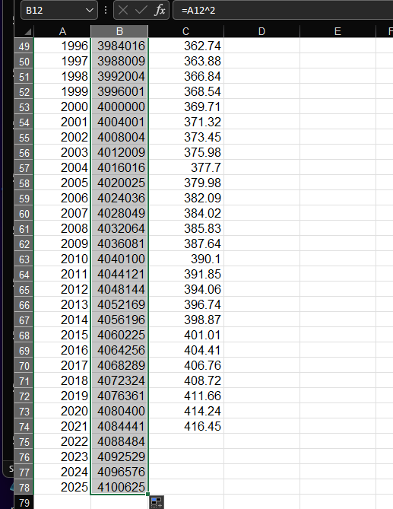
REGRESSION
IN-CLASS PROBLEM 1b
Copy it down
to 2025

Slide 58
REGRESSION
IN-CLASS PROBLEM 1b
Now we’re ready to do the regression

Slide 59
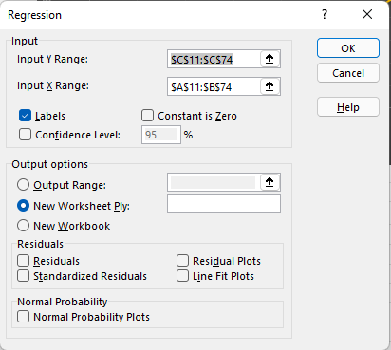
REGRESSION
IN-CLASS PROBLEM 1b
What is “y”?

Slide 60
REGRESSION
IN-CLASS PROBLEM 1b
What is “y”?
What is “x”

Slide 61
REGRESSION
IN-CLASS PROBLEM 1b
What is “y”?
What is “x”
Include both
Year AND
Yr²
Anything
else?

Slide 62

Nonlinear Time Series
This WILL work! Trust me!
Anything
else?
https://blog.foodservicewarehouse.com/wp-content/uploads/2013/07/Skeptical-Baby-2.jpg

Slide 63
REGRESSION
IN-CLASS PROBLEM 1b
Click “Labels”
Click “OK”

Slide 64
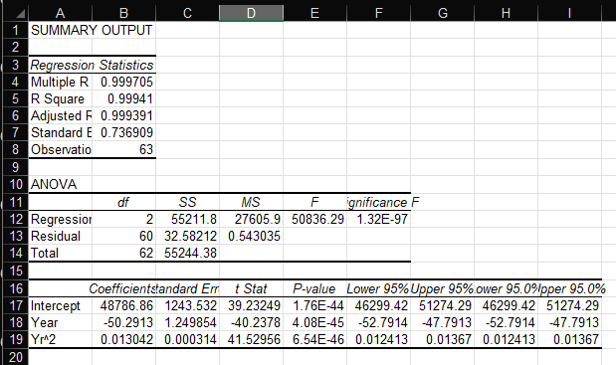
Nonlinear Time Series
~Poof!~
See… I told you it would work!

Slide 65
Nonlinear Time Series
This is called a “multiple regression” when you have more than one x input
Excel handles it just fine!

Slide 66
Nonlinear Time Series
There is also “multivariate regression” when you have more than one y output
Excel can’t do these…

Slide 67
Nonlinear Time Series
…and see why it’s important to include the labels?

Slide 68
Nonlinear Time Series
You don’t have to figure out which coefficient is which!

Slide 69
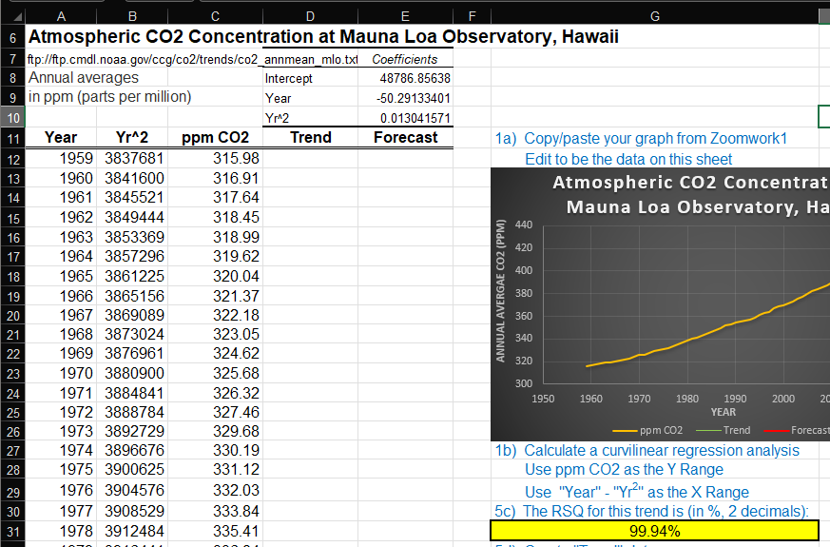
REGRESSION
IN-CLASS PROBLEM 1c
Copy the RSQ (%, 2 dec) and the coefficients to the new sheet
(I put
mine
in D7)

Slide 70
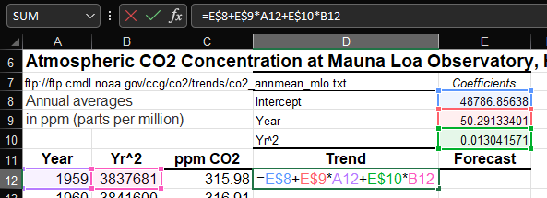
REGRESSION
IN-CLASS PROBLEM 1d
The coefficient labels tell you which variable each will multiply!

Slide 71
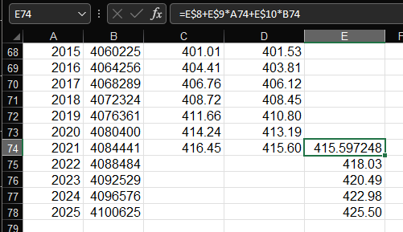
REGRESSION
IN-CLASS PROBLEM 1e
Don’t forget the “$”
Copy it down to 2025
Move the forecast over
Copy the 2021 text

Slide 72

REGRESSION
IN-CLASS PROBLEM 1f
Do you think this is a good forecast? Why or why not?
VFrench, 2022

Slide 73
Nonlinear Time Series
A forecast from a good fit line will be a good forecast
VFrench, 2022

Slide 74
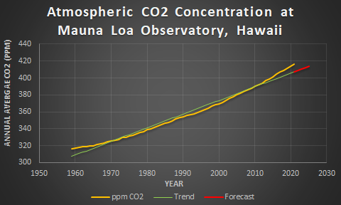
Nonlinear Time Series
Remember: A forecast from a bad fit line will be a bad forecast, even if the RSQ is high
BUT…
VFrench, 2022

Slide 75
Nonlinear Time Series
Rule of Thumb: a good forecast will start at the last observed data value and continue the same trend as observed for the last few data points

Slide 76
Nonlinear Time Series
Rule of Thumb: a good forecast will start at the last observed data value and continue the same trend as observed for the last few data points
Even if the rest of the trend data don’t fit the observed data well

Slide 77
Time Series
For time series data, our goal is often to create a forecast of future data values

Slide 78
Time Series
We’ve been doing “estimates” for our trend calculations

Slide 79
Time Series
“Estimates” are values we calculate using the regression equation for x-values within the range of our observed data
“Forecasts” are values we calculate using the regression equation for x-values beyond the range of our observed data

Slide 80
Questions?
http://i.imgur.com/aliTlT3.jpg

Slide 81
Regression in Excel
If you have only one input (x) variable and one output (y) variable, you can calculate a regression that is:
y = mx + b
(the equation of a line… remember algebra?)

Slide 82
Regression in Excel
Often you have a whole bunch of inputs affecting your output
This is called “multiple regression”

Slide 83
Regression in Excel
It often isn’t covered in introductory statistics classes because the teachers (being mathematicians) think you will be doing the calculation by hand

Slide 84
Regression in Excel
But, since we are in the 21st century and have statistical tools on all our computers, we can actually create a real model using real data
(I try to do this for all applications)

Slide 85
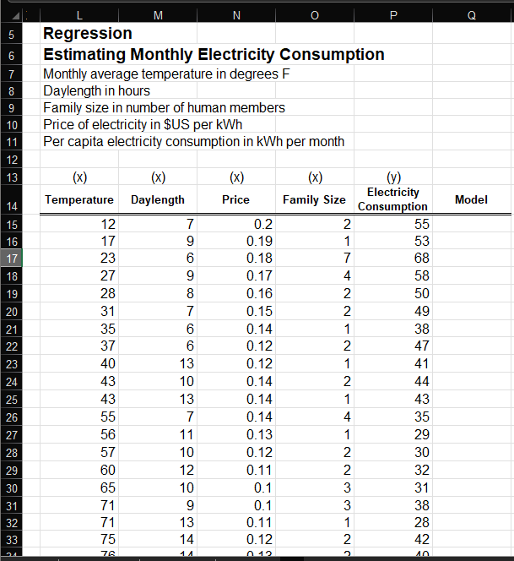
Regression in Excel
Let’s take a
look!
Go to:
Estimating
Monthly
Electricity
Consumption

Slide 86
REGRESSION
IN-CLASS PROBLEM 2a
What do we do first?

Slide 87
REGRESSION
IN-CLASS PROBLEM 2a
What do we do first?
GRAPH THE DATA!

Slide 88
REGRESSION
IN-CLASS PROBLEM 2a
What do we do first?
GRAPH THE DATA!
Well, there’s a problem on this one… there are a whole bunch of variables, and the graph would be messy and uninformative…
So we’ll do it later…

Slide 89
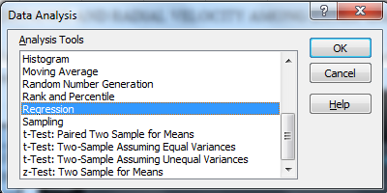
REGRESSION
IN-CLASS PROBLEM 2a
Now we’re going to go to:
Data
Data Analysis
Regression

Slide 90
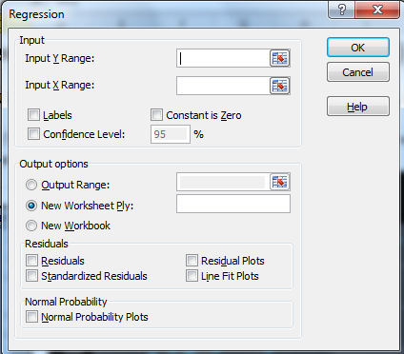
REGRESSION
IN-CLASS PROBLEM 2a
They want “y” first
(I HATE
this…
“x” should
be first!)

Slide 91
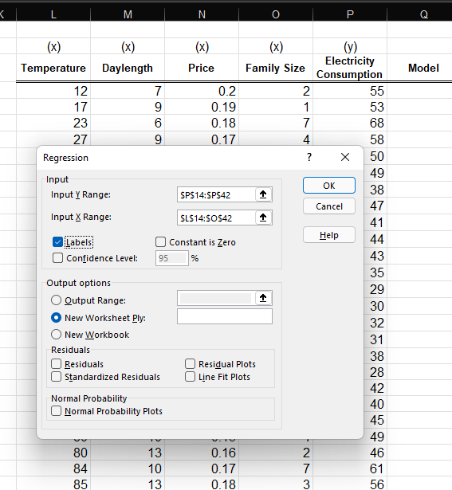
REGRESSION
IN-CLASS PROBLEM 2a
Let’s use
“electricity
consumption”
for “y” and
all the rest
for the “x”
variables

Slide 92
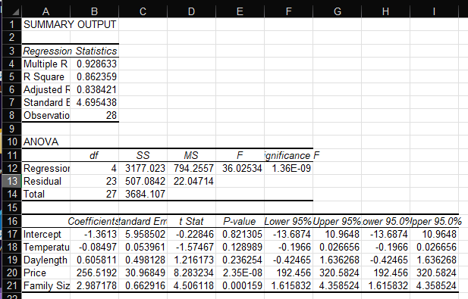
REGRESSION
IN-CLASS PROBLEM 2a
Eeek! What’s all this????

Slide 93
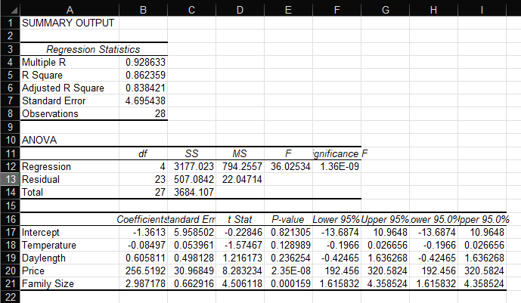
REGRESSION
IN-CLASS PROBLEM 2a
Here’s the RSQ:

Slide 94
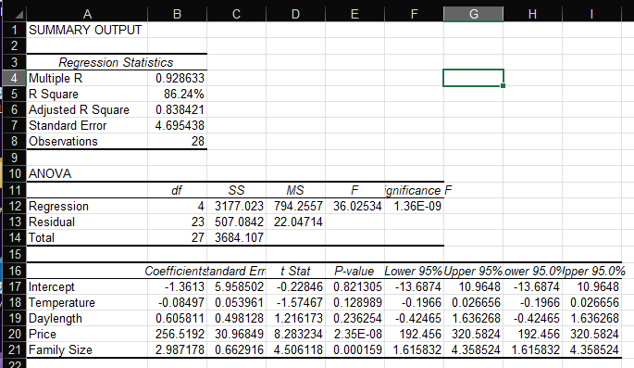
REGRESSION
IN-CLASS PROBLEM 2a
Change it to a % with 2 decimal places

Slide 95
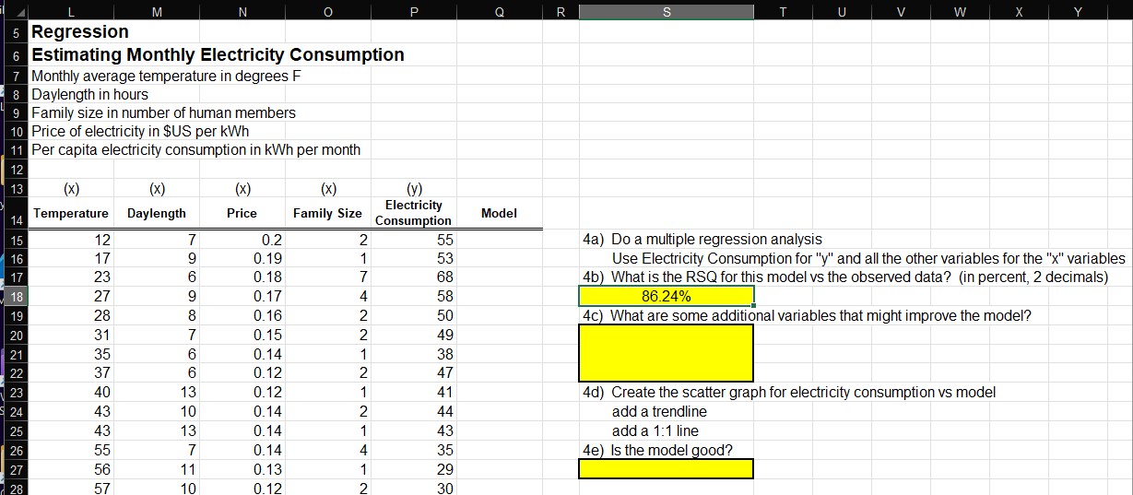
REGRESSION
IN-CLASS PROBLEM 2b
Copy it to your “Zoomwork” sheet

Slide 96
REGRESSION
IN-CLASS PROBLEM 2a
For the model values, you need:

Slide 97
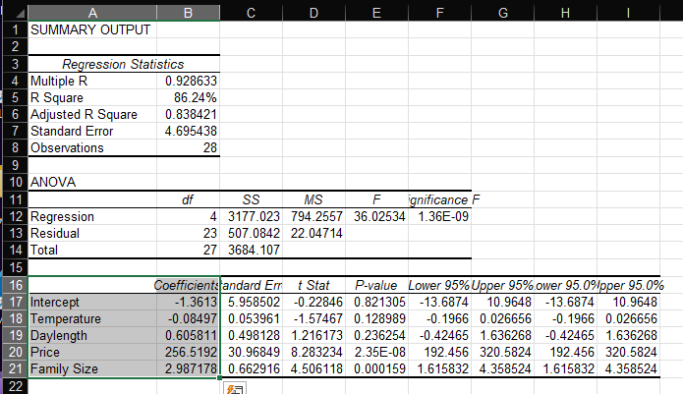
REGRESSION
IN-CLASS PROBLEM 2a
Highlight and copy:

Slide 98
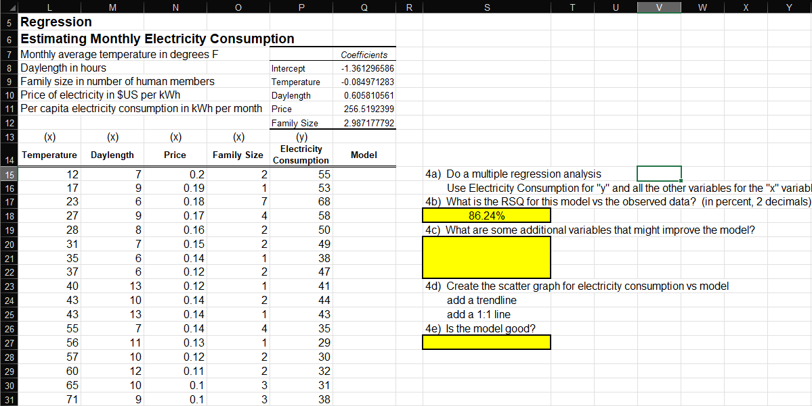
REGRESSION
IN-CLASS PROBLEM 2a
Paste in P7 on the “Zoomwork” page

Slide 99
REGRESSION
IN-CLASS PROBLEM 2a
This (believe it or not) is the model equation!

Slide 100
REGRESSION
IN-CLASS PROBLEM 2a
Our model equation is:
ElecCon = -1.361 -0.085Temp + 0.606Dylng
+ 256.519Price + 2.987FamSiz

Slide 101
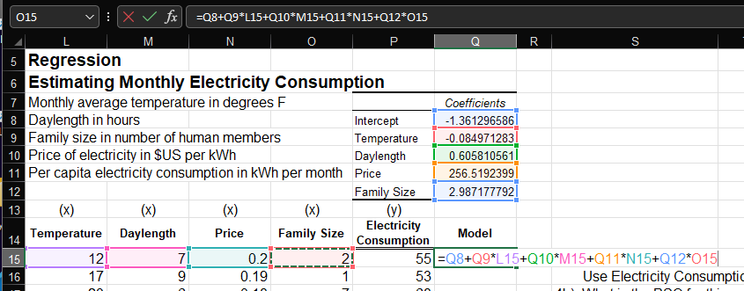
REGRESSION
IN-CLASS PROBLEM 2a
In the column labeled: “Model”
type in our model equation:
=Q8+Q9*L15+Q10*M15+Q11*N15+Q12*O15

Slide 102
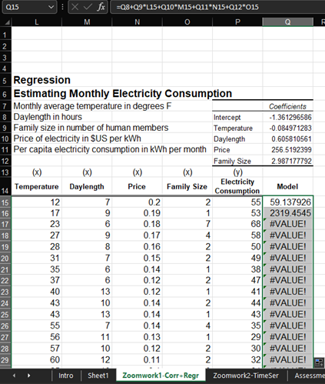
REGRESSION
IN-CLASS PROBLEM 2a
Copy it down…
Oops!
That doesn’t
look right!

Slide 103
REGRESSION
IN-CLASS PROBLEM 2a
The reference cells are changing for each row
We need to make those constant
Go back to the first entry
Add a $ before the row numbers
you want to keep constant:
=Q$8+Q$9*L15+Q$10*M15+Q$11*N15+Q$12*O15

Slide 104
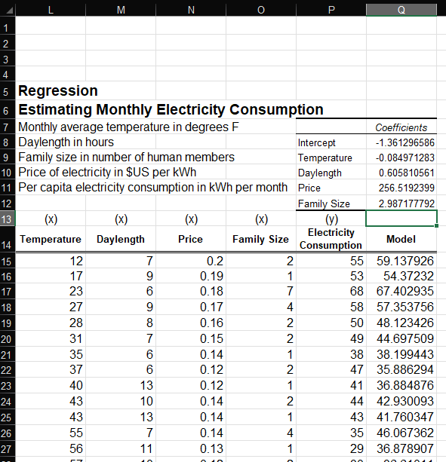
REGRESSION
IN-CLASS PROBLEM 2a
Now, copy
it down!
Much
better!

Slide 105
REGRESSION
IN-CLASS PROBLEM 2a
Now we can make the graph!
We want a graph of electricity consumption vs our model of electrical consumption

Slide 106
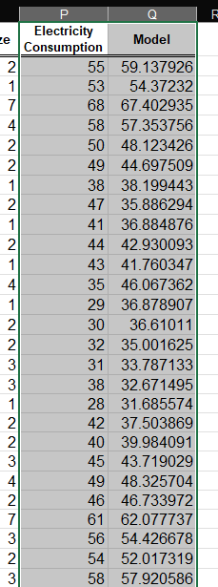
REGRESSION
IN-CLASS PROBLEM 2a
Highlight JUST those
two columns in our data

Slide 107
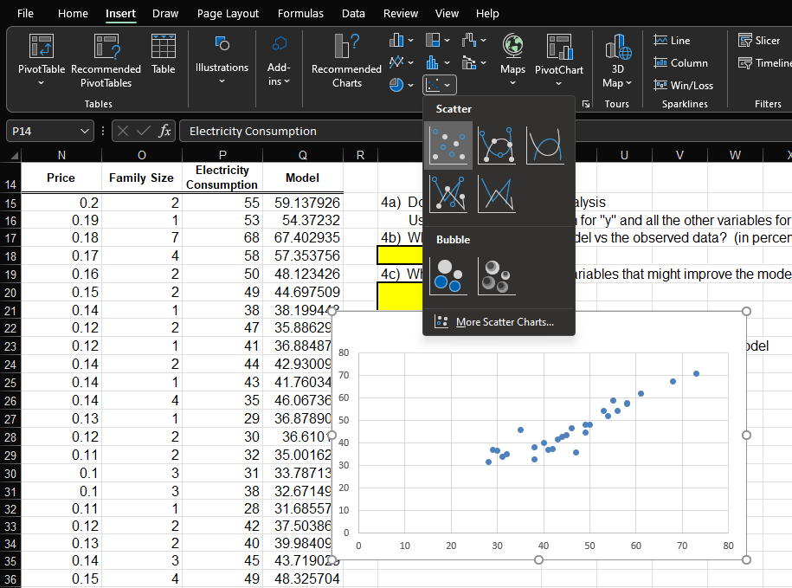
REGRESSION
IN-CLASS PROBLEM 2a
Click “Insert”, Scatter,
Pick the “dots” one

Slide 108
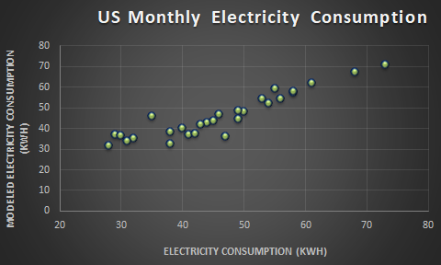
REGRESSION
IN-CLASS PROBLEM 2a
Make it purty!
VFrench, 2022

Slide 109
REGRESSION
IN-CLASS PROBLEM 2c
If we had a perfect model, then electricity consumption and our model would have identical values (hint: this NEVER happens)

Slide 110
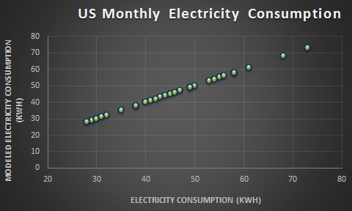
REGRESSION
IN-CLASS PROBLEM 2c
But a perfect model would produce this graph:
VFrench, 2022

Slide 111
REGRESSION
IN-CLASS PROBLEM 2c
The graph forms a 1:1 line (remember Foundations?)
VFrench, 2022

Slide 112
REGRESSION
IN-CLASS PROBLEM 2c
We can draw (or create data so Excel will draw) a 1:1 line on our graph to show how good our model is:
VFrench, 2022

Slide 113
REGRESSION
IN-CLASS PROBLEM 2c
We can also create a “trendline” (the line of best fit for our data)
If the trendline and 1:1 line are “close” then our model is “good”

Slide 114
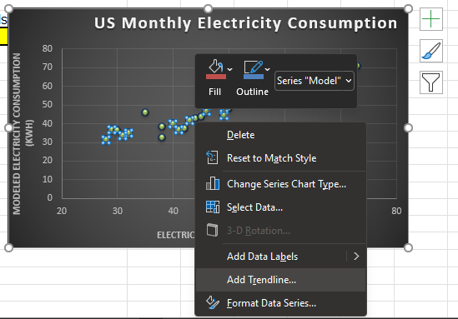
REGRESSION
IN-CLASS PROBLEM 2c
Right click on any of the graphed data “dots”
Click “Add Trendline”

Slide 115
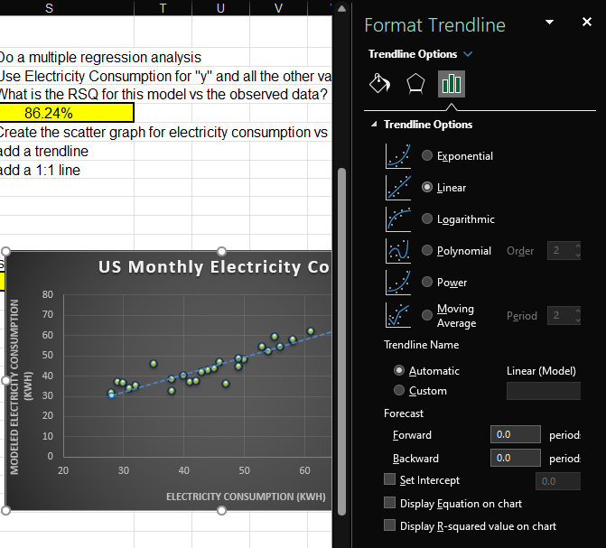
REGRESSION
IN-CLASS PROBLEM 2c
Choose
“Linear”

Slide 116
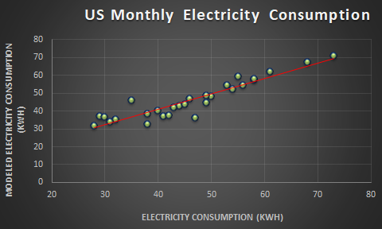
REGRESSION
IN-CLASS PROBLEM 2d
Is our model good?
Trend Line
1:1 Line
VFrench, 2022

Slide 117
Questions?
http://i.imgur.com/aliTlT3.jpg

Slide 118
Summary
Today we studied:
Review of Correlation,
Regression, Time Series
New: Nonlinear Time Series,
Multiple Regression

Slide 119

You Survived!
www.playbuzz.com

