Slide 1
Welcome to
Unit 4 Part 08
MATH366 Probability and Statistics
https://online.stanford.edu/sites/default/files/styles/figure_default/public/2018-04/theory-of-probability_stats116.jpg?itok=ms4fRMO-

Slide 2
What’s Up?
Today we will be going over:
Review of Nonlinear Time Series and
Multiple Regression
New: Discrete Probability
Conditional Probability

Slide 3
What’s Up?
Outcome 2) Formulate models for the probability of simple events and then apply the properties of probabilities to calculate the probabilities of complex events

Slide 4

Review
http://995642590.r.lightningbase-cdn.com/wp-content/uploads/2010/12/looking-back-hrexaminer-v144-cover425px.jpg

Slide 5
Nonlinear Time Series
Can we make a curved trend line?
Sure can!
It takes some work…
And you have to know which
curve you need

Slide 6
Nonlinear Time Series
The quadratic formula makes a parabolic curve
y = ax² + bx + c
and it’s easy!

Slide 7
Nonlinear Time Series
When you have more than one x input, it is called a “multiple regression”
Excel handles it just fine!

Slide 8
Nonlinear Time Series
There is also “multivariate regression” when you have more than one y output
Excel can’t do these…

Slide 9
Nonlinear Time Series
Rule of Thumb: a good forecast will start at the last observed data value and continue the same trend as observed for the last few data points
Even if the rest of the trend data don’t fit the observed data well

Slide 10
Time Series
“Estimates” are values we calculate using the regression equation for x-values within the range of our observed data
“Forecasts” are values we calculate using the regression equation for x-values beyond the range of our observed data

Slide 11
Multiple Regression
If we don’t have time series data, we can’t make a forecast

Slide 12
Multiple Regression
If we don’t have time series data, we can’t make a forecast
We can create a mathematical model of our observed data which may be useful and informative

Slide 13
Multiple Regression
If we had a perfect model, then our observed data and our model values would be identical (hint: this NEVER happens)

Slide 14
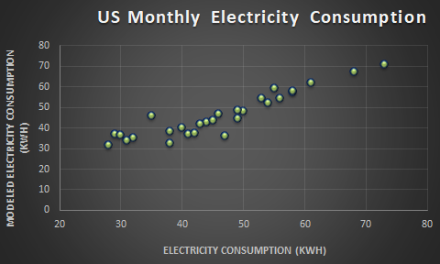
Multiple Regression
We can draw (or create data so Excel will draw) a 1:1 line on our graph to show how good our model is:
VFrench, 2022

Slide 15
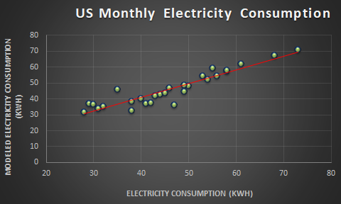
Multiple Regression
We can also create a “trendline” (the line of best fit for our data)
Trend Line

Slide 16
Multiple Regression
If the trendline and 1:1 line are “close” then our model is “good”
Trend Line
1:1 Line
VFrench, 2022

Slide 17
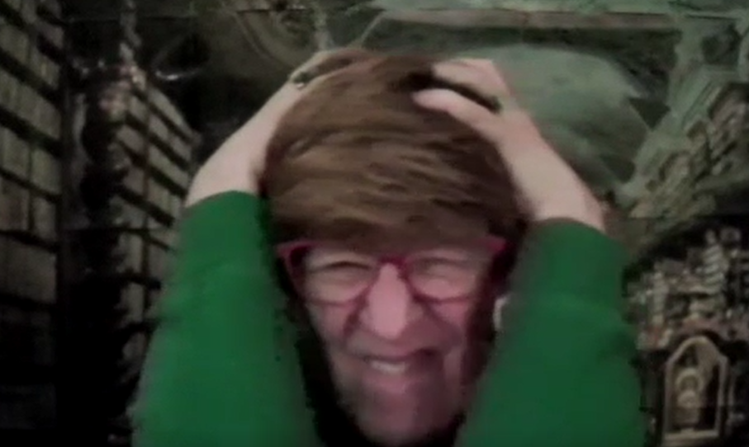
Stuff You Ignored When I Said It
correlation does not imply causation

Slide 18

Questions?
http://i.imgur.com/aliTlT3.jpg

Slide 19
Probability
The traditional second of the three halves of statistics

Slide 20
Discrete Probability
The likelihood of outcomes that are not continuous

Slide 21
Discrete Probability
Specific outcomes are “discrete”:
“Heads” on a coin toss
“Snake eyes” when rolling 2 dice
“Blue eyes” (as opposed to all
other colors)

Slide 22
Discrete Probability
A lot of times these events are categorical (qualitative)
But sometimes they kinda look quantitative (getting a 90 on an exam when only whole number grades are possible)

Slide 23
Discrete Probability
Again – some things are VERY discrete (heads/tails), some things are VERY continuous (your height) and some things are kinda in between

Slide 24
Probability
Probability - likelihood of a favorable outcome

Slide 25
Probability
Probability is defined to be:
# favorable outcomes
total # of outcomes
P =

Slide 26
Probability
So, probability is:
count/total count

Slide 27
Probability
Or:
frequency/total frequency

Slide 28
Probability
So, probability is:
a relative frequency!
frequency/total frequency

Slide 29
Probability
For our old
Internet Usage data:
Minutes Internet Usage | Number of Users | Cumulative Number of Users | Relative Frequency
1-20 | 9 | 9 | 9/52 = 17%
21-40 | 18 | 27 | 18/52 = 35%
41-60 | 15 | 42 | 15/52 = 29%
61-80 | 8 | 50 | 15%
81-100 | 1 | 51 | 2%
101-120 | 0 | 51 | 0%
121+ | 1 | 52 | 2%

Slide 30
Probability
The probability that a subscriber uses 1-20 minutes:
P (1-20 min) = 17%
Minutes Internet Usage | Number of Users | Cumulative Number of Users | Relative Frequency
1-20 | 9 | 9 | 9/52 = 17%
21-40 | 18 | 27 | 18/52 = 35%
41-60 | 15 | 42 | 15/52 = 29%
61-80 | 8 | 50 | 15%
81-100 | 1 | 51 | 2%
101-120 | 0 | 51 | 0%
121+ | 1 | 52 | 2%

Slide 31
Probability
The probability that a subscriber uses 101-120 minutes: P(101-120 min) = 0%
Minutes Internet Usage | Number of Users | Cumulative Number of Users | Relative Frequency
1-20 | 9 | 9 | 9/52 = 17%
21-40 | 18 | 27 | 18/52 = 35%
41-60 | 15 | 42 | 15/52 = 29%
61-80 | 8 | 50 | 15%
81-100 | 1 | 51 | 2%
101-120 | 0 | 51 | 0%
121+ | 1 | 52 | 2%

Slide 32
Probability
Probability can be expressed in % or as a decimal:
Minutes Internet Usage | Relative Frequency
1-20 | 9/52 = 0.17 = 17%
21-40 | 18/52 = 0.35 = 35%
41-60 | 15/52 = 0.29 = 29%
61-80 | 0.15 = 15%
81-100 | 0.02 = 2%
101-120 | 0.00 = 0%
121+ | 0.02 = 2%

Slide 33
Probability
Because the # favorable outcomes is always less than or equal to the total # of outcomes
0 ≤ P ≤ 1
or
0% ≤ P ≤ 100%

Slide 34
Probability
A probability cannot be bigger than 1.00 (100%)
A probability cannot be negative

Slide 35
Probability
And
P(all possible outcomes) = 100%

Slide 36
Probability
Probability calculations assume each outcome is equally likely to occur –
RANDOM

Slide 37
PROBABILITY
IN-CLASS PROBLEM 1
What is
P(head on 1 toss of a fair coin)

Slide 38
PROBABILITY
IN-CLASS PROBLEM 1
P(head on 1 toss of a fair coin)
What are all of the outcomes?

Slide 39
PROBABILITY
IN-CLASS PROBLEM 1
P(head on 1 toss of a fair coin)
What are all of the outcomes?
H or T
What are the favorable outcomes?

Slide 40
PROBABILITY
IN-CLASS PROBLEM 1
P(head on 1 toss of a fair coin)
What are the favorable outcomes?
H or T

Slide 41
PROBABILITY
IN-CLASS PROBLEM 1
So:
P(head on 1 toss of a fair coin)
= 1/2 or 0.5 or 50%

Slide 42
How to Lie with Probability
The Law of Averages
And why it doesn’t work the way people think it does
http://natgeotv.com.au/videos/the-numbers-game/law-of-averages-28887244.aspx

Slide 43
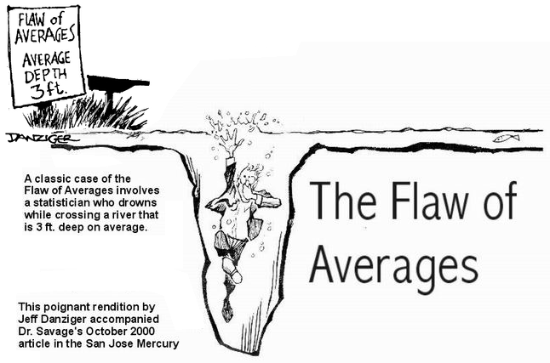
http://www.vumc.nl/afdelingen-themas/239911/7351096/27788/FlawOfAverages.jpg

Slide 44
Probability
The principle of
PERSISTENCE

Slide 45
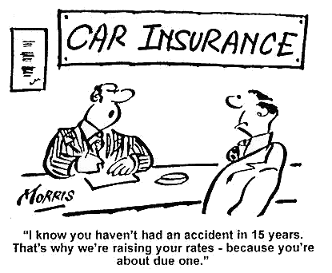
http://i.imgur.com/nEcOf.jpg

Slide 46
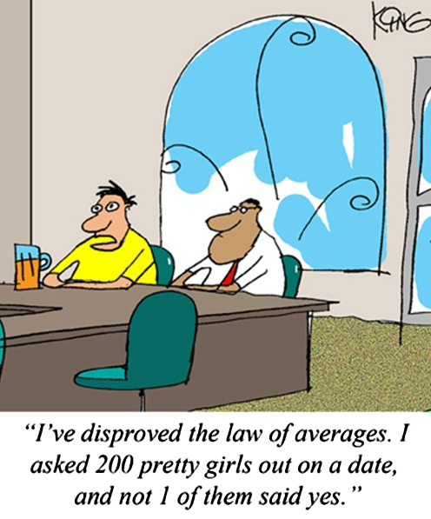
http://cdn3.howtogeek.com/wp-content/uploads/2012/03/20120319hedisprovedthelawofaverages.jpg

Slide 47
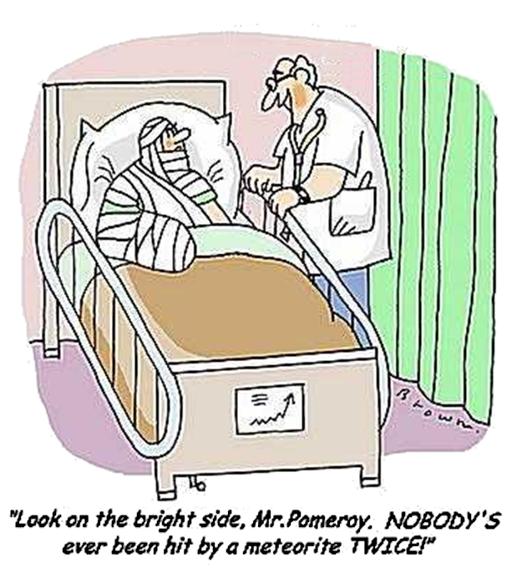
http://i.imgur.com/cz47t.jpg

Slide 48

http://moodleshare.org/pluginfile.php/8626/course/section/1180/averages.jpg

Slide 49
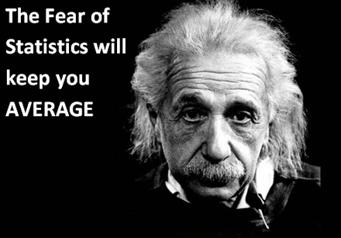
http://www.optimizesmart.com/wp-content/uploads/2013/01/fear-of-statstics.jpg

Slide 50
Questions?
http://i.imgur.com/aliTlT3.jpg

Slide 51
Probability
Because the # favorable outcomes is always less than or equal to the total # of outcomes
0 ≤ P ≤ 1
or
0% ≤ P ≤ 100%

Slide 52
Probability
And
P(all possible outcomes) = 100%

Slide 53
Probability
The complement of an outcome is all outcomes that are not favorable
Called P′ (pronounced “P prime")
P′ = 1 – P
or
P′ = 100% – P

Slide 54
Probability
Note: complement means the things that is necessary for completion
Compliment is when someone says something nice about you

Slide 55
PROBABILITY
IN-CLASS PROBLEM 2
Find:
P(2,3,4,5 or 6 on one roll of a fair die)

Slide 56
PROBABILITY
IN-CLASS PROBLEM 2
This is the same as:
P(not 1 on one roll of a fair die)
This is the complement of:
P(a 1 on one roll of a fair die) =

Slide 57
PROBABILITY
IN-CLASS PROBLEM 2
Since:
P(a 1 on one roll of a fair die) = 1/6
Then P(not 1 on one roll of a fair die) would be:
P′ = 1 – P = 1 – 1/6 =

Slide 58
PROBABILITY
IN-CLASS PROBLEM 2
Since:
P(a 1 on one roll of a fair die) = 1/6
Then P(not 1 on one roll of a fair die) would be:
P′ = 1 – P = 1 – 1/6 = 5/6

Slide 59
Questions?
http://i.imgur.com/aliTlT3.jpg

Slide 60
Probability
Mutually exclusive outcomes:
If event A occurs then
event B cannot occur
Ex: if you have a “H” then you can’t have a “T”

Slide 61
Probability
Mutually exclusive events:
Event A: I am 5’ 2” tall today
Event B: I am 5’ 6” tall today

Slide 62
PROBABILITY
IN-CLASS PROBLEM 3a
For categorical or histogram data, calculating probabilities is easy:
Minutes Internet Usage | Relative Frequency
1-20 | 9/52 = 0.17 = 17%
21-40 | 18/52 = 0.35 = 35%
41-60 | 15/52 = 0.29 = 29%
61-80 | 0.15 = 15%
81-100 | 0.02 = 2%
101-120 | 0.00 = 0%
121+ | 0.02 = 2%
Find the probability a subscriber uses either 1-20 OR 61-80 minutes?

Slide 63
PROBABILITY
IN-CLASS PROBLEM 3a
For categorical or histogram data, calculating probabilities is easy:
Minutes Internet Usage | Relative Frequency
1-20 | 9/52 = 0.17 = 17%
21-40 | 18/52 = 0.35 = 35%
41-60 | 15/52 = 0.29 = 29%
61-80 | 0.15 = 15%
81-100 | 0.02 = 2%
101-120 | 0.00 = 0%
121+ | 0.02 = 2%
P(1-20 or 61-80)
= 0.17 + 0.15
= 0.32 or 32%

Slide 64
Probability
If two categories are “mutually exclusive”
you add their probabilities to get the probability of one OR the other

Slide 65
Probability
This is called the
Addition Rule

Slide 66
Probability
Addition rule - if you have mutually exclusive outcomes:
P(one or the other) =
= P(one) + P(the other)

Slide 67
Probability
If two categories are “mutually exclusive”
you add their probabilities to get the probability of one OR the other

Slide 68
Probability
For tables of data, calculating probabilities is easy:
Minutes Internet Usage | Probability of Being in Category
1-20 | 9/52 = 0.17 = 17%
21-40 | 18/52 = 0.35 = 35%
41-60 | 15/52 = 0.29 = 29%
61-80 | 0.15 = 15%
81-100 | 0.02 = 2%
101-120 | 0.00 = 0%
121+ | 0.02 = 2%
The probability that a subscriber uses 1-20 min:
P(1-20) = 0.17

Slide 69
PROBABILITY
IN-CLASS PROBLEM 3b
What is the probability of living more than 12 years after this diagnosis?
Years After Diagnosis | % of Deaths
1-2 | 15
3-4 | 35
5-6 | 16
7-8 | 9
9-10 | 6
11-12 | 4
13-14 | 2
15+ | 13

Slide 70
PROBABILITY
IN-CLASS PROBLEM 3b
Since you can’t live BOTH 13-14 AND 15+ years after diagnosis (you fall
into one category
or the other) the
events are
mutually exclusive
Years After Diagnosis | % of Deaths
1-2 | 15
3-4 | 35
5-6 | 16
7-8 | 9
9-10 | 6
11-12 | 4
13-14 | 2
15+ | 13

Slide 71
PROBABILITY
IN-CLASS PROBLEM 3b
You can use the addition rule!
P(living >12 years)
= P(living13-14)
+ P(living 15+)
= 2% + 13%
= 15%
Years After Diagnosis | % of Deaths
1-2 | 15
3-4 | 35
5-6 | 16
7-8 | 9
9-10 | 6
11-12 | 4
13-14 | 2
15+ | 13

Slide 72
Questions?
http://i.imgur.com/aliTlT3.jpg

Slide 73
Probability
If two categories are “mutually exclusive”
you add their probabilities to get the probability of one OR the other

Slide 74
Probability
If they are not mutually exclusive, you can add them together but then must subtract any overlap

Slide 75
PROBABILITY
IN-CLASS PROBLEM 3c
Category A: rolling 1,2 or 3 on a fair die
Category B: rolling an even number on a fair die
These are not mutually exclusive

Slide 76
PROBABILITY
IN-CLASS PROBLEM 3c
Category A: rolling 1,2 or 3 on a fair die
Category B: rolling an even number on a fair die
P(A) = P(1)+P(2)+P(3) =
P(B) = P(2)+P(4)+P(6) =

Slide 77
PROBABILITY
IN-CLASS PROBLEM 3c
Category A: rolling 1,2 or 3 on a fair die
Category B: rolling an even number on a fair die
P(A) = P(1)+P(2)+P(3) = 3/6
P(B) = P(2)+P(4)+P(6) =

Slide 78
PROBABILITY
IN-CLASS PROBLEM 3c
Category A: rolling 1,2 or 3 on a fair die
Category B: rolling an even number on a fair die
P(A) = P(1)+P(2)+P(3) = 3/6
P(B) = P(2)+P(4)+P(6) = 3/6

Slide 79
PROBABILITY
IN-CLASS PROBLEM 3c
Category A: rolling 1,2 or 3 on a fair die
Category B: rolling an even number on a fair die
P(A) = P(1)+P(2)+P(3) = 3/6
P(B) = P(2)+P(4)+P(6) = 3/6
If you add P(A) and P(B) you will have added P(2) in twice!

Slide 80
PROBABILITY
IN-CLASS PROBLEM 3c
Category A: rolling 1,2 or 3 on a fair die
Category B: rolling an even number on a fair die
P(A) = P(1)+P(2)+P(3) = 3/6
P(B) = P(2)+P(4)+P(6) = 3/6
So P(A or B) = P(A)+P(B)-P(2) =

Slide 81
PROBABILITY
IN-CLASS PROBLEM 3c
Category A: rolling 1,2 or 3 on a fair die
Category B: rolling an even number on a fair die
P(A) = P(1)+P(2)+P(3) = 3/6
P(B) = P(2)+P(4)+P(6) = 3/6
So P(A or B) = P(A)+P(B)-P(2) =
= 3/6 + 3/6 – 1/6 = 5/6

Slide 82
PROBABILITY
IN-CLASS PROBLEM 3c
We can check it:
Category A: rolling 1,2 or 3 on a fair die
Category B: rolling an even number on a fair die
P(A or B) = P(1)+P(2)+P(3)+P(4)+P(6)
= 1/6+1/6+1/6+1/6+1/6 = 5/6
Or P(A or B) = P′(5) = 100% – P(5)
= 1 – 1/6 = 5/6

Slide 83
Questions?
http://i.imgur.com/aliTlT3.jpg

Slide 84
Probability
Sequential outcomes – one after the other
first toss: H
second toss: T
third toss: T . . .

Slide 85
Probability
If one outcome in the sequence does not affect the outcome of the next event in the sequence we can call them “independent outcomes”

Slide 86
Probability
Independent events:
The probability of event A occurring does not affect the probability of event B occurring

Slide 87
Probability
Independent events:
Event A: I came to school today
Event B: Governor P signed a
law into effect

Slide 88
Probability
To get the probability of both event A AND event B occurring, you multiply their probabilities to get the probability of both

Slide 89
Probability
Multiplication rule - if you have independent outcomes:
P(one and another) =
P(one) * P(another)

Slide 90
PROBABILITY
IN-CLASS PROBLEM 4a
What if you had data:
Natural Hair Color |  |  | Eye Color
Blonde | 34.0% |  | Blue | 36.0%
Brown | 43.0% |  | Brown | 64.0%
Red | 7.0%
Black | 14.0%

Slide 91
PROBABILITY
IN-CLASS PROBLEM 4a
If hair color and eye color are independent events, then find:
P(blonde AND blue eyes)
Natural Hair Color |  |  | Eye Color
Blonde | 34.0% |  | Blue | 36.0%
Brown | 43.0% |  | Brown | 64.0%
Red | 7.0%
Black | 14.0%

Slide 92
PROBABILITY
IN-CLASS PROBLEM 4a
P(blonde AND blue eyes) =
=.34 x .36 ≈ .12 or 12%
Natural Hair Color |  |  | Eye Color
Blonde | 34.0% |  | Blue | 36.0%
Brown | 43.0% |  | Brown | 64.0%
Red | 7.0%
Black | 14.0%

Slide 93
PROBABILITY
IN-CLASS PROBLEM 4b
What would be the probability of a subscriber being both
(1-20 minutes)
and
(61-80 minutes)?
Minutes Internet Usage | Probability of Being in Category
1-20 | 9/52 = 0.17 = 17%
21-40 | 18/52 = 0.35 = 35%
41-60 | 15/52 = 0.29 = 29%
61-80 | 0.15 = 15%
81-100 | 0.02 = 2%
101-120 | 0.00 = 0%
121+ | 0.02 = 2%

Slide 94
PROBABILITY
IN-CLASS PROBLEM 4b
Zero!
They are mutually exclusive events

Slide 95
Questions?
http://i.imgur.com/aliTlT3.jpg

Slide 96
Sources of Probabilities
Probabilities can come from a variety of sources

Slide 97
Sources of Probabilities
Probability sources:
classical probability –
based on theory, assumes
equal likelihood of events

Slide 98
Sources of Probabilities
Probability sources:
classical probability
empirical probability –
based on observations (not on theory)

Slide 99
Sources of Probabilities
Probability sources:
classical probability
empirical probability –
the probability that an event E
will occur: P(E) = f/n
where f is how often the event
E occurred
n is the total number of events
in the experiment (n = Σf)

Slide 100
Sources of Probabilities
Probability sources:
classical probability
empirical probability
subjective probability –
  an individual's personal judgment about the likelihood
  of the occurrence of an event
  based on estimates, intuition, and educated guesswork

Slide 101
SOURCES OF PROBABILITY
IN-CLASS PROBLEM 5
What is the probability source?
H/T for coin tossing
classical probability
empirical probability
subjective probability

Slide 102
SOURCES OF PROBABILITY
IN-CLASS PROBLEM 5
What is the probability source?
Minutes Internet Usage | Probability of Being in Category
1-20 | 9/52 = 0.17 = 17%
21-40 | 18/52 = 0.35 = 35%
41-60 | 15/52 = 0.29 = 29%
61-80 | 0.15 = 15%
81-100 | 0.02 = 2%
101-120 | 0.00 = 0%
121+ | 0.02 = 2%
classical probability
empirical probability
subjective probability

Slide 103
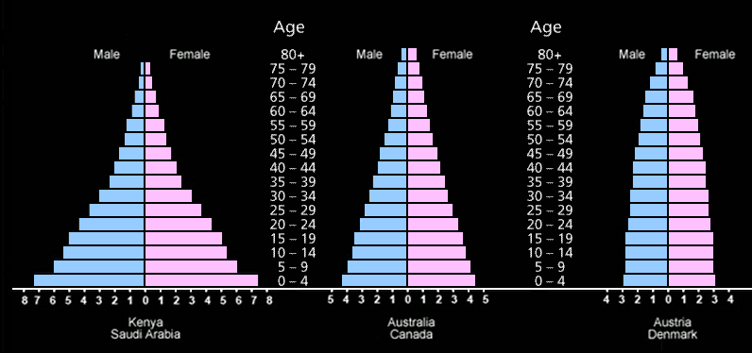
SOURCES OF PROBABILITY
IN-CLASS PROBLEM 5
What is the probability source?
Age Structure graphs
classical probability
empirical probability
subjective probability
https://www.quia.com/files/quia/users/lmcgee/ecology/age-structure-3-countries.gif

Slide 104
SOURCES OF PROBABILITY
IN-CLASS PROBLEM 5
What is the probability source?
Climatologists voting on the likelihood of negative El Niño impacts on southern Africa
classical probability
empirical probability
subjective probability

Slide 105
Questions?
http://i.imgur.com/aliTlT3.jpg

Slide 106
Probability and Sets
Since:
P(a 1 on one roll of a fair die) = 1/6
Then P(not 1 on one roll of a fair die) would be:
P′ = 1 – P = 1 – 1/6 = 5/6

Slide 107
Probability and Sets
The empty set or null set
Has no elements
Symbolized:
∅

Slide 108
Probability and Sets
We call non-overlapping sets “mutually exclusive”
or
“disjoint”

Slide 109
Probability and Sets
P(both events happening if they are mutually exclusive) = Zero!
They are mutually exclusive events

Slide 110
Probability and Sets
To get the probability of both event A AND event B occurring, you multiply their probabilities to get the probability of both

Slide 111
Probability and Sets
Remember, probabilities are percents (or decimals, or fractions)
When you multiply two of them together, you get a small value than either was originally (unless one or the other is 100%)

Slide 112
Probability and Sets
If two categories are “mutually exclusive”
you add their probabilities to get the probability of one OR the other

Slide 113
Probability and Sets
Since you can’t live BOTH 13-14 AND 15+ years after diagnosis (you fall
into one category
or the other) the
events are
mutually exclusive
Years After Diagnosis | % of Deaths
1-2 | 15
3-4 | 35
5-6 | 16
7-8 | 9
9-10 | 6
11-12 | 4
13-14 | 2
15+ | 13

Slide 114
Probability and Sets
You can use the addition rule!
P(living >12 years)
= P(living13-14)
+ P(living 15+)
= 2% + 13%
= 15%
Years After Diagnosis | % of Deaths
1-2 | 15
3-4 | 35
5-6 | 16
7-8 | 9
9-10 | 6
11-12 | 4
13-14 | 2
15+ | 13

Slide 115
Probability and Sets
What if they’re NOT mutually exclusive?
VFrench, 2011

Slide 116
Probability and Sets
Category A: rolling 1,2 or 3 on a fair die
Category B: rolling an even number on a fair die
P(A) = P(1)+P(2)+P(3) = 3/6
P(B) = P(2)+P(4)+P(6) = 3/6
So P(A or B) = P(A)+P(B)-P(2) =
A∩B

Slide 117
Questions?
http://i.imgur.com/aliTlT3.jpg

Slide 118
Conditional Probability
Independent events:
One event has no effect on the outcome of another event

Slide 119

Conditional Probability
http://www.bellevuerarecoins.com/wp-content/uploads/2013/11/bigstock-Coin-Flip-5807921.jpg

Slide 120
Conditional Probability
But… in the universe we live in, one event often changes the likelihood of another event happening

Slide 121

Conditional Probability
http://thedailycannibal.com/wp-content/uploads/2014/05/cards-620x329.jpg

Slide 122


Conditional Probability
https://www.shutterstock.com/image-photo/young-student-overwhelmed-studying-piles-books-116965057?utm_medium=Affiliate&utm_campaign=Idee%20Inc.&utm_source=77643&irgwc=1
http://dlabprep.com/wp-content/uploads/2013/08/Student-stress-study-1.jpg

Slide 123
Conditional Probability
Notation:
P(A|B)
means:
the probability of A given B is trues or has already happened

Slide 124
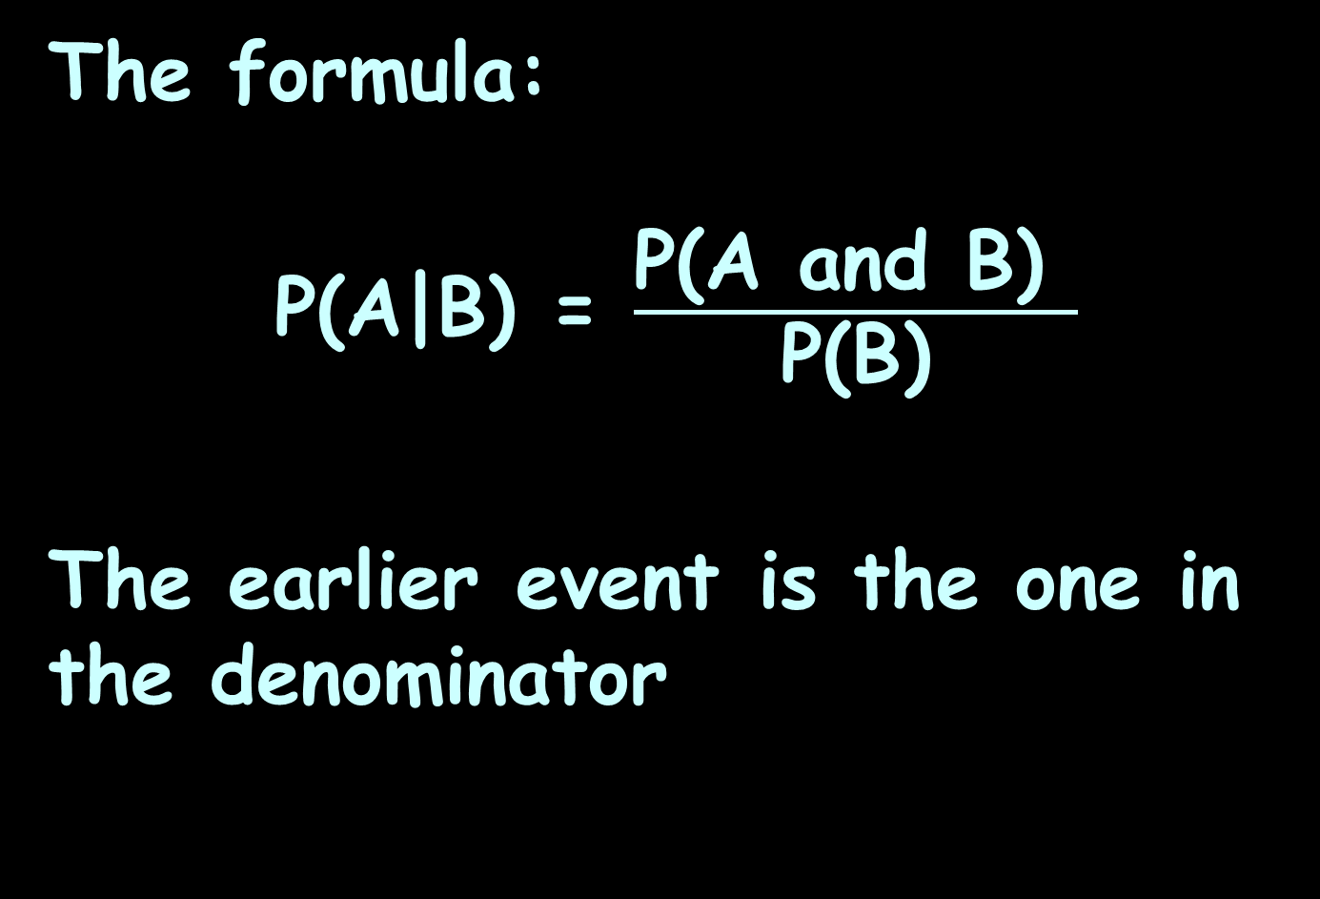
Conditional Probability
The formula:
P(A|B) = $\frac{\text{P}\text{(}\text{A} \text{and} \text{B}\text{) }}{\text{P}\text{(}\text{B}\text{)}}$
The earlier event is the one in the denominator

Slide 125
CONDITIONAL PROBABILITY
IN-CLASS PROBLEM 6a
Survival rate and life expectancy in a population

Slide 126
CONDITIONAL PROBABILITY
IN-CLASS PROBLEM 6a
Let P(N) be the probability of a newborn reaching the age of N years

Slide 127
CONDITIONAL PROBABILITY
IN-CLASS PROBLEM 6a
Age Structure graphs
rapid growth slow growth zero growth
www.algebralab.org

Slide 128
CONDITIONAL PROBABILITY
IN-CLASS PROBLEM 6a
A study has shown that:
P(50) = 91.3%
P(55) = 88.1%
P(65) = 74.6%

Slide 129
CONDITIONAL PROBABILITY
IN-CLASS PROBLEM 6a
What is the probability of a 50-year-old man reaching the age of 55?

Slide 130
CONDITIONAL PROBABILITY
IN-CLASS PROBLEM 6a
What is P(55|50)?

Slide 131
CONDITIONAL PROBABILITY
IN-CLASS PROBLEM 6a
P(55|50) = P(55 and 50)/P(50)
= P(55)/P(50)
P(50) = 91.3%
P(55) = 88.1%
P(65) = 74.6%

Slide 132
CONDITIONAL PROBABILITY
IN-CLASS PROBLEM 6a
P(55|50) = P(55 and 50)/P(50)
= P(55)/P(50)
= 88.1/91.3
≈ .965 or 96.5%
P(50) = 91.3%
P(55) = 88.1%
P(65) = 74.6%

Slide 133
Conditional Probability
A probability that a 50-year- old will die within 5 years is then a rather comforting:
1 - .965 = .035
or 3.5%

Slide 134
Conditional Probability
However, the probability of dying within the next 5 years grows with age

Slide 135
CONDITIONAL PROBABILITY
IN-CLASS PROBLEM 6b
So if the probability that a man who just turned 65 will die within 5 years is .16, what is the probability for that man to survive till his 70th birthday?

Slide 136
CONDITIONAL PROBABILITY
IN-CLASS PROBLEM 6b
So if the probability that a man who just turned 65 will die within 5 years is .16, what is the probability for that man to survive till his 70th birthday?
P(70|65)?

Slide 137
CONDITIONAL PROBABILITY
IN-CLASS PROBLEM 6b
If the probability that a man
who just turned 65 will die
within 5 years is .16, then:
P(70|65) = 1 - .16 = .84 or 84%

Slide 138
CONDITIONAL PROBABILITY
IN-CLASS PROBLEM 6c
Eye color of Germans:
 | Blue | Grey | Green | Brown
Males | 22% | 3% | 8% | 16%
Females | 17% | 2% | 12% | 20%

Slide 139

CONDITIONAL PROBABILITY
IN-CLASS PROBLEM 6c
What is the probability your subject is a female given your subject has blue eyes?
 | Blue | Grey | Green | Brown
Males | 22% | 3% | 8% | 16%
Females | 17% | 2% | 12% | 20%
P(A|B) = $\frac{\text{P}\text{(}\text{A} \text{and} \text{B}\text{) }}{\text{P}\text{(}\text{B}\text{)}}$

Slide 140

CONDITIONAL PROBABILITY
IN-CLASS PROBLEM 6c
P(female|blue)=$\frac{\text{P}\text{(}\text{female} \text{and} \text{blue}\text{) }}{\text{P}\text{(}\text{blue}\text{)}}$
 | Blue | Grey | Green | Brown
Males | 22% | 3% | 8% | 16%
Females | 17% | 2% | 12% | 20%
49%
51%
39%

Slide 141
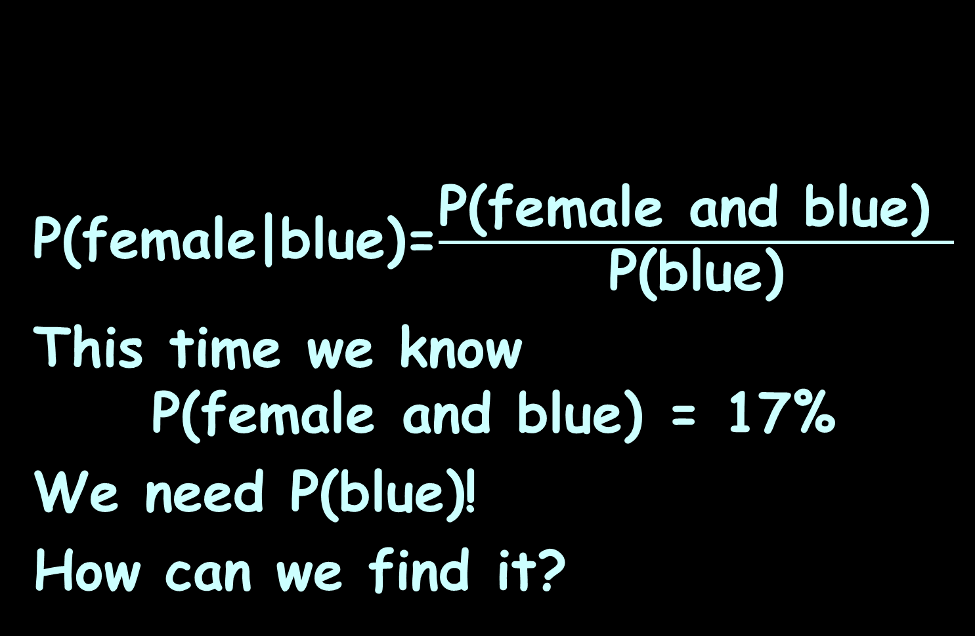
CONDITIONAL PROBABILITY
IN-CLASS PROBLEM 6c
P(female|blue)=$\frac{\text{P}\text{(}\text{female} \text{and} \text{blue}\text{) }}{\text{P}\text{(}\text{blue}\text{)}}$
This time we know
P(female and blue) = 17%
We need P(blue)!
How can we find it?
 | Blue | Grey | Green | Brown
Males | 22% | 3% | 8% | 16%
Females | 17% | 2% | 12% | 20%
49%
51%
39%

Slide 142
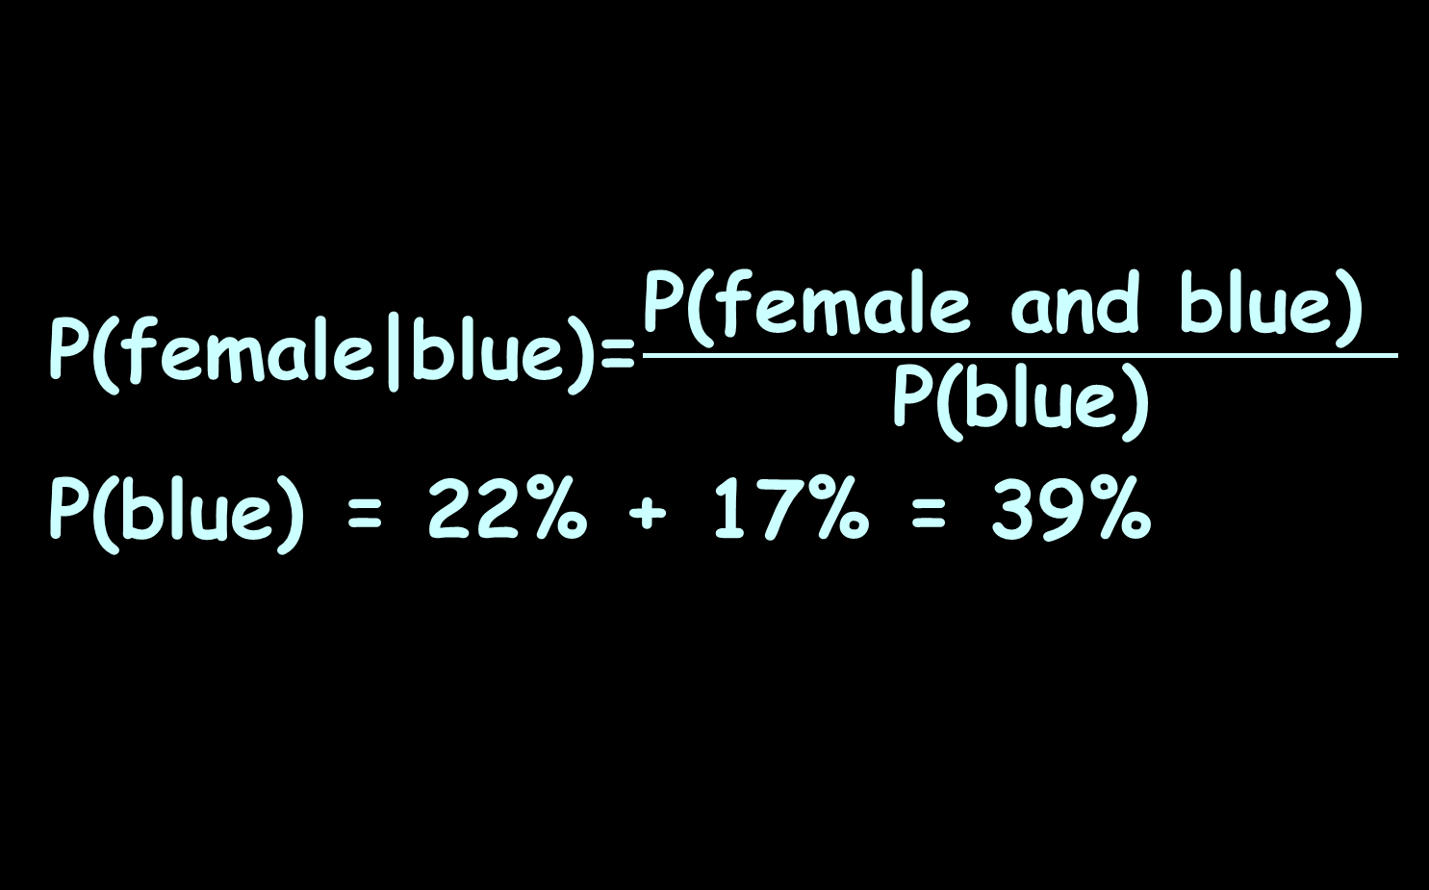
CONDITIONAL PROBABILITY
IN-CLASS PROBLEM 6c
P(female|blue)=$\frac{\text{P}\text{(}\text{female} \text{and} \text{blue}\text{) }}{\text{P}\text{(}\text{blue}\text{)}}$
P(blue) = 22% + 17% = 39%
 | Blue | Grey | Green | Brown
Males | 22% | 3% | 8% | 16%
Females | 17% | 2% | 12% | 20%
49%
51%
39%

Slide 143
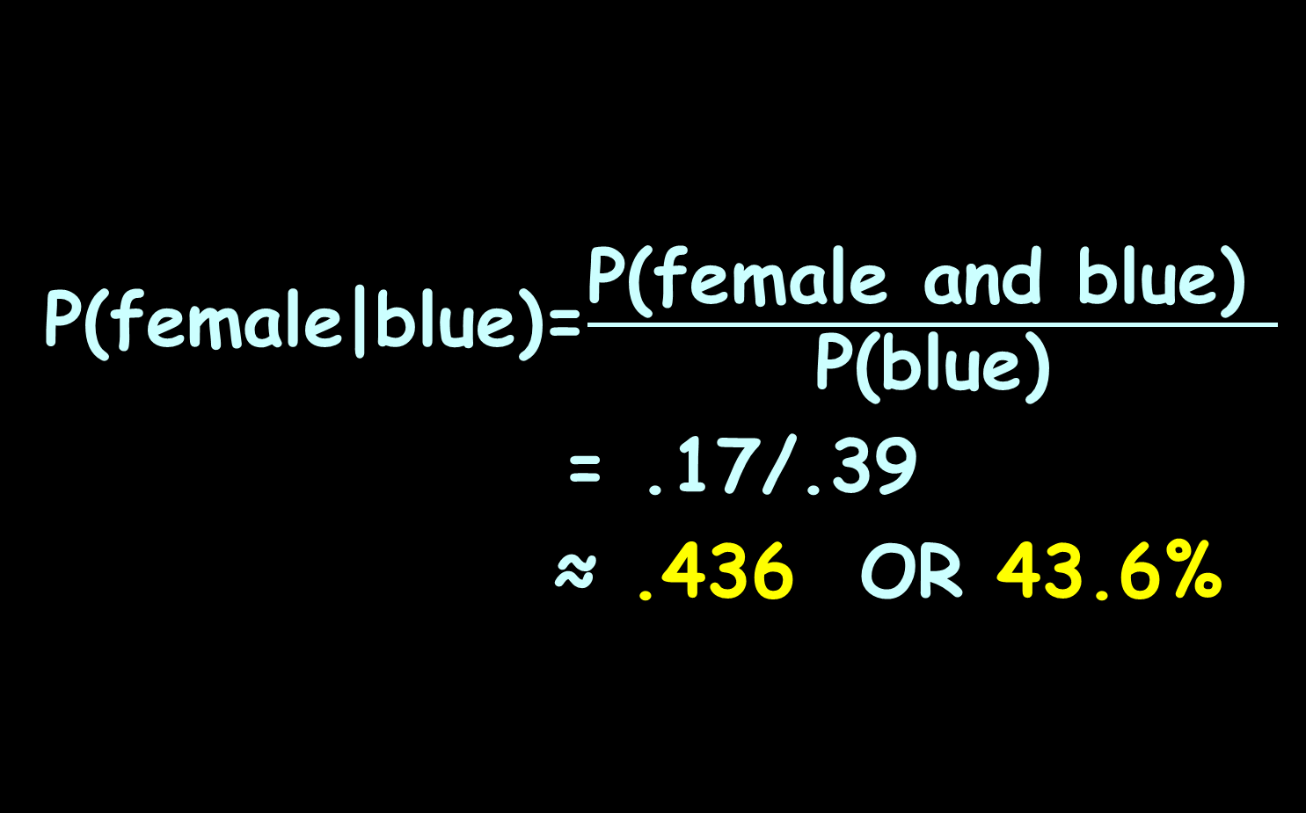
CONDITIONAL PROBABILITY
IN-CLASS PROBLEM 6c
P(female|blue)=$\frac{\text{P}\text{(}\text{female} \text{and} \text{blue}\text{) }}{\text{P}\text{(}\text{blue}\text{)}}$
= .17/.39
≈ .436 OR 43.6%
 | Blue | Grey | Green | Brown
Males | 22% | 3% | 8% | 16%
Females | 17% | 2% | 12% | 20%
49%
51%
39%

Slide 144
Questions?
http://i.imgur.com/aliTlT3.jpg

Slide 145
Summary
Today we studied:
Review of Nonlinear Time
Series and Multiple Regression
New: Discrete Probability
Conditional Probability

Slide 146

You Survived!
www.playbuzz.com

