Slide 1
Welcome to
Unit 5 Part 10
MATH366 Probability and Statistics
https://online.stanford.edu/sites/default/files/styles/figure_default/public/2018-04/theory-of-probability_stats116.jpg?itok=ms4fRMO-

Slide 2
What’s Up?
Today we will be going over:
Review of Counting Principles
Combinatorics
New: Odds
Meteorological Probability

Slide 3
What’s Up?
Outcome 2) Formulate models for the probability of simple events and then apply the properties of probabilities to calculate the probabilities of complex events

Slide 4

Review
http://995642590.r.lightningbase-cdn.com/wp-content/uploads/2010/12/looking-back-hrexaminer-v144-cover425px.jpg

Slide 5
Probability
Probability is defined to be:
# favorable outcomes
total # of outcomes
P =

Slide 6
Probability
Because the # favorable outcomes is always less than the total # of outcomes
0 ≤ P ≤ 1
or
0% ≤ P ≤ 100%

Slide 7
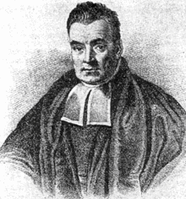

Conditional Probability
Bayes’ Theorem:
P(A|B) = $\frac{\text{P}\text{(}\text{B}\text{|}\text{A}\text{)} \text{P}\text{(}\text{A}\text{)} }{\text{P}\text{(}\text{B}\text{)}}$
https://upload.wikimedia.org/wikipedia/commons/thumb/d/d4/Thomas_Bayes.gif/220px-Thomas_ Bayes.gif

Slide 8
Fundamental Counting Principle
the number of ways things can occur

Slide 9
Fundamental Counting Principle
The number of ways in which characteristics can be combined is found by multiplying the possibilities of each characteristic together

Slide 10
Combinatorics
Combinatorics expands on this idea – from a complete group, how many subgroups can you select?

Slide 11
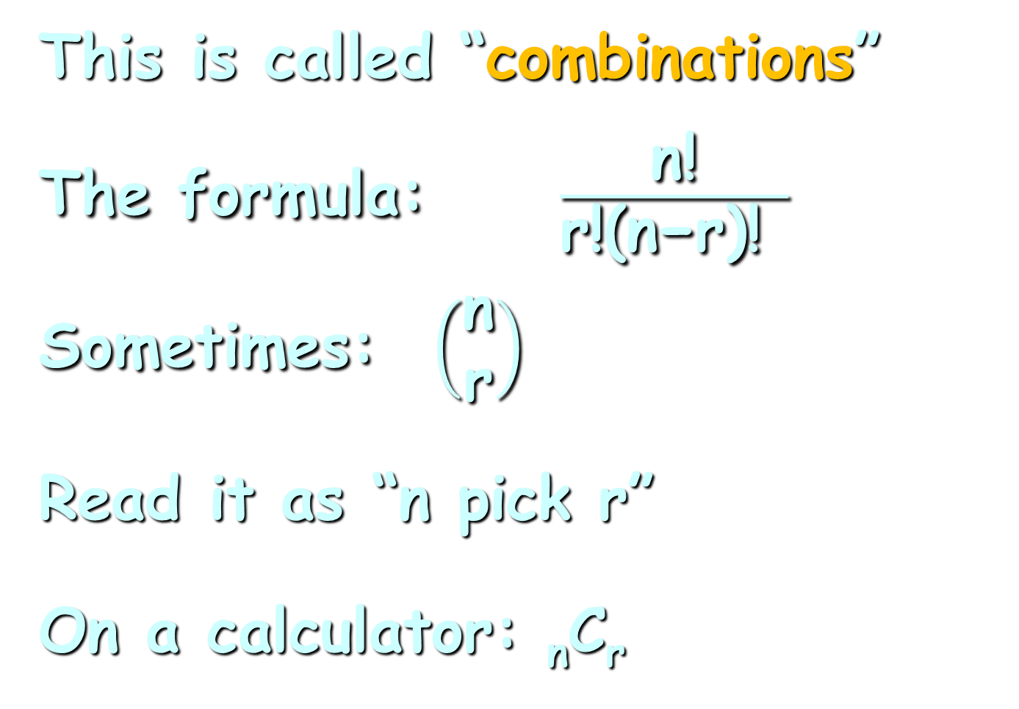
Combinatorics
This is called “combinations”
The formula: $\frac{\text{n}\text{!}}{\text{r}\text{!(}\text{n}\text{−}\text{r}\text{)! }}$
Sometimes: $\left(\begin{matrix}\text{n} \\ \text{r}\end{matrix}\right)$
Read it as “n pick r”
On a calculator: _{n}C_{r}

Slide 12
Combinatorics
Combinations
an arrangement of items such that:
the items are selected from
the same group
no item is used more than once
the order makes no difference

Slide 13
Combinatorics
For _{n}C_{r} or n!/r!(n-r)!
“n” is the total number in the group
“r” is the number you are selecting

Slide 14
Combinatorics
What happens if order IS important in selecting your subgroup?

Slide 15
Combinatorics
We call this “permutations”
an arrangement of items such that:
no item is used more than
once
the order DOES make a
difference

Slide 16

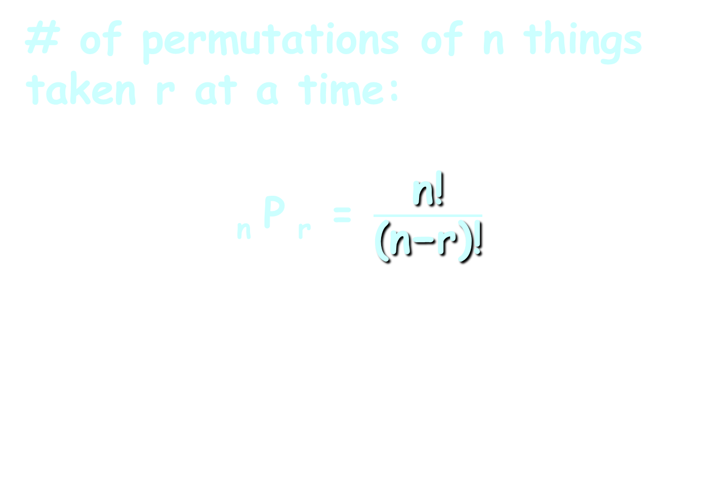
Combinatorics
# of permutations of n things taken r at a time:
_{n} P _{r} = $\frac{\text{n}\text{!}}{\text{(}\text{n}\text{−}\text{r}\text{)!}}$
_{n} C _{r} = $\frac{\text{n}\text{!}}{\text{r}\text{!(}\text{n}\text{−}\text{r}\text{)!}}$

Slide 17

Questions?
http://i.imgur.com/aliTlT3.jpg

Slide 18
Odds
Three types:
  American
  Decimal
  Fractional

Slide 19
Odds
American odds have a negative in front of the number to show what you must bet to make $100
Sometimes they have a positive in front of the number to show how much you might profit if you bet $100

Slide 20
Odds
You bet $110 on a team with American odds of -110
American odds have a negative in front of the number to show what you must bet to make $100

Slide 21
Odds
You bet $110 on a team with American odds of -110
They win!
American odds have a negative in front of the number to show what you must bet to make $100

Slide 22
Odds
You bet $110 on a team with American odds of -110
They win!
You get $100 profit (plus your original $110 stake) for a total of $210
American odds have a negative in front of the number to show what you must bet to make $100

Slide 23
Odds
You bet $100 on a team with odds of +120
Sometimes they have a positive in front of the number to show how much you might profit if you bet $100

Slide 24
Odds
You bet $100 on a team with odds of +120
They win!
Sometimes they have a positive in front of the number to show how much you might profit if you bet $100

Slide 25
Odds
You bet $100 on a team with odds of +120
They win!
You get $120 profit (plus your original $100 stake) for a total of $220
Sometimes they have a positive in front of the number to show how much you might profit if you bet $100

Slide 26
Odds
Decimal odds show the potential return of a bet including the stake amount

Slide 27
Odds
You bet $100 on a team with decimal odds 1.885
Decimal odds show the potential return of a bet including the stake amount

Slide 28
Odds
You bet $100 on a team with decimal odds 1.885
They win!
Decimal odds show the potential return of a bet including the stake amount

Slide 29
Odds
You bet $100 on a team with decimal odds 1.885
They win!
You get $188.50 (this includes your original stake)
Decimal odds show the potential return of a bet including the stake amount

Slide 30
Odds
Fractional odds can easily be identified by their use of a dash or a backslash:
5/1, 5-1, or 5-to-1

Slide 31
Odds
You bet $15 on a team with odds of 10/15
Fractional odds can easily be identified by their use of a dash or a backslash:
5/1, 5-1, or 5-to-1

Slide 32
Odds
You bet $15 on a team with odds of 10/15
They win!
Fractional odds can easily be identified by their use of a dash or a backslash:
5/1, 5-1, or 5-to-1

Slide 33
Odds
You bet $15 on a team with odds of 10/15
They win!
You get $10 profit (plus your original $15 stake) for a total of $25
Fractional odds can easily be identified by their use of a dash or a backslash:
5/1, 5-1, or 5-to-1

Slide 34
Odds
Most fractional odds are shown as xx:1 so you can easily see how much you would make for every dollar bet

Slide 35
Odds
Odds in favor
# favorable outcomes :
# unfavorable outcomes

Slide 36
Odds
# favorable outcomes:
# unfavorable outcomes
2:1 means 2 favorable outcomes and 1 unfavorable outcome

Slide 37
ODDS
IN-CLASS PROBLEM 1a
2:1 means 2 favorable outcomes and 1 unfavorable outcome
How many outcomes total?

Slide 38
ODDS
IN-CLASS PROBLEM 1a
2:1 means 2 favorable outcomes and 1 unfavorable outcome
How many outcomes total? 3

Slide 39
Odds
So 2:1 means P(win) = 2/3

Slide 40
Odds
Odds against are
# unfavorable outcomes :
# favorable outcomes

Slide 41
Odds
“Odds against” are more commonly used than “odds in favor”

Slide 42
Odds
Odds against are generally stated as xx

Slide 43
Odds
Odds against are generally stated as xx
This is really shorthand for xx:1

Slide 44
Odds
xx:1
where xx is the number of people betting against divided by the number betting for and reduced to the nearest whole number
Somebody is pocketing the “rounding downward” amounts, and it’s not YOU

Slide 45
ODDS
IN-CLASS PROBLEM 1b
For example, 753 people bet on horse A out of a total of 9,821

Slide 46
ODDS
IN-CLASS PROBLEM 1b
For example, 753 people bet on horse A out of a total of 9,821
The odds against would need the number betting on any other horse: 9821 – 753 = ?

Slide 47
ODDS
IN-CLASS PROBLEM 1b
For example, 753 people bet on horse A out of a total of 9,821
The odds against would need the number betting on any other horse: 9821 – 753 = 9068

Slide 48
ODDS
IN-CLASS PROBLEM 1b
For example, 753 people bet on horse A out of a total of 9,821
The odds against would then be the number betting against (9068) divided by the number betting for (753) = ?

Slide 49
ODDS
IN-CLASS PROBLEM 1b
For example, 753 people bet on horse A out of a total of 9,821
The odds against would then be the number betting against (9068) divided by the number betting for (753) = 12.04249668 or 12
Rounding down

Slide 50
Odds
Odds = # unfavorable outcomes/
# favorable outcomes
This tells you how much profit you will make on a bet

Slide 51
Odds
Odds against are shown this way so it is easy to calculate how much you would profit on a $1 bet

Slide 52
Odds
Ex: You bet $2 at odds of 20:1
You win!
You will get a profit of
$2 x 20 = $40
The bookie will pay you (payout) $40 + $2 = $42

Slide 53
Odds
Ex: You bet $2 at odds of 20:1
You win!
Some bookies don’t seem to know this…

Slide 54
Odds
Ex: You bet $2 at odds of 20:1
You win!
Some bookies don’t seem to know this…
They pay you $40

Slide 55
Odds
Ex: You bet $2 at odds of 20:1
You win!
Some bookies don’t seem to know this…
They pay you $40
I wouldn’t fight them on it…

Slide 56
Questions?
http://i.imgur.com/aliTlT3.jpg

Slide 57

Horse | Odds
Daddy Long Legs | 26
Optimizer | 42
Take Charge Indy | 11
Union Rags | 5
Dullahan | 12
Bodemeister | 4
Rousing Sermon | 40
Creative Cause | 11
Trinniberg Bisnath Parboo | 44
Daddy Nose Best | 14
Alpha | 19
Prospective | 57
Went the Day Well | 30
Hansen | 13
Gemologist | 8
El Padrino | 29
Done Talking | 39
Sabercat | 37
I'll Have Another | 15
Liaison | 56
ODDS
IN-CLASS PROBLEM 2a
Kentucky Derby 2012
What horse is everyone betting
on to win?

Slide 58
Horse | Odds
Daddy Long Legs | 26
Optimizer | 42
Take Charge Indy | 11
Union Rags | 5
Dullahan | 12
Bodemeister | 4
Rousing Sermon | 40
Creative Cause | 11
Trinniberg Bisnath Parboo | 44
Daddy Nose Best | 14
Alpha | 19
Prospective | 57
Went the Day Well | 30
Hansen | 13
Gemologist | 8
El Padrino | 29
Done Talking | 39
Sabercat | 37
I'll Have Another | 15
Liaison | 56
ODDS
IN-CLASS PROBLEM 2a
Kentucky Derby 2012
What horse is everyone betting
on to win? Bodemeister

Slide 59
Horse | Odds
Daddy Long Legs | 26
Optimizer | 42
Take Charge Indy | 11
Union Rags | 5
Dullahan | 12
Bodemeister | 4
Rousing Sermon | 40
Creative Cause | 11
Trinniberg Bisnath Parboo | 44
Daddy Nose Best | 14
Alpha | 19
Prospective | 57
Went the Day Well | 30
Hansen | 13
Gemologist | 8
El Padrino | 29
Done Talking | 39
Sabercat | 37
I'll Have Another | 15
Liaison | 56
ODDS
IN-CLASS PROBLEM 2b
Kentucky Derby 2012
What horse is being bet on by the fewest number of people?

Slide 60
Horse | Odds
Daddy Long Legs | 26
Optimizer | 42
Take Charge Indy | 11
Union Rags | 5
Dullahan | 12
Bodemeister | 4
Rousing Sermon | 40
Creative Cause | 11
Trinniberg Bisnath Parboo | 44
Daddy Nose Best | 14
Alpha | 19
Prospective | 57
Went the Day Well | 30
Hansen | 13
Gemologist | 8
El Padrino | 29
Done Talking | 39
Sabercat | 37
I'll Have Another | 15
Liaison | 56
ODDS
IN-CLASS PROBLEM 2b
Kentucky Derby 2012
What horse is being bet on by the fewest number of people?
Prospective

Slide 61
Horse | Odds
Daddy Long Legs | 26
Optimizer | 42
Take Charge Indy | 11
Union Rags | 5
Dullahan | 12
Bodemeister | 4
Rousing Sermon | 40
Creative Cause | 11
Trinniberg Bisnath Parboo | 44
Daddy Nose Best | 14
Alpha | 19
Prospective | 57
Went the Day Well | 30
Hansen | 13
Gemologist | 8
El Padrino | 29
Done Talking | 39
Sabercat | 37
I'll Have Another | 15
Liaison | 56
Kentucky Derby 2012
I’ll Have Another won!

Slide 62
Horse | Odds
Daddy Long Legs | 26
Optimizer | 42
Take Charge Indy | 11
Union Rags | 5
Dullahan | 12
Bodemeister | 4
Rousing Sermon | 40
Creative Cause | 11
Trinniberg Bisnath Parboo | 44
Daddy Nose Best | 14
Alpha | 19
Prospective | 57
Went the Day Well | 30
Hansen | 13
Gemologist | 8
El Padrino | 29
Done Talking | 39
Sabercat | 37
I'll Have Another | 15
Liaison | 56
ODDS
IN-CLASS PROBLEM 2c
If you bet $100 on I’ll Have Another, how much profit would you get?

Slide 63
Horse | Odds
Daddy Long Legs | 26
Optimizer | 42
Take Charge Indy | 11
Union Rags | 5
Dullahan | 12
Bodemeister | 4
Rousing Sermon | 40
Creative Cause | 11
Trinniberg Bisnath Parboo | 44
Daddy Nose Best | 14
Alpha | 19
Prospective | 57
Went the Day Well | 30
Hansen | 13
Gemologist | 8
El Padrino | 29
Done Talking | 39
Sabercat | 37
I'll Have Another | 15
Liaison | 56
ODDS
IN-CLASS PROBLEM 2c
If you bet $100 on I’ll Have Another, how much profit would you get? $1500!
$100 x 15

Slide 64
Horse | Odds
Daddy Long Legs | 26
Optimizer | 42
Take Charge Indy | 11
Union Rags | 5
Dullahan | 12
Bodemeister | 4
Rousing Sermon | 40
Creative Cause | 11
Trinniberg Bisnath Parboo | 44
Daddy Nose Best | 14
Alpha | 19
Prospective | 57
Went the Day Well | 30
Hansen | 13
Gemologist | 8
El Padrino | 29
Done Talking | 39
Sabercat | 37
I'll Have Another | 15
Liaison | 56
ODDS
IN-CLASS PROBLEM 2d
If you bet $100 on I’ll Have Another, how much payout would you (hopefully) get? $1600
$100 x 15 + $100

Slide 65
Horse | Odds
Daddy Long Legs | 26
Optimizer | 42
Take Charge Indy | 11
Union Rags | 5
Dullahan | 12
Bodemeister | 4
Rousing Sermon | 40
Creative Cause | 11
Trinniberg Bisnath Parboo | 44
Daddy Nose Best | 14
Alpha | 19
Prospective | 57
Went the Day Well | 30
Hansen | 13
Gemologist | 8
El Padrino | 29
Done Talking | 39
Sabercat | 37
I'll Have Another | 15
Liaison | 56
ODDS
IN-CLASS PROBLEM 2e
What horse would have had the best profit (if the horse had won)?

Slide 66
Horse | Odds
Daddy Long Legs | 26
Optimizer | 42
Take Charge Indy | 11
Union Rags | 5
Dullahan | 12
Bodemeister | 4
Rousing Sermon | 40
Creative Cause | 11
Trinniberg Bisnath Parboo | 44
Daddy Nose Best | 14
Alpha | 19
Prospective | 57
Went the Day Well | 30
Hansen | 13
Gemologist | 8
El Padrino | 29
Done Talking | 39
Sabercat | 37
I'll Have Another | 15
Liaison | 56
ODDS
IN-CLASS PROBLEM 2e
What horse would have had the best profit (if the horse had won)? Prospective

Slide 67
Horse | Odds
Daddy Long Legs | 26
Optimizer | 42
Take Charge Indy | 11
Union Rags | 5
Dullahan | 12
Bodemeister | 4
Rousing Sermon | 40
Creative Cause | 11
Trinniberg Bisnath Parboo | 44
Daddy Nose Best | 14
Alpha | 19
Prospective | 57
Went the Day Well | 30
Hansen | 13
Gemologist | 8
El Padrino | 29
Done Talking | 39
Sabercat | 37
I'll Have Another | 15
Liaison | 56
ODDS
IN-CLASS PROBLEM 2f
What horse would have had the lowest profit (if the horse had won)?

Slide 68
Horse | Odds
Daddy Long Legs | 26
Optimizer | 42
Take Charge Indy | 11
Union Rags | 5
Dullahan | 12
Bodemeister | 4
Rousing Sermon | 40
Creative Cause | 11
Trinniberg Bisnath Parboo | 44
Daddy Nose Best | 14
Alpha | 19
Prospective | 57
Went the Day Well | 30
Hansen | 13
Gemologist | 8
El Padrino | 29
Done Talking | 39
Sabercat | 37
I'll Have Another | 15
Liaison | 56
ODDS
IN-CLASS PROBLEM 2f
What horse would have had the lowest profit (if the horse had won)? Bodemeister

Slide 69
Horse | Odds
Daddy Long Legs | 26
Optimizer | 42
Take Charge Indy | 11
Union Rags | 5
Dullahan | 12
Bodemeister | 4
Rousing Sermon | 40
Creative Cause | 11
Trinniberg Bisnath Parboo | 44
Daddy Nose Best | 14
Alpha | 19
Prospective | 57
Went the Day Well | 30
Hansen | 13
Gemologist | 8
El Padrino | 29
Done Talking | 39
Sabercat | 37
I'll Have Another | 15
Liaison | 56
To find the probabilities:
P(win) =
1-(odds/(odds+1))
Complement to get favorable P
Unfavorable P
Unfavorable = odds value
Favorable = scaled to 1
so Total = odds + 1

Slide 70
Horse | Odds
Daddy Long Legs | 26
Optimizer | 42
Take Charge Indy | 11
Union Rags | 5
Dullahan | 12
Bodemeister | 4
Rousing Sermon | 40
Creative Cause | 11
Trinniberg Bisnath Parboo | 44
Daddy Nose Best | 14
Alpha | 19
Prospective | 57
Went the Day Well | 30
Hansen | 13
Gemologist | 8
El Padrino | 29
Done Talking | 39
Sabercat | 37
I'll Have Another | 15
Liaison | 56
ODDS
IN-CLASS PROBLEM 2g
What is the probability I’ll Have Another wins?
P(win) =
1-(odds/(odds+1))

Slide 71
Horse | Odds
Daddy Long Legs | 26
Optimizer | 42
Take Charge Indy | 11
Union Rags | 5
Dullahan | 12
Bodemeister | 4
Rousing Sermon | 40
Creative Cause | 11
Trinniberg Bisnath Parboo | 44
Daddy Nose Best | 14
Alpha | 19
Prospective | 57
Went the Day Well | 30
Hansen | 13
Gemologist | 8
El Padrino | 29
Done Talking | 39
Sabercat | 37
I'll Have Another | 15
Liaison | 56
ODDS
IN-CLASS PROBLEM 2g
What is the probability I’ll Have Another wins?
P = 0.0625 = 6.25%

Slide 72
Horse | Odds
Daddy Long Legs | 26
Optimizer | 42
Take Charge Indy | 11
Union Rags | 5
Dullahan | 12
Bodemeister | 4
Rousing Sermon | 40
Creative Cause | 11
Trinniberg Bisnath Parboo | 44
Daddy Nose Best | 14
Alpha | 19
Prospective | 57
Went the Day Well | 30
Hansen | 13
Gemologist | 8
El Padrino | 29
Done Talking | 39
Sabercat | 37
I'll Have Another | 15
Liaison | 56
ODDS
IN-CLASS PROBLEM 2h
What is the lowest probability of a horse winning?
P(win) =
1-(odds/(odds+1))

Slide 73
Horse | Odds
Daddy Long Legs | 26
Optimizer | 42
Take Charge Indy | 11
Union Rags | 5
Dullahan | 12
Bodemeister | 4
Rousing Sermon | 40
Creative Cause | 11
Trinniberg Bisnath Parboo | 44
Daddy Nose Best | 14
Alpha | 19
Prospective | 57
Went the Day Well | 30
Hansen | 13
Gemologist | 8
El Padrino | 29
Done Talking | 39
Sabercat | 37
I'll Have Another | 15
Liaison | 56
ODDS
IN-CLASS PROBLEM 2h
What is the lowest probability of a horse winning?
0.01724 ≈ 1.72%

Slide 74
Horse | Odds
Daddy Long Legs | 26
Optimizer | 42
Take Charge Indy | 11
Union Rags | 5
Dullahan | 12
Bodemeister | 4
Rousing Sermon | 40
Creative Cause | 11
Trinniberg Bisnath Parboo | 44
Daddy Nose Best | 14
Alpha | 19
Prospective | 57
Went the Day Well | 30
Hansen | 13
Gemologist | 8
El Padrino | 29
Done Talking | 39
Sabercat | 37
I'll Have Another | 15
Liaison | 56
ODDS
IN-CLASS PROBLEM 2i
What is the highest probability of a horse winning?
P(win) =
1-(odds/(odds+1))

Slide 75
Horse | Odds
Daddy Long Legs | 26
Optimizer | 42
Take Charge Indy | 11
Union Rags | 5
Dullahan | 12
Bodemeister | 4
Rousing Sermon | 40
Creative Cause | 11
Trinniberg Bisnath Parboo | 44
Daddy Nose Best | 14
Alpha | 19
Prospective | 57
Went the Day Well | 30
Hansen | 13
Gemologist | 8
El Padrino | 29
Done Talking | 39
Sabercat | 37
I'll Have Another | 15
Liaison | 56
ODDS
IN-CLASS PROBLEM 2i
What is the highest probability of a horse winning?
0.2 or 20.00%

Slide 76
Horse | Odds | Prob
Daddy Long Legs | 26 | 3.70%
Optimizer | 42 | 2.33%
Take Charge Indy | 11 | 8.33%
Union Rags | 5 | 16.67%
Dullahan | 12 | 7.69%
Bodemeister | 4 | 20.00%
Rousing Sermon | 40 | 2.44%
Creative Cause | 11 | 8.33%
Trinniberg Bisnath Parboo | 44 | 2.22%
Daddy Nose Best | 14 | 6.67%
Alpha | 19 | 5.00%
Prospective | 57 | 1.72%
Went the Day Well | 30 | 3.23%
Hansen | 13 | 7.14%
Gemologist | 8 | 11.11%
El Padrino | 29 | 3.33%
Done Talking | 39 | 2.50%
Sabercat | 37 | 2.63%
I'll Have Another | 15 | 6.25%
Liaison | 56 | 1.75%
ODDS
IN-CLASS PROBLEM 2j
What is the sum of all the probabilities?

Slide 77
Horse | Odds | Prob
Daddy Long Legs | 26 | 3.70%
Optimizer | 42 | 2.33%
Take Charge Indy | 11 | 8.33%
Union Rags | 5 | 16.67%
Dullahan | 12 | 7.69%
Bodemeister | 4 | 20.00%
Rousing Sermon | 40 | 2.44%
Creative Cause | 11 | 8.33%
Trinniberg Bisnath Parboo | 44 | 2.22%
Daddy Nose Best | 14 | 6.67%
Alpha | 19 | 5.00%
Prospective | 57 | 1.72%
Went the Day Well | 30 | 3.23%
Hansen | 13 | 7.14%
Gemologist | 8 | 11.11%
El Padrino | 29 | 3.33%
Done Talking | 39 | 2.50%
Sabercat | 37 | 2.63%
I'll Have Another | 15 | 6.25%
Liaison | 56 | 1.75%
ODDS
IN-CLASS PROBLEM 2j
What is the sum of all the probabilities? 123.04%

Slide 78
Horse | Odds | Prob
Daddy Long Legs | 26 | 3.70%
Optimizer | 42 | 2.33%
Take Charge Indy | 11 | 8.33%
Union Rags | 5 | 16.67%
Dullahan | 12 | 7.69%
Bodemeister | 4 | 20.00%
Rousing Sermon | 40 | 2.44%
Creative Cause | 11 | 8.33%
Trinniberg Bisnath Parboo | 44 | 2.22%
Daddy Nose Best | 14 | 6.67%
Alpha | 19 | 5.00%
Prospective | 57 | 1.72%
Went the Day Well | 30 | 3.23%
Hansen | 13 | 7.14%
Gemologist | 8 | 11.11%
El Padrino | 29 | 3.33%
Done Talking | 39 | 2.50%
Sabercat | 37 | 2.63%
I'll Have Another | 15 | 6.25%
Liaison | 56 | 1.75%
ODDS
IN-CLASS PROBLEM 2k
Why does it not equal 100%?

Slide 79
Horse | Odds | Prob
Daddy Long Legs | 26 | 3.70%
Optimizer | 42 | 2.33%
Take Charge Indy | 11 | 8.33%
Union Rags | 5 | 16.67%
Dullahan | 12 | 7.69%
Bodemeister | 4 | 20.00%
Rousing Sermon | 40 | 2.44%
Creative Cause | 11 | 8.33%
Trinniberg Bisnath Parboo | 44 | 2.22%
Daddy Nose Best | 14 | 6.67%
Alpha | 19 | 5.00%
Prospective | 57 | 1.72%
Went the Day Well | 30 | 3.23%
Hansen | 13 | 7.14%
Gemologist | 8 | 11.11%
El Padrino | 29 | 3.33%
Done Talking | 39 | 2.50%
Sabercat | 37 | 2.63%
I'll Have Another | 15 | 6.25%
Liaison | 56 | 1.75%
ODDS
IN-CLASS PROBLEM 2k
Why does it not equal 100%?
MASSIVE cumulative rounding errors!
All downward…

Slide 80
ODDS
IN-CLASS PROBLEM 2l
What is the probability source for these numbers?
Probability sources:
classical probability
empirical probability
subjective probability

Slide 81
Questions?
http://i.imgur.com/aliTlT3.jpg

Slide 82
Probability in Weather
Every day we hear something like:
The probability of precipitation is 15%

Slide 83
Probability in Weather
Every day we hear something like:
The probability of precipitation is 15%
Where does that come from??

Slide 84
Probability in Weather
Most countries have daily weather data stretching back to the 1870s

Slide 85
Probability in Weather
Most countries have daily weather data stretching back to the 1870s
Often the stations recording the data change over time

Slide 86
Probability in Weather
Most countries have daily weather data stretching back to the 1870s
Often the stations recoding the data change over time
Ex: Stapleton vs DIA

Slide 87
Probability in Weather
Most countries have daily weather data stretching back to the 1870s
Often the stations recoding the data change over time
Ex: Stapleton vs DIA
Does that affect the trend or amplitude of the data?

Slide 88
Probability in Weather
Most countries have daily weather data stretching back to the 1870s
Often the stations recoding the data change over time
Does that affect the trend or amplitude of the data?
Usually YES (sadly)

Slide 89
Probability in Weather
Most countries have daily weather data stretching back to the 1870s
So there are actually FEW stations that have a consistent record from 1870 to present

Slide 90
Probability in Weather
The World Meteorological Organization (part of the UN)
Have what is called the “synoptic system”

Slide 91
Probability in Weather
The World Meteorological Organization (part of the UN)
Have what is called the “synoptic system”
Stations report precipitation, max and min temperature, wind speed and dew point/relative humidity every 24 hours

Slide 92
Probability in Weather
Stations report precipitation, max and min temperature, wind speed and dew point/relative humidity every 24 hours
Data are collected at 9am local time

Slide 93
Probability in Weather
The data are to be collected by each government and then shared with the UN for use by anyone who is creating a model or a forecast

Slide 94
Probability in Weather
The data are to be collected by each government and then shared with the UN for use by anyone who is creating a model or a forecast
In exchange, the country gets the inalienable right to make all forecasts for their country (to the exclusion of all others)

Slide 95
Probability in Weather
But…

Slide 96
Probability in Weather
But…
Many countries view their weather data as a strategic resource that they don’t want to share

Slide 97
Probability in Weather
But…
Many countries view their weather data as a strategic resource that they don’t want to share
They demand sole right of forecast, but do not actually ever send data into the UN

Slide 98
Probability in Weather
SO…
In the modern “satellite” world, (post 1985) climate modelers use satellite estimates of (especially) precipitation based on cloud-top temperatures calibrated by occasional (available) ground station data

Slide 99
Probability in Weather
Data collected over several years are used to create climate models

Slide 100
Probability in Weather
The problem is… satellites only last about 5-7 years (occasionally only a few seconds) and must be calibrated every time a new satellite flies

Slide 101
Probability in Weather
The problem is… satellites only last about 5-7 years (occasionally only a few seconds) and must be calibrated every time a new satellite flies
The sensors also degrade over time, so recalibration must be ongoing

Slide 102
Probability in Weather
SO, assume you have a good data series, you can look at historic data and see how many days “like” today had precipitation:
# days with precip
total # days in the dataset
the probability of precip!

Slide 103
Probability in Weather
So… how do you define “days like today”?

Slide 104
Probability in Weather
Forecast models show the trough that comes ashore on the West Coast on Monday being slightly slower. In addition, models have come into somewhat better agreement on the location and strength of the trough but there remain large differences. The GFS has a cut-off trough stalling near the Texas panhandle which would put our area in a zone of maximum precipitation. The Canadian and ECMWF has a more positively tilted trough that progress eastward quicker resulting in less precipitation for our area. Nonetheless, the consensus appears to be that our forecast area will receive at least some precipitation from this system and possibly a healthy amount.
https://www.weather.gov/bou/winter

Slide 105
PROBABILITY IN WEATHER
IN-CLASS PROBLEM 3a
How would you interpret the statement:
“There is a 10% likelihood of rainfall tomorrow”
Notes:
Would you cal

Slide 106
Questions?
http://i.imgur.com/aliTlT3.jpg

Slide 107
Probability in Weather
A probabilistic snowfall forecast would look like:
>=0.1" | >=1" | >=2" | >=4" | >=6" | >=8" | >=12" | >=18"
67% | 36% | 14% | 7% | 2% | 0% | 0% | 0%
https://www.weather.gov/bou/winter

Slide 108
Probability in Weather
This allows the forecaster to make statements like:
“There is a 36% chance we will be getting one inch or more of snow”
>=0.1" | >=1" | >=2" | >=4" | >=6" | >=8" | >=12" | >=18"
67% | 36% | 14% | 7% | 2% | 0% | 0% | 0%
https://www.weather.gov/bou/winter

Slide 109
PROBABILITY IN WEATHER
IN-CLASS PROBLEM 3b
But are these probabilities?
There are no negative values…
What is the sum of all of the category values?
>=0.1" | >=1" | >=2" | >=4" | >=6" | >=8" | >=12" | >=18"
67% | 36% | 14% | 7% | 2% | 0% | 0% | 0%
https://www.weather.gov/bou/winter

Slide 110
PROBABILITY IN WEATHER
IN-CLASS PROBLEM 3c
They add up to 128%…
bigger than 100%
What’s going on??
>=0.1" | >=1" | >=2" | >=4" | >=6" | >=8" | >=12" | >=18"
67% | 36% | 14% | 7% | 2% | 0% | 0% | 0%
https://www.weather.gov/bou/winter

Slide 111
PROBABILITY IN WEATHER
IN-CLASS PROBLEM 3c
What’s going on??
These are all >= values…
>=0.1" | >=1" | >=2" | >=4" | >=6" | >=8" | >=12" | >=18"
67% | 36% | 14% | 7% | 2% | 0% | 0% | 0%
https://www.weather.gov/bou/winter

Slide 112
PROBABILITY IN WEATHER
IN-CLASS PROBLEM 3d
>=0.1” also includes >=1” and
>=2” and >’4” and …
How would you calculate the probabilities of each category?
>=0.1" | >=1" | >=2" | >=4" | >=6" | >=8" | >=12" | >=18"
67% | 36% | 14% | 7% | 2% | 0% | 0% | 0%
https://www.weather.gov/bou/winter
Notes:
Would you cal

Slide 113
PROBABILITY IN WEATHER
IN-CLASS PROBLEM 3d
What would the probability of >18” be?
>=0.1" | >=1" | >=2" | >=4" | >=6" | >=8" | >=12" | >=18"
67% | 36% | 14% | 7% | 2% | 0% | 0% | 0%
https://www.weather.gov/bou/winter
Notes:
Would you cal

Slide 114
PROBABILITY IN WEATHER
IN-CLASS PROBLEM 3d
What would the probability of >18” be?
How about 12-17.99”
and 8-11.99”?
>=0.1" | >=1" | >=2" | >=4" | >=6" | >=8" | >=12" | >=18"
67% | 36% | 14% | 7% | 2% | 0% | 0% | 0%
https://www.weather.gov/bou/winter
Notes:
Would you cal

Slide 115
PROBABILITY IN WEATHER
IN-CLASS PROBLEM 3d
How about 12-17.99”
and 8-11.99”?
How about 6-7.99”?
>=0.1" | >=1" | >=2" | >=4" | >=6" | 8-11.9" | 12-17.9" | >=18"
67% | 36% | 14% | 7% | 2% | 0% | 0% | 0%
https://www.weather.gov/bou/winter
Notes:
Would you cal

Slide 116
PROBABILITY IN WEATHER
IN-CLASS PROBLEM 3d
How about 6-7.99”?
How about 4-5.99”?
>=0.1" | >=1" | >=2" | >=4" | 6-7.9" | 8-11.9" | 12-17.9" | >=18"
67% | 36% | 14% | 7% | 2% | 0% | 0% | 0%
https://www.weather.gov/bou/winter
Notes:
Would you cal

Slide 117
PROBABILITY IN WEATHER
IN-CLASS PROBLEM 3d
How about 4-5.99”? 7%-2%=5%
How about 2-3.99”?
>=0.1" | >=1" | >=2" | 4-5.9" | 6-7.9" | 8-11.9" | 12-17.9" | >=18"
67% | 36% | 14% | 5% | 2% | 0% | 0% | 0%
https://www.weather.gov/bou/winter
Notes:
Would you cal

Slide 118
PROBABILITY IN WEATHER
IN-CLASS PROBLEM 3d
How about 2-3.99”?
14%-5%-2%=7%
How about 1-1.99”?
>=0.1" | >=1" | 2-3.9" | 4-5.9" | 6-7.9" | 8-11.9" | 12-17.9" | >=18"
67% | 36% | 7% | 5% | 2% | 0% | 0% | 0%
https://www.weather.gov/bou/winter
Notes:
Would you cal

Slide 119
PROBABILITY IN WEATHER
IN-CLASS PROBLEM 3d
How about 1-1.99”?
36%-7%-5%-2%=22%
How about 0.1-0.99”?
>=0.1" | 1-1.9" | 2-3.9" | 4-5.9" | 6-7.9" | 8-11.9" | 12-17.9" | >=18"
67% | 22% | 7% | 5% | 2% | 0% | 0% | 0%
https://www.weather.gov/bou/winter
Notes:
Would you cal

Slide 120
PROBABILITY IN WEATHER
IN-CLASS PROBLEM 3d,e
How about 0.1-0.99”?
67%-22%-7%-5%-2%=31%
Now add ‘em all up! Do they add up to 100%?
0.1-0.9" | 1-1.9" | 2-3.9" | 4-5.9" | 6-7.9" | 8-11.9" | 12-17.9" | >=18"
31% | 22% | 7% | 5% | 2% | 0% | 0% | 0%
https://www.weather.gov/bou/winter
Notes:
Would you cal

Slide 121
PROBABILITY IN WEATHER
IN-CLASS PROBLEM 3e,f
Now add ‘em all up! Do they add up to 100%?
No, they add up to 67%…
What’s missing?
0.1-0.9" | 1-1.9" | 2-3.9" | 4-5.9" | 6-7.9" | 8-11.9" | 12-17.9" | >=18"
31% | 22% | 7% | 5% | 2% | 0% | 0% | 0%
https://www.weather.gov/bou/winter
Notes:
Would you cal

Slide 122
PROBABILITY IN WEATHER
IN-CLASS PROBLEM 3f,g
“No measurable precipitation”
What % will that be?
0.1-0.9" | 1-1.9" | 2-3.9" | 4-5.9" | 6-7.9" | 8-11.9" | 12-17.9" | >=18"
31% | 22% | 7% | 5% | 2% | 0% | 0% | 0%
https://www.weather.gov/bou/winter
Notes:
Would you cal

Slide 123
PROBABILITY IN WEATHER
IN-CLASS PROBLEM 3g
“No measurable precipitation”
What % will that be?
100–31-22-7-5-2=33%
NMP | 0.1-0.9" | 1-1.9" | 2-3.9" | 4-5.9" | 6-7.9" | 8-11.9" | 12-17.9" | >=18"
33% | 31% | 22% | 7% | 5% | 2% | 0% | 0% | 0%
https://www.weather.gov/bou/winter
Notes:
Would you cal

Slide 124
Probability in Weather
This table will still allow the forecaster to say:
“There is a 36% chance we will be getting one inch or more of snow”
(36=22+7+5+2)
NMP | 0.1-0.9" | 1-1.9" | 2-3.9" | 4-5.9" | 6-7.9" | 8-11.9" | 12-17.9" | >=18"
33% | 31% | 22% | 7% | 5% | 2% | 0% | 0% | 0%
https://www.weather.gov/bou/winter
Notes:
Would you cal

Slide 125
Probability in Weather
But now the forecaster can also say:
“There is a 5% chance we will be getting 4-6 inches of snow”
NMP | 0.1-0.9" | 1-1.9" | 2-3.9" | 4-5.9" | 6-7.9" | 8-11.9" | 12-17.9" | >=18"
33% | 31% | 22% | 7% | 5% | 2% | 0% | 0% | 0%
https://www.weather.gov/bou/winter
Notes:
Would you cal

Slide 126
PROBABILITY IN WEATHER
IN-CLASS PROBLEM 3h
What is the most likely category in the forecast?
NMP | 0.1-0.9" | 1-1.9" | 2-3.9" | 4-5.9" | 6-7.9" | 8-11.9" | 12-17.9" | >=18"
33% | 31% | 22% | 7% | 5% | 2% | 0% | 0% | 0%
https://www.weather.gov/bou/winter
Notes:
Would you cal

Slide 127
PROBABILITY IN WEATHER
IN-CLASS PROBLEM 3h
What is the most likely category in the forecast?
No measurable precipitation
(Note: there could still be a trace!)
NMP | 0.1-0.9" | 1-1.9" | 2-3.9" | 4-5.9" | 6-7.9" | 8-11.9" | 12-17.9" | >=18"
33% | 31% | 22% | 7% | 5% | 2% | 0% | 0% | 0%
https://www.weather.gov/bou/winter
Notes:
Would you cal

Slide 128
PROBABILITY IN WEATHER
IN-CLASS PROBLEM 3i
What is the source of these probabilities?
NMP | 0.1-0.9" | 1-1.9" | 2-3.9" | 4-5.9" | 6-7.9" | 8-11.9" | 12-17.9" | >=18"
33% | 31% | 22% | 7% | 5% | 2% | 0% | 0% | 0%
Probability sources:
classical probability
empirical probability
subjective probability
https://www.weather.gov/bou/winter
Notes:
Would you cal

Slide 129
Questions?
http://i.imgur.com/aliTlT3.jpg

Slide 130
Summary
Today we studied:
Review of Counting Principles, Combinatorics
New: Odds , Meteorological Probability

Slide 131

You Survived!
www.playbuzz.com

