Slide 1
Welcome to
Unit 6 Part 11
MATH366 Probability and Statistics
https://online.stanford.edu/sites/default/files/styles/figure_default/public/2018-04/theory-of-probability_stats116.jpg?itok=ms4fRMO-

Slide 2
What’s Up?
Today we will be going over:
Review of Odds and Weather Probability
New: DNA Probability

Slide 3
What’s Up?
Outcome 2) Formulate models for the probability of simple events and then apply the properties of probabilities to calculate the probabilities of complex events

Slide 4

Review
http://995642590.r.lightningbase-cdn.com/wp-content/uploads/2010/12/looking-back-hrexaminer-v144-cover425px.jpg

Slide 5
Fundamental Counting Principle
the number of ways things can occur

Slide 6
Fundamental Counting Principle
The number of ways in which characteristics can be combined is found by multiplying the possibilities of each characteristic together

Slide 7
Combinatorics
Combinations
an ordered arrangement of items such that:
the items are selected from
the same group
no item is used more than once
the order makes no difference

Slide 8
Combinatorics
For _{n}C_{r} or n!/r!(n-r)!
“n” is the total number in the group
“r” is the number you are selecting

Slide 9
Combinatorics
We call this “permutations”
an ordered arrangement of items such that:
no item is used more than
once
the order DOES make a
difference

Slide 10
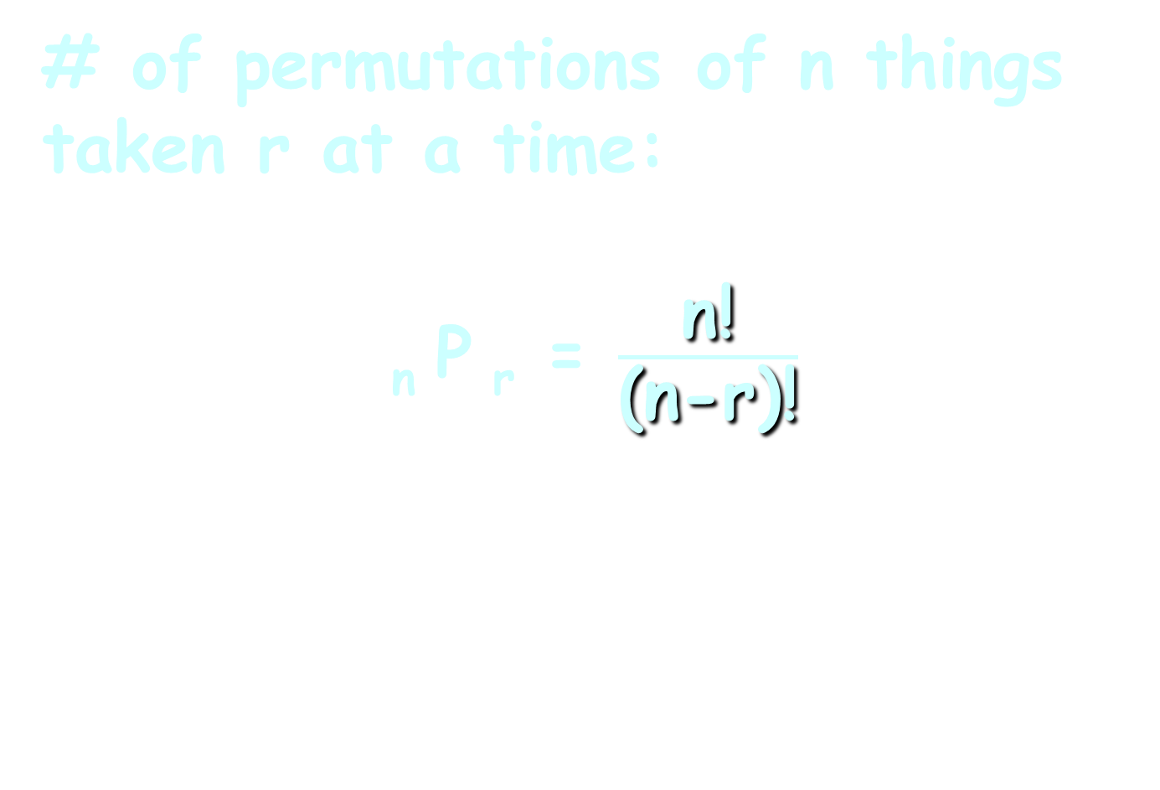
Combinatorics
# of permutations of n things taken r at a time:
_{n} P _{r} = $\frac{\text{n}\text{!}}{\text{(}\text{n}\text{−}\text{r}\text{)!}}$
_{n}C_{r} = n!/r!(n-r)!

Slide 11
Odds
Odds = # unfavorable outcomes/
# favorable outcomes
This tells you how much profit you will make on a bet

Slide 12
Probability in Weather
A probabilistic snowfall forecast would look like:
Note: these are all >= values, so they are not probabilities!
>=0.1" | >=1" | >=2" | >=4" | >=6" | >=8" | >=12" | >=18"
67% | 36% | 14% | 7% | 2% | 0% | 0% | 0%
https://www.weather.gov/bou/winter

Slide 13
Probability in Weather
For each individual category, you could calculate:
and these would be probabilities!
NMP | 0.1-0.9" | 1-1.9" | 2-3.9" | 4-5.9" | 6-7.9" | 8-11.9" | 12-17.9" | >=18"
33% | 31% | 22% | 7% | 5% | 2% | 0% | 0% | 0%
https://www.weather.gov/bou/winter
Notes:
Would you cal

Slide 14

Questions?
http://i.imgur.com/aliTlT3.jpg

Slide 15
DNA Probabilities
Thanks to: http://www.biology.arizona.edu/human_bio/activities/blackett/introduction.html
and
http://en.wikipedia.org/wiki/Genetic_fingerprinting
and the Royal Canadian Mounted Police

Slide 16
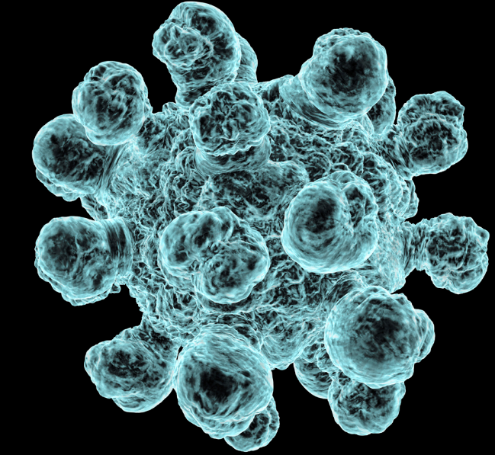
DNA Probabilities
Cells provide structure for the body, take in nutrients from food, convert
those nutrients
into energy,
and carry out
specialized
functions
https://brigetoun.files.wordpress.com/2012/03/microbe1.jpg

Slide 17
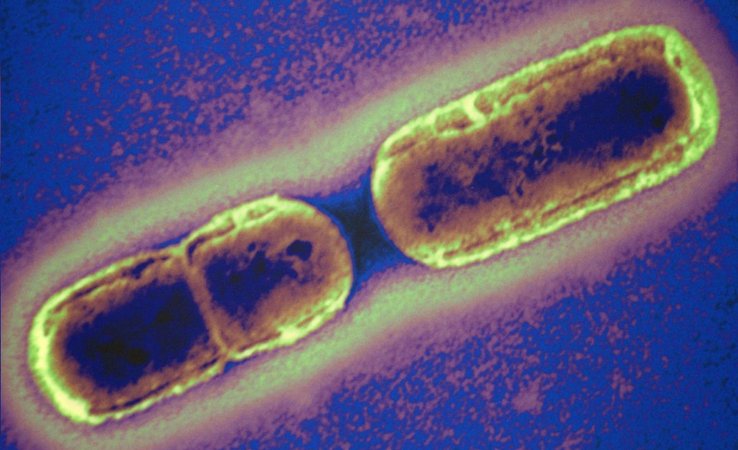
DNA Probabilities
Cells also contain the body’s hereditary material and can make copies of themselves
http://cx.aos.ask.com/question/aq/1400px-788px/bacteria-multiply_b196d916f742676d.jpg

Slide 18
DNA Probabilities
Within each cell, humans have a total of 23 pairs of chromosomes
Each pair contains one chromosome inherited from mom and one from dad

Slide 19
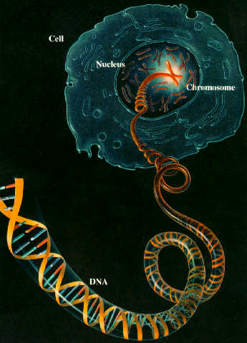
DNA Probabilities
Chromosomes
contain DNA
http://homepage.smc.edu/hgp/images/cell-to-DNA.jpeg

Slide 20

DNA Probabilities
DNA (deoxyribonucleic acid) is the hereditary material in almost all organisms
http://www.clanhendersonsociety.org/wp-content/uploads/2013/08/DNA2.gif

Slide 21
DNA Probabilities
DNA not only creates the proteins but contains the programming for our cells to replicate
http://www.clanhendersonsociety.org/wp-content/uploads/2013/08/DNA2.gif

Slide 22
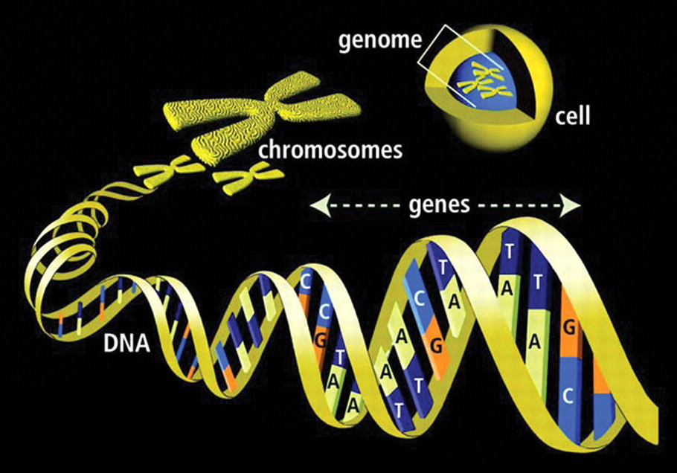
DNA Probabilities

Slide 23
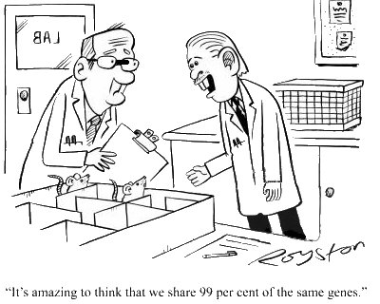
DNA Probabilities
Most living things share a lot of the same DNA
https://s3.amazonaws.com/lowres.cartoonstock.com/animals-genes-dna-rats-mice-lab_rats-rron1016_low.jpg

Slide 24
DNA Probabilities
We share 50% of our DNA with trees, 70% with slugs (gross), 44% with honey bees, and even 25% with daffodils

Slide 25
DNA Probabilities
Certain regions of human DNA which are highly individual are called "markers"

Slide 26
DNA Probabilities
These markers are good for identifying and comparing individuals

Slide 27
DNA Probabilities
The markers are usually named after their locations on the chromosomes
For example, the marker on chromosome 2 is called D2S44 (section 44 of chromosome 2)

Slide 28
DNA Probabilities
The markers most commonly used for DNA profile analysis are found on chromosomes 1, 2, 4, 5, 10 and 17

Slide 29
DNA Probabilities
Some markers have unique names:
vWA (von Willebrand factor gene)
FGA (fibrinogen A alpha) – a blood clotting gene
AMEL (amelogenin) - used to
identify gender in humans (and
cattle!)
TPOX (Human thyroid peroxidase gene)

Slide 30
DNA Probabilities
The markers used most commonly are:
D1S7
D2S44
D4S139
D5S110
D10S28
D17S79

Slide 31
DNA Probabilities
DNA is used by forensic scientists to identify individuals

Slide 32
DNA Probabilities
Autorads are x-ray films with dark bands representing DNA markers

Slide 33
DNA Probabilities
Chemical reagents remove the DNA from a sample
Enzymes chop it into segments
The segments are placed on a slab of gel to which an electric current is applied
Shorter segments move farther through the gel than longer segments (“lengths”)

Slide 34
DNA Probabilities
The pattern is transferred to a nylon membrane and exposed to radioisotopes which attach to the DNA segments
When photographed on x-ray film the segments show up dark and the familiar bar code pattern emerges

Slide 35
DNA Probabilities
The same lengths at all markers mean it is the same person or an identical twin
Similar lengths mean people are related
Different lengths mean they are unrelated

Slide 36
DNA Probabilities
Only certain lengths occur for each of the markers
The length values are called “alleles”

Slide 37
DNA Probabilities
Each person inherits one allele value from Mom and one from Dad (they can be the same value)
This combination is called a “genotype”

Slide 38
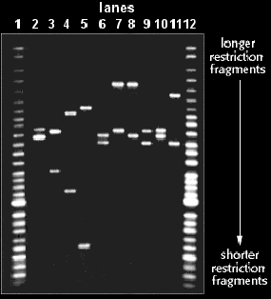
DNA Probabilities
For D1S7:
Person 10
Ladder
Person 2
Ladder

Slide 39
DNA Probabilities
Bob Blackett (dad)
x
x
Anne Blackett (mom)
x
x
David Blackett (son)
x
x
Katie Blackett (daughter)
x
x
one from her dad
one from her mom
one from his mom
one from his dad

Slide 40
DNA Probabilities
Paternity tests use 16 markers to determine whether a man is the father of a child

Slide 41
DNA PROBABILITIES
IN-CLASS PROBLEM 1a
Using the following 5 markers:
Are either the father of the child?
Marker | Mother | Child | Alleged Father 1 | Alleged Father 2
D21S11 | 28, 30 | 28, 31 | 29, 31 | , 31
D7S820 | 9, 10 | 10, 11 | 11, 12 | 11, 12
TH01 | 15, 16 | 14, 15 | 14, 16 | 14, 16
D13S317 | 7, 9 | 7, 8 | 7, 8 | 7, 9
D19S433 | 14, 16.2 | 14, 15 | 15, 17 | 15, 17

Slide 42
DNA PROBABILITIES
IN-CLASS PROBLEM 1a
Using the following 5 markers:
Are either the father of the child?
Marker | Mother | Child | Alleged Father 1 | Alleged Father 2
D21S11 | 28, 30 | 28, 31 | 29, 31 | 30, 31
D7S820 | 9, 10 | 10, 11 | 11, 12 | 11, 12
TH01 | 15, 16 | 14, 15 | 14, 16 | 14, 16
D13S317 | 7, 9 | 7, 8 | 7, 8 | 7, 9
D19S433 | 14, 16.2 | 14, 15 | 15, 17 | 15, 17

Slide 43
DNA PROBABILITIES
IN-CLASS PROBLEM 1a
Using the following 5 markers:
Are either the father of the child?
Marker | Mother | Child | Alleged Father 1 | Alleged Father 2
D21S11 | 28, 30 | 28, 31 | 29, 31 | 30, 31
D7S820 | 9, 10 | 10, 11 | 11, 12 | 11, 12
TH01 | 15, 16 | 14, 15 | 14, 16 | 14, 16
D13S317 | 7, 9 | 7, 8 | 7, 8 | 7, 9
D19S433 | 14, 16.2 | 14, 15 | 15, 17 | 15, 17

Slide 44
DNA PROBABILITIES
IN-CLASS PROBLEM 1a
Using the following 5 markers:
Are either the father of the child?
Marker | Mother | Child | Alleged Father 1 | Alleged Father 2
D21S11 | 28, 30 | 28, 31 | 29, 31 | 30, 31
D7S820 | 9, 10 | 10, 11 | 11, 12 | 11, 12
TH01 | 15, 16 | 14, 15 | 14, 16 | 14, 16
D13S317 | 7, 9 | 7, 8 | 7, 8 | 7, 9
D19S433 | 14, 16.2 | 14, 15 | 15, 17 | 15, 17

Slide 45
DNA PROBABILITIES
IN-CLASS PROBLEM 1a
Using the following 5 markers:
Are either the father of the child?
Marker | Mother | Child | Alleged Father 1 | Alleged Father 2
D21S11 | 28, 30 | 28, 31 | 29, 31 | 30, 31
D7S820 | 9, 10 | 10, 11 | 11, 12 | 11, 12
TH01 | 15, 16 | 14, 15 | 14, 16 | 14, 16
D13S317 | 7, 9 | 7, 8 | 7, 8 | 7, 9
D19S433 | 14, 16.2 | 14, 15 | 15, 17 | 15, 17

Slide 46
DNA PROBABILITIES
IN-CLASS PROBLEM 1a
Using the following 5 markers:
Are either the father of the child?
Marker | Mother | Child | Alleged Father 1 | Alleged Father 2
D21S11 | 28, 30 | 28, 31 | 29, 31 | 30, 31
D7S820 | 9, 10 | 10, 11 | 11, 12 | 11, 12
TH01 | 15, 16 | 14, 15 | 14, 16 | 14, 16
D13S317 | 7, 9 | 7, 8 | 7, 8 | 7, 9
D19S433 | 14, 16.2 | 14, 15 | 15, 17 | 15, 17
Order doesn’t matter!

Slide 47
DNA PROBABILITIES
IN-CLASS PROBLEM 1a
Using the following 5 markers:
Are either the father of the child?
Marker | Mother | Child | Alleged Father 1 | Alleged Father 2
D21S11 | 28, 30 | 28, 31 | 29, 31 | 30, 31
D7S820 | 9, 10 | 10, 11 | 11, 12 | 11, 12
TH01 | 15, 16 | 14, 15 | 14, 16 | 14, 16
D13S317 | 7, 9 | 7, 8 | 7, 8 | 7, 9
D19S433 | 14, 16.2 | 14, 15 | 15, 17 | 15, 17

Slide 48
DNA PROBABILITIES
IN-CLASS PROBLEM 1a
Using the following 5 markers:
Are either the father of the child?
Marker | Mother | Child | Alleged Father 1 | Alleged Father 2
D21S11 | 28, 30 | 28, 31 | 29, 31 | 30, 31
D7S820 | 9, 10 | 10, 11 | 11, 12 | 11, 12
TH01 | 15, 16 | 14, 15 | 14, 16 | 14, 16
D13S317 | 7, 9 | 7, 8 | 7, 8 | 7, 9
D19S433 | 14, 16.2 | 14, 15 | 15, 17 | 15, 17
Father 2 is eliminated!
(Unless mom is not mom!)

Slide 49
DNA PROBABILITIES
IN-CLASS PROBLEM 1a
Using the following 5 markers:
Is father 1 the father?
Marker | Mother | Child | Alleged Father 1
D21S11 | 28, 30 | 28, 31 | 29, 31
D7S820 | 9, 10 | 10, 11 | 11, 12
TH01 | 15, 16 | 14, 15 | 14, 16
D13S317 | 7, 9 | 7, 8 | 7, 8
D19S433 | 14, 16.2 | 14, 15 | 15, 17

Slide 50
DNA PROBABILITIES
IN-CLASS PROBLEM 1a
Using the following 5 markers:
Is father 1 the father?
Marker | Mother | Child | Alleged Father 1
D21S11 | 28, 30 | 28, 31 | 29, 31
D7S820 | 9, 10 | 10, 11 | 11, 12
TH01 | 15, 16 | 14, 15 | 14, 16
D13S317 | 7, 9 | 7, 8 | 7, 8
D19S433 | 14, 16.2 | 14, 15 | 15, 17

Slide 51
DNA PROBABILITIES
IN-CLASS PROBLEM 1a
Using the following 5 markers:
Is father 1 the father? Could be!
Marker | Mother | Child | Alleged Father 1
D21S11 | 28, 30 | 28, 31 | 29, 31
D7S820 | 9, 10 | 10, 11 | 11, 12
TH01 | 15, 16 | 14, 15 | 14, 16
D13S317 | 7, 9 | 7, 8 | 7, 8
D19S433 | 14, 16.2 | 14, 15 | 15, 17

Slide 52
DNA Probabilities
To calculate the probabilities, you need to know population percentages for each of the marker values (alleles)

Slide 53
DNA PROBABILITIES
IN-CLASS PROBLEM 1b
Assuming in this population, the probability of:
D21S11=31 is 0.0512
D7S820=11 is 0.0628
TH01=14 is 0.0931
D13S317=8 is 0.0777
D19S433=15 is 0.0838
What is the probability?
https://www.promega.com/resources/profiles-in-dna/2012/variability-of-new-str-loci-and-kits-in-us-population-groups/

Slide 54
DNA PROBABILITIES
IN-CLASS PROBLEM 1b
D21S11=31 is 0.0512
D7S820=11 is 0.0628
TH01=14 is 0.0931
D13S317=8 is 0.0777
D19S433=15 is 0.0838
What is the probability?
What rule will you use?
This AND that AND that - multiplication rule
This OR that OR that – addition rule
https://www.promega.com/resources/profiles-in-dna/2012/variability-of-new-str-loci-and-kits-in-us-population-groups/

Slide 55
DNA PROBABILITIES
IN-CLASS PROBLEM 1b
D21S11=31 is 0.0512
D7S820=11 is 0.0628
TH01=14 is 0.0931
D13S317=8 is 0.0777
D19S433=15 is 0.0838
What is the probability?
multiplication rule!
This AND that AND that - multiplication rule
This OR that OR that – addition rule
https://www.promega.com/resources/profiles-in-dna/2012/variability-of-new-str-loci-and-kits-in-us-population-groups/

Slide 56
DNA PROBABILITIES
IN-CLASS PROBLEM 1b
D21S11=31 is 0.0512
D7S820=11 is 0.0628
TH01=14 is 0.0931
D13S317=8 is 0.0777
D19S433=15 is 0.0838
What is the probability? .0512*.0628*.0931*.0777*.0838
≈.000001949 or .0001949%
https://www.promega.com/resources/profiles-in-dna/2012/variability-of-new-str-loci-and-kits-in-us-population-groups/

Slide 57
DNA PROBABILITIES
IN-CLASS PROBLEM 1b
0.0001949%
But, is that the probability he’s the father?
https://www.promega.com/resources/profiles-in-dna/2012/variability-of-new-str-loci-and-kits-in-us-population-groups/

Slide 58
DNA PROBABILITIES
IN-CLASS PROBLEM 1b
0.0001949%
That’s the probability of having this DNA pattern in this population
So what’s the population?
https://www.promega.com/resources/profiles-in-dna/2012/variability-of-new-str-loci-and-kits-in-us-population-groups/

Slide 59
DNA PROBABILITIES
IN-CLASS PROBLEM 1b
0.0001949%
That’s the probability of having this DNA pattern in this population
So what’s the population?
I dunno…
https://www.promega.com/resources/profiles-in-dna/2012/variability-of-new-str-loci-and-kits-in-us-population-groups/

Slide 60
DNA PROBABILITIES
IN-CLASS PROBLEM 1b
0.0001949%
That’s the probability of having this DNA pattern in this population
So what’s the population?
I dunno… but let’s use Americans
https://www.promega.com/resources/profiles-in-dna/2012/variability-of-new-str-loci-and-kits-in-us-population-groups/

Slide 61
DNA PROBABILITIES
IN-CLASS PROBLEM 1b
0.0001949%
That’s the probability of having this DNA pattern in this population
So what’s the population?
I dunno… but let’s use Americans
My latest COVID data reports a population of 334,284,143
https://www.promega.com/resources/profiles-in-dna/2012/variability-of-new-str-loci-and-kits-in-us-population-groups/

Slide 62
DNA PROBABILITIES
IN-CLASS PROBLEM 1b
0.0001949%
That’s the probability of having this DNA pattern in this population
So what’s the population?
I dunno… but let’s use Americans
My latest COVID data reports a population of 334,284,143
0.000001949 * 334,284,143 = ?
https://www.promega.com/resources/profiles-in-dna/2012/variability-of-new-str-loci-and-kits-in-us-population-groups/

Slide 63
DNA PROBABILITIES
IN-CLASS PROBLEM 1b
0.000001949 * 334,284,143 =
≈ 651.5197947 people
Is our alleged father one of those?
https://www.promega.com/resources/profiles-in-dna/2012/variability-of-new-str-loci-and-kits-in-us-population-groups/

Slide 64
DNA PROBABILITIES
IN-CLASS PROBLEM 1b
0.000001949 * 334,284,143 =
≈ 651.5197947 people
Is our alleged father one of those?
Yes… but about half of these are women, and not in the running to be the father!
651.5197947 * 0.5 = ?
https://www.promega.com/resources/profiles-in-dna/2012/variability-of-new-str-loci-and-kits-in-us-population-groups/

Slide 65
DNA PROBABILITIES
IN-CLASS PROBLEM 1b
0.000001949 * 334,284,143 =
≈ 651.5197947 people
651.5197947 * 0.5 =
≈ 325.7598974 people
Is he one of those?
https://www.promega.com/resources/profiles-in-dna/2012/variability-of-new-str-loci-and-kits-in-us-population-groups/

Slide 66
DNA PROBABILITIES
IN-CLASS PROBLEM 1b
0.000001949 * 334,284,143 =
≈ 651.5197947 people
651.5197947 * 0.5 =
≈ 325.7598974 people
Is he one of those?
Yes, but toddlers are also unlikely to be the father… we need some way to eliminate the kids!
https://www.promega.com/resources/profiles-in-dna/2012/variability-of-new-str-loci-and-kits-in-us-population-groups/

Slide 67
DNA PROBABILITIES
IN-CLASS PROBLEM 1b
651.5197947 * 0.5 =
≈ 325.7598974 people
Children’s Defense Fund reports 22% of Americans are below the age of 12, so:
325.7598974 * 0.78 = ?
https://www.childrensdefense.org/state-of-americas-children/soac-2021-child-population/

Slide 68
DNA PROBABILITIES
IN-CLASS PROBLEM 1b
651.5197947 * 0.5 =
≈ 325.7598974 people
Children’s Defense Fund reports 22% of Americans are below the age of 12, so:
325.7598974 * 0.78 =
≈ 254.0927199 people
https://www.childrensdefense.org/state-of-americas-children/soac-2021-child-population/

Slide 69
DNA PROBABILITIES
IN-CLASS PROBLEM 1b
≈ 254.0927199 people
Is he one of those?
https://www.childrensdefense.org/state-of-americas-children/soac-2021-child-population/

Slide 70
DNA PROBABILITIES
IN-CLASS PROBLEM 1b
≈ 254.0927199 people
Is he one of those?
Yes! But that’s not the probability he is the father!
https://www.childrensdefense.org/state-of-americas-children/soac-2021-child-population/

Slide 71
DNA PROBABILITIES
IN-CLASS PROBLEM 1b
≈ 254.0927199 people
The probability he is the father would come from:
It’s NOT one of the other 253 people with this DNA pattern (complement rule)
https://www.childrensdefense.org/state-of-americas-children/soac-2021-child-population/

Slide 72
DNA PROBABILITIES
IN-CLASS PROBLEM 1b
It’s NOT one of the other 253 people with this DNA pattern:
AND AND AND …
(multiplication rule again!)
not
Allen
not
Bob
not
Carl
250 more
https://www.childrensdefense.org/state-of-americas-children/soac-2021-child-population/

Slide 73
DNA PROBABILITIES
IN-CLASS PROBLEM 1b
It’s NOT one of the other 253 people with this DNA pattern:
AND AND AND …
Our population total will be:
334,284,143 * 0.5 * 0.78
≈ 130,370,816 people
not
Allen
not
Bob
not
Carl
https://www.childrensdefense.org/state-of-americas-children/soac-2021-child-population/

Slide 74
DNA PROBABILITIES
IN-CLASS PROBLEM 1b
It’s NOT one of the other 253 people with this DNA pattern:
AND AND AND …
So, the probability of not being Allen would be:
130,370,815 / 130,370,816
And there will be 253 “nots”
not
Allen
not
Bob
not
Carl
https://www.childrensdefense.org/state-of-americas-children/soac-2021-child-population/

Slide 75
DNA PROBABILITIES
IN-CLASS PROBLEM 1b
So the probability of
AND AND AND …
would be:
(130,370,815/130,370,816)²⁵³
not
Allen
not
Bob
not
Carl
https://www.childrensdefense.org/state-of-americas-children/soac-2021-child-population/

Slide 76
DNA PROBABILITIES
IN-CLASS PROBLEM 1b
So the probability of
AND AND AND …
would be:
(130,370,815/130,370,816)²⁵³
≈ 0.99999806
Remember, this is the probability of our guy being the father of this child…
not
Allen
not
Bob
not
Carl
https://www.childrensdefense.org/state-of-americas-children/soac-2021-child-population/

Slide 77
DNA PROBABILITIES
IN-CLASS PROBLEM 1b
(130,370,815/130,370,816)²⁵³
≈ 0.99999806
Remember, this is the probability of our guy being the father of this child…
The probability that he is the father is: 99.999806%
https://www.childrensdefense.org/state-of-americas-children/soac-2021-child-population/

Slide 78
DNA PROBABILITIES
IN-CLASS PROBLEM 1b
(130,370,815/130,370,816)²⁵³
≈ 0.99999806
Remember, this is the probability of our guy being the father of this child…
The probability that he is the father is: 99.999806%
Is he the father?
https://www.childrensdefense.org/state-of-americas-children/soac-2021-child-population/

Slide 79
DNA PROBABILITIES
IN-CLASS PROBLEM 1b
(130,370,815/130,370,816)²⁵³
≈ 0.99999806
Remember, this is the probability of our guy being the father of this child…
The probability that he is the father is: 99.999806%
Is he the father?
…and that’s with only 5 of the markers!
Usually they use 16!
https://www.childrensdefense.org/state-of-americas-children/soac-2021-child-population/

Slide 80
Questions?
http://i.imgur.com/aliTlT3.jpg

Slide 81
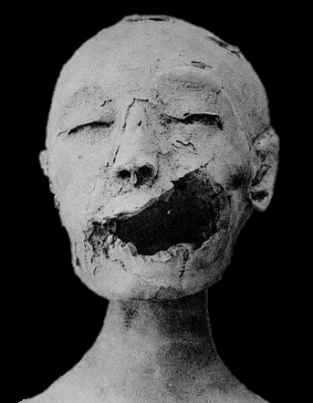
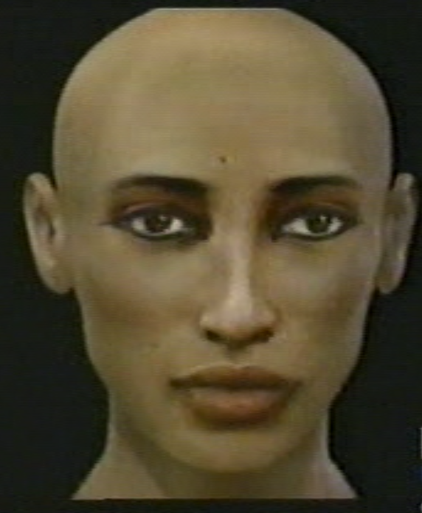
DNA PROBABILITIES
IN-CLASS PROBLEM 1c
Who were King Tut’s parents?
DNA Marker | KV35YL | Tut | Akhenaten
D13S317 | 10, 12 | 10, 12 | 10, 12
D7S820 | 6, 10 | 10, 15 | 15, 15
D2S1338 | 16, 26 | 16, 26 | 16, 26
D21S11 | 25, 29 | 29, 34 | 29, 34
D16S539 | 8, 11 | 8, 13 | 11, 13
D18S51 | 16, 19 | 19, 19 | 16, 19
CSF1PO | 6, 12 | 6, 12 | 9, 12
FGA | 20, 23 | 23, 23 | 20, 23
KV55
(Hawass et al. 2010)
Elisabeth Daynes
Jean-Noël Vignal
Cicero Moraes

Slide 82
DNA PROBABILITIES
IN-CLASS PROBLEM 1c
Who were King Tut’s parents?
DNA Marker | KV35YL | Tut | Akhenaten
D13S317 | 10, 12 | 10, 12 | 10, 12
D7S820 | 6, 10 | 10, 15 | 15, 15
D2S1338 | 16, 26 | 16, 26 | 16, 26
D21S11 | 25, 29 | 29, 34 | 29, 34
D16S539 | 8, 11 | 8, 13 | 11, 13
D18S51 | 16, 19 | 19, 19 | 16, 19
CSF1PO | 6, 12 | 6, 12 | 9, 12
FGA | 20, 23 | 23, 23 | 20, 23
KV55
(Hawass et al. 2010)
Elisabeth Daynes
Jean-Noël Vignal
Cicero Moraes

Slide 83
DNA PROBABILITIES
IN-CLASS PROBLEM 1c
Who were King Tut’s parents?
HOWCUM the similarity between the parents?
DNA Marker | KV35YL | Tut | Akhenaten
D13S317 | 10, 12 | 10, 12 | 10, 12
D7S820 | 6, 10 | 10, 15 | 15, 15
D2S1338 | 16, 26 | 16, 26 | 16, 26
D21S11 | 25, 29 | 29, 34 | 29, 34
D16S539 | 8, 11 | 8, 13 | 11, 13
D18S51 | 16, 19 | 19, 19 | 16, 19
CSF1PO | 6, 12 | 6, 12 | 9, 12
FGA | 20, 23 | 23, 23 | 20, 23
KV55
(Hawass et al. 2010)
Elisabeth Daynes
Jean-Noël Vignal
Cicero Moraes

Slide 84
DNA PROBABILITIES
IN-CLASS PROBLEM 1c
Who were King Tut’s parents?
HOWCUM the similarity between the parents?
KV55 and KV35YL were full brother and sister
DNA Marker | KV35YL | Tut | Akhenaten
D13S317 | 10, 12 | 10, 12 | 10, 12
D7S820 | 6, 10 | 10, 15 | 15, 15
D2S1338 | 16, 26 | 16, 26 | 16, 26
D21S11 | 25, 29 | 29, 34 | 29, 34
D16S539 | 8, 11 | 8, 13 | 11, 13
D18S51 | 16, 19 | 19, 19 | 16, 19
CSF1PO | 6, 12 | 6, 12 | 9, 12
FGA | 20, 23 | 23, 23 | 20, 23
KV55
(Hawass et al. 2010)
Elisabeth Daynes
Jean-Noël Vignal
Cicero Moraes

Slide 85
DNA PROBABILITIES
IN-CLASS PROBLEM 1c
Who were King Tut’s parents?
HOWCUM the similarity between the parents?
KV55 and KV35YL were full brother and sister
…but we have no idea who they were!
DNA Marker | KV35YL | Tut | Akhenaten
D13S317 | 10, 12 | 10, 12 | 10, 12
D7S820 | 6, 10 | 10, 15 | 15, 15
D2S1338 | 16, 26 | 16, 26 | 16, 26
D21S11 | 25, 29 | 29, 34 | 29, 34
D16S539 | 8, 11 | 8, 13 | 11, 13
D18S51 | 16, 19 | 19, 19 | 16, 19
CSF1PO | 6, 12 | 6, 12 | 9, 12
FGA | 20, 23 | 23, 23 | 20, 23
KV55
(Hawass et al. 2010)
Elisabeth Daynes
Jean-Noël Vignal
Cicero Moraes

Slide 86
Who were King Tut’s parents?
How about the probabilities?

Slide 87
Who were King Tut’s parents?
How about the probabilities?
These come from population statistics…

Slide 88
Who were King Tut’s parents?
How about the probabilities?
These come from population statistics…
We don’t have those for ancient Egyptians!

Slide 89
Questions?
http://i.imgur.com/aliTlT3.jpg

Slide 90
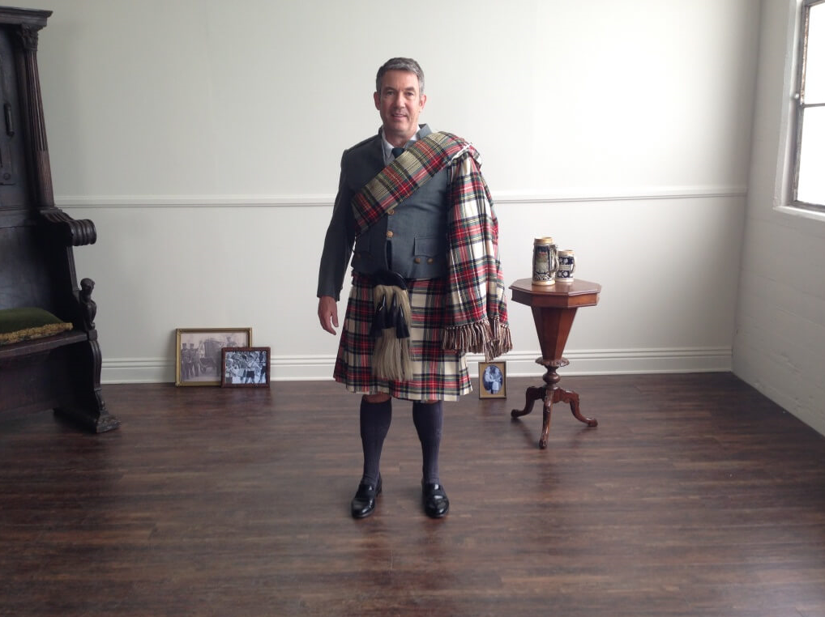
How to Lie with DNA
https://blogs.ancestry.com/ancestry/files/2016/04/Kyle-Scottish-Kilt-1024x768.jpg

Slide 91
DNA Probabilities
Genetic ancestry testing -
the use of DNA information to make inferences about someone’s "deep" ancestry, hundreds or thousands of years into the past
https://www.ucl.ac.uk/mace-lab/debunking/understanding

Slide 92
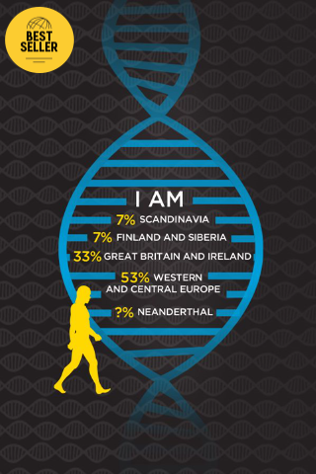
DNA Probabilities
For men, Y
chromosome
markers passed
down from father
to son reveal
direct paternal
deep ancestry
http://www.mobihealthnews.com/sites/default/files/Screen%20Shot%202016-10-27%20at%
201.58.50%20PM.png

Slide 93
DNA Probabilities
Only males carry a
Y-chromosome, so
a female can only
learn about her
father line through
her father or
brother
http://www.mobihealthnews.com/sites/default/files/Screen%20Shot%202016-10-27%20at%
201.58.50%20PM.png

Slide 94
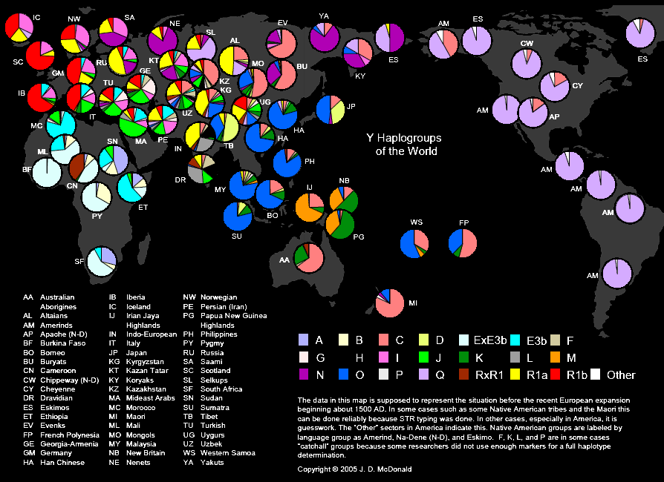
21+
https://dnaexplained.files.wordpress.com/2013/01/haplogroups-of-the-world-y.png

Slide 95
DNA Probabilities
A mitochondrial
DNA haplogroup is
defined by
differences in
mitochondrial DNA
inherited from
your mother’s line
http://www.mobihealthnews.com/sites/default/files/Screen%20Shot%202016-10-27%20at%
201.58.50%20PM.png

Slide 96
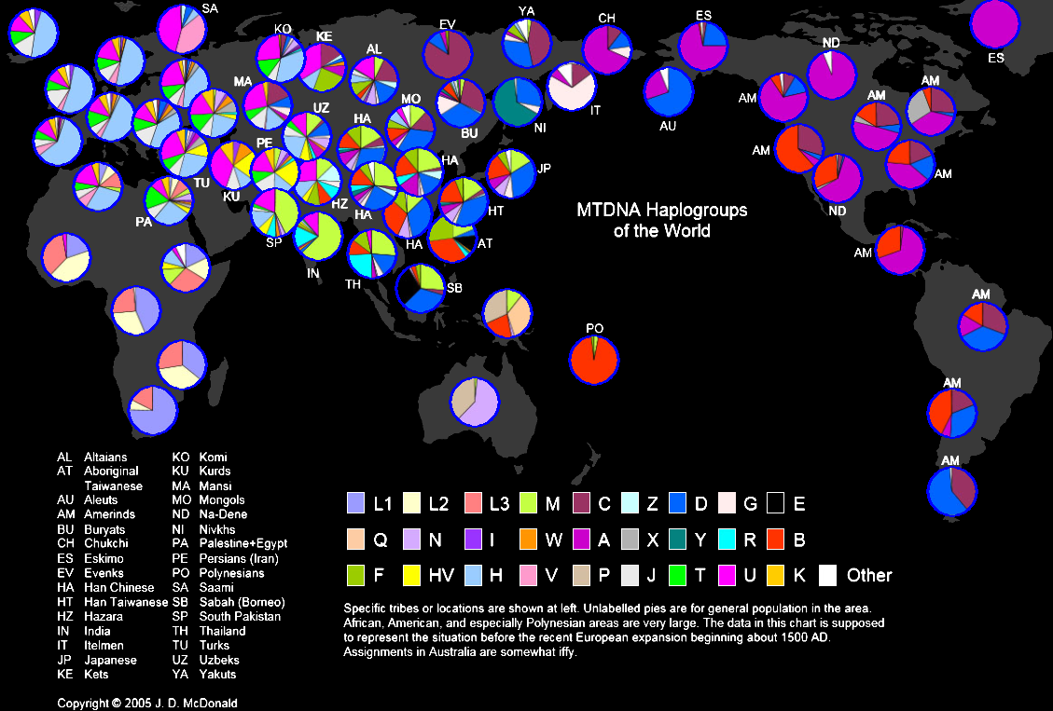
27++
Major_Y-DNA_and_mtDNA_Haplogroups-3.jpg (1163×791) (wikitree.com)

Slide 97
DNA Probabilities
An autosome is any of the numbered chromosomes (as opposed to the gender X or Y chromosomes) and the mtDNA
Humans have 22 pairs of autosomes

Slide 98
DNA Probabilities
Autosomal DNA testing describes
the amount of autosomal DNA
which two individuals share
https://s3.amazonaws.com/lowres.cartoonstock.com/animals-genes-dna-rats-mice-lab_rats-rron1016_low.jpg

Slide 99
DNA Probabilities
Autosomal DNA shared by relatives
% shared | Relationship
100% | Identical twins (monozygotic twins)
50% | Parent/child
50% | Full siblings
25% | Grandparent/grandchild, aunt-or-uncle/niece-or-nephew, half-siblings
25% | Double first cousins
12.5% | Great-grandparent/great-grandchild, first cousins
6.25% | Double second cousins
3.125% | Second cousins
0.781% | Third cousins
0.195% | Fourth cousins
0.0488% | Fifth cousins
0.0122% | Sixth cousins
0.00305% | Seventh cousins
0.00076% | Eighth cousins
(on average)

Slide 100
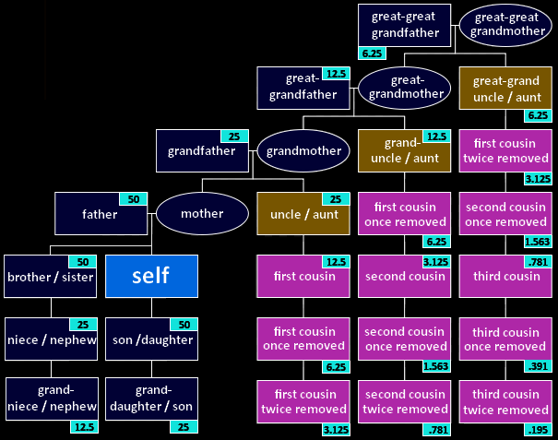
http://isogg.org/wiki/Autosomal_DNA_statistics#mediaviewer/File:Cousin_tree_%28with_genetic_kinship%29.png

Slide 101
DNA Probabilities
Autosomal DNA tests can be used to identify individuals with whom you share a common ancestor up to a handful of generations in the past
https://www.ucl.ac.uk/mace-lab/debunking/understanding

Slide 102
DNA Probabilities
Sometimes it happens that a large chunk of DNA is conserved in two individuals from a common ancestor more than 10 generations in the past, but this is very unlikely

Slide 103
DNA Probabilities
Autosomal tests also provide information about your ethnicity by identifying sections of your DNA that best match reference databases of modern populations with different geographical or ethnic labels

Slide 104
DNA Probabilities
The reference populations used for comparison are limited, the ethnic labels may be questionable, and they were mainly collected by population geneticists to answer questions about differences between populations not questions about individual ancestry

Slide 105
DNA Probabilities
As a result of the random inheritance of DNA, siblings and other close relatives can often receive markedly different ethnicity percentages

Slide 106
DNA Probabilities
So, can your “pie” be considered a DNA probability?

Slide 107
DNA Probabilities
So, can your “pie” be considered a DNA probability?
… only if the data that generated the pie is representative of the entire Earth’s population…

Slide 108
Questions?
http://i.imgur.com/aliTlT3.jpg

Slide 109
DNA Probabilities
In the United States the FBI has organized the CODIS (COmbined Dna Index System) database using 13 markers for forensic identification in criminal cases

Slide 110
DNA Probabilities
Number of values (alleles) for CODIS markers and the AMEL (gender)
Marker | D3S1358 | vWA | FGA | D8S1179 | D21S11 | D18S51 | D5S818
Alleles | 8 | 11 | 14 | 12 | 22 | 21 | 10
Marker | D13S317 | D7S820 | D16S539 | THO1 | TPOX | CSF1PO | AMEL
Alleles | 8 | 10 | 9 | 7 | 8 | 10 | X Y

Slide 111
DNA Probabilities
If there are two possible values, A and B, at a genetic marker in a population, there are three possible pairs (genotypes): AA, BB, and AB

Slide 112
DNA Probabilities
If there are three values, A or B or C, there are six possible genotypes: AA, BB, CC,
AB, AC, and BC

Slide 113
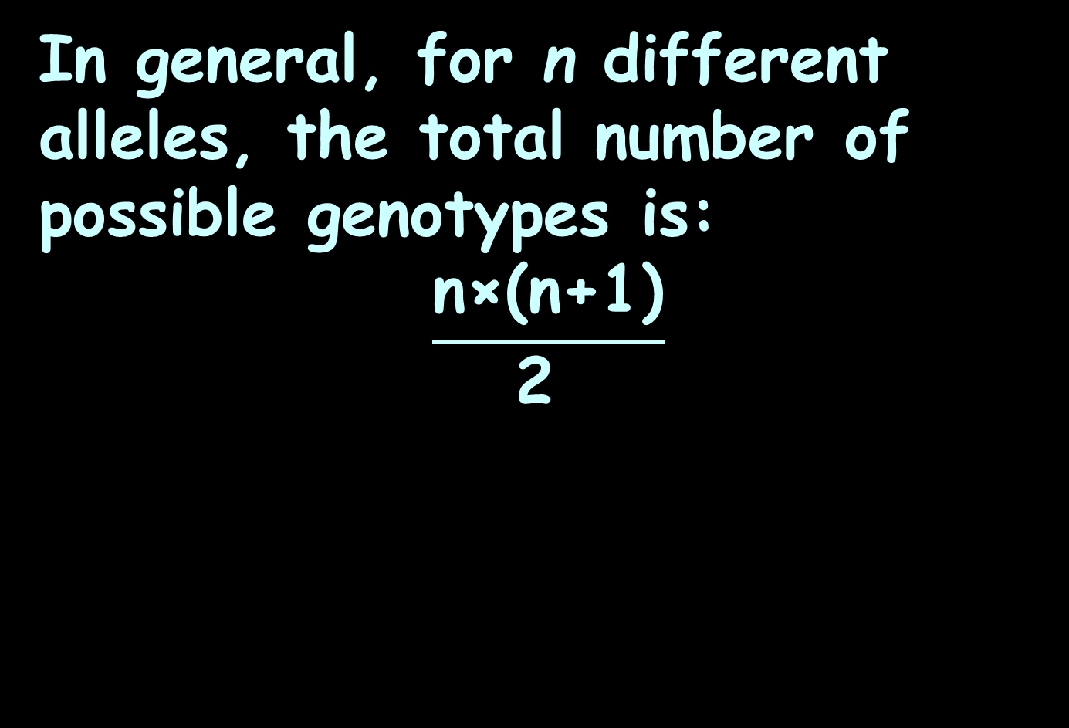
DNA Probabilities
In general, for n different alleles, the total number of possible genotypes is:
$$\frac{\text{n}\text{×(}\text{n}\text{+1)}}{\text{2 }}$$

Slide 114

DNA PROBABILITIES
IN-CLASS PROBLEM 2
Marker | D3S1358 | vWA | FGA | D8S1179 | D21S11 | D18S51 | D5S818
Alleles | 8 | 11 | 14 | 12 | 22 | 21 | 10
How many genotypes are possible in a population for marker D3S1358?
Marker | D13S317 | D7S820 | D16S539 | THO1 | TPOX | CSF1PO | AMEL
Alleles | 8 | 10 | 9 | 7 | 8 | 10 | X Y
$$\frac{\text{n}\text{×(}\text{n}\text{+1)}}{\text{2 }}$$

Slide 115
DNA PROBABILITIES
IN-CLASS PROBLEM 2
Marker | D3S1358 | vWA | FGA | D8S1179 | D21S11 | D18S51 | D5S818
Alleles | 8 | 11 | 14 | 12 | 22 | 21 | 10
How many genotypes are possible in a population for marker D3S1358? 8*9/2 = 36
Marker | D13S317 | D7S820 | D16S539 | THO1 | TPOX | CSF1PO | AMEL
Alleles | 8 | 10 | 9 | 7 | 8 | 10 | X Y
$$\frac{\text{n}\text{×(}\text{n}\text{+1)}}{\text{2 }}$$

Slide 116
DNA PROBABILITIES
IN-CLASS PROBLEM 2
Marker | D3S1358 | vWA | FGA | D8S1179 | D21S11 | D18S51 | D5S818
Alleles | 8 | 11 | 14 | 12 | 22 | 21 | 10
How many genotypes are possible in a population for marker vWA?
Marker | D13S317 | D7S820 | D16S539 | THO1 | TPOX | CSF1PO | AMEL
Alleles | 8 | 10 | 9 | 7 | 8 | 10 | X Y
$$\frac{\text{n}\text{×(}\text{n}\text{+1)}}{\text{2 }}$$

Slide 117
DNA PROBABILITIES
IN-CLASS PROBLEM 2
Marker | D3S1358 | vWA | FGA | D8S1179 | D21S11 | D18S51 | D5S818
Alleles | 8 | 11 | 14 | 12 | 22 | 21 | 10
How many genotypes are possible in a population for marker vWA? 11*12/2 = 66
Marker | D13S317 | D7S820 | D16S539 | THO1 | TPOX | CSF1PO | AMEL
Alleles | 8 | 10 | 9 | 7 | 8 | 10 | X Y
$$\frac{\text{n}\text{×(}\text{n}\text{+1)}}{\text{2 }}$$

Slide 118
DNA PROBABILITIES
IN-CLASS PROBLEM 2
Marker | D3S1358 | vWA | FGA | D8S1179 | D21S11 | D18S51 | D5S818
Alleles | 8 | 11 | 14 | 12 | 22 | 21 | 10
How many genotypes are possible in a population for marker FGA?
Marker | D13S317 | D7S820 | D16S539 | THO1 | TPOX | CSF1PO | AMEL
Alleles | 8 | 10 | 9 | 7 | 8 | 10 | X Y
$$\frac{\text{n}\text{×(}\text{n}\text{+1)}}{\text{2 }}$$

Slide 119
DNA PROBABILITIES
IN-CLASS PROBLEM 2
Marker | D3S1358 | vWA | FGA | D8S1179 | D21S11 | D18S51 | D5S818
Alleles | 8 | 11 | 14 | 12 | 22 | 21 | 10
How many genotypes are possible in a population for marker FGA? 14*15/2 = 105
Marker | D13S317 | D7S820 | D16S539 | THO1 | TPOX | CSF1PO | AMEL
Alleles | 8 | 10 | 9 | 7 | 8 | 10 | X Y
$$\frac{\text{n}\text{×(}\text{n}\text{+1)}}{\text{2 }}$$

Slide 120
DNA PROBABILITIES
IN-CLASS PROBLEM 2
Marker | D3S1358 | vWA | FGA | D8S1179 | D21S11 | D18S51 | D5S818
Alleles | 8 | 11 | 14 | 12 | 22 | 21 | 10
AMEL is the gender marker - how many genotypes are there?
Marker | D13S317 | D7S820 | D16S539 | THO1 | TPOX | CSF1PO | AMEL
Alleles | 8 | 10 | 9 | 7 | 8 | 10 | X Y

Slide 121
DNA PROBABILITIES
IN-CLASS PROBLEM 2
Marker | D3S1358 | vWA | FGA | D8S1179 | D21S11 | D18S51 | D5S818
Alleles | 8 | 11 | 14 | 12 | 22 | 21 | 10
AMEL is the gender marker - how many genotypes are there?
2: male (XY) and female (XX)
Marker | D13S317 | D7S820 | D16S539 | THO1 | TPOX | CSF1PO | AMEL
Alleles | 8 | 10 | 9 | 7 | 8 | 10 | X Y

Slide 122
DNA PROBABILITIES
IN-CLASS PROBLEM 2
Marker | D3S1358 | vWA | FGA | D8S1179 | D21S11 | D18S51 | D5S818
Alleles | 8 | 11 | 14 | 12 | 22 | 21 | 10
What is the probability that AMEL will have the value "X X" (female)?
Marker | D13S317 | D7S820 | D16S539 | THO1 | TPOX | CSF1PO | AMEL
Alleles | 8 | 10 | 9 | 7 | 8 | 10 | X Y

Slide 123
DNA PROBABILITIES
IN-CLASS PROBLEM 2
Marker | D3S1358 | vWA | FGA | D8S1179 | D21S11 | D18S51 | D5S818
Alleles | 8 | 11 | 14 | 12 | 22 | 21 | 10
What is the probability that AMEL will have the value "X X" (female)? 50%
Marker | D13S317 | D7S820 | D16S539 | THO1 | TPOX | CSF1PO | AMEL
Alleles | 8 | 10 | 9 | 7 | 8 | 10 | X Y

Slide 124
Questions?
http://i.imgur.com/aliTlT3.jpg

Slide 125
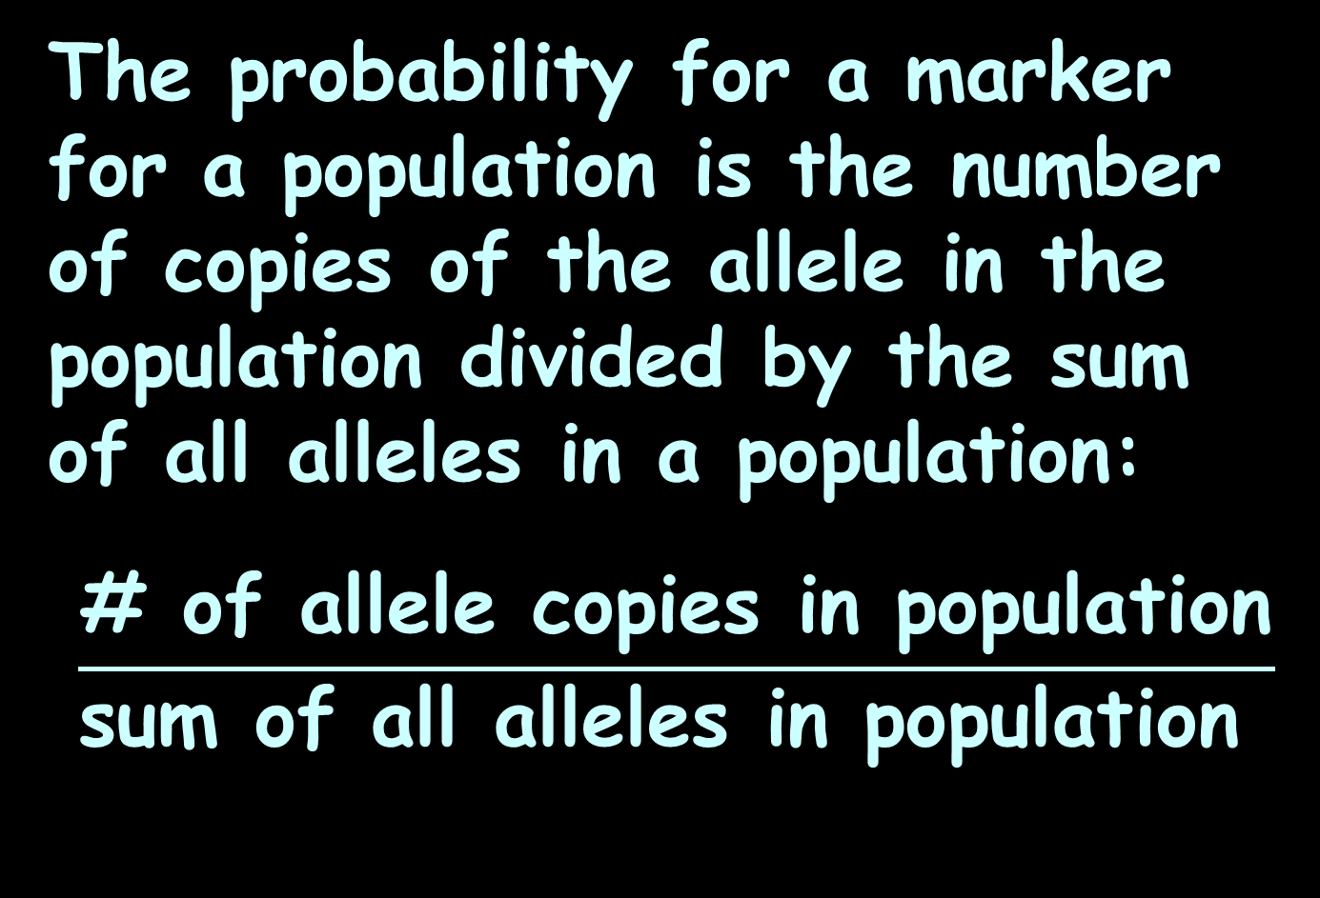
DNA Probabilities
The probability for a marker for a population is the number of copies of the allele in the population divided by the sum of all alleles in a population:
$$\frac{\text{\#} \text{of} \text{allele} \text{copies} \text{in} \text{population}}{\text{sum} \text{of} \text{all} \text{alleles} \text{in} \text{population} }$$

Slide 126
DNA Probabilities
This is called the “allele frequency”

Slide 127
DNA Probabilities
Marker | Allele | Frequency |  | Marker | Allele | Frequency |  | Marker | Allele | Frequency
D3S1358 | 12 | 0.0150 |  | VWA | 12 | 0.0150 |  | FGA | 18 | 0.0151
D3S1358 | 13 | 0.0151 |  | VWA | 14 | 0.1311 |  | FGA | 19 | 0.0610
D3S1358 | 14 | 0.1341 |  | VWA | 15 | 0.1189 |  | FGA | 20 | 0.1250
D3S1358 | 15 | 0.2896 |  | VWA | 16 | 0.1860 |  | FGA | 21 | 0.1799
D3S1358 | 16 | 0.2287 |  | VWA | 17 | 0.2774 |  | FGA | 22 | 0.2287
D3S1358 | 17 | 0.1616 |  | VWA | 18 | 0.189 |  | FGA | 23 | 0.1311
D3S1358 | 18 | 0.1616 |  | VWA | 19 | 0.0884 |  | FGA | 24 | 0.1463
D3S1358 | 19 | 0.0152 |  | VWA | 20 | 0.0151 |  | FGA | 25 | 0.0945
 |  |  |  |  |  |  |  | FGA | 26 | 0.0183
 |  |  |  |  |  |  |  | FGA | 27 | 0.0150

Slide 128
DNA Probabilities
For an individual, if the two alleles have frequencies of p and q in a population, the probability (P) of an individual of having both alleles at a single marker is: P = 2pq

Slide 129
DNA PROBABILITIES
IN-CLASS PROBLEM 3a
P = 2pq
Why are the probabilities multiplied together?

Slide 130
DNA PROBABILITIES
IN-CLASS PROBLEM 3a
P = 2pq
Why are the probabilities multiplied together?
the multiplication rule (both this value AND that)

Slide 131
DNA PROBABILITIES
IN-CLASS PROBLEM 3a
P = 2pq
Why is the formula multiplied by two?

Slide 132
DNA PROBABILITIES
IN-CLASS PROBLEM 3a
P = 2pq
Why is the formula multiplied by two?
the addition rule (either this value came from mom OR from dad)

Slide 133
DNA PROBABILITIES
IN-CLASS PROBLEM 3b
Marker | Allele | Frequency |  | Marker | Allele | Frequency |  | Marker | Allele | Frequency
D3S1358 | 12 | 0.0150 |  | VWA | 12 | 0.0150 |  | FGA | 18 | 0.0151
D3S1358 | 13 | 0.0151 |  | VWA | 14 | 0.1311 |  | FGA | 19 | 0.0610
D3S1358 | 14 | 0.1341 |  | VWA | 15 | 0.1189 |  | FGA | 20 | 0.1250
D3S1358 | 15 | 0.2896 |  | VWA | 16 | 0.1860 |  | FGA | 21 | 0.1799
D3S1358 | 16 | 0.2287 |  | VWA | 17 | 0.2774 |  | FGA | 22 | 0.2287
D3S1358 | 17 | 0.1616 |  | VWA | 18 | 0.189 |  | FGA | 23 | 0.1311
D3S1358 | 18 | 0.1616 |  | VWA | 19 | 0.0884 |  | FGA | 24 | 0.1463
D3S1358 | 19 | 0.0152 |  | VWA | 20 | 0.0151 |  | FGA | 25 | 0.0945
 |  |  |  |  |  |  |  | FGA | 26 | 0.0183
 |  |  |  |  |  |  |  | FGA | 27 | 0.0150
What would be the
rarest profile for Caucasians for the D3S1358 marker?

Slide 134
DNA PROBABILITIES
IN-CLASS PROBLEM 3b
Marker | Allele | Frequency |  | Marker | Allele | Frequency |  | Marker | Allele | Frequency
D3S1358 | 12 | 0.0150 |  | VWA | 12 | 0.0150 |  | FGA | 18 | 0.0151
D3S1358 | 13 | 0.0151 |  | VWA | 14 | 0.1311 |  | FGA | 19 | 0.0610
D3S1358 | 14 | 0.1341 |  | VWA | 15 | 0.1189 |  | FGA | 20 | 0.1250
D3S1358 | 15 | 0.2896 |  | VWA | 16 | 0.1860 |  | FGA | 21 | 0.1799
D3S1358 | 16 | 0.2287 |  | VWA | 17 | 0.2774 |  | FGA | 22 | 0.2287
D3S1358 | 17 | 0.1616 |  | VWA | 18 | 0.189 |  | FGA | 23 | 0.1311
D3S1358 | 18 | 0.1616 |  | VWA | 19 | 0.0884 |  | FGA | 24 | 0.1463
D3S1358 | 19 | 0.0152 |  | VWA | 20 | 0.0151 |  | FGA | 25 | 0.0945
 |  |  |  |  |  |  |  | FGA | 26 | 0.0183
 |  |  |  |  |  |  |  | FGA | 27 | 0.0150
What would be the
rarest profile for Caucasians for the D3S1358 marker?

Slide 135
DNA PROBABILITIES
IN-CLASS PROBLEM 3b
Marker | Allele | Frequency |  | Marker | Allele | Frequency |  | Marker | Allele | Frequency
D3S1358 | 12 | 0.0150 |  | VWA | 12 | 0.0150 |  | FGA | 18 | 0.0151
D3S1358 | 13 | 0.0151 |  | VWA | 14 | 0.1311 |  | FGA | 19 | 0.0610
D3S1358 | 14 | 0.1341 |  | VWA | 15 | 0.1189 |  | FGA | 20 | 0.1250
D3S1358 | 15 | 0.2896 |  | VWA | 16 | 0.1860 |  | FGA | 21 | 0.1799
D3S1358 | 16 | 0.2287 |  | VWA | 17 | 0.2774 |  | FGA | 22 | 0.2287
D3S1358 | 17 | 0.1616 |  | VWA | 18 | 0.189 |  | FGA | 23 | 0.1311
D3S1358 | 18 | 0.1616 |  | VWA | 19 | 0.0884 |  | FGA | 24 | 0.1463
D3S1358 | 19 | 0.0152 |  | VWA | 20 | 0.0151 |  | FGA | 25 | 0.0945
 |  |  |  |  |  |  |  | FGA | 26 | 0.0183
 |  |  |  |  |  |  |  | FGA | 27 | 0.0150
What would be the
rarest profile for Caucasians for the vWA marker?

Slide 136
DNA PROBABILITIES
IN-CLASS PROBLEM 3b
Marker | Allele | Frequency |  | Marker | Allele | Frequency |  | Marker | Allele | Frequency
D3S1358 | 12 | 0.0150 |  | VWA | 12 | 0.0150 |  | FGA | 18 | 0.0151
D3S1358 | 13 | 0.0151 |  | VWA | 14 | 0.1311 |  | FGA | 19 | 0.0610
D3S1358 | 14 | 0.1341 |  | VWA | 15 | 0.1189 |  | FGA | 20 | 0.1250
D3S1358 | 15 | 0.2896 |  | VWA | 16 | 0.1860 |  | FGA | 21 | 0.1799
D3S1358 | 16 | 0.2287 |  | VWA | 17 | 0.2774 |  | FGA | 22 | 0.2287
D3S1358 | 17 | 0.1616 |  | VWA | 18 | 0.189 |  | FGA | 23 | 0.1311
D3S1358 | 18 | 0.1616 |  | VWA | 19 | 0.0884 |  | FGA | 24 | 0.1463
D3S1358 | 19 | 0.0152 |  | VWA | 20 | 0.0151 |  | FGA | 25 | 0.0945
 |  |  |  |  |  |  |  | FGA | 26 | 0.0183
 |  |  |  |  |  |  |  | FGA | 27 | 0.0150
What would be the
rarest profile for Caucasians for the vWA marker?

Slide 137
DNA PROBABILITIES
IN-CLASS PROBLEM 3b
Marker | Allele | Frequency |  | Marker | Allele | Frequency |  | Marker | Allele | Frequency
D3S1358 | 12 | 0.0150 |  | VWA | 12 | 0.0150 |  | FGA | 18 | 0.0151
D3S1358 | 13 | 0.0151 |  | VWA | 14 | 0.1311 |  | FGA | 19 | 0.0610
D3S1358 | 14 | 0.1341 |  | VWA | 15 | 0.1189 |  | FGA | 20 | 0.1250
D3S1358 | 15 | 0.2896 |  | VWA | 16 | 0.1860 |  | FGA | 21 | 0.1799
D3S1358 | 16 | 0.2287 |  | VWA | 17 | 0.2774 |  | FGA | 22 | 0.2287
D3S1358 | 17 | 0.1616 |  | VWA | 18 | 0.189 |  | FGA | 23 | 0.1311
D3S1358 | 18 | 0.1616 |  | VWA | 19 | 0.0884 |  | FGA | 24 | 0.1463
D3S1358 | 19 | 0.0152 |  | VWA | 20 | 0.0151 |  | FGA | 25 | 0.0945
 |  |  |  |  |  |  |  | FGA | 26 | 0.0183
 |  |  |  |  |  |  |  | FGA | 27 | 0.0150
What would be the
rarest profile for Caucasians for the FGA marker?

Slide 138
DNA PROBABILITIES
IN-CLASS PROBLEM 3b
Marker | Allele | Frequency |  | Marker | Allele | Frequency |  | Marker | Allele | Frequency
D3S1358 | 12 | 0.0150 |  | VWA | 12 | 0.0150 |  | FGA | 18 | 0.0151
D3S1358 | 13 | 0.0151 |  | VWA | 14 | 0.1311 |  | FGA | 19 | 0.0610
D3S1358 | 14 | 0.1341 |  | VWA | 15 | 0.1189 |  | FGA | 20 | 0.1250
D3S1358 | 15 | 0.2896 |  | VWA | 16 | 0.1860 |  | FGA | 21 | 0.1799
D3S1358 | 16 | 0.2287 |  | VWA | 17 | 0.2774 |  | FGA | 22 | 0.2287
D3S1358 | 17 | 0.1616 |  | VWA | 18 | 0.189 |  | FGA | 23 | 0.1311
D3S1358 | 18 | 0.1616 |  | VWA | 19 | 0.0884 |  | FGA | 24 | 0.1463
D3S1358 | 19 | 0.0152 |  | VWA | 20 | 0.0151 |  | FGA | 25 | 0.0945
 |  |  |  |  |  |  |  | FGA | 26 | 0.0183
 |  |  |  |  |  |  |  | FGA | 27 | 0.0150
What would be the
rarest profile for Caucasians for the FGA marker?

Slide 139
DNA PROBABILITIES
IN-CLASS PROBLEM 3c
Marker | Allele | Frequency |  | Marker | Allele | Frequency |  | Marker | Allele | Frequency
D3S1358 | 12 | 0.0150 |  | VWA | 12 | 0.0150 |  | FGA | 18 | 0.0151
D3S1358 | 13 | 0.0151 |  | VWA | 14 | 0.1311 |  | FGA | 19 | 0.0610
D3S1358 | 14 | 0.1341 |  | VWA | 15 | 0.1189 |  | FGA | 20 | 0.1250
D3S1358 | 15 | 0.2896 |  | VWA | 16 | 0.1860 |  | FGA | 21 | 0.1799
D3S1358 | 16 | 0.2287 |  | VWA | 17 | 0.2774 |  | FGA | 22 | 0.2287
D3S1358 | 17 | 0.1616 |  | VWA | 18 | 0.189 |  | FGA | 23 | 0.1311
D3S1358 | 18 | 0.1616 |  | VWA | 19 | 0.0884 |  | FGA | 24 | 0.1463
D3S1358 | 19 | 0.0152 |  | VWA | 20 | 0.0151 |  | FGA | 25 | 0.0945
 |  |  |  |  |  |  |  | FGA | 26 | 0.0183
 |  |  |  |  |  |  |  | FGA | 27 | 0.0150
What is the probability
of an individual (Bob Blackett) having the 15,18 genotype for D3S1358?
P = 2pq

Slide 140
DNA PROBABILITIES
IN-CLASS PROBLEM 3c
Marker | Allele | Frequency |  | Marker | Allele | Frequency |  | Marker | Allele | Frequency
D3S1358 | 12 | 0.0150 |  | VWA | 12 | 0.0150 |  | FGA | 18 | 0.0151
D3S1358 | 13 | 0.0151 |  | VWA | 14 | 0.1311 |  | FGA | 19 | 0.0610
D3S1358 | 14 | 0.1341 |  | VWA | 15 | 0.1189 |  | FGA | 20 | 0.1250
D3S1358 | 15 | 0.2896 |  | VWA | 16 | 0.1860 |  | FGA | 21 | 0.1799
D3S1358 | 16 | 0.2287 |  | VWA | 17 | 0.2774 |  | FGA | 22 | 0.2287
D3S1358 | 17 | 0.1616 |  | VWA | 18 | 0.189 |  | FGA | 23 | 0.1311
D3S1358 | 18 | 0.1616 |  | VWA | 19 | 0.0884 |  | FGA | 24 | 0.1463
D3S1358 | 19 | 0.0152 |  | VWA | 20 | 0.0151 |  | FGA | 25 | 0.0945
 |  |  |  |  |  |  |  | FGA | 26 | 0.0183
 |  |  |  |  |  |  |  | FGA | 27 | 0.0150
What is the probability
of an individual having the 15,18 genotype for D3S1358?
2×.2896×.1616 = .09359872 ≈ 9.3%
P = 2pq

Slide 141
DNA PROBABILITIES
IN-CLASS PROBLEM 3c
Marker | Allele | Frequency |  | Marker | Allele | Frequency |  | Marker | Allele | Frequency
D3S1358 | 12 | 0.0150 |  | VWA | 12 | 0.0150 |  | FGA | 18 | 0.0151
D3S1358 | 13 | 0.0151 |  | VWA | 14 | 0.1311 |  | FGA | 19 | 0.0610
D3S1358 | 14 | 0.1341 |  | VWA | 15 | 0.1189 |  | FGA | 20 | 0.1250
D3S1358 | 15 | 0.2896 |  | VWA | 16 | 0.1860 |  | FGA | 21 | 0.1799
D3S1358 | 16 | 0.2287 |  | VWA | 17 | 0.2774 |  | FGA | 22 | 0.2287
D3S1358 | 17 | 0.1616 |  | VWA | 18 | 0.189 |  | FGA | 23 | 0.1311
D3S1358 | 18 | 0.1616 |  | VWA | 19 | 0.0884 |  | FGA | 24 | 0.1463
D3S1358 | 19 | 0.0152 |  | VWA | 20 | 0.0151 |  | FGA | 25 | 0.0945
 |  |  |  |  |  |  |  | FGA | 26 | 0.0183
 |  |  |  |  |  |  |  | FGA | 27 | 0.0150
What is the probability
of an individual having the 16,16 genotype for vWA?
P = 2pq

Slide 142
DNA PROBABILITIES
IN-CLASS PROBLEM 3c
Marker | Allele | Frequency |  | Marker | Allele | Frequency |  | Marker | Allele | Frequency
D3S1358 | 12 | 0.0150 |  | VWA | 12 | 0.0150 |  | FGA | 18 | 0.0151
D3S1358 | 13 | 0.0151 |  | VWA | 14 | 0.1311 |  | FGA | 19 | 0.0610
D3S1358 | 14 | 0.1341 |  | VWA | 15 | 0.1189 |  | FGA | 20 | 0.1250
D3S1358 | 15 | 0.2896 |  | VWA | 16 | 0.1860 |  | FGA | 21 | 0.1799
D3S1358 | 16 | 0.2287 |  | VWA | 17 | 0.2774 |  | FGA | 22 | 0.2287
D3S1358 | 17 | 0.1616 |  | VWA | 18 | 0.189 |  | FGA | 23 | 0.1311
D3S1358 | 18 | 0.1616 |  | VWA | 19 | 0.0884 |  | FGA | 24 | 0.1463
D3S1358 | 19 | 0.0152 |  | VWA | 20 | 0.0151 |  | FGA | 25 | 0.0945
 |  |  |  |  |  |  |  | FGA | 26 | 0.0183
 |  |  |  |  |  |  |  | FGA | 27 | 0.0150
What is the probability
of an individual having the 16,16 genotype for vWA?
2×.1860×.1860 = .069192 ≈ 6.9%
P = 2pq

Slide 143
DNA PROBABILITIES
IN-CLASS PROBLEM 3c
Marker | Allele | Frequency |  | Marker | Allele | Frequency |  | Marker | Allele | Frequency
D3S1358 | 12 | 0.0150 |  | VWA | 12 | 0.0150 |  | FGA | 18 | 0.0151
D3S1358 | 13 | 0.0151 |  | VWA | 14 | 0.1311 |  | FGA | 19 | 0.0610
D3S1358 | 14 | 0.1341 |  | VWA | 15 | 0.1189 |  | FGA | 20 | 0.1250
D3S1358 | 15 | 0.2896 |  | VWA | 16 | 0.1860 |  | FGA | 21 | 0.1799
D3S1358 | 16 | 0.2287 |  | VWA | 17 | 0.2774 |  | FGA | 22 | 0.2287
D3S1358 | 17 | 0.1616 |  | VWA | 18 | 0.189 |  | FGA | 23 | 0.1311
D3S1358 | 18 | 0.1616 |  | VWA | 19 | 0.0884 |  | FGA | 24 | 0.1463
D3S1358 | 19 | 0.0152 |  | VWA | 20 | 0.0151 |  | FGA | 25 | 0.0945
 |  |  |  |  |  |  |  | FGA | 26 | 0.0183
 |  |  |  |  |  |  |  | FGA | 27 | 0.0150
What is the probability
of an individual having the 19,24 genotype for FGA?
P = 2pq

Slide 144
DNA PROBABILITIES
IN-CLASS PROBLEM 3c
Marker | Allele | Frequency |  | Marker | Allele | Frequency |  | Marker | Allele | Frequency
D3S1358 | 12 | 0.0150 |  | VWA | 12 | 0.0150 |  | FGA | 18 | 0.0151
D3S1358 | 13 | 0.0151 |  | VWA | 14 | 0.1311 |  | FGA | 19 | 0.0610
D3S1358 | 14 | 0.1341 |  | VWA | 15 | 0.1189 |  | FGA | 20 | 0.1250
D3S1358 | 15 | 0.2896 |  | VWA | 16 | 0.1860 |  | FGA | 21 | 0.1799
D3S1358 | 16 | 0.2287 |  | VWA | 17 | 0.2774 |  | FGA | 22 | 0.2287
D3S1358 | 17 | 0.1616 |  | VWA | 18 | 0.189 |  | FGA | 23 | 0.1311
D3S1358 | 18 | 0.1616 |  | VWA | 19 | 0.0884 |  | FGA | 24 | 0.1463
D3S1358 | 19 | 0.0152 |  | VWA | 20 | 0.0151 |  | FGA | 25 | 0.0945
 |  |  |  |  |  |  |  | FGA | 26 | 0.0183
 |  |  |  |  |  |  |  | FGA | 27 | 0.0150
What is the probability
of an individual having the 19,24 genotype for FGA?
2×.0610×.1463 = .0178486 ≈ 1.78%
P = 2pq

Slide 145
DNA PROBABILITIES
IN-CLASS PROBLEM 3d
What is the probability of an individual having the profile:
D3S1358 = 15,18
vWA = 16,16
FGA = 19,24?

Slide 146
DNA PROBABILITIES
IN-CLASS PROBLEM 3d
What is the probability of an individual having the profile:
D3S1358 = 15,18 .09359872
vWA = 16,16 .069192
FGA = 19,24? .0178486
Which Rule?

Slide 147
DNA PROBABILITIES
IN-CLASS PROBLEM 3d
What is the probability of an individual having the profile:
D3S1358 = 15,18 .09359872
vWA = 16,16 .069192
FGA = 19,24? .0178486
.09359872 × .069192 × .0178486
=.000115593 or ≈ 0.012%

Slide 148
DNA PROBABILITIES
IN-CLASS PROBLEM 3e
Marker | Allele | Frequency |  | Marker | Allele | Frequency |  | Marker | Allele | Frequency
D3S1358 | 12 | 0.0150 |  | VWA | 12 | 0.0150 |  | FGA | 18 | 0.0151
D3S1358 | 13 | 0.0151 |  | VWA | 14 | 0.1311 |  | FGA | 19 | 0.0610
D3S1358 | 14 | 0.1341 |  | VWA | 15 | 0.1189 |  | FGA | 20 | 0.1250
D3S1358 | 15 | 0.2896 |  | VWA | 16 | 0.1860 |  | FGA | 21 | 0.1799
D3S1358 | 16 | 0.2287 |  | VWA | 17 | 0.2774 |  | FGA | 22 | 0.2287
D3S1358 | 17 | 0.1616 |  | VWA | 18 | 0.189 |  | FGA | 23 | 0.1311
D3S1358 | 18 | 0.1616 |  | VWA | 19 | 0.0884 |  | FGA | 24 | 0.1463
D3S1358 | 19 | 0.0152 |  | VWA | 20 | 0.0151 |  | FGA | 25 | 0.0945
 |  |  |  |  |  |  |  | FGA | 26 | 0.0183
 |  |  |  |  |  |  |  | FGA | 27 | 0.0150
What would be the
rarest profile for these three markers?

Slide 149
DNA PROBABILITIES
IN-CLASS PROBLEM 3e
Marker | Allele | Frequency |  | Marker | Allele | Frequency |  | Marker | Allele | Frequency
D3S1358 | 12 | 0.0150 |  | VWA | 12 | 0.0150 |  | FGA | 18 | 0.0151
D3S1358 | 13 | 0.0151 |  | VWA | 14 | 0.1311 |  | FGA | 19 | 0.0610
D3S1358 | 14 | 0.1341 |  | VWA | 15 | 0.1189 |  | FGA | 20 | 0.1250
D3S1358 | 15 | 0.2896 |  | VWA | 16 | 0.1860 |  | FGA | 21 | 0.1799
D3S1358 | 16 | 0.2287 |  | VWA | 17 | 0.2774 |  | FGA | 22 | 0.2287
D3S1358 | 17 | 0.1616 |  | VWA | 18 | 0.189 |  | FGA | 23 | 0.1311
D3S1358 | 18 | 0.1616 |  | VWA | 19 | 0.0884 |  | FGA | 24 | 0.1463
D3S1358 | 19 | 0.0152 |  | VWA | 20 | 0.0151 |  | FGA | 25 | 0.0945
 |  |  |  |  |  |  |  | FGA | 26 | 0.0183
 |  |  |  |  |  |  |  | FGA | 27 | 0.0150
What would be the
rarest profile for these three markers? D3S1358 = 12,12,
vWA = 12,12 and FGA = 27,27

Slide 150
Questions?
http://i.imgur.com/aliTlT3.jpg

Slide 151
DNA Probabilities
DNA and ethnic background:
Bob Blackthorn has the profile:
  D3S1358 = 15,18
  vWA = 16,16
  FGA = 19,24

Slide 152
DNA PROBABILITIES
IN-CLASS PROBLEM 3f
Looking only at D3S1358 = 15,18:
what is Bob’s most likely ethnic background?
Ethnic Background | Prob
Caucasian | 7.64%
African-Canadian | 4.01%
Asian | 3.62%
East Indian | 6.87%

Slide 153
DNA PROBABILITIES
IN-CLASS PROBLEM 3f
Looking only at D3S1358 = 15,18:
what is Bob’s most likely ethnic background?
Ethnic Background | Prob
Caucasian | 7.64%
African-Canadian | 4.01%
Asian | 3.62%
East Indian | 6.87%

Slide 154
DNA PROBABILITIES
IN-CLASS PROBLEM 3f
Looking only at vWA = 16,16:
what is Bob’s most likely ethnic background?
Ethnic Background | Prob
Caucasian | 5.33%
African-Canadian | 5.06%
Asian | 2.41%
East Indian | 6.24%

Slide 155
DNA PROBABILITIES
IN-CLASS PROBLEM 3f
Looking only at vWA = 16,16:
what is Bob’s most likely ethnic background?
Ethnic Background | Prob
Caucasian | 5.33%
African-Canadian | 5.06%
Asian | 2.41%
East Indian | 6.24%

Slide 156
DNA PROBABILITIES
IN-CLASS PROBLEM 3f
  Looking only at FGA = 19,24:
what is Bob’s most likely ethnic background?
Ethnic Background | Prob
Caucasian | 2.27%
African-Canadian | 1.90%
Asian | 1.91%
East Indian | 1.98%

Slide 157
DNA PROBABILITIES
IN-CLASS PROBLEM 3f
  Looking only at FGA = 19,24:
what is Bob’s most likely ethnic background?
Ethnic Background | Prob
Caucasian | 2.27%
African-Canadian | 1.90%
Asian | 1.91%
East Indian | 1.98%

Slide 158
DNA PROBABILITIES
IN-CLASS PROBLEM 3f
What is Bob’s most likely ethnic background?

Slide 159
Questions?
http://i.imgur.com/aliTlT3.jpg

Slide 160
SOURCES OF PROBABILITY
IN-CLASS PROBLEMS 3g
What is the probability source for DNA probabilities?
Marker | Allele | Probability
D3S1358 | 12 | 1.50%
D3S1358 | 13 | 1.51%
D3S1358 | 14 | 13.41%
D3S1358 | 15 | 28.96%
D3S1358 | 16 | 22.87%
D3S1358 | 17 | 16.16%
D3S1358 | 18 | 16.16%
D3S1358 | 19 | 1.52%
Probability sources:
classical probability
empirical probability
subjective probability

Slide 161
SOURCES OF PROBABILITY
IN-CLASS PROBLEMS 3g
What is the probability source for DNA probabilities?
Marker | Allele | Probability
D3S1358 | 12 | 1.50%
D3S1358 | 13 | 1.51%
D3S1358 | 14 | 13.41%
D3S1358 | 15 | 28.96%
D3S1358 | 16 | 22.87%
D3S1358 | 17 | 16.16%
D3S1358 | 18 | 16.16%
D3S1358 | 19 | 1.52%
Probability sources:
classical probability
empirical probability
subjective probability

Slide 162
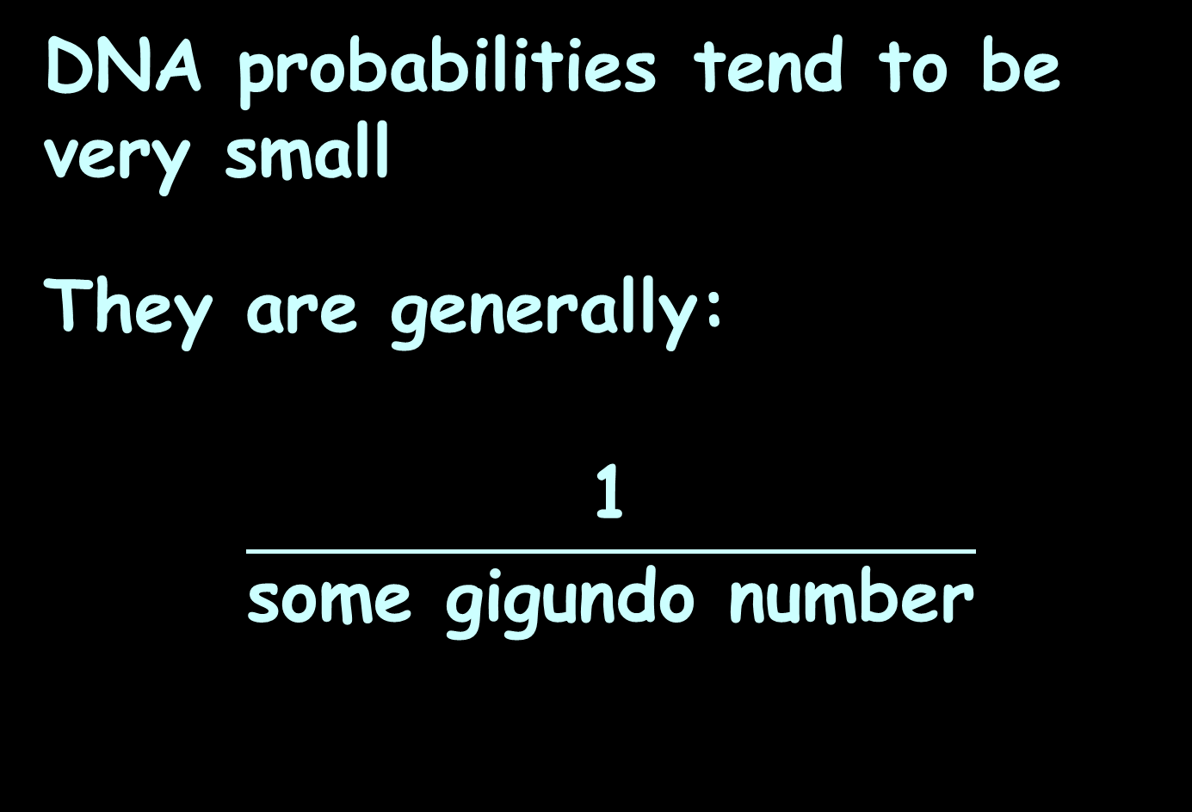
DNA Probabilities
DNA probabilities tend to be very small
They are generally:
$$\frac{\text{1}}{\text{some} \text{gigundo} \text{number}}$$

Slide 163
DNA Probabilities
Here’s a strategy to find the highest probability:
Find the smallest denominator!

Slide 164
DNA Probabilities
Sometimes Sometimes
these look like: they look like:
Random Match Prob
1/(1.51903 *10^14)
1/(1.32801*10^14)
1/(3.1400*10^15)
1/(4.435*10^16)
1/(3.041*10^16)
1/(2.108*10^16)
1/(9.85*10^17)
1/(1.091*10^16)
1/(5.33*10^17)
1/(6.04*10^17)
1/(6.55*10^17)
1/(5.27*10^17)
Random Match Prob
1.51903*10^-14
1.32801*10^-14
3.1400*10^-15
4.435*10^-16
3.041*10^-16
2.108*10^-16
9.85*10^-17
1.091*10^-16
5.33*10^-17
6.04*10^-17
6.55*10^-17
5.27*10^-17
Note:
These would not be the same values!

Slide 165
DNA Probabilities
First look for the smallest exponent digit
Random Match Prob
1/(1.51903 *10^14)
1/(1.32801*10^14)
1/(3.1400*10^15)
1/(4.435*10^16)
1/(3.041*10^16)
1/(2.108*10^16)
1/(9.85*10^17)
1/(1.091*10^16)
1/(5.33*10^17)
1/(6.04*10^17)
1/(6.55*10^17)
1/(5.27*10^17)

Slide 166
DNA Probabilities
First look for the smallest exponent digit
Random Match Prob
1/(1.51903 *10^14)
1/(1.32801*10^14)
1/(3.1400*10^15)
1/(4.435*10^16)
1/(3.041*10^16)
1/(2.108*10^16)
1/(9.85*10^17)
1/(1.091*10^16)
1/(5.33*10^17)
1/(6.04*10^17)
1/(6.55*10^17)
1/(5.27*10^17)

Slide 167
DNA Probabilities
Then, select the smallest multiple (‘cause it’s in the denominator)
Random Match Prob
1/(1.51903 *10^14)
1/(1.32801*10^14)
1/(3.1400*10^15)
1/(4.435*10^16)
1/(3.041*10^16)
1/(2.108*10^16)
1/(9.85*10^17)
1/(1.091*10^16)
1/(5.33*10^17)
1/(6.04*10^17)
1/(6.55*10^17)
1/(5.27*10^17)

Slide 168
DNA Probabilities
That is the highest probability!
Random Match Prob
1/(1.51903 *10^14)
1/(1.32801*10^14)
1/(3.1400*10^15)
1/(4.435*10^16)
1/(3.041*10^16)
1/(2.108*10^16)
1/(9.85*10^17)
1/(1.091*10^16)
1/(5.33*10^17)
1/(6.04*10^17)
1/(6.55*10^17)
1/(5.27*10^17)

Slide 169
SOURCES OF PROBABILITY
IN-CLASS PROBLEMS 3h
Profile submitted: The Random Match probability:
What is the most likely ethnic background for this profile?
Locus | allele | allele
D3S1358 | 15 | 18
vWA | 16 | 16
FGA | 19 | 24
D8S1179 | 12 | 13
D21S11 | 29 | 31
D18S51 | 12 | 13
D5S818 | 11 | 13
D13S317 | 11 | 11
D7S820 | 10 | 10
D16S539 | 11 | 11
THO1 | 9 | 9.3
TPOX | 8 | 8
CSF1PO | 11 | 11
Population | Source | Likelihood
Caucasian | RCMP | 1/(8.02 x 10^14)
Caucasian | FBI | 1/(1.05 x 10^15)
Caucasian | CFS | 1/(5.34 x 10^14)
N Ontario Native | RCMP | 1/(7.03 x 10^18)
Saskatchewan Native | RCMP | 1/(1.08 x 10^17)
Salishan (Coastal BC Native) | RCMP | 1/(2.27 x 10^17)
Asian | CFS | 1/(3.87 x 10^17)
Apache Aboriginal | FBI | 1/(1.31 x 10^17)
East Indian | CFS | 1/(6.65 x 10^15)
African American | FBI | 1/(1.52 x 10^17)
African Canadian | CFS | 1/(7.03 x 10^18)

Slide 170
SOURCES OF PROBABILITY
IN-CLASS PROBLEMS 3h
Profile submitted: The Random Match probability:
What is the most likely ethnic background for this profile?
Locus | allele | allele
D3S1358 | 15 | 18
vWA | 16 | 16
FGA | 19 | 24
D8S1179 | 12 | 13
D21S11 | 29 | 31
D18S51 | 12 | 13
D5S818 | 11 | 13
D13S317 | 11 | 11
D7S820 | 10 | 10
D16S539 | 11 | 11
THO1 | 9 | 9.3
TPOX | 8 | 8
CSF1PO | 11 | 11
Population | Source | Likelihood
Caucasian | RCMP | 1/(8.02 x 10^14)
Caucasian | FBI | 1/(1.05 x 10^15)
Caucasian | CFS | 1/(5.34 x 10^14)
N Ontario Native | RCMP | 1/(7.03 x 10^18)
Saskatchewan Native | RCMP | 1/(1.08 x 10^17)
Salishan (Coastal BC Native) | RCMP | 1/(2.27 x 10^17)
Asian | CFS | 1/(3.87 x 10^17)
Apache Aboriginal | FBI | 1/(1.31 x 10^17)
East Indian | CFS | 1/(6.65 x 10^15)
African American | FBI | 1/(1.52 x 10^17)
African American | CFS | 1/(7.03 x 10^18)

Slide 171
Questions?
http://i.imgur.com/aliTlT3.jpg

Slide 172
Summary
Today we studied:
Review: Odds
Meteorological Probability
New: DNA Probability

Slide 173

You Survived!
www.playbuzz.com

