Slide 1
Welcome to
Unit 6 Part 12
MATH366 Probability and Statistics
https://online.stanford.edu/sites/default/files/styles/figure_default/public/2018-04/theory-of-probability_stats116.jpg?itok=ms4fRMO-

Slide 2
What’s Up?
Today we will be going over:
Review of DNA probability
New: Discrete random variables and
their probabilities

Slide 3
What’s Up?
Outcome 4) Calculate the parameters of several discrete random variable distributions and compute the probability of events in a typical discrete event application

Slide 4

Review
http://995642590.r.lightningbase-cdn.com/wp-content/uploads/2010/12/looking-back-hrexaminer-v144-cover425px.jpg

Slide 5
DNA Probabilities
Within each cell, humans have a total of 23 pairs of chromosomes containing DNA
Each pair contains one chromosome inherited from mom and one from dad

Slide 6
DNA Probabilities
Certain regions of human DNA which are highly individual are called "markers"
These markers are good for identifying and comparing individuals

Slide 7
DNA Probabilities
Autorads are x-ray films with dark bands representing DNA markers
An electric current is applied to DNA on a gel slab
Shorter segments move farther through the gel than longer segments (“lengths”)

Slide 8
DNA Probabilities
The same lengths at all markers mean it is the same person or an identical twin
Similar lengths mean people are related
Different lengths mean they are unrelated

Slide 9
DNA Probabilities
Only certain lengths occur for each of the markers
The length values are called “alleles”

Slide 10
DNA Probabilities
Each person inherits one allele value from Mom and one from Dad (they can be the same value)
This combination is called a “genotype”

Slide 11
DNA Probabilities
To calculate the probabilities, you need to know population percentages for each of the marker values (alleles)
Some values are more common in a given population than others

Slide 12
DNA Probabilities
You typically use the multiplication rule to find the probability that a person has a given pattern of alleles for the markers

Slide 13
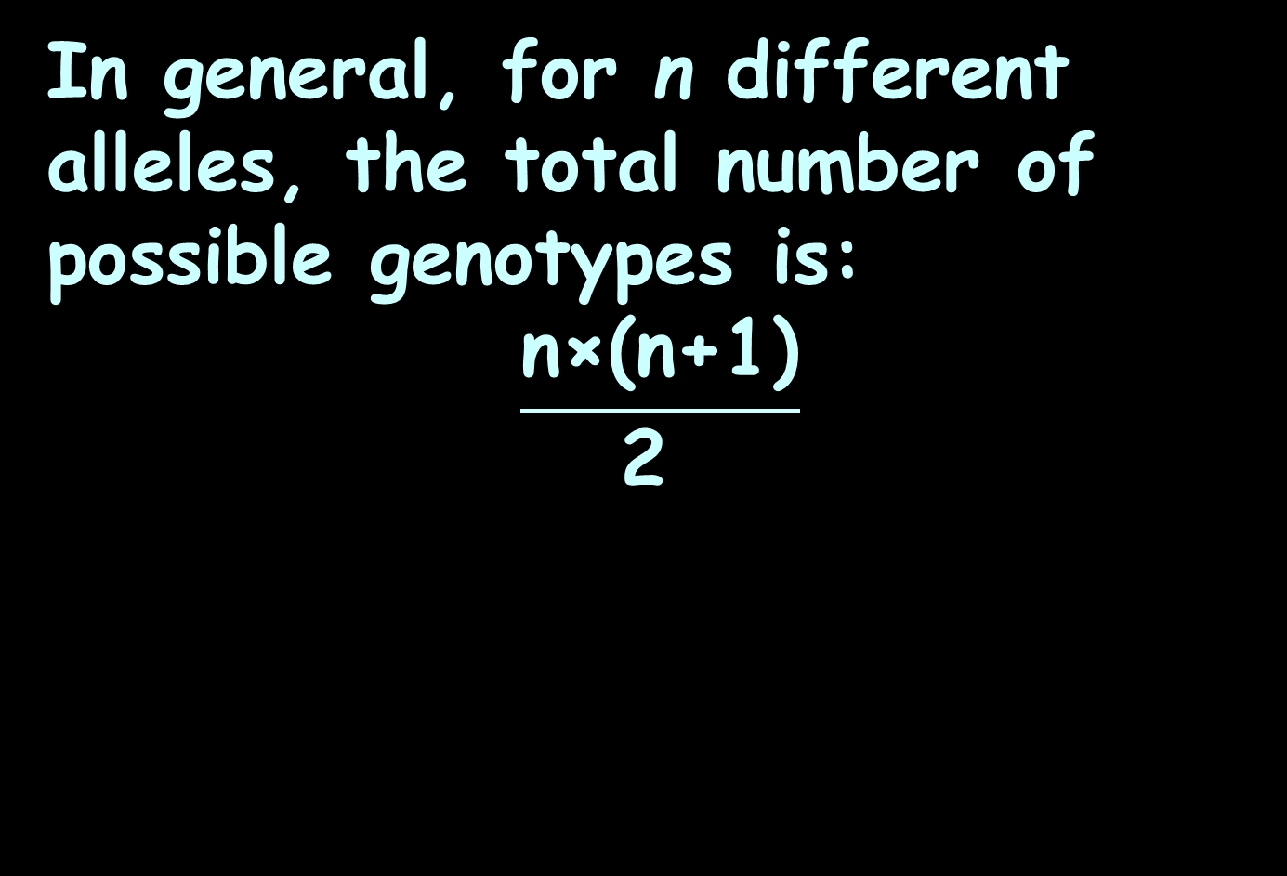
DNA Probabilities
In general, for n different alleles, the total number of possible genotypes is:
$$\frac{\text{n}\text{×(}\text{n}\text{+1)}}{\text{2 }}$$

Slide 14
DNA Probabilities
For an individual, if the two alleles have frequencies of p and q in a population, the probability (P) of an individual of having both alleles at a single marker is: P = 2pq

Slide 15

Questions?
http://i.imgur.com/aliTlT3.jpg

Slide 16
Random Variables
A sample space is all the possible outcomes

Slide 17
Random Variables
A sample point is one of the outcomes from the sample space

Slide 18
Random Variables
A random variable

Slide 19
Random Variables
A random variable
“varies”
(not always the same)

Slide 20
Random Variables
A random variable
“varies”
is “random”

Slide 21

Random Variables
Random variable…
hmmm… what’s that?
http://www.testically.org/wp-content/uploads/2010/11/hmm.jpg

Slide 22
Random Variables
A random variable…
Is a way to quantify outcomes
of unforecastable processes

Slide 23
Random Variables
We often say for a random sample, every member of the population has an equal likelihood of being included in the sample

Slide 24
Random Variables
A random variable won’t necessarily have an equal likelihood for each of the possible outcome, only that it can’t be predicted with 100% certainty

Slide 25
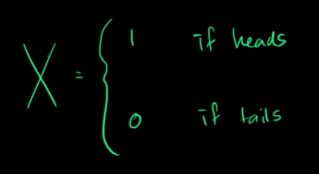
Random Variables
For a coin toss:
X is a random variable that assigns a number to an outcome
https://www.khanacademy.org/math/statistics-probability/random-variables-stats-library/discrete-and-continuous-random-variables/v/random-variables

Slide 26
Random Variables
This allows us to do arithmetic with the outcomes

Slide 27
Random Variables
Fred + Angela – Juan = ?
Not easy!

Slide 28
Random Variables
1 + 7 – 4.2 = ?
Much easier!

Slide 29
Random Variables
There are two types of random variables:

Slide 30
Random Variables
There are two types of random variables:
discrete

Slide 31
Random Variables
There are two types of random variables:
discrete
continuous

Slide 32
Random Variables
A discrete variable has countable values, such as a list of non-negative integers

Slide 33
Random Variables
Or the list of people in a club

Slide 34
Random Variables
The values are distinct or separate

Slide 35
Random Variables
vs discrete
Not discreet (which means on the down low, under the radar)

Slide 36
Random Variables
There are two types of random variables:
discrete
continuous

Slide 37
Random Variables
A continuous variable can take on any value in an interval

Slide 38
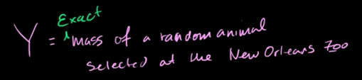

RANDOM VARIABLES
IN-CLASS PROBLEM 1a,b
Which?
discrete
continuous
https://www.khanacademy.org/math/statistics-probability/random-variables-stats-library/discrete-and-continuous-random-variables/v/random-variables

Slide 39
RANDOM VARIABLES
IN-CLASS PROBLEM 1a,b
Which?
continuous/discrete
discrete/continuous
discrete
continuous
https://www.khanacademy.org/math/statistics-probability/random-variables-stats-library/discrete-and-continuous-random-variables/v/random-variables

Slide 40
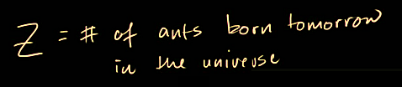
RANDOM VARIABLES
IN-CLASS PROBLEM 1c
Which?
discrete
continuous
https://www.khanacademy.org/math/statistics-probability/random-variables-stats-library/discrete-and-continuous-random-variables/v/random-variables

Slide 41
RANDOM VARIABLES
IN-CLASS PROBLEM 1c
Which?
discrete
discrete
continuous
https://www.khanacademy.org/math/statistics-probability/random-variables-stats-library/discrete-and-continuous-random-variables/v/random-variables

Slide 42
Random Variables
A discrete variable can have an infinite number of outcomes

Slide 43
Random Variables
A discrete variable can have an infinite number of outcomes
“countably infinite”

Slide 44
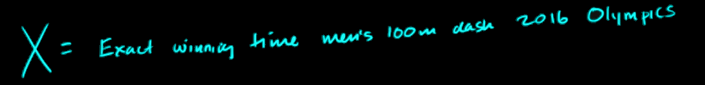
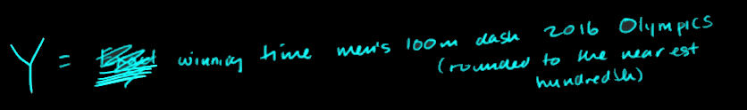
RANDOM VARIABLES
IN-CLASS PROBLEM 1d,e
Which?
discrete
continuous
https://www.khanacademy.org/math/statistics-probability/random-variables-stats-library/discrete-and-continuous-random-variables/v/random-variables

Slide 45
RANDOM VARIABLES
IN-CLASS PROBLEM 1d,e
Which?
continuous
discrete
discrete
continuous
https://www.khanacademy.org/math/statistics-probability/random-variables-stats-library/discrete-and-continuous-random-variables/v/random-variables

Slide 46

RANDOM VARIABLES
IN-CLASS PROBLEM 1f
Which?
https://pixabay.com/p-1150021/?no_redirect

Slide 47
Questions?
http://i.imgur.com/aliTlT3.jpg

Slide 48
Probability Functions
A table listing all possible values that a random variable can take on together with the associated probabilities is called a “probability distribution”

Slide 49
Probability Functions
A probability distribution lists
P(X=x) = some probability value
where X is the random variable and x is a particular value

Slide 50
Probability Functions
Note: it is a tradition to use capital letters near the end of the alphabet to represent random variables
Small letters of the capital letter are used to represent values of the random variable

Slide 51
Probability Functions
P(X=x) = some probability value
Example:
X = value on one roll of a die
x = 1
P(X=1) = 1/6

Slide 52
Probability Functions
Is it a probability distribution?
Are all the probabilities ≥ 0?
Do the probabilities add up to 1 (100%)?

Slide 53
Probability Functions
A formula which generates probabilities associated with values of a numerical random variable is called a “probability function”

Slide 54
Probability Functions
Example of a probability function:
ƒ(x) = P(X=x) = 1/6
X = value on one roll of a die
x = 1,2,3,4,5 or 6

Slide 55
Probability Functions
The probability of an event occurring is:
number of favorable outcomes total number of outcomes

Slide 56
Probability Functions
The most common way to present probabilities associated with values of a numerical random variable is as the cumulative distribution or cumulative distribution function

Slide 57
Probability Functions
The cumulative distribution function:
F(x) = P(X≤x)

Slide 58
Probability Functions
ƒ(x) = P(X=x) = 1/6
X = value on one roll of a die
x = 1,2,3,4,5 or 6
F(x) = P(X≤x)
x
1
2
3
4
5
6
F(x)
1/6
2/6
3/6
4/6
5/6
6/6

Slide 59
Probability Functions
Note1: you are using the “addition rule” to calculate these cumulative probabilities
x
1
2
3
4
5
6
F(x)
1/6
2/6
3/6
4/6
5/6
6/6

Slide 60
Probability Functions
Note2: the final F(x) value will ALWAYS be “1”
x
1
2
3
4
5
6
F(x)
1/6
2/6
3/6
4/6
5/6
6/6

Slide 61
Probability Functions
Note2: the final F(x) value will ALWAYS be “1”
That’s because that “x” covers ALL the possible values of “x”
x
1
2
3
4
5
6
F(x)
1/6
2/6
3/6
4/6
5/6
6/6

Slide 62
Probability Functions
Note2: the final F(x) value will ALWAYS be “1”
That’s because that “x” covers ALL the possible values of “x”
And ALL THE POSSIBLE probabilities have to add up to 1
x
1
2
3
4
5
6
F(x)
1/6
2/6
3/6
4/6
5/6
6/6

Slide 63
Probability Functions
In the 1600s and 1700s, there were a lot of wealthy gamblers

Slide 64
Probability Functions
In the 1600s and 1700s, there were a lot of wealthy gamblers
There were also a few wealthy mathematicians

Slide 65
Probability Functions
The gamblers were always trying to get the mathematicians to “tell them the odds” of certain outcomes

Slide 66
Probability Functions
For example, getting a “2” when rolling two dice can only happen one way: 1 on both dice
Getting a “3” happens when you have 1 on one of the dice and 2 on the other

Slide 67
Probability Functions
For example, getting a “2” when rolling two dice can only happen one way: 1 on both dice
Getting a “3” happens when you have 1 on one of the dice and 2 on the other
But the gamblers knew that “3” happened twice as often as “2”

Slide 68
Probability Functions
Howcum?

Slide 69
Probability Functions
Sample space for two dice and random variables Y (think of a red die) and Z (a blue die)
Y,Z
1,1
2,1
3,1
4,1
5,1
6,1
1,2
2,2
3,2
4,2
5,2
6,2
1,3
2,3
3,3
4,3
5,3
6,3
1,4
2,4
3,4
4,4
5,4
6,4
1,5
2,5
3,5
4,5
5,5
6,5
1,6
2,6
3,6
4,6
5,6
6,6

Slide 70
Probability Functions
There is only one way to get a “2” on a roll of 2 dice
Y,Z
1,1
2,1
3,1
4,1
5,1
6,1
1,2
2,2
3,2
4,2
5,2
6,2
1,3
2,3
3,3
4,3
5,3
6,3
1,4
2,4
3,4
4,4
5,4
6,4
1,5
2,5
3,5
4,5
5,5
6,5
1,6
2,6
3,6
4,6
5,6
6,6

Slide 71
Probability Functions
There are two ways to get a “3” on a roll of 2 dice
Y,Z
1,1
2,1
3,1
4,1
5,1
6,1
1,2
2,2
3,2
4,2
5,2
6,2
1,3
2,3
3,3
4,3
5,3
6,3
1,4
2,4
3,4
4,4
5,4
6,4
1,5
2,5
3,5
4,5
5,5
6,5
1,6
2,6
3,6
4,6
5,6
6,6

Slide 72
Probability Functions
That’s why it happens twice as often!
Y,Z
1,1
2,1
3,1
4,1
5,1
6,1
1,2
2,2
3,2
4,2
5,2
6,2
1,3
2,3
3,3
4,3
5,3
6,3
1,4
2,4
3,4
4,4
5,4
6,4
1,5
2,5
3,5
4,5
5,5
6,5
1,6
2,6
3,6
4,6
5,6
6,6

Slide 73
Probability Functions
Probability distribution and cumulative distribution for the sum of spots (y) on two dice:
y
2
3
4
5
6
7
8
9
10
11
12
ƒ(y)
1/36
2/36
3/36
4/36
5/36
6/36
5/36
4/36
3/36
2/36
1/36
F(y)
1/36
3/36
6/36
10/36
15/36
21/36
26/36
30/36
33/36
35/36
36/36

Slide 74
Probability Functions
Probability distribution and cumulative distribution for the sum of spots (y) on two dice:
y
2
3
4
5
6
7
8
9
10
11
12
ƒ(y)
1/36
2/36
3/36
4/36
5/36
6/36
5/36
4/36
3/36
2/36
1/36
F(y)
1/36
3/36
6/36
10/36
15/36
21/36
26/36
30/36
33/36
35/36
36/36
the final F(x) value is “1”

Slide 75
PROBABILITY FUNCTIONS
IN-CLASS PROBLEM 2a
The probability function for a random variable X is:
ƒ(x) = x/10 for x=1,2,3,4
What are the “x” values for the table?
x
ƒ(x)
F(x)

Slide 76
PROBABILITY FUNCTIONS
IN-CLASS PROBLEM
The probability function for a random variable X is:
ƒ(x) = x/10 for x=1,2,3,4
What are the ƒ(x) values for the table?
x
1
2
3
4
ƒ(x)
?
?
?
?
F(x)

Slide 77
PROBABILITY FUNCTIONS
IN-CLASS PROBLEM
The probability function for a random variable X is:
ƒ(x) = x/10 for x=1,2,3,4
What are the ƒ(x) values for the table?
x
1
2
3
4
ƒ(x)
1/10
?
?
?
F(x)

Slide 78
PROBABILITY FUNCTIONS
IN-CLASS PROBLEM
The probability function for a random variable X is:
ƒ(x) = x/10 for x=1,2,3,4
What are the ƒ(x) values for the table?
x
1
2
3
4
ƒ(x)
1/10
2/10
?
?
F(x)

Slide 79
PROBABILITY FUNCTIONS
IN-CLASS PROBLEM
The probability function for a random variable X is:
ƒ(x) = x/10 for x=1,2,3,4
What are the ƒ(x) values for the table?
x
1
2
3
4
ƒ(x)
1/10
2/10
3/10
?
F(x)

Slide 80
PROBABILITY FUNCTIONS
IN-CLASS PROBLEM
The probability function for a random variable X is:
ƒ(x) = x/10 for x=1,2,3,4
What are the F(x) values for the table?
x
1
2
3
4
ƒ(x)
1/10
2/10
3/10
4/10
F(x)
?
?
?
?

Slide 81
PROBABILITY FUNCTIONS
IN-CLASS PROBLEM
The probability function for a random variable X is:
ƒ(x) = x/10 for x=1,2,3,4
What are the F(x) values for the table?
x
1
2
3
4
ƒ(x)
1/10
2/10
3/10
4/10
F(x)
1/10
?
?
?

Slide 82
PROBABILITY FUNCTIONS
IN-CLASS PROBLEM
The probability function for a random variable X is:
ƒ(x) = x/10 for x=1,2,3,4
What are the F(x) values for the table?
x
1
2
3
4
ƒ(x)
1/10
2/10
3/10
4/10
F(x)
1/10
3/10
?
?

Slide 83
PROBABILITY FUNCTIONS
IN-CLASS PROBLEM
The probability function for a random variable X is:
ƒ(x) = x/10 for x=1,2,3,4
What are the F(x) values for the table?
x
1
2
3
4
ƒ(x)
1/10
2/10
3/10
4/10
F(x)
1/10
3/10
6/10
?

Slide 84
PROBABILITY FUNCTIONS
IN-CLASS PROBLEM
The probability function for a random variable X is:
ƒ(x) = x/10 for x=1,2,3,4
What are the F(x) values for the table?
x
1
2
3
4
ƒ(x)
1/10
2/10
3/10
4/10
F(x)
1/10
3/10
6/10
10/10

Slide 85
PROBABILITY FUNCTIONS
IN-CLASS PROBLEM
The probability function for a random variable X is:
ƒ(x) = x/10 for x=1,2,3,4
What are the F(x) values for the table?
x
1
2
3
4
ƒ(x)
1/10
2/10
3/10
4/10
F(x)
1/10
3/10
6/10
10/10
the final F(x) value is “1”

Slide 86
Questions?
http://i.imgur.com/aliTlT3.jpg

Slide 87
Probability Functions
P(X=x)
P(x) means “the probability that the random variable X equals the value x”

Slide 88
Probability Functions
Remember “Σ” means
“the sum of”

Slide 89
Probability Functions
Rules for discrete probabilities:
Σ P(x) = 1 or 100%

Slide 90
Probability Functions
Rules for discrete probabilities:
Σ P(x) = 1 or 100%
0 ≤ P(x) ≤ 1 or 100%

Slide 91
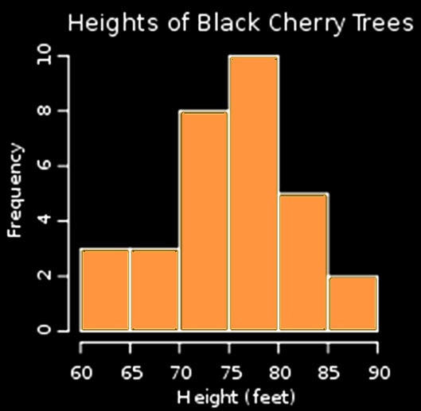
Probability Functions
A probability histogram:
http://img.bhs4.com/10/a/10ab4d31632e8176c49e20c8f1887dc164dc0648_small.jp

Slide 92
PROBABILITY FUNCTIONS
IN-CLASS PROBLEM 2b
What is the probability a black cherry tree is shorter than 70 feet?
http://img.bhs4.com/10/a/10ab4d31632e8176c49e20c8f1887dc164dc0648_small.jp

Slide 93
PROBABILITY FUNCTIONS
IN-CLASS PROBLEM 2b
What is the probability a black cherry tree is shorter than 70 feet? 6/31
http://img.bhs4.com/10/a/10ab4d31632e8176c49e20c8f1887dc164dc0648_small.jp

Slide 94
PROBABILITY FUNCTIONS
IN-CLASS PROBLEM 2b
What is the probability a black cherry tree is between 70 and 80 feet?
http://img.bhs4.com/10/a/10ab4d31632e8176c49e20c8f1887dc164dc0648_small.jp

Slide 95
PROBABILITY FUNCTIONS
IN-CLASS PROBLEM 2b
What is the probability a black cherry tree is between 70 and 80 feet? 18/31
http://img.bhs4.com/10/a/10ab4d31632e8176c49e20c8f1887dc164dc0648_small.jp

Slide 96
PROBABILITY FUNCTIONS
IN-CLASS PROBLEM 2b
What is the cumulative probability a black cherry tree being 80 feet or
shorter?
http://img.bhs4.com/10/a/10ab4d31632e8176c49e20c8f1887dc164dc0648_small.jp

Slide 97
PROBABILITY FUNCTIONS
IN-CLASS PROBLEM 2b
What is the cumulative probability a black cherry tree being 80 feet or
shorter?
24/31
http://img.bhs4.com/10/a/10ab4d31632e8176c49e20c8f1887dc164dc0648_small.jp

Slide 98
Probability Functions
This uses the “addition rule”

Slide 99
Questions?
http://i.imgur.com/aliTlT3.jpg

Slide 100
PROBABILITY FUNCTIONS
IN-CLASS PROBLEM 2c
In the game of “Chuckaluck”, a player bets on a number from 1 to 6
Then a cage containing two dice is spun

Slide 101
PROBABILITY FUNCTIONS
IN-CLASS PROBLEM 2c
If doubles of the player’s number appear, the player wins back 3x the original bet
If one of the player’s number appears, the player wins back 2x the original bet
If neither is the players’ number, the player loses

Slide 102
PROBABILITY FUNCTIONS
IN-CLASS PROBLEM 2c
A player bets $1 on “2”
What is “X”?
x
?
?
?
?
ƒ(x)

Slide 103
PROBABILITY FUNCTIONS
IN-CLASS PROBLEM 2c
A player bets $1 on “2”
What is “X”? The number of twos that appear
What are the “x” values?
x
?
?
?
?
ƒ(x)

Slide 104
PROBABILITY FUNCTIONS
IN-CLASS PROBLEM 2c
A player bets $1 on “2”
What are the x values?
x
0
1
2
ƒ(x)
?

Slide 105
PROBABILITY FUNCTIONS
IN-CLASS PROBLEM 2c
A player bets $1 on “2”
How many total outcomes are there for the two dice?
Y,Z
1,1
2,1
3,1
4,1
5,1
6,1
1,2
2,2
3,2
4,2
5,2
6,2
1,3
2,3
3,3
4,3
5,3
6,3
1,4
2,4
3,4
4,4
5,4
6,4
1,5
2,5
3,5
4,5
5,5
6,5
1,6
2,6
3,6
4,6
5,6
6,6

Slide 106
PROBABILITY FUNCTIONS
IN-CLASS PROBLEM 2c
A player bets $1 on “2”
How many total outcomes are there for the two dice? 36
What are the ƒ(x) values?
x
0
1
2
ƒ(x)
?

Slide 107
PROBABILITY FUNCTIONS
IN-CLASS PROBLEM 2c
A player bets $1 on “2”
What are the ƒ(x) values?
x
0
1
2
ƒ(x)
?
1/36
Only 2,2

Slide 108
PROBABILITY FUNCTIONS
IN-CLASS PROBLEM 2c
A player bets $1 on “2”
What are the ƒ(x) values?
x
0
1
2
ƒ(x)
?
10/36
1/36
2,1 1,2 2,3 3,2 2,4 4,2 2,5 5,2 2,6 6,2

Slide 109
PROBABILITY FUNCTIONS
IN-CLASS PROBLEM 2c
A player bets $1 on “2”
What are the ƒ(x) values?
x
0
1
2
ƒ(x)
25/36
10/36
1/36
36/36 -10/36 -1/36

Slide 110
Questions?
http://i.imgur.com/aliTlT3.jpg

Slide 111
Expected Values
In the Chuckaluck game, it’s interesting to know what is a player’s likelihood of winning…

Slide 112
Expected Values
In the Chuckaluck game, it’s interesting to know what is a player’s likelihood of winning…
but a player might actually be more interested in how much money might be expected to come their way

Slide 113
Expected Values
This expected return is called the “expected value” of the random variable

Slide 114
Expected Values
For a simple illustration, suppose 100 tickets are sold for $1 each to raffle off a watch worth $80

Slide 115
Expected Values
For a simple illustration, suppose 100 tickets are sold for $1 each to raffle off a watch worth $80
One ticket will be worth $80

Slide 116
Expected Values
For a simple illustration, suppose 100 tickets are sold for $1 each to raffle off a watch worth $80
One ticket will be worth $80
99 tickets will be worth $0

Slide 117
Expected Values
One ticket will be worth $80
99 tickets will be worth $0
The average value of a ticket will be:
$80 + $0 + $0 + … + $0
100

Slide 118
Expected Values
One ticket will be worth $80
99 tickets will be worth $0
The average value of a ticket will be:
$80 + $0 + $0 + … + $0
100
= $0.80

Slide 119
Expected Values
So, the average amount received by all ticketholders is $0.80

Slide 120
Expected Values
You could also write
$80 + $0 + $0 + … + $0
100
as:
$80(1/100) + $0(99/100)

Slide 121
Expected Values
If you let X = the amount a ticket is worth…
well, it could either be worth $80 (probability of that occurring = 1/100)
or it could be worth $0 (probability of that occurring = 99/100)

Slide 122
Expected Values
The probability distribution table would be:
x
$0
$80
ƒ(x)
99/100
1/100

Slide 123
Expected Values
If a player participates in only one raffle with a single ticket, the player would receive either $0 or $80

Slide 124
Expected Values
If a player buys one ticket for many similar raffles

Slide 125
Expected Values
If a player buys one ticket for many similar raffles
After a few thousand raffles, it is quite likely the player will have won a few times

Slide 126
Expected Values
Suppose after 10,000 raffles, the player has won 110 times
On the average, this player has received:
$80(110) + $0(9,890)
10,000
= $0.88
Notice this is a tiny bit better than the average amount received by all ticketholders of $0.80

Slide 127
Expected Values
110/10,000 and 9,890/10,000 are relative frequencies

Slide 128
Expected Values
A Definition
If an experiment is performed “n” times with “f” successes, and as “n” increases so does “f”, then the probability of a success is:
lim (n→∞) f/n

Slide 129
Expected Values
Of course, the player can’t really buy an infinite number of raffle tickets, but 10,000 is probably “close-enuf”

Slide 130
Expected Values
Most would be willing to use:
110/10,000 as the probability of winning and 9,890/10,000 as the probability of losing (assuming no one actually knew the real values)
x
$0
$80
ƒ(x)
99/100
1/100

Slide 131
Expected Values
If a random variable X has values:
x₁, x₂, … , x_{k}
that occur with probabilities: ƒ(x₁), ƒ(x₂), … , ƒ(x_{k})
then the expected value of X is:
E(X) = x₁ƒ(x₁) + x₂ƒ(x₂) + … + x_{k} ƒ(x_{k})

Slide 132
Expected Values
The expected value of X is also called the “expectation of X” or the “mean of the probability distribution”

Slide 133
Expected Values
The symbol for the expected value of X is E(X) or μ_{x} or μ

Slide 134
EXPECTED VALUES
IN-CLASS PROBLEM 3a
A player bets $1 on “2”
What can the player expect to win (“Y”)?
If doubles of the player’s number appear, the player wins back 3x the original bet
If one of the player’s number appears, the player wins back 2x the original bet
If neither is the players’ number, the player loses
x
0
1
2
y
?
ƒ(x)
25/36
10/36
1/36

Slide 135
EXPECTED VALUES
IN-CLASS PROBLEM 3a
A player bets $1 on “2”
What can the player expect to win (“Y”)?
If doubles of the player’s number appear, the player wins back 3x the original bet
If one of the player’s number appears, the player wins back 2x the original bet
If neither is the players’ number, the player loses
x
0
1
2
y
$-1
?
ƒ(x)
25/36
10/36
1/36
bet $1

Slide 136
EXPECTED VALUES
IN-CLASS PROBLEM 3a
A player bets $1 on “2”
What can the player expect to win (“Y”)?
If doubles of the player’s number appear, the player wins back 3x the original bet
If one of the player’s number appears, the player wins back 2x the original bet
If neither is the players’ number, the player loses
x
0
1
2
y
$-1
$1
?
ƒ(x)
25/36
10/36
1/36

Slide 137
EXPECTED VALUES
IN-CLASS PROBLEM 3a
A player bets $1 on “2”
What can the player expect to win (“Y”)?
x
0
1
2
y
$-1
$1
$2
ƒ(x)
25/36
10/36
1/36

Slide 138
EXPECTED VALUES
IN-CLASS PROBLEM 3b
The player can expect:
$-1 occurs 25/36 of the time
$1 occurs 10/36 of the time
$2 occurs 1/36 of the time
x
0
1
2
y
$-1
$1
$2
ƒ(x)
25/36
10/36
1/36
E(X) = x₁ƒ(x₁) + x₂ƒ(x₂) + … + x_{k} ƒ(x_{k})

Slide 139
EXPECTED VALUES
IN-CLASS PROBLEM 3b
The player can expect:
$-1 x 25/36
+ $1 x 10/36
+ $2 x 1/36
= ?
x
0
1
2
y
$-1
$1
$2
ƒ(x)
25/36
10/36
1/36
E(X) = x₁ƒ(x₁) + x₂ƒ(x₂) + … + x_{k} ƒ(x_{k})

Slide 140
EXPECTED VALUES
IN-CLASS PROBLEM 3b
The player can expect:
$-1 x 25/36
+ $1 x 10/36
+ $2 x 1/36
≈ $-0.36
x
0
1
2
y
$-1
$1
$2
ƒ(x)
25/36
10/36
1/36

Slide 141
Questions?
http://i.imgur.com/aliTlT3.jpg

Slide 142
Variance
One constant used to characterize a probability distribution is E(X) or μ_{x}

Slide 143
Variance
Another constant which is used to characterize a probability distribution is the variance

Slide 144
Variance
You might be tempted to find the average deviation: (X - μ_{x})

Slide 145
Variance
You might be tempted to find the average deviation: (X - μ_{x})
but
E(X - μ_{x}) = 0
(because E(X) = μ_{x}
(so the average deviation is always zero)

Slide 146
Variance
Instead we use the average squared deviation:
E((X - μ_{x})²)
for the variance

Slide 147
Variance
Again, because of accumulating rounding errors, we use the calculator formula:
E(X²) – μ²_{x}

Slide 148
Variance
Again, the symbol for the variance is:
Var(X) or σ_{x}² or σ²

Slide 149
Variance
And again, because the units for the variance will be squared (and irritating), we more often use the standard deviation:
SD(X) or STD(X) or σ_{x} or σ
which is the square root of the variance

Slide 150
VARIANCE
IN-CLASS PROBLEM 4a
A random variable X has a probability function: ƒ(x) = x/10
for values of x: 1,2,3,4
E(X) = x₁ƒ(x₁) + x₂ƒ(x₂) + … + x_{k} ƒ(x_{k})

Slide 151
VARIANCE
IN-CLASS PROBLEM 4a
A random variable X has a probability function: ƒ(x) = x/10
for values of x: 1,2,3,4
Is it a probability distribution?
E(X) = x₁ƒ(x₁) + x₂ƒ(x₂) + … + x_{k} ƒ(x_{k})

Slide 152
VARIANCE
IN-CLASS PROBLEM 4a
A random variable X has a probability function: ƒ(x) = x/10
for values of x: 1,2,3,4
Is it a probability distribution?
What are the values of X?
x
?
?
?
?
ƒ(x)
E(X) = x₁ƒ(x₁) + x₂ƒ(x₂) + … + x_{k} ƒ(x_{k})

Slide 153
VARIANCE
IN-CLASS PROBLEM 4a
A random variable X has a probability function: ƒ(x) = x/10
for values of x: 1,2,3,4
Is it a probability distribution?
What are the values of X?
x
1
2
3
4
ƒ(x)
E(X) = x₁ƒ(x₁) + x₂ƒ(x₂) + … + x_{k} ƒ(x_{k})

Slide 154
VARIANCE
IN-CLASS PROBLEM 4a
A random variable X has a probability function: ƒ(x) = x/10
for values of x: 1,2,3,4
Is it a probability distribution?
Are all the probabilities ≥ 0?
x
1
2
3
4
ƒ(x)
?
?
?
?
E(X) = x₁ƒ(x₁) + x₂ƒ(x₂) + … + x_{k} ƒ(x_{k})

Slide 155
VARIANCE
IN-CLASS PROBLEM 4a
A random variable X has a probability function: ƒ(x) = x/10
for values of x: 1,2,3,4
Is it a probability distribution?
Are all the probabilities ≥ 0?
x
1
2
3
4
ƒ(x)
1/10
?
?
?
E(X) = x₁ƒ(x₁) + x₂ƒ(x₂) + … + x_{k} ƒ(x_{k})

Slide 156
VARIANCE
IN-CLASS PROBLEM 4a
A random variable X has a probability function: ƒ(x) = x/10
for values of x: 1,2,3,4
Is it a probability distribution?
Are all the probabilities ≥ 0?
x
1
2
3
4
ƒ(x)
1/10
2/10
?
?
E(X) = x₁ƒ(x₁) + x₂ƒ(x₂) + … + x_{k} ƒ(x_{k})

Slide 157
VARIANCE
IN-CLASS PROBLEM 4a
A random variable X has a probability function: ƒ(x) = x/10
for values of x: 1,2,3,4
Is it a probability distribution?
Are all the probabilities ≥ 0?
x
1
2
3
4
ƒ(x)
1/10
2/10
3/10
?
E(X) = x₁ƒ(x₁) + x₂ƒ(x₂) + … + x_{k} ƒ(x_{k})

Slide 158
VARIANCE
IN-CLASS PROBLEM 4a
A random variable X has a probability function: ƒ(x) = x/10
for values of x: 1,2,3,4
Is it a probability distribution?
Are all the probabilities ≥ 0? yep
x
1
2
3
4
ƒ(x)
1/10
2/10
3/10
4/10
E(X) = x₁ƒ(x₁) + x₂ƒ(x₂) + … + x_{k} ƒ(x_{k})

Slide 159
VARIANCE
IN-CLASS PROBLEM 4a
A random variable X has a probability function: ƒ(x) = x/10
for values of x: 1,2,3,4
Is it a probability distribution?
Do the probabilities add up to 1 (100%)?
x
1
2
3
4
ƒ(x)
1/10
2/10
3/10
4/10
E(X) = x₁ƒ(x₁) + x₂ƒ(x₂) + … + x_{k} ƒ(x_{k})

Slide 160
VARIANCE
IN-CLASS PROBLEM 4a
A random variable X has a probability function: ƒ(x) = x/10
for values of x: 1,2,3,4
Is it a probability distribution?
Do the probabilities add up to 1 (100%)? Yep!
= 10/10
x
1
2
3
4
ƒ(x)
1/10
2/10
3/10
4/10
E(X) = x₁ƒ(x₁) + x₂ƒ(x₂) + … + x_{k} ƒ(x_{k})

Slide 161
VARIANCE
IN-CLASS PROBLEM 4a
A random variable X has a probability function: ƒ(x) = x/10
for values of x: 1,2,3,4
Is it a probability distribution?
Yep!
= 10/10
x
1
2
3
4
ƒ(x)
1/10
2/10
3/10
4/10
E(X) = x₁ƒ(x₁) + x₂ƒ(x₂) + … + x_{k} ƒ(x_{k})

Slide 162
VARIANCE
IN-CLASS PROBLEM 4b
A random variable X has a probability function: ƒ(x) = x/10
for values of x: 1,2,3,4
Find μ_{x}
μ_{x} = 1(1/10) + 2(2/10) + 3(3/10) + 4(4/10)
x
1
2
3
4
ƒ(x)
1/10
2/10
3/10
4/10
E(X) = x₁ƒ(x₁) + x₂ƒ(x₂) + … + x_{k} ƒ(x_{k})

Slide 163
VARIANCE
IN-CLASS PROBLEM 4b
A random variable X has a probability function: ƒ(x) = x/10
for values of x: 1,2,3,4
Find μ_{x}
μ_{x} = 1(1/10) + 2(2/10) + 3(3/10) + 4(4/10)
= (1+4+9+16)/10
= 30/10 = 3
x
1
2
3
4
ƒ(x)
1/10
2/10
3/10
4/10
E(X) = x₁ƒ(x₁) + x₂ƒ(x₂) + … + x_{k} ƒ(x_{k})

Slide 164
VARIANCE
IN-CLASS PROBLEM 4c
A random variable X has a probability function: ƒ(x) = x/10
for values of x: 1,2,3,4
Let’s prove E(X-μ_{x}) = 0
E(X-μ_{x}) = ?
E(X-μ_{x}) = (x₁-μ_{x})ƒ(x₁) + (x₂-μ_{x})ƒ(x₂) + … + (x_{k}-μ_{x})ƒ(x_{k})

Slide 165
VARIANCE
IN-CLASS PROBLEM 4c
A random variable X has a probability function: ƒ(x) = x/10
for values of x: 1,2,3,4
Let’s prove E(X-μ_{x}) = 0
E(X-μ_{x}) = (1-3)(1/10) + (2-3)(2/10) +
(3-3)(3/10) + (4-3)(4/10)
= (-2+-2+0+4)/10
= 0/10 = 0
E(X-μ_{x}) = (x₁-μ_{x})ƒ(x₁) + (x₂-μ_{x})ƒ(x₂) + … + (x_{k}-μ_{x})ƒ(x_{k})

Slide 166
VARIANCE
IN-CLASS PROBLEM 4d
A random variable X has a probability function: ƒ(x) = x/10
for values of x: 1,2,3,4
Find σ_{x}²
σ_{x}² = ?
x
1
2
3
4
ƒ(x)
1/10
2/10
3/10
4/10
σ_{x}² = (x₁–μ_{x})²ƒ(x₁) + (x₂ –μ_{x})²ƒ(x₂) + … + (x_{k} –μ_{x})²ƒ(x_{k})
or σ_{x}² = (x₁)²ƒ(x₁) + (x₂)²ƒ(x₂) + … + (x_{k})²ƒ(x_{k}) – (μ_{x})²

Slide 167
VARIANCE
IN-CLASS PROBLEM 4d
A random variable X has a probability function: ƒ(x) = x/10
for values of x: 1,2,3,4
Find σ_{x}²
σ_{x}² = (1-3)²(1/10) + (2-3)²(2/10) +
(3-3)²(3/10) + (4-3)²(4/10) = 1
Or:
σ_{x}² = 1²(1/10) + 2²(2/10) + 3²(3/10) +
4²(4/10) – 3²
= (1+8+27+64)/10 – 9 = 1
σ_{x}² = (x₁–μ_{x})²ƒ(x₁) + (x₂ –μ_{x})²ƒ(x₂) + … + (x_{k} –μ_{x})²ƒ(x_{k})
or σ_{x}² = (x₁)²ƒ(x₁) + (x₂)²ƒ(x₂) + … + (x_{k})²ƒ(x_{k}) – (μ_{x})²

Slide 168
VARIANCE
IN-CLASS PROBLEM 4e
A random variable X has a probability function: ƒ(x) = x/10
for values of x: 1,2,3,4
Find σ_{x}
σ_{x} = ?
σ_{x} = sqrt(σ_{x}²)

Slide 169
VARIANCE
IN-CLASS PROBLEM 4e
A random variable X has a probability function: ƒ(x) = x/10
for values of x: 1,2,3,4
Find σ_{x}
σ_{x} = sqrt(1) = 1
σ_{x} = sqrt(σ_{x}²)

Slide 170
Questions?
http://i.imgur.com/aliTlT3.jpg

Slide 171
Summary
Today we studied:
Review of DNA probability
New: Probabilities of random variables

Slide 172

You Survived!
www.playbuzz.com

