Slide 1
Welcome to
Unit 7 Part 13
MATH366 Probability and Statistics
https://online.stanford.edu/sites/default/files/styles/figure_default/public/2018-04/theory-of-probability_stats116.jpg?itok=ms4fRMO-

Slide 2
What’s Up?
Today we will be going over:
Review: Discrete random variables
and their probabilities
New: Types of discrete probabilities

Slide 3
What’s Up?
Outcome 3) Modeling will be assisted by Monte Carlo simulations run with mathematical software
Outcome 4) Calculate the parameters of several discrete random variable distributions and compute the probability of events in a typical discrete event application

Slide 4

Review
http://995642590.r.lightningbase-cdn.com/wp-content/uploads/2010/12/looking-back-hrexaminer-v144-cover425px.jpg

Slide 5
Random Variables
A sample space is all the possible outcomes
A sample point is one of the outcomes from the sample space

Slide 6
Random Variables
A random variable
“varies”
is “random”

Slide 7
Random Variables
A random variable…
Is a way to quantify outcomes
of unforecastable processes

Slide 8
Random Variables
There are two types of random variables:
discrete
continuous

Slide 9
Random Variables
A discrete variable has countable values, such as a list of non-negative integers

Slide 10
Random Variables
A discrete variable can have an infinite number of outcomes
“countably infinite”

Slide 11
Probability Functions
A table listing all possible values that a random variable can take on together with the associated probabilities is called a “probability distribution”

Slide 12
Probability Functions
Is it a probability distribution?
All the probabilities ≥ 0
The probabilities add up to 1 (100%)?

Slide 13
Probability Functions
A formula which generates probabilities associated with values of a numerical random variable is called a “probability function”

Slide 14
Probability Functions
The most common way to present probabilities associated with values of a numerical random variable is as the cumulative distribution or cumulative distribution function
F(x) = P(X≤x)

Slide 15
Expected Values
A Definition
If an experiment is performed “n” times with “f” successes, and as “n” increases so does “f”, then the probability of a success is:
lim (n→∞) f/n

Slide 16
Expected Values
If a random variable X has values:
x₁, x₂, … , x_{k}
that occur with probabilities: ƒ(x₁), ƒ(x₂), … , ƒ(x_{k})
then the expected value of X is:
E(X) = x₁ƒ(x₁) + x₂ƒ(x₂) + … + x_{k} ƒ(x_{k})

Slide 17
Expected Values
The expected value of X is also called the “expectation of X” or the “mean of the probability distribution”
The symbol for the expected value of X is E(X) or μ_{x} or μ

Slide 18
Variance
Another constant which is used to characterize a probability distribution is the variance
We use the average squared deviation:
E((X - μ_{x})²)
for the variance

Slide 19
Variance
The symbol for the variance is:
Var(X) or σ²_{x} or σ²

Slide 20
Variance
Because the units for the variance will be squared (and irritating), we more often use the standard deviation:
SD(X) or STD(X) or σ_{x} or σ
which is the square root of the variance

Slide 21

Questions?
http://i.imgur.com/aliTlT3.jpg

Slide 22
Discrete Probability
A lot of variables can have only two values:
M/F
H/T
Black/White
On/Off
1/0

Slide 23
Binomial Probability
Variables that can have only two values are called:
“binomial”
The values are mutually exclusive events

Slide 24
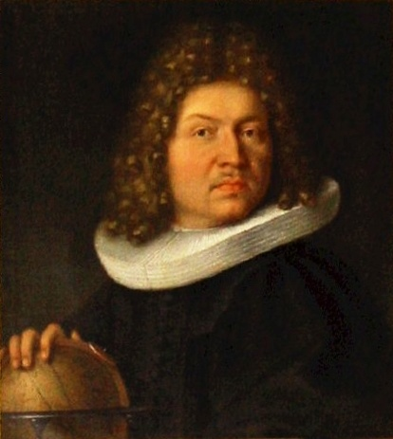
Binomial Probability
The Binomial was invented by Jakob Bernoulli in a paper published after
his death in 1713
https://www.maa.org/sites/default/files/images/upload_library/46/Euler-Bedard/2a-Jakob_
Bernoulli.jpg

Slide 25
Binomial Probability
The probability of one of the values occurring is called “p”
The probability of the other value occurring is called “q”

Slide 26
Binomial Probability
p + q = 1 or 100%

Slide 27
Binomial Probability
A binomial experiment:

Slide 28
Binomial Probability
A binomial experiment:
is performed a fixed
number of times

Slide 29
Binomial Probability
A binomial experiment:
is performed a fixed
number of times
each repetition is called a
“trial”

Slide 30
Binomial Probability
A binomial experiment:
the trials are independent

Slide 31
Binomial Probability
A binomial experiment:
the trials are independent
the outcome of one trial will
not affect the outcome
of another trial

Slide 32
Binomial Probability
A binomial experiment:
for each trial, there are
two mutually exclusive
outcomes:
success or failure

Slide 33
Binomial Probability
A binomial experiment:
the probability of success is
the same for each trial

Slide 34
Binomial Probability
Note: individually, these are also called “Bernoulli” trials
Bernoulli deals with the outcome of the single trial of the event, whereas Binomial deals with the outcome of the multiple trials of the single event

Slide 35
Binomial Probability
A single coin toss is “Bernoulli”
Multiple coin tosses are “Binomial”

Slide 36
Binomial Probability
Notation:
“n” trials

Slide 37
Binomial Probability
Notation:
“n” trials
“p” is the probability of
success

Slide 38
Binomial Probability
Notation:
“n” trials
“p” is the probability of
success
“q” or “1-p” is the
probability of failure

Slide 39
Binomial Probability
Notation:
“n” trials
“p” is the probability of
success
“q” or “1-p” is the
probability of failure
“X” is the number of
successes in the “n” trials

Slide 40
Binomial Probability
0 ≤ p ≤ 1
0 ≤ q ≤ 1
and:
0 ≤ x ≤ n

Slide 41
Binomial Probability
Binomial Experiment Rules:

Slide 42
Binomial Probability
Binomial Experiment Rules:
You must have a fixed
number of trials

Slide 43
Binomial Probability
Binomial Experiment Rules:
You must have a fixed
number of trials
Each trial is an independent
event

Slide 44
Binomial Probability
Binomial Experiment Rules:
You must have a fixed
number of trials
Each trial is an independent
event
There are only two outcomes

Slide 45
BINOMIAL PROBABILITY
IN-CLASS PROBLEM 1a
Binomial or not?
Tossing a coin a hundred times to see how many land on heads
You must have a fixed number of trials
Each trial is an independent event
There are only two outcomes

Slide 46
BINOMIAL PROBABILITY
IN-CLASS PROBLEM 1a
Binomial or not?
Tossing a coin a hundred times to see how many land on heads
yes
You must have a fixed number of trials
Each trial is an independent event
There are only two outcomes

Slide 47
BINOMIAL PROBABILITY
IN-CLASS PROBLEM 1b
Binomial or not?
Tossing a coin until you get heads
You must have a fixed number of trials
Each trial is an independent event
There are only two outcomes

Slide 48
BINOMIAL PROBABILITY
IN-CLASS PROBLEM 1b
Binomial or not?
Tossing a coin until you get heads
no
You must have a fixed number of trials
Each trial is an independent event
There are only two outcomes

Slide 49
BINOMIAL PROBABILITY
IN-CLASS PROBLEM 1c
Binomial or not?
Asking 100 people how much they weigh
You must have a fixed number of trials
Each trial is an independent event
There are only two outcomes

Slide 50
BINOMIAL PROBABILITY
IN-CLASS PROBLEM 1c
Binomial or not?
Asking 100 people how much they weigh
no
You must have a fixed number of trials
Each trial is an independent event
There are only two outcomes

Slide 51
BINOMIAL PROBABILITY
IN-CLASS PROBLEM 1d
Binomial or not?
Asking 100 people if they have ever been to Paris
You must have a fixed number of trials
Each trial is an independent event
There are only two outcomes

Slide 52
BINOMIAL PROBABILITY
IN-CLASS PROBLEM 1d
Binomial or not?
Asking 100 people if they have ever been to Paris
yes
You must have a fixed number of trials
Each trial is an independent event
There are only two outcomes

Slide 53
Questions?
http://i.imgur.com/aliTlT3.jpg

Slide 54
Binomial Probability
Remember _{n}C_{x} is the number of ways of obtaining x successes in n trials

Slide 55
Binomial Probability
The probability of obtaining X successes in n independent trials of a binomial experiment:
P(X) = _{n}C_{x} p^{x}(1-p)^{n-x}
or:
P(X) = _{n}C_{x} p^{x}(q)^{n-x}

Slide 56
Binomial Probability
To work a binomial problem:

Slide 57
Binomial Probability
To work a binomial problem:
What is a “Success”?
Success must be for a
single trial

Slide 58
Binomial Probability
To work a binomial problem:
What is the probability of success “p”?

Slide 59
Binomial Probability
To work a binomial problem:
What is the probability of failure “q”?

Slide 60
Binomial Probability
To work a binomial problem:
What is the number of trials “n”?

Slide 61
Binomial Probability
To work a binomial problem:
What is the number of successes out of those trials needed “X”?

Slide 62
Binomial Probability
To work a binomial problem:
  What is a “Success”?
  What is the probability of success “p”?
  What is the probability of failure “q”?
  What is the number of trials “n”?
  What is the number of successes out
  of those trials needed “X”?

Slide 63
BINOMIAL PROBABILITY
IN-CLASS PROBLEM 2a
What is the probability of rolling exactly two sixes in 7 rolls of a die?
What is a “Success”?

Slide 64
BINOMIAL PROBABILITY
IN-CLASS PROBLEM 2a
What is the probability of rolling exactly two sixes in 7 rolls of a die?
What is a “Success”?
Success = "Rolling a 6 on a
single die"

Slide 65
BINOMIAL PROBABILITY
IN-CLASS PROBLEM 2b
What is the probability of rolling exactly two sixes in 7 rolls of a die?
What is the probability of success?

Slide 66
BINOMIAL PROBABILITY
IN-CLASS PROBLEM 2b
What is the probability of rolling exactly two sixes in 7 rolls of a die?
What is the probability of success?
p = 1/6

Slide 67
BINOMIAL PROBABILITY
IN-CLASS PROBLEM 2c
What is the probability of rolling exactly two sixes in 7 rolls of a die?
What is the probability of failure?

Slide 68
BINOMIAL PROBABILITY
IN-CLASS PROBLEM 2c
What is the probability of rolling exactly two sixes in 7 rolls of a die?
What is the probability of failure?
q = 5/6

Slide 69
BINOMIAL PROBABILITY
IN-CLASS PROBLEM 2d
What is the probability of rolling exactly two sixes in 7 rolls of a die?
What is the number of trials?

Slide 70
BINOMIAL PROBABILITY
IN-CLASS PROBLEM 2d
What is the probability of rolling exactly two sixes in 7 rolls of a die?
What is the number of trials?
n = 7

Slide 71
BINOMIAL PROBABILITY
IN-CLASS PROBLEM 2e
What is the probability of rolling exactly two sixes in 7 rolls of a die?
What is the number of successes out of those trials needed?

Slide 72
BINOMIAL PROBABILITY
IN-CLASS PROBLEM 2e
What is the probability of rolling exactly two sixes in 7 rolls of a die?
What is the number of successes out of those trials needed?
X = 2

Slide 73
BINOMIAL PROBABILITY
IN-CLASS PROBLEM 2f
What is the probability of rolling exactly two sixes in 7 rolls of a die? You could list the outcomes:
FFFFFFF SFFFFFF FSFFFFF FFSFFFF FFFSFFF FFFFSFF
FFFFFSF FFFFFFS FFSSFFF SSFFFFF SFFSFFF FSSFFFF FSFSFFF SFSFFFF FSSSFFF SFSSFFF SSFSFFF…
Aagh!!!

Slide 74
BINOMIAL PROBABILITY
IN-CLASS PROBLEM 2f
Remember:
The probability of getting exactly X success in n trials, with the probability of success on a single trial being p is:
P(X) = _{n}C_{x} × p^{x} × q^{n-x}

Slide 75
BINOMIAL PROBABILITY
IN-CLASS PROBLEM 2f
What is the probability of rolling exactly two sixes in 7 rolls of a die?
n=7 X=2 p=1/6 q=5/6
P(2) = _{n}C_{X} × (p)^{X} × (q)^{n-X}
P(X) = _{n}C_{x} × p^{x} × q^{n-x}

Slide 76
BINOMIAL PROBABILITY
IN-CLASS PROBLEM 2f
What is the probability of rolling exactly two sixes in 7 rolls of a die?
P(2) = ₇C₂ × (1/6)² × (5/6)⁷⁻²
P(X) = _{n}C_{x} × p^{x} × q^{n-x}

Slide 77
BINOMIAL PROBABILITY
IN-CLASS PROBLEM 2f
What is the probability of rolling exactly two sixes in 7 rolls of a die?
P(2) = ₇C₂ × (1/6)² × (5/6)⁷⁻²
⁼ 21 × .028 × .402
≈ 0.2344
P(X) = _{n}C_{x} × p^{x} × q^{n-x}

Slide 78

BINOMIAL PROBABILITY
IN-CLASS PROBLEM 2f
What is the probability of rolling exactly two sixes in 7 rolls of a die?
P(2) = ₇C₂ × (1/6)² × (5/6)⁷⁻²
Surely Excel must do
this?
http://cdn3.sbnation.com/imported_assets/1930587/cross-fingers-100712-02.jpg

Slide 79

BINOMIAL PROBABILITY
IN-CLASS PROBLEM 2f
What is the probability of rolling exactly two sixes in 7 rolls of a die?
P(2) = ₇C₂ × (1/6)² × (5/6)⁷⁻²
= BINOM.DIST(2,7,1/6,FALSE)
X
n
p
Cum?
http://www.shutterstock.com/s/whew/search.html

Slide 80
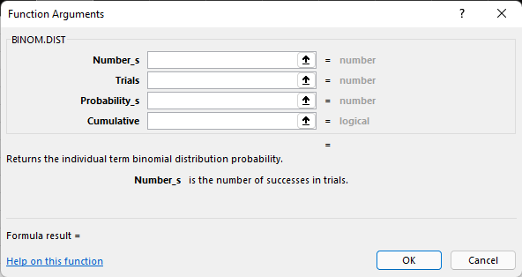
Binomial Probability
In Excel, start typing
=binom.dist(
Click the ƒ_{x} icon
This comes up:

Slide 81
Binomial Probability
Or use:
https://stattrek.com/online-calculator/binomial.aspx

Slide 82
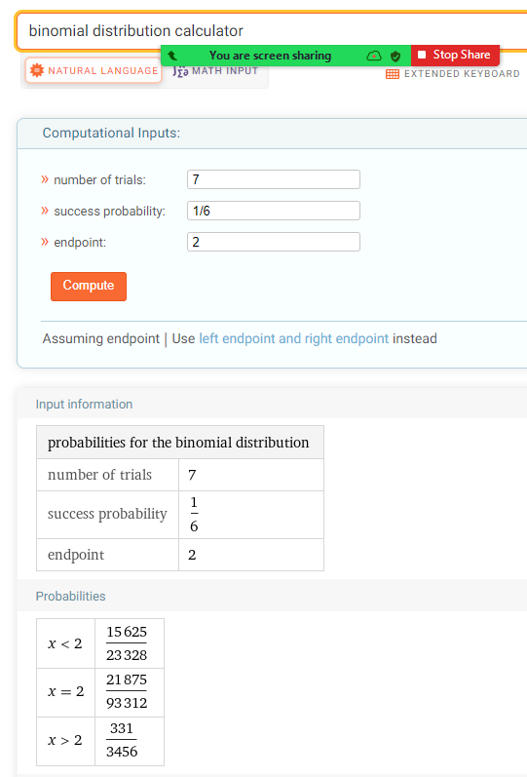
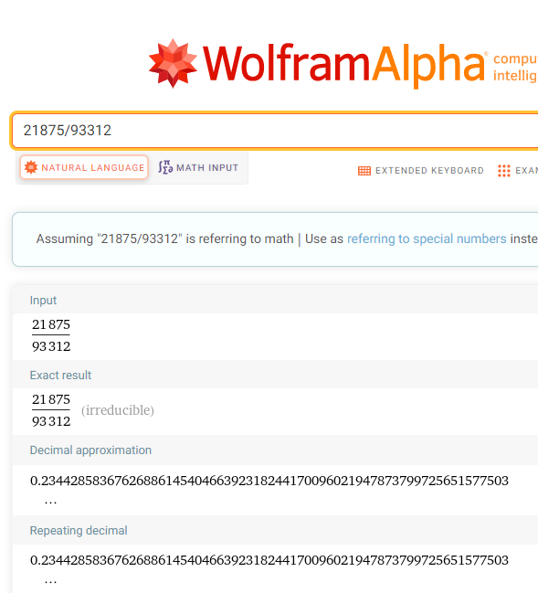
Click on x=2:

Slide 83
Symbolab wants you to enter the formula

Slide 84
Questions?
http://i.imgur.com/aliTlT3.jpg

Slide 85
Binomial Probability
The mean and standard deviation of a binomial are easy!

Slide 86
Binomial Probability
The mean of a binomial experiment:
μ_{x} = np

Slide 87
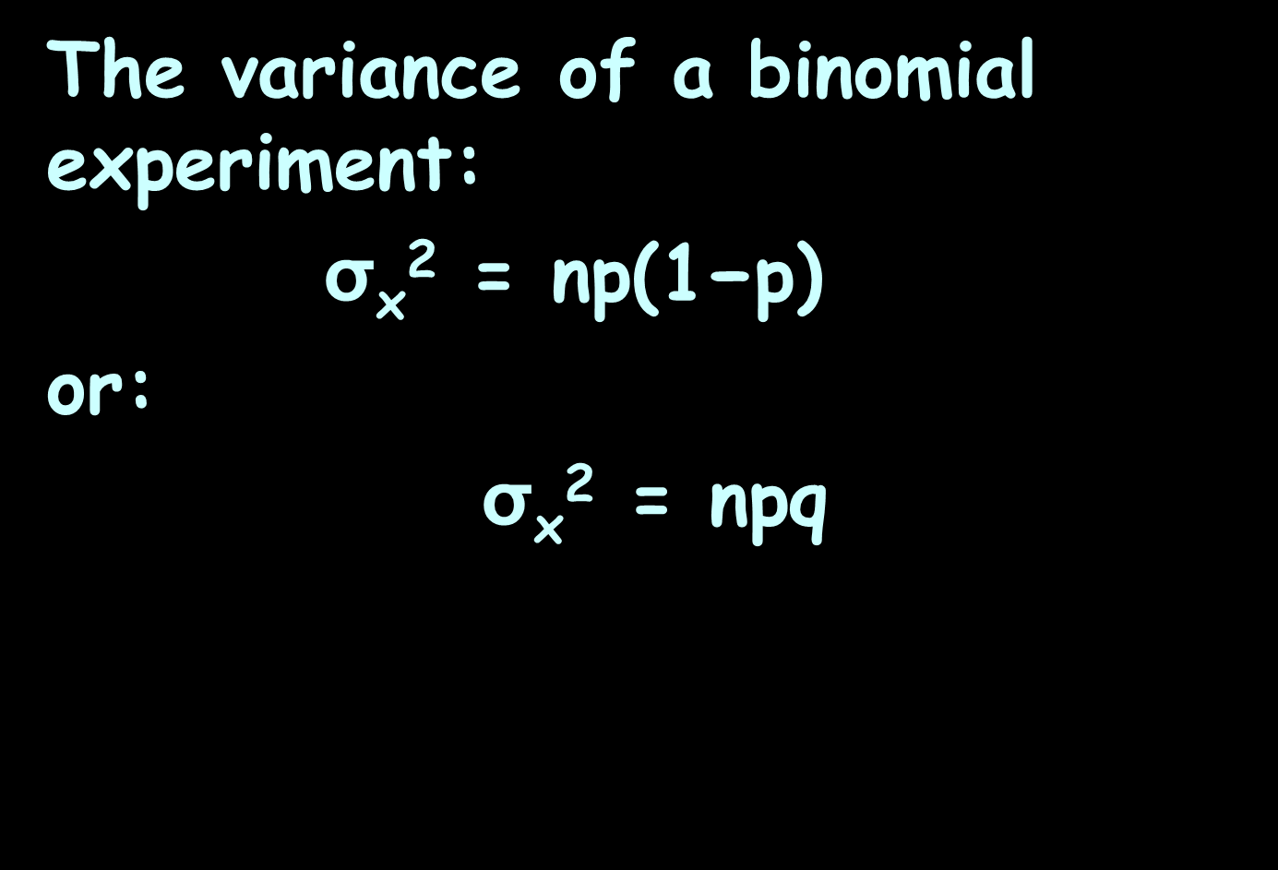
Binomial Probability
The variance of a binomial experiment:
σ_{x}² = $\text{np}\text{(1−}\text{p}\text{)}$
or:
σ_{x}² = npq

Slide 88
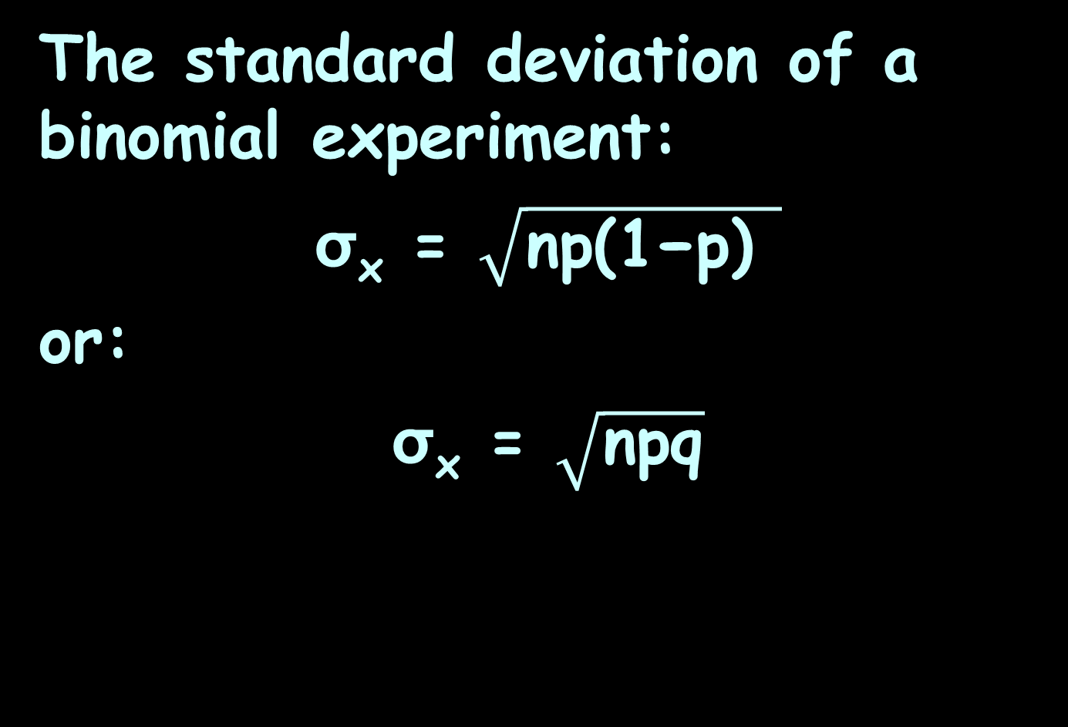
Binomial Probability
The standard deviation of a binomial experiment:
σ_{x} = $\sqrt{\text{np}\text{(1−}\text{p}\text{)} }$
or:
σ_{x} = $\sqrt{\text{np}\text{q}}$

Slide 89
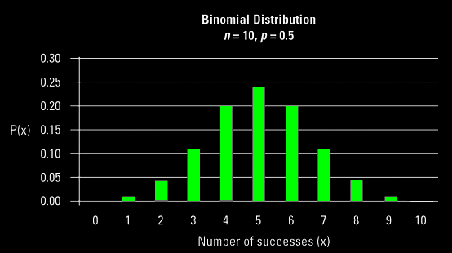
Binomial Probability
A binomial distribution histogram:
http://d2r5da613aq50s.cloudfront.net/wp-content/uploads/460747.image0.jpg

Slide 90
BINOMIAL PROBABILITY
IN-CLASS PROBLEM 3c
What is n?
https://onlinecourses.science.psu.edu/stat414/sites/onlinecourses.science.psu.edu.stat414/files/lesson09/graph_n15_p02.gif

Slide 91
BINOMIAL PROBABILITY
IN-CLASS PROBLEM 3c
What is n?
n = 15
https://onlinecourses.science.psu.edu/stat414/sites/onlinecourses.science.psu.edu.stat414/files/lesson09/graph_n15_p02.gif

Slide 92
BINOMIAL PROBABILITY
IN-CLASS PROBLEM 3a
What is p?
https://onlinecourses.science.psu.edu/stat414/sites/onlinecourses.science.psu.edu.stat414/files/lesson09/graph_n15_p02.gif

Slide 93
BINOMIAL PROBABILITY
IN-CLASS PROBLEM 3a
What is p?
p = 0.2
https://onlinecourses.science.psu.edu/stat414/sites/onlinecourses.science.psu.edu.stat414/files/lesson09/graph_n15_p02.gif

Slide 94
BINOMIAL PROBABILITY
IN-CLASS PROBLEM 3b
What is q?
https://onlinecourses.science.psu.edu/stat414/sites/onlinecourses.science.psu.edu.stat414/files/lesson09/graph_n15_p02.gif

Slide 95
BINOMIAL PROBABILITY
IN-CLASS PROBLEM 3b
What is q?
q = 1-p
= 1-.2
= 0.8
https://onlinecourses.science.psu.edu/stat414/sites/onlinecourses.science.psu.edu.stat414/files/lesson09/graph_n15_p02.gif

Slide 96
BINOMIAL PROBABILITY
IN-CLASS PROBLEM 3d
What is μ_{x}?
μ_{x} = np
https://onlinecourses.science.psu.edu/stat414/sites/onlinecourses.science.psu.edu.stat414/files/lesson09/graph_n15_p02.gif

Slide 97

BINOMIAL PROBABILITY
IN-CLASS PROBLEM 3d
What is μ_{x}?
μ_{x} = np
= 15$\text{×}$.2
= 3
https://onlinecourses.science.psu.edu/stat414/sites/onlinecourses.science.psu.edu.stat414/files/lesson09/graph_n15_p02.gif

Slide 98

BINOMIAL PROBABILITY
IN-CLASS PROBLEM 3e
What is σ_{x}²?
σ_{x}² = $\text{npq}$
https://onlinecourses.science.psu.edu/stat414/sites/onlinecourses.science.psu.edu.stat414/files/lesson09/graph_n15_p02.gif

Slide 99

BINOMIAL PROBABILITY
IN-CLASS PROBLEM 3e
What is σ_{x}²?
σ_{x}² = $\text{npq}$
= $\text{15}\text{×.2×.8}$
= 2.4
https://onlinecourses.science.psu.edu/stat414/sites/onlinecourses.science.psu.edu.stat414/files/lesson09/graph_n15_p02.gif

Slide 100
BINOMIAL PROBABILITY
IN-CLASS PROBLEM 3f
What is σ_{x}?
https://onlinecourses.science.psu.edu/stat414/sites/onlinecourses.science.psu.edu.stat414/files/lesson09/graph_n15_p02.gif

Slide 101

BINOMIAL PROBABILITY
IN-CLASS PROBLEM 3f
What is σ_{x}?
σ_{x} = $\sqrt{\text{npq}}$
= $\sqrt{\text{15}\text{×}\text{.2}\text{×}\text{.8}}$
= $\sqrt{\text{2.4}}$
≈ 1.5492
https://onlinecourses.science.psu.edu/stat414/sites/onlinecourses.science.psu.edu.stat414/files/lesson09/graph_n15_p02.gif

Slide 102
Questions?
http://i.imgur.com/aliTlT3.jpg

Slide 103
Generating Binomial Data
One of the outcomes for this class states:
Modeling will be assisted by Monte Carlo simulations run with mathematical software.

Slide 104
Generating Binomial Data
A “Monte Carlo” simulation includes a random input

Slide 105
Generating Binomial Data
Monte Carlo methods rely on repeated random sampling to obtain numerical results
The underlying concept is to use randomness to solve problems that might be deterministic in principle
https://www.investopedia.com/terms/m/montecarlosimulation.asp#:~:text=A%20Monte%20Carlo%20simulation%20is,in%20prediction%20and%20forecasting%20models

Slide 106
Generating Binomial Data
In Excel, you can use a function to generate binomial random variables:
binom.inv(n,p,rand())

Slide 107
Generating Binomial Data
The problem with binom.inv is that it cannot handle the extreme p (the probability of success), e.g., p=0, or p=1

Slide 108
Generating Binomial Data
https://shiny.rit.albany.edu/stat/binomial/

Slide 109
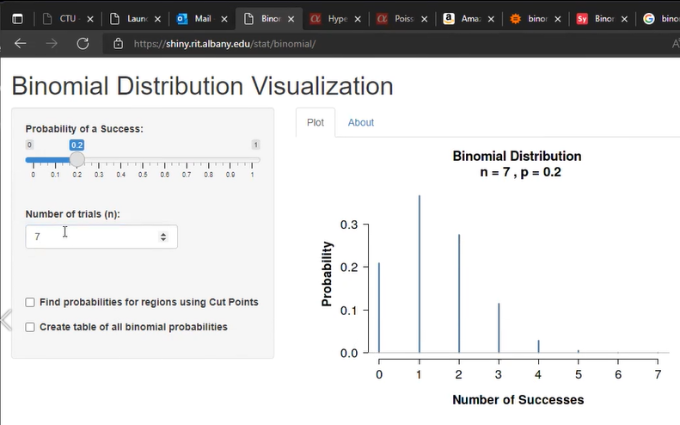

Slide 110
Questions?
http://i.imgur.com/aliTlT3.jpg

Slide 111
Negative Binomial
The negative binomial is a discrete probability distribution concerning the number of trials that must occur in order to have a predetermined number of successes

Slide 112
Negative Binomial
It was included in Jakob Bernoulli’s 1713 paper
https://www.maa.org/sites/default/files/images/upload_library/46/Euler-Bedard/2a-Jakob_
Bernoulli.jpg

Slide 113
Negative Binomial
Assume Bernoulli trials:
1) there are two possible outcomes
2) the trials are independent 3) p, the probability of success, remains the same from trial to trial

Slide 114
Negative Binomial
Let X denote the number of trials until the r^{th} success
The probability function of X is:
P(X=x) = _{(x−1)}C_{(r−1)}(1−p)^{x−r}p^{r}
for x=r,r+1,r+2,…

Slide 115
Negative Binomial
Example: A representative from the National Football League's Marketing Division randomly selects people on a random street in Kansas City, Kansas until he finds a person who attended the last home football game

Slide 116
Negative Binomial
Let p, the probability that he succeeds in finding such a person, equal 0.20
Let X denote the number of people he selects until he finds r=3 who attended the last home football game
What is the probability that
X=10?

Slide 117
NEGATIVE BINOMIAL
IN-CLASS PROBLEM 4a
X = the number of people selected
p = 0.20 r=3
What is the probability that
X=10?
P(X=x) = _{(x−1)}C_{(r−1)}(1−p)^{x−r}p^{r}

Slide 118
NEGATIVE BINOMIAL
IN-CLASS PROBLEM 4a
X = the number of people selected
p = 0.20 r=3
What is the probability that
X=10?
P(X=10) = ₍₁₀₋₁₎C₍₃₋₁₎(1−.2)¹⁰⁻³0.2³
= ?

Slide 119
NEGATIVE BINOMIAL
IN-CLASS PROBLEM 4a
X = the number of people selected
p = 0.20 r=3
What is the probability that
X=10?
P(X=10) = ₍₁₀₋₁₎C₍₃₋₁₎(1−.2)¹⁰⁻³0.2³
= (36) (0.2097152) (.008)
≈ .0604 or 6.04%

Slide 120
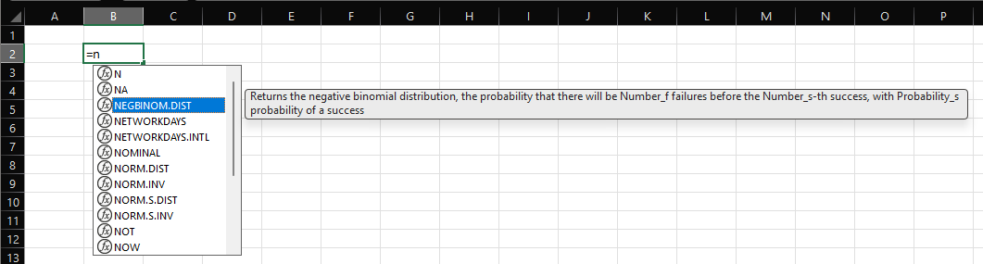
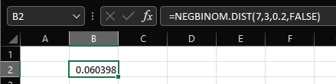
Negative Binomial
In Excel:

Slide 121
Negative Binomial
https://stattrek.com/online-calculator/negative-binomial.aspx

Slide 122
Negative Binomial
The expected value of X in a negative binomial distribution with parameters (r, p) is:
μ_{X} = r/p

Slide 123
Negative Binomial
The variance of X in a negative binomial distribution with parameters (r, p) is:
σ_{X}² = r(1-p)/p²

Slide 124
NEGATIVE BINOMIAL
IN-CLASS PROBLEM 4b
X = the number of people selected
p = 0.20 r=3
What is the expected number of
successes?
μ_{X} = r/p = ?

Slide 125
NEGATIVE BINOMIAL
IN-CLASS PROBLEM 4c
X = the number of people selected
p = 0.20 r=3
What is the expected number of
successes?
μ_{X} = r/p = 15
What is the variance of the number of successes?
σ_{X}² = r(1-p)/p²

Slide 126
NEGATIVE BINOMIAL
IN-CLASS PROBLEM 4c
X = the number of people selected
p = 0.20 r=3
μ_{X} = r/p = 15
What is the variance of the number of successes?
σ_{X}² = r(1-p)/p² = 60
What is the standard deviation?

Slide 127
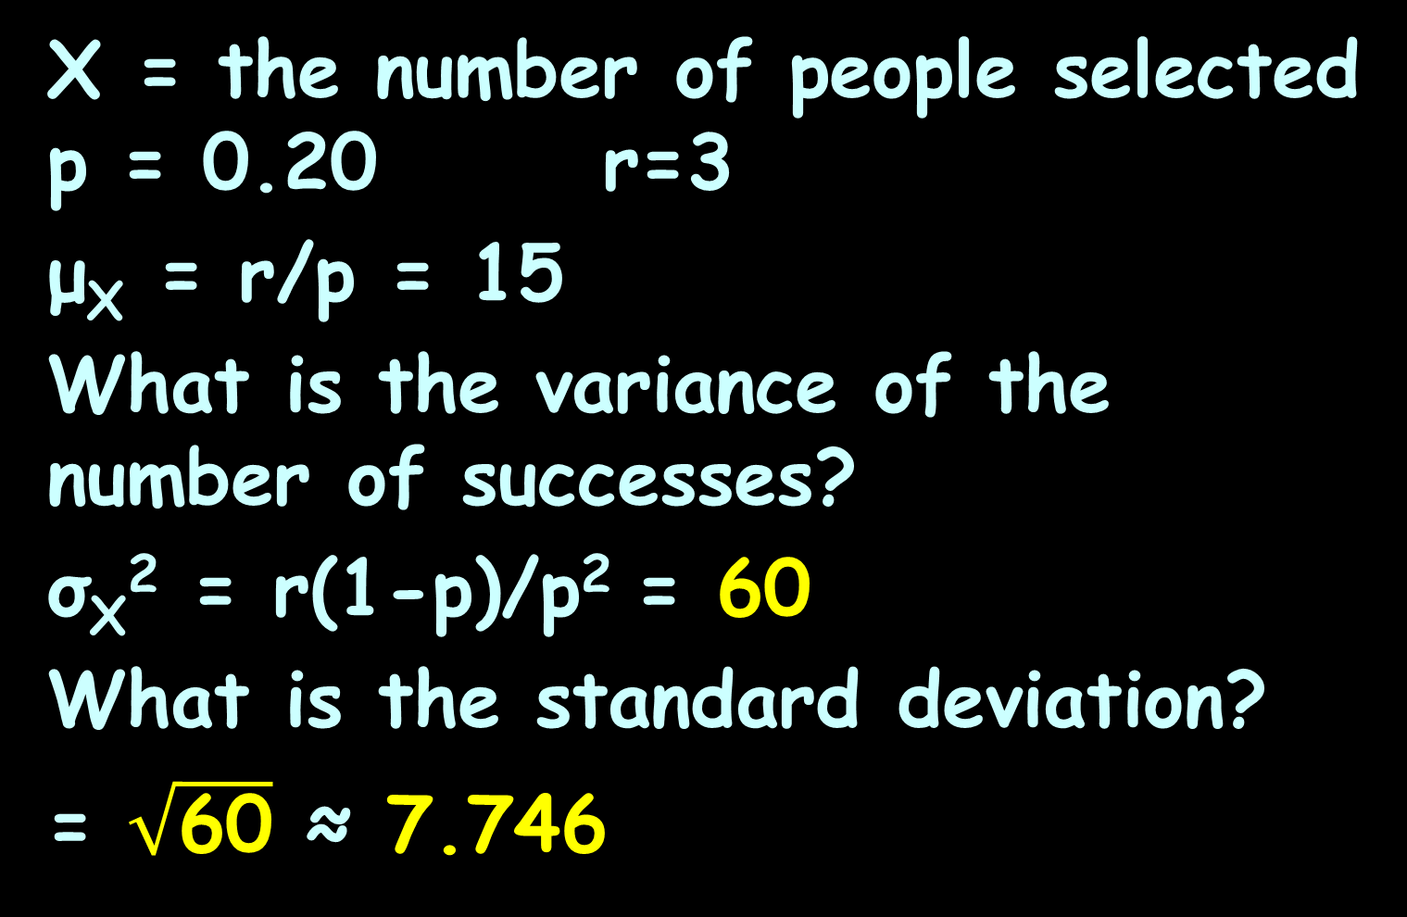
NEGATIVE BINOMIAL
IN-CLASS PROBLEM 4c
X = the number of people selected
p = 0.20 r=3
μ_{X} = r/p = 15
What is the variance of the number of successes?
σ_{X}² = r(1-p)/p² = 60
What is the standard deviation?
= $\sqrt{\text{60}}$ ≈ 7.746

Slide 128
Questions?
http://i.imgur.com/aliTlT3.jpg

Slide 129
Geometric Distribution
The geometric distribution is a special case of the negative binomial distribution
It deals with the number of trials required for a single success

Slide 130
Geometric Distribution
Thus, the geometric distribution is the negative binomial distribution where the number of successes (r) is equal to 1

Slide 131
Pascal and Polya
The Pascal distribution (after Blaise Pascal) and Polya distribution (for George Pólya) are other special cases of the negative binomial distribution

Slide 132
Pascal and Polya
Engineers and climatologists use a “Pascal” negative binomial for the case of an integer-valued stopping-time parameter r
and use “Polya” for the real-valued case

Slide 133
Questions?
http://i.imgur.com/aliTlT3.jpg

Slide 134
Hypergeometric
The binomial distribution assumes a huge population
Taking repeated tiny samples will not affect the probabilities from a huge population

Slide 135
Hypergeometric
And, of course, if you replace the sample before taking another, it will assure the probabilities are not affected at all

Slide 136
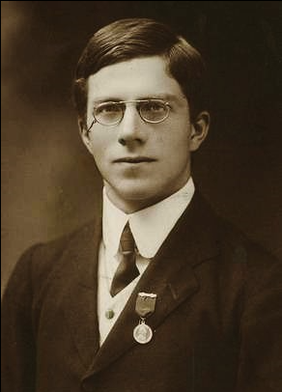
Hypergeometric
Sir Ronald Aylmer
Fisher wondered
about taking
samples without
replacement from
a small population
https://en.wikipedia.org/wiki/Hypergeometric_distribution#/media/File:Youngronaldfisher2.JPG

Slide 137
Hypergeometric
The hypergeometric distribution describes the probability of k successes in n draws, without replacement, from a finite population of size N that contains exactly K objects with a desired feature, where each draw is either a success or a failure

Slide 138
Hypergeometric
In contrast, the binomial distribution describes the probability of k successes in n draws with replacement

Slide 139
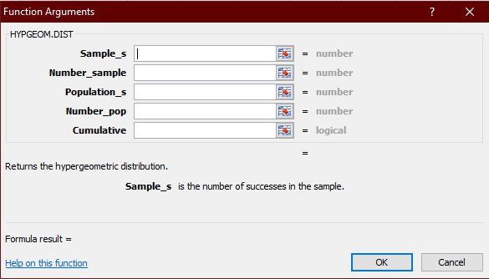
Hypergeometric
In Excel:

Slide 140
Hypergeometric
Or use:
http://stattrek.com/online-calculator/hypergeometric.aspx

Slide 141
Hypergeometric
The test is often used to identify which sub-populations are over- or under-represented in a sample

Slide 142
Hypergeometric
For example, a marketing group could use the test to understand their customer base by testing a set of known customers for over-representation of people under 30

Slide 143
Hypergeometric
Apparently the gambling game “Keno” follows the hypergeometric distribution

Slide 144
HYPERGEOMETRIC PROBABILITY
IN-CLASS PROBLEM 5a
Suppose you had a hypergeometric distribution with:
N = 25 K = 8 n = 9 k = 5
Find the mean = n(K/N)

Slide 145
HYPERGEOMETRIC PROBABILITY
IN-CLASS PROBLEM 5b
Suppose you had a hypergeometric distribution with:
N = 25 K = 8 n = 9 k = 5
Find the mean = n(K/N) = 2.88
Find the variance
n(K/N)((N-K)/N)((N-n)/(N-1))

Slide 146
HYPERGEOMETRIC PROBABILITY
IN-CLASS PROBLEM 5b
Suppose you had a hypergeometric distribution with:
N = 25 K = 8 n = 9 k = 5
Find the variance =
n(K/N)((N-K)/N)((N-n)/(N-1)) =
0.0768

Slide 147
HYPERGEOMETRIC PROBABILITY
IN-CLASS PROBLEM 5c
Suppose you had a hypergeometric distribution with:
N = 25 K = 8 n = 9 k = 5
Find the standard deviation

Slide 148
HYPERGEOMETRIC PROBABILITY
IN-CLASS PROBLEM 5c
Suppose you had a hypergeometric distribution with:
N = 25 K = 8 n = 9 k = 5
Find the standard deviation ≈
0.2771

Slide 149
HYPERGEOMETRIC PROBABILITY
IN-CLASS PROBLEM 5d
Suppose you had a hypergeometric distribution with:
N = 25 K = 8 n = 9 k = 5
Find P(K=5)

Slide 150
HYPERGEOMETRIC PROBABILITY
IN-CLASS PROBLEM 5d
Suppose you had a hypergeometric distribution with:
N = 25 K = 8 n = 9 k = 5
Find P(K=5) ≈ 0.065

Slide 151
Questions?
http://i.imgur.com/aliTlT3.jpg

Slide 152
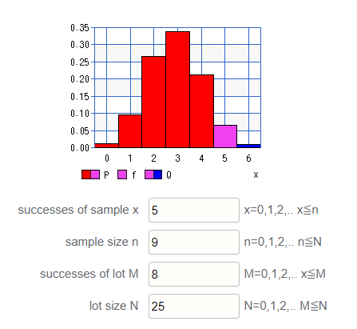
Generating Hypergeometric Data
For a Monte Carlo Simulation:
https://keisan.casio.com/exec/system/1180573201
P(K=5) ≈ 0.065

Slide 153
Questions?
http://i.imgur.com/aliTlT3.jpg

Slide 154
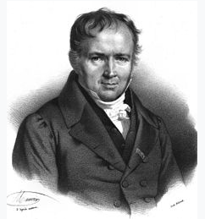
Poisson Probability
The Poisson distribution was introduced by the French mathematician Siméon Denis
Poisson
https://en.wikipedia.org/wiki/Siméon_Denis_Poisson#/media/File:Simeon_Poisson.jpg

Slide 155
Poisson Probability
He was using it to investigate the number of wrongful convictions in a country
https://en.wikipedia.org/wiki/Siméon_Denis_Poisson#/media/File:Simeon_Poisson.jpg

Slide 156
Poisson Probability
Is a discrete probability distribution for the probability of a given number of events occurring in a fixed interval of time (or space) when the events happen with a known constant rate and independently of the time since the last event

Slide 157
Poisson Probability
For instance, an individual keeping track of the amount of mail they receive each day may notice that they receive an average number of 4 letters per day

Slide 158
Poisson Probability
If receiving any particular piece of mail does not affect the arrival times of future pieces of mail, the number of pieces of mail received in a day exhibits a Poisson distribution

Slide 159
Poisson Probability
The number of students who arrive at the student union per minute will likely not follow a Poisson distribution:
the rate is not constant (low rate during class time, high rate between class times)

Slide 160
Poisson Probability
The number of students who arrive at the student union per minute will likely not follow a Poisson distribution:
the arrivals of individual students are not independent (students tend to come in groups)

Slide 161
Poisson Probability
The number of magnitude 5 earthquakes per year in a country would not follow a Poisson distribution because one large earthquake increases the probability of aftershocks of similar magnitude

Slide 162
Poisson Probability
Among patients admitted to the intensive care unit of a hospital, the number of days that the patients spend in the ICU is not Poisson distributed because the number of days cannot be zero

Slide 163
Poisson Probability
The Poisson distribution may be useful to model events such as:
-The number of meteorites greater than 1 meter diameter that strike Earth in a year
-The number of patients arriving in an emergency room between 10 and 11 pm

Slide 164
Poisson Probability
The Poisson distribution is appropriate if:
-k is the number of times an event occurs in an interval
-events occur independently
-the rate at which events occur is constant

Slide 165
Poisson Probability
The Poisson distribution is appropriate if:
-two events cannot occur at exactly the same instant
-the probability of an event in a small sub-interval is proportional to the length of the sub-interval

Slide 166
Poisson Probability
The Poisson distribution is appropriate if:
the actual probability distribution is given by a binomial distribution and the number of trials is sufficiently bigger than the number of successes one is asking about

Slide 167
Poisson Probability
As you can imagine, it is painful to calculate

Slide 168
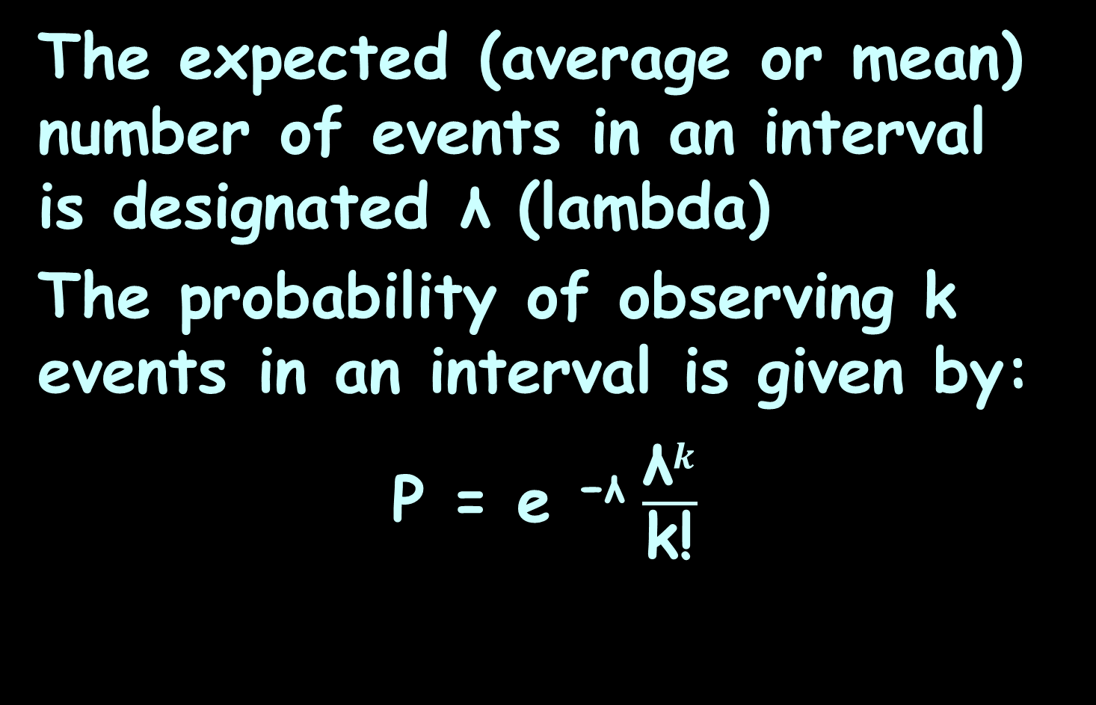
Poisson Probability
The expected (average or mean) number of events in an interval is designated λ (lambda)
The probability of observing k events in an interval is given by:
P = e ^{−λ} $\frac{{\text{λ}}^{k}}{\text{k}\text{!}}$

Slide 169
Poisson Probability
The variance of a Poisson distribution is always equal to its mean value!
designated λ (lambda)

Slide 170
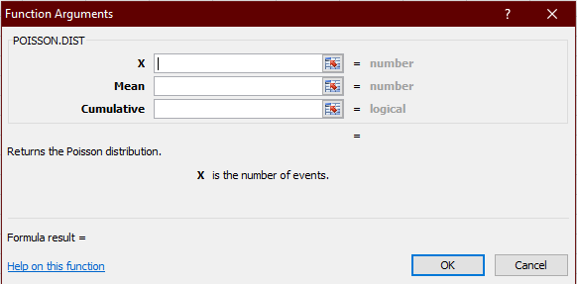
Poisson Probability
Excel has a formula:

Slide 171
Poisson Probability
Excel has a formula:
k
λ
False
(for an individual probability)
True
(for a cumulative probability)

Slide 172
Poisson Probability
Or:
http://stattrek.com/online-calculator/poisson.aspx

Slide 173
POISSON PROBABILITY
IN-CLASS PROBLEM 6a
Suppose you had a Poisson distribution with:
k = 5 λ = 8
Find the mean

Slide 174
POISSON PROBABILITY
IN-CLASS PROBLEM 6b
Suppose you had a Poisson distribution with:
k = 5 λ = 8
Find the mean = 8
Find the variance

Slide 175
POISSON PROBABILITY
IN-CLASS PROBLEM 6c
Suppose you had a Poisson distribution with:
k = 5 λ = 8
Find the mean = 8
Find the variance = 8
Find the standard deviation

Slide 176
POISSON PROBABILITY
IN-CLASS PROBLEM 6c
Suppose you had a Poisson distribution with:
k = 5 λ = 8
Find the mean = 8
Find the variance = 8
Find the standard deviation ≈
2.83

Slide 177
POISSON PROBABILITY
IN-CLASS PROBLEM 6d
Suppose you had a Poisson distribution with:
k = 5 λ = 8
Calculate P(K=5)

Slide 178
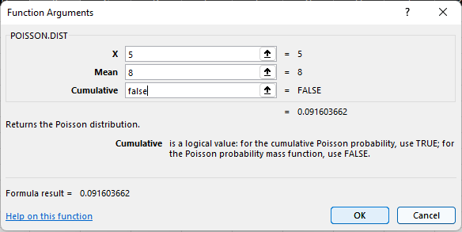
POISSON PROBABILITY
IN-CLASS PROBLEM 6d
Suppose you had a Poisson distribution with:
k = 5 λ = 8
Calculate P(K=5)

Slide 179
POISSON PROBABILITY
IN-CLASS PROBLEM 6d
Suppose you had a Poisson distribution with:
k = 5 λ = 8
P(K=5) ≈ 9.16%

Slide 180
Poisson Probability
The negative binomial distribution becomes identical to Poisson in the limit r→∞ for a given mean μ

Slide 181
Questions?
http://i.imgur.com/aliTlT3.jpg

Slide 182
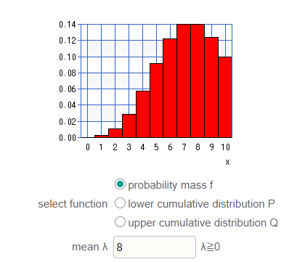
Generating Poisson Data
For a Monte Carlo simulation:
https://keisan.casio.com/exec/system/1180573180
P(K=5) ≈ 9.16%

Slide 183
Questions?
http://i.imgur.com/aliTlT3.jpg

Slide 184
Generating Monte Carlo Data
https://www.portfoliovisualizer.com/
monte-carlo-simulation
#analysisResults

Slide 185
Generating Monte Carlo Data
https://retirementplans.vanguard.com/VGApp/pe/pubeducation/calculators/RetirementNestEggCalc.jsf

Slide 186
Generating Monte Carlo Data
https://www.retirementsimulation.com

Slide 187
Questions?
http://i.imgur.com/aliTlT3.jpg

Slide 188
Summary
Today we studied:
Review of discrete random variables
New: Discrete probability distributions: binomial, negative binomial, geometric, Poisson, hypergeometric

Slide 189

You Survived!
www.playbuzz.com

