Slide 1
Welcome to
Unit 8 Part 15
MATH366 Probability and Statistics
https://online.stanford.edu/sites/default/files/styles/figure_default/public/2018-04/theory-of-probability_stats116.jpg?itok=ms4fRMO-

Slide 2
What’s Up?
Today we will be going over:
Review: Uses for discrete probabilities New: Project Management Charts

Slide 3
What’s Up?
Outcome 3) Modeling will be assisted by Monte Carlo simulations run with mathematical software
Outcome 4) Calculate the parameters of several discrete random variable distributions and compute the probability of events in a typical discrete event application

Slide 4

Review
http://995642590.r.lightningbase-cdn.com/wp-content/uploads/2010/12/looking-back-hrexaminer-v144-cover425px.jpg

Slide 5
Assignment
Sometimes you need to make decisions about assigning people to jobs, tasks to machines, etc.
These are called “Assignment Problems”

Slide 6
Assignment
Again, you want to minimize something: cost, time takes, errors made, maintenance required
or maximize something: profits, number of customers, etc.

Slide 7
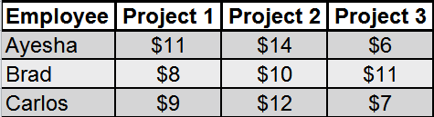
Assignment
Suppose past experience has given you information on how much it would cost for each of n employees to do each of k projects
VFrench, 2022

Slide 8
Assignment
How many ways can you assign the projects to the employees?

Slide 9
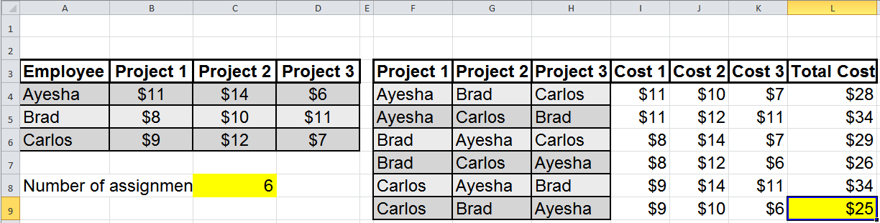
Assignment
There are
n!
ways you can assign the projects
VFrench, 2022

Slide 10
Assignment
Once you know how many possible ways there are to make the assignments, we need to list those possibilities:
VFrench, 2022

Slide 11
Assignment
Once you have the list of possible assignments, you need to list the cost of each employee doing the assigned task
VFrench, 2022

Slide 12
Assignment
Calculate the total costs for each assignment and identify the assignment with the lowest cost:
VFrench, 2022

Slide 13
Probability Assignment
Some Assignment problems are about time
Some are about cost or profit
Some are about probabilities

Slide 14
Probability Assignment
Probability is the likelihood of a favorable outcome
It is designated “P”

Slide 15
Probability Assignment
# favorable outcomes
total # of outcomes
So, you have to be able to count the number of favorable outcomes and the total number of outcomes
P =

Slide 16
Probability Assignment
Probabilities are most often expressed in terms of %

Slide 17
Probability Assignment
Because the number of favorable outcomes is always less than the total number of outcomes
0% ≤ P ≤ 100%

Slide 18
Probability Assignment
Multiplication rule - if you have sequential outcomes:
P(one occurring, then another occurring) =
P(one occurring)*P(another occurring)

Slide 19
Probability Assignment
When we had Assignment problems trying to minimize time or cost we had to add the values to get the total time or cost

Slide 20
Probability Assignment
When we have a problem with probabilities, we will have to multiply the probabilities to get the total probability

Slide 21

Questions?
http://i.imgur.com/aliTlT3.jpg

Slide 22
Project Management
… is planning, organizing, motivating, and controlling resources to achieve specific goals

Slide 23
Project Management
A project is a temporary endeavor with a defined beginning and end

Slide 24
Project Management
Usually projects are time-constrained and are often also constrained by funding or deliverables

Slide 25
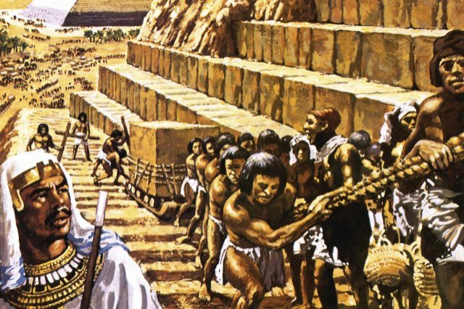
Project Management
Managing projects is very ancient
http://1.bp.blogspot.com/-b9AWEon9HSk/UDU_kZCaatI/AAAAAAAAB-g/w9KKYs1TPjg/s200/pyramid-building3.jpg

Slide 26
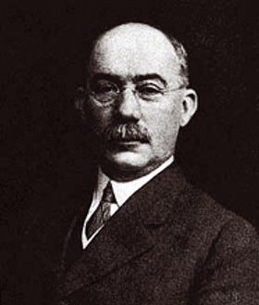
Project Management
One of the founders of Project Management is Henry Gantt
(May 20, 1861 –
November 23, 1919)
He was an
American
mechanical engineer
and management
consultant
https://alamy-ltd.ewrvdi.net/c/77643/748811/10905?u=https%3A%2F%2F
www.alamy.com%2Fstock-photo-henri-Gantt-139984479.html

Slide 27
Project Management
He is famous for inventing the Gantt chart

Slide 28
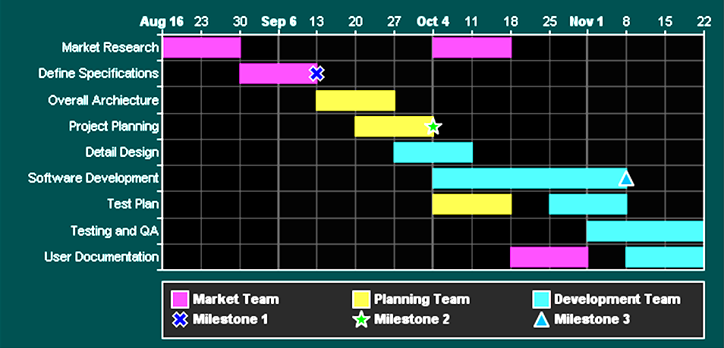
Project Management
Gantt chart:
http://www.monkeybreadsoftware.de/realbasic/chartdirector/images/colorgantt_m.png

Slide 29
Project Management
Gantt charts show the viewer when parts of the project are to be done and how long each will take
http://www.monkeybreadsoftware.de/realbasic/chartdirector/images/colorgantt_m.png

Slide 30
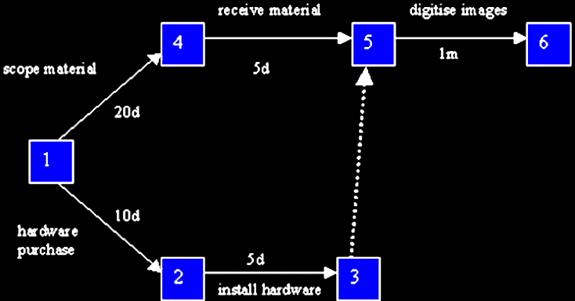
Project Management
A different way of graphing project timing is the “Critical Path Method” (CPM)
http://www.ahds.ac.uk/images/exec/project-management-illustration1.gif

Slide 31
Project Management
CPM includes paths showing which activities must be done before the next activity can start
http://www.ahds.ac.uk/images/exec/project-management-illustration1.gif

Slide 32
Project Management
Times are shown using numbers, not lengths of bars
http://www.ahds.ac.uk/images/exec/project-management-illustration1.gif

Slide 33
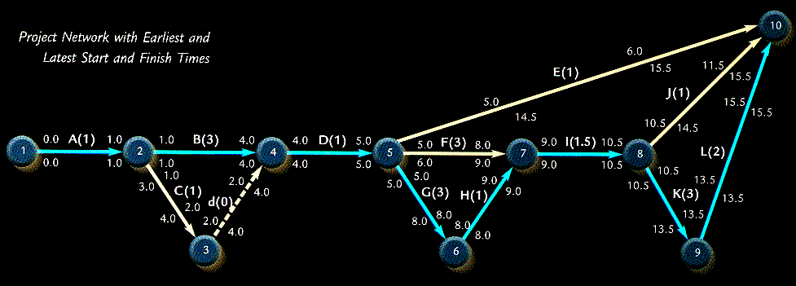
Project Management
Another way of graphing project timing is the “Program Evaluation and Review Technique” (PERT)
http://www1bpt.bridgeport.edu/sed/projects/cs597/unfiled/zhipingli/Pert.gif

Slide 34
Project Management
CPM uses only a single estimate of the duration of each activity
PERT uses up to three estimates of the duration of each activity (optimistic, likely and pessimistic times)

Slide 35
Project Management
This PERT chart uses how many activity duration times?
http://www1bpt.bridgeport.edu/sed/projects/cs597/unfiled/zhipingli/Pert.gif

Slide 36
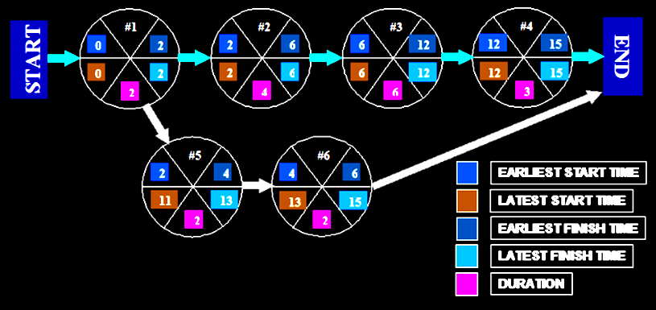
Project Management
Another ‘nother way of graphing project timing is the “Activity on Node” (AON) chart
http://project-management-basics.com/images/project%20management/big/
AON_network_bubble.png

Slide 37
Project Management
Each type of chart provides more information but is harder to read and understand

Slide 38
Questions?
http://i.imgur.com/aliTlT3.jpg

Slide 39
Project Management
Most of the charts you will do for your boss are Gantt charts
They are easy to do in Microsoft Project but can also be done in Excel

Slide 40
Project Management
Suppose you have a project you want to chart
It has 7 activities (A-G)

Slide 41
Project Management
You know approximately how long each activity will take to complete
You know which activities need to be done before the next can begin (“immediate predecessors”)

Slide 42
Project Management
Make a table summarizing your information:
Activity | Expected Time (weeks) | Immediate Predecessors
A | 2 | -
B | 3 | -
C | 5 | A
D | 6 | B
E | 1 | C,D
F | 4 | D
G | 2 | E
VFrench, 2022

Slide 43
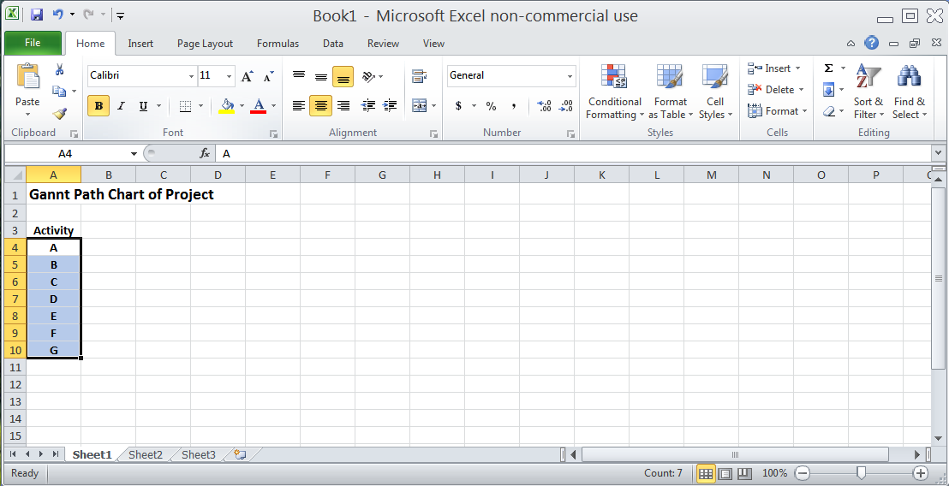
Project Management
Start with a title and your list of activities
VFrench, 2022

Slide 44
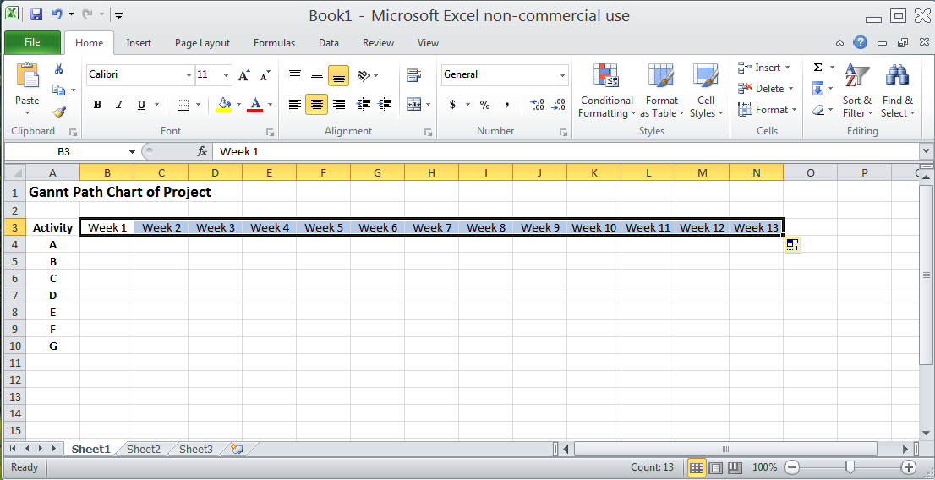
Project Management
Add a few time intervals (you’ll probably need more…)
VFrench, 2022

Slide 45
Project Management
Activity A is expected to last two weeks
Activity | Expected Time (weeks) | Immediate Predecessors
A | 2 | -
B | 3 | -
C | 5 | A
D | 6 | B
E | 1 | C,D
F | 4 | D
G | 2 | E
VFrench, 2022

Slide 46
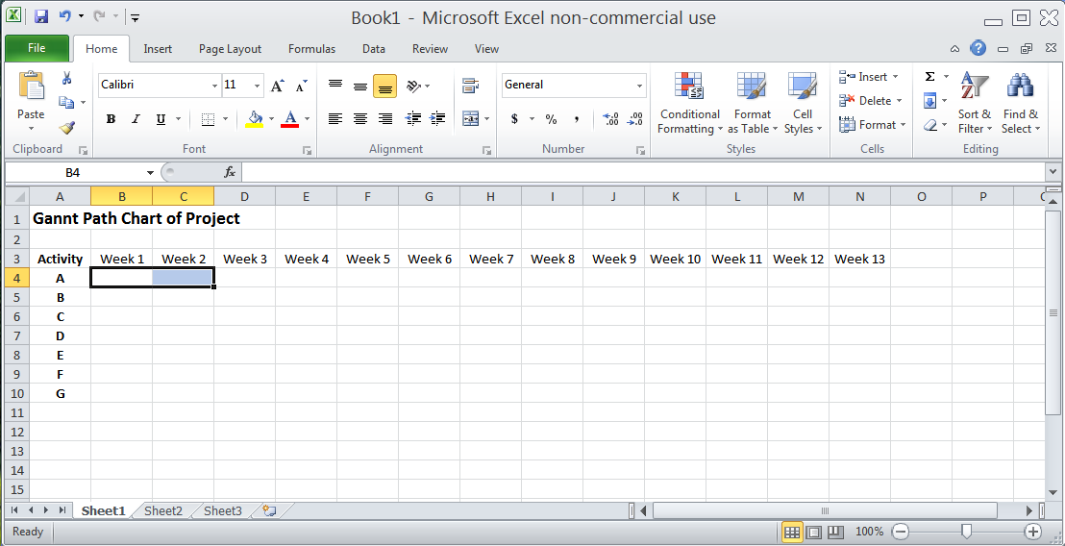
Project Management
Highlight a two-week area next to Activity A
VFrench, 2022

Slide 47
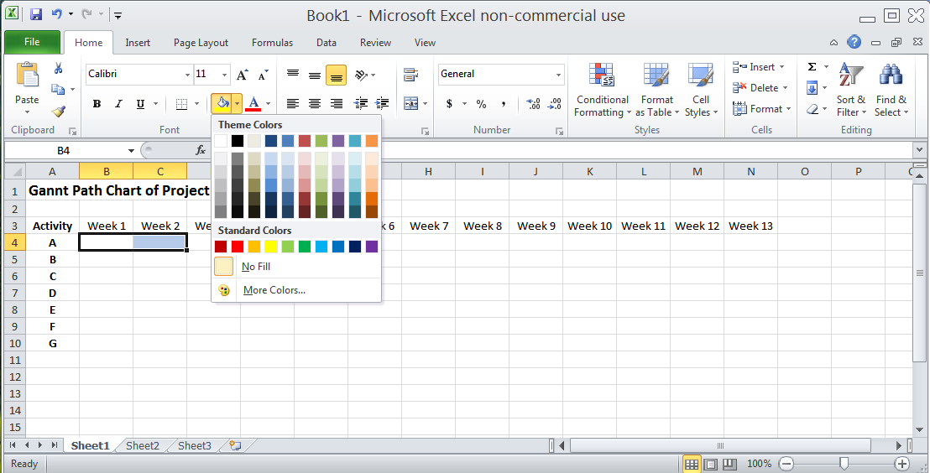
Project Management
Click the “Fill” icon:
VFrench, 2022

Slide 48
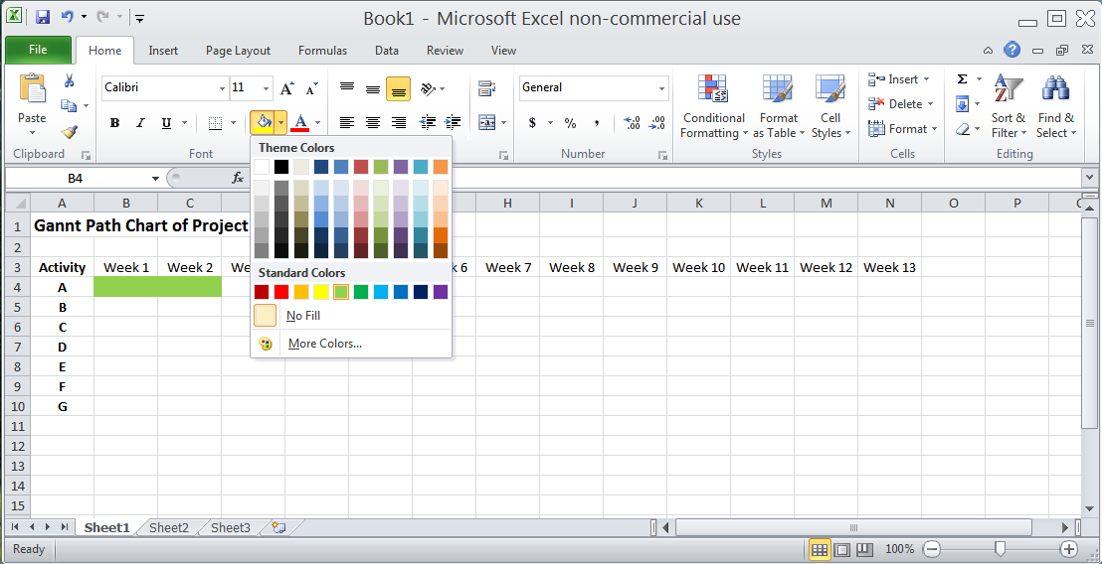
Project Management
Pick a color you like:
VFrench, 2022

Slide 49
Project Management
Activity B is expected to take 3 weeks
Activity | Expected Time (weeks) | Immediate Predecessors
A | 2 | -
B | 3 | -
C | 5 | A
D | 6 | B
E | 1 | C,D
F | 4 | D
G | 2 | E
VFrench, 2022

Slide 50
Project Management
It doesn’t have any predecessors, so it could start at the same time as Activity A
Activity | Expected Time (weeks) | Immediate Predecessors
A | 2 | -
B | 3 | -
C | 5 | A
D | 6 | B
E | 1 | C,D
F | 4 | D
G | 2 | E
VFrench, 2022

Slide 51
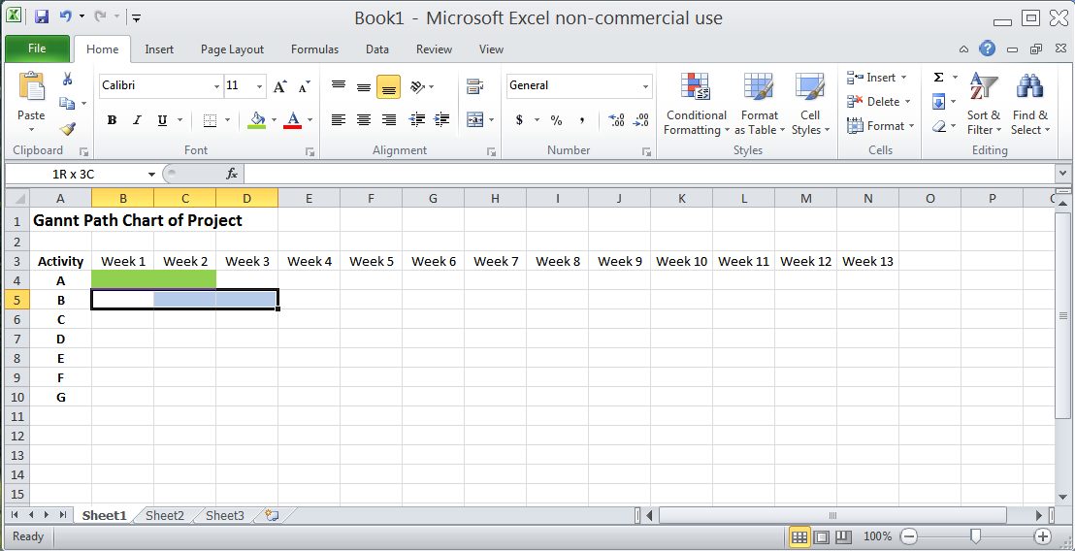
Project Management
Select the cells:
VFrench, 2022

Slide 52
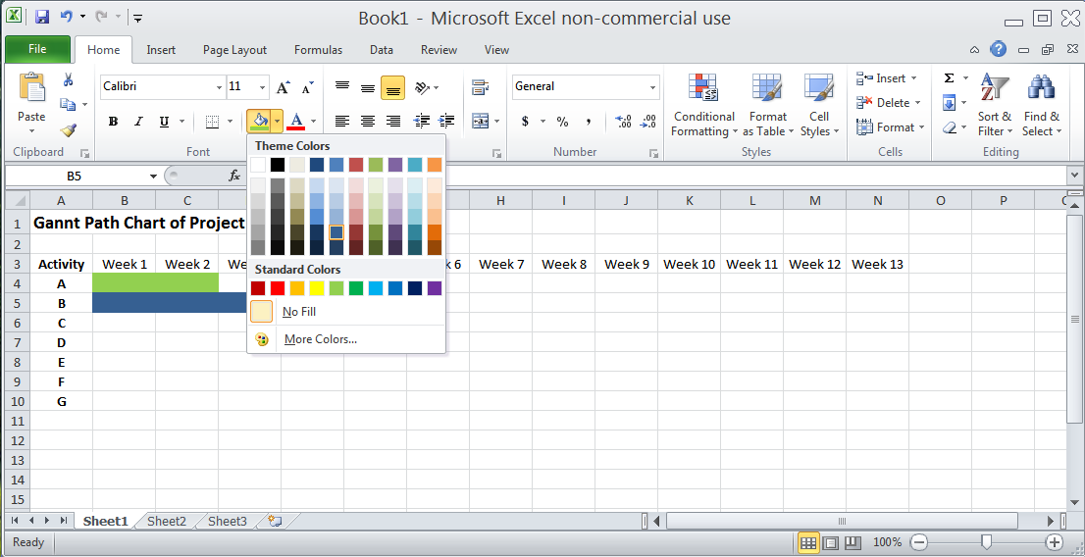
Project Management
Select the same or a new color:
VFrench, 2022

Slide 53
Project Management
Activity C is expected to take 5 weeks
Activity | Expected Time (weeks) | Immediate Predecessors
A | 2 | -
B | 3 | -
C | 5 | A
D | 6 | B
E | 1 | C,D
F | 4 | D
G | 2 | E
VFrench, 2022

Slide 54
Project Management
It has a predecessor, though!
Activity A must be completed before it can start!
Activity | Expected Time (weeks) | Immediate Predecessors
A | 2 | -
B | 3 | -
C | 5 | A
D | 6 | B
E | 1 | C,D
F | 4 | D
G | 2 | E
VFrench, 2022

Slide 55
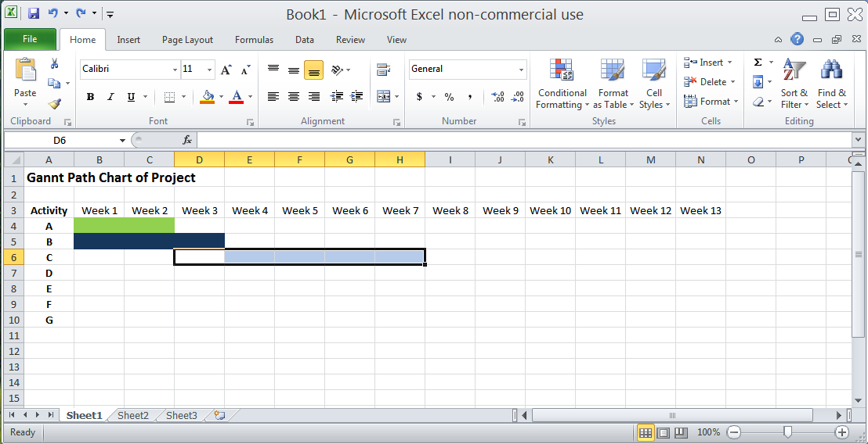
Project Management
Activity A ends on week 2, so start Activity C’s cells then
VFrench, 2022

Slide 56
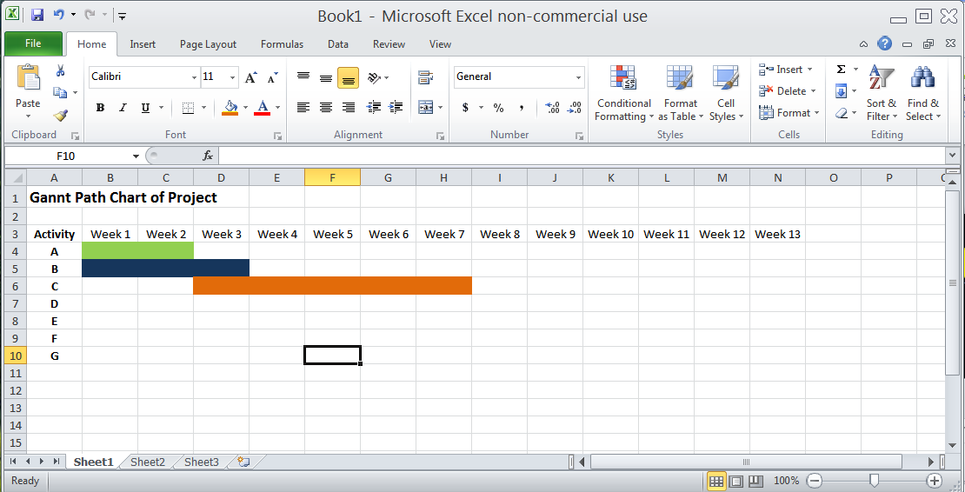
Project Management
Pick another color (or use the same one!)
VFrench, 2022

Slide 57
Project Management
Activity D takes 6 weeks and starts after B is done
Activity | Expected Time (weeks) | Immediate Predecessors
A | 2 | -
B | 3 | -
C | 5 | A
D | 6 | B
E | 1 | C,D
F | 4 | D
G | 2 | E
VFrench, 2022

Slide 58
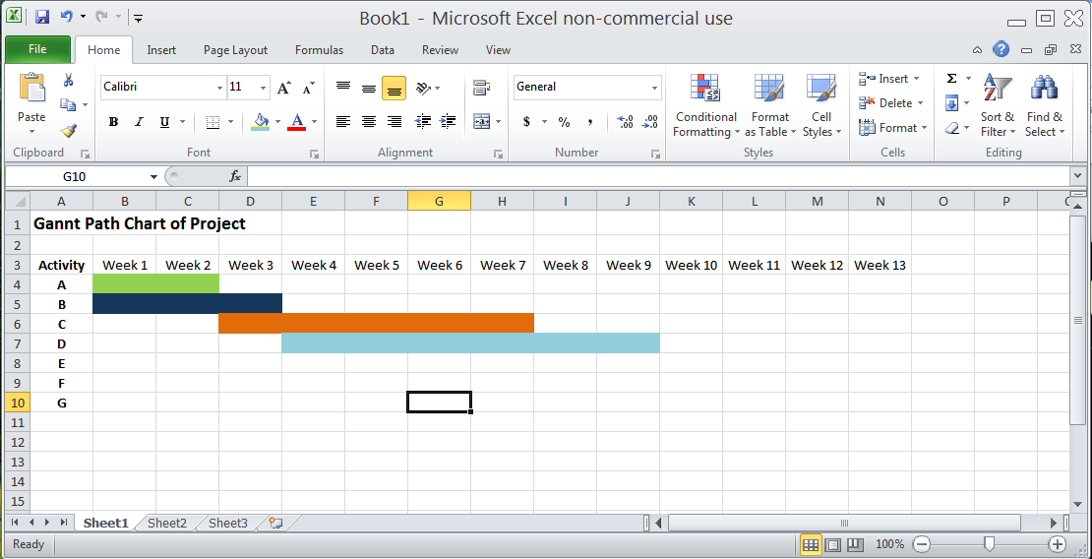
Project Management
VFrench, 2022

Slide 59
Project Management
Activity E takes 1 week and starts after both C and D are done
Activity | Expected Time (weeks) | Immediate Predecessors
A | 2 | -
B | 3 | -
C | 5 | A
D | 6 | B
E | 1 | C,D
F | 4 | D
G | 2 | E
VFrench, 2022

Slide 60
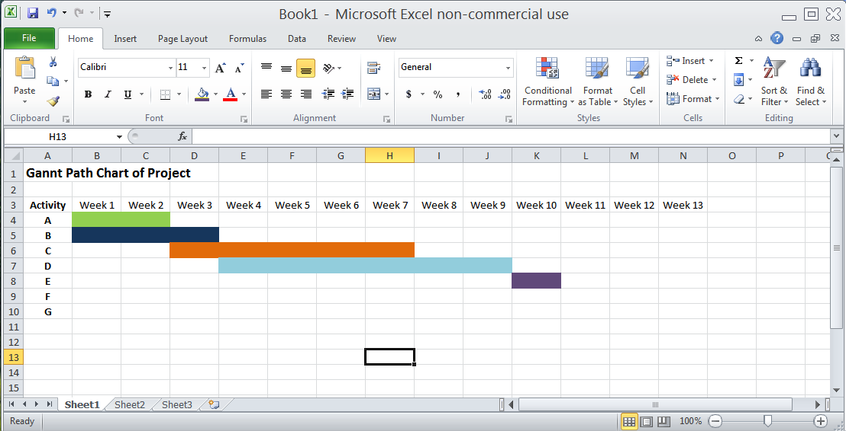
Project Management
VFrench, 2022

Slide 61
Project Management
Activity F takes 4 weeks and starts after D is done
Activity | Expected Time (weeks) | Immediate Predecessors
A | 2 | -
B | 3 | -
C | 5 | A
D | 6 | B
E | 1 | C,D
F | 4 | D
G | 2 | E
VFrench, 2022

Slide 62
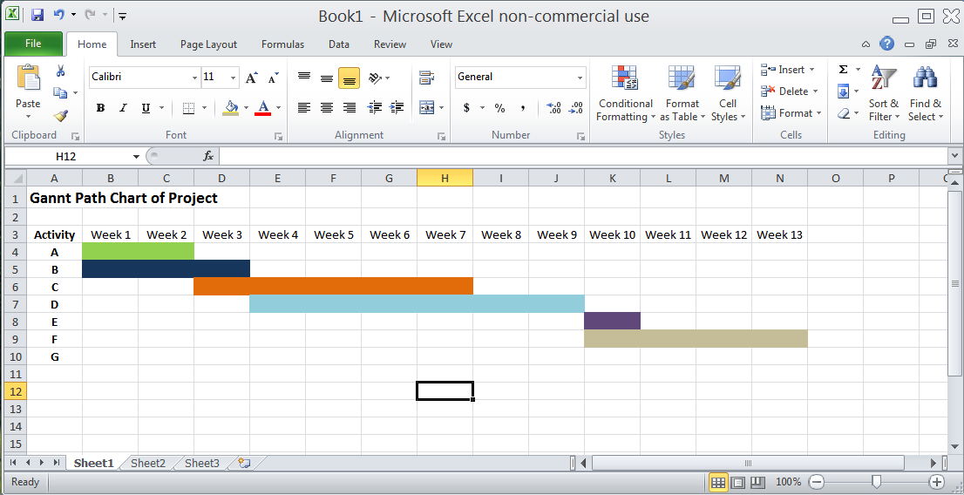
Project Management
VFrench, 2022

Slide 63
Project Management
Activity G takes 2 weeks and starts after E is done
Activity | Expected Time (weeks) | Immediate Predecessors
A | 2 | -
B | 3 | -
C | 5 | A
D | 6 | B
E | 1 | C,D
F | 4 | D
G | 2 | E
VFrench, 2022

Slide 64
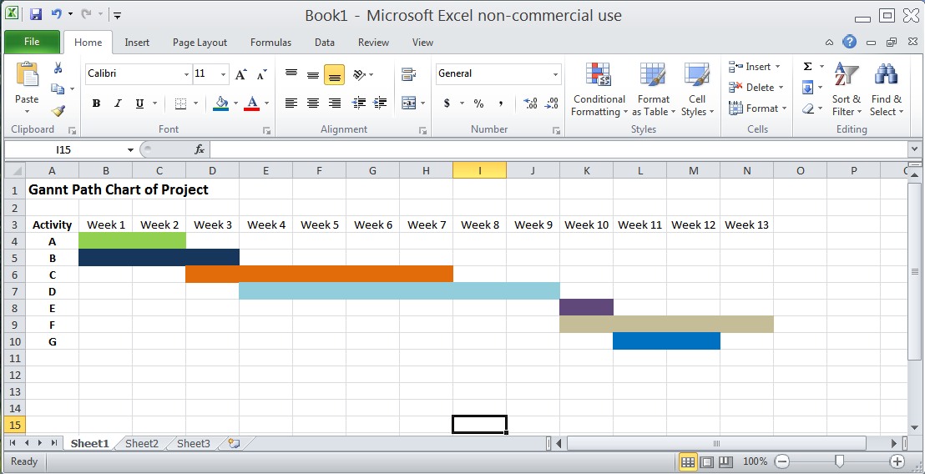
Project Management
The complete chart:
VFrench, 2022

Slide 65
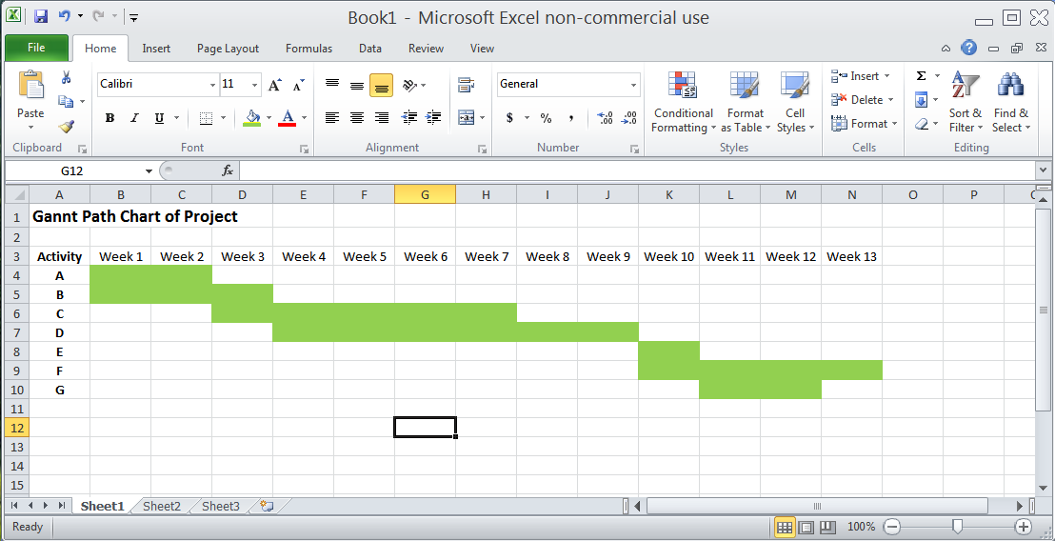
Project Management
If you used all the same color:
VFrench, 2022

Slide 66
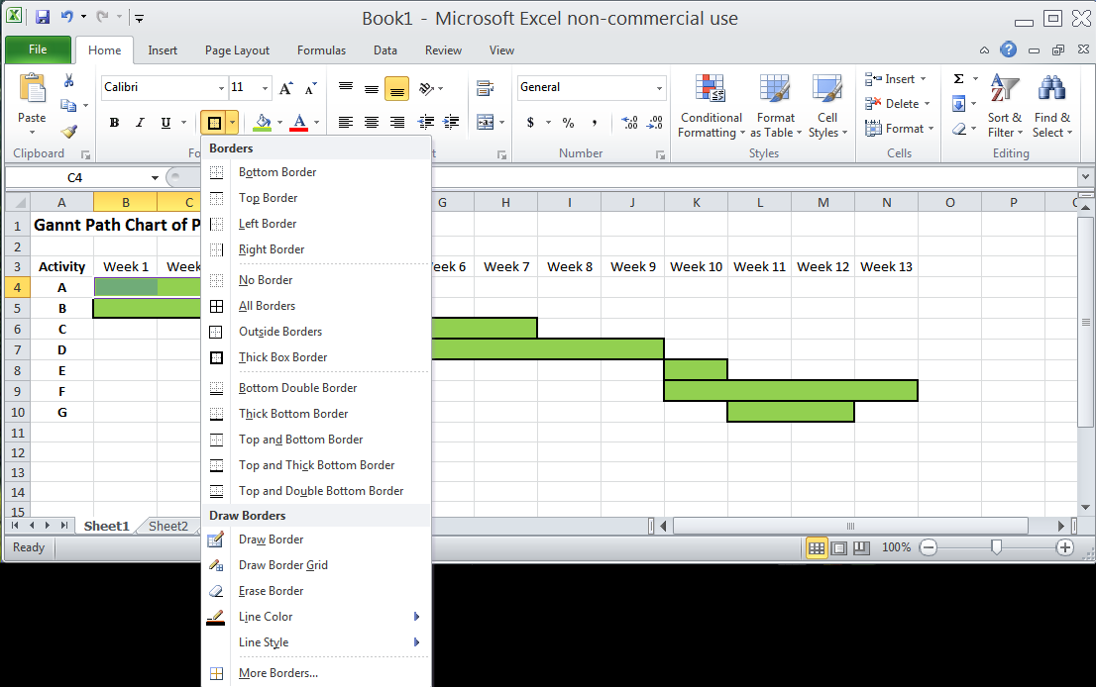
Project Management
You will probably want to outline each bar:
VFrench, 2022

Slide 67
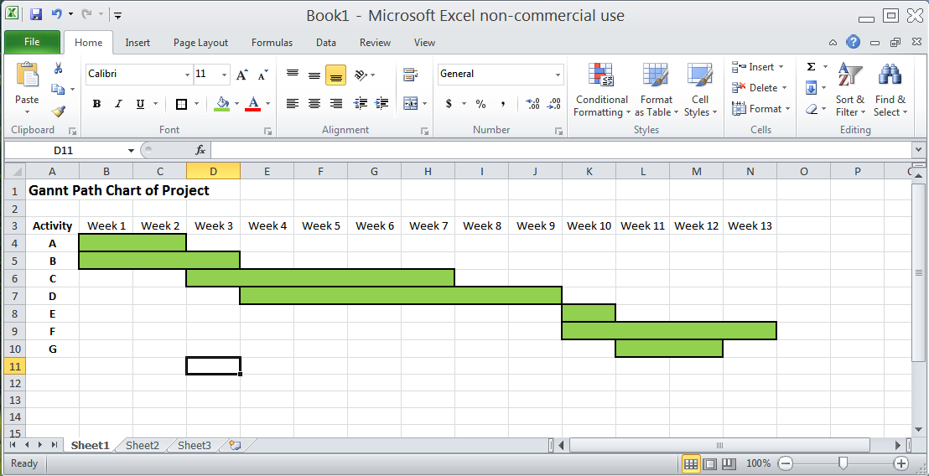
Project Management
Tah-dah!
VFrench, 2022

Slide 68
Project Management
How long will the project take?
VFrench, 2022

Slide 69
Project Management
What is the last activity completed?
VFrench, 2022

Slide 70
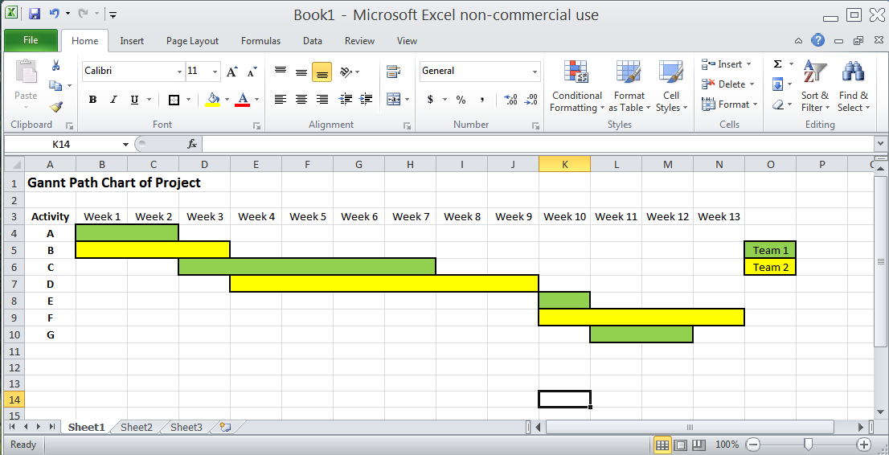
Project Management
If the colors mean something, be sure to label them!
VFrench, 2022

Slide 71
Questions?
http://i.imgur.com/aliTlT3.jpg

Slide 72
Project Management
Try the second Gantt chart on your own!

Slide 73
Questions?
http://i.imgur.com/aliTlT3.jpg

Slide 74
Summary
Today we studied:
Review of uses for discrete probabilities
Project Management Charts

Slide 75

You Survived!
www.playbuzz.com

