Slide 1

Welcome to Wk03
MATH225 Applications of Discrete Mathematics and Statistics
http://media.dcnews.ro/image/201109/w670/statistics.jpg

Slide 2
Graph Theory
We do three kinds of graphs in this class…

Slide 3
Graph Theory
We do three kinds of graphs in this class…
Graph paper was the first

Slide 4
Graph Theory
We do three kinds of graphs in this class…
Graph paper was the first
This is the second

Slide 5
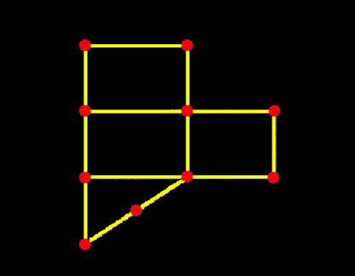
Graph Theory
Not an “x,y” graph

Slide 6
Graph Theory
A graph or path consists of:
a set points (also called vertices or nodes)
a set of lines
(also called edges
or arcs)

Slide 7
Graph Theory
An edge e is said to be incident on two nodes v and w
v
e
w

Slide 8
Graph Theory
Points v and w are said to be incident on edge e and to be adjacent vertices
v
e
w

Slide 9
Graph Theory
IN-CLASS PROBLEMS
How many vertices?
How many edges?

Slide 10
Graph Theory
IN-CLASS PROBLEMS
List the vertex set:
List the edge set:
e10
v1
v10
e9
e1
e11
v2
e2
v3
v9
e8
e13
e3
e12
v8
v5
e4
v4
e5
e7
v6
e6
v7

Slide 11
Graph Theory
Edge endpoint function:
Edge | Endpoint
e1 | {v1,v2}
e2 | {v2,v3}

Slide 12
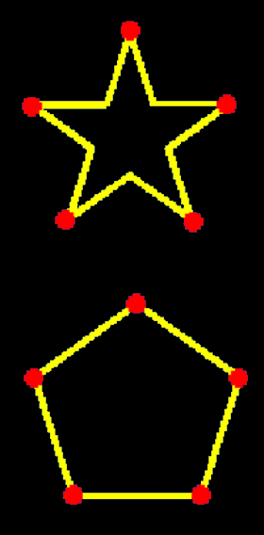
Graph Theory
These are the same
graphs:
Because they have
the same vertex and
edge sets

Slide 13
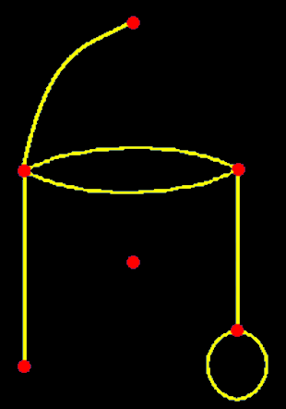
Graph Theory
Parallel edges
Isolated vertex
Loop

Slide 14
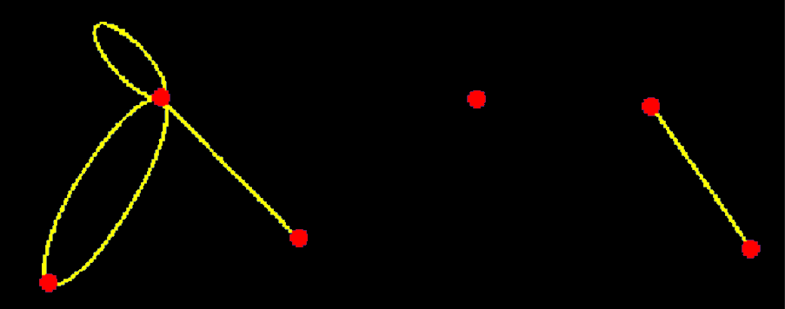
Graph Theory
IN-CLASS PROBLEMS
Parallel edges?
Isolated vertex?
Loop?

Slide 15
Graph Theory
A simple graph has no loops
or parallel edges

Slide 16
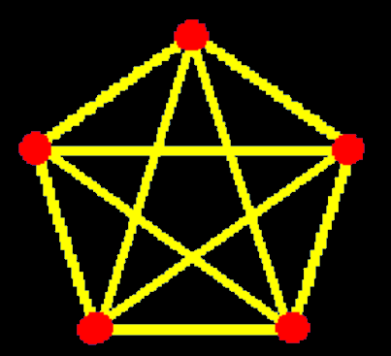
Graph Theory
A complete graph is
a simple graph with
one edge
connecting
each pair
of vertices

Slide 17
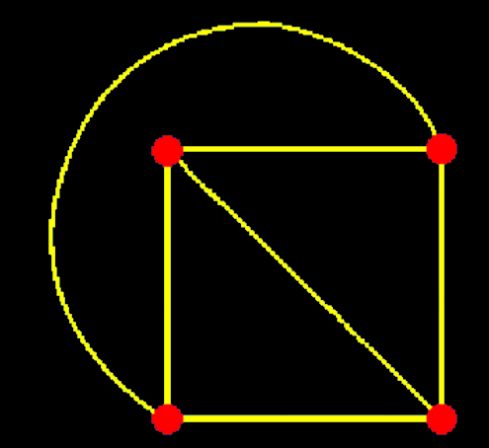
Graph Theory
It doesn’t have
to be the
obvious
one…

Slide 18
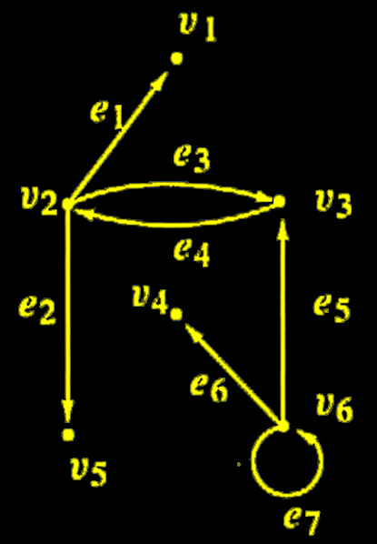
Graph Theory
A directed graph
(digraph) consists
of:
an ordered
set of
vertices
a set of
directed edges

Slide 19
Graph Theory
A complete bipartite graph is a simple graph such that:
the vertices can be separated
into two subsets
each vertex is connected by one
edge to at least one member
of the other subset
each vertex is unconnected to
any vertex in its subset

Slide 20
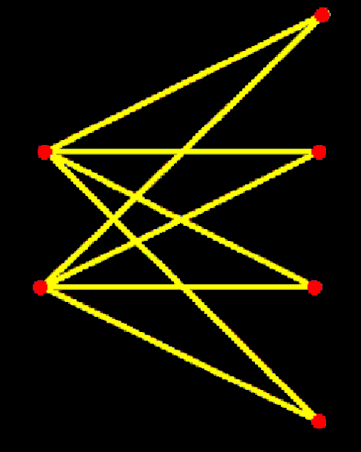
Graph Theory
Two groups – none of the
vertices are connected
within each group
The vertices are
connected
between the groups

Slide 21
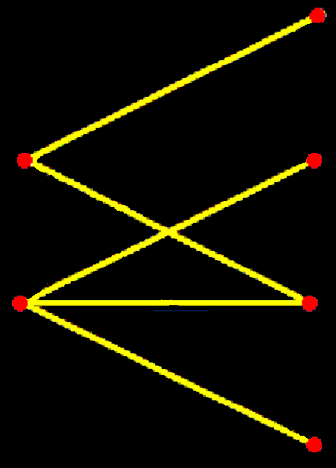
Graph Theory
The vertices do not
have to be connected
to every member
of the other
group

Slide 22
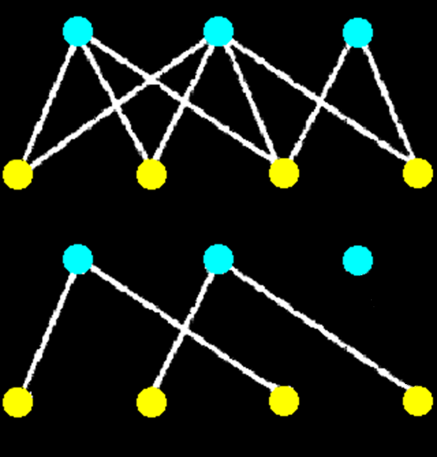
Graph Theory
IN-CLASS PROBLEMS
Which graph is bipartite?

Slide 23
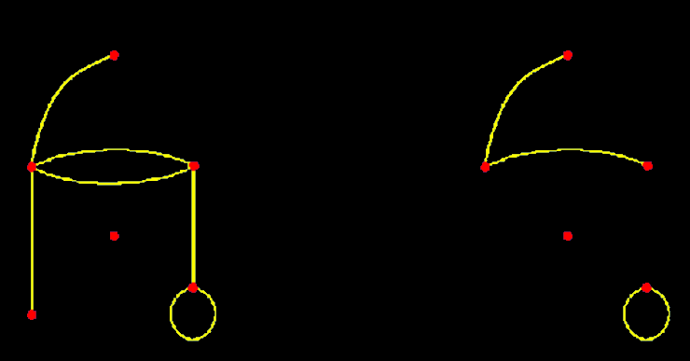
Graph Theory
A graph is a subgraph of the original graph IFF every vertex and edge in the subgraph is in the original graph

Slide 24
Graph Theory
Degree:
the degree of a vertex is the number of edges incident to it
a loop is counted twice

Slide 25
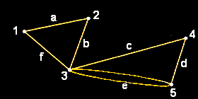
Graph Theory
IN-CLASS PROBLEMS
What is the degree?

Slide 26
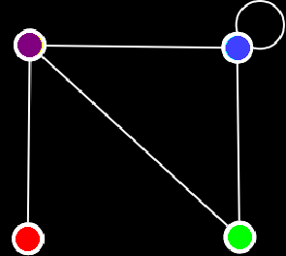
Graph Theory
IN-CLASS PROBLEMS
Which vertex has degree 1:
Which has degree 2?
Which has degree 3?
Which has degree 4?

Slide 27
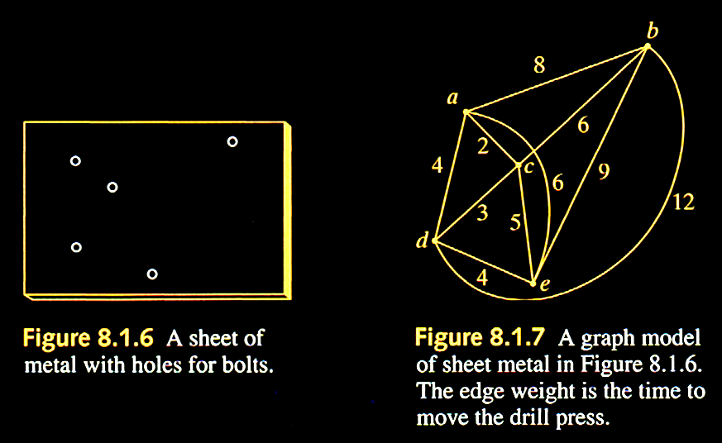
Graph Theory
What is this used for?

Slide 28
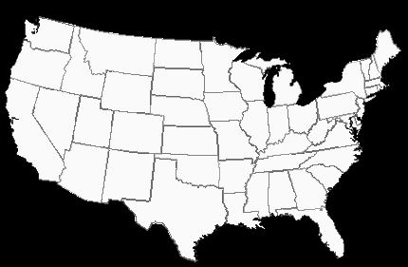
Graph Theory
How many colors do you need to ensure no two states next to each other are the same color?

Slide 29
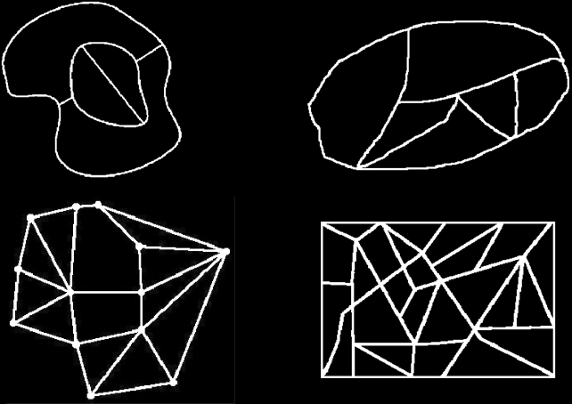
Graph Theory
IN-CLASS PROBLEMS
Simpler problems:

Slide 30
Graph Theory
IN-CLASS PROBLEMS
How many colors do you need to ensure no two states next to each other are the same color?

Slide 31
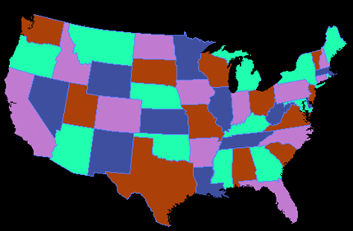
Graph Theory
The four-color map theorem

Slide 32

Questions?

Slide 33
Paths
Travel on a map begins at some city, goes down roads, passes through several cities, and terminates at some city

Slide 34
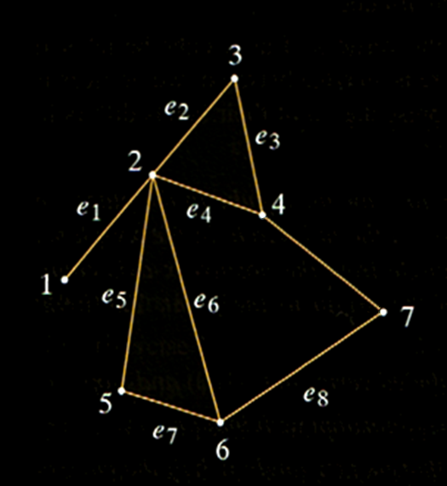
Paths
For a graph, think of the vertices as cities on
a map and the
edges as roads

Slide 35
Paths
Travel in a graph is accomplished by moving from one vertex to another along a sequence of adjacent edges

Slide 36
Paths
Four normal words used in a specific way:
walk, trail, path

Slide 37
Paths
A walk from one vertex to another vertex is a finite alternating sequence of adjacent vertices and edges

Slide 38
Paths
IN-CLASS PROBLEMS
Describe a walk from
vertex 1 to
vertex 4

Slide 39
Paths
The trivial walk from vertex v to vertex v consists of just sitting on v

Slide 40
Paths
A trail from vertex v to vertex w is a walk from v to w that does not contain a repeated edge

Slide 41
Paths
IN-CLASS PROBLEMS
Describe a trail from
vertex 1 to
vertex 4
(no repeated
“e”s)

Slide 42
Paths
A path from vertex v to vertex w is a trail that does not contain a repeated vertex

Slide 43
Paths
IN-CLASS PROBLEMS
Describe a path from
vertex 1 to
vertex 4
(no repeated
“e”s or
numbers)

Slide 44
Paths
IN-CLASS PROBLEMS
(1,e1,2,e2,3,e3,4)
is a path from
vertex 1 to
vertex 4

Slide 45
Paths
Four normal words used in a specific way:
walk, trail (doesn’t repeat an edge), path (doesn’t repeat an edge or a vertex)

Slide 46
Questions?

Slide 47
Circuits
A closed walk is a walk that starts and ends at the same vertex

Slide 48
Circuits
A circuit (or cycle) is a closed walk that contains at least one edge and does not contain a repeated edge

Slide 49
Circuits
IN-CLASS PROBLEMS
Describe a circuit from
vertex 2 to
vertex 2
(no repeated
es)

Slide 50
Circuits
A simple circuit is a circuit that does not have any other repeated vertex except the first and last

Slide 51
Circuits
IN-CLASS PROBLEMS
Describe a circuit that is NOT simple from
vertex 2 to
vertex 2

Slide 52
Circuits
IN-CLASS PROBLEMS
(6,5,2,4,3,2,1)
Is it a path?

Slide 53
Circuits
IN-CLASS PROBLEMS
(6,5,2,4,3,2,1)
Is it a path?
no
(vertex 2
is repeated)

Slide 54
Circuits
IN-CLASS PROBLEMS
(6,5,2,4,3,2,1)
Is it a circuit?

Slide 55
Circuits
IN-CLASS PROBLEMS
(6,5,2,4,3,2,1)
Is it a circuit?
no

Slide 56
Circuits
IN-CLASS PROBLEMS
(6,5,2,4)
Is it a path?

Slide 57
Circuits
IN-CLASS PROBLEMS
(6,5,2,4)
Is it a path?
yes

Slide 58
Circuits
IN-CLASS PROBLEMS
(6,5,2,4)
Is it a circuit?

Slide 59
Circuits
IN-CLASS PROBLEMS
(6,5,2,4)
Is it a circuit?
no

Slide 60
Circuits
IN-CLASS PROBLEMS
(2,6,5,2,4,3,2)
Is it a path?

Slide 61
Circuits
IN-CLASS PROBLEMS
(2,6,5,2,4,3,2)
Is it a path?
no

Slide 62
Circuits
IN-CLASS PROBLEMS
(2,6,5,2,4,3,2)
Is it a circuit?

Slide 63
Circuits
IN-CLASS PROBLEMS
(2,6,5,2,4,3,2)
Is it a circuit?
yes

Slide 64
Circuits
IN-CLASS PROBLEMS
(2,6,5,2,4,3,2)
Is it a simple circuit?

Slide 65
Circuits
IN-CLASS PROBLEMS
(2,6,5,2,4,3,2)
Is it a simple circuit?
no
(vertex 2 is
repeated)

Slide 66
Circuits
IN-CLASS PROBLEMS
(5,6,2,5)
Is it a path?

Slide 67
Circuits
IN-CLASS PROBLEMS
Path: (5,6,2,5)
Is it a path?
no

Slide 68
Circuits
IN-CLASS PROBLEMS
Path: (5,6,2,5)
Is it a circuit?

Slide 69
Circuits
IN-CLASS PROBLEMS
Path: (5,6,2,5)
Is it a circuit?
yes

Slide 70
Circuits
IN-CLASS PROBLEMS
Path: (5,6,2,5)
Is it a simple circuit?

Slide 71
Circuits
IN-CLASS PROBLEMS
Path: (5,6,2,5)
Is it a simple circuit?
yes

Slide 72
Circuits
IN-CLASS PROBLEMS
Path: (7)
Is it a path?

Slide 73
Circuits
IN-CLASS PROBLEMS
Path: (7)
Is it a path?
yes

Slide 74
Circuits
IN-CLASS PROBLEMS
Path: (7)
Is it a circuit?

Slide 75
Circuits
IN-CLASS PROBLEMS
Path: (7)
Is it a circuit?
nope!

Slide 76
Circuits
A connected graph is a graph in which we can get from any vertex to any other vertex on a path

Slide 77
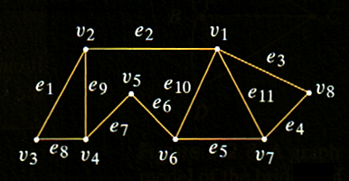
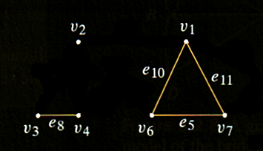
Circuits
A connected graph consists of one “piece” while a graph that is not connected consists of two or more “pieces”
Connected graph
How many pieces?

Slide 78
Circuits
These “pieces” are subgraphs of the original graph and are called components
Connected graph
How many components?

Slide 79
Circuits
The subgraph of a graph consisting of all edges and vertices that are contained in some path beginning at
v is called the component containing v

Slide 80
Circuits
IN-CLASS PROBLEMS
Is the graph connected?

Slide 81
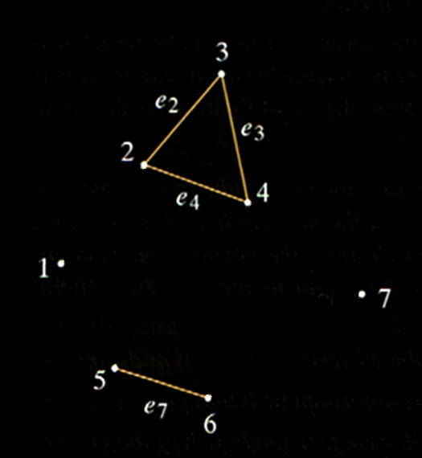
Circuits
IN-CLASS PROBLEMS
Is the graph connected?

Slide 82
Circuits
IN-CLASS PROBLEMS
How many components?

Slide 83
Questions?

Slide 84
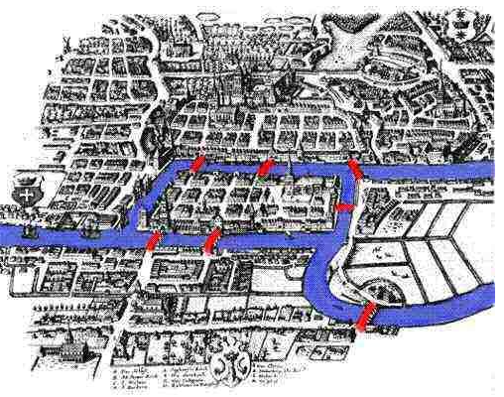
Paths and Circuits
https://www.maa.org/sites/default/files/images/cms_upload/Konigsberg_colour37936.jpg

Slide 85
Paths and Circuits
The city of Königsberg in Prussia (now Kaliningrad, Russia) was set on both sides of the Pregel River

Slide 86
Paths and Circuits
It included two large islands which were connected to each other and to the two riverbanks of the city by
seven bridges

Slide 87
Paths and Circuits
The problem was to devise a walk through the city that would cross each of the bridges once and only once

Slide 88
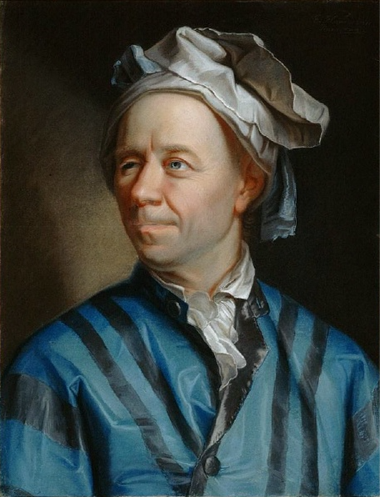
Paths and Circuits
Leonhardt Euler
(1707-1783)
wanted to solve
the problem
https://upload.wikimedia.org/wikipedia/commons/d/d7/Leonhard_Euler.jpg

Slide 89
Paths and Circuits
He labeled areas of land separated by the river into vertices which he labeled with capital letters
The bridges are the edges between the vertices

Slide 90
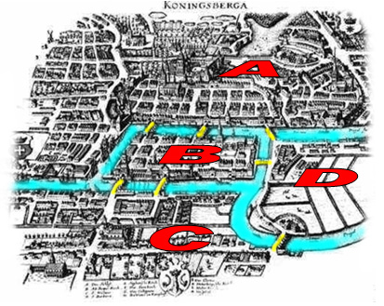
Paths and Circuits

Slide 91
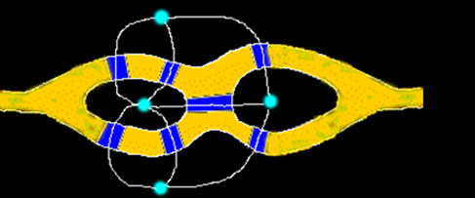
Paths and Circuits
IN-CLASS PROBLEMS
Can you find a circuit?

Slide 92
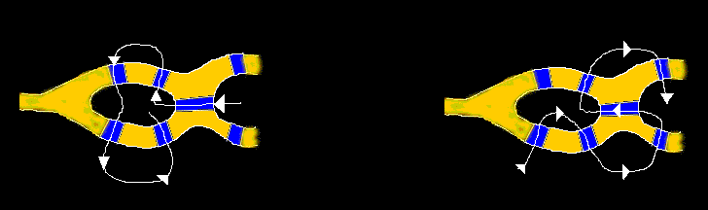
Paths and Circuits
Some ways that don’t work…

Slide 93
Paths and Circuits
Some ways that don’t work…
Euler proved it was not possible to solve this problem!

Slide 94
Paths and Circuits
Euler went on to generalize this mode of thinking, laying a foundation for graph theory

Slide 95
Paths and Circuits
A network is a figure made up of points (vertices) connected by non-intersecting curves (edges)

Slide 96
Paths and Circuits
A vertex is called odd if it has an odd number of edges leading to it, otherwise it is called even

Slide 97
Paths and Circuits
An Euler path is a continuous path that passes through every edge once and only once

Slide 98
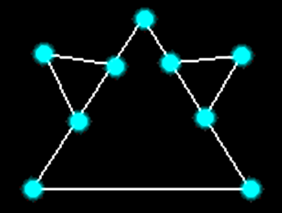
Paths and Circuits
If a network has more than two odd vertices, it does not have an Euler path

Slide 99
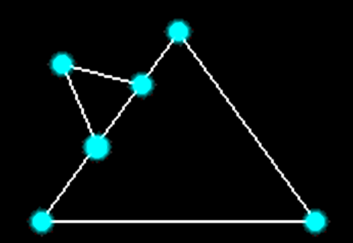
Paths and Circuits
If a network has more than two odd vertices, it does not have an Euler path

Slide 100
Paths and Circuits
If a network has two or zero odd vertices, it has at least one Euler path

Slide 101
Paths and Circuits
If a network has exactly two odd vertices, then its Euler paths can only start
on one of
the odd
vertices and
end on the
other

Slide 102
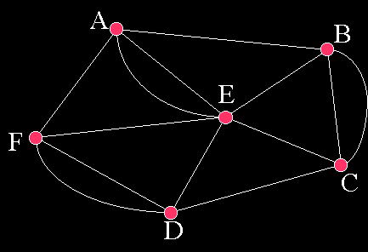
Paths and Circuits
An Euler circuit is a closed walk that contains every vertex and every edge

Slide 103
Paths and Circuits
If a network has an odd vertex, it does not have an Euler circuit

Slide 104
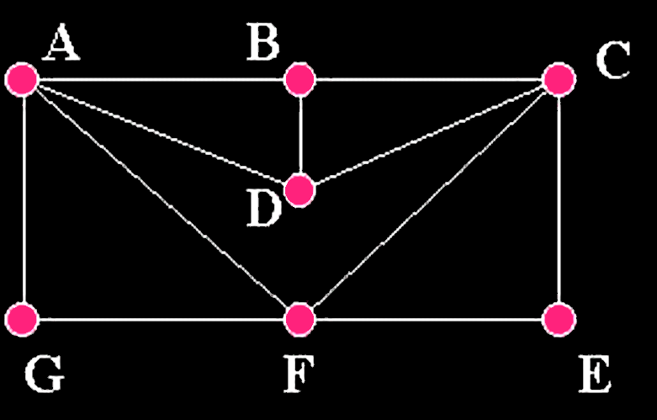
Paths and Circuits
This has an Euler path, but no Euler circuit

Slide 105
Paths and Circuits
One possible solution: AGFADCFECBA

Slide 106
Paths and Circuits
A Hamiltonian circuit is a simple circuit that includes every vertex in the graph only one except the first and last

Slide 107
Paths and Circuits
One possible solution: AGFECDBA

Slide 108
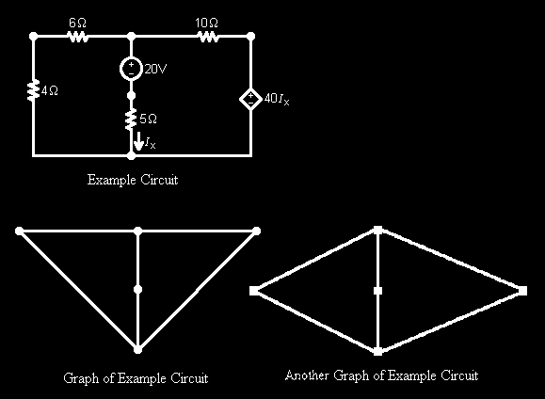
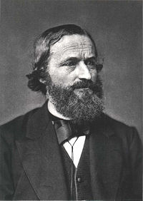
Paths and Circuits
Gustav Kirchoff - electrical circuits

Slide 109
Questions?

Slide 110
Trees
In computer science, a tree is an abstract data type (ADT) that simulates a hierarchical structure with a parent and children represented as a linked set

Slide 111
Trees
A tree simulates a hierarchical structure with a parent and children represented as a linked set

Slide 112
Trees
Mathematically, trees must have connected branches
And they must not form a closed circuit

Slide 113
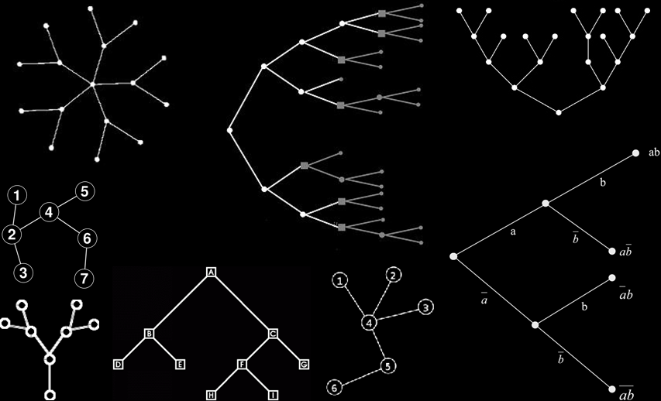
Trees
Trees

Slide 114
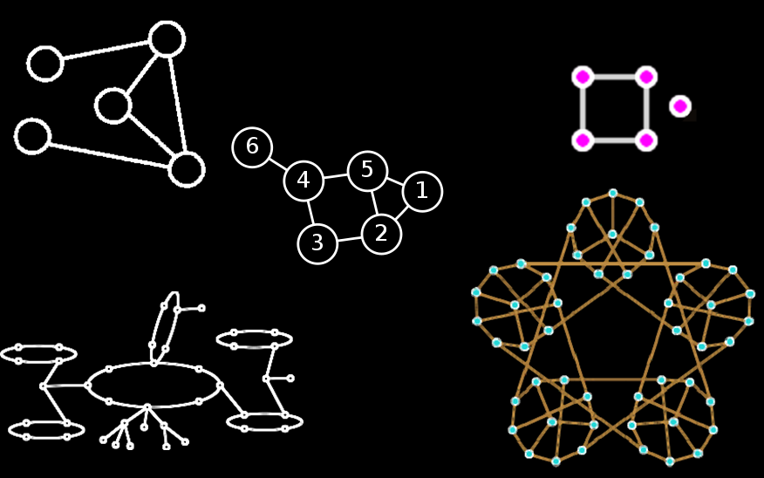
Trees
Not Trees

Slide 115
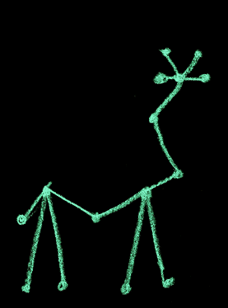
Trees
IN-CLASS PROBLEMS
Tree or not a tree?

Slide 116
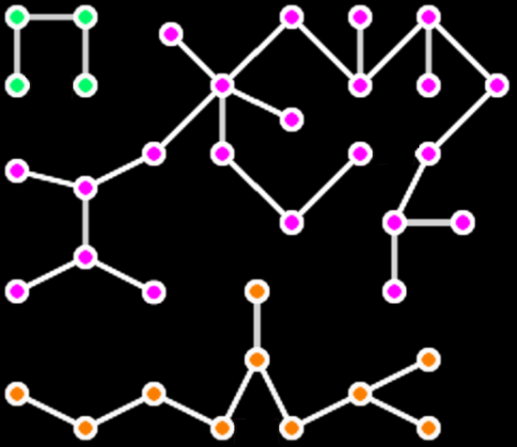
Trees
IN-CLASS PROBLEMS
Tree or not a tree?

Slide 117
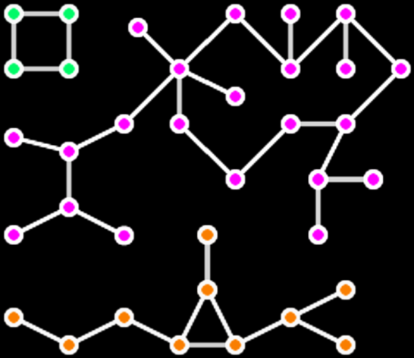
Trees
IN-CLASS PROBLEMS
Tree or not a tree?

Slide 118
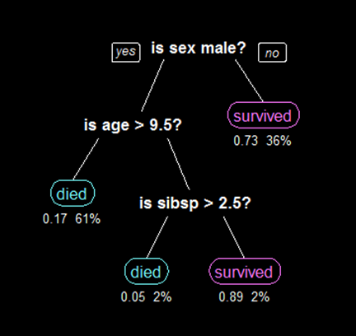
Trees
A decision tree
for Titanic
survivors
“sibsp” means having a spouse or sibling on board

Slide 119
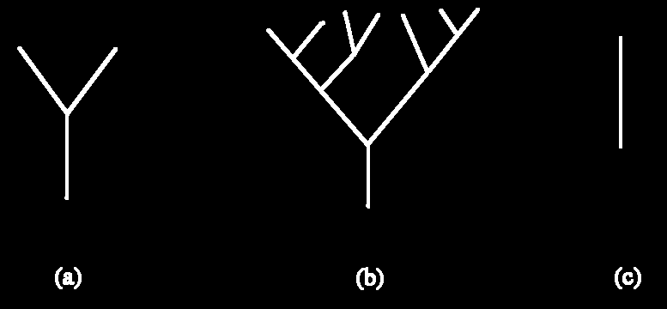
Trees
A trivial tree is a graph that consists of a single vertex

Slide 120
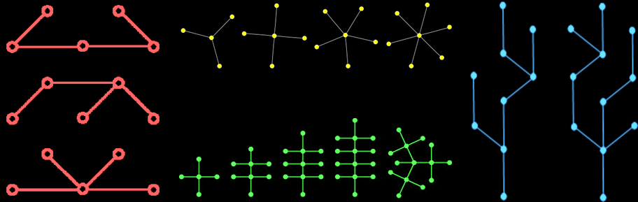
Trees
A graph is called a forest if and only if it is circuit-free and not connected

Slide 121
Trees
IN-CLASS PROBLEMS
Is it a forest?

Slide 122
Trees
IN-CLASS PROBLEMS
Is it a forest?

Slide 123
Questions?

Slide 124
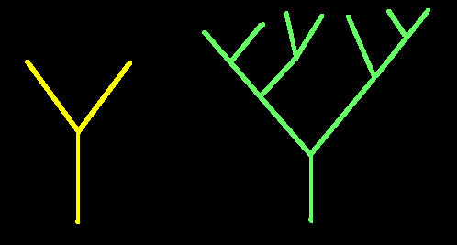
Trees
The important things in a tree are the pointy-things
Called nodes or vertices or points

Slide 125
Trees
An edge (or line) is the connection between one node and another (usually a line)

Slide 126
Trees
The edges are directed to the root

Slide 127
Trees
Usually you don’t draw the edges with arrows, it's just understood

Slide 128
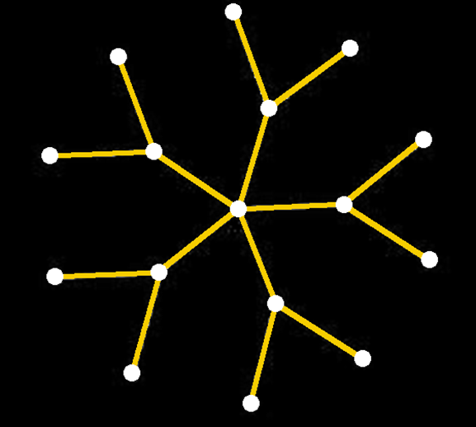
Trees
If a tree has n nodes
it will have n-1 edges

Slide 129
Trees
If not empty, there is a distinguished node called the root and zero or more sub­trees whose roots are connected by a directed edge to r

Slide 130
Trees
Trees defined this way are called rooted trees
They have a distinguished root
Not all trees are considered to be rooted

Slide 131
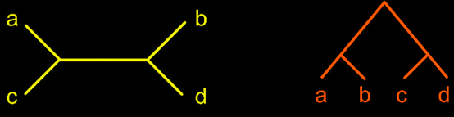
Trees
IN-CLASS PROBLEMS
Rooted or unrooted?

Slide 132
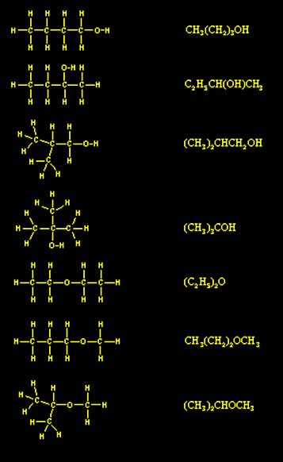
Trees
IN-CLASS PROBLEMS
Rooted or
unrooted?
Structure of
hydrocarbon
molecules

Slide 133
Trees
The node of each subtree is called a child (or descendent) of r

Slide 134
Trees
r is called the parent of each child

Slide 135
Trees
Nodes with the same parent are called siblings

Slide 136
Trees
An ancestor is a node reachable by repeated proceeding from child to parent

Slide 137
Trees
A path is a sequence of nodes and edges connecting a node with a descendant

Slide 138
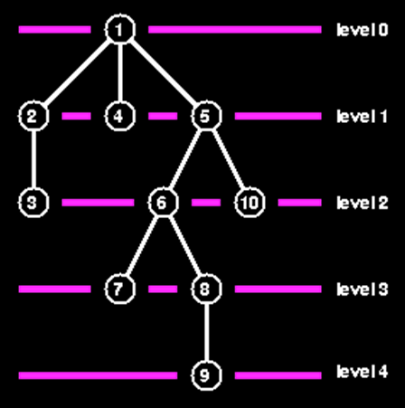
Trees
The level or
depth of
a node is
the number
of edges
along the
unique path
between it
and the root

Slide 139
Trees
The height of a node is the maximum number of edges between the node and a leaf

Slide 140
Trees
The degree of a tree is the maximum number of edges between the root and a leaf

Slide 141
Trees
Nodes with no children (degree=0) are called leaves or terminal nodes

Slide 142
Trees
A node with degree greater
than 1 is called a branch (or internal node)

Slide 143
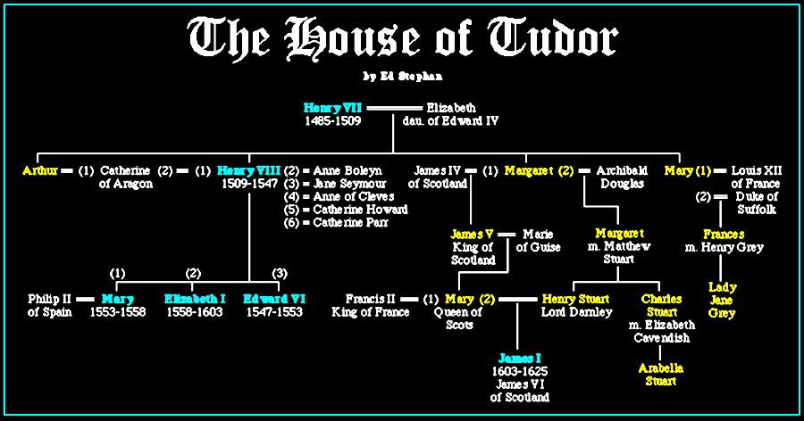
Trees
IN-CLASS PROBLEMS
Rooted or unrooted?

Slide 144
Trees
IN-CLASS PROBLEMS
Who are the roots?

Slide 145
Trees
IN-CLASS PROBLEMS
What is the degree of the tree?

Slide 146
Trees
IN-CLASS PROBLEMS
How many nodes?

Slide 147
Trees
IN-CLASS PROBLEMS
Who are leaves?

Slide 148
Trees
IN-CLASS PROBLEMS
What is the level of Mary Queen of Scots?

Slide 149
Trees
IN-CLASS PROBLEMS
What is the height of Mary Queen of Scots?

Slide 150
Questions?

Slide 151
Trees
Parse trees are ordered, rooted trees that represent the structure of a string

Slide 152
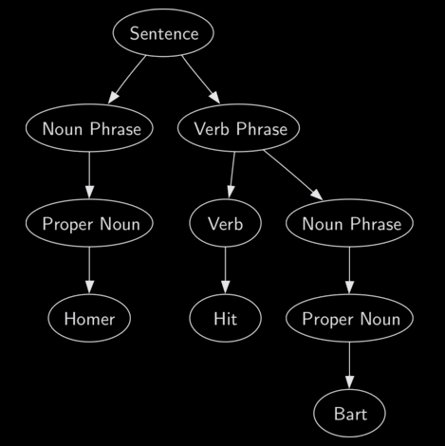
Trees
A parse tree of
the sentence:
Homer hit
Bart.

Slide 153
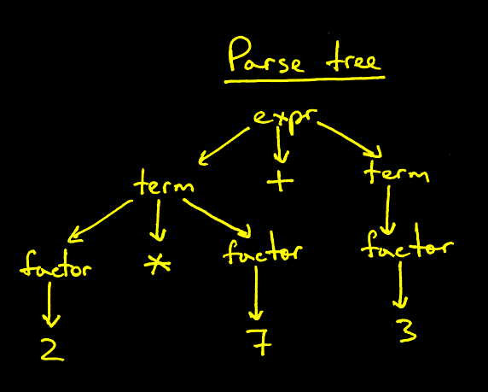
Trees
A parse tree
for the equation:
2 × 7 + 3

Slide 154
Trees
Fortunately a full parse tree is rarely needed for program analysis

Slide 155
Trees
An Abstract Syntax Tree (AST) is a simpler, space-saving version of the parse tree that still accurately represents the meaning

Slide 156
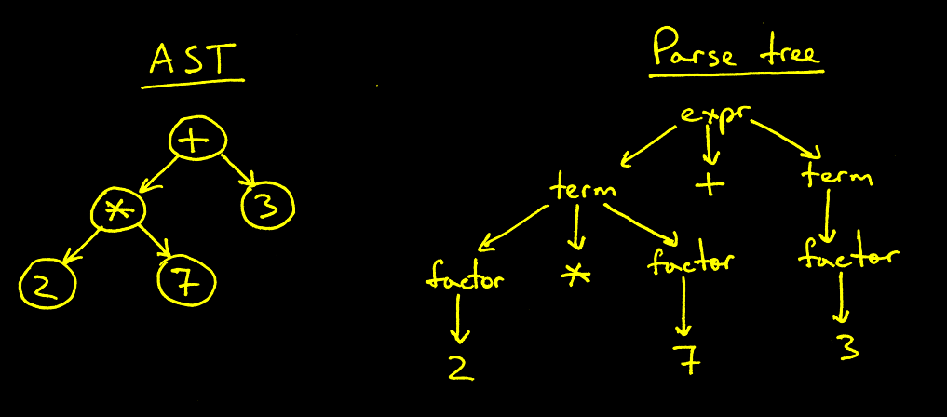
Trees
AST vs Parse tree for 2 × 7 + 3

Slide 157
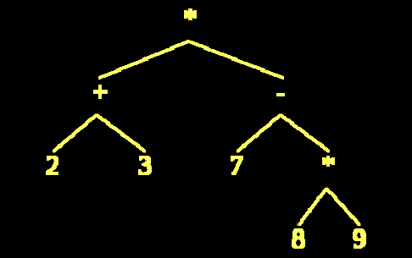
Trees
IN-CLASS PROBLEMS
Calculate the Abstract Syntax Tree:

Slide 158
Searching Trees
In computer science, tree traversal (also known as tree search) refers to the process of visiting (checking and/or updating) each node in a tree data structure exactly once

Slide 159
Searching Trees
Such traversals are classified by the order in which the nodes are visited

Slide 160
Searching Trees
A tree search starts at some point and explores nodes from that point looking for a goal node that satisfies certain conditions

Slide 161

Searching Trees
A breadth-first search (BFS) explores nodes
nearest the root
before exploring
nodes further
away

Slide 162
Searching Trees
A breadth-first search (BFS) is also called a level order search

Slide 163

Searching Trees
Some depth-first search (DFS) types start with the
leaves and
backtrack to
the root

Slide 164
Searching Trees
Depth-first traversals:
Preorder-root, left, right
Postorder-left, right, root
Inorder-left, root, right

Slide 165

Searching Trees

Slide 166
Questions?

Slide 167

Binary Trees
When every node in a rooted tree has at most two children and each child is
designated either
the (unique) left child
or the (unique) right
child, it is called a
binary tree

Slide 168

Binary Trees
For a full binary tree each parent has exactly two children

Slide 169

Binary Trees
IN-CLASS PROBLEMS
Which is binary and which is full binary?

Slide 170

Binary Trees
IN-CLASS PROBLEMS
Is it a tree?
Is it rooted?
Is it binary?
Is it full binary?

Slide 171
Binary Trees
When we encode characters in computers, we assign each an 8-bit code based on an ASCII chart

Slide 172
Binary Trees
But in most files, some characters appear more often than others

Slide 173
Binary Trees
So wouldn't it make more sense to assign shorter codes for characters that appear more often and longer codes for characters that appear less often?

Slide 174

Binary Trees
Huffman coding is an
encoding algorithm
used for lossless
data compression
David A Huffman (1925-1999)
Inventor of mathematical origami

Slide 175
Binary Trees
Huffman coding uses a representation for each symbol resulting in a prefix code (sometimes called "prefix-free codes“)

Slide 176
Binary Trees
Huffman coding results in a Huffman tree

Slide 177
Binary Trees
Lets say you have a set of letters and want to create a Huffman encoding for them:
aoeretaeoaateoeoaeneeotaaereteateaeaetereteootaeetneeneoeeeoerneeoeteaeteetaeernaeeaenettaaeeretaeeaena

Slide 178
Binary Trees
First put them in order. This makes it easier to count how many of each there are:
aaaaaaaaaaaaaaaaaaaannnnnnnooooooooootttttttttttttttrrrrrreeeeeeeeeeeeeeeeeeeeeeeeeeeeeeeeeeeeeeeeeeeee

Slide 179
Binary Trees
IN-CLASS PROBLEMS
Aaaaaaaaaaaaaaaaaaaannnnnnnooooooooootttttttttttttttrrrrrreeeeeeeeeeeeeeeeeeeeeeeeeeeeeeeeeeeeeeeeeeeee
Count the frequency of each value and put into a summary table:
FREQUENCY VALUE

Slide 180
Binary Trees
Count the frequency of each value and put into a summary table:
FREQUENCY VALUE
20 a
7 n
10 o
15 t
6 r
45 e

Slide 181
Binary Trees
Sort the list by frequency and make the two elements into pairs separated by “:”
FREQUENCY VALUE becomes
6 r 6:r
7 n 7:n
10 o 10:o
15 t 15:t
20 a 20:a
45 e 45:e

Slide 182
Binary Trees
The first element in each pair is the frequency, the second is the value
6:r
7:n
10:o
15:t
20:a
45:e

Slide 183
Binary Trees
Make the two smallest pairs into leaves:
6:r 7:n

Slide 184
Binary Trees
Create a parent node with a frequency that is the sum of the two pair’s frequencies (the first number in the pair) and a value of “*”
13: ∗

Slide 185
Binary Trees
6:r 7:n
Which goes on the right side and which on the left??
It does matter!
Put the frequencies in order – smallest to the left, largest to the right

Slide 186
Binary Trees
Put these into tree formation
This will be the lowest part of your tree:
13:∗
/ \
6:r 7:n

Slide 187
Binary Trees
The two elements are removed from the list and the new parent node, with frequency 13, is inserted into the list by frequency

Slide 188
Binary Trees
So now the list, sorted by frequency, is:
10:o
13:∗
15:t
20:a
45:e

Slide 189
Binary Trees
Repeat the loop, combining the two smallest elements: 10:o and 13:*
Their root will be 23:*

Slide 190
Binary Trees
10:3 goes on the left because 13:* has a larger frequency:
23:∗
/ \
10:o 13:∗
/ \
6:r 7:n

Slide 191
Binary Trees
The list is now:
15 : t
20 : a
23 : ∗
45 : e

Slide 192
Binary Trees
You repeat until there is only one element left in the list
15:t 20:a comes from the node 35:∗

Slide 193
Binary Trees
Put 23:* and 35:* in right/left order by frequency:
23:∗ 35:∗
/ \ / \
10:o 13:∗ 15:t 20:a
/ \
6:r 7:n

Slide 194
Binary Trees
And the list is:
23:*
35:*
45:e

Slide 195
Binary Trees
The two lowest, 23:∗ and 35:∗ come from the node 58:∗
58 : ∗
___/ \___
/ \
23 : ∗ 35 : ∗
/ \ / \
10:o 13:∗ 15:t 20:a
/ \
6:r 7:n

Slide 196
Binary Trees
Leaving the list:
45:e
58:∗
which would have come from the node: 103:∗

Slide 197
Binary Trees
45:e
58:∗
Which goes on the right side and which on the left??

Slide 198
Binary Trees
103:∗
__/ \__
/ \
45:e 58:∗
__/ \__
/ \
23:∗ 35:∗
/ \ / \
10:o 13:∗ 15:t 20:a
/ \
6:r 7:n

Slide 199
Binary Trees
Now the list is just one element containing 103:∗, so you are done
This element (103:∗) is the root of your binary Huffman tree

Slide 200
Binary Trees
103:∗
__/ \__
/ \
45:e 58:∗
__/ \__
/ \
23:∗ 35:∗
/ \ / \
10:o 13:∗ 15:t 20:a
/ \
6:r 7:n
Remember – the
first element is
the frequency,
the second is
the value

Slide 201
Binary Trees
To generate a Huffman code, travel the tree backwards from the leaf you want to the root building the binary Huffman encoding string from finish to start—backwards

Slide 202
Binary Trees
Code a 0 every time you take a left-hand branch and a 1 every time you take a right-hand branch

Slide 203
Binary Trees
IN-CLASS PROBLEMS
103:∗
__/ \__
/ \
45:e 58:∗
__/ \__
/ \
23:∗ 35:∗
/ \ / \
10:o 13:∗ 15:t 20:a
/ \
6:r 7:n
Examples:
Find the encoding for
“t”
Find the encoding for
“e”
Remember – the first element is the frequency, the second is the value

Slide 204
Binary Trees
IN-CLASS PROBLEMS
103:∗
__/ \__
/ \
45:e 58:∗
__/ \__
/ \
23:∗ 35:∗
/ \ / \
10:o 13:∗ 15:t 20:a
/ \
6:r 7:n
Examples:
The encoding for
“t” is 110
The encoding for
“e” is 0
Remember – the first element is the frequency, the second is the value

Slide 205
Binary Trees
Values with the highest frequency will be near the top of the tree and have shorter codes

Slide 206
Binary Trees
Decoding a Huffman encoding is just as easy:
- you read bits in from your input stream
- you traverse the tree beginning at the root

Slide 207
Binary Trees
- take the left hand path if you read a 0 and the right hand path if you read a 1
When you hit a leaf, you have found the value

Slide 208
Binary Trees
IN-CLASS PROBLEMS
What letter has
the Huffman
code 1011?
103:∗
__/ \__
/ \
45:e 58:∗
__/ \__
/ \
23:∗ 35:∗
/ \ / \
10:o 13:∗ 15:t 20:a
/ \
6:r 7:n
Remember – the first element is the frequency, the second is the value

Slide 209
Binary Trees
IN-CLASS PROBLEMS
What letter has
the Huffman
code 1011?
n
103:∗
__/ \__
/ \
45:e 58:∗
__/ \__
/ \
23:∗ 35:∗
/ \ / \
10:o 13:∗ 15:t 20:a
/ \
6:r 7:n
Remember – the first element is the frequency, the second is the value

Slide 210
Binary Trees
Generally, a Huffman compression scheme requires the Huffman tree to be written out as part of the file, otherwise the reader cannot decode the data

Slide 211
Binary Trees
For a static tree, you don't have to do this since the tree is known and fixed

Slide 212
Binary Trees
Any symbols can be used to generate a Huffman tree!

Slide 213
Binary Trees
Visit:
http://huffman.ooz.ie
for a Huffman tree generator
for your own slogan

Slide 214
Questions?

Slide 215
Iteration
Means repeating a process until you reach a goal

Slide 216
Iteration
In math class, we are trying to solve an equation by closer and closer approximations to the “true” answer

Slide 217
Iteration
We can manually tweak values of the coefficients until we get the best fit to our data

Slide 218
Iteration
WAF Precipitation demo

Slide 219
Iteration
Iteration is used by your calculator and in computer software to do calculations

Slide 220
Iteration
Some people think their calculators have a huge look-up table for all the answers

Slide 221
Iteration
They don’t – it would be impossible for a calculator to have a look-up table for every possible value a user might enter for every possible function the user might want to use!

Slide 222
Iteration
The calculator has a formula for every function that will zero in on the right answer after a short number of tweaks

Slide 223

Iteration
Which is the
better formula?

Slide 224
Iteration
The one that
gets there
quickest!

Slide 225

Iteration
For example, to find a square root:

Slide 226
Iteration
Suppose you wanted to calculate the square root of 3
x would be “2”

Slide 227
Iteration
All the functions in your calculator are based on a long series that iterates back and forth and zeros in on the correct answer

Slide 228

Iteration
Calculator formula for the sine:
This works for all values

Slide 229

Iteration
Calculator formula for e:
This works for all values

Slide 230
Iteration
The formula selected by your calculator manufacturer determines how fast and accurate your calculator will be

Slide 231
Iteration
It’s why different people get slightly different answers to calculator problems

Slide 232
Questions?

Slide 233
Spanning Trees
A spanning tree covers all the vertices with the minimum possible number of edges

Slide 234

Spanning Trees
Original graph:
Spanning trees:

Slide 235
Spanning Trees
A spanning tree does not have cycles and it cannot be disconnected

Slide 236
Spanning Trees
The Minimal-Spanning Tree Model:
What is the shortest path?

Slide 237

Spanning Trees
The edges can have a direction:
Or be bidirectional:

Slide 238

Spanning Trees
Dijkstra’s Algorithm
Edsger Dijkstra, a Dutch
computer scientist,
developed in 1959 a graph
search algorithm to solve
the shortest path problem
This algorithm is often
used in routing
(ex: Google Maps)

Slide 239

Spanning Trees
The Problem: Move from point A to
point B along the shortest
path

Slide 240
Spanning Trees
Easy for a small graph
Dijkstra's algorithm translates the steps our minds take into steps
a computer can take
http://vasir.net/blog/game_development/dijkstras_algorithm_shortest_path

Slide 241
Spanning Trees
The Algorithm
Let the point at which we are starting be called the initial point
Let the distance of a point be the distance from the initial point

Slide 242

Spanning Trees
Step 0: Assign a permanent distance of
“0” to the initial point and
temporarily assign a distance of
to all others
∞

Slide 243
Spanning Trees
Step 1: Calculate temporary distances for
the two points adjacent to the
initial point:
Top point:
initial point’s distance + distance to the point
= 0 + 1 = 1
Bottom point:
= 0 + 2 = 2

Slide 244
Spanning Trees
Step 2: Give that temporary distance to
the point if it is less than the
value that's already there
Which is less?
∞
1 or ?
∞
2 or ?

Slide 245

Spanning Trees
Tah-dah!

Slide 246
Spanning Trees
Step 3: Which point has the smallest value?
or

Slide 247

Spanning Trees
Make it permanent!

Slide 248
Spanning Trees
We use the smallest value because we are looking for the shortest distance across the network

Slide 249
Spanning Trees
Do the same steps using this new point as the initial point

Slide 250

Spanning Trees
Step 1: There is only one blank adjacent
point
initial point’s distance + distance to the point
= 1 + 10 = 11

Slide 251

Spanning Trees
∞
Step 2: 11 is smaller than so make
the temporary distance 11

Slide 252
Spanning Trees
Step 3: Which temporary point (black
and white print) has the
smallest value?

Slide 253

Spanning Trees
Make it permanent!

Slide 254
Spanning Trees
Do the same steps using this new point as the initial point
(Do you begin to see why this is an iteration?)

Slide 255

Spanning Trees
Step 1: There is only one blank adjacent
point
initial point’s distance + distance to the point
= 2 + 5
= 7

Slide 256
Spanning Trees
Step 2: Our value is 7, but there is
already a distance of 11
assigned to the point
Which do we use?
7 or 11 ?

Slide 257

Spanning Trees
Step 3: The smallest one! (Shortest
distance, remember!)
Since we’re done, make it permanent!

Slide 258
Spanning Trees
So, what is the shortest path from A to B?

Slide 259

Spanning Trees

Slide 260

Spanning Trees
Dijkstra’s algorithm on Numb3rs

Slide 261

Spanning Trees
IN-CLASS PROBLEMS
Find the shortest path from
A to B

Slide 262
Spanning Trees
IN-CLASS PROBLEMS

Slide 263

Spanning Trees
IN-CLASS PROBLEMS
Step 1
What is the next step?
What is the next step?

Slide 264

Spanning Trees
IN-CLASS PROBLEMS
What is the next step?

Slide 265

Spanning Trees
IN-CLASS PROBLEMS
What is the next step?

Slide 266

Spanning Trees
IN-CLASS PROBLEMS
Change the “7” to a “4”
What is the next step?

Slide 267

Spanning Trees
IN-CLASS PROBLEMS
What is the next step?

Slide 268

Spanning Trees
IN-CLASS PROBLEMS
What is the next step?

Slide 269

Spanning Trees
IN-CLASS PROBLEMS
What is the next step?

Slide 270

Spanning Trees
IN-CLASS PROBLEMS
What is the next step?

Slide 271

Spanning Trees
IN-CLASS PROBLEMS
Tah-dah!
What is the next step?

Slide 272
Spanning Trees
IN-CLASS PROBLEMS
Finish the project

Slide 273
Spanning Trees
IN-CLASS PROBLEMS
The shortest paths:

Slide 274

Spanning Trees
IN-CLASS PROBLEMS
Find the shortest route from the plant to the warehouse

Slide 275
Spanning Trees
IN-CLASS PROBLEMS
Find the fastest route from the plant to the warehouse

Slide 276
Questions?

Slide 277
Decision Trees
A decision tree shows various outcomes from a series of decisions

Slide 278

Decision Trees
In computer science, a flowchart is a decision tree

Slide 279
Decision Trees
Flowcharts show program actions and their sequencing (control flow)

Slide 280


Slide 281
Decision Trees
A flowgraph of a program documents the implementation of a program

Slide 282
Decision Trees
Clearly define the problem
List all possible alternatives
Identify outcomes for each alternative
Identify the cost or payout for each alternative and outcome

Slide 283

Decision Trees
Thompson Lumber Company needs to know whether to manufacture a
new product:
backyard
storage sheds

Slide 284
Decision Trees
What is the problem?

Slide 285
Decision Trees
To manufacture backyard storage sheds or not

Slide 286
Decision Trees
Generate a complete list of decision alternatives

Slide 287
Decision Trees
Suppose these were the alternatives the owner came up with:
Build a large plant to manufacture storage sheds
Build a small plant to manufacture storage sheds
Don’t do it

Slide 288
Decision Trees
The costs of each alternative:
Alternative | Cost
Build large plant | $148,000
Build small plant | $46,000
Don’t do it | $0

Slide 289
Decision Trees
Identify all possible future outcomes

Slide 290
Decision Trees
Suppose these were the outcomes the owner came up with:
Demand is high
Demand is moderate
Demand is low
(They don’t have to be the same for all alternatives)

Slide 291
Decision Trees
What are the payouts for each outcome?
Consider payouts:
 | Demand is high | Demand is moderate | Demand is low
Payout | $200,000 | $100,000 | $20,000

Slide 292
Decision Trees
Define a measurable result from each combination of alternatives and outcomes

Slide 293
Decision Trees
What are all the combinations?

Slide 294
Decision Trees
All the combinations:
 | Demand is high | Demand is moderate | Demand is low
Build large plant
Build small plant
Don’t do it

Slide 295
Decision Trees
What are the results?
Consider profits:
 | Demand is high | Demand is moderate | Demand is low
Build large plant | $200,000 - $148,000 = $52,000 | $100,000 - $148,000 = -$48,000 | $20,000 - $148,000 = -$128,000
Build small plant | $200,000 - $46,000 = $154,000 | $100,000 - $46,000 = $54,000 | $20,000 - $46,000 = -$26,000
Don’t do it | $0 | $0 | $0

Slide 296
Decision Trees
The table may be all you need to make a decision!
 | Demand is high | Demand is moderate | Demand is low
Build large plant | $200,000 - $148,000 = $52,000 | $100,000 - $148,000 = -$48,000 | $20,000 - $148,000 = -$128,000
Build small plant | $200,000 - $46,000 = $154,000 | $100,000 - $46,000 = $54,000 | $20,000 - $46,000 = -$26,000
Don’t do it | $0 | $0 | $0

Slide 297
Decision Trees
Another graphical way:
Build a tree!

Slide 298

Decision Trees
Each branch of the tree is an alternative decision

Slide 299
Decision Trees
Make sure the first branches coming out of the “root” are the possible decisions you want to decide between

Slide 300

Decision Trees
Each sub-branch of the tree is an alternative scenario for the decision and a possible outcome

Slide 301

Decision Trees
The “leaves” are the possible profits

Slide 302
Decision Trees
Of all the decision support tools available, decision trees have several advantages

Slide 303
Decision Trees
Are simple to understand and interpret
People are able to understand decision tree models after a brief explanation

Slide 304
Decision Trees
Have value even with little hard data
Important insights can be generated based on experts describing a situation (its alternatives, probabilities, and costs) and their preferences for outcomes

Slide 305
Decision Trees
Possible scenarios can be added
Worst, best and expected values can be determined for different scenarios

Slide 306
Decision Trees
Disadvantages of decision trees:
Decision trees are biased in favor of those attributes with more levels

Slide 307
Decision Trees
Disadvantages of decision trees:
Calculations can get very complex particularly if many values are uncertain and/or if many outcomes are linked

Slide 308
Decision Trees
What if you think you know the probabilities of the different outcomes?
You can include that, too!

Slide 309
Decision Trees
Suppose we believe:
the probability of high demand is 30%
the probability of moderate demand is 50%
the probability of low demand is 20%

Slide 310

Decision Trees
IN-CLASS PROBLEMS
Which will give incomes higher than the cost of operation?
Proj Proj Proj Proj
Decision Cost Outcome Income Prob Profit

Slide 311
Decision Trees
IN-CLASS PROBLEMS
Proj Proj Proj Proj
Decision Cost Outcome Income Prob Profit

Slide 312
Decision Trees
IN-CLASS PROBLEMS
What is the probability a large plant will bring a profit?
Proj Proj Proj Proj
Decision Cost Outcome Income Prob Profit

Slide 313
Decision Trees
IN-CLASS PROBLEMS
30%
Proj Proj Proj Proj
Decision Cost Outcome Income Prob Profit

Slide 314
Decision Trees
IN-CLASS PROBLEMS
What is the probability a small plant will bring a profit?
Proj Proj Proj Proj
Decision Cost Outcome Income Prob Profit

Slide 315
Decision Trees
IN-CLASS PROBLEMS
50% + 30% = 80%
Proj Proj Proj Proj
Decision Cost Outcome Income Prob Profit

Slide 316
Decision Trees
IN-CLASS PROBLEMS
What would you do?
Proj Proj Proj Proj
Decision Cost Outcome Income Prob Profit

Slide 317
Decision Trees
You can calculate “Expected Monetary Value” (EMV) using the profit and probability values

Slide 318
Decision Trees
Multiply each profit by its probability to calculate the EMV
Proj Proj Proj Proj
Decision Cost Outcome Income Prob Profit

Slide 319

Decision Trees
You add the EMVs if you want to find the EMV for a branch
Proj Proj Proj Proj
Decision Cost Outcome Income Prob Profit EMV

Slide 320
Decision Trees
IN-CLASS PROBLEMS
What is the EMV for a large plant?
Proj Proj Proj Proj
Decision Cost Outcome Income Prob Profit EMV

Slide 321
Decision Trees
IN-CLASS PROBLEMS
What is the EMV for a small plant?
Proj Proj Proj Proj
Decision Cost Outcome Income Prob Profit EMV

Slide 322
Decision Trees
IN-CLASS PROBLEMS
What is the EMV for “don’t do it”?
Proj Proj Proj Proj
Decision Cost Outcome Income Prob Profit EMV

Slide 323
Decision Trees + Prob
Compare the EMVs:
Large plant = -$34,000
Small plant = $68,000
Don’t do it = $0

Slide 324
Decision Trees + Prob
EMVs are easy for bosses to understand

Slide 325
Questions?

