Slide 1

Welcome to Wk04
MATH225 Applications of Discrete Mathematics and Statistics
http://media.dcnews.ro/image/201109/w670/statistics.jpg

Slide 2
Relations
A relation is a correspondence between two sets of information

Slide 3
Relations
An identifier is “paired” to some information about the subject identified

Slide 4
Relations
In a table:
Subject Height
Alice 5’8’’
Ben 5’3’’
Carlos 6’
Delphine 5’7’’

Slide 5
Relations
These can also be written as ordered pairs
Usually the identifier is first and the information about that subject is second

Slide 6
Relations
The set or list of identifiers is called the domain

Slide 7
Relations
The set or list of information is called the range

Slide 8
Relations
These ordered pairs form a set

Slide 9
Relations
The pairs are paired inside parentheses:
S = {(Alice,5’8’’),(Ben,5’3’’),
(Carlos,6’),(Delphine,5’7’’)}

Slide 10
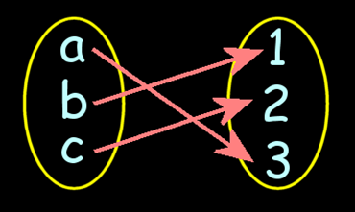
Relations
Another graphical way to display a relation:

Slide 11
Relations
If there is only one piece of information for each identifier, the relation is called binary

Slide 12
Relations
If more information is available, it is called n-ary

Slide 13
Relations
Subject | Height | Weight
Alice 5’8’’ 170
Ben 5’3’’ 120
Carlos 6’ 200
Delphine 5’7’’ 250

Slide 14

Questions?

Slide 15
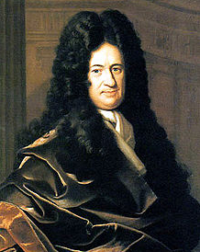
Functions
The term, "function" was coined by Gottfried Wilhelm Leibniz in 1673

Slide 16
Functions
Leibnitz observed that in many real-world processes there are inputs and outputs

Slide 17
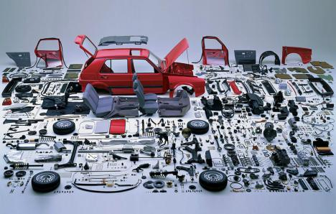
Functions
In a factory, the inputs are the components

Slide 18
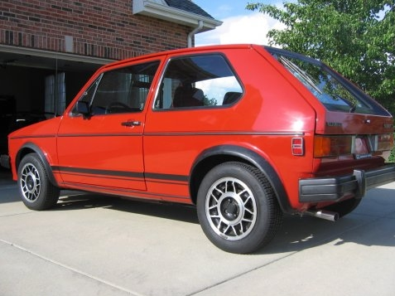
Functions
The output is the final product

Slide 19
Functions
In formulas, some variables are “input” variables
The thing you are calculating with the formula is the “output”

Slide 20
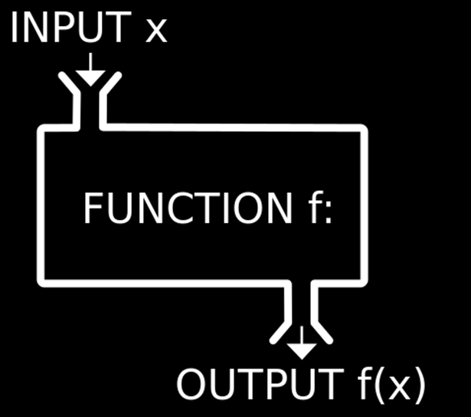
Functions

Slide 21
Functions
IN-CLASS PROBLEMS
In the formula:
A = πr²
What is the input variable?
What is the output variable?

Slide 22
Functions
IN-CLASS PROBLEMS
A = πr²
The size of “r” the radius is the input, it completely determines A the area of the circle (the output)

Slide 23
Functions
The input variable is ALWAYS put on the x-axis (horizontal axis)
No reason – it’s a TRADITION!

Slide 24
Functions
IN-CLASS PROBLEMS
Which variable goes on the horizontal axis in A = πr²

Slide 25
Functions
What the output turns out to be depends on what the input is
The output is frequently called the “dependent” variable

Slide 26
Functions
The input is called the “independent” variable because it’s value comes from an outside (sometimes uncontrollable) source

Slide 27
Functions
When you have a certain input, you want to be able to forecast exactly what the output will be

Slide 28

Functions
You don’t want several possible outputs

Slide 29
Functions
We call these mathematical models “deterministic”

Slide 30
Functions
A special type of mathematical formula was designed for input-outputs: functions

Slide 31
Functions
For a formula to be a function, every x can have only one y

Slide 32
Functions
Example:
The set: {(1,3)(2,4)(7,25)}
is a function because:
every x-value (1,2,7) has only one y-value:
1→3
2→4
7→25

Slide 33
Functions
IN-CLASS PROBLEMS
Is this set of points a function?
{(0,-2)(5,0)(13,4.2)(8.1,6)}

Slide 34
Functions
IN-CLASS PROBLEMS
Is this set of points a function?
{(0,-2)(5,0)(13,4.2)(8.1,6)}
YES! Because every x-value has only one y-value:
0 → -2
5 → 0
13 → 4.2
8.1 → 6

Slide 35
Functions
IN-CLASS PROBLEMS
Is this set of points a function?
{(0,-2)(5,0)(0,4.2)(8.1,6)}

Slide 36
Functions
IN-CLASS PROBLEMS
Is this set of points a function?
{(0,-2)(5,0)(0,4.2)(8.1,6)}
NO! Because when x = 0, the y-value could be -2 or 4.2:
0 → -2 or 4.2
5 → 0
8.1 → 6

Slide 37
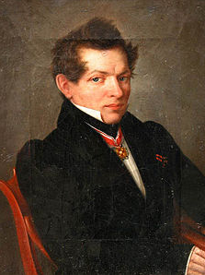
Functions
Nikolai Lobachevsky gave the modern "formal" definition of a function as a relation in which every first element has a unique second element
(1830-ish)

Slide 38
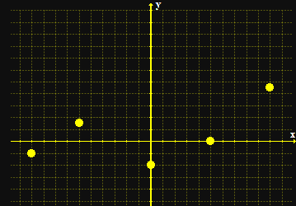
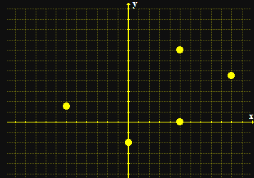
Functions
When you graph a function, none of the points fall on a vertical line
a function not a function

Slide 39
Functions
To test whether a formula is a function, you graph it and do the “vertical line test”
If it passes the VLT, it is a function

Slide 40
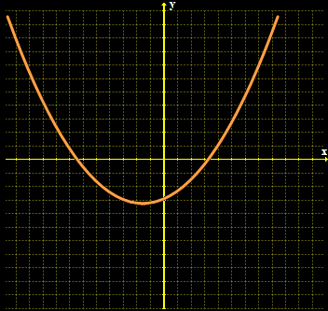
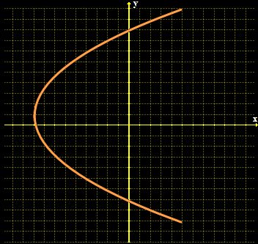
Functions
IN-CLASS PROBLEMS
Is it a function?

Slide 41
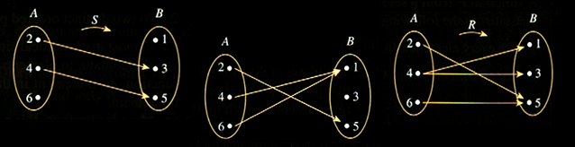
Functions
IN-CLASS PROBLEMS
Is it a function?

Slide 42
Functions
Naturally, there is a special symbol for functions
Where you used to write
y = 8x + 13
A function is written:
f (x) = 8x + 13
read as: “f of x”

Slide 43
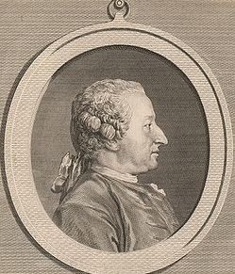
Functions
Alexis Claude Clairaut introduced the familiar notation "f (x)" in 1734

Slide 44
Functions
f (x) shows that the formula uses “x” as the input and that the output depends on it

Slide 45
Functions
When you evaluate a function, you need to substitute the given value for x in the formula

Slide 46
Functions
f (3) means “evaluate the function for x=3”

Slide 47
Functions
IN-CLASS PROBLEMS
f (x) = 3x + 7
find f (4)
find f (x+1)
find f (-x)

Slide 48
Functions
IN-CLASS PROBLEMS
If f (x) = x² - 2x +7
evaluate each of the following:
f (-5)
f (x+4)
f (-x)

Slide 49
Functions
The “legal” values for a function are called:
Domain - the xs
Range - the ys

Slide 50
Functions
IN-CLASS PROBLEMS
What is the domain for this function:
{(0,-2)(5,0)(13,4.2)(8.1,6)}

Slide 51
Functions
IN-CLASS PROBLEMS
What is the domain for this function:
{(0,-2)(5,0)(13,4.2)(8.1,6)}
Domain = 0,5,13,8.1

Slide 52
Functions
IN-CLASS PROBLEMS
What is the range for this function:
{(0,-2)(5,0)(13,4.2)(8.1,6)}

Slide 53
Functions
IN-CLASS PROBLEMS
What is the range for this function:
{(0,-2)(5,0)(13,4.2)(8.1,6)}
Range = -2,0,4.2,6

Slide 54
Questions?

Slide 55
Inverse Functions
Undo a function

Slide 56
Inverse Functions
A function ƒ(x)
has an inverse ƒ⁻¹ (x)

Slide 57
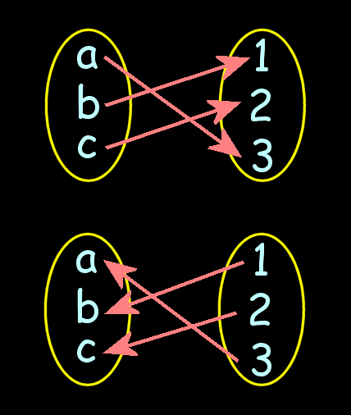
Inverse Functions
ƒ(x)
ƒ⁻¹(x)

Slide 58
Inverse Functions
The domain of ƒ is equal to the range of ƒ ⁻¹ and vice-versa

Slide 59
Inverse Functions
The “x”s become the “y”s and vice versa

Slide 60
Inverse Functions
IN-CLASS PROBLEMS
Is {(2,5), (7,3)} the inverse of the function: {(5,2), (3,7)}?

Slide 61
Inverse Functions
IN-CLASS PROBLEMS
Given the function :
ƒ(x) = {(7,–1), (0,5), (6,2), (–8,3)}
is the inverse also a function?

Slide 62
Inverse Functions
Finding the inverse for formulas
1) Replace "ƒ(x)" with "y"
2) Interchange "x" and "y"
3) Solve for "y"
4) Replace "y" in with ƒ⁻¹

Slide 63
Inverse Functions
Example:
ƒ(x) = 8x – 9
find ƒ⁻¹ (x)

Slide 64
Inverse Functions
Example:
ƒ(x) = 8x – 9
y = 8x – 9
x = 8y – 9
y = (x + 9)/8
ƒ⁻¹ (x) = (x + 9)/8

Slide 65
Inverse Functions
IN-CLASS PROBLEMS
Find the inverse of the function:
ƒ(x) = 9x

Slide 66
Inverse Functions
IN-CLASS PROBLEMS
Find the inverse of the function:
ƒ(x) = 4x + 12

Slide 67
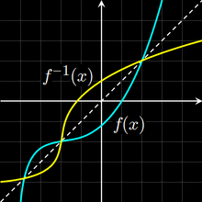
Inverse Functions
Because the domain of ƒ is equal to the range of ƒ⁻¹ and vice-versa, an inverse will
rotate a function:

Slide 68
Inverse Functions
The function is always rotated around the 1:1 y=x line

Slide 69
Inverse Functions
For a function to have an inverse that is also a function, the original function must pass a horizontal line test

Slide 70
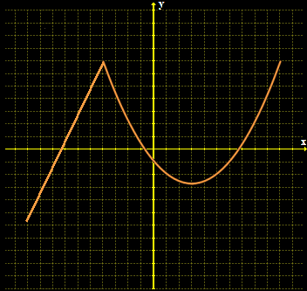
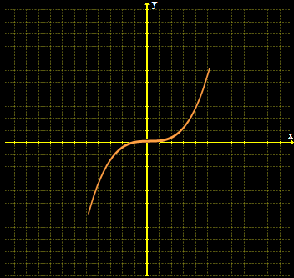
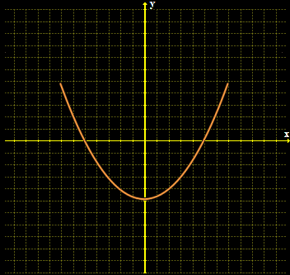
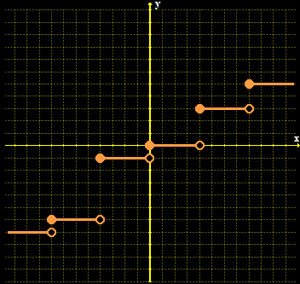
Inverse Functions
IN-CLASS PROBLEMS
Does it have an inverse?

Slide 71
Questions?

Slide 72
Sequences
1 2 3
What’s the next item in this sequence?

Slide 73
Sequences
3 5 7
What’s the next item in this sequence?

Slide 74
Sequences
Sequences are ordered lists

Slide 75

Sequences
They don’t have to be numbers

Slide 76
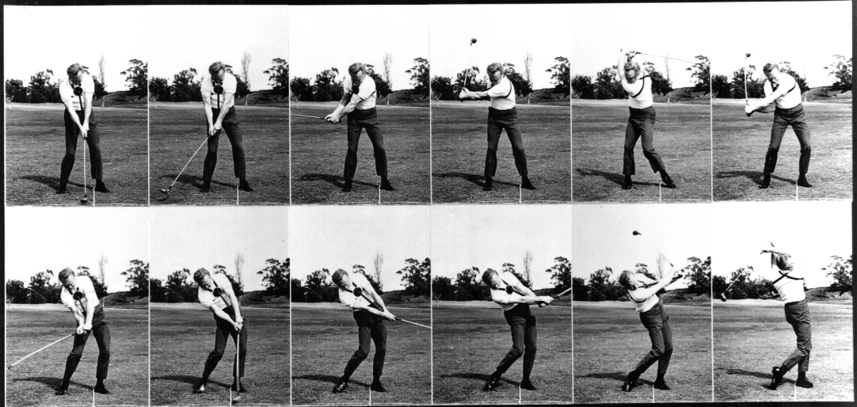
Sequences
→ →

Slide 77

Sequences

Slide 78

Sequences
IN-CLASS PROBLEMS
Sequence or not?

Slide 79
Sequences
Each member of a sequence is called a “term”

Slide 80
Sequences
Each term is designated by a subscript:
a_{1,} a_{2,} a_{3, ...,} a_{n, ...}
The 2nd term in the sequence
is a₂
The n^{th} term is a_{n}

Slide 81
Sequences
IN-CLASS PROBLEMS
What is a₁₇ in the sequence:
1 2 3 4 5 6 7 8 9 10 11 12 13 14 15 16 17 18 19 20 21 22 23 24 25 26 27 28 29 30

Slide 82
Sequences
IN-CLASS PROBLEMS
What is a₅ in the following sequence:
@ $ # % ^ & * ( ~ )

Slide 83
Sequences
An infinite sequence goes on forever:
a_{1,} a_{2,} a_{3, ...}
A finite sequence stops at some point:
a_{1,} a_{2,} a_{3, ...,} a₁₂

Slide 84
Sequences
IN-CLASS PROBLEMS
Which is the infinite series:
1 2 3 5 8 13 21 …
2 4 6 8 10

Slide 85
Sequences
Numerical sequences are often formed by a formula that uses one term to calculate the next term in the sequence

Slide 86
Sequences
You evaluate a sequence by plugging in the requested numbers for each term

Slide 87
Sequences
In an explicit formula each term in the sequence will be based on the subscript (or index) k:
a_{k} = k/(k+1)
a₁ = 1/(1+1) = 1/2
a₂ = 2/(2+1) = 2/3
...

Slide 88
Sequences
An alternating sequence:
a_{k} = (-1)^{k}
a₁ = (-1)¹ = -1
a₂ = (-1)² = 1
a₃ = (-1)³ = -1
a₄ = (-1)⁴ = 1
...

Slide 89
Sequences
IN-CLASS PROBLEMS
What is a₃ if
n = 3 and a_{n} = 3 / n ?

Slide 90
Sequences
IN-CLASS PROBLEMS
What is a₃ if
n = 3 and a_{n} = 3 / n ?
Plug in n=3!

Slide 91
Sequences
IN-CLASS PROBLEMS
What is a₃ if
n = 3 and a_{n} = 3 / n ?
a_{n} = 3 / n
a₃ = 3 / 3
a₃ = 1

Slide 92
Sequences
IN-CLASS PROBLEMS
What is a_{n} if
n = 2
a₁ = 4
a_{n} = a_{n-1} + 1

Slide 93
Sequences
IN-CLASS PROBLEMS
What is a_{n} if
n = 2
a₁ = 4
a_{n} = a_{n-1} + 1
Plug in n = 2

Slide 94
Sequences
IN-CLASS PROBLEMS
What is a_{n} if
n = 2
a₁ = 4
a_{n} = a_{n-1} + 1
a₂ = a₂₋₁ + 1
a₂ = a₁ + 1
What is a₁?

Slide 95
Sequences
IN-CLASS PROBLEMS
What is a_{n} if
n = 2
a₁ = 4
a_{n} = a_{n-1} + 1
a₂ = a₂₋₁ + 1
a₂ = a₁ + 1
a₂ = 4 + 1
a₂ = 5

Slide 96
Sequences
These are called “recursion formulas” - the formula calculates each term based on the previous term

Slide 97
Sequences
(You have to be given a starting term)

Slide 98
Questions?

Slide 99
Arithmetic Sequences
1 2 3
What’s the next item in this sequence?

Slide 100
Arithmetic Sequences
3 5 7
What’s the next item in this sequence?

Slide 101
Arithmetic Sequences
4 7 10
What’s the next item in this sequence?

Slide 102
Arithmetic Sequences
These are called “arithmetic sequences”
air-rith-MEH-tic
not
ah-RITH-meh-tic

Slide 103
Arithmetic Sequences
Each term in the sequence (after the first) differs from the preceding one by a constant amount (positive or negative)

Slide 104
Arithmetic Sequences
start with a₁
increase each time by "d"

Slide 105
Arithmetic Sequences
IN-CLASS PROBLEMS
start with a₁
increase each time by "d"
3 7 11 15 19 …
What is a₁?
What is d?

Slide 106
Arithmetic Sequences
start with a₁
increase each time by "d"
General term of an arithmetic sequence:
a_{n} = a₁ + (n-1)d

Slide 107
Arithmetic Sequences
IN-CLASS PROBLEMS
a_{n} = a₁ + (n-1)d
If a₁ = 0 and d = 3 what are the first four terms of the arithmetic sequence?
Just plug in a₁ and d
and n= 1,2,3,4

Slide 108
Arithmetic Sequences
IN-CLASS PROBLEMS
a_{n} = a₁ + (n-1)d
a_{n} = 0 + (n-1)3
a₁ = 0 + (1-1)3 = ?
a₂ = 0 + (2-1)3 = ?
a₃ = 0 + (3-1)3 = ?
a₄ = 0 + (4-1)3 = ?

Slide 109
Arithmetic Sequences
You can calculate the 10,000th term in an arithmetic sequence using the formula without having to list up the 9,999 that come before it!

Slide 110
Arithmetic Sequences
IN-CLASS PROBLEMS
If a₁ = 5 and d = 2 what are the first four terms of the arithmetic sequence?

Slide 111
Arithmetic Sequences
IN-CLASS PROBLEMS
If a₁ = 5 and d = 2 what are the first four terms of the arithmetic sequence?
a_{n} = a₁ + (n-1)d

Slide 112
Arithmetic Sequences
IN-CLASS PROBLEMS
If a₁ = 5 and d = 2 what are the first four terms of the arithmetic sequence?
a_{n} = 5 + (n-1)2
n = ?

Slide 113
Arithmetic Sequences
IN-CLASS PROBLEMS
If a₁ = 5 and d = 2 what are the first four terms of the arithmetic sequence?
a₁ = 5 + (1-1)2 =
a₂ = 5 + (2-1)2 =
a₃ = 5 + (3-1)2 =
a₄ = 5 + (4-1)2 =

Slide 114
Questions?

Slide 115
Geometric Sequences
What is the next term in this sequence:
1 2 4 8

Slide 116
Geometric Sequences
How about this one?
1 3 9 27

Slide 117
Geometric Sequences
Geometric sequences - each term in the sequence (after the first) is a common multiple (positive or negative) of the previous term

Slide 118
Geometric Sequences
For a geometric sequence, you need:
the starting value a₁
the multiple r

Slide 119
Geometric Sequences
IN-CLASS PROBLEMS
For the sequence: 1 4 16 64
What is a₁?
What is r?

Slide 120
Geometric Sequences
General term of a geometric series:
a_{n} = a₁r ^{n-1}

Slide 121
Geometric Sequences
IN-CLASS PROBLEMS
If a₁ = 1 and r = 2, what are the first four terms of the geometric sequence?

Slide 122
Geometric Sequences
IN-CLASS PROBLEMS
If a₁ = 1 and r = 2, what are the first four terms of the geometric sequence?
a_{n} = a₁r ^{n-1}

Slide 123
Geometric Sequences
IN-CLASS PROBLEMS
If a₁ = 1 and r = 2, what are the first four terms of the geometric sequence?
a_{n} = 1(2 ^{n-1})
What is n?

Slide 124
Geometric Sequences
IN-CLASS PROBLEMS
If a₁ = 1 and r = 2, what are the first four terms of the geometric sequence?
a₁ = 1(2 ¹⁻¹) = ?
a₂ = 1(2 ²⁻¹) = ?
a₃ = 1(2 ³⁻¹) = ?
a₄ = 1(2 ⁴⁻¹) = ?

Slide 125
Geometric Sequences
IN-CLASS PROBLEMS
If a₁ = 1 and r = 2, what are the first four terms of the geometric sequence?
a₁ = 1(2 ¹⁻¹) = 1(1) = 1
a₂ = 1(2 ²⁻¹) = 1(2) = 2
a₃ = 1(2 ³⁻¹) = 1(4) = 4
a₄ = 1(2 ⁴⁻¹) = 1(8) = 8

Slide 126
Geometric Sequences
IN-CLASS PROBLEMS
If a₁ = 2 and r = 2, what are the first four terms of the geometric sequence?

Slide 127
Geometric Sequences
IN-CLASS PROBLEMS
If a₁ = 2 and r = 2, what are the first four terms of the geometric sequence?
a_{n} = a₁r ^{n-1}

Slide 128
Geometric Sequences
IN-CLASS PROBLEMS
If a₁ = 2 and r = 2, what are the first four terms of the geometric sequence?
a_{n} = 2(2 ^{n-1})
What is n?

Slide 129
Geometric Sequences
IN-CLASS PROBLEMS
If a₁ = 2 and r = 2, what are the first four terms of the geometric sequence?
a₁ = 2(2 ¹⁻¹) = ?
a₂ = 2(2 ²⁻¹) = ?
a₃ = 2(2 ³⁻¹) = ?
a₄ = 2(2 ⁴⁻¹) = ?

Slide 130
Geometric Sequences
IN-CLASS PROBLEMS
If a₁ = 2 and r = 2, what are the first four terms of the geometric sequence?
a₁ = 2(2 ¹⁻¹) = 2(1) = 2
a₂ = 2(2 ²⁻¹) = 2(2) = 4
a₃ = 2(2 ³⁻¹) = 2(4) = 8
a₄ = 2(2 ⁴⁻¹) = 2(8) = 16

Slide 131
Geometric Sequences
IN-CLASS PROBLEMS
Consider a string of amplifiers each with a voltage gain ‘A’
If a signal V is applied to the first amplifier, show the sequence that describes the successive output voltages
of each stage:

Slide 132
Geometric Sequences
IN-CLASS PROBLEMS
Consider a string of amplifiers each with a voltage gain ‘A’
If a signal V is applied to the first amplifier, show the sequence that describes the successive output voltages
of each stage:
V AV A²V A³V A⁴V …

Slide 133
Sequences
IN-CLASS PROBLEMS
Which is geometric?
3 6 9 12
1 2 4 8
7 10 13 16
2 3 4.5 6.75
2 4 6 8

Slide 134
Sequences
IN-CLASS PROBLEMS
Identify which are arithmetic and geometric series:
1, 5, 25, 125, ...
2, 5, 8, 11, ...
19, 26, 33, 40, ...
21, 42, 84, 168, ...

Slide 135
Sequences
IN-CLASS PROBLEMS
Identify which are arithmetic and geometric series:
1, 5, 25, 125, ... geometric
2, 5, 8, 11, ... arithmetic
19, 26, 33, 40, ... arithmetic
21, 42, 84, 168, ... geometric

Slide 136
Questions?

Slide 137
Sequences
Limit of a sequence:
if the terms of a sequence approach a specific number, we say the limit of the sequence exists and it converges to the number

Slide 138
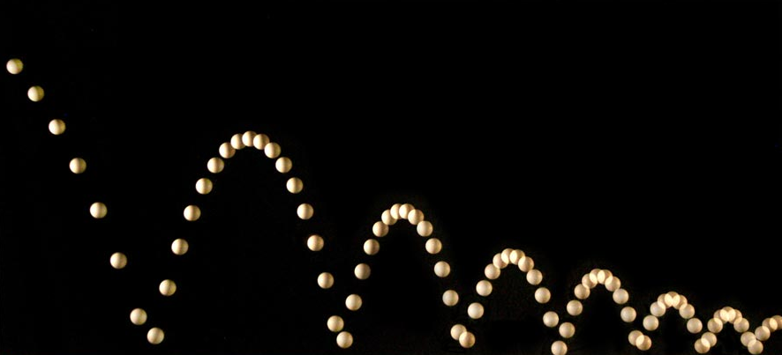
Sequences
Example: height of a bouncing ball
http://people.rit.edu/andpph/photofile-sci/bouncing-ball-7810.jpg

Slide 139
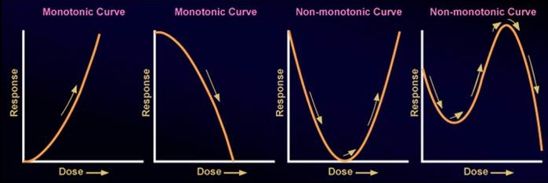
Sequences
Monotonic – either increasing or decreasing only
http://epa.gov/ncct/edr/images/nonmonotoniccurves2.jpg

Slide 140
Sequences
Non-decreasing – each term is greater than or equal to
the preceding term

Slide 141
Sequences
Non-increasing – each term is less than or equal to the preceding term

Slide 142
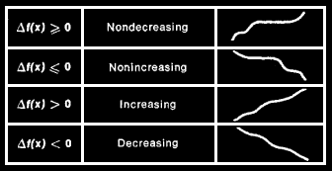
Sequences
http://img.tfd.com/ggse/2c/gsed_0001_0016_0_img4169.png

Slide 143
Sequences
Bounded – all terms are less than or equal to some finite number in magnitude

Slide 144
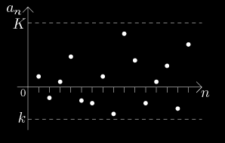
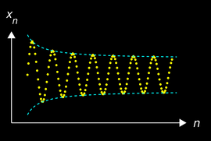
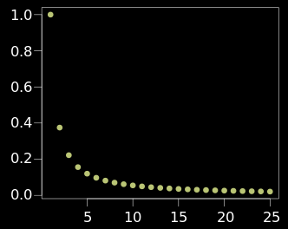
Sequences
http://math.feld.cvut.cz/mt/txta/1/gifa1/pc3aa1ba.gif
http://upload.wikimedia.org/wikipedia/commons/thumb/f/f4/Cauchy_sequence_illustration2.png/250px-Cauchy_sequence_illustration2.png
http://upload.wikimedia.org/wikipedia/commons/thumb/e/e4/Converging_Sequence_example.svg/320px-Converging_Sequence_example.svg.png

Slide 145
Sequences
Alternating Sequence:
Each term: (-1)^{n} a_{n}

Slide 146
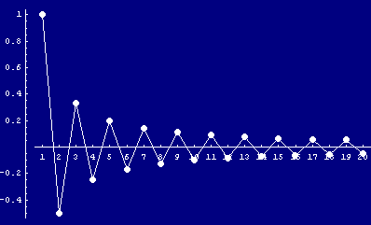
Sequences
5 -5 5 -5 5 -5 5 -5
http://www.cs.cas.cz/portal/AlgoMath/MathematicalAnalysis/InfiniteSeriesAndProducts/InfiniteSeries/SeriesWithArbitraryTerms/HTMLFiles/AlternatingSeries_38.gif

Slide 147
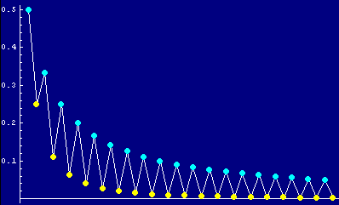
Sequences
IN-CLASS PROBLEMS
Is this an alternating sequence?
http://www.cs.cas.cz/portal/AlgoMath/MathematicalAnalysis/InfiniteSeriesAndProducts/InfiniteSeries/SeriesWithArbitraryTerms/HTMLFiles/AlternatingSeries_28.gif

Slide 148
Sequences
Fibonacci Sequence
a series of numbers in which each number is the sum of the two preceding numbers
0, 1, 1, 2, 3, 5, 8, ...

Slide 149
Sequences
IN-CLASS PROBLEMS
What is the next number in the Fibonacci sequence?
1 1 2 3 5 8

Slide 150
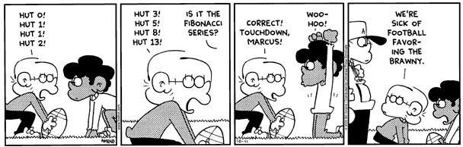
Sequences
(Amend 2005)

Slide 151
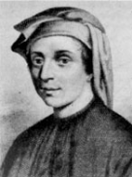
Sequences
The Fibonacci sequence first appears in the book
Liber Abaci (1202)
Leonardo of Pisa
(Fibonacci)
(1175-1250)

Slide 152
Sequences
Fibonacci considers the growth of an idealized rabbit population, assuming:
Start with a single
newly born pair of
rabbits (m/f)
Leonardo of Pisa
(Fibonacci)
(1175-1250)

Slide 153
Sequences
Rabbits are able to
mate at the age of
one month so that at
the end of its second
month a female can
produce another pair
of rabbits
Leonardo of Pisa
(Fibonacci)
(1175-1250)

Slide 154
Sequences
Rabbits never die and a mating pair always produces
one new pair (m/f)
every month from the
second month on
Leonardo of Pisa
(Fibonacci)
(1175-1250)

Slide 155
Sequences
IN-CLASS PROBLEMS
How many pairs will there be in one year?
Leonardo of Pisa
(Fibonacci)
(1175-1250)

Slide 156
Sequences
How many pairs will there be in one year?
Month | 0 | 1 | 2 | 3 | 4 | 5 | 6 | 7 | 8 | 9 | 10 | 11 | 12
Pairs | 0 | 1 | 1 | 2 | 3 | 5 | 8 | 13 | 21 | 34 | 55 | 89 | 144

Slide 157
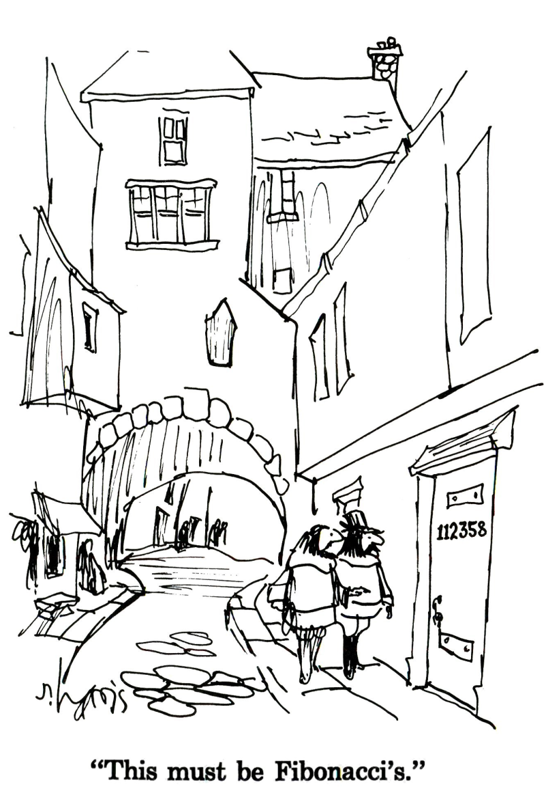

Slide 158
Questions?

Slide 159
Series
If you combine the numbers in a sequence into a single number, it’s called a “series”

Slide 160
Series
A sequence is a list of terms
A series is a sum of terms

Slide 161
Series
IN-CLASS PROBLEMS
What is the sum of the first 10 counting numbers?

Slide 162
Series
IN-CLASS PROBLEMS
What is the sum of the first 10 counting numbers?
1+2+3+4+5+6+7+8+9+10

Slide 163
Series
IN-CLASS PROBLEMS
Here’s a trick:
1 + 10 = 11
2 + 9 = 11
3 + 8 = 11
4 + 7 = 11
5 + 6 = 11
So the answer is 5 ∗ 11 = 55

Slide 164
Series
It’s math class… so there’s always a new symbol!
∑
called “summation”
means “add ‘em up!”

Slide 165
Series
We could have written:
What is the sum of the first 10 counting numbers?
as:
∑1 2 3…10

Slide 166
Series
We usually use ∑ with a formula:
10
∑ n
n=1
This means “add up the n’s where n goes from 1 to 10”

Slide 167
Series
We usually use ∑ with a formula:
10
∑ n
n=1
This means “add up the n’s where n goes from 1 to 10”
upper limit
lower limit

Slide 168
Series
Calculating a series:
5
∑ k = 2 + 3 + 4 + 5
k=2
= 14

Slide 169
Series
IN-CLASS PROBLEMS
4
In: ∑ (n + 1)
n=1
what is the lower limit?
what is the upper limit?

Slide 170
Series
IN-CLASS PROBLEMS
4
What is ∑ (n + 1)
n=1

Slide 171
Series
IN-CLASS PROBLEMS
4
What is ∑ (n + 1)
n=1
Just start adding up the (n + 1)s
Plugging in n=1, n=2, n=3, n=4

Slide 172
Series
IN-CLASS PROBLEMS
4
What is ∑ (n + 1)
n=1
= 1 + 1
+ 2 + 1
+ 3 + 1
+ 4 + 1
= 2 + 3 + 4 + 5 = ?

Slide 173
Series
No, all series do not add up to
14
(just a coincidence)

Slide 174
Series
IN-CLASS PROBLEMS
What is the sum of the first five terms in the arithmetic sequence 1, 4, 7…?

Slide 175
Series
IN-CLASS PROBLEMS
What is the sum of the first five terms in the arithmetic sequence 1, 4, 7…?
a_{n} = a₁ + (n-1)d
What is a₁?
What is d?
What is n?

Slide 176
Series
IN-CLASS PROBLEMS
What is the sum of the first five terms in the arithmetic sequence 1, 4, 7…?
a₁ = 1 + (1-1)3 =
a₂ = 1 + (2-1)3 =
a₃ = 1 + (3-1)3 =
a₄ = 1 + (4-1)3 =
a₅ = 1 + (5-1)3 =

Slide 177
Series
IN-CLASS PROBLEMS
What is the sum of the first five terms in the arithmetic sequence 1, 4, 7…?
a₁ = 1 + (1-1)3 = 1
a₂ = 1 + (2-1)3 = 4
a₃ = 1 + (3-1)3 = 7
a₄ = 1 + (4-1)3 = 10
a₅ = 1 + (5-1)3 = 13

Slide 178
Series
IN-CLASS PROBLEMS
So the sum is:
1+4+7+10+13 = 14∗2 + 7 = 35

Slide 179
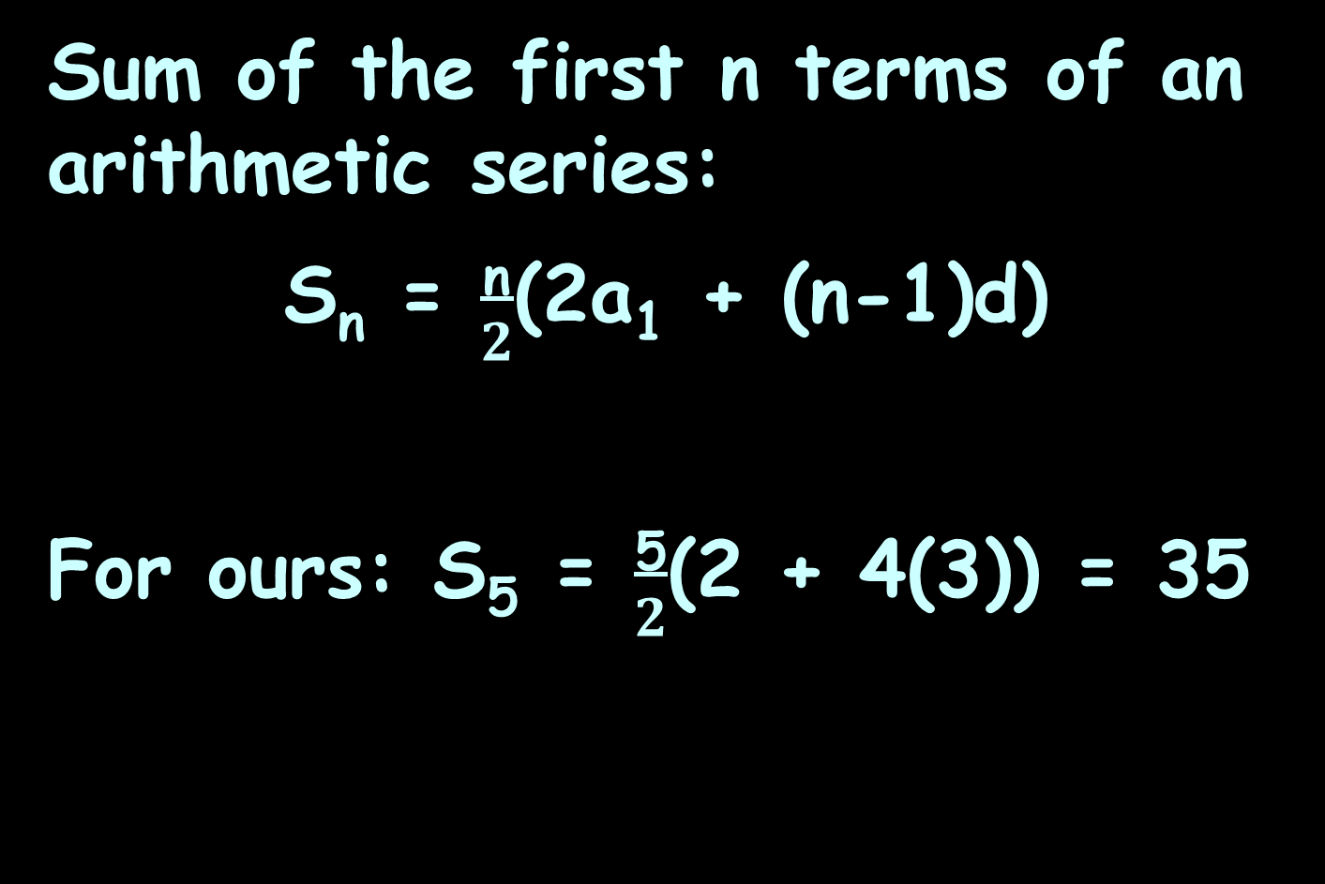
Series
Sum of the first n terms of an arithmetic series:
S_{n} = $\frac{\text{n}}{2}$(2a₁ + (n-1)d)
For ours: S₅ = $\frac{\text{5}}{2}$(2 + 4(3)) = 35

Slide 180
Series
IN-CLASS PROBLEMS
What is the sum of the first five terms in the geometric sequence 1, 4, 16…?

Slide 181
Series
IN-CLASS PROBLEMS
What is the sum of the first five terms in the geometric sequence 1, 4, 16…?
a_{n} = a₁r ^{n-1}
What is a₁?
What is r?

Slide 182
Series
IN-CLASS PROBLEMS
What is the sum of the first five terms in the geometric sequence 1, 4, 16…?
a_{n} = 1(4 ^{n-1})
What is n?

Slide 183
Series
IN-CLASS PROBLEMS
What is the sum of the first five terms in the geometric sequence 1, 4, 16…?
a₁ = 1(4 ¹⁻¹) = ?
a₂ = 1(4 ²⁻¹) = ?
a₃ = 1(4 ³⁻¹) = ?
a₄ = 1(4 ⁴⁻¹) = ?
a₅ = 1(4 ⁵⁻¹) = ?

Slide 184
Series
IN-CLASS PROBLEMS
What is the sum of the first five terms in the geometric sequence 1, 4, 16…?
a₁ = 1(4 ¹⁻¹) = 1
a₂ = 1(4 ²⁻¹) = 4
a₃ = 1(4 ³⁻¹) = 16
a₄ = 1(4 ⁴⁻¹) = 64
a₅ = 1(4 ⁵⁻¹) = 256

Slide 185
Series
IN-CLASS PROBLEMS
What is the sum of the first five terms in the geometric sequence 1, 4, 16…?
1 + 4 + 16 + 64 + 256
= 341

Slide 186
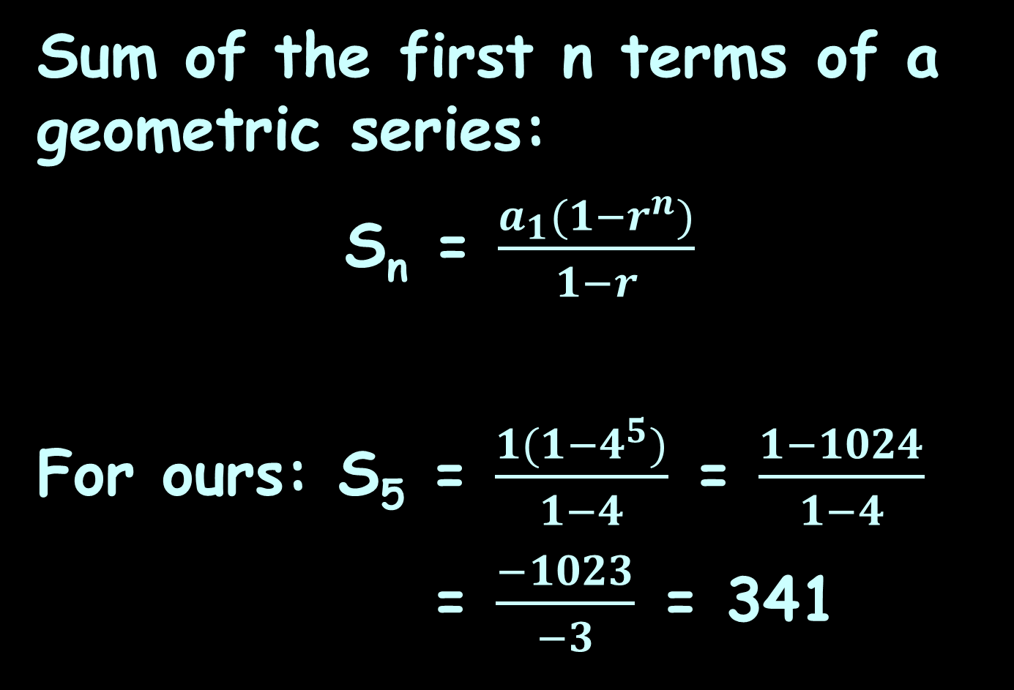
Series
Sum of the first n terms of a geometric series:
S_{n} = $\frac{a_{1}(1−r^{n})}{1−r}$
For ours: S₅ = $\frac{1(1−4^{5})}{1−4}$ = $\frac{1−1024}{1−4}$
= $\frac{−1023}{−3}$ = 341

Slide 187
Series
Another new symbol:
π
which is the product operator
(multiply ‘em all together)

Slide 188
Series
IN-CLASS PROBLEMS
3
What is π n ?
n=1

Slide 189
Series
IN-CLASS PROBLEMS
3
What is π 2n ?
n=1

Slide 190
Series
Another new symbol:
n!
which is the factorial operator
(the product of the integers from 1 to n)

Slide 191
Series
n! = n×(n-1)×(n-2)...3×2×1

Slide 192
Series
IN-CLASS PROBLEMS
What is 5! ?

Slide 193
Questions?

Slide 194
Series Convergence
Not in your book…

Slide 195
Series Convergence
Not in your book…
but important for IT

Slide 196
Series Convergence
Given a sequence of numbers {a_{n}}, the sum of the terms of this sequence:
a₁ + a₂ + a₃ + ... + a_{n} + ...
is called an infinite series

Slide 197
Series Convergence
The sequence Sn defined by
S₁ = a₁
S₂ = a₁ + a₂
S_{n} = a₁ + a₂ + a₃ + ... + a_{n}
n
= ∑ a_{k}
k=1
is the sequence of partial sums of the series

Slide 198
Series Convergence
The number S_{n} is the nth partial sum

Slide 199
Series Convergence
If the sequence of partial sums converge to a limit L, then we can say that the series converges and its sum is L

Slide 200
Series Convergence
If the sequence of partial sums of the series does not converge, then the series diverges

Slide 201
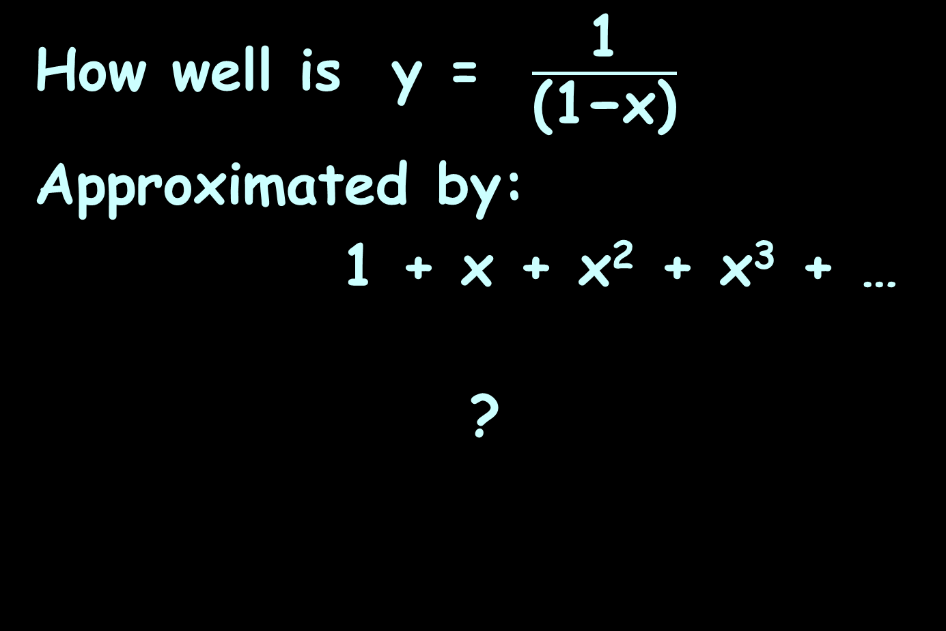
Series Convergence
IN-CLASS PROBLEMS
How well is y = $\frac{\text{1}}{\text{(1−}\text{x}\text{)}}$
Approximated by:
1 + x + x² + x³ + …
?

Slide 202
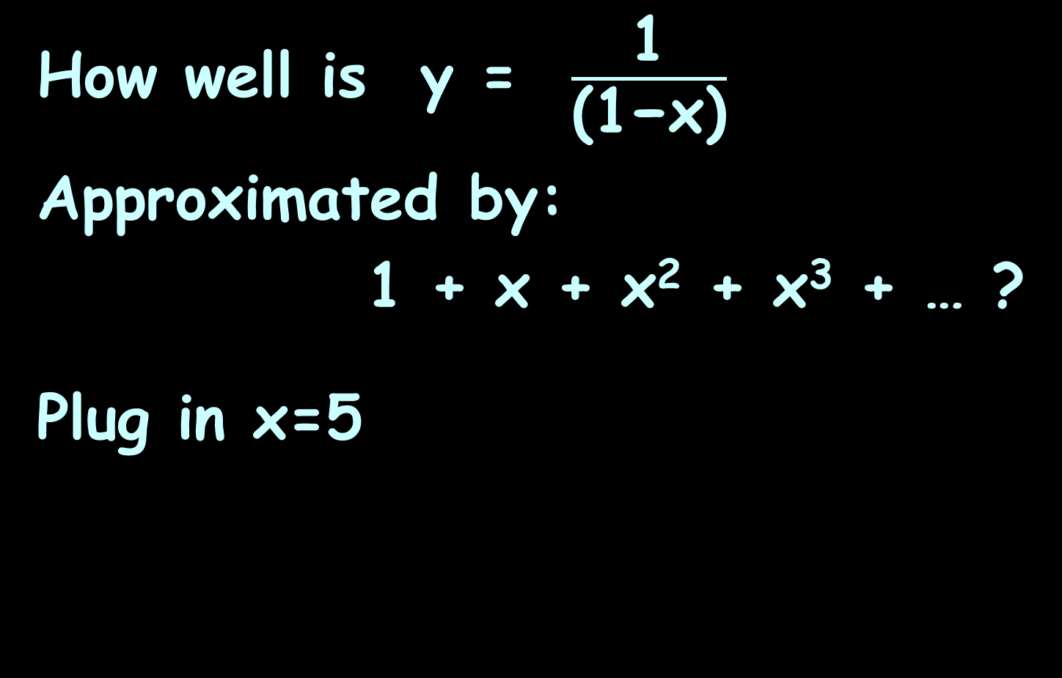
Series Convergence
IN-CLASS PROBLEMS
How well is y = $\frac{\text{1}}{\text{(1−}\text{x}\text{)}}$
Approximated by:
1 + x + x² + x³ + … ?
Plug in x=5

Slide 203
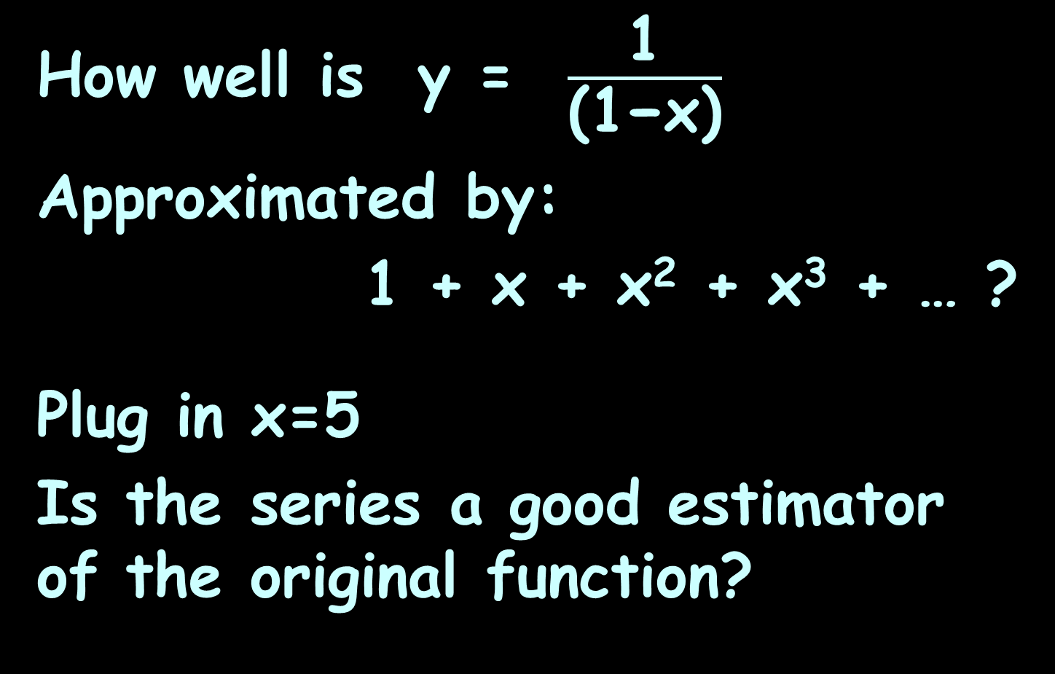
Series Convergence
IN-CLASS PROBLEMS
How well is y = $\frac{\text{1}}{\text{(1−}\text{x}\text{)}}$
Approximated by:
1 + x + x² + x³ + … ?
Plug in x=5
Is the series a good estimator of the original function?

Slide 204
Series Convergence
If not, the series is said to diverge

Slide 205
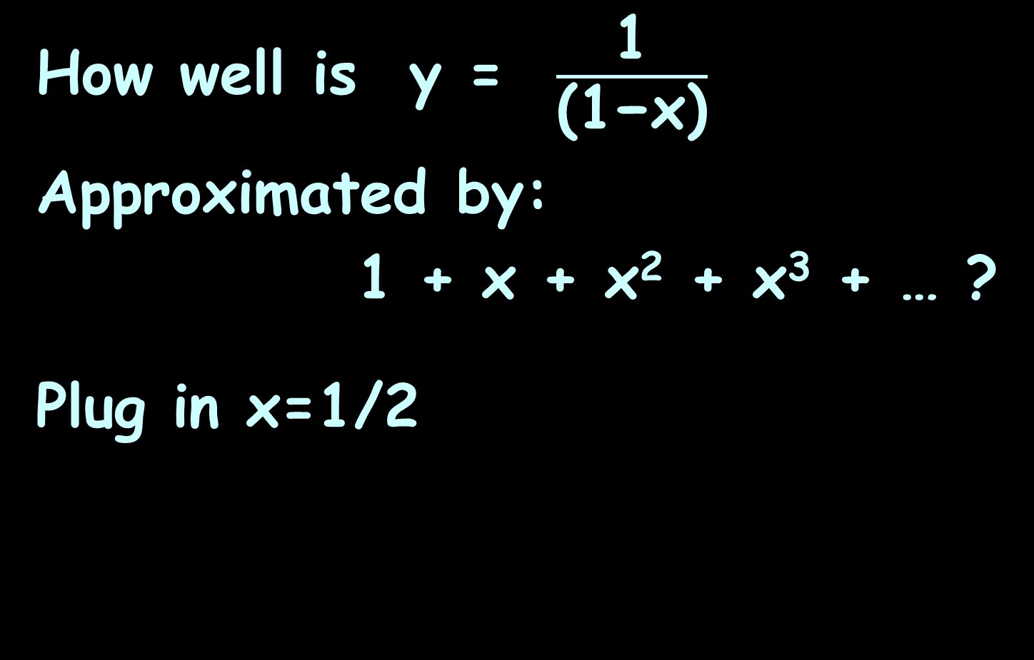
Series Convergence
IN-CLASS PROBLEMS
How well is y = $\frac{\text{1}}{\text{(1−}\text{x}\text{)}}$
Approximated by:
1 + x + x² + x³ + … ?
Plug in x=1/2

Slide 206
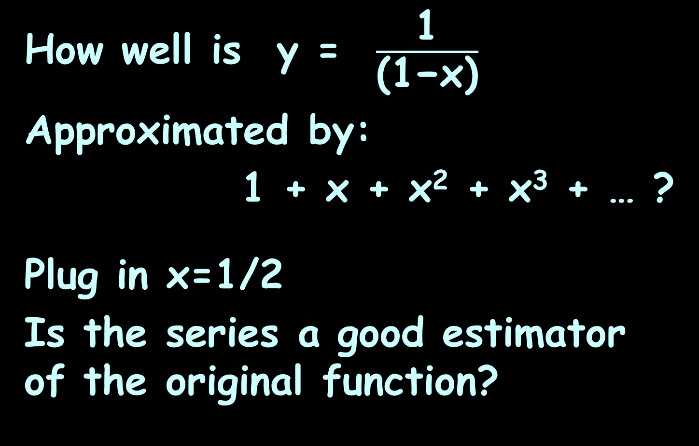
Series Convergence
IN-CLASS PROBLEMS
How well is y = $\frac{\text{1}}{\text{(1−}\text{x}\text{)}}$
Approximated by:
1 + x + x² + x³ + … ?
Plug in x=1/2
Is the series a good estimator of the original function?

Slide 207
Series Convergence
If the series is a good estimator of the original function, the series is said to converge

Slide 208
Series Convergence
To what extent does the original function equal the series?

Slide 209
Series Convergence
To what extent does the original function equal the series?
A good estimator converges

Slide 210
Series Convergence
To what extent does the original function equal the series?
A good estimator converges
A bad estimator diverges

Slide 211
Series Convergence
Range of convergence
Where is the series a good estimator of the original?

Slide 212
Series Convergence
The formulas in calculators and
computers are not lookup
tables
The formulas are calculated
using series approximations

Slide 213
Series Convergence
Companies look for:
accurate approximations
approximations that
converge quickly (after
only a few iterations)

Slide 214
Series Convergence
The “Squeeze Theorem”: a function gets squeezed between the other functions

Slide 215
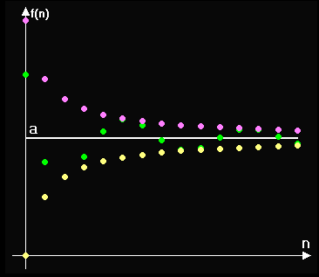
Series Convergence

Slide 216
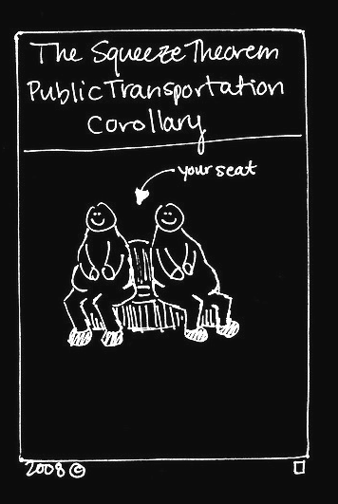
http://brownsharpie.courtneygibbons.org/wp-content/comics/2008-11-10-squeeze.jpg

Slide 217
Series Convergence
Divergence & Convergence Tests
If a series converges, then the
larger terms get closer and closer to zero
If not then the series diverges

Slide 218
Series Convergence
IN-CLASS PROBLEMS
Alternating series:
1 - 1 + 1 - 1 + 1 - …
Does it converge?

Slide 219
Series Convergence
IN-CLASS PROBLEMS
The series:
1/1 + 1/4 + 1/9 + …
Does it converge?

Slide 220
Series Convergence
Series convergence is actually hard to test and requires calculus

Slide 221
Questions?

Slide 222
Matrices
Matrix (plural matrices) - a rectangular table of elements (or entries), numbers or abstract quantities
Arranged in rows and columns

Slide 223

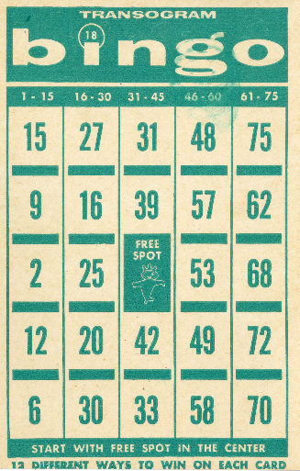
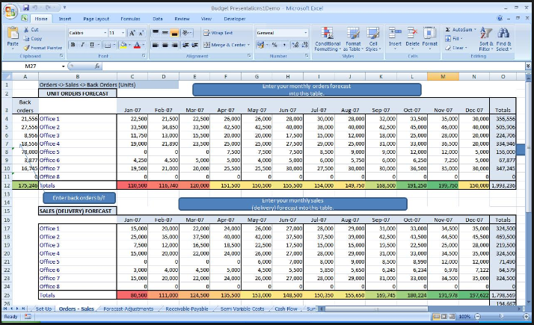
Matrices
Matrices in everyday life

Slide 224
Matrices
An n-ary relation is a matrix:
Subject | Height | Weight
Alice 5’8’’ 170
Ben 5’3’’ 120
Carlos 6’ 200
Delphine 5’7’’ 250

Slide 225
Matrices
The term "matrix" for arrangements of numbers was introduced in 1850 by James Joseph Sylvester

Slide 226
Matrices
Horizontal lines in a matrix are called rows
Vertical lines are called columns

Slide 227
Matrices
A matrix with m rows and n columns is called an m-by-n matrix (written m × n)
m and n are called its dimensions

Slide 228
Matrices
The dimensions of a matrix are always given with the number of
rows first, then the number of columns:
r x c

Slide 229
Matrices
Matrices are usually given capital letter names like “A”

Slide 230
Matrices
To designate a specific element in a matrix, you use small letters with subscripts r and c:
a₃₇ means the element in matrix A in row 3 column 7

Slide 231
Matrices
In Math class, matrices are shown by listing the elements inside square braces: [ ]

Slide 232
Matrices
┌ ┐
│ a₁₁ a₁₂ a₁₃ │
A = │ a₂₁ a₂₂ a₂₃ │
│ a₃₁ a₃₂ a₃₃ │
└ ┘

Slide 233
Matrices
IN-CLASS PROBLEMS
The Matrix Game

Slide 234
Questions?

Slide 235
Matrix Calculations
When information is entered into a computer, it is recorded in a field that behaves in the same way as a mathematical matrix

Slide 236
Matrix Calculations
When the computer adds, subtracts, multiplies or divides the information in a field, it is performing the same calculations that we execute when using matrices

Slide 237
Matrix Calculations
In mathematics, a matrix is used to store individual numbers or other pieces of data

Slide 238
Matrix Calculations
The amount of data that can be stored in the matrix depends upon its size
The size is expressed as the number of rows and columns in the matrix

Slide 239
Matrix Calculations
Although each of these matrices has six slots for data, they have different shapes and are different sized matrices
┌ d e f ┐
│ a b c │
│ d e f │
└ d e f ┘
┌ e f ┐
│ a b │
│ c d │
│ e f │
└ e f ┘
2 rows
3 columns
3 rows
2 columns

Slide 240
Matrix Calculations
If the number of rows is the same as the number of columns, it is a square matrix
┌ d e f ┐
│ a b c │
│ d e f │
│ g h i │
└ d e f ┘

Slide 241
Matrix Calculations
Two or more matrices may be added or subtracted only if they are the same size

Slide 242
Matrix Calculations
A 2 x 3 matrix can be added to another 2 x 3 matrix but not to a 3 x 2 matrix

Slide 243
Matrix Calculations
To add two matrices, add the components in each of the slots:
┌ d f ┐
│ a b │
│ c d │
└ e f ┘
┌ d f ┐
│ e f │
│ g h │
└ e f ┘
┌ dxc doc ┐
│ a+e b+f │
│ c+g d+h │
└ dxc doc ┘
+
=

Slide 244
Matrix Calculations
To subtract matrices, subtract the second component from the first component in each slot
┌ d f ┐
│ a b │
│ c d │
└ e f ┘
┌ d f ┐
│ e f │
│ g h │
└ e f ┘
┌ dxc doc ┐
│ a-e b-f │
│ c-g d-h │
└ dxc doc ┘
-
=

Slide 245
Matrix Calculations
Example:
┌ d f ┐
│ 5 6 │
│ 7 8 │
└ e f ┘
┌ d f ┐
│ 2 1 │
│ 5 4 │
└ e f ┘
┌ dxc doc ┐
│ 5-2 6-1 │
│ 7-5 8-4 │
└ dxc doc ┘
-
=
┌ doc ┐
│ 3 5 │
│ 2 4 │
└ doc ┘
=

Slide 246
Matrix Calculations
IN-CLASS PROBLEMS
Find:
┌ d f ┐
│ 2 3 4 │
│ 6 7 1 │
└ e f ┘
┌ d f ┐
│ 1 4 9 │
│ 3 2 4 │
└ e f ┘
+

Slide 247
Matrix Calculations
IN-CLASS PROBLEMS
Find:
┌ d ┐
│ 2 1 │
│ -4 6 │
│ 7 -2 │
└ e f ┘
┌ d f ┐
│ 3 1 7 │
│ 4 -5 6 │
└ e f ┘
+

Slide 248
Matrix Calculations
IN-CLASS PROBLEMS
Find:
┌ d┐
│ 2 │
│ 3 │
│ -6 │
│ 4 │
└ d┘
┌ d┐
│ -1 │
│ 5 │
│ -2 │
│ -9 │
└ d┘
-

Slide 249
Matrix Calculations
There are two kinds of matrix multiplication

Slide 250
Matrix Calculations
There are two kinds of matrix multiplication
Scalar multiplication multiplies a matrix by a constant

Slide 251
Matrix Calculations
Example:
┌ d f ┐
│ 5 6 │
│ 7 8 │
└ e f ┘
┌ 3×5 3×6 ┐
│ 3×5 3×6 │
│ 3×7 3×8 │
└ 3×5 3×6 ┘
=
3
┌ d f ┐
│ 15 18 │
│ 21 24 │
└ e f ┘
=

Slide 252
Matrix Calculations
IN-CLASS PROBLEMS
Find:
┌ 2 3 ┐
│ 2 3 │
│ 5 6 │
└ 2 3 ┘
3

Slide 253
Matrix Calculations
IN-CLASS PROBLEMS
Find:
┌ 2 ┐
│ 2 │
│ -3 │
│ 4 │
│ -2 │
└ 2 ┘
-5

Slide 254
Matrix Calculations
IN-CLASS PROBLEMS
Find:
┌ 2 3 ┐
│ -1 2 -3 │
│ 4 6 -2 │
│ -5 1 7 │
└ 2 3 ┘
-4

Slide 255
Matrix Calculations
Multiplying two matrices is more complicated than addition or subtraction or scalar multiplication

Slide 256
Matrix Calculations
Only certain matrices can be multiplied

Slide 257
Matrix Calculations
Only certain matrices can be multiplied
If the number of columns of the first matrix is the same as the number of rows of the second matrix, they can be multiplied

Slide 258
Matrix Calculations
We call these the inner dimensions of the matrices
7 x 5 5 x 8
inner dimensions

Slide 259
Matrix Calculations
For example, a 3 x 2 matrix can be multiplied by a 2 x 3 matrix since the inner dimensions of 2 agree:
3 x 2 2 x 3
Terms agree

Slide 260
Matrix Calculations
However, a 3 x 2 matrix cannot be multiplied by another 3 x 2 matrix since the inner dimensions do not agree:
3 x 2 3 x 2
Terms do not agree

Slide 261
Matrix Calculations
Factoid: the size of the solution matrix will be the outer dimensions:
for the 7 x 5 times 5 x 8 matrix multiplication, the solution matrix will be a 7 x 8 matrix

Slide 262
Matrix Calculations
Example: Multiply
┌ 2 3 ┐
│ 1 2 │
│ 3 4 │
└ 2 3 ┘
┌ 2 3 ┐
│ 5 7 │
│ 6 8 │
└ 2 3 ┘
x

Slide 263
Matrix Calculations
Example: Multiply
First, check to see if the two matrices can be multiplied
Are the inner dimensions the same?
┌ 2 3 ┐
│ 1 2 │
│ 3 4 │
└ 2 3 ┘
┌ 2 3 ┐
│ 5 7 │
│ 6 8 │
└ 2 3 ┘
x

Slide 264
Matrix Calculations
Example: Multiply
First, check to see if the two matrices can be multiplied
Since the inner dimensions are both 2, the matrices can be multiplied
┌ 2 3 ┐
│ 1 2 │
│ 3 4 │
└ 2 3 ┘
┌ 2 3 ┐
│ 5 7 │
│ 6 8 │
└ 2 3 ┘
x

Slide 265
Matrix Calculations
Example: Multiply
Next, we look at the outer dimensions to determine the expected dimensions of the solution matrix
┌ 2 3 ┐
│ 1 2 │
│ 3 4 │
└ 2 3 ┘
┌ 2 3 ┐
│ 5 7 │
│ 6 8 │
└ 2 3 ┘
x

Slide 266
Matrix Calculations
Example: Multiply
Since the outer dimensions of both are 2, we know that the solution matrix must be 2 x 2
┌ 2 3 ┐
│ 1 2 │
│ 3 4 │
└ 2 3 ┘
┌ 2 3 ┐
│ 5 7 │
│ 6 8 │
└ 2 3 ┘
x

Slide 267
Matrix Calculations
To multiply the two matrices, each row of the left matrix is multiplied by each column of the right matrix
These individual products are then added to get the entries in the solution matrix

Slide 268

Matrix Calculations
dreamstime.com

Slide 269
Matrix Calculations
It’s easier done than said…

Slide 270
Matrix Calculations
It’s easier done than said…
but it IS tricky!

Slide 271
Matrix Calculations
Use the ROWS in the first matrix
And the COLUMNS in the second matrix

Slide 272
Matrix Calculations
The first row in the first matrix and the first column in the second matrix are combined to create the top left entry in the solution matrix

Slide 273
Matrix Calculations
Example: Multiply
┌ 2 3 ┐
│ 1 2 │
│ 3 4 │
└ 2 3 ┘
┌ 2 3 ┐
│ 5 7 │
│ 6 8 │
└ 2 3 ┘
x
=
Top left entry:
┌ 2 3 ┐
│ 1×5+2×6 1×7+2×8 │
│ 1×5+2×6 1×7+2×8 │
└ 2 3 ┘

Slide 274
Matrix Calculations
Example: Multiply
┌ 2 3 ┐
│ 1 2 │
│ 3 4 │
└ 2 3 ┘
┌ 2 3 ┐
│ 5 7 │
│ 6 8 │
└ 2 3 ┘
x
=
Top right entry:
┌ 2 3 ┐
│ 1×5+2×6 1×7+2×8 │
│ 1×5+2×6 1×7+2×8 │
└ 2 3 ┘

Slide 275
Matrix Calculations
Example: Multiply
┌ 2 3 ┐
│ 1 2 │
│ 3 4 │
└ 2 3 ┘
┌ 2 3 ┐
│ 5 7 │
│ 6 8 │
└ 2 3 ┘
x
=
Bottom left entry:
┌ 2 3 ┐
│ 1×5+2×6 1×7+2×8 │
│ 3×5+4×6 1×7+2×8 │
└ 2 3 ┘

Slide 276
Matrix Calculations
Example: Multiply
┌ 2 3 ┐
│ 1 2 │
│ 3 4 │
└ 2 3 ┘
┌ 2 3 ┐
│ 5 7 │
│ 6 8 │
└ 2 3 ┘
x
=
Bottom right entry:
┌ 2 3 ┐
│ 1×5+2×6 1×7+2×8 │
│ 3×5+4×6 3×7+4×8 │
└ 2 3 ┘

Slide 277
Matrix Calculations
Example: Multiply
┌ 2 3 ┐
│ 1 2 │
│ 3 4 │
└ 2 3 ┘
┌ 2 3 ┐
│ 5 7 │
│ 6 8 │
└ 2 3 ┘
x
=
┌ 2 3 ┐
│1×5+2×6 1×7+2×8│
│3×5+4×6 3×7+4×8│
└ 2 3 ┘
┌ 2 ┐
│17 23│
│39 53│
└ 2 3 ┘
=

Slide 278
Matrix Calculations
IN-CLASS PROBLEMS
┌ 2 3 ┐
│ 3 1 │
│ 2 5 │
└ 2 3 ┘
┌ 2 3 ┐
│ 6 1 │
│ 4 9 │
└ 2 3 ┘
Find:
x

Slide 279
Matrix Calculations
IN-CLASS PROBLEMS
Find:
┌ 2 3 ┐
│2.8 9.1│
└ 2 3 ┘
┌ 2 3 ┐
│4.2 3.1 4.7│
└ 2 3 ┘
x

Slide 280
Matrix Calculations
IN-CLASS PROBLEMS
┌ 2 3 ┐
│ 2 5 9 │
└ 2 3 ┘
┌ 2 ┐
│ 1 │
│ 5 │
│ 4 │
└ 2 ┘
Find:
x

Slide 281
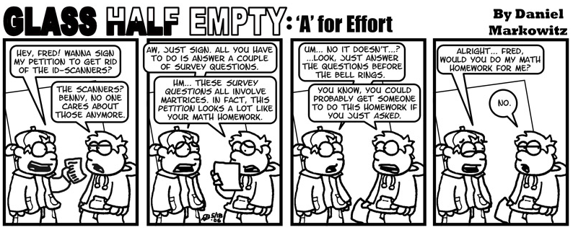

Slide 282
Questions?

Slide 283
Systems of Equations
A set of two equations containing two variables ...
A set of three equations containing three variables ...
Are you seeing a pattern?

Slide 284
Systems of Equations
To solve a system, you must have at least as many equations as you have variables

Slide 285
Systems of Equations
2x + 5y = 38
x + 7y = 37
Lots of equations come in groups!

Slide 286
Systems of Equations
If they give you values for “x” and “y” and ask if they are true values, plug them in to both equations – both equations must be true for the values

Slide 287
Systems of Equations
Are x = 4 and y = 6 true values for the system:
2x + 5y = 38
x + 7y = 37
Plug in x = 4 and y = 6

Slide 288
Systems of Equations
Plug in x = 4 and y = 6
2(4) + 5(6) =? 38
(4) + 7(6) =? 37
Are the values x = 4 and y = 6 a true solution to this system?

Slide 289
Systems of Equations
Suppose we wanted to find “x” and “y” for the equations:
2x + 5y = 38
x + 7y = 37

Slide 290
Systems of Equations
Strategy: try to get one of the variables written in terms of the other variable:
2x + 5y = 38
x + 7y = 37
Look for a “loner”

Slide 291
Systems of Equations
x + 7y = 37
Use algebra to solve for “x”:
x = 37 – 7y
Now, plug in this “x” into the other equation

Slide 292
Systems of Equations
2x + 5y = 38
x = 37 – 7y
To get:
2(37-7y) + 5y = 38
Now, solve for “y”!

Slide 293
Systems of Equations
2(37-7y) + 5y = 38
74 – 14y + 5y = 38
-9y = 38 – 74 = -36
y = -36/-9
y = 4
Then we plug in this value for “y” and solve for “x”

Slide 294
Systems of Equations
We already have:
x = 37 – 7y
y = 4
So just plug in y = 4:
x = 37 – 7(4)
x = 37 – 28
x = 9

Slide 295
Systems of Equations
So, the true solution to the system:
2x + 5y = 38
x + 7y = 37
is x = 9, y = 4
or (x,y) = (9,4)

Slide 296
Systems of Equations
To find the true solution to the system:
2x + 5y = 38
3x + 7y = 50
Solve one of the equations for either “x” or “y”

Slide 297
Systems of Equations
2x + 5y = 38
2x = 38 – 5y
x = 38 – 5y
2
Then plug in this “x” into the other equation

Slide 298
Systems of Equations
3x + 7y = 50
x = 38 – 5y
2

Slide 299
Systems of Equations
3(38/2 - 5y/2) + 7y = 50
57 – 7.5y + 7y = 50
Solve for “y”:
-7.5y + 7y = 50 – 57
-0.5y = -7
y = -7/-0.5
y = 14

Slide 300
Systems of Equations
You already have:
x = 38 – 5y
2
and y = 14
so: x = 38 – 5(14) = 38-70
2 2
x = -32/2 = -16

Slide 301
Systems of Equations
So the true solution to the system:
2x + 5y = 38
3x + 7y = 50
is x = -16, y = 14
or (x,y) = (-16,14)

Slide 302
Systems of Equations
For more equations –
Same stuff, just more of it!

Slide 303
Systems of Equations
Solve the following system of equations:
x + z = 3
x + 2y – z = 1
2x – y + z = 3

Slide 304
Systems of Equations
x + z = 3
is the easiest – let’s start there:
z = 3 – x
Plug that in!

Slide 305
Systems of Equations
z = 3 – x
x + 2y – z = 1
2x – y + z = 3
become:
x + 2y – (3 – x) = 1
2x – y + (3 – x) = 3
Now it’s just two equations!

Slide 306
Systems of Equations
x + 2y – 3 + x = 1
2x – y + 3 – x = 3
or
2x + 2y = 4
x – y = 0
Use x – y = 0 → x = y

Slide 307
Systems of Equations
x = y
2x + 2y = 4
2x + 2x = 4
4x = 4
x = 1

Slide 308
Systems of Equations
So, now we have:
x = 1
x = y
z = 3 – x
So, (x,y,z) = (1,1,2)

Slide 309
Systems of Equations
Lots of business applications use systems of equations

Slide 310
Systems of Equations
The income function is the total amount generated by selling the product:
I(x) = (price per unit sold) ∗ x
x is the quantity sold

Slide 311
Systems of Equations
The cost function is the total cost of producing the product:
C(x) = fixed cost +
(cost per unit produced) ∗ x
x is the quantity produced

Slide 312
Systems of Equations
The profit function is the difference between the cost and the revenue functions:
P(x) = I(x) – C(x)
x is the quantity of the product

Slide 313
Systems of Equations
The x-solution for the two equations Cost and Income
is the true solution of the system of the two equations (the Cost and Income equations)

Slide 314
Systems of Equations
The solution to the system is called the “break-even point”

Slide 315
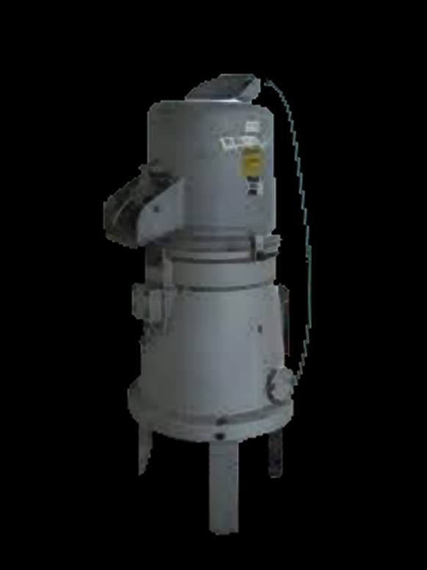
Systems of Equations
IN-CLASS PROBLEMS
Example:
A widget-maker produces widgets
Each widget sells for $300
They sell 20,000 widgets each year
What is their annual income?

Slide 316
Systems of Equations
IN-CLASS PROBLEMS
I(x) = (price per unit sold) ∗ x
I = $300 (20,000)
= $6,000,000

Slide 317
Systems of Equations
IN-CLASS PROBLEMS
They have a fixed cost (rent, utilities, salaries, etc.) of
$950,000 per year
Each widget costs $10 to make
They make 20,000 widgets each year
What is their annual cost?

Slide 318
Systems of Equations
IN-CLASS PROBLEMS
C(x) = fixed cost +
(cost per unit produced) ∗ x
C = $950,000 + $10(20,000)
= $1,150,000

Slide 319
Systems of Equations
IN-CLASS PROBLEMS
What is their annual profit?

Slide 320
Systems of Equations
IN-CLASS PROBLEMS
P(x) = I(x) – C(x)
P = $6,000,000 - $1,150,000
= $4,850,000

Slide 321
Systems of Equations
IN-CLASS PROBLEMS
Let’s buy Widget stock!!!

Slide 322
Systems of Equations
IN-CLASS PROBLEMS
Break-even point:
How many widgets you need to make for the cost to equal the income (profit of $0)

Slide 323
Systems of Equations
IN-CLASS PROBLEMS
Break-even point:
C(x) = I(x)
fixed cost + (cost per unit) ∗ x
=
(price per unit sold) ∗ x

Slide 324
Systems of Equations
IN-CLASS PROBLEMS
Break-even point:
950,000 + 10(x) = 300(x)
Algebra magic…
950,000 = 300x - 10x
950,000 = 290x
950,000/290 = x
So x = 3275.86 units

Slide 325
Systems of Equations
IN-CLASS PROBLEMS
They will “break even” when they make and sell 3276 units
Since they make and sell a lot more, they are making a huge profit!

Slide 326
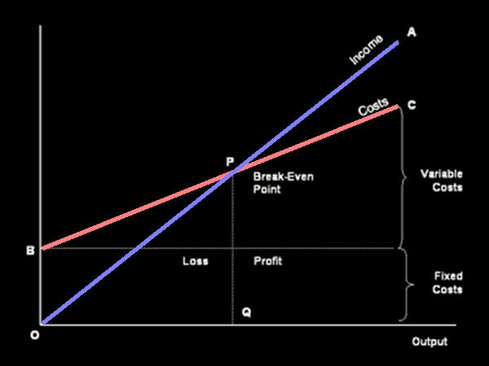
Systems of Equations
If you graph the income and cost curves, the break-even point is
where the
two curves
cross

Slide 327
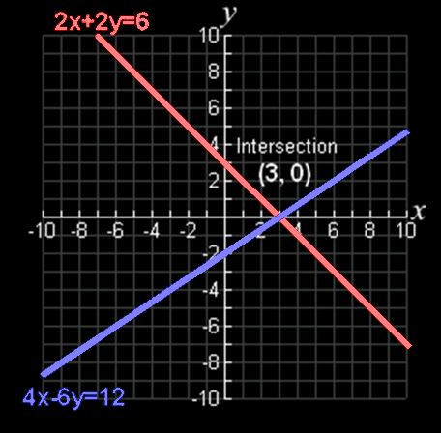
Systems of Equations
Actually this is true for all systems of equations – the true solution (x,y) is
the point where
the graph of the
two curves cross

Slide 328
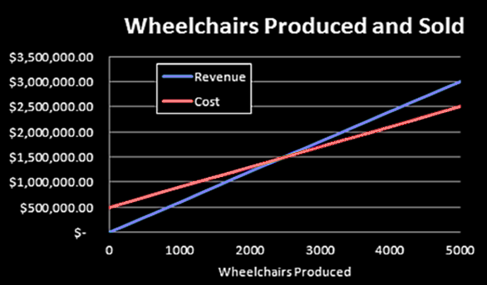
Systems of Equations
IN-CLASS PROBLEMS
For this example, w is the number of wheelchairs produced
Revenue: R = $600w
Cost: C = $500,000 + $400w
Break-even
point:

Slide 329
Questions?

