Slide 1

Welcome to Wk06
MATH225 Applications of Discrete Mathematics and Statistics
http://media.dcnews.ro/image/201109/w670/statistics.jpg

Slide 2
Probability
Probability - likelihood of a favorable outcome

Slide 3
Probability
Probability is defined to be:
# favorable outcomes
total # of outcomes
Usually probabilities are given
in %
P =

Slide 4
Probability
This assumes each outcome is equally likely to occur –
RANDOM

Slide 5
Probability
IN-CLASS PROBLEMS
What is
P(head on 1 toss of a fair coin)

Slide 6
Probability
IN-CLASS PROBLEMS
P(head on 1 toss of a fair coin)
What are all of the outcomes?

Slide 7
Probability
IN-CLASS PROBLEMS
P(head on 1 toss of a fair coin)
What are all of the outcomes?
H or T
What are the favorable outcomes?

Slide 8
Probability
IN-CLASS PROBLEMS
P(head on 1 toss of a fair coin)
What are the favorable outcomes?
H or T

Slide 9
Probability
IN-CLASS PROBLEMS
So:
P(head on 1 toss of a fair coin)
= 1/2 or 50%

Slide 10
Probability
IN-CLASS PROBLEMS
Probabilities for tossing 2 coins

Slide 11
Probability
The Law of Averages
And why it doesn’t work the way people think it does

Slide 12
Probability
IN-CLASS PROBLEMS
Amy Bob Carlos Dawn Ed
ABC ABD ABE ACD ACE ADE
BCD BCE BDE
CDE
What is the probability that Bob will be going to the conference?

Slide 13
Probability
IN-CLASS PROBLEMS
ABC ABD ABE ACD ACE ADE
BCD BCE BDE
CDE
How many outcomes total?
How many outcomes favorable?

Slide 14
Probability
IN-CLASS PROBLEMS
ABC ABD ABE ACD ACE ADE
BCD BCE BDE
CDE
How many outcomes total? 10
How many outcomes favorable?
6 have a “B” in them

Slide 15
Probability
IN-CLASS PROBLEMS
ABC ABD ABE ACD ACE ADE
BCD BCE BDE
CDE
So there is a 6/10 or 60% probability Bob will be going to the conference

Slide 16
Probability
Because the # favorable outcomes is always less than the total # of outcomes
0 ≤ P ≤ 1
or
0% ≤ P ≤ 100%

Slide 17
Probability
And
P(all possible outcomes) = 100%

Slide 18
Probability
The complement of an outcome is all outcomes that are not favorable
Called P′ (pronounced “P prime")
P′ = 1 – P
or
P′ = 100% – P

Slide 19
Probability
IN-CLASS PROBLEMS
To find:
P (not 1 on one roll of a fair die)
This is the complement of:
P (a 1 on one roll of a fair die) = 1/6

Slide 20
Probability
IN-CLASS PROBLEMS
Since:
P (a 1 on one roll of a fair die) = 1/6
Then P (not 1 on one roll of a fair die) would be:
P′ = 1 – P = 1 – 1/6 = 5/6

Slide 21
Probability
Mutually exclusive outcomes – if one occurs, then the other cannot occur
Ex: if you have a “H” then you can’t have a “T”

Slide 22
Probability
Addition rule - if you have mutually exclusive outcomes:
P(both) = P(first) + P(second)

Slide 23
Probability
Mutually exclusive events:
Event A: I am 5’ 2” tall today
Event B: I am 5’ 6” tall today

Slide 24
Probability
For tables of data, calculating probabilities is easy:
Minutes Internet Usage | Probability of Being in Category
1-20 | 9/52 = 0.17 = 17%
21-40 | 18/52 = 0.35 = 35%
41-60 | 15/52 = 0.29 = 29%
61-80 | 0.15 = 15%
81-100 | 0.02 = 2%
101-120 | 0.00 = 0%
121+ | 0.02 = 2%
The probability that a subscriber uses 1-20 min:
P(1-20) = 0.17

Slide 25
Probability
IN-CLASS PROBLEMS
What is the probability of living more than 12 years after this diagnosis?
Years After Diagnosis | % of Deaths
1-2 | 15
3-4 | 35
5-6 | 16
7-8 | 9
9-10 | 6
11-12 | 4
13-14 | 2
15+ | 13

Slide 26
Probability
IN-CLASS PROBLEMS
Since you can’t live BOTH 13-14 AND 15+ years after diagnosis (you fall
into one category
or the other) the
events are
mutually exclusive
Years After Diagnosis | % of Deaths
1-2 | 15
3-4 | 35
5-6 | 16
7-8 | 9
9-10 | 6
11-12 | 4
13-14 | 2
15+ | 13

Slide 27
Probability
IN-CLASS PROBLEMS
You can use the addition rule!
P(living >12 years)
= P(living13-14)
+ P(living 15+)
= 2% + 13%
= 15%
Years After Diagnosis | % of Deaths
1-2 | 15
3-4 | 35
5-6 | 16
7-8 | 9
9-10 | 6
11-12 | 4
13-14 | 2
15+ | 13

Slide 28
Probability
If two categories are “mutually exclusive”
you add their probabilities to get the probability of one OR the other

Slide 29
Probability
Sequential outcomes – one after the other
first toss: H
second toss: T
third toss: T . . .

Slide 30
Probability
Because one outcome in the sequence does not affect the outcome of the next event in the sequence we call them “independent outcomes”

Slide 31
Probability
Multiplication rule - if you have independent outcomes:
P(one then another) =
P(one) * P(another)

Slide 32
Probability
To get the probability of both event A AND event B occurring, you multiply their probabilities to get the probability of both

Slide 33
Probability
IN-CLASS PROBLEMS
What if you had data:
Natural Hair Color |  |  | Eye Color
Blonde | 34.0% |  | Blue | 36.0%
Brown | 43.0% |  | Brown | 64.0%
Red | 7.0%
Black | 14.0%

Slide 34
Probability
IN-CLASS PROBLEMS
If hair color and eye color are independent events, then find:
P(blonde AND blue eyes)
Natural Hair Color |  |  | Eye Color
Blonde | 34.0% |  | Blue | 36.0%
Brown | 43.0% |  | Brown | 64.0%
Red | 7.0%
Black | 14.0%

Slide 35
Probability
IN-CLASS PROBLEMS
P(blonde AND blue eyes) =
=.34 x .36 ≈ .12 or 12%
Natural Hair Color |  |  | Eye Color
Blonde | 34.0% |  | Blue | 36.0%
Brown | 43.0% |  | Brown | 64.0%
Red | 7.0%
Black | 14.0%

Slide 36
Probability
IN-CLASS PROBLEMS
What would be the probability of a subscriber being both
(1-20 minutes)
and
(61-80 minutes)?
Minutes Internet Usage | Probability of Being in Category
1-20 | 9/52 = 0.17 = 17%
21-40 | 18/52 = 0.35 = 35%
41-60 | 15/52 = 0.29 = 29%
61-80 | 0.15 = 15%
81-100 | 0.02 = 2%
101-120 | 0.00 = 0%
121+ | 0.02 = 2%

Slide 37
Probability
Zero!
They are mutually exclusive categories

Slide 38
Probability
The most common use of probability in everyday modern life is DNA

Slide 39
Probability
IN-CLASS PROBLEMS
Probability in DNA Profiling

Slide 40
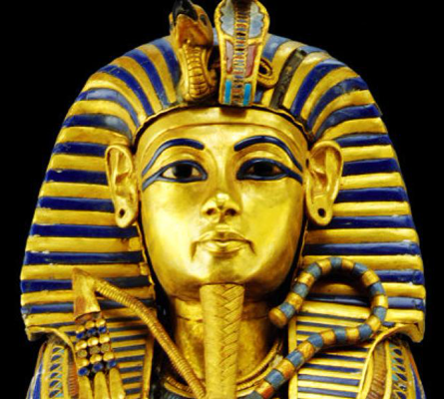
Probability
IN-CLASS PROBLEMS
Who were King Tut’s parents?
http://assets.nydailynews.com/polopoly_fs/1.179021.1314048368!/img/httpImage/image.jpg_gen/derivatives/article_750/alg-king-tut-jpg.jpg

Slide 41

Questions?

Slide 42
Probability
# favorable outcomes
total # of outcomes
you’ll need to know the total
# of outcomes!
If P =

Slide 43
Fundamental Counting Principle
the number of ways things can occur

Slide 44
COUNTING
IN-CLASS PROBLEMS
Male/Female and Tall/Short
How many ways can these characteristics combine?

Slide 45
COUNTING
IN-CLASS PROBLEMS
Male/Female and Tall/Short
I try to build a tree:

Slide 46
COUNTING
IN-CLASS PROBLEMS
Male/Female and Tall/Short
Male Female
/ \ / \
Tall Short Tall Short

Slide 47
COUNTING
IN-CLASS PROBLEMS
Male Female
/ \ / \
Tall Short Tall Short
4 possible ways to combine the characteristics:
MT MS FT FS

Slide 48
COUNTING
IN-CLASS PROBLEMS
How about: Blonde/Brunette/Redhead and Blue eyes/Green eyes/Brown eyes
Build a tree!

Slide 49
COUNTING
IN-CLASS PROBLEMS
Blonde Brunette Red
/ | \ / | \ / | \
Bl Br Gr Bl Br Gr Bl Br Gr
How many ways to combine these characteristics?

Slide 50
COUNTING
IN-CLASS PROBLEMS
Blonde Brunette Red
/ | \ / | \ / | \
Bl Br Gr Bl Br Gr Bl Br Gr
How many ways to combine these characteristics? 9:
BdBl BdBr BdGr BtBl BtBr BtGr
RdBl RdBr RdGr

Slide 51
Fundamental Counting Principle
The number of ways in which characteristics can be combined is found by multiplying the possibilities of each characteristic together

Slide 52
COUNTING
IN-CLASS PROBLEMS
Two pairs of jeans: black blue Three shirts: white yellow blue Two pairs of shoes: black brown
How many different ways can you get dressed?

Slide 53
COUNTING
IN-CLASS PROBLEMS
Two pairs of jeans: black blue Three shirts: white yellow blue Two pairs of shoes: black brown
How many different ways can you get dressed?
2 ∗ 3 ∗ 2 = 12

Slide 54
COUNTING
IN-CLASS PROBLEMS
Multiple choice quiz
10 questions
4 choices on each
How many ways are there to answer the questions on the test?

Slide 55
COUNTING
IN-CLASS PROBLEMS
Multiple choice quiz
10 questions
4 choices on each
4 ∗ 4 ∗ 4 ∗… (10 of them)

Slide 56
COUNTING
IN-CLASS PROBLEMS
Multiple choice quiz
10 questions
4 choices on each
4 ∗ 4 ∗ 4 ∗… (10 of them)
Otherwise known as 4¹⁰
= 1,048,576

Slide 57
COUNTING
IN-CLASS PROBLEMS
Multiple choice quiz
10 questions
4 choices on each
How many ways out of the 1,048,576 can you get a 100?

Slide 58
COUNTING
IN-CLASS PROBLEMS
Multiple choice quiz
10 questions
4 choices on each
1/1,048,576 chance of getting 100% if you guess on all questions

Slide 59
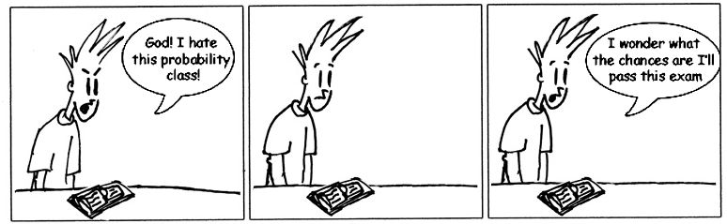

Slide 60
COUNTING
IN-CLASS PROBLEMS
How many zip codes?
5 slots
Can’t start with a 0 or a 1

Slide 61
COUNTING
IN-CLASS PROBLEMS
How many zip codes?
___ ___ ___ ___ ___

Slide 62
COUNTING
IN-CLASS PROBLEMS
How many zip codes?
8 10 10 10 10

Slide 63
COUNTING
IN-CLASS PROBLEMS
How many zip codes?
8 10 10 10 10
8∗10⁴ = 80,000

Slide 64
COUNTING
IN-CLASS PROBLEMS
In Canada, they alternate Letter Number Letter
Number Letter Number
How many area codes can they have?

Slide 65
COUNTING
IN-CLASS PROBLEMS
In Canada, they alternate Letter Number Letter
Number Letter Number
26∗10∗26 ∗ 10∗26∗10
= 26³ ∗ 10³ = 17,576,000
(A whole lot more than 80,000!)

Slide 66
COUNTING
IN-CLASS PROBLEMS
What are the number of outcomes?

Slide 67
Questions?

Slide 68
Combinatorics
The number of ways in which characteristics can be combined is found by multiplying the possibilities of each characteristic together

Slide 69
Combinatorics
Combinatorics expands on this idea – from a complete group, how many subgroups can you select?

Slide 70
Combinatorics
IN-CLASS PROBLEMS
If you have 5 club members, how many ways can you pick 3 of them to go to a conference?
Amy Bob Carlos Dawn Ed

Slide 71
Combinatorics
IN-CLASS PROBLEMS
If you have 5 club members, how many ways can you pick 3 of them to go to a conference?
Amy Bob Carlos Dawn Ed
The order in which they are selected is not important

Slide 72
Combinatorics
IN-CLASS PROBLEMS
You can make a list:
ABC ABD ABE ACD ACE ADE
BCD BCE BDE
CDE

Slide 73

Combinatorics
Even for a small list,
it’s a lot of work
And… how do you
know you’ve got
them all?

Slide 74
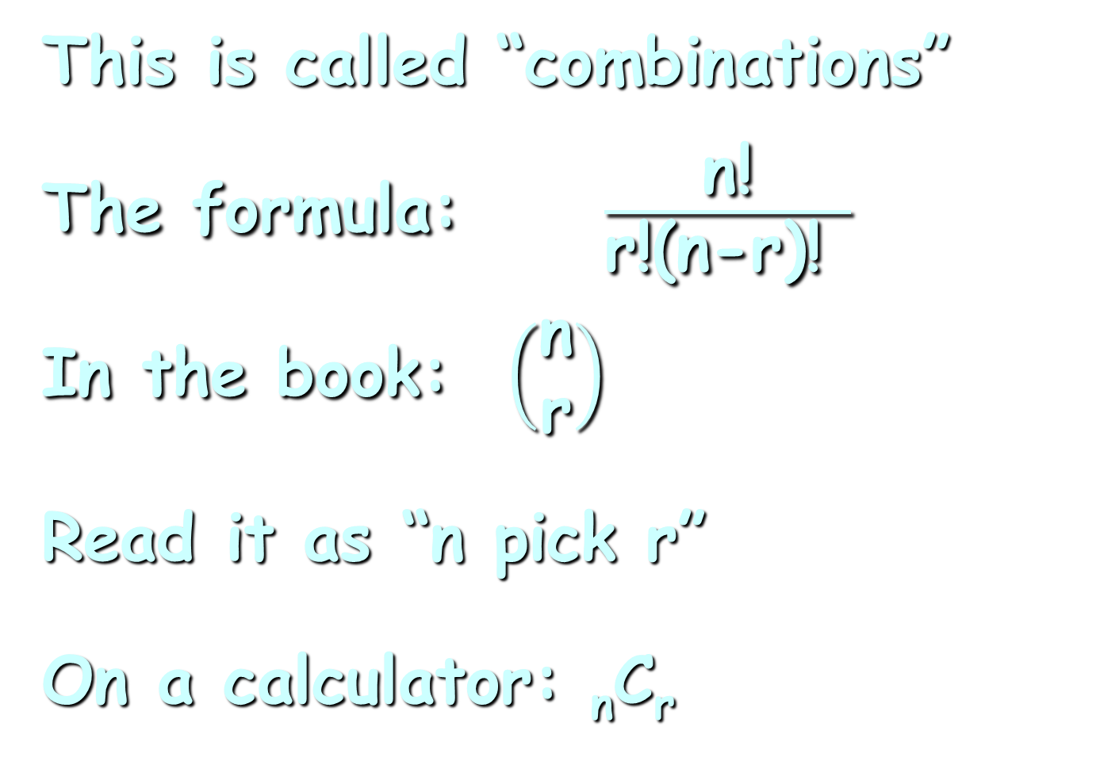
Combinatorics
This is called “combinations”
The formula: $\frac{\text{n}\text{!}}{\text{r}\text{!(}\text{n}\text{−}\text{r}\text{)! }}$
In the book: $\left(\begin{matrix}\text{n} \\ \text{r}\end{matrix}\right)$
Read it as “n pick r”
On a calculator: _{n}C_{r}

Slide 75
Combinatorics
Combinations
an ordered arrangement of items such that:
the items are selected from
the same group
no item is used more than once
the order makes no difference

Slide 76
Combinatorics
For _{n}C_{r} or n!/r!(n-r)!
“n” is the total number in the group
“r” is the number you are selecting

Slide 77
Combinatorics
IN-CLASS PROBLEMS
If you have 5 club members, how many ways can you pick 3 of them to go to a conference?
Amy Bob Carlos Dawn Ed
What is “n”?
What is “r”?

Slide 78
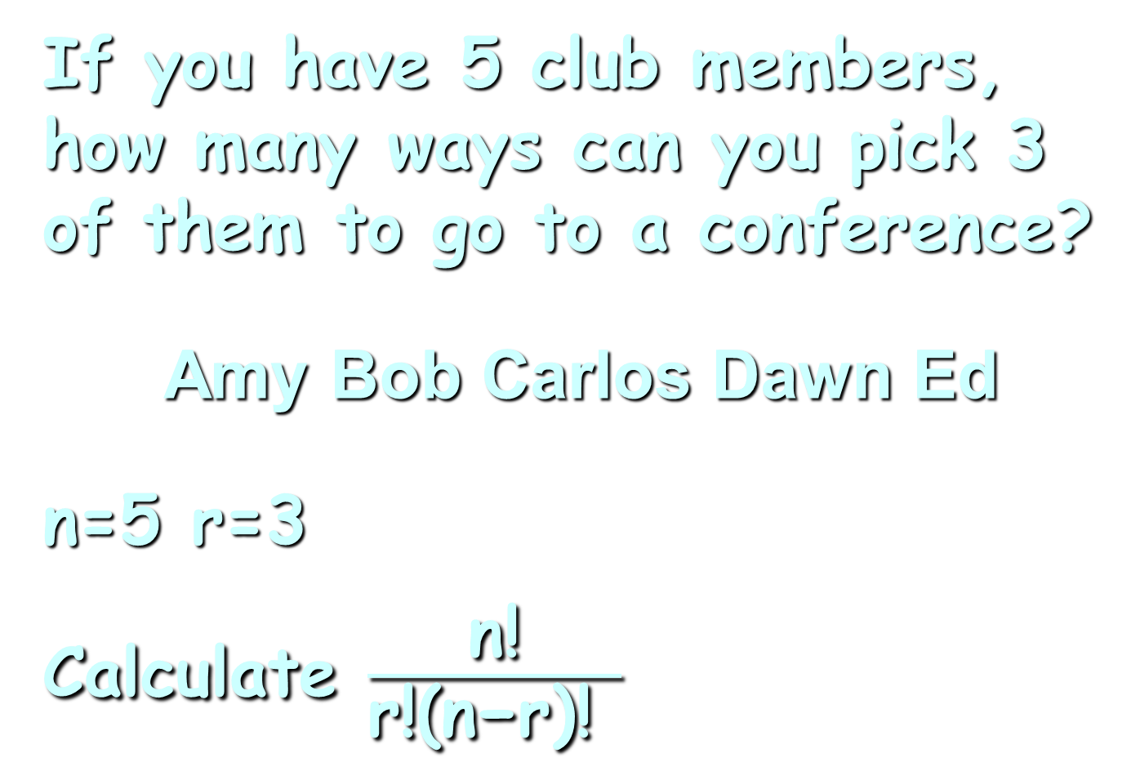
Combinatorics
IN-CLASS PROBLEMS
If you have 5 club members, how many ways can you pick 3 of them to go to a conference?
Amy Bob Carlos Dawn Ed
n=5 r=3
Calculate $\frac{\text{n}\text{!}}{\text{r}\text{!(}\text{n}\text{−}\text{r}\text{)! }}$

Slide 79
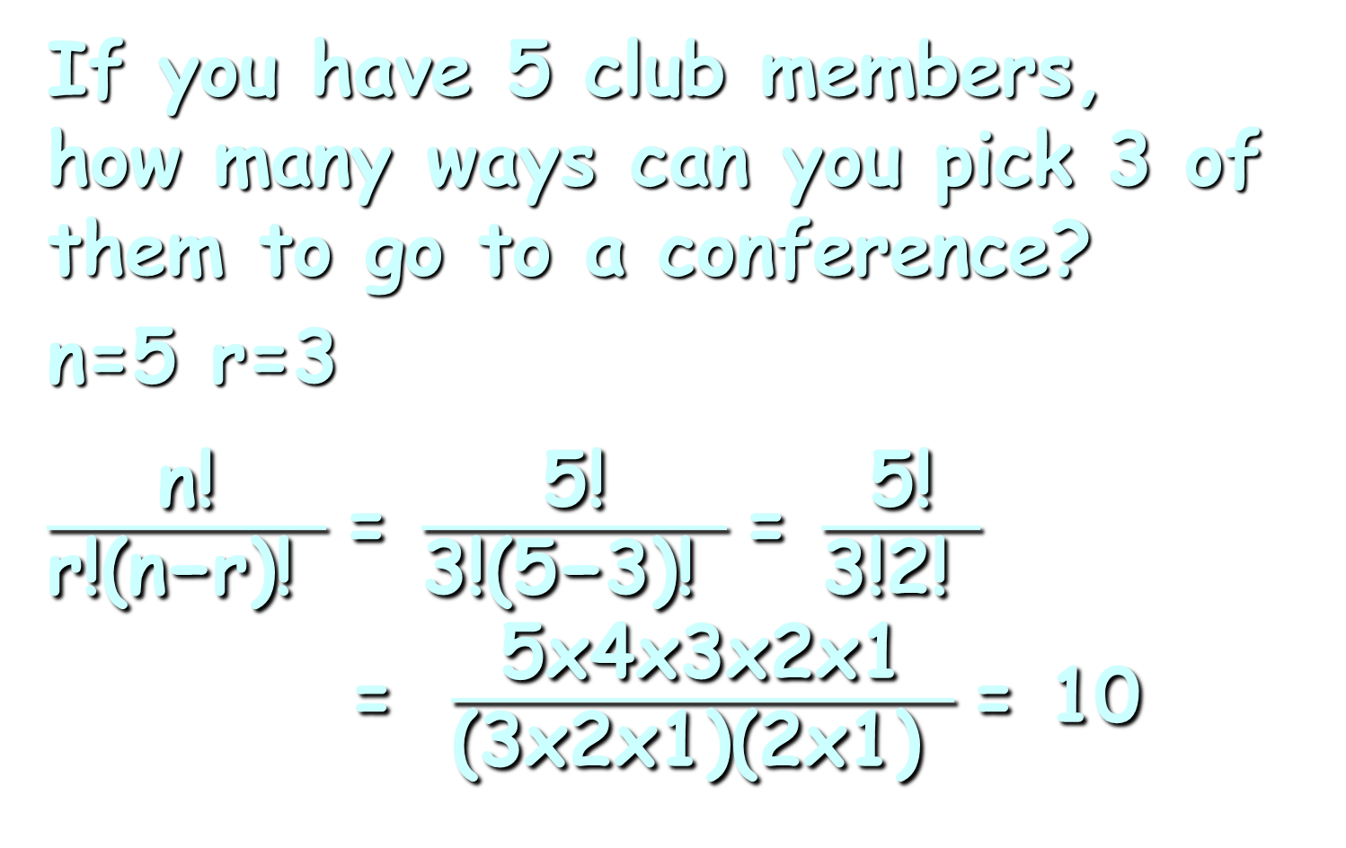
Combinatorics
IN-CLASS PROBLEMS
If you have 5 club members,
how many ways can you pick 3 of them to go to a conference?
n=5 r=3
$\frac{\text{n}\text{!}}{\text{r}\text{!(}\text{n}\text{−}\text{r}\text{)! }}$= $\frac{\text{5}\text{!}}{\text{3}\text{!(}\text{5}\text{−}\text{3}\text{)! }}$= $\frac{\text{5}\text{!}}{\text{3}\text{!}\text{2}\text{! }}$ = $\frac{\text{5}\text{x}\text{4}\text{x}\text{3}\text{x}\text{2}\text{x}\text{1}}{\text{(3}\text{x}\text{2}\text{x}\text{1)(2}\text{x}\text{1)} }$= 10

Slide 80
Combinatorics
IN-CLASS PROBLEMS
Did we have 10 listed before?
ABC ABD ABE ACD ACE ADE
BCD BCE BDE
CDE

Slide 81
Combinatorics
IN-CLASS PROBLEMS
Try this on your calculator!
Look for _{n}C_{r}
Usually you enter: 5 _{n}C_{r} 3
Do you get 10?

Slide 82
Combinatorics
IN-CLASS PROBLEMS
Try: ₈C₅ ₄C₀ ₁₂C₁₀

Slide 83
Questions?

Slide 84
Combinatorics
What happens if order IS important in selecting your subgroup?

Slide 85
Combinatorics
IN-CLASS PROBLEMS
If you have 5 club members, how many ways can you pick a President, VP and Treasurer?
Amy Bob Carlos Dawn Ed

Slide 86
Combinatorics
Example:
P: A
VP: B or C or D or E
T: whichever you didn’t pick
for VP

Slide 87

Combinatorics
This is going to be a REALLY hard one to do by making a list!

Slide 88
Pres | VP | Treas
A | B | C
A | C | B
A | B | D
A | D | B
A | B | E
A | E | B
A | C | D
A | D | C
A | C | E
A | E | C
A | D | E
A | E | D
And that’s just with Amy as president!

Slide 89
Combinatorics
We call this “permutations”
an ordered arrangement of items such that:
no item is used more than
once
the order DOES make a
difference

Slide 90
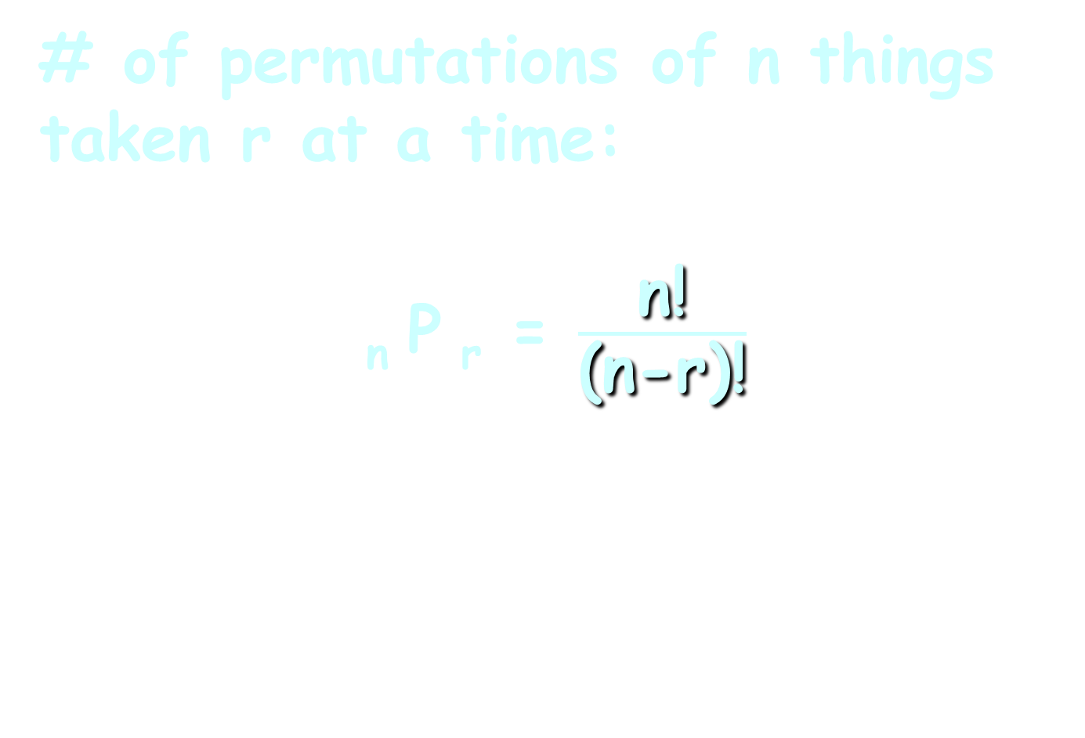
Combinatorics
# of permutations of n things taken r at a time:
_{n} P _{r} = $\frac{\text{n}\text{!}}{\text{(}\text{n}\text{−}\text{r}\text{)!}}$

Slide 91

Combinatorics
IN-CLASS PROBLEMS
For our club members:
₅P₃ = $\frac{\text{5}\text{!}}{\text{(}\text{5}\text{−}\text{3}\text{)!}}$ = $\frac{\text{5}\text{x}\text{4}\text{x}\text{3}\text{x}\text{2}\text{x}\text{1}}{\text{2}\text{x}\text{1}}$ = 60

Slide 92
Combinatorics
IN-CLASS PROBLEMS
Try:
₈P₅ ₄P₀ ₁₂P₁₀

Slide 93
Combinatorics
Word problems:
Try to figure out if order is important or not
Usually, it’s not, so it’s combinations
If it is, it’s permutations

Slide 94
Combinatorics
In Colorado Powerball, you choose 5 from 69 numbers and then 1 from 26 for the Powerball

Slide 95
Combinatorics
Because you are selecting 5 out of 69 and 1 out of 26, it is combinatorics!

Slide 96
Combinatorics
IN-CLASS PROBLEMS
What is the probability of winning the top prize
(5 + Powerball)?

Slide 97
Combinatorics
IN-CLASS PROBLEMS
What is the probability of winning the top prize
(5 + Powerball)?
To do this, you have to pick all five numbers correctly and you also have to pick the Powerball number correctly

Slide 98
Combinatorics
IN-CLASS PROBLEMS
What is the probability of winning the top prize
(5 + Powerball)?
Is order important?

Slide 99
Combinatorics
IN-CLASS PROBLEMS
What is the probability of winning the top prize
(5 + Powerball)?
Is order important? Nope
so we will use

Slide 100
Combinatorics
IN-CLASS PROBLEMS
What is the probability of winning the top prize
(5 + Powerball)?
Is order important? Nope
so we will use combinations

Slide 101
Combinatorics
IN-CLASS PROBLEMS
What is the probability of winning the top prize
(5 + Powerball)?
What is the number of possible outcomes (the denominator)?

Slide 102
Combinatorics
IN-CLASS PROBLEMS
What is the probability of winning the top prize
(5 + Powerball)?
How many ways are there to pick the five numbers?

Slide 103
Combinatorics
IN-CLASS PROBLEMS
What is the probability of winning the top prize
(5 + Powerball)?
How many ways are there to pick the five numbers?
C(69,5) = 69!/(5! * (69-5)!) = 11,238,513

Slide 104
Combinatorics
IN-CLASS PROBLEMS
What is the probability of winning the top prize
(5 + Powerball)?
How many ways are there to pick the Powerball?

Slide 105
Combinatorics
IN-CLASS PROBLEMS
What is the probability of winning the top prize
(5 + Powerball)?
How many ways are there to pick the Powerball?
C(26,1) = 26

Slide 106
Combinatorics
IN-CLASS PROBLEMS
What is the probability of winning the top prize
(5 + Powerball)?
What is the number of possible outcomes (the denominator)?

Slide 107
Combinatorics
IN-CLASS PROBLEMS
What is the probability of winning the top prize
(5 + Powerball)?
What is the number of possible outcomes (the denominator)?
11,238,513 * 26 = 292,201,338

Slide 108
Combinatorics
IN-CLASS PROBLEMS
What is the probability of winning the top prize
(5 + Powerball)?
Now for the numerator!
How many ways can you win?

Slide 109
Combinatorics
IN-CLASS PROBLEMS
What is the probability of winning the top prize
(5 + Powerball)?
Now for the numerator!
How many ways can you win? 1

Slide 110
Combinatorics
IN-CLASS PROBLEMS
What is the probability of winning the top prize
(5 + Powerball)?
So the probability of winning the top prize is:

Slide 111
Combinatorics
IN-CLASS PROBLEMS
What is the probability of winning the top prize
(5 + Powerball)?
So the probability of winning the top prize is:
1/292,201,338

Slide 112
Combinatorics
IN-CLASS PROBLEMS
To make it easier to calculate the other prizes, let’s specify more exactly how the “1” way of winning happened

Slide 113
Combinatorics
IN-CLASS PROBLEMS
Among the 69 numbers, 5 are "winners" and 64 are "losers"
Similarly, among the 26 Powerball numbers, 1 is a "winner" and 25 are "losers"

Slide 114
Combinatorics
IN-CLASS PROBLEMS
To pick all five numbers and the Powerball correctly, you must pick 5 out of the 5 winners and 0 out of the 64 losers, and you must pick 1 out of 1 Powerball winners and 0 out of 25 Powerball losers

Slide 115
Combinatorics
IN-CLASS PROBLEMS
Or:
₅C₅ * ₆₄C₀ * ₁C₁ * ₂₅C₀
= 1 * 1 * 1 * 1
= 1

Slide 116
Combinatorics
IN-CLASS PROBLEMS
Now we can calculate the probabilities of all of the prizes!
(Get the Wk06 spreadsheet on vf-tropi.com)

Slide 117
Combinatorics
IN-CLASS PROBLEMS
What is the probability of winning a prize (any prize?)

Slide 118
Combinatorics
IN-CLASS PROBLEMS
What is the probability of winning a prize (any prize?)
a tad over 4%

Slide 119
Combinatorics
IN-CLASS PROBLEMS
Remember the EMV (expected monetary value) from trees?

Slide 120
Combinatorics
IN-CLASS PROBLEMS
Remember the EMV (expected monetary value) from trees?
You multiplied the profit by its probability

Slide 121
Combinatorics
IN-CLASS PROBLEMS
Remember the EMV (expected monetary value) from trees?
You multiplied the profit by its probability
Can you do the same for your expected winnings?

Slide 122
Questions?

Slide 123
Conditional Probability
Independent events:
One event has no effect on the outcome of another event

Slide 124
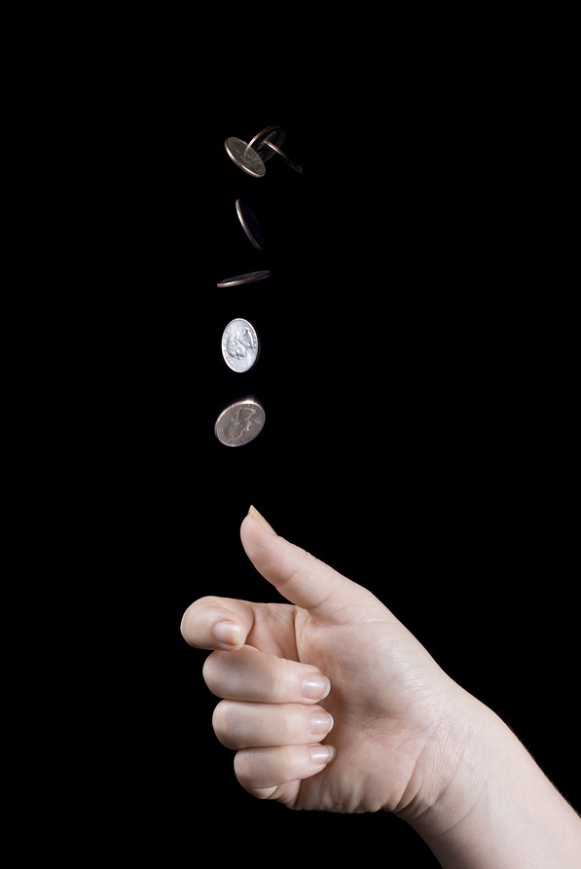
Conditional Probability
http://www.bellevuerarecoins.com/wp-content/uploads/2013/11/bigstock-Coin-Flip-5807921.jpg

Slide 125
Conditional Probability
But… in the universe we live in, one event often changes the likelihood of another event happening

Slide 126
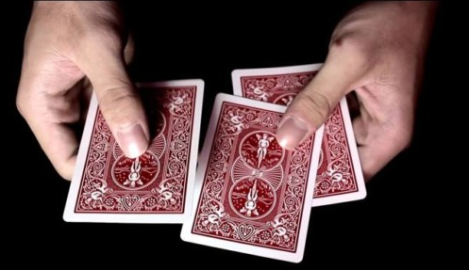
Conditional Probability
http://thedailycannibal.com/wp-content/uploads/2014/05/cards-620x329.jpg

Slide 127

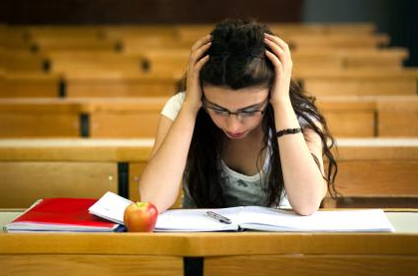
Conditional Probability
https://www.shutterstock.com/image-photo/young-student-overwhelmed-studying-piles-books-116965057?utm_medium=Affiliate&utm_campaign=Idee%20Inc.&utm_source=77643&irgwc=1
http://dlabprep.com/wp-content/uploads/2013/08/Student-stress-study-1.jpg

Slide 128
Conditional Probability
Notation:
P(A|B)
means:
the probability of A given B

Slide 129

Conditional Probability
The formula:
P(A|B) = $\frac{\text{P}\text{(}\text{A} \text{and} \text{B}\text{) }}{\text{P}\text{(}\text{B}\text{)}}$

Slide 130
CONDITIONAL PROBABILITY
IN-CLASS PROBLEMS
Survival rate and life expectancy in a population

Slide 131
CONDITIONAL PROBABILITY
IN-CLASS PROBLEMS
Let P(N) be the probability of a newborn reaching the age of N years

Slide 132
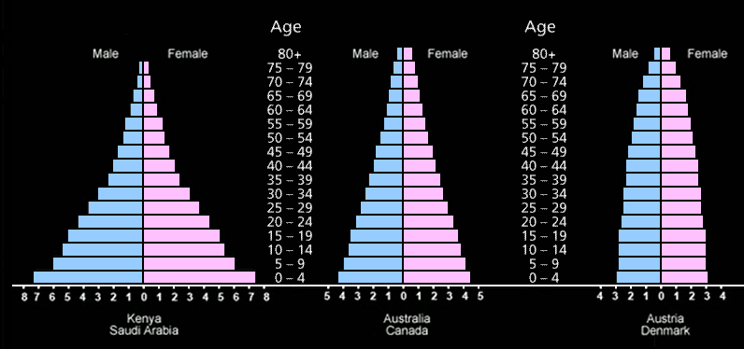
CONDITIONAL PROBABILITY
IN-CLASS PROBLEMS
Age Structure graphs
rapid growth slow growth zero growth
www.algebralab.org

Slide 133
CONDITIONAL PROBABILITY
IN-CLASS PROBLEMS
A study has shown that:
P(50) = 91.3%
P(55) = 88.1%
P(65) = 74.6%

Slide 134
CONDITIONAL PROBABILITY
IN-CLASS PROBLEMS
What is the probability of a 50-year-old man reaching the age of 55?

Slide 135
CONDITIONAL PROBABILITY
IN-CLASS PROBLEMS
What is P(55|50)?

Slide 136
CONDITIONAL PROBABILITY
IN-CLASS PROBLEMS
P(55|50) = P(55 and 50)/P(50)
= P(55)/P(50)
= 88.1/91.3
≈ .965 or 96.5%

Slide 137
Conditional Probability
A probability that a 50 years old will die within 5 years is then a rather comforting:
1 - .965 = .035
or 3.5%

Slide 138
Conditional Probability
However, the probability of dying within the next 5 years grows with age

Slide 139
CONDITIONAL PROBABILITY
IN-CLASS PROBLEMS
So if the probability that a man who just turned 65 will die within 5 years is .16, what is the probability for a man to survive till his 70th birthday?

Slide 140
CONDITIONAL PROBABILITY
IN-CLASS PROBLEMS
So if the probability that a man who just turned 65 will die within 5 years is .16, what is the probability for a man to survive till his 70th birthday?
P(70|65)?

Slide 141
CONDITIONAL PROBABILITY
IN-CLASS PROBLEMS
If the probability that a man
who just turned 65 will die
within 5 years is .16, then:
P(70|65) = 1 - .16 = .84 or 84%

Slide 142
CONDITIONAL PROBABILITY
IN-CLASS PROBLEMS
Eye color of Germans:
 | Blue | Grey | Green | Brown
Males | 22% | 3% | 8% | 16%
Females | 17% | 2% | 12% | 20%

Slide 143
CONDITIONAL PROBABILITY
IN-CLASS PROBLEMS
What is the probability your subject is a female given your subject has blue eyes?
 | Blue | Grey | Green | Brown
Males | 22% | 3% | 8% | 16%
Females | 17% | 2% | 12% | 20%

Slide 144

CONDITIONAL PROBABILITY
IN-CLASS PROBLEMS
P(female|blue)=$\frac{\text{P}\text{(}\text{female} \text{and} \text{blue}\text{) }}{\text{P}\text{(}\text{blue}\text{)}}$
 | Blue | Grey | Green | Brown
Males | 22% | 3% | 8% | 16%
Females | 17% | 2% | 12% | 20%

Slide 145
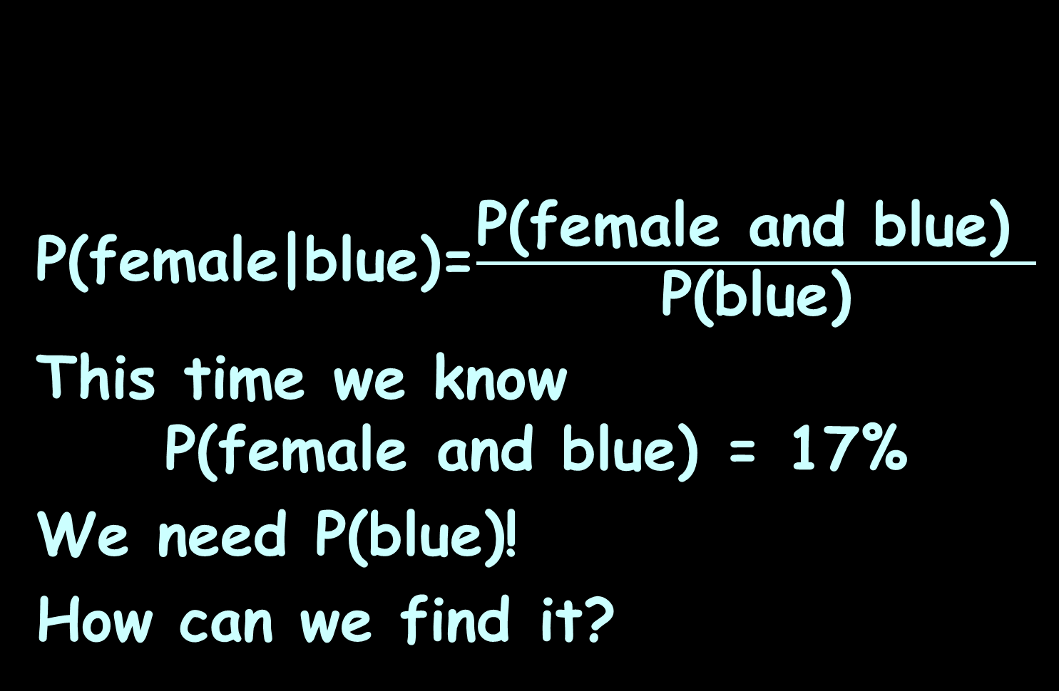
CONDITIONAL PROBABILITY
IN-CLASS PROBLEMS
P(female|blue)=$\frac{\text{P}\text{(}\text{female} \text{and} \text{blue}\text{) }}{\text{P}\text{(}\text{blue}\text{)}}$
This time we know
P(female and blue) = 17%
We need P(blue)!
How can we find it?
 | Blue | Grey | Green | Brown
Males | 22% | 3% | 8% | 16%
Females | 17% | 2% | 12% | 20%

Slide 146
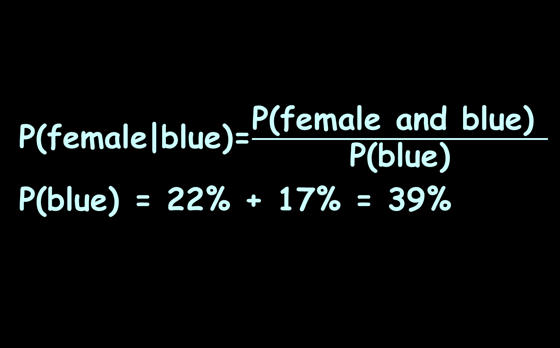
CONDITIONAL PROBABILITY
IN-CLASS PROBLEMS
P(female|blue)=$\frac{\text{P}\text{(}\text{female} \text{and} \text{blue}\text{) }}{\text{P}\text{(}\text{blue}\text{)}}$
P(blue) = 22% + 17% = 39%
 | Blue | Grey | Green | Brown
Males | 22% | 3% | 8% | 16%
Females | 17% | 2% | 12% | 20%

Slide 147
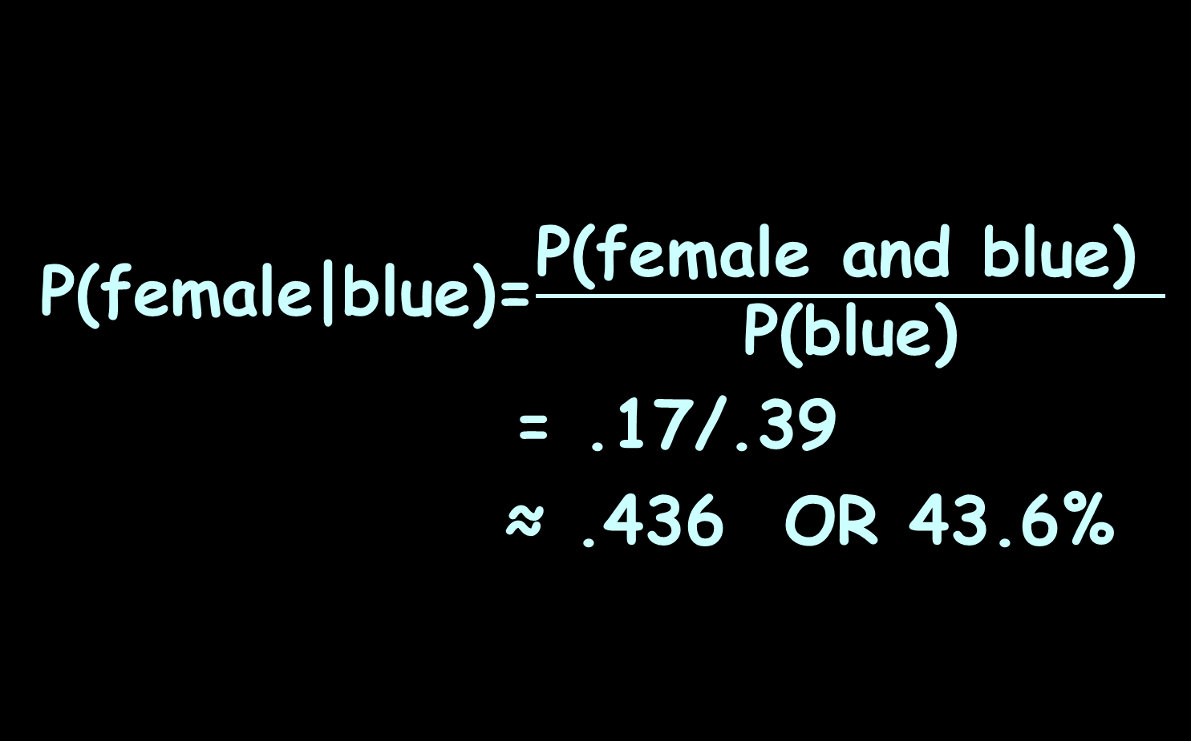
CONDITIONAL PROBABILITY
IN-CLASS PROBLEMS
P(female|blue)=$\frac{\text{P}\text{(}\text{female} \text{and} \text{blue}\text{) }}{\text{P}\text{(}\text{blue}\text{)}}$
= .17/.39
≈ .436 OR 43.6%
 | Blue | Grey | Green | Brown
Males | 22% | 3% | 8% | 16%
Females | 17% | 2% | 12% | 20%

Slide 148
Questions?

Slide 149
Discrete Probability
P(X=x)
P(x) means “the probability that the random variable X equals the value x”

Slide 150
Discrete Probability
Remember “Σ” means
“the sum of”

Slide 151
Discrete Probability
Rules for discrete probabilities:
Σ P(x) = 1 or 100%

Slide 152
Discrete Probability
Rules for discrete probabilities:
Σ P(x) = 1 or 100%
0 ≤ P(x) ≤ 1 or 100%

Slide 153
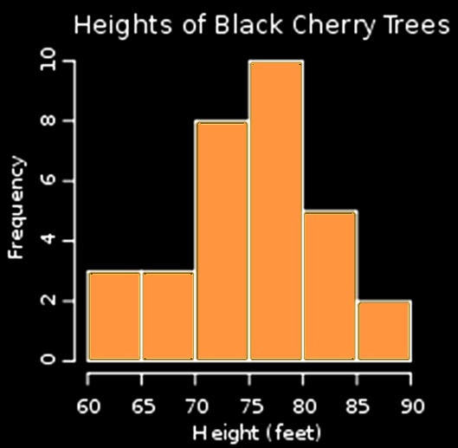
Discrete Probability
A probability histogram:

Slide 154
DISCRETE PROBABILITY
IN-CLASS PROBLEMS
What is the probability a black cherry tree is shorter than 70 feet?

Slide 155
DISCRETE PROBABILITY
IN-CLASS PROBLEMS
What is the probability a black cherry tree is between 70 and 80 feet?

Slide 156
Questions?

Slide 157
Binomial Probability
A lot of variables can have only two values:
M/F
H/T
Black/White
On/Off
1/0

Slide 158
Binomial Probability
Variables that can have only two values are called:
“binomial”
The values are mutually exclusive events

Slide 159
Binomial Probability
The probability of one of the values occurring is called “p”
The probability of the other value occurring is called “q”

Slide 160
Binomial Probability
p + q = 1 or 100%

Slide 161
Binomial Probability
A binomial experiment:

Slide 162
Binomial Probability
A binomial experiment:
is performed a fixed
number of times

Slide 163
Binomial Probability
A binomial experiment:
is performed a fixed
number of times
each repetition is called a
“trial”

Slide 164
Binomial Probability
A binomial experiment:
the trials are independent

Slide 165
Binomial Probability
A binomial experiment:
the trials are independent
the outcome of one trial will
not affect the outcome
of another trial

Slide 166
Binomial Probability
A binomial experiment:
for each trial, there are
two mutually exclusive
outcomes:
success or failure

Slide 167
Binomial Probability
A binomial experiment:
the probability of success is
the same for each trial

Slide 168
Binomial Probability
Notation:
“n” trials

Slide 169
Binomial Probability
Notation:
“n” trials
“p” is the probability of
success

Slide 170
Binomial Probability
Notation:
“n” trials
“p” is the probability of
success
“q” or “1-p” is the
probability of failure

Slide 171
Binomial Probability
Notation:
“n” trials
“p” is the probability of
success
“q” or “1-p” is the
probability of failure
“X” is the number of
successes in the “n” trials

Slide 172
Binomial Probability
0 ≤ p ≤ 1
0 ≤ q ≤ 1
and:
0 ≤ x ≤ n

Slide 173
Binomial Probability
Binomial Experiment Rules:

Slide 174
Binomial Probability
Binomial Experiment Rules:
You must have a fixed
number of trials

Slide 175
Binomial Probability
Binomial Experiment Rules:
You must have a fixed
number of trials
Each trial is an independent
event

Slide 176
Binomial Probability
Binomial Experiment Rules:
You must have a fixed
number of trials
Each trial is an independent
event
There are only two outcomes

Slide 177
BINOMIAL PROBABILITY
IN-CLASS PROBLEMS
Binomial or not?
Tossing a coin a hundred times to see how many land on heads

Slide 178
BINOMIAL PROBABILITY
IN-CLASS PROBLEMS
Binomial or not?
Tossing a coin until you get heads

Slide 179
BINOMIAL PROBABILITY
IN-CLASS PROBLEMS
Binomial or not?
Asking 100 people how much they weigh

Slide 180
BINOMIAL PROBABILITY
IN-CLASS PROBLEMS
Binomial or not?
Asking 100 people if they have ever been to Paris

Slide 181
Questions?

Slide 182
Binomial Probability
Remember _{n}C_{x} is the number of ways of obtaining x successes in n trials

Slide 183
Binomial Probability
The probability of obtaining X successes in n independent trials of a binomial experiment:
P(x) = _{n}C_{x} p^{x}(1-p)^{n-x}
or:
P(x) = _{n}C_{x} p^{x}(q)^{n-x}

Slide 184
Binomial Probability
To work a binomial problem:

Slide 185
Binomial Probability
To work a binomial problem:
What is a “Success”?
Success must be for a
single trial

Slide 186
Binomial Probability
To work a binomial problem:
What is the probability of success “p”?

Slide 187
Binomial Probability
To work a binomial problem:
What is the probability of failure “q”?

Slide 188
Binomial Probability
To work a binomial problem:
What is the number of trials?

Slide 189
Binomial Probability
To work a binomial problem:
What is the number of successes out of those trials needed?

Slide 190
Binomial Probability
To work a binomial problem:
  What is a “Success”?
  What is the probability of success “p”?
  What is the probability of failure “q”?
  What is the number of trials?
  What is the number of successes out
  of those trials needed?

Slide 191
BINOMIAL PROBABILITY
IN-CLASS PROBLEMS
What is the probability of rolling exactly two sixes in 6 rolls of a die?

Slide 192
BINOMIAL PROBABILITY
IN-CLASS PROBLEMS
What is the probability of rolling exactly two sixes in 6 rolls of a die?
What is a “Success”?

Slide 193
BINOMIAL PROBABILITY
IN-CLASS PROBLEMS
What is the probability of rolling exactly two sixes in 6 rolls of a die?
What is a “Success”?
Success = "Rolling a 6 on a
single die"

Slide 194
BINOMIAL PROBABILITY
IN-CLASS PROBLEMS
What is the probability of rolling exactly two sixes in 6 rolls of a die?
What is the probability of success?

Slide 195
BINOMIAL PROBABILITY
IN-CLASS PROBLEMS
What is the probability of rolling exactly two sixes in 6 rolls of a die?
What is the probability of success?
p = 1/6

Slide 196
BINOMIAL PROBABILITY
IN-CLASS PROBLEMS
What is the probability of rolling exactly two sixes in 6 rolls of a die?
What is the probability of failure?

Slide 197
BINOMIAL PROBABILITY
IN-CLASS PROBLEMS
What is the probability of rolling exactly two sixes in 6 rolls of a die?
What is the probability of failure?
q = 5/6

Slide 198
BINOMIAL PROBABILITY
IN-CLASS PROBLEMS
What is the probability of rolling exactly two sixes in 6 rolls of a die?
What is the number of trials?

Slide 199
BINOMIAL PROBABILITY
IN-CLASS PROBLEMS
What is the probability of rolling exactly two sixes in 6 rolls of a die?
What is the number of trials?
n = 6

Slide 200
BINOMIAL PROBABILITY
IN-CLASS PROBLEMS
What is the probability of rolling exactly two sixes in 6 rolls of a die?
What is the number of successes out of those trials needed?

Slide 201
BINOMIAL PROBABILITY
IN-CLASS PROBLEMS
What is the probability of rolling exactly two sixes in 6 rolls of a die?
What is the number of successes out of those trials needed?
x = 2

Slide 202
BINOMIAL PROBABILITY
IN-CLASS PROBLEMS
What is the probability of rolling exactly two sixes in 6 rolls of a die? You could list the outcomes:
FFFFFS FFFFSS FFFSSS FFSSSS FSSSSS SSSSSS
FFFSFS FFSFFS FSFFFS SFFFFS SFFFSS SFFSSS
SFSSSS SFSFFS SSFFFS …
Aagh!!!

Slide 203
BINOMIAL PROBABILITY
IN-CLASS PROBLEMS
Remember:
The probability of getting exactly x success in n trials, with the probability of success on a single trial being p is:
P(x) = _{n}C_{x} × p^{x} × q^{n-x}

Slide 204
BINOMIAL PROBABILITY
IN-CLASS PROBLEMS
What is the probability of rolling exactly two sixes in 6 rolls of a die?
P(2) = ₆C₂ × (1/6)² × (5/6)⁶⁻²

Slide 205
BINOMIAL PROBABILITY
IN-CLASS PROBLEMS
What is the probability of rolling exactly two sixes in 6 rolls of a die?
P(2) = ₆C₂ × (1/6)² × (5/6)⁶⁻²
⁼ 15 × .028 × .48
≈ .20

Slide 206
Questions?

Slide 207
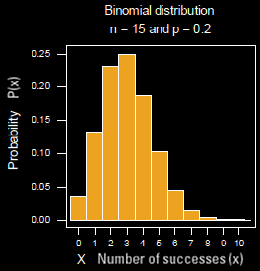
BINOMIAL PROBABILITY
IN-CLASS PROBLEMS
For the binomial distribution:
What is p?

Slide 208
BINOMIAL PROBABILITY
IN-CLASS PROBLEMS
What is p?
p = 0.2

Slide 209
BINOMIAL PROBABILITY
IN-CLASS PROBLEMS
What is q?

Slide 210
BINOMIAL PROBABILITY
IN-CLASS PROBLEMS
What is q?
q = 1-p
= 1-.2
= .8

Slide 211
BINOMIAL PROBABILITY
IN-CLASS PROBLEMS
What is n?

Slide 212
BINOMIAL PROBABILITY
IN-CLASS PROBLEMS
What is n?
n = 15

Slide 213
Questions?

Slide 214
Sources of Probabilities
Probabilities can come from a variety of sources

Slide 215
Sources of Probabilities
Probability sources:
classical probability –
based on theory, assumes
equal likelihood of events

Slide 216
Sources of Probabilities
Probability sources:
classical probability
empirical probability –
based on observations (not on theory)

Slide 217
Sources of Probabilities
Probability sources:
classical probability
empirical probability –
the probability that an event E
will occur: P(E) = f/n
where f is how often the event
E occurred
n is the total number of events
in the experiment (n = Σf)

Slide 218
Sources of Probabilities
Probability sources:
classical probability
empirical probability
subjective probability –
  an individual's personal judgment about the likelihood
  of the occurrence of an event
  based on estimates, intuition, and educated guess

Slide 219
SOURCES OF PROBABILITY
IN-CLASS PROBLEMS
What is the probability source?
H/T for coin tossing

Slide 220
SOURCES OF PROBABILITY
IN-CLASS PROBLEMS
What is the probability source?
Minutes Internet Usage | Probability of Being in Category
1-20 | 9/52 = 0.17 = 17%
21-40 | 18/52 = 0.35 = 35%
41-60 | 15/52 = 0.29 = 29%
61-80 | 0.15 = 15%
81-100 | 0.02 = 2%
101-120 | 0.00 = 0%
121+ | 0.02 = 2%

Slide 221
SOURCES OF PROBABILITY
IN-CLASS PROBLEMS
What is the probability source?

Slide 222
SOURCES OF PROBABILITY
IN-CLASS PROBLEMS
What is the probability source?
Climatologists voting on the likelihood of negative El Niño impacts on southern Africa

Slide 223
Questions?

Slide 224
Odds
Three types:
  American
  Decimal
  Fractional

Slide 225
Odds
American odds have a negative in front of the number to show what you must bet to make $100
Sometimes they have a positive in front of the number to show how much you might profit if you bet $100

Slide 226
Odds
You bet $110 on a team with American odds of -110

Slide 227
Odds
You bet $110 on a team with American odds of -110
They win!

Slide 228
Odds
You bet $110 on a team with American odds of -110
They win!
You get $100 profit (plus your original $110 stake) for a total of $210

Slide 229
Odds
You bet $100 on a team with odds of +120

Slide 230
Odds
You bet $100 on a team with odds of +120
They win!

Slide 231
Odds
You bet $100 on a team with odds of +120
They win!
You get $120 profit (plus your original $100 stake) for a total of $220

Slide 232
Odds
Decimal odds show the potential return of a bet including the stake amount

Slide 233
Odds
You bet $100 on a team with decimal odds 1.885

Slide 234
Odds
You bet $100 on a team with decimal odds 1.885
They win!

Slide 235
Odds
You bet $100 on a team with decimal odds 1.885
They win!
You get $188.50 (this includes your original stake)

Slide 236
Odds
Fractional odds can easily be identified by their use of a dash or a backslash:
5/1, 5-1, or 5-to-1

Slide 237
Odds
You bet $15 on a team with odds of 10/15

Slide 238
Odds
You bet $15 on a team with odds of 10/15
They win!

Slide 239
Odds
You bet $15 on a team with odds of 10/15
They win!
You get $10 profit (plus your original $15 stake) for a total of $25

Slide 240
Odds
Most fractional odds are shown as xx:1 so you can easily see how much you would make for every dollar bet

Slide 241
Odds
Odds in favor
# favorable outcomes:
# unfavorable outcomes

Slide 242
Odds
# favorable outcomes:
# unfavorable outcomes
2:1 means 2 favorable outcomes and 1 unfavorable outcome

Slide 243
ODDS
IN-CLASS PROBLEMS
2:1 means 2 favorable outcomes and 1 unfavorable outcome
How many outcomes total?

Slide 244
ODDS
IN-CLASS PROBLEMS
2:1 means 2 favorable outcomes and 1 unfavorable outcome
How many outcomes total? 3

Slide 245
Odds
So 2:1 means P(win) = 2/3

Slide 246
Odds
Odds against are
# unfavorable outcomes:
# favorable outcomes

Slide 247
Odds
“Odds against” are more commonly used than “odds in favor”

Slide 248
Odds
Odds against are generally stated as xx

Slide 249
Odds
Odds against are generally stated as xx
This is really shorthand for xx:1

Slide 250
Odds
xx:1
where xx is the number of people betting against divided by the number betting for and reduced to the nearest whole number

Slide 251
ODDS
IN-CLASS PROBLEMS
For example, 753 people bet on horse A out of a total of 9,821

Slide 252
ODDS
IN-CLASS PROBLEMS
For example, 753 people bet on horse A out of a total of 9,821
The odds against would need the number betting on any other horse: 9821 – 753 = ?

Slide 253
ODDS
IN-CLASS PROBLEMS
For example, 753 people bet on horse A out of a total of 9,821
The odds against would need the number betting on any other horse: 9821 – 753 = 9068

Slide 254
ODDS
IN-CLASS PROBLEMS
For example, 753 people bet on horse A out of a total of 9,821
The odds against would then be the number betting against (9068) divided by the number betting for (753) = ?

Slide 255
ODDS
IN-CLASS PROBLEMS
For example, 753 people bet on horse A out of a total of 9,821
The odds against would then be the number betting against (9068) divided by the number betting for (753) = 12.04249668 or 12

Slide 256
Odds
Odds = # unfavorable outcomes/
# favorable outcomes
This tells you how much profit you will make on a bet

Slide 257
Odds
Odds against are shown this way so it is easy to calculate how much you would profit on a $1 bet

Slide 258
Odds
Ex: You bet $2 at odds of 20:1
You win!
You will get a profit of
$2 x 20 = $40
The bookie will pay you (payout) $40 + $2 = $42

Slide 259
Odds
Ex: You bet $2 at odds of 20:1
You win!
Some bookies don’t seem to know this…

Slide 260
Odds
Ex: You bet $2 at odds of 20:1
You win!
Some bookies don’t seem to know this…
They pay you $40

Slide 261
Odds
Ex: You bet $2 at odds of 20:1
You win!
Some bookies don’t seem to know this…
They pay you $40
I wouldn’t fight them on it…

Slide 262

Horse | Odds
Daddy Long Legs | 26
Optimizer | 42
Take Charge Indy | 11
Union Rags | 5
Dullahan | 12
Bodemeister | 4
Rousing Sermon | 40
Creative Cause | 11
Trinniberg Bisnath Parboo | 44
Daddy Nose Best | 14
Alpha | 19
Prospective | 57
Went the Day Well | 30
Hansen | 13
Gemologist | 8
El Padrino | 29
Done Talking | 39
Sabercat | 37
I'll Have Another | 15
Liaison | 56
Daddy Long Legs | 26
Kentucky Derby 2012
What horse is everyone betting
on to win?

Slide 263
Horse | Odds
Daddy Long Legs | 26
Optimizer | 42
Take Charge Indy | 11
Union Rags | 5
Dullahan | 12
Bodemeister | 4
Rousing Sermon | 40
Creative Cause | 11
Trinniberg Bisnath Parboo | 44
Daddy Nose Best | 14
Alpha | 19
Prospective | 57
Went the Day Well | 30
Hansen | 13
Gemologist | 8
El Padrino | 29
Done Talking | 39
Sabercat | 37
I'll Have Another | 15
Liaison | 56
Daddy Long Legs | 26
Kentucky Derby 2012
What horse is being bet on by the fewest number of people?

Slide 264
Horse | Odds
Daddy Long Legs | 26
Optimizer | 42
Take Charge Indy | 11
Union Rags | 5
Dullahan | 12
Bodemeister | 4
Rousing Sermon | 40
Creative Cause | 11
Trinniberg Bisnath Parboo | 44
Daddy Nose Best | 14
Alpha | 19
Prospective | 57
Went the Day Well | 30
Hansen | 13
Gemologist | 8
El Padrino | 29
Done Talking | 39
Sabercat | 37
I'll Have Another | 15
Liaison | 56
Daddy Long Legs | 26
Kentucky Derby 2012
I’ll Have Another won!

Slide 265
Horse | Odds
Daddy Long Legs | 26
Optimizer | 42
Take Charge Indy | 11
Union Rags | 5
Dullahan | 12
Bodemeister | 4
Rousing Sermon | 40
Creative Cause | 11
Trinniberg Bisnath Parboo | 44
Daddy Nose Best | 14
Alpha | 19
Prospective | 57
Went the Day Well | 30
Hansen | 13
Gemologist | 8
El Padrino | 29
Done Talking | 39
Sabercat | 37
I'll Have Another | 15
Liaison | 56
Daddy Long Legs | 26
Kentucky Derby 2012
If you bet $100 on I’ll Have Another, how much profit would you get?

Slide 266
Horse | Odds
Daddy Long Legs | 26
Optimizer | 42
Take Charge Indy | 11
Union Rags | 5
Dullahan | 12
Bodemeister | 4
Rousing Sermon | 40
Creative Cause | 11
Trinniberg Bisnath Parboo | 44
Daddy Nose Best | 14
Alpha | 19
Prospective | 57
Went the Day Well | 30
Hansen | 13
Gemologist | 8
El Padrino | 29
Done Talking | 39
Sabercat | 37
I'll Have Another | 15
Liaison | 56
Daddy Long Legs | 26
Kentucky Derby 2012
If you bet $100 on I’ll Have Another, how much payout would you (hopefully) get?

Slide 267
Horse | Odds
Daddy Long Legs | 26
Optimizer | 42
Take Charge Indy | 11
Union Rags | 5
Dullahan | 12
Bodemeister | 4
Rousing Sermon | 40
Creative Cause | 11
Trinniberg Bisnath Parboo | 44
Daddy Nose Best | 14
Alpha | 19
Prospective | 57
Went the Day Well | 30
Hansen | 13
Gemologist | 8
El Padrino | 29
Done Talking | 39
Sabercat | 37
I'll Have Another | 15
Liaison | 56
Daddy Long Legs | 26
Kentucky Derby 2012
What would have been the best profit (if the horse had won)?

Slide 268
Horse | Odds
Daddy Long Legs | 26
Optimizer | 42
Take Charge Indy | 11
Union Rags | 5
Dullahan | 12
Bodemeister | 4
Rousing Sermon | 40
Creative Cause | 11
Trinniberg Bisnath Parboo | 44
Daddy Nose Best | 14
Alpha | 19
Prospective | 57
Went the Day Well | 30
Hansen | 13
Gemologist | 8
El Padrino | 29
Done Talking | 39
Sabercat | 37
I'll Have Another | 15
Liaison | 56
Daddy Long Legs | 26
Kentucky Derby 2012
What would have been the lowest profit (if the horse had won)?

Slide 269
Horse | Odds
Daddy Long Legs | 26
Optimizer | 42
Take Charge Indy | 11
Union Rags | 5
Dullahan | 12
Bodemeister | 4
Rousing Sermon | 40
Creative Cause | 11
Trinniberg Bisnath Parboo | 44
Daddy Nose Best | 14
Alpha | 19
Prospective | 57
Went the Day Well | 30
Hansen | 13
Gemologist | 8
El Padrino | 29
Done Talking | 39
Sabercat | 37
I'll Have Another | 15
Liaison | 56
Daddy Long Legs | 26
To find the probabilities:
P(win) =
1-(odds/(odds+1))

Slide 270
Horse | Odds
Daddy Long Legs | 26
Optimizer | 42
Take Charge Indy | 11
Union Rags | 5
Dullahan | 12
Bodemeister | 4
Rousing Sermon | 40
Creative Cause | 11
Trinniberg Bisnath Parboo | 44
Daddy Nose Best | 14
Alpha | 19
Prospective | 57
Went the Day Well | 30
Hansen | 13
Gemologist | 8
El Padrino | 29
Done Talking | 39
Sabercat | 37
I'll Have Another | 15
Liaison | 56
Daddy Long Legs | 26
What is the probability I’ll Have Another wins?

Slide 271
Horse | Odds
Daddy Long Legs | 26
Optimizer | 42
Take Charge Indy | 11
Union Rags | 5
Dullahan | 12
Bodemeister | 4
Rousing Sermon | 40
Creative Cause | 11
Trinniberg Bisnath Parboo | 44
Daddy Nose Best | 14
Alpha | 19
Prospective | 57
Went the Day Well | 30
Hansen | 13
Gemologist | 8
El Padrino | 29
Done Talking | 39
Sabercat | 37
I'll Have Another | 15
Liaison | 56
Daddy Long Legs | 26
What is the probability I’ll Have Another wins?
P = 6.25%

Slide 272
Horse | Odds
Daddy Long Legs | 26
Optimizer | 42
Take Charge Indy | 11
Union Rags | 5
Dullahan | 12
Bodemeister | 4
Rousing Sermon | 40
Creative Cause | 11
Trinniberg Bisnath Parboo | 44
Daddy Nose Best | 14
Alpha | 19
Prospective | 57
Went the Day Well | 30
Hansen | 13
Gemologist | 8
El Padrino | 29
Done Talking | 39
Sabercat | 37
I'll Have Another | 15
Liaison | 56
Daddy Long Legs | 26
What is the lowest probability of a horse winning?

Slide 273
Horse | Odds
Daddy Long Legs | 26
Optimizer | 42
Take Charge Indy | 11
Union Rags | 5
Dullahan | 12
Bodemeister | 4
Rousing Sermon | 40
Creative Cause | 11
Trinniberg Bisnath Parboo | 44
Daddy Nose Best | 14
Alpha | 19
Prospective | 57
Went the Day Well | 30
Hansen | 13
Gemologist | 8
El Padrino | 29
Done Talking | 39
Sabercat | 37
I'll Have Another | 15
Liaison | 56
Daddy Long Legs | 26
What is the highest probability of a horse winning?

Slide 274
Horse | Odds
Daddy Long Legs | 26
Optimizer | 42
Take Charge Indy | 11
Union Rags | 5
Dullahan | 12
Bodemeister | 4
Rousing Sermon | 40
Creative Cause | 11
Trinniberg Bisnath Parboo | 44
Daddy Nose Best | 14
Alpha | 19
Prospective | 57
Went the Day Well | 30
Hansen | 13
Gemologist | 8
El Padrino | 29
Done Talking | 39
Sabercat | 37
I'll Have Another | 15
Liaison | 56
Daddy Long Legs | 26
What is the sum of all the probabilities?

Slide 275
Horse | Odds
Daddy Long Legs | 26
Optimizer | 42
Take Charge Indy | 11
Union Rags | 5
Dullahan | 12
Bodemeister | 4
Rousing Sermon | 40
Creative Cause | 11
Trinniberg Bisnath Parboo | 44
Daddy Nose Best | 14
Alpha | 19
Prospective | 57
Went the Day Well | 30
Hansen | 13
Gemologist | 8
El Padrino | 29
Done Talking | 39
Sabercat | 37
I'll Have Another | 15
Liaison | 56
Daddy Long Legs | 26
Why does it not equal 100%?

Slide 276
Odds
What is the probability source for these numbers?

Slide 277
Questions?

