Slide 1

Welcome to Wk09
MATH225 Applications of Discrete Mathematics and Statistics
http://media.dcnews.ro/image/201109/w670/statistics.jpg

Slide 2
Histograms
Many bar/column charts display
count data

Slide 3
HISTOGRAMS
IN-CLASS PROBLEMS
Many bar/column charts display
count data
The counts shown in each
category are called
“frequencies”

Slide 4
Histograms
There are a lot of graphs that specialize in showing frequencies

Slide 5
HISTOGRAMS
IN-CLASS PROBLEMS
There are a lot of graphs that specialize in showing frequencies
These are called “histograms”

Slide 6
Frequencies
Types of frequencies:
Absolute frequency – the
number of observations that
fall in a certain category

Slide 7
Frequencies
A table of absolute frequencies is called a frequency distribution

Slide 8
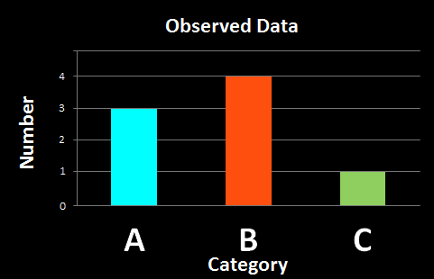
Frequencies
Data table:
A B A B A C B B
Frequency Histogram:
distribution:
A: 3
B: 4
C: 1

Slide 9
HISTOGRAMS
IN-CLASS PROBLEMS
There are several popular types of histograms

Slide 10
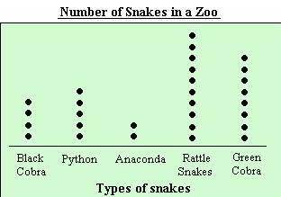
Histograms
Dot plot (automatic graph)

Slide 11
Histograms
What month is your birthday?

Slide 12
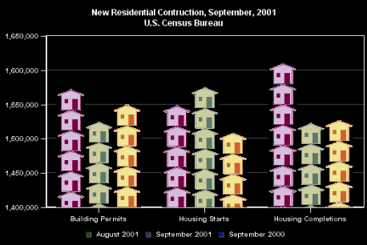
Histograms
Fancy dot plot using pictographs:

Slide 13
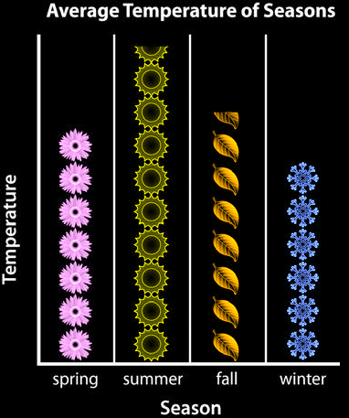
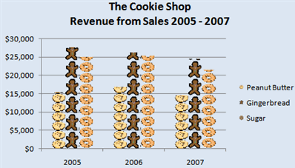
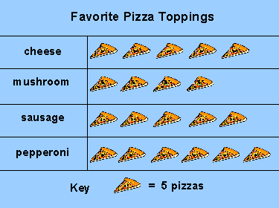
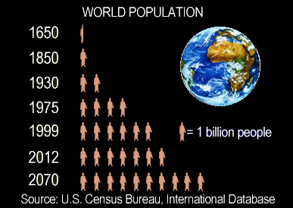
Histograms

Slide 14
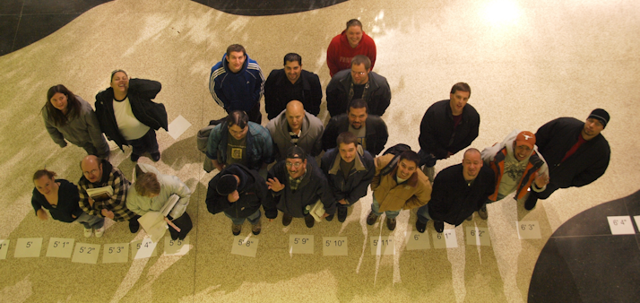
Histograms
Living Histogram

Slide 15
Histograms
Stem and leaf plot
Also changes the data into a bar graph
For measurement data
Let you see the original data values

Slide 16
Histograms
the stem is usually the leftmost
digit/s
the leaf is the rightmost digit
(the "ones")

Slide 17
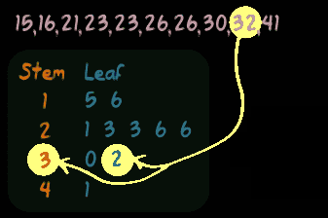
Histograms
It forms a sort of dot plot…
But the data are still there!

Slide 18
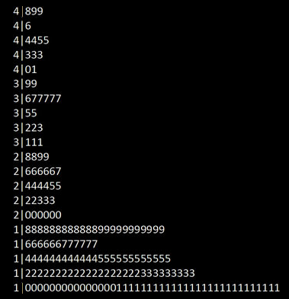
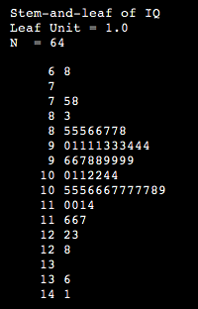
Histograms
More stem and leaf:

Slide 19
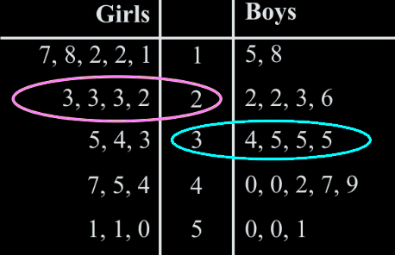
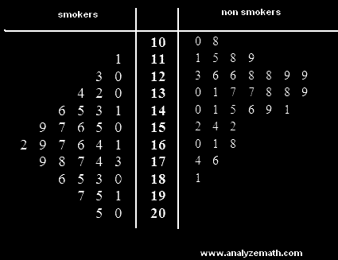
Histograms
Comparative stem and leaf

Slide 20

Questions?

Slide 21
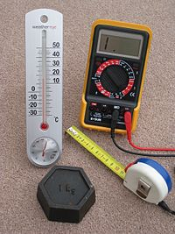

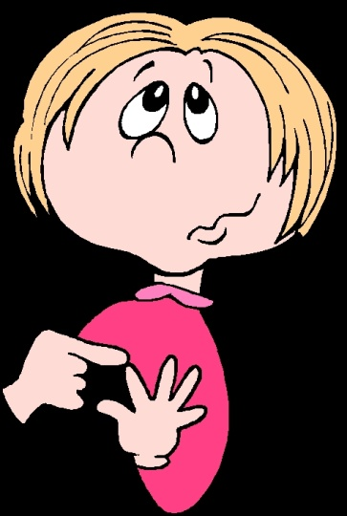
Measurement Frequencies
So… what if your data are measurements rather than counts?

Slide 22
Measurement Frequencies
Often we change the measurements into counts
These derived counts are also “frequencies”

Slide 23
Measurement Frequencies
We can change measured data to categories by splitting the continuum into named categories

Slide 24
Measurement Frequencies
Sale price (in thousand $)
8.0 – 11.0
11.1 - 14.1
14.2 – 17.2
17.3 – 20.3
20.4 – 23.4
23.5 – 26.5
Minutes Internet Usage
1-10
11-20
21-30
31-40
41-50
51-60
60+
Years of experience
1 - 2
3 - 4
5 - 6
7 - 8
9 - 10
11+

Slide 25
Measurement Frequencies
The counts of observations falling in these user-manufactured categories are still called
“frequencies”

Slide 26
Measurement Frequencies
A bar graph of frequencies in user-manufactured categories is still called a “histogram”

Slide 27
Measurement Frequencies
It is less confusing to viewers to keep the numerical categories the same width

Slide 28
Measurement Frequencies
Numerical categories should not overlap
Numerical categories should not leave any blank spaces in the continuum

Slide 29
Measurement Frequencies
We want at least 5 categories
This allows us to pretend the data is still “continuous” (one of those statistical things)

Slide 30
Measurement Frequencies
For psychological reasons, we usually limit the number of categories to a maximum of 8

Slide 31
Measurement Frequencies
Typically the human brain can compare only 7-8 things before becoming overloaded

Slide 32
FREQUENCIES
IN-CLASS PROBLEM
Which would be better?
Minutes Internet Usage | Number of Users
1-15
16-30
31-45
46-60
61-75
76-90
91-105
106-120
121+
Minutes Internet Usage | Number of Users
1-20
21-40
41-60
61-80
81-100
101-120
121+

Slide 33
FREQUENCIES
IN-CLASS PROBLEM
You are doing research on traffic offenses in Denver

Slide 34
FREQUENCIES
IN-CLASS PROBLEM
Your first research objective is to find out if Franklin Street’s speed limit should be greater than 25 mph

Slide 35
FREQUENCIES
IN-CLASS PROBLEM
You start by sampling 30 speeding tickets from this street and record the speed

Slide 36
FREQUENCIES
IN-CLASS PROBLEM
What is the population?
What is the variable?
Is the variable Qualitative
or Quantitative?

Slide 37
FREQUENCIES
IN-CLASS PROBLEM
Here is your raw data:
Create a histogram of the data
48 | 92 | 50 | 29 | 40 | 129 | 43 | 108 | 39 | 42
57 | 42 | 104 | 83 | 45 | 81 | 45 | 123 | 38 | 48
45 | 67 | 32 | 65 | 42 | 46 | 80 | 46 | 100 | 98

Slide 38
Questions?

Slide 39
Frequencies
A relative frequency is the fraction or percent of observations that fall in each category

Slide 40
Frequencies
You first find the total sample size (n) by adding up all of the counts in each category

Slide 41
Frequencies
Then divide each category count by n

Slide 42
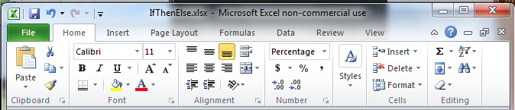
Frequencies
You can make these percentages by multiplying by 100 (or just clicking the % sign on the Excel ribbon)

Slide 43
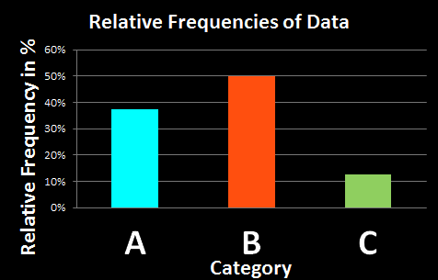
Frequencies
Data table: n = 8
A B A B A C B B
Rel Freq Histogram:
distribution:
A: 3/8
B: 4/8
C: 1/8

Slide 44
Frequencies
Notice the shapes of the absolute frequency and relative frequency graphs are the same

Slide 45
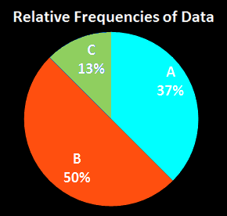
Frequencies
Because we see % more easily in a pie chart, relative frequencies should be shown in this format

Slide 46
FREQUENCIES
IN-CLASS PROBLEM
Create a relative frequency distribution for the Franklin Street data:

Slide 47
Questions?

Slide 48
Measurement Frequencies
Numerical categories are also called “classes”

Slide 49
Measurement Frequencies
For numerical categories, the maximum and minimum values in each category are called the “class limits”

Slide 50
FREQUENCIES
IN-CLASS PROBLEM
What are the class limits for the Franklin Street data?

Slide 51
Measurement Frequencies
For numerical categories, the range of values included in each category is called the “width”

Slide 52
FREQUENCIES
IN-CLASS PROBLEM
What is the class width for the Franklin Street data?

Slide 53
Measurement Frequencies
The middle of each numerical category is called the “midpoint”
Add the maximum and minimum (class limits) and divide by 2

Slide 54
FREQUENCIES
IN-CLASS PROBLEM
What is the midpoint for the first class in the Franklin Street data?

Slide 55
Measurement Frequencies
Rounding may move observed values into different numerical categories
The actual maximum and minimum values that end up in a given numerical category are called the “class boundaries”

Slide 56
FREQUENCIES
IN-CLASS PROBLEM
What are the class boundaries for second category in the Franklin Street data?

Slide 57
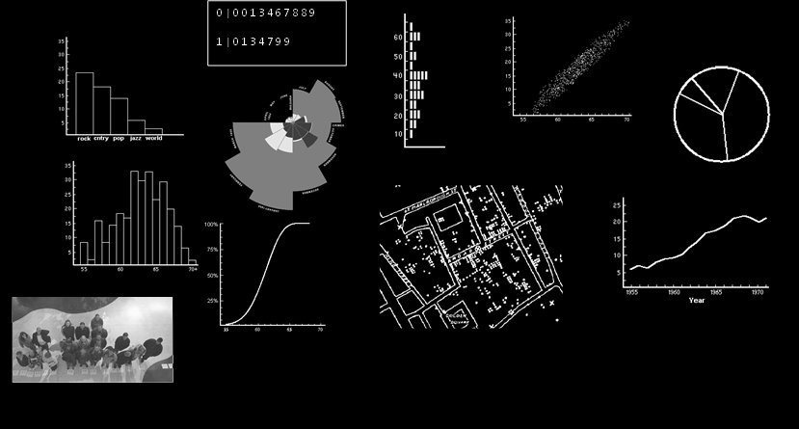
FREQUENCIES
IN-CLASS PROBLEM
Which are frequency distributions?

Slide 58
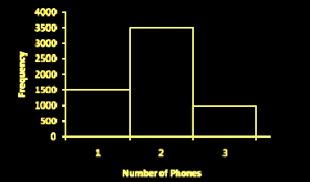
FREQUENCIES
IN-CLASS PROBLEM
The histogram represents the number of cell phones per household for a sample of U.S. households.
How many
households
are included
in the
histogram?

Slide 59
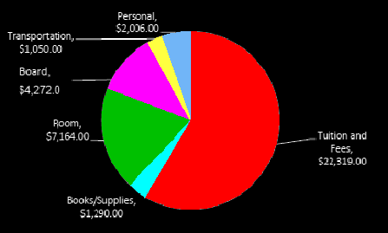
FREQUENCIES
IN-CLASS PROBLEM
University students’ yearly
cost of attendance
What percentage of students’
budget is room and board?

Slide 60
FREQUENCIES
IN-CLASS PROBLEM
University students’ yearly
cost of attendance
What is the ratio of personal expenses to transportation expenses?

Slide 61
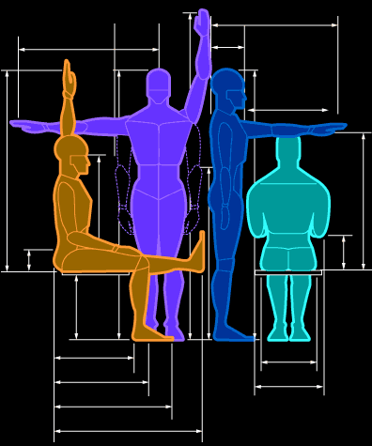
In-Class Project
Anthropometrics!

Slide 62
Excel Histograms
You can analyze your data and display it in a histogram (a column chart that displays frequency data) by using the Histogram tool of the Analysis ToolPak in Microsoft Office Excel

Slide 63
Excel Histograms
To create a histogram, you must enter your input data in a column on the worksheet

Slide 64
HANDS-ON
IN-CLASS PROBLEM
Get the spreadsheet from
vf-tropi.com and add our data to the top of the list

Slide 65
HANDS-ON
IN-CLASS PROBLEM
Add the Excel Data Analysis Add-In on your computer

Slide 66
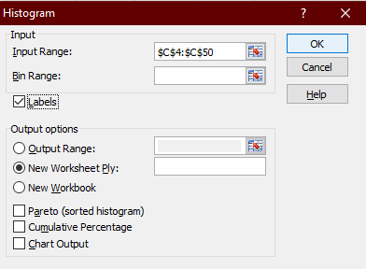
HANDS-ON
IN-CLASS PROBLEM
For fun (it will be ugly) go to: Data
Data Analysis
Histogram
Enter the data
Input Range
(include the
column label)
Mark “Labels”
Click “OK”

Slide 67
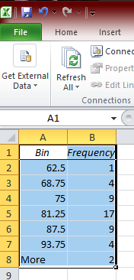
HANDS-ON
IN-CLASS PROBLEM
All the wrong
categories!
(But it was easy!)

Slide 68
Excel Histograms
A second column will specify your “bin numbers” – minimum bounds for your intervals

Slide 69
Excel Histograms
Excel counts the number of data points in each data bin if the number is greater than the bound number in your bin and less than or equal to the next larger bound number

Slide 70
Excel Histograms
If you omit the bin range, Excel creates a set of evenly distributed bins between the minimum and maximum values of the input data

Slide 71
Excel Histogram
Be sure to have a label for the bin range as well as the input data

Slide 72
HANDS-ON
IN-CLASS PROBLEM
What are the bin range numbers you need to get the proper results for the cephalic categories?

Slide 73
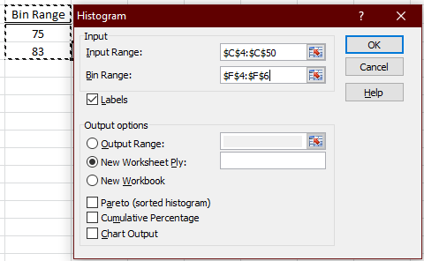
HANDS-ON
IN-CLASS PROBLEM
Go back to: Histogram
Enter the Bin Range
(include the column label)
Click “OK”

Slide 74
HANDS-ON
IN-CLASS PROBLEM
Much better!
Bin Range | Frequency
75 | 14
83 | 19
More | 13

Slide 75
HANDS-ON
IN-CLASS PROBLEM
Change the labels to something more informative:
Cephalic Type | Frequency
Dolichocephalic | 14
Mesocephalic | 19
Brachycephalic | 13

Slide 76
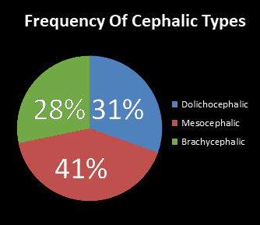
HANDS-ON
IN-CLASS PROBLEM
Make a pie chart
Include an informative title
and % labels on the slices
Make it purty!

Slide 77
Questions?

Slide 78
Frequencies
Frequency –
the number in a category
Number of Users
9
18
15
8
1
0
1

Slide 79
Frequencies
Cumulative frequency – the number of observations that fall in that category or a previous category
This can only be done if the categories can be ordered

Slide 80
Cumulative Frequencies
How many observations occur in a given category and any previous ordered categories:
Minutes Internet Usage | Number of Users | Cumulative Number of Users
1-20 | 9 | 9
21-40 | 18 | 27
41-60 | 15 | 42
61-80 | 8 | 50
81-100 | 1 | 51
101-120 | 0 | 51
121+ | 1 | 52

Slide 81
Cumulative Frequencies
The last value is always “n” the sample size
Minutes Internet Usage | Number of Users | Cumulative Number of Users
1-20 | 9 | 9
21-40 | 18 | 27
41-60 | 15 | 42
61-80 | 8 | 50
81-100 | 1 | 51
101-120 | 0 | 51
121+ | 1 | 52

Slide 82
Cumulative Frequencies
The histogram for a cumulative frequency distribution is called an
“ogive”

Slide 83
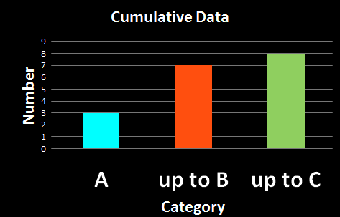
Cumulative Frequencies
Data table: n = 8
A B A B A C B B
Cum Freq Histogram:
distribution:
A: 3
A or B: 3+4=7
A,B or C: 8

Slide 84
Cumulative Frequencies
Note that the last category in a cumulative frequency ALWAYS has the value n

Slide 85
Cumulative Frequencies
Note also a cumulative frequency cannot get smaller as you move up the categories

Slide 86
Cumulative Frequencies
Note also a cumulative frequency cannot get smaller as you move up the categories
It can stay the same (if the category count is 0)

Slide 87
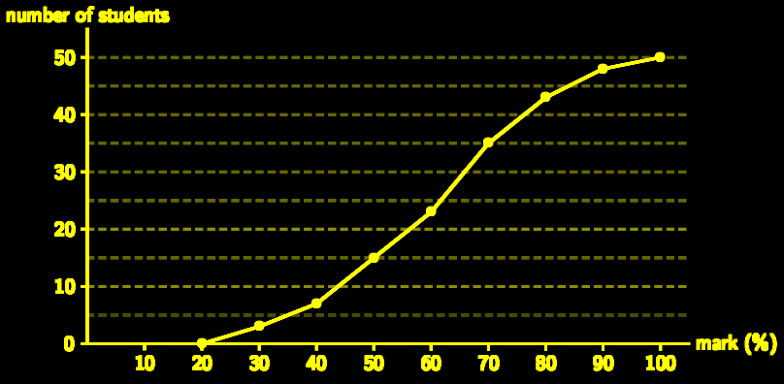
Cumulative Frequencies
An ogive typically forms an “s” shape
http://everythingmaths.co.za/maths/grade-11/11-statistics/tikzpictures/4d8229e8dd2b71fe85520a97acdab63a.png

Slide 88
Questions?

Slide 89
Fractiles
Another way of describing frequency data
A measure of position
Based on the ogive (cumulative frequency) or ordered data

Slide 90
Fractiles
How to do it:
find n
order the data
divide the data into the # of pieces you want, each with an equal # of members

Slide 91
Fractiles
quartile - four pieces
percentile - 100 pieces

Slide 92
FRACTILES
IN-CLASS PROBLEM 6
17
88
33
30
11
41
46
62
5
78
31
54
Step 1: Find n!

Slide 93
FRACTILES
IN-CLASS PROBLEM 6
17
88
33
30
11
41
46
62
5
78
31
54
n = 12
What’s next?

Slide 94
FRACTILES
IN-CLASS PROBLEM 7
5
11
17
30
31
33
41
46
5462
78
88
Order the data!
What if you split it into equal halves?
How many observations would be in each half?

Slide 95
FRACTILES
IN-CLASS PROBLEM 8
5
11
17
30
31
33
41
46
5462
78
88
Poof!
6 observations in each half!
This is the 50th percentile
or the “median”

Slide 96
FRACTILES
IN-CLASS PROBLEM 9,12
5
11
17
30
31
33
41
46
5462
78
88
The 50th percentile
or the “median”
33+41
2
= = 37

Slide 97
FRACTILES
IN-CLASS PROBLEM 10
5
11
17
30
31
33
41
46
5462
78
88
What if you wanted quartiles?
How many observations would be in each quartile?
Where would the splits be?

Slide 98
FRACTILES
IN-CLASS PROBLEM 11,13
5
11
17
30
31
33
41
46
5462
78
88
Poof!
3 observations in each quartile!

Slide 99
FRACTILES
IN-CLASS PROBLEM 11,13
5
11
17
30
31
33
41
46
5462
78
88
1st quartile = = 23.5
3rd quartile = = 58
30+17
2
62+54
2

Slide 100
Fractiles
Quartiles and percentiles are common, others not so much
The median is also common, but it is called “the median” rather than “the 50th percentile” or “2nd quartile”

Slide 101
Questions?

Slide 102
Types of Statistics
Remember, we take a sample to find out something about the whole population

Slide 103
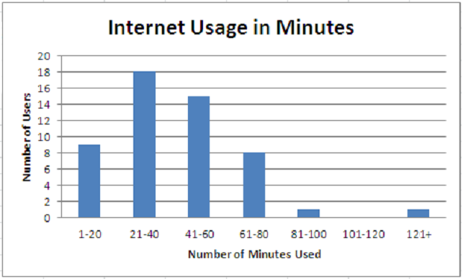
Types of Statistics
We can learn a lot about
our population
by graphing the data:

Slide 104
Types of Statistics
But it would also be convenient
to be able to “explain” or describe the population
in a few summary words or numbers based on our data

Slide 105
Types of Statistics
Descriptive statistics –
describe our sample – we’ll use this to make inferences about the population
Inferential statistics –
make inferences about the population with a level of probability attached

Slide 106
TYPES OF STATISTICS
IN-CLASS PROBLEMS
What type of statistics are graphs?

Slide 107
Descriptive Statistics
Observation –
a member of a data set

Slide 108
Descriptive Statistics
Each observation in our data and the sample data set as a whole is a descriptive statistic
We use them to make inferences about the population

Slide 109
Descriptive Statistics
Sample size –
the total number of observations in your sample, called: “n”

Slide 110
Descriptive Statistics
The population also has a size (probably really REALLY huge, and also probably unknown)
called: “N”

Slide 111
Descriptive Statistics
The maximum or minimum values from our sample can help describe or summarize our data

Slide 112
DESCRIPTIVE STATISTICS
IN-CLASS PROBLEMS
Name some descriptive statistics:

Slide 113
Questions?

Slide 114
Descriptive Statistics
Other numbers and calculations can be used to summarize our data

Slide 115
Descriptive Statistics
More often than not we want a single number (not another table of numbers) to help summarize our data

Slide 116
Descriptive Statistics
One way to do this is to find a number that gives a “usual” or “normal” or “typical” observation

Slide 117
AVERAGES
IN-CLASS PROBLEMS
What do we usually think of as
“The Average”?
Data:
3 1 4 1 1
Average = _________ ?

Slide 118

Averages
If you add up all the data values and divide by the number of data points, this is not called the “average” in
Statistics
Class
It’s called the
“arithmetic mean”

Slide 119
Averages
…and “arithmetic” isn’t pronounced “arithmetic” but “arithmetic”

Slide 120

Averages
More bad news…
It’s bad enough that statisticians gave this a
wacky name, but…
IT’S NOT THE ONLY “AVERAGE”

Slide 121
Averages
In statistics, we not only have the good ol’ “arithmetic mean” average, we also have:
- median
- midrange
- mode

Slide 122
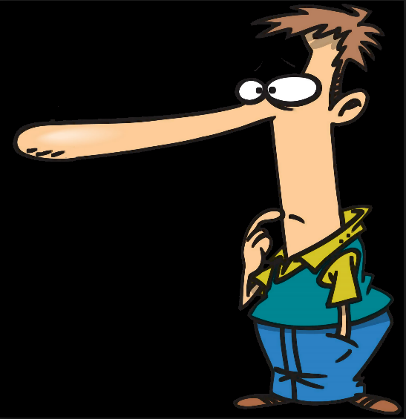
And…
Since all these are called
“average”
There is lots of room for statistical skullduggery
and lying!

Slide 123
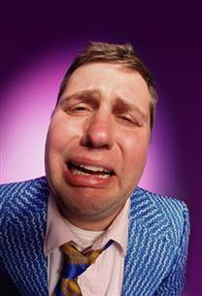
And…
Of course, statisticians can’t call them “averages” like everyone else
In Statistics class they are called
“Measures of
Central Tendency”

Slide 124
Measures of Central Tendency
The averages give an idea of where the data “lump together”
Or “center”
Where they “tend to center”

Slide 125
Measures of Central Tendency
Mean = sum of obs/# of obs
Median = the middle obs
(ordered data)
Midrange = (Max+Min)/2
Mode = the most common value

Slide 126
Measures of Central Tendency
The “arithmetic mean” is what normal people call the average

Slide 127
Measures of Central Tendency
Add up the data values and divide by how may values there are

Slide 128
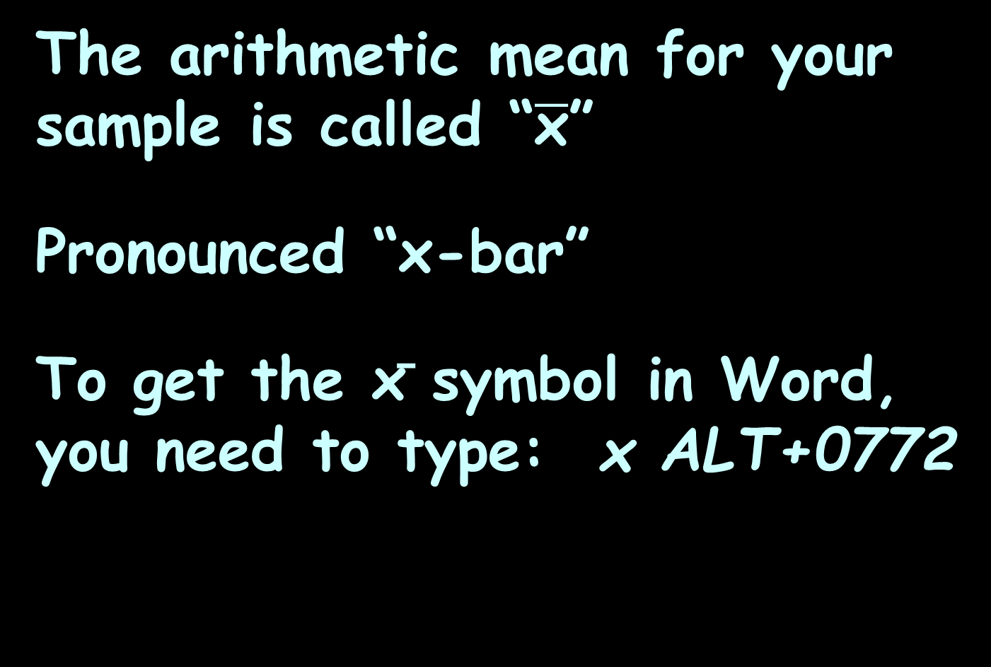
Measures of Central Tendency
The arithmetic mean for your sample is called “$\overline{\text{x}}$”
Pronounced “x-bar”
To get the x̄ symbol in Word, you need to type: x ALT+0772

Slide 129
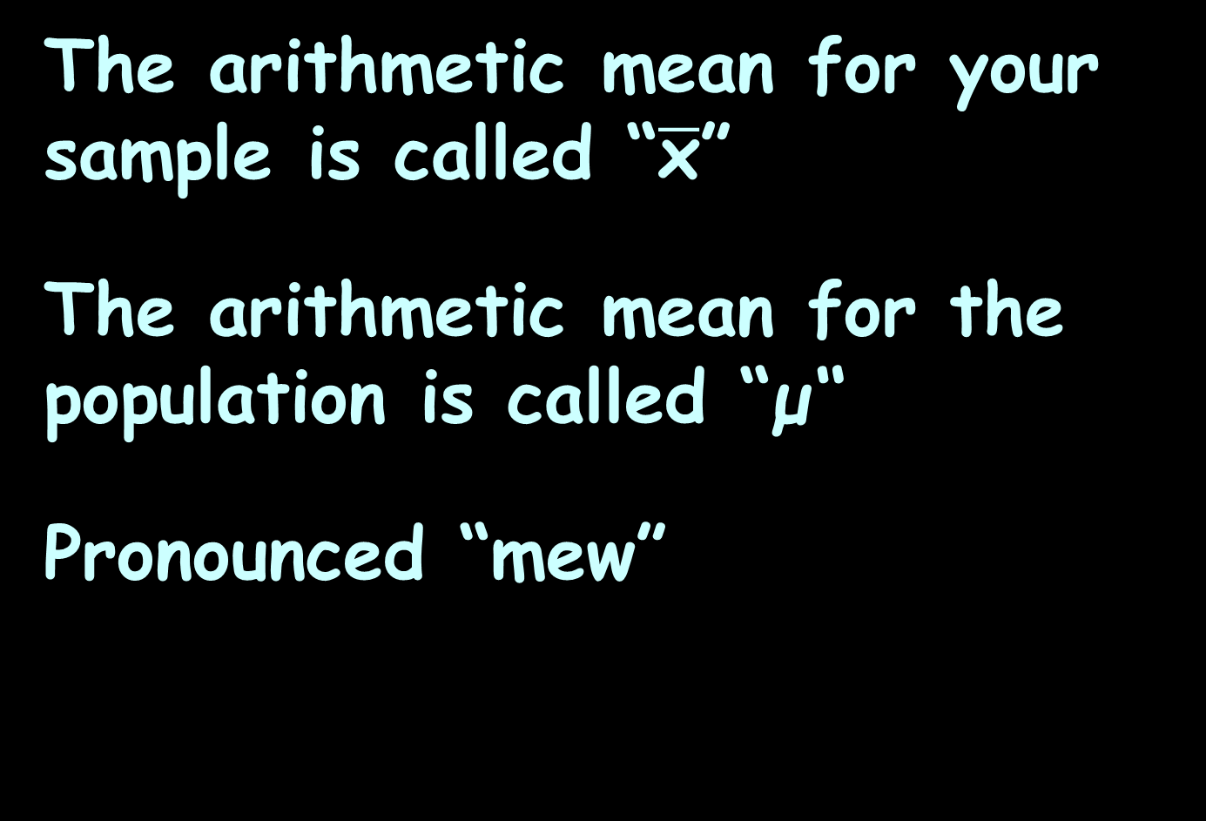
Measures of Central Tendency
The arithmetic mean for your sample is called “$\overline{\text{x}}$”
The arithmetic mean for the population is called “μ“
Pronounced “mew”

Slide 130
Measures of Central Tendency
Remember we use sample statistics to estimate population parameters?
Our sample arithmetic mean estimates the (unknown) population arithmetic mean

Slide 131
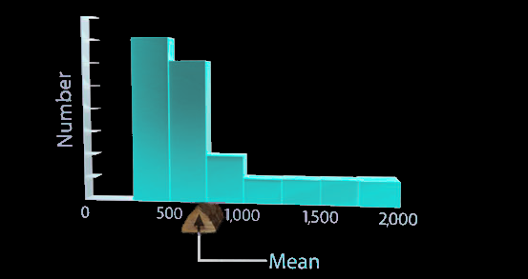
Measures of Central Tendency
The arithmetic mean is also the balance point for the data

Slide 132
AVERAGES
IN-CLASS PROBLEMS
Data:
3 1 4 1 1
Arithmetic mean = _________ ?

Slide 133
Measures of Central Tendency
Median = the middle obs
(ordered data)
(Remember we ordered the data to create categories from measurement data?)

Slide 134
Measures of Central Tendency
Step 1: find n!
DON’T COMBINE THE DUPLICATES!

Slide 135
Measures of Central Tendency
Step 2: order the data from low to high

Slide 136
Measures of Central Tendency
The median will be the (n+1)/2 value in the ordered data set

Slide 137
Measures of Central Tendency
Data:
3 1 4 1 1
What is n?

Slide 138
Measures of Central Tendency
Data:
3 1 4 1 1
n = 5
So we will want the (n+1)/2
(5+1)/2
The third observation in the ordered data

Slide 139
Measures of Central Tendency
Data:
3 1 4 1 1
Next, order the data!

Slide 140
Measures of Central Tendency
Ordered data:
1 1 1 3 4
So, which is the third observation in the ordered data?

Slide 141
Measures of Central Tendency
Ordered data:
1 1 1 3 4
group 1
group 2
(median)

Slide 142
Measures of Central Tendency
What if you have an even number of observations?

Slide 143
Measures of Central Tendency
You take the average (arithmetic mean) of the two middle observations

Slide 144
Measures of Central Tendency
Ordered data:
1 1 1 3 4 7
group 1
group 2
median = (1+3)/2
= 2

Slide 145
Measures of Central Tendency
Ordered data:
1 1 1 3 4 7
Notice that for an even number of observations, the median may not be one of the observed values!
group 1
group 2
median = 2

Slide 146
Measures of Central Tendency
Of course, that can be true of the arithmetic mean, too!

Slide 147
AVERAGES
IN-CLASS PROBLEMS
Data:
3 1 4 1 1
Median = _________ ?

Slide 148
Measures of Central Tendency
The midrange is the midpoint of the range of the data values (like the category midpoint)

Slide 149
Measures of Central Tendency
Midrange = (Max+Min)/2

Slide 150
Measures of Central Tendency
Data:
3 1 4 1 1
Max = _________ ?
Min = _________ ?

Slide 151
Measures of Central Tendency
Data:
3 1 4 1 1
Max = 4
Min = 1
Midrange = (Max+Min)/2

Slide 152
AVERAGES
IN-CLASS PROBLEMS
Data:
3 1 4 1 1
Midrange = _________ ?

Slide 153
Measures of Central Tendency
Again, the midrange may not be one of the observed values!

Slide 154
Measures of Central Tendency
Mode = the most common value

Slide 155
Measures of Central Tendency
What if there are two?
3 1 4 1 3

Slide 156
Measures of Central Tendency
What if there are two?
3 1 4 1 3
You have two modes: 1 and 3

Slide 157
Measures of Central Tendency
What if there are none?
62.3 1 4 2 3

Slide 158
Measures of Central Tendency
What if there are none?
62.3 1 4 2 3

Slide 159
Measures of Central Tendency
Then there are none…
62.3 1 4 2 3
Mode = #N/A

Slide 160
AVERAGES
IN-CLASS PROBLEMS
Data:
3 1 4 1 1
Mode = _________ ?

Slide 161
Measures of Central Tendency
The mode will ALWAYS be one of the observed values!

Slide 162
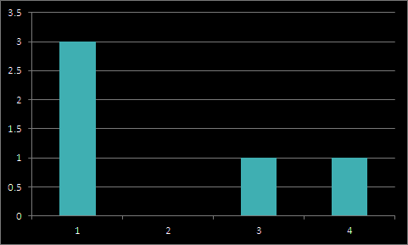
Measures of Central Tendency
Ordered Data: 1 1 1 3 4
Mean = 10/5 = 2
Median = 1
Midrange = 2.5
Mode = 1
Minimum = 1
Maximum = 4
Sum = 10
Count = 5

Slide 163
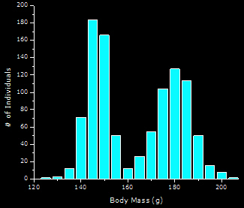
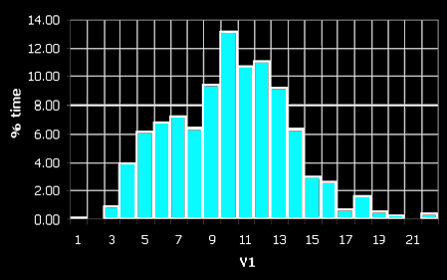
Measures of Central Tendency
Peaks of a histogram are called “modes”
bimodal 6-modal

Slide 164
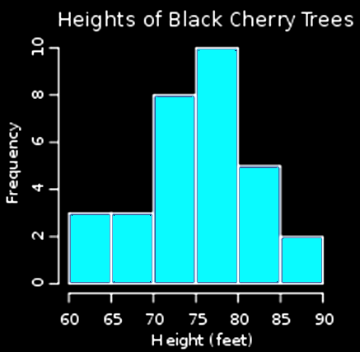
MEASURES OF CENTRAL TENDENCY
IN-CLASS PROBLEMS
What is the
most common
height for
black cherry
trees?

Slide 165
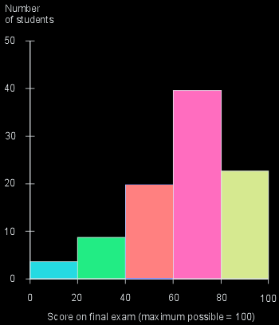
MEASURES OF CENTRAL TENDENCY
IN-CLASS PROBLEMS
What is the
typical score
on the final
exam?

Slide 166
MEASURES OF CENTRAL TENDENCY
IN-CLASS PROBLEMS
Mode = the most common value
Median = the middle observation
(ordered data)
Mean = sum of obs/# of obs
Midrange = (Max+Min)/2
Data: 40 70 50 10 50
Calculate the “averages”

Slide 167
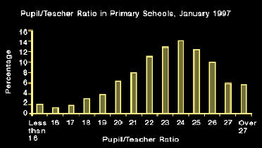
MEASURES OF CENTRAL TENDENCY
IN-CLASS PROBLEMS
How many modes does this data have?

Slide 168
MEASURES OF CENTRAL TENDENCY
IN-CLASS PROBLEMS
What is the value (or values) of the mode(s)?

Slide 169
MEASURES OF CENTRAL TENDENCY
IN-CLASS PROBLEMS
What is the value of the
midrange?

Slide 170
MEASURES OF CENTRAL TENDENCY
IN-CLASS PROBLEMS
What is an approximate value for the mean?

Slide 171
MEASURES OF CENTRAL TENDENCY
IN-CLASS PROBLEMS
Why am I not asking you for the median?

Slide 172
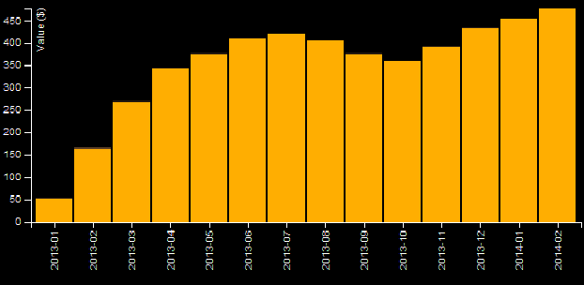
MEASURES OF CENTRAL TENDENCY
IN-CLASS PROBLEMS
How many modes does this data have?

Slide 173
MEASURES OF CENTRAL TENDENCY
IN-CLASS PROBLEMS
What is the value (or values) of the mode(s)?

Slide 174
MEASURES OF CENTRAL TENDENCY
IN-CLASS PROBLEMS
What is an approximate value for the mean?

Slide 175
MEASURES OF CENTRAL TENDENCY
IN-CLASS PROBLEMS
Why am I not asking you about the midrange?

Slide 176
Questions?

Slide 177
Excel Averages
To use Excel to calculate Descriptive Statistics for bigger data sets, you need to install the Analysis Toolpak Add-In

Slide 178
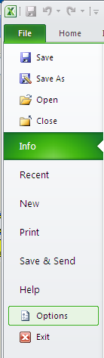
Excel Averages
Adding the Analysis ToolPak in
Microsoft Office Excel
Opening Excel and click on the
'File' tab at the top left
of the screen
At the bottom of the menu,
click on the 'Options'
button
The Excel Options window
will open

Slide 179
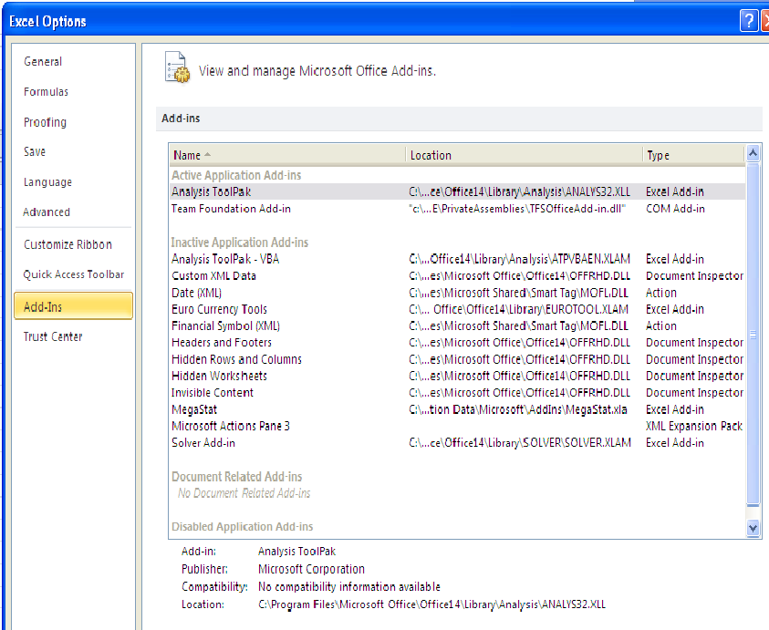
Excel Averages
In the column on the left, click on the
'Add-Ins'
heading

Slide 180
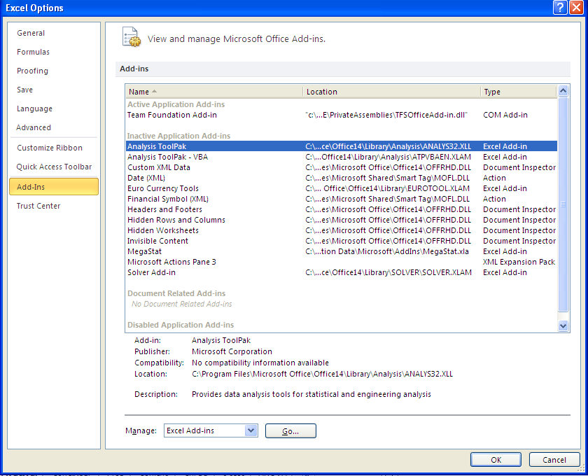
Excel Averages
On the right side of the window, scroll down to Add-Ins
Click the 'Go' \
button at the
bottom

Slide 181
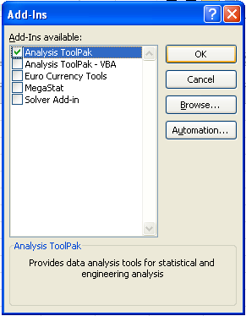
Excel Averages
An 'Add-Ins' window will open
Click in the checkbox next to
'Analysis ToolPak'
Click the 'OK' button

Slide 182
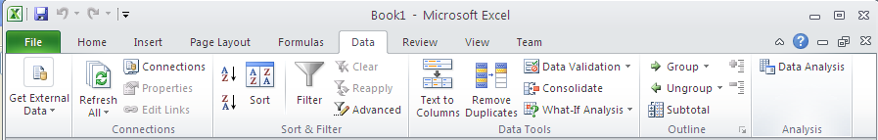
Excel Averages
Click on the “Data” tab at the top
“Data Analysis” should be on the far right of the ribbon

Slide 183
Excel Averages
Click on the “Data Analysis” button at the far right
Click on “Descriptive Statistics”
Click “OK”

Slide 184
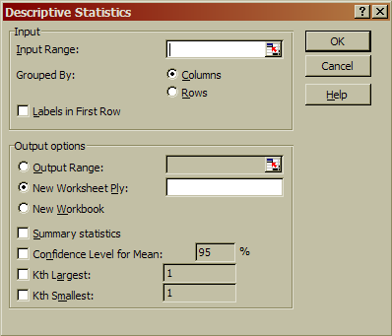
Excel Averages
Click on the button at the far right of “Input Range”

Slide 185
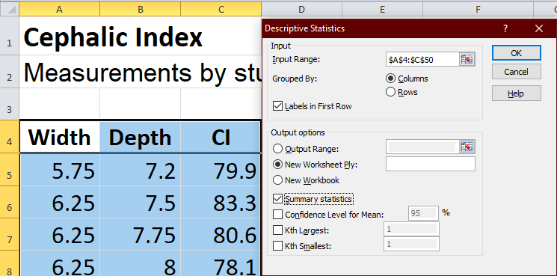
Excel Averages
Highlight the data in the table including the column labels

Slide 186
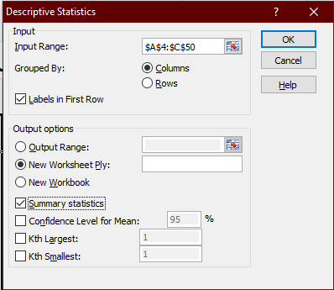
Excel Averages
Click “Labels in First Row”
Click
“Summary
statistics”

Slide 187
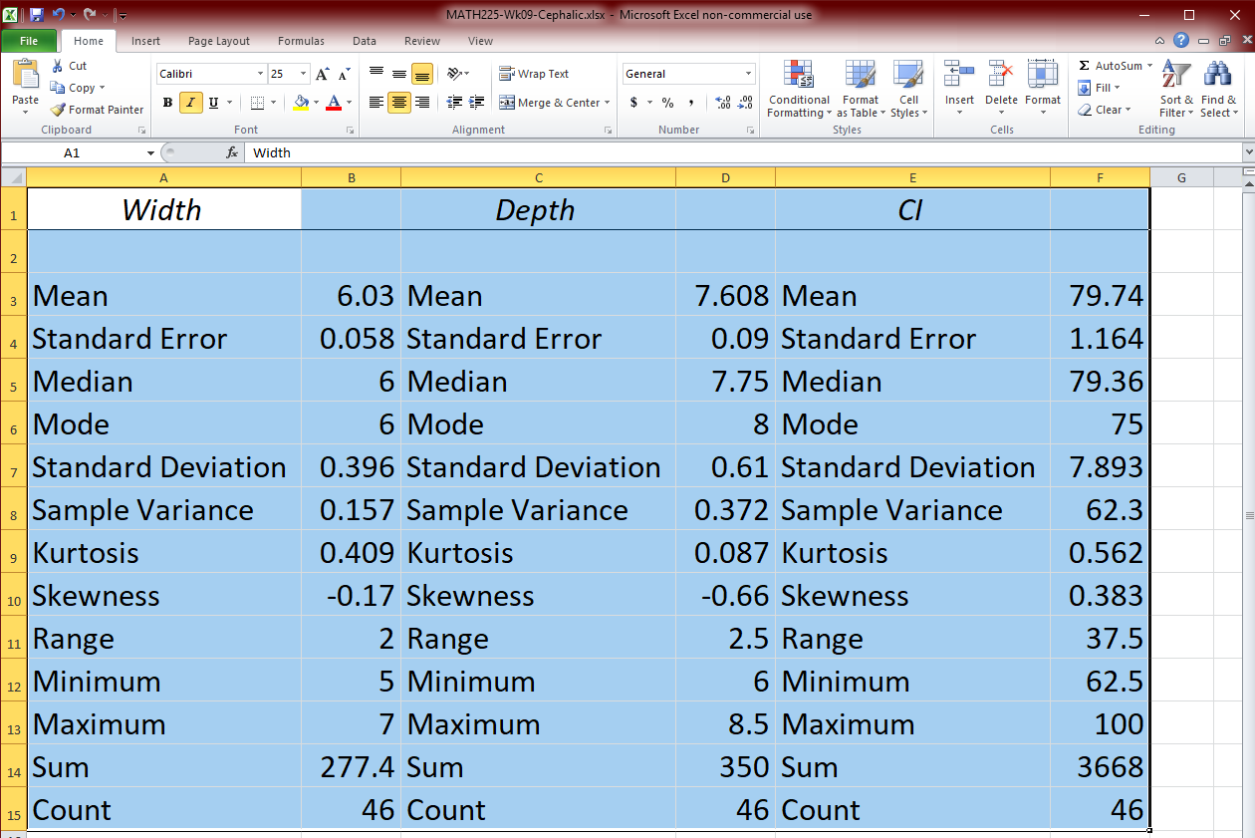
Excel Averages
Tah-dah! (Yuck…)

Slide 188

Excel Averages
To make this a useful summary table, highlight the row of labels

Slide 189

Excel Averages
Then drag it by the edge so the labels are over the columns containing numbers

Slide 190

Excel Averages
Right click the letters at the top of the
duplicate columns then delete

Slide 191

Excel Averages
You may need to adjust the width of column A so you can see the words

Slide 192
Excel Averages
What statistics do you recognize?

Slide 193
Excel Averages
OK… but… where’s the midrange?

Slide 194

Excel Averages
Add another row for the “Midrange” For the values, start with “=” then
enter the
formula for the
midrange
Copy to the
Other cells

Slide 195


Slide 196
Questions?

Slide 197
Weighted Average
A way to calculate an arithmetic mean if values are repeated or if certain data are given different weights

Slide 198
Weighted Average
A student earned grades of 77, 81, 95 and 77 on four regular tests which count for 40% of the final grade
She earned an 88 on the final exam which counts for 40%
Her average homework grade was 83 which counts for 20%

Slide 199
Weighted Average
What is her weighted average grade?

Slide 200
Weighted Average
First spread out any data that have been grouped:
For the 4 test grades, each is individually worth 40%/4 or 10%
Grade | Weight
77, 81, 95, 77 | 40%
88 | 40%
83 | 20%

Slide 201
Weighted Average
Tah-dah! Each grade has its own weight
Grade | Weight
77 | 10%
81 | 10%
95 | 10%
77 | 10%
88 | 40%
83 | 20%

Slide 202
Weighted Average
Next change the % into decimals:
Grade | Weight
77 | 10% -> 0.10
81 | 0.10
95 | 0.10
77 | 0.10
88 | 40% -> 0.40
83 | 20% -> 0.20

Slide 203
WEIGHTED AVERAGES
IN-CLASS PROBLEMS
Next multiply the grades by the weights:
Grade | Weight | G x W
77 | 0.10 | 7.7
81 | 0.10 | 8.1
95 | 0.10 | ?
77 | 0.10 | ?
88 | 0.40 | ?
83 | 0.20 | ?

Slide 204
Weighted Average
Next multiply the grades by the weights:
Grade | Weight | G x W
77 | 0.10 | 7.7
81 | 0.10 | 8.1
95 | 0.10 | 9.5
77 | 0.10 | 7.7
88 | 0.40 | 35.2
83 | 0.20 | 16.6

Slide 205
WEIGHTED AVERAGES
IN-CLASS PROBLEMS
Add ‘em up!
Grade | Weight | G x W
77 | 0.10 | 7.7
81 | 0.10 | 8.1
95 | 0.10 | 9.5
77 | 0.10 | 7.7
88 | 0.40 | 35.2
83 | 0.20 | 16.6
 |  | = ?

Slide 206
Weighted Average
That is the weighted average!
Grade | Weight | G x W
77 | 0.10 | 7.7
81 | 0.10 | 8.1
95 | 0.10 | 9.5
77 | 0.10 | 7.7
88 | 0.40 | 35.2
83 | 0.20 | 16.6
 |  | 84.8

Slide 207
Questions?

Slide 208
How to Lie with Statistics #3
Data set: Wall Street Bonuses
CEO $5,000,000
COO $3,000,000
CFO $2,000,000
3VPs $1,000,000
5 top traders $ 500,000
9 heads of dept $ 100,000
51 employees $ 0

Slide 209

How to Lie with Statistics #3
You would enter the data in Excel including the 51 zeros

Slide 210
How to Lie with Statistics #3
Excel Summary Table:
Wall Street Bonuses
Mean | $ 230,985.90
Median | $ 0.00
Mode | $ 0.00
Midrange | $2,500,000.00

Slide 211

How to Lie with Statistics #3
Since all of
these are
“averages”
you can use
whichever one
you like…
Wall Street Bonuses
Mean | $ 230,985.90
Median | $ 0.00
Mode | $ 0.00
Midrange | $2,500,000.00

Slide 212

MEASURES OF CENTRAL TENDENCY
IN-CLASS PROBLEMS
Which one would
you use to show
this company is
evil?
Wall Street Bonuses
Mean | $ 230,985.90
Median | $ 0.00
Mode | $ 0.00
Midrange | $2,500,000.00

Slide 213

MEASURES OF CENTRAL TENDENCY
IN-CLASS PROBLEMS
Which one could you use to show the company is not paying
any bonuses?
Wall Street Bonuses
Mean | $ 230,985.90
Median | $ 0.00
Mode | $ 0.00
Midrange | $2,500,000.00

Slide 214

HOW TO LIE WITH AVERAGES
#1
The average we get may not have any real meaning

Slide 215

HOW TO LIE WITH AVERAGES
#2

Slide 216

HOW TO LIE WITH AVERAGES
#3

Slide 217
Questions?

Slide 218
Descriptive Statistics
Averages tell where the data tends to pile up

Slide 219

Descriptive Statistics
Another good way to describe data is how spread out it is

Slide 220

VARIABILITY
IN-CLASS PROBLEMS

Slide 221
Descriptive Statistics
Suppose you are using the mean “5” to describe each of the observations in your sample

Slide 222
VARIABILITY
IN-CLASS PROBLEMS
For which sample would “5” be closer to the actual data values?

Slide 223
VARIABILITY
IN-CLASS PROBLEMS
In other words, for which of the two sets of data would the mean be a better descriptor?

Slide 224

VARIABILITY
IN-CLASS PROBLEMS
For which of the two sets of data would the mean be a better descriptor?

Slide 225
Variability
Numbers telling how spread out our data values are
are called
“Measures of Variability”

Slide 226

Variability
The variability tells how close to the “average” the sample data tend to be

Slide 227
Variability
Just like measures of central tendency, there are several measures of variability

Slide 228
Variability
Range = max – min

Slide 229
Variability
Interquartile range (symbolized IQR):
IQR = 3rd quartile – 1st quartile

Slide 230
Variability
“Range Rule of Thumb”
A quick-and-dirty variance measure:
(Max – Min)/4
Note to self: yes, this is correct…

Slide 231

Variability
Variance (symbolized s²)
s² =
sum of (obs – $\overline{\text{x}}$)²
n - 1

Slide 232

Variability
An observation “x” minus the mean $\overline{\text{x}}$ is called a “deviation”
The variance is sort of an average (arithmetic mean) of the squared deviations

Slide 233
Variability
Sums of squared deviations are used in the formula for a circle:
r² = (x-h)² + (y-k)²
where r is the radius of the circle and (h,k) is its center

Slide 234

Variability
OK… so if its sort of an arithmetic mean, howcum is it divided by “n-1” not “n”?

Slide 235
Variability
Every time we estimate something in the population using our sample we have used up a bit of the “luck” that we had in getting a (hopefully) representative sample

Slide 236
Variability
To make up for that, we give a little edge to the opposing side of the story

Slide 237
Variability
Since a small variability means our sample arithmetic mean is a better estimate of the population mean than a large variability is, we bump up our estimate of variability a tad to make up for it

Slide 238
Variability
Dividing by “n” would give us a smaller variance than dividing by “n-1”, so we use that

Slide 239
Variability
Why not “n-2”?

Slide 240

Variability
Why not “n-2”?
Because we only have used 1 estimate to calculate the variance: $\overline{\text{x}}$

Slide 241

Variability
So, the variance is sort of an average (arithmetic mean) of the squared deviations bumped up a tad to make up for using an estimate ($\overline{\text{x}}$) of the population mean (μ)

Slide 242

Variability
Trust me…

Slide 243

Variability
Standard deviation (symbolized “s” or “std”)
s = $\sqrt{\text{v}\text{ariance}}$

Slide 244

Variability
The standard deviation is an average square root of a sum of squared deviations
We’ve used this before in distance calculations:
d = $\sqrt{\text{(}\text{x}\text{1}\text{−}\text{x}\text{2}\text{)}\text{2} \text{+ (}\text{y}\text{1}\text{−}\text{y}\text{2}\text{)}\text{2}}$

Slide 245
Variability
The range, interquartile range and standard deviation are in the same units as the original data (a good thing)
The variance is in squared units (which can be confusing…)

Slide 246
Variability
Naturally, the measure of variability used most often is the hard-to-calculate one…

Slide 247
Variability
Naturally, the measure of variability used most often is the hard-to-calculate one…
… the standard deviation

Slide 248
Variability
Statisticians like it because it is an average distance of all of the data from the center – the arithmetic mean

Slide 249


Variability
Range = max – min
IQR = 3rd quartile – 1st quartile
Range Rule of Thumb =
(max – min)/4
Variance =
s = $\sqrt{\text{variance}}$
sum of (obs – $\overline{\text{x}}$)²
n - 1

Slide 250
Questions?

Slide 251


Variability
Range = max – min
IQR = 3rd quartile – 1st quartile
Thumb = (max – min)/4
Variance =
s = $\sqrt{\text{variance}}$
sum of (obs – $\overline{\text{x}}$)²
n - 1

Slide 252

VARIABILITY
IN-CLASS PROBLEMS
Range = max – min
IQR = 3rd quartile – 1st quartile
Thumb = (max – min)/4
Variance =
s = $\sqrt{\text{variance}}$
Data: 1 1 2 2 3 3
What is the range?
sum of (obs – $\overline{\text{x}}$)²
n - 1

Slide 253

VARIABILITY
IN-CLASS PROBLEMS
Range = max – min
IQR = 3rd quartile – 1st quartile
Thumb = (max – min)/4
Variance =
s = $\sqrt{\text{variance}}$
Data: 1 1 2 2 3 3
Range = 3 – 1 = 2
sum of (obs – $\overline{\text{x}}$)²
n - 1
Min Max

Slide 254

VARIABILITY
IN-CLASS PROBLEMS
Range = max – min
IQR = 3rd quartile – 1st quartile
Thumb = (max – min)/4
Variance =
s = $\sqrt{\text{variance}}$
Data: 1 1 2 2 3 3
What is the IQR?
sum of (obs – $\overline{\text{x}}$)²
n - 1

Slide 255

VARIABILITY
IN-CLASS PROBLEMS
Range = max – min
IQR = 3rd quartile – 1st quartile
Thumb = (max – min)/4
Variance =
s = $\sqrt{\text{variance}}$
Data: 1 1 2 2 3 3
IQR = 3 – 1 = 2
sum of (obs – $\overline{\text{x}}$)²
n - 1
Q1 Median Q3

Slide 256

VARIABILITY
IN-CLASS PROBLEMS
Range = max – min
IQR = 3rd quartile – 1st quartile
Thumb = (max – min)/4
Variance =
s = $\sqrt{\text{variance}}$
Data: 1 1 2 2 3 3
What is the Thumb?
sum of (obs – $\overline{\text{x}}$)²
n - 1

Slide 257

VARIABILITY
IN-CLASS PROBLEMS
Range = max – min
IQR = 3rd quartile – 1st quartile
Thumb = (max – min)/4
Variance =
s = $\sqrt{\text{variance}}$
Data: 1 1 2 2 3 3
Thumb = (3-1)/4 = 0.5
sum of (obs – $\overline{\text{x}}$)²
n - 1
Min Max

Slide 258

VARIABILITY
IN-CLASS PROBLEMS
Range = max – min
IQR = 3rd quartile – 1st quartile
Thumb = (max – min)/4
Variance =
s = $\sqrt{\text{variance}}$
Data: 1 1 2 2 3 3
What is the Variance?
sum of (obs – $\overline{\text{x}}$)²
n - 1

Slide 259

VARIABILITY
IN-CLASS PROBLEMS
Range = max – min
IQR = 3rd quartile – 1st quartile
Thumb = (max – min)/4
Variance =
s = $\sqrt{\text{variance}}$
Data: 1 1 2 2 3 3
First find $\overline{\text{x}}$!
sum of (obs – $\overline{\text{x}}$)²
n - 1

Slide 260

VARIABILITY
IN-CLASS PROBLEMS
Range = max – min
IQR = 3rd quartile – 1st quartile
Thumb = (max – min)/4
Variance =
s = $\sqrt{\text{variance}}$
Data: 1 1 2 2 3 3
$\overline{\text{x}}$ = = 2
sum of (obs – $\overline{\text{x}}$)²
n - 1
3+3+2+2+1+1
6

Slide 261

VARIABILITY
IN-CLASS PROBLEMS
Range = max – min
IQR = 3rd quartile – 1st quartile
Thumb = (max – min)/4
Variance =
s = $\sqrt{\text{variance}}$
Data: 1 1 2 2 3 3
Now calculate the deviations!
sum of (obs – $\overline{\text{x}}$)²
n - 1

Slide 262

VARIABILITY
IN-CLASS PROBLEMS
Range = max – min
IQR = 3rd quartile – 1st quartile
Thumb = (max – min)/4
Variance =
s = $\sqrt{\text{variance}}$
Data: 1 1 2 2 3 3
Dev: 1-2=-1 1-2=-1 2-2=0 2-2=0 3-2=1 3-2=1
sum of (obs – $\overline{\text{x}}$)²
n - 1

Slide 263
Variability
What do you get if you add up all of the deviations?
Data: 1 1 2 2 3 3
Dev: 1-2=-1 1-2=-1 2-2=0 2-2=0 3-2=1 3-2=1

Slide 264
Variability
Zero!

Slide 265
Variability
Zero!
That’s true for ALL deviations everywhere in all times!

Slide 266
Variability
Zero!
That’s true for ALL deviations everywhere in all times!
That’s why they are squared in the sum of squares!

Slide 267

VARIABILITY
IN-CLASS PROBLEMS
Range = max – min
IQR = 3rd quartile – 1st quartile
Thumb = (max – min)/4
Variance =
s = $\sqrt{\text{variance}}$
Data: 1 1 2 2 3 3
Dev: -1²=1 -1²=1 0²=0 0²=0 1²=1 1²=1
sum of (obs – $\overline{\text{x}}$)²
n - 1

Slide 268

VARIABILITY
IN-CLASS PROBLEMS
Range = max – min
IQR = 3rd quartile – 1st quartile
Thumb = (max – min)/4
Variance =
s = $\sqrt{\text{variance}}$
Data: 1 1 2 2 3 3
sum(obs–$\overline{\text{x}}$)²: 1+1+0+0+1+1 = 4
sum of (obs – $\overline{\text{x}}$)²
n - 1

Slide 269

VARIABILITY
IN-CLASS PROBLEMS
Range = max – min
IQR = 3rd quartile – 1st quartile
Thumb = (max – min)/4
Variance =
s = $\sqrt{\text{variance}}$
Data: 1 1 2 2 3 3
Variance: 4/(6-1) = 4/5 = 0.8
sum of (obs – $\overline{\text{x}}$)²
n - 1

Slide 270
YAY!

Slide 271

VARIABILITY
IN-CLASS PROBLEMS
Range = max – min
IQR = 3rd quartile – 1st quartile
Thumb = (max – min)/4
Variance =
s = $\sqrt{\text{variance}}$
Data: 1 1 2 2 3 3
What is s?
sum of (obs – $\overline{\text{x}}$)²
n - 1

Slide 272

VARIABILITY
IN-CLASS PROBLEMS
Range = max – min
IQR = 3rd quartile – 1st quartile
Thumb = (max – min)/4
Variance =
s = $\sqrt{\text{variance}}$
Data: 1 1 2 2 3 3
s = $\sqrt{\text{0.8 }}$ ≈ 0.89
sum of (obs – $\overline{\text{x}}$)²
n - 1

Slide 273


VARIABILITY
IN-CLASS PROBLEMS
So, for: Data: 1 1 2 2 3 3
Range = max – min = 2
IQR = 3rd quartile – 1st quartile = 2
Thumb = (max – min)/4 = 0.5
Variance = = 0.8
s = $\sqrt{\text{variance}}$ ≈ 0.89
sum of (obs – $\overline{\text{x}}$)²
n - 1

Slide 274

Variability
Aren’t you glad Excel
does all this for you???

Slide 275
Variability
Note: Excel will give you “Q3” and “Q1” in the functions

Slide 276
Variability
Note: Excel will give you “Q3” and “Q1” in the functions
BUT
it’s not the Q3 and Q1 we study in class

Slide 277
Variability
Note: Excel will give you “Q3” and “Q1” in the functions
BUT
it’s not the Q3 and Q1 we study in class
DON’T USE IT!

Slide 278
Questions?

Slide 279

Variability
Just like for n and N
and $\overline{\text{x}}$ and μ there are population variability symbols, too!

Slide 280

Variability
Naturally, these are going to have funny Greek-y symbols just like the averages …

Slide 281
Variability
The population variance
is “σ²”
called “sigma-squared”
The population standard deviation is “σ”
called “sigma”

Slide 282
Variability
Again, the sample statistics s² and s values estimate population parameters σ² and σ (which are unknown)

Slide 283

Variability
Some calculators can find $\overline{\text{x}}$ s and σ for you
(Not recommended for large data sets – use EXCEL)

Slide 284
Variability
s sq vs sigma sq

Slide 285
Variability
s sq is divided by “n-1”
sigma sq is divided by “n”

Slide 286
Questions?

Slide 287

Variability
Outliers!
They can really affect your statistics!

Slide 288
OUTLIERS
IN-CLASS PROBLEMS
Suppose we originally had data:
1 1 1 2 3 5
Suppose we now have data:
1 1 1 2 3 741
Is the mode affected?

Slide 289
OUTLIERS
IN-CLASS PROBLEMS
Suppose we originally had data:
1 1 1 2 3 5
Suppose we now have data:
1 1 1 2 3 741
Original mode: 1
New mode: 1

Slide 290
OUTLIERS
IN-CLASS PROBLEMS
Suppose we originally had data:
1 1 1 2 3 5
Suppose we now have data:
1 1 1 2 3 741
Is the midrange affected?

Slide 291
OUTLIERS
IN-CLASS PROBLEMS
Suppose we originally had data:
1 1 1 2 3 5
Suppose we now have data:
1 1 1 2 3 741
Original midrange: 3
New midrange: 371

Slide 292
OUTLIERS
IN-CLASS PROBLEMS
Suppose we originally had data:
1 1 1 2 3 5
Suppose we now have data:
1 1 1 2 3 741
Is the median affected?

Slide 293
OUTLIERS
IN-CLASS PROBLEMS
Suppose we originally had data:
1 1 1 2 3 5
Suppose we now have data:
1 1 1 2 3 741
Original median: 1.5
New median: 1.5

Slide 294
OUTLIERS
IN-CLASS PROBLEMS
Suppose we originally had data:
1 1 1 2 3 5
Suppose we now have data:
1 1 1 2 3 741
Is the mean affected?

Slide 295

OUTLIERS
IN-CLASS PROBLEMS
Suppose we originally had data:
1 1 1 2 3 5
Suppose we now have data:
1 1 1 2 3 741
Original mean: 2 $\frac{1}{6}$
New mean: 124 $\frac{5}{6}$

Slide 296
Outliers!
How about measures of variability?

Slide 297
OUTLIERS
IN-CLASS PROBLEMS
Suppose we originally had data:
1 1 1 2 3 5
Suppose we now have data:
1 1 1 2 3 741
Is the range affected?

Slide 298
OUTLIERS
IN-CLASS PROBLEMS
Suppose we originally had data:
1 1 1 2 3 5
Suppose we now have data:
1 1 1 2 3 741
Original range: 4
New range: 740

Slide 299
OUTLIERS
IN-CLASS PROBLEMS
Suppose we originally had data:
1 1 1 2 3 5
Suppose we now have data:
1 1 1 2 3 741
Is the interquartile range affected?

Slide 300
OUTLIERS
IN-CLASS PROBLEMS
Suppose we originally had data:
1 1 1 2 3 5
Suppose we now have data:
1 1 1 2 3 741
Original IQR: 2.5 – 1 = 1.5
New IQR: 1.5

Slide 301
OUTLIERS
IN-CLASS PROBLEMS
Suppose we originally had data:
1 1 1 2 3 5
Suppose we now have data:
1 1 1 2 3 741
Is the variance affected?

Slide 302
OUTLIERS
IN-CLASS PROBLEMS
Suppose we originally had data:
1 1 1 2 3 5
Suppose we now have data:
1 1 1 2 3 741
Original s²: ≈2.57
New s²: ≈91,119.37

Slide 303
OUTLIERS
IN-CLASS PROBLEMS
Suppose we originally had data:
1 1 1 2 3 5
Suppose we now have data:
1 1 1 2 3 741
Is the standard deviation affected?

Slide 304
OUTLIERS
IN-CLASS PROBLEMS
Suppose we originally had data:
1 1 1 2 3 5
Suppose we now have data:
1 1 1 2 3 741
Original s: ≈1.60
New s: ≈301.86

Slide 305
Questions?

Slide 306

DESCRIPTIVE STATISTICS
IN-CLASS PROBLEMS
We got this summary table from
Excel -
Descriptive
Statistics

Slide 307
DESCRIPTIVE STATISTICS
IN-CLASS PROBLEMS
Which are Measures of Central Tendency?

Slide 308

DESCRIPTIVE STATISTICS
IN-CLASS PROBLEMS
Which are Measures of Central Tendency?

Slide 309
DESCRIPTIVE STATISTICS
IN-CLASS PROBLEMS
Which are Measures of Variability?

Slide 310

DESCRIPTIVE STATISTICS
IN-CLASS PROBLEMS
Which are Measures of Variability?

Slide 311
Questions?

Slide 312
Variability
Ok… swell… but
WHAT DO YOU USE THESE MEASURES OF VARIABILITY FOR???

Slide 313
Variability
In a previous class, we wanted to know – could you use sieves to separate the beans?
 | Moong-L | Moong-W | Moong-D | Black-L | Black-W | Black-D | Cran-L | Cran-W | Cran-D | Lima-L | Lima-W | Lima-D | Fava-L | Fava-W | Fava-D
Mean | 4.77 | 3.38 | 3.00 | 8.23 | 5.54 | 4.15 | 12.85 | 7.85 | 5.92 | 20.77 | 13.08 | 6.54 | 27.92 | 17.77 | 8.00
Standard Deviation | 0.44 | 0.65 | 0.71 | 1.01 | 0.78 | 0.90 | 1.21 | 0.69 | 0.86 | 1.01 | 1.12 | 1.66 | 1.75 | 1.36 | 2.42
Sample Variance | 0.19 | 0.42 | 0.50 | 1.03 | 0.60 | 0.81 | 1.47 | 0.47 | 0.74 | 1.03 | 1.24 | 2.77 | 3.08 | 1.86 | 5.83
Range | 1.00 | 2.00 | 2.00 | 3.00 | 3.00 | 2.00 | 4.00 | 2.00 | 3.00 | 4.00 | 4.00 | 7.00 | 5.00 | 5.00 | 10.00
Minimum | 4.00 | 2.00 | 2.00 | 7.00 | 4.00 | 3.00 | 10.00 | 7.00 | 4.00 | 19.00 | 11.00 | 4.00 | 26.00 | 15.00 | 5.00
Maximum | 5.00 | 4.00 | 4.00 | 10.00 | 7.00 | 5.00 | 14.00 | 9.00 | 7.00 | 23.00 | 15.00 | 11.00 | 31.00 | 20.00 | 15.00

Slide 314

Variability
You could have plotted the mean measurement for each bean type:

Slide 315
Variability
This might have helped you tell whether sieves could separate the types of beans

Slide 316
Variability
But… beans are not all “average” – smaller beans might slip through the holes of the sieve!
How could you tell if the beans were totally separable?

Slide 317
Variability
Make a graph that includes not just the average, but also the spread of the measurements!

Slide 318
Variability
New Excel Graph:
hi-lo-close

Slide 319

Which beans can you sieve?

Slide 320
Variability
Using the Bean Data, rearrange your data so that the labels are followed by the maximums, then the minimums, then the means:

Slide 321

Highlight this data
Click “Insert”
Click “Other Charts”
Click the first Stock chart: “Hi-Lo-Close”

Slide 322

Ugly… as usual
…but informative!

Slide 323

Left click the graph area
Click on “Layout”

Slide 324

Enter title and y-axis label:

Slide 325

Click one of the “mean”
markers on the graph
Click
Format
Data
Series

Slide 326

Click Marker Options to adjust the markers

Slide 327


Repeat for the max (top of black vertical line) and min
(bottom of
black
vertical line)

Slide 328

TAH DAH!

Slide 329

Which beans can you sieve?

Slide 330
Questions?

Slide 331
How to Lie with Statistics #4
You can probably guess…
It involves using the type of measure of variability that serves your purpose best
This is almost always the smallest one

Slide 332



Slide 333
Questions?

