Slide 1

Welcome to Wk11
MATH225 Applications of Discrete Mathematics and Statistics
http://media.dcnews.ro/image/201109/w670/statistics.jpg

Slide 2

Research
What is research?

Slide 3
Research
Question
Hypothesis
Test
Conclusion

Slide 4
Research
Hypothesis
an educated guess

Slide 5
Research
A hypothesis has to be tested before it will be believed

Slide 6
Research
To test a hypothesis, you must do an observational study or an experiment

Slide 7

Research
Just like in a court of law, in research it’s all about the EVIDENCE

Slide 8

Research
And, just like in a court, only certain evidence is admissible

Slide 9

Research
Evidence is called “data”
(no… not that kind of “Data”)

Slide 10

Research
Data!

Slide 11
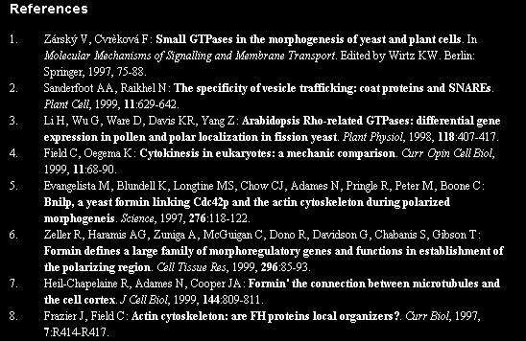
Research
Evidence is called “citations”

Slide 12
Research
  This is why we want as many citations as possible – it provides more evidence to prove our case!

Slide 13
Research
Uncertainty in research

Slide 14
Research
Uncertainty in research
hence statistics!

Slide 15
Research
Descriptive research

Slide 16
Research
Descriptive research
Describes a situation

Slide 17
Research
Exploratory research

Slide 18
Research
Exploratory research
Clarifies a situation

Slide 19
Research
Limitations?

Slide 20
Research
Limitations?
Time
Data
Money

Slide 21

Research
at Hershey Foods Corporation
For a company manufacturing food products, the ingredients are a major expense
http://c4.soap.com/images/products/p/zqb/zqb-22132_1z.jpg

Slide 22
To manufacture chocolate, the major ingredients are:
sugar
milk
cocoa

Slide 23
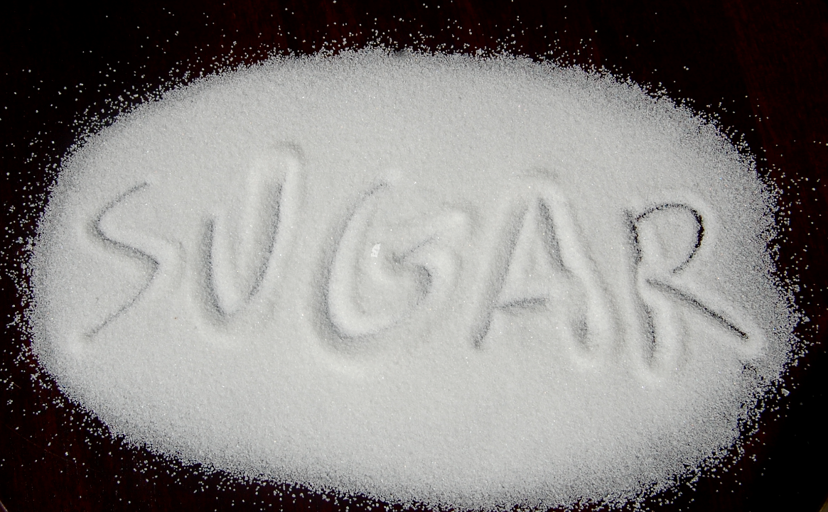
In the US, sugar is a protected commodity – producers receive a minimum price regardless of the true market conditions
http://sugarcane.org/global-policies/policies-in-the-united-states/sugar-in-the-united-states
http://www.foodnavigator.com/var/plain_site/storage/images/publications/food-beverage-nutrition/foodnavigator.com/science/sugar-science-fructose-more-toxic-than-sucrose-suggests-mouse-study/9571454-1-eng-GB/Sugar-science-Fructose-more-toxic-than-sucrose-suggests-mouse-study.jpg

Slide 24

Hershey’s has a contract with local dairy farmers to source milk from them – no opportunity for cost
savings
there
either!
http://newscontent.thaivisa.com/wp-content/uploads/2015/03/10091005/milk-cow-thailand.png

Slide 25
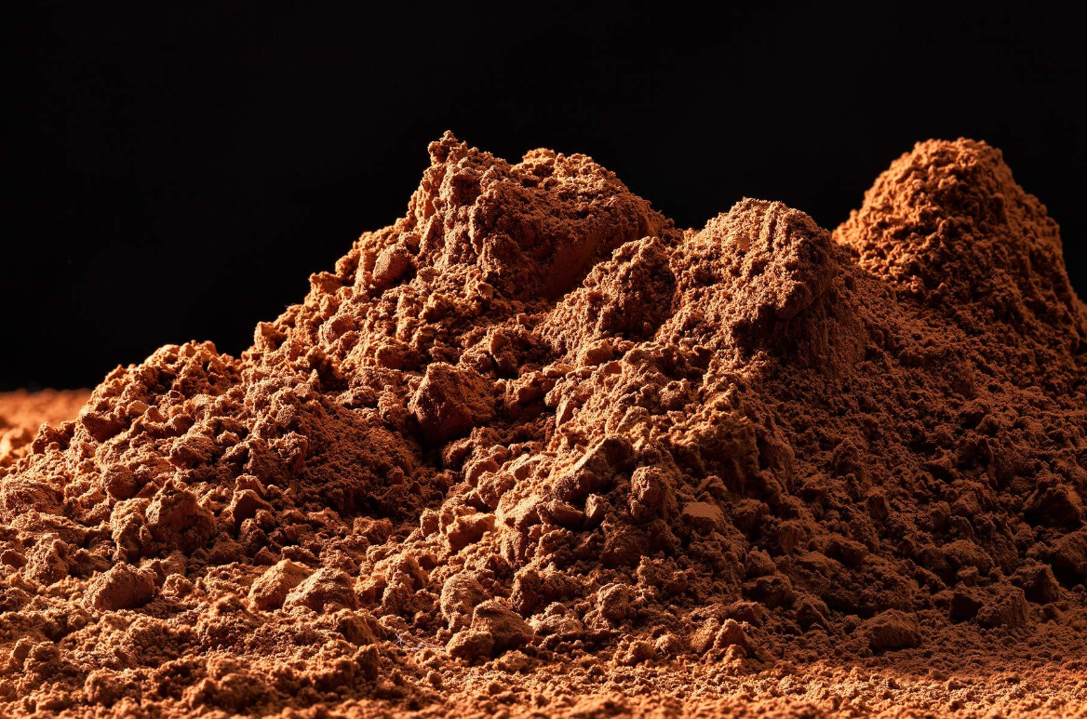
So… the only cost savings can come from cocoa
http://www.flaniganphotography.com/data/photos/193_1cocoapowder.jpg

Slide 26
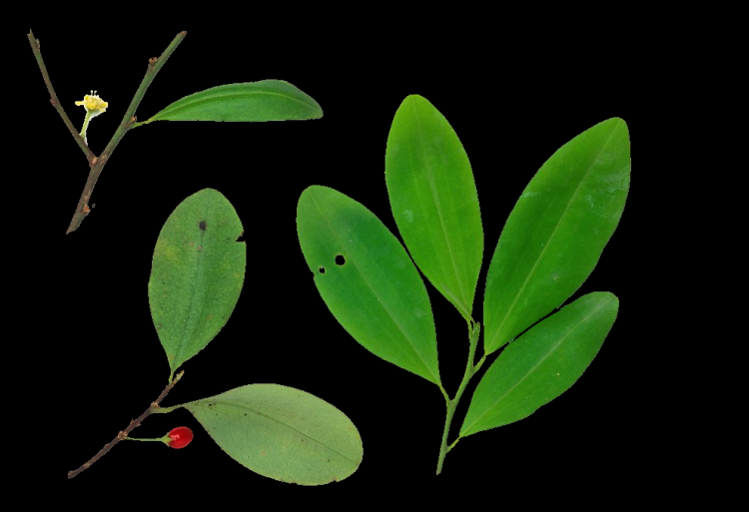
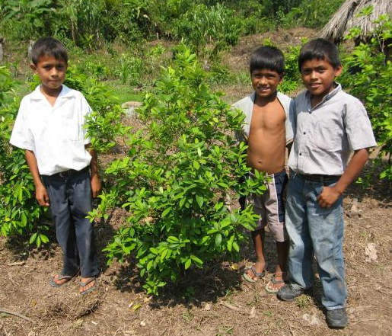
Cocoa… not coca
coca
http://rideforclimate.com/photos/main.php?g2_view=core.DownloadItem&g2_itemId=6105&g2_serialNumber=2
http://images.nationalgeographic.com/wpf/media-live/photos/000/548/cache/how-coca-plant-uses-cocaine_54857_990x742.jpg

Slide 27
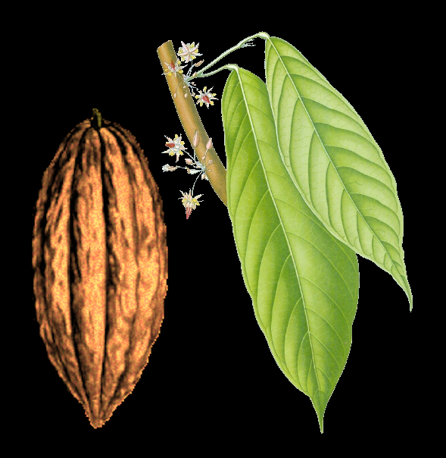
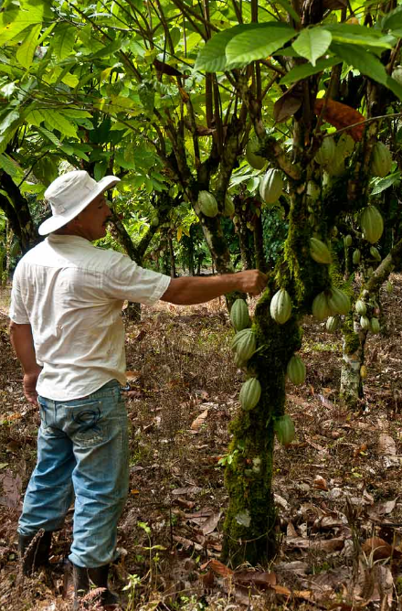
Cocoa… not coca
cocoa
http://www.farmcostarica.com/wp-content/uploads/2011/09/DSC_4643-copy.jpg
http://www.ibiblio.org/pub/docs/books/gutenberg/1/6/0/3/16035/16035-h/images/g020.jpg
http://vintageprintable.swivelchairmedia.com/wp-content/uploads/2011/05/Botanical-Kohlers-Mediznar-Pflanzen-Cacao.jpg

Slide 28
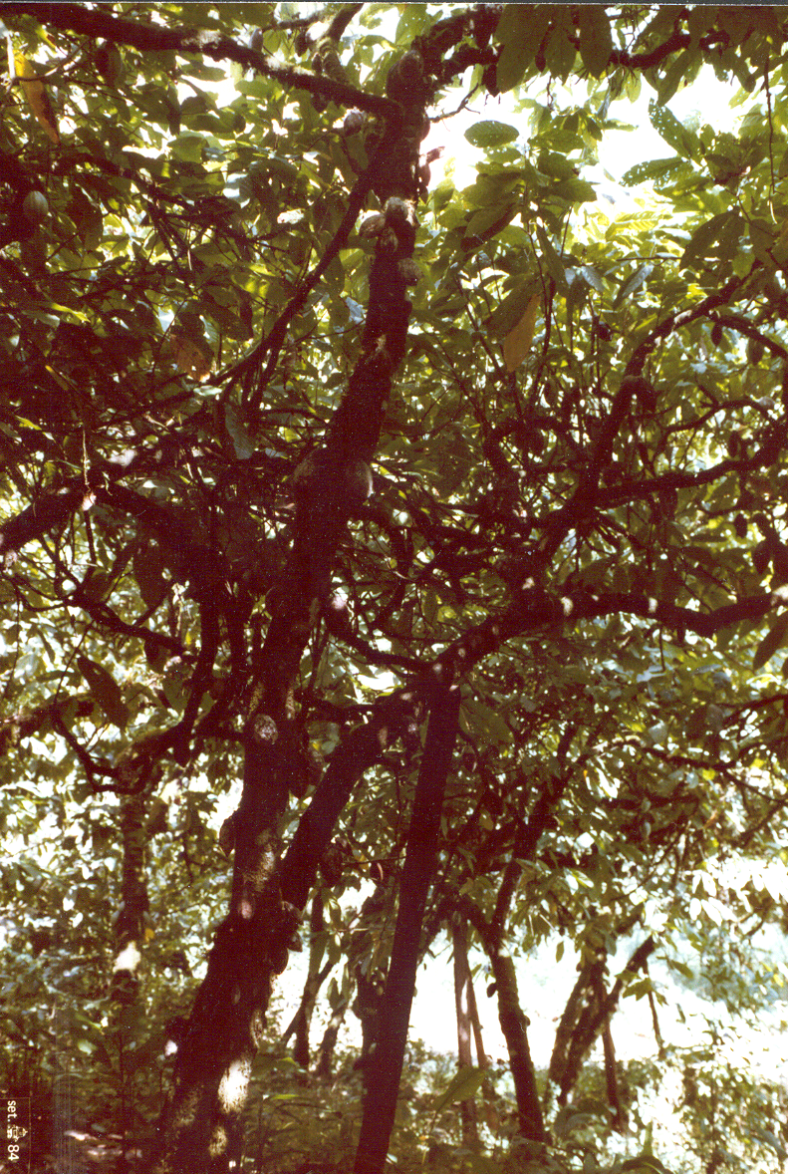
Cocoa plants
(Theobroma cacao)
are trees
French, 1990

Slide 29
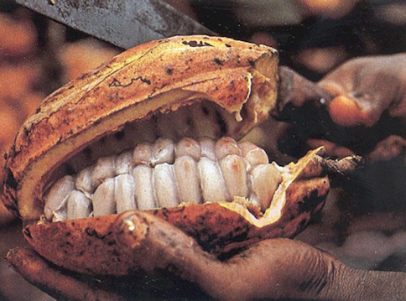
The cocoa comes from beans inside the pods
http://www.herbmuseum.ca/files/images/teeth%20cocao%20001.jpg

Slide 30
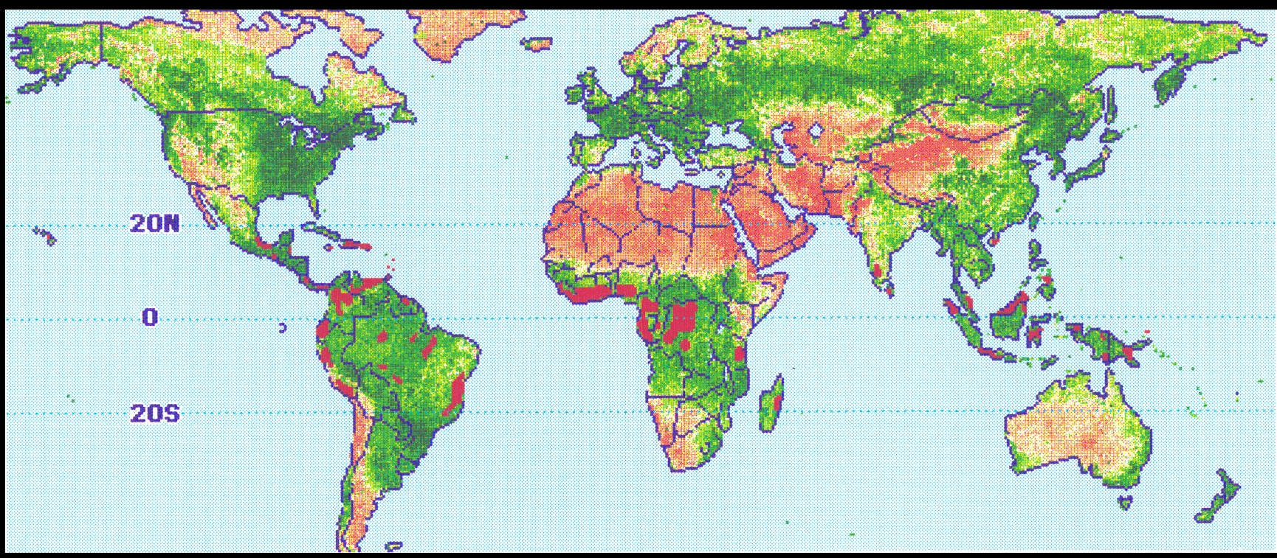
Cocoa grows only in the humid tropics
French, 1990

Slide 31
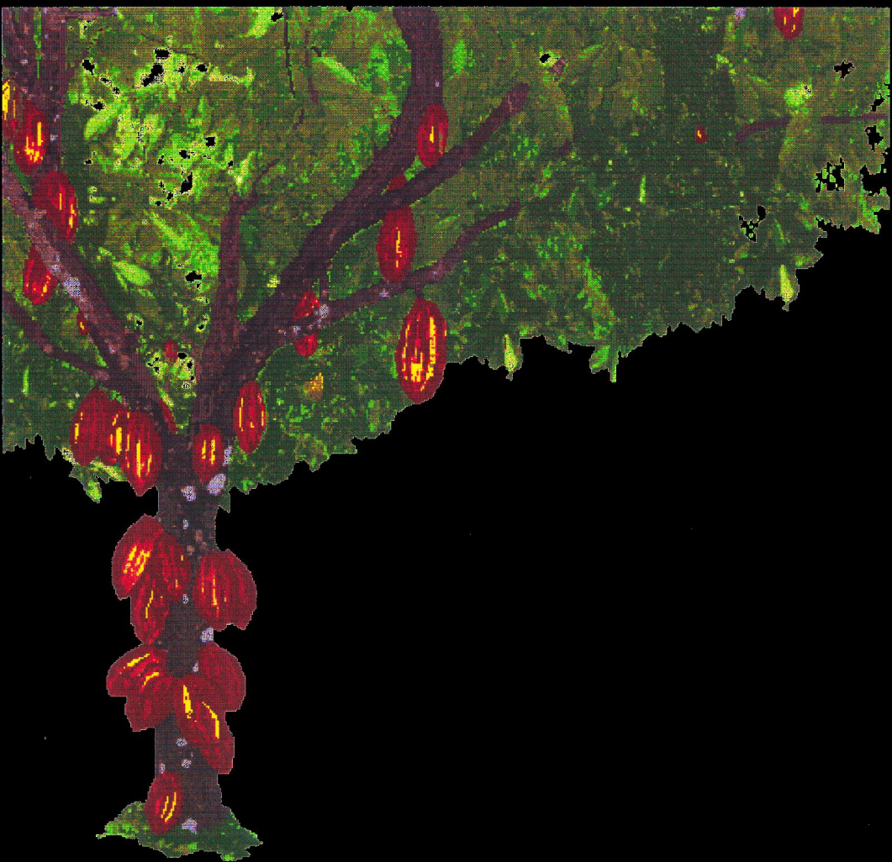

The average coca tree produces enough cocoa in a year to make 1 chocolate bar
French, 1990
http://c4.soap.com/images/products/p/zqb/zqb-22132_1z.jpg

Slide 32
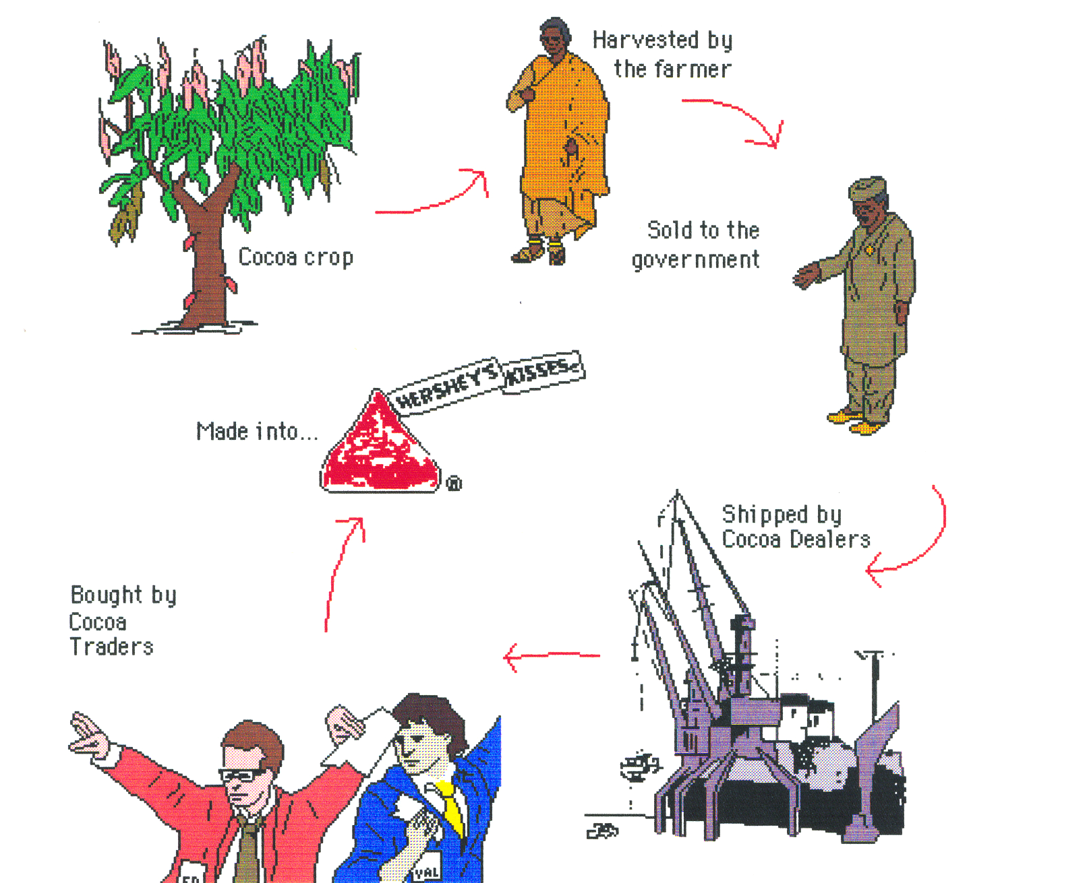
French, 1990

Slide 33
Commodities brokers and chocolate manufacturers need to know how much cocoa is going to be available in a given year

Slide 34
They employ “pod counters” to visit producing areas and monitor pod numbers and development to estimate world production

Slide 35
That worked well…

Slide 36
That worked well…
Until 1984/5

Slide 37
A nasty “El Niño” event caused world-wide drought

Slide 38
But…
there were lots of pods on the trees…
and the pods seemed to be developing normally…

Slide 39
It wasn’t until the first harvest that they discovered the pods had thicker shells than normal, and that the beans inside were fewer and smaller than usual

Slide 40
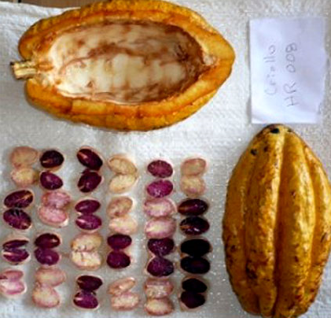
Inside each
pod are
typically
20-40 beans
http://inventorspot.com/files/blog1/pod2.jpg

Slide 41
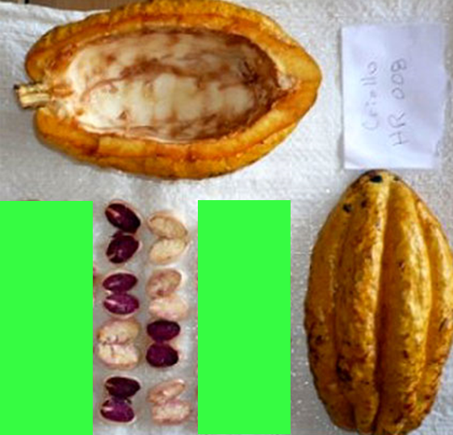
The 1985
harvest
averaged
5-20 beans
http://inventorspot.com/files/blog1/pod2.jpg

Slide 42
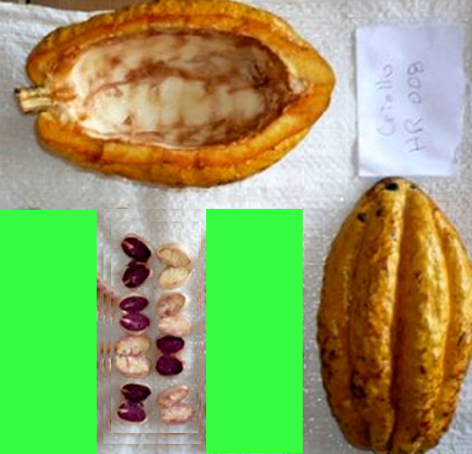
… and they
were
smaller …
http://inventorspot.com/files/blog1/pod2.jpg

Slide 43
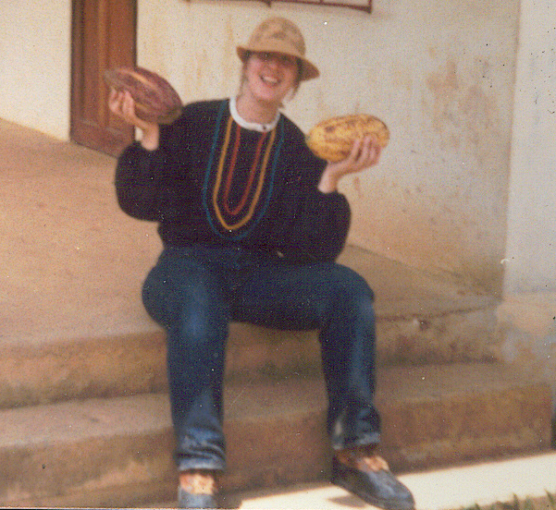
Everybody hired an agroclimatologist to come up with a way
to forecast
harvest
based on
weather
French, 1990

Slide 44
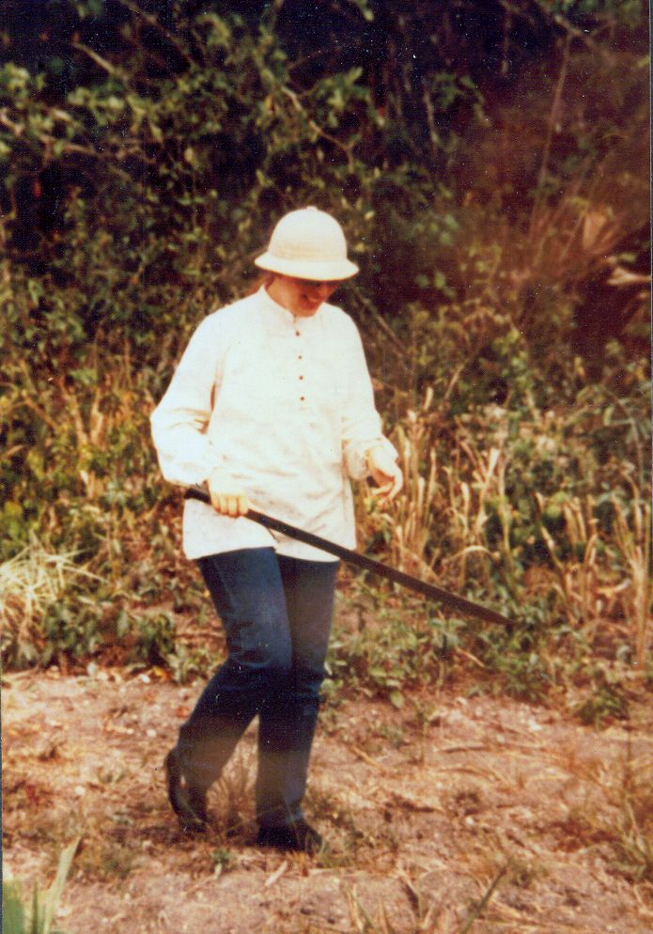
My job:
to find
out how cocoa
grows
to create
a mathematical
model
to forecast
global cocoa
production
French, 1990

Slide 45
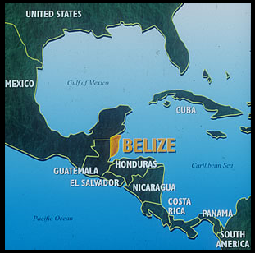
A Research Project
Hershey Foods Corporation owned
a cocoa farm in Belize 1980-1991
It was used to research cocoa farming, processing
and cocoa biology
http://www.belizefishfinder.com/central-america-map.jpg

Slide 46
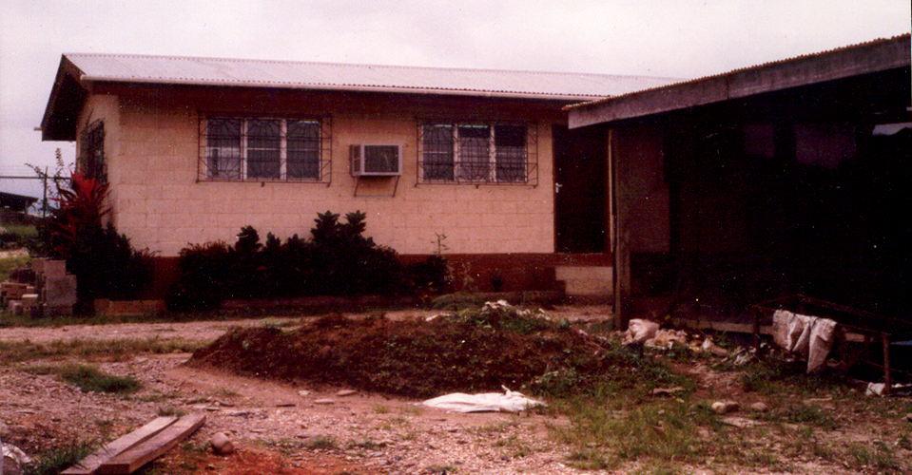
Hershey Hummingbird Farm research lab
French, 1990

Slide 47
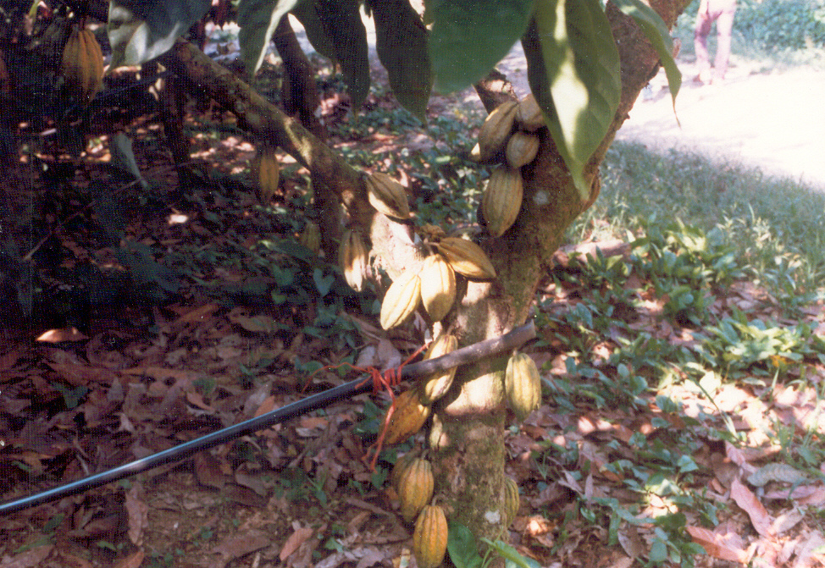
A previous team had been doing an irrigation project
French, 1990

Slide 48
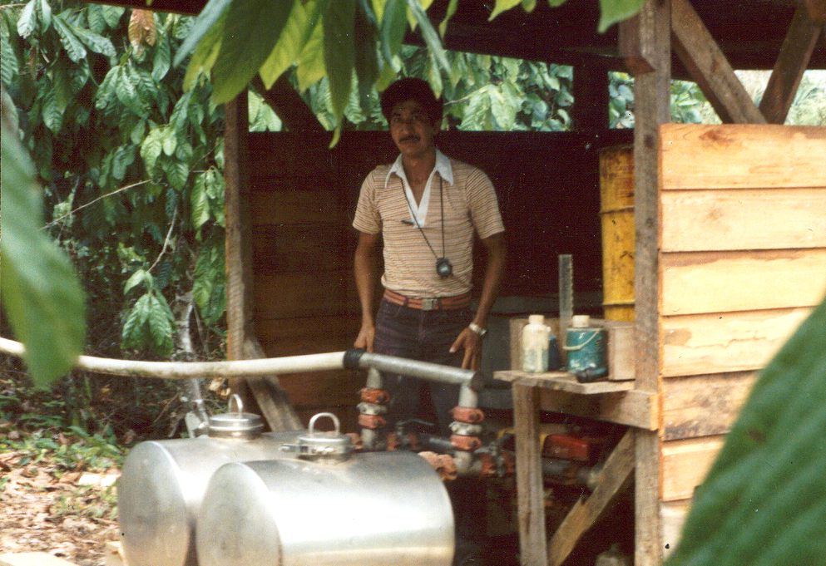
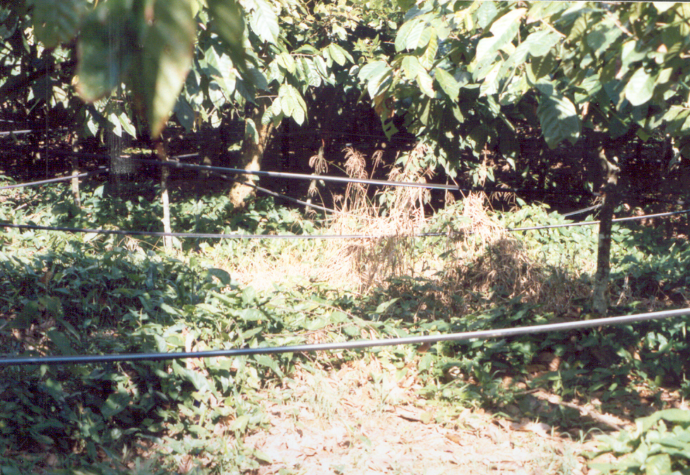
French, 1990

Slide 49
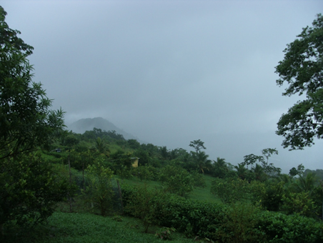
But… in Belize it’s never dry enough for the trees to need irrigation
http://2.bp.blogspot.com/-rAFFrpCjBEs/UHhYCOWLXXI/AAAAAAAAEUo/5iI2-ejbxDE/s1600/003.JPG

Slide 50
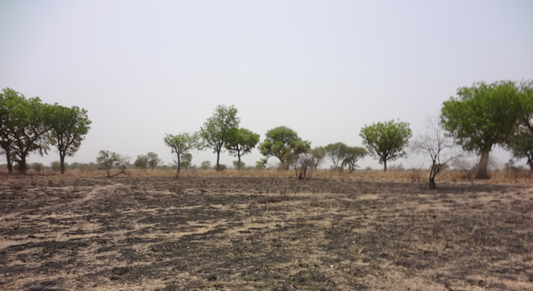
In West Africa (where most cocoa grows) it IS dry 4 months out if the year
https://mydevelopmentdiary.files.wordpress.com/2012/02/landscape.jpg

Slide 51
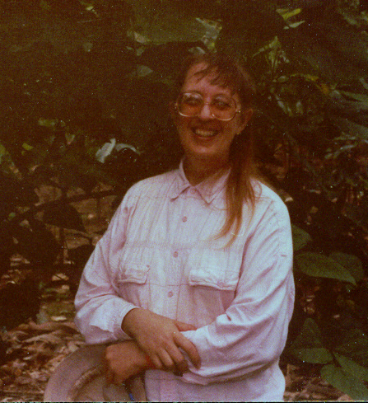
So, I need to duplicate dry African conditions in a rainforest…
French, 1990

Slide 52

HOW?

Slide 53
How about putting the trees in a box?

Slide 54
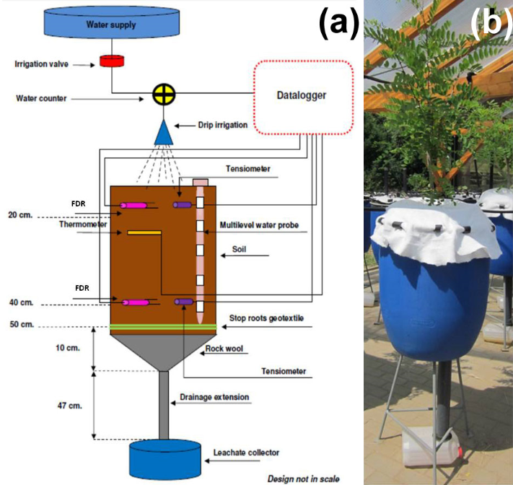
That’s actually what we did:
a lysimeter
http://www.sisef.it/iforest/papers/2013/Mantovani_100@image001.jpg

Slide 55
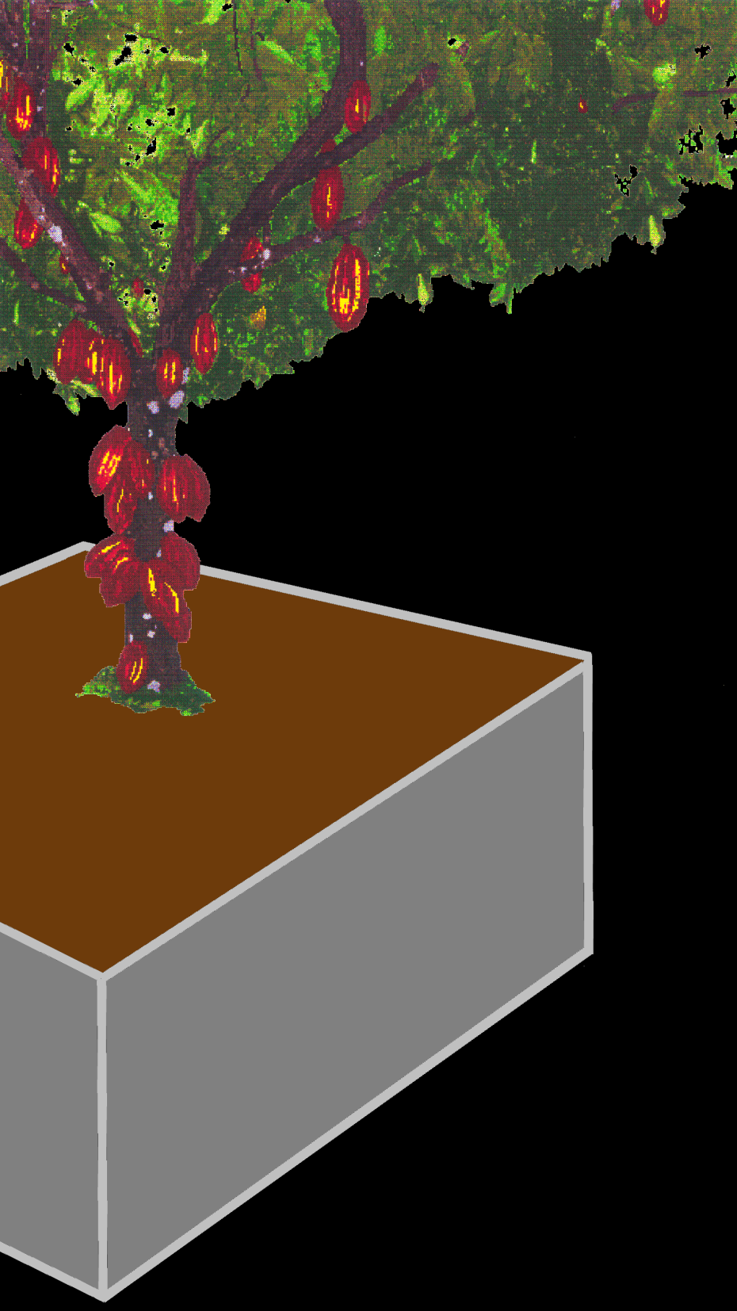
Our lysimeter was built around the trees in the ground
The roots are not deep (only about a foot), so we didn’t need to seal the bottom
French, 1990

Slide 56
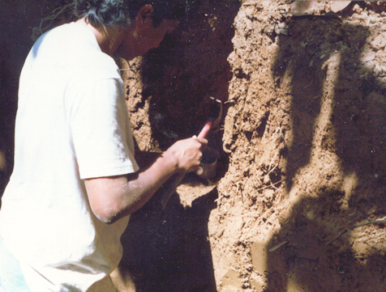
First we dug trenches around the trees
French, 1990

Slide 57
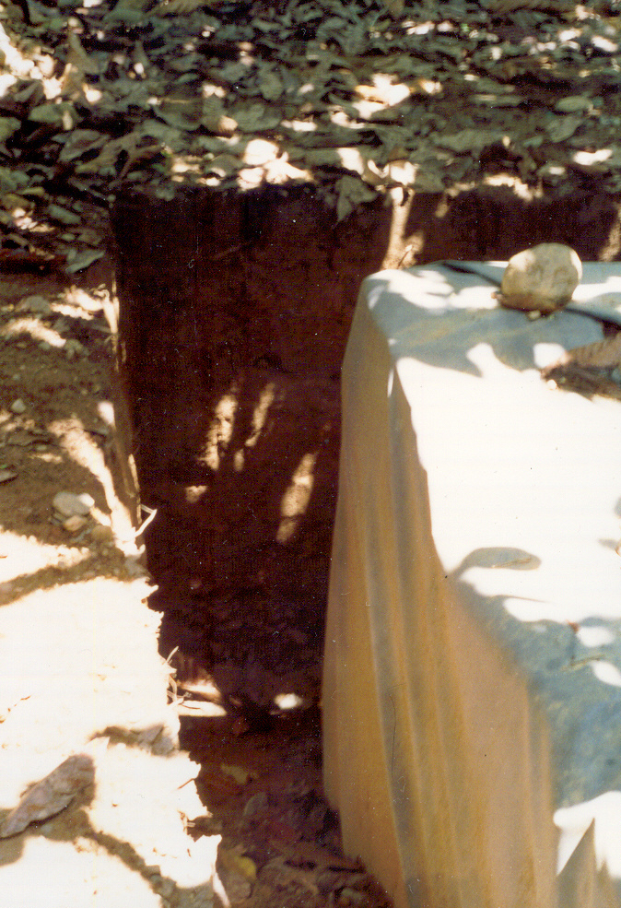
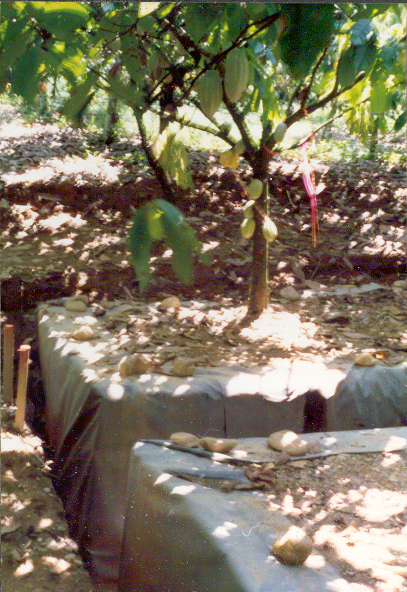
The walls of the trenches were covered with thick plastic
French, 1990

Slide 58
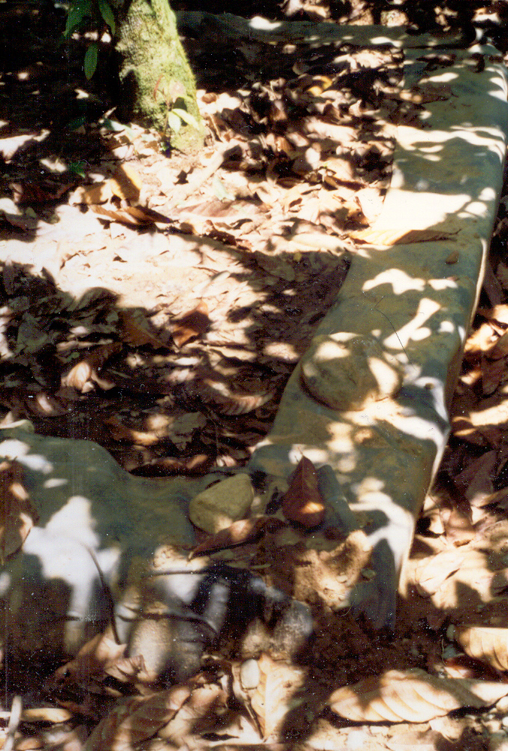
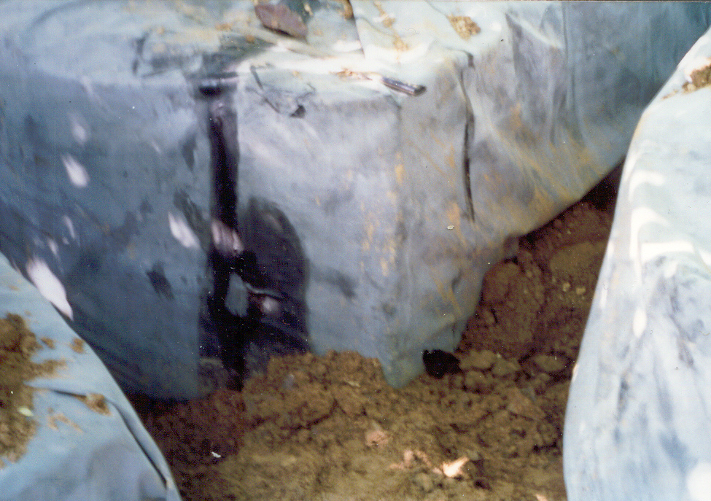
The trenches were refilled with soil
French, 1990

Slide 59
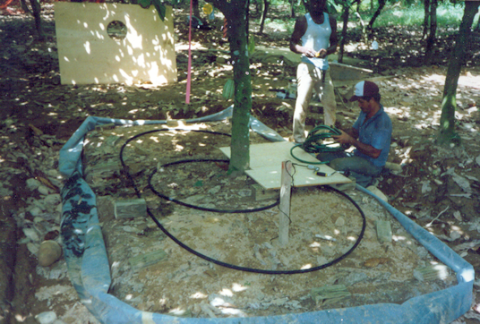
Soaker hoses were put under the lid
French, 1990

Slide 60
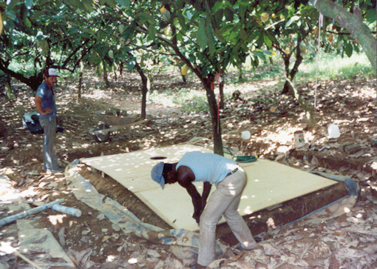
The top of the box was installed
French, 1990

Slide 61
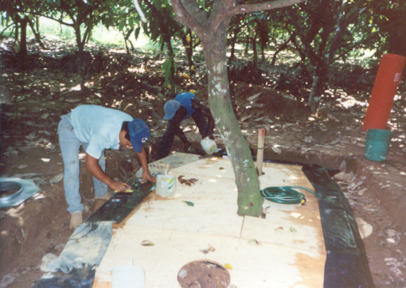
The top was sealed
French, 1990

Slide 62
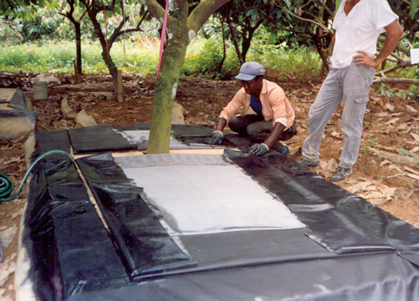
And covered with the plastic
French, 1990

Slide 63
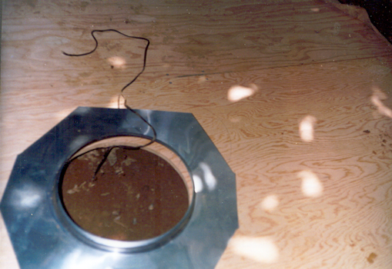
Holes were left for ventilation and access for soil moisture measurements
French, 1990

Slide 64
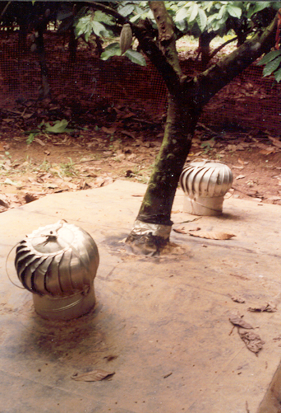
Ventilators covered the holes
French, 1990

Slide 65
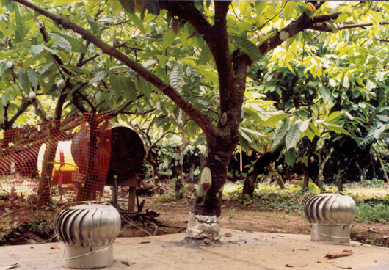
Fences around the trees alert farm workers to leave this one alone!
French, 1990

Slide 66
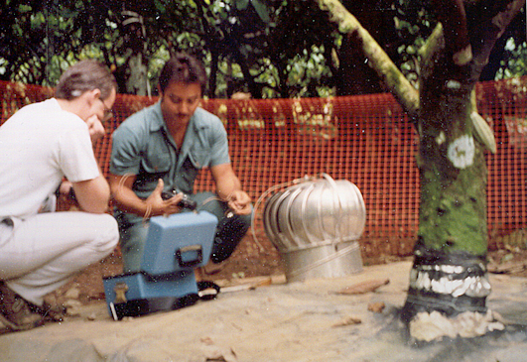
Weekly measurements of soil moisture were taken
French, 1990

Slide 67
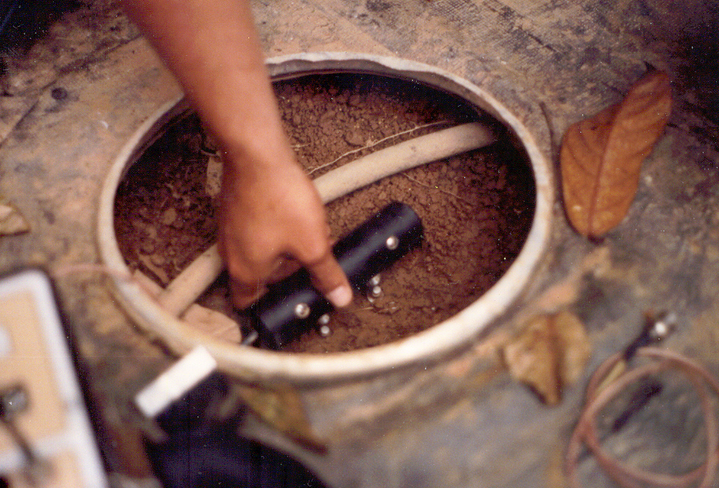
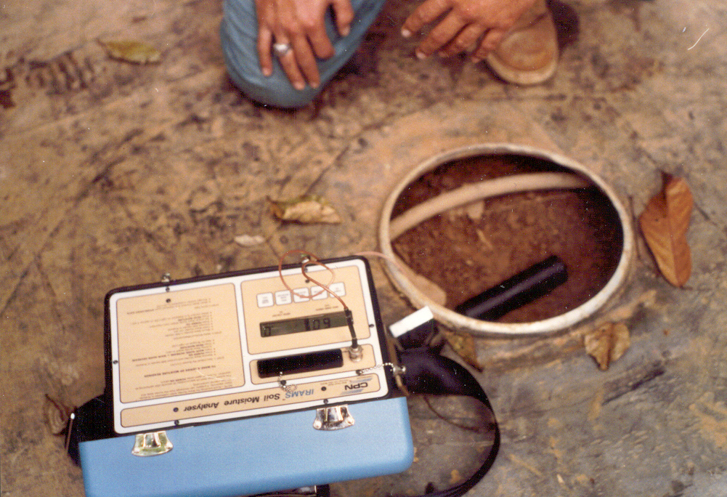
6-foot probes measured soil moisture levels
French, 1990

Slide 68
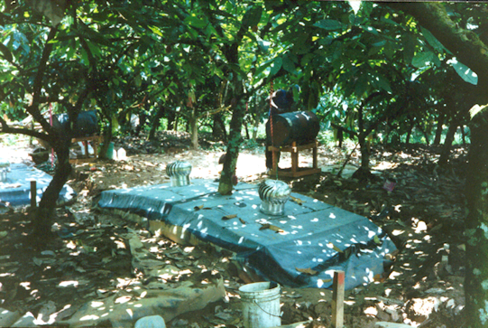
A measured amount of water was provided weekly from a drum
French, 1990

Slide 69
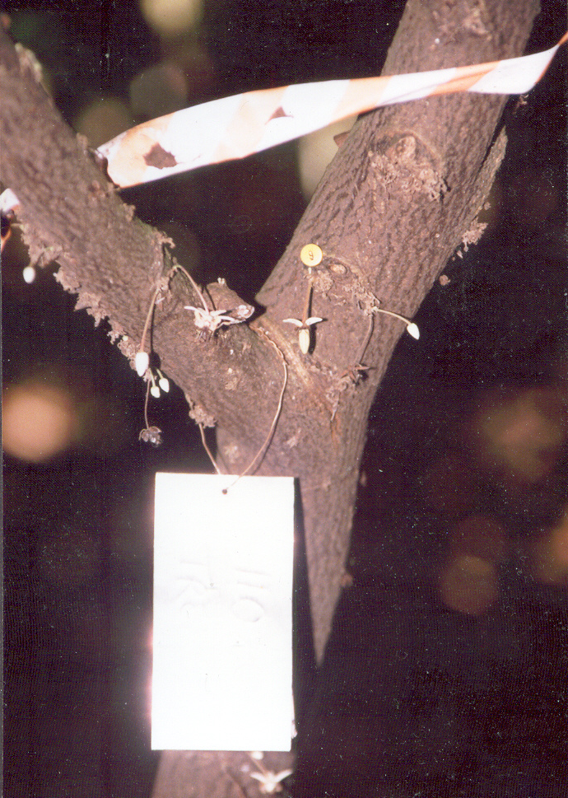
The trees are numbered and marked with metal tags
French, 1990

Slide 70
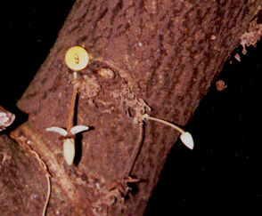
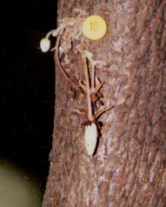
As pods are set, they are also numbered and marked so their development can be tracked
French, 1990

Slide 71
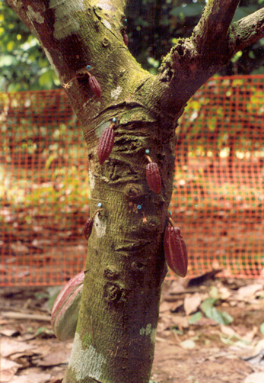
Pod development
is recorded
monthly
French, 1990

Slide 72
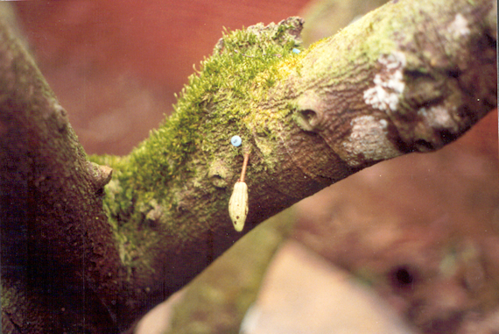
Sometimes they don’t make it…
French, 1990

Slide 73
When tracked pods are ripe, they are harvested and taken to the lab

Slide 74
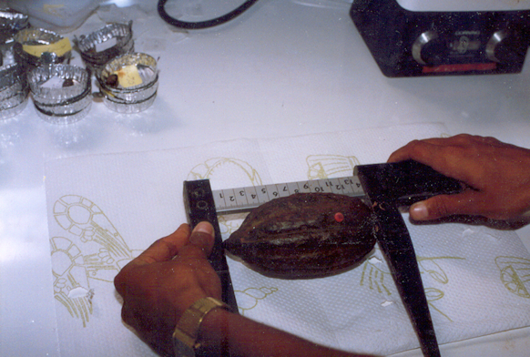
We measured their length
French, 1990

Slide 75
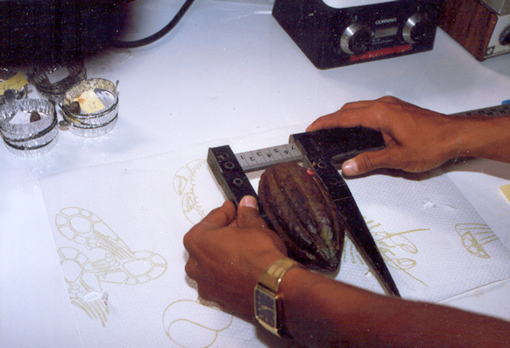
Diameter
French, 1990

Slide 76

And weight
French, 1990

Slide 77

Opening the pods
French, 1990

Slide 78

The number of beans is counted
French, 1990

Slide 79

The wet weight of the beans
French, 1990

Slide 80

The beans are dried in a microwave
French, 1990

Slide 81

The dry weight of the beans
Photoshopped because I lost the pic!
French, 1990

Slide 82

The lysimeter team
French, 1990

Slide 83
The results allowed me to create my mathematical model
It worked so well…

Slide 84
… that they didn’t need an agroclimatologist any more…

Slide 85
… and they didn’t need the Belize research farm, either!

Slide 86

Now the farm is a popular attraction for eco-tourism
http://chocolopolis.blogspot.com/2014/07/a-visit-to-hummingbird-farm-in-belize.html

Slide 87
Questions?

Slide 88

In-class Project
You survived!
Have a great
break!

