Slide 1
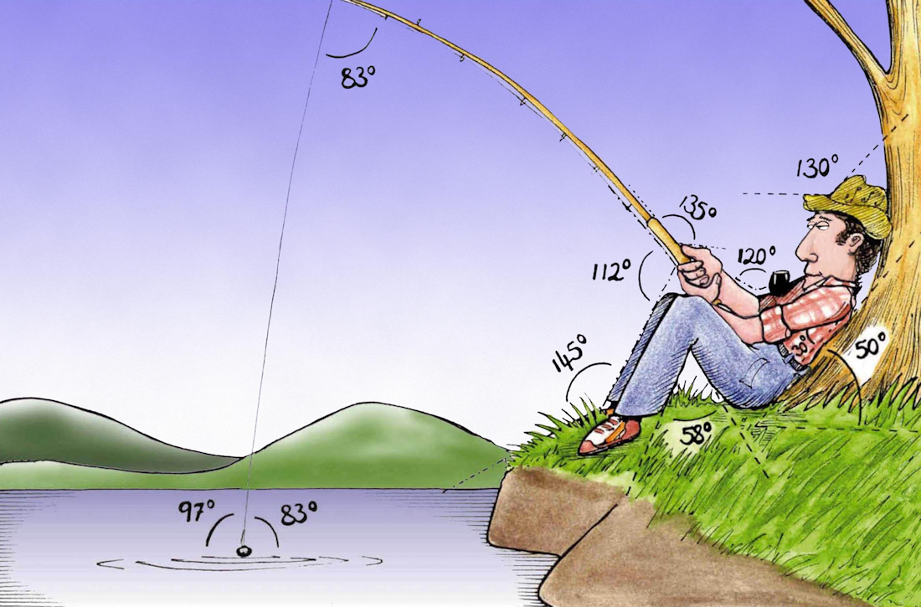
Welcome to
Week 1!
Analytic Trigonometry
http://www.lab-initio.com/images/fullsize/nz211.jpg

Slide 2
What’s Up?
Today we will be going over:
Info for the class
Angles
Triangles

Slide 3
Trigonometry?
What is trigonometry?

Slide 4
Trigonometry?
Tri means three
Gon means sides
Ometry means measurement

Slide 5
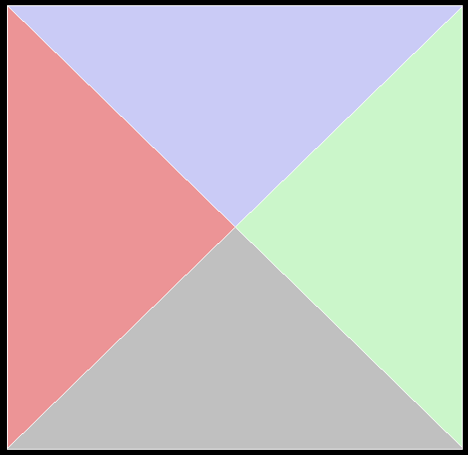
Trigonometry?
Originated with the Egyptians
VFrench, 2015

Slide 6
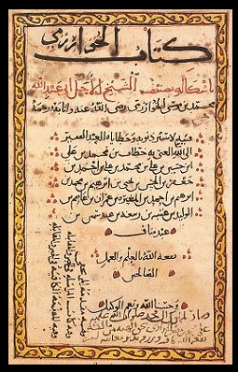
Trigonometry?
Arabic Trigonometry was developed in order to
observe holy days on
the correct days in
all parts of the
Islamic world
https://upload.wikimedia.org/wikipedia/commons/thumb/2/23/Image-Al-Kit%C4%81b_al-mu%E1%B8%ABta%E1%B9%A3ar_f%C4%AB_%E1%B8%A5is%C4%81b_al-%C4%9Fabr_wa-l-muq%C4%81bala.jpg/220px-Image-Al-Kit%C4%81b_al-mu%E1%B8%ABta%E1%B9%A3ar_f%C4%AB_%E1%B8%A5is%C4%81b_al-%C4%9Fabr_wa-l-muq%C4%81bala.jpg

Slide 7
Trigonometry?
There was also a need for non-navigators to be able
to travel to Mecca
each year and return successfully
https://upload.wikimedia.org/wikipedia/commons/thumb/2/23/Image-Al-Kit%C4%81b_al-mu%E1%B8%ABta%E1%B9%A3ar_f%C4%AB_%E1%B8%A5is%C4%81b_al-%C4%9Fabr_wa-l-muq%C4%81bala.jpg/220px-Image-Al-Kit%C4%81b_al-mu%E1%B8%ABta%E1%B9%A3ar_f%C4%AB_%E1%B8%A5is%C4%81b_al-%C4%9Fabr_wa-l-muq%C4%81bala.jpg

Slide 8
Trigonometry?
In the early 9th century AD, Muhammad ibn Mūsā
al-Khwārizmī wrote
the first modern
trig book
(blame him…)
https://upload.wikimedia.org/wikipedia/commons/thumb/2/23/Image-Al-Kit%C4%81b_al-mu%E1%B8%ABta%E1%B9%A3ar_f%C4%AB_%E1%B8%A5is%C4%81b_al-%C4%9Fabr_wa-l-muq%C4%81bala.jpg/220px-Image-Al-Kit%C4%81b_al-mu%E1%B8%ABta%E1%B9%A3ar_f%C4%AB_%E1%B8%A5is%C4%81b_al-%C4%9Fabr_wa-l-muq%C4%81bala.jpg

Slide 9
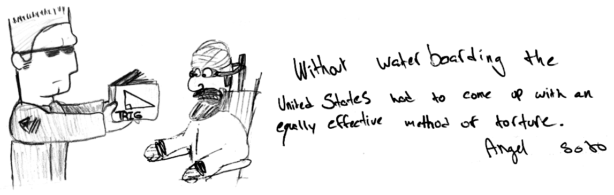

Slide 10
Trigonometry?
The trig functions we study in this class are needed in most formulas used to describe how our complicated universe works

Slide 11
Trigonometry?
astronomy
banking
electronics
biology
atoms
forensics
construction
...

Slide 12
Trigonometry!
At last!
Something USEFUL!!!

Slide 13
Trigonometry
The most useful things about trigonometry is its use in predicting cyclical events

Slide 14
Trigonometry
The most useful things about trigonometry is its use in predicting cyclical events…
More about that later!

Slide 15

Questions?
www.career.gatech.edu

Slide 16
Angles
To study triangles, let’s start with one corner:
an angle

Slide 17
Angles
A ray is half of a line
it has an origin
the other end stretches
on forever
origin

Slide 18

Sun rays
http://wolftoothpromotion.yolasite.com/resources/sun-rays-coming-out-of-the-clouds-in-a-blue-sky.jpg

Slide 19
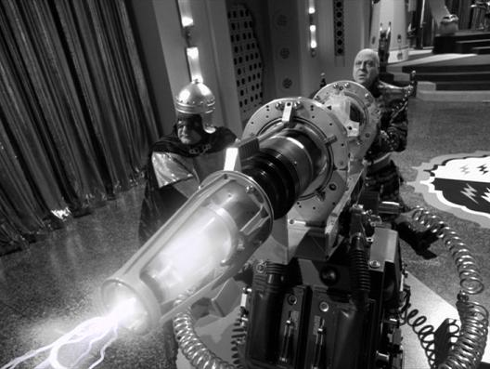
Death rays
https://www.dkn.tv/wp-content/uploads/2018/05/sung-hien-dai.jpg

Slide 20
Angles
Real-life death rays:
UVC rays (254 nm)
x-rays (1 pm)
gamma (“y”) rays (100 pm)
cosmic rays (particles)

Slide 21
Angles
If two rays start at the same
origin, they form an “angle”

Slide 22
Angles
Their point of common origin is called the “vertex”
vertex

Slide 23
Angles
Angles are usually represented by lowercase Greek letters:
α, β, θ
θ

Slide 24
Angles
Angles have an
initial (beginning) side and a
terminal (ending) side
terminal
θ
initial

Slide 25
Angles
The “standard position” for an angle: vertex at origin and initial side along x-axis
θ
x
(0,0)

Slide 26
Angles
Positive angles - counterclockwise rotation from initial side
θ

Slide 27
Angles
Negative angles - clockwise rotation from initial side
θ

Slide 28
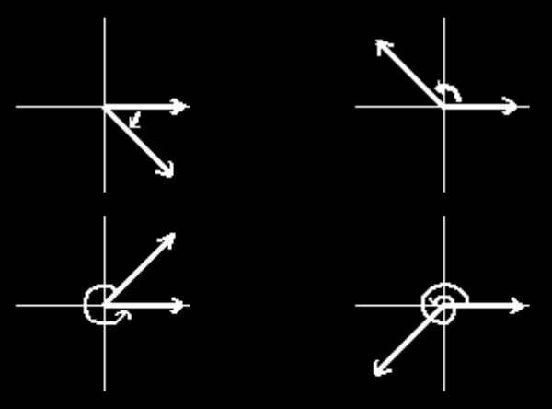
ANGLES
IN-CLASS PROBLEM 1
Which of the following graphs represent negative angles?
a
b
c
d
VFrench, 2015

Slide 29
Questions?
www.career.gatech.edu

Slide 30
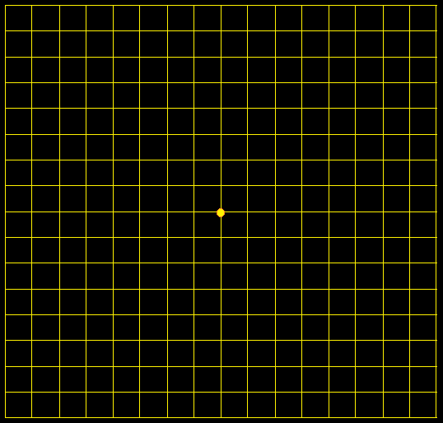
Angles
Remember graph paper?
VFrench, 2015

Slide 31
Angles
Graph paper is made of angles:
VFrench, 2015

Slide 32
Angles
Graph paper is
split into 4
quadrants:
VFrench, 2015

Slide 33
Angles
The quadrants move counterclockwise
around the grid
just like positive
angles
II
I
III
IV
VFrench, 2015

Slide 34
Angles
An angle with a terminal side in a quadrant
"lies" in that
quadrant
II
I
III
IV
VFrench, 2015

Slide 35
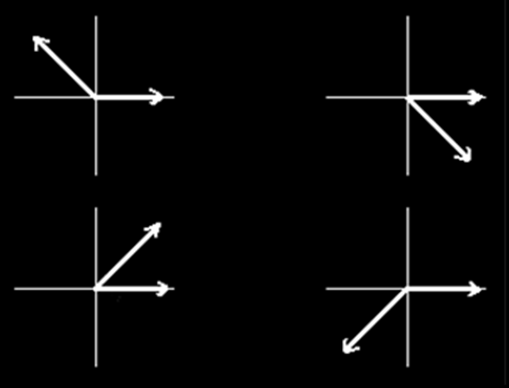
ANGLES
IN-CLASS PROBLEMS 2,3
Which quadrant does each angle lie?
a
b
c
d
VFrench, 2015

Slide 36
Angles
An angle with a terminal side along any axis is called “quadrantal”

Slide 37
Questions?
www.career.gatech.edu

Slide 38
Angles
Angles are measure by determining the amount of rotation from the initial side to the terminal side
θ

Slide 39
Angles
A degree, symbolized by ° measures angles
23°
θ

Slide 40

ANGLES
IN-CLASS PROBLEM 4
Which of the graphs represents the angle θ = –45º in standard position?
a
b
c
d
VFrench, 2015

Slide 41
Angles
Types of angles:
Acute angles 0º< θ < 90º
θ
VFrench, 2015

Slide 42
Angles
Types of angles:
Obtuse angles 90º< θ < 180º
θ
VFrench, 2015

Slide 43
Angles
Types of angles:
Right angles θ = 90º
Notice: it has its own symbol!
VFrench, 2015

Slide 44
Angles
Types of angles:
Straight angles θ = 180º
θ
VFrench, 2015

Slide 45
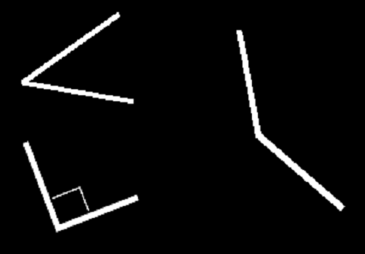
ANGLES
IN-CLASS PROBLEMS 5,6,7
Classify the angle:
5
6
7
VFrench, 2015

Slide 46
ANGLES
IN-CLASS PROBLEM 8
Classify the angle:
168º
42º
90º
180º
1º
263º

Slide 47
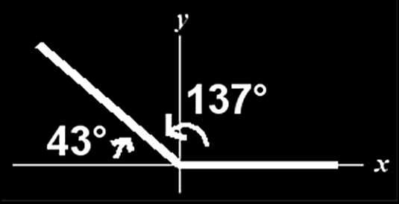
Angles
A “reference angle” is a positive acute angle θ° formed by the terminal side of a nonacute angle θ and the x-axis
VFrench, 2015

Slide 48
ANGLES
IN-CLASS PROBLEM 9
Which is the reference angle?
VFrench, 2015

Slide 49
ANGLES
IN-CLASS PROBLEM 10
Co-terminal angle θ ± k•360°
Which angle is co-terminal to 275º?
a) 85º b) –85º
c) –55º d) 55º

Slide 50
ANGLES
IN-CLASS PROBLEM 12
Complementary - two positive angles whose sum = 90°
Find the complementary angle to 32º
a) 148º b) –32º
c) 328º d) 58º

Slide 51
ANGLES
IN-CLASS PROBLEM 13
Supplementary - two positive angles whose sum = 180°
Find the supplementary angle to 32º:
a) 148º b) –32º
c) 328º d) 58º

Slide 52
ANGLES
IN-CLASS PROBLEM 14
Explementary - two positive angles whose sum = 360°
Find the explementary angle to 32º:
a) 148º b) –32º
c) 328º d) 58º

Slide 53
Questions?
www.career.gatech.edu

Slide 54
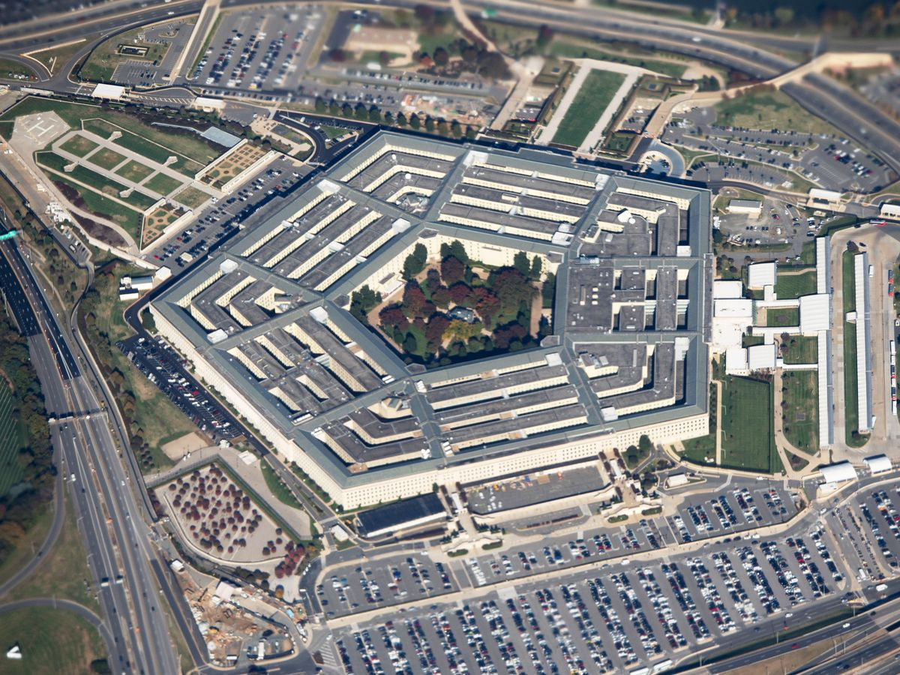
N-gons
What is a five-sided closed figure called?
https://www.bloomberg.com/news/articles/2020-01-22/pentagon-racks-up-35-trillion-in-accounting-changes-in-one-year

Slide 55
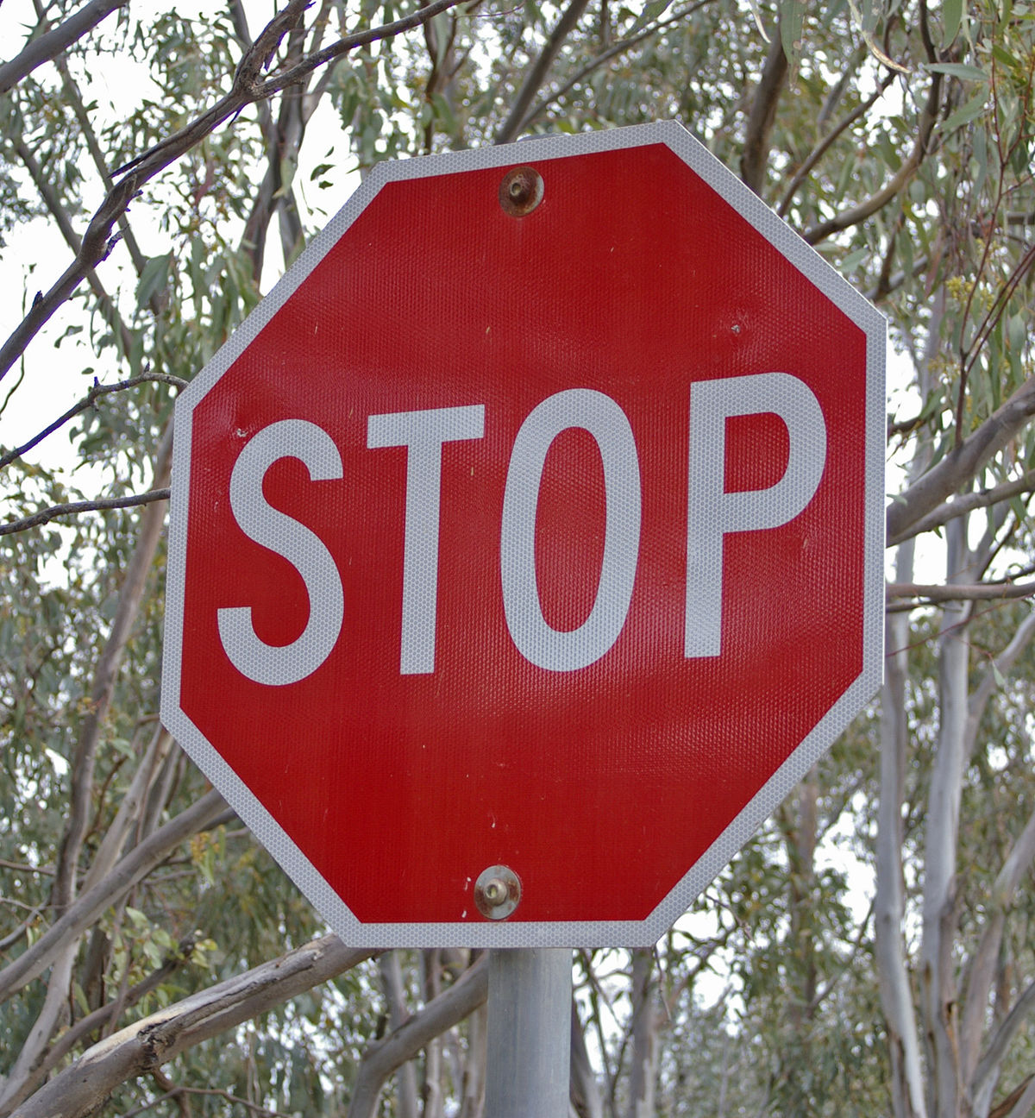
N-gons
What is an eight-sided closed figure called?
https://en.wikipedia.org/wiki/Stop_sign

Slide 56
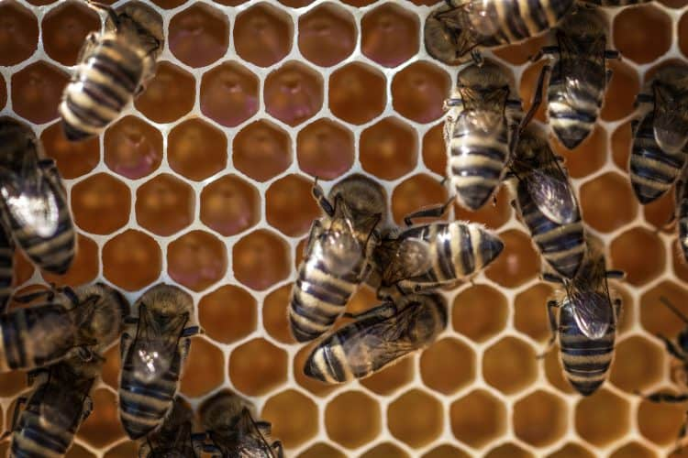
N-gons
What is a six-sided closed figure called?
https://schoolofbees.com/how-do-bees-make-hexagons/

Slide 57
N-gons
In general, closed many-sided figures are called…

Slide 58
N-gons
In general, closed many-sided figures are called…
polygons

Slide 59
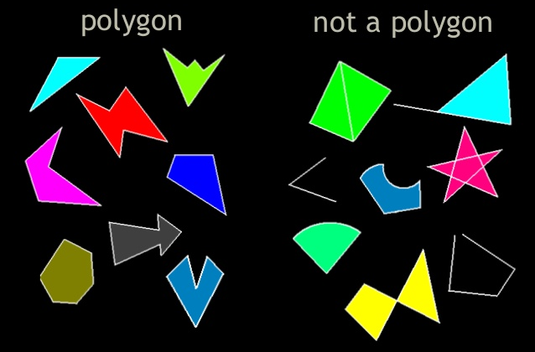
N-gons
https://www.tes.com/lessons/VS9sZArC4JlDnQ/3-g-1-polygons-play

Slide 60
N-GONS
IN-CLASS PROBLEM 15
A closed polygon with three sides is called _______

Slide 61
N-Gons
A triangle!
VFrench, 2015

Slide 62
N-Gons
It should be called a “tri-gon”!
VFrench, 2015

Slide 63
N-Gons
The ancient Greeks were interested in triangles because they are the polygons with the least number of sides

Slide 64
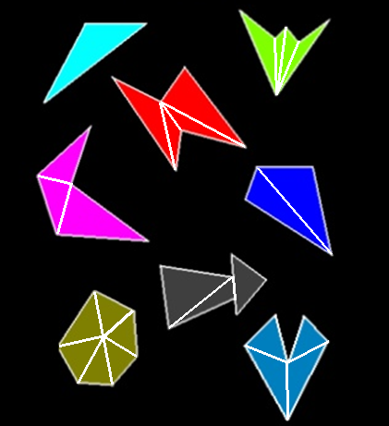
N-Gons
They can be
used to build
any other
polygon

Slide 65
N-Gons
So they can be used to build generalizations about larger figures

Slide 66
Questions?
www.career.gatech.edu

Slide 67
Triangles
The angles of a triangle must add up to 180º

Slide 68
TRIANGLES
IN-CLASS PROBLEM 16
Find θ
25º
15º
θ
18º
θ
50º
VFrench, 2015

Slide 69
Questions?
www.career.gatech.edu

Slide 70
Triangles
Types of triangles:
If all the sides are equal in length, what is
it called?
VFrench, 2015

Slide 71
Triangles
Types of triangles:
If all the sides are equal in length, what is
it called?
An equilateral
triangle
VFrench, 2015

Slide 72
Triangles
Types of triangles:
If two sides are equal in length, what is it called?
VFrench, 2015

Slide 73
Triangles
Types of triangles:
If two sides are equal in length, what is it called?
an isosceles
triangle
VFrench, 2015

Slide 74
Triangles
Types of triangles:
If no sides are equal in length, what is it called?
VFrench, 2015

Slide 75
Triangles
Types of triangles:
If two sides are equal in length, what is it called?
a scalene
triangle
VFrench, 2015

Slide 76
Triangles
Types of triangles:
If all the angles in the triangle are acute, what is it called?
VFrench, 2015

Slide 77
Triangles
Types of triangles:
If all the angles in the triangle are acute, what is it called?
an acute
triangle
VFrench, 2015

Slide 78
Triangles
Types of triangles:
If one of the angles in the triangle is obtuse, what is it called?
VFrench, 2015

Slide 79
Triangles
Types of triangles:
If one of the angles in the triangle is obtuse, what is it called?
an obtuse
triangle
VFrench, 2015

Slide 80
TRIANGLES
IN-CLASS PROBLEM 17
If it contains a right angle, what is it called?
VFrench, 2015

Slide 81
TRIANGLES
IN-CLASS PROBLEM 17
A “right triangle”
VFrench, 2015

Slide 82
TRIANGLES
IN-CLASS PROBLEM 18
What is the side opposite the right angle called in this polygon?
_________
VFrench, 2015

Slide 83
TRIANGLES
IN-CLASS PROBLEM 18
What is the side opposite the right angle called in this polygon?
hypotenuse
_________
VFrench, 2015

Slide 84
TRIANGLES
IN-CLASS PROBLEM 19
Given the lengths of two sides of a right triangle, you can calculate the third using ____
a² + b² = c²
B
Hypotenuse
c
a
Side opposite θ
θ
A
C
b
Side adjacent to θ
VFrench, 2015

Slide 85
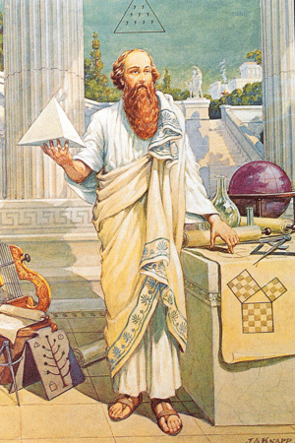
Right Angle Triangles
the Pythagorean Theorem
https://classicalwisdom.com/wp-content/uploads/2014/07/pythagoras-painting.jpg

Slide 86
RIGHT ANGLE TRIANGLES
IN-CLASS PROBLEM 20
Using: a² + b² = c²,
find the missing side:
a = 4 b = 3 c = _____
a = _____ b = 3 c = 5
a = 4 b = _____ c = 5
a = 6 b = 2 c = _____
a = 1 b = 2 c = _____
a = 2 b = 1 c = _____

Slide 87
Questions?
www.career.gatech.edu

Slide 88

You Survived!
Don’t forget
your Homework
due next week!
Have a great rest
of the week!
www.playbuzz.com

