Slide 1
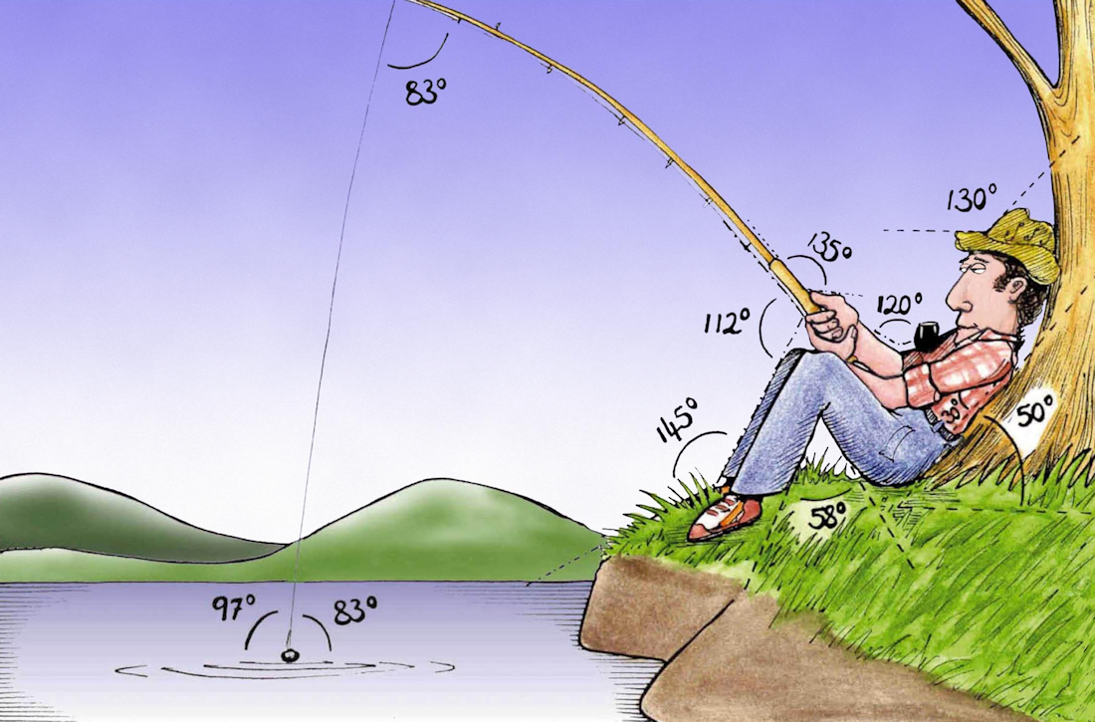
Welcome to
Week 2!
Analytic Trigonometry
http://www.lab-initio.com/images/fullsize/nz211.jpg

Slide 2
What’s Up?
Today we will be going over:
Review of angles and
triangles
Triangles in circles
Trigonometric functions

Slide 3
What’s Up?
Obj 1) Apply the six trigonometric functions to solve problems using degrees, right triangles and unit circles
Obj 2) State the exact values of trigonometric functions of special angles, and compute approximate values using technology
Obj 4) Apply trigonometric identities to simplify expressions and to solve equations

Slide 4

Review
www.hrexaminer.com

Slide 5
Angles
Positive angles - counterclockwise rotation from initial side
Negative angles - clockwise rotation from initial side
θ
θ
VFrench, 2015

Slide 6
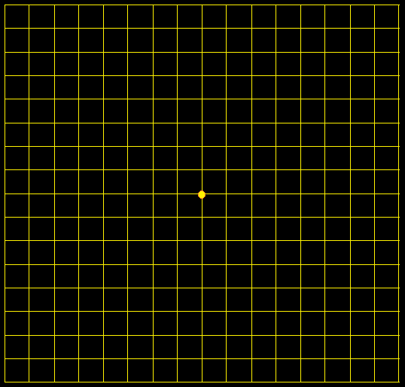
Angles
An angle with a terminal side in a quadrant
"lies" in that
quadrant
II
I
III
IV
VFrench, 2015

Slide 7
Angles
A degree, symbolized by ° measures angles
23°
θ
VFrench, 2015

Slide 8
Angles
Types of angles:
Acute angles 0º< θ < 90º
Right angles θ = 90º
Obtuse angles 90º< θ < 180º
Straight angles θ = 180º
θ
θ
θ
θ
VFrench, 2015

Slide 9
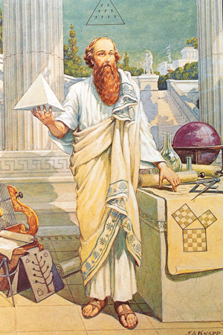
Triangles
Pythagorean Theorem
https://classicalwisdom.com/wp-content/uploads/2014/07/pythagoras-painting.jpg

Slide 10
Triangles
Based on a right triangle:
a² + b² = c²
B
Hypotenuse
c
a
Side opposite θ
θ
A
C
b
Side adjacent to θ
VFrench, 2015

Slide 11
Angles and Triangles
Any questions on the Homework Problems?

Slide 12
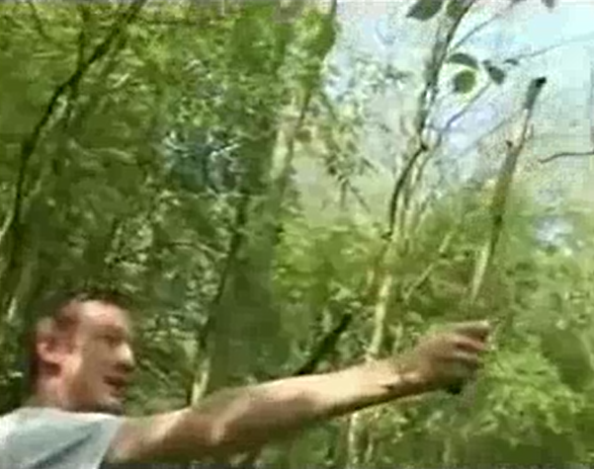
TRIGONOMETRY DISCUSSION
IN-CLASS PROBLEM 1
Tell me about how the "Stick Method" works to find the height of a tree
Markus Eichhorn. University of Nottingham. 2008

Slide 13
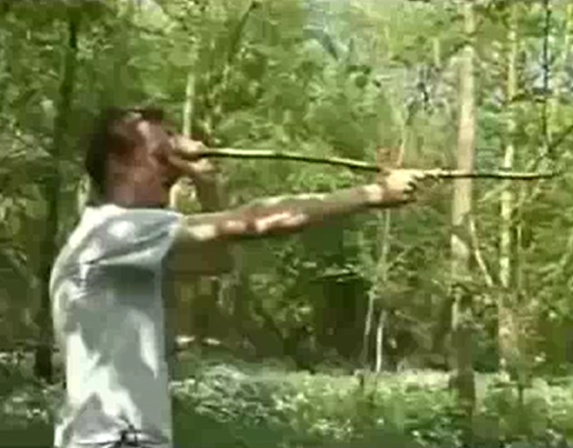
TRIGONOMETRY DISCUSSION
IN-CLASS PROBLEM 1
Tell me about how the "Stick Method" works to find the height of a tree
“a”
“hypotenuse”
“a”
“a”
“a”
Markus Eichhorn. University of Nottingham. 2008

Slide 14
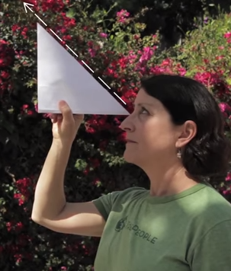
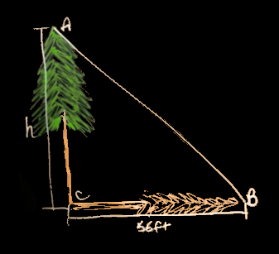
TRIGONOMETRY DISCUSSION
IN-CLASS PROBLEM 1
Tell me about how the "Stick Method" works to find the height of a tree
https://www.youtube.com/watch?v=qq9-k_J1zdg
https://www.youtube.com/watch?v=fw7OnimBtpE

Slide 15
TRIGONOMETRY DISCUSSION
IN-CLASS PROBLEM 2
Tell me about how the ancient Greeks viewed the Pythagorean Theorem

Slide 16
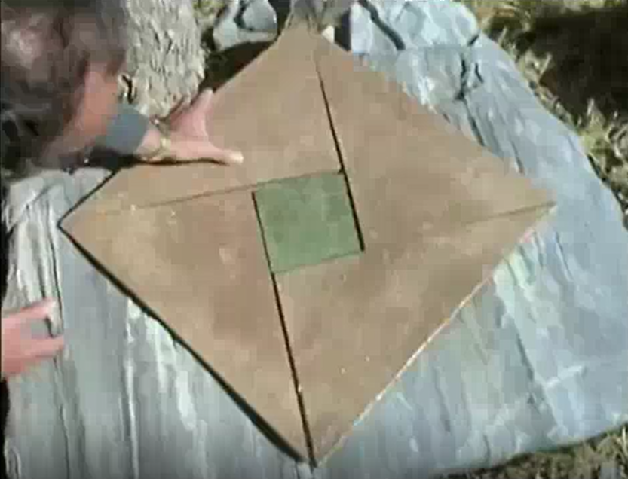
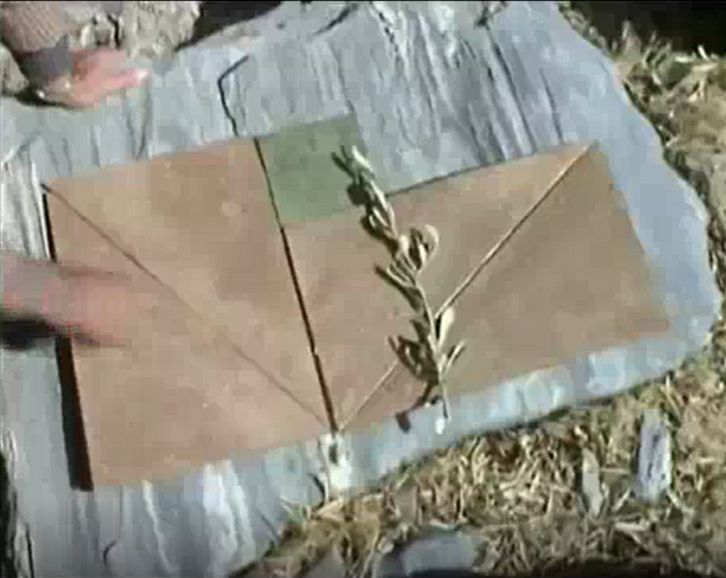
TRIGONOMETRY DISCUSSION
IN-CLASS PROBLEM 2
Tell me about how the ancient Greeks viewed the Pythagorean Theorem
Square of the hypotenuse = Sum of squares of each side

Slide 17


Questions?
lol-rofl.com

Slide 18
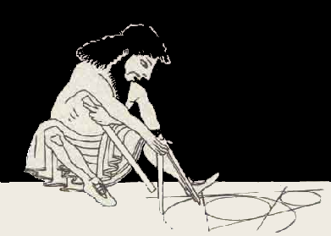
Trigonometry
Trigonometry came to us from the ancient Greeks who drew triangles in circles
http://www.hellenicaworld.com/Greece/Science/en/Archimedes.html

Slide 19
Trigonometry
Like this: Not this:
.
VFrench, 2015

Slide 20
Trigonometry
This is called a “central angle”
.
VFrench, 2015

Slide 21
Trigonometry
Angles are “swept” around the circle like a backwards clock
.
θ
VFrench, 2015

Slide 22
Trigonometry
Remember, the slope of a line is rise
run
.
rise
θ
run
VFrench, 2015

Slide 23
Trigonometry
So, the slope of the hypotenuse is: rise
run
hypotenuse
.
rise
θ
run
VFrench, 2015

Slide 24
Trigonometry
If you double the rise, it forms a geometric “chord” (which is what the Greeks were interested in)
hypotenuse
.
rise
θ
← chord →
run
VFrench, 2015

Slide 25
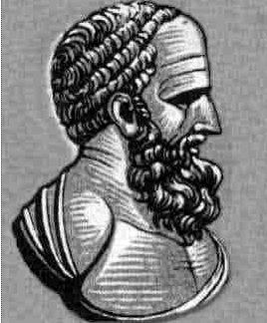
Trigonometry
Hipparchus calculated the first chord table about 125 BC
https://en.wikipedia.org/wiki/Hipparchus

Slide 26
Trigonometry
According to the Pythagorean Theorem, the length of the hypotenuse will be:
hyp² = rise² + run²
hypotenuse
.
rise
θ
run
VFrench, 2015

Slide 27
Questions?
www.career.gatech.edu

Slide 28
Trigonometry
Modern trigonometry was developed in India starting in the 500s AD

Slide 29
Trigonometry
In trigonometry, the terms “opposite” and “adjacent” are traditionally used for the “rise” and the “run”
hypotenuse
opposite
rise
.
θ
run
adjacent
VFrench, 2015

Slide 30
Trigonometry
There are six trig functions:
sine(θ) = length of side opposite θ
length of hypotenuse
Abbreviated “sin”
hypotenuse
.
opposite
θ
rise
run
adjacent
VFrench, 2015

Slide 31
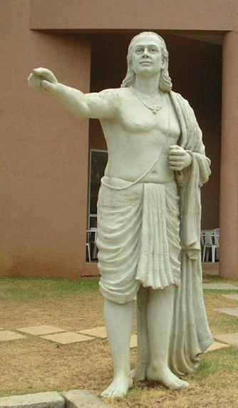
Trigonometry
Aryabhata called the
rise “ardha-jya”
https://en.wikipedia.org/wiki/Aryabhata#/media/File:2064_aryabhata-crp.jpg

Slide 32
Trigonometry
Arabic mathematicians called it “jiba” or “jb” (since Arabic doesn’t have vowels)
Europeans translating it to Latin misread it as “jaib” (inlet)
So they called it “sinus” (Latin for “inlet”)

Slide 33
Trigonometry
There are six trig functions:
cosine(θ) = length of side adjacent θ
length of hypotenuse
Abbreviated “cos”
hypotenuse
.
opposite
θ
rise
run
adjacent
VFrench, 2015

Slide 34
TRIGONOMETRY DISCUSSION
IN-CLASS PROBLEM 2
When would sin or cos be a whole number?

Slide 35
TRIGONOMETRY DISCUSSION
IN-CLASS PROBLEM 2
When would sin or cos be a whole number?
At θ = 0º
The sin (rise) = 0
and the
cos (run) = 1
.
0º
VFrench, 2015

Slide 36
TRIGONOMETRY DISCUSSION
IN-CLASS PROBLEM 2
This will also be true for 360º, 720º, -360º …
(are you seeing a pattern here?)

Slide 37
TRIGONOMETRY DISCUSSION
IN-CLASS PROBLEM 2
This will also be true for 360º, 720º, -360º …
(are you seeing a pattern here?)
It will be true for any integer multiple of 360º
It cycles around!

Slide 38
Trigonometry
This repeating (cyclical) pattern will be very important…
More about that later!

Slide 39
TRIGONOMETRY DISCUSSION
IN-CLASS PROBLEM 2
When would sin or cos be a whole number?
At θ = 180º
The sin (rise) = 0
and the
cos (run) = -1
180º
.
VFrench, 2015

Slide 40
TRIGONOMETRY DISCUSSION
IN-CLASS PROBLEM 2
This will also be true for 540º, 900º, -180º …
(another cycle here?)

Slide 41
TRIGONOMETRY DISCUSSION
IN-CLASS PROBLEM 2
This will also be true for 540º, 900º, -180º …
(another cycle here?)
It will be true for 180º + c360º
for any integer multiplier “c”

Slide 42
TRIGONOMETRY DISCUSSION
IN-CLASS PROBLEM 2
When would sin or cos be a whole number?
At θ = 90º
The sin (rise) = 1
and the
cos (run) = 0
.
90º
VFrench, 2015

Slide 43
TRIGONOMETRY DISCUSSION
IN-CLASS PROBLEM 2
This will also be true for 450º, 810º, -270º …
(again, a cycle?)
It will be true for 90º + c360º
for any integer multiplier “c”

Slide 44
TRIGONOMETRY DISCUSSION
IN-CLASS PROBLEM 2
When would sin or cos be a whole number?
At θ = 270º
The sin (rise) = -1
and the
cos (run) = 0
.
90º
VFrench, 2015

Slide 45
TRIGONOMETRY DISCUSSION
IN-CLASS PROBLEM 2
This will also be true for 630º, 990º, -95º …
(what’s with the cycles?)
It will be true for 270º + c360º
for any integer multiplier “c”

Slide 46
Trigonometry
There are six trig functions:
tangent(θ) = length of side opposite θ
length of side adjacent θ
= sin θ
cos θ
Abbreviated “tan”
hypotenuse
.
opposite
θ
rise
run
adjacent
VFrench, 2015

Slide 47
TRIGONOMETRY
IN-CLASS PROBLEM 3
Given sin θ = 3/5 and
cos θ = 4/5, find tan θ
a) 4/5 b) 3/4
c) 5/3 d) 5/4
tangent(θ) = length of side opposite θ
length of side adjacent θ
= sin θ
cos θ

Slide 48
TRIGONOMETRY
IN-CLASS PROBLEM 3
Given sin θ = 3/5 and
cos θ = 4/5, find tan θ
a) 4/5 b) 3/4
c) 5/3 d) 5/4
tangent(θ) = length of side opposite θ
length of side adjacent θ
= sin θ
cos θ

Slide 49
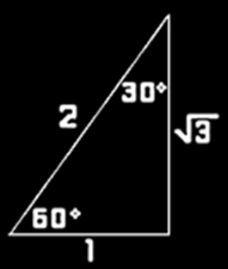

TRIGONOMETRY
IN-CLASS PROBLEM 4
Evaluate tan 60º
a) $\sqrt{3}$ b) $\sqrt{2}$
c) –1 d) 1
tangent(θ) = length of side opposite θ
length of side adjacent θ
= sin θ
cos θ

Slide 50

TRIGONOMETRY
IN-CLASS PROBLEM 4
Evaluate tan 60º
a) $\sqrt{3}$ b) $\sqrt{2}$
c) –1 d) 1
tangent(θ) = length of side opposite θ
length of side adjacent θ
= sin θ
cos θ

Slide 51
TRIGONOMETRY DISCUSSION
IN-CLASS PROBLEM 5
When would tan be zero?

Slide 52
TRIGONOMETRY DISCUSSION
IN-CLASS PROBLEM 6
When would tan be zero?
when sin=0 (at 0º)
When would tan be 1?

Slide 53
TRIGONOMETRY DISCUSSION
IN-CLASS PROBLEM 7
When would tan be zero?
when sin=0 (at 0º)
When would tan be 1?
when sin=cos (at 45º)
When would tan be “undefined”?

Slide 54
TRIGONOMETRY DISCUSSION
IN-CLASS PROBLEM 7
When would tan be zero?
when sin=0 (at 0º)
When would tan be 1?
when sin=cos (at 45º)
When would tan be “undefined”?
when cos=0 (at 90º)

Slide 55
TRIGONOMETRY DISCUSSION
IN-CLASS PROBLEM 7
When would tan be zero?
when sin=0 (at 0º)
When would tan be 1?
when sin=cos (at 45º)
When would tan be “undefined”?
when cos=0 (at 90º)
and, because of the cycles, at any point 360º away

Slide 56
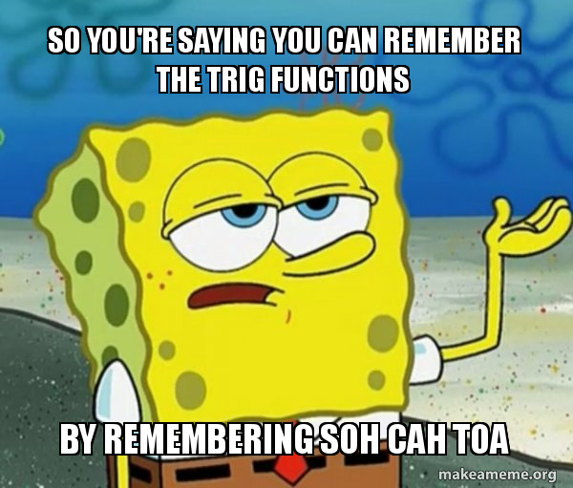
Trigonometry
https://makeameme.org/meme/so-youre-saying-5c4f27

Slide 57
Trigonometry
There are six trig functions:
cotangent = length of side adjacent θ
(cot) length of side opposite θ
= cos θ
sin θ

Slide 58
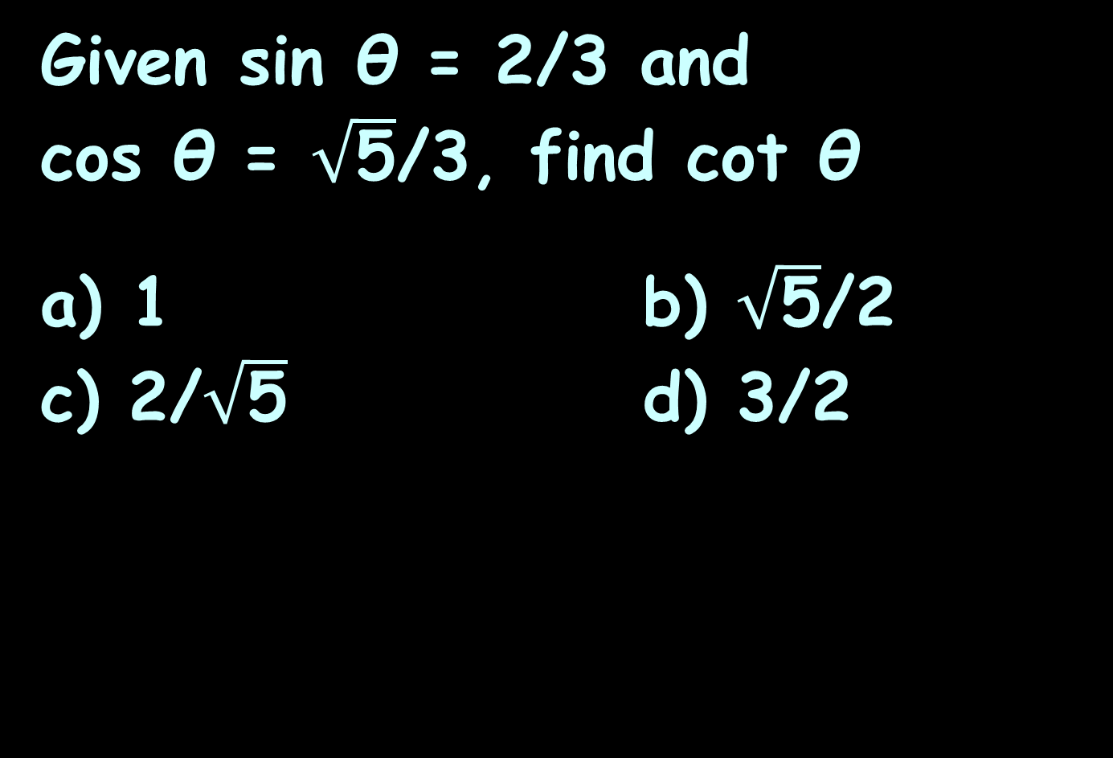
TRIGONOMETRY
IN-CLASS PROBLEM 8
Given sin θ = 2/3 and
cos θ = $\sqrt{\text{5}}$/3, find cot θ
a) 1 b) $\sqrt{\text{5}}$/2
c) 2/$\sqrt{\text{5}}$ d) 3/2
cotangent = length of side adjacent θ
(cot) length of side opposite θ
  = cos θ
sin θ

Slide 59
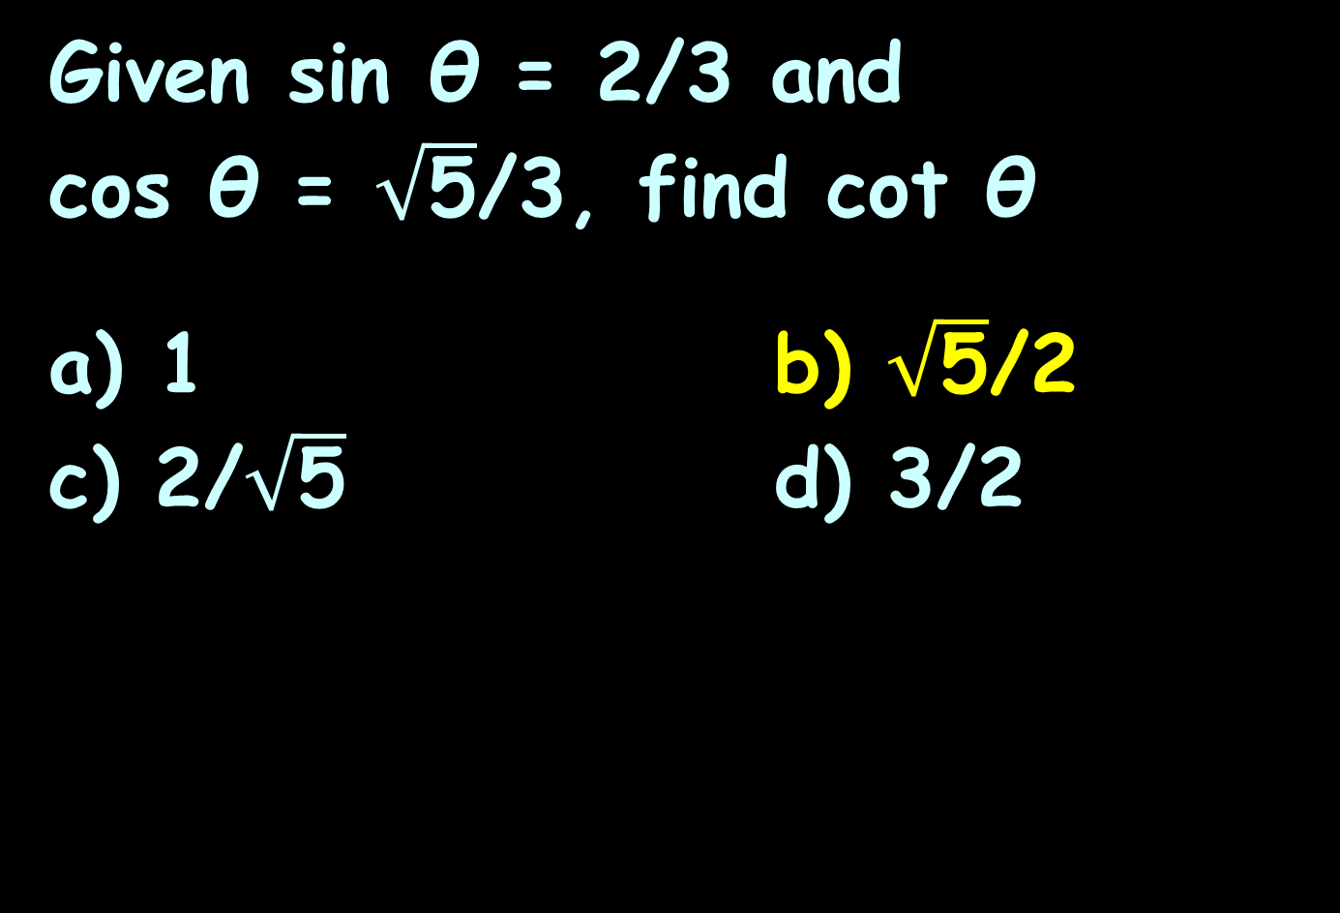
TRIGONOMETRY
IN-CLASS PROBLEM 8
Given sin θ = 2/3 and
cos θ = $\sqrt{\text{5}}$/3, find cot θ
a) 1 b) $\sqrt{\text{5}}$/2
c) 2/$\sqrt{\text{5}}$ d) 3/2
cotangent = length of side adjacent θ
(cot) length of side opposite θ
  = cos θ
sin θ

Slide 60

TRIGONOMETRY
IN-CLASS PROBLEM 9
Evaluate cot 30º
a) $\sqrt{3}$ b) $\sqrt{2}$
c) –1/$\sqrt{3}$ d) 1/$\sqrt{3}$
Careful!!
cotangent = length of side adjacent θ
(cot) length of side opposite θ
  = cos θ
sin θ

Slide 61

TRIGONOMETRY
IN-CLASS PROBLEM 9
Evaluate cot 30º
a) $\sqrt{3}$ b) $\sqrt{2}$
c) –1/$\sqrt{3}$ d) 1/$\sqrt{3}$
Careful!!
cotangent = length of side adjacent θ
(cot) length of side opposite θ
  = cos θ
sin θ

Slide 62
Trigonometry
There are six trig functions:
secant = length of hypotenuse
(sec) length of side adjacent θ
= 1 .
cos θ

Slide 63
TRIGONOMETRY
IN-CLASS PROBLEM 10
Given sin θ = 2/3 and
cos θ = 5/3, find sec θ
a) 1 b) 3/5
c) 5/3 d) 3/2
secant = length of hypotenuse
(sec) length of side adjacent θ
= 1 .
cos θ

Slide 64
TRIGONOMETRY
IN-CLASS PROBLEM 10
Given sin θ = 2/3 and
cos θ = 5/3, find sec θ
a) 1 b) 3/5
c) 5/3 d) 3/2
secant = length of hypotenuse
(sec) length of side adjacent θ
= 1 .
cos θ

Slide 65
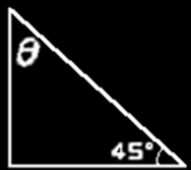

TRIGONOMETRY
IN-CLASS PROBLEM 11
Evaluate sec 45º
a) $\sqrt{3}$ b) $\sqrt{2}$
c) 5/3 d) 5/4
Careful!!
3
4
secant = length of hypotenuse
(sec) length of side adjacent θ
= 1 .
cos θ

Slide 66

TRIGONOMETRY
IN-CLASS PROBLEM 11
Evaluate sec 45º
a) $\sqrt{3}$ b) $\sqrt{2}$
c) 5/3 d) 5/4
Careful!!
3
4
secant = length of hypotenuse
(sec) length of side adjacent θ
= 1 .
cos θ

Slide 67
Trigonometry
There are six trig functions:
cosecant = length of hypotenuse
(csc) length of side opposite θ
= 1 .
sin θ

Slide 68
TRIGONOMETRY
IN-CLASS PROBLEM 12
Given sin θ = 3/5 and
cos θ = 4/5, find csc θ
a) 4/5 b) 3/4
c) 5/3 d) 5/4
cosecant = length of hypotenuse
(csc) length of side opposite θ
= 1 .
sin θ

Slide 69
TRIGONOMETRY
IN-CLASS PROBLEM 12
Given sin θ = 3/5 and
cos θ = 4/5, find csc θ
a) 4/5 b) 3/4
c) 5/3 d) 5/4
cosecant = length of hypotenuse
(csc) length of side opposite θ
= 1 .
sin θ

Slide 70

TRIGONOMETRY
IN-CLASS PROBLEM 13
Evaluate csc θº
a) $\sqrt{3}$ b) $\sqrt{2}$
c) 5/3 d) 5/4
Careful!!
3
4
cosecant = length of hypotenuse
(csc) length of side opposite θ
= 1 .
sin θ

Slide 71

TRIGONOMETRY
IN-CLASS PROBLEM 13
Evaluate csc θº
a) $\sqrt{3}$ b) $\sqrt{2}$
c) 5/3 d) 5/4
Careful!!
3
4
cosecant = length of hypotenuse
(csc) length of side opposite θ
= 1 .
sin θ

Slide 72
TRIGONOMETRY
IN-CLASS PROBLEM 14
Remembering that the three angles of a triangle must add up to 180º, what is θ?
3
4

Slide 73
TRIGONOMETRY
IN-CLASS PROBLEM 14
Remembering that the three angles of a triangle must add up to 180º, what is θ?
θ = 45º
3
4

Slide 74
Questions?
www.career.gatech.edu

Slide 75
Trigonometry
  Because of the cyclical nature of these formulas,
  sin θ = cos (θ-90°)
  cos θ = sin (θ-90°)
  sec θ = csc (θ-90°)
  csc θ = sec (θ-90°)
  where c is any integer

Slide 76
TRIGONOMETRY
IN-CLASS PROBLEM 15
Which of the following would have the same value as sin 35º?
a) cos 305º b) cos 665º
c) cos 1025º d) cos -55º
  sin θ = cos (θ-90°)
  cos θ = sin (θ-90°)
  sec θ = csc (θ-90°)
  csc θ = sec (θ-90°)

Slide 77
TRIGONOMETRY
IN-CLASS PROBLEM 15
Which of the following would have the same value as sin 35º?
a) cos 305º b) cos 665º
c) cos 1025º d) cos -55º
All of them!
(More cycles!)
  sin θ = cos (θ+90°)
  cos θ = sin (θ+90°)
  sec θ = csc (θ+90°)
  csc θ = sec (θ+90°)

Slide 78
Questions?
www.career.gatech.edu

Slide 79
Trigonometry
For a “unit circle” (radius=1)
calculations become much easier:
1
opposite
rise
.
θ
run
adjacent
VFrench, 2015

Slide 80
Trigonometry
Because the hypotenuse is 1:
sine = length of side opposite θ
1
= “rise”
1
opposite
rise
.
θ
run
adjacent
VFrench, 2015

Slide 81
Trigonometry
Because the hypotenuse is 1:
cos = length of side adjacent θ
1
= “run”
1
opposite
rise
.
θ
run
adjacent
VFrench, 2015

Slide 82
Trigonometry
Graphically:
sin
.
θ
cos
VFrench, 2015

Slide 83
Trigonometry
Graphically:
tan
sin
.
θ
…and that’s why it’s called the “tangent”
cos
VFrench, 2015

Slide 84
Trigonometry
Graphically:
sec
tan
sin
.
θ
cos
VFrench, 2015

Slide 85
Trigonometry
Graphically:
sec
tan
sin
.
θ
cos
VFrench, 2015

Slide 86
Trigonometry
Graphically:
sec
tan
sin
.
θ
cos
VFrench, 2015

Slide 87
Trigonometry
Graphically:
sec
tan
tan
sin
.
θ
cos
VFrench, 2015

Slide 88
Trigonometry
Graphically:
sec
tan
tan
sin
.
θ
cos
VFrench, 2015

Slide 89
Trigonometry
Graphically:
sec
cot
tan
tan
sin
.
θ
cos
VFrench, 2015

Slide 90
Trigonometry
Graphically:
sec
cot
tan
csc
tan
sin
.
θ
cos
VFrench, 2015

Slide 91
Trigonometry
Graphically:
sec
cot
tan
csc
tan
sin
.
θ
cos
sec
VFrench, 2015

Slide 92
Trigonometry
Graphically:
sec
cot
tan
csc
tan
sin
.
θ
cos
sec
VFrench, 2015

Slide 93
Trigonometry
Graphically:
sec
cot
tan
csc
tan
sin
.
θ
cos
sec
VFrench, 2015

Slide 94
Trigonometry
Graphically:
sec
cot
tan
csc
csc
tan
sin
.
θ
cos
sec
VFrench, 2015

Slide 95

Trigonometry
Graphically:
VFrench, 2015
https://www.yourdictionary.com/images/main.shriek.jpg

Slide 96

Trigonometry
This is the
important one:
tan
sin
.
θ
cos
VFrench, 2015
http://www.shutterstock.com/s/whew/search.html

Slide 97
Questions?
www.career.gatech.edu

Slide 98
Trigonometry
According to the Pythagorean Theorem, for a hypotenuse of length 1:
hyp² = rise² + run²
1² = rise² + run²
1 = sin² + cos²
(an identity)
hypotenuse
opposite
.
rise
“sin”
θ
run
adjacent
“cos”
VFrench, 2015

Slide 99
Trigonometry
Based on the formula a²+b²=c², where c is the hypotenuse and a and b are the other sides, there are three identities:
sin² θ + cos² θ = 1
1 + tan² θ = sec² θ
1 + cot² θ = csc² θ

Slide 100
Trigonometry
Obj 4: Apply trigonometric identities to simplify expressions and to solve equations

Slide 101
TRIGONOMETRY
IN-CLASS PROBLEM 16
Simplify sin² 10º + cos² 10º
a) 2 b) 1
c) 3 d) 10

Slide 102
TRIGONOMETRY
IN-CLASS PROBLEM 16
Simplify sin² 10º + cos² 10º
a) 2 b) 1
c) 3 d) 10

Slide 103
TRIGONOMETRY
IN-CLASS PROBLEM 17
Let’s find the sin and cos for the isosceles right triangle of the unit circle:
sin² θ + cos² θ = 1
hypotenuse
opposite
.
rise
“sin”
θ
run
adjacent
“cos”
VFrench, 2015

Slide 104
TRIGONOMETRY
IN-CLASS PROBLEM 17
For an isosceles right triangle, sin=cos
so
sin² θ + cos² θ = 1
would be
2sin² θ = 1
hypotenuse
opposite
.
rise
“sin”
θ
run
adjacent
“cos”
VFrench, 2015

Slide 105

TRIGONOMETRY
IN-CLASS PROBLEM 17
sin² θ + cos² θ = 1
2sin² θ = 1
sin² θ = ½
sin θ = $\sqrt{\text{½}}$
≈.7071
hypotenuse
opposite
.
rise
“sin”
θ
run
adjacent
“cos”
VFrench, 2015

Slide 106
Trigonometry
Notice that these are calculated using a square root…
so they are not an “easy” number very often!

Slide 107
Questions?
www.career.gatech.edu

Slide 108
Trigonometry
Since you don’t REALLY want to do these problems using square roots,
for trig calculations, you will need a scientific calculator (probably on your phone)

Slide 109
TRIGONOMETRY
IN-CLASS PROBLEM 18
Find these trig functions using your calculator:
sin 10º sin 0º sin 45º
sin 90º cos 20º cos 0º
cos 45º cos 90º tan 30º
tan 0º tan 45º tan 90º

Slide 110
Questions?
www.career.gatech.edu

Slide 111

You Survived!
Don’t forget
your Homework
due next week!
Have a great rest
of the week!
www.playbuzz.com

