Slide 1
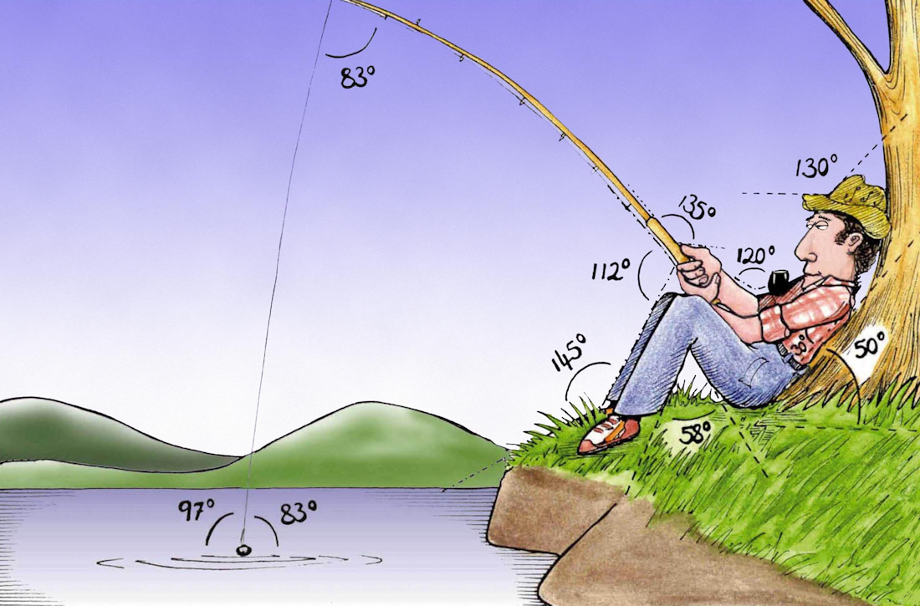
Welcome to
Week 4!
Analytic Trigonometry
http://www.lab-initio.com/images/fullsize/nz211.jpg

Slide 2
What’s Up?
Today we will be going over:
Review of trig graphs,
radians, arc length
Max, min, period
Exact values of trig
functions
Transforms of trig functions

Slide 3
What’s Up?
Obj 2) State the exact values of trigonometric functions of special angles, and compute approximate values using technology
Obj 3) Graph transformed sine and cosine functions, with various phase shifts, frequencies and amplitudes
Obj 4) Apply trigonometric identities to simplify expressions and to solve equations

Slide 4

Review
www.hrexaminer.com

Slide 5
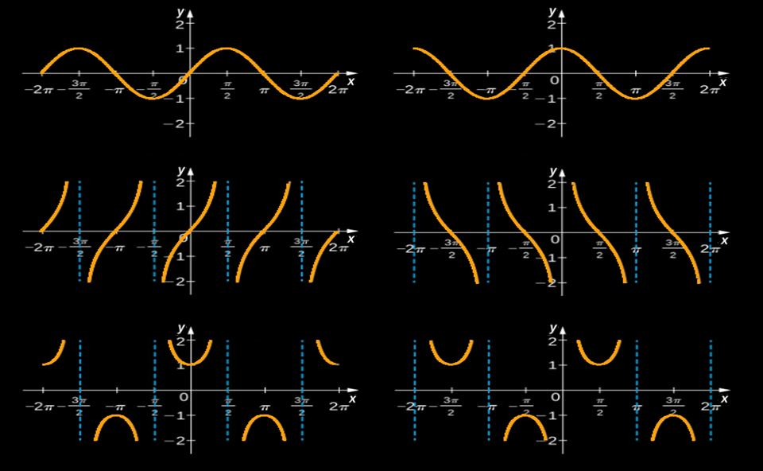
Graphs of Trig Functions
ƒ(x) = sin(x)
ƒ(x) = cos(x)
ƒ(x) = tan(x)
ƒ(x) = cot(x)
ƒ(x) = sec(x)
ƒ(x) = csc(x)
VFrench, 2015

Slide 6
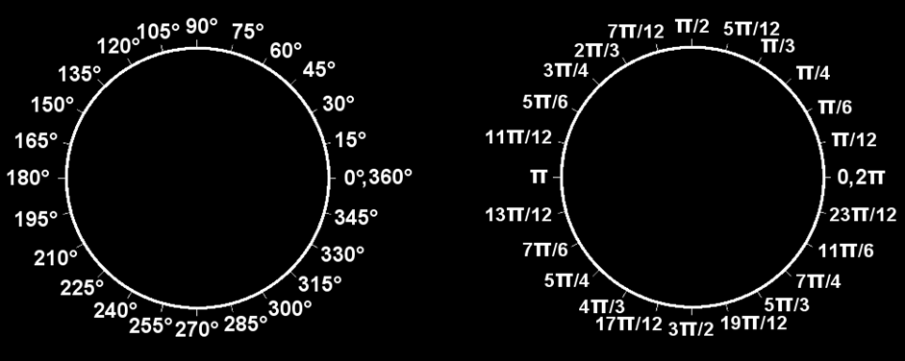
Degrees vs Radians
All the way around the circle once (360º) is 2π (a length)
VFrench, 2015

Slide 7
Arc Length
Sometimes we want to measure the length of the curve on the circle
s
r
.
θ
VFrench, 2015

Slide 8
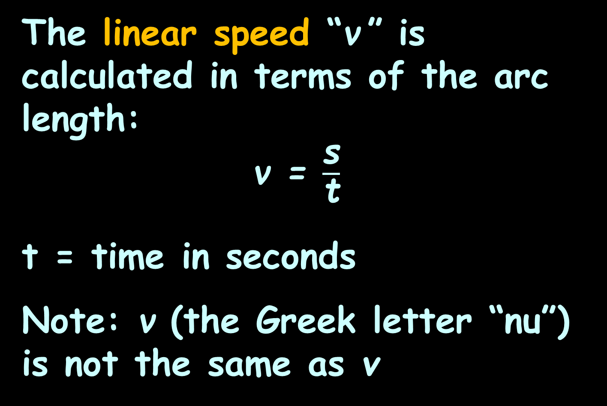
Arc Length
The linear speed “ν ” is calculated in terms of the arc length:
ν = $\frac{\text{s}}{\text{t}}$
t = time in seconds
Note: ν (the Greek letter “nu”) is not the same as v

Slide 9
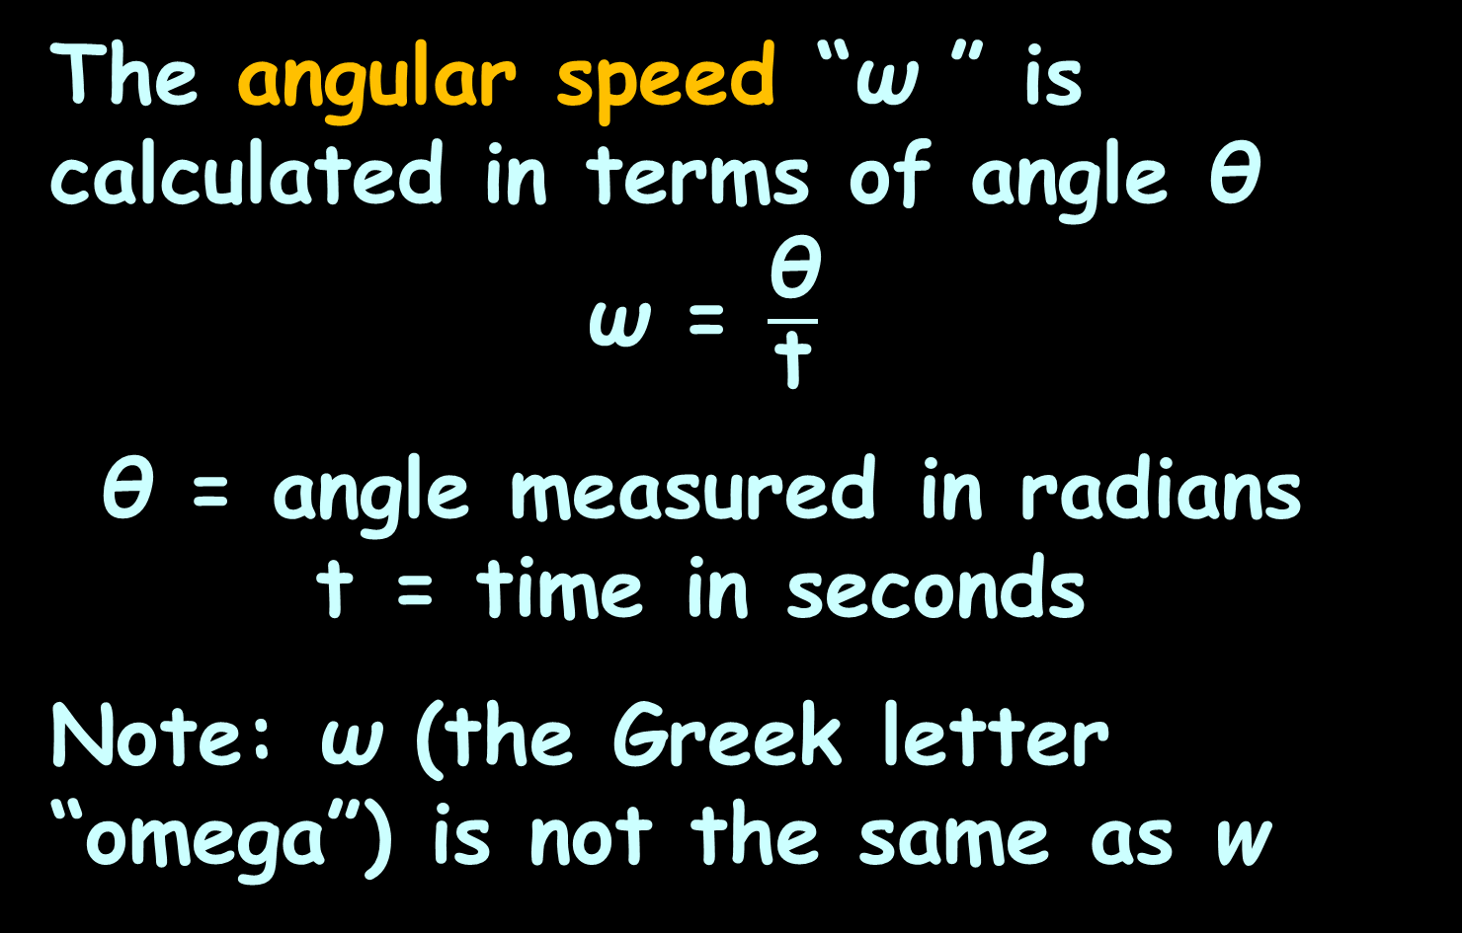
Arc Length
The angular speed “ω ” is calculated in terms of angle θ
ω = $\frac{\text{θ}}{\text{t}}$
θ = angle measured in radians
t = time in seconds
Note: ω (the Greek letter “omega”) is not the same as w

Slide 10


Questions?
lol-rofl.com

Slide 11
More Trig Stuff
Back to algebra!

Slide 12
More Trig Stuff
Remember when we did functions…

Slide 13
More Trig Stuff
We said functions had only one “y” value for each “x” value

Slide 14
MORE TRIG STUFF
IN-CLASS PROBLEM 1
Are the trig graphs functions?
VFrench, 2015

Slide 15
More Trig Stuff
In algebra, we also looked at the maximum and minimum values for functions

Slide 16
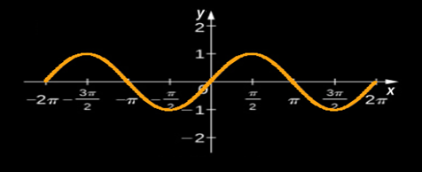
MORE TRIG STUFF
IN-CLASS PROBLEM 2
What is the natural maximum x value for ƒ(x) = sin(x)?
VFrench, 2015

Slide 17
MORE TRIG STUFF
IN-CLASS PROBLEM 2
What is the natural minimum x value for ƒ(x) = sin(x)?
VFrench, 2015

Slide 18
MORE TRIG STUFF
IN-CLASS PROBLEM 2
What is the natural maximum y value for ƒ(x) = sin(x)?
VFrench, 2015

Slide 19
MORE TRIG STUFF
IN-CLASS PROBLEM 2
What is the natural minimum y value for ƒ(x) = sin(x)?
VFrench, 2015

Slide 20
More Trig Stuff
Now, here’s a new one
Because the trig functions
cycle, they have a “period”

Slide 21
MORE TRIG STUFF
IN-CLASS PROBLEM 2
What is the natural period for ƒ(x) = sin(x)?
VFrench, 2015

Slide 22
MORE TRIG STUFF
IN-CLASS PROBLEM 2
What is the natural period for ƒ(x) = sin(x) in degrees?
VFrench, 2015

Slide 23
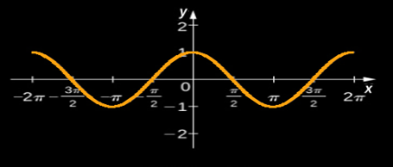
MORE TRIG STUFF
IN-CLASS PROBLEM 2
What is the natural maximum x value for ƒ(x) = cos(x)?
VFrench, 2015

Slide 24
MORE TRIG STUFF
IN-CLASS PROBLEM 2
What is the natural minimum x value for ƒ(x) = cos(x)?
VFrench, 2015

Slide 25
MORE TRIG STUFF
IN-CLASS PROBLEM 2
What is the natural maximum y value for ƒ(x) = cos(x)?
VFrench, 2015

Slide 26
MORE TRIG STUFF
IN-CLASS PROBLEM 2
What is the natural minimum y value for ƒ(x) = cos(x)?
VFrench, 2015

Slide 27
MORE TRIG STUFF
IN-CLASS PROBLEM 2
What is the natural period for ƒ(x) = cos(x)?
VFrench, 2015

Slide 28
MORE TRIG STUFF
IN-CLASS PROBLEM 2
What is the natural period for ƒ(x) = cos(x) in degrees?
VFrench, 2015

Slide 29
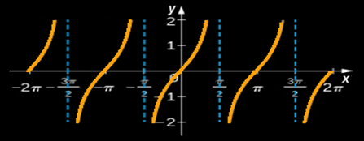
MORE TRIG STUFF
IN-CLASS PROBLEM 2
What is the natural maximum x value for ƒ(x) = tan(x)?
VFrench, 2015

Slide 30
MORE TRIG STUFF
IN-CLASS PROBLEM 2
What is the natural minimum x value for ƒ(x) = tan(x)?
VFrench, 2015

Slide 31
MORE TRIG STUFF
IN-CLASS PROBLEM 2
What is the natural maximum y value for ƒ(x) = tan(x)?
VFrench, 2015

Slide 32
MORE TRIG STUFF
IN-CLASS PROBLEM 2
What is the natural minimum y value for ƒ(x) = tan(x)?
VFrench, 2015

Slide 33
MORE TRIG STUFF
IN-CLASS PROBLEM 2
What is the natural period for ƒ(x) = tan(x)?
VFrench, 2015

Slide 34
MORE TRIG STUFF
IN-CLASS PROBLEM 2
What is the natural period for ƒ(x) = tan(x) in degrees?
VFrench, 2015

Slide 35
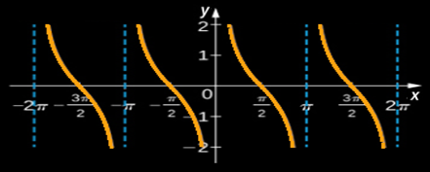
MORE TRIG STUFF
IN-CLASS PROBLEM 2
What is the natural maximum x value for ƒ(x) = cot(x)?
VFrench, 2015

Slide 36
MORE TRIG STUFF
IN-CLASS PROBLEM 2
What is the natural minimum x value for ƒ(x) = cot(x)?
VFrench, 2015

Slide 37
MORE TRIG STUFF
IN-CLASS PROBLEM 2
What is the natural maximum y value for ƒ(x) = cot(x)?
VFrench, 2015

Slide 38
MORE TRIG STUFF
IN-CLASS PROBLEM 2
What is the natural minimum y value for ƒ(x) = cot(x)?
VFrench, 2015

Slide 39
MORE TRIG STUFF
IN-CLASS PROBLEM 2
What is the natural period for ƒ(x) = cot(x)?
VFrench, 2015

Slide 40
MORE TRIG STUFF
IN-CLASS PROBLEM 2
What is the natural period for ƒ(x) = cot(x) in degrees?
VFrench, 2015

Slide 41
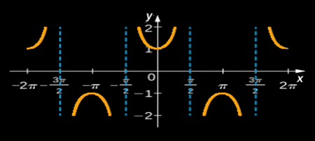
MORE TRIG STUFF
IN-CLASS PROBLEM 2
What is the natural maximum x value for ƒ(x) = sec(x)?
VFrench, 2015

Slide 42
MORE TRIG STUFF
IN-CLASS PROBLEM 2
What is the natural minimum x value for ƒ(x) = sec(x)?
VFrench, 2015

Slide 43
MORE TRIG STUFF
IN-CLASS PROBLEM 2
What is the natural maximum y value for ƒ(x) = sec(x)?
VFrench, 2015

Slide 44
MORE TRIG STUFF
IN-CLASS PROBLEM 2
What is the natural minimum y value for ƒ(x) = sec(x)?
VFrench, 2015

Slide 45
MORE TRIG STUFF
IN-CLASS PROBLEM 2
What is the natural period for ƒ(x) = sec(x)?
VFrench, 2015

Slide 46
MORE TRIG STUFF
IN-CLASS PROBLEM 2
What is the natural period for ƒ(x) = sec(x) in degrees?
VFrench, 2015

Slide 47
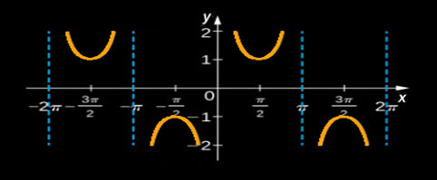
MORE TRIG STUFF
IN-CLASS PROBLEM 2
What is the natural maximum x value for ƒ(x) = csc(x)?
VFrench, 2015

Slide 48
MORE TRIG STUFF
IN-CLASS PROBLEM 2
What is the natural minimum x value for ƒ(x) = csc(x)?
VFrench, 2015

Slide 49
MORE TRIG STUFF
IN-CLASS PROBLEM 2
What is the natural maximum y value for ƒ(x) = csc(x)?
VFrench, 2015

Slide 50
MORE TRIG STUFF
IN-CLASS PROBLEM 2
What is the natural minimum y value for ƒ(x) = csc(x)?
VFrench, 2015

Slide 51
MORE TRIG STUFF
IN-CLASS PROBLEM 2
What is the natural period for ƒ(x) = csc(x)?
VFrench, 2015

Slide 52
MORE TRIG STUFF
IN-CLASS PROBLEM 2
What is the natural period for ƒ(x) = csc(x) in degrees?
VFrench, 2015

Slide 53
Questions?
www.career.gatech.edu

Slide 54
More Trig Stuff
Exact values for trig functions
vs
Approximate values for trig functions

Slide 55
More Trig Stuff
Exact values for trig functions: the real/true EXACT values
Approximate values for trig
functions: “close-enough” “good-enough” values that come out of your calculator

Slide 56
More Trig Stuff
Week 02 we did an exercise “when would sin or cos be a whole number?”

Slide 57
More Trig Stuff
We found at θ = 0º (0 rad)
(and all the 360º or 2π multiples)
sin(θ) = 0 and cos(θ) = 1
These were “exact” values

Slide 58
More Trig Stuff
We found at θ = 180º (π rad)
(and all the 360º or 2π multiples)
sin(θ) = 0 and cos(θ) = -1
These were “exact” values, too

Slide 59
More Trig Stuff
We found at θ = 90º (π/2 rad)
(and all the 360º or 2π multiples)
sin(θ) = 1 and cos(θ) = 0
These were “exact” values, too

Slide 60
More Trig Stuff
We found at θ = 270º (3π/2 rad)
(and all the 360º or 2π multiples)
sin(θ) = -1 and cos(θ) = 0
These were “exact” values, too!

Slide 61
More Trig Stuff
But, there are more “exact” values!

Slide 62
More Trig Stuff
Remember, these are all based on the Pythagorean theorem

Slide 63
More Trig Stuff
If we just leave the square root as a square root – it will be exact, not approximated!

Slide 64
More Trig Stuff
It is traditional to look at “exact” values for “even” multiples of degrees or radians

Slide 65
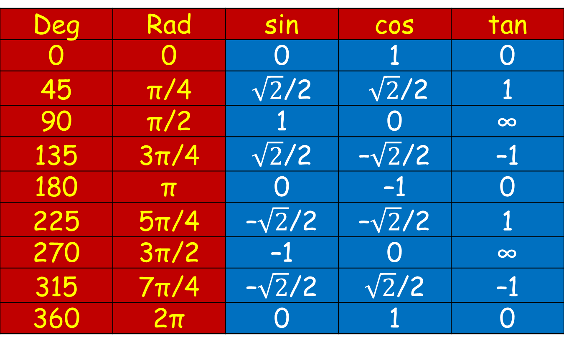
More Trig Stuff
Exact Values of Sin, Cos and Tan Functions
Deg | Rad | sin | cos | tan
0 | 0 | 0 | 1 | 0
45 | π/4 | $\sqrt{2}$/2 | $\sqrt{2}$/2 | 1
90 | π/2 | 1 | 0 | ∞
135 | 3π/4 | $\sqrt{2}$/2 | –$\sqrt{2}$/2 | –1
180 | π | 0 | –1 | 0
225 | 5π/4 | –$\sqrt{2}$/2 | –$\sqrt{2}$/2 | 1
270 | 3π/2 | –1 | 0 | ∞
315 | 7π/4 | –$\sqrt{2}$/2 | $\sqrt{2}$/2 | –1
360 | 2π | 0 | 1 | 0
VFrench, 2015

Slide 66
More Trig Stuff
Let’s see how they came up with these “exact” values

Slide 67
More Trig Stuff
Suppose our θ = 45º (π/4 rad)

Slide 68
More Trig Stuff
Suppose our θ = 45º (π/4 rad)
How big is the rise compared to the run?
hypotenuse
.
opposite
rise
θ
run
adjacent

Slide 69
More Trig Stuff
Suppose our θ = 45º (π/4 rad)
How big is the rise compared to the run?
At 45º: rise = run
hypotenuse
.
opposite
rise
θ
run
adjacent

Slide 70
More Trig Stuff
Suppose our θ = 45º (π/4 rad)
rise = run
What is our hypotenuse?
(Remember, it’s a unit circle)
hypotenuse
.
opposite
rise
θ
run
adjacent

Slide 71
More Trig Stuff
Suppose our θ = 45º (π/4 rad)
rise = run
hypotenuse = 1
So according to Pythagorus:
hyp² = rise² + run²
hypotenuse
.
opposite
rise
θ
run
adjacent

Slide 72
More Trig Stuff
Suppose our θ = 45º (π/4 rad)
rise = run, hypotenuse = 1
hyp² = rise² + run²
1² = 2rise²
hypotenuse
.
opposite
rise
θ
run
adjacent

Slide 73
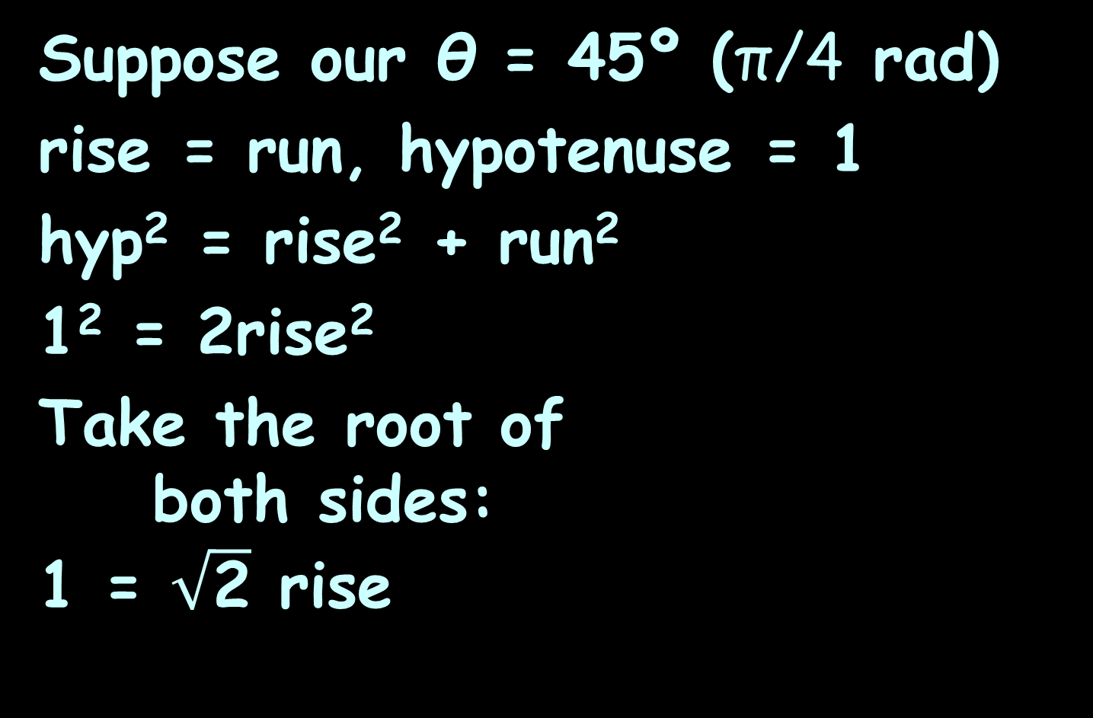
More Trig Stuff
Suppose our θ = 45º (π/4 rad)
rise = run, hypotenuse = 1
hyp² = rise² + run²
1² = 2rise²
Take the root of
both sides:
1 = $\sqrt{\text{2}}$ rise
hypotenuse
.
opposite
rise
θ
run
adjacent

Slide 74
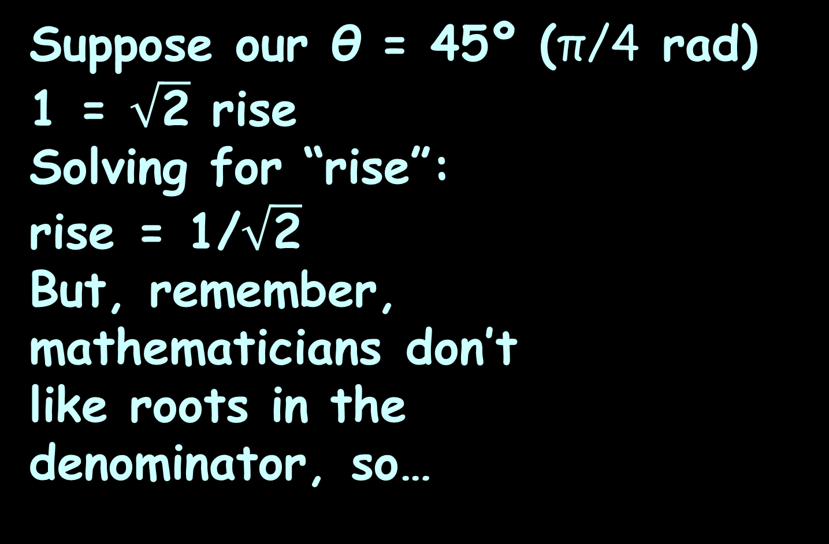
More Trig Stuff
Suppose our θ = 45º (π/4 rad)
1 = $\sqrt{\text{2}}$ rise
Solving for “rise”:
rise = 1/$\sqrt{\text{2}}$
But, remember,
mathematicians don’t
like roots in the
denominator, so…
hypotenuse
.
opposite
rise
θ
run
adjacent

Slide 75
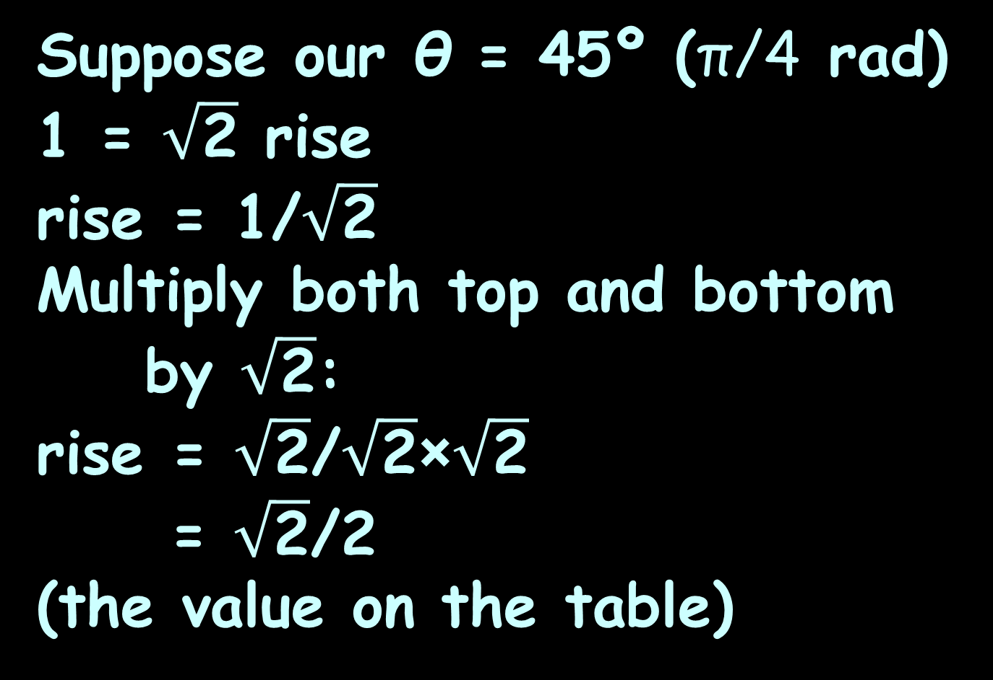
More Trig Stuff
Suppose our θ = 45º (π/4 rad)
1 = $\sqrt{\text{2}}$ rise
rise = 1/$\sqrt{\text{2}}$
Multiply both top and bottom by $\sqrt{\text{2}}$:
rise = $\sqrt{\text{2}}$/$\sqrt{\text{2}}$×$\sqrt{\text{2}}$
= $\sqrt{\text{2}}$/2
(the value on the table)
hypotenuse
.
opposite
rise
θ
run
adjacent

Slide 76
More Trig Stuff
Exact Values of Sin, Cos and Tan Functions
Deg | Rad | sin | cos | tan
0 | 0 | 0 | 1 | 0
45 | π/4 | $\sqrt{2}$/2 | $\sqrt{2}$/2 | 1
90 | π/2 | 1 | 0 | ∞
135 | 3π/4 | $\sqrt{2}$/2 | –$\sqrt{2}$/2 | –1
180 | π | 0 | –1 | 0
225 | 5π/4 | –$\sqrt{2}$/2 | –$\sqrt{2}$/2 | 1
270 | 3π/2 | –1 | 0 | ∞
315 | 7π/4 | –$\sqrt{2}$/2 | $\sqrt{2}$/2 | –1
360 | 2π | 0 | 1 | 0
VFrench, 2015

Slide 77
More Trig Stuff
So, if you use the “square-root form” of the trig value, it is the “exact” value

Slide 78
More Trig Stuff
This could be useful in making calculations where it is important to be VERY exact

Slide 79
More Trig Stuff
This could be useful in making calculations where it is important to be VERY exact
It saves a bunch of accumulating rounding errors

Slide 80
More Trig Stuff
This could be useful in making calculations where it is important to be VERY exact
It saves a bunch of accumulating rounding errors
But it’s a pain, so people don’t do it very often

Slide 81
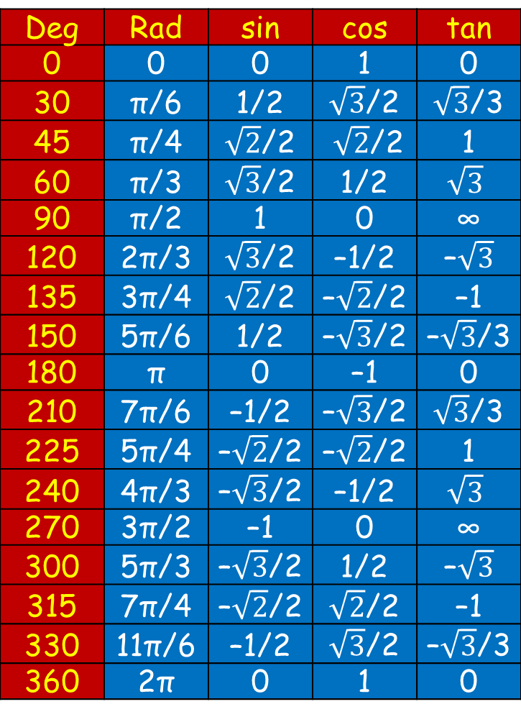
MORE TRIG STUFF
IN-CLASS PROBLEM 3
What is the
exact value for:
sin 30°
cos 3π/4
tan 5π/3
sin 7π/4
sec 60°
cot π
Deg | Rad | sin | cos | tan
0 | 0 | 0 | 1 | 0
30 | π/6 | 1/2 | $\sqrt{3}$/2 | $\sqrt{3}$/3
45 | π/4 | $\sqrt{2}$/2 | $\sqrt{2}$/2 | 1
60 | π/3 | $\sqrt{3}$/2 | 1/2 | $$\sqrt{3}$$
90 | π/2 | 1 | 0 | ∞
120 | 2π/3 | $\sqrt{3}$/2 | –1/2 | –$\sqrt{3}$
135 | 3π/4 | $\sqrt{2}$/2 | –$\sqrt{2}$/2 | –1
150 | 5π/6 | 1/2 | –$\sqrt{3}$/2 | –$\sqrt{3}$/3
180 | π | 0 | –1 | 0
210 | 7π/6 | –1/2 | –$\sqrt{3}$/2 | $\sqrt{3}$/3
225 | 5π/4 | –$\sqrt{2}$/2 | –$\sqrt{2}$/2 | 1
240 | 4π/3 | –$\sqrt{3}$/2 | –1/2 | $$\sqrt{3}$$
270 | 3π/2 | –1 | 0 | ∞
300 | 5π/3 | –$\sqrt{3}$/2 | 1/2 | –$\sqrt{3}$
315 | 7π/4 | –$\sqrt{2}$/2 | $\sqrt{2}$/2 | –1
330 | 11π/6 | –1/2 | $\sqrt{3}$/2 | –$\sqrt{3}$/3
360 | 2π | 0 | 1 | 0

Slide 82
Questions?
www.career.gatech.edu

Slide 83
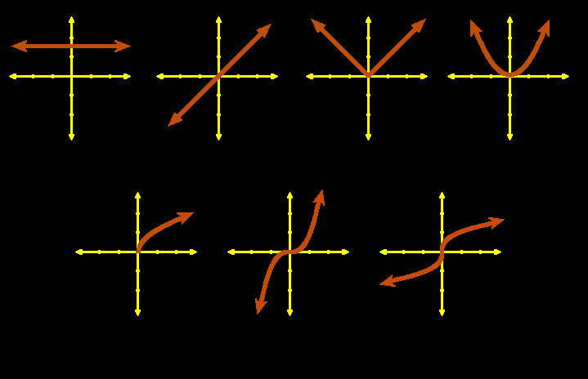
Algebraic Functions
Graphs of common algebraic functions:
constant identity abs value quadratic
square root cubic cube root
VFrench, 2015

Slide 84
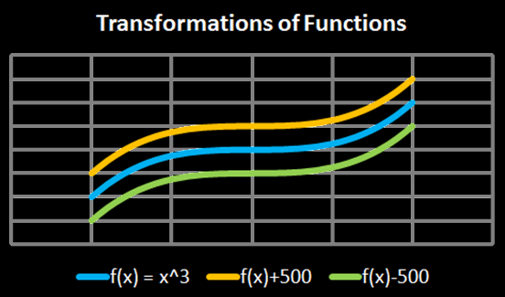
Transforming Functions
vertical shifts:
f (x) + c plus shifts up
f (x) - c minus shifts down
VFrench, 2015

Slide 85
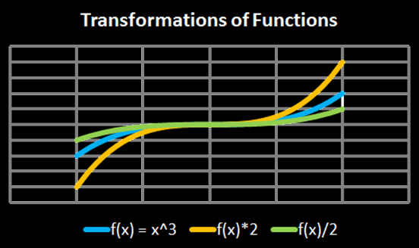
Transforming Functions
vertical stretch:
f (x) ∗ c stretches
f (x) ÷ c squashes
VFrench, 2015

Slide 86
Transforming Functions
Any operations done to the function “outside of the parentheses” affects the “y” values
These operations lead to an intuitive result

Slide 87
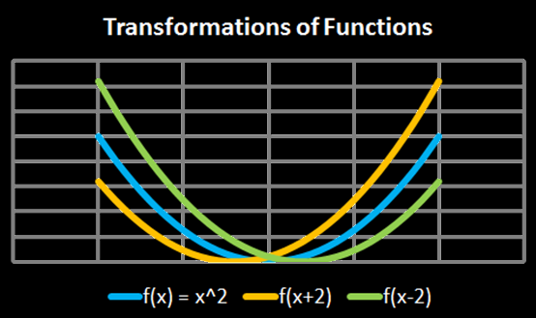
Transforming Functions
horizontal shifts:
f (x + c) shifts left
f (x - c) shifts right
VFrench, 2015

Slide 88
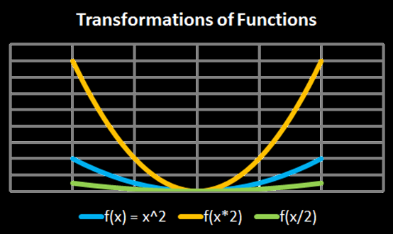
Transforming Functions
horizontal shifts:
f (x × c) squashes
f (x ÷ c) stretches
VFrench, 2015

Slide 89
Transforming Functions
Any operations done to the function “inside the parentheses” affects the “x” values
These operations lead to an counterintuitive result

Slide 90
Transforming Functions
Another way to look at it:
y-transformations affect the graph but keep the graph paper the same
x-transformations keep the graph the same but modify the graph paper

Slide 91
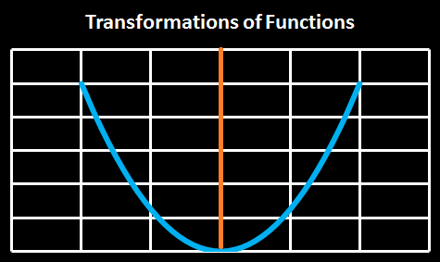
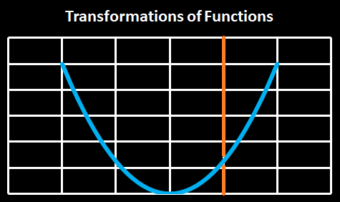
Transforming Functions
f (x + c)
shifts the
origin right
(which shifts
the graph left)
VFrench, 2015

Slide 92
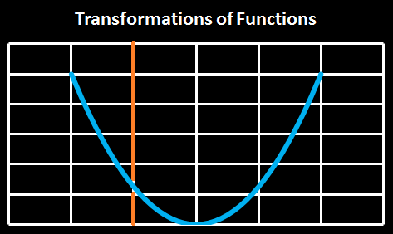
Transforming Functions
f (x - c)
shifts the
origin left
(which shifts
the graph
right)
VFrench, 2015

Slide 93
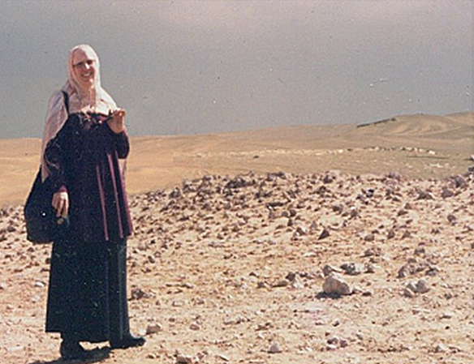
Who Am I?
When I am not teaching, I do famine prevention in sub-Saharan Africa and arrange delivery of water purification units to disaster areas
VFrench, 1998

Slide 94
TRANSFORMING TRIG GRAPHS
IN-CLASS PROBLEM 4-7
Excel exercise

Slide 95
Transforming Functions
General form of trig functions:
y = A sin (Bx - C) + D
y = A cos (Bx - C) + D

Slide 96
Transforming Functions
y = A sin (Bx - C) + D
“A” stretches the graph up and down – “Amplitude”

Slide 97
Transforming Functions
y = A sin (Bx - C) + D
“A” stretches the graph up and down – “Amplitude”
“B” stretches the graph side to side – “Period”

Slide 98
Transforming Functions
y = A sin (Bx - C) + D
“A” stretches the graph up and down – “Amplitude”
“B” stretches the graph side to side – “Period”
“C” moves the graph side to side – “Phase shift”

Slide 99
Transforming Functions
y = A sin (Bx - C) + D
“A” stretches the graph up and down – “Amplitude”
“B” stretches the graph side to side – “Period”
“C” moves the graph side to side – “Phase shift”
“D” moves the graph up and down – “Vertical shift”

Slide 100
TRANSFORMING TRIG GRAPHS
DISCUSSION
Think of a stadium wave

Slide 101
TRANSFORMING TRIG GRAPHS
DISCUSSION
Think of a stadium wave
How would you increase the amplitude of this wave?

Slide 102
TRANSFORMING TRIG GRAPHS
DISCUSSION
Think of a stadium wave
How would you increase the period (frequency) of this wave?

Slide 103
TRANSFORMING TRIG GRAPHS
DISCUSSION
Think of a stadium wave
How would you move the phase (start) of this wave?

Slide 104
TRANSFORMING TRIG GRAPHS
DISCUSSION
Think of a stadium wave
How would you shift this wave vertically?

Slide 105
Questions?
www.career.gatech.edu

Slide 106
Transforming Functions
Is my function transformed?
If the tops and bottoms of the sine/cosine curves are at 1 and -1, it is a “regular” curve
(“A” is 1)

Slide 107
Transforming Functions
Is my function transformed?
If the inflexion point of a tan/cot curve is at the x-axis, it is a “regular” curve (“A” is 1)

Slide 108
Transforming Functions
Is my function transformed?
If the tops and bottoms of the “Us” for sec /csc curves are at 1 and -1, it is a “regular” curve (“A” is 1)

Slide 109
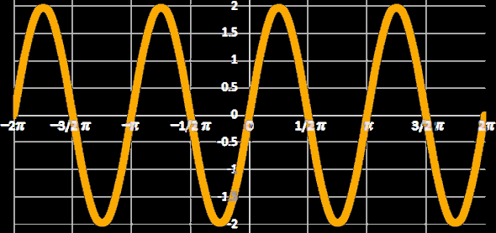
Transforming Functions
What is the equation for the graph?
VFrench, 2015

Slide 110
Transforming Functions
Is it a sin/cos/tan/cot/sec/csc?
VFrench, 2015

Slide 111
Transforming Functions
Is it a sin/cos/tan/cot/sec/csc?
A sin (it undulates and goes thru (0,0)
VFrench, 2015

Slide 112
Transforming Functions
Does it have the natural amplitude for a sin?
VFrench, 2015

Slide 113
Transforming Functions
Does it have the natural amplitude for a sin? No, it goes from -2 to 2 rather than -1 to 1
VFrench, 2015

Slide 114
Transforming Functions
So it’s going to be 2sin… but is the frequency the natural one?
VFrench, 2015

Slide 115
Transforming Functions
So it’s going to be 2sin… but is the frequency the natural one?
No, it cycles twice as often
VFrench, 2015

Slide 116
Transforming Functions
So it’s going to be: 2sin(2x)
VFrench, 2015

Slide 117
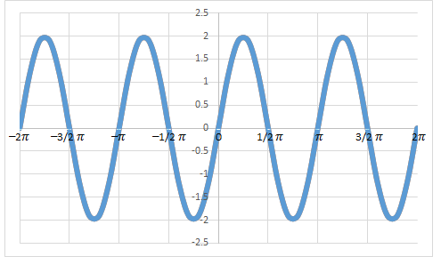
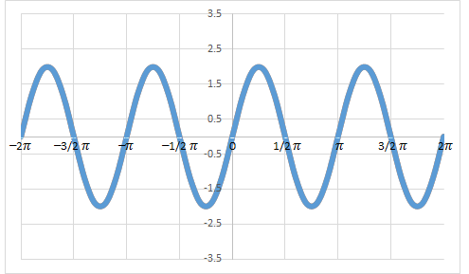
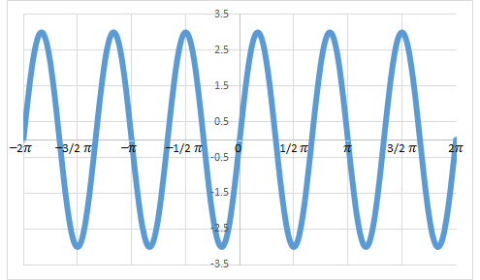
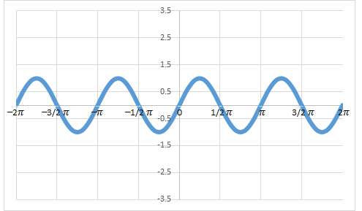
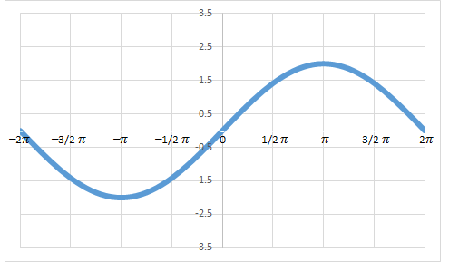
For your Homework:
What is the equation for the graph?
a) y = 2sin (2x)
b) y = 3sin (3x)
c) y = sin (2x)
d) y = 2sin (x/2)

Slide 118
How It’s Used
Applying transformations to sound waves results in effects that are prevalent in audio industries: altering pitch, and amplifying or diminishing sound waves and their echoes

Slide 119
How It’s Used
Transformed sound waves can be combined, resulting in a different quality of sound - the difference between a voice and a violin, for instance, or between two different voices

Slide 120
How It’s Used
Synthesizers use these combinations to recreate the sounds of common musical instruments

Slide 121
Questions?
www.career.gatech.edu

Slide 122

You Survived!
Don’t forget
your Homework
due next week!
Have a great rest
of the week!
www.playbuzz.com

