Slide 1
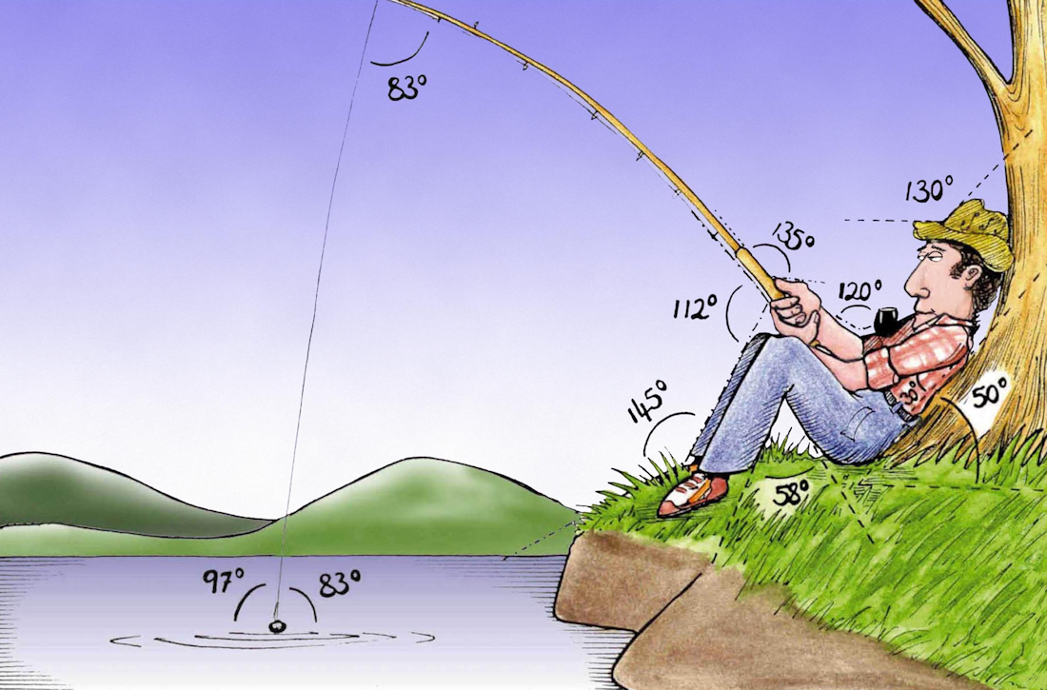
Welcome to
Week 5!
Analytic Trigonometry
http://www.lab-initio.com/images/fullsize/nz211.jpg

Slide 2
What’s Up?
Today we will be going over:
Review of transforms of
trig functions
Inverses of trig functions,
circuit analysis
Area of a triangle

Slide 3
What’s Up?
Obj 1) Apply the six trigonometric functions and their inverses to solve problems using degree and radian measures, right triangles and unit circles
Obj 5) Find the area of any triangle
Obj 9) Solve a problem by identifying the given data, making a sketch as appropriate, using trigonometric tools to model the problem, and calculating the final answer

Slide 4

Review
www.hrexaminer.com

Slide 5
More Trig Stuff
Descriptors for the natural trig functions:
 | Max x | Min x | Max y | Min y | Period (rad) | Period (degrees)
sin | ∞ | -∞ | 1 | -1 | 2π | 360°
cos | ∞ | -∞ | 1 | -1 | 2π | 360°
tan | ∞ | -∞ | ∞ | -∞ | π | 360°
cot | ∞ | -∞ | ∞ | -∞ | π | 360°
sec | ∞ | -∞ | ∞ | -∞ | 2π | 360°
csc | ∞ | -∞ | ∞ | -∞ | 2π | 360°
VFrench, 2015

Slide 6
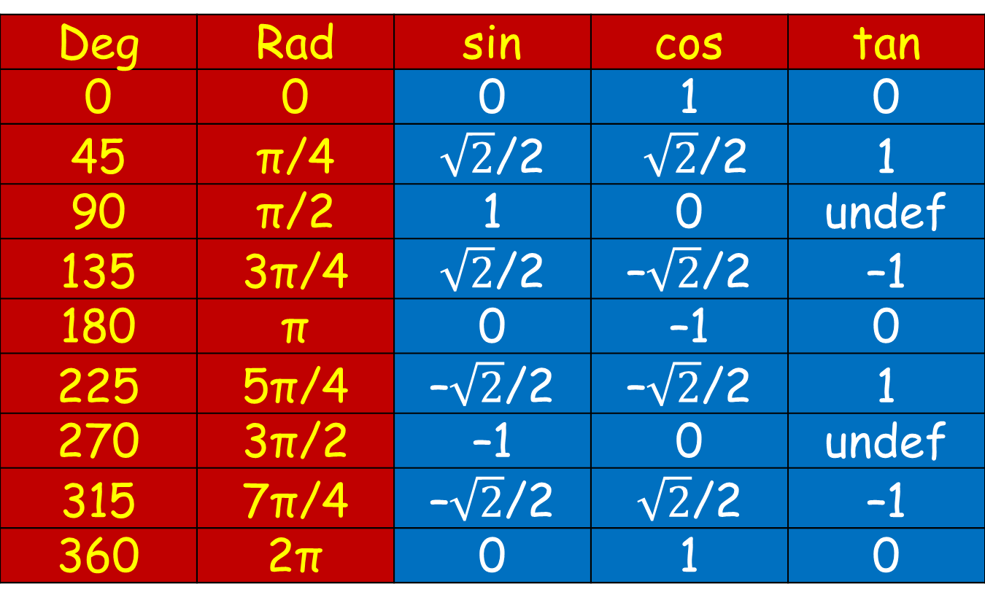
More Trig Stuff
Exact Values of Trig Functions
Deg | Rad | sin | cos | tan
0 | 0 | 0 | 1 | 0
45 | π/4 | $\sqrt{2}$/2 | $\sqrt{2}$/2 | 1
90 | π/2 | 1 | 0 | undef
135 | 3π/4 | $\sqrt{2}$/2 | –$\sqrt{2}$/2 | –1
180 | π | 0 | –1 | 0
225 | 5π/4 | –$\sqrt{2}$/2 | –$\sqrt{2}$/2 | 1
270 | 3π/2 | –1 | 0 | undef
315 | 7π/4 | –$\sqrt{2}$/2 | $\sqrt{2}$/2 | –1
360 | 2π | 0 | 1 | 0
VFrench, 2015

Slide 7
Transforming Functions
General form of trig functions:
y = A sin (Bx - C) + D
y = A cos (Bx - C) + D

Slide 8
Transforming Functions
y = A sin (Bx - C) + D
“A” stretches the graph up and down – “Amplitude”
“B” stretches the graph side to side – “Period”
“C” moves the graph side to side – “Phase shift”
“D” moves the graph up and down – “Vertical shift”

Slide 9


Questions?
lol-rofl.com

Slide 10
Inverse Functions
Undo a function

Slide 11
Inverse Functions
When you want to “undo” an addition, you ...

Slide 12
Inverse Functions
When you want to “undo” a multiplication, you ...

Slide 13
Inverse Functions
When you want to “undo an exponent, you ...

Slide 14
Inverse Functions
These are all called “inverse” functions

Slide 15
Inverse Functions
A function f (x)
has an inverse f ⁻¹ (x)

Slide 16
Inverse Trig Functions
Naturally, we want a way to “undo” trig functions, too

Slide 17
Inverse Trig Functions
The inverse of a trig function “undoes” the trig operation

Slide 18
Inverse Trig Functions
What angle will give you a sin of approximately 0.7071?

Slide 19
Inverse Trig Functions
If sin(45°) ≈ 0.7071
Then sin⁻¹(0.7071) ≈ 45°

Slide 20
Inverse Trig Functions
sin(45°) ≈ 0.7071
sin⁻¹(0.7071) ≈ 45°
So, an inverse trig function tells you the ANGLE that would give you that trig function value

Slide 21
Inverse Trig Functions
The inverse of a sine is called an
“arcsine”

Slide 22
Inverse Trig Functions
On your calculator, it is shown as:
sin ⁻¹

Slide 23
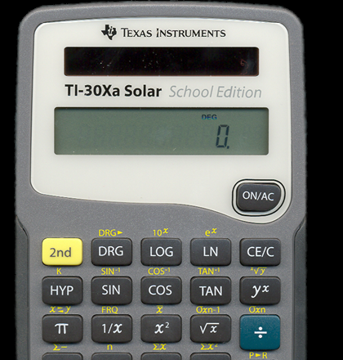
Inverse Trig Functions
It is found on your calculator usually as a “shift” of the trig function

Slide 24
Inverse Trig Functions
Likewise for cos and tan

Slide 25
TRIG INVERSE
IN-CLASS PROBLEMS 1,2,3
Calculate the angle in degrees:
cos ⁻¹(0.7314)
sin ⁻¹(-0.4384)
tan ⁻¹(-2.4751)

Slide 26
TRIG INVERSE
IN-CLASS PROBLEMS 4,5,6
Calculate the angle in radians:
cos ⁻¹(-0.6213)
sin ⁻¹(0.1129)
tan ⁻¹(27.6821)

Slide 27
Inverse Trig Functions
An inverse trig function tells you the ANGLE that would give you that trig function value

Slide 28
TRIG INVERSE
IN-CLASS PROBLEMS 7,8,9
Find the angle θ in radians with a trig function value of:
cos θ = -0.2756 θ = ?
sin θ = 0.6561 θ = ?
tan θ = 28.6363 θ = ?

Slide 29
Questions?
www.career.gatech.edu

Slide 30
Inverse Trig Functions
The bad news…

Slide 31
Inverse Trig Functions
The bad news…
The notation cos ⁻¹(0.7314)
would USUALLY mean:
1 .
cos(0.7314)
(which would be the secant, so it’s not… but don’t let the notation confuse you!)

Slide 32
Inverse Trig Functions
There’s another notation for inverse trig functions that avoids this ambiguity:
cos⁻¹(x)=arccos(x)
sin⁻¹(x)=arcsin(x)
tan⁻¹(x)=arctan(x)

Slide 33
Inverse Trig Functions
Just remember:
θ = cos⁻¹(x) ⇔ x = cos(θ)
θ = sin⁻¹(x) ⇔ x = sin(θ)
θ = tan⁻¹(x) ⇔ x = tan(θ)

Slide 34
Questions?
www.career.gatech.edu

Slide 35
Inverse Trig Functions
What it’s used for…

Slide 36
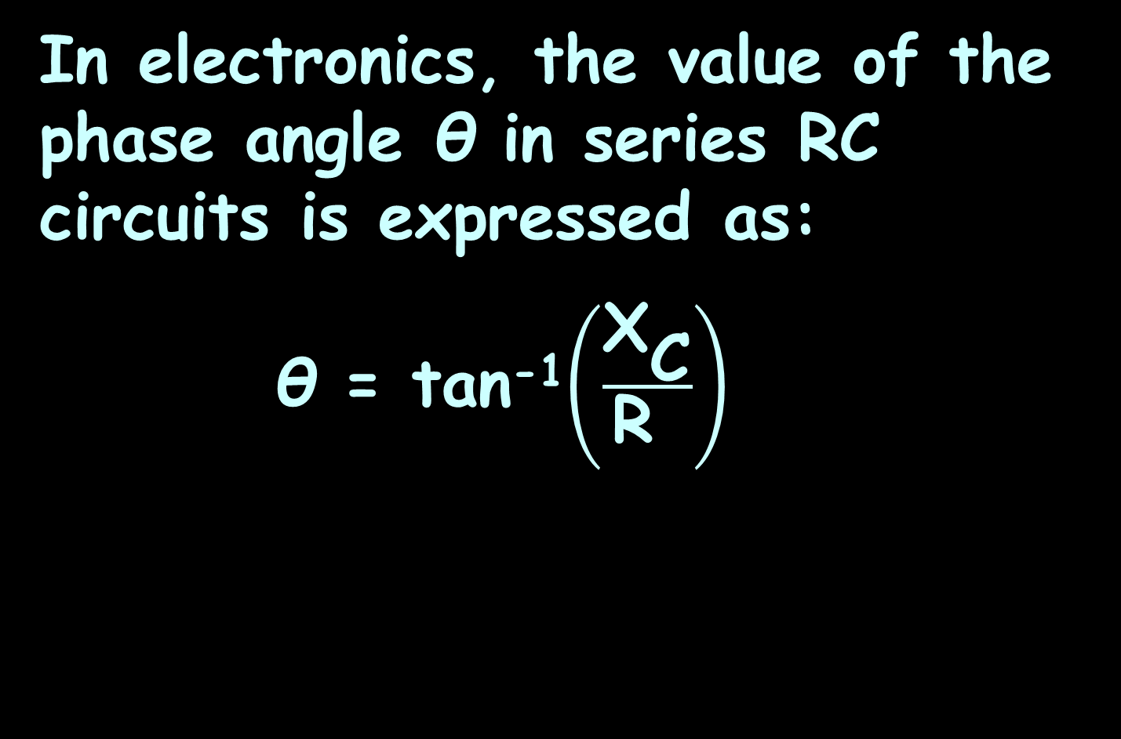
Inverse Trig Functions
In electronics, the value of the phase angle θ in series RC circuits is expressed as:
θ = tan⁻¹$\left(\frac{{\text{X}}_{\text{C}}}{\text{R} }\right)$
capacitive reactance
resistance

Slide 37
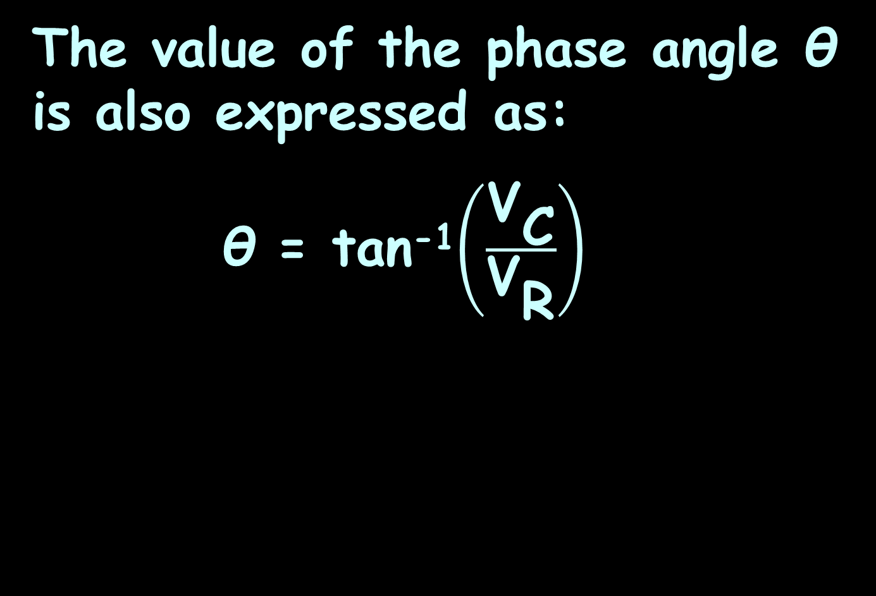
Inverse Trig Functions
The value of the phase angle θ is also expressed as:
θ = tan⁻¹$\left(\frac{{\text{V}}_{\text{C}}}{{\text{V}}_{\text{R}}}\right)$
source voltage
resistor voltage

Slide 38
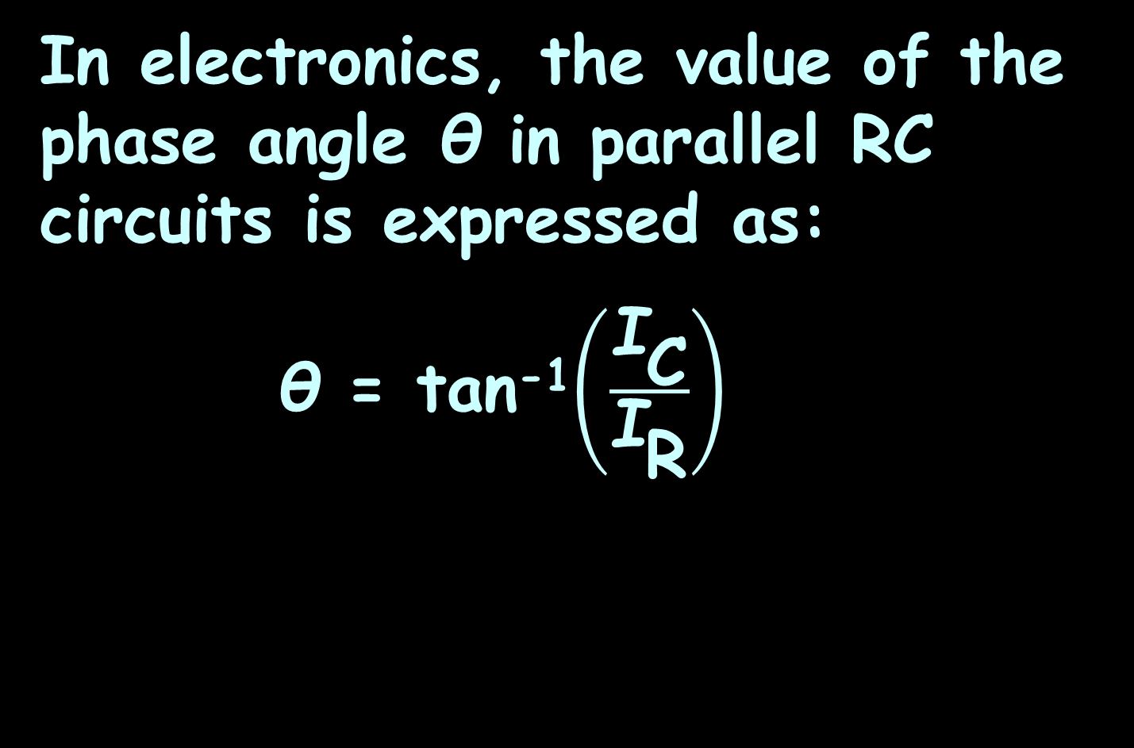
Inverse Trig Functions
In electronics, the value of the phase angle θ in parallel RC circuits is expressed as:
θ = tan⁻¹$\left(\frac{{\text{I}}_{\text{C}}}{{\text{I}}_{\text{R}}}\right)$
total current
resistor current

Slide 39

Inverse Trig Functions
Or:
θ = tan⁻¹$\left(\frac{\text{R}}{{\text{X}}_{\text{C}}}\right)$

Slide 40
Inverse Trig Functions
There’s a problem: your calculator will give you the “first” answer it comes up with

Slide 41
Inverse Trig Functions
There’s a problem: your calculator will give you the “first” answer it comes up with
This will be in quadrant I or II

Slide 42
Inverse Trig Functions
There’s a problem: your calculator will give you the “first” answer it comes up with
This will be in quadrant I or II
But, your answer may need to be in QIII or QIV

Slide 43
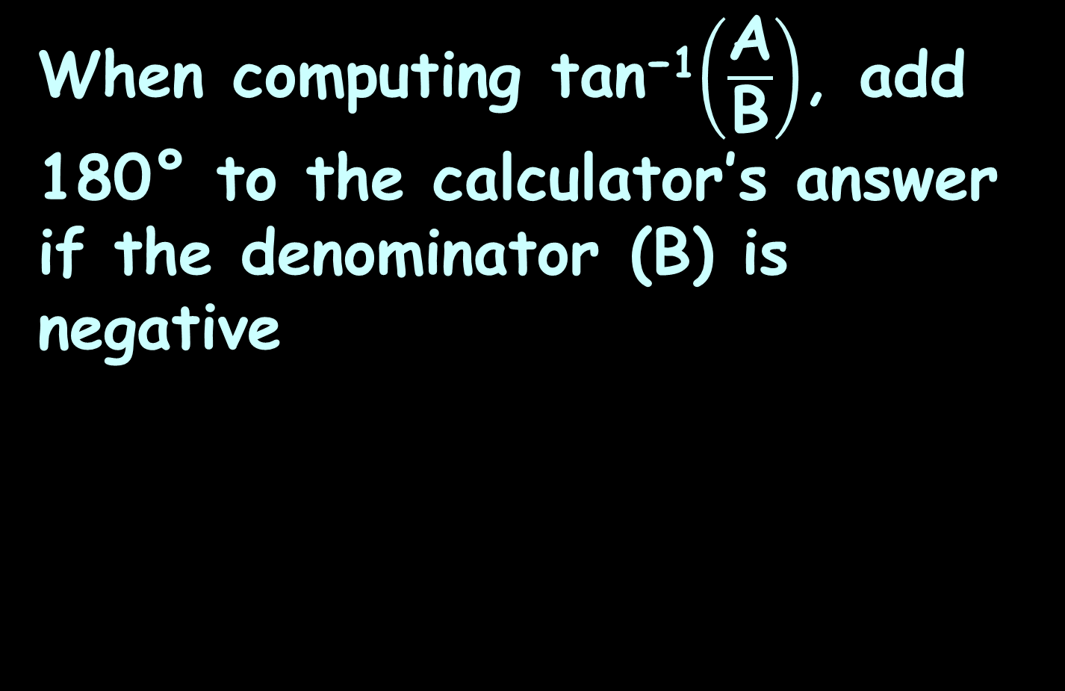
Inverse Trig Functions
When computing tan⁻¹$\left(\frac{\text{A}}{\text{B}}\right)$, add 180° to the calculator’s answer if the denominator (B) is negative

Slide 44

Inverse Trig Functions
The RC lag circuit :
Φ = 90° - tan⁻¹$\left(\frac{{\text{X}}_{\text{C}}}{\text{R} }\right)$
phase lag

Slide 45

Inverse Trig Functions
The RC lead circuit :
Φ = tan⁻¹$\left(\frac{{\text{X}}_{\text{C}}}{\text{R} }\right)$
phase lead

Slide 46

TRIG INVERSE
IN-CLASS PROBLEM 10
Determine the impedance and phase angle of the RC circuit:
$${\text{X}}_{\text{C}}$$
R
~
47 Ω
100 Ω
V_{S}

Slide 47
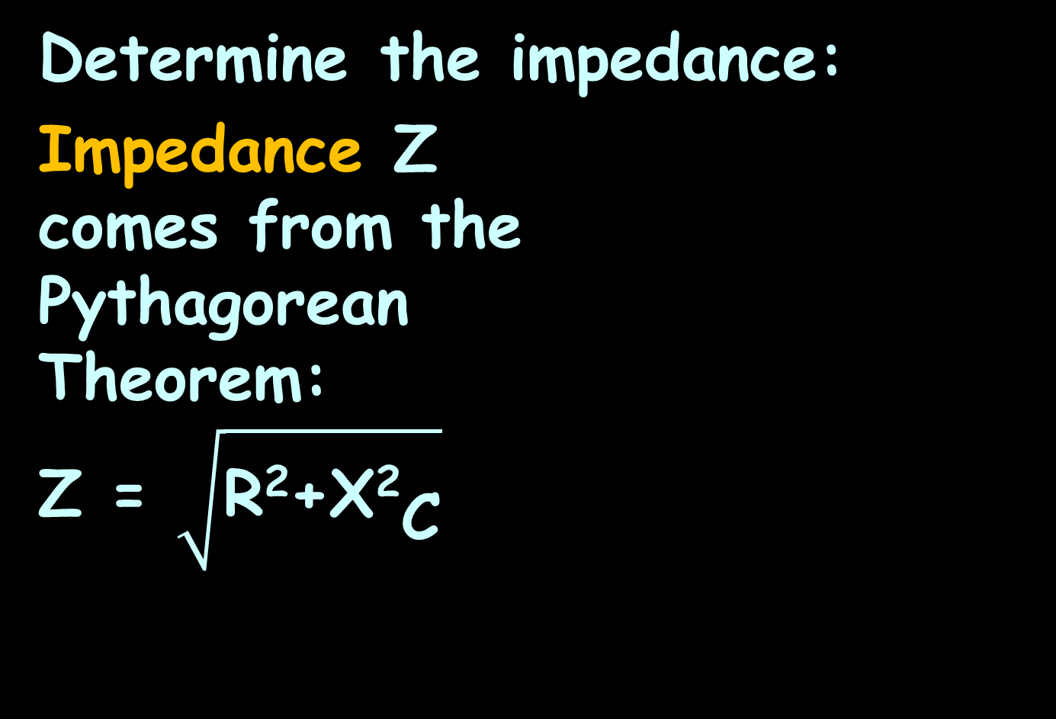
TRIG INVERSE
IN-CLASS PROBLEM 10
Determine the impedance:
Impedance Z
comes from the
Pythagorean
Theorem:
Z = $\sqrt{\text{R}\text{2}\text{+}{\text{X}\text{2}}_{\text{C}}}$
$${\text{X}}_{\text{C}}$$
R
~
47 Ω
100 Ω
V_{S}

Slide 48
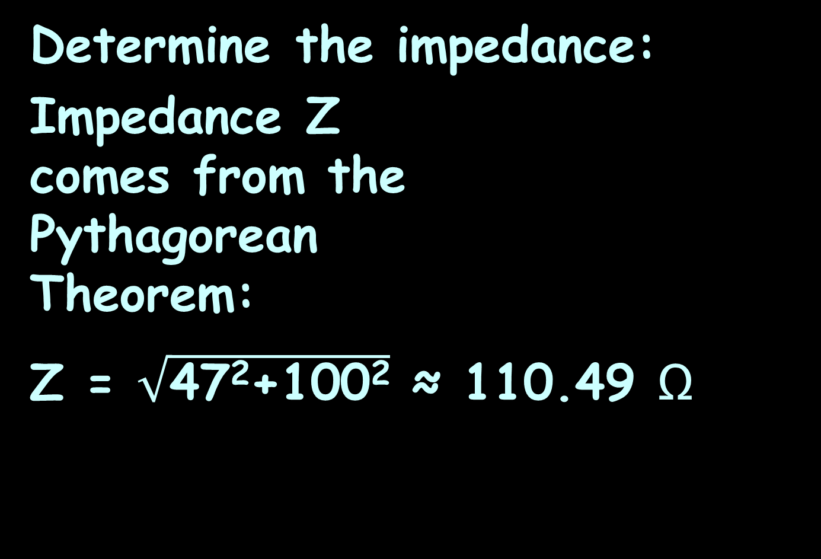
TRIG INVERSE
IN-CLASS PROBLEM 10
Determine the impedance:
Impedance Z
comes from the
Pythagorean
Theorem:
Z = $\sqrt{\text{47}\text{2}\text{+}\text{100}\text{2}}$ ≈ 110.49 Ω
$${\text{X}}_{\text{C}}$$
R
~
47 Ω
100 Ω
V_{S}

Slide 49
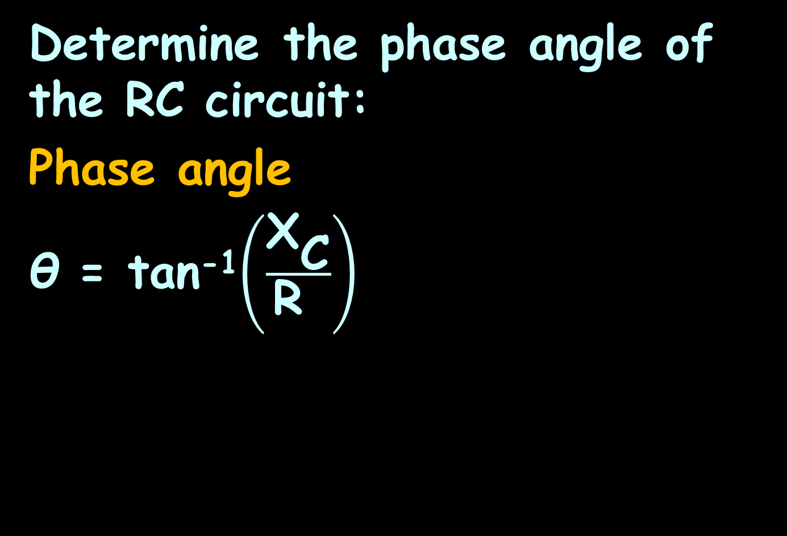
TRIG INVERSE
IN-CLASS PROBLEM 11
Determine the phase angle of the RC circuit:
Phase angle
θ = tan⁻¹$\left(\frac{{\text{X}}_{\text{C}}}{\text{R} }\right)$
$${\text{X}}_{\text{C}}$$
R
~
47 Ω
100 Ω
V_{S}

Slide 50
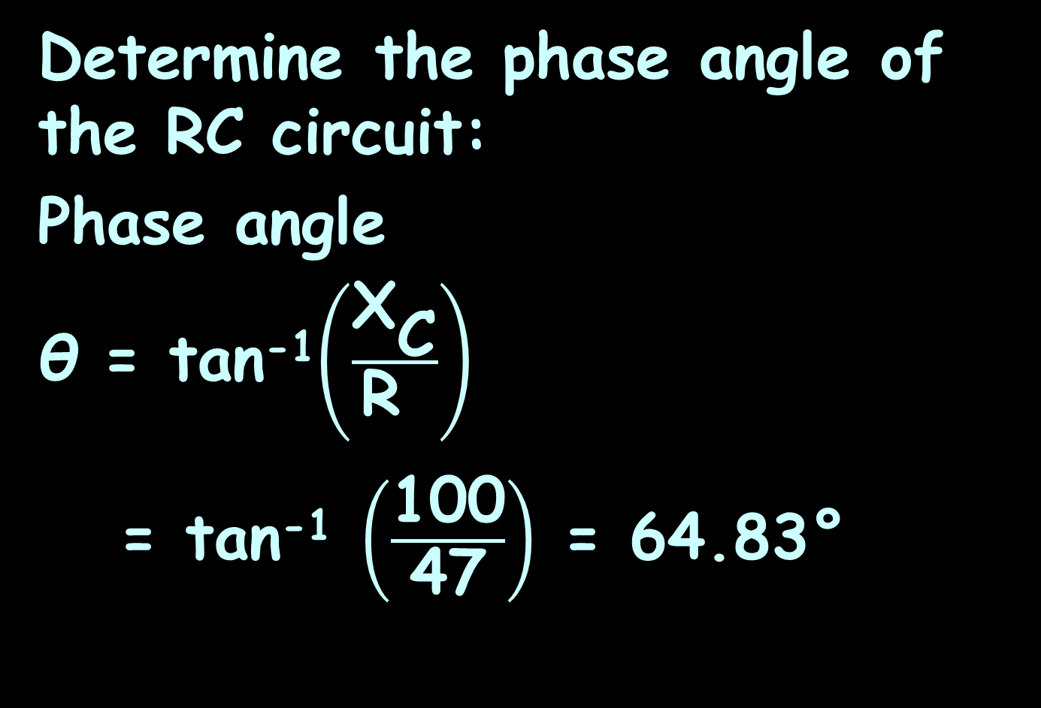
TRIG INVERSE
IN-CLASS PROBLEM 11
Determine the phase angle of the RC circuit:
Phase angle
θ = tan⁻¹$\left(\frac{{\text{X}}_{\text{C}}}{\text{R} }\right)$
= tan⁻¹ $\left(\frac{\text{100}}{\text{47}}\right)$ = 64.83°
$${\text{X}}_{\text{C}}$$
R
~
47 Ω
100 Ω
V_{S}

Slide 51
Inverse Trig Functions
Resistance (R) and reactance (X) are 90° apart, so their angle of intersection forms a right angle

Slide 52
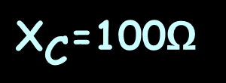
Inverse Trig Functions
Resistance (R) and reactance (X) are 90° apart, so their angle of intersection forms a right angle
R=47Ω
${\text{X}}_{\text{C}}$=100Ω

Slide 53
Inverse Trig Functions
Adding the impedance (Z) line at the angle θ makes a right triangle
R=47Ω
θ=64.8°
${\text{X}}_{\text{C}}$=100Ω
Z=110Ω

Slide 54
TRIG INVERSE
IN-CLASS PROBLEM 12
This is called the “impedance triangle”
R=47Ω
θ=64.8°
${\text{X}}_{\text{C}}$=100Ω
Z=110Ω

Slide 55
Inverse Trig Functions
Now you know how to analyze an RC circuit!

Slide 56
Questions?
www.career.gatech.edu

Slide 57
Oblique Triangles
Trig without radians!!!!!

Slide 58
Oblique Triangles
“Oblique” means “slanting”

Slide 59
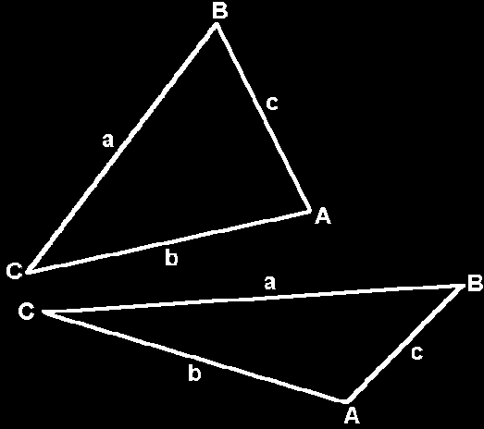
Oblique Triangles
Do not contain a right angle

Slide 60
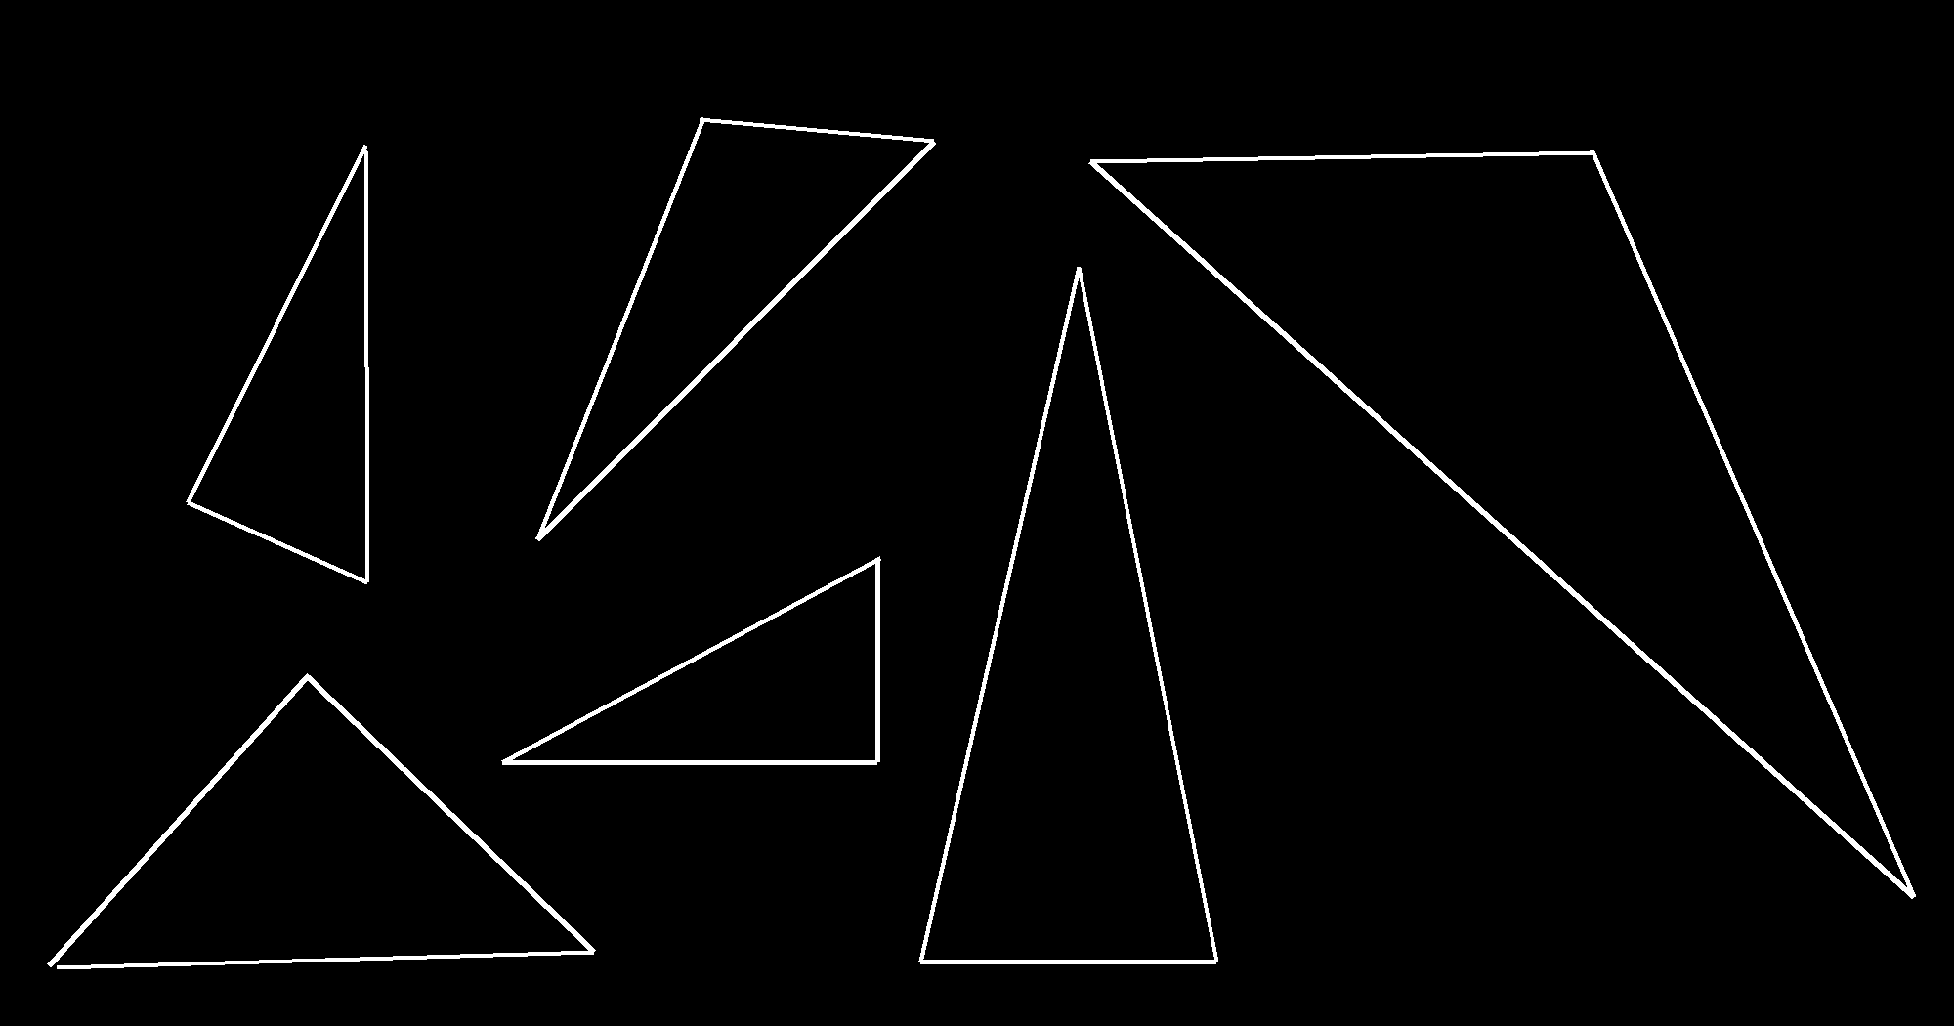
Oblique Triangles
IN-CLASS PROBLEM 13
Which is oblique?
Which is right?
b
c
a
e
f
d

Slide 61
Oblique Triangles
IN-CLASS PROBLEM 14
Which is oblique?
Which is right?
A = 90° B = 20° C = 70°
A = 100° B = 30° C = 50°

Slide 62
Oblique Triangles
All the angles of a triangle
add up to _____

Slide 63
Oblique Triangles
IN-CLASS PROBLEM 15
Solve for C:
A = 68° B = 49°
A = 13° B = 170°
A = 102° B = 89°

Slide 64
Oblique Triangles
IN-CLASS PROBLEM 16
Which is a triangle?
A = 80° B = 20° C = 70°
A = 110° B = 30° C = 50°
A = 75° B = 20° C = 85°

Slide 65
Questions?
www.career.gatech.edu

Slide 66
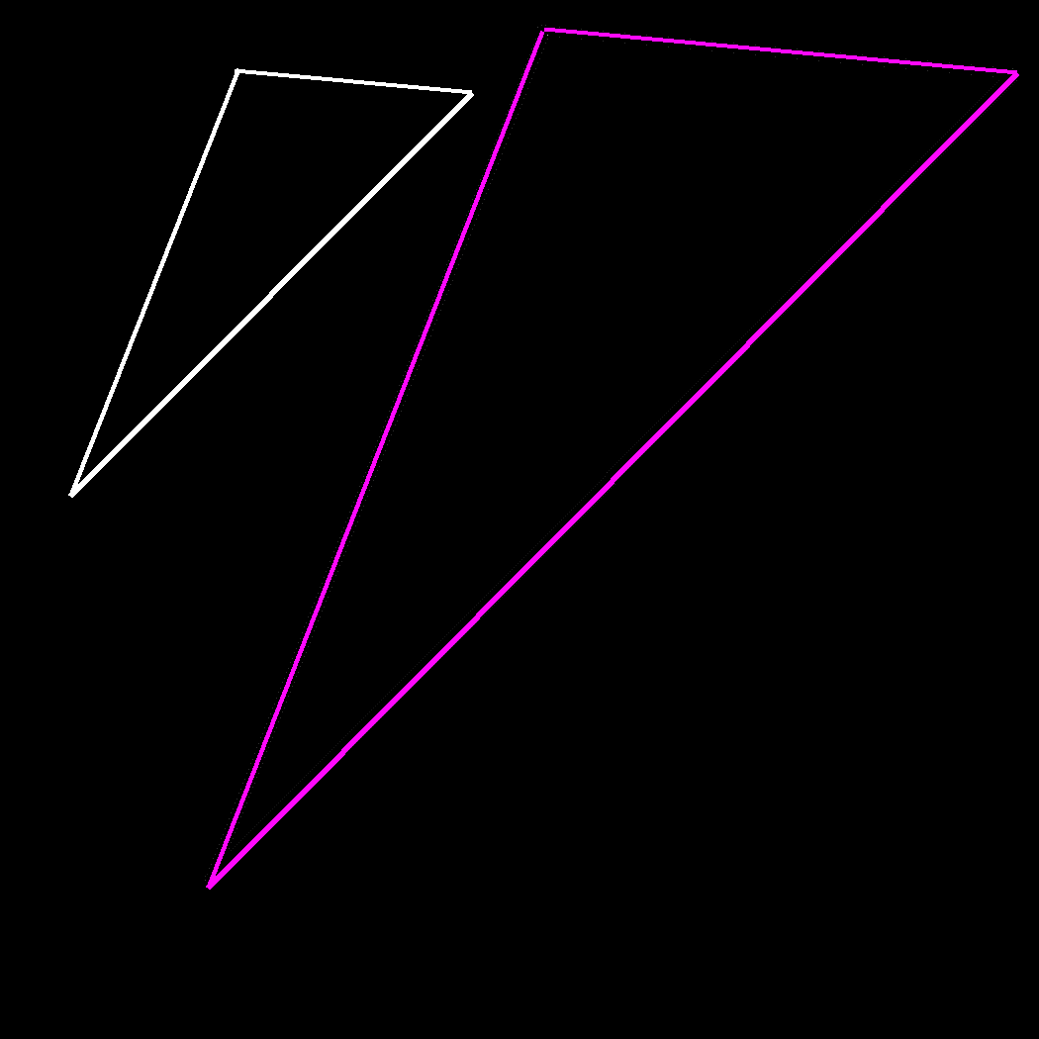
Area of a Triangle
Given the three angles of a triangle, you have no clue as to how long the sides
are:

Slide 67
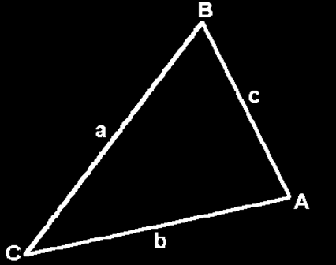
Area of a Triangle
If you have measurements of some of the sides and some of the angles it is usually
possible to figure
out all of the
measurements
of a triangle

Slide 68
Area of a Triangle
(More about that in two weeks)

Slide 69
Area of a Triangle
You can calculate the area of a triangle using the formulas:
Area = ½ cb sinA
= ½ ac sinB
= ½ ab sinC

Slide 70
Area of a Triangle
Area = ½ cb sinA
= ½ ac sinB
= ½ ab sinC
Note: These
formulas work
if you have
measurements for two sides and the angle between them (the “included” angle)

Slide 71
Area of a Triangle
Traditionally, these are called “SAS” (side-angle-side) problems

Slide 72
Area of a Triangle
IN-CLASS PROBLEM 17
Find the area of a triangle with two sides 8 meters and 12 meters with an angle between them of 135º

Slide 73
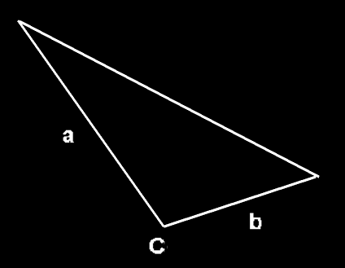
Area of a Triangle
IN-CLASS PROBLEM 17
a = 8 meters
b = 12 meters
C = 135º
Area = ?

Slide 74
Area of a Triangle
IN-CLASS PROBLEM 17
a = 8 meters
b = 12 meters
C = 135º
Area = ½ ab sinC

Slide 75
Area of a Triangle
IN-CLASS PROBLEM 17
a = 8 meters
b = 12 meters
C = 135º
Area = ½ ab sinC
= ½ (8)(12)sin135º
≈ 48(0.7071) ≈ 33.9

Slide 76
Area of a Triangle
IN-CLASS PROBLEM 17
What are the units?

Slide 77
Area of a Triangle
IN-CLASS PROBLEM 17
Meters squared!
The area of the triangle is (approximately)
33.9 sq meters

Slide 78
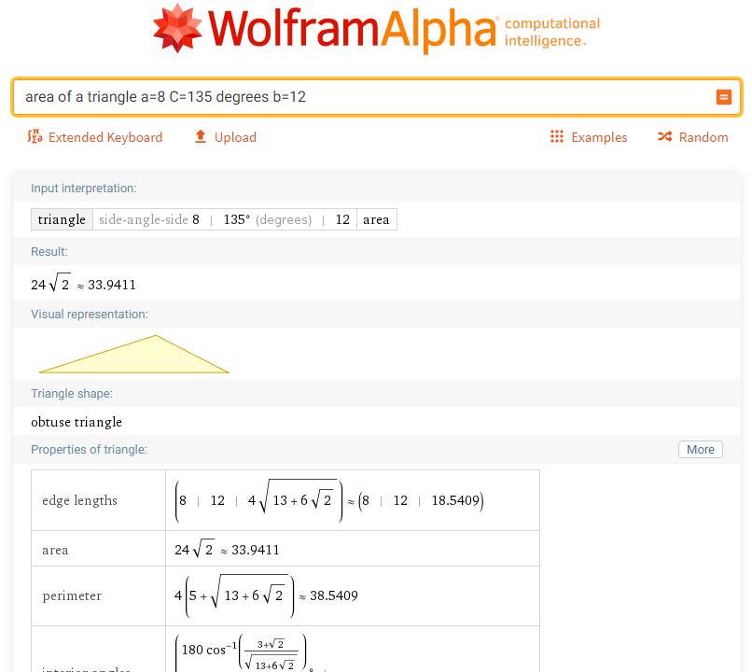

Slide 79
Area of a Triangle
Note you must enter it in the form:
triangle 8, 135 degrees, 12

Slide 80
Heron’s Formula
How to find the area of a triangle when you don’t have an included angle

Slide 81
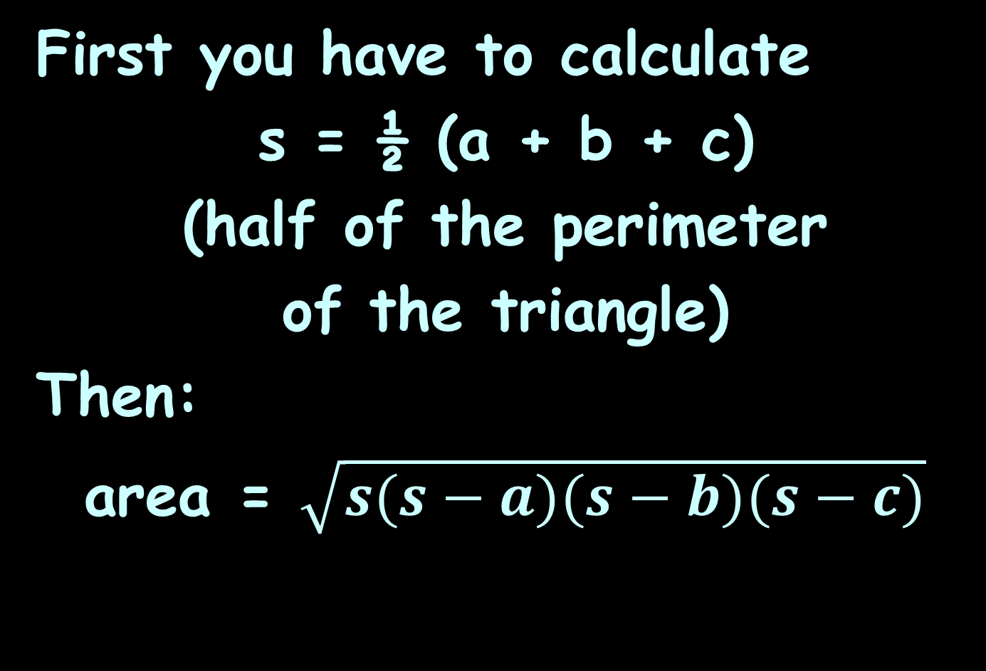
Heron’s Formula
First you have to calculate
s = ½ (a + b + c)
(half of the perimeter
of the triangle)
Then:
area = $\sqrt{s(s−a)(s−b)(s−c)}$

Slide 82
Heron’s Formula
IN-CLASS PROBLEM 18
Find the area of a triangle with
a = 6m, b = 16m and c = 18m
What do we need to do first?

Slide 83
Heron’s Formula
IN-CLASS PROBLEM 18
Find the area of a triangle with a = 6m, b = 16m and c = 18m
s = ½ (a + b + c)
s = ½ (6 + 16 + 18)
s = 20
Now what?

Slide 84
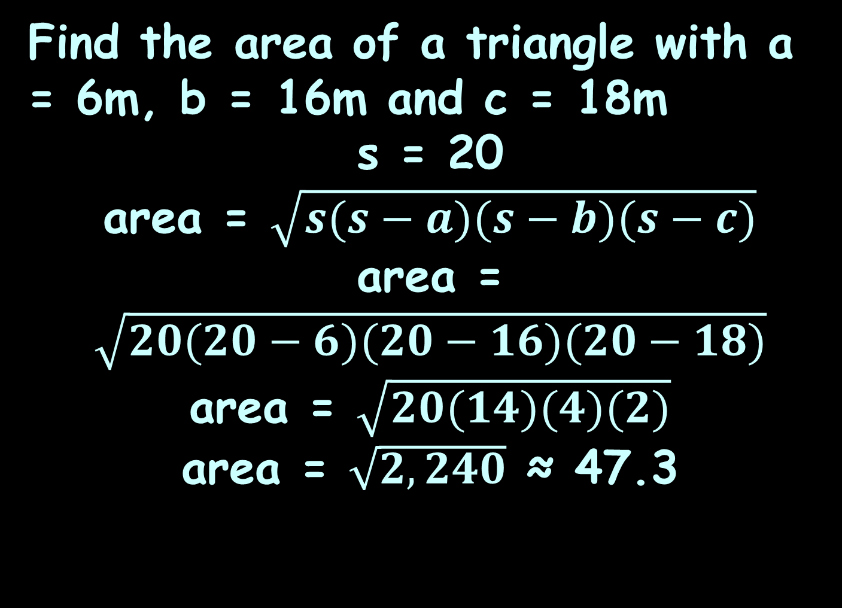
Heron’s Formula
IN-CLASS PROBLEM 18
Find the area of a triangle with a = 6m, b = 16m and c = 18m
s = 20
area = $\sqrt{s(s−a)(s−b)(s−c)}$
area = $\sqrt{20(20−6)(20−16)(20−18)}$
area = $\sqrt{20(14)(4)(2)}$
area = $\sqrt{2,240}$ ≈ 47.3

Slide 85
Heron’s Formula
IN-CLASS PROBLEM 18
What’s the units???

Slide 86
Heron’s Formula
IN-CLASS PROBLEM 18
Find the area of a triangle with a = 6m, b = 16m and c = 18m
s = 20
area ≈ 47.3 sq meters

Slide 87
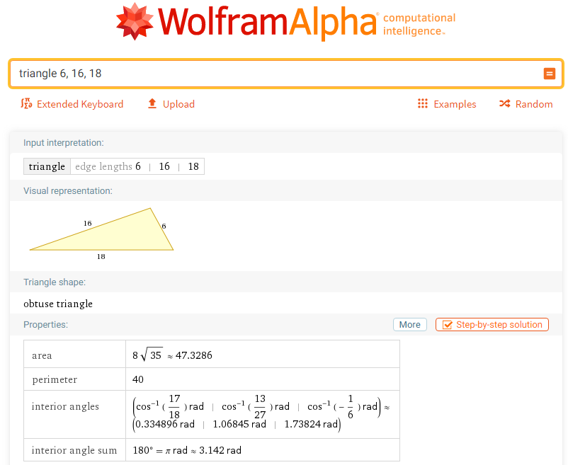

Slide 88
Heron’s Formula
Note you must enter it in the form:
triangle 6, 16, 18

Slide 89
Questions?
www.career.gatech.edu

Slide 90

You Survived!
Don’t forget
your Homework
due next week!
Have a great rest
of the week!
www.playbuzz.com

