Slide 1
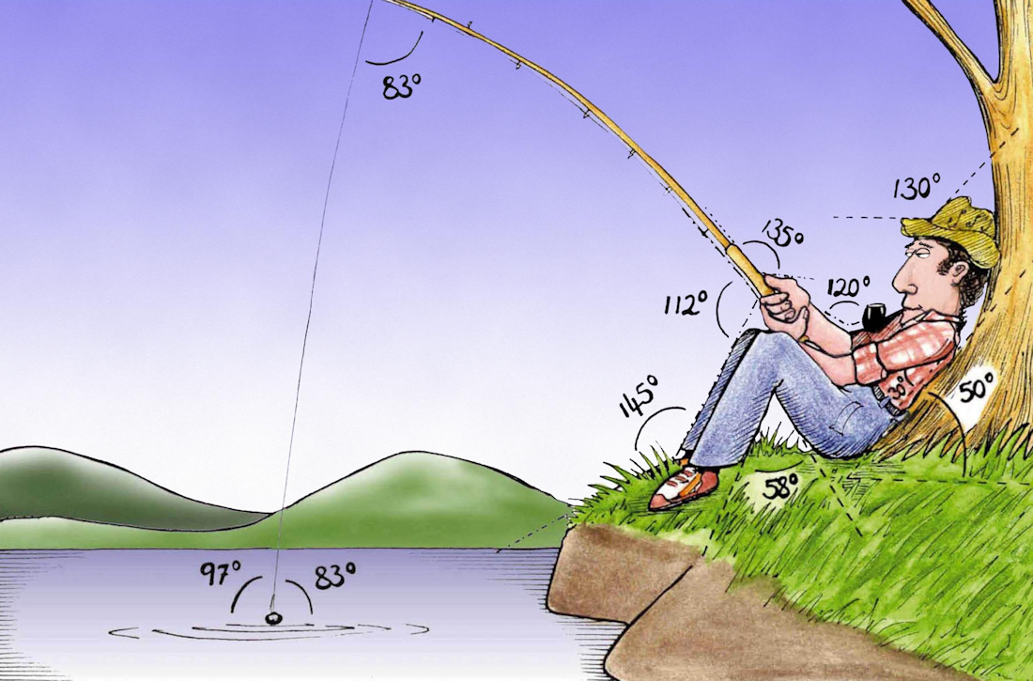
Welcome to
Week 6!
Analytic Trigonometry
http://www.lab-initio.com/images/fullsize/nz211.jpg

Slide 2
What’s Up?
Today we will be going over:
Review of inverses of trig
functions and area of a
triangle
Law of Sines
Law of Cosines

Slide 3
What’s Up?
Obj 5) Solve triangles using the Laws of Sines and Cosines

Slide 4

Review
www.hrexaminer.com

Slide 5
Inverse Trig Functions
We want a way to “undo” trig functions
The inverse of a trig function “undoes” the trig operation

Slide 6
Inverse Trig Functions
The inverse of a sine is called an
“arcsine”
On your calculator, it is shown as:
sin ⁻¹

Slide 7
Inverse Trig Functions
An inverse trig function tells you the ANGLE that would give you that trig function value

Slide 8
RC Circuit Analysis
An RC circuit contains both a resistor and a capacitor
V_{S}
~
VFrench 2015

Slide 9
RC Circuit Analysis
The resistor reduces current flow
Called resistance
Symbolized “R”
Measured in
ohms Ω
R
~
47 Ω
V_{S}
VFrench 2015

Slide 10
RC Circuit Analysis
The capacitor also opposes current flow by causing the alternating voltage
to lag behind
the alternating
current
R
~
47 Ω
V_{S}
VFrench 2015

Slide 11

RC Circuit Analysis
This opposition is called capacitive reactance
Symbolized “X_{C}”
Measured in
ohms Ω
$${\text{X}}_{\text{C}}$$
R
~
47 Ω
100 Ω
V_{S}
VFrench 2015

Slide 12

RC Circuit Analysis
Reactance (X_{C}) has a 90° lag compared to resistance (R), so their angle of intersection
forms a right
angle
(Downward because
it lags)
R
${\text{X}}_{\text{C}}$
VFrench 2015

Slide 13
RC Circuit Analysis
Adding the impedance (Z) line at the angle θ makes a right triangle
This is called the
“impedance triangle”
R
θ
${\text{X}}_{\text{C}}$
Z
VFrench 2015

Slide 14

RC Circuit Analysis
Impedance Z comes from the
Pythagorean Theorem:
Z = $\sqrt{ \text{R}\text{2} \text{+} \text{X}\text{C}\text{2} }$
R
θ
${\text{X}}_{\text{C}}$
Z
VFrench 2015

Slide 15

RC Circuit Analysis
The value of the phase angle θ is:
θ = tan⁻¹$\left(\frac{{\text{X}}_{\text{C}}}{\text{R} }\right)$
R
θ
${\text{X}}_{\text{C}}$
Z
VFrench 2015

Slide 16
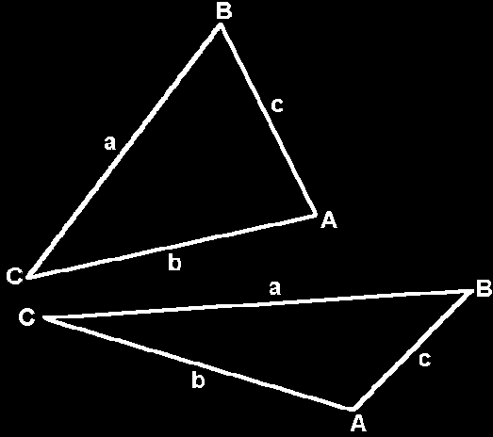
Oblique Triangles
Do not contain a right angle
VFrench 2015

Slide 17
Oblique Triangles
All the angles of a triangle
add up to 180°

Slide 18
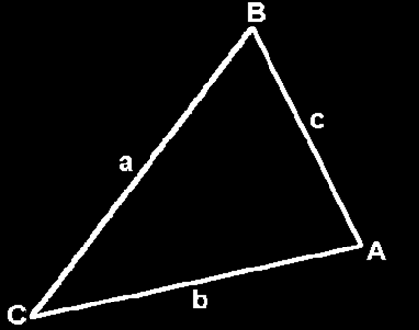
Area of a Triangle
Area = ½ cb sinA
= ½ ac sinB
= ½ ab sinC
Note: You need
two sides and the angle
between them (the “included” angle) OR you need two “little” letters and the other “big”
VFrench 2015

Slide 19
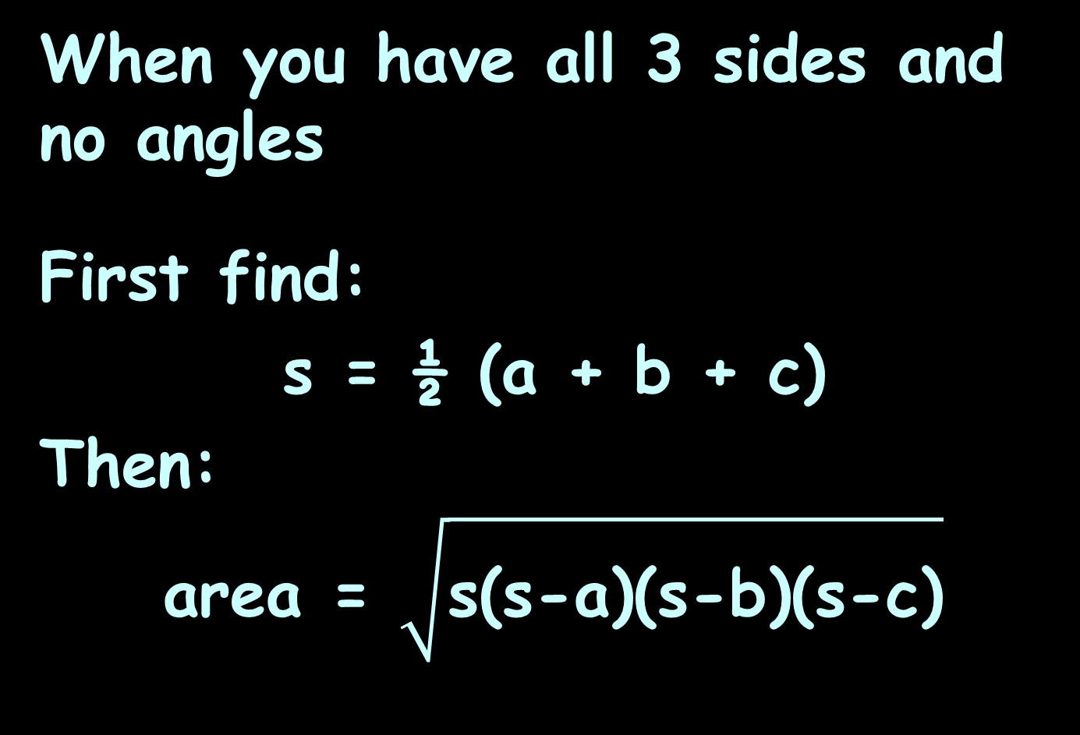
Heron’s Formula
When you have all 3 sides and no angles
First find:
s = ½ (a + b + c)
Then:
area = $\sqrt{\text{s}\text{(}\text{s}\text{−}\text{a}\text{)(}\text{s}\text{−}\text{b}\text{)(}\text{s}\text{−}\text{c}\text{)}}$

Slide 20


Questions?
lol-rofl.com

Slide 21

Oblique Triangles
Trig without radians!!!!!
hooray.jpg

Slide 22
Oblique Triangles
Do not contain a right angle
VFrench 2015

Slide 23
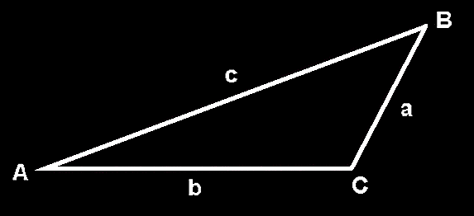
Oblique Triangles
Standard way of showing them:
VFrench 2015

Slide 24
Oblique Triangles
If you have measurements of some of the sides and some of the angles, it is usually
possible to figure
out all of the
measurements
of a triangle
VFrench 2015

Slide 25
Oblique Triangles
There are two rules we use for these calculations:
the Law of Sines
the Law of Cosines

Slide 26
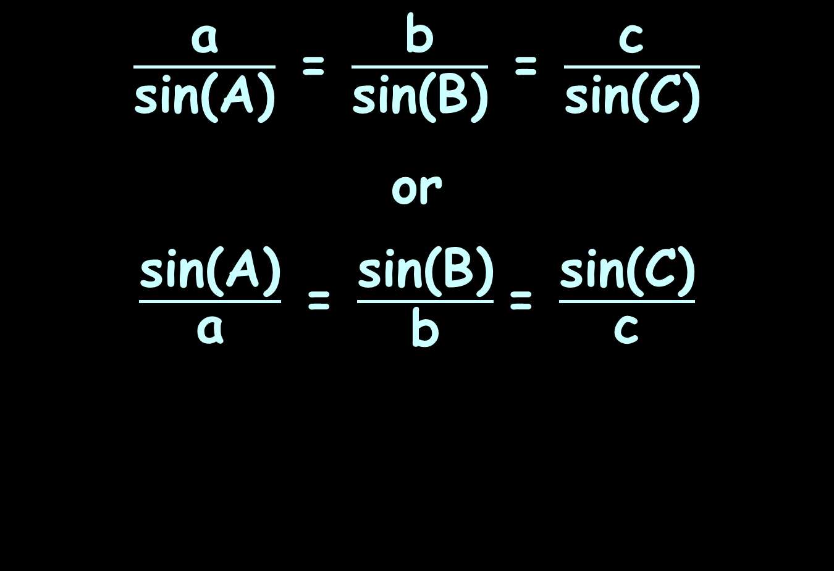
Law of Sines
$\frac{\text{a}}{\text{sin}\text{(}\text{A}\text{)}}$ = $\frac{\text{b}}{\text{sin}\text{(}\text{B}\text{)}}$ = $\frac{\text{c}}{\text{sin}\text{(}\text{C}\text{)}}$
or
$\frac{\text{sin}\text{(}\text{A}\text{)}}{\text{a}}$ = $\frac{\text{sin}\text{(}\text{B}\text{)}}{\text{b}}$= $\frac{\text{sin}\text{(}\text{C}\text{)}}{\text{c}}$

Slide 27
Law of Sines
You use the version that makes it easiest to solve for what you want to find

Slide 28
Law of Sines
If you have 2 angles, you can solve for the third one using:
A+B+C = 180°

Slide 29
Law of Sines
If you have 2 angles, you can solve for the third one using:
A+B+C = 180°
If you have a “big” and a “little” of the same letter, you can use the Law of Sines

Slide 30
LAW OF SINES
IN-CLASS PROBLEM 1
Solve the triangle:
A = 64°
C = 82°
c = 14 cm
First rewrite it into a table to make it easier to see what we have and what we need

Slide 31
LAW OF SINES
IN-CLASS PROBLEM 1
Solve the triangle:
A = 64° a = ___
B = ___ b = ___
C = 82° c = 14 cm
What do we have?
What do we need?

Slide 32
LAW OF SINES
IN-CLASS PROBLEM 1
Solve the triangle:
A = 64° a = ___
B = ___ b = ___
C = 82° c = 14 cm
We have two “bigs”, so we can solve for B:
A + B + C = 180°

Slide 33
LAW OF SINES
IN-CLASS PROBLEM 1
Solve the triangle:
A = 64° a = ___
B = ___ b = ___
C = 82° c = 14 cm
We have two “bigs”, so we can solve for B:
B = 180°- A - C

Slide 34
LAW OF SINES
IN-CLASS PROBLEM 1
Solve the triangle:
A = 64° a = ___
B = ___ b = ___
C = 82° c = 14 cm
We have two “bigs”, so we can solve for B:
B = 180°- 64° - 82°

Slide 35
LAW OF SINES
IN-CLASS PROBLEM 1
Solve the triangle:
A = 64° a = ___
B = 34° b = ___
C = 82° c = 14 cm
We have two “bigs”, so we can solve for B:
B = 180°- 64° - 82° = 34°

Slide 36
LAW OF SINES
IN-CLASS PROBLEM 1
Solve the triangle:
A = 64° a = ___
B = 34° b = ___
C = 82° c = 14 cm
We’ve got all the angles! YAY!
Now for the sides…

Slide 37
LAW OF SINES
IN-CLASS PROBLEM 1
Solve the triangle:
A = 64° a = ___
B = 34° b = ___
C = 82° c = 14 cm
Do we have a “big” and a “little”?

Slide 38
LAW OF SINES
IN-CLASS PROBLEM 1
Solve the triangle:
A = 64° a = ___
B = 34° b = ___
C = 82° c = 14 cm
Do we have a “big” and a “little”? We have C and c
What do we need?

Slide 39
LAW OF SINES
IN-CLASS PROBLEM 1
Solve the triangle:
A = 64° a = ___
B = 34° b = ___
C = 82° c = 14 cm
Do we have a “big” and a “little”? We have C and c
What do we need? a and b
So we can use…

Slide 40
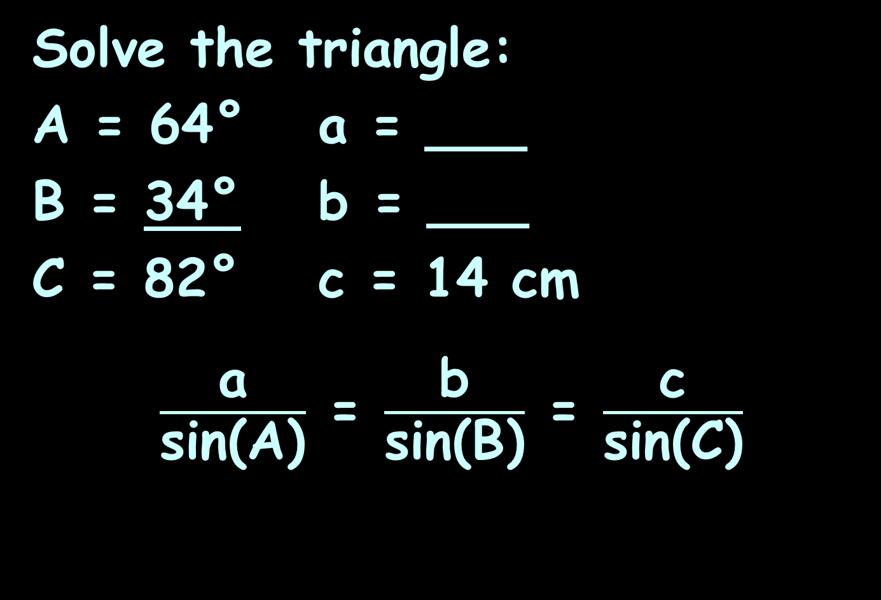
LAW OF SINES
IN-CLASS PROBLEM 1
Solve the triangle:
A = 64° a = ___
B = 34° b = ___
C = 82° c = 14 cm
$\frac{\text{a}}{\text{sin}\text{(}\text{A}\text{)}}$ = $\frac{\text{b}}{\text{sin}\text{(}\text{B}\text{)}}$ = $\frac{\text{c}}{\text{sin}\text{(}\text{C}\text{)}}$

Slide 41
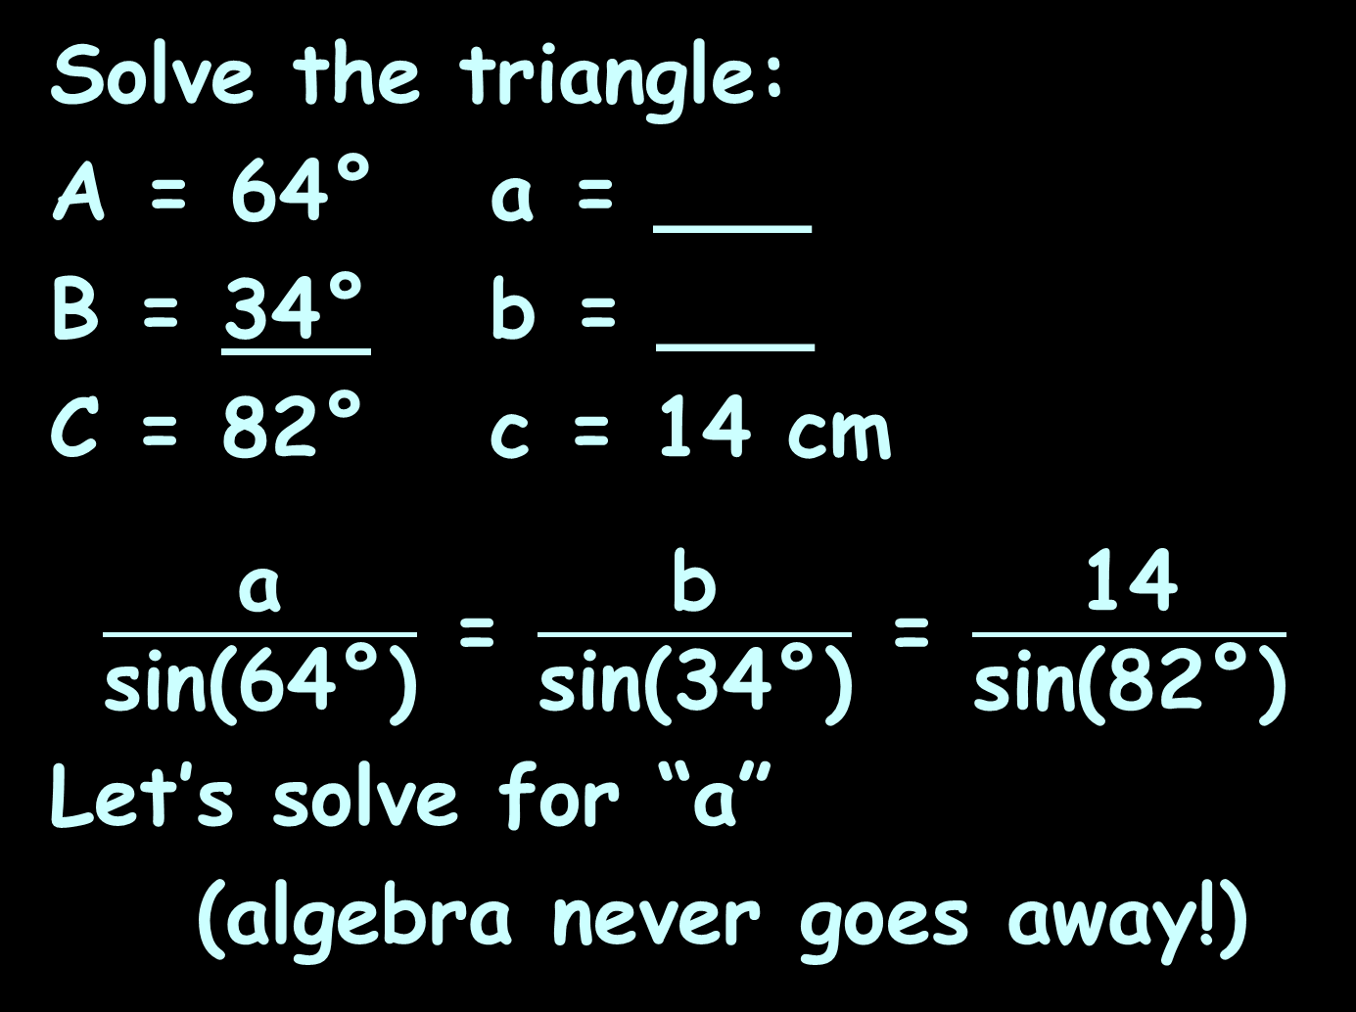
LAW OF SINES
IN-CLASS PROBLEM 1
Solve the triangle:
A = 64° a = ___
B = 34° b = ___
C = 82° c = 14 cm
$\frac{\text{a}}{\text{sin}\text{(}\text{64}\text{°)}}$ = $\frac{\text{b}}{\text{sin}\text{(}\text{34}\text{°)}}$ = $\frac{\text{14}}{\text{sin}\text{(}\text{82}\text{°)}}$
Let’s solve for “a”
(algebra never goes away!)

Slide 42
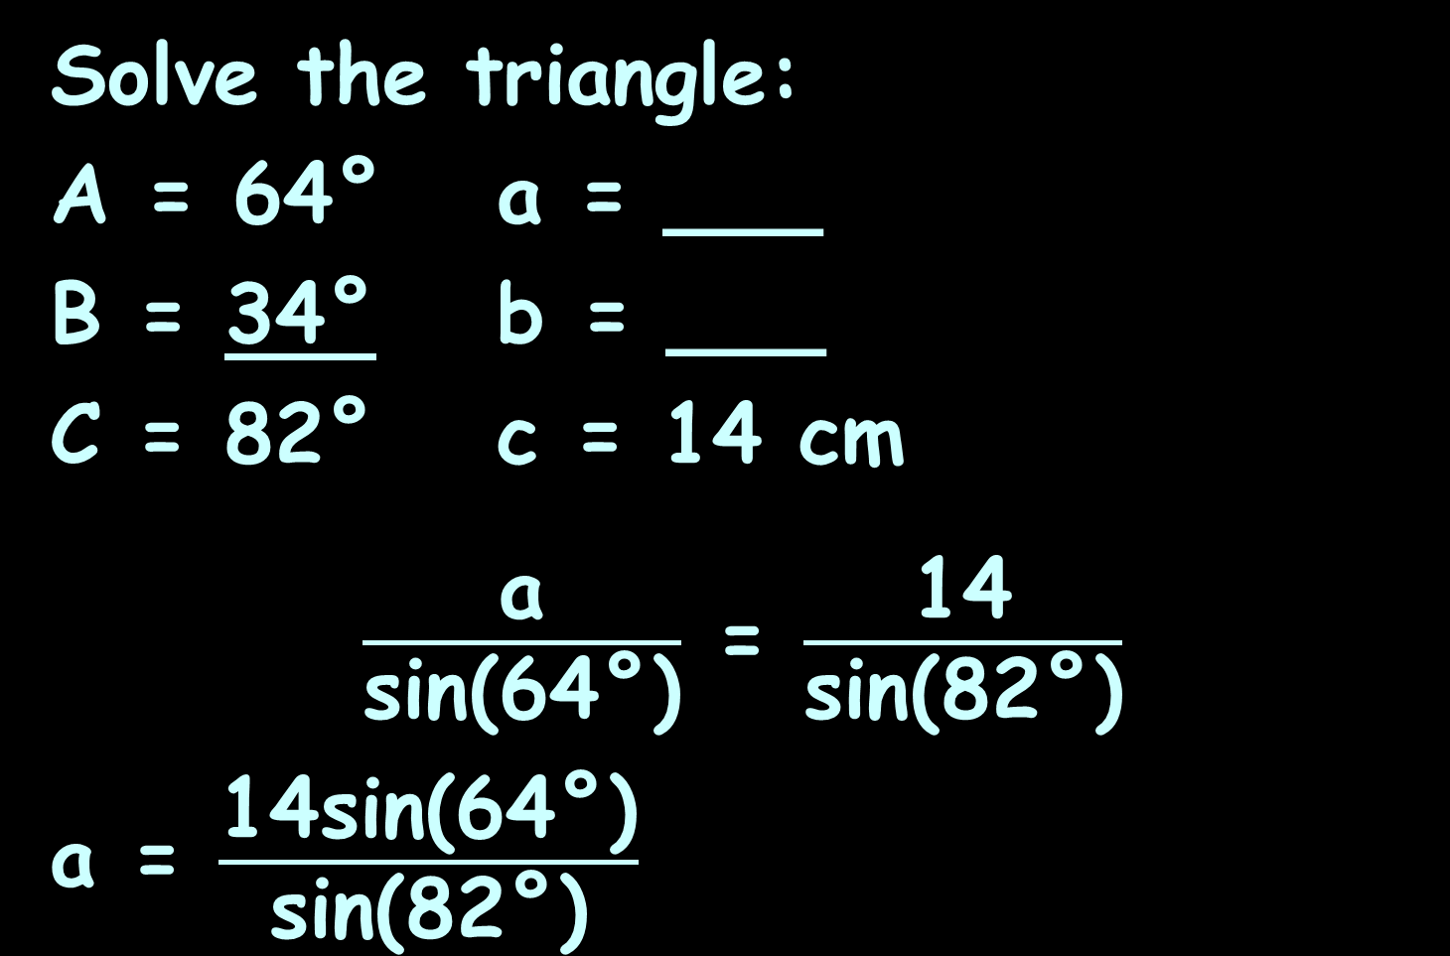
LAW OF SINES
IN-CLASS PROBLEM 1
Solve the triangle:
A = 64° a = ___
B = 34° b = ___
C = 82° c = 14 cm
$\frac{\text{a}}{\text{sin}\text{(}\text{64}\text{°)}}$ = $\frac{\text{14}}{\text{sin}\text{(82}\text{°}\text{)}}$
a = $\frac{\text{14}\text{sin}\text{(64°}\text{)}}{\text{sin}\text{(82°)}}$

Slide 43
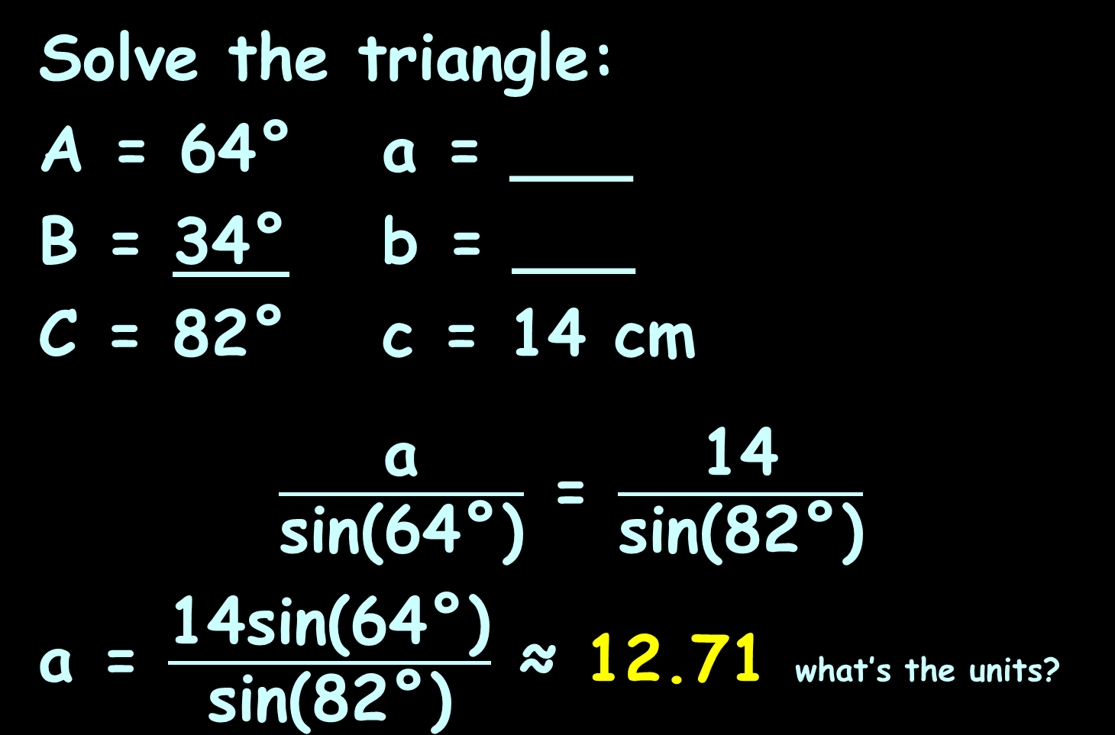
LAW OF SINES
IN-CLASS PROBLEM 1
Solve the triangle:
A = 64° a = ___
B = 34° b = ___
C = 82° c = 14 cm
$\frac{\text{a}}{\text{sin}\text{(}\text{64}\text{°)}}$ = $\frac{\text{14}}{\text{sin}\text{(82}\text{°}\text{)}}$
a = $\frac{\text{14}\text{sin}\text{(64°}\text{)}}{\text{sin}\text{(82°)}}$ ≈ 12.71 what’s the units?

Slide 44
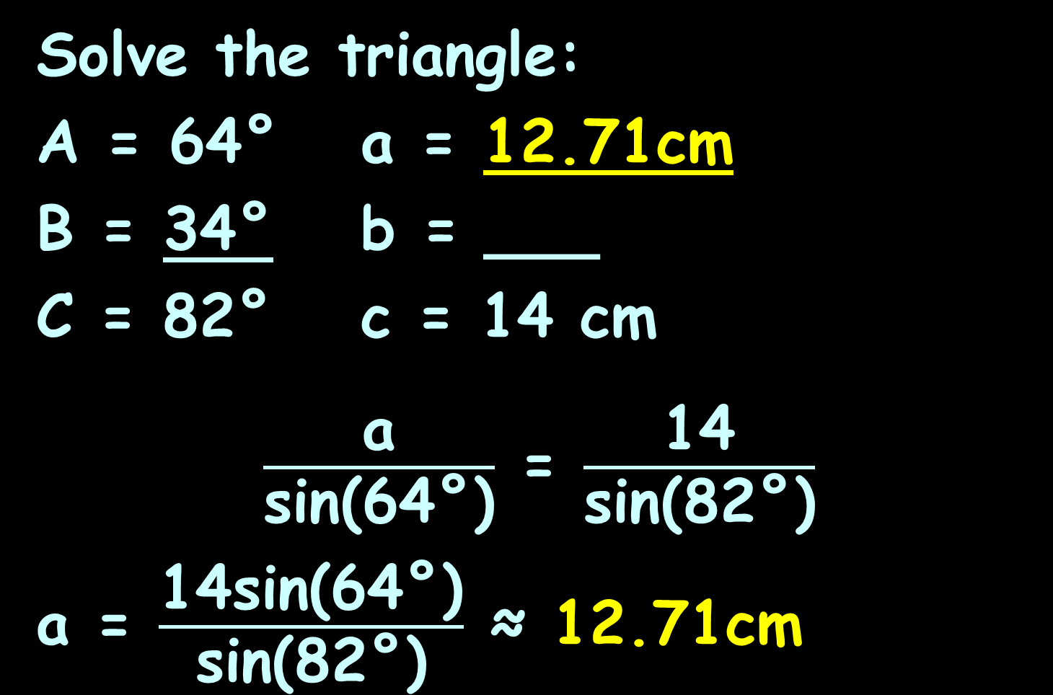
LAW OF SINES
IN-CLASS PROBLEM 1
Solve the triangle:
A = 64° a = 12.71cm
B = 34° b = ___
C = 82° c = 14 cm
$\frac{\text{a}}{\text{sin}\text{(}\text{64}\text{°)}}$ = $\frac{\text{14}}{\text{sin}\text{(82}\text{°}\text{)}}$
a = $\frac{\text{14}\text{sin}\text{(64°}\text{)}}{\text{sin}\text{(82°)}}$ ≈ 12.71cm

Slide 45
LAW OF SINES
IN-CLASS PROBLEM 1
Solve the triangle:
A = 64° a = 12.71cm
B = 34° b = ___
C = 82° c = 14 cm
That was easy! Let’s try “b”!

Slide 46
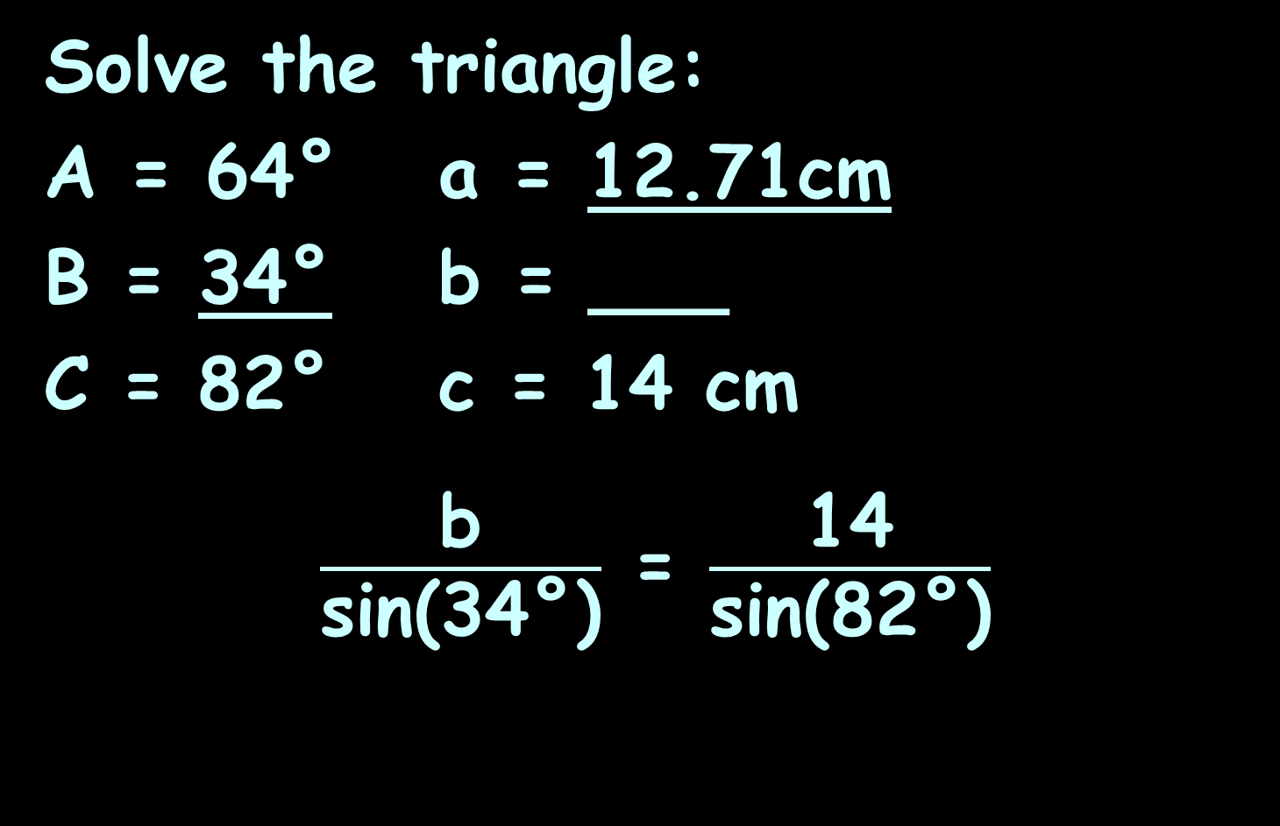
LAW OF SINES
IN-CLASS PROBLEM 1
Solve the triangle:
A = 64° a = 12.71cm
B = 34° b = ___
C = 82° c = 14 cm
$\frac{\text{b}}{\text{sin}\text{(}\text{34}\text{°)}}$ = $\frac{\text{14}}{\text{sin}\text{(82}\text{°}\text{)}}$

Slide 47
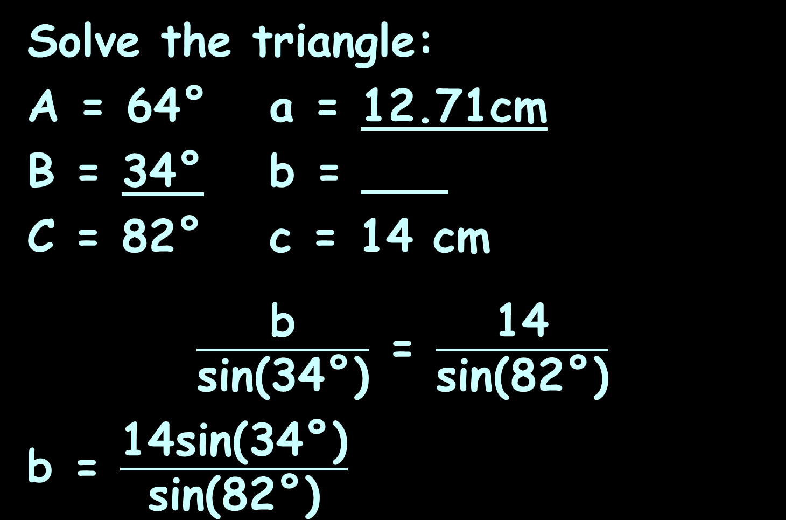
LAW OF SINES
IN-CLASS PROBLEM 1
Solve the triangle:
A = 64° a = 12.71cm
B = 34° b = ___
C = 82° c = 14 cm
$\frac{\text{b}}{\text{sin}\text{(}\text{34}\text{°)}}$ = $\frac{\text{14}}{\text{sin}\text{(82}\text{°}\text{)}}$
b = $\frac{\text{14}\text{sin}\text{(}\text{3}\text{4°}\text{)}}{\text{sin}\text{(82°)}}$

Slide 48
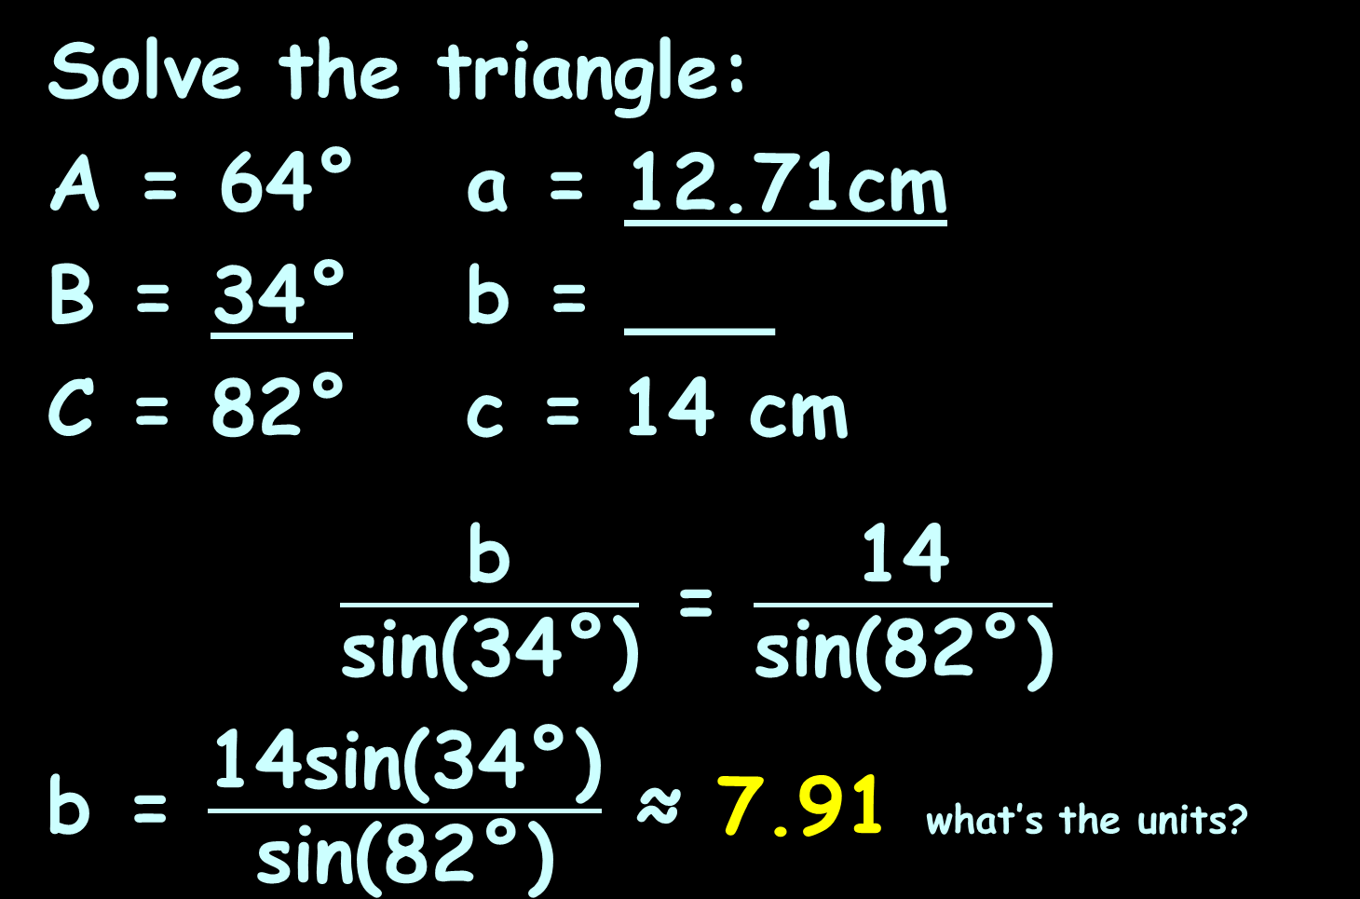
LAW OF SINES
IN-CLASS PROBLEM 1
Solve the triangle:
A = 64° a = 12.71cm
B = 34° b = ___
C = 82° c = 14 cm
$\frac{\text{b}}{\text{sin}\text{(}\text{34}\text{°)}}$ = $\frac{\text{14}}{\text{sin}\text{(82}\text{°}\text{)}}$
b = $\frac{\text{14}\text{sin}\text{(}\text{3}\text{4°}\text{)}}{\text{sin}\text{(82°)}}$ ≈ 7.91 what’s the units?

Slide 49
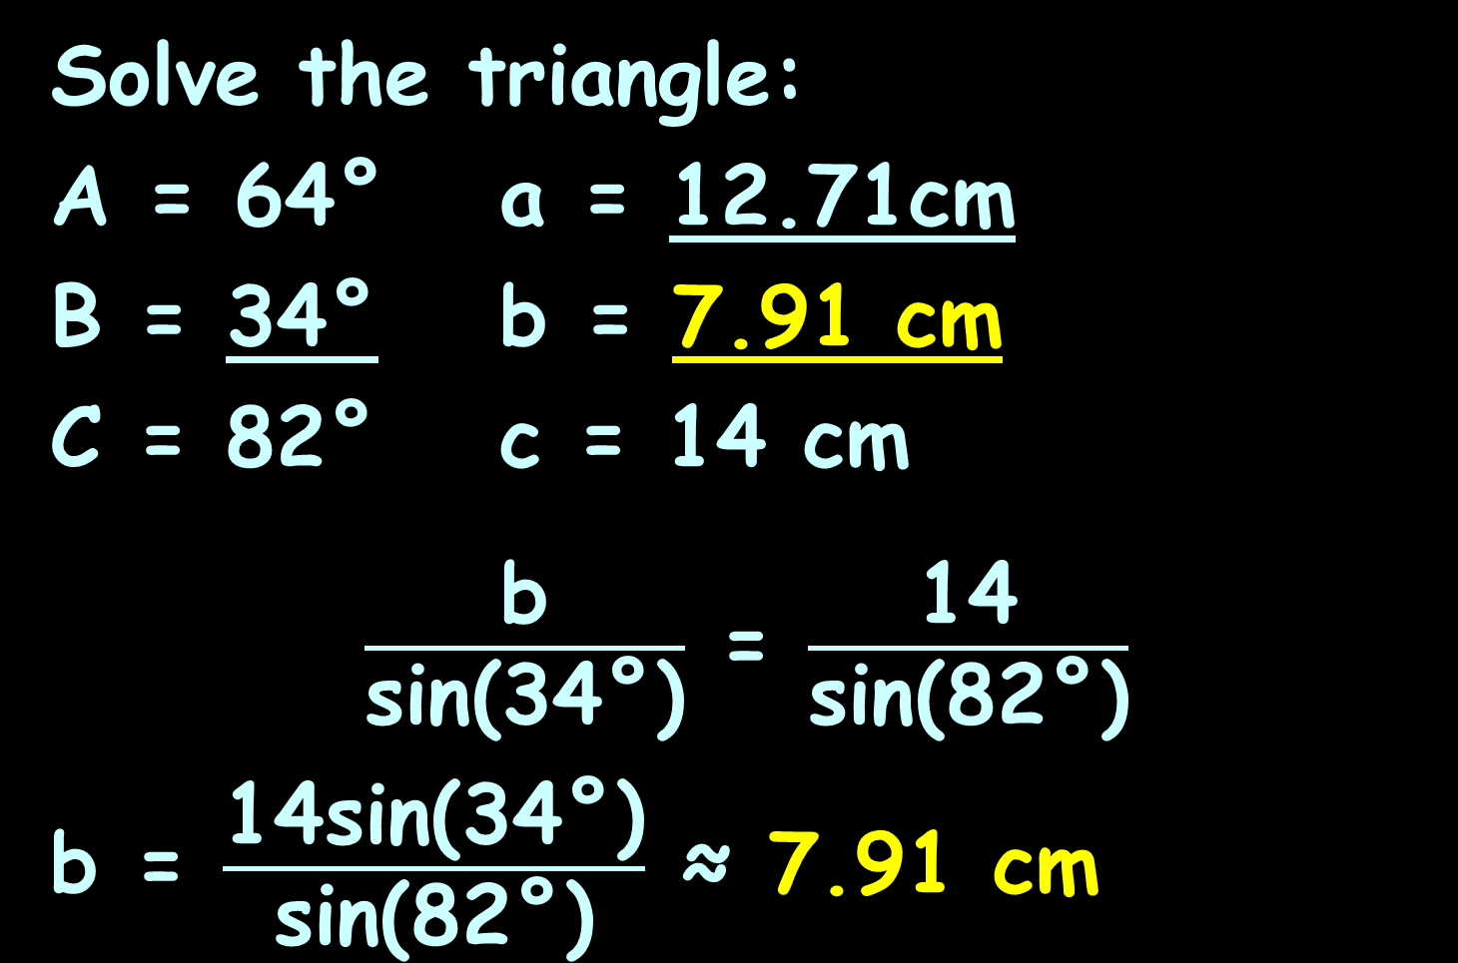
LAW OF SINES
IN-CLASS PROBLEM 1
Solve the triangle:
A = 64° a = 12.71cm
B = 34° b = 7.91 cm
C = 82° c = 14 cm
$\frac{\text{b}}{\text{sin}\text{(}\text{34}\text{°)}}$ = $\frac{\text{14}}{\text{sin}\text{(82}\text{°}\text{)}}$
b = $\frac{\text{14}\text{sin}\text{(}\text{3}\text{4°}\text{)}}{\text{sin}\text{(82°)}}$ ≈ 7.91 cm

Slide 50
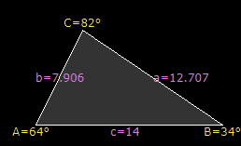
LAW OF SINES
IN-CLASS PROBLEM 1
Now we have:
A = 64° a = 12.71cm
B = 34° b = 7.91 cm
C = 82° c = 14 cm
Yay! Done!
https://www.calculator.net/triangle-calculator.html

Slide 51
Questions?
www.career.gatech.edu

Slide 52
How Many Triangles
Rules for oblique triangles can be used to find out whether a certain set of measurements describes a real triangle or not

Slide 53
How Many Triangles
Suppose you have an angle and the length of its opposite side and one of its adjacent sides

Slide 54
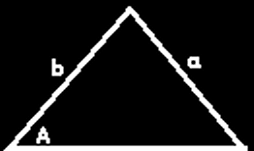
How Many Triangles
Sometimes the measurements describe a triangle that is unique:
VFrench 2015

Slide 55
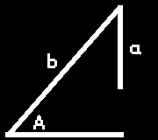
How Many Triangles
Sometimes the measurements
cannot possibly describe a real triangle:
VFrench 2015

Slide 56
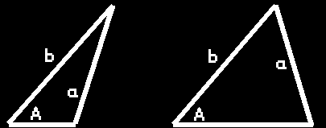
How Many Triangles
Sometimes the measurements
describe two possible triangles:
This is called the “ambiguous case”
VFrench 2015

Slide 57
How Many Triangles
We need to calculate a new variable, the height “h”
h = b sinA

Slide 58
How Many Triangles
If a>h and a>b there is only one triangle
If a=h – it’s a right triangle!
If a<h there is no triangle
If a>h and a<b there are two triangles

Slide 59
HOW MANY TRIANGLES
IN-CLASS PROBLEM 2
How many triangles if
A = 57°
a = 33
b = 26
What do we do first?

Slide 60
HOW MANY TRIANGLES
IN-CLASS PROBLEM 2
How many triangles if
A = 57°
a = 33
b = 26
Calculate h! h = b sinA

Slide 61
HOW MANY TRIANGLES
IN-CLASS PROBLEM 2
How many triangles if
A = 57°
a = 33
b = 26
h = b sinA = 26 sin 57°
≈ 26 (0.8387) ≈ 21.8

Slide 62
HOW MANY TRIANGLES
IN-CLASS PROBLEM 2
How many triangles if
A = 57°
a = 33
b = 26
h ≈ 21.8
If a>h and a>b there is only one triangle
If a=h – it’s a right triangle!
If a<h there is no triangle
If a>h and a<b there are two triangles

Slide 63
HOW MANY TRIANGLES
IN-CLASS PROBLEM 2
How many triangles if
A = 57°
a = 33
b = 26
h ≈ 21.8
If a>h and a>b there is only one triangle
If a=h – it’s a right triangle!
If a<h there is no triangle
If a>h and a<b there are two triangles

Slide 64
HOW MANY TRIANGLES
IN-CLASS PROBLEM 2
How many triangles if
A = 57°
a = 33
b = 26
h ≈ 21.8
One triangle!
If a>h and a>b there is only one triangle
If a=h – it’s a right triangle!
If a<h there is no triangle
If a>h and a<b there are two triangles

Slide 65
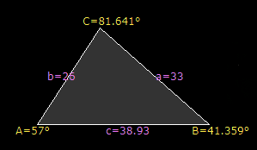
HOW MANY TRIANGLES
IN-CLASS PROBLEM 2
How many triangles if
A = 57°
a = 33
b = 26
h ≈ 21.8
One triangle!
https://www.calculator.net/triangle-calculator.html

Slide 66
HOW MANY TRIANGLES
IN-CLASS PROBLEM 3
How many triangles if
A = 50°
a = 10
b = 20
If a>h and a>b there is only one triangle
If a=h – it’s a right triangle!
If a<h there is no triangle
If a>h and a<b there are two triangles

Slide 67
HOW MANY TRIANGLES
IN-CLASS PROBLEM 3
How many triangles if
A = 50°
a = 10
b = 20
h = b sinA
If a>h and a>b there is only one triangle
If a=h – it’s a right triangle!
If a<h there is no triangle
If a>h and a<b there are two triangles

Slide 68
HOW MANY TRIANGLES
IN-CLASS PROBLEM 3
How many triangles if
A = 50°
a = 10
b = 20
h ≈ 15.32
If a>h and a>b there is only one triangle
If a=h – it’s a right triangle!
If a<h there is no triangle
If a>h and a<b there are two triangles

Slide 69
HOW MANY TRIANGLES
IN-CLASS PROBLEM 3
How many triangles if
A = 50°
a = 10
b = 20
h ≈ 15.32
No triangle!
If a>h and a>b there is only one triangle
If a=h – it’s a right triangle!
If a<h there is no triangle
If a>h and a<b there are two triangles

Slide 70
HOW MANY TRIANGLES
IN-CLASS PROBLEM 3
How many triangles if
A = 50°
a = 10
b = 20
h ≈ 15.32
If a>h and a>b there is only one triangle
If a=h – it’s a right triangle!
If a<h there is no triangle
If a>h and a<b there are two triangles
No angle
will make a triangle
VFrench 2020

Slide 71
HOW MANY TRIANGLES
IN-CLASS PROBLEM 4
How many triangles if
A = 50°
a = 10
b = 11
If a>h and a>b there is only one triangle
If a=h – it’s a right triangle!
If a<h there is no triangle
If a>h and a<b there are two triangles

Slide 72
HOW MANY TRIANGLES
IN-CLASS PROBLEM 4
How many triangles if
A = 50°
a = 10
b = 11
h = b sinA
If a>h and a>b there is only one triangle
If a=h – it’s a right triangle!
If a<h there is no triangle
If a>h and a<b there are two triangles

Slide 73
HOW MANY TRIANGLES
IN-CLASS PROBLEM 4
How many triangles if
A = 50°
a = 10
b = 11
h ≈ 8.43
If a>h and a>b there is only one triangle
If a=h – it’s a right triangle!
If a<h there is no triangle
If a>h and a<b there are two triangles

Slide 74
How Many Triangles
IN-CLASS PROBLEMS
How many triangles if
A = 50°
a = 10
b = 11
h ≈ 8.43
2 triangles!
If a>h and a>b there is only one triangle
If a=h – it’s a right triangle!
If a<h there is no triangle
If a>h and a<b there are two triangles

Slide 75
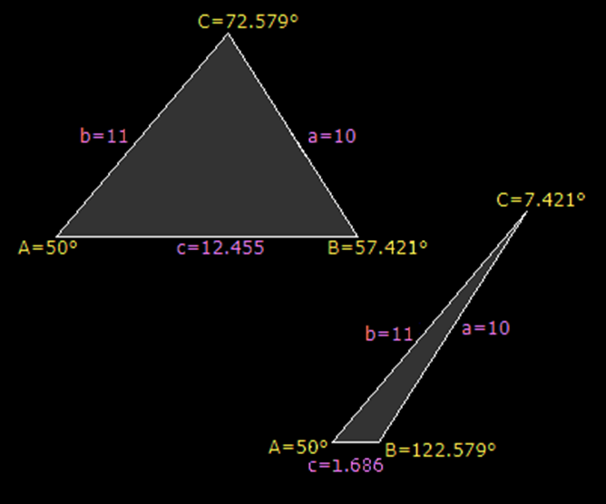
How Many Triangles
IN-CLASS PROBLEMS
How many triangles if
A = 50°
a = 10
b = 11
h ≈ 8.43
2 triangles!
https://www.calculator.net/triangle-calculator.html

Slide 76
Questions?
www.career.gatech.edu

Slide 77
Law of Cosines
To calculate using the Law of Sines you need a “big” and a “little”:
A and a or
B and b or
C and c

Slide 78

Law of Cosines
Suppose you don’t have a big and a little???
http://www.gettyimages.com/detail/photo/businessman-crying-close-up-high-res-stock-photography/AB34183

Slide 79

Law of Cosines
Fear not!
There is a Law of Cosines that can be used in these cases!
shutterstock_65175625.jpg

Slide 80

Law of Cosines
It is harder to use… but actually safer!
stock-photo-skeptical-senior-man-1724336.jpg

Slide 81
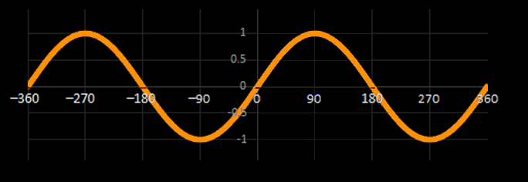
Law of Cosines
Safer?
How many degrees in the three angles of a triangle?
VFrench 2015

Slide 82
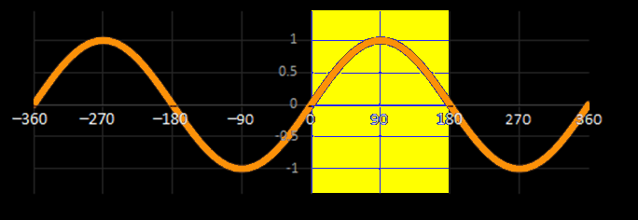
Law of Cosines
180!
There are two possible answers for every sine in this range!
VFrench 2015

Slide 83
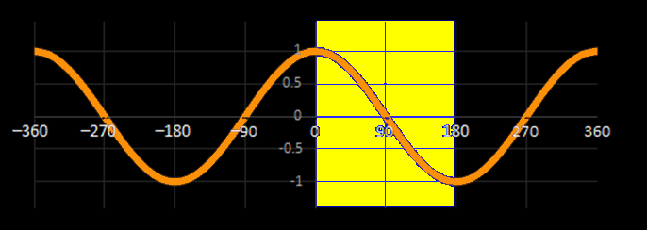
Law of Cosines
Cosines
don’t
have
this problem
VFrench 2015

Slide 84
Law of Cosines
Law of Cosines:
a² = b² + c² - 2bc cosA or
b² = a² + c² - 2ac cosB or
c² = a² + b² - 2ab cosC

Slide 85
Law of Cosines
You use Law of Cosines when you don’t have a big and a little of the same letter

Slide 86
LAW OF COSINES
IN-CLASS PROBLEM 5
Solve the triangle:
A = 120°
b = 7 in
c = 8 in
Do we have a big and a little?

Slide 87
LAW OF COSINES
IN-CLASS PROBLEM 5
Solve the triangle:
A = 120°
b = 7 in
c = 8 in
Do we have a big and a little?
Bummer, no!
What do we have to use?

Slide 88
LAW OF COSINES
IN-CLASS PROBLEM 5
Solve the triangle:
A = 120°
b = 7 in
c = 8 in
Do we have a big and a little?
Bummer, no!
What do we have to use?
Law of Cosines

Slide 89
LAW OF COSINES
IN-CLASS PROBLEM 5
Solve the triangle:
A = 120° a = ____
B = ____ b = 7 in
C = ____ c = 8 in
Which?
a² = b² + c² - 2bc cosA b² = a² + c² - 2ac cosB c² = a² + b² - 2ab cosC

Slide 90
LAW OF COSINES
IN-CLASS PROBLEM 5
Solve the triangle:
A = 120° a = ____
B = ____ b = 7 in
C = ____ c = 8 in
Which:
a² = b² + c² - 2bc cosA

Slide 91
LAW OF COSINES
IN-CLASS PROBLEM 5
Solve the triangle:
A = 120° a = ____
B = ____ b = 7 in
C = ____ c = 8 in
a² = b² + c² - 2bc cosA
a² = 7² + 8² - 2(7)(8)cos120º

Slide 92
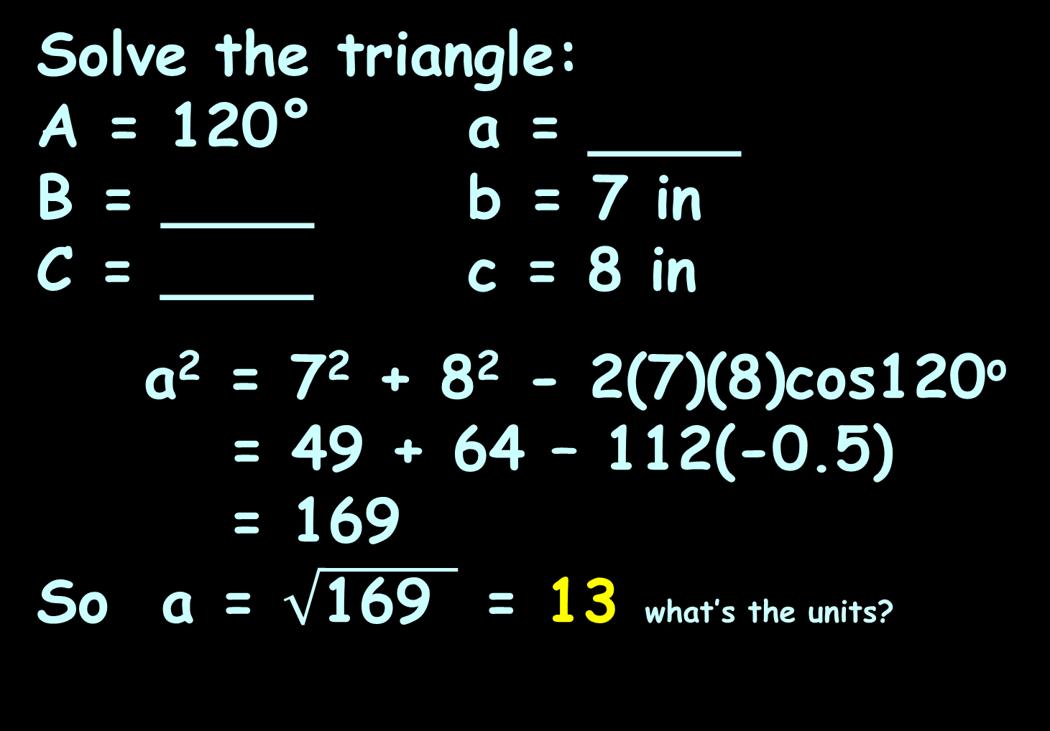
LAW OF COSINES
IN-CLASS PROBLEM 5
Solve the triangle:
A = 120° a = ____
B = ____ b = 7 in
C = ____ c = 8 in
a² = 7² + 8² - 2(7)(8)cos120º
= 49 + 64 – 112(-0.5)
= 169
So a = $\sqrt{\text{169 }}$ = 13 what’s the units?

Slide 93
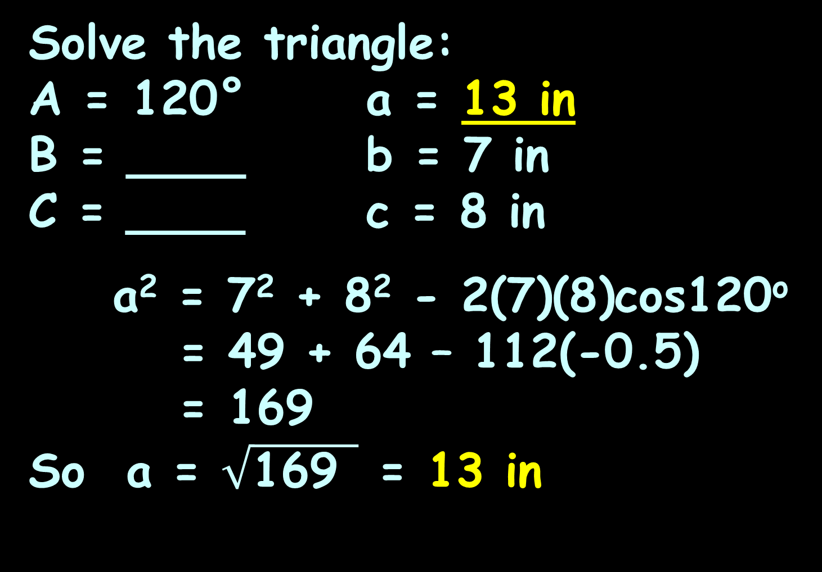
LAW OF COSINES
IN-CLASS PROBLEM 5
Solve the triangle:
A = 120° a = 13 in
B = ____ b = 7 in
C = ____ c = 8 in
a² = 7² + 8² - 2(7)(8)cos120º
= 49 + 64 – 112(-0.5)
= 169
So a = $\sqrt{\text{169 }}$ = 13 in

Slide 94
LAW OF COSINES
IN-CLASS PROBLEM 5
Solve the triangle:
A = 120° a = 13 in
B = ____ b = 7 in
C = ____ c = 8 in
Are we done?

Slide 95
LAW OF COSINES
IN-CLASS PROBLEM 5
Solve the triangle:
A = 120° a = 13 in
B = ____ b = 7 in
C = ____ c = 8 in
Now you have a big and a little!

Slide 96
LAW OF COSINES
IN-CLASS PROBLEM 5
Solve the triangle:
A = 120° a = 13 in
B = ____ b = 7 in
C = ____ c = 8 in
Now you have a big and a little!
It is tempting to change over to
the (easier) Law of Sines

Slide 97

LAW OF COSINES
IN-CLASS PROBLEM 5
Solve the triangle:
A = 120° a = 13 in
B = ____ b = 7 in
C = ____ c = 8 in
Resist
temptation!
https://www.learnreligions.com/how-to-avoid-temptation-701018

Slide 98
Law of Cosines
If the test tells you “Use the Law of Cosines” DO NOT USE LAW OF SINES – KEEP USING LAW OF COSINES

Slide 99
Law of Cosines
Remember, there are two possible answers for every sine in this range!
You will often get the wrong answer!
VFrench 2015

Slide 100
LAW OF COSINES
IN-CLASS PROBLEM 5
Solve the triangle:
A = 120° a = 13 in
B = ____ b = 7 in
C = ____ c = 8 in
To solve for B, use
b² = a² + c² - 2ac cosB
(it’s the only one with “B” in it)

Slide 101
LAW OF COSINES
IN-CLASS PROBLEM 5
Solve the triangle:
A = 120° a = 13 in
B = ____ b = 7 in
C = ____ c = 8 in
Algebra time!
b² = a² + c² - 2ac cosB
b² -a² -c² = -2ac cosB

Slide 102
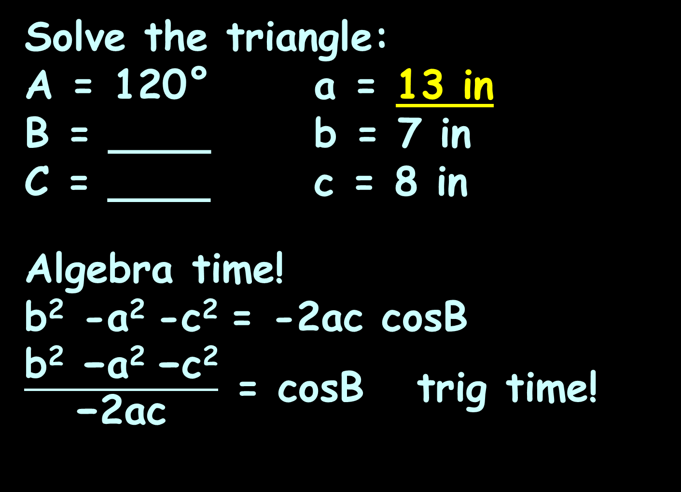
LAW OF COSINES
IN-CLASS PROBLEM 5
Solve the triangle:
A = 120° a = 13 in
B = ____ b = 7 in
C = ____ c = 8 in
Algebra time!
b² -a² -c² = -2ac cosB
$\frac{\text{b}\text{2}\text{ −}\text{a}\text{2 }\text{−}\text{c}\text{2}}{\text{−2}\text{ac}}$ = cosB trig time!

Slide 103
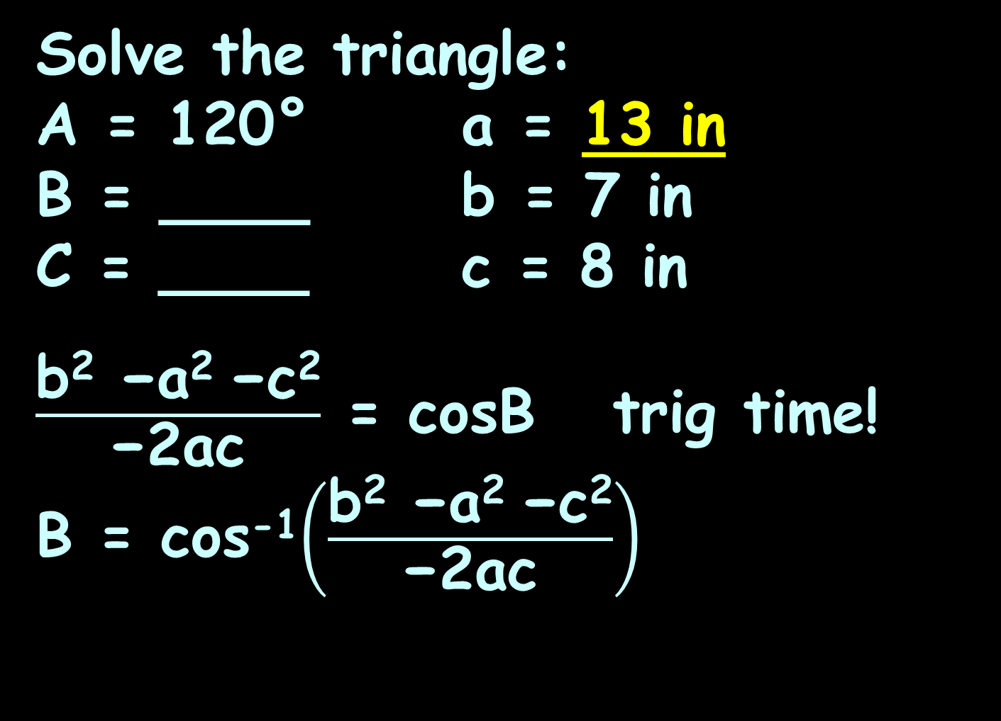
LAW OF COSINES
IN-CLASS PROBLEM 5
Solve the triangle:
A = 120° a = 13 in
B = ____ b = 7 in
C = ____ c = 8 in
$\frac{\text{b}\text{2}\text{ −}\text{a}\text{2 }\text{−}\text{c}\text{2}}{\text{−2}\text{ac}}$ = cosB trig time!
B = cos⁻¹$\left(\frac{\text{b}\text{2}\text{ −}\text{a}\text{2 }\text{−}\text{c}\text{2}}{\text{−2}\text{ac}}\right)$

Slide 104
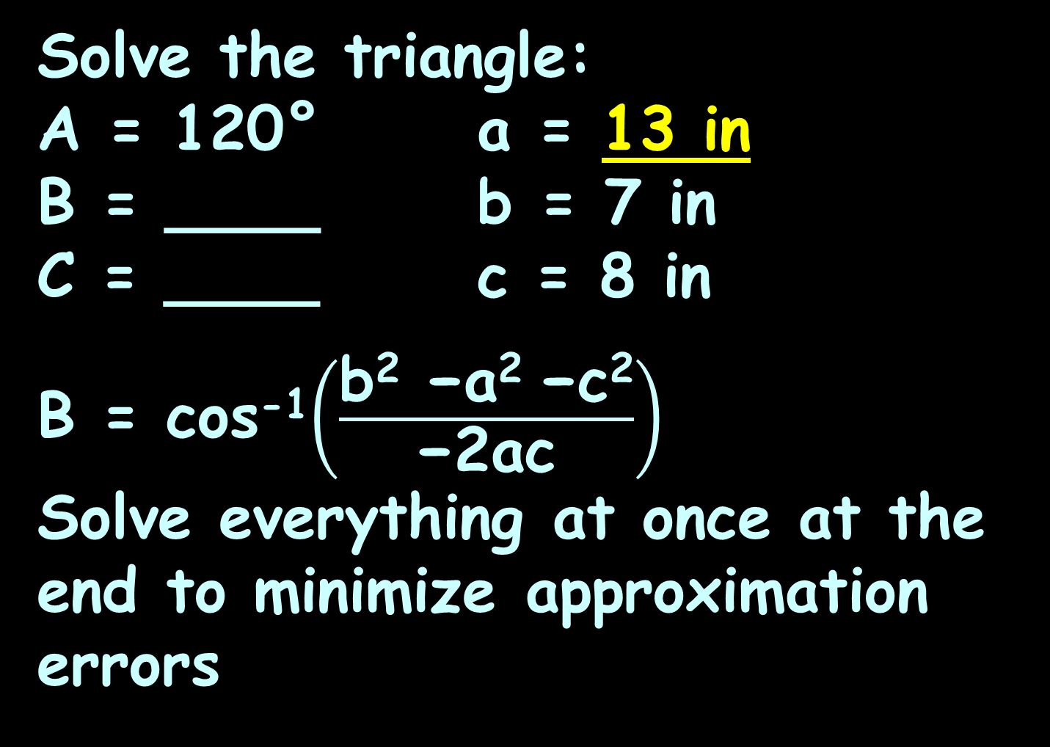
LAW OF COSINES
IN-CLASS PROBLEM 5
Solve the triangle:
A = 120° a = 13 in
B = ____ b = 7 in
C = ____ c = 8 in
B = cos⁻¹$\left(\frac{\text{b}\text{2}\text{ −}\text{a}\text{2 }\text{−}\text{c}\text{2}}{\text{−2}\text{ac}}\right)$
Solve everything at once at the end to minimize approximation errors

Slide 105
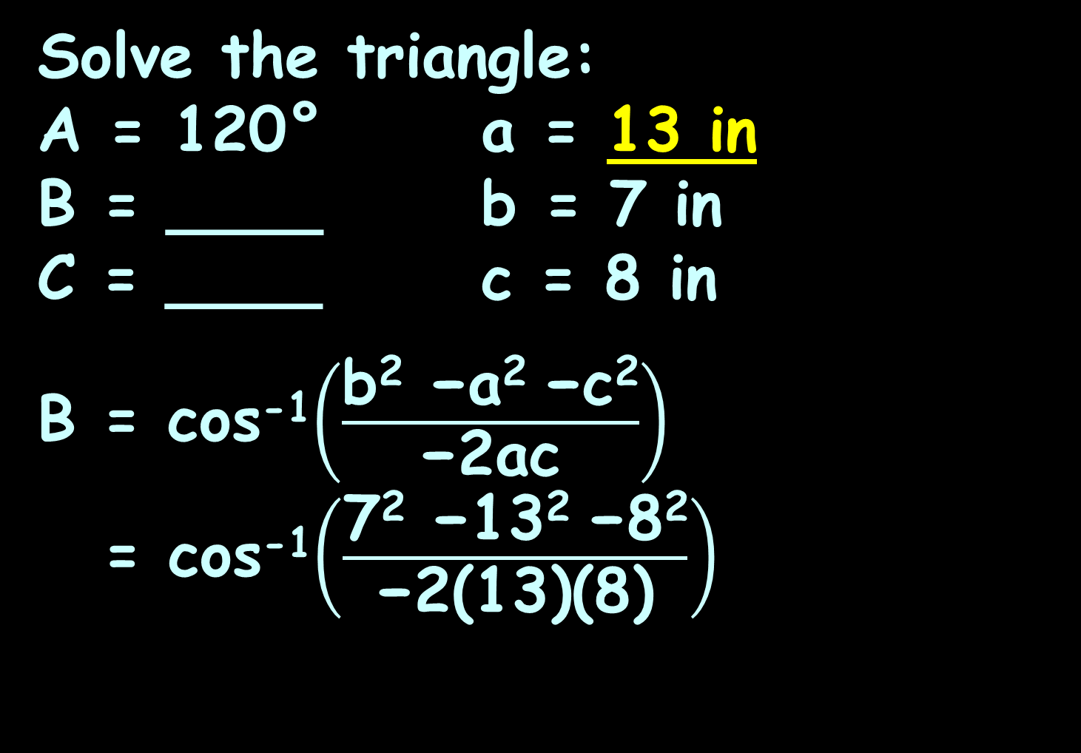
LAW OF COSINES
IN-CLASS PROBLEM 5
Solve the triangle:
A = 120° a = 13 in
B = ____ b = 7 in
C = ____ c = 8 in
B = cos⁻¹$\left(\frac{\text{b}\text{2}\text{ −}\text{a}\text{2 }\text{−}\text{c}\text{2}}{\text{−2}\text{ac}}\right)$
= cos⁻¹$\left(\frac{\text{7}\text{2}\text{ −}\text{13}\text{2 }\text{−}\text{8}\text{2}}{\text{−2}\text{(13)(8)}}\right)$

Slide 106
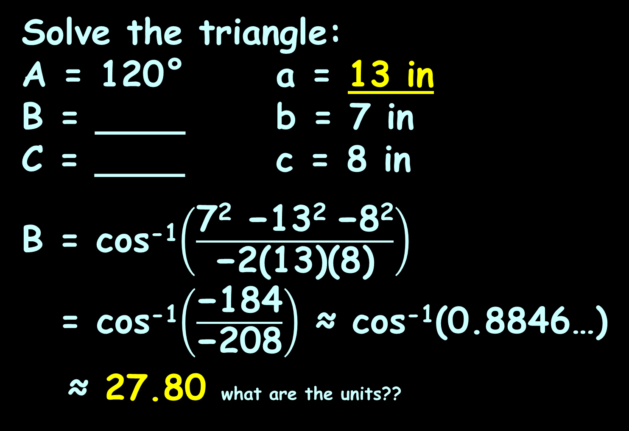
LAW OF COSINES
IN-CLASS PROBLEM 5
Solve the triangle:
A = 120° a = 13 in
B = ____ b = 7 in
C = ____ c = 8 in
B = cos⁻¹$\left(\frac{\text{7}\text{2}\text{ −}\text{13}\text{2 }\text{−}\text{8}\text{2}}{\text{−2}\text{(13)(8)}}\right)$
= cos⁻¹$\left(\frac{\text{−1}\text{84}}{\text{−2}\text{0}\text{8}}\right)$ ≈ cos⁻¹(0.8846…)
≈ 27.80 what are the units??

Slide 107
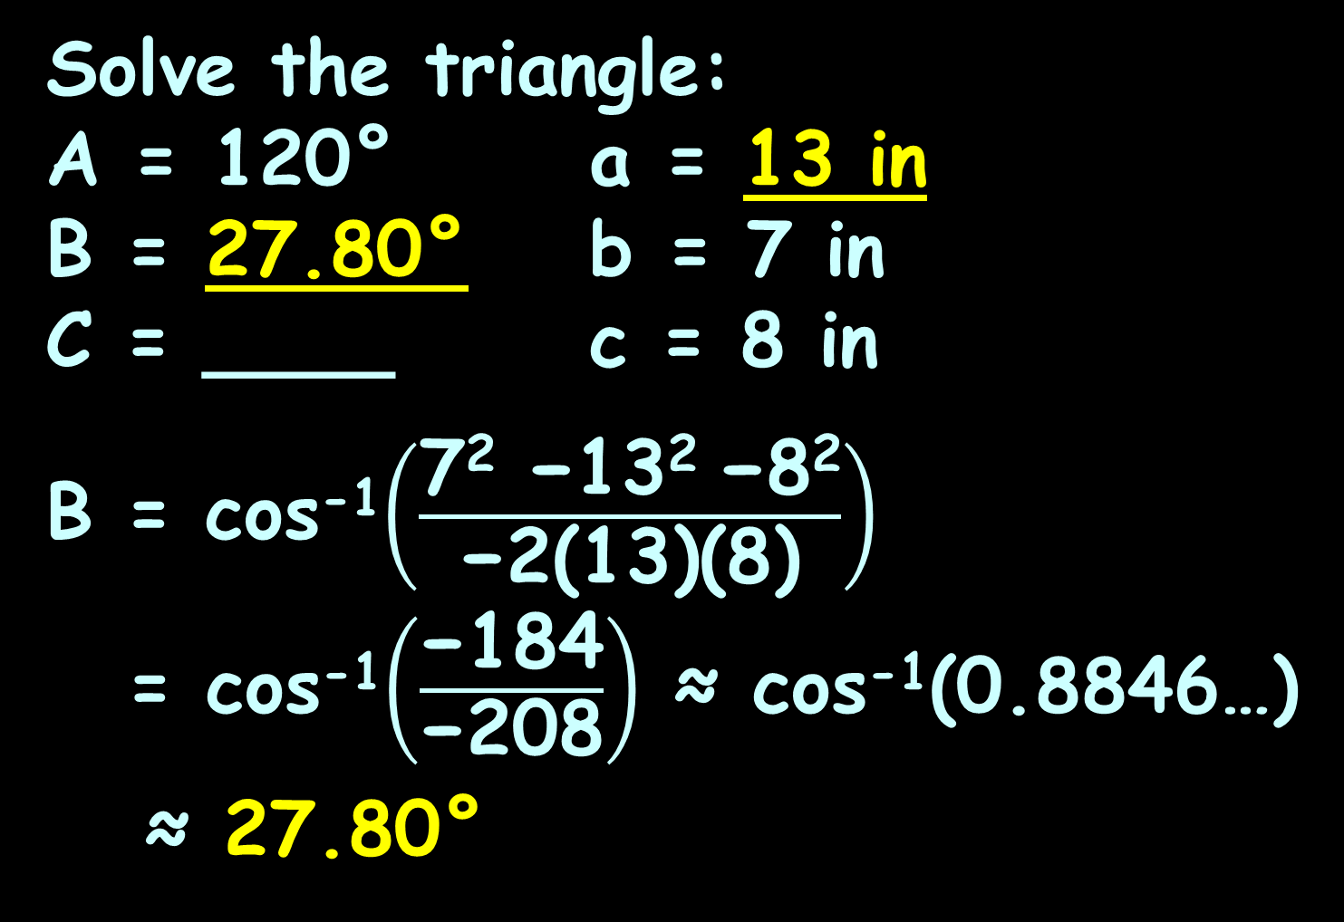
LAW OF COSINES
IN-CLASS PROBLEM 5
Solve the triangle:
A = 120° a = 13 in
B = 27.80° b = 7 in
C = ____ c = 8 in
B = cos⁻¹$\left(\frac{\text{7}\text{2}\text{ −}\text{13}\text{2 }\text{−}\text{8}\text{2}}{\text{−2}\text{(13)(8)}}\right)$
= cos⁻¹$\left(\frac{\text{−1}\text{84}}{\text{−2}\text{0}\text{8}}\right)$ ≈ cos⁻¹(0.8846…)
≈ 27.80°

Slide 108

LAW OF COSINES
IN-CLASS PROBLEM 5
Solve the triangle:
A = 120° a = 13 in
B = 27.80° b = 7 in
C = ____ c = 8 in
Now what???
More Law of
Cosines????
tscng.files.wordpress.com/2012/06/crying-man2.jpg

Slide 109

LAW OF COSINES
IN-CLASS PROBLEM 5
Solve the triangle:
A = 120° a = 13 in
B = 27.80° b = 7 in
C = ____ c = 8 in
Nope!
C = 180°-120°-27.80°
http://www.shutterstock.com/s/whew/search.html

Slide 110
LAW OF COSINES
IN-CLASS PROBLEM 5
Solve the triangle:
A = 120° a = 13 in
B = 27.80° b = 7 in
C = 32.20° c = 8 in
C = 180°- 120° - 27.80°
= 32.20°

Slide 111

LAW OF COSINES
IN-CLASS PROBLEM 5
Solve the triangle:
A = 120° a = 13 in
B = 27.80° b = 7 in
C = 32.20° c = 8 in
DONE!
Whew!
https://intuitturbotax.files.wordpress.com/2013/04/istock_000020645672xsmall.jpg

Slide 112
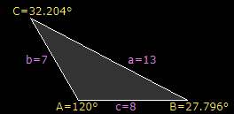
LAW OF COSINES
IN-CLASS PROBLEM 5
Solve the triangle:
A = 120° a = 13 in
B = 27.80° b = 7 in
C = 32.20° c = 8 in
https://www.calculator.net/triangle-calculator.html

Slide 113
Law of Cosines
A Law of Cosines calculator can be found at:
https://www.engineeringtoolbox.com/law-cosines-d_1857.html

Slide 114
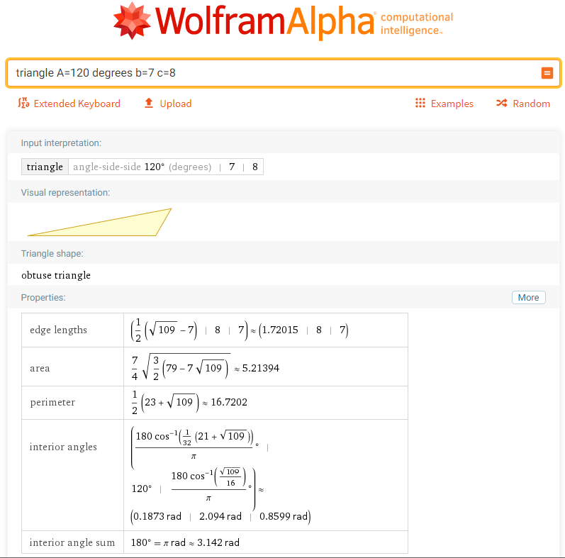

Slide 115
Law of Cosines
You have to say:
triangle A=120 degrees b=7 c=8
…and this is the only one it works for…

Slide 116
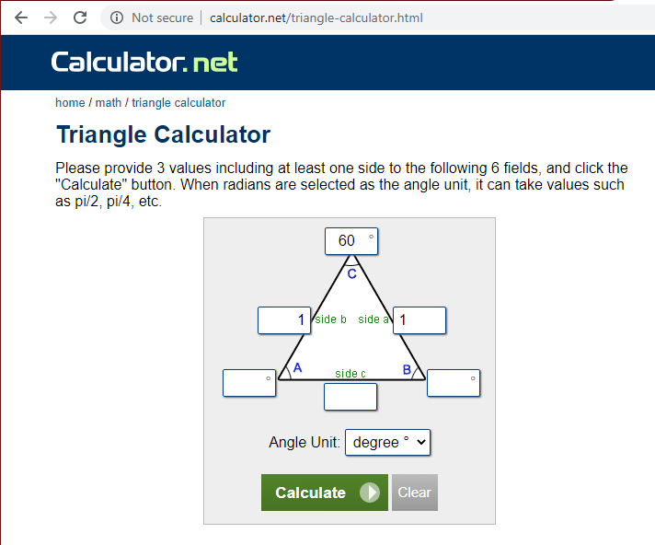
Law of Cosines
https://www.calculator.net/
triangle-calculator.html

Slide 117
Homework Problems
Navigation notation:
N35ºE means 35º east of due north
N49ºW means 49º west of due north
35º
49º
VFrench 2015

Slide 118
Questions?
www.career.gatech.edu

Slide 119

You Survived!
Don’t forget
your Homework
due next week!
Have a great rest
of the week!
www.playbuzz.com

