Slide 1
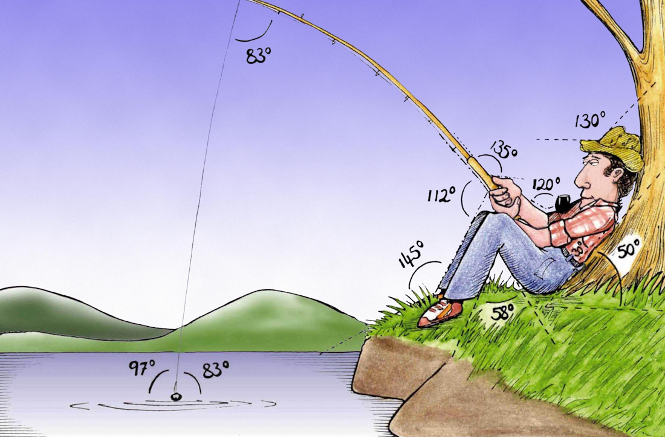
Welcome to
Week 9!
Analytic Trigonometry
http://www.lab-initio.com/images/fullsize/nz211.jpg

Slide 2
What’s Up?
Today we will be going over:
Review of polar coordinates
and polar equations
Vectors!

Slide 3
What’s Up?
Obj 8) Perform vector operations and solve problems using vector magnitude, direction, components, dot product and angle between two vectors.

Slide 4

Review
http://995642590.r.lightningbase-cdn.com/wp-content/uploads/2010/12/looking-back-hrexaminer-v144-cover425px.jpg

Slide 5
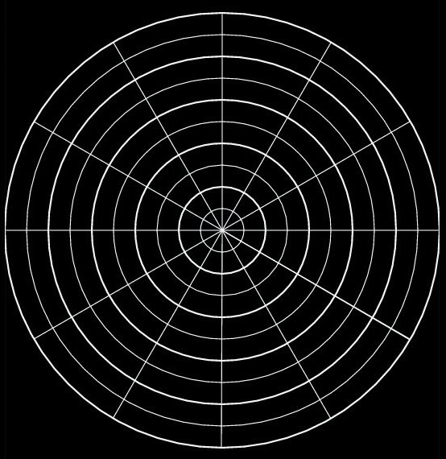
Polar Coordinates
Circular graph paper!
angle of rotation
polar axis
VFrench, 2015

Slide 6
Polar Coordinates
point P = (r,θ)
r is the distance (radius) from the pole to P (+,- or 0)
θ is the angle from the polar axis to the terminal side of the angle (degrees or radians)

Slide 7
Polar to Rectangular
Polar to rectangular conversion
If you have a polar point:
P = (r,θ)
To convert to (x,y) coordinates:
x = r cos θ
y = r sin θ

Slide 8
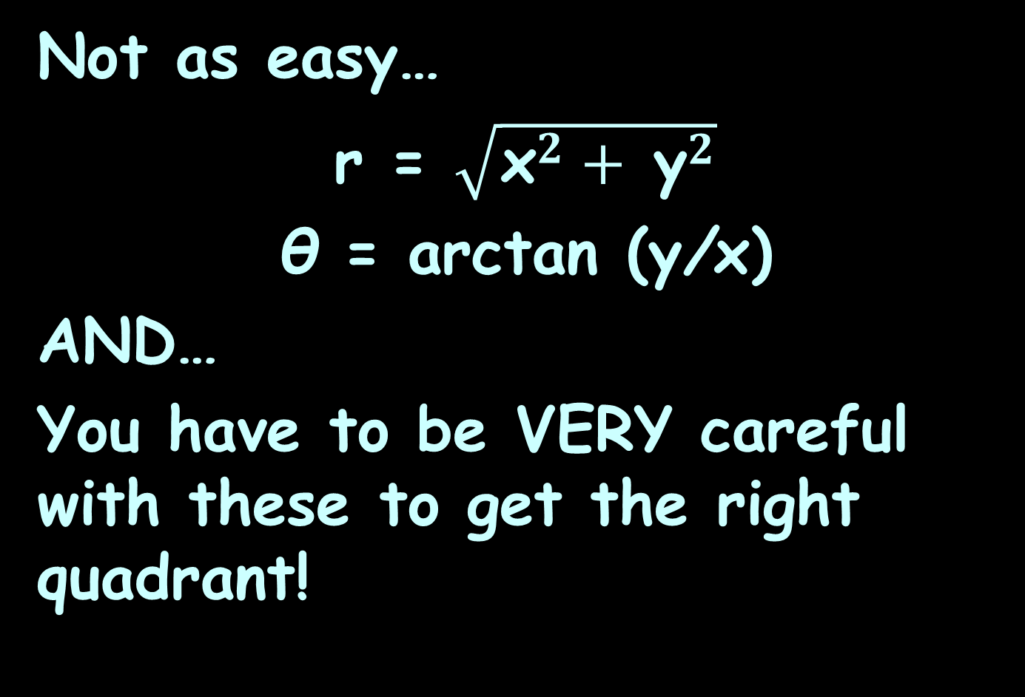
Rectangular to Polar
Not as easy…
r = $\sqrt{{\text{x}}^{2}+ {\text{y}}^{2}}$
θ = arctan (y/x)
AND…
You have to be VERY careful with these to get the right quadrant!

Slide 9
Polar Equations
Polar equations
have variables r and θ

Slide 10
Polar Equations
To convert rectangular equations to polar equations,
replace:
x with r cosθ and
y with r sinθ

Slide 11
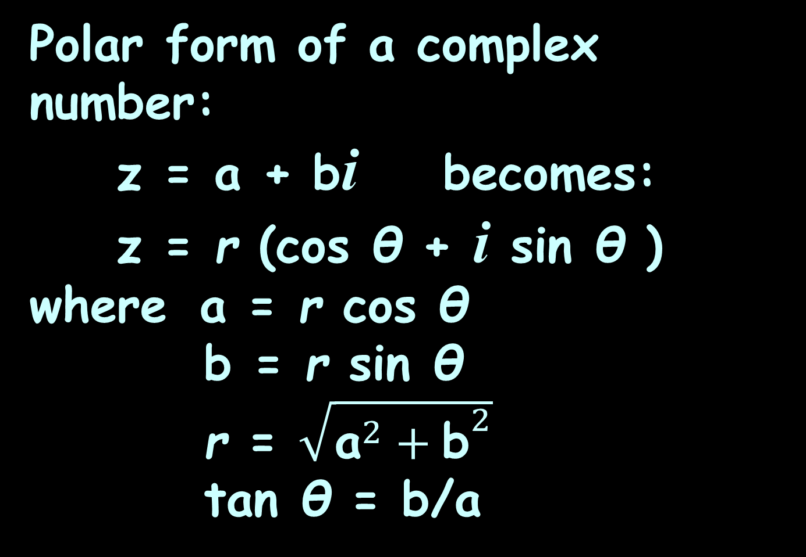
Polar Form
Polar form of a complex number:
z = a + bi becomes:
z = r (cos θ + i sin θ )
where a = r cos θ
b = r sin θ
r = $\sqrt{{\text{a}}^{2}+{\text{b}}^{2}}$
tan θ = b/a

Slide 12
Polar Form
Always plot these first or you may end up in the wrong quadrant!
(This is because of the tan)

Slide 13
DeMoivre’s Theorem
the power of a complex number
z = r (cos θ + i sin θ )
For n>0
z^{n} = [r (cos θ + i sin θ )] ^{n}
= r^{n}(cos nθ + i sin nθ )

Slide 14


Questions?
lol-rofl.com

Slide 15
Vectors
A vector is a directed line segment - from an initial point P to terminal point Q

Slide 16
Vectors
Vectors have both magnitude and direction
(ex: N 5mph)

Slide 17
Vectors
Scalars have only magnitude
(ex: 5mph)

Slide 18
VECTORS
IN-CLASS PROBLEM 1
Is it a vector?
A car is moving at 5 mph

Slide 19
VECTORS
IN-CLASS PROBLEM 1
Is it a vector?
A car is moving at 5 mph
Nope, it’s a scalar (the speed)

Slide 20
VECTORS
IN-CLASS PROBLEM 1
Is it a vector?
A car is moving at 5 mph due east

Slide 21
VECTORS
IN-CLASS PROBLEM 1
Is it a vector?
A car is moving at 5 mph due east
Yep, it has a magnitude and a direction (called the velocity)

Slide 22
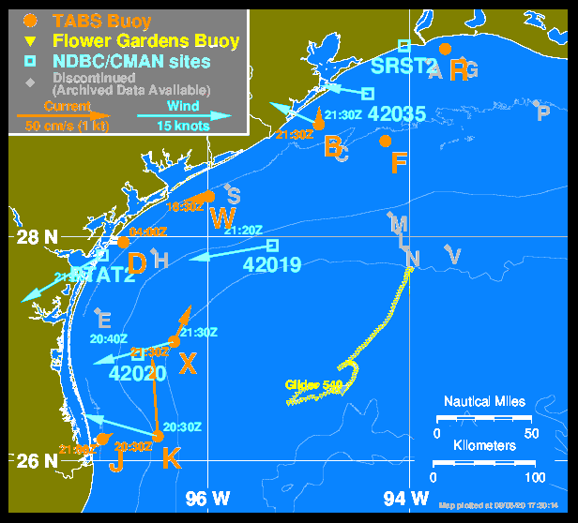
Vectors
Texas
Automated
Buoy
System
Supporting oil
spill prevention
and response
https://tabs.gerg.tamu.edu/tglo/
Notes:
https://tabs.gerg.tamu.edu/tglo/

Slide 23
Vectors
Vectors are shown by boldface letters: v w
or with arrows v w
→ →

Slide 24
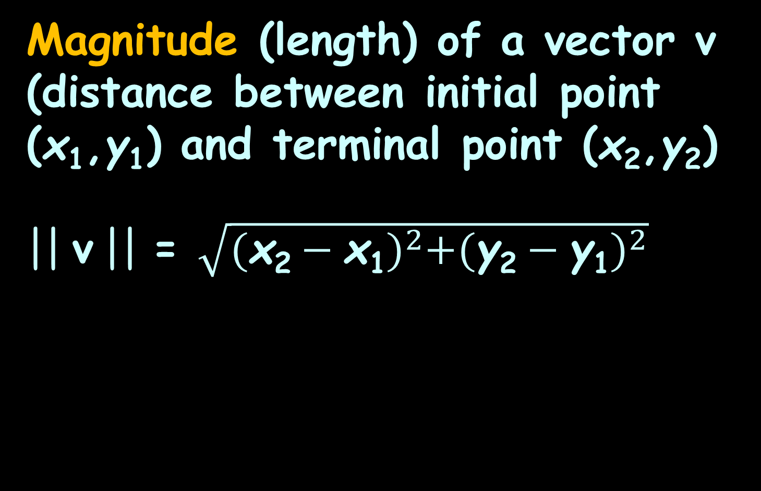
Vectors
Magnitude (length) of a vector v (distance between initial point (x₁,y₁) and terminal point (x₂,y₂)
|| v || = $\sqrt{{(\text{x}\text{2}−\text{x}\text{1})}^{2}+{(\text{y}\text{2}−\text{y}\text{1})}^{2}}$

Slide 25
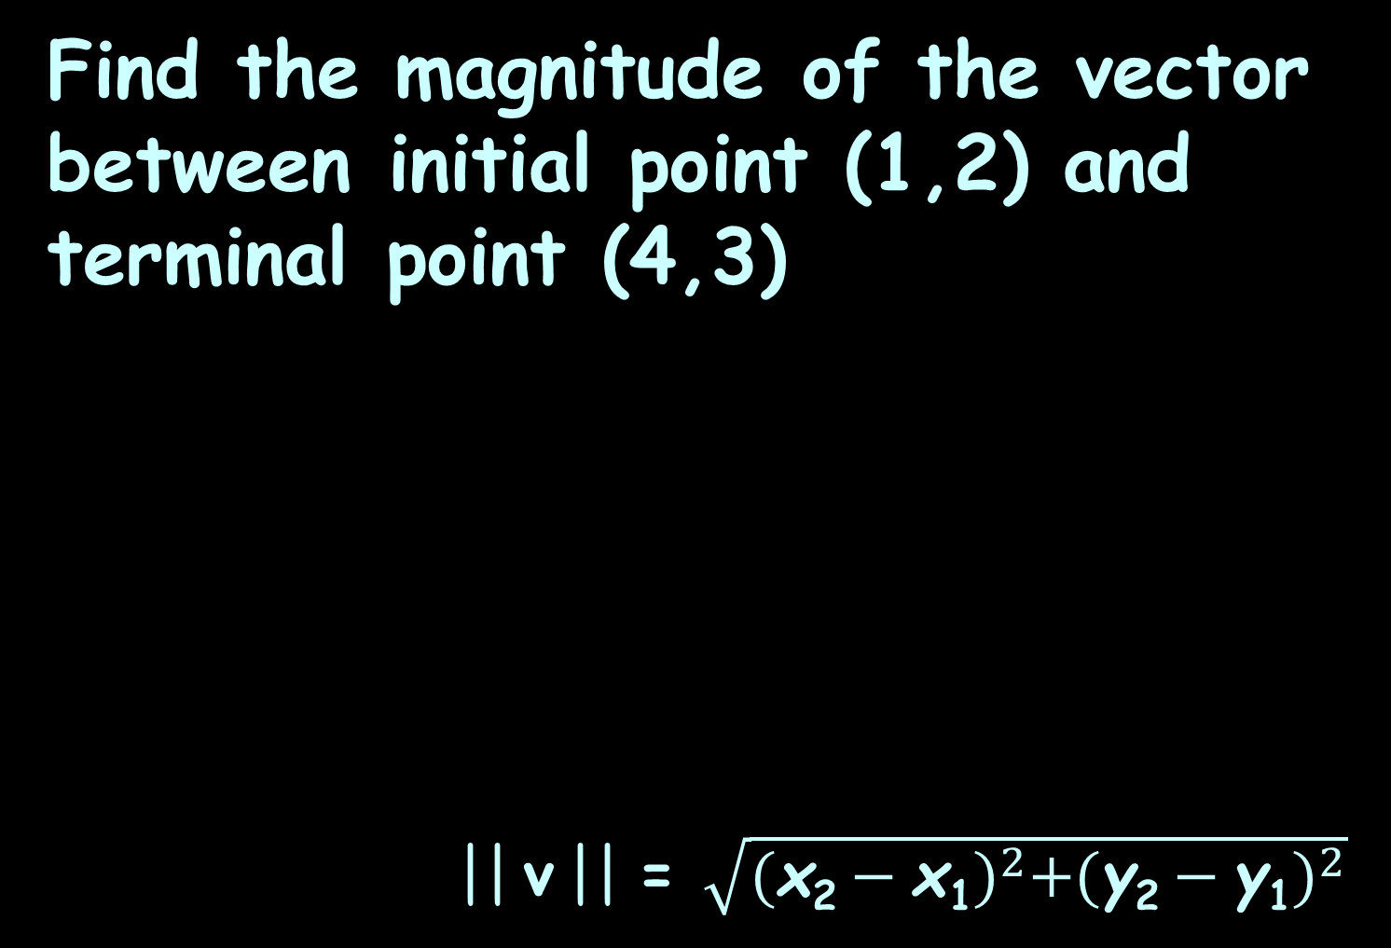
VECTORS
IN-CLASS PROBLEM 2
Find the magnitude of the vector between initial point (1,2) and terminal point (4,3)
|| v || = $\sqrt{{(\text{x}\text{2}−\text{x}\text{1})}^{2}+{(\text{y}\text{2}−\text{y}\text{1})}^{2}}$

Slide 26
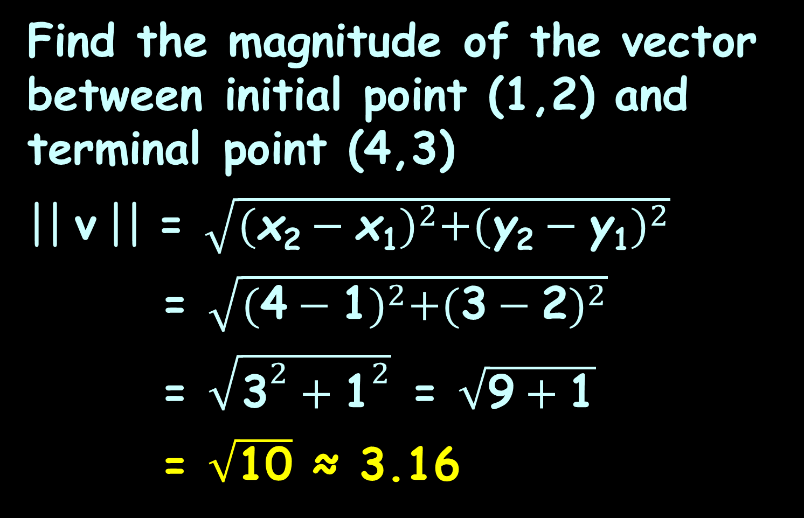
VECTORS
IN-CLASS PROBLEM 2
Find the magnitude of the vector between initial point (1,2) and terminal point (4,3)
|| v || = $\sqrt{{(\text{x}\text{2}−\text{x}\text{1})}^{2}+{(\text{y}\text{2}−\text{y}\text{1})}^{2}}$
= $\sqrt{{(\text{4}−\text{1})}^{2}+{(\text{3}−\text{2})}^{2}}$
= $\sqrt{{\text{3}}^{2}+{\text{1}}^{2}}$ = $\sqrt{\text{9}+\text{1}}$
= $\sqrt{\text{1}\text{0}}$ ≈ 3.16

Slide 27
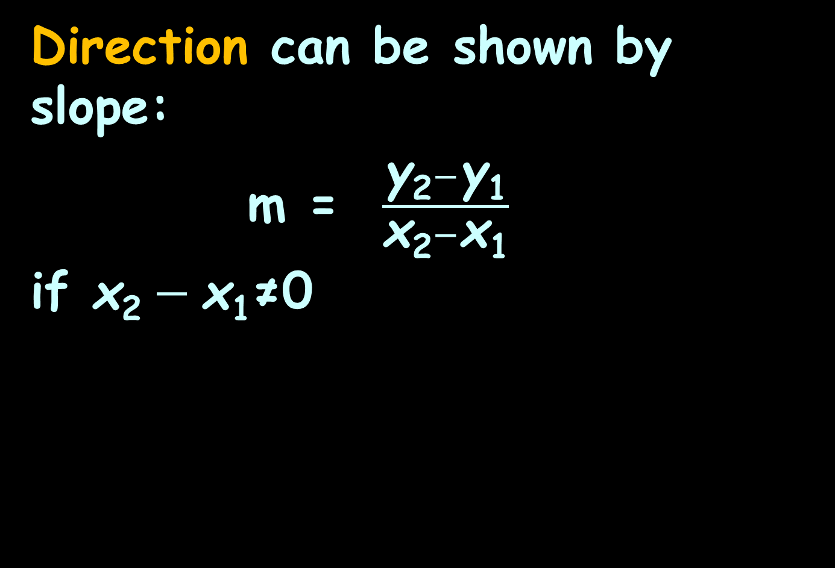
Vectors
Direction can be shown by slope:
m = $\frac{\text{y}\text{2}−\text{y}\text{1}}{\text{x}\text{2}−\text{x}\text{1}}$
if $\text{x}\text{2}−\text{x}\text{1}$≠0

Slide 28

VECTORS
IN-CLASS PROBLEM 3
Find the direction of the vector between initial point (1,2) and terminal point (4,3)
m = $\frac{\text{y}\text{2}−\text{y}\text{1}}{\text{x}\text{2}−\text{x}\text{1}}$

Slide 29
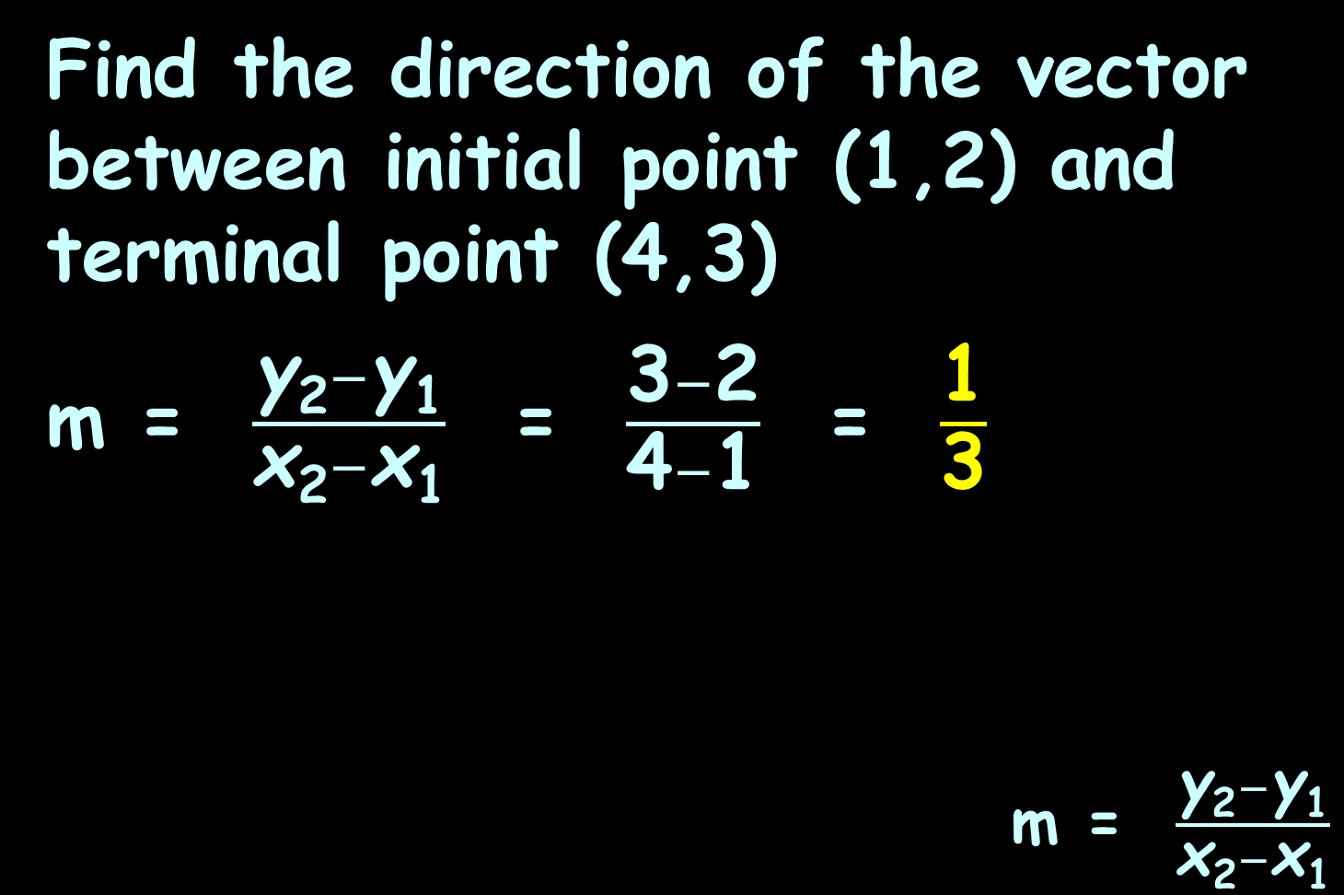
VECTORS
IN-CLASS PROBLEM 3
Find the direction of the vector between initial point (1,2) and terminal point (4,3)
m = $\frac{\text{y}\text{2}−\text{y}\text{1}}{\text{x}\text{2}−\text{x}\text{1}}$ = $\frac{\text{3}−\text{2}}{\text{4}−\text{1}}$ = $\frac{\text{1}}{\text{3}}$
m = $\frac{\text{y}\text{2}−\text{y}\text{1}}{\text{x}\text{2}−\text{x}\text{1}}$

Slide 30
Questions?
http://i.imgur.com/aliTlT3.jpg

Slide 31
Vectors
There are different types of notation to specify a vector

Slide 32
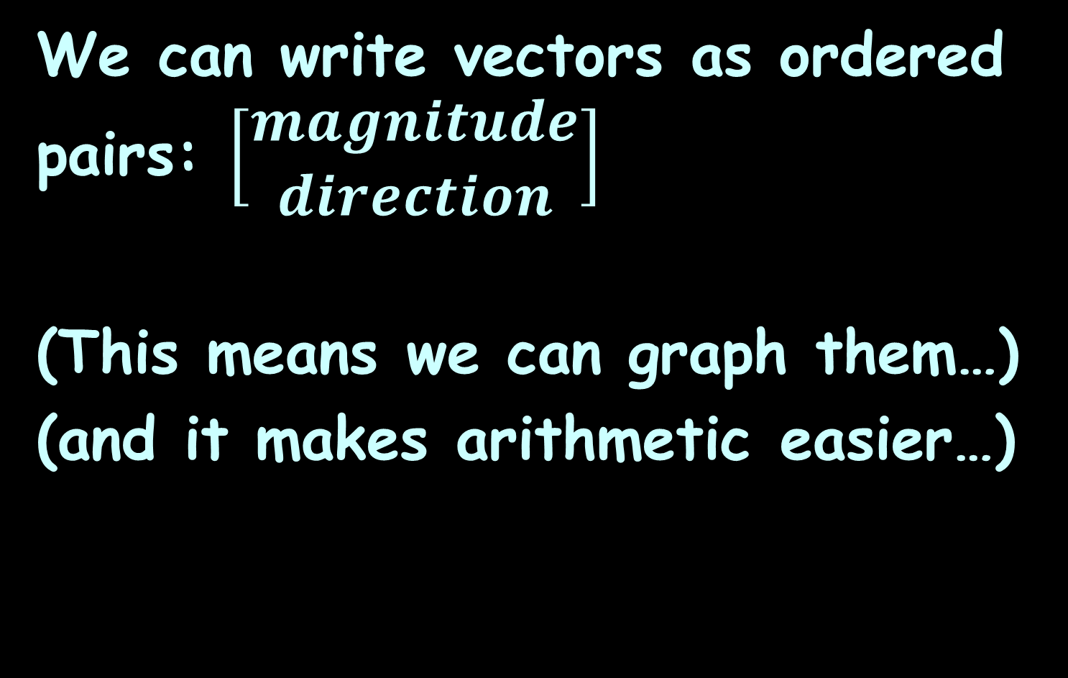
Vectors
We can write vectors as ordered pairs: $\left[\begin{matrix}magnitude \\ direction\end{matrix}\right]$
(This means we can graph them…)
(and it makes arithmetic easier…)

Slide 33
Vectors
Interesting point…

Slide 34
Vectors
Interesting point… because vectors are designated by only their magnitude and direction…

Slide 35
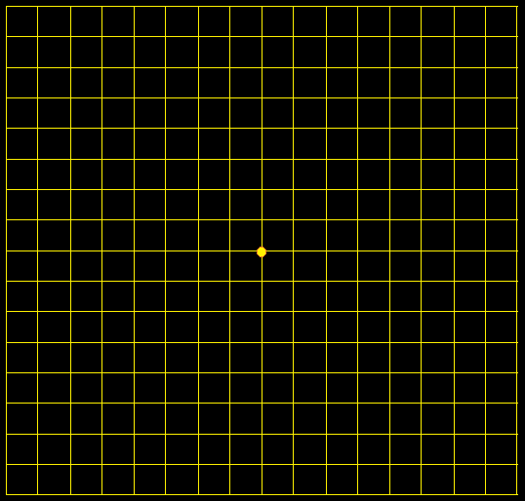
Vectors
These are all the same vector!
VFrench 2020

Slide 36
Vectors
Location doesn’t matter!
VFrench 2020

Slide 37
Vectors
So we usually start them at (0,0)
VFrench 2020

Slide 38
Vectors
Starting everything at (0,0) is called the “standard position”

Slide 39
Questions?
http://i.imgur.com/aliTlT3.jpg

Slide 40

Vectors
We can designate vectors using their magnitude and direction:
$$\left[\begin{matrix}magnitude \\ direction\end{matrix}\right]$$

Slide 41
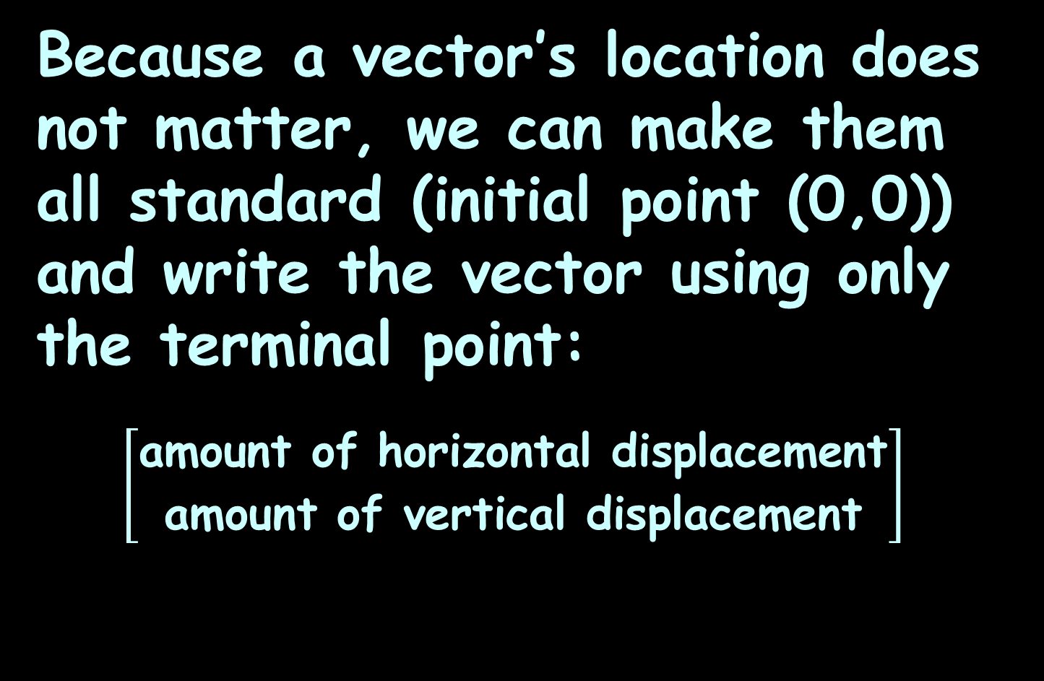
Vectors
Because a vector’s location does not matter, we can make them all standard (initial point (0,0)) and write the vector using only the terminal point:
$$\left[\begin{matrix}\text{amount} \text{of} \text{horizontal} \text{displacement} \\ \text{amount} \text{of} \text{vertical} \text{displacement}\end{matrix}\right]$$

Slide 42
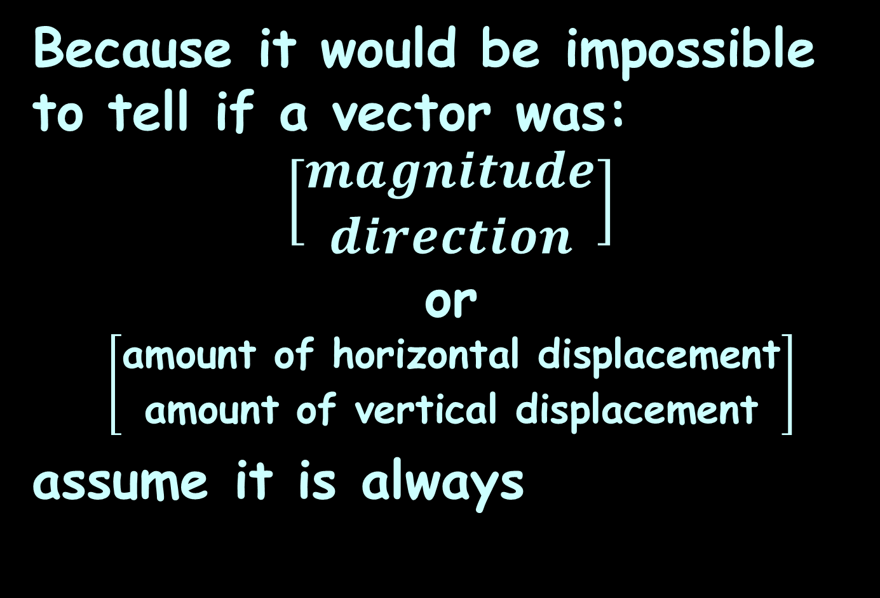
Vectors
Because it would be impossible to tell if a vector was:
$$\left[\begin{matrix}magnitude \\ direction\end{matrix}\right]$$
or
$$\left[\begin{matrix}\text{amount} \text{of} \text{horizontal} \text{displacement} \\ \text{amount} \text{of} \text{vertical} \text{displacement}\end{matrix}\right]$$
assume it is always

Slide 43

VECTORS
IN-CLASS PROBLEM 4
Graph vector $\left[\begin{matrix}\text{3} \\ \text{2}\end{matrix}\right]$:
ver
4
3
2
1
0
hor
-4
-3
-2
-1
0
1
2
3
4
-1
-2
-3
VFrench 2020
-4

Slide 44

VECTORS
IN-CLASS PROBLEM 4
Graph vector $\left[\begin{matrix}\text{3} \\ \text{2}\end{matrix}\right]$:
Start at the origin:
ver
4
3
2
1
0
hor
-4
-3
-2
-1
0
1
2
3
4
-1
-2
-3
VFrench 2020
-4

Slide 45

VECTORS
IN-CLASS PROBLEM 4
Graph vector $\left[\begin{matrix}\text{3} \\ \text{2}\end{matrix}\right]$:
Find the horizontal displacement:
ver
4
3
2
1
0
hor
-4
-3
-2
-1
0
1
2
3
4
-1
-2
-3
VFrench 2020
-4

Slide 46

VECTORS
IN-CLASS PROBLEM 4
Graph vector $\left[\begin{matrix}\text{3} \\ \text{2}\end{matrix}\right]$:
Find the vertical displacement:
ver
4
3
2
1
0
hor
-4
-3
-2
-1
0
1
2
3
4
-1
-2
-3
VFrench 2020
-4

Slide 47

VECTORS
IN-CLASS PROBLEM 4
Graph vector $\left[\begin{matrix}\text{3} \\ \text{2}\end{matrix}\right]$:
Draw the line:
ver
4
3
2
1
0
hor
-4
-3
-2
-1
0
1
2
3
4
-1
-2
-3
VFrench 2020
-4

Slide 48
Questions?
http://i.imgur.com/aliTlT3.jpg

Slide 49
Vectors
Multiplying a vector by a constant is called “scalar multiplication”

Slide 50
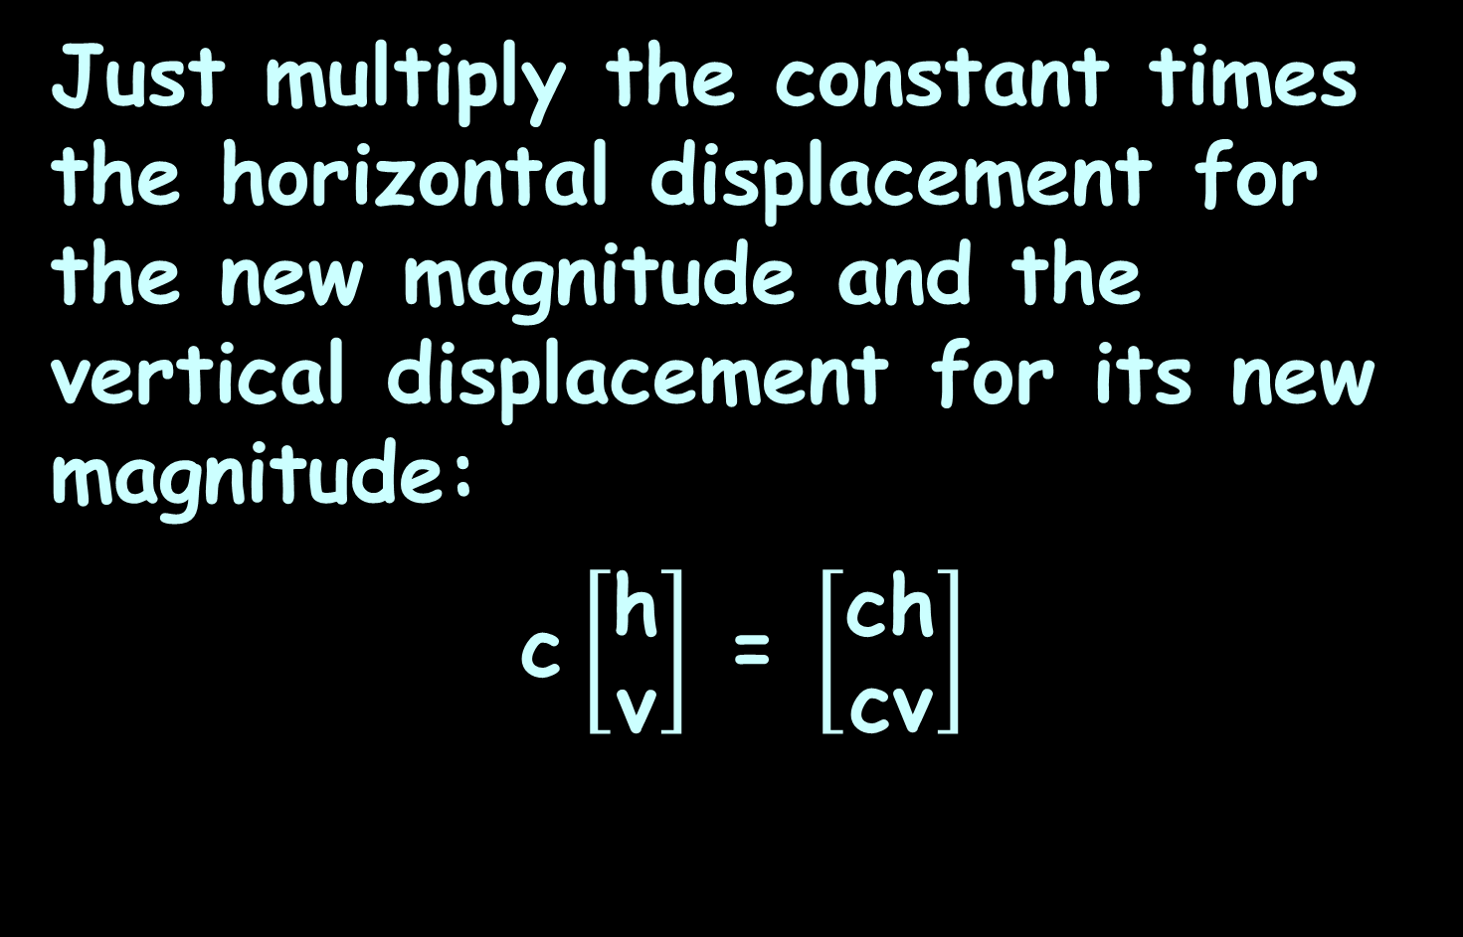
Vectors
Just multiply the constant times the horizontal displacement for the new magnitude and the vertical displacement for its new magnitude:
c $\left[\begin{matrix}\text{h} \\ \text{v}\end{matrix}\right]$ = $\left[\begin{matrix}\text{c}\text{h} \\ \text{c}\text{v}\end{matrix}\right]$

Slide 51

VECTORS
IN-CLASS PROBLEM 5
Calculate and graph 2 $\left[\begin{matrix}\text{3} \\ \text{2}\end{matrix}\right]$ :
c $\left[\begin{matrix}\text{h} \\ \text{v}\end{matrix}\right]$ = $\left[\begin{matrix}\text{c}\text{h} \\ \text{c}\text{v}\end{matrix}\right]$

Slide 52
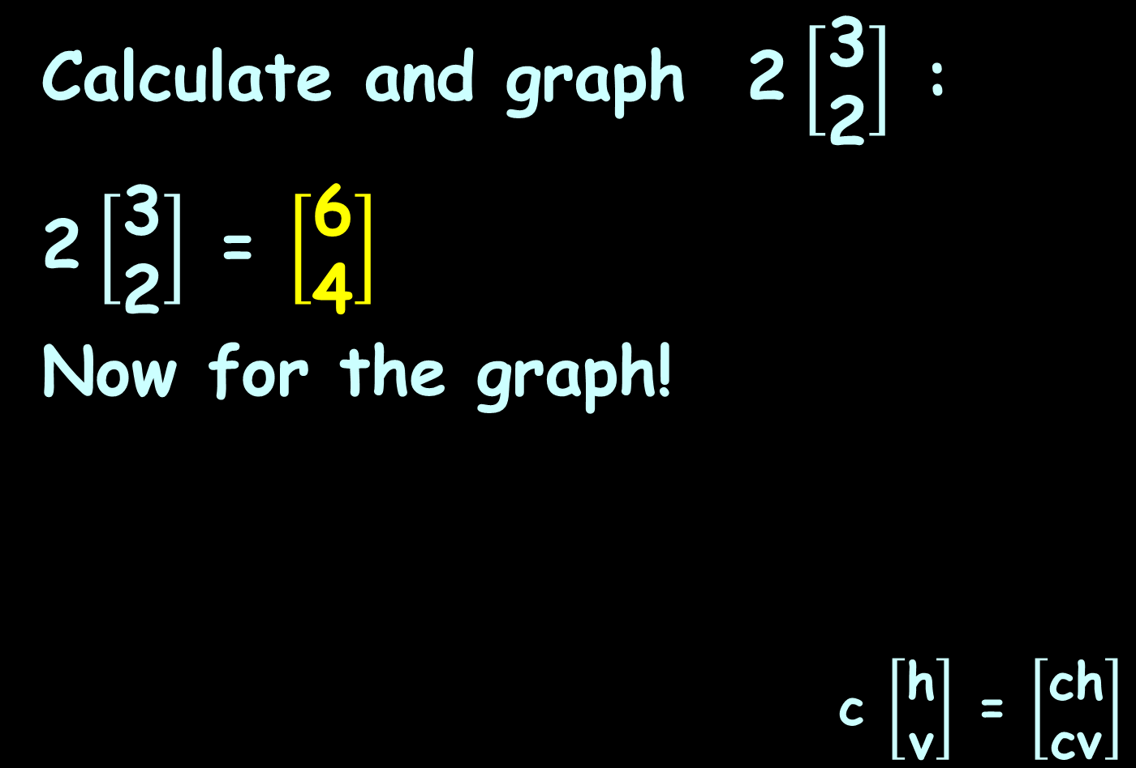
VECTORS
IN-CLASS PROBLEM 5
Calculate and graph 2 $\left[\begin{matrix}\text{3} \\ \text{2}\end{matrix}\right]$ :
2 $\left[\begin{matrix}\text{3} \\ \text{2}\end{matrix}\right]$ = $\left[\begin{matrix}\text{6} \\ \text{4}\end{matrix}\right]$
Now for the graph!
c $\left[\begin{matrix}\text{h} \\ \text{v}\end{matrix}\right]$ = $\left[\begin{matrix}\text{ch} \\ \text{cv}\end{matrix}\right]$

Slide 53

VECTORS
IN-CLASS PROBLEM 5
Graph 2 $\left[\begin{matrix}\text{3} \\ \text{2}\end{matrix}\right]$ = $\left[\begin{matrix}\text{6} \\ \text{4}\end{matrix}\right]$
ver
8
6
4
2
0
hor
-8
-6
-4
-2
0
2
4
6
8
-2
-4
-6
-8
VFrench 2020

Slide 54
VECTORS
IN-CLASS PROBLEM 5
Graph 2 $\left[\begin{matrix}\text{3} \\ \text{2}\end{matrix}\right]$ = $\left[\begin{matrix}\text{6} \\ \text{4}\end{matrix}\right]$
ver
8
6
4
2
0
hor
-8
-6
-4
-2
0
2
4
6
8
-2
-4
-6
-8
VFrench 2020

Slide 55

VECTORS
IN-CLASS PROBLEM 5
Graph 2 $\left[\begin{matrix}\text{3} \\ \text{2}\end{matrix}\right]$ = $\left[\begin{matrix}\text{6} \\ \text{4}\end{matrix}\right]$
It’s now twice as long
ver
8
6
4
2
0
hor
-8
-6
-4
-2
0
2
4
6
8
-2
-4
-6
-8
VFrench 2020

Slide 56

VECTORS
IN-CLASS PROBLEM 5
Graph 2 $\left[\begin{matrix}\text{3} \\ \text{2}\end{matrix}\right]$ = $\left[\begin{matrix}\text{6} \\ \text{4}\end{matrix}\right]$
It’s been “scaled” (hence the name)
ver
8
6
4
2
0
hor
-8
-6
-4
-2
0
2
4
6
8
-2
-4
-6
-8
VFrench 2020

Slide 57
Vectors
Scalar multiplication kv:
Multiplying a vector by a positive real number changes the magnitude but not the direction

Slide 58
Vectors
Scalar multiplication kv:
A negative scalar points
it in the opposite direction

Slide 59
Questions?
http://i.imgur.com/aliTlT3.jpg

Slide 60
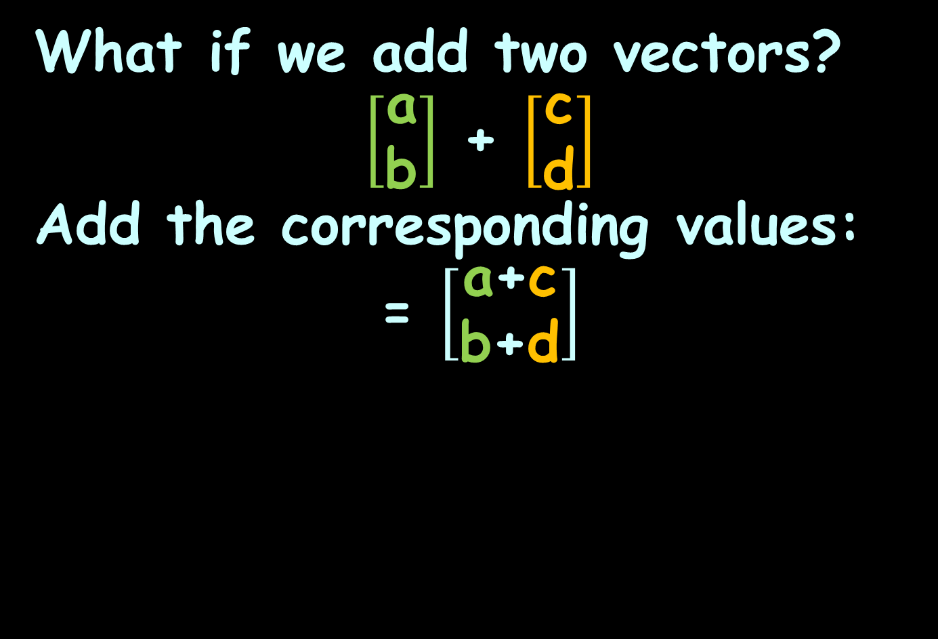
Vectors
What if we add two vectors?
$\left[\begin{matrix}\text{a} \\ \text{b}\end{matrix}\right]$ + $\left[\begin{matrix}\text{c} \\ \text{d}\end{matrix}\right]$
Add the corresponding values:
= $\left[\begin{matrix}\text{a}\text{+}\text{c} \\ \text{b}\text{+}\text{d}\end{matrix}\right]$

Slide 61
Vectors
The sum of two vectors is called the resultant

Slide 62

VECTORS
IN-CLASS PROBLEM 6
Find $\left[\begin{matrix}\text{1} \\ \text{4}\end{matrix}\right]$ + $\left[\begin{matrix}\text{2} \\ \text{3}\end{matrix}\right]$ =

Slide 63

VECTORS
IN-CLASS PROBLEM 6
Find $\left[\begin{matrix}\text{1} \\ \text{4}\end{matrix}\right]$ + $\left[\begin{matrix}\text{2} \\ \text{3}\end{matrix}\right]$ = $\left[\begin{matrix}\text{1}\text{+}\text{2} \\ \text{4}\text{+}\text{3}\end{matrix}\right]$ = $\left[\begin{matrix}\text{3} \\ \text{7}\end{matrix}\right]$

Slide 64

VECTORS
IN-CLASS PROBLEM 6
Graph $\left[\begin{matrix}\text{1} \\ \text{4}\end{matrix}\right]$ + $\left[\begin{matrix}\text{2} \\ \text{3}\end{matrix}\right]$ = $\left[\begin{matrix}\text{3} \\ \text{7}\end{matrix}\right]$
ver
8
6
4
2
0
hor
-8
-6
-4
-2
0
2
4
6
8
-2
-4
-6
VFrench 2020
-8

Slide 65

VECTORS
IN-CLASS PROBLEM 6
Graph $\left[\begin{matrix}\text{1} \\ \text{4}\end{matrix}\right]$ + $\left[\begin{matrix}\text{2} \\ \text{3}\end{matrix}\right]$ = $\left[\begin{matrix}\text{3} \\ \text{7}\end{matrix}\right]$
Remember, it doesn’t matter where a vector starts…
ver
8
6
4
2
0
hor
-8
-6
-4
-2
0
2
4
6
8
-2
-4
-6
VFrench 2020
-8

Slide 66
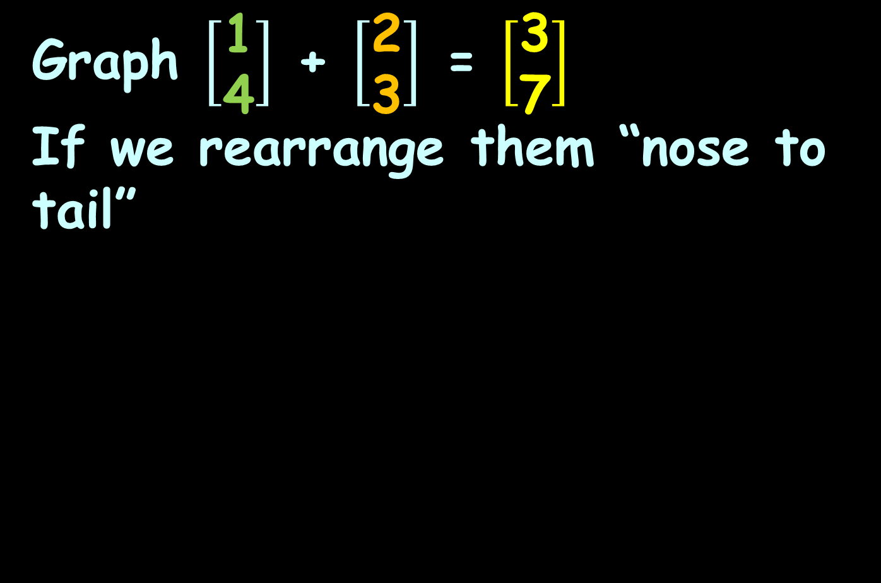
VECTORS
IN-CLASS PROBLEM 6
Graph $\left[\begin{matrix}\text{1} \\ \text{4}\end{matrix}\right]$ + $\left[\begin{matrix}\text{2} \\ \text{3}\end{matrix}\right]$ = $\left[\begin{matrix}\text{3} \\ \text{7}\end{matrix}\right]$
If we rearrange them “nose to tail”
ver
8
6
4
2
0
hor
-8
-6
-4
-2
0
2
4
6
8
-2
-4
-6
VFrench 2020
-8

Slide 67
VECTORS
IN-CLASS PROBLEM 6
If we rearrange them “nose to tail”, the sum starts where the first vector starts and ends where the second vector ends
ver
8
6
4
2
0
hor
-8
-6
-4
-2
0
2
4
6
8
-2
-4
-6
VFrench 2020
-8

Slide 68
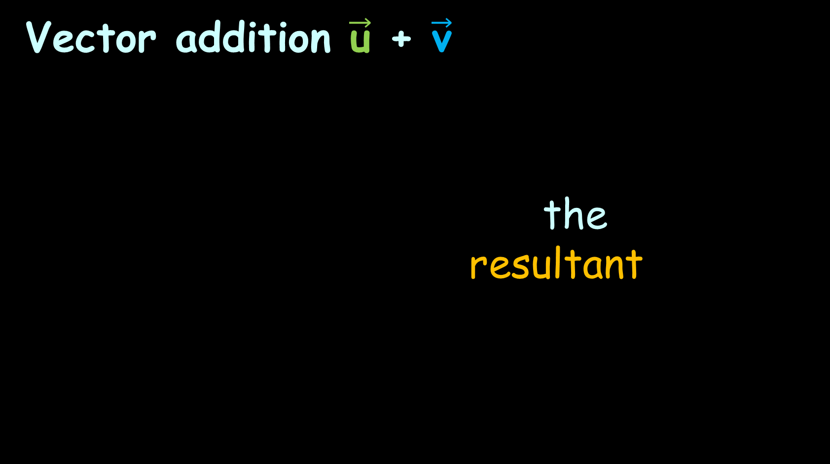
Vectors
Vector addition $\vec{\text{u}}$ + $\vec{\text{v}}$
the
resultant

Slide 69

Vectors
Vector subtraction $\vec{\text{u}}$ - $\vec{\text{v}}$
flip
the
resultant

Slide 70
Questions?
http://i.imgur.com/aliTlT3.jpg

Slide 71
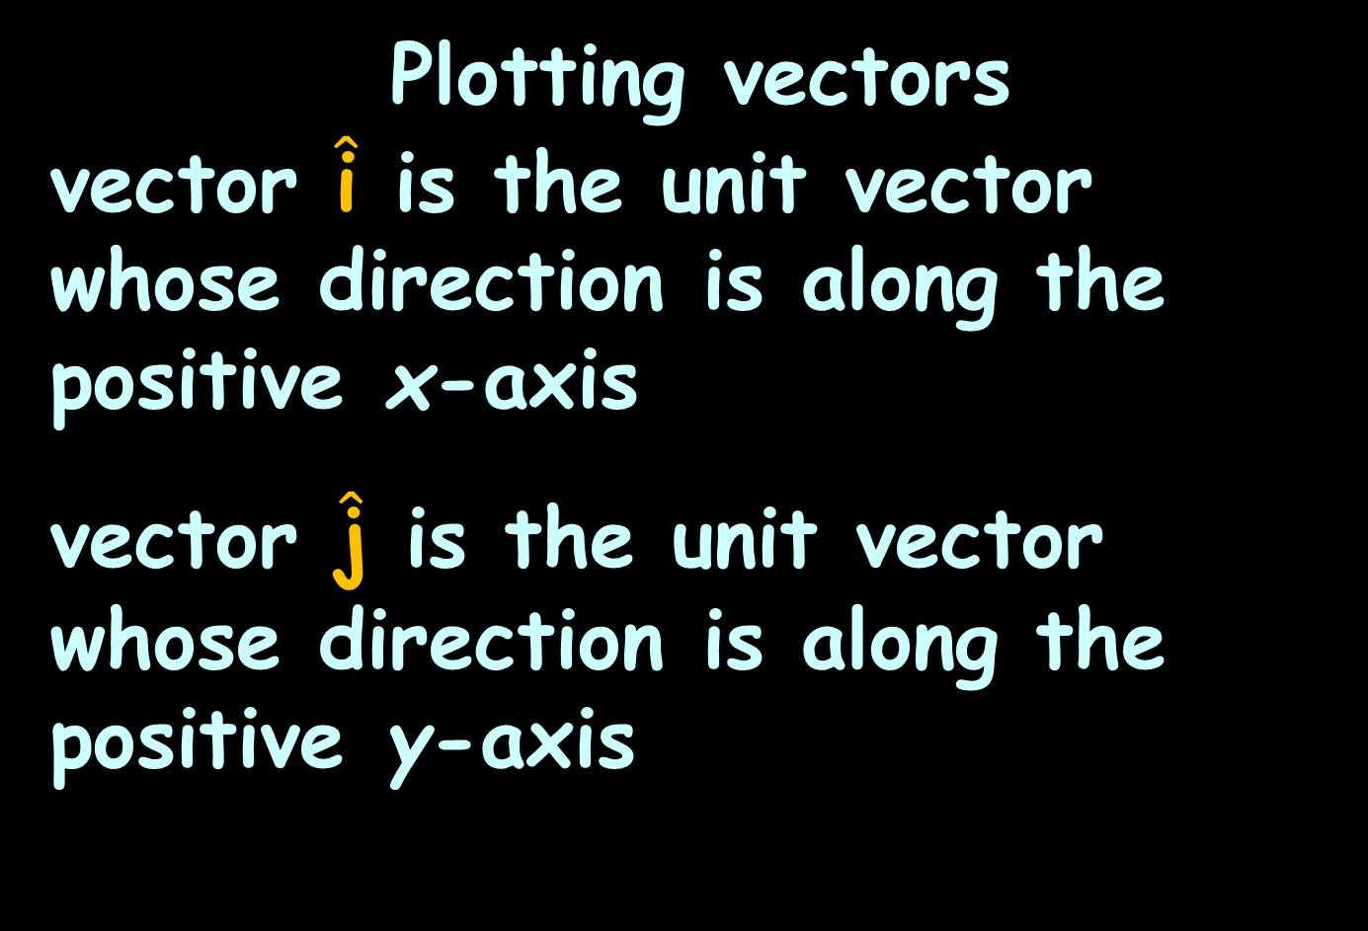
Vectors
Plotting vectors
vector $\hat{\text{i}}$ is the unit vector whose direction is along the positive x-axis
vector $\hat{\text{j}}$ is the unit vector whose direction is along the positive y-axis

Slide 72
Vectors
(This is just another way of describing what we’ve been doing so far)

Slide 73

Vectors
So we can write the vector $\vec{\text{v}}$ from (0,0) to (a,b) as:
$\vec{\text{v}}$ = a $\hat{\text{i}}$ + b $\hat{\text{j}}$

Slide 74
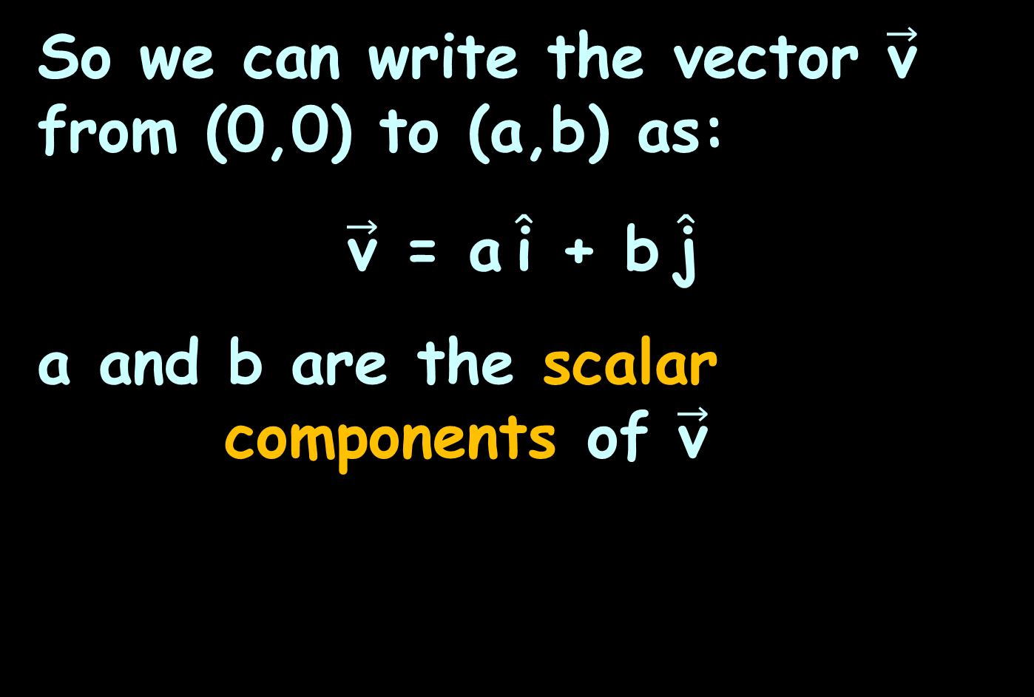
Vectors
So we can write the vector $\vec{\text{v}}$ from (0,0) to (a,b) as:
$\vec{\text{v}}$ = a $\hat{\text{i}}$ + b $\hat{\text{j}}$
a and b are the scalar
components of $\vec{\text{v}}$

Slide 75
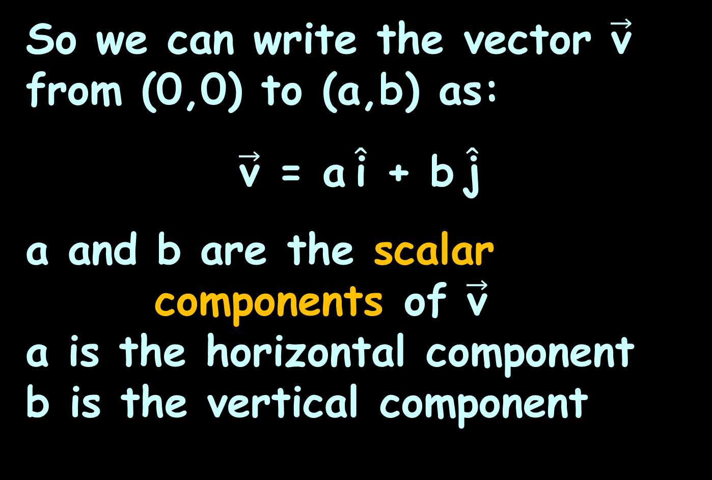
Vectors
So we can write the vector $\vec{\text{v}}$ from (0,0) to (a,b) as:
$\vec{\text{v}}$ = a $\hat{\text{i}}$ + b $\hat{\text{j}}$
a and b are the scalar
components of $\vec{\text{v}}$
a is the horizontal component
b is the vertical component

Slide 76

Vectors
$\vec{\text{v}}$ = a $\hat{\text{i}}$ + b $\hat{\text{j}}$
is called component form
or
“ai + bj form”

Slide 77

Vectors
Vector Operations
Scalar multiplication:
k$\vec{\text{v}}$ = (ka) $\hat{\text{i}}$ + (kb) $\hat{\text{j}}$

Slide 78

VECTORS
IN-CLASS PROBLEM 7
Find 5$\vec{\text{v}}$ for $\vec{\text{v}}$ = -3$\hat{\text{i}}$ + 2$\hat{\text{j}}$ :

Slide 79

VECTORS
IN-CLASS PROBLEM 7
Find 5$\vec{\text{v}}$ for $\vec{\text{v}}$ = -3$\hat{\text{i}}$ + 2$\hat{\text{j}}$ :
5$\vec{\text{v}}$ = 5(-3$\hat{\text{i}}$+2$\hat{\text{j}}$) = -15$\hat{\text{i}}$ + 10$\hat{\text{j}}$

Slide 80

VECTORS
IN-CLASS PROBLEM 8
Find 7 $\vec{\text{v}}$ for $\vec{\text{v}}$ = -2$\hat{\text{i}}$ - 2$\hat{\text{j}}$ :

Slide 81

VECTORS
IN-CLASS PROBLEM 8
Find 7 $\vec{\text{v}}$ for $\vec{\text{v}}$ = -2$\hat{\text{i}}$ - 2$\hat{\text{j}}$ :
7 $\vec{\text{v}}$ = 7(-2$\hat{\text{i}}$-2$\hat{\text{j}}$) = -14$\hat{\text{i}}$-14$\hat{\text{j}}$

Slide 82
Questions?
http://i.imgur.com/aliTlT3.jpg

Slide 83
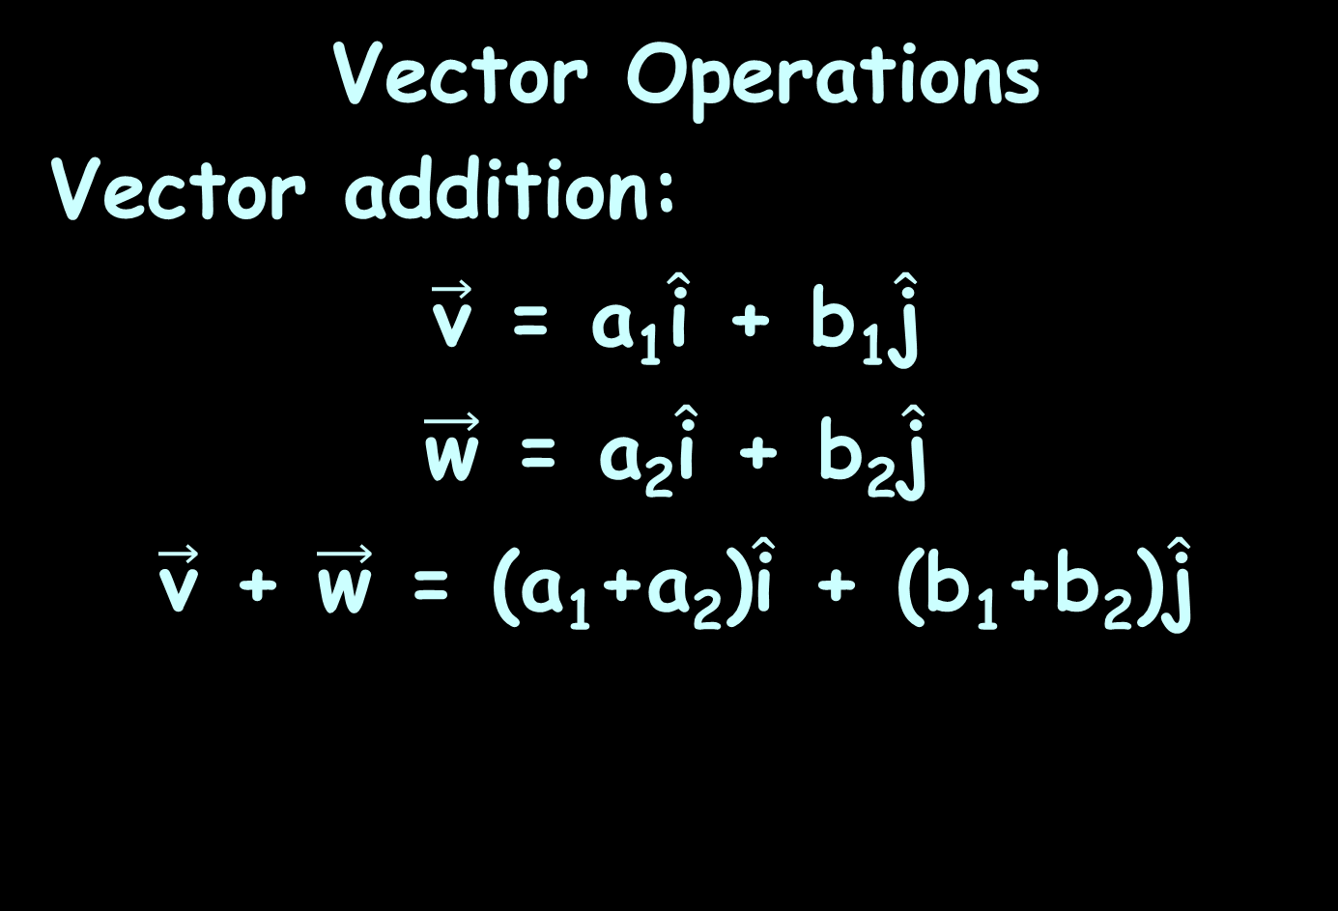
Vectors
Vector Operations
Vector addition:
$\vec{\text{v}}$ = a₁$\hat{\text{i}}$ + b₁$\hat{\text{j}}$
$\vec{\text{w}}$ = a₂$\hat{\text{i}}$ + b₂$\hat{\text{j}}$
$\vec{\text{v}}$ + $\vec{\text{w}}$ = (a₁+a₂)$\hat{\text{i}}$ + (b₁+b₂)$\hat{\text{j}}$

Slide 84

VECTORS
IN-CLASS PROBLEM 9
Find $\vec{\text{v}}$ + $\vec{\text{w}}$ for: $\vec{\text{v}}$ = 2$\hat{\text{i}}$ - 6$\hat{\text{j}}$ and $\vec{\text{w}}$ = 3$\hat{\text{i}}$ + 4$\hat{\text{j}}$

Slide 85
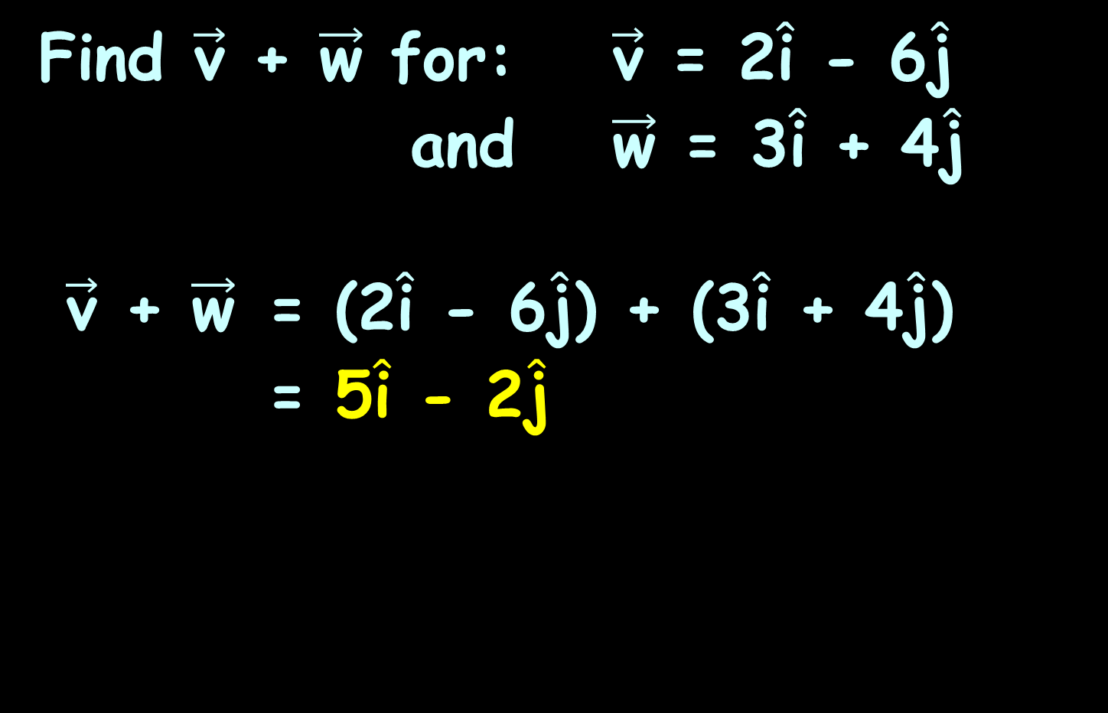
VECTORS
IN-CLASS PROBLEM 9
Find $\vec{\text{v}}$ + $\vec{\text{w}}$ for: $\vec{\text{v}}$ = 2$\hat{\text{i}}$ - 6$\hat{\text{j}}$ and $\vec{\text{w}}$ = 3$\hat{\text{i}}$ + 4$\hat{\text{j}}$
$\vec{\text{v}}$ + $\vec{\text{w}}$ = (2$\hat{\text{i}}$ - 6$\hat{\text{j}}$) + (3$\hat{\text{i}}$ + 4$\hat{\text{j}}$)
= 5$\hat{\text{i}}$ - 2$\hat{\text{j}}$

Slide 86

VECTORS
IN-CLASS PROBLEM 10
Find $\vec{\text{v}}$ + $\vec{\text{w}}$ for: $\vec{\text{v}}$ = 2$\hat{\text{i}}$ + 4$\hat{\text{j}}$ and $\vec{\text{w}}$ = 3$\hat{\text{i}}$ - 4$\hat{\text{j}}$

Slide 87
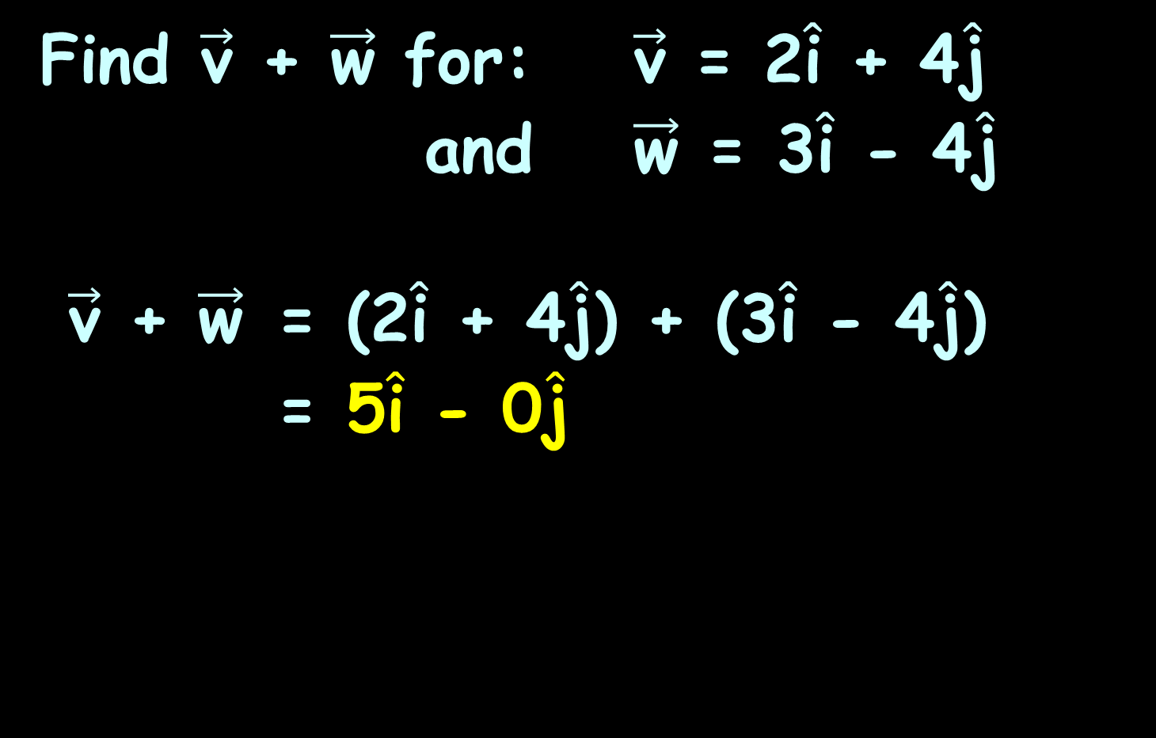
VECTORS
IN-CLASS PROBLEM 10
Find $\vec{\text{v}}$ + $\vec{\text{w}}$ for: $\vec{\text{v}}$ = 2$\hat{\text{i}}$ + 4$\hat{\text{j}}$ and $\vec{\text{w}}$ = 3$\hat{\text{i}}$ - 4$\hat{\text{j}}$
$\vec{\text{v}}$ + $\vec{\text{w}}$ = (2$\hat{\text{i}}$ + 4$\hat{\text{j}}$) + (3$\hat{\text{i}}$ - 4$\hat{\text{j}}$)
= 5$\hat{\text{i}}$ - 0$\hat{\text{j}}$

Slide 88

VECTORS
IN-CLASS PROBLEM 11
Find $\vec{\text{v}}$ - $\vec{\text{w}}$ for: $\vec{\text{v}}$ = 2$\hat{\text{i}}$ + 4$\hat{\text{j}}$ and $\vec{\text{w}}$ = 3$\hat{\text{i}}$ - 4$\hat{\text{j}}$

Slide 89

VECTORS
IN-CLASS PROBLEM 11
Find $\vec{\text{v}}$ - $\vec{\text{w}}$ for: $\vec{\text{v}}$ = 2$\hat{\text{i}}$ + 4$\hat{\text{j}}$ and $\vec{\text{w}}$ = 3$\hat{\text{i}}$ - 4$\hat{\text{j}}$
$\vec{\text{v}}$ - $\vec{\text{w}}$ = (2$\hat{\text{i}}$ + 4$\hat{\text{j}}$) - (3$\hat{\text{i}}$ - 4$\hat{\text{j}}$)
= -1$\hat{\text{i}}$ + 8$\hat{\text{j}}$

Slide 90

VECTORS
IN-CLASS PROBLEM 12
Find 2$\vec{\text{v}}$ + 4$\vec{\text{w}}$ for: $\vec{\text{v}}$ = 3$\hat{\text{i}}$ - 7$\hat{\text{j}}$ and $\vec{\text{w}}$ = $\hat{\text{i}}$ - $\hat{\text{j}}$

Slide 91

VECTORS
IN-CLASS PROBLEM 12
Find 2$\vec{\text{v}}$ + 4$\vec{\text{w}}$ for: $\vec{\text{v}}$ = 3$\hat{\text{i}}$ - 7$\hat{\text{j}}$ and $\vec{\text{w}}$ = $\hat{\text{i}}$ - $\hat{\text{j}}$
2$\vec{\text{v}}$ + 4$\vec{\text{w}}$ = 2(3$\hat{\text{i}}$-7$\hat{\text{j}}$) + 4($\hat{\text{i}}$-$\hat{\text{j}}$)
= 6$\hat{\text{i}}$ - 14$\hat{\text{j}}$ + 4$\hat{\text{i}}$ - 4$\hat{\text{j}}$
= 10$\hat{\text{i}}$ - 18$\hat{\text{j}}$

Slide 92

VECTORS
IN-CLASS PROBLEM 13
In what quadrant is the terminal point of the vector
$\vec{\text{v}}$ = 5$\hat{\text{i}}$ - 3$\hat{\text{j}}$
located?
II
I
III
IV

Slide 93
VECTORS
IN-CLASS PROBLEM 13
In what quadrant is the terminal point of the vector
$\vec{\text{v}}$ = 5$\hat{\text{i}}$ - 3$\hat{\text{j}}$
located?
8
7
6
5
4
3
2
1
0
-1
-2
-3
-4
-5
-5
-7
-8
II
I
-8 -7 -6 -5 -4 -3 -2 -1 1 2 3 4 5 6 7 8
III
IV

Slide 94

VECTORS
IN-CLASS PROBLEM 14
If the vector $\vec{\text{v}}$ = 2$\hat{\text{i}}$ + 2$\hat{\text{j}}$
is multiplied by the scalar –2, in which quadrant will the terminal point of the product vector be?
–2$\vec{\text{v}}$

Slide 95

VECTORS
IN-CLASS PROBLEM 14
If the vector $\vec{\text{v}}$ is multiplied by a scalar, in which quadrant will the terminal point of the product vector
be?
$\vec{\text{v}}$ = 2$\hat{\text{i}}$ + 2$\hat{\text{j}}$
–2$\vec{\text{v}}$
8
7
6
5
4
3
2
1
0
-1
-2
-3
-4
-5
-5
-7
-8
II
I
-8 -7 -6 -5 -4 -3 -2 -1 1 2 3 4 5 6 7 8
III
IV

Slide 96
Vectors
The component form describes lines in 2-D

Slide 97

Vectors
You can easily do 3-D “lines” (planes):
$\vec{\text{v}}$ = a$\hat{\text{i}}$ + b$\hat{\text{j}}$+ c$\hat{\text{k}}$

Slide 98
Vectors
You can write lines (planes… whatever) in n-D!

Slide 99
Questions?

Slide 100

Vectors
The magnitude of $\vec{\text{v}}$
||$\vec{\text{v}}$|| = $\sqrt{{\text{a}}^{2}+{\text{b}}^{2}}$

Slide 101

VECTORS
IN-CLASS PROBLEM 15
Find the magnitude of the vector: $\vec{\text{v}}$ = -5$\hat{\text{i}}$ - 6$\hat{\text{j}}$

Slide 102

VECTORS
IN-CLASS PROBLEM 15
Find the magnitude of the vector: $\vec{\text{v}}$ = -5$\hat{\text{i}}$ - 6$\hat{\text{j}}$
$\vec{\text{v}}$ = a$\hat{\text{i}}$ + b$\hat{\text{j}}$
What is a?
What is b?

Slide 103

VECTORS
IN-CLASS PROBLEM 15
Find the magnitude of the vector: $\vec{\text{v}}$ = -5$\hat{\text{i}}$ - 6$\hat{\text{j}}$
a = -5
b = -6
Now find: ||$\vec{\text{v}}$|| = $\sqrt{{\text{a}}^{2}+{\text{b}}^{2}}$

Slide 104

VECTORS
IN-CLASS PROBLEM 15
Find the magnitude of the vector: $\vec{\text{v}}$ = -5$\hat{\text{i}}$ - 6$\hat{\text{j}}$
2$\sqrt{\text{5}}$ b) $\sqrt{\text{61}}$
c) 30 d) 11

Slide 105

VECTORS
IN-CLASS PROBLEM 15
Find the magnitude of the vector: $\vec{\text{v}}$ = -5$\hat{\text{i}}$ - 6$\hat{\text{j}}$
2$\sqrt{\text{5}}$ b) $\sqrt{\text{61}}$
c) 30 d) 11

Slide 106
Questions?

Slide 107

Vectors
Position Vector
if $\vec{\text{v}}$ doesn't start at (0,0):
$\vec{\text{v}}$ = (x₂-x₁) $\hat{\text{i}}$ + (y₂-y₁) $\hat{\text{j}}$

Slide 108
VECTORS
IN-CLASS PROBLEM 16
Find the position vector for the vector with initial point: (–1, 1)
and terminal point: (2, –2):

Slide 109

VECTORS
IN-CLASS PROBLEM 16
Find the position vector for the vector with initial point: (–1, 1)
and terminal point: (2, –2):
$\vec{\text{v}}$ = (x₂-x₁) $\hat{\text{i}}$ + (y₂-y₁) $\hat{\text{j}}$

Slide 110

VECTORS
IN-CLASS PROBLEM 16
Find the position vector for the vector with initial point: (–1, 1)
and terminal point: (2, –2):
$\vec{\text{v}}$ = (x₂-x₁) $\hat{\text{i}}$ + (y₂-y₁) $\hat{\text{j}}$
$\vec{\text{v}}$ = (2-(-1)) $\hat{\text{i}}$ + (-2-1) $\hat{\text{j}}$

Slide 111

VECTORS
IN-CLASS PROBLEMS
Find the position vector for the vector with initial point: (–1, 1)
and terminal point: (2, –2):
$\vec{\text{v}}$ = (x₂-x₁) $\hat{\text{i}}$ + (y₂-y₁) $\hat{\text{j}}$
$\vec{\text{v}}$ = (2-(-1)) $\hat{\text{i}}$ + (-2-1) $\hat{\text{j}}$
$\vec{\text{v}}$ = 3$\hat{\text{i}}$ - 3$\hat{\text{j}}$

Slide 112
Questions?

Slide 113
Vectors
A “unit vector” has a magnitude of 1
Sometimes it is called a “direction vector”

Slide 114

VECTORS
IN-CLASS PROBLEM 17
Find the unit vector that has the same direction as the vector:
$\vec{\text{v}}$ = 4$\hat{\text{j}}$
8
7
6
5
4
3
2
1
0
-1
-2
-3
-4
-5
-5
-7
-8
-8 -7 -6 -5 -4 -3 -2 -1 1 2 3 4 5 6 7 8

Slide 115

VECTORS
IN-CLASS PROBLEM 17
Find the unit vector that has the same direction as the vector:
$\vec{\text{v}}$ = 4$\hat{\text{j}}$
What is the
direction?
8
7
6
5
4
3
2
1
0
-1
-2
-3
-4
-5
-5
-7
-8
-8 -7 -6 -5 -4 -3 -2 -1 1 2 3 4 5 6 7 8

Slide 116

VECTORS
IN-CLASS PROBLEM 17
Find the unit vector that has the same direction as the vector:
$\vec{\text{v}}$ = 4$\hat{\text{j}}$
The unit vector
will be going
in the same
direction but
have length
(magnitude) 1
8
7
6
5
4
3
2
1
0
-1
-2
-3
-4
-5
-5
-7
-8
-8 -7 -6 -5 -4 -3 -2 -1 1 2 3 4 5 6 7 8

Slide 117

VECTORS
IN-CLASS PROBLEM 17
Find the unit vector that has the same direction as the vector:
$\vec{\text{v}}$ = 4$\hat{\text{j}}$
$\vec{\text{v}}$ = $\hat{\text{j}}$
8
7
6
5
4
3
2
1
0
-1
-2
-3
-4
-5
-5
-7
-8
-8 -7 -6 -5 -4 -3 -2 -1 1 2 3 4 5 6 7 8

Slide 118
Questions?

Slide 119

Vectors
writing a vector in terms of its magnitude and direction:
magnitude ||$\vec{\text{v}}$|| direction angle θ
$\vec{\text{v}}$ = ||$\vec{\text{v}}$|| (cosθ $\hat{\text{i}}$ + sinθ $\hat{\text{j}}$)

Slide 120
Vectors
LOTS of real-world things have lengths and directions

Slide 121

Vectors
If you are given the length (||$\vec{\text{v}}$||) and direction angle θ, you can use:
$\vec{\text{v}}$ = ||$\vec{\text{v}}$|| (cosθ $\hat{\text{i}}$ + sinθ $\hat{\text{j}}$)

Slide 122
VECTORS
IN-CLASS PROBLEM 17
A football quarterback throws the football with a speed of 48 feet per second at an angle of 45 degrees upward from the ground. What is the length (magnitude) of the throw?

Slide 123

VECTORS
IN-CLASS PROBLEM 17
A football quarterback throws the football with a speed of 48 feet per second at an angle of 45 degrees upward from the ground. What is the length (magnitude)
of the throw?
magnitude ||$\vec{\text{v}}$|| = 48

Slide 124
VECTORS
IN-CLASS PROBLEM 17
A football quarterback throws the football with a speed of 48 feet per second at an angle of 45 degrees upward from the ground. What is the direction?

Slide 125
VECTORS
IN-CLASS PROBLEM 17
A football quarterback throws the football with a speed of 48 feet per second at an angle of 45 degrees upward from the ground. What is the direction?
direction angle θ = 45°

Slide 126

VECTORS
IN-CLASS PROBLEM 17
magnitude ||$\vec{\text{v}}$|| = 48 direction angle θ = 45
What is the vector describing the motion of the football?

Slide 127

VECTORS
IN-CLASS PROBLEM 17
magnitude ||$\vec{\text{v}}$|| = 48 direction angle θ = 45
What is the vector describing the motion of the football?
$\vec{\text{v}}$ = ||$\vec{\text{v}}$|| (cosθ $\hat{\text{i}}$ + sinθ $\hat{\text{j}}$)

Slide 128

VECTORS
IN-CLASS PROBLEM 17
magnitude ||$\vec{\text{v}}$|| = 48 direction angle θ = 45
What is the vector describing the motion of the football?
$\vec{\text{v}}$ = ||$\vec{\text{v}}$|| (cosθ $\hat{\text{i}}$ + sinθ $\hat{\text{j}}$)
$\vec{\text{v}}$ = 48 (cos45 $\hat{\text{i}}$ + sin45 $\hat{\text{j}}$)

Slide 129

VECTORS
IN-CLASS PROBLEM 17
A football quarterback throws the football with a speed of 48 feet per second at an angle of 45 degrees upward from the ground. The vector that describes the motion of the football is:
68$\hat{\text{i}}$ + 68$\hat{\text{j}}$ b) 30$\hat{\text{i}}$ + 30$\hat{\text{j}}$
c) 34$\hat{\text{i}}$ + 34$\hat{\text{j}}$ d) 34$\hat{\text{i}}$ – 34$\hat{\text{j}}$

Slide 130

VECTORS
IN-CLASS PROBLEM 17
A football quarterback throws the football with a speed of 48 feet per second at an angle of 45 degrees upward from the ground. The vector that describes the motion of the football is:
68$\hat{\text{i}}$ + 68$\hat{\text{j}}$ b) 30$\hat{\text{i}}$ + 30$\hat{\text{j}}$
c) 34$\hat{\text{i}}$ + 34$\hat{\text{j}}$ d) 34$\hat{\text{i}}$ – 34$\hat{\text{j}}$

Slide 131
Questions?

Slide 132

Vectors
Dot Product - Multiplying two
vectors
For $\vec{\text{v}}$ = a₁$\hat{\text{i}}$ + b₁$\hat{\text{j}}$
and $\vec{\text{w}}$ = a₂$\hat{\text{i}}$ + b₂$\hat{\text{j}}$
$\vec{\text{v}}$● $\vec{\text{w}}$ = a₁a₂ + b₁b₂

Slide 133

Vectors
Dot Product - Multiplying two
vectors
For $\vec{\text{v}}$ = a₁$\hat{\text{i}}$ + b₁$\hat{\text{j}}$
and $\vec{\text{w}}$ = a₂$\hat{\text{i}}$ + b₂$\hat{\text{j}}$
$\vec{\text{v}}$● $\vec{\text{w}}$ = a₁a₂ + b₁b₂
Note: there are no $\hat{\text{i}}$’s or $\hat{\text{j}}$’s – only a number

Slide 134
Vectors
The dot product is sometimes called the “inner product”

Slide 135
Vectors
You can think of the dot product as directional multiplication

Slide 136
Vectors
If a vector is “growth in a direction”
Adding vectors accumulates the growth contained in several vectors

Slide 137
Vectors
If a vector is “growth in a direction”
Multiplying by a constant makes an existing vector stronger

Slide 138
Vectors
If a vector is “growth in a direction”
The dot product applies the directional growth of one vector to another

Slide 139
Vectors
If a vector is “growth in a direction”
The dot product applies the directional growth of one vector to another
The result is how much stronger we've made the original (positive, negative, or zero)

Slide 140
Vectors
Suppose there are two vectors:
3i+0j and 4i+0j
3 is "directional growth" in a single dimension
4 is "directional growth" in the same direction
3 x 4 = 12 means we get 12x growth in a that direction

Slide 141
Vectors
Suppose there are two vectors:
3i+0j and 0i+2j
i is “one orange”
j is “one banana”
3i+0j means triple the oranges,
destroy the bananas
0i+2j means destroy the
oranges, double the bananas

Slide 142
Vectors
Suppose there are two vectors:
3i+0j and 0i+2j
i is “oranges”
j is “bananas”
The dot product means “destroy all your fruit, buddy!”

Slide 143
Vectors
A dot product result can be:
zero: we don't have any growth
in the original direction
positive: we have growth in the
original direction
negative number: we have
reverse growth in the
original direction

Slide 144

VECTORS
IN-CLASS PROBLEM 18
Find the dot product of vector $\vec{\text{v}}$ and vector $\vec{\text{w}}$ if:
$\vec{\text{v}}$ = 2$\hat{\text{i}}$ - 3$\hat{\text{j}}$ and $\vec{\text{w}}$ = $\hat{\text{i}}$ - $\hat{\text{j}}$

Slide 145

VECTORS
IN-CLASS PROBLEM 18
Find the dot product of vector $\vec{\text{v}}$ and vector $\vec{\text{w}}$ if:
$\vec{\text{v}}$ = 2$\hat{\text{i}}$ - 3$\hat{\text{j}}$ and $\vec{\text{w}}$ = $\hat{\text{i}}$ - $\hat{\text{j}}$
2×1 + -3×-1

Slide 146

VECTORS
IN-CLASS PROBLEM 18
Find the dot product of vector $\vec{\text{v}}$ and vector $\vec{\text{w}}$ if:
$\vec{\text{v}}$ = 2$\hat{\text{i}}$ - 3$\hat{\text{j}}$ and $\vec{\text{w}}$ = $\hat{\text{i}}$ - $\hat{\text{j}}$
2×1 + -3×-1
2+3
5

Slide 147

VECTORS
IN-CLASS PROBLEM 19
Find the dot product of vector $\vec{\text{v}}$ and vector $\vec{\text{w}}$ if:
$\vec{\text{v}}$ = 3$\hat{\text{i}}$ + 3$\hat{\text{j}}$ and $\vec{\text{w}}$ = $\hat{\text{i}}$ + 4$\hat{\text{j}}$

Slide 148

VECTORS
IN-CLASS PROBLEM 19
Find the dot product of vector $\vec{\text{v}}$ and vector $\vec{\text{w}}$ if:
$\vec{\text{v}}$ = 3$\hat{\text{i}}$ + 3$\hat{\text{j}}$ and $\vec{\text{w}}$ = $\hat{\text{i}}$ + 4$\hat{\text{j}}$
15

Slide 149

VECTORS
IN-CLASS PROBLEM 20
Find the dot product of vector $\vec{\text{v}}$ and vector $\vec{\text{w}}$ if:
$\vec{\text{v}}$ = 7$\hat{\text{i}}$ - 2$\hat{\text{j}}$ and $\vec{\text{w}}$ = -3$\hat{\text{i}}$ - $\hat{\text{j}}$

Slide 150

VECTORS
IN-CLASS PROBLEM 20
Find the dot product of vector $\vec{\text{v}}$ and vector $\vec{\text{w}}$ if:
$\vec{\text{v}}$ = 7$\hat{\text{i}}$ - 2$\hat{\text{j}}$ and $\vec{\text{w}}$ = -3$\hat{\text{i}}$ - $\hat{\text{j}}$
-19

Slide 151
Questions?

Slide 152


VECTORS
IN-CLASS PROBLEMS
You can do some vector things in wolframalpha:
Suppose you wanted to find the magnitude of $\vec{\text{v}}$ = 2$\hat{\text{i}}$ - 5$\hat{\text{j}}$ + 4$\hat{\text{k}}$
Type in:
vector {2,-5, 4}
“vector length” is the magnitude

Slide 153

VECTORS
IN-CLASS PROBLEMS
Vector calculations in wolframalpha:
To find $\vec{\text{v}}$ + $\vec{\text{w}}$ for
$\vec{\text{v}}$ = 2$\hat{\text{i}}$-5$\hat{\text{j}}$+4$\hat{\text{k}}$ and $\vec{\text{w}}$ = 7$\hat{\text{i}}$+4$\hat{\text{j}}$+15$\hat{\text{k}}$
Type in:
vector {2,-5,4} + vector {7,4,15}
gives: (9, -1, 19)
so the answer is: 9$\hat{\text{i}}$ – $\hat{\text{j}}$ + 19$\hat{\text{k}}$

Slide 154

VECTORS
IN-CLASS PROBLEMS
Vector calculations in wolframalpha:
In what quadrant is the terminal point of the vector $\vec{\text{v}}$ = 5$\hat{\text{i}}$ - 3$\hat{\text{j}}$?
Type in:
vector 5i - 3j
This will give you a plot, so you
can tell which quadrant it’s in

Slide 155

VECTORS
IN-CLASS PROBLEMS
Vector calculations in wolframalpha:
Find the unit vector that has the same direction as the vector
$\vec{\text{v}}$ = 4$\hat{\text{j}}$
Type in:
vector 4j
The unit vector is the normalized vector

Slide 156

VECTORS
IN-CLASS PROBLEMS
Vector calculations in wolframalpha:
Find the dot product of vector
3$\hat{\text{i}}$ + 5$\hat{\text{j}}$ and vector 7$\hat{\text{i}}$ - 4$\hat{\text{j}}$
Type in:
Find the dot product of vector
3i + 5j and vector 7i - 4j

Slide 157
Questions?
www.career.gatech.edu

Slide 158

You Survived!
Don’t forget
your Final Exam
due next week!
Have a great rest
of the week!
www.playbuzz.com

