Slide 1

Welcome to
Unit 5- Part 10
MATH116-Foundations for Calculus
https://media.istockphoto.com/vectors/green-blackboard-mathematical-with-thin-line-shapes-and-inscriptions-vector-id1084380192?k=6&m=1084380192&s=612x612&w=0&h=TcEOVpnUmyuswT4Pay
AL6lNiHU8SS8g33yOSg-jR5BE=

Slide 2
What’s Up?
Today we will be going over:
Review: rational functions
New stuff: more rational
functions
Inequalities

Slide 3
What’s Up?
Outcome 3) Graph rational, exponential, logarithmic functions, and their transformations, identifying all intercepts and asymptotes
Outcome 4) Solve equations, inequalities and applied problems involving rational functions

Slide 4

Review
http://995642590.r.lightningbase-cdn.com/wp-content/uploads/2010/12/looking-back-hrexaminer-v144-cover425px.jpg

Slide 5
Rational Equation Graphs
Graphing rational equations can be tricky

Slide 6
Rational Equation Graphs
A vertical asymptote, when it occurs, describes the behavior of the graph when x is close to some number c
The graph of a rational function will never intersect a vertical asymptote

Slide 7
Rational Equation Graphs
The vertical asymptotes of a rational function are located at the real zeros of the denominator

Slide 8
Rational Equation Graphs
A horizontal asymptote, when it occurs, describes the end behavior of the graph
The graph of a function may intersect a horizontal asymptote (!)

Slide 9
Rational Equation Graphs
Horizontal asymptotes will happen at the extreme values of x for the rational function
as x→∞ or x→-∞ (the end behavior)

Slide 10
Rational Equation Graphs
How to find horizontal asymptotes:
1) Is the degree of the numerator less than the degree of the denominator (proper)?
The graph will have the horizontal asymptote y=0 (the x-axis)

Slide 11
Rational Equation Graphs
How to find horizontal asymptotes:
2) Is the degree of the numerator the same as the degree of the denominator?
It has a horizontal asymptote:
coeff largest degree num “a”
coeff largest degree denom “b”

Slide 12
Rational Equation Graphs
How to find horizontal asymptotes:
3) Is the degree of the numerator larger than the degree of the denominator?
There is no horizontal asymptote

Slide 13
Rational Equation Graphs
An oblique asymptote, when it occurs, also describes the end behavior of the graph
The graph of a function may intersect an oblique asymptote

Slide 14
Rational Equation Graphs
So to find oblique asymptotes, we again need to find the end behavior of the rational function as x→∞ or as x→-∞

Slide 15
Rational Equation Graphs
How to find oblique asymptotes:
3) Is the degree of the numerator 1 larger than the degree of the denominator?
y = ax + b is an oblique asymptote
where “a” is the coefficient of the largest degree in the numerator and “b” is the coefficient of the largest degree in the denominator

Slide 16
Rational Equation Graphs
How to find oblique asymptotes:
4) Is the degree of the numerator 2 or more larger than the degree of the denominator?
There is no oblique asymptote
(or horizontal)

Slide 17
Uses of Rational Equations
Rational equations are common in real-life problems (sorry!)

Slide 18

Questions?
http://i.imgur.com/aliTlT3.jpg

Slide 19
Don’t Forget…
No class next Monday 10/25/2021
(Midterm Break)
Problems and Discussion Boards are due Wednesday 10/27/2021

Slide 20
Absolute Value Equations
Contain an absolute value

Slide 21
Absolute Value Equations
Here’s the strategy:
Isolate the absolute value

Slide 22
Absolute Value Equations
Set the quantity inside the absolute value notation equal to
+ the quantity on the other side and
- the quantity on the other side of the equation

Slide 23
Absolute Value Equations
Solve both equations
Check your answer analytically or graphically

Slide 24
ABSOLUTE VALUE EQUATIONS
IN-CLASS PROBLEM 1
Solve: |x + 2| - 3 = 4
First isolate the absolute value on one side of the equals sign

Slide 25
ABSOLUTE VALUE EQUATIONS
IN-CLASS PROBLEM 1
Solve: |x + 2| - 3 = 4
|x + 2| = 7
Now split the equation!
Take the x + 2 and set it equal to -7 and +7

Slide 26
ABSOLUTE VALUE EQUATIONS
IN-CLASS PROBLEM 1
Solve: |x + 2| - 3 = 4
|x + 2| = 7
x + 2 = -7 x + 2 = 7
Solve both equations!

Slide 27
ABSOLUTE VALUE EQUATIONS
IN-CLASS PROBLEM 1
Solve: |x + 2| - 3 = 4
|x + 2| = 7
x + 2 = -7 x + 2 = 7
x = -9 x = 5
Now, plug both of ‘em in!

Slide 28
ABSOLUTE VALUE EQUATIONS
IN-CLASS PROBLEM 1
Solve: |x + 2| - 3 = 4
|x + 2| = 7
x + 2 = -7 x + 2 = 7
x = -9 x = 5
|-9 + 2| = 7 |5 + 2| = 7
?
?
=
=

Slide 29
ABSOLUTE VALUE EQUATIONS
IN-CLASS PROBLEM 1
Solve: |x + 2| - 3 = 4
|x + 2| = 7
x + 2 = -7 x + 2 = 7
x = -9 x = 5
|-9 + 2| = 7 |5 + 2| = 7
In this case, both are true solutions: x=-9 and x=5
?
?
=
=

Slide 30
Absolute Value Equations
Always check the answers!

Slide 31
Absolute Value Equations
Always check the answers!
There may be only one real solution, or even none!

Slide 32
Absolute Value Equations
Always check the answers!
There may be only one real solution, or even none!
Solving the "derived" equation may create false solutions ("extraneous roots")

Slide 33
Questions?
http://i.imgur.com/aliTlT3.jpg

Slide 34
ABSOLUTE VALUE EQUATIONS
IN-CLASS PROBLEM 2
Solve: |4x + 6| + 8 = 3

Slide 35
ABSOLUTE VALUE EQUATIONS
IN-CLASS PROBLEM 2
Solve: |4x + 6| + 8 = 3
Isolate the absolute value:

Slide 36
ABSOLUTE VALUE EQUATIONS
IN-CLASS PROBLEM 2
Solve: |4x + 6| + 8 = 3
Isolate the absolute value:
|4x + 6| = -5

Slide 37
ABSOLUTE VALUE EQUATIONS
IN-CLASS PROBLEM 2
Solve: |4x + 6| + 8 = 3
Isolate the absolute value:
|4x + 6| = -5
Is there a true solution to this equation?

Slide 38
ABSOLUTE VALUE EQUATIONS
IN-CLASS PROBLEM 2
Solve: |4x + 6| + 8 = 3
Isolate the absolute value:
|4x + 6| = -5
Is there a true solution to this equation? nope
Remember, absolute values can only be positive!

Slide 39
Questions?
http://i.imgur.com/aliTlT3.jpg

Slide 40
ABSOLUTE VALUE EQUATIONS
IN-CLASS PROBLEM 3
Solve: |3x + 2| = 4x + 5

Slide 41
ABSOLUTE VALUE EQUATIONS
IN-CLASS PROBLEM 3
Solve: |3x + 2| = 4x + 5
Isolate the absolute value:
|3x + 2| = 4x + 5
(already done!)
Now what?

Slide 42
ABSOLUTE VALUE EQUATIONS
IN-CLASS PROBLEM 3
Solve |3x + 2| = 4x + 5
Split the equation:
3x+2 = -(4x+5) 3x+2 = +(4x+5)

Slide 43
ABSOLUTE VALUE EQUATIONS
IN-CLASS PROBLEM 3
Solve |3x + 2| = 4x + 5
3x+2 = -(4x+5) 3x+2 = +(4x+5)
3x+2 = -4x-5 3x+2 = 4x+5

Slide 44
ABSOLUTE VALUE EQUATIONS
IN-CLASS PROBLEM 3
Solve |3x + 2| = 4x + 5
3x+2 = -(4x+5) 3x+2 = +(4x+5)
3x+2 = -4x-5 3x+2 = 4x+5
7x = -7 -1x = 3
x = -1 x = -3

Slide 45
ABSOLUTE VALUE EQUATIONS
IN-CLASS PROBLEM 3
Solve |3x + 2| = 4x + 5
Test ‘em!
x = -1
|3(-1) + 2| = 4(-1) + 5
|-3 + 2| = -4 + 5
|-1| = 1
That one is OK!
How about x = -3 ?
?
=
?
=
?
=

Slide 46
ABSOLUTE VALUE EQUATIONS
IN-CLASS PROBLEM 3
Solve |3x + 2| = 4x + 5
Test ‘em!
x = -3
|3(-3) + 2| = 4(-3) + 5
|-9 + 2| = -12 + 5
|-7| = -7
That one is false!
Only x = -1 is a true solution
?
=
?
=
?
=

Slide 47
Questions?
http://i.imgur.com/aliTlT3.jpg

Slide 48

Radical Equations
Contain a root
(not a terrorist…)
https://pbs.twimg.com/media/CUeJHCEUYAAUqIV.png

Slide 49
Radical Equations
When solving radical equation, isolate one root on one side of the equation
Raise both sides to the nth power in order to remove the nth root

Slide 50

RADICAL EQUATIONS
IN-CLASS PROBLEM 4
Solve for x: $\sqrt{\text{x}−\text{1}}$ = x - 7

Slide 51

RADICAL EQUATIONS
IN-CLASS PROBLEM 4
Solve for x: $\sqrt{\text{x}−\text{1}}$ = x - 7
square both sides:
x – 1 = (x - 7)²

Slide 52

RADICAL EQUATIONS
IN-CLASS PROBLEM 4
Solve for x: $\sqrt{\text{x}−\text{1}}$ = x - 7
square both sides:
x – 1 = (x - 7)²
x – 1 = x² - 14x + 49

Slide 53
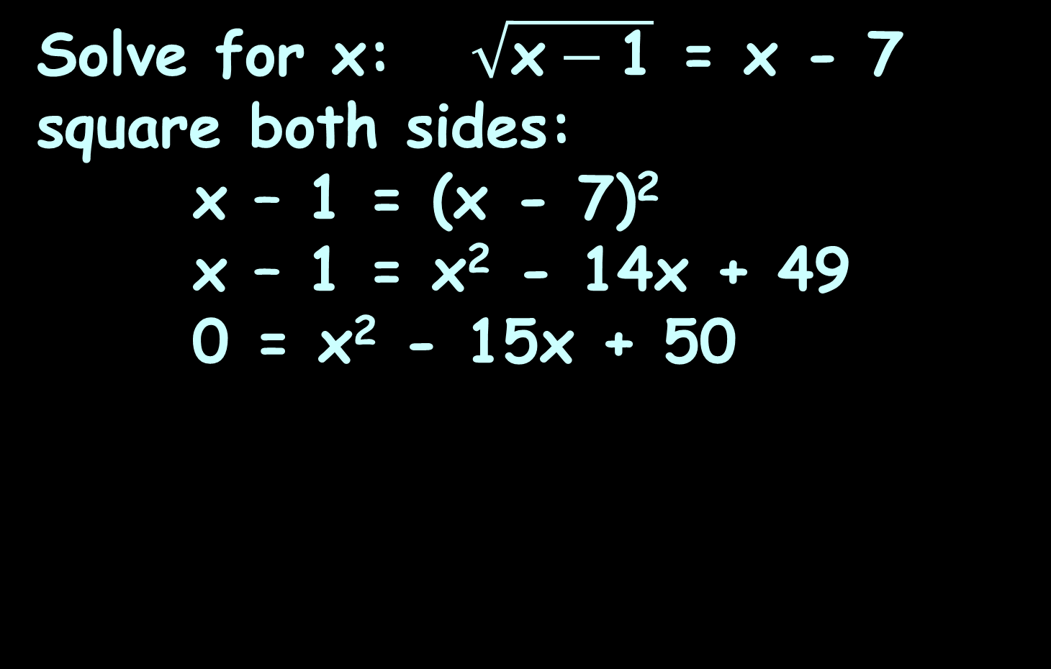
RADICAL EQUATIONS
IN-CLASS PROBLEM 4
Solve for x: $\sqrt{\text{x}−\text{1}}$ = x - 7
square both sides:
x – 1 = (x - 7)²
x – 1 = x² - 14x + 49
0 = x² - 15x + 50

Slide 54
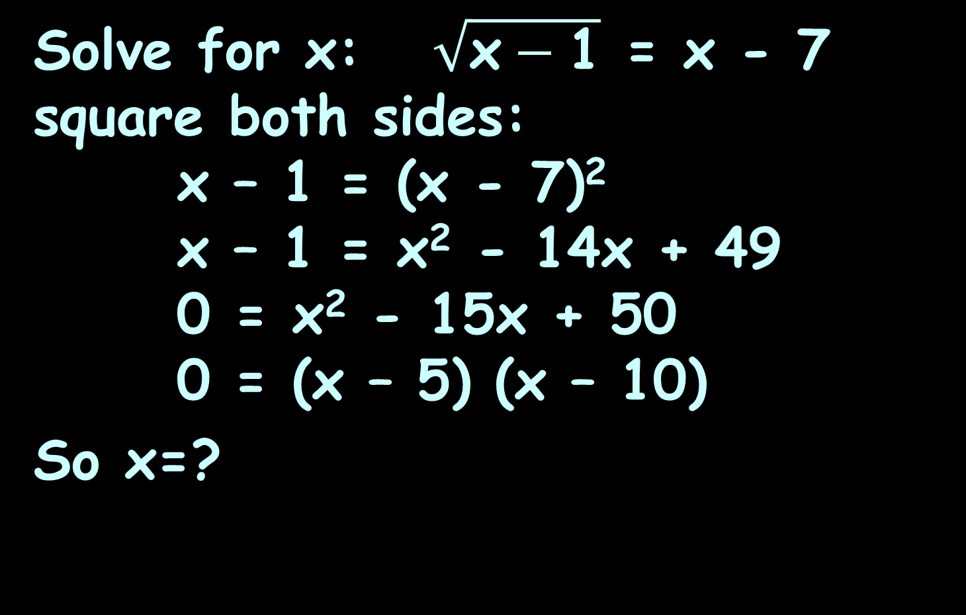
RADICAL EQUATIONS
IN-CLASS PROBLEM 4
Solve for x: $\sqrt{\text{x}−\text{1}}$ = x - 7
square both sides:
x – 1 = (x - 7)²
x – 1 = x² - 14x + 49
0 = x² - 15x + 50
0 = (x – 5) (x – 10)
So x=?

Slide 55
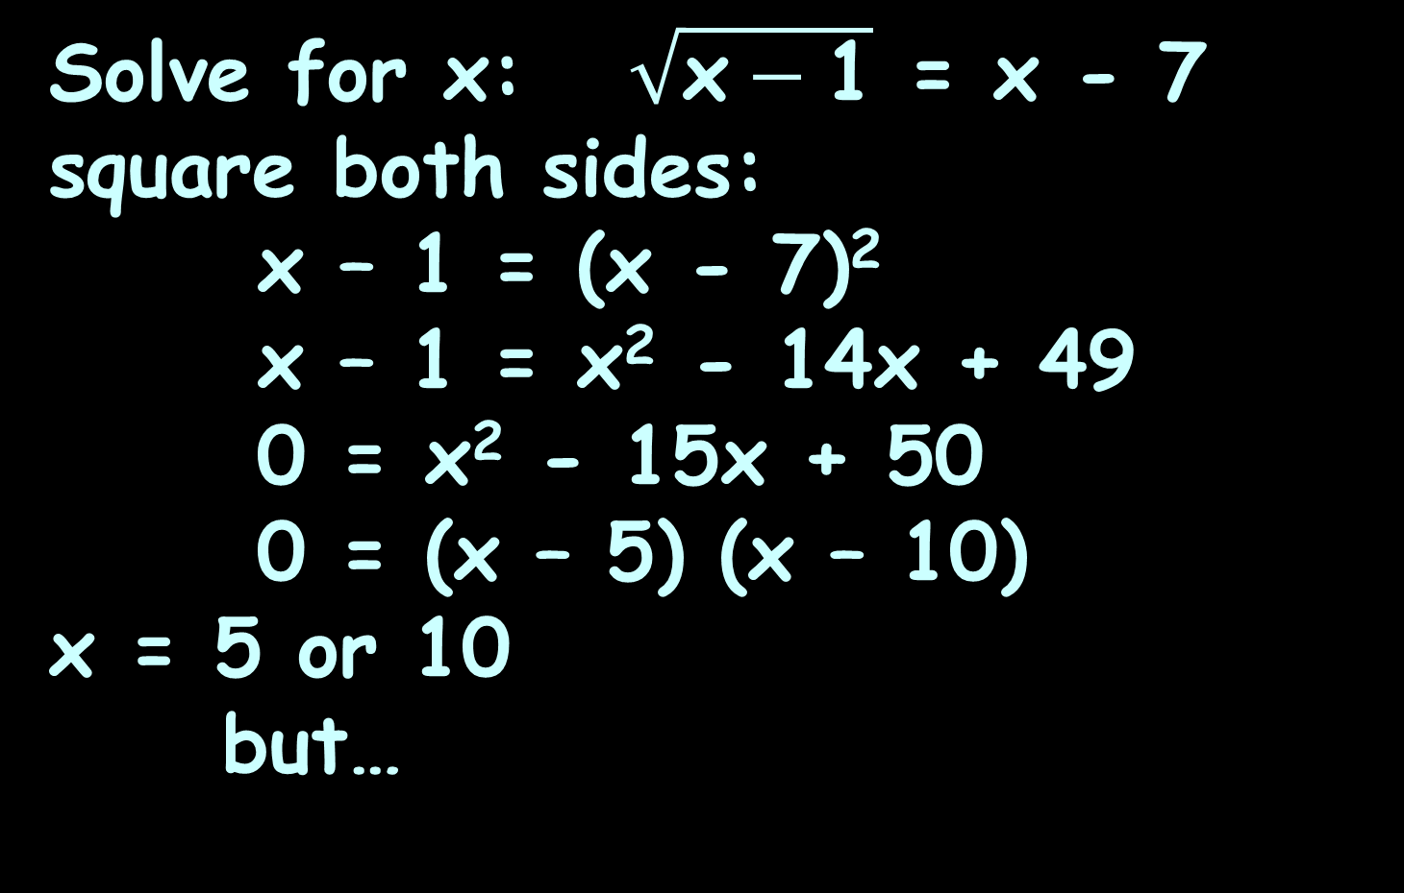
RADICAL EQUATIONS
IN-CLASS PROBLEM 4
Solve for x: $\sqrt{\text{x}−\text{1}}$ = x - 7
square both sides:
x – 1 = (x - 7)²
x – 1 = x² - 14x + 49
0 = x² - 15x + 50
0 = (x – 5) (x – 10)
x = 5 or 10
but…

Slide 56
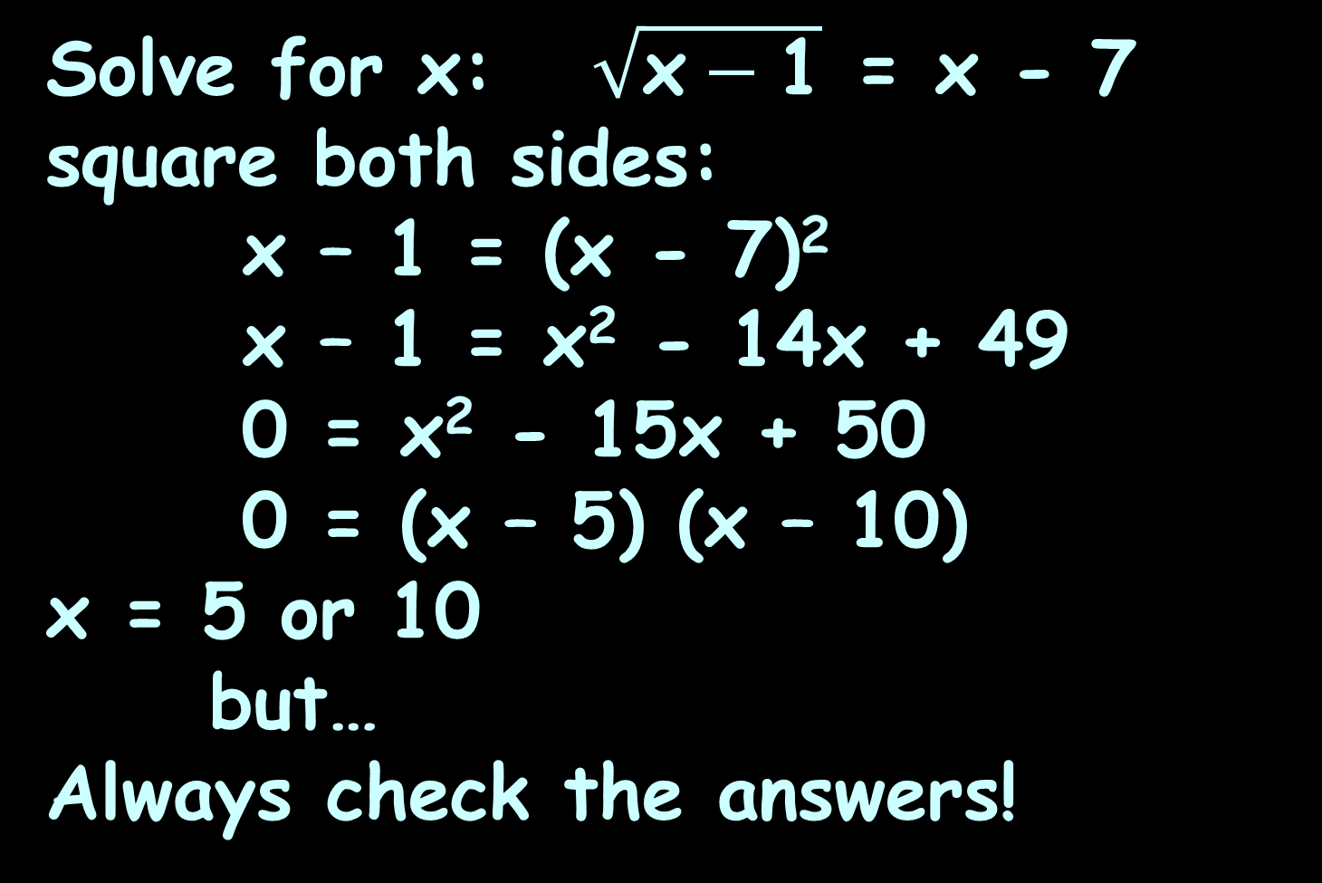
RADICAL EQUATIONS
IN-CLASS PROBLEM 4
Solve for x: $\sqrt{\text{x}−\text{1}}$ = x - 7
square both sides:
x – 1 = (x - 7)²
x – 1 = x² - 14x + 49
0 = x² - 15x + 50
0 = (x – 5) (x – 10)
x = 5 or 10
but…
Always check the answers!

Slide 57
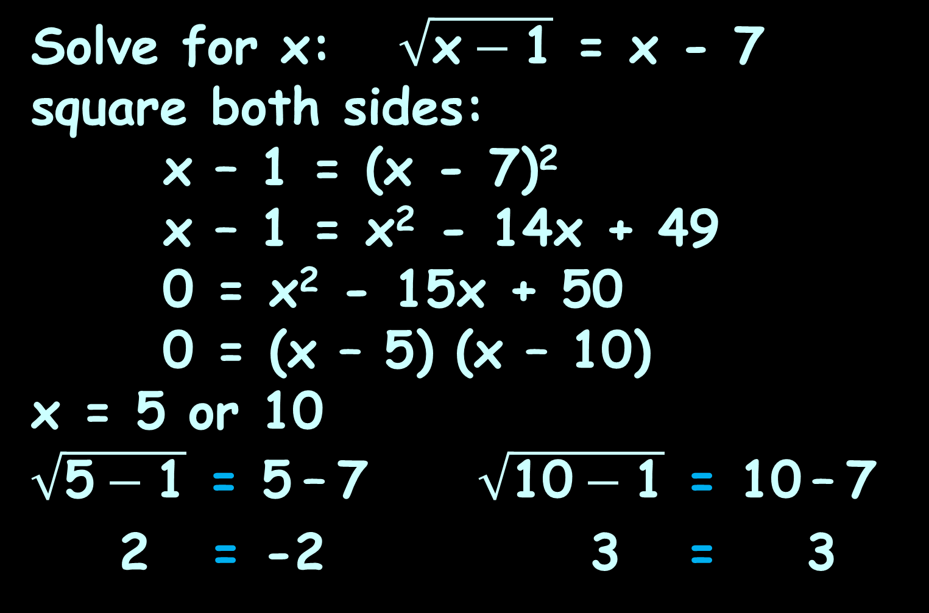
RADICAL EQUATIONS
IN-CLASS PROBLEM 4
Solve for x: $\sqrt{\text{x}−\text{1}}$ = x - 7
square both sides:
x – 1 = (x - 7)²
x – 1 = x² - 14x + 49
0 = x² - 15x + 50
0 = (x – 5) (x – 10)
x = 5 or 10
$\sqrt{\text{5}−\text{1}}$ = 5 – 7 $\sqrt{\text{10}−\text{1}}$ = 10 – 7
2 = -2 3 = 3
?
?
=
=
?
?
=
=

Slide 58
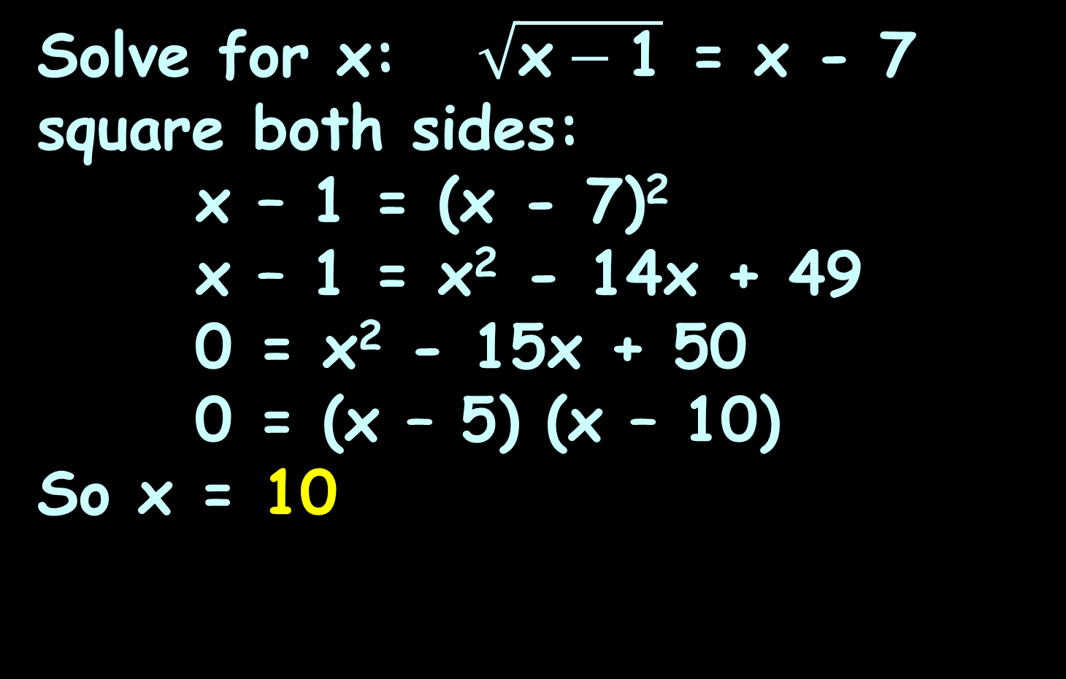
RADICAL EQUATIONS
IN-CLASS PROBLEM 4
Solve for x: $\sqrt{\text{x}−\text{1}}$ = x - 7
square both sides:
x – 1 = (x - 7)²
x – 1 = x² - 14x + 49
0 = x² - 15x + 50
0 = (x – 5) (x – 10)
So x = 10

Slide 59
Questions?
http://i.imgur.com/aliTlT3.jpg

Slide 60
Radical Equations
Squaring the sides of an equation creates a "derived" equation which may not be equivalent to the original!

Slide 61
Radical Equations
Solving the "derived" equation may create false solutions ("extraneous roots")

Slide 62
Radical Equations
You can eliminate the problem of extraneous roots by graphing
Graph lines for each of the two sides of the unsquared equation
If the lines cross – that is the solution (or solutions)

Slide 63
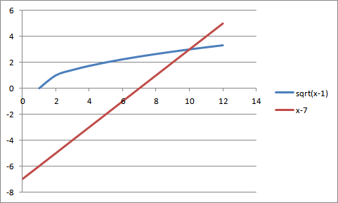
Radical Equations
For: $\sqrt{\text{x}−\text{1}}$ = x – 7
Only one intersection, so only one solution!

Slide 64
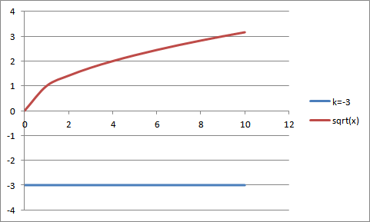

Radical Equations
For: $\sqrt{\text{x}}$ = –3
No solution – the lines don’t intersect

Slide 65
Questions?
http://i.imgur.com/aliTlT3.jpg

Slide 66
Radical Equations
Rationalizing the denominator
Pre-calculator era way of making it easier to calculate ratios with a root in the denominator

Slide 67
Radical Equations
Multiply both the numerator and denominator by the root in the denominator

Slide 68

RADICAL EQUATIONS
IN-CLASS PROBLEM 5
Simplify: 12x²/$\sqrt{\text{3}\text{x}}$

Slide 69
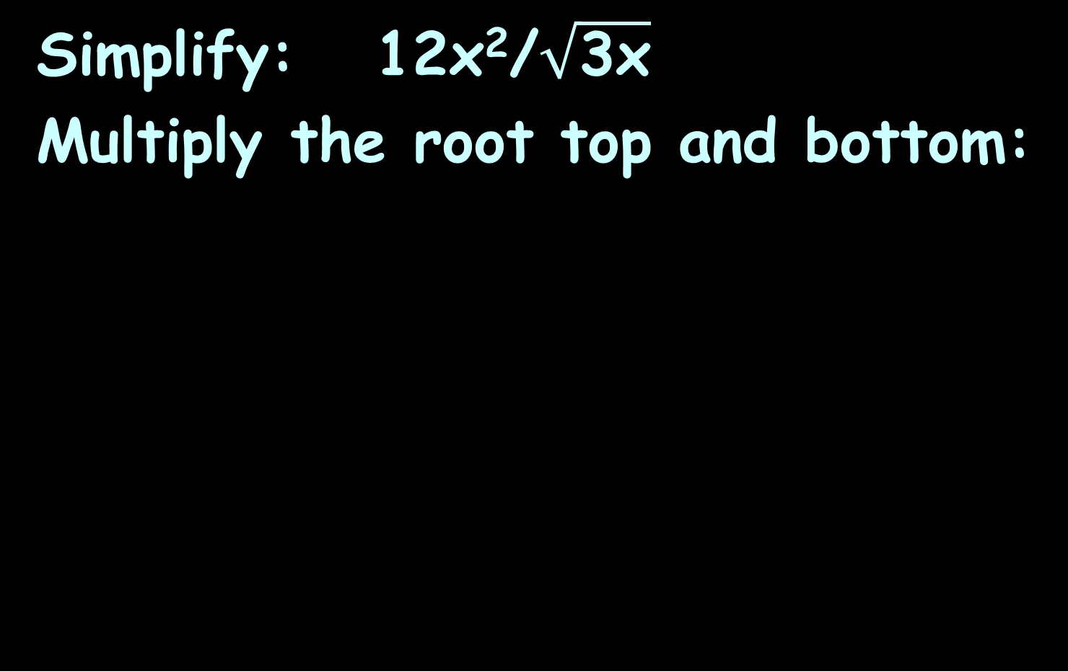
RADICAL EQUATIONS
IN-CLASS PROBLEM 5
Simplify: 12x²/$\sqrt{\text{3}\text{x}}$
Multiply the root top and bottom:

Slide 70
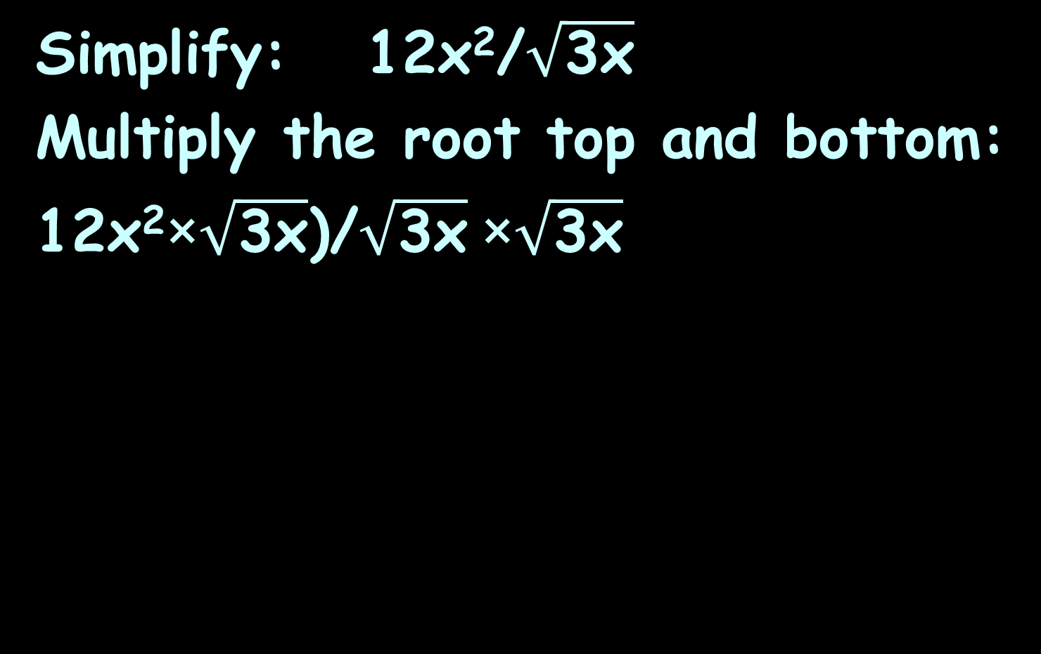
RADICAL EQUATIONS
IN-CLASS PROBLEM 5
Simplify: 12x²/$\sqrt{\text{3}\text{x}}$
Multiply the root top and bottom:
12x²×$\sqrt{\text{3}\text{x}}$)/$\sqrt{\text{3}\text{x}}$×$\sqrt{\text{3}\text{x}}$

Slide 71
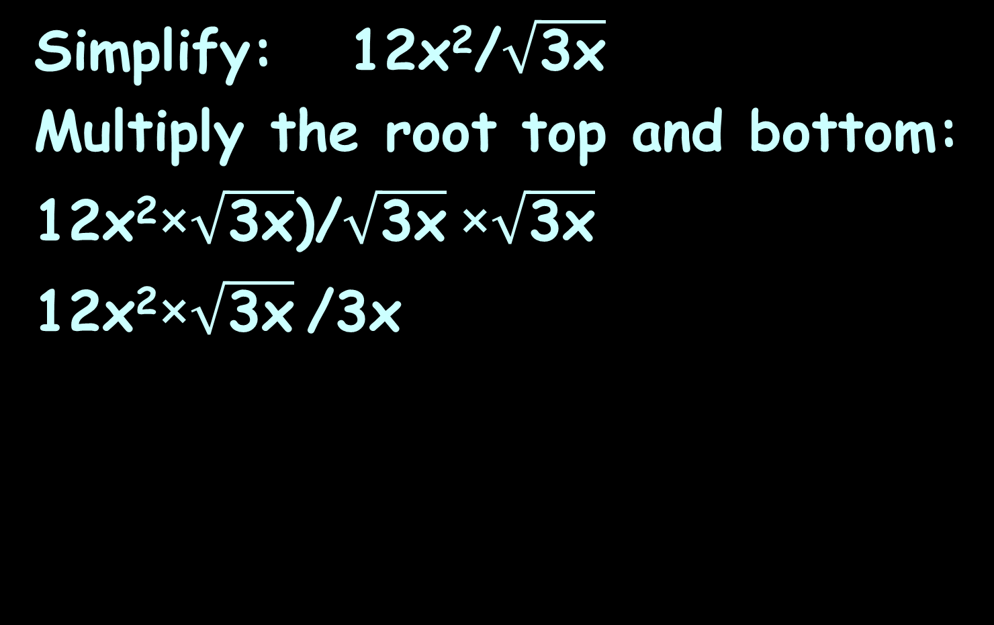
RADICAL EQUATIONS
IN-CLASS PROBLEM 5
Simplify: 12x²/$\sqrt{\text{3}\text{x}}$
Multiply the root top and bottom:
12x²×$\sqrt{\text{3}\text{x}}$)/$\sqrt{\text{3}\text{x}}$×$\sqrt{\text{3}\text{x}}$
12x²×$\sqrt{\text{3}\text{x}}$/3x

Slide 72
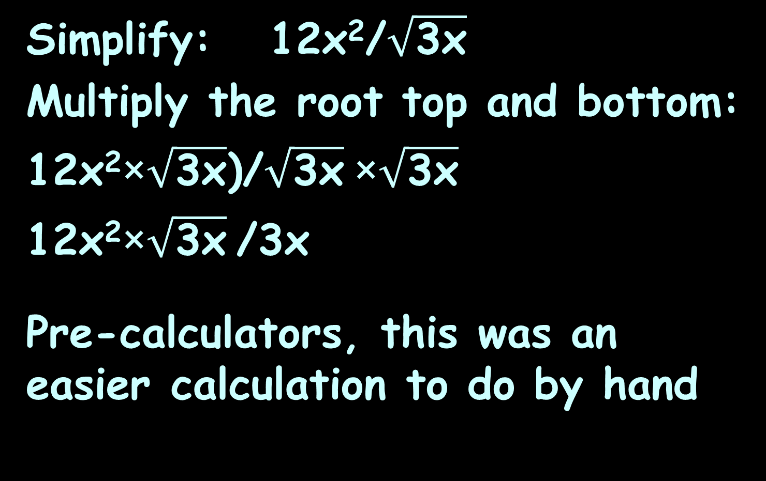
RADICAL EQUATIONS
IN-CLASS PROBLEM 5
Simplify: 12x²/$\sqrt{\text{3}\text{x}}$
Multiply the root top and bottom:
12x²×$\sqrt{\text{3}\text{x}}$)/$\sqrt{\text{3}\text{x}}$×$\sqrt{\text{3}\text{x}}$
12x²×$\sqrt{\text{3}\text{x}}$/3x
Pre-calculators, this was an easier calculation to do by hand

Slide 73
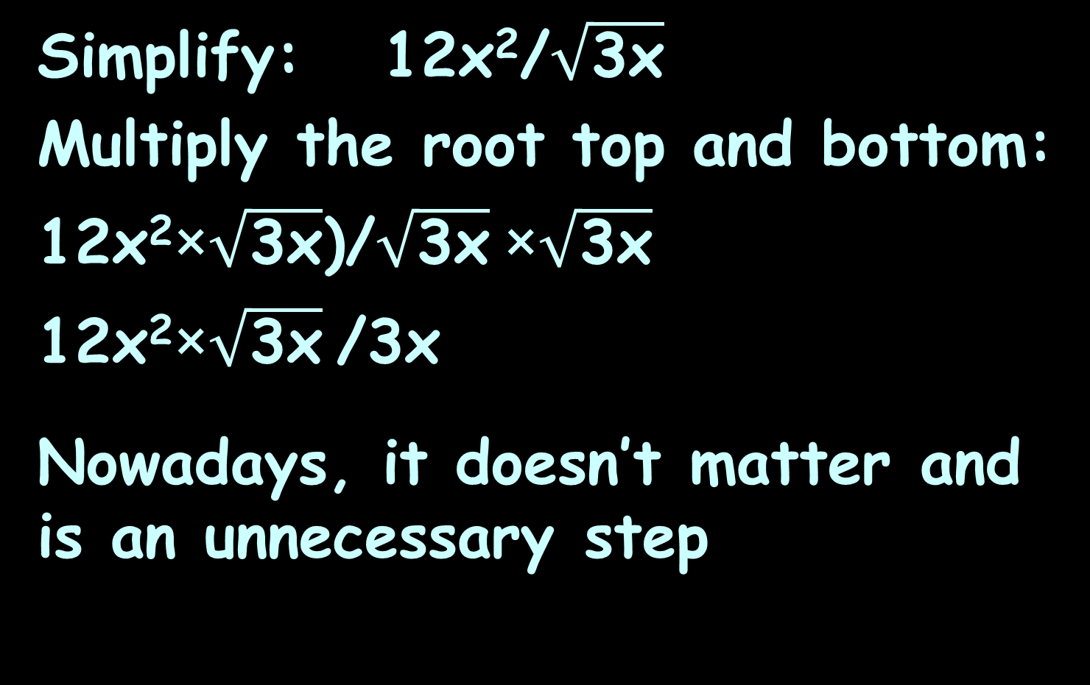
RADICAL EQUATIONS
IN-CLASS PROBLEM 5
Simplify: 12x²/$\sqrt{\text{3}\text{x}}$
Multiply the root top and bottom:
12x²×$\sqrt{\text{3}\text{x}}$)/$\sqrt{\text{3}\text{x}}$×$\sqrt{\text{3}\text{x}}$
12x²×$\sqrt{\text{3}\text{x}}$/3x
Nowadays, it doesn’t matter and is an unnecessary step

Slide 74
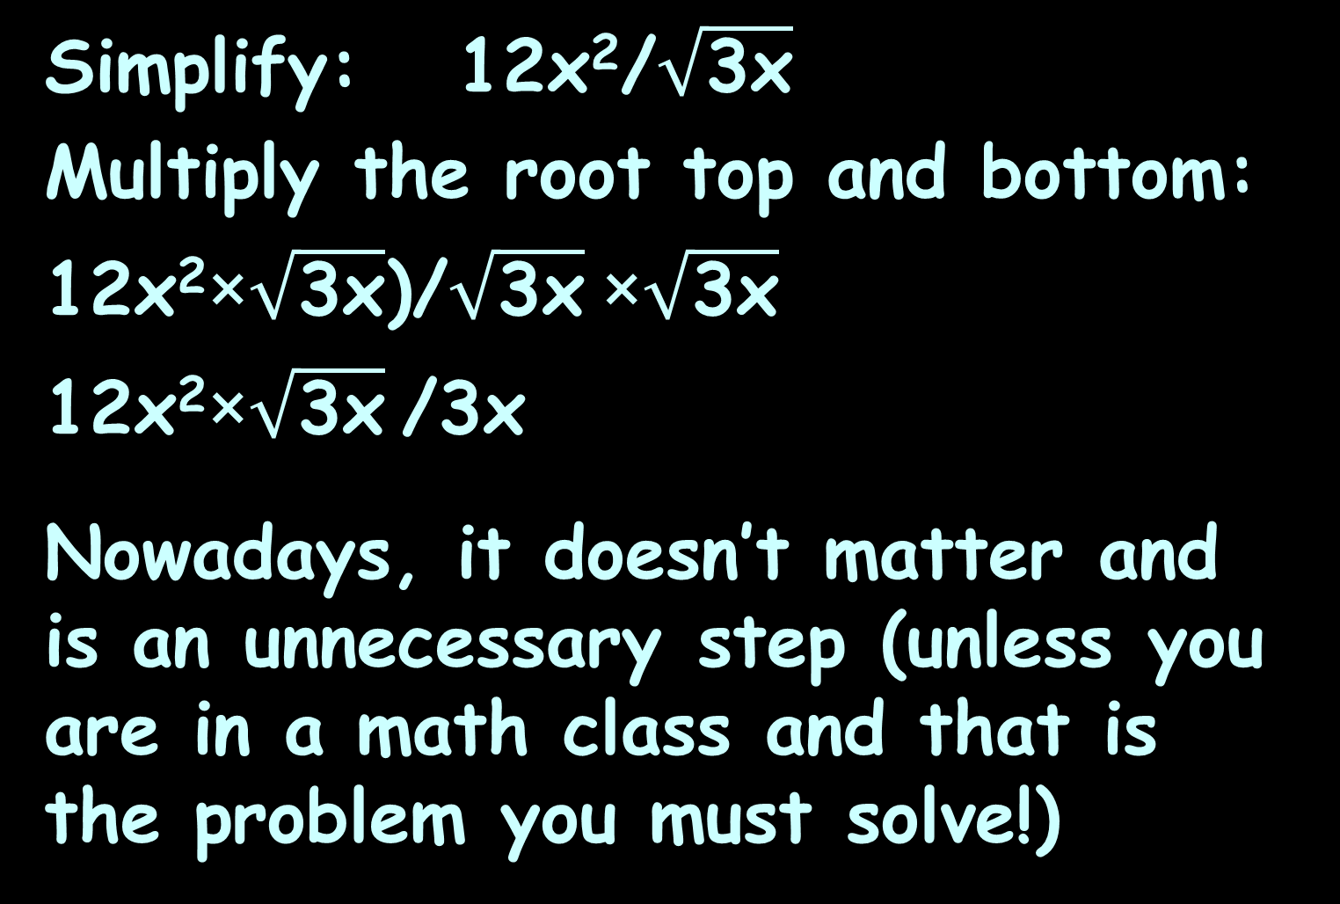
RADICAL EQUATIONS
IN-CLASS PROBLEM 5
Simplify: 12x²/$\sqrt{\text{3}\text{x}}$
Multiply the root top and bottom:
12x²×$\sqrt{\text{3}\text{x}}$)/$\sqrt{\text{3}\text{x}}$×$\sqrt{\text{3}\text{x}}$
12x²×$\sqrt{\text{3}\text{x}}$/3x
Nowadays, it doesn’t matter and is an unnecessary step (unless you are in a math class and that is the problem you must solve!)

Slide 75
Questions?
http://i.imgur.com/aliTlT3.jpg

Slide 76
Inequalities
When you have < > ≤ ≥
rather than =

Slide 77
Inequalities
I call them “inequations”
(No one else does…)

Slide 78
Inequalities
You can solve “inequations” for a variable
Just pretend the “<” or “>”
is an “=”

Slide 79
INEQUALITIES
IN-CLASS PROBLEMS 6,7
Solve: x - 15 = 25
Solve: 2x + 5 = 17

Slide 80
INEQUALITIES
IN-CLASS PROBLEMS 6,7
Solve: x - 15 = 25
. +15 +15
x = 40
Solve: 2x + 5 = 17

Slide 81
INEQUALITIES
IN-CLASS PROBLEMS 6,7
Solve: x - 15 = 25
. +15 +15
x = 40
Solve: 2x + 5 = 17

Slide 82
INEQUALITIES
IN-CLASS PROBLEMS 6,7
Solve: x - 15 = 25
x = 40
Solve: 2x + 5 = 17
2x = 17-5 = 12

Slide 83
INEQUALITIES
IN-CLASS PROBLEMS 6,7
Solve: x - 15 = 25
x = 40
Solve: 2x + 5 = 17
2x = 17-5 = 12
x = 12/2 = 6

Slide 84
INEQUALITIES
IN-CLASS PROBLEMS 8,9
Solve: x - 15 > 25
Solve: 2x + 5 ≤ 17

Slide 85
INEQUALITIES
IN-CLASS PROBLEMS 8,9
Solve: x - 15 > 25
x > 25--15 > 40
Solve: 2x + 5 ≤ 17

Slide 86
INEQUALITIES
IN-CLASS PROBLEMS 8,9
Solve: x - 15 > 25
x > 40
Solve: 2x + 5 ≤ 17
2x ≤ 17-5 ≤ 12
x ≤ 12/2 ≤ 6

Slide 87
INEQUALITIES
IN-CLASS PROBLEMS 8,9
Solve: x - 15 > 25
x > 40
Solve: 2x + 5 ≤ 17
x ≤ 6

Slide 88
Questions?
http://i.imgur.com/aliTlT3.jpg

Slide 89
Inequalities
Exception to the rule:
If you multiply or divide by a negative number, it flips the inequality sign

Slide 90
INEQUALITIES
IN-CLASS PROBLEM 10
Solve: -2x + 5 < 17

Slide 91
INEQUALITIES
IN-CLASS PROBLEM 10
Solve: -2x + 5 < 17
-2x < 17-5
-2x < 12

Slide 92
INEQUALITIES
IN-CLASS PROBLEM 10
Solve: -2x + 5 < 17
-2x < 17-5
-2x/(-2) > 12/(-2)
flip

Slide 93
INEQUALITIES
IN-CLASS PROBLEM 10
Solve: -2x + 5 < 17
-2x < 17-5
-2x/(-2) > 12/(-2)
x > -6
flip
https://www.wolframalpha.com/input/?i=-2x+%2B+5+%3C+17

Slide 94
Questions?
http://i.imgur.com/aliTlT3.jpg

Slide 95
Inequalities
For a double-sided inequality (bounded), it is safest to change it into two problems, then combine the answers at the end into a bounded interval

Slide 96
INEQUALITIES
IN-CLASS PROBLEM 11
Solve: -7 < -2x + 7 < 5

Slide 97
INEQUALITIES
IN-CLASS PROBLEM 11
Solve: -7 < -2x + 7 < 5
Change it into two problems:
-7 < -2x+7 -2x+7 < 5

Slide 98
INEQUALITIES
IN-CLASS PROBLEM 11
Solve: -7 < -2x + 7 < 5
-7 < -2x+7 -2x+7 < 5
-7-7 < -2x

Slide 99
INEQUALITIES
IN-CLASS PROBLEM 11
Solve: -7 < -2x + 7 < 5
-7 < -2x+7 -2x+7 < 5
-7-7 < -2x
-14/-2>-2x/-2
flip

Slide 100
INEQUALITIES
IN-CLASS PROBLEM 11
Solve: -7 < -2x + 7 < 5
-7 < -2x+7 -2x+7 < 5
-7-7 < -2x
-14/-2>-2x/-2
7 > x
or x<7
flip

Slide 101
INEQUALITIES
IN-CLASS PROBLEM 11
Solve: -7 < -2x + 7 < 5
-7 < -2x+7 -2x+7 < 5
-7-7 < -2x -2x < 5-7
-14/-2>-2x/-2
x<7
flip

Slide 102
INEQUALITIES
IN-CLASS PROBLEM 11
Solve: -7 < -2x + 7 < 5
-7 < -2x+7 -2x+7 < 5
-7-7 < -2x -2x < 5-7
-14/-2>-2x/-2 -2x < -2
x<7
flip

Slide 103
INEQUALITIES
IN-CLASS PROBLEM 11
Solve: -7 < -2x + 7 < 5
-7 < -2x+7 -2x+7 < 5
-7-7 < -2x -2x < 5-7
-14/-2>-2x/-2 -2x < -2
x<7 -2x/-2>-2/-2
flip
flip

Slide 104
INEQUALITIES
IN-CLASS PROBLEM 11
Solve: -7 < -2x + 7 < 5
-7 < -2x+7 -2x+7 < 5
-7-7 < -2x -2x < 5-7
-14/-2>-2x/-2 -2x < -2
x<7 -2x/-2>-2/-2
x>1 or 1<x
flip
flip

Slide 105
INEQUALITIES
IN-CLASS PROBLEM 11
Solve: -7 < -2x + 7 < 5
-7 < -2x+7 -2x+7 < 5
-7-7 < -2x -2x < 5-7
-14/-2>-2x/-2 -2x < -2
x<7 -2x/-2>-2/-2
1<x
So 1<x<7
flip
flip

Slide 106
Questions?
http://i.imgur.com/aliTlT3.jpg

Slide 107
Interval Notation
When there are two inequalities hemming in the function

Slide 108
Interval Notation
To write the intervals covered by an inequality, you can use several styles

Slide 109
Interval Notation
Inequality notation:
x<1, x≥2

Slide 110
Interval Notation
A variation using set notation:
x<1 ∪ x≥2
means “or”
∩ means “and”

Slide 111
Interval Notation
Interval notation:
(–∞,1] ∪ [2,∞)
( or ) means the point is not included (open interval)
[ or ] means the point is included (closed interval)

Slide 112
Interval Notation
Interval notation is confusing:
(2,7)
Is it the point: x=2, y=7
Or is it the interval: 2<x<7 ?

Slide 113
Interval Notation
Graphical notation #1:
number line with parentheses/ square brackets
Parentheses are used if the point is not included (open interval)
Square brackets are used if the
point is included (closed interval)
)
1
[
2

Slide 114
Interval Notation
Graphical notation #2:
number line with dots
Open dots are used if the point is not included (open interval)
Filled-in dots are used if the
point is included (closed interval)
1
2

Slide 115
Interval Notation
All of the formats are equally valid
Inequality is the most common
(Math class likes interval)

Slide 116
Questions?
http://i.imgur.com/aliTlT3.jpg

Slide 117
Inequalities
Inequalities are common in real-life problems (but we usually don’t even notice they are inequalities)

Slide 118
INTERVAL NOTATION
IN-CLASS PROBLEM 12
You need to choose between two telephone plans for local calls:
Plan A charges $25 per month for unlimited calls
Plan B charges a monthly fee of $13 with a charge of $0.06 per local call

Slide 119
INTERVAL NOTATION
IN-CLASS PROBLEM 12
Plan A charges $25 per month for unlimited calls
Write a mathematical model for the monthly cost for plan A:

Slide 120
INTERVAL NOTATION
IN-CLASS PROBLEM 12
Plan A charges $25 per month for unlimited calls
Mathematical model for the monthly cost for plan A:
CostA = $25

Slide 121
INTERVAL NOTATION
IN-CLASS PROBLEM 12
Plan B charges a monthly fee of $13 with a charge of $0.06 per local call
Write a mathematical model for the monthly cost for plan B:

Slide 122
INTERVAL NOTATION
IN-CLASS PROBLEM 12
Plan B charges a monthly fee of $13 with a charge of $0.06 per local call
Write a mathematical model for the monthly cost for plan B:
CostB = $13 + $0.06(#calls)

Slide 123
INTERVAL NOTATION
IN-CLASS PROBLEM 12
Write a mathematical model using an inequality that compares A and B that can be used to find how many local telephone calls in a month make Plan A the better deal:

Slide 124
INTERVAL NOTATION
IN-CLASS PROBLEM 12
Plan A is a better deal when:
CostA < CostB
This happens when:
$25 < $13 + $0.06(#calls)

Slide 125
INTERVAL NOTATION
IN-CLASS PROBLEM 12
Do the calculation:
$25 < $13 + $0.06(#calls)

Slide 126
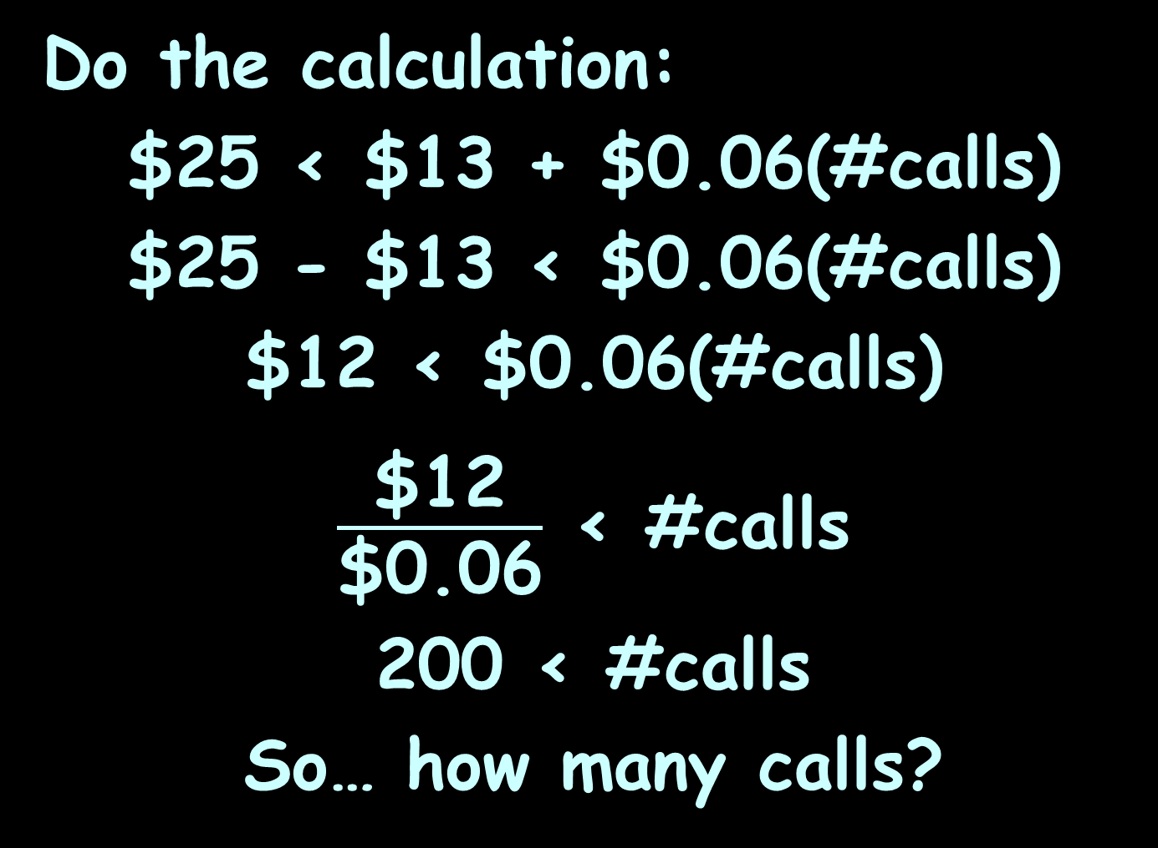
INTERVAL NOTATION
IN-CLASS PROBLEM 12
Do the calculation:
$25 < $13 + $0.06(#calls)
$25 - $13 < $0.06(#calls)
$12 < $0.06(#calls)
$\frac{\text{\$12}}{\text{\$0.06}}$ < #calls
200 < #calls
So… how many calls?

Slide 127
INTERVAL NOTATION
IN-CLASS PROBLEM 12
PlanA is the better deal as soon as you make 201 calls

Slide 128
Questions?
http://i.imgur.com/aliTlT3.jpg

Slide 129

You Survived!
Today we studied:
Review of rational functions
More about rational functions
Inequalities
www.playbuzz.com

