Slide 1

Welcome to
Unit 1 Part 1!
MATH 205 Differential Calculus
https://www.smu.edu.sg/programmes/core-curriculum/course-structure/calculus

Slide 2
What’s Up?
Today we will be going over:
Increments
Rate of Change
Limits

Slide 3
What’s Up?
Outcome 2) Use algebra and limits to examine the properties and graphs of functions
Outcome 7) Solve problems by identifying the requirements, making a sketch as appropriate, and using calculus techniques to model the problem, calculating the final answer and verifying the solution

Slide 4
Course Description
Demonstrate differentiation skills for linear, polynomial, rational, trigonometric, exponential, and logarithmic functions and proper application of the Product, Quotient and Chain Rules of differentiation.
Use algebra, limits and derivatives to examine the properties and graphs of functions, including finding their extrema, inflection points, and intervals of monotonicity and concavity.
Apply derivatives to solve optimization and related rates problems.
Use l’Hôpital’s Rule and other methods to find nontrivial limits of functions.
Use basic integration techniques, including the method of substitution and the Fundamental Theorem of Calculus.
Use definite integrals to find areas under and between curves.
Solve problems by identifying the requirements, making a sketch as appropriate, and using calculus techniques to model the problem, calculating the final answer and verifying the solution.

Slide 5
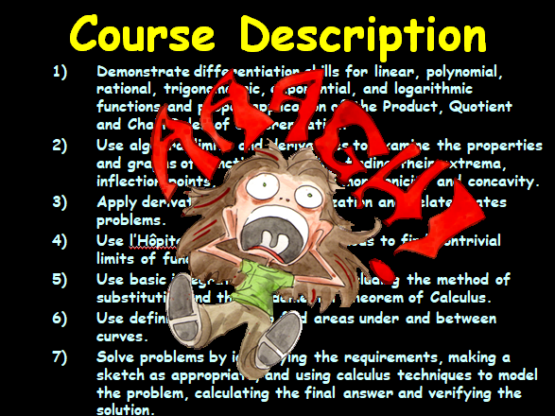

Slide 6
Course Outcomes
But, what I really want is for you to…

Slide 7
Course Outcomes
Learn how to think!

Slide 8
Course Outcomes
文 (wen) vs 力 (li)
learning

Slide 9
Course Outcomes
Wen learning is the “wisdom of the ages” – books, the Internet, teachers, Mom…
Li learning is what you see with your own eyes

Slide 10
Course Outcomes
The Greeks had this idea, too!
akoέ vs οπσις
“akoe”
“opsis” – from which we get words like “optical”

Slide 11
Course Outcomes
What might be some problems with wen learning?
What might be some benefits of li learning?

Slide 12
“A university’s obligation is not to teach students what to think but to teach students how to think”
Michael Bloomberg
Former mayor of New York City

Slide 13

A visit!
Video from the CTU librarian
Tina Morrell
VFrench 2022

Slide 14
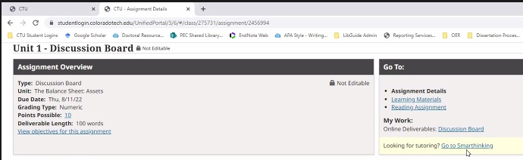
Tutoring!
You have unlimited tutoring available 24/7 365 at:

Slide 15
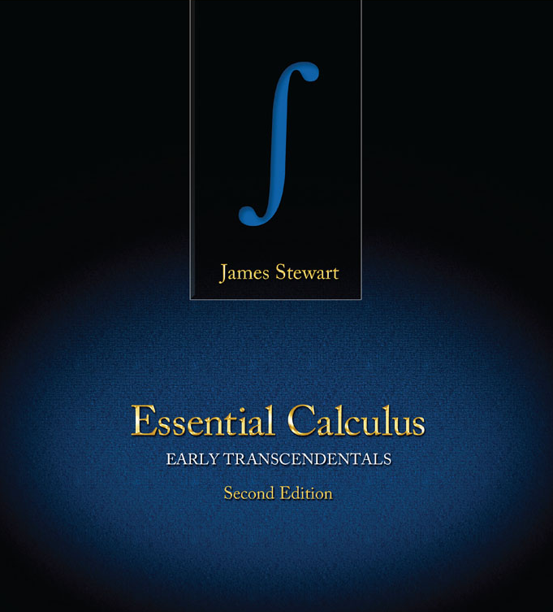
Textbook
Don’t let the title scare you!
https://coloradotech.vitalsource.com/#/books/9780357233375/cfi/6/20!/4/76@0:5.85

Slide 16
Textbook
Transcend
the
transcendentals!
https://coloradotech.vitalsource.com/#/books/9780357233375/cfi/6/20!/4/76@0:5.85

Slide 17
Textbook
It just means we are doing logarithms and exponential functions (like viral transmission) early in the course
https://coloradotech.vitalsource.com/#/books/9780357233375/cfi/6/20!/4/76@0:5.85

Slide 18
Instructional Approach
In addition to readings from the book, I provide short readings on: vf-tropi.com

Slide 19
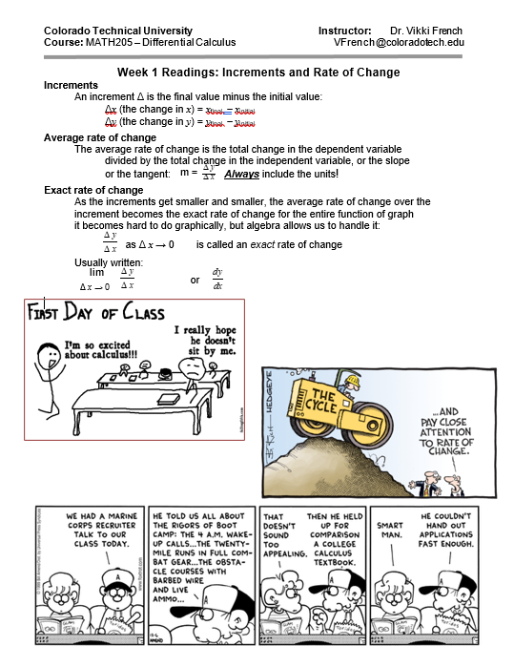

Slide 20
Instructional Approach
We will cover two major topics each Unit

Slide 21
Schedule
(Subject to change arbitrarily and without prior notice)
Unit 01 Part 1 Increments and Rate of Change
Unit 01 Part 2 Functions
Unit 02 Part 3 Transforming Functions and Mathematical Modeling
Unit 02 Part 4 Limits
Unit 03 Part 5 Infinite Limits
Unit 03 Part 6 Derivatives
Unit 04 Part 7 Derivatives Rules, Transcendentals
Unit 04 Part 8 Higher-Order Derivatives
Unit 05 Part 9 Chain Rule
Unit 05 Part 10 Implicit
Unit 06 Part 11 Extrema (Max and Min)
Unit 06 Part 12 Related Rates
Unit 07 Part 13 Optimization
Unit 07 Part 14 L’Hôpital’s Rule
Unit 08 Part 15 Anti-derivatives and Integration
Unit 08 Part 16 Reverse Chain Rule (U-Substitution)
Unit 09 Part 17 Area Under a Curve
Unit 09 Part 18 Area Between Two Curves
Unit 10 Part 19 Uses of Integration
Unit 10 Part 20 More Uses of Integration

Slide 22
Instructional Approach
Your grade is composed of two things each unit:
Discussion Board postings
Individual Project:
Review problems and new stuff

Slide 23
Instructional Approach
The primary Discussion Board posting is due Thursday 10:59pm MT
Everything else is due
Sunday night 10:59pm MT

Slide 24
Instructional Approach
Discussion Board
During the unit be sure to post a reply to the original
Discussion Board posting and reply to at least 2 other students

Slide 25
Instructional Approach
Late Work
There are basically 2 categories

Slide 26
Instructional Approach
If you have an “extreme circumstance”:
Loss of home
Medical conditions, injuries, hospital stays, and medical emergencies
Natural disasters
Loss of family members
Family emergencies or care for a family member
Military commitments
AND you contact me, you can turn it in before end of term with no late penalty

Slide 27
Instructional Approach
For late assignments not due to extreme circumstances, you can turn it in before end of term but a 10% penalty of total possible points per assignment will be deducted

Slide 28
Instructional Approach
For discussion board assignments, only the initial reply will be accepted late

Slide 29
Instructional Approach
In all instances, no late work will be accepted from a student beyond the timeframe of the course end date, unless an Incomplete has been granted

Slide 30
Why did I get the grade I got?
Do you know about feedback?
Go to the gradebook
On the line for each assignment there will be an icon that looks like the text bubble in a cartoon
Hover over that, and the
instructor's feedback will show up

Slide 31
Problems?
Use CTU Messenger in the Portal

Slide 32
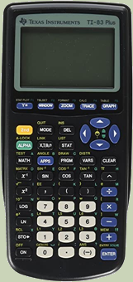
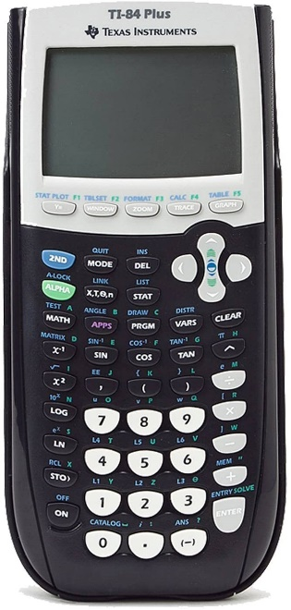
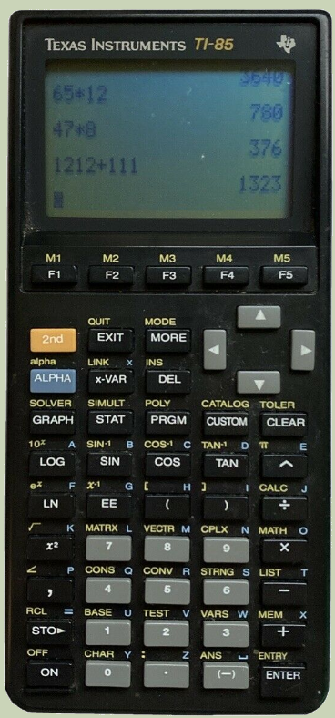
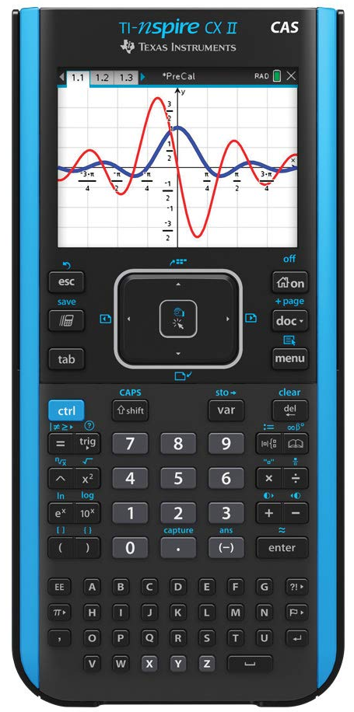
Fancy Calculator?
You need a fancy calculator OR you can use online software (WolframAlpha or Symbolab) for this class…

Slide 33

Questions?
http://i.imgur.com/aliTlT3.jpg

Slide 34
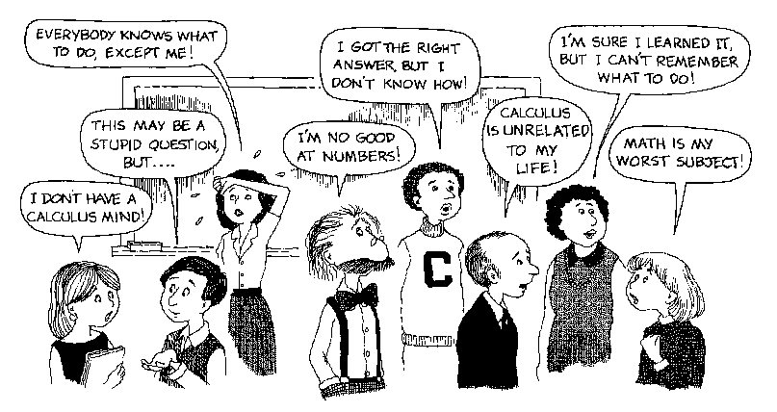
So… Howcum we have to take CALCULUS ???
https://www.smu.edu.sg

Slide 35
What Is Calculus?

Slide 36

What Is Calculus?
Ancient Romans used smooth pebbles to count with called “calculus”
https://m.media-amazon.com/images/I/51CKuWNdSxL._AC_.jpg

Slide 37
What Is Calculus?
We get words like “calculate” from these pebbles!

Slide 38
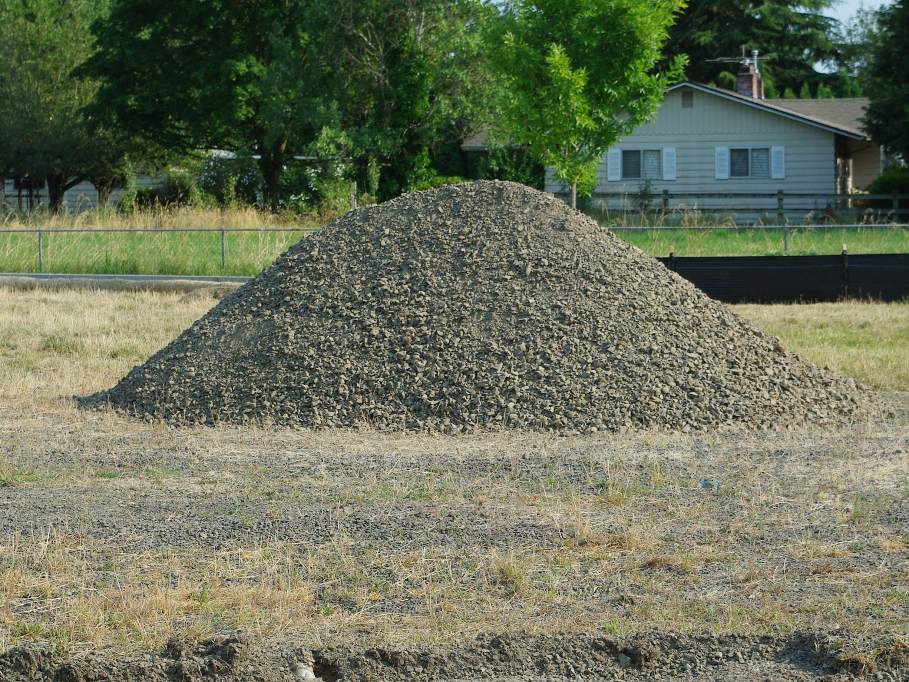
But, it’s not just rocks…
1280px-Lone_pile_of_gravel_-_Hillsboro,_Oregon.JPG

Slide 39

CALCULUS
is the mathematics of CHANGE
541711_329185230530409_2035452876_n.jpg

Slide 40

CALCULUS
Of course, we haven’t experienced much CHANGE lately…
Supply chain
Climate change
Ukraine
Politics
$
Monkey pox
Black lives matter
Inflation
Gas prices
Putin
https://news.usc.edu/167512/covid-19-stress-coping-healthy-habits-usc-social-science-experts/

Slide 41
New Symbol
∆ means “change”
∆x means the change in x
∆y means the change in y

Slide 42
Another Way to Write It
“d” also means change
dx means the change in x
dy means the change in y

Slide 43
∆ Increments
An increment Δ is the final value minus the initial value:
Δx (the change in x) = x_{final} - x_{initial}
Δy (the change in y) = y_{final} - y_{initial}

Slide 44
∆ Increments
Δx = x_{final} - x_{initial}
= x₁ - x₀
Δy = y_{final} - y_{initial}
= y₁ - y₀

Slide 45
INCREMENTS
IN-CLASS PROBLEM 1
The price of an item changes from $16.50 to $26.90. What is the increment in price Δp?

Slide 46
INCREMENTS
IN-CLASS PROBLEM 1
The price of an item changes from $16.50 to $26.90. What is the increment in price Δp?
What is the initial price?
Δx = x_{final} - x_{initial}

Slide 47
INCREMENTS
IN-CLASS PROBLEM 1
The price of an item changes from $16.50 to $26.90. What is the increment in price Δp?
What is the initial price?
x_{initial} = $16.50
What is the final price?
Δx = x_{final} - x_{initial}

Slide 48
INCREMENTS
IN-CLASS PROBLEM 1
The price of an item changes from $16.50 to $26.90. What is the increment in price Δp?
x_{initial} = $16.50
What is the final price?
x_{final} = $26.90
Δx = x_{final} - x_{initial}

Slide 49
INCREMENTS
IN-CLASS PROBLEM 1
The price of an item changes from $16.50 to $26.90. What is the increment in price Δp?
x_{initial} = $16.50
x_{final} = $26.90
What is the price increment?
Δx = x_{final} - x_{initial}

Slide 50
INCREMENTS
IN-CLASS PROBLEM 1
The price of an item changes from $16.50 to $26.90. What is the increment in price Δp?
x_{initial} = $16.50
x_{final} = $26.90
What is the price increment?
Δx = 26.9 – 16.5
= 10.4 is this the answer?

Slide 51
INCREMENTS
IN-CLASS PROBLEM 1
The price of an item changes from $16.50 to $26.90. What is the increment in price Δp?
Δx = 26.9 – 16.5
= $10.40
Don't forget the units!
(you lose points if you do…)

Slide 52
Questions?
www.career.gatech.edu

Slide 53
Rate of Change
A ∆ increment is a change
The ratio of two increments will be a rate of change

Slide 54
Rate of Change
A ∆ increment is a change
The ratio of two increments will be a rate of change
So the slope of a line “m”
m = ∆y/∆x
Is a rate of change in y vs x

Slide 55
Rate of Change
∆ location (distance you went)
d₁ – d₀
∆ time (time it took)
t₁ – t₀
∆location / ∆time is the rate of change of your distance vs change in time

Slide 56
Rate of Change
∆ location (distance you went)
d₁ – d₀
∆ time (time it took)
t₁ – t₀
∆location / ∆time is the rate of change of your distance vs change in time “mph”

Slide 57
Rate of Change
∆ location (distance you went)
d₁ – d₀
∆ time (time it took)
t₁ – t₀
mph = ∆location / ∆time
= (d₁ – d₀)/(t₁ – t₀)

Slide 58
RATE OF CHANGE
IN-CLASS PROBLEM 2
Your car is in the garage (distance = 0). You drive to the grocery store 2.3 miles away. It takes 5 minutes. What is your rate of change in miles per minute?
What is d_{initial}?

Slide 59
RATE OF CHANGE
IN-CLASS PROBLEM 2
Your car is in the garage (distance = 0). You drive to the grocery store 2.3 miles away. It takes 5 minutes. What is your rate of change in miles per minute?
What is d_{initial}? 0
What is d_{final}?

Slide 60
RATE OF CHANGE
IN-CLASS PROBLEM 2
Your car is in the garage (distance = 0). You drive to the grocery store 2.3 miles away. It takes 5 minutes. What is your rate of change in miles per minute?
What is d_{initial}? 0
What is d_{final}? 2.3

Slide 61
RATE OF CHANGE
IN-CLASS PROBLEM 2
Your car is in the garage (distance = 0). You drive to the grocery store 2.3 miles away. It takes 5 minutes. What is your rate of change in miles per minute?
d_{initial} = 0 d_{final} = 2.3
What is t_{initial}?

Slide 62
RATE OF CHANGE
IN-CLASS PROBLEM 2
Your car is in the garage (distance = 0). You drive to the grocery store 2.3 miles away. It takes 5 minutes. What is your rate of change in miles per minute?
d_{initial} = 0 d_{final} = 2.3
What is t_{initial}? 0

Slide 63
RATE OF CHANGE
IN-CLASS PROBLEM 2
Your car is in the garage (distance = 0). You drive to the grocery store 2.3 miles away. It takes 5 minutes. What is your rate of change in miles per minute?
d_{initial} = 0 d_{final} = 2.3
t_{initial} = 0 What is t_{final}?

Slide 64
RATE OF CHANGE
IN-CLASS PROBLEM 2
Your car is in the garage (distance = 0). You drive to the grocery store 2.3 miles away. It takes 5 minutes. What is your rate of change in miles per minute?
d_{initial} = 0 d_{final} = 2.3
t_{initial} = 0 What is t_{final}? 5
(d₁ – d₀)/(t₁ – t₀)

Slide 65
RATE OF CHANGE
IN-CLASS PROBLEM 2
Your car is in the garage (distance = 0). You drive to the grocery store 2.3 miles away. It takes 5 minutes.
d_{initial} = 0 d_{final} = 2.3
t_{initial} = 0 What is t_{final}? 5
What is your rate of change in miles per minute?

Slide 66
RATE OF CHANGE
IN-CLASS PROBLEM 2
Your car is in the garage (distance = 0). You drive to the grocery store 2.3 miles away. It takes 5 minutes.
d_{initial} = 0 d_{final} = 2.3
t_{initial} = 0 What is t_{final}? 5
What is your rate of change in miles per minute? (2.3-0)/(5-0)
= 0.46 is it?

Slide 67
RATE OF CHANGE
IN-CLASS PROBLEM 2
Your car is in the garage (distance = 0). You drive to the grocery store 2.3 miles away. It takes 5 minutes.
d_{initial} = 0 d_{final} = 2.3
t_{initial} = 0 What is t_{final}? 5
What is your rate of change in miles per minute? (2.3-0)/(5-0)
2.3/5 mpm = 0.46 mpm

Slide 68
RATE OF CHANGE
IN-CLASS PROBLEM 3
What is your rate of change in miles per hour?
If it was 0.46 mpm, how do you make it mph?

Slide 69
RATE OF CHANGE
IN-CLASS PROBLEM 3
What is your rate of change in miles per hour?
If it was 0.46 mpm, how do you make it mph?
Since there are 60 minutes in an hour, you multiply by 60:

Slide 70
RATE OF CHANGE
IN-CLASS PROBLEM 3
What is your rate of change in miles per hour?
If it was 0.46 mpm, how do you make it mph?
Since there are 60 minutes in an hour, you multiply by 60:
0.46 x 60 = 27.6 are we done?

Slide 71
RATE OF CHANGE
IN-CLASS PROBLEM 3
What is your rate of change in miles per hour?
If it was 0.46 mpm, how do you make it mph?
Since there are 60 minutes in an hour, you multiply by 60:
0.46 x 60 = 27.6 mph

Slide 72
RATE OF CHANGE
IN-CLASS PROBLEM 3
Does it make sense?
In a minute, if your speed is 60mph you will drive 1 mile

Slide 73
RATE OF CHANGE
IN-CLASS PROBLEM 3
Does it make sense?
If your speed is less than 60mph, you will drive less than a full mile
Going half a mile in 1 minute means you are going 30mph

Slide 74
RATE OF CHANGE
IN-CLASS PROBLEM 3
Does it make sense?
Going half a mile in 1 minute means you are going about 30mph
Since we went slightly less than ½ mile, it makes sense that our speed was slightly less than 30mph

Slide 75
Questions?
www.career.gatech.edu

Slide 76
Average Speed
Velocity is speed with a direction
If something is moving at 5 mph that is a speed
But if it is moving at 5 mph
westward, that is a velocity

Slide 77
Average Speed
mph is a speed
It is also an average value over the entire journey

Slide 78
AVERAGE SPEED
IN-CLASS PROBLEM 4
Susan is driving to her parent’s house in another state. On the first day (8 hours), she travels 450 miles. The next day (9 hours) she travels 550 miles. What is her average speed?

Slide 79
AVERAGE SPEED
IN-CLASS PROBLEM 4
Susan is driving to her parent’s house in another state. On the first day (8 hours), she travels 450 miles. The next day (9 hours) she travels 550 miles. What is her average speed?
Δdistance/Δtime

Slide 80
AVERAGE SPEED
IN-CLASS PROBLEM 4
Susan is driving to her parent’s house in another state. On the first day (8 hours), she travels 450 miles. The next day (9 hours) she travels 550 miles. What is her average speed?
Δdistance/Δtime
(450+550)/(8+9)

Slide 81
AVERAGE SPEED
IN-CLASS PROBLEM 4
Susan is driving to her parent’s house in another state. On the first day (8 hours), she travels 450 miles. The next day (9 hours) she travels 550 miles. What is her average speed?
Δdistance/Δtime
(450+550)/(8+9)
≈ 58.82 ?

Slide 82
AVERAGE SPEED
IN-CLASS PROBLEM 4
Susan is driving to her parent’s house in another state. On the first day (8 hours), she travels 450 miles. The next day (9 hours) she travels 550 miles. What is her average speed?
Δdistance/Δtime
(450+550)/(8+9)
≈ 58.82 mph

Slide 83
Questions?
www.career.gatech.edu

Slide 84
Average Speed
mph an average value for speed over the entire journey

Slide 85
Instantaneous Speed
At any instant in time, your speed would be a bit different from the average
This is called your “instantaneous speed”

Slide 86
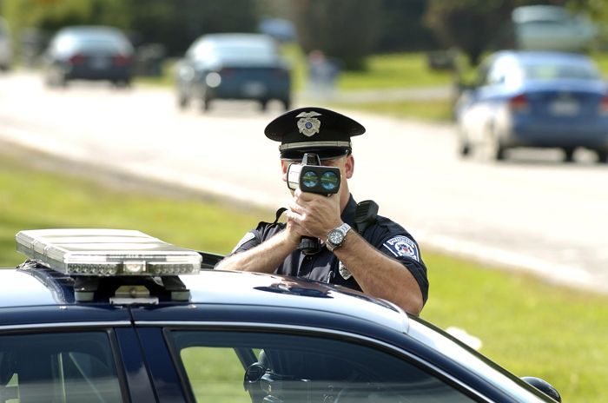
Instantaneous Speed
We run into instantaneous speed all the time in real life
https://www.thecarconnection.com/news/1065654_north-americas-top-25-speed-trap-cities-for-2011

Slide 87
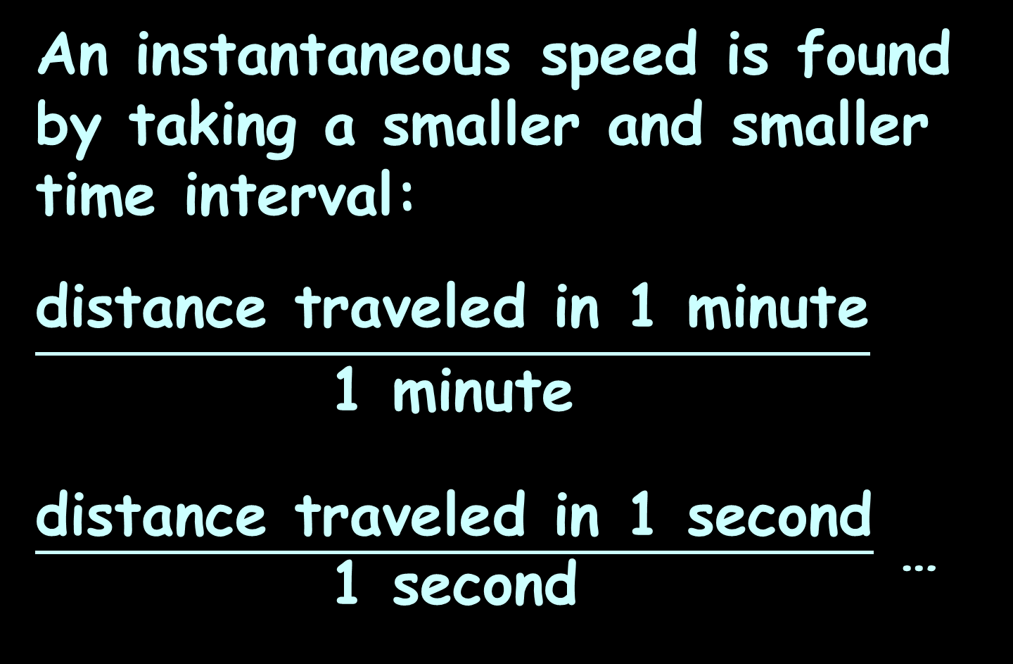
Instantaneous Speed
An instantaneous speed is found by taking a smaller and smaller time interval:
$$\frac{\text{distance} \text{traveled} \text{in}\text{ 1 }\text{minute}}{\text{1 }\text{minute}}$$
$\frac{\text{distance} \text{traveled} \text{in}\text{ 1 }\text{second}}{\text{1 }\text{second}}$ …

Slide 88
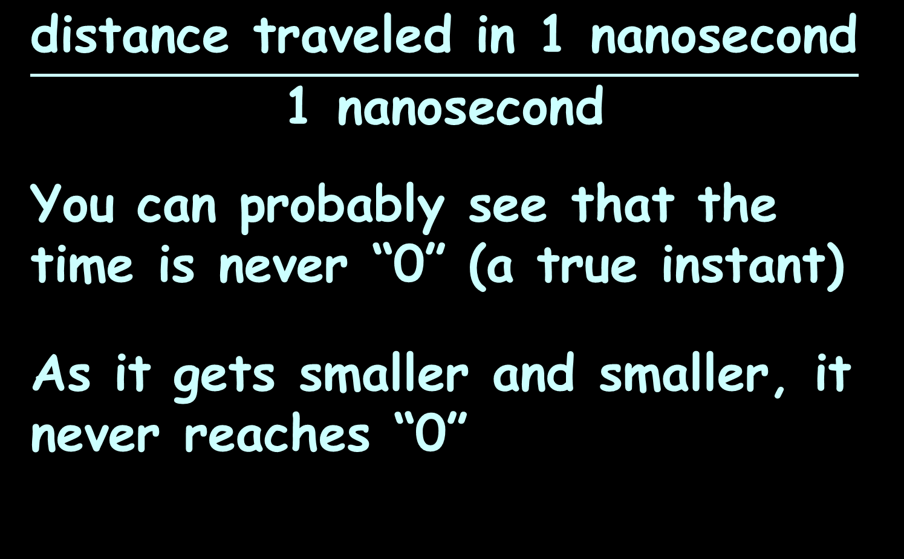
Instantaneous Speed
$$\frac{\text{distance} \text{traveled} \text{in}\text{ 1 }\text{nano}\text{second}}{\text{1 }\text{nano}\text{second}}$$
You can probably see that the time is never “0” (a true instant)
As it gets smaller and smaller, it never reaches “0”

Slide 89
Instantaneous Speed
This is the basis for the first subject we study in calculus:
limits
As we get closer and closer to the thing we want to know, are we zeroing in on a single value or not?

Slide 90
INSTANTANEOUS SPEED
IN-CLASS PROBLEM 5
Is there an instantaneous speed? What is it (approximately)?
99.6ft/10sec =
49.75ft/5sec
9.945ft/1sec

Slide 91
INSTANTANEOUS SPEED
IN-CLASS PROBLEM 5
Is there an instantaneous speed? What is it (approximately)?
99.6ft/10sec = 9.96 fps
49.75ft/5sec =
9.945ft/1sec

Slide 92
INSTANTANEOUS SPEED
IN-CLASS PROBLEM 5
Is there an instantaneous speed? What is it (approximately)?
99.6ft/10sec = 9.96 fps
49.75ft/5sec = 9.95 fps
9.945ft/1sec =

Slide 93
INSTANTANEOUS SPEED
IN-CLASS PROBLEM 5
Is there an instantaneous speed? What is it (approximately)?
99.6ft/10sec = 9.96 fps
49.75ft/5sec = 9.95 fps
9.945ft/1sec = 9.945 fps

Slide 94
INSTANTANEOUS SPEED
IN-CLASS PROBLEM 5
Is there an instantaneous speed? What is it (approximately)?
99.6ft/10sec = 9.96 fps
49.75ft/5sec = 9.95 fps
9.945ft/1sec = 9.945 fps
This is a bit in the eyes of the beholder – probably “yes” and probably 9.945 or 9.94 fps

Slide 95
Questions?
www.career.gatech.edu

Slide 96
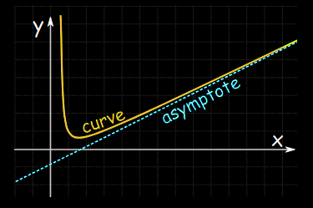
Limits
Asymptotes get closer and closer to a value, but never actually get there
https://www.mathsisfun.com/algebra/asymptote.html

Slide 97
Limits
This concept of getting closer and closer to a value or a location on a graph is called
finding a “limit”

Slide 98
LIMITS
IN-CLASS PROBLEM 6
What would you estimate the limit to be for this table of data?
Distance | Time Interval | Change in Time | Average Speed
48 ft | [1, 2] | 2 – 1 = 1 sec | 48 ft/sec
28 ft | [1, 1.5] | 1.5 – 1 = 0.5 sec | 56 ft/sec
6.24 ft | [1, 1.1] | 1.1 – 1 = 0.1 sec | 62.4 ft/sec
0.6384 ft | [1, 1.01] | 1.01 – 1 = 0.01 sec | 63.84 ft/sec
0.063984 ft | [1, 1.001] | 1.001 – 1 = 0.001 sec | 63.984 ft/sec
0.00639984 ft | [1, 1.0001] | 1.0001 – 1 = 0.0001 sec | 63.9984 ft/sec

Slide 99
LIMITS
IN-CLASS PROBLEM 6
What would you estimate the limit to be for this table of data?
It’s getting really close to 64 ft/sec
Distance | Time Interval | Change in Time | Average Speed
48 ft | [1, 2] | 2 – 1 = 1 sec | 48 ft/sec
28 ft | [1, 1.5] | 1.5 – 1 = 0.5 sec | 56 ft/sec
6.24 ft | [1, 1.1] | 1.1 – 1 = 0.1 sec | 62.4 ft/sec
0.6384 ft | [1, 1.01] | 1.01 – 1 = 0.01 sec | 63.84 ft/sec
0.063984 ft | [1, 1.001] | 1.001 – 1 = 0.001 sec | 63.984 ft/sec
0.00639984 ft | [1, 1.0001] | 1.0001 – 1 = 0.0001 sec | 63.9984 ft/sec

Slide 100

Limits
We write this as:
lim = 64
change in time →0
or
lim = 64
∆time →0
or
lim = 64
∆t →0
or
lim(∆t →0) = 64
$$\lim_{∆t→0}{=64}$$

Slide 101
LIMITS
IN-CLASS PROBLEM 7
What would you estimate your instantaneous velocity would be at t=2?
Time Interval | [2,3] | [2,2.5] | [2,2.1] | [2,2.01] | [2,2.001]
Average Speed | 22.4682 mph | 23.7187 mph | 24.5307 mph | 24.9851 mph | 24.9936 mph

Slide 102
LIMITS
IN-CLASS PROBLEM 7
What would you estimate your instantaneous velocity would be at t=2?
Again, this is kinda in the eyes of the beholder… I’d go with 25mph
Time Interval | [2,3] | [2,2.5] | [2,2.1] | [2,2.01] | [2,2.001]
Average Speed | 22.4682 mph | 23.7187 mph | 24.5307 mph | 24.9851 mph | 24.9936 mph

Slide 103
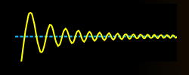
Limits
Sometimes, while it LOOKS like there is a limit, you’ll find out (in a more advanced class) that it isn’t zeroing in fast enough, so technically there’s not!
https://www.mathsisfun.com/algebra/asymptote.html

Slide 104
Questions?
www.career.gatech.edu

Slide 105
Summary
Today we studied:
Increments
Rate of change
Limits

Slide 106

You Survived!
www.playbuzz.com

